Slide 1
OCLC RLP Works in Progress webinar
Reimagining digital data curation: New structured data approaches for digital collections
January 30, 2020
CONTENTdm linked data pilot project staff and partners

Slide 2
Bruce Washburn
Principal Engineer, OCLC

Slide 3
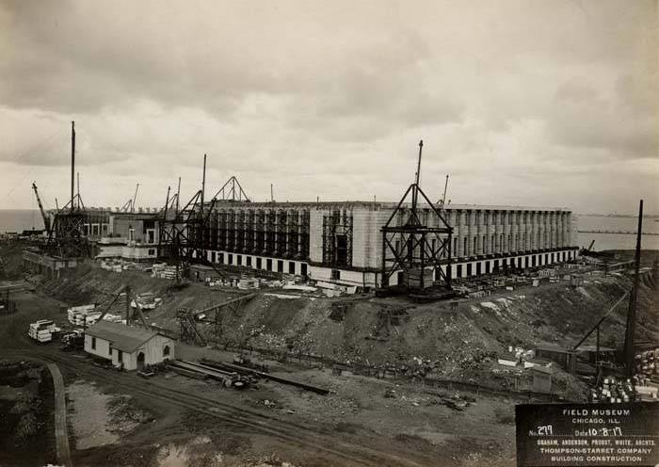
MOTIVATIONS and CONTEXT
Field Museum construction site photograph. Long distance view of Field Museum construction site with completed columns. Illinois Digital Archives. https://cdm16614.contentdm.oclc.org/digital/collection/fmnh/id/724
Notes:
We'd like to start by going over some of the motivations and context for the work we'll focus on in just a bit, to better understand the foundations on which that work is based.

Slide 4
OCLC and Linked Data: Prior Work
2012: Schema.org Linked Data in WorldCat
2013: EntityJS Linked Data discovery app
2014: Person Entity Lookup pilot project
2015-16: CONTENTdm Metadata Refinery
2017-18: Project Passage
2018-19: IIIF APIs in CONTENTdm
Notes:
The project we’ll be focusing on today represents another step in a cumulative sequence of OCLC projects, going back several years, where different aspects of working with library, archive, and museum Linked Data have been evaluated and tested.

Slide 5
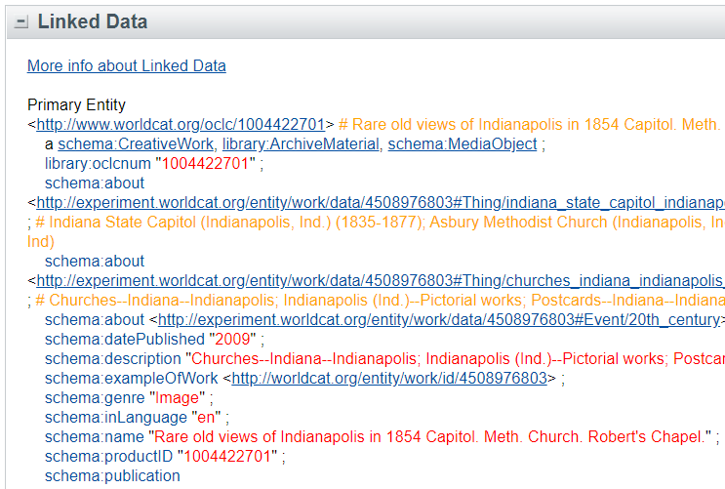
OCLC and Linked Data: Prior Work
2012: Schema.org Linked Data in WorldCat
2013: EntityJS RDF Viewer experiment
2014: Person Entity Lookup pilot project
2015-16: CONTENTdm Metadata Refinery
2017-18: Project Passage
2018-19: IIIF APIs in CONTENTdm
http://www.worldcat.org/oclc/1004422701
Notes:
Schema.org is a collaborative activity across major search engines to promote schemas for structured data on web pages, in email, and beyond. Use of this standard is posited to be beneficial for making web content understandable and usable to search engines and others.
Shortly after this vocabulary was first announced by Google, Yahoo, Microsoft, and Yandex in 2011, OCLC developed a transformation of MARC data to Schema.org, and began publishing that data as part of each item description in WorldCat.org.
In addition to that publication channel, OCLC provides an experimental service for other applications to make use of this linked data in a range of RDF serializations.
Transformation of MARC data, with some fields reconciled and related to authority control system identifiers, taught us much about shifting from vocabularies that are used primarily in the library domain to vocabularies designed for use on the wider web.

Slide 6
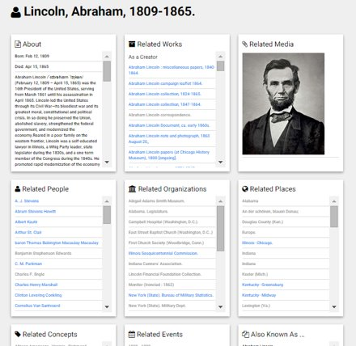
OCLC and Linked Data: Prior Work
2012: Schema.org Linked Data in WorldCat
2013: EntityJS RDF Viewer experiment
2014: Person Entity Lookup pilot project
2015-16: CONTENTdm Metadata Refinery
2017-18: Project Passage
2018-19: IIIF APIs in CONTENTdm
Notes:
The EntityJS RDF linked data viewer experiment focused on techniques for discovery of and navigation across descriptions of different entities: people, organizations, places, events, concepts, and creative works.
We worked with several subsets of records from WorldCat that had a thematic focus, for example records about the US Civil War, or records about Irish literature, to see closer relationships across entities.

Slide 7
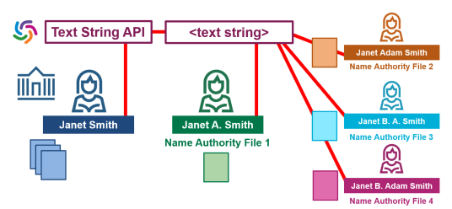
OCLC and Linked Data: Prior Work
2012: Schema.org Linked Data in WorldCat
2013: EntityJS RDF Viewer experiment
2014: Person Entity Lookup pilot project
2015-16: CONTENTdm Metadata Refinery
2017-18: Project Passage
2018-19: IIIF APIs in CONTENTdm
Notes:
The Person Entity Lookup pilot project was conducted in 2014.
With the help of several OCLC Member Libraries we explored the features and user requirements of a shared reconciliation service for personal names.
This pilot project explored offering that capability as a production service, with a focus on delivering linked data representations of person entities, and considered what would be required to also support inclusion of local name authority data in a shared service, for personal names that are not currently being submitted to and shared by a national authority system (like NACO).

Slide 8
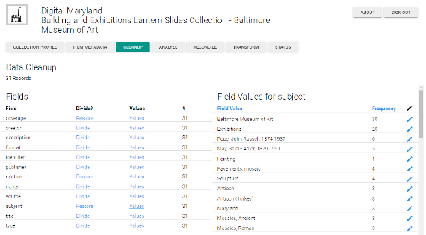
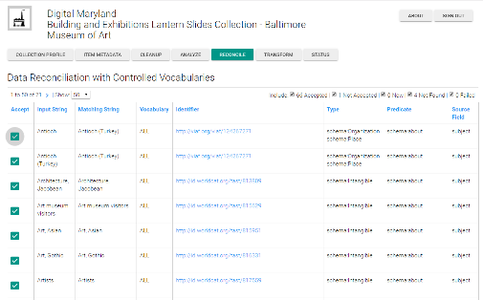
OCLC and Linked Data: Prior Work
2012: Schema.org Linked Data in WorldCat
2013: EntityJS RDF Viewer experiment
2014: Person Entity Lookup pilot project
2015-16: CONTENTdm Metadata Refinery
2017-18: Project Passage
2018-19: IIIF APIs in CONTENTdm
Notes:
The CONTENTdm Metadata Refinery experiment tested workflows for analyzing, cleaning, reconciling, and transforming metadata from CONTENTdm collections in a shared, web-based application.
CONTENTdm is an OCLC service for building, preserving and showcasing a library's unique digital collections.
The analysis, cleanup, and reconciliation steps in the Metadata Refinery were similar to the functions supported by applications like OpenRefine, without requiring local software installation and with a preset focus on the characteristics of CONTENTdm metadata and its local field mappings to Dublin Core, and with an integrated reconciliation index.
The results of the cleanup, analysis, and reconciliation could be transformed in the Metadata Refinery to RDF Linked Data, so that OCLC staff could explore how the RDF data could be used to enhance discovery.

Slide 9
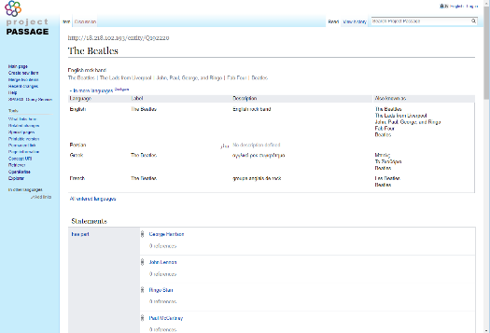
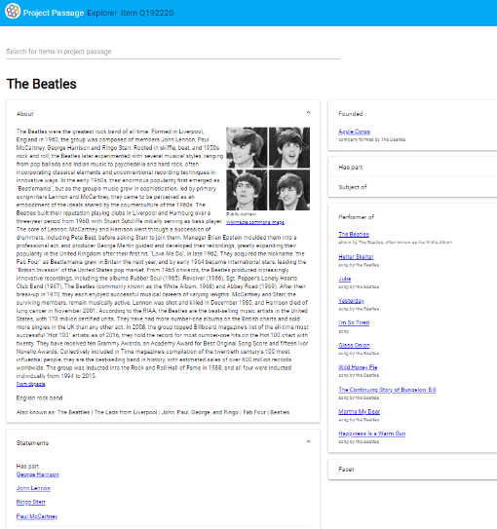
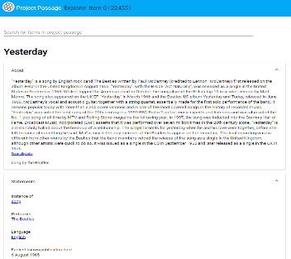
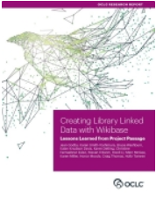
OCLC and Linked Data: Prior Work
2012: Schema.org Linked Data in WorldCat
2013: EntityJS RDF Viewer experiment
2014: Person Entity Lookup pilot project
2015-16: CONTENTdm Metadata Refinery
2017-18: Project Passage
2018-19: IIIF APIs in CONTENTdm
https://www.oclc.org/research/themes/data-science/linkeddata/linked-data-prototype.html
https://www.oclc.org/research/publications/2019/oclcresearch-creating-library-linked-data-with-wikibase-project-passage.html
Notes:
Project Passage was a major pilot project carried out by OCLC in 2017 and 2018, where we partnered with 16 libraries on a prototype to demonstrate the value of linked data for improving resource-description workflows in libraries.
The project used the MediaWiki platform, and its Wikibase extension, as the software foundation for importing, creating, and managing bibliographic linked data.
The project also produced some additional software prototypes, built on top of the MediaWiki platform, to evaluate discovery interfaces for exploring bibliographic linked data and for accelerating the data ingest process for more efficient workflows.
A report on the work was published in 2019.

Slide 10
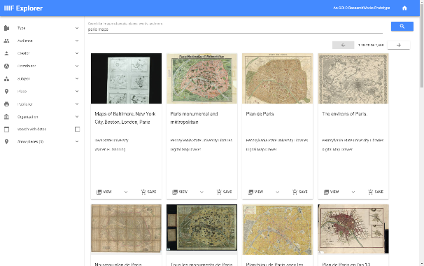
OCLC and Linked Data: Prior Work
2012: Schema.org Linked Data in WorldCat
2013: EntityJS RDF Viewer experiment
2014: Person Entity Lookup pilot project
2015-16: CONTENTdm Metadata Refinery
2017-18: Project Passage
2018-19: IIIF APIs in CONTENTdm
https://www.oclc.org/en/contentdm/iiif.html
Notes:
The IIIF (International Image Interoperability Framework) APIs are the result of an open community effort to make digital materials more accessible and usable. OCLC was an early adopter of these APIs and is an active contributor to the standard’s development and testing. These APIs are now foundational to OCLC's CONTENTdm digital content management system.
Working with the IIIF APIs and CONTENTdm digital images, we experimented with a cross-collection, cross-institution discovery system. Those experiments revealed promising potential, but also pointed to descriptive data variations that we think may be resolved by moving from a distributed, record-oriented cataloging system to one that applies linked data principles to describing works and other entities, and their relationships.
And those experimental findings led to the formulation of the project we’ll focus on next.

Slide 11
Jeff Mixter
Lead Software Engineer, OCLC

Slide 12
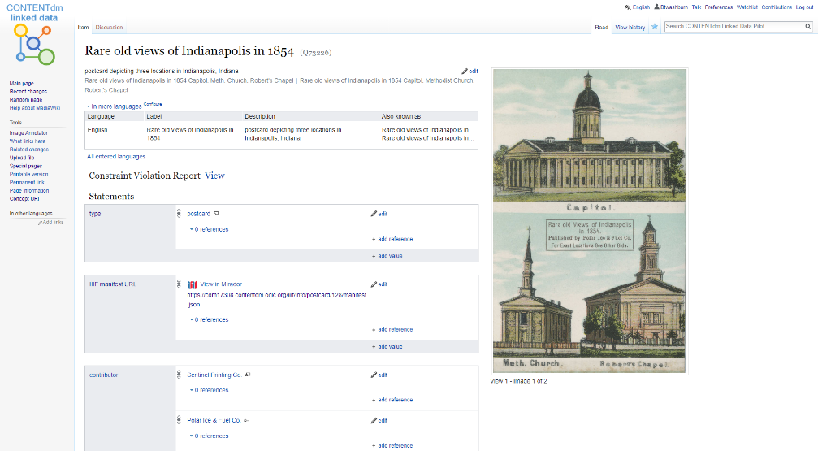
CONTENTDM LINKED DATA Pilot Project overview

Slide 13
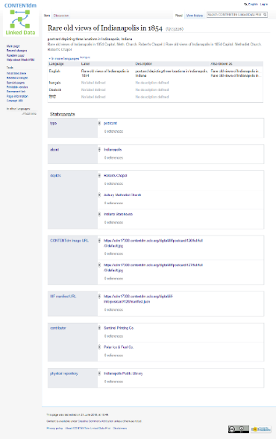
POSTCARD
Notes:
This pilot project is designed to demonstrate that when record-oriented data shifts to an entity-oriented framework, the relationships between creative works and related entities become clearer, and data management for separate entities becomes potentially much more efficient, interoperable, and extensible.

Slide 14
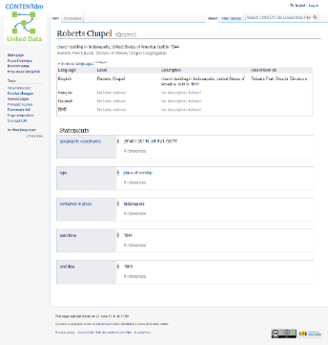
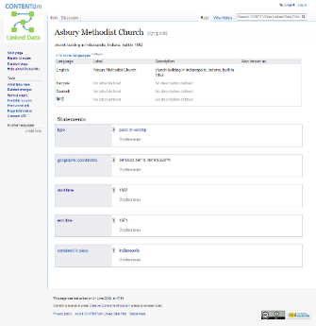
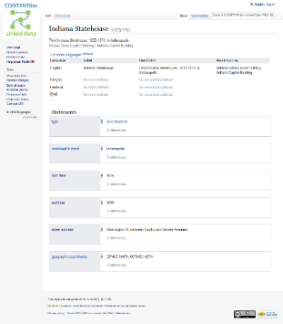
PLACE OF WORSHIP
depicts
POSTCARD
PLACE OF WORSHIP
CIVIC STRUCTURE
Notes:
This pilot project is designed to demonstrate that when record-oriented data shifts to an entity-oriented framework, the relationships between creative works and related entities become clearer, and data management for separate entities becomes potentially much more efficient, interoperable, and extensible.

Slide 15
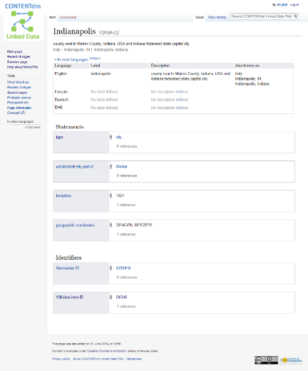
PLACE OF WORSHIP
depicts
POSTCARD
PLACE OF WORSHIP
CIVIC STRUCTURE
about
CITY
contained in place
Notes:
This pilot project is designed to demonstrate that when record-oriented data shifts to an entity-oriented framework, the relationships between creative works and related entities become clearer, and data management for separate entities becomes potentially much more efficient, interoperable, and extensible.

Slide 16
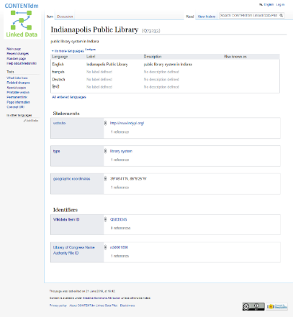
PLACE OF WORSHIP
depicts
POSTCARD
PLACE OF WORSHIP
CIVIC STRUCTURE
about
held by
LIBRARY SYSTEM
CITY
contained in place
contained in place
Notes:
This pilot project is designed to demonstrate that when record-oriented data shifts to an entity-oriented framework, the relationships between creative works and related entities become clearer, and data management for separate entities becomes potentially much more efficient, interoperable, and extensible.

Slide 17
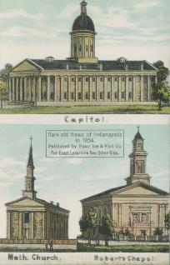
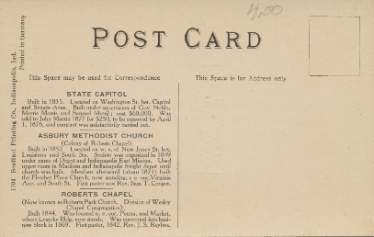
PLACE OF WORSHIP
depicts
POSTCARD
CONTENTdm image URL
PLACE OF WORSHIP
CIVIC STRUCTURE
about
held by
LIBRARY SYSTEM
CITY
contained in place
contained in place
Notes:
This pilot project is designed to demonstrate that when record-oriented data shifts to an entity-oriented framework, the relationships between creative works and related entities become clearer, and data management for separate entities becomes potentially much more efficient, interoperable, and extensible.

Slide 18
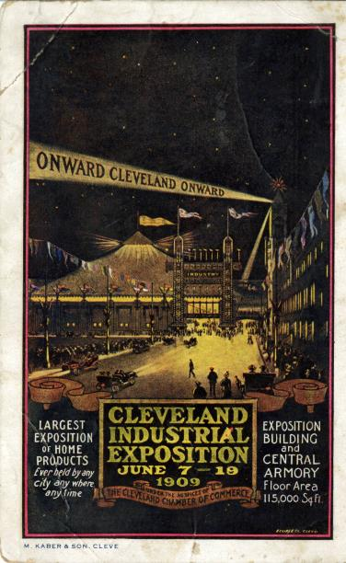
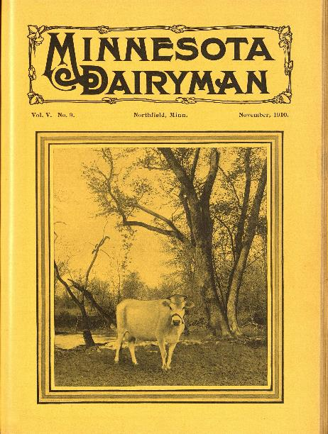
Phase 1 project partners
Huntington Library, Art Museum, and Botanical Gardens
Minnesota Digital Library
Cleveland Public Library
https://cplorg.contentdm.oclc.org/digital/collection/p16014coll6/id/1864
https://hdl.huntington.org/digital/collection/p9539coll1/id/19305
https://reflections.mndigital.org/catalog/nfh:1579#/image/0

Slide 19
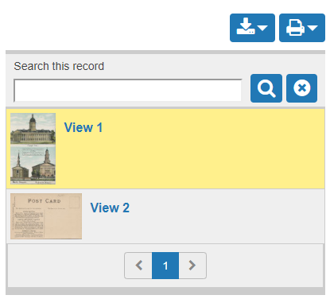
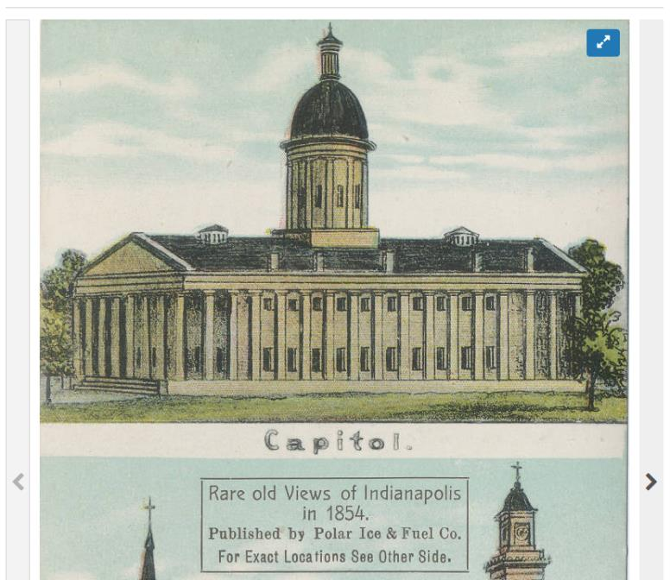
Phase 1:
Map CONTENTdm data to Wikibase
Work with CONTENTdm content owners
CONTENTdm
Transformation & Mapping
Wikibase
Notes:
We’ve divided the pilot project into 3 phases, each phase taking about 4 months to complete.
In the first phase, we worked with a selection of CONTENTdm hosted collections from the 3 participant sites, to develop and test methods for transforming the record-oriented metadata into descriptions of separate but connected real world entities … creative works, people, organizations, places, concepts, and events, and the relationships between those entities.

Slide 20
Phase 1:
Map CONTENTdm data to Wikibase
Work with CONTENTdm content owners
Add UI context found through Wikibase connections to external sources
CONTENTdm
Transformation & Mapping
Wikibase
CONTENTdm
Javascript Plug-in
Indianapolis
Indianapolis is the capital of the US state of Indiana, and the county seat of Marion County, Indiana. As of the 2010 United States Census, the city's population is 829,718. It is Indiana's largest city and, as of the 2010 U.S. Census, is the 12th largest city in the U.S. , the second largest city in the Midwest, the second most populous state capital, and the most populous state capital east of the Mississippi River.
From: DBPedia
Notes:
Once the record-oriented data has been transformed and loaded into a linked data ecosystem, we can use a feature of the current CONTENTdm user interface to show contextual data about the linked data entities, enriching the user experience.

Slide 21
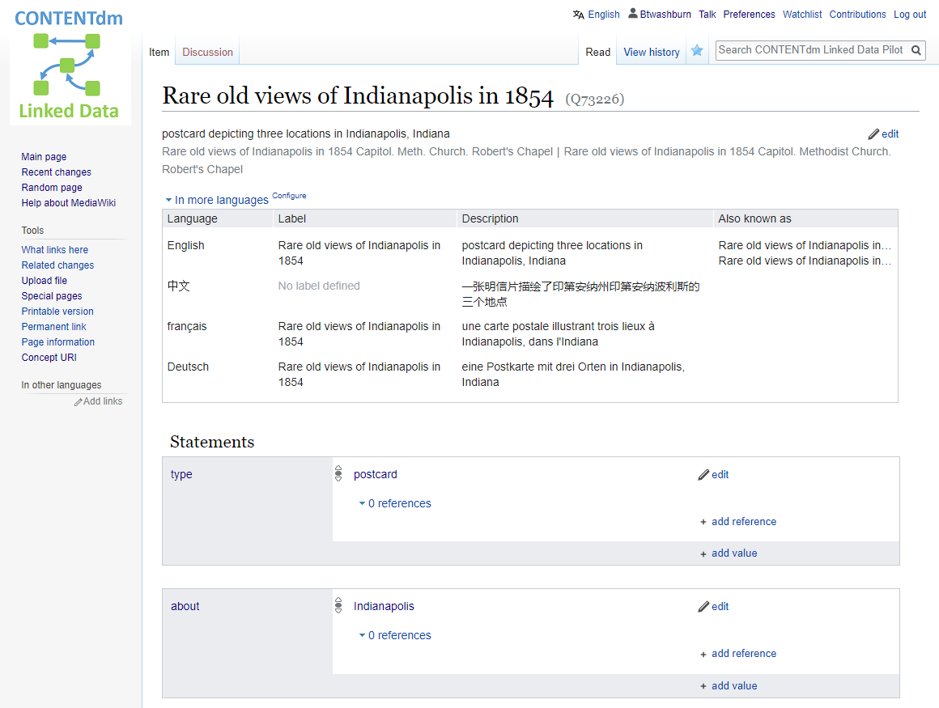
Phase 2:
Evaluate Wikibase as a platform for creating and maintaining CONTENTdm metadata
Wikibase
Notes:
We’re just beginning the second phase of the pilot project, where our focus will shift to evaluating Wikibase as a platform for creating and managing entity descriptions of the digital materials in CONTENTdm.

Slide 22
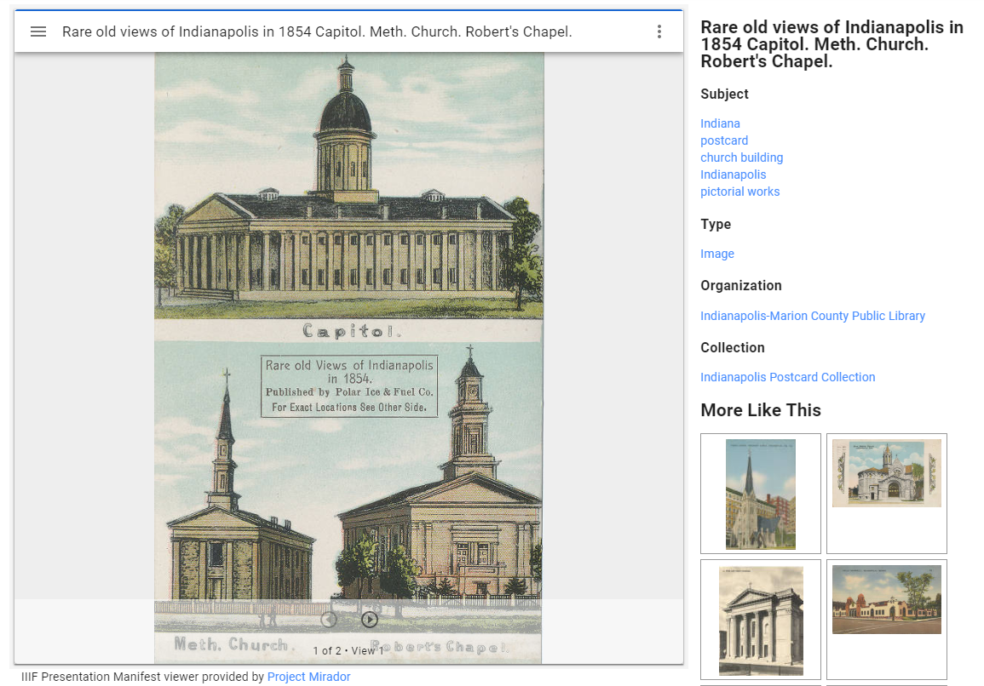
Phase 3:
Evaluate Wikibase as a platform on which to build CONTENTdm discovery interfaces
Wikibase
Notes:
In phase 3, projected to begin later in the spring, we’ll shift our attention to relying solely on the Wikibase platform as the backend system to support the CONTENTdm discovery interface.

Slide 23
Jason Roy
Director, Digital Library Services
University of Minnesota Libraries

Slide 24
Minnesota Reflections, the premier project of the Minnesota Digital Library (MDL), contains a collection of over 270,000 images, maps, and documents from more than 192 of the state’s cultural heritage organizations, offering resources on Minnesota’s history and geography for researchers, educators, students, and the public.

Slide 25
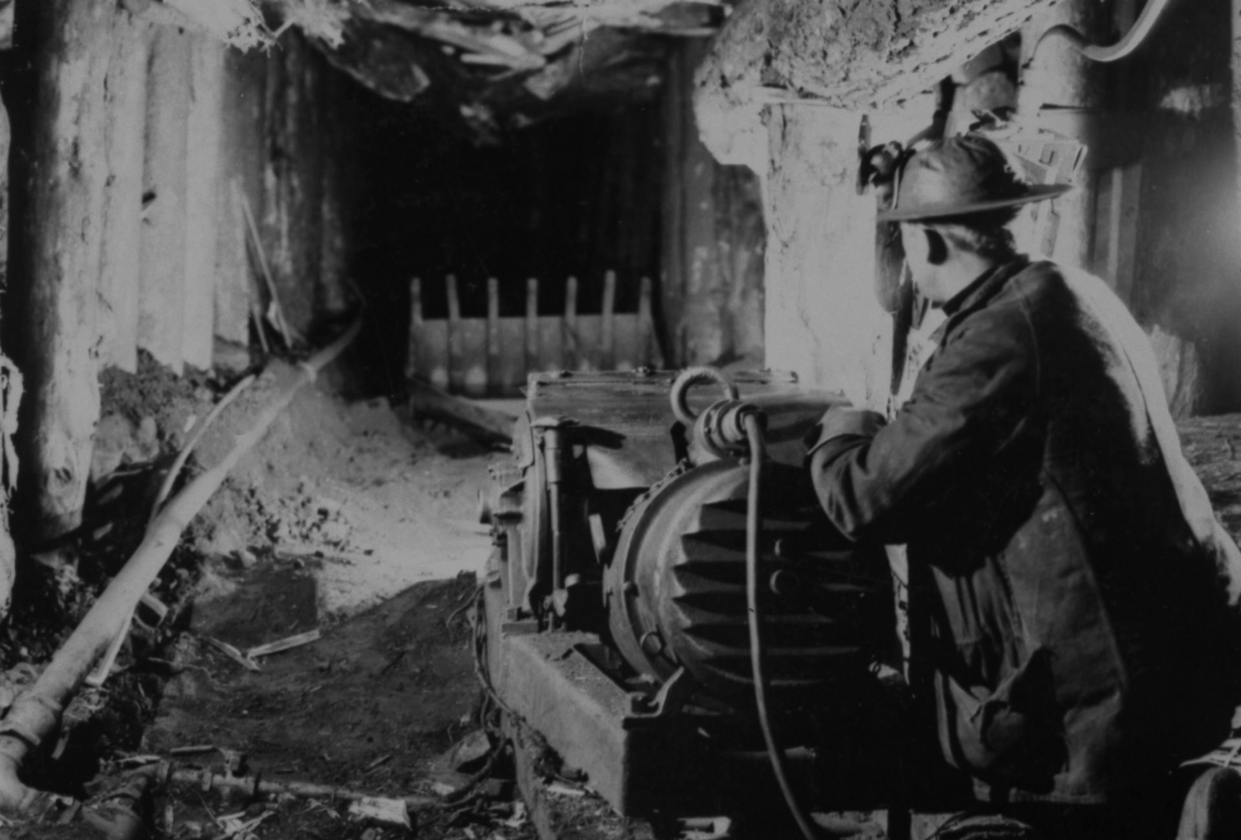
MDL VISION
Minnesota’s digital legacy: past,
present, and into the future.
MDL MISSION
Create Minnesota’s digital legacy
in partnership with libraries and
cultural heritage institutions.
Underground iron miner, 1920-25. Iron Range Research Center. reflections.mndigital.org/catalog/irrc:1861

Slide 26
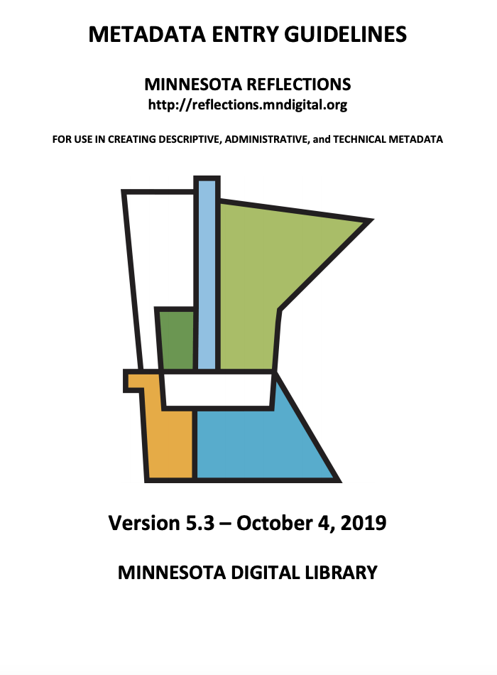
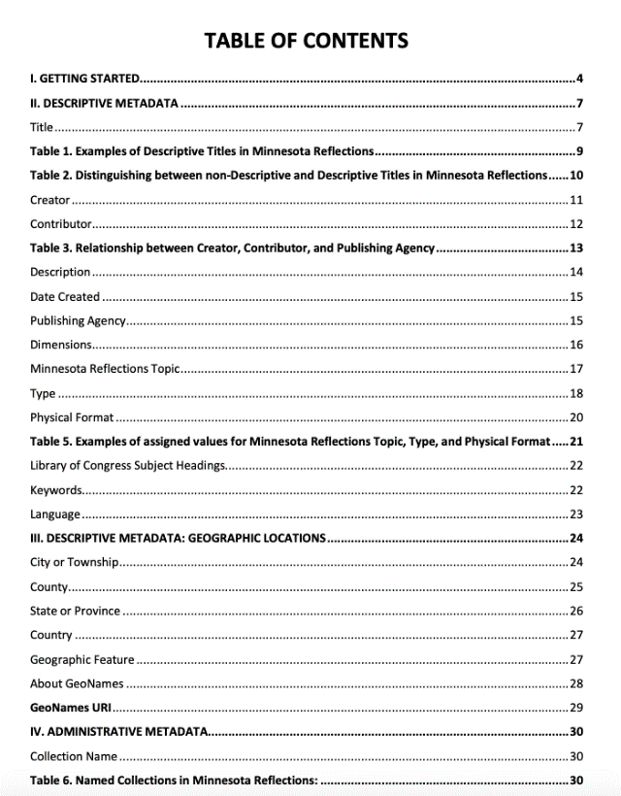
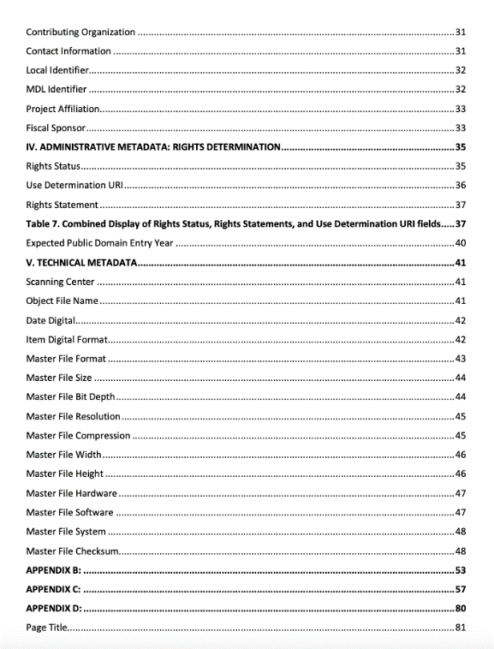
*
*
*
*
*
*
*
*
*
*
*
*
*
*

Slide 27
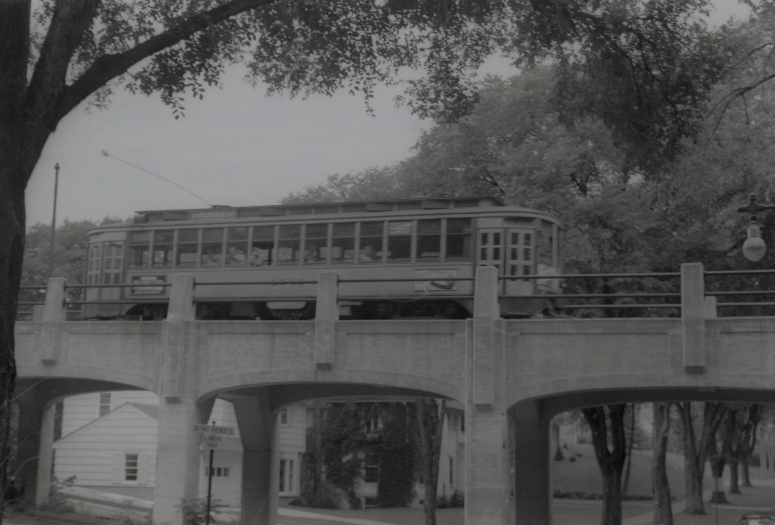
American Swedish Institute
Becker County Historical Society
Minnesota Streetcar Museum
Bryant at Minnehaha Creek,1953. Minnesota Streetcar Museum. reflections.mndigital.org/catalog/msn:1139

Slide 28
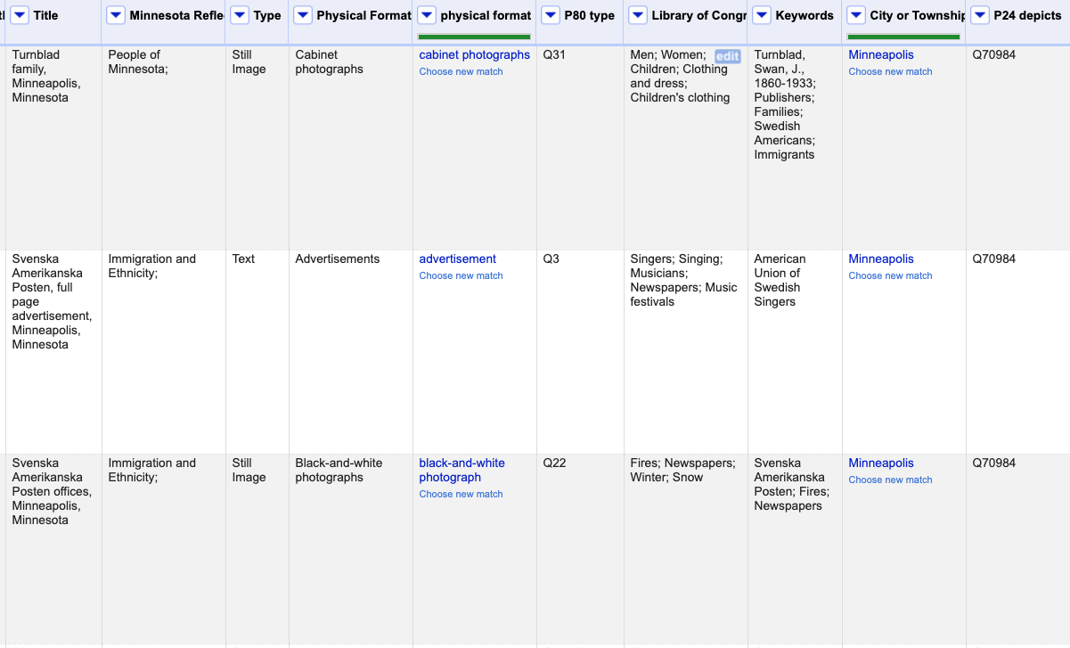
Using OpenRefine to reconcile Formats and Places

Slide 29
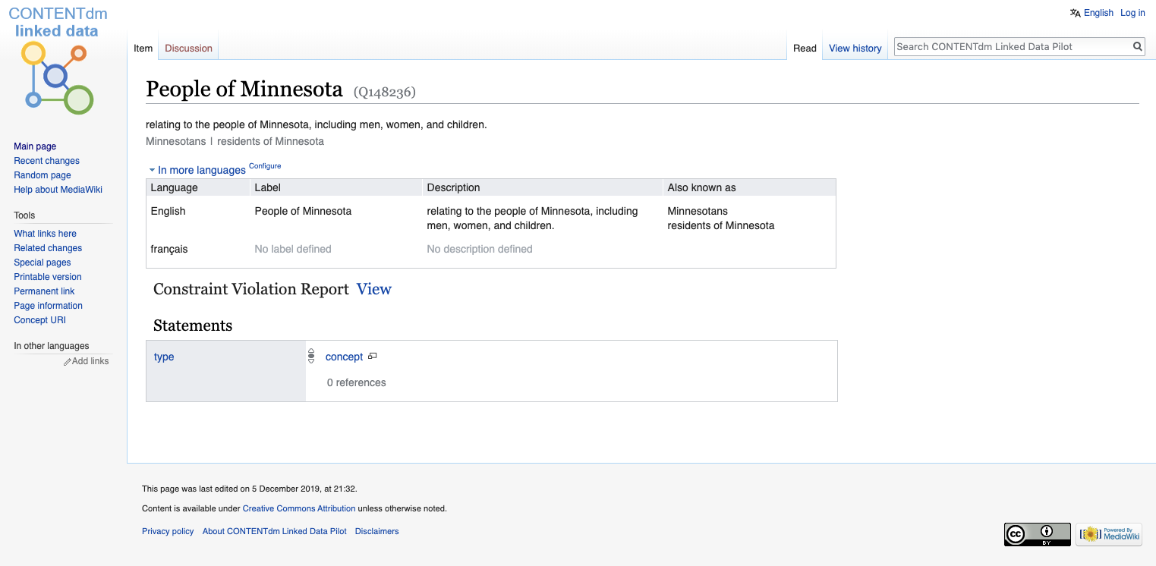

Slide 30
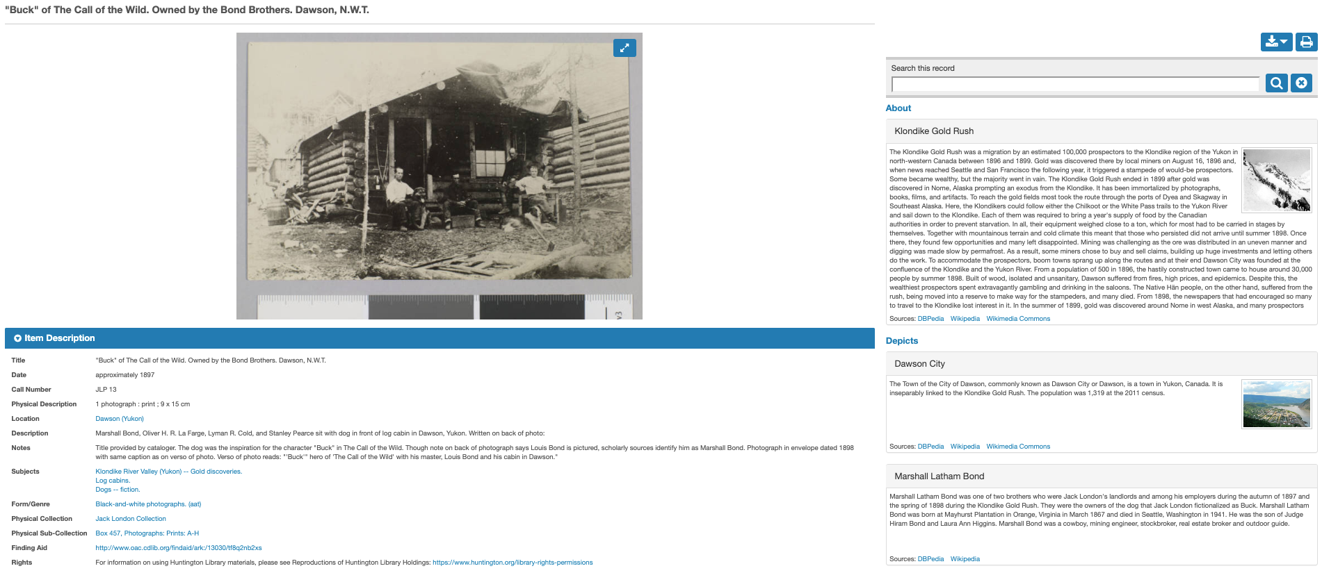
CONTENTdm record pulling in contextual information from the Web

Slide 31
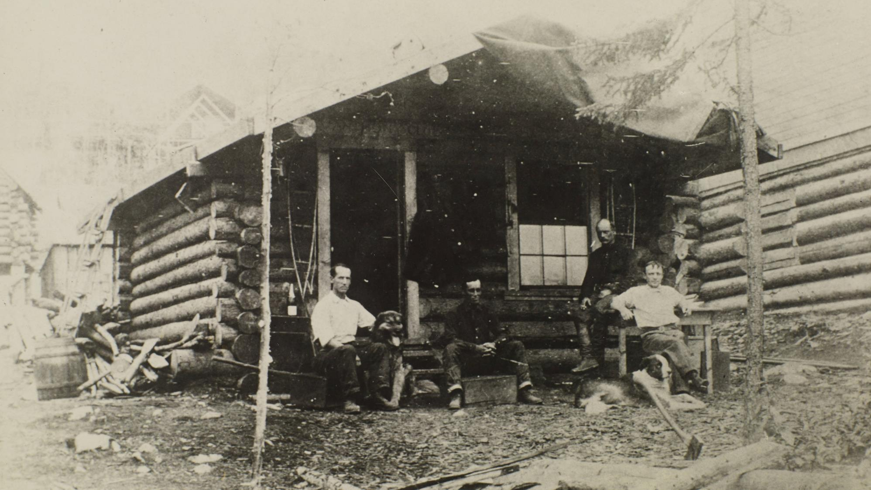
"Buck" of The Call of the Wild. Owned by the Bond Brothers. Dawson, N.W.T., 1897. Jack London Photographs and Negatives, Huntington Digital Library. https://hdl.huntington.org/digital/collection/p16003coll7/id/14/rec/2

Slide 32
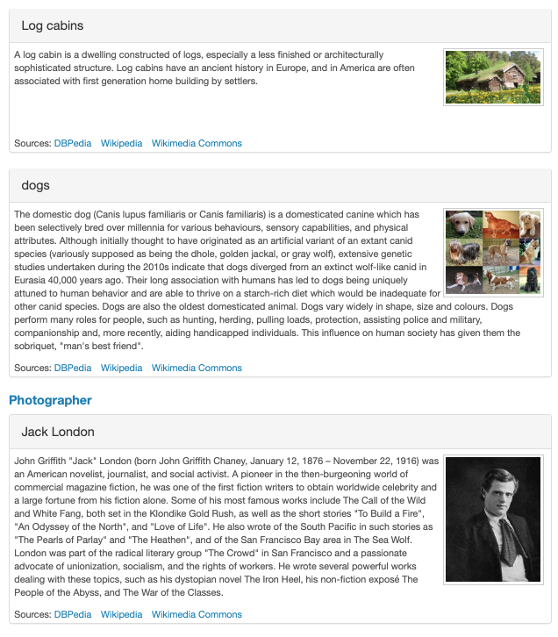
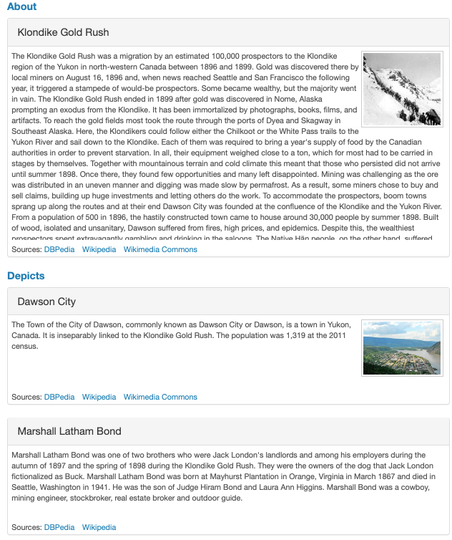
Additional Contextual Information

Slide 33
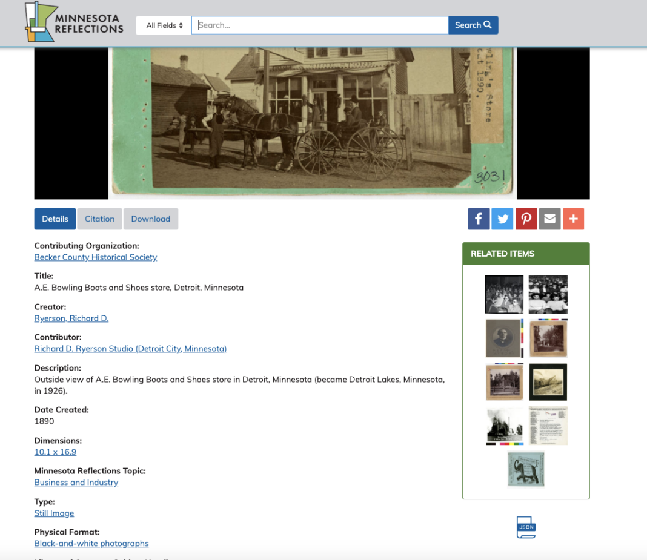
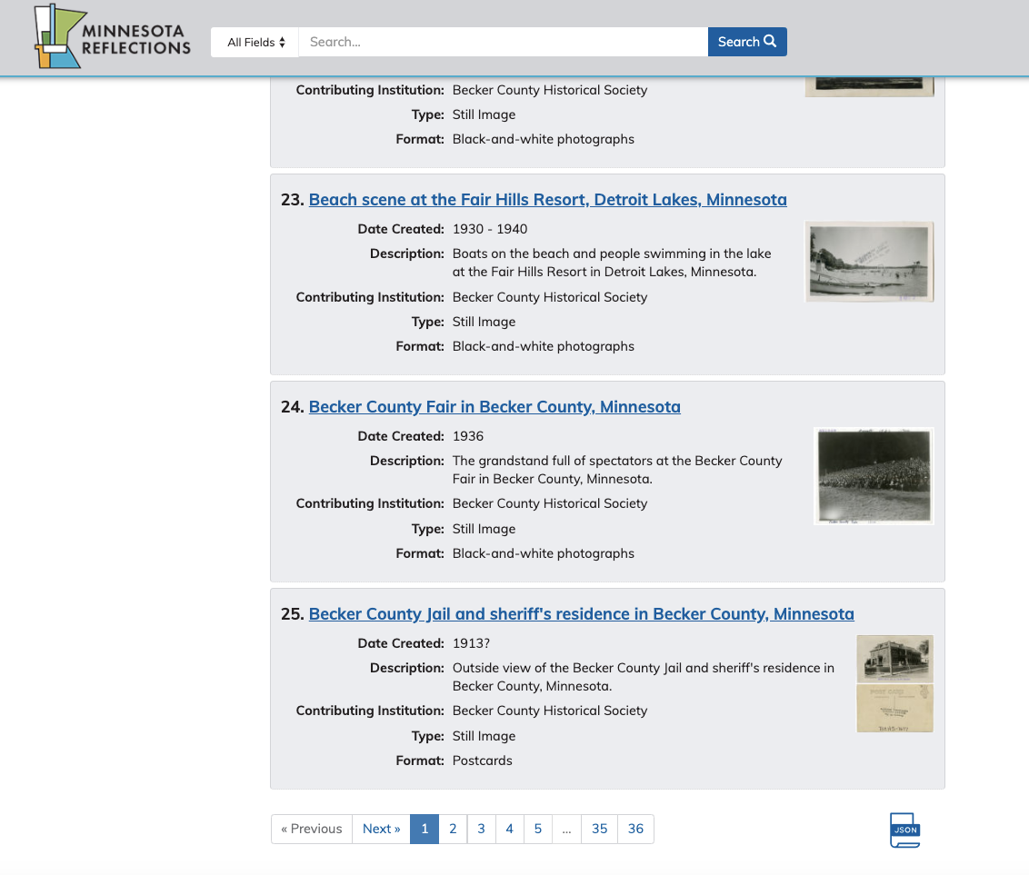

Slide 34
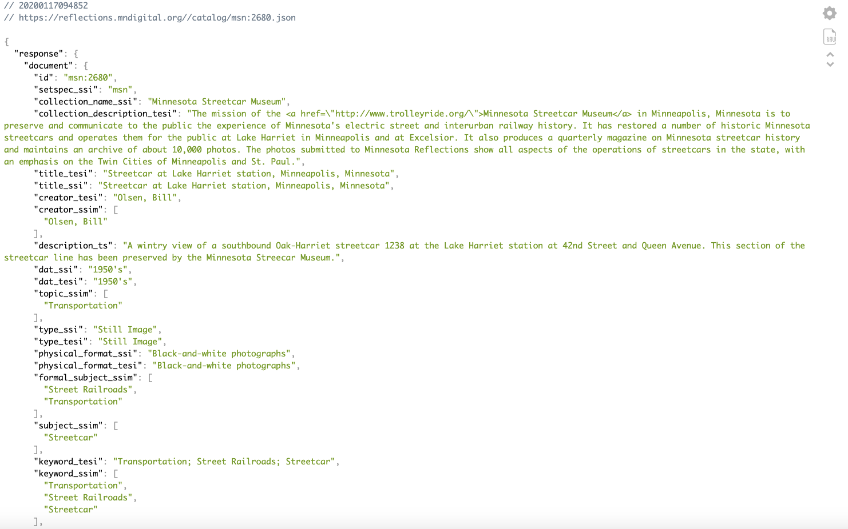

Slide 35
Linked data creates opportunities to better support access to additional data points and to share this information alongside the rest of our data set.

Slide 36
https://dp.la/
https://www.umbrasearch.org/

Slide 37
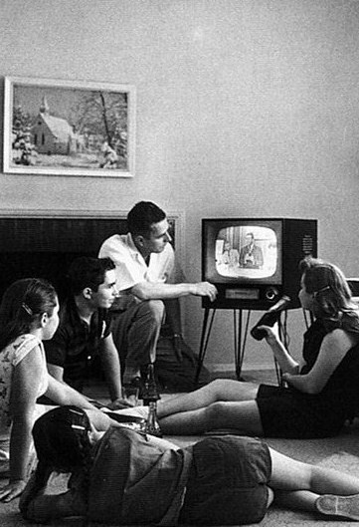
American family watching TV, ca. 1958. Evert F. Baumgardner. National Archives and Records Administration. https://web.archive.org/web/20071226081329/teachpol.tcnj.edu/amer_pol_hist/thumbnail427.html
Programming with safety gear, 2013. Dmellas. https://creativecommons.org/licenses/by-sa/3.0/deed.en

Slide 38
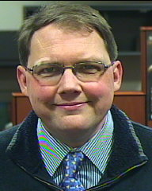
The Huntington Digital Library
Mario Einaudi
Digital Repository Manager

Slide 39
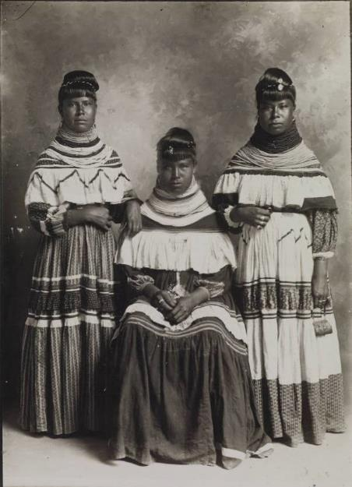
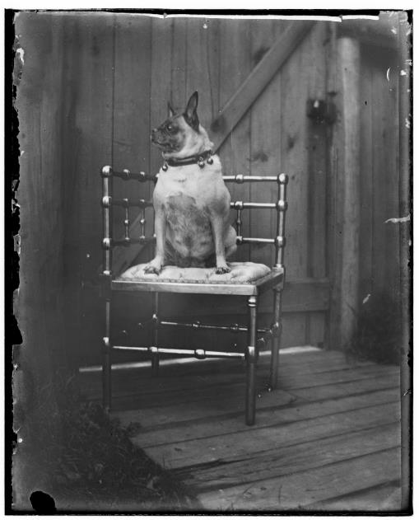
The Huntington Digital Library: more than 160,000 photographs
Notes:
A little background to the Huntington Digital Library; it went live in 2011 after 2 years of planning and development, and contains more that 230,00 objects of which 160,000 are photographs from several major collections, including Southern California Edison, Maynard Parker, Native American collections;

Slide 40
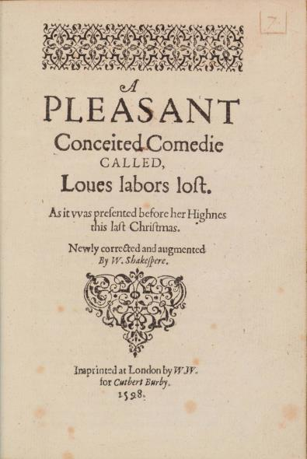
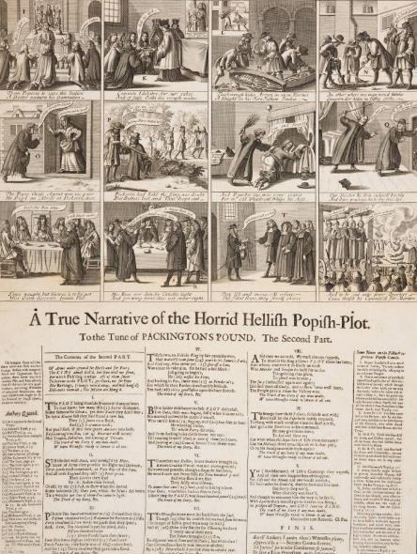
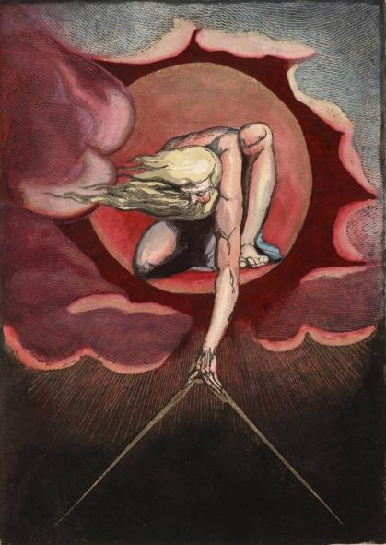
The Huntington Digital Library: 603 rare books and broadsides
Notes:
There are 603 rare books and broadsides, with a total of 5,413 pages;

Slide 41
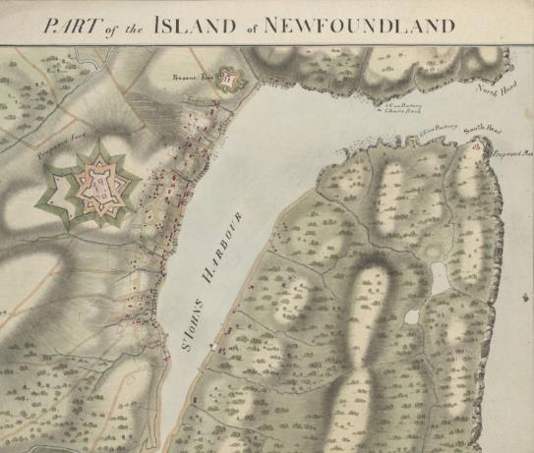
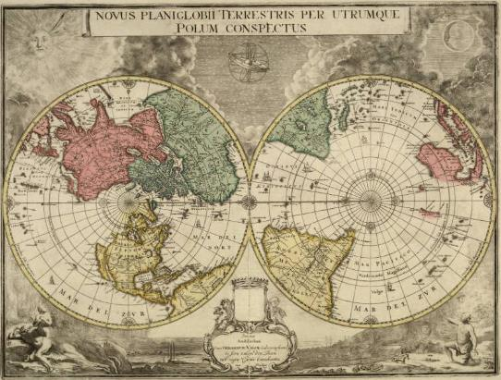
The Huntington Digital Library: over 7,455 maps and atlases
Notes:
There are over 7,455 maps and atlases;

Slide 42
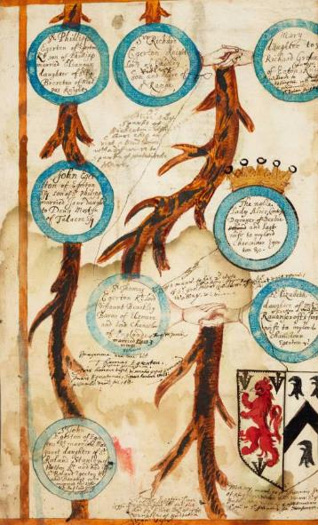
The Huntington Digital Library: 2,364 manuscripts, a total of 34,149 pages
Notes:
A total of 2,364 manuscripts, with a total of 34,149 pages; most are letters, but some drawings, and drafts of autobiographies, such as Benjamin Franklin’s;

Slide 43
The Huntington Digital Library: 6,604 prints and ephemera
Notes:
6,604 prints and ephemera, including a sampling of material, from the John Kemble Maritime Ephemera Collection, the Jay T. Last Collection and California Letter sheets;

Slide 44
The Huntington Digital Library: 712 objects in Huntington history
Notes:
And 712 objects from Huntington history. We are celebrating our 100th Anniversary this year!

Slide 45
IIIF, Mirador & Education
Notes:
In classrooms teachers are exploring new ways to add context to their teaching plans. There are mandated modules to teach about California history, but what if they wanted to set up an in-depth module on the development of Los Angeles, exploring the use of space in downtown? One way would be to reflect on the 80th anniversary of Union Station, asking what was there before? The answer is Old Chinatown.

Slide 46
IIIF, Mirador & Education
Notes:
There are multiple ways to tell the story of Old Chinatown, there are maps showing the original layout of the streets (1888), and growth over time (1893 and 1904), and printed maps showing just the block (1920) the typical view in most maps (Chinatown was seen as monolithic, not a place for people to venture into)….

Slide 47
IIIF, Mirador & Education
Notes:
and there are images. In the past we would see these singly in searches, or teachers would download them and show them in slide decks like this, but now they can direct students to use Mirador to construction comparisons on screen

Slide 48
Notes:
Here is the 1904 map of Los Angeles, and if we zoom in,

Slide 49
Notes:
Here is the 1904 map of Los Angeles, and if we zoom in, we can see Chinatown as it was in 1904.

Slide 50
Notes:
Here is the 1904 map of Los Angeles, and if we zoom in, we can see Chinatown as it was in 1904. We can add to this to build context, the 1888 map. Now both maps are in Mirador, can be manipulated and compared.

Slide 51
Notes:
Here is the 1904 map of Los Angeles, and if we zoom in, we can see Chinatown as it was in 1904. We can add to this to build context, the 1888 map. Now both maps are in Mirador, can be manipulated and compared. Adding a slot to the right allow us to add more context, an image from 1930s showing the building at the corner of Apablasa and Cayetano Alley.

Slide 52
Notes:
Here is the 1904 map of Los Angeles, and if we zoom in, we can see Chinatown as it was in 1904. We can add to this to build context, the 1888 map. Now both maps are in Mirador, can be manipulated and compared. Adding a slot to the right allow us to add more context, an image from 1930s showing the building at the corner of Apablasa and Cayetano Alley. These connections give the students more to work with, give them context, gives them the ability to compare, connect, places through time. These connections are made by the teacher, yes, but the students can act of them. What if we made it easier for the Teachers and the students to see these connections. That is where linked data comes in.

Slide 53
Notes:
Here is the 1904 map of Los Angeles, and if we zoom in, we can see Chinatown as it was in 1904. We can add to this to build context, the 1888 map. Now both maps are in Mirador, can be manipulated and compared. Adding a slot to the right allow us to add more context, an image from 1930s showing the building at the corner of Apablasa and Cayetano Alley. These connections give the students more to work with, give them context, gives them the ability to compare, connect, places through time. These connections are made by the teacher, yes, but the students can act of them. What if we made it easier for the Teachers and the students to see these connections. That is where linked data comes in.

Slide 54
Notes:
Here is the 1904 map of Los Angeles, and if we zoom in, we can see Chinatown as it was in 1904. We can add to this to build context, the 1888 map. Now both maps are in Mirador, can be manipulated and compared. Adding a slot to the right allow us to add more context, an image from 1930s showing the building at the corner of Apablasa and Cayetano Alley. These connections give the students more to work with, give them context, gives them the ability to compare, connect, places through time. These connections are made by the teacher, yes, but the students can act of them. What if we made it easier for the Teachers and the students to see these connections. That is where linked data comes in.

Slide 55
Notes:
Here is the 1904 map of Los Angeles, and if we zoom in, we can see Chinatown as it was in 1904. We can add to this to build context, the 1888 map. Now both maps are in Mirador, can be manipulated and compared. Adding a slot to the right allow us to add more context, an image from 1930s showing the building at the corner of Apablasa and Cayetano Alley. These connections give the students more to work with, give them context, gives them the ability to compare, connect, places through time. These connections are made by the teacher, yes, but the students can act of them. What if we made it easier for the Teachers and the students to see these connections. That is where linked data comes in.

Slide 56
Cleaning data / creating links

Slide 57
Data Queries and Quality Assessment
Notes:
The OpenRefine application is a primary tool for cleaning up, analyzing, and transforming data.
Here’s one example, where CONTENTdm fields that may hold “approximate” date strings, and a corresponding fields that hold a searchable string of dates within a range, can be transformed into more semantically rich earliest and latest dates, improving discovery and data interoperability in the Wikibase system.

Slide 58
Data Queries and Quality Assessment
Notes:
The Wikibase environment provides a powerful SPARQL Query tool for interrogation the data.
In this example, a query is sent to report all of the works in the Verner Photographic Negatives collection, to find any that lack a “depicts” statement.

Slide 59
Data Queries and Quality Assessment
Notes:
The Wikibase environment provides a powerful SPARQL Query tool for interrogation the data.
In this example, a query is sent to report all of the works in the Verner Photographic Negatives collection, to find any that lack a “depicts” statement.
Linking from that result to the description of the work in the CONTENTdm Wikibase, a link to the image …

Slide 60
Data Queries and Quality Assessment
Notes:
The Wikibase environment provides a powerful SPARQL Query tool for interrogation the data.
In this example, a query is sent to report all of the works in the Verner Photographic Negatives collection, to find any that lack a “depicts” statement.
Linking from that result to the description of the work in the CONTENTdm Wikibase, a link to the image …
provides a full view of the panoramic photograph …

Slide 61
Data Queries and Quality Assessment
Notes:
The Wikibase environment provides a powerful SPARQL Query tool for interrogation the data.
In this example, a query is sent to report all of the works in the Verner Photographic Negatives collection, to find any that lack a “depicts” statement.
Linking from that result to the description of the work in the CONTENTdm Wikibase, a link to the image …
provides a full view of the panoramic photograph …
and at higher-resolution shows a distinctive number “57” on the far hillside, a novelty that may help in determining the location.

Slide 62
Data Queries and Quality Assessment
“Aside from the painted signboards and cut out 57's along the main railroad lines are to be found these giant numerals built of concrete into the faces of hills and mountains. Horseshoe Curve on the Pennsylvania wouldn't seem like Horseshoe Curve without the Heinz contribution to the scenery. There is the 57 mountain at Salt Lake City (Helper, Utah?) The King's Highway of California picks its way among mountainous 57s. Most spectacular of these is a ground sign with 125 foot figures Illuminated with powerful flood lights. (Baldwin Hills 57) It glistens out through the night to be read by automobilists and patrons of the railroads and interurban car lines.”
-- A Priceless Trademark Found on the "L" (Elevated Rail). Ohliger, C.F. 1919. Printers' Ink Monthly. N.W. Ayer & Son. Pg. 57.
Notes:
The Wikibase environment provides a powerful SPARQL Query tool for interrogation the data.
In this example, a query is sent to report all of the works in the Verner Photographic Negatives collection, to find any that lack a “depicts” statement.
Linking from that result to the description of the work in the CONTENTdm Wikibase, a link to the image …
provides a full view of the panoramic photograph …
and at higher-resolution shows a distinctive number “57” on the far hillside, a novelty that may help in determining the location.
Research on the web uncovers an article from Printers’ Ink Monthly in 1919 about these large advertisements placed throughout the US by the Heinz company, noting one in Baldwin Hills (near Culver City in California) that was illuminated by flood lights.

Slide 63
Data Queries and Quality Assessment
“Aside from the painted signboards and cut out 57's along the main railroad lines are to be found these giant numerals built of concrete into the faces of hills and mountains. Horseshoe Curve on the Pennsylvania wouldn't seem like Horseshoe Curve without the Heinz contribution to the scenery. There is the 57 mountain at Salt Lake City (Helper, Utah?) The King's Highway of California picks its way among mountainous 57s. Most spectacular of these is a ground sign with 125 foot figures Illuminated with powerful flood lights. (Baldwin Hills 57) It glistens out through the night to be read by automobilists and patrons of the railroads and interurban car lines.”
-- A Priceless Trademark Found on the "L" (Elevated Rail). Ohliger, C.F. 1919. Printers' Ink Monthly. N.W. Ayer & Son. Pg. 57.
Notes:
The Wikibase environment provides a powerful SPARQL Query tool for interrogation the data.
In this example, a query is sent to report all of the works in the Verner Photographic Negatives collection, to find any that lack a “depicts” statement.
Linking from that result to the description of the work in the CONTENTdm Wikibase, a link to the image …
provides a full view of the panoramic photograph …
and at higher-resolution shows a distinctive number “57” on the far hillside, a novelty that may help in determining the location.
Research on the web uncovers an article from Printers’ Ink Monthly in 1919 about these large advertisements placed throughout the US by the Heinz company, noting one in Baldwin Hills (near Culver City in California) that was illuminated by flood lights.
The mention of floodlights provides another possible clue. A separate Huntington Digital Library collection, the archive from Southern California Edison, documents all things electrical from hydroelectric dams to lighting. Sure enough, there are photographs documenting the installation of the floodlights for the hillside sign, including one illustrating it illuminated. The location depicted in the SCE images are identified as Culver City.

Slide 64
Data Queries and Quality Assessment
“Aside from the painted signboards and cut out 57's along the main railroad lines are to be found these giant numerals built of concrete into the faces of hills and mountains. Horseshoe Curve on the Pennsylvania wouldn't seem like Horseshoe Curve without the Heinz contribution to the scenery. There is the 57 mountain at Salt Lake City (Helper, Utah?) The King's Highway of California picks its way among mountainous 57s. Most spectacular of these is a ground sign with 125 foot figures Illuminated with powerful flood lights. (Baldwin Hills 57) It glistens out through the night to be read by automobilists and patrons of the railroads and interurban car lines.”
-- A Priceless Trademark Found on the "L" (Elevated Rail). Ohliger, C.F. 1919. Printers' Ink Monthly. N.W. Ayer & Son. Pg. 57.
Notes:
The Wikibase environment provides a powerful SPARQL Query tool for interrogation the data.
In this example, a query is sent to report all of the works in the Verner Photographic Negatives collection, to find any that lack a “depicts” statement.
Linking from that result to the description of the work in the CONTENTdm Wikibase, a link to the image …
provides a full view of the panoramic photograph …
and at higher-resolution shows a distinctive number “57” on the far hillside, a novelty that may help in determining the location.
Research on the web uncovers an article from Printers’ Ink Monthly in 1919 about these large advertisements placed throughout the US by the Heinz company, noting one in Baldwin Hills (near Culver City in California) that was illuminated by flood lights.
In a different Huntington Library collection focusing on photographs from Southern California Edison includes other photographs of this hillside sign, including one depicting it illuminated, with the location depicted identified as Culver City.
And with that verifiable data, the description for this panorama in the Verner Photographic Negatives collection can be supplemented with the location depicted and a note about the sign. [It is hoped that similar data from cleanup and reconciliation can also be brought back into the live CONTENTdm collection, with the understanding that with the creation of data for Wikibase entities some items teased apart will not go back together....]

Slide 65
Connecting and Visualizing Related Entities
Notes:
Returning to the point that linked data is to activate the connections between things.
Looking again at the Verner Photographs, each entity for the creative work notes a depicted place …

Slide 66
Connecting and Visualizing Related Entities
Notes:
Which links to a unique entity description of the depicted place with its own properties, for example geographic coordinates, wholly separate from the description of the created work.

Slide 67
Notes:
Once we’ve made this connection between the creative works and the places they depict, and once we’ve included geo-location data provided by the depicted place entity, the opportunity to visualize that location data and the relationship between depicted places and the creative works can be realized using tools built into the Wikibase Query environment. This map is one such example.

Slide 68
Shane Huddleston
CONTENTdm Product Manager, OCLC

Slide 69
What’s next
SAFEGE Monorail test track, artist's rendering, Paris, France, January 1960. University of Washington Libraries, Special Collections. https://digitalcollections.lib.washington.edu/digital/collection/seattle/id/3583

Slide 70
What’s next
Phase 2 kick-off
More partners
Temple University Libraries
University of Miami Libraries
Temple University Libraries digital collections https://digital.library.temple.edu/digital/ University of Miami Libraries digital collections https://merrick.library.miami.edu/
Notes:
Phase 1 was about getting the pilot system running and migrating text-based descriptions into an entity data model. We learned a lot from that process and have developed methods that scale better for onboarding additional partners (and with an eye toward potential production-grade services). Now that we have a functioning system that is populated with real-world data, we will shift our focus to the staff tools that will be needed to create new descriptions and manage existing ones. Operating with entity-based metadata descriptions allows all of us be more open-minded in how to approach library staff workflows. Prototyping interfaces for managing these descriptions and getting feedback from all of the partners are key goals of phase 2. We are also very happy to welcome two additional institutions for this second phase. Heartful thanks to Temple University and the University of Miami for joining the pilot. Phase 2 gets underway in February.

Slide 71
DISCUSSION
“Students. Outdoor Discussion Group.” University of Minnesota Archives Photograph Collection
https://umedia.lib.umn.edu/item/p16022coll175:1581

Slide 72
Thank you!
Visit oc.lc/cdmld for more information
Questions? Mercy Procaccini procaccm@oclc.org
http://cdm.slu.edu/cdm/singleitem/collection/photos/id/1111 https://digital.libraries.psu.edu/digital/collection/maps1/id/30191 https://collections.lib.uwm.edu/digital/collection/wpa/id/71 https://mtmemory.org/digital/collection/p16013coll91/id/704 https://digitalcollections.lib.washington.edu/digital/collection/mhm/id/206

