Slide 1
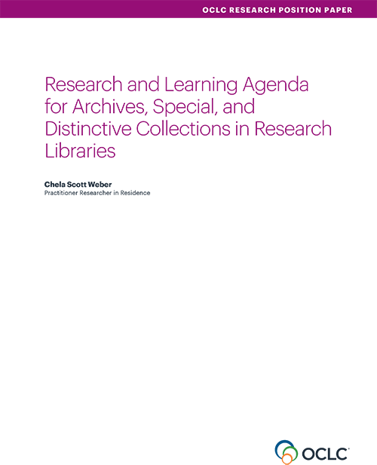
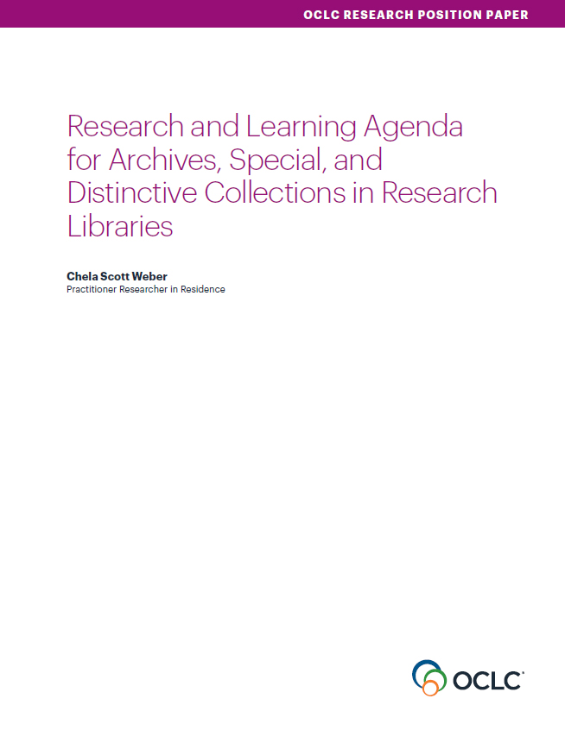
Our Work in Archives, Special, and
Distinctive Collections:
oc.lc/rlp-agenda
Notes:
OCLC Research has a long history of work in the area of archives, special, and distinctive collections in research libraries. We work in special collections because they are an important sight of knowledge creation, made possible by library’s commitment to the stewardship of their distinctive collections. The unique nature of material in special collections can make scaling a challenge, and we work to identify areas of common need and patterns of innovation to help libraries scale learning and expertise with these collections.
In October, we released the Research & Learning Agenda for Archives, Special, and Distinctive Collections.
articulates the shared challenges and opportunities research libraries are are facing in this sphere, and suggests approaches for working on them together.
The agenda will guide OCLC Research work in this area in the future, and we hope it will also serve to frame larger conversations and spur action across the field
This year, OCLC RLP will be presenting a number of webinars that respond to issue surfaced during our work on the agenda.

Slide 2
Responding to the Agenda
“With an ever-expanding universe of information to steward and sizable existing backlogs, it is time to re-emphasize the importance of appraisal.”
…
“Our continued backlogs and resource challenges require a renewed energy be put toward appraisal and reappraisal as part of comprehensive strategies to fulfill our stewardship obligations.”
Notes:
We see this working group as responding to multiple needs in the agenda:
The agenda calls for a renewed
Appraisal – in general and specifically related to needed frameworks for AV and born digital
Advocacy
Data collection for reporting and assessment
Stewardship Responsibilities and Collection Management
Valuing special collections and the labor that goes into their responsible stewardship and care

Slide 3
Taking Action: Collection Building & Operational Impacts Working Group
“A key to making informed collection development, appraisal, and processing decisions is a strong understanding of the necessary institutional resources and capacity for the work to preserve, describe, store, and make accessible collection material.”
Notes:
Recognize the connection between the work of collection building and collection management, and our ultimate ability to live up to our obligations to our donors, collections, and users.

Slide 4
Working Group Goals
explore the intersections between current collecting and collection management practices
seek ways to better integrate collection management considerations into the collection development process
bring together colleagues across these important, interdependent functions

Slide 5
To Help Us All
assess total cost of ownership of collections
determine operational impact of collections
facilitate better communication across our orgs
enable informed decision-making in collection building
advocate for the necessary resources to steward our collections.
Notes:
a white paper, toolkit, and sample documentation
practical strategies for enacting responsible collecting
a toolkit to help institutions implement these strategies

Slide 6
Working Group Members
Matthew Beacom
Yale University
Heather Briston
UCLA
Paul Constantine
University of Washington
Martha Conway
University of Michigan
Gordon Daines
Brigham Young University
Andra Darlington
Getty Research Institute
Audra Eagle Yun
University of California Irvine
Ed Galloway
University of Pittsburgh
Carrie Hintz
Emory University
Jasmine Jones
UCLA
Brigette Kamsler
George Washington University
Mary Kidd
New York Public Library
Sue Luftschein
University of Southern California
Nicholas Martin
New York University
Erik Moore
University of Minnesota
Susan Pyzynski
Harvard University
Andrea Riley
NARA
Gioia Stevens
New York University

Slide 7
Annotated Bibliography Working Group
Annotated Bibliography is available at: https://docs.google.com/document/d/1YW5ctrbA5PuoO4ZLWAExn6nhtEUG_y_YDloVatYUhXk/edit?usp=sharing
Feedback is welcome: gordon_daines@byu.edu
  Gordon Daines
  Department Chair, L. Tom Perry Special Collections, Brigham Young University

Slide 8
Communication Tools
Carrie Hintz
Head of Collection Services
Rose Library, Emory University

Slide 9
Scope
The Communication Tools subgroup will create a suite of tools to assist selectors and other special collections professionals responsible for collection development to collect and share information regarding potential acquisitions with stakeholders. These tools will help repositories develop policies and best practices to support sound collection development, and will support selectors’ efforts to gather and share information about potential acquisitions, assess and communicate the impact an acquisition will have on repository staff and operations, to communicate with donors and administrators about the resources required to effectively steward a collection, and to articulate and promote the value that library workers’ labor and expertise bring to bear on collections and collecting decisions.

Slide 10
Goals and Outcomes
Suite of tools to assist selectors, resource allocators, and technical services managers collaborate on how to select, resource, appraise, and steward new acquisitions

Slide 11
Timeline
January 2019: Draft sample workflows for new acquisitions
February 2019: Identify where in those workflows a communication tool could facilitate effective transfer of knowledge about an acquisition
March 2019: Identify the tools we will create
April 2019: Call for Community samples
May 2019: Create, modify, or identify and aggregate tools
June 2019: Refine and test tool suite
July 2019: Present tool suite to broader CBOI group, request feedback, refine as needed.

Slide 12
Workflow Analysis
Pre-Custodial
Acquisition and Transfer
Ongoing Stewardship

Slide 13
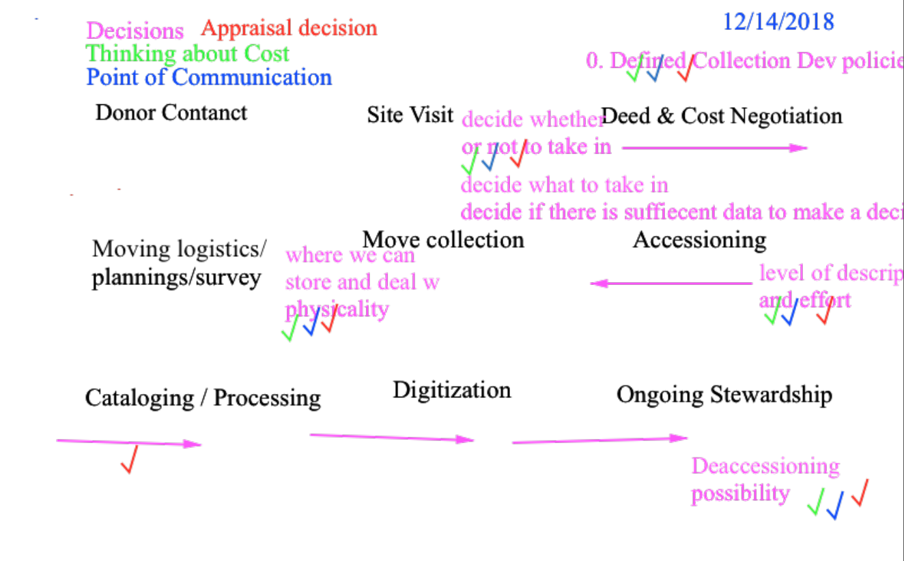

Slide 14
Categorized
Policy and Local Practice
Collection Assessment Tools
Internal Communication and Advocacy
Donor and External Communication

Slide 15
Policy and Local Practice
Collection development policy templates, checklists, or examples
Levels of description document
Processing/Cataloging plan template
Checklist of pre-acquisition and acquisition steps
Documentation checklist
Transfer tools for electronic records

Slide 16
Collection Assessment Tools
Background Research Form
Field Notes Template
Electronic records Survey
Talking Points document to guide conversations with donors
Ingest Checklist
Preservation Assessment Template

Slide 17
Internal Communication and Advocacy
Operational Impact Report
Digitization Consideration Form

Slide 18
Donor and External Communication
Information Packet for Potential Donors
Donor Communication Checklist

Slide 19
User Documentation

Slide 20
Where We
Are Now
Collected Sample Tools, Worksheets, Forms and Policies from the Community
Identifying or drafting exemplars of different documentation types
Getting feedback about where colleagues need/want formal or informal tools to support our work
Integrating those forms back into a workflow

Slide 21
Operational Impact Estimator (OIE) Subgroup
Mary Kidd
Operations and Systems Coordinator
New York Public Library

Slide 22
Timeline
February 2019: Draft a Statement of Scope for the Cost Estimator
March 2019: Review existing cost calculator tools and literature, input findings into a list, and discuss strengths/weaknesses of available tools. Begin developing a list of major functions, activities/actions/tasks.
April 2019: Continue developing list of major functions by adding to it cost units. Draft calculations.
May 2019: Workshop building up calculations: break out work.
June 2019: Transpose cost categories/calculations to a shared Google sheet and begin testing..
July 2019: Present Cost Estimator with great CBOI group to provide feedback to group; refine as needed.

Slide 23
Scope
“The Operational Impact Estimator, or OIE, will provide a total estimated dollar value for a single acquisition. The total estimate will encompass, mainly, the cost of labor, supplies and transport.
The tool will take on the form of a spreadsheet template. The user will input certain variables that will influence one or many calculations.
The tool will be tested by the smaller subgroup using example collections; from there, it will be presented to the greater CBOI working group and refined, and then shared widely.”

Slide 24
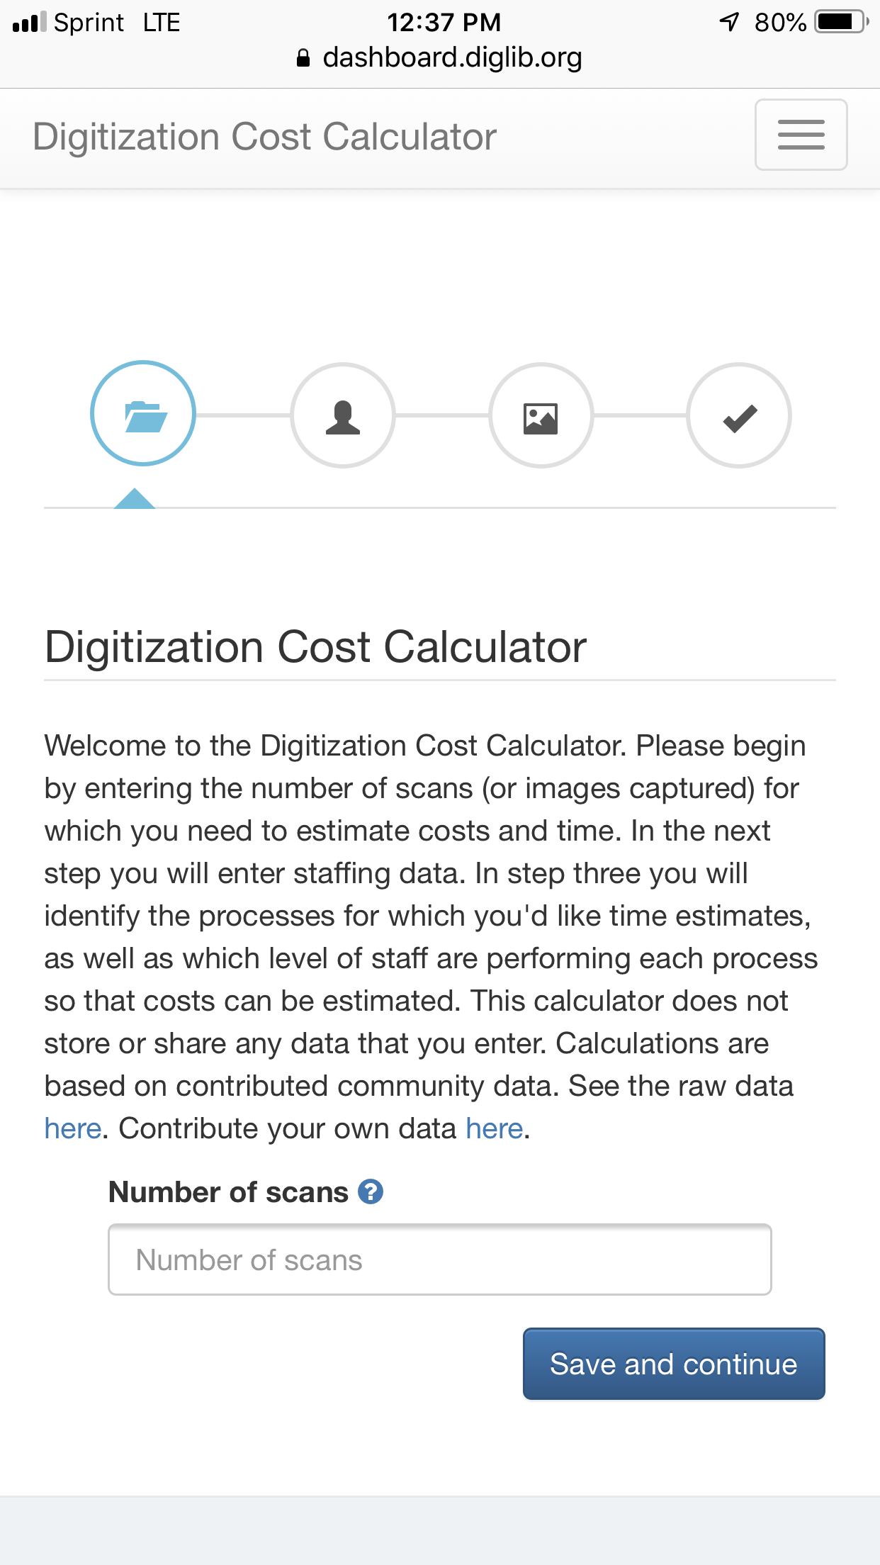
Gather Existing Literature and Calculator/
Estimator Tool Scan

Slide 25
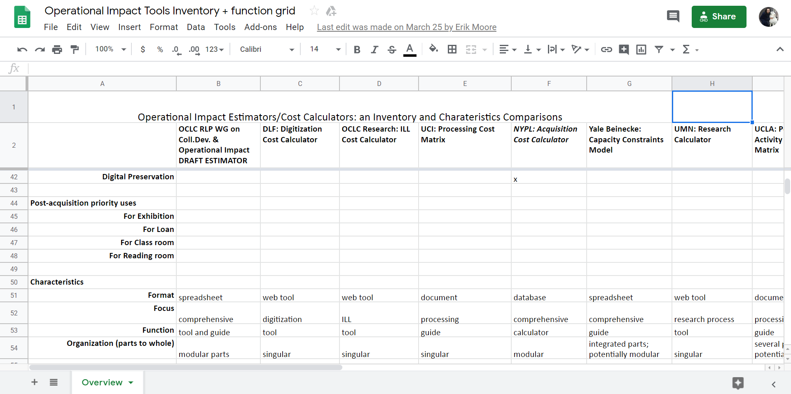
Operational Impact Tools Inventory + Function Grid

Slide 26
The purpose of this document is to create a list of major functions across which the Operational Impact Estimator (OIE) will be developed to estimate cost. Each major function (i.e. “Pre-Acquisition”) consists of one or many activities (i.e. “Site Visit”). Each activity may consist of one or many sub-activities (i.e. “Create preliminary inventory”, “Prepare for transport”, etc.).
Once this list is drafted and reviewed by the group, we will work on refining this list, and once refined, associate costs for each activity, with the idea that the cost of each task can be rolled up into each activity.
Major Functions and Activities List

Slide 27
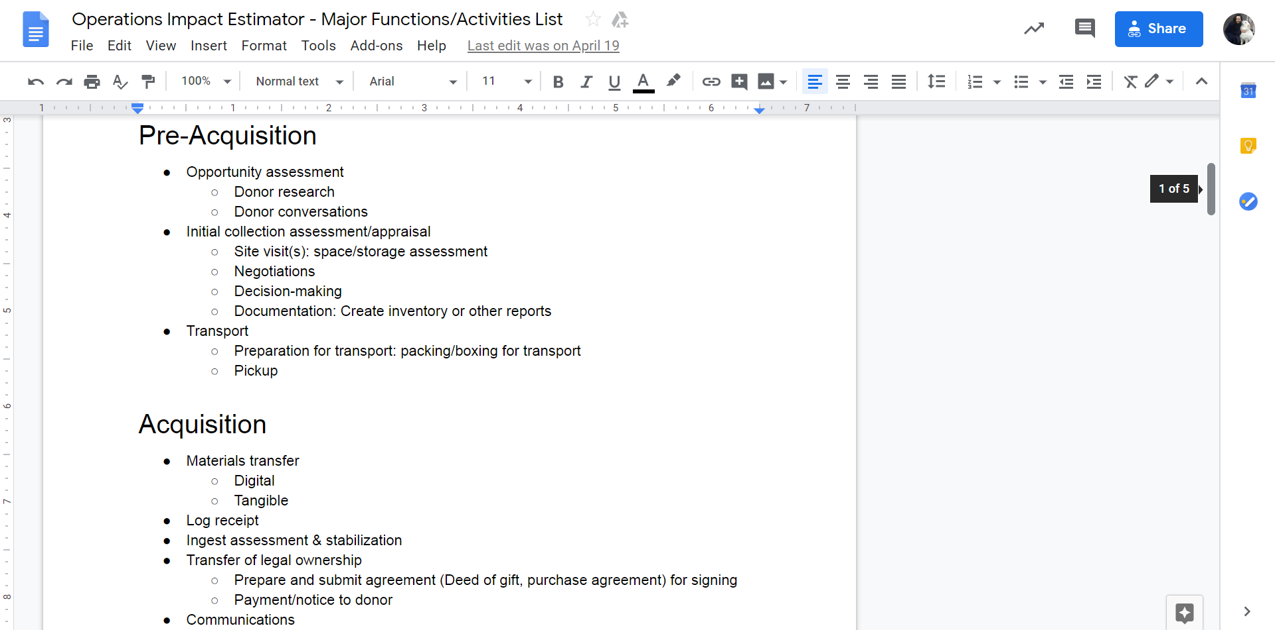

Slide 28
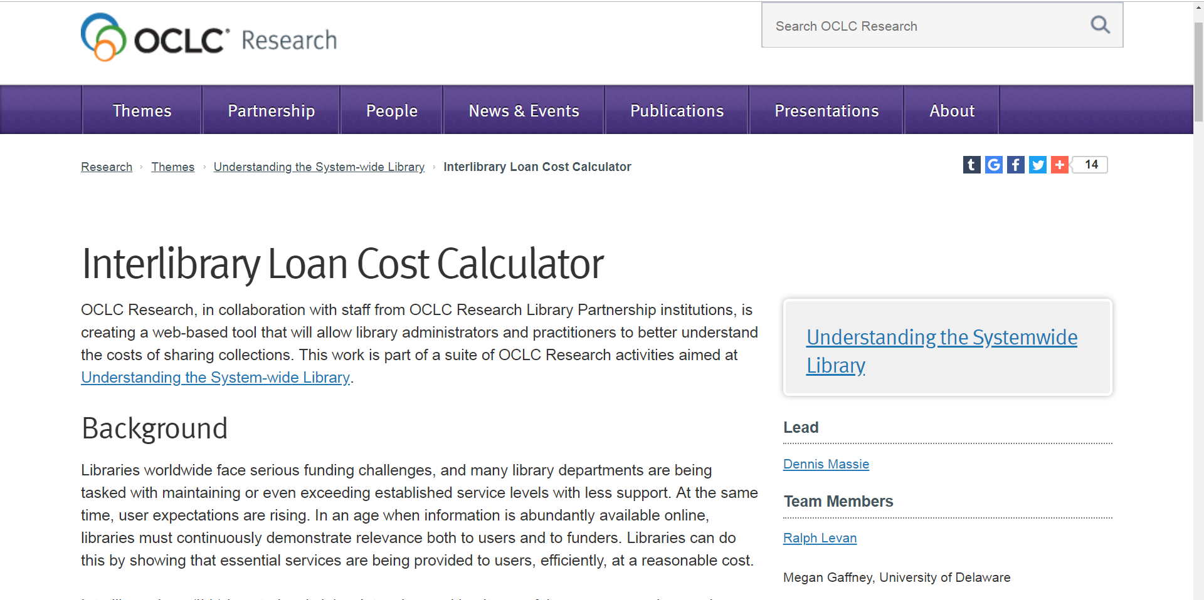
Talking to our Peers

Slide 29
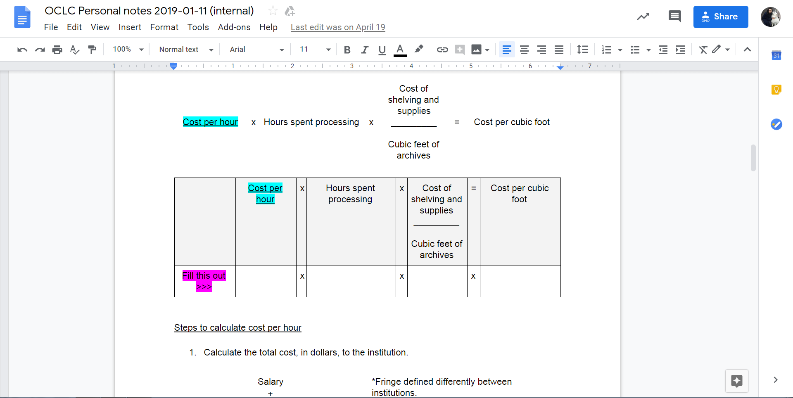
Calculation Build Up

Slide 30
Questions/comments
Can you see yourself using some or all of the tools presented by the group today?
If you can see yourself using these tools, can you explain how or for what purpose?
What might these tools be missing or lacking?
Gordon Daines
gordon_daines@byu.edu
Carrie Hintz
carrie.hintz@emory.edu
Mary Kidd
marykidd@nypl.org

