Slide 1
2019 LD4 Conference on Linked Data in Libraries, Boston
11 May 2019
Taking Advantage of Multilingualism Support in Wikidata
Karen Smith-Yoshimura
Xiaoli Li
University of California, Davis
OCLC Research

Slide 2

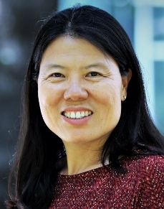
Karen Smith-Yoshimura
Senior Program Officer, OCLC Research
Xiaoli Li
Department Head, Content Support
Services, UC Davis
Notes:
Xiaoli Li and I both participated in the OCLC Research project last year using a Wikibase platform to create entities, called Project Passage. We focused on multilingual support, and as Wikibase is the same platform underlying Wikidata, our multilingual experiences there are the same as those you’d find in Wikidata.

Slide 3
Linked Data Wikibase Prototype:
“Project Passage”
Notes:
First, a short summary of Project Passage, the OCLC Research linked data Wikibase prototype.

Slide 4
About the Passage Pilot
Ran from December 2017 through September 2018
16 OCLC Member libraries participated
The objective was to evaluate a framework for reconciling, creating, and managing bibliographic and authority data as linked data entities and relationships
The pilot Wikibase instance included 1.2M entities, mostly data representing overlaps between Wikidata, VIAF, and WorldCat

Slide 5
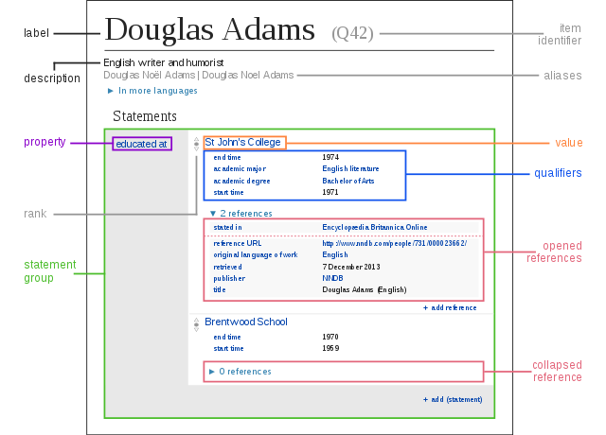
Entity-based
Create linked data without
needing to learn its technical underpinnings
Notes:
A crucial aspect of this project was that it allowed all of us to create entities and make statements and claims about them without needing to learn the technical underpinnings of linked data like triple stores or RDF. For Xiaoli and me, we also could explore the multilingual support.
I will now hand off to Xiaoli for context setting and her experiences with creating entities in Chinese.

Slide 6
Context Setting for Non-Latin Scripts

Slide 7
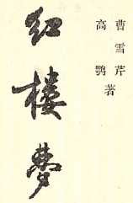
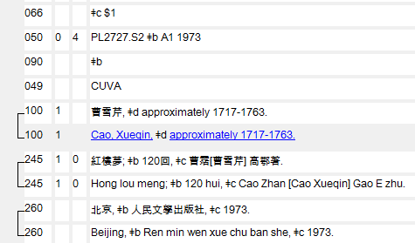
Authority Record
100 1_ $a Cao, Xueqin, $d approximately 1717-1763
400 1_ $aTsʻau, Sjuè Tsjʻin, $d approximately 1717-1763
400 1_ $a 曹雪芹, $d approximately 1717-1763
Bibliographic Record
Notes:
Current cataloging practices in the United States require catalogers provide romanized form of native scripts in both authority and bibliographic records. Inputting native scripts are optional. In bibliographic records, native scripts and their romanized forms are linked as showed on this slide.
Catalogers in the America use the ALA-LC Romanization Tables to transliterate native scripts. The table is approved by the Library of Congress and the American Library Association. Currently, there are 75 tables representing non-Latin scripts that appear in publications more frequently.

Slide 8
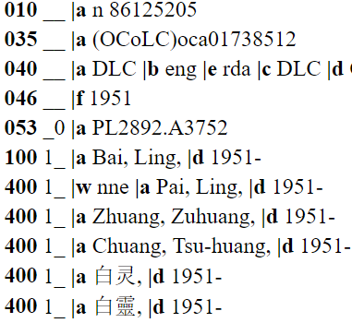
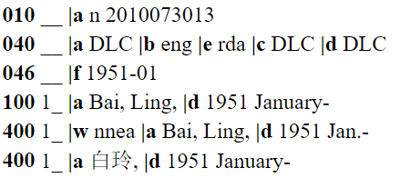
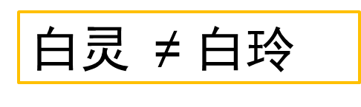
白灵
Bai, Ling = Bai, Ling
白玲
白灵 ≠ 白玲
Notes:
This slide demonstrates one of the pain points using the romanized form as an authorized string for authors whose names are different in native scripts but the same in romanized forms. Additional information (in this case, the birth month) is needed to differentiate them.

Slide 9



曹雪芹
Notes:
Another issue is that romanization systems vary from country to country. Here are some transliteration examples of a famous Chinese author, 曹雪芹:
North America, France, Estonia, Portugal, and South Korea. This does not help data sharing or reuse.

Slide 10
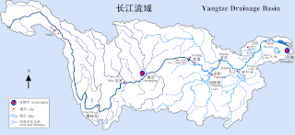
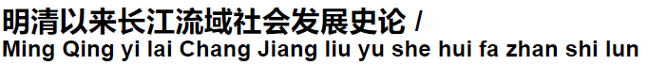
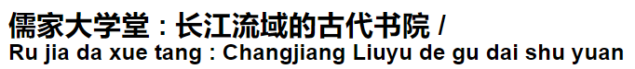
Notes:
ALA-LC romanization systems are complicate and often can be difficult to apply consistently. Here are three different ways appear in OCLC WorldCat for 4 Chinese characters: 长江流域, Yangtze Drainage Basin.

Slide 11
Creating Wikidata Entities with Non-Latin Scripts

Slide 12
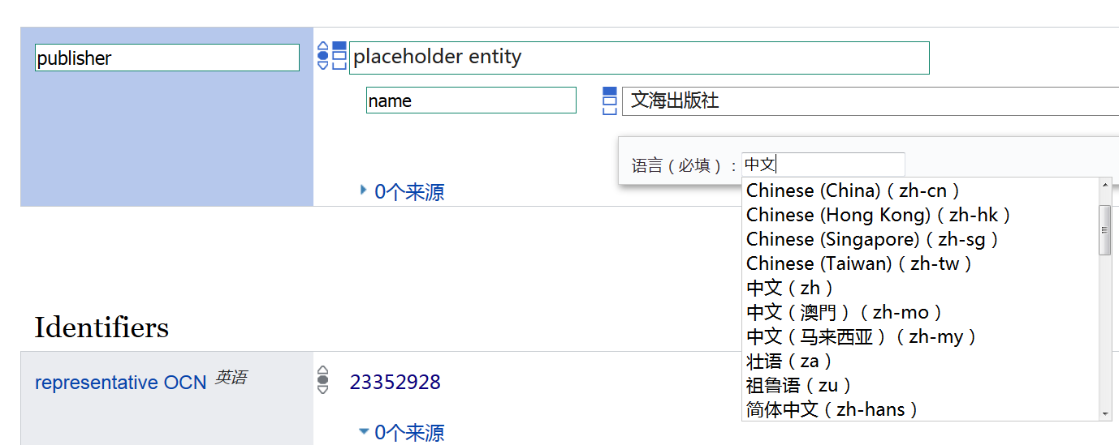
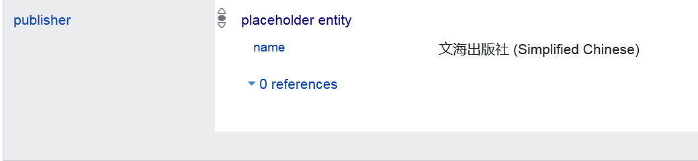
Notes:
Since there is information about language and writing styles, it is possible to rely on computer programs to add other writing styles as well as transliteration.

Slide 13
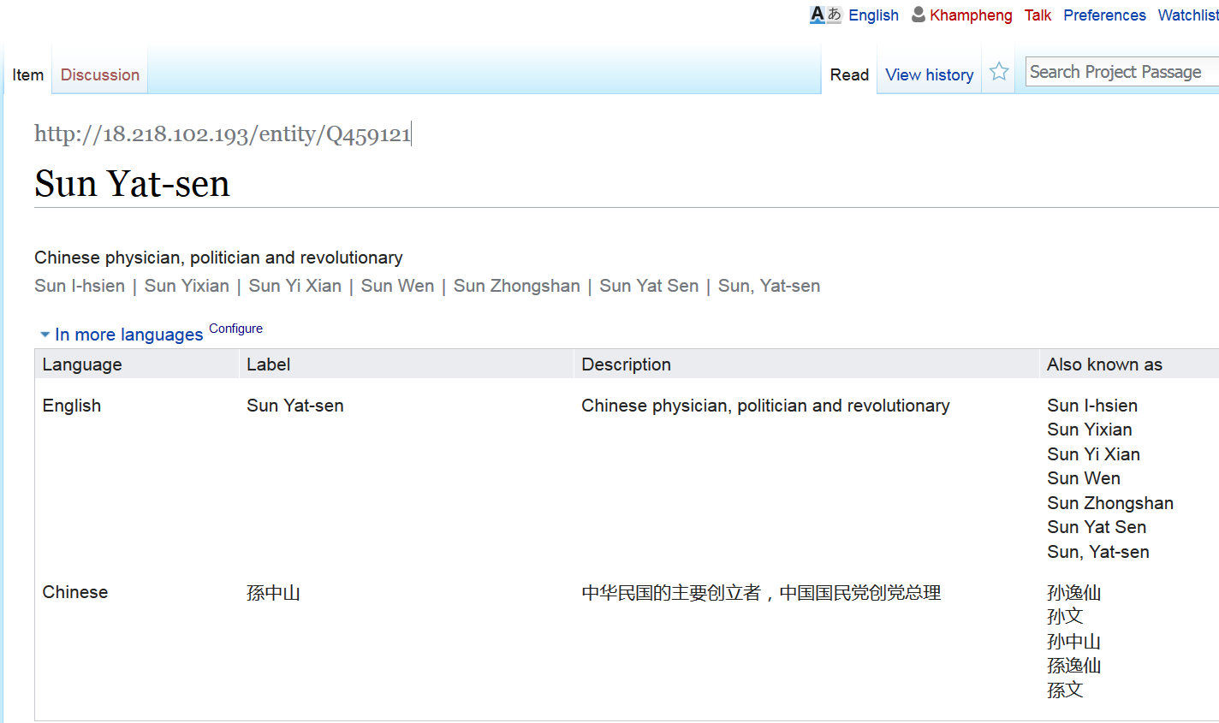
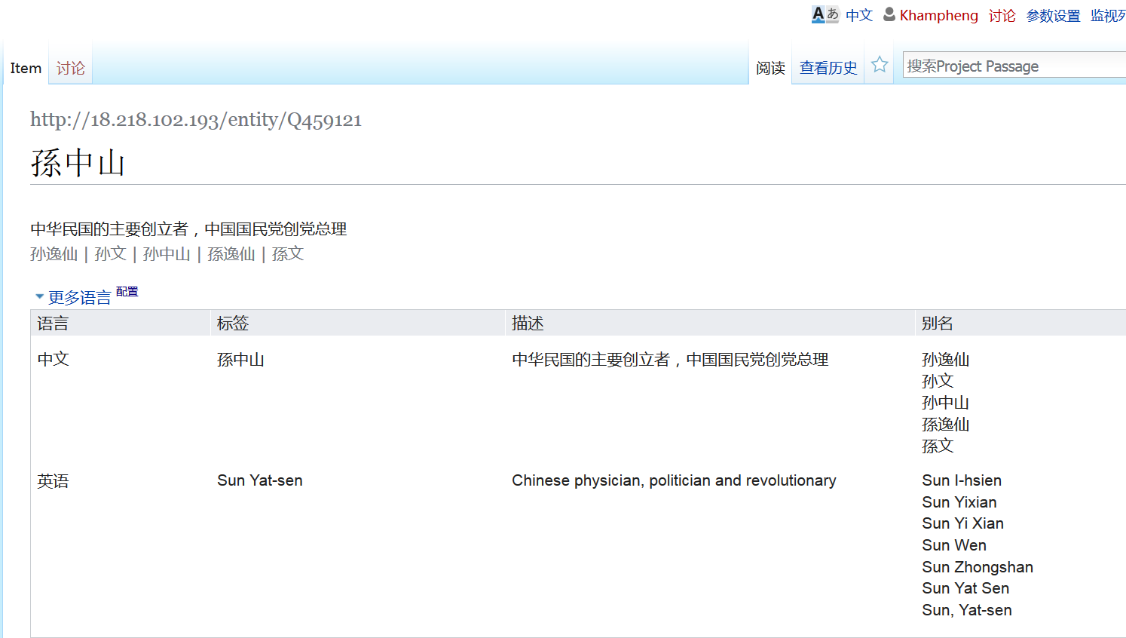
Notes:
The same entity—with the same identifier—can be displayed in different languages. No need to decide which form of the name is considered as an authorized string (like current practice).

Slide 14
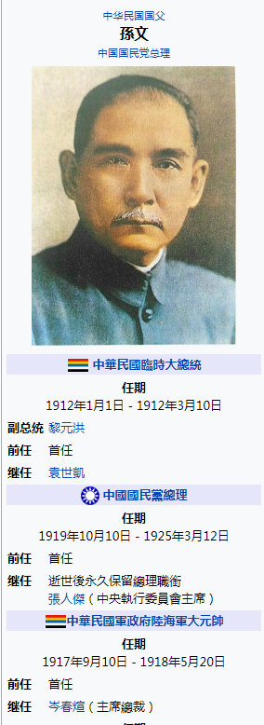
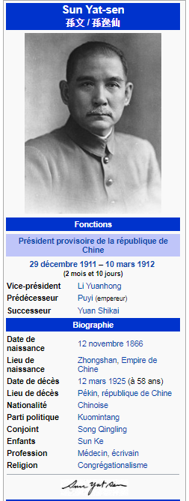
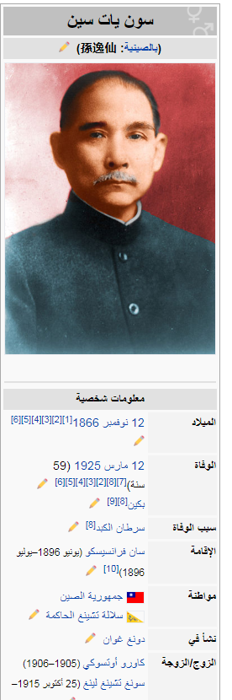
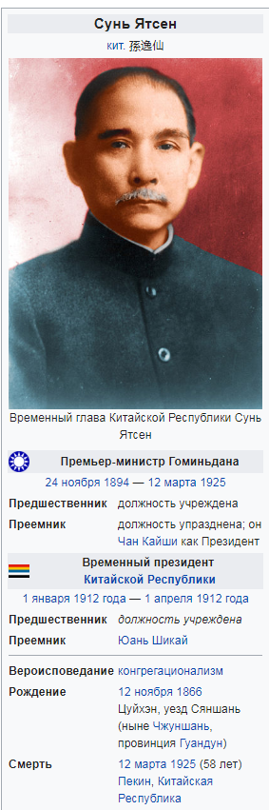
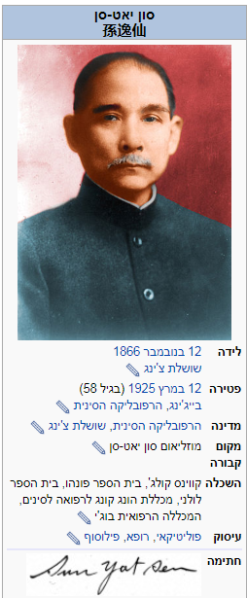
Notes:
Here we can see the effects of structured metadata associated with the same entity. These are Wikipedia information boxes with the data represented in Wikidata – Chinese, French, Russia, Arabic, and Hebrew. All are tied to the same Wikidata identifier--representing the same entity—but the information is presented in the preferred language and script of the user.

Slide 15
Translations
Notes:
I’d like to focus on the case studies we did on translations. The cream of the world’s cultural and knowledge heritage is shared by being translated – it’s how we learn about other cultures and how other cultures learn about us. WorldCat contains many rich cataloguing records for these translations, and our Project Passage participants had “homework assignments” to enter works and their translations into our Wikibase sandbox.

Slide 16
源氏物語
Ιλιάδα
紅樓夢
The Iliad
Dream of the Red Chamber
زقاق المدق
ঘরে বাইরে
The Home and the World
The Tale of Genji
Midaq Alley
Война и миръ
דער בעל-תשובה
War and Peace
The Penitent
સત્યના પ્રયોગો અથવા આત્મકથા
The Story of My Experiments with Truth
[Gandhi autobiography]
Notes:
Translations are a time-tested channel for learning about other cultures – a key method for “knowledge transfer.”. Only 7% of the unique authors in WorldCat have works that have been translated into at least one other language. This is the “short head” [as opposed to the “long tail” ] of works that have the most impact on readers worldwide.
I’ve listed here a few titles—some classic, some written by Nobel Prize laureates of literature— in the original language and script. Likely you’ve heard of all or most of them? But probably in another language. (click).

Slide 17
A work and its translations: a model
Title: Sein und Zeit
Language: German
Author: Martin Heidegger
Created: 1927
Title: 존재 와 시간 Language: Korean
Translator: 전 양범
Date: 1989
IsTranslationOf:
Title: 存在와時間
Language: Korean
Translator: 鄭明五, 鄭淳喆
Date: 1972
IsTranslationOf:
Title: Being and Time
Language: English
Translator: Joan Stambaugh
Date: 2010
IsTranslationOf:
schema:translationOfWork
Title: Время и бытие
Language: Russian
Translator: Владимир Вениамович
Бибихин
Date: 1993
IsTranslationOf:
Title: 存在と時間
Language: Japanese
Translator: 細谷貞雄
Date: 1997
IsTranslationOf:
Notes:
This is the model we used for representing a work and its associated translations with some translations of Heidegger’s Sein und Zeit, along with a few key properties. Each translation has a “translationOfWork” relationship to the original German work, indicated by the red arrows. There can be multiple translations into the same language. In this case, we’ve shown two Korean translations, one with hangul only and one with hangul and hanja, published in different years and with different translators. The earlier translation has two translators.
We identified 570 translations in 33 languages for Heidegger’s Sein und Zeit in WorldCat.

Slide 18
Wikibase Statements
Work
Title (original title)
Language (of original)
Instance of: (Book)
Author(s) (of original)
Earliest known publication date
Translation
Title (translated title)
Language (of translation)
Instance of: (Translation)
Translator(s)
Earliest known publication date
Translated from
Notes:
We translated that model into a desired minimum set of statements for our Project Passage participants.

Slide 19
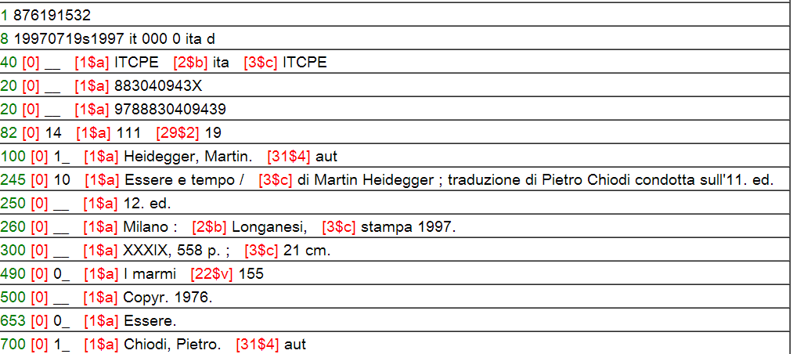
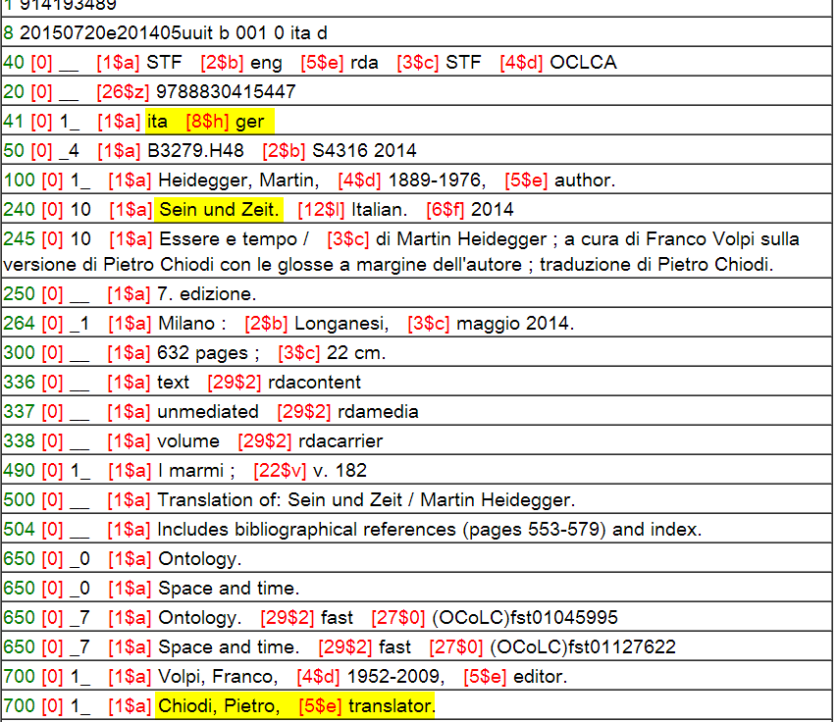
No original language
No original title
Chiodi translator, not author
Notes:
I mentioned earlier that we imported entities from WorldCat to populate our Project Passage Wikibase. WorldCat’s metadata can identify translations of works. But it’s often not easy. In this first record, there is no indication what the original language was, or the original title. And although Chiodi is identified as a translator in the statement of responsibility, the added entry incorrectly identifies him as an author. <click> This is a much richer record for a later Italian translation, also by Chiodi. Here the original language is identified, as well as the original title. There is an added entry for Chiodi, correctly identified as the translator. We can consider this a “gold standard” for representing a translation in MARC.
As long as some records accurately reflect this information, then we can assert the correct relationships for the records that lack the information. However, there are many translations where we are not able to do this from WorldCat alone.

Slide 20
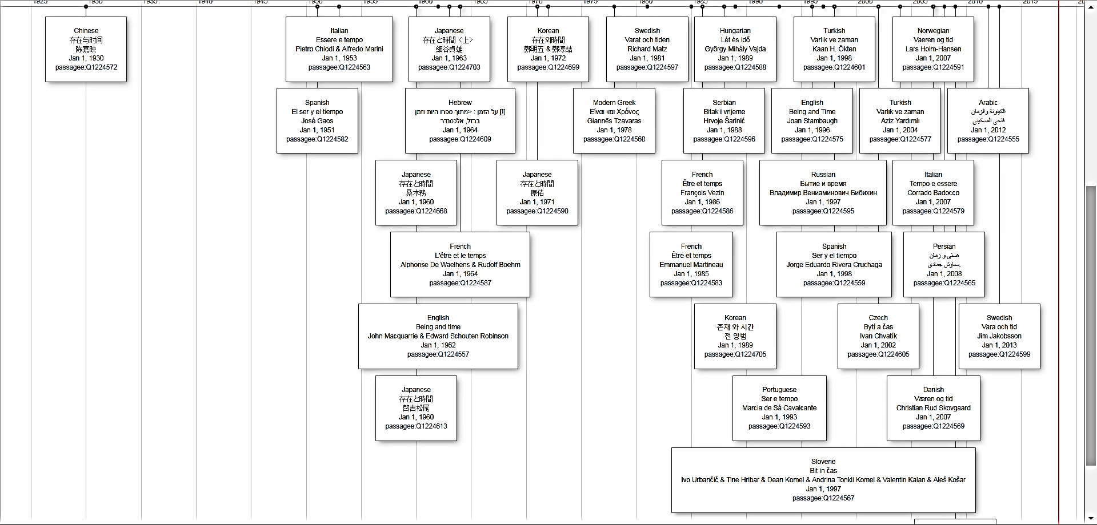
Translations of Sein und Zeit
Notes:
These are all the Passage entities retrieved by a SPARQL query that had a “ “Translated from:” statement for Sein und Zeit displayed in a timeline.. I chose to display in a timeline the statements for Language of the translation, the translated title, the translators, and the date. <click> The four circled here are for Japanese translations, each by a different translator. Some translations are better than others, especially for languages as different as German and Japanese, which is why it’s so crucial to identify the respective translators. This visualization far exceeds what we can accomplish with raw MARC records.

Slide 21
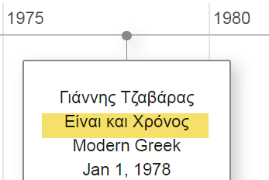
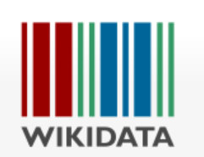
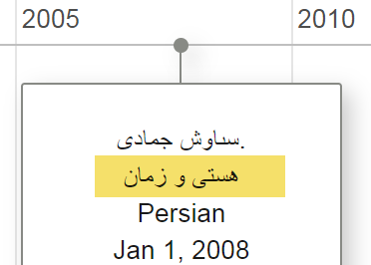
Non-Latin scripts imported from Wikidata
Notes:
Currently there are over 30 million records in WorldCat with non-Latin scripts for 34 different languages. But 76% of them are for Chinese-Japanese-Korean; 29 non-Latin script languages combined total only 1% of the total. Romanization only predominates in WorldCat records for most languages written in non-Latin scripts.
Two of those languages are Greek and Persian. WorldCat has records for these translations of Sein und Zeit, but only in romanization. The two entries we saw on the earlier slide have Greek and Persian scripts because we ingested them from Wikidata.

Slide 22
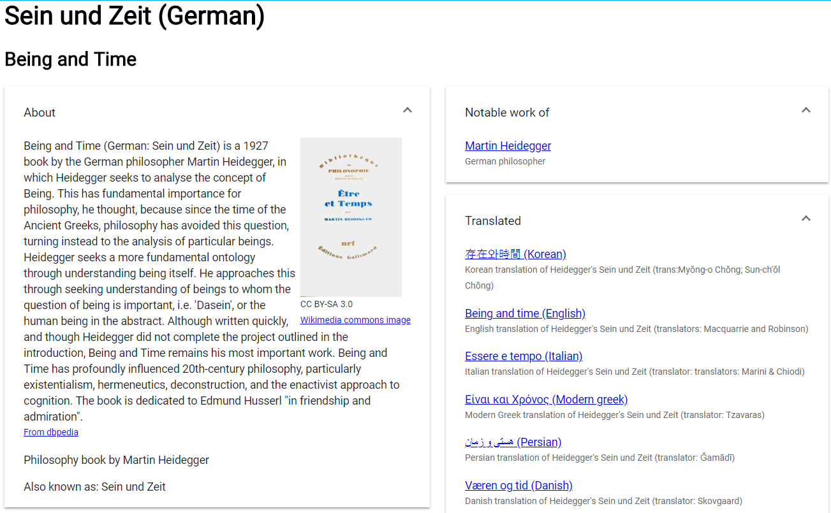
Discovery layer crucial
Notes:
During the Passage Project we learned how crucial a discovery layer was – not just for end users, but to the metadata creators to verify all the inverse relationships were indeed represented. In this case, we show that the original work, Sein und Zeit was translated into other languages. The discovery layer we created during the Passage project also pulled in images from Wikimedia commons and descriptions from DBpedia. And it served to remind us that the free text descriptions we’re used in putting into our MARC records could be pulled in from other sources instead in a linked data environment.

Slide 23

Multilingual labels
Other identifiers
Common descriptions
Original scripts
Work sets
Book instances
Series
Editions
Translations
Publishers
Subjects
Classifications
Materials
Library holdings
…
Multilingual labels
First publication date
Original language and script of work
First line
Freebase ID
MusicBrainz work ID
…
Work ID
Richer bibliographic descriptions
Translations
Library related identifiers
Courtesy of Shenghui Wang
Notes:
Linked data offers us not only the opportunity to represent authors, translators, and titles by identifiers rather than by text strings but also take advantage of other linked data resources to enrich our own datasets. We see a mutual benefit between WorldCat and Wikidata.

Slide 24

2019 LD4 Conference on Linked Data in Libraries, Boston
11 May 2019
Thank you!
Contact: Karen Smith-Yoshimura
Contact: Xiaoli Li
smithyok@oclc.org
xlli@ucdavis.edu
@KarenS_Y
©2019 OCLC. This work is licensed under a Creative Commons Attribution 4.0 International License. Suggested attribution: “This work uses content from Taking Advantage of Multilingualism Support in Wikidata © OCLC, used under a Creative Commons Attribution 4.0 International License: http://creativecommons.org/licenses/by/4.0/.”

