Slide 1
20 March 2019 RLP @ RLUK
2018 OCLC Open Access Study: Highlights of Findings
Merrilee Proffitt
Senior Manager, OCLC Research Library Partnership

Slide 2
A global network of libraries
EMEA
6,050 members in 78 countries
Americas
Asia Pacific
10,060 members in 23 countries
1,472 members in 20 countries
As of 30 December 2018

Slide 3
18,000
member libraries
worldwide who elect
48
delegates to Global
Council, who elect
6
members of the 15-member
OCLC Board of Trustees

Slide 4
“sharing and camaraderie”
“power in numbers, power of the network, power of expertise”
“innovation”
“I believe in the concept of the cooperative”
Why OCLC?
“making the world feel smaller and connected for
the public good”
“research on
our behalf”
“understanding of shared challenges”
“collaboration”

Slide 5
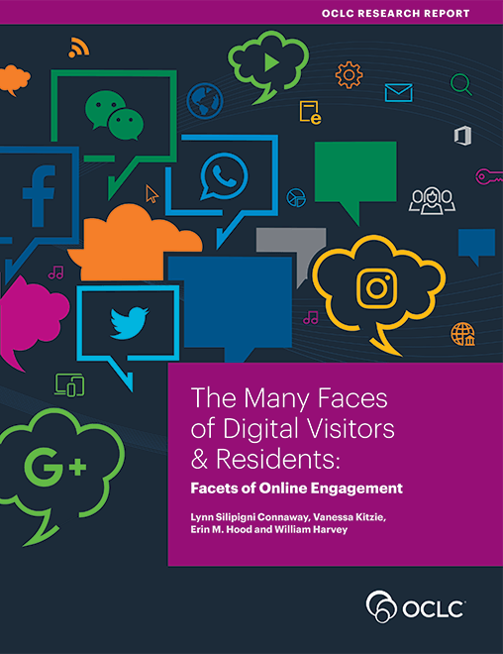
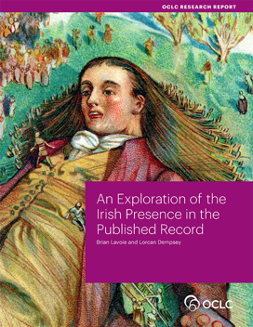

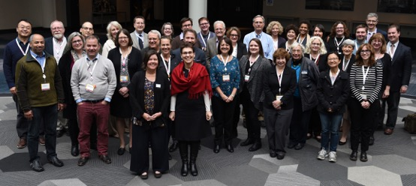
OCLC’s Membership and Research Division
Research devoted exclusively to the challenges facing libraries and archives
Community resource for shared Research and Development
RLP is the platform to collaborate with institutions on research and issues
Lifelong learning from WebJunction
OCLC
Research Library Partnership

Slide 6
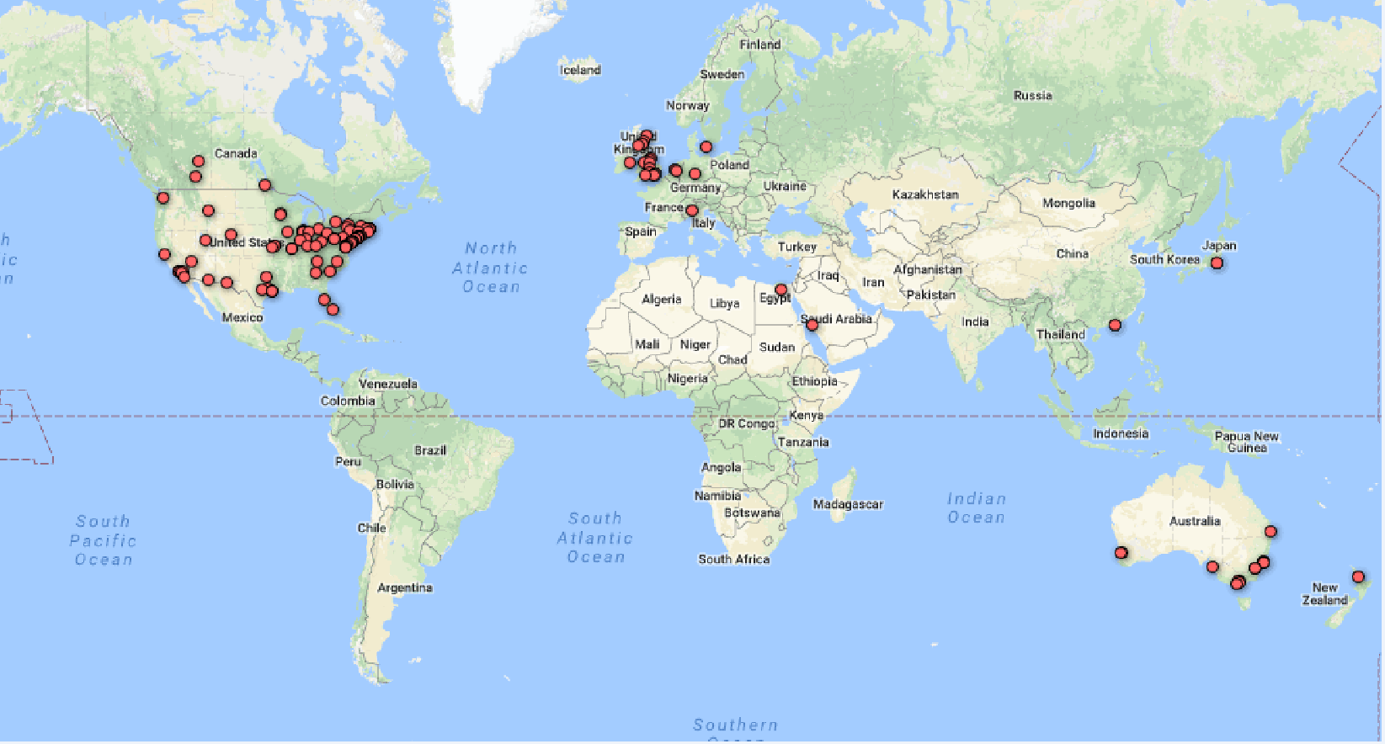
OCLC Research Library Partnership (RLP)
Transnational network of peer institutions
Direct interaction with OCLC Research
Shared understanding for collaborative solutions

Slide 7
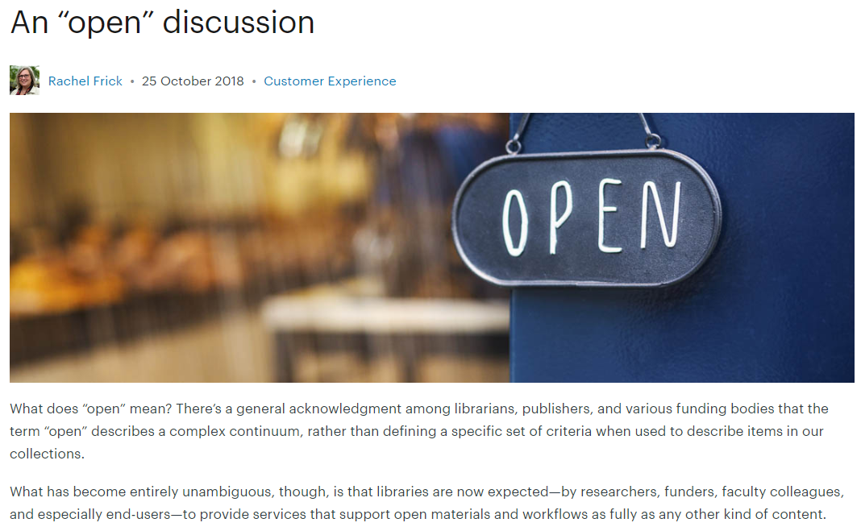
FRAMING THE OPEN CONTENT DISCUSSION
What has become entirely unambiguous, though, is that libraries are now expected—by researchers, funders, faculty colleagues, and especially end-users—to provide services that support open materials and workflows as fully as any other kind of content.

Slide 8

Identify OA-links: MARC proposal accepted
Changes to MARC fields for designating Open Access and License information
Scales to millions of links at OCLC

Slide 9
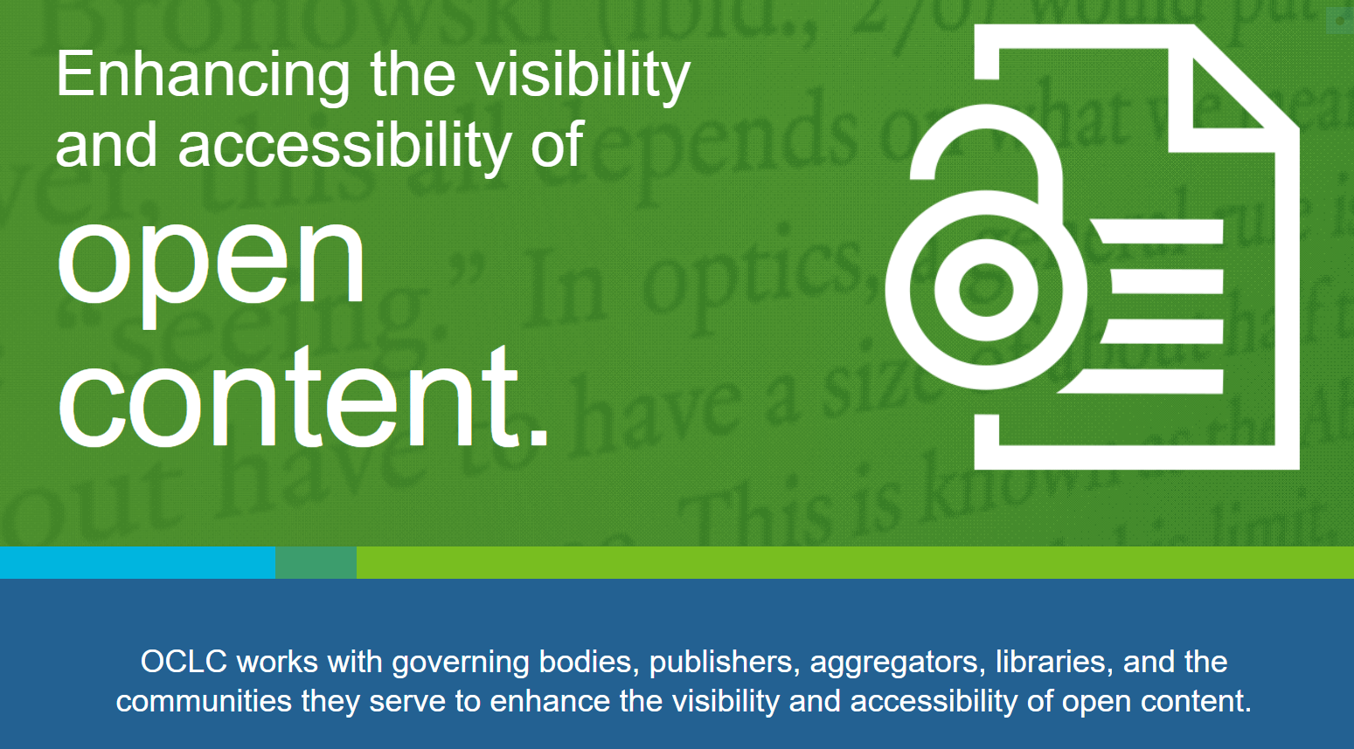

Slide 10
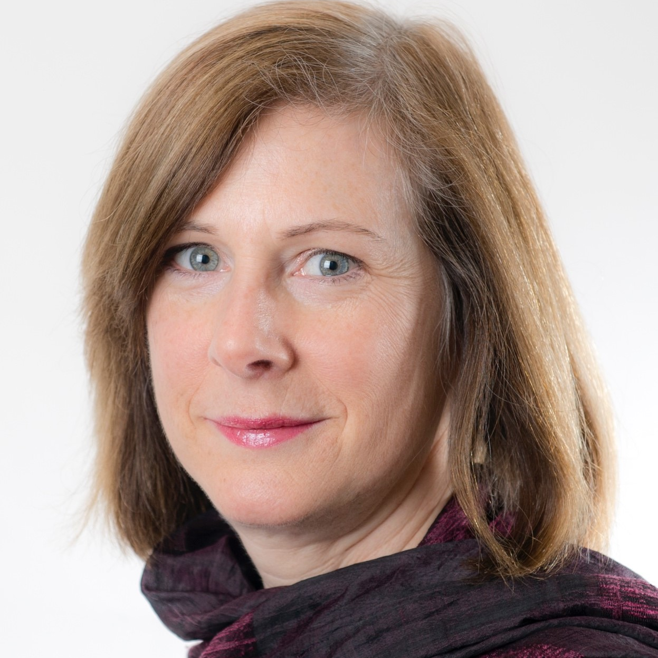
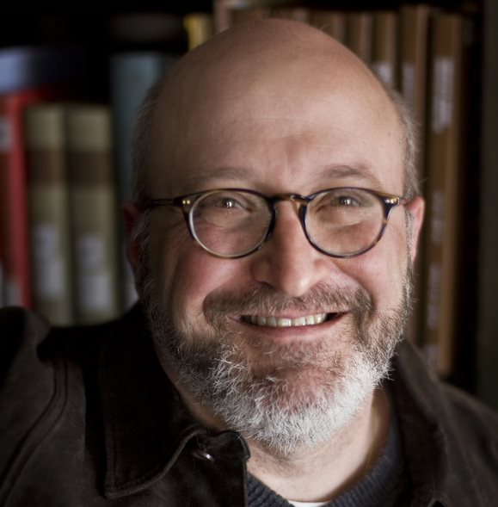

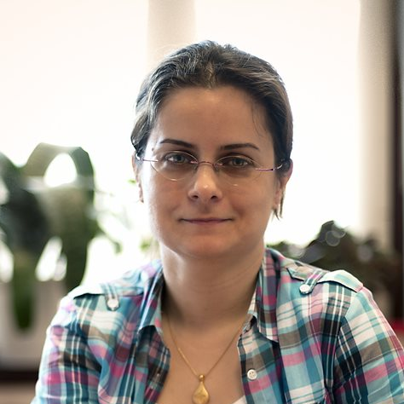
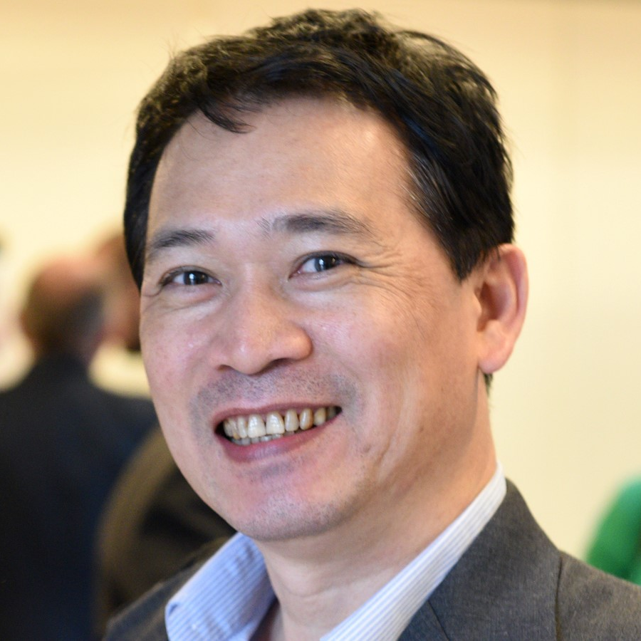
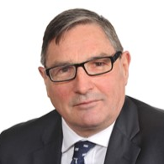
OCLC Global Council: OA and Open Content
Debbie Schachter, Chair (ARC)
Scott Walter (ARC)
Rupert Schaab (EMEA)
Tuba Akbaytürk (EMEA)
Howard Amos (APRC)
Kuang-hua Chen (APRC)

Slide 11
Defining Open Content
Open and freely available
Accessible immediately and online
Digital and usable in a digital environment
Acknowledging the "continuum of openness"

Slide 12
Overview of survey findings
705 responses from 82 different countries
72% are Research and University libraries
91% are currently involved in Open Content activities
Current top 3 Open Content activities:
  Supporting users/instructors/digital literacy programs
  Promoting the discovery of Open Content
  Operating an institutional repository

Slide 13
Responses by Region
Half (49%) of the respondents are from the Americas region; just over a third (36%) from EMEA and 15% from Asia Pacific.
DRAFT

Slide 14
Responses by Library Type
Nearly three-fourths of the respondents are Research & University Libraries (72%) and another 8% are from other Educational Libraries.
DRAFT

Slide 15
Nearly half (49%) of the lead contributors are higher level staff (director, assistant director or manager); 47% are librarians/library staff. The lead contributor represents various areas of responsibilities, with e-resources being the most represented.
260 total respondents did not provide level of responsibility for the lead contributor.
270 total respondents did not provide area(s) of responsibility for the lead contributor.

Slide 16
Most (91%) are CURRENTLY and 72% PLAN to be involved in open content activities.
More than half are CURRENTLY involved in:
supporting users/instructors/ digital literacy programs (65%);
promoting the discovery of open content (61%);
institutional repository (60%);
supporting authors/researchers/ teachers (58%);
digitizing collections (57%);
selecting open content not managed by the library (54%).
A tenth or more PLAN to be involved in most of the open content activities.
None/Not sure
Current (9%)
Plan to (28%)
*Many of those planning to get involved in specific open content activities are also currently involved in open content activities.
DRAFT

Slide 17
Significantly more EMEA respondents (compared to Americas) PLAN to be involved in data services; digital collections library; deep interactions of open content; publishing; and born-digital (legal) deposit/Web-archive. Significantly more respondents from the Americas (compared to EMEA) PLAN to be involved in assessment.
DRAFT

Slide 18
Americas’ respondents are more likely to have been involved in Digital Collections Library; digitizing collections; and deep interactions of open content for more than 3 years. EMEA respondents are more likely to be involved in institutional repository; supporting authors/researchers/teachers; and supporting users/instructing/digital literacy programs for more than 3 years. AP respondents are more likely to have been involved in bibliometrics; assessment; data services; born-digital (legal) deposit/Web-archive; and advocacy & policies longer (more than 3 years).
DRAFT

Slide 19
Total respondents
In planning for expenses/investment, please indicate if the source of investment for each of your current open access activities is a budget line item, full-time equivalent (FTE) allocation and/or project-specific funding. (Select all that apply.) (Table sorted in descending order based on “no source of investment”)
 | Budget line item | FTE allocation | Project money | Other | No source of investment | Not sure
Data services (n=168) | 33% | 46% | 12% | 8% | 11% | 16%
Digital Collections Library (n=284) | 47% | 36% | 19% | 7% | 12% | 14%
Institutional repository (n=340) | 52% | 37% | 12% | 5% | 12% | 11%
Publishing (n=197) | 37% | 38% | 17% | 10% | 12% | 15%
Digitizing collections (n=320) | 37% | 31% | 35% | 8% | 13% | 12%
Born-digital (legal) deposit/Web-archive (n=108) | 38% | 32% | 15% | 10% | 15% | 17%
Bibliometrics (n=129) | 27% | 43% | 7% | 7% | 19% | 13%
Deep interactions with open content (n=73) | 23% | 26% | 14% | 11% | 21% | 18%
Assessment (n=114) | 16% | 32% | 8% | 10% | 25% | 21%
Supporting of authors/researchers/teachers (n=329) | 19% | 35% | 8% | 8% | 26% | 16%
Supporting users/instructing/digital literacy programs (n=373) | 17% | 35% | 8% | 6% | 30% | 14%
Advocacy and policies (n=285) | 18% | 33% | 8% | 7% | 32% | 13%
Selecting open content not managed by the library (n=316) | 16% | 27% | 7% | 7% | 36% | 17%
Promoting the discovery of open content (n=357) | 16% | 28% | 5% | 7% | 37% | 13%
DRAFT

Slide 20
74% of total respondents want to accelerate the impact for current and/or planned data services open content activities; and more than half feel this way for many of the other open content activities.
DRAFT

Slide 21
Total respondents
DRAFT

Slide 22
Nearly half or more total respondents report OCLC currently supports or they see a role for OCLC to support their library’s efforts in the various open content activities. Half or more do NOT see a role for OCLC to support publishing (55%); supporting users/instructing/digital literacy programs (54%); supporting authors/researchers/teachers (51%); and institutional repository (50%) open content activities.
DRAFT

Slide 23
The top OCLC Research areas most relevant to library’s open content activities are discoverability of open content (63%) and standardization of metadata (49%) among total respondents.
DRAFT

Slide 24
The top OCLC Research areas most relevant to library’s open content activities are discoverability of open content and standardization of metadata among all regions. There is more interest among EMEA and AP respondents in RIM/CRIS and Research Data Management (RDM) – nearly a third or more selected these as most relevant areas compared to approximately a tenth of respondents from the Americas.
DRAFT

