Slide 1
CNI Spring 2019 Membership Meeting
Trends and Priorities in Canadian Research Libraries: Results of a CARL-OCLC Survey
Vivian Lewis, University Librarian, McMaster University @VivianLewis1
Merrilee Proffitt, Senior Manager, OCLC Research @MerrileeIam

Slide 2
A global network of libraries
EMEA
6,050 members in 78 countries
Americas
Asia Pacific
10,060 members in 23 countries
1,472 members in 20 countries
As of 30 December 2018
Notes:
OCLC libraries are part of an active and engaged global network of libraries with approximately 18,000 members across 121 countries.
Global network provides unparalleled access to the world’s collected knowledge in ways that cannot be achieved independently
Ability to address shared challenges at scale
Together, we connect people to the information they need to achieve their goals
[Per Ellen McCarthy, the 12/31/2018 update is the most current info available for this slide—notes current 3/11/19]

Slide 3
18,000
member libraries
worldwide who elect
48
delegates to Global
Council, who elect
6
members of the 15-member
OCLC Board of Trustees
Notes:
The OCLC cooperative is member-governed. Its 18,000 member libraries worldwide elect 48 delegates to OCLC's Global Council, who in turn elect six members of the 15-member OCLC Board of Trustees.
[Notes current as of 3/11/19]

Slide 4
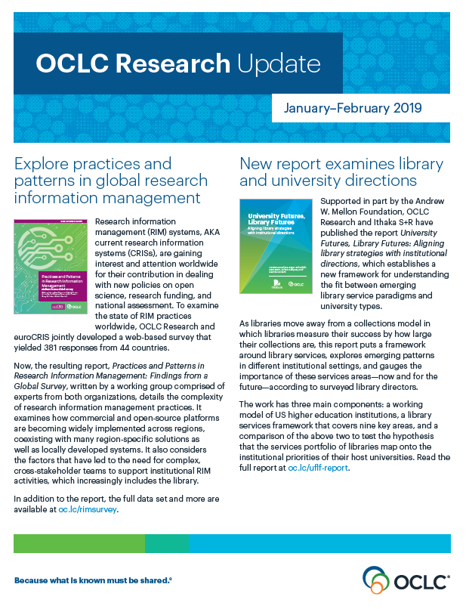
OCLC Research
Scale and accelerate library learning innovation and collaboration.

Slide 5
Why this survey?
In 2017, OCLC Research was encouraged by OCLC EMEA Regional Council to sharpen intelligence around research library needs and priorities outside the United States
  2017: survey of library directors at 238 institutions in the UK, the Netherlands, Germany, Austria, Switzerland, Denmark, Spain, France, and Italy
  2018: survey of library directors in CARL and CAUL
Notes:
OCLC research undertook this survey at the urging of the EMEA regional council, part of OCLC’s governance structure. Members of the EMEA regional council were kind but firm – if OCLC Research was to be successful in serving a global library community, it should have a baseline understanding of what challenges and priorities are faced by libraries in different parts of the globe. The EMEA innovation survey was sent to library directors at 238 institutions in the UK, the Netherlands, Germany, Austria, Switzerland, Denmark, Spain, France, and Italy
(Institutions were chosen from the Times Higher Education World University Rankings 2016-2017). Encouraged by the findings from this initial survey, which revealed that OCLC Research is working in areas that are meaningful to the institutions surveyed, we partnered with CARL and CAUL (the Council of Australian University Libraries, which also includes research libraries in New Zealand) to help us better understand issues in research libraries in Canada and in Australia / New Zealand. Today I will share with you preliminary results from the CARL / OCLC Survey.

Slide 6

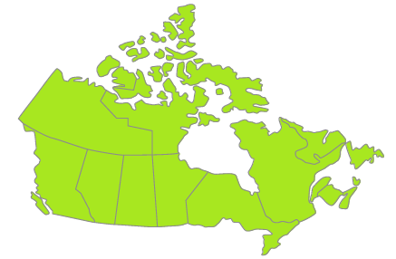
29
of Canada’s largest university libraries and
2
Federal libraries
Notes:
The Canadian Association of Research Libraries is the voice of research libraries in Canada. Our association represents 29 of the largest university libraries in the country – as well as two federal institutions – the National Science Library and Library and Archives Canada.

Slide 7
Advance research
Strengthen capacity
Measure impact
Influence public policy
Notes:
CARL spends a lot of time thinking about where we, as an organization, can add value above and beyond what is already being supported locally or through our other professional bodies. We traditionally focus our attention on four areas – advancing research, strengthening capacity, measuring impact and influencing public policy.

Slide 8
Strategic Planning
Environmental scan of other research library organization
Review of past plan
Online survey
Member interviews
Workshop
Review of preliminary data from the CARL-OCLC Trends and Priorities Survey
Notes:
In 2018, we found ourselves at that critical point that all good organizations regularly find themselves in – we were embarking on a review of our strategic plan.
The strategic planning group, of which I am a member, has utilized many of the tools you would expect from such a process. We’ve done an environmental scan, conducted an online survey, interviewed each member, etc.
When we were approached by OCLC about the idea of replicating the trends and priorities survey we were very receptive. We viewed the survey as potentially providing another lens on where our members wanted us to act. Having a third party frame the questions and work with us to analyze the results can sometimes result in rich results.

Slide 9
The International Context
Notes:
CARL has a strong international focus. We have increasingly close connections with ARL, LIBER, RLUK. We are a founding member of IARLA. So the opportunity to put our own experience in an international context was appealing.
The fact that half of the membership is embarking on a study tour of Australia and New Zealand (one of the two comparator areas) in June was made the survey particularly compelling!

Slide 10
26 library directors took the survey in Canada
80% have been in profession for 20+ years; 65% in their current position for 5 years or less
Notes:
The majority of library directors who took this survey (80%) have a long tenure in libraries (21 years and up), but 65% have held their current leadership positions for 5 years or less.

Slide 11
Majority (60%) expect use of physical library to increase over next 5 years; 92% expect online use to increase
Notes:
We asked library directors to share with us their top of mind observations about the use of the library by faculty and students, and also to share with us where there are challenges and opportunities for innovation.
Here we see that library directors expect the change in visits to the physical library to increase modestly, while use of the “online library” (access to collections and services that can be used without entering a physical building will expand over the next 5 years, with 44% of those surveyed predicting an increase of over 20%.

Slide 12
Accessing online resources, receiving research support and borrowing materials:
Main reasons faculty/staff use the library today, according to nearly two-thirds or more respondents
Notes:
We asked a pair of questions about students and faculty, asking for impressions of the top 5 reasons that faculty or students would use the library now, and in 2023. Remember as you see these slides that percentages reflect only those top 5 reasons – all of these service areas are important and the fact that something is not ranked high does not mean that it is unimportant.
Faculty use of the library is expected to change only modestly, but let’s take a look at where that change might be.

Slide 13
Respondents expect growth in receiving research support services and using the library as a technology center among faculty.
Notes:
If you contrast the blue (current) with the magenta (2023) you can see that library leaders expect an increase in faculty reliance on library provided research support services, as well as an increase in use of the library as a technology center, as well as the library serving as a social or meeting place.

Slide 14
Using the library for individual or group work/study space and accessing online resources: Main reasons students use the library today, say 80%+ respondents
Notes:
As with faculty, use of the library by students is expected to change only modestly, but let’s take a look at where that change might be.

Slide 15
While only 16% believe using the library as a technology center is a main reason students use the library today, more than half (58%) of respondents believe this will be true in 5 years
Notes:
Again, we see a big jump in reliance on the library as a technology center, as well as an increase in students receiving research support services. Students are already heavy users of library spaces, both their for study, collaboration, and social needs and we expect this will continue.

Slide 16
Top priorities focus on research data, facilities and demonstrating value
Digital humanities, open access, research information management and research data: Most challenging/ripe for innovation
Notes:
Next we asked library leaders to rank their current top priorities, and also tell us areas they see as the most challenging / ripe for innovation. OCLC is interested in how libraries engage as networks to solve challenges and to innovate, and we were pleased to see several of the issues called out by Canadian research library leaders also areas where we are already engaging: research information management, research data management and open access.
VIVIAN: This became the slide we turned to frequently in our discussions of our new strategic plan. We focused most intently on the areas deemed MOST CHALLENGING / RIPE FOR INNOVATION – with the understanding that these were the areas where CARL as an organization could bring value.

Slide 17
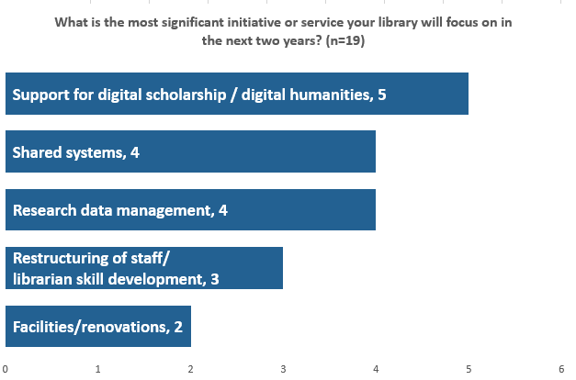
Digital scholarship/humanities and research data management:
Most-mentioned significant initiatives for next two years
Notes:
We also asked library leaders what the most significant initiative is that they will be investing in in the short term. Digital scholarship, RDM and skill development all scored high.

Slide 18
ANZ Top priorities Demonstrating value, facilities, e-resources
Demonstrating value, digital scholarship: Most challenging/ripe for innovation

Slide 19
UK Top priorities, e-resources, open access publishing, RIM
RDM, digital scholarship, most challenging/ripe for innovation

Slide 20
Students now and in the future (UK)

Slide 21
Students now and in the future (ANZ)

Slide 22
OCLC Research investments
Research Data Management
  Realities of RDM (publication series) oc.lc/rdm
  Webinars + learning guide
Research Information Management oc.lc/rim
  Case studies, global survey results, position paper
Open Access – Access to Open Content Survey oc.lc/oasurvey (closed 31 January)
Notes:
We are heartened to see that a number of the areas flagged as “challenging / ripe for innovation” are ones that OCLC has already invested in. I’d like to draw your attention to just a few of these. For example, in the area of Research Data Management, OCLC Research has issued a report series, the Realities of Research Data Management. We also have a recorded webinar series and learner guide to help those who are looking to sharpen their skills in that area.
Similarly, in the area of Research Information Management, we have a number of reports available to help provide an evidence base for research information management as it is practiced globally and to help practitioners see the big picture.
We share your concern with open access and with the leadership of OCLC’s global council, we are undertaking the global access to open content survey. This survey closes soon, so please share your views on fruitful open content activities.

Slide 23

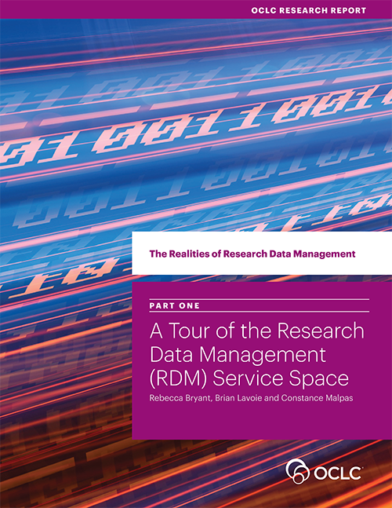
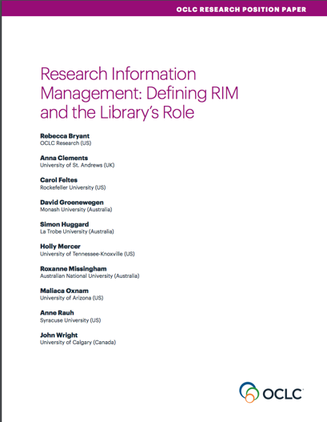
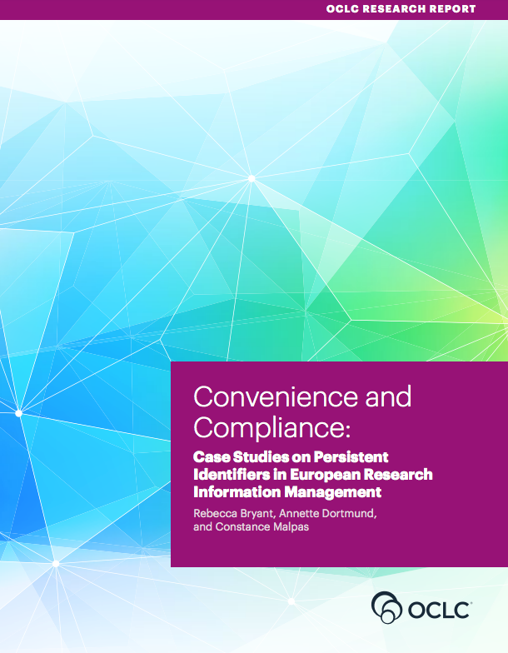
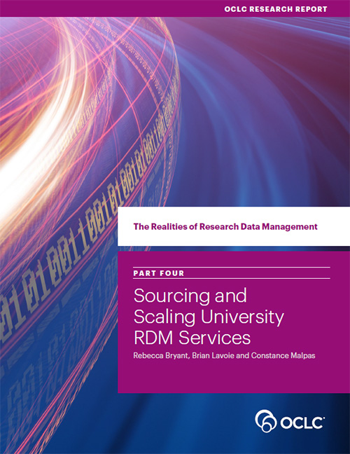
OCLC Research publications on Research Data Management
oc.lc/rdm

Slide 24
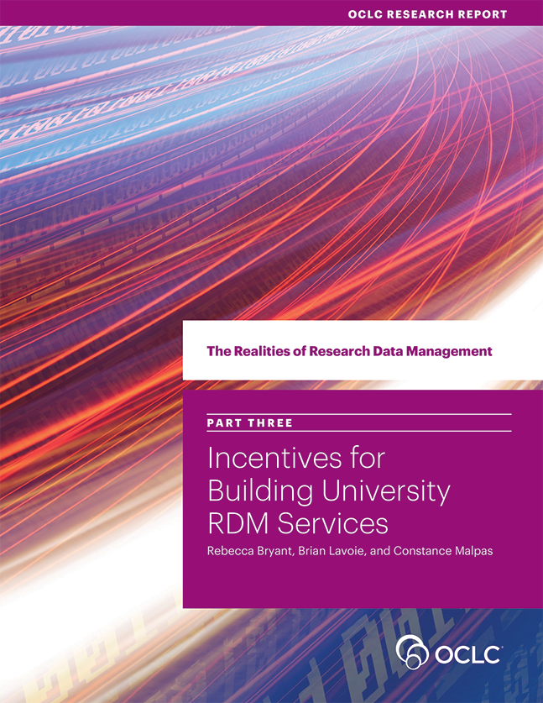
OCLC Research publications on Research Information Management
oc.lc/rim
Notes:
An area of recent research for OCLC is research information management, as we recognize this as an important emerging service categories for libraries. We’ve been developing an arc of research to describe, explain, and document international practices in research information management.
In 2017 we released a position paper on research information management, which I’ll talk a bit more about in a minute.
That year we also published a research report, conducted in collaboration with LIBER, documenting case studies in persistent identifiers in research information management.
We have also been collaborating with euroCRIS on an international survey on Research Information Management Practices, which was published in late 2018, providing a quantitative view of RIM practices worldwide.
Though all of these research efforts, we have sought to better understand what constitutes research information management (i.e., the different use cases), and how the library is supporting these activities.

Slide 25
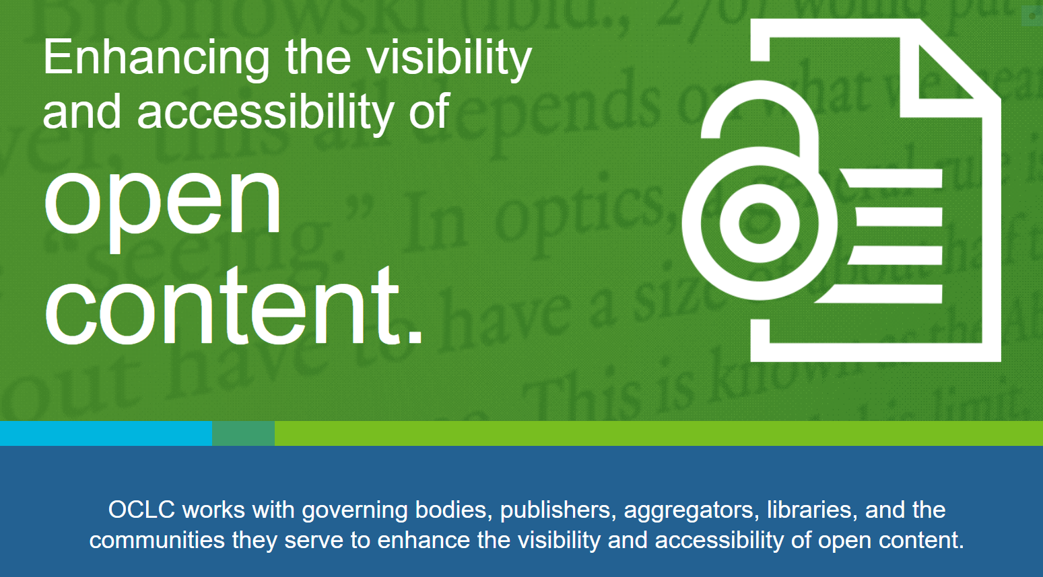
Notes:
The library community and OCLC have big aspirations – this is clear from discussions we have had so far on this topic with our members.
OCLC has therefore set-up a strategic working group to plan for OA and Open Content in a strategic way.
This survey will help inform the roadmap of the activities this group is planning.
The group has already started. It looks at the big challenges and the low hanging fruit and makes progress in small steps.
Where are we today? What do we have in the Index (49 Million e-books and articles are identifiable as OA)? How do we identify open content and surface it? How can we help discovery of open content in WC Discovery and WorldCat.org (100 Million users/year)? How do we shift from privileging print to privileging open access?

Slide 26
Next steps
Finish analysis of preliminary results
Publication of results (along with results from the UK and CAUL data) – later in 2019

Slide 27
If you took the survey….
THANK YOU!
Questions and discussion
Vivian Lewis lewisvm@mcmaster.ca
Merrilee Proffitt proffitm@oclc.org
Notes:
Thank you to CARL, especially to Susan Haigh and Vivian Lewis for being wonderful partners in helping to bring this survey to life. If you took the survey, our thanks to you for helping provide context for how our work makes a difference in Canada.
Questions about the surveys? Merrilee Proffitt
Questions about work with RDM or RIM? Rebecca Bryant
Questions about open content survey? Titia van der Werf?

