Slide 1
12 June 2019 @ SCONUL19
The costs of “open”: preliminary results from a global survey
Merrilee Proffitt
Senior Manager, OCLC Research Library Partnership
@MerrileeIam

Slide 2
A global network of libraries
EMEA
6,050 members in 78 countries
Americas
Asia Pacific
10,060 members in 23 countries
1,472 members in 20 countries
As of 30 December 2018
Notes:
OCLC libraries are part of an active and engaged global network of libraries with approximately 18,000 members across 121 countries.
Global network provides unparalleled access to the world’s collected knowledge in ways that cannot be achieved independently
Ability to address shared challenges at scale
Together, we connect people to the information they need to achieve their goals
[Per Ellen McCarthy, the 12/31/2018 update is the most current info available for this slide—notes current 3/11/19]

Slide 3
18,000
member libraries
worldwide who elect
48
delegates to Global
Council, who elect
6
members of the 15-member
OCLC Board of Trustees
Notes:
The OCLC cooperative is member-governed. Its 18,000 member libraries worldwide elect 48 delegates to OCLC's Global Council, who in turn elect six members of the 15-member OCLC Board of Trustees.
[Notes current as of 3/11/19]

Slide 4
“sharing and camaraderie”
“power in numbers, power of the network, power of expertise”
“innovation”
“I believe in the concept of the cooperative”
Why OCLC?
“making the world feel smaller and connected for
the public good”
“research on
our behalf”
“understanding of shared challenges”
“collaboration”
Notes:
Libraries come together as OCLC to advance librarianship around the world – there is a commitment and a passion. Our cooperative is unique.
Slide contains feedback from our Global Council members who were asked “why OCLC?”
These quotes represent members’ appreciation for the uniqueness of the cooperative.
[Notes current as of 3/11/19]

Slide 5
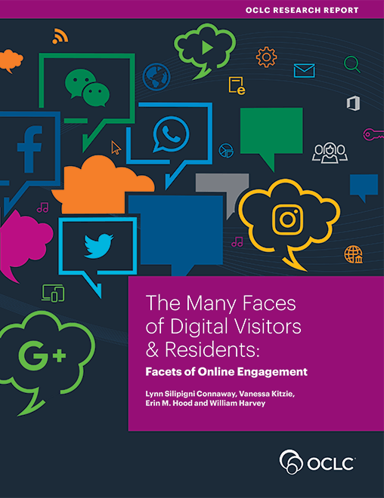
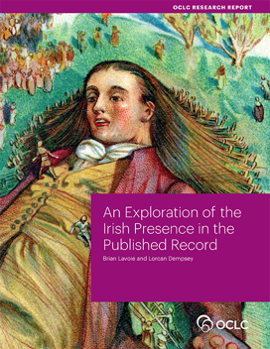

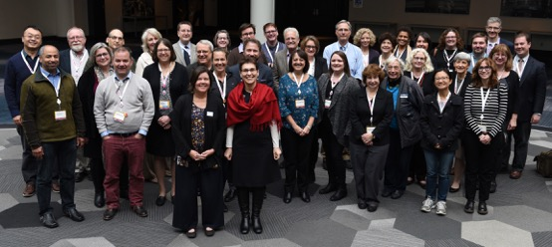
OCLC’s Membership and Research Division
Research devoted exclusively to the challenges facing libraries and archives
Community resource for shared Research and Development
RLP is the platform to collaborate with institutions on research and issues
Lifelong learning from WebJunction
OCLC
Research Library Partnership
Notes:
OCLC's Membership and Research Division serves the OCLC global network of 16,000+ member libraries and beyond in several key ways:
OCLC Research concentrates its efforts on research devoted exclusively to the challenges that libraries and archives face.
The OCLC Research Library Partnership includes some 130 research library partners who collaborate with other libraries and each other on research and related issues through working groups.
Since its launch in 2003, WebJunction has helped more than 80,000 library staff build the knowledge, skills, and confidence they need to deliver transformational services to their communities. WebJunction is free and welcome to all libraries to use, regardless of size, type, or location.
[Notes added 8/27/18]

Slide 6
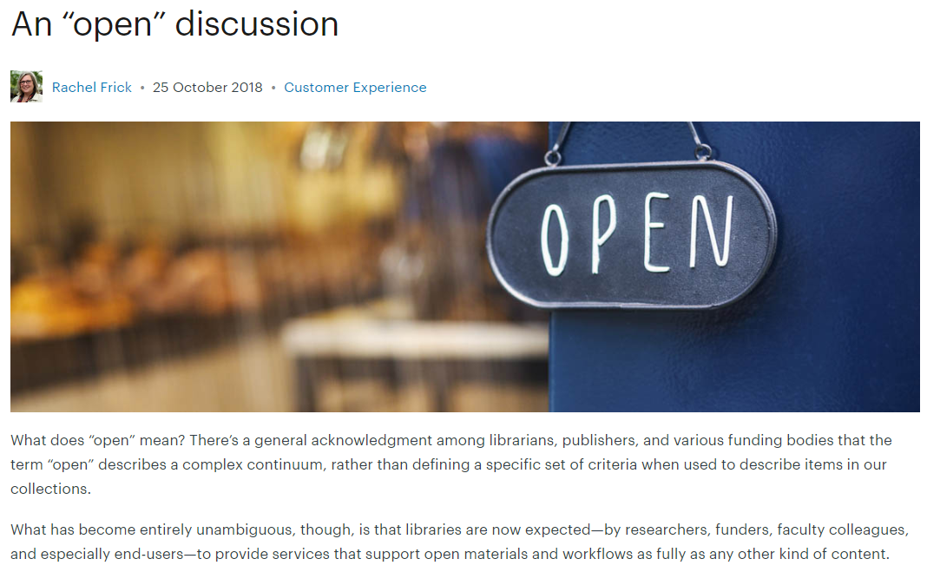
FRAMING THE OPEN CONTENT DISCUSSION
What has become entirely unambiguous, though, is that libraries are now expected—by researchers, funders, faculty colleagues, and especially end-users—to provide services that support open materials and workflows as fully as any other kind of content.
Notes:
And as this blog post makes clear, OCLC has been working in “open for some time”
The ability for WorldCat Discovery users to limit search results to a subset of WorldCat.org source databases known for providing open content, with full-text Digital Object Identifiers (DOIs) informed by Unpaywall.
The Digital Collection Gateway, which is used by libraries, publishers, and other organizations with OAI-PMH-compliant repositories as a self-serve way to add metadata about their open collections to WorldCat at no charge.
The inclusion of millions of records of OA content and collections from libraries, publishers, and third parties in WorldCat; over the past decade, we’ve added 320 collections of OA materials representing hundreds of providers to our knowledge base.
Specific research that centers around Research Data Management and Research Information Management, for which open access issues are an important piece.
Active membership in associations that support open access progress, including COAR, SPARC, IIIF, ORCid, and DataCite.
But we acknowledge that we can do even more, and that is why…

Slide 7

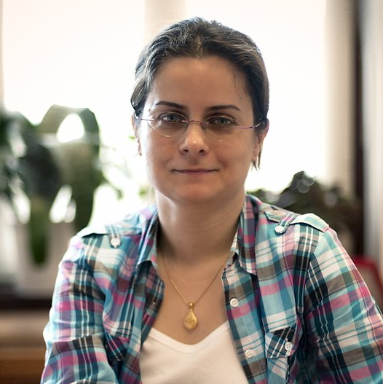
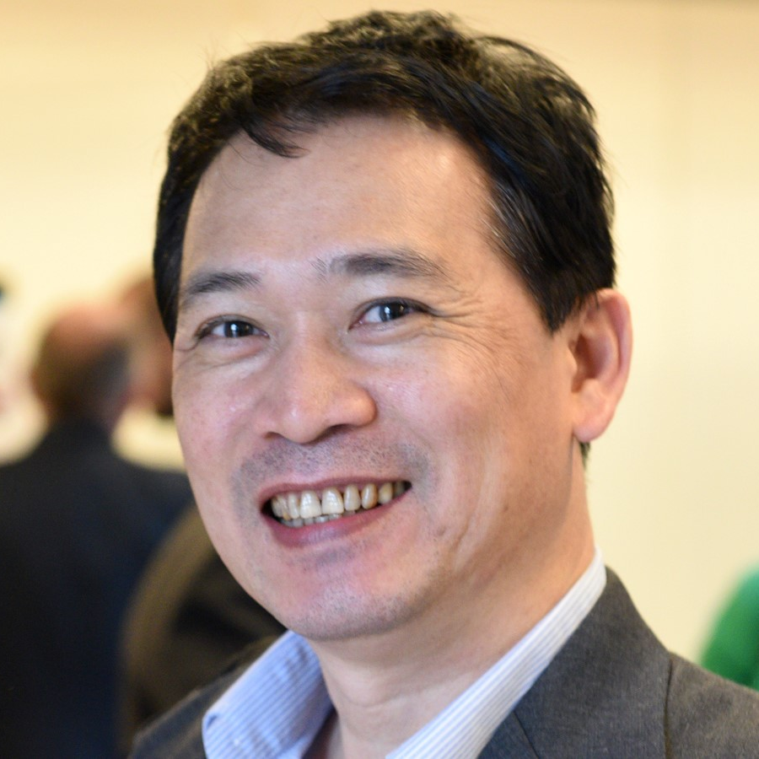
OCLC Global Council Program Committee
Rupert Schaab
(EMEA)
Debbie Schachter
Chair (ARC)
Tuba Akbaytürk
(EMEA)
Kuang-hua Chen
(APRC)
Notes:
Global Members Council in relation to the Open Content survey.
Indeed, the survey was their initiative. Last year, they expressed interest in exploring the impact and use of open access in libraries.

Slide 8
Open Content Survey – Methodology
Not only OA – also other freely available online open content
Acknowledging the "continuum of openness“
Global
All library types
Survey data collected November 12, 2018 – January 31, 2019
Convenience sample of 705 respondents from 82 different countries
Notes:
The scope is intentionally expansive and includes all open content that is relevant to the large diversity of libraries. We define is as the full range of freely available, unrestricted, online content (including OA-scientific articles and e-books, pre-prints, open educational resources, governmental and non-governmental publications, grey literature, open datasets, open collections from digitized heritage, web-resources like YouTube videos, news websites, any freely available born-digital materials, etc.).
The online survey was circulated as widely as possible, through the networks of the Global Council Delegates, through the OCLC Research Library Partnership and other, relevant networks, and through social media. Responses came in between 12 November 2018 and 31 January 2019.
Within such a short timeframe, we received a record number of 705 responses from 82 different countries.
The pool of respondents was self-selected and not representative from a methodological point of view.
The responses should be considered as individual voices instead of statistics.
However, for analysis purposes, we have tried to group responses together in order to be able to distill some meaningful data.

Slide 9
Overview of survey findings
705 responses from 82 different countries
72% are Research and University libraries
91% are currently involved in Open Content activities
Current top 3 Open Content activities:
  Operating an institutional repository
  Supporting users/instructors/digital literacy programs
  Promoting the discovery of Open Content
Notes:
Survey data collected between November 2018 – January 2109.
705 respondents from 82 different countries completed, or partially completed, the survey.
Half (49%) from the Americas; just over 1/3 (36%) from EMEARC and 15% from Asia Pacific.
Nearly ¾ of the respondents are Research and University libraries.
Most libraries (91%) are currently involved in Open Content activities and most of them plan to be involved in more/other Open Content activities

Slide 10
Responses by Region
Half (49%) of the respondents are from the Americas region; just over a third (36%) from EMEA and 15% from Asia Pacific.

Slide 11
Responses by Library Type
Research & University: 511/705 responses from 69 countries
Notes:
The pool of respondents was self-selected and not representative from a methodological point of view. In many cases, only one respondent per country participated in the survey.
So there are quite a few imbalances.
Nearly ¾ of the respondents (72%) are University and Research libraries. The results for the total responses are heavily skewed by this majority segment.
Therefore I will just focus on the responses from this category in my presentation today.
With 511 respondents from 69 countries – this group provides an insightful and current snapshot of the state of open content support in higher education and research, worldwide

Slide 12
Nearly half (49%) of the lead contributors are higher level staff (director, assistant director or manager); 47% are librarians/library staff. The lead contributor represents various areas of responsibilities, with e-resources being the most represented.
260 total respondents did not provide level of responsibility for the lead contributor.
270 total respondents did not provide area(s) of responsibility for the lead contributor.

Slide 13
We asked…
Where are you invested?
Where are you successful?
Is there identified funding for activities?
Where do you want to accelerate services?
What is the right scale (institutional, regional, national, global)?
Where do you see a role for OCLC?
Where is the work of OCLC Research likely to make an impact?

Slide 14
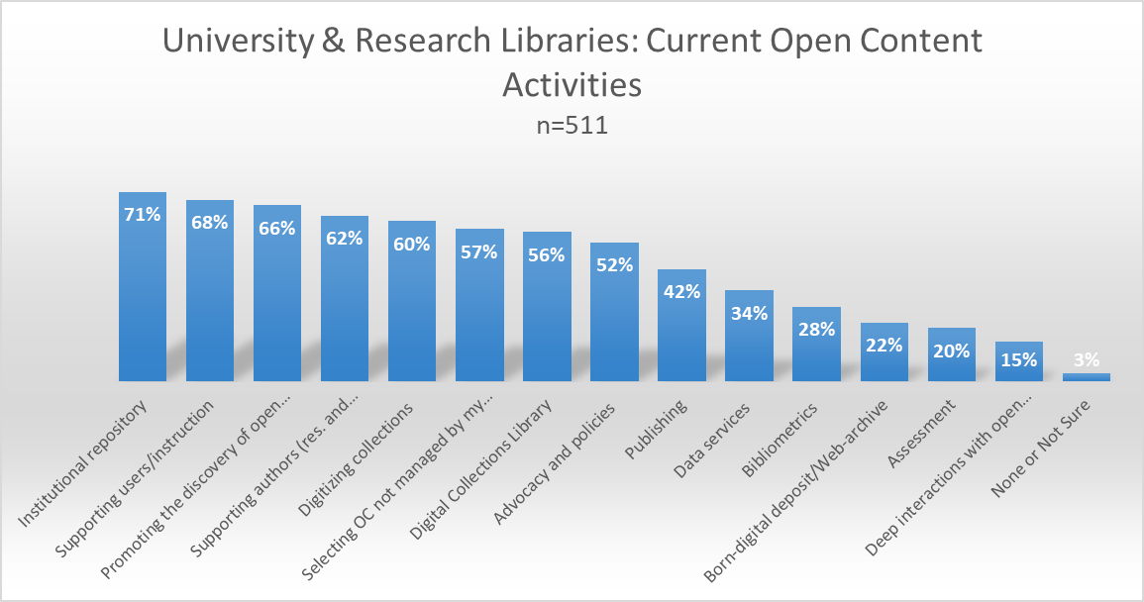
14 categories
Notes:
These are the open content activities that University & Research Libraries currently support. As you can see, the institutional repository scores highest of all OC activities reported by this group of libraries.

Slide 15
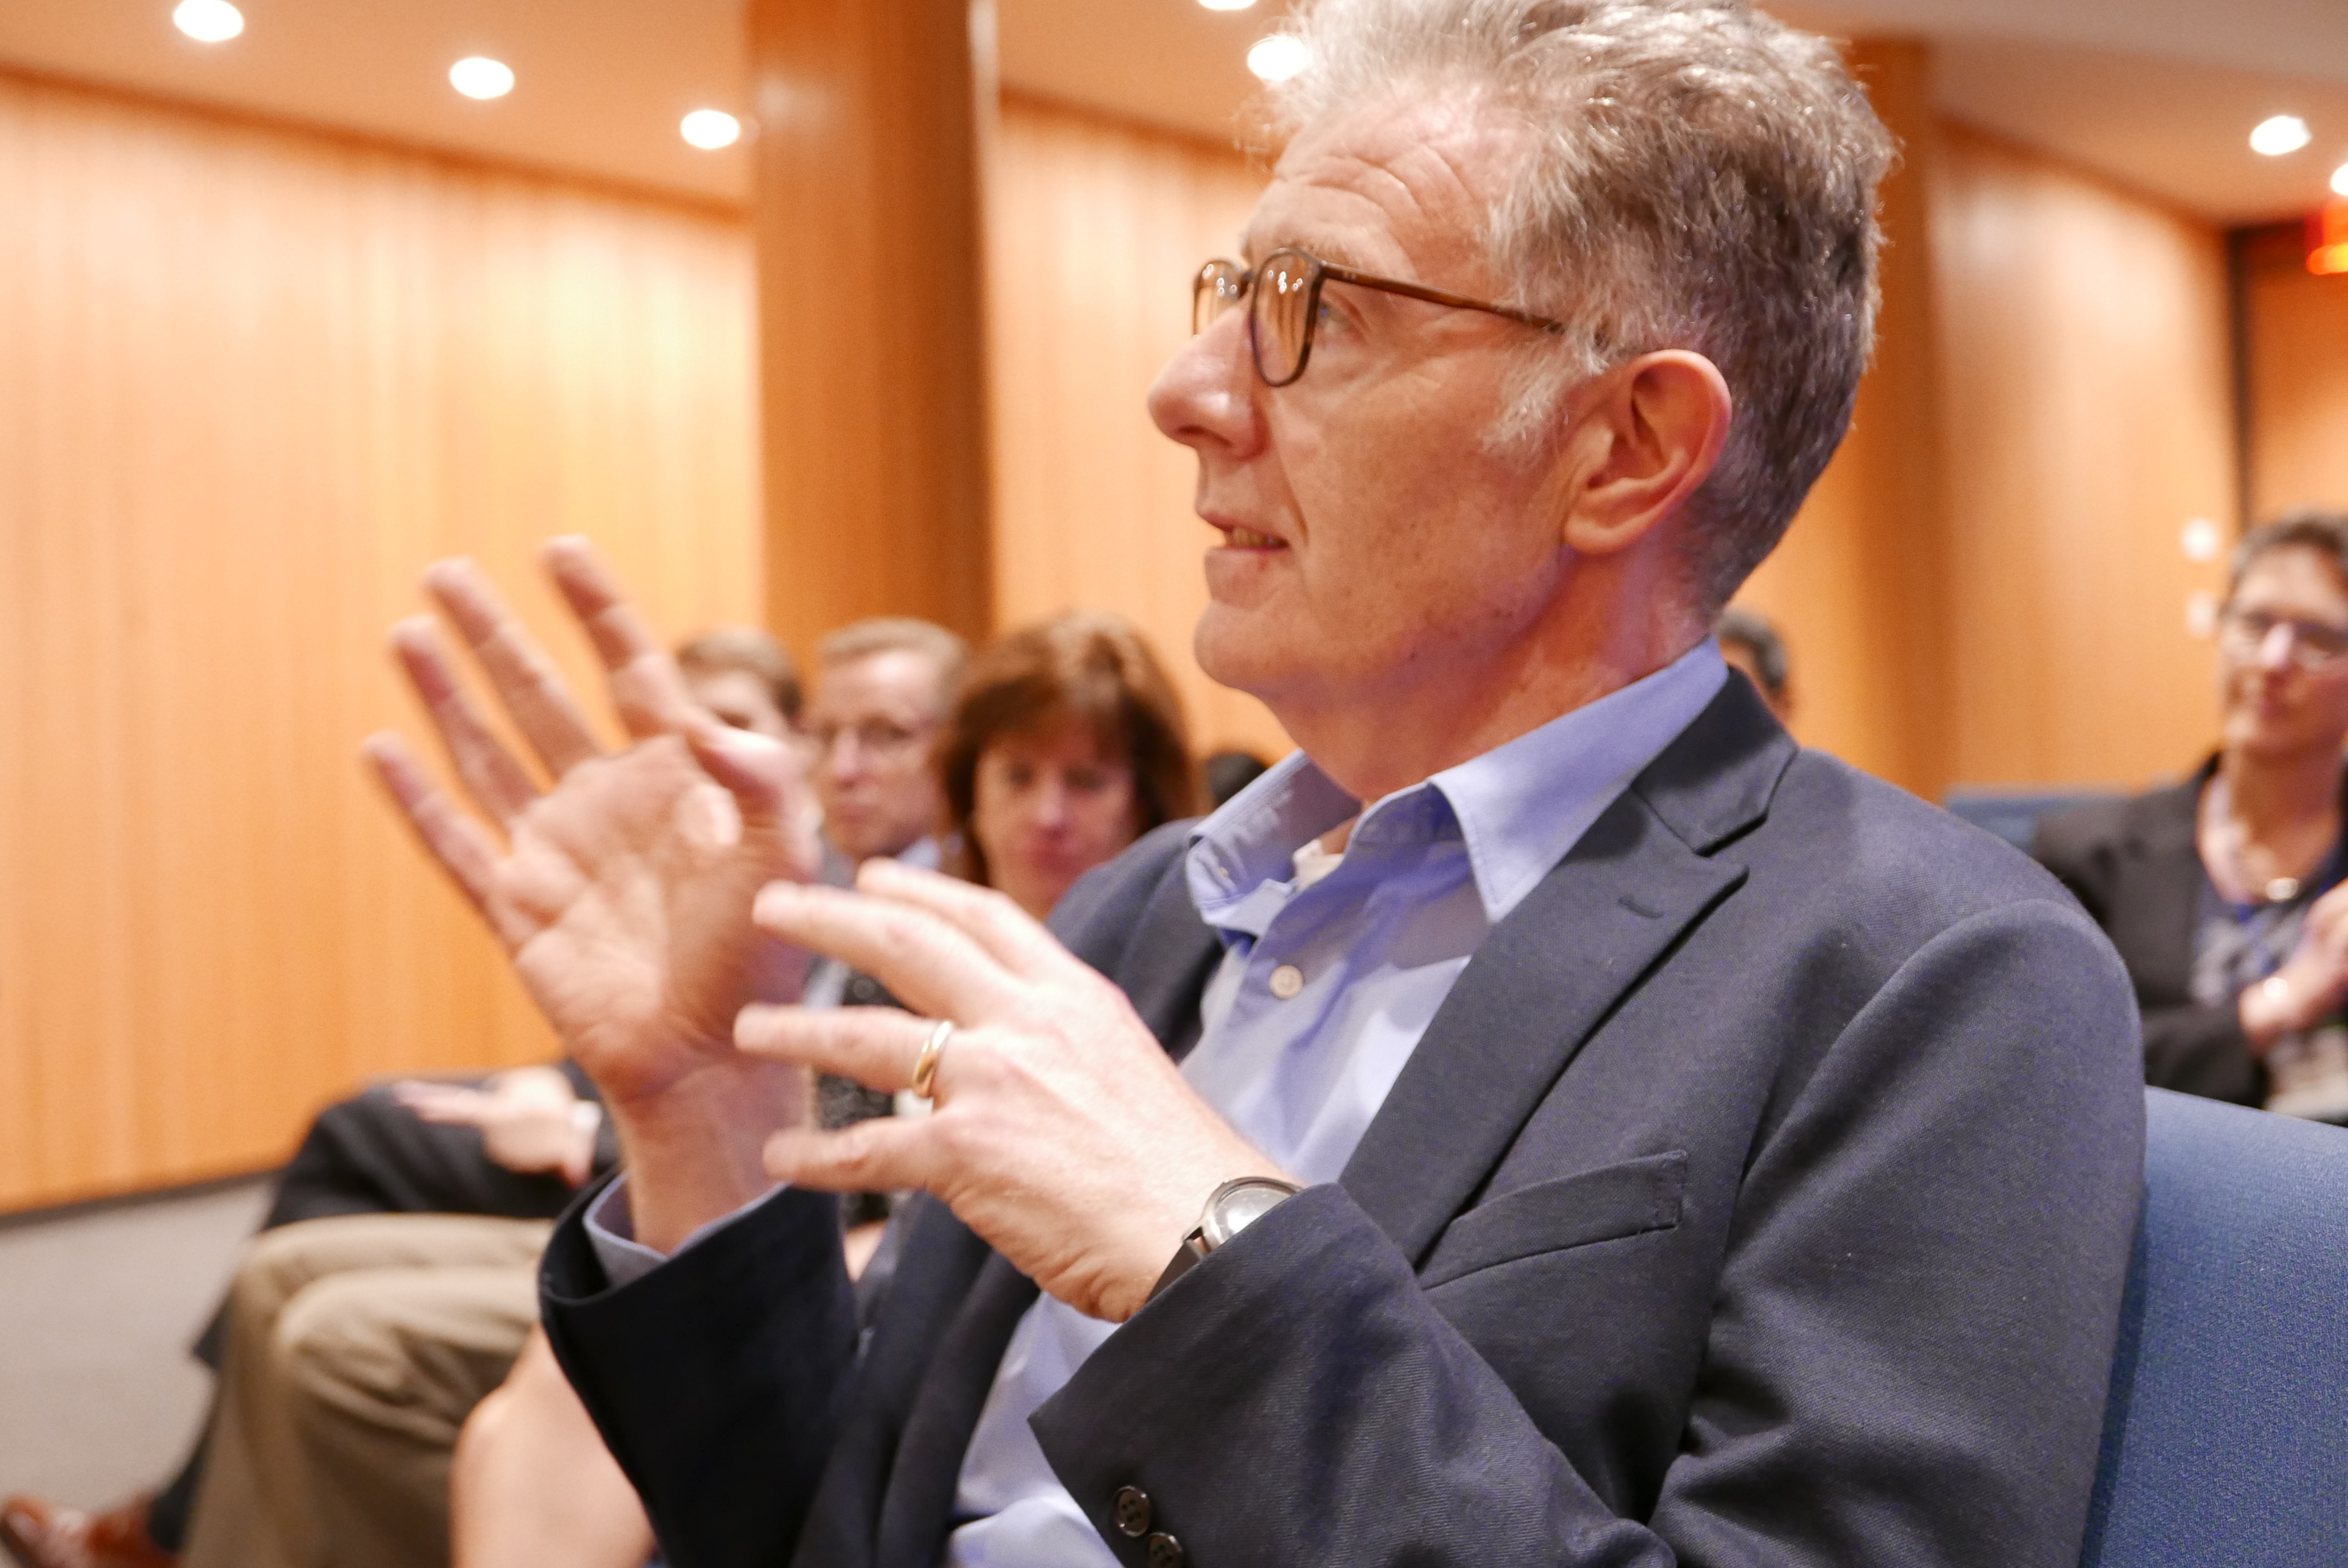
Some Readings from The Book of Dempsey

Slide 16
Lorcan’s three trends
Reconfiguration
of research work by network/digital
environment.
Reconfiguration
of the information space by network/digital environment.
The facilitated collection
The inside out collection
The collective collection
Reconfiguration
of library collaboration by network/digital environment.
Notes:
Using Lorcan’s typology of collections as a framework for data analysis. Asking the question: How does the shift to open impact library activities in these 3 collection areas?

Slide 17
Chapter One: The Collective Collection
“One important trend is that libraries and the organizations that provide services to them will devote more attention to system-wide organization of collections—whether the “system” is a consortium, a region or a country.
….a more systemic perspective is now emerging and we have been using the phrase “collective collection” to evoke this more focused attention on collective development, management and disclosure of collections across groups of libraries at different levels.”
Dempsey, Lorcan. 2013. The Emergence of the Collective Collection: Analyzing Aggregate Print Library Holdings. http://www.oclc.org/content/dam/research/publications/library/2013/2013-09intro.pdf

Slide 18
Chapter Two: The Inside Out Collection
“Libraries increasingly support the creation, curation and discoverability of institutional creations (research data, preprints, scholarly profiles, academic profiles, digitized special collections, …). The university wishes to share these materials with the rest of the world.”
Dempsey, L., 2016. Library collections in the life of the user: two directions. LIBER Quarterly, 26(4), pp.338–359. DOI: http://doi.org/10.18352/lq.10170

Slide 19
Chapter Three: The Facilitated Collection
Increasingly, the library does not assemble collections for local use, but facilitates access to a coordinated mix of local, external and collaborative services assembled around user needs and available on the network.
Dempsey, L., 2016. Library collections in the life of the user: two directions. LIBER Quarterly, 26(4), pp.338–359. DOI: http://doi.org/10.18352/lq.10170

Slide 20
Preliminary findings
Libraries are most invested in Open Content activities relating to:
  Research support
  Digital Libraries
where they are more confident to achieve impact.
BUT. . .
. . . just because something is OA doesn’t mean it’s accessible.
There are significant gaps in
Discovery
Access
We need to address challenges of:
Convenience
Multiple versions of same content
Metadata quality and aggregation
Notes:
The survey is telling us that libraries are mostly invested in Open Content activities relating to Research support and those relating to their Digital Libraries.
Open Content activities relating to Discovery of Open content (that is including supporting users to find and use OC resources) seem to be suffering from lack of resources, unclear funding and priorities. So there is a gap here that we need to start addressing: the access gap. If something is OA, it does not mean that it is accessible.
The problem of the 17 different versions of a paper. The different types of OA. The metadata quality and aggregation problems. All leading to serious barriers to access and use. We see researchers and students increasingly turning to shadow libraries, like SciHub, because that’s much more convenient and effective.

Slide 21
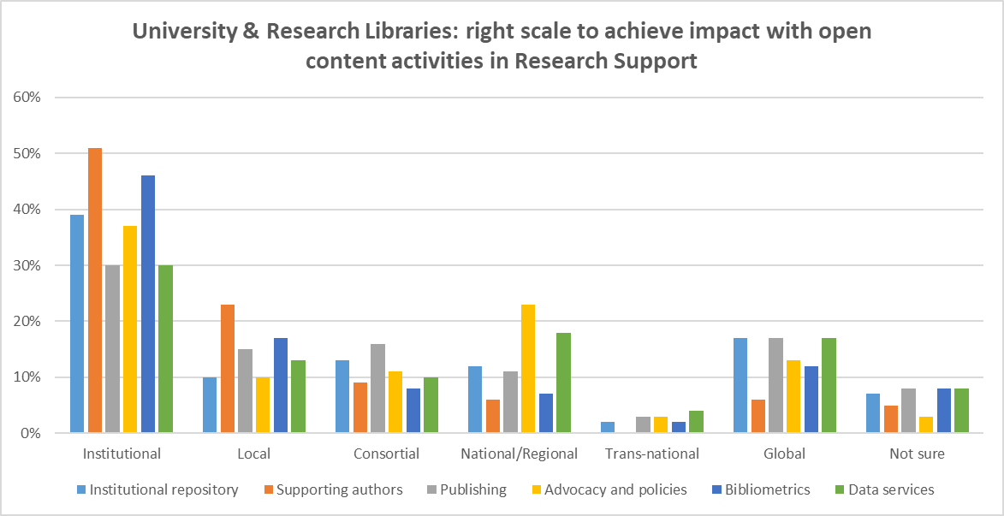
Preliminary findings
Libraries are most often working at institutional scale on research support issues
There are opportunities to explore how to right scale for greater impact

Slide 22
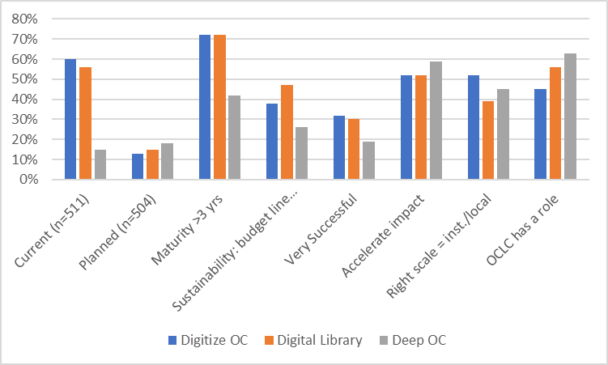
Library Open Content activities (in order of maturity)
1. Digitize collections => successful, accelerate
2. Digital Libraries => successful, accelerate,
3. Deep-interactions with OC => least mature, less successful, most planned (18%), accelerate, highest score for OCLC role (63%)
The collective collection
Reconfiguration
of library collaboration by network/digital environment.
Notes:
Digitizing print collections and making them available as open collections in a digital library is a set of activities in which respondents indicate they are deeply-invested in: it is well-resourced, mature, successful and respondents want to accelerate the impact.
Deep-interactions with the open content of digitized collections is top-op-mind: relatively new, not yet very successful but respondents clearly indicate they see the potential for accelerating impact in this direction.
The OC-activities relating to the collective collection are also, according to the respondents, relatively more suitable for collaboration at a scale beyond the institutional and local scale: with Digital Libraries most frequently noted as an activity most suitable for a consortial/national or global scale.

Slide 23
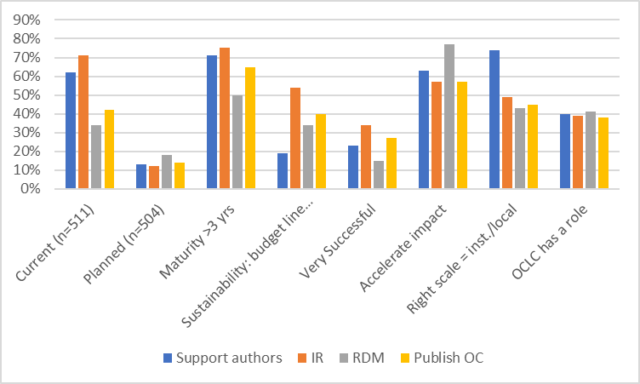
Reconfiguration
of research work by network/digital
environment.
The inside out collection
Library Open Content activities (in order of maturity)
Institutional repository => most resourced, most successful, accelerate
Support authors/producers => less well resourced, accelerate
Publish OC => well-resourced, accelerate
RDM/Data services => less successful, significantly higher score for acceleration
Notes:
IR – the deposit of OA and pre-prints also known as green OA, is the only category for which more than 50% of the respondents indicate they have a budget line item. So in that sense it is the most resourced OC activity: it is most assured of money, personnel and materials, that it needs to function properly.
Supporting authors with OA-publishing and licenses, etc. but also teachers with OER: not so well resourced, but an activity which 63% of respondents engaged in this activity, would like to accelerate.
Publishing is relatively well-resourced and successful and also an activity which more than 50% (57%) of those doing it, want to accelerate.
Although respondents report that data services/RDM have relatively not been that successful yet, this activity is well resourced and 77% of the respondents want to accelerate its impact.
All in all respondents indicate they are investing in the inside out collection, not only currently but they intend to continue doing so in the future and accelerate all their OC-related activities.

Slide 24
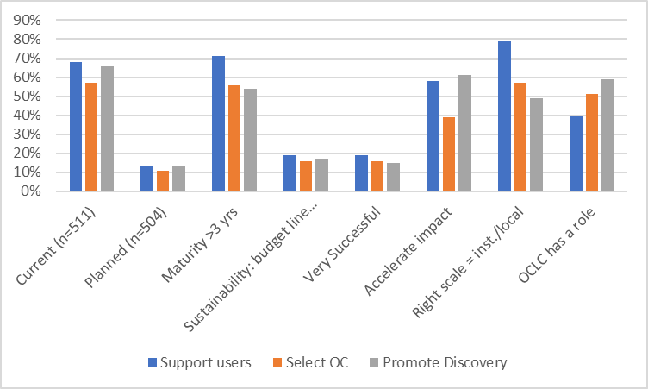
Reconfiguration
of the information space by network/digital environment.
The facilitated collection
Library Open Content activities (in order of maturity)
1. Support users/digital literacy => right scale, second-best in comparison with supporting producers of OC
2. Select Open Content
NOT managed by my library => least planned, least resourced (16%), near least successful (16%), lowest score for acceleration
3. Promote the discovery of OC=> near least resourced (17%), least successful (15%), accelerate
Notes:
Supporting users to find open content and to assess open content materials and to use the tools to do so, is somewhat second-best compared to supporting authors and producers of OC. It scores lower on investment, successfulness, comfort level on impact and the need to accelerate.
Selecting OC not managed by my library scores lowest in many respects, and it is the only activity which scores below 50% in terms of respondents who say they want to accelerate the activity (and significantly so, with 39%).
Promoting the discovery of OC scores equally low in that more than 50% of the respondents say they have no source of investment or are not sure about it. Yet, 61% want to accelerate it.
So all in all respondents indicate that the OC-activities around the facilitated collection are less successful and less well resourced and they do not consider these activities as suitable for acceleration as those around the inside out collection.

Slide 25
Libraries are mostly invested in Open Content activities relating to:
  The inside-out collection
  The collective collection
where they are more confident to achieve impact.
Open Content activities relating to the Facilitated Collection seem to be suffering from a lack of resources and unclear impact.
Notes:
So, we could conclude from the survey, that libraries are mostly invested in Open Content activities relating to the Inside-out collection and those relating to the Collective collection.
Open Content activities relating to the Facilitated Collection seem to be suffering from lack of resources, unclear funding and priorities.

Slide 26
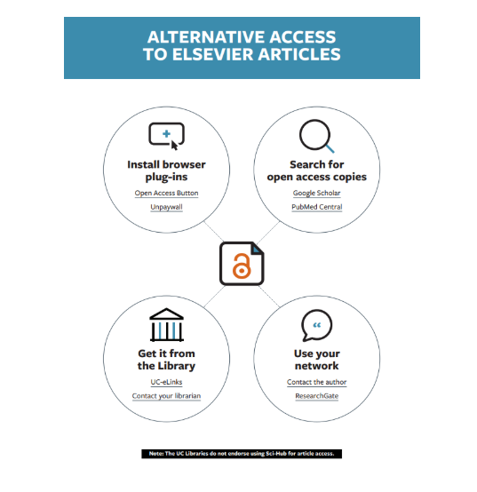
http://orweblog.oclc.org/the-facilitated-collection-redux-a-note-on-collections-as-a-service-the-university-of-california-and-elsevier/
Notes:
Published 5 April 2019. In this recent blog post, Lorcan Dempsey pays special attention to the facilitated collection.
He looks at how the University of California, having terminated its contract with ES, is supporting its community for alternate access to content published in Elsevier Journals.
The University of California gives guidance by supporting users to find OA resources with the use of OA Button and Unpaywall, pointing them to various pre-print archives or article supply via ILL, or contacting authors directly via scholarly networking sites such as ResearchGate.

Slide 27
“What this means is that the library view is shifting somewhat from management of a locally acquired collection to facilitating access to a broader range of scholarly resources. (…)
The facilitated collection becomes a more important part of what a library does in this diversified context.”
Lorcan Dempsey,
http://orweblog.oclc.org/the-facilitated-collection-redux-a-note-on-collections-as-a-service-the-university-of-california-and-elsevier/
Notes:
Lorcan concludes that:

Slide 28
Respondents see a role for OCLC in:
The facilitated collection:
  Promote the discovery of OC (59%)
  Select OC NOT managed by my library (51%)
The collective collection
  Deep interactions with OC (63%)
  Digital Library (56%)

Slide 29
Research report in progress
Expected later this year
Country-level analyses for:
  Australia
  Germany
  Netherlands
  UK
  Canada
  Turkey
  France
  USA
  Philippines
Report and dataset will be publicly available at
  oc.lc/research
Follow our blog at Hangingtogether.org

Slide 30
Questions?
Thanks to Titia van der Werf, Rebecca Bryant, and Lorcan Dempsey

