Slide 1
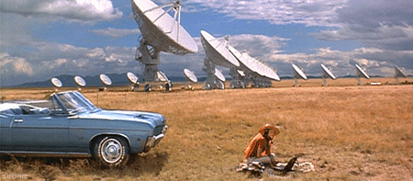
researchworks
shaping an applied research agenda

Slide 3
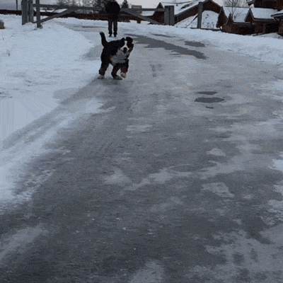
icebreaker
introduce yourself to colleagues at table
share what motivated you to attend
write motivation on post-it and place at back of room

Slide 4
researchworks
shaping an applied research agenda

Slide 5
thomas padilla
rebecca bryant
rachel frick
jean godby
dennis massie
nancy lensenmayer
ralph levan
andrew pace
mercy procaccini
merrilee profitt
susan saggio
chela scott weber
devon smith
diane vizine-goetz

Slide 6
objectives
research agenda
activities

Slide 7
objectives
research agenda
activities

Slide 8
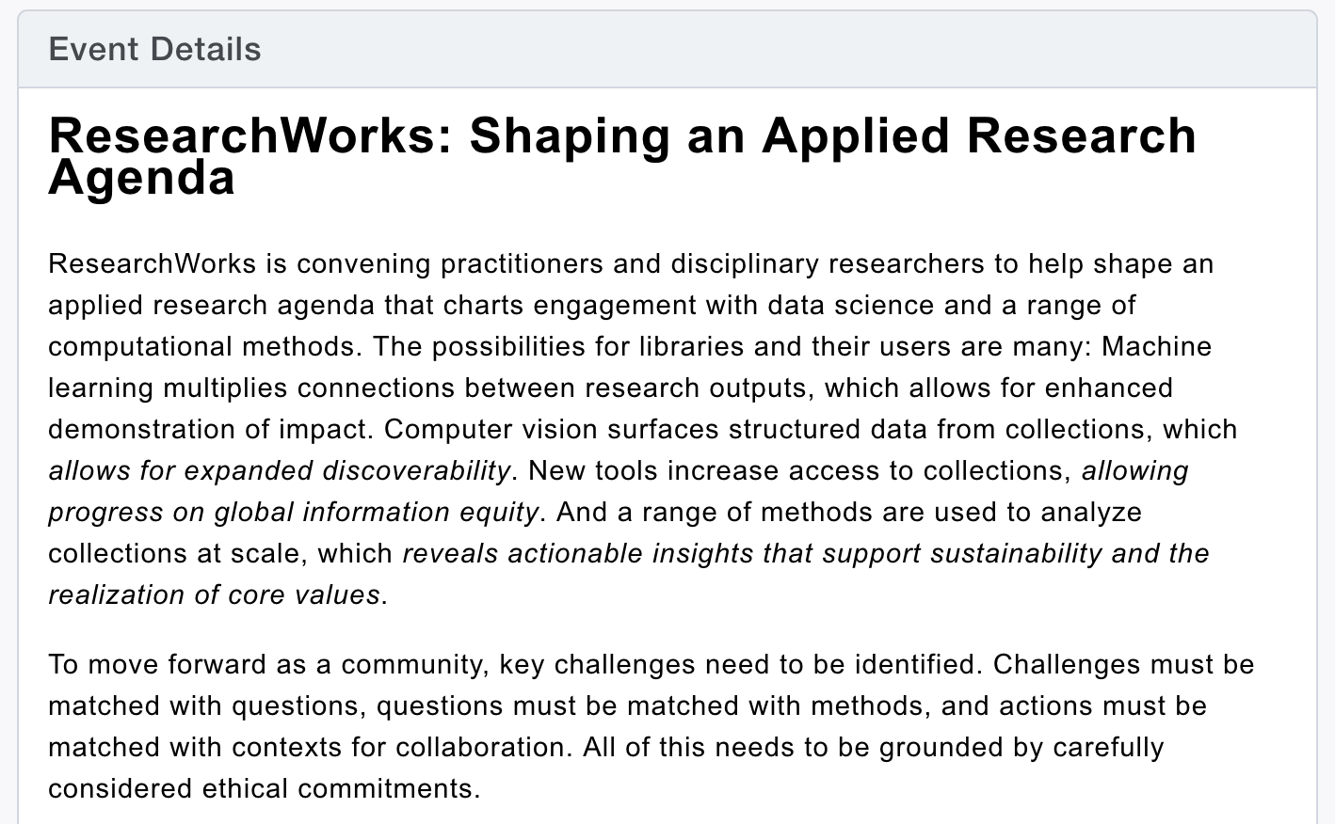

Slide 9
… machine learning multiplies connections between research outputs, which allows for enhanced demonstration of impact.
… computer vision surfaces structured data from collections, which allows for expanded discoverability.
… new tools increase access to collections, allowing progress on global information equity.
… and a range of methods are used to analyze collections at scale, which reveals actionable insights that support sustainability and the realization of core values.

Slide 10
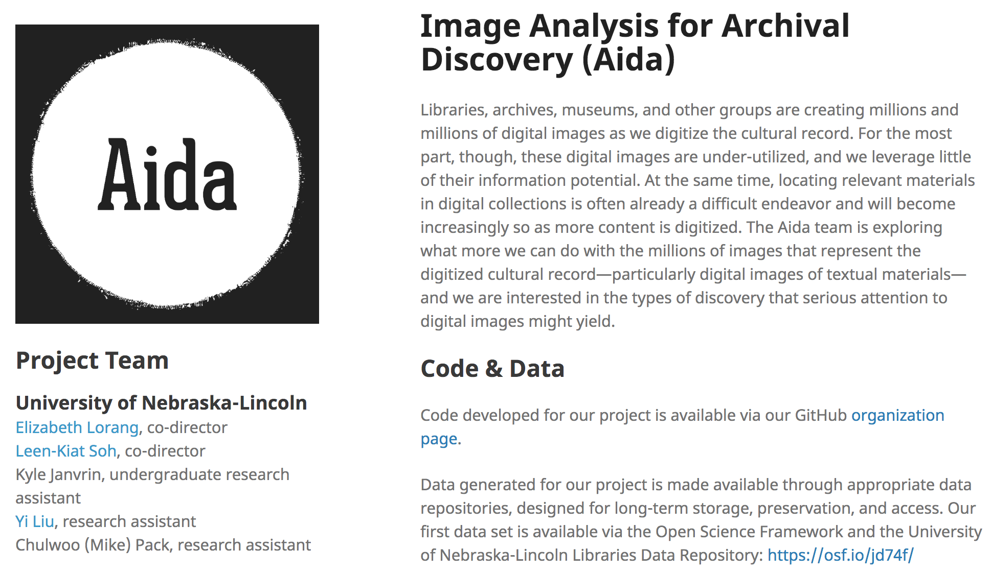

Slide 11
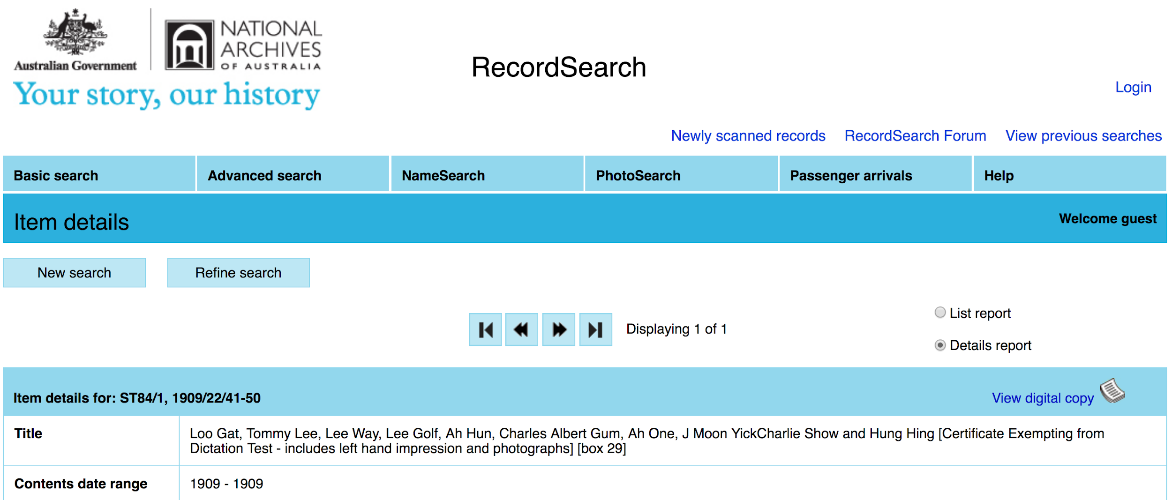

Slide 12
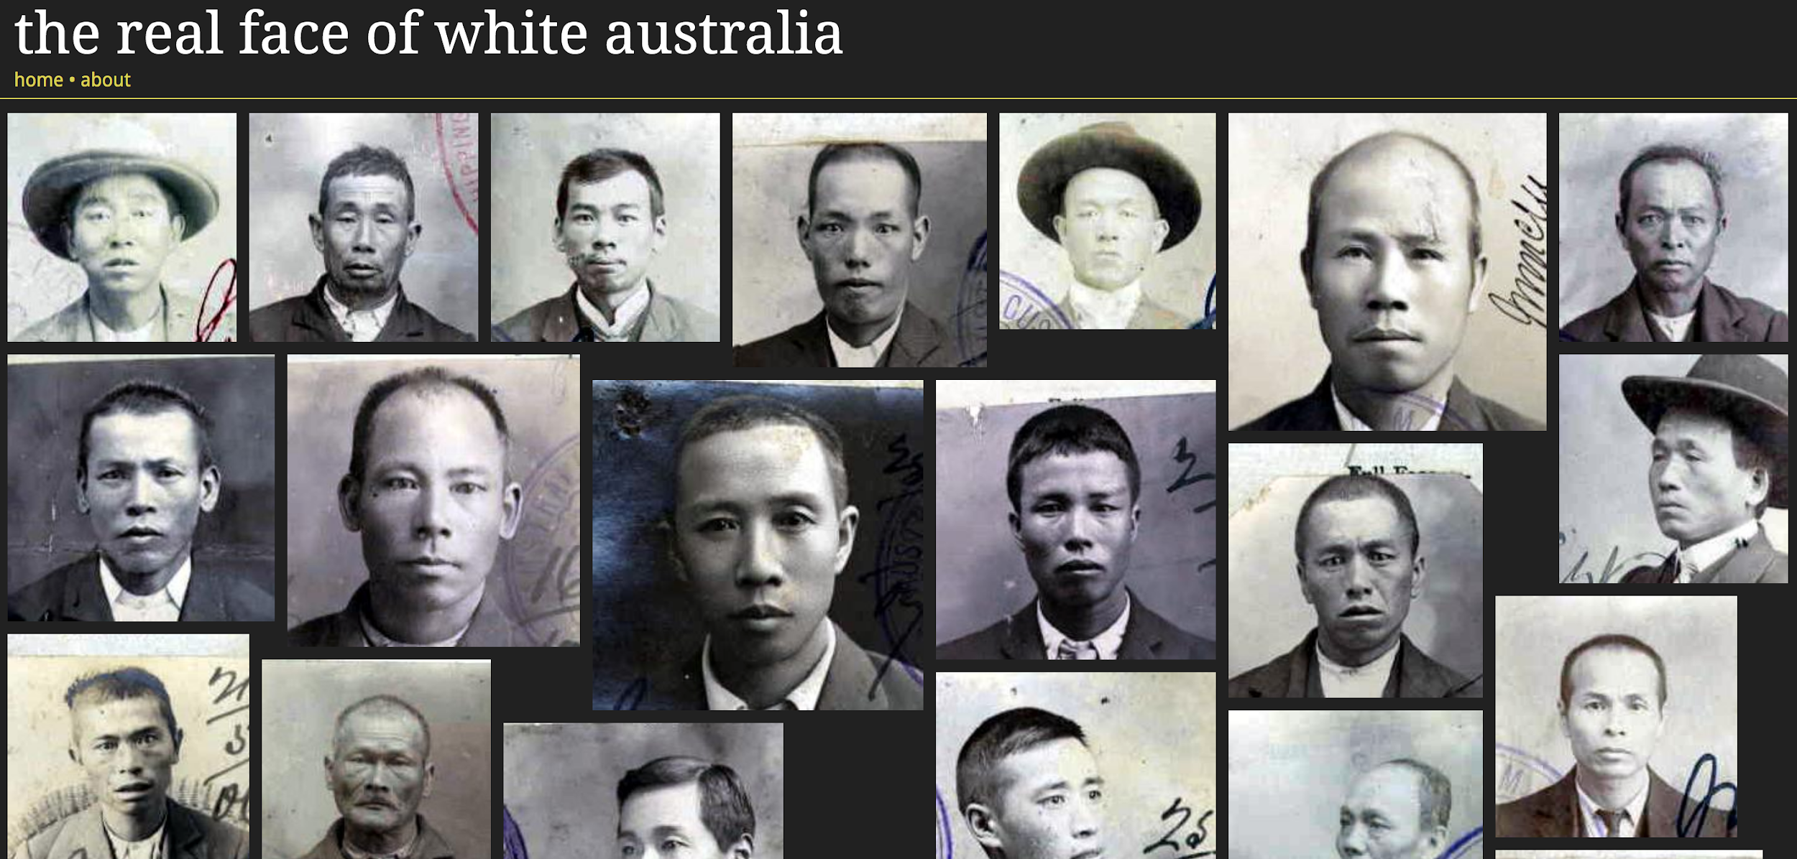

Slide 15
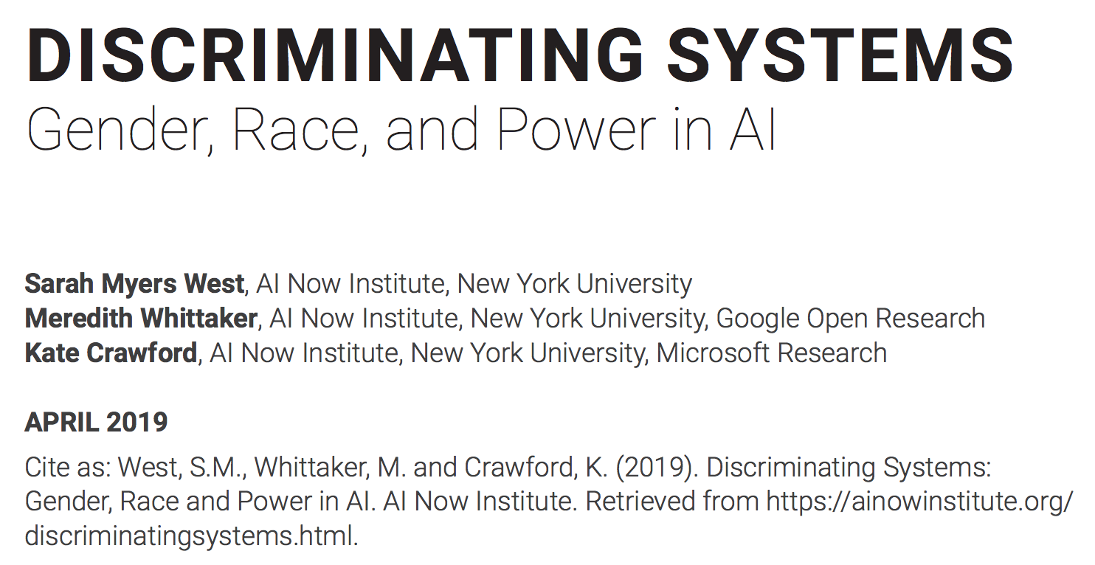

Slide 17
challenges must be matched with questions,
questions must be matched with methods,
actions must be matched with contexts for collaboration.
all of this needs to be grounded by carefully considered ethical commitments.

Slide 19
surface challenges and opportunities for the applied research agenda ... driven by community needs and values
determine which challenges require collective action … entails engagement with the norms, guidelines, and resources we believe are required in order to make progress
integrate and share what we learn … via the applied research agenda

Slide 20
@ OCLC
informs efforts to serve and partner with the library community
informs intra-division collaboration
informs inter-division cooperation

Slide 21
objectives
research agenda
activities

Slide 23
… an applied research agenda that charts a path for library community engagement with data science and a range of computational methods.

Slide 24
data science and libraries agenda

Slide 25
data science in order to … ?
machine learning in order to … ?
artificial intelligence in order to … ?

Slide 26
questions
---
technology

Slide 27
… an applied research agenda that charts a path for library community engagement with data science and a range of computational methods.

Slide 28
core working group
Kenning Arlitsch, Montana State University
Jon Cawthorne, Wayne State University
Karen Estlund, Penn State University
Josh Hadro, IIIF Consortium
Bohyun Kim, University of Rhode Island
Trevor Owens, Library of Congress
Ben Schmidt, Northeastern University
Sarah Shreeves, University of Arizona
MacKenzie Smith, University of California Davis
Claire Stewart, University of Minnesota
Melissa Terras, University of Edinburgh
Diane Vizine-Goetz, OCLC Research
John Wilkin, University of Illinois at Urbana Champaign
Kate Zwaard, Library of Congress

Slide 29
landscape (to grow ... )
Ruth Ahnert, Queen Mary
Alex Gil, Columbia University
Barbara Fister, Gustavus College
Carole Palmer, University of Washington
Danielle Robinson, Code for Science and Society
David Smith, Northeastern
Dominique Luster, Carnegie Museum of Art
Ed Summers, University of Maryland
Harriett Greene, University of Washington St Louis
Jason Clark, Montana State University
Jer Thorp, Library of Congress
Jon Dunn, Indiana University
Kathleen Fitzpatrick, Michigan State University
Keith Webster, Carnegie Mellon University
Lauren Klein, Georgia Tech
Matthew Reidsma, Grand Valley State University
Mia Ridge, British Library
Nicole Coleman, Stanford University
Peace Ossom Williamson, UT Dallas
Quinn Dombrowski, Stanford University
Ruth Ahnert, Queen Mary
Sara Mannheimer, Montana State University
Scott Young, Montana State University
Shari Laster, Arizona State University
Umi Hsu, City of Los Angeles
Yasmeen Shorish, James Madison University,
Jamie Wittenberg, Indiana University
Ted Underwood, UIUC

Slide 30
march 5 - april 25

Slide 31
17 hours (and growing)
working group discussion
28 hours (and growing)
landscape group discussion

Slide 32
+ y’all!

Slide 33
73
high-level challenges
(and growing)

Slide 35
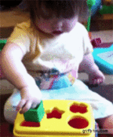

Slide 36
heuristic
challenge
need
opportunity
activities
outcomes

Slide 37
challenges are
technical
social
organizational

Slide 38
How can libraries use machine learning to support traditional cataloging activity?
(m smith)
Develop strategies to prevent amplification of algorithmic bias.
(j thorp)
Investigate what skills, competencies, and organizational support are needed for library staff to critically engage with and advance machine learning, AI, and data science, in a library context.
(many)

Slide 39
Foster library conversations and develop materials that support staff cultivation of algorithmic literacy.
(fister)
Use data science engagement as a vector for library driven undergraduate digital literacy instruction.
(shorish)
Develop technical strategies for addressing bias in library discovery systems.
(schmidt, kim)

Slide 40
objectives
research agenda
activities

Slide 41
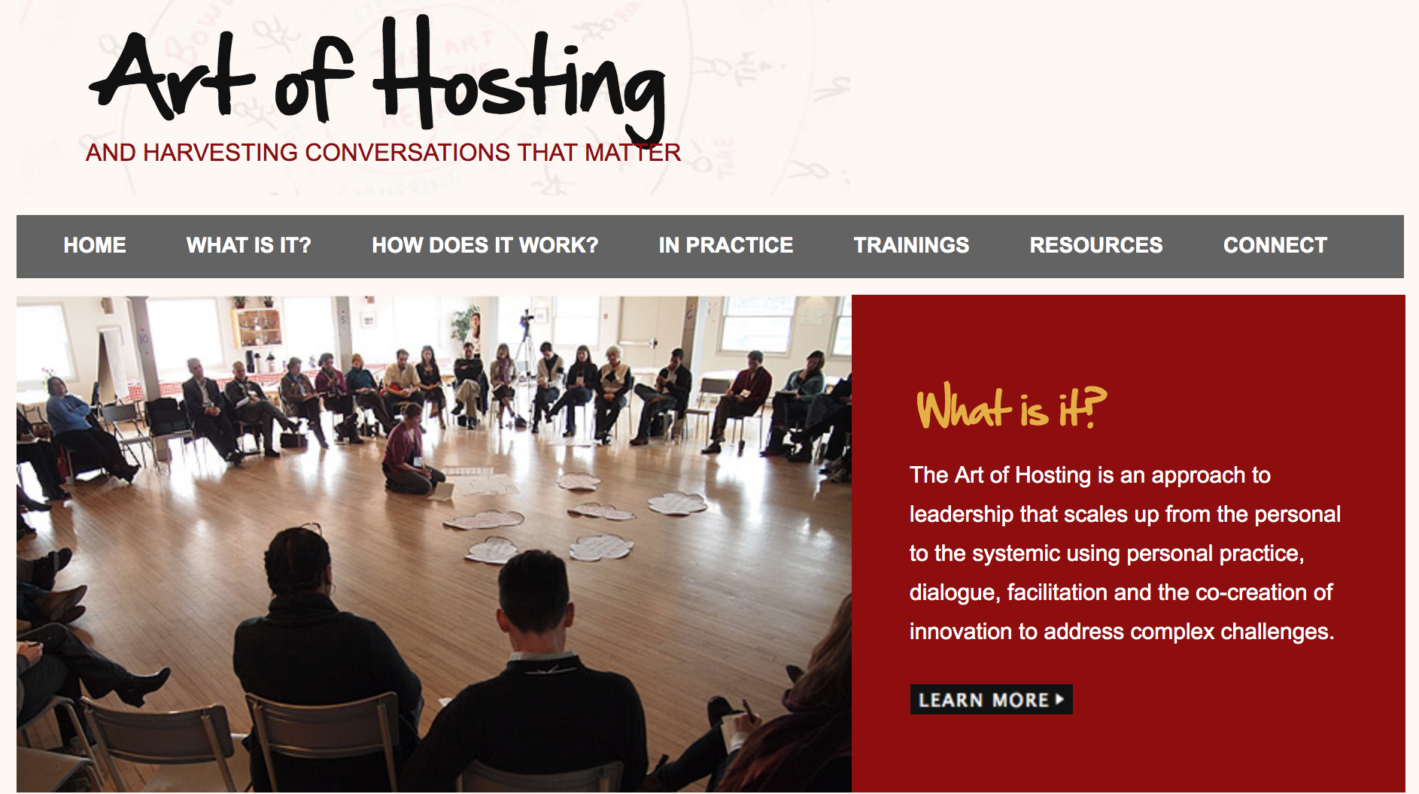

Slide 42
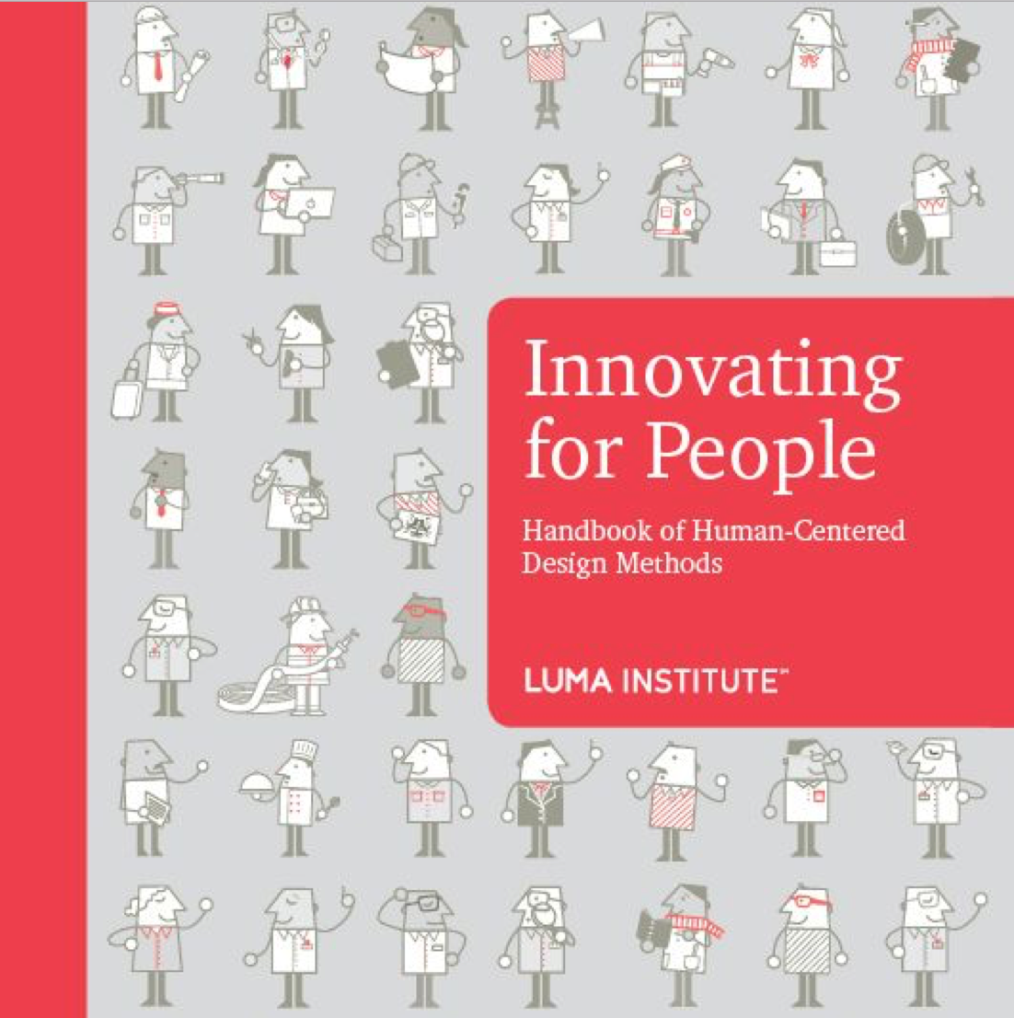

Slide 43
surface challenges and opportunities for the applied research agenda ... driven by community needs and values
determine which challenges require collective action … entails engagement with the norms, guidelines, and resources we believe are required in order to make progress
integrate and share what we learn … via the applied research agenda

Slide 44
break
950-1000

Slide 46
question 1
An applied research agenda identifies challenges that can be addressed with critical, ethically grounded use of data science and a range of other computational methods.
Thinking big picture …
What technical, social, and/or organizational challenges would you like to see the library community invest more effort in?
What needs do these challenges address?

Slide 47
question 2
Of the challenges you discussed …
which are the most urgent? why?
what collective efforts are needed?

Slide 48
lunch
12:00 - 1:00

Slide 49
challenge heuristic
… a way of formally structuring a challenge

Slide 50
goals
formally structure your challenge
data within structure informs subsequent activities .

Slide 51
Build on challenge from prior activity
challenge
needs
opportunities (if needs were met)
activities (to make progress)
deliverables

Slide 52
stakeholder mapping
… a way of diagramming the network of people who have a stake in a given system

Slide 53
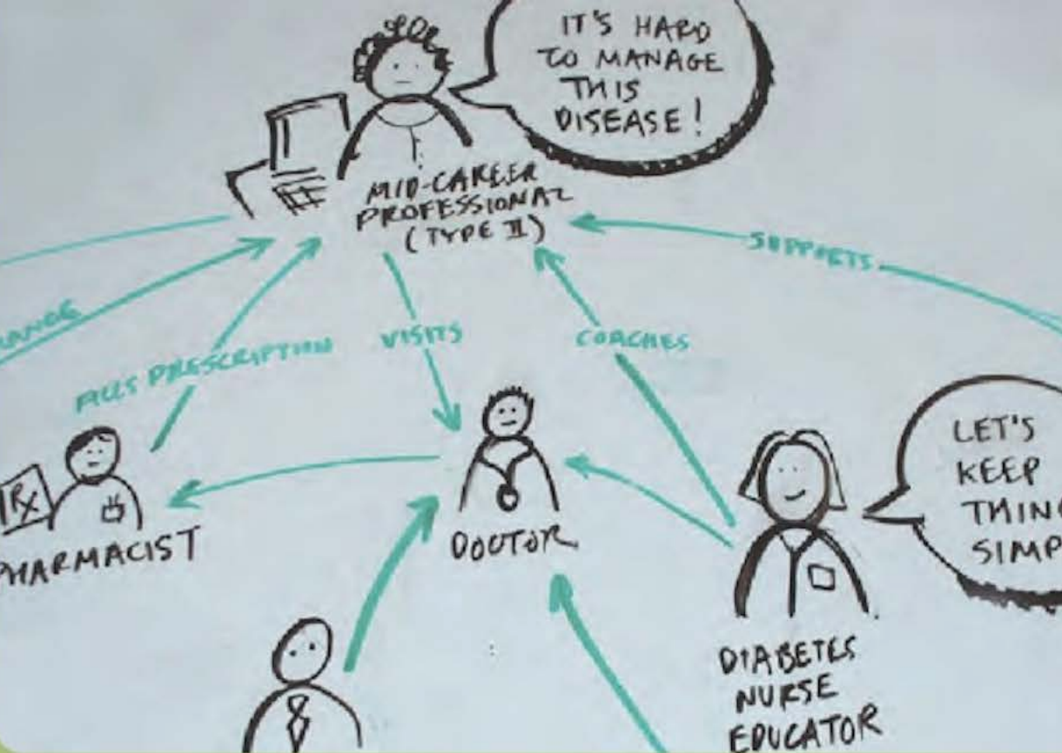

Slide 54
goals
focus on people above other factors
guide plans for future research
build a shared understanding of who is involved in a proposed challenge .

Slide 55
Build on challenge from prior activity
Host briefs group on challenge, prior discussion
Generate very broad list of stakeholders
Draw a symbol of a person for each stakeholder type
Write a speech bubble to summarize their mindset
Write a label describing their role or title
Draw lines with arrows connecting the stakeholders
Write a label on the line to describe relationships
Circle and label related groupings

Slide 57
break
3:00 - 3:30

Slide 58
schematic diagramming
… an outline of the structure and essential components of a system

Slide 59
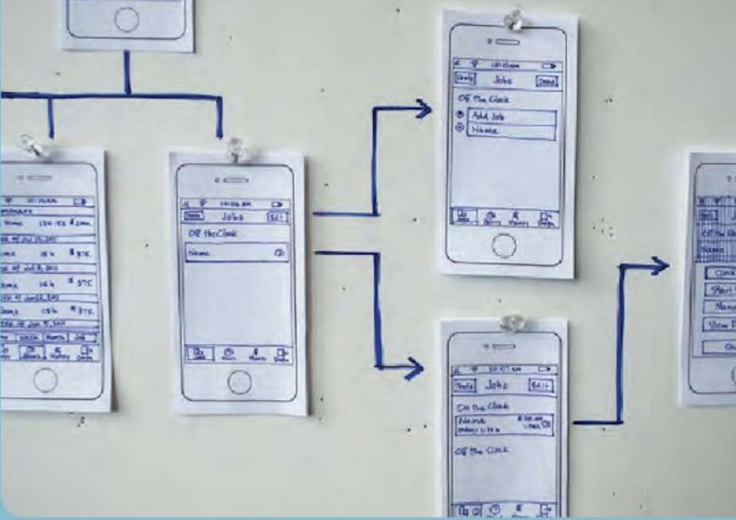

Slide 60
goals
visually structure a proposed solution
build shared understanding
inform subsequent design activities
begin working out functional details .

Slide 61
think of the diagram as an x-ray of your solution.
the diagram helps your team collaboratively define how a solution to your challenge could work as a functional system.
although it may sound technical ... schematic diagramming can be used in nearly any project, from structuring screen layouts to sequencing steps in a service experience

Slide 62
Build on challenge from prior activity
Host briefs group on challenge + prior discussion
Identify basic elements of proposed solution (keep it simple)
Draw each element simplistically
Compose relationships between elements across solution

Slide 63
think of the diagram as an x-ray of your solution.
the diagram helps your team collaboratively define how a solution to your challenge could work as a functional system.
although it may sound technical ... schematic diagramming can be used in nearly any project, from structuring screen layouts to sequencing steps in a service experience

Slide 64
Build on challenge from prior activity
Host briefs group on challenge + prior discussion
Identify basic elements of proposed solution (keep it simple)
Draw each element simplistically
Compose relationships between elements across solution

Slide 65
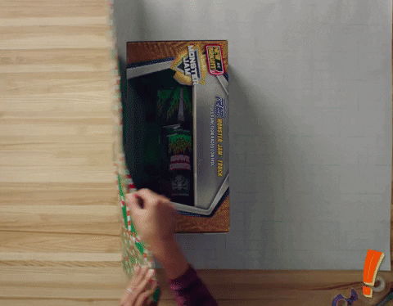

Slide 69
researchworks
shaping an applied research agenda

Slide 70
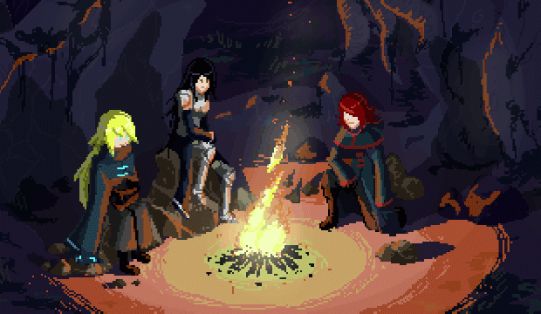

Slide 71
50! things

Slide 73
Over the course of our ... project, members of the project team often heard a question along the lines of: “We’ve read the Santa Barbara Statement, the Facets, the Personas. We’re subscribed to the google group.
But where do we start? How do we move this work forward?

Slide 75
rapidly enumerate as many discrete “things that can be done” to move forward on the challenges we’ve discussed
write em’ on post-its
place on wall
.

Slide 76
break
11:00 -11:15

Slide 77
50! things

Slide 78
Discuss and prioritize “things that can be done”
rearrange post-its along axes on wall
.

Slide 79
high
impact
medium
difficulty
low
medium
high

Slide 80
collaboration focus group

Slide 81
How do we now work together to make progress?
What organizations should be involved?
What principles and norms should guide collaboration?
How do we ensure inclusivity?
What resources are required?

Slide 83
surface challenges and opportunities for the applied research agenda ... driven by community needs and values
determine which challenges require collective action … entails engagement with the norms, guidelines, and resources we believe are required in order to make progress
integrate and share what we learn … via the applied research agenda

