Slide 1
OCLC RLP Works-in-Progress Webinar • June 13, 2019
SHARES Policy Rethink: Outcomes, Next Steps, and a Passing of the Baton
Dennis Massie
Program Officer, OCLC Research Library Partnership
Notes:
Thanks, everyone, for joining us today for this Webinar about outcomes and next steps from the SHARES Policy Think that took place throughout last year and into the early part of 2019. Zack Lane, Beth Posner and I will be talking about how the policy rethink came about, what some of the outcomes have been, and what some of the next steps for SHARES will be.
We’ll talk about all this from three distinct points of view.

Slide 2
Dennis Massie
Program Officer
OCLC Research Library Partnership
Notes:
I’ll start out the program by providing some context and then will come back at the end to do the wrap-up, and I’ll be speaking from the point of view of the longtime coordinator of SHARES activities.

Slide 3
Zack Lane
Head of Delivery Services
Columbia University Libraries
Beth Posner
Head of Library Resource Sharing
The Graduate Center, CUNY
Notes:
Zack Lane of Columbia University, and this year’s winner of the Virginia Boucher Award, will speak from the point of view of a SHARES Executive Group member. Zack was a member of the SEG in 2017, the year when the policy rethink was conceived and designed, and again last year, when the discussions actually took place, with some exciting and far reaching results.
Then Beth Posner of The Graduate Center, CUNY, will speak from the point of view of a newcomer to SHARES who earlier this year joined the SHARES Best Practices Working Group. Beth is already pretty far along in leading a reciprocal onsite access subgroup of the Best Practices Working Group. She’ll share her thoughts about how we as a consortium can build upon the outcomes of the policy rethink to keep SHARES vibrant and delivering maximum value to patrons and staff at SHARES libraries across the globe.
We hope to save 15-20 minutes at the end of the Webinar for questions and discussion, which is a good opportunity for you to chime in about the challenges you’re facing at your own institutions and to weigh in on how SHARES partners and OCLC Research can work together to help address those challenges.

Slide 4
SHARES is typical, and yet unique
75 RLP institutions in SHARES
103 separate SHARES OCLC symbols
Academic, museum, law, medical, national, public
In 7 countries
Make exceptions
Share expertise
Push boundaries
Question processes
Collaborate
8-member executive group
Notes:
If you’re attending this Webinar, chances are you already know a little something about SHARES.
In many ways SHARES is like most resource sharing consortia. We share collections. We go the extra mile for each other. We come together in various ways to address challenges that we hold in common.
But there are some things that make SHARES unusual. The mix of library types. The transnational membership. The degree to which we collaborate and push the envelope.

Slide 5
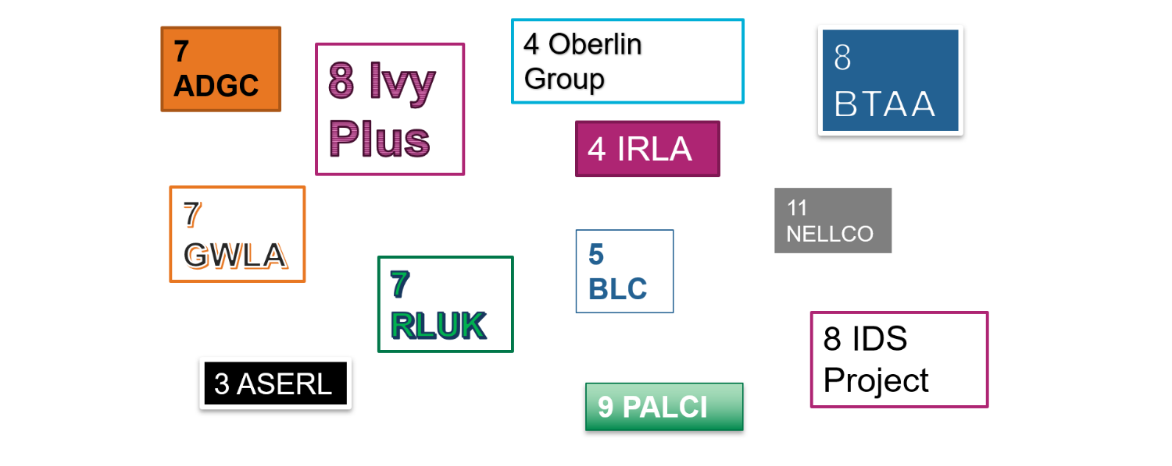
SHARES overlaps many consortia
Notes:
SHARES is also something of a melting pot. Just about every SHARES institution is also part of multiple other resource sharing consortia. This allows for a great deal of cross pollenization when it comes to ideas about trying things a new way and finding more ways to get to yes as a lender.

Slide 6
SHARES Policy Rethink
Notes:
So the Policy Rethink really grew out of the 2017 SHARES Executive Group taking a close look at the SHARES Web site as we prepared to start recruitment efforts to bring in some new partners. What we saw made us realize that not only could the Web site stand for some refreshing, but so could many of our policies and guidelines.
We decided to spend 2018 engaging in conversations across SHARES, conversations that were equal parts brainstorming, soul-searching, and reporting on what we’ve all been trying at our own shops, around five major themes.

Slide 7
SHARES Policy Rethink
2017 Executive Group
Zack Lane, Columbia
Lars Leon, U Kansas
Deborah Mitoraj, U Michigan Law
Kristin Walker, UT Austin
Lynn Wexler, MFAH
Jennifer DeVito, Stony Brook
Joanne Docherty, U Glasgow
Kurt Munson, Northwestern
Notes:
What we saw made us realize that not only could the Web site stand for some refreshing, but so could many of our policies and guidelines.

Slide 8
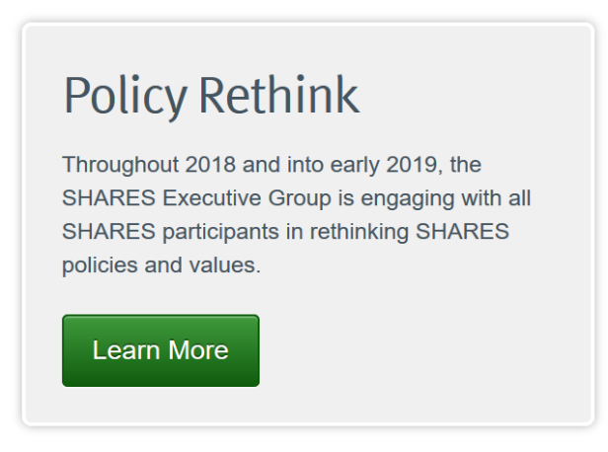
SHARES Policy Rethink
2017 Executive Group
Zack Lane, Columbia
Lars Leon, U Kansas
Deborah Mitoraj, U Michigan Law
Kristin Walker, UT Austin
Lynn Wexler, MFAH
Jennifer DeVito, Stony Brook
Joanne Docherty, U Glasgow
Kurt Munson, Northwestern
Notes:
We decided to spend 2018 engaging in conversations across SHARES, conversations that were equal parts brainstorming, soul-searching, and reporting on what we’ve all been trying at our own shops, around five major themes. And the Policy Rethink was born.

Slide 9
SHARES Policy Rethink
2018 Executive Group
Zack Lane, Columbia
Lars Leon, U Kansas
Deborah Mitoraj, U Michigan Law
Kristin Walker, UT Austin
Lynn Wexler, MFAH
Mike Paxton, U Chicago
Carl Jones, U Edinburgh
Elise Thornley, Binghamton
Notes:
Then the 2018 SHARES Executive group, with some overlap from the previous year, took up the baton and helped flesh out each of the five themes, adding some suggested activities or new approaches under each theme, and making a recommendation for a way forward on each.
As always, the best ideas came from the consortium’s most valuable assets – you, the SHARES participants.

Slide 10
SHARES Policy Rethink

Slide 11
SHARES Policy Rethink
Encourage evidence-based
processes

Slide 12
SHARES Policy Rethink
Encourage evidence-based
processes
Build in flexibility

Slide 13
SHARES Policy Rethink
Encourage evidence-based
processes
Build in flexibility
Enhance access

Slide 14
SHARES Policy Rethink
Encourage evidence-based
processes
Build in flexibility
Enhance access
Embrace local procedures that add value

Slide 15
SHARES Policy Rethink
Encourage evidence-based
processes
Build in flexibility
Enhance access
Embrace local procedures that add value
Mitigate international sharing costs
Notes:
The five themes were:
(read the themes as slides are clicked through)
We put all the themes up on the Web site and then marched through them one at a time, spending a couple of months on each one. Most of the discussion happened on the SHARES-L listserv; some also took place at in-person meetings.

Slide 16
SHARES Policy Rethink
Encourage evidence-based
processes
Many have adopted 16-week loan periods
Build in flexibility
Enhance access
Embrace local procedures that add value
Mitigate international sharing costs

Slide 17
SHARES Policy Rethink
Encourage evidence-based
processes
Many have adopted 16-week loan periods
Opt-in reciprocal no-charge for copies
Build in flexibility
Enhance access
Embrace local procedures that add value
Mitigate international sharing costs

Slide 18
SHARES Policy Rethink
Encourage evidence-based
processes
Many have adopted 16-week loan periods
Opt-in reciprocal no-charge for copies
Reciprocal onsite borrowing, sharing special collections
Build in flexibility
Enhance access
Embrace local procedures that add value
Mitigate international sharing costs

Slide 19
SHARES Policy Rethink
Encourage evidence-based
processes
Many have adopted 16-week loan periods
Opt-in reciprocal no-charge for copies
Reciprocal onsite borrowing, sharing special collections
Pretty much anyone can order pretty much anything
Build in flexibility
Enhance access
Embrace local procedures that add value
Mitigate international sharing costs

Slide 20
SHARES Policy Rethink
Encourage evidence-based
processes
Many have adopted 16-week loan periods
Opt-in reciprocal no-charge for copies
Reciprocal onsite borrowing, sharing special collections
Pretty much anyone can order pretty much anything
Build in flexibility
Enhance access
Embrace local procedures that add value
Borrow once, buy if cheaper
Mitigate international sharing costs
Notes:
And we had some game-changing outcomes, many of which came from ideas brought over from other consortia.
Zack brought in the idea of extended loan periods, which grew out of analysis he’d done of Columbia circ data and sharing within the Ivy Plus’ Borrow Direct.
A subgroup of SHARES started a non-charge-for-copies subgroup within SHARES.
We started a reciprocal onsite borrowing pilot project among 7 SHARES institutions and established a new working group on sharing special collections – and hey, that working group is having their own Webinar on July 9.
Maybe I’ve overstated the outcome about anyone being able to borrow pretty much everything – but many SHARES participants have reported doing away with limits on borrowing items owned by the library and being willing to borrow and lend things like bound serials and textbooks.
And we developed a list of things one can do to mitigate the costs of international sharing, including finding cheaper alternatives to borrowing returnables from overseas. So we didn’t just have interesting discussions – we changed our behaviors. And now we’re ready to build upon those changes and keep the ball rolling for SHARES experimentation and innovation

Slide 21
SHARES Policy Rethink
?
2019 Executive Group
Ralph Baylor, Frick
Juan Fernandez, Fordham Law
Ronald Figueroa, Syracuse
Merrie Fuller, U Michigan
Travis Goode, UT Dallas
Richard Zwiercan, UNLV
Carl Jones, U Edinburgh
Elise Thornley, Binghamton
Notes:
I’m about to turn the microphone over to Zack and Beth to talk about some of the ways we’ll be building upon the policy rethink outcomes. And then I’ll come back around at the end to talk a little about what the 2019 SHARES executive group plans to move the rock forward.

Slide 22
Zack Lane
Head of Delivery Services
Columbia University Libraries
Notes:
Now I’d like to turn things over to Zack Lane of Columbia University, who was instrumental in the development and rollout and yes the overall success of the SHARES policy rethink.

Slide 23
OCLC RLP Works-in-Progress Webinar • June 13, 2019
Hit Them With The Carrot: Part II
Zack Lane
Head of Delivery Services, Columbia University Library

Slide 24
SHARES SEG
Fantastic set of colleagues to discuss ideas and advocate for change
An opportunity to surface local initiatives
Platform to share-out and contribute to network level activity

Slide 25
How Did We Get To This Point?
Data analysis led to policy change at Columbia
Same analysis contributed to changes within the Ivy Plus Consortium (Borrow Direct)
Dovetailing with SHARES themes
Encourage evidence-based processes
Enhance Access
Large-scale adoption of a 16-week loan period

Slide 26
Hit Them With the Carrot
Because it’s not really about longer loan periods; it is about fear and control
Large-scale consortial transaction data proves there is low risk involved with sharing returnables
Large-scale Columbia fine data strongly suggests need for term-length loan period

Slide 27
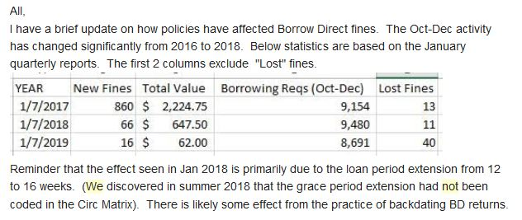
16-Week Loans = 92.3% Fewer Fines

Slide 28
What Happened?
Consortium-wide increase loan period from 12- to 16-weeks
Decision to seriously chill on invoicing
Rationalized local loan periods during shift to ReCAP Shared Collection (big deal, very boring)
Columbia changed ILL loan period from 6-weeks (perpetual renewals) to 16-weeks (no renewal)
Campus loan periods extended (Term loans, max renewals) – big, generational change on 5/23/19

Slide 29
Integration of acquisition routines
Shift footing from renewal footstooling to the integrity of recall
Recall Re-Think
Penalties adjusted:
“Casual” late fines eliminated (it’s a secret)
Time to “Lost” & account block shortened from 45 to 30 days
Aligning to promote efficiency & user experience:
IDS Project Membership
Rapid: Articles, Book Chapters & Rapid-R (mainly lending)

Slide 30
Merits Pointing Out
Users love Borrow Direct
Predictable & Consistent User Experience is where we need to be (because Amazon is eating our lunch)
Data shows: Users Are Good People (or People Are Not the Horrible Monsters We Fear)
Anecdotally: Users overwhelmingly act in good faith
Shared Values are Powerful: “We care about the book not the money”

Slide 31
Data With Purpose
Context: Columbia increasingly dependent as a borrower in resource sharing
Lending: Lending data strongly suggests Columbia can be a confident & generous lender
Punishment: Fine distribution suggests preferred terms of use and/or vagaries of human behavior
Collections: Leveraging activity to make routinized decisions

Slide 36
5.6%

Slide 37
12.4%

Slide 38
The Carrot & The Stick
Past changes:
Borrow Direct loan period increased from 12 to 16 weeks
Columbia ILL 16-week, no renewal loan period
Ongoing changes:
Large scale adoption 16-week, no renewal loan period
Future change:
How good must Columbia be to be bad?
Priority to push ILL Borrowing into local LMS (consistent user experience, recall & account blocks)

Slide 39
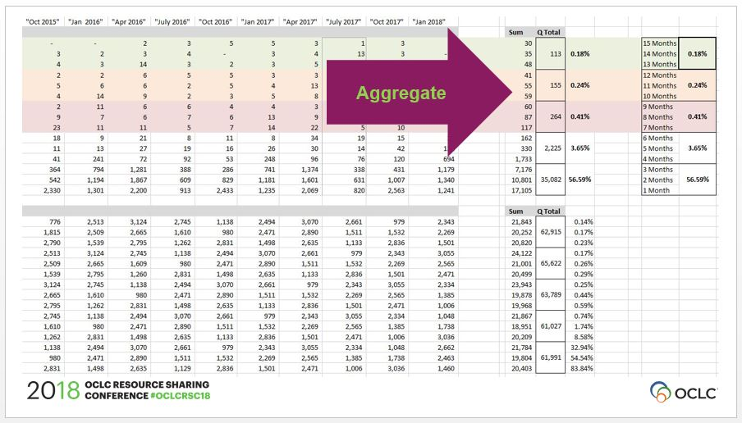

Slide 40
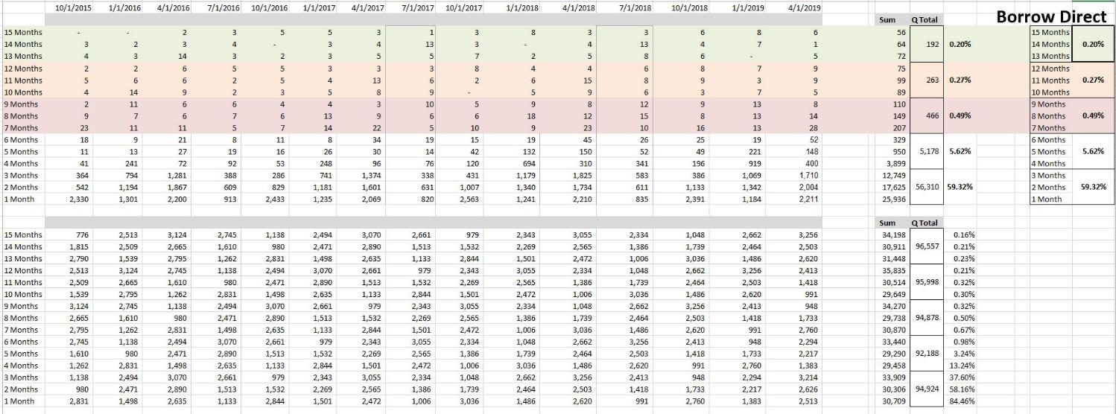

Slide 42
Danger Time
A frank confession of bad things that happened
There was a problem with returns
There was a problem with recalls
But…

Slide 43
Discharging Returns
Perception that heavy return load now falls in mid-late January
Voyager lists service desks as “closed” over the winter break
Non-Due Period = Last day of Finals to MLK Day
Pushes out Fall due dates to the day after MLK Day
Yikes ~30-35% increase in January
End of year discharge also increased by ~20% (Far less painful)

Slide 44
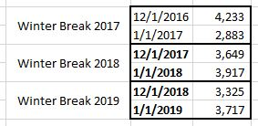

Slide 45
Recalls
Common topic of pushback
Likelihood of recall increases with longer loan period
Likelihood of loss increases with longer loan period
Both true
But the order of magnitude is very, very low
Negative impact does not outweigh the net benefit to Columbia patrons

Slide 46
System-wide Borrowing Recalls
Recalls have been dropping at Columbia for 6 years
System-wide recall stats represent only recalls placed for Columbia-owned collections
Recognition that some user groups should be able to recall; others should not have this permission
Hypothesis: there are often “better” options than recall

Slide 48
Borrow Direct Borrowing Recalls
It looks like I made a huge mistake
I did but not what seems obvious at first look
Borrow Direct recalls have continued to drop, even with a 16-week loan period

Slide 50
Before “I Told You So!”
Borrowing recalls can only be done by Columbia staff
Partner systems or staff communicate with Columbia staff
Who then act accordingly…
Back in October 2017 I alluded to how Columbia planned to be a “well-patrolled borrower rather than a mindful, assiduous lender”
Workflow was designed accordingly
I made a huge mistake

Slide 53
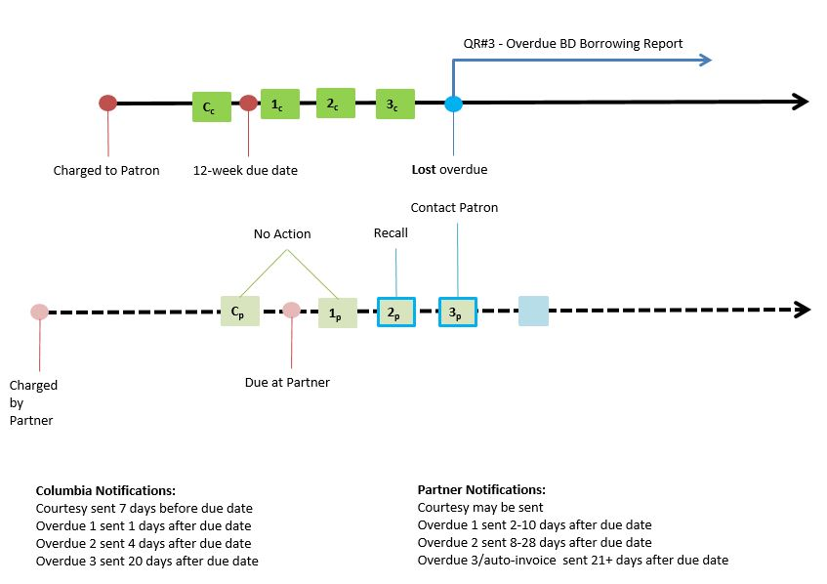

Slide 54
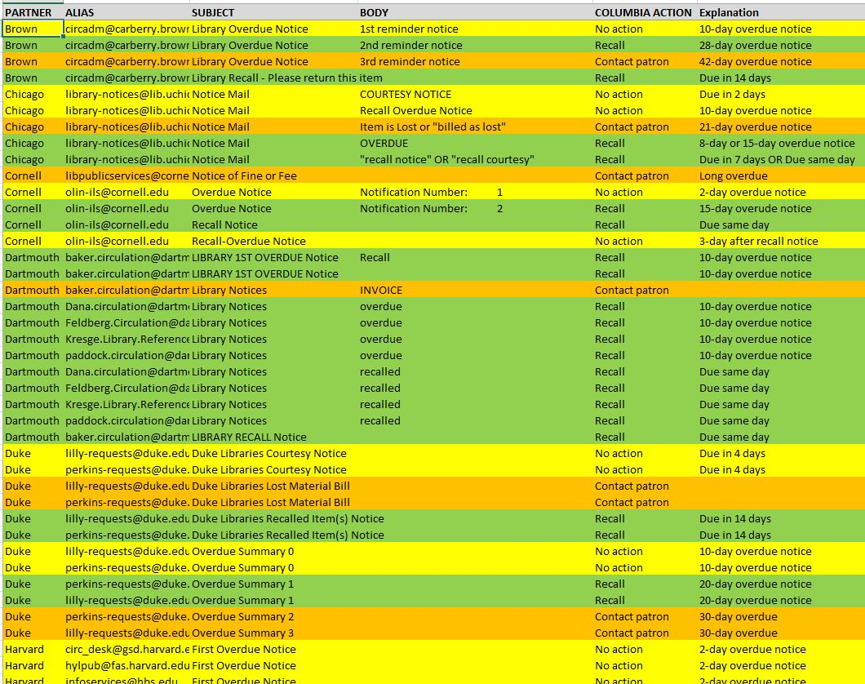

Slide 55
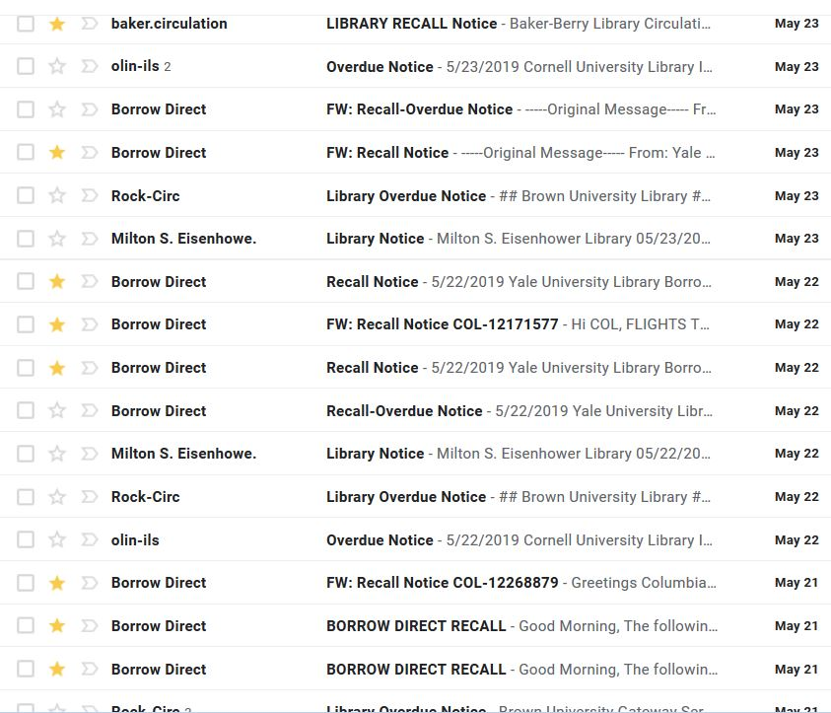
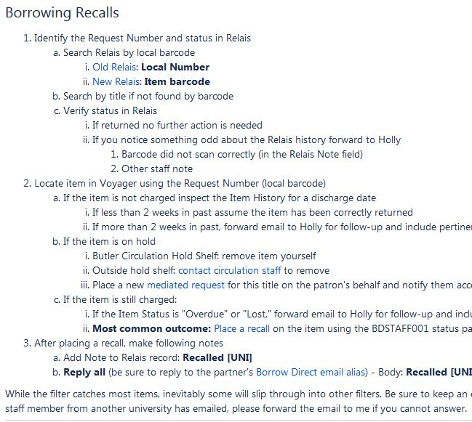

Slide 56
Borrow Direct Lending Recalls
Columbia opted to reverse the fire hose
Staff-mediated recalls; akin to consortium’s staff-mediated invoicing

Slide 58
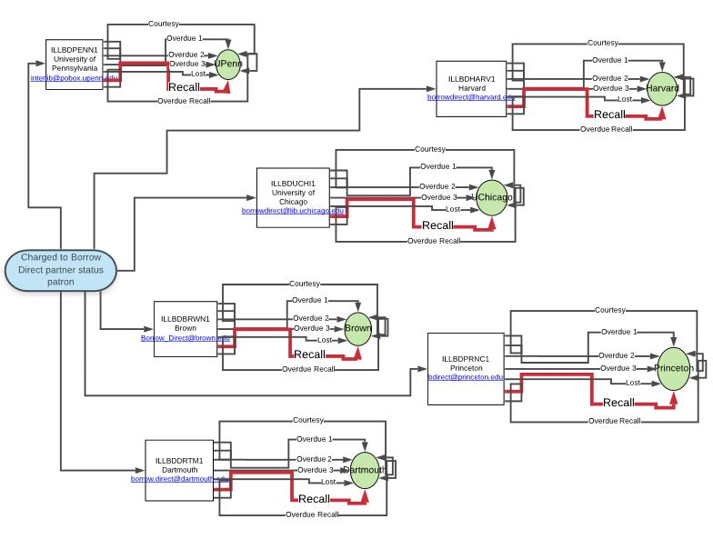

Slide 59
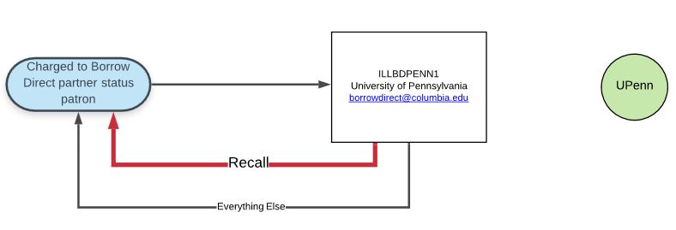

Slide 60
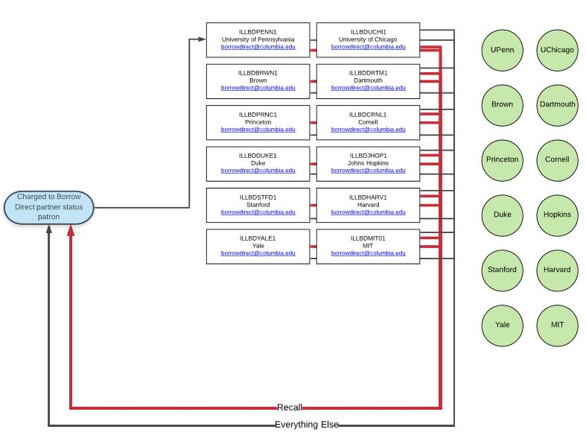

Slide 61
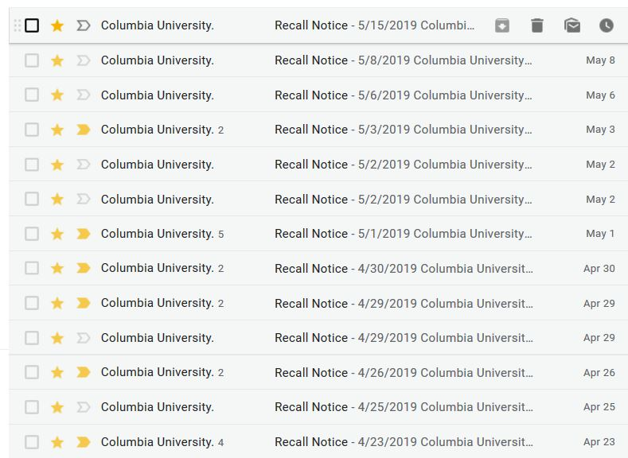

Slide 62
Running Lending Recall Interference
90% of recalls can be cancelled
Opportunity to provide better user experience (for 2 patrons)
Passive collection development strategy
How many copies are too many copies?
How many copies are too few copies?
Problem: it is labor intensive

Slide 63
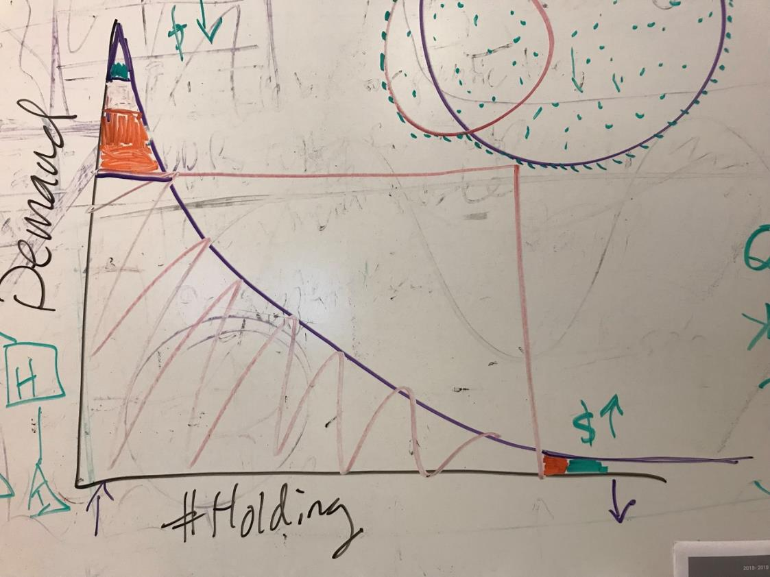

Slide 64
Beth Posner
Head of Library Resource Sharing
The Graduate Center, CUNY

Slide 65
Comprehensive, expedited access to partners' collections.
Access to restricted, noncirculating, and special collections materials that partners would not normally lend.
Costs of interlibrary loan and document supply held to minimum through agreements to supply one another at fixed below-market prices.
On-site access for one's constituency: partners give each other's visiting faculty and scholars the same degree of access to collections and services that they provide for their own communities.
Collegiality, trust, mentoring, sharing expertise, and going the extra mile.
Quick turn-around time on requests.
Availability of hard-to-find items.
Consideration of each request without blanket restrictions.
Access to theses and dissertations.
Trusted partners with whom SHARES participants get to interact.
Engagement with institutions such as NYPL that lend returnables almost exclusively to SHARES partners.
An OCLC Research Program Officer who coordinates many of the consortium's activities.
Access to expertise, career development, and collaborative opportunities within the SHARES partnership.
First priority lending.
Lending to only to SHARES partners when they are so short staffed that other requests must be deflected.
Multiple renewals.
Confirmation of questionable citations.
Personal attention, exceptions and special favors.
SHARES
Partner
Benefits
https://www.oclc.org/research/activities/shares/benefits.html

Slide 66
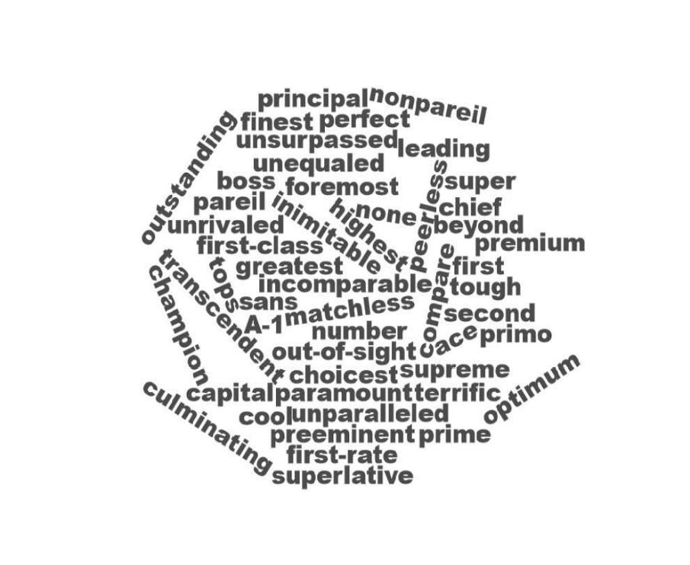
What is
“best”?

Slide 67
•Community listserv discussions (ILL-L; WorkflowToolkit-L; DOCDEL-L (and more, especially the SHARES list!)
•Conferences
•Journal Articles (JILLDDER)
•SHARE-ILL
•The Rethinking Resource Sharing Initiative and ALA RUSA STARS: STAR Checklist
•IFLA Guidelines for Best Practice in Interlibrary Loan and Document Delivery
•IDS Online Learning Institute
•The IDS Project Workflow Toolkit
•ALA ILL Code
What are
best practices?
Resources
in
interlibrary loan/ library resource sharing

Slide 68
Working with other consortia
Sharing special collections
Patron-centered policies
Packaging/shipping
Physical delivery
Lending
E-delivery
International returnables
SHARES-specific
Advocating for ILL
Tutorial/training
About your ILL unit
Borrowing
Negotiating e-licenses
Managing renovations/moves
Reciprocal onsite access
SHARES
Best Practice
Working Group

Slide 69
(Expanding Reciprocal On-Site Access and Direct Borrowing
Setting specific turnaround target times
Controlled digital lending of e-books
Facilitating special collection and archives payments
Expanding consortial cooperation: sharing staff expertise, collection development...and more!)
From best practices…
...to next practices!

Slide 70
Next steps, and a passing of the baton
Notes:
So, thank you, Beth, and thank you, Zack. Before we open it up for questions and comments I want to speak very briefly about what comes next.

Slide 71
Passing the SHARES baton…
?
2019 Executive Group
Ralph Baylor, Frick
Juan Fernandez, Fordham Law
Ronald Figueroa, Syracuse
Merrie Fuller, U Michigan
Travis Goode, UT Dallas
Richard Zwiercan, UNLV
Carl Jones, U Edinburgh
Elise Thornley, Binghamton
Notes:
Now we have a new roster of SHARES Executives who are busy coalescing as a group and putting the finishing touches on a work plan for 2019. Carl and Elise bring last year’s experience and wisdom forward. Most of these folks, the ones listed in green, will be back again next year for the second year of their terms. So in 2020 we’ll have lots of continuity and the ability to build on this year’s momentum.

Slide 72
Passing the SHARES baton…
2019 Executive Group
Ralph Baylor, Frick
Juan Fernandez, Fordham Law
Ronald Figueroa, Syracuse
Merrie Fuller, U Michigan
Travis Goode, UT Dallas
Richard Zwiercan, UNLV
Carl Jones, U Edinburgh
Elise Thornley, Binghamton
Make accessibility of ILL materials routine instead of the exception
Advocate internally for the value of collection sharing, and for specific ILL policies and practices
Help collection sharing practitioners acquire the skill sets essential to their positions
Notes:
The 2019 SHARES Executive Group is putting its own stamp on how they will go about their business. Last year the Rethink was about policy and practice. This year’s group has chosen to focus on areas of need where SHARES can work to have an impact and then team up with folks in other resource sharing consortia to broaden, enrich and amplify that impact. The three areas identified by the group are making accessibility of ILL materials routine rather than the exception, advocating internally for the value of sharing collections, and for the adoption of specific policies and practices, and the building up of the skill sets of resource sharing practitioners and managers. You’ll be hearing quite a lot about these themes and how the exec group plans to address them and engage with you around them in the coming weeks and months.

Slide 73
Passing the SHARES baton…
SHARES Sharing Special Collections Working Group
Brian Miller, Ohio State University (chair)
Ralph Baylor, Frick
Lesliediana Jones. GWU Law
Richard Zwiercan, UNLV
SHARES Best Practices Working Group
Kathy Britt-Rogers, Emory
Ralph Baylor, Frick
Silvia Cho, CUNY Grad Center
Jennifer DeVito, Stony Brook
Amy Gherardini, U Michigan
Katharine Haldeman, Boston U Law
Jenny Lee, UCLA
Aimee Lind, Getty
Meg Massey, Penn State
Autumn Mather, Art Institute of Chicago
David Perry, Bryn Mawr
Beth Posner, Graduate Center, CUNY
John Sandoval, U Miami
Phoebe Walker, NYU
Notes:
Meanwhile, these two SHARES working groups have taken the Policy Rethink baton and are running fast with it, doing work that will inject some fresh vitality and creativity and yes boundary-pushing into the SHARES environment. I fully anticipate that the innovations and knowledge creating that comes out of these efforts will bring substantial benefit to all who are part of the resource sharing community. Exciting times, really productive smart energetic people, and much good work being done.

Slide 74
Questions/comments?
Dennis Massie
Program Officer, OCLC Membership and Research
massied@oclc.org
Notes:
With that I’d like to thank you for listening, and to thank Zack and Beth for sharing their thoughts with us. And now we’ll open it up to questions and comments. Please let us know what’s on your mind by typing into chat. We’ve seen a few questions come through chat already…

