Slide 1
Practices and Patterns in Research Information Management
CNI Spring Meeting * St. Louis * 9 April 2019
Findings from a Global Survey
Jan Fransen
Service Lead for Research Information
Management Systems, University of Minnesota
Rebecca Bryant
Senior Program Officer, OCLC Research
bryantr@oclc.org
@RebeccaBryant18
https://orcid.org/0000-0002-2753-3381
fransen@umn.edu
https://orcid.org/0000-0002-0302-2761

Slide 2
Some (not so) Random Examples

Slide 3
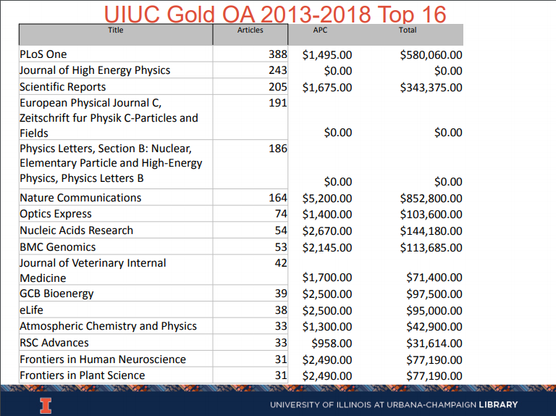
How much are we spending for Open Access?
University of Illinois
From The Shadow Acquisitions Budget: APCs and Open Access Publications at a Research University
William H. Mischo & Thomas H. Teper (UIUC) – CNI Meeting, December 2018
https://youtu.be/mqm7siVBGs4

Slide 4
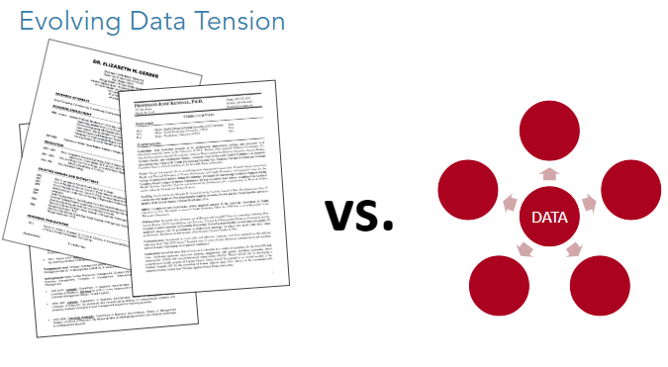
How can we unlock all the data in faculty CVs?
University of Arizona
From Research Information Management: Libraries Leading the Way
Bryant, Fransen, Oxnam, and Rauh – ACRL 2019, Later this week!

Slide 5
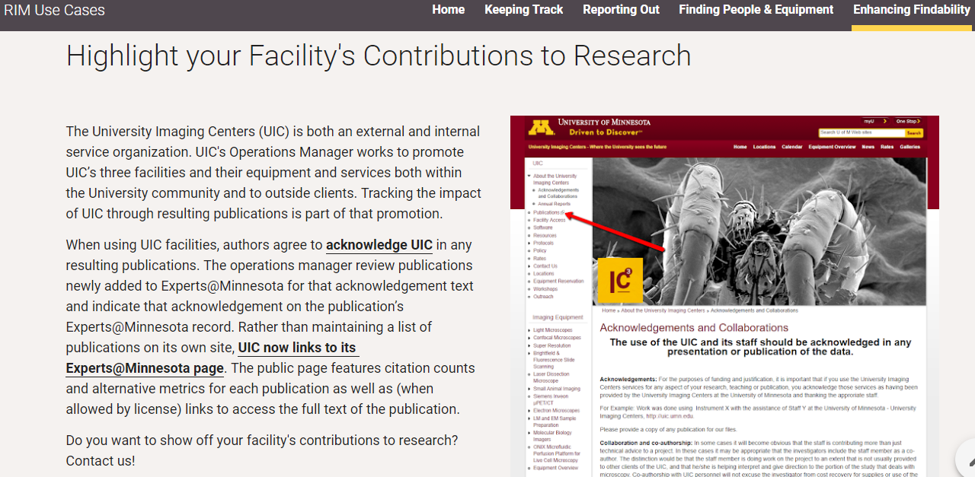
How can we show the impact of equipment and facilities?
University of Minnesota
From University of Minnesota Libraries: RIM Use Cases website
https://z.umn.edu/RIMUseCases

Slide 6
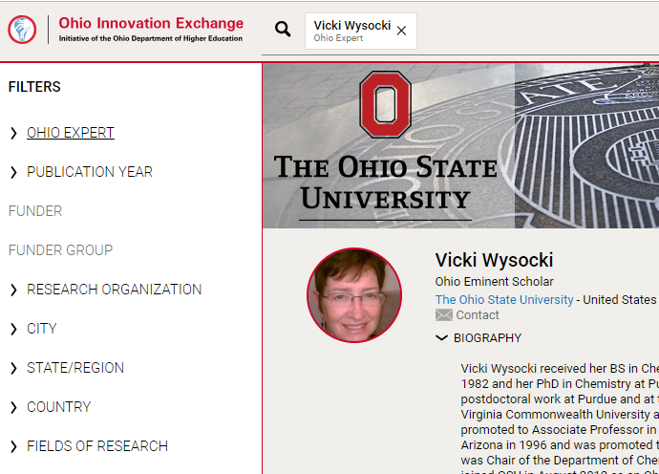
How can we connect Ohio businesses with university expertise?
State of Ohio
From Ohio Innovation Exchange
https://www.ohioinnovationexchange.org/

Slide 7
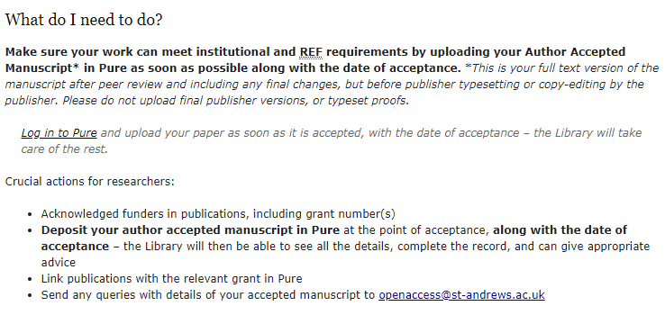
How can we prepare for
REF 2021*?
University of St Andrews
*REF 2021 is the Research Excellence Framework. See https://www.ref.ac.uk/ for more information.
From University of St Andrews Library website
https://www.st-andrews.ac.uk/library/services/researchsupport/openaccess/

Slide 8
What do these examples have in common?

Slide 9
are used to collect the scholarly output of an institution.
And allow it to be combined with other information collected on campus.
RIM Systems…
oc.lc/rim
“RIM Metadata” by OCLC Research, from Research Information Management: Defining RIM and the Library’s Role (doi.org/10.25333/C3NK88), CC BY 4.0

Slide 10
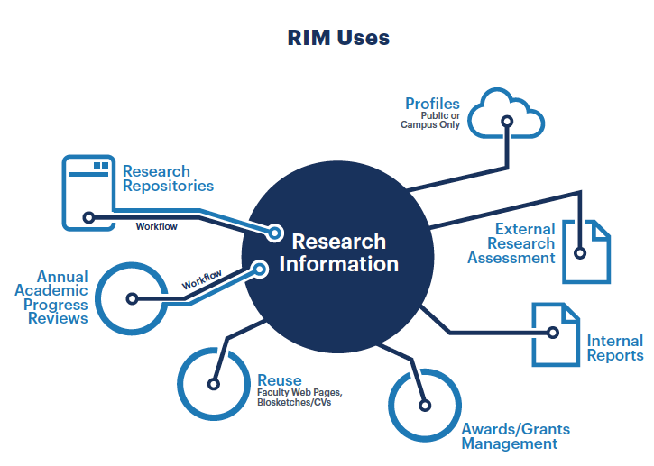
are used to collect the scholarly output of an institution.
And allow it to be combined with other information collected on campus.
RIM Systems…
oc.lc/rim
“RIM Metadata” by OCLC Research, from Research Information Management: Defining RIM and the Library’s Role (doi.org/10.25333/C3NK88), CC BY 4.0

Slide 11
Is this a trend?
Learning more…

Slide 12

Devoted to challenges facing libraries and archives since 1978
Community resource for shared Research and Development (R&D)
Engagement with OCLC members and the community around shared concerns
Learn more
  oc.lc/research
  Hangingtogether.org blog

Slide 13

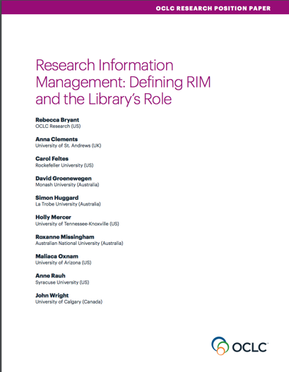
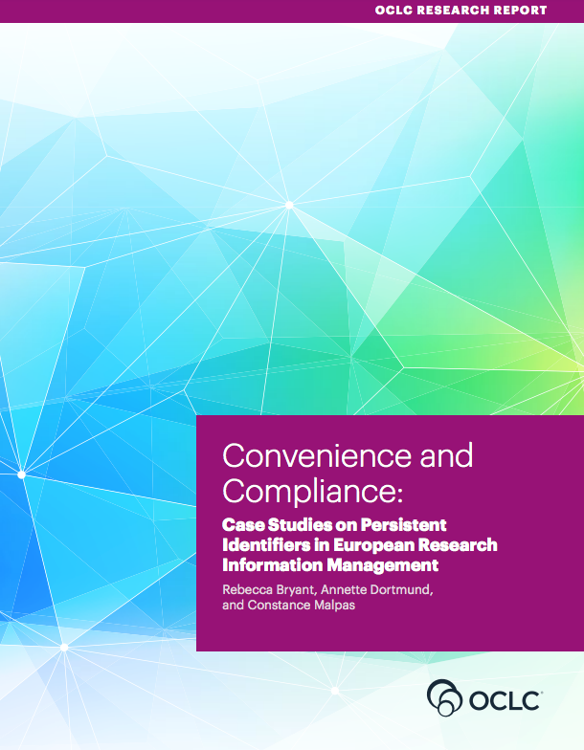
OCLC Research publications on Research Information Management
oc.lc/rim

Slide 14
The aggregation, curation, & utilization of metadata about research activities
RIM =

Slide 15


The aggregation, curation, & utilization of metadata about research activities
Overlapping terms:
  CRIS (Current Research Information System)
  RIS (Research Information System)
  RNS (Research Networking System)
  RPS (Research Profiling System)
  EFS (Expert Finder System)
  FAR (Faculty Activity Reporting)
RIM =

Slide 16
Practices and Patterns in Research Information Management: Findings from a Global Survey
Rebecca Bryant, PI, OCLC Research
Pablo de Castro, Strathclyde University and euroCRIS
Anna Clements, University of St. Andrews and euroCRIS
Annette Dortmund, OCLC EMEA
Jan Fransen, University of Minnesota, Twin Cities
Michele Mennielli, DuraSpace and euroCRIS
Plus a number of valuable collaborators at OCLC
oc.lc/rim

Slide 17
Results we’ll be talking about
Incentives for RIM Adoption
Functions/Uses of RIM
Interoperability
RIM Stakeholders
Use of Persistent Identifiers

Slide 18
Methodology and Promotion
Online survey data collection: Oct 2017 – Jan 2018
  English and Spanish versions
Survey promotion through:
  OCLC and euroCRIS communications channels and events worldwide
  Communications by RIM vendors and user communities
  Listservs, social media, and announcements to research & library organizations

Slide 19
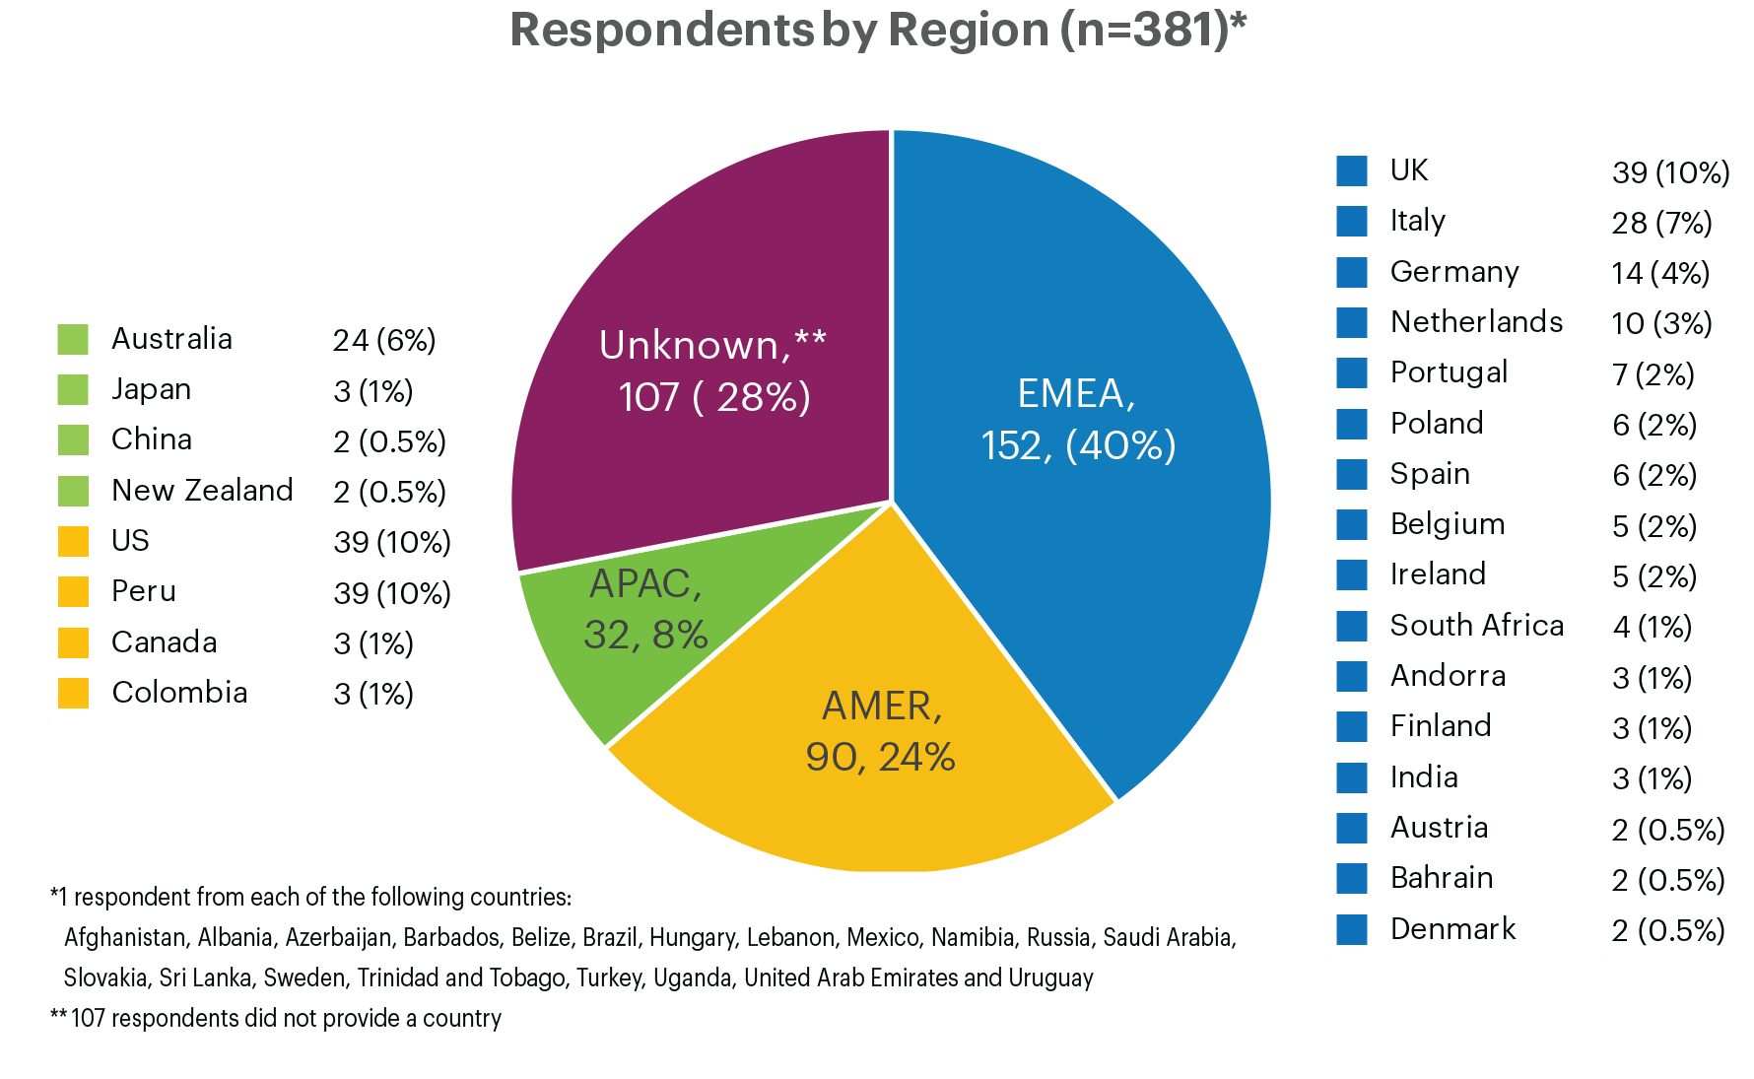

RIM Survey responses: geographic overview
381 survey respondents from 44 countries
“Total number of survey respondents, by broad region” by OCLC and euroCRIS, Practices and Patterns in Research Information Management: Findings from a Global Survey (DOI:10.25333/BGFG-D241), CC BY 4.0

Slide 20
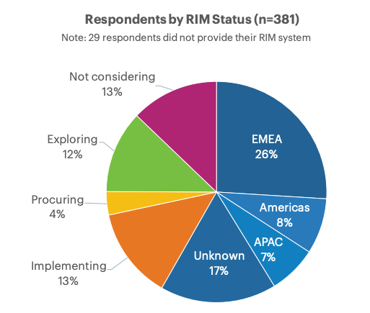
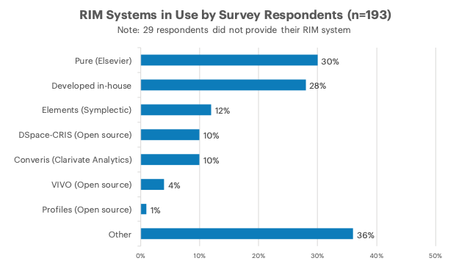
Research Information Management Systems
Well over half (58%) have a live RIM System
Practices and Patterns in Research Information Management: Findings from a Global Survey (DOI:10.25333/BGFG-D241), CC BY 4.0

Slide 21
“Please indicate the importance of the following reasons for pursuing RIM activities”
Managing annual academic activity reporting
Supporting expertise discovery
Supporting institutional compliance (e.g., funder mandates, national assessment exercise like REF or ERA, etc.)
Supporting institutional reputation and strategic decision making
Improving services for researchers
Recording institutional research facilities and their use

Slide 22
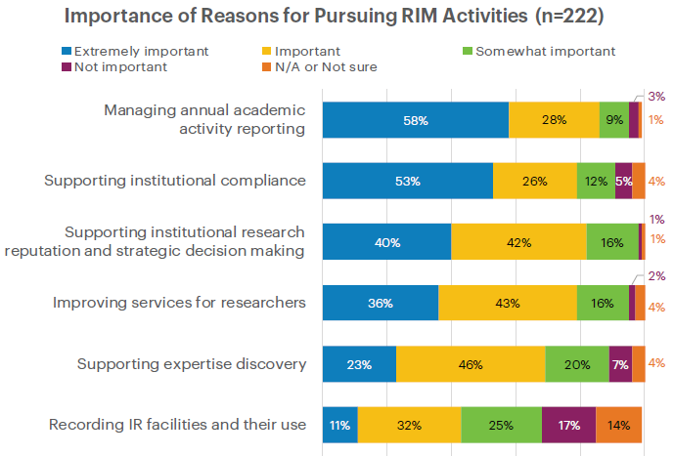
Reporting and compliance drive RIM adoption
Practices and Patterns in Research Information Management: Findings from a Global Survey (DOI:10.25333/BGFG-D241), CC BY 4.0

Slide 23
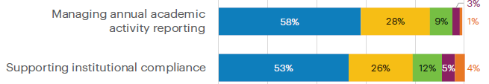

Slide 24
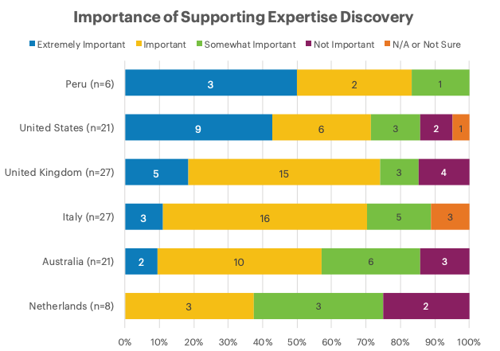
Practices and Patterns in Research Information Management: Findings from a Global Survey (DOI:10.25333/BGFG-D241), CC BY 4.0

Slide 26
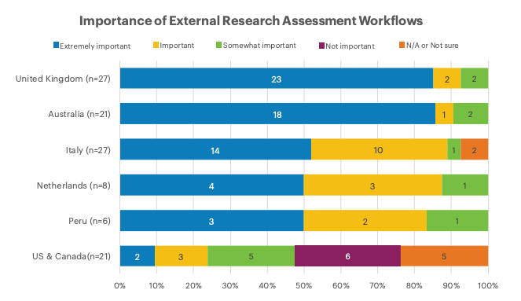
Practices and Patterns in Research Information Management: Findings from a Global Survey (DOI:10.25333/BGFG-D241), CC BY 4.0

Slide 27
Summary:
Reasons for adoption
US is an outlier
  No national compliance requirements
  Early emphasis on Research Networking Systems (e.g., Harvard Profiles)
Action for the next survey
  Different platforms emphasize different capabilities, so…
  Increase promotion to Profiles RNS and VIVO communities
Research Question for the next survey
  Will incentives for new adopters of RIM shift away from compliance and toward expertise discovery?
  Most institutions with reporting mandates will have already implemented RIM

Slide 28
“How important are the following functions of RIM at your institution?”
Registry of institutional research output
Publicly available researcher profiles
Reporting scholarly impact
Reporting societal impact
External (e.g., National) research assessment
Internal reporting
Annual academic activity reporting workflows
Awards/grants management workflows
Compliance and open access to publications
Reuse (in CVs, biosketches, other web pages)
Identifying collaborators or expertise

Slide 29
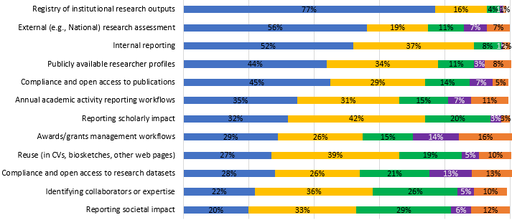
Practices and Patterns in Research Information Management: Findings from a Global Survey (DOI:10.25333/BGFG-D241), CC BY 4.0

Slide 30
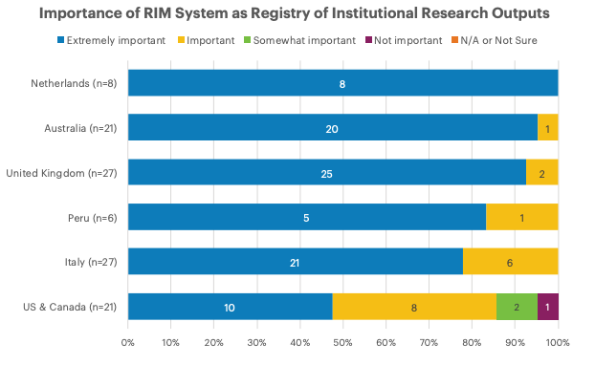
Practices and Patterns in Research Information Management: Findings from a Global Survey (DOI:10.25333/BGFG-D241), CC BY 4.0

Slide 31
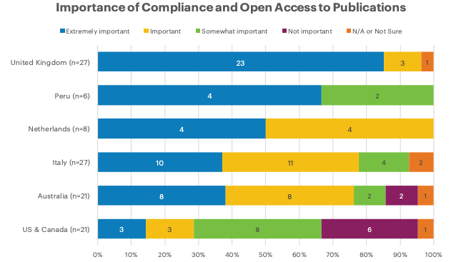
Practices and Patterns in Research Information Management: Findings from a Global Survey (DOI:10.25333/BGFG-D241), CC BY 4.0

Slide 32
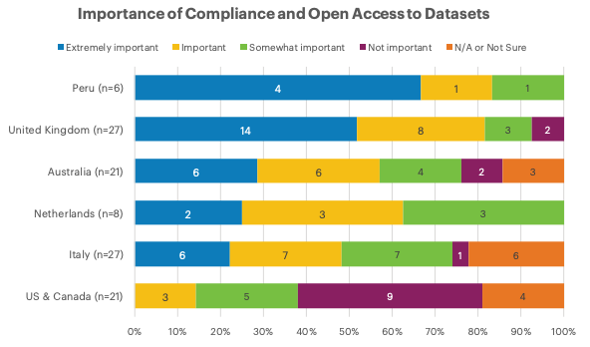
Practices and Patterns in Research Information Management: Findings from a Global Survey (DOI:10.25333/BGFG-D241), CC BY 4.0

Slide 33
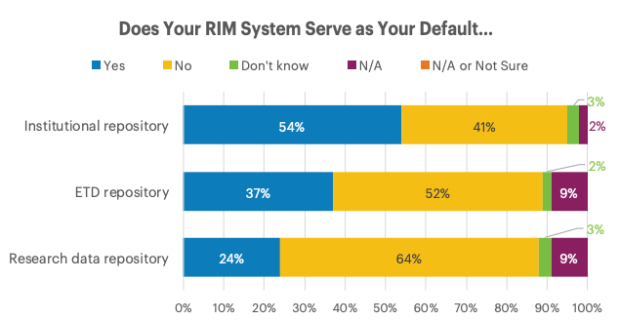
Use of RIM Systems to support repository functions

Slide 34
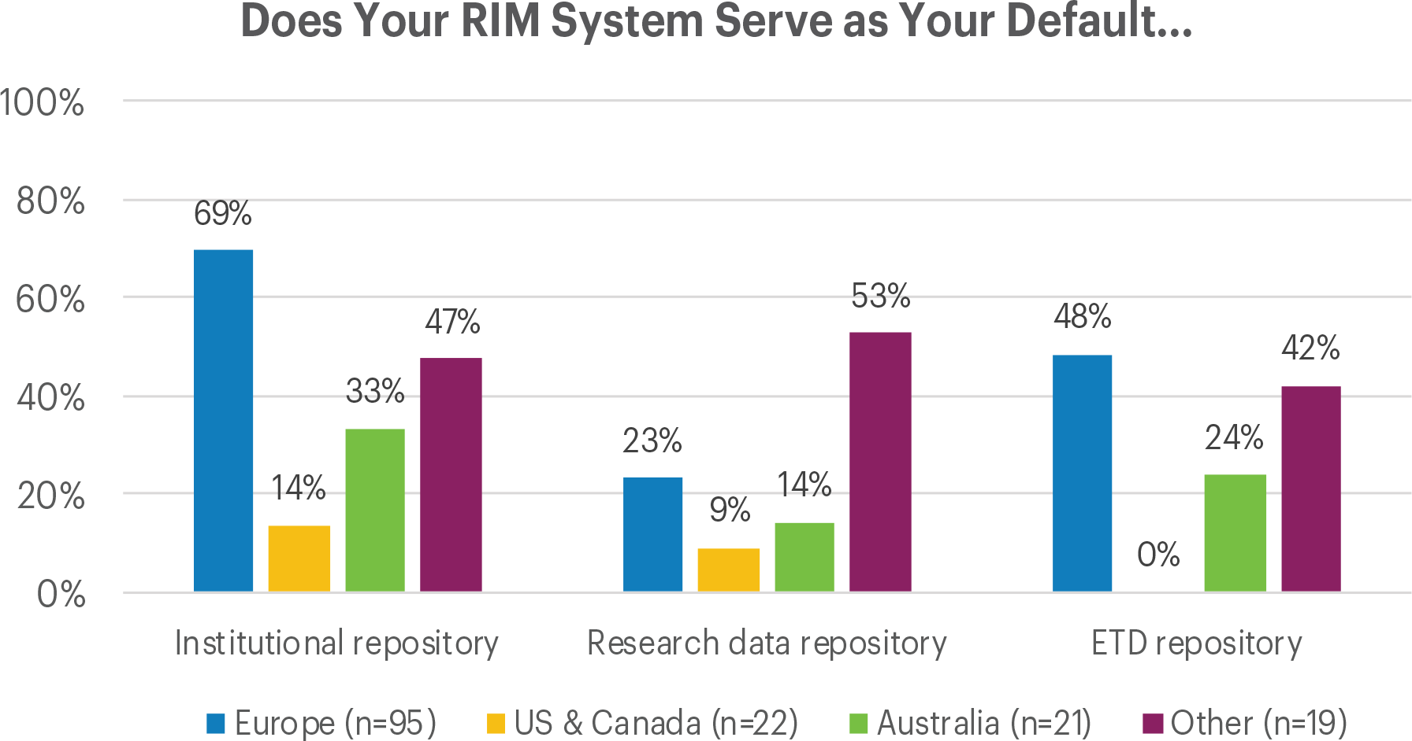
“Institutions with a live RIM system reporting that their RIM system serves as their default institutional repository/ETD repository/research data repository, with regional subdivisions” by OCLC and euroCRIS, Practices and Patterns in Research Information Management: Findings from a Global Survey (DOI:10.25333/BGFG-D241), CC BY 4.0

Slide 35
Summary:
RIM Uses
RIM has multiple uses at most institutions
  External & internal assessment are among the most important (and unsurprising)
  Managing OA compliance is also important
  Supporting the discovery of potential research collaborators is less important

Slide 36
Stakeholders

Slide 37
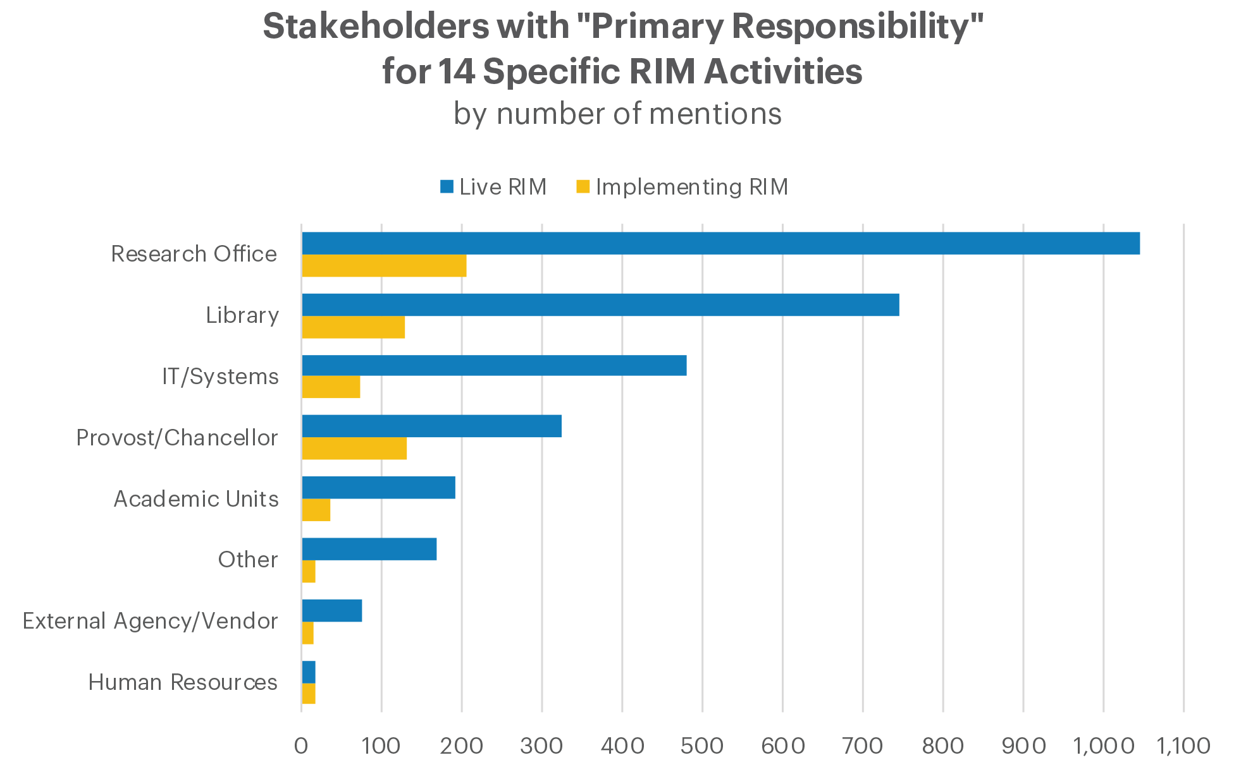
“Primary stakeholders based on total number of mentions across all responses for all areas of activity, in aggregate. Note that multiple primary stakeholders could be selected per area of activity” by OCLC and euroCRIS, Practices and Patterns in Research Information Management: Findings from a Global Survey (DOI:10.25333/BGFG-D241), CC BY 4.0

Slide 38
Stakeholders with Primary Responsibility for RIM Activities by Country
Based on # of Mentions (Decreasing Importance of Library)
Base: Institution with a Live RIM system
Practices and Patterns in Research Information Management: Findings from a Global Survey (DOI:10.25333/BGFG-D241), CC BY 4.0

Slide 39
Persistent Identifiers

Slide 40
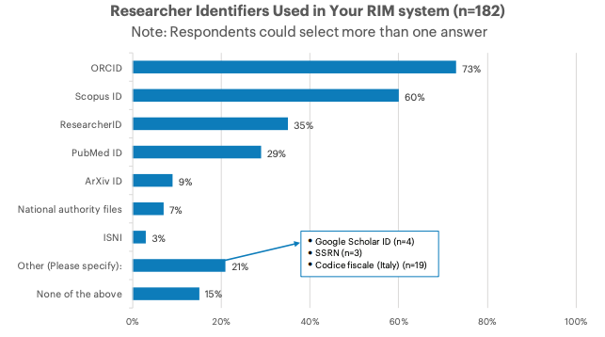
Practices and Patterns in Research Information Management: Findings from a Global Survey (DOI:10.25333/BGFG-D241), CC BY 4.0

Slide 41
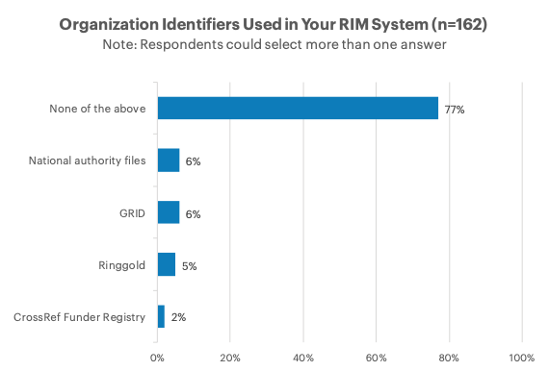
Practices and Patterns in Research Information Management: Findings from a Global Survey (DOI:10.25333/BGFG-D241), CC BY 4.0

Slide 42
Summary:
Persistent Identifiers
Congruent with our qualitative Convenience and Compliance* findings
Strong adoption of person identifiers
  ORCID becoming a de facto standard in scholarly literature, but other identifiers also needed and used
Organizational identifiers largely unused. . . for now
*Bryant, Rebecca, Annette Dortmund, and Constance Malpas. 2017. Convenience and Compliance: Case Studies on Persistent Identifiers in European Research Information. Dublin, Ohio: OCLC Research. doi:10.25333/C32K7M

Slide 43
References
Bryant, Rebecca, Anna Clements, Carol Feltes, David Groenewegen, Simon Huggard, Holly Mercer, Roxanne Missingham, Maliaca Oxnam, Anne Rauh and John Wright. 2017. Research Information Management: Defining RIM and the Library’s Role. Dublin, OH: OCLC Research. doi:10.25333/C3NK88
Bryant, Rebecca, Annette Dortmund, and Constance Malpas. 2017. Convenience and Compliance: Case Studies on Persistent Identifiers in European Research Information. Dublin, Ohio: OCLC Research. doi:10.25333/C32K7M
Bryant, Rebecca, Anna Clements, Pablo de Castro, Joanne Cantrell, Annette Dortmund, Jan Fransen, Peggy Gallagher, and Michele Mennielli. 2018. Practices and Patterns in Research Information Management: Findings from a Global Survey. Dublin, OH: OCLC Research. https://doi.org/10.25333/BGFG-D241
Ribeiro, Lígia, Pablo De Castro, and Michele Mennielli. “EUNIS-EuroCRIS Joint Survey on CRIS and IR,” 2016. http://www.eurocris.org/news/cris-ir-survey-report.

Slide 44
Discussion
Rebecca Bryant, PhD, Senior Program Officer, OCLC Research
bryantr@oclc.org @RebeccaBryant18
https://orcid.org/0000-0002-2753-3881
Jan Fransen, Service Lead for RIM Systems, University of Minnesota
fransen@umn.edu
https://orcid.org/0000-0002-0302-2761
oc.lc/rim

