Slide 1
OCLC EMEA Regional Council Conference, 26-27 February 2019, Marseille, France
OCLC and the Evolving Scholarly Record
Ixchel M. Faniel, PhD
Senior Research Scientist, OCLC

Slide 2
The Evolving Scholarly Record: Drivers
Shifting formats: print centric to digital and networked
Expanding boundaries: articles/monographs to research data, computer models, lab notebooks, blogs, e-prints
Changing characteristics: formal, outcome-focused, static to formal/informal, process-focused, dynamic
Reconfiguring stakeholders: new paths for scholarship lead to new stakeholders and new stakeholder roles
(Lavoie et al., 2014)

Slide 3
“I use it as a way of illustrating how libraries have a powerful future ahead of them. People who kind of gave up on libraries 20 years ago understand very quickly, when you explain the model, what it is that we can do.”
– Keith Webster, Dean of University Libraries,
Carnegie Mellon University
https://www.oclc.org/en/member-stories/carnegie-mellon.html
Image: https://www.flickr.com/photos/34053291@N05/3551238175 by Temari 09 / CC BY-NC 2.0

Slide 4
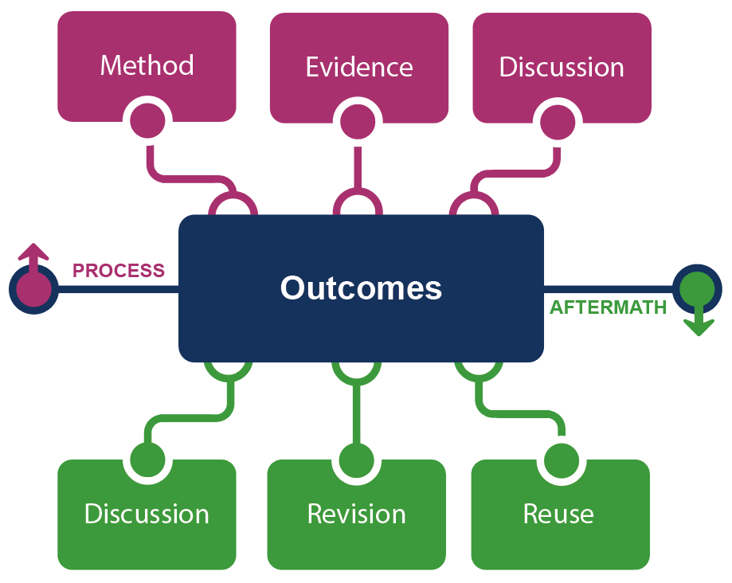
The Evolving Scholarly Record: Content
(Lavoie et al., 2014)

Slide 5
“Our strengths tend to be on the end of it in terms of putting things in and ar­chiving them and maintaining them over a longer period and not that ‘what are you [scholars] doing with it while you’re using it’ sort of thing.”
– Librarian 22
(Faniel & Connaway, 2018, p. 108)
Image: https://www.flickr.com/photos/78830297@N05/14556250857 by OnePoint Services / CC BY 2.0

Slide 6
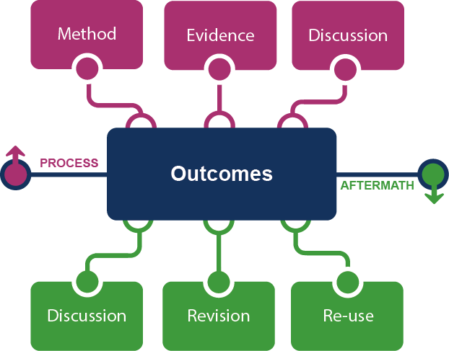
The Evolving Scholarly Record: Stakeholder Ecosystem
Fix
Collect
Create
Use
(Lavoie et al., 2014)

Slide 7
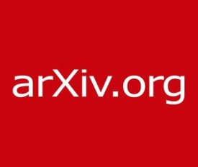
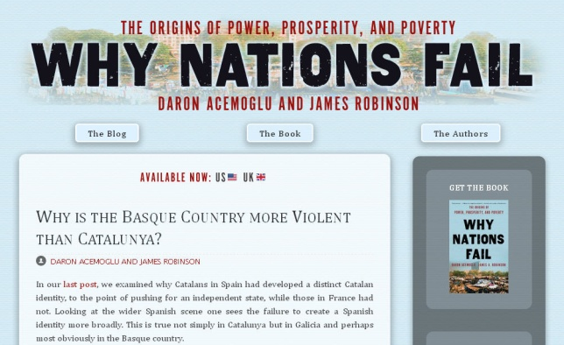
The Evolving Scholarly Record: Stewardship
The Journal of Brief Ideas
(Lavoie et al., 2014)

Slide 8
Conscious Coordination
“a strategy of deliberate engagement with – and growing dependence on – cooperative agreements, characterized by increased reliance on network intelligence…and global data networks.”
(Lavoie and Malpas, 2015, p. 15)
Image: https://www.flickr.com/photos/22506384@N02/17396482255 by Daniel Kohn / CC BY-ND 2.0

Slide 9
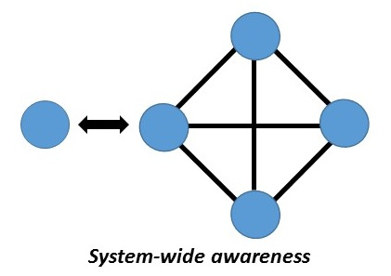
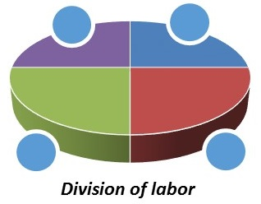
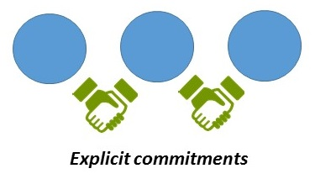
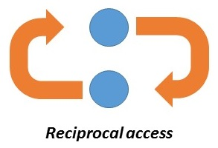
Features of Consciously Coordinated Stewardship
“Align local action with collective effort”
“Collect more of less”
“Move commitments above the institution”
“Curate locally, share globally”
(Lavoie & Malpas, 2015)

Slide 10
Collections Spectrum
A print logic: the distribution of print copies to multiple local destinations
A network logic: a coordinated mix of local, external and collaborative services are assembled around user needs
A collections spectrum
The ‘owned’ collection
The ‘facilitated’ collection
Purchased and physically stored
Meet research and
learning needs in best way
(Dempsey, 2017)

Slide 11
The Inside-out Library
“is about more deeply engaging with the creative life of the university, mobilizing library services and expertise to support the creation, curation, and discoverability of institutional assets (research and learning materials, researchers…).”
(Dempsey, 2017, p. 342)
Image: https://www.flickr.com/photos/kevinrechts/8652482836 by kaveman743 / CC BY-NC 2.0

Slide 12
The inside-out library:
Two service examples

Slide 13
Research Data Management (RDM):
“activities and processes associated with the [research] data lifecycle, involving the design and creation of [research] data, storage, security, preservation, retrieval, sharing, and reuse….”
(Cox & Pinfield, 2014, p. 300)
1
Research Information Management (RIM):
“the aggregation, curation, and utilization of metadata about research activities.”
(Bryant et al., 2017, p. 6)
2

Slide 14
Data Reuse for Research
Marine biologists reused price data from the New York Public Library’s collection of 45,000 restaurant menus along with other sources to test whether abalone stocks were being overharvested in the 1920s.
(Enis 2015)
Image: https://www.flickr.com/photos/albamass__canvas/5315308442 by AL BaMass / CC BY-NC-ND 2.0

Slide 15
Data Reuse for Teaching and Learning
“we examined data from Mark Lehner's Giza (Egypt) excavations. Great for students to get hands-on experience with archaeological data. Thanks Lehner et al. and @OpenContext cc @ekansa”
(Carter, 2019)
Image: https://www.flickr.com/photos/albamass__canvas/5315308442 by AL BaMass / CC BY-NC-ND 2.0

Slide 16
FAIR Data Principles
Findable
Accessible
Interoperable
Reusable
(Wilkinson et al., 2016)

Slide 17
Reusability: Role of Context Information
Repository Information
Provenance
Reputation and History
Curation and Digitization
Data Reuse Information
Prior reuse
Terms of Use
Advice on reuse
Data Production Information
Data Collection
Specimen and Artifact
Data Producer
Data Analysis
Missing Data
Research Objectives
(Faniel, Frank, & Yakel, in press)

Slide 18
Reusability: Role of Context Information
(Faniel, Frank, & Yakel, in press)

Slide 19
Reusability: Role of the Scholarly Record
(Faniel & Yakel, 2017)

Slide 20
Reusability: Role of Data Quality
RELEVANCE
EASE OF OPERATION
QUALITY
ACCESSIBILITY
INTERPRETABILITY
CREDIBILITY
COMPLETENESS
DATA PRODUCER REPUTATION
(Faniel, Kriesberg, & Yakel, 2016)

Slide 21
Positioning Library Expertise Throughout the Research Data Lifecycle
Virtuous and Vicious Circles in the Data Lifecycle
Elizabeth Yakel, Ixchel M. Faniel, Zachary Maiorana
Accepted for publication in Information Research
Beyond the Archive: Bridging Data Creation and Reuse in Archaeology
Ixchel Faniel, Anne Austin, Eric Kansa, Sarah Whitcher Kansa, Phoebe France, Jennifer Jacobs, Ran Boytner, and Elizabeth Yakel
Advances in Archaeological Practice

Slide 22
Research data management (RDM):
“activities and processes associated with the [research] data lifecycle, involving the design and creation of [research] data, storage, security, preservation, retrieval, sharing, and reuse….”
(Cox & Pinfield, 2014, p. 300)
1
Research Information Management (RIM):
“the aggregation, curation, and utilization of metadata about research activities.”
(Bryant et al., 2017, p. 6)
2

Slide 23
Institutional Collaborators
(Bryant et al., 2017)

Slide 24
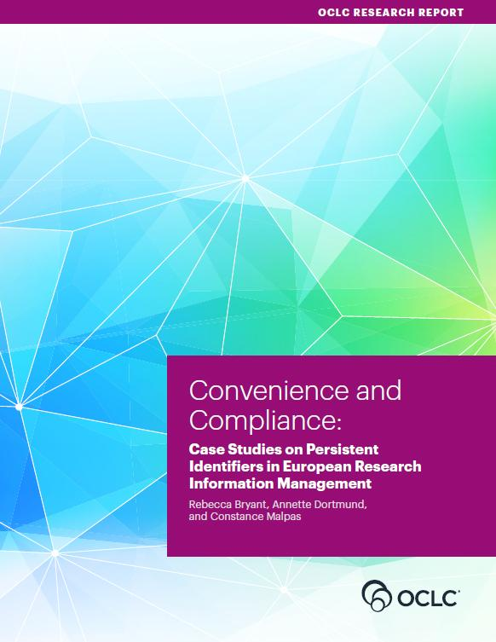
Convenience and Compliance
(Bryant, Dortmund, & Malpas, 2017)

Slide 25
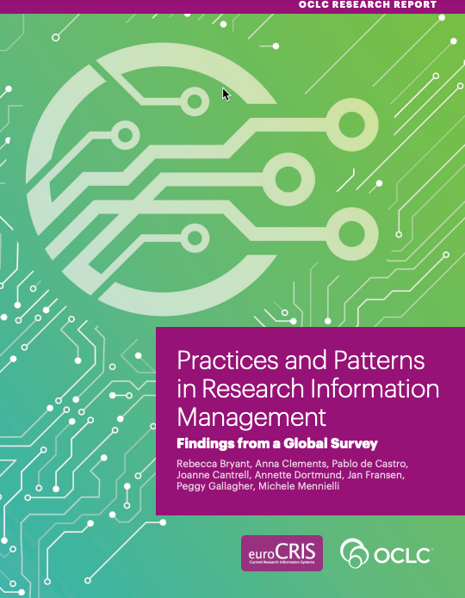
Practices and Patterns
(Bryant et al., 2018)

Slide 26
RIM Activities for which the Library Plays a Role
(n=172)
(Bryant et al., 2018)

Slide 27
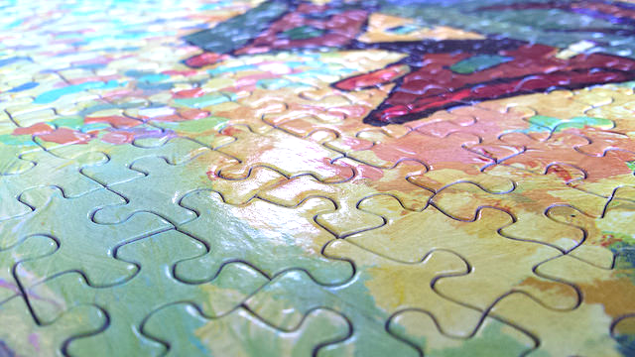
Implications
Image: https://www.flickr.com/photos/waferboard/19151455538 by waferboard / CC BY 2.0

Slide 28
References
Bryant, R., Clements, A., de Castro, P., Cantrell, J., Dortmund, A., Fransen, J., … Mennielli, M. (2018). Practices and patterns in research information management: Findings from a global survey. Dublin, OH: OCLC Research. https://doi.org/10.25333/BGFG-D241.
Bryant, R., Clements, A., Feltes, C., Groenewegen, D., Huggard, S., Mercer, H., … Wright, J. (2017). Research information management: Defining RIM and the library’s role. Dublin, OH: OCLC Research. doi:10.25333/C3NK88.
Bryant, R., Dortmund, A., & Malpas, C. (2017). Convenience and compliance: Case studies on persistent identifiers in european research information management. Dublin, Ohio: OCLC Research. doi:10.25333/C32K7M
Carter, B. @archeoscape. (2019, January 31). “…we examined data from Mark Lehner's Giza (Egypt) excavations. Great for students to get hands-on experience with archaeological data. Thanks Lehner et al. and @OpenContext cc @ekansa”. [Twitter Post]. Retrieved from https://twitter.com/archaeoscape/status/1091034237342486528
Cox, A. M., & Pinfield, S. (2014). Research data management and libraries: Current activities and future priorities. Journal of Librarianship and Information Science 46(4), 299-316. doi:10.1177/0961000613492542.

Slide 29
References
Dempsey, L. (2017). Library collections in the life of the user: Two directions. LIBER Quarterly, 26(4). https://www.liberquarterly.eu/articles/10.18352/lq.10170/.
Enis, M. (2015). “Wisdom of the Crowd | Digital Collections.” Library Journal, July 13. http://lj.libraryjournal.com/2015/07/technology/wisdom-of-the-crowd-digital-collections/#_.
Faniel, I. M., Austin, A., Kansa, E., Kansa, S. W., France, P., Jacobs, J., … Yakel, E. (2018). Beyond the archive: Bridging data creation and reuse in archaeology. Advances in Archaeological Practice, 6(02), 105-116. https://doi.org/10.1017/aap.2018.2.
Faniel, I. M., Frank, R. D., & Yakel, E. (In Press). Context from the data reuser’s point of view. Journal of Documentation.
Faniel, I. M., Kriesberg, A., & Yakel, E. (2016). Social scientists’ satisfaction with data reuse. Journal of the Association for Information Science and Technology, 67(6), 1404–1416. https://doi.org/10.1002/asi.23480
Faniel, I.M., & Connaway, L. S. (2018). Librarians' perspectives on the factors influencing research data management programs. College & Research Libraries 79(1), 100-119. https://doi.org/10.5860/crl.79.1.100

Slide 30
References
Faniel, I.M., & Yakel, E. (2017). Practices do not make perfect: Disciplinary data sharing and reuse practices and their implications for repository data curation. In L.R. Johnston (Ed.), Curating research data volume 1: Practical strategies for your digital repository (pp. 103-125). Chicago: Association of College and Research Libraries Press.
Lavoie, B., & Malpas, C. (2015). Stewardship of the evolving scholarly record: From the invisible hand to conscious coordination. Dublin, Ohio: OCLC Research. https://doi.org/10.25333/C3J63N.
Lavoie, B., Childress, E., Erway, R., Faniel, I., Malpas, C., Schaffner, J., & van der Werf, T. (2014). The evolving scholarly record. Dublin, Ohio: OCLC Research. https://doi.org/10.25333/C3763V.
Prepare for the next evolution of libraries: Carnegie Mellon University. (n.d.). https://www.oclc.org/en/member-stories/carnegie-mellon.html.
Wilkinson, M. D., Dumontier, M., Aalbersberg, Ij. J., Appleton, G., Axton, M., Baak, A., … Mons, B. (2016). The FAIR Guiding Principles for scientific data management and stewardship. Scientific Data, 3, 160018. https://doi.org/10.1038/sdata.2016.18
Yakel, E., Faniel, I. M., & Maioriana, Z. (In Press). Virtuous and vicious circles in the data lifecycle. Information Research.

Slide 31
Ixchel M. Faniel, PhD
Senior Research Scientist
fanieli@oclc.org, @imfaniel

