Slide 1
Library consortia: scale, opportunity, challenge
ICOLC
Vancouver, 8 Apr 2019
Lorcan Dempsey, OCLC @LorcanD

Slide 4
Consortial activity is about ‘right scaling’
But the network has changed our notions of scale
(Right) Scaling
Shared print
Research data

Slide 5
Scaling capacity
Scaling learning
Scaling innovation
Scaling influence

Slide 6
Scaling learning
Scaling capacity
Scaling innovation
Scaling influence

Slide 7
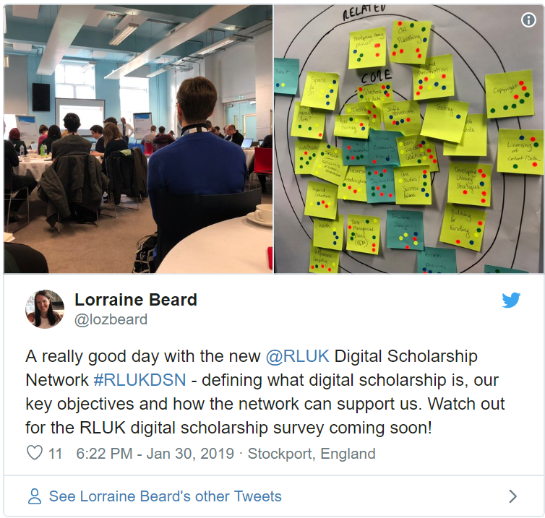
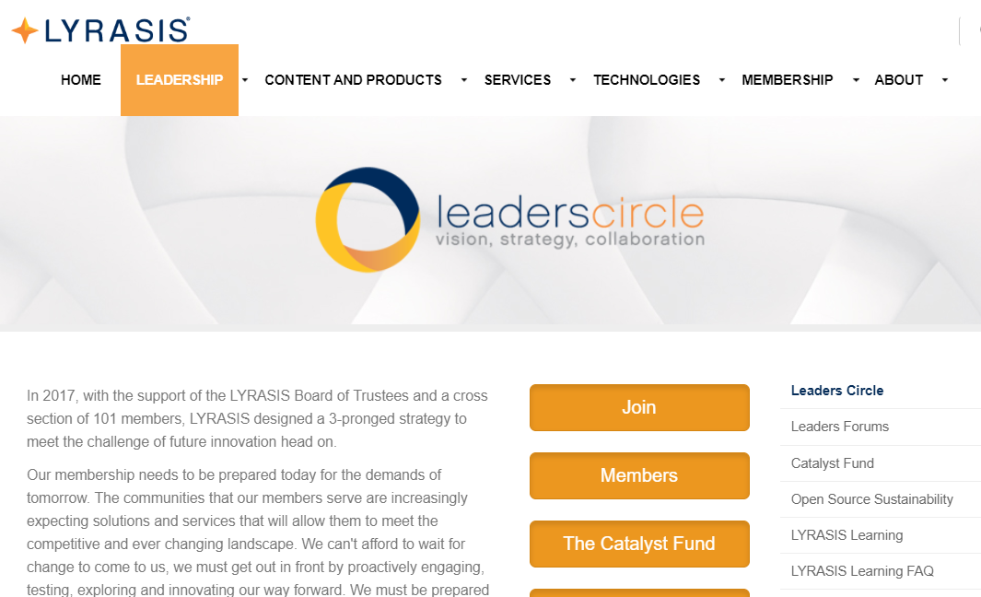

Slide 8
In rapidly changing environments, it’s important to realize that tacit knowledge trumps explicit knowledge. …
Tacit knowledge becomes accessible through shared practice
… By working together, we also develop deeper, trust-based relationships that create a safer environment for us to explore new insights with others in our group that we have a hard time expressing to ourselves.
John Hagel

Slide 9
Learning:
Soft power of existing networks
… networking
… discuss direction
… 'pool uncertainty’
… shared practices
… communities of practice
… peer learning
Scaling learning

Slide 10
Scaling capacity
Scaling learning
Scaling innovation
Scaling influence

Slide 12
Negotiation and licensing
Negotiation and licensing
Negotiation and licensing
Shared Print Collections
Shared Print Collections
Shared D2D
Shared D2D
Shared D2D
Shared ILS
Shared ILS
Shared digital infrastructure
Shared digital infrastructure
Shared digital infrastructure
Shared Research Data Management

Slide 13
Collections: it’s complicated
Negotiation and licensing
Shared Print Collections
Shared D2D
“Acquired collection” becoming less central. Facilitated access to a network rich in scholarly and cultural materials.
Complex move to new publishing models and business models.
Publishers diversifying into scholarly productivity and workflow tools.
No single path to open access.
Licensing models under pressure.
Growing interest in collective approach to print management. New structures emerging.

Slide 14
Collection management and sharing: it’s complicated
Shared D2D
Shared ILS
Library service platforms – cloud based total collection management.
Group library service platforms
Integrated discovery and fulfilment across print, licensed, and open.
Shared electronic resource management

Slide 15
Digital infrastructure for scholarly and cultural materials: it’s very complicated
Shared digital infrastructure
Shared Research Data Management
Evolving research infrastructure
Research data management
Research information management
Digital scholarship
Scholarly communication
Evolving digital infrastructure for cultural materials
At what scale?
Contested – publisher solutions
Disciplinary approaches
Preservation

Slide 16
From ….
To ….
Library | Library operations (metrics around collection, reference, …) | Community needs (research support, student success, community engagement)
Organization | Bureaucracy Well understood goals, perfect the means. | Enterprise Changing goals, reallocate the means.
Expertise | Subject, process | Partner in research and learning, creation, …
Systems | Back office | Workflow, digital scholarship, shared systems
Space | Configured around collections | Configured around user experiences
Collections | Acquired (just in time); Central; Institutional; Consumption. | Facilitated (just in case); One service among others; Collective; Creation.

Slide 17
Scope

Slide 18
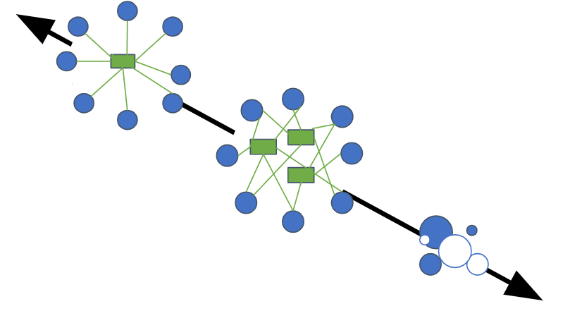
Consolidation
Integrated user experience
Ease of management
Reduced coordination costs
Consortial agency
Local optimization
Close to the user
Control of costs
Pragmatic
Institutional agency
Cooperation
(autonomy)
Degrees of coordination: tradeoff between autonomy and consolidation

Slide 19
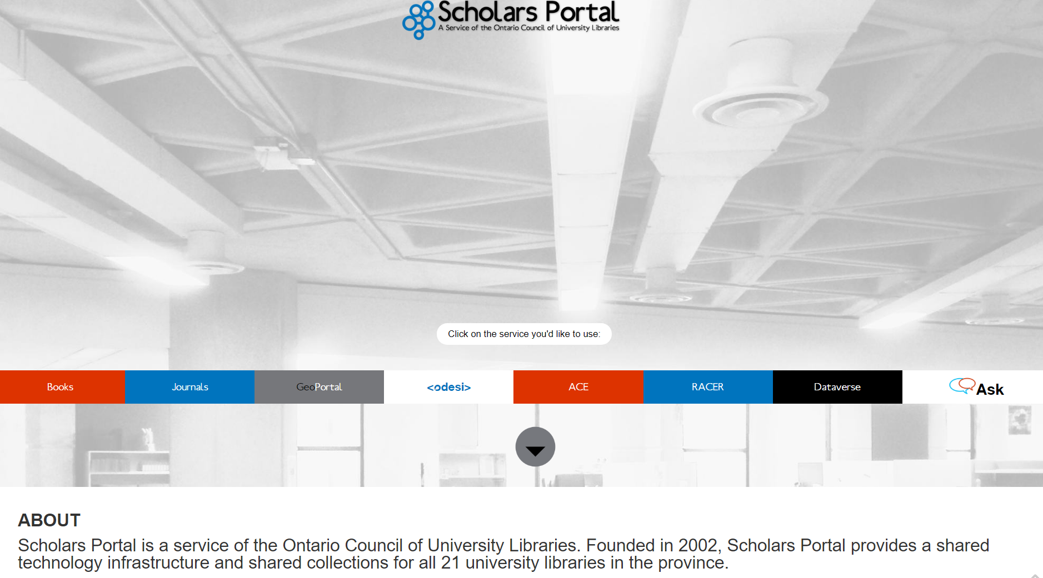
Scaling capacity
Scaling capacity

Slide 20
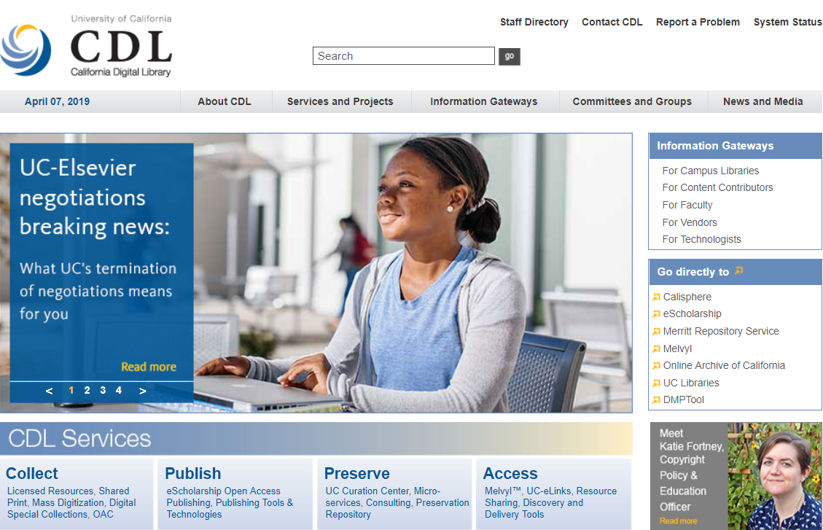
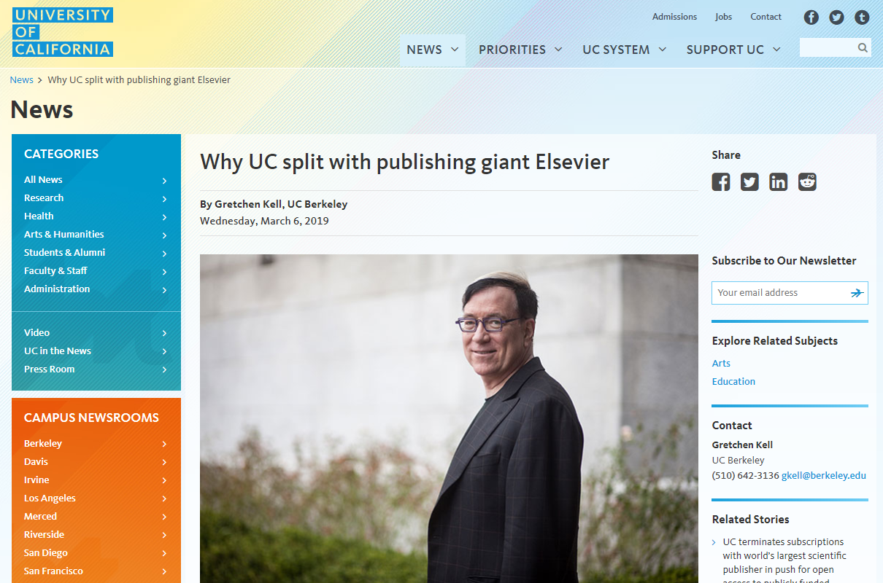
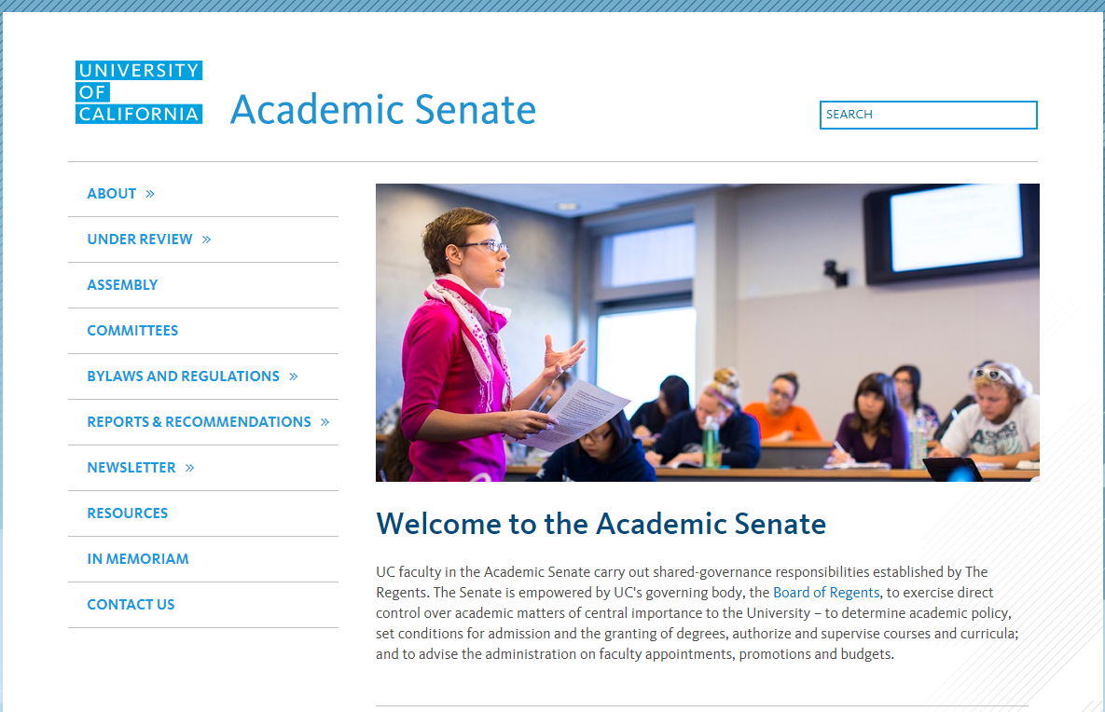
UC: Shared capacity and organizational alignment
BTAA and Ivy Plus? A gathering of independent organizations

Slide 21
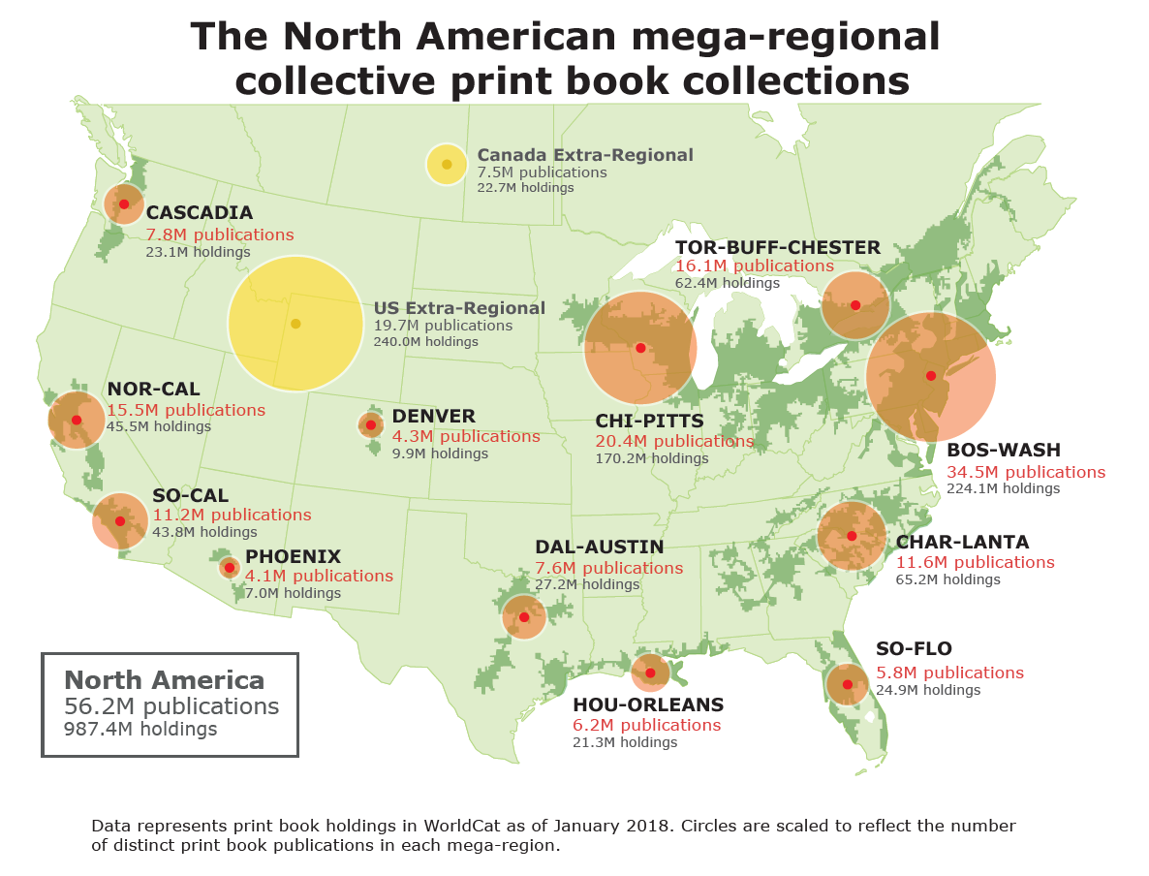

Slide 22
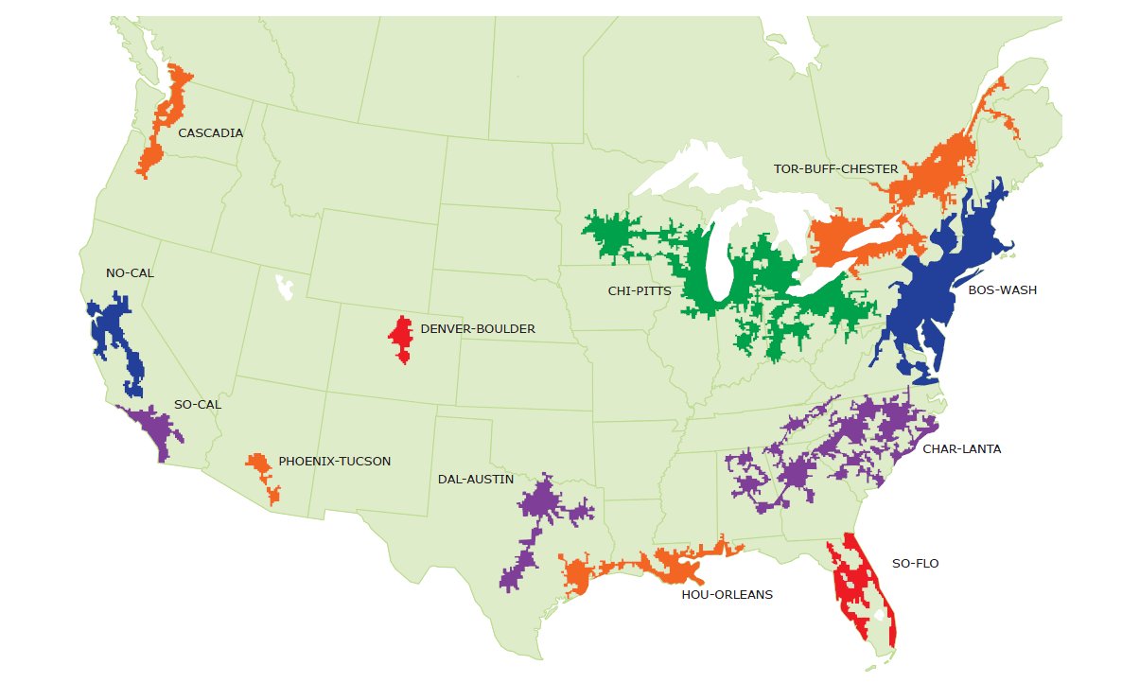
Collective collections: Coverage
(Distinct print publications; excludes gov. docs & theses/dissertations)
Ivy Plus: 19.5m
Chi-Pitts: 21.5m
BTAA coverage
of Ivy Plus:
46%
BTAA coverage
of Chi-Pitts:
53%
BTAA: 13.0m
BTAA: 13.0m
As of January 2019

Slide 23
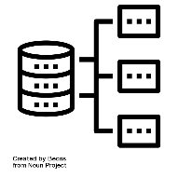
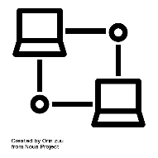
15 libraries
6 library management systems
26 resource sharing networks
6 discovery interfaces
7 shared print programs
5+ resource sharing platforms

Slide 24
NN/LM GMR
Current ecosystem
ALI

Slide 26
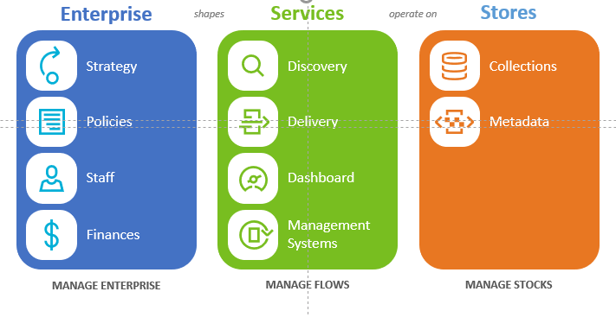
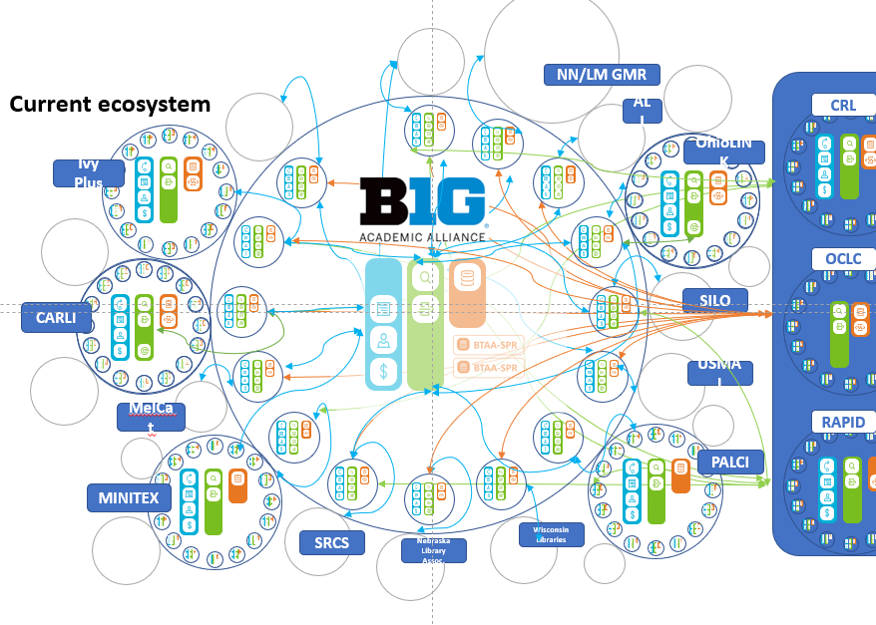
Coordination costs are high – Amazon like fulfilment?

Slide 27
Integrated user experience
Ease of management
Reduced coordination costs
Consortial agency
Trade-offs:
Efficiency vs control?
Systemwide vs local optimization?
Reengineering vs retrofitting?
Ideal vs pragmatic?
Local optimization
Close to the user
Control of costs
Pragmatic
Institutional agency
Degrees of coordination: tradeoff between autonomy and consolidation

Slide 28
Collective action
Even where collaboration around goals is beneficial, institutional interests and incentives aren’t always aligned.
Service needs are diversifying … coordination more difficult.
Scaling
capacity:
some
systemwide
challenges
Too much and not enough
Major investment in consortial activity.
Need to collaborate less (more strategic)
Need to collaborate more (new needs)
Unorganized proliferation may not be meeting needs
Network level: collaboration and scaling
Network favors scale
Cross consortium collaboration is hard

Slide 29
Collective action
Even where collaboration around goals is beneficial, institutional interests and incentives aren’t always aligned.
Service needs are diversifying … coordination more difficult.
Scaling
capacity:
some
systemwide
challenges
Prospective collection development
Too much and too little
Need to collaborate more (new needs)
Need to collaborate less (existing structures not always the right ones)
Unorganized proliferation
Network level: collaboration and scaling
Network favors scale
Cross consortium collaboration is hard
Shared print
Scholary communication, preservation

Slide 30
Organization:
consortium leadership
Personalities and politics
Exec director – leadership and followership
Library leadership turnover/founders retire – continued buyin
Different perspectives on tradeoffs between autonomy and consolidation
Trust – soft power?
Personal relationships
Shared history
Facilitates quicker decision-making and evolution

Slide 31
Positions of influence and fiduciary responsibility.
Special responsibility to be careful stewards of community resources and expectations.
Consider the scope and role of existing groups as well as their relationships to other groups.
Caution about setting up new organizations which are not strongly motivated by need or community gaps.
Organization:
library leaders

Slide 32
Organization:
library strategy
Library strategy
Recognizing where the impulse to local control may be a barrier to longer term progress.
Collaboration is as much about strategic choices as are internal library operations, and should be approached with the same discipline.

Slide 33
Scaling capacity
Scaling learning
Scaling innovation
Scaling influence
Institutional innovation a major challenge for libraries.
Consortia have a major role – but also need to evolve.
Scale learning and innovation to help libraries evolve.
Scale capacity to help libraries increase efficiency and impact.

Slide 34
Thank you!
Library consortia: scale, opportunity, challenge
Lorcan Dempsey, OCLC @LorcanD

