Slide 1
New Ways of Seeing: Understanding Individuals on their Terms
Lynn Silipigni Connaway, PhD
Director of Library Trends and User Research, OCLC
connawal@oclc.org
@LynnConnaway

Slide 2

Image: https://www.flickr.com/photos/75279887@N05/6886478111 by luckey_sun / CC BY-SA 2.0
When put on the spot and asked to define “research,” what would you say?
Notes:
Image: https://www.flickr.com/photos/75279887@N05/6886478111 by luckey_sun / CC BY-SA 2.0

Slide 3
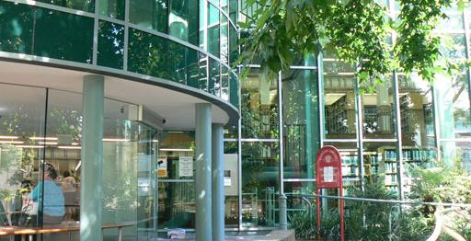
(Connaway & Radford, 2017)
“Much of the library-related research has been applied research dealing with everything from evaluating e-collections, to assessment of reference services, to analyzing integrated library systems.”
Image: https://commons.wikimedia.org/wiki/File:Stanton_Library_front2008.jpg by Orderinchaos / CC BY-SA 3.0
Notes:
Image: https://commons.wikimedia.org/wiki/File:Stanton_Library_front2008.jpg by Orderinchaos / CC BY-SA 3.0 (Stanton Library, North Sydney)
Two types of research:
Basic:
“deriv[es] new knowledge and is at most only indirectly involved with how that knowledge will be applied to specific, practical, or real problems” (Connaway & Radford, 2017)
Produces generalizable findings; can be applied to a larger population than the sample
Applied:
Solves specific problems in real situations
Majority of LIS research
Basic and applied research are not dichotomous
Connaway, L. S., & Radford, M. L. (2017). Research Methods for Library and Information Science, 6th ed. Westport, CT: Libraries Unlimited.

Slide 4
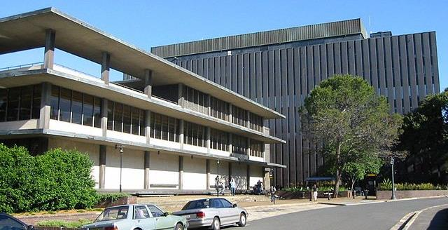
Image: https://commons.wikimedia.org/wiki/File:Fisher_Library,_University_of_Sydney.JPG by James Foster / CC BY-SA 3.0
Method: “Any procedure employed to attain a certain end” (e.g., focus groups)
Methodology: “A study of the plans which are used to obtain knowledge”
(Runes, 2001, 346)
(Polkinghorne, 1983, 5)
Notes:
Image: https://commons.wikimedia.org/wiki/File:Fisher_Library,_University_of_Sydney.JPG by James Foster / CC BY-SA 3.0 (Fisher Library, University of Sydney)
Methods and methodology:
Methods and methodology often used interchangeably when that’s not the case
Method:
“Any procedure employed to attain a certain end” (Runes, 2001, 346)
End is the data to be gathered and method is the means by which data is gathered
Quantitative (numbers), qualitative (participant accounts), mixed methods (e.g., combination of quant and qual)
Methodology:
Broader term than method
“A study of the plans which are used to obtain knowledge” as defined by (Polkinghorne, 1983, 5)
Strategies surrounding the use of multiple methods to achieve higher degrees of reliability and validity
Runes, D. D. (Ed.). (2001). The dictionary of philosophy. New York, NY: Citadel Press.
Polkinghorne, D. (1983). Methodology for the human sciences: Systems of inquiry. Albany, NY: State University of New York Press.
Connaway, L. S., & Radford, M. L. (2017). Research Methods for Library and Information Science, 6th ed. Westport, CT: Libraries Unlimited.

Slide 5
Most widely used research methods in LIS
Notes:
What do you think the most widely used data collection method was from 1950-1975?

Slide 6
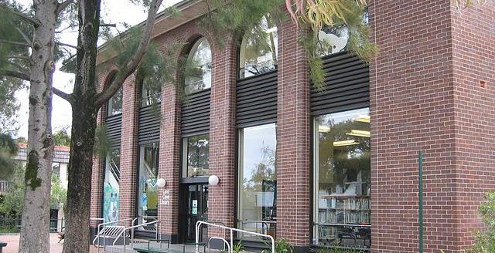
Image: https://commons.wikimedia.org/wiki/File:Lane_Cove,_New_South_Wales_Library.jpg by John Rotenstein / Public Domain
“The LIS field is maturing in terms of research method selection and application in that a greater number and wider variety of research methods are used in all the research publications this study examines…Scholars are no longer limited to the research methods traditionally applied in LIS explorations…"
(Chu, 2015, 40)
Notes:
Image: https://commons.wikimedia.org/wiki/File:Lane_Cove,_New_South_Wales_Library.jpg by John Rotenstein / Public Domain (Lane Cove Library, New South Wales, Australia)
Current landscape
“The LIS field is maturing in terms of research method selection and application in that a greater number and wider variety of research methods are used in all the research publications this study examines…Scholars are no longer limited to the research methods traditionally applied in LIS explorations (e.g., questionnaire and historical method)" (Chu, 2015, 40).
Chu, H. (2015). Research Methods in Library and Information Science: A Content Analysis. Library & Information Science Research 37(1), 36-41.

Slide 7
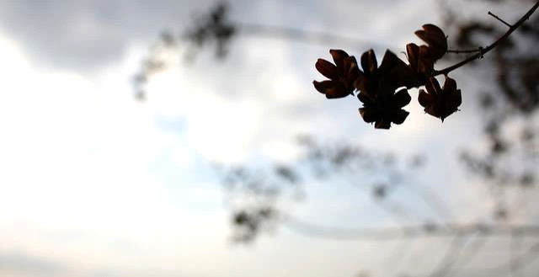
Survey research is one of the most popular methods used in the LIS literature.
(Case & Given, 2016)
Image: https://www.flickr.com/photos/courtneymcgough/3267225383 by Courtney McGough / CC BY-NC-ND 2.0
Notes:
Image: https://www.flickr.com/photos/courtneymcgough/3267225383 by Courtney McGough / CC BY-NC-ND 2.0
Case, D. O., & Given, L. S. (2016). Looking for information: A survey of research on information seeking, needs, and behaviour. Bingley, UK: Emerald.

Slide 8

Qualitative and mixed-method studies are not as prevalent in information behavior studies but demonstrate a greater variety of research strategies and data collection techniques.
(Matusiak, 2017; McKechnie et al., 2002)
Image: https://www.flickr.com/photos/stewdean/3801630111 by Stew Dean / CC BY-NC 2.0
Notes:
Image: https://www.flickr.com/photos/stewdean/3801630111 by Stew Dean / CC BY-NC 2.0
Matusiak, K. K. (2017). Studying information behavior of image users: An overview of research methodology in LIS literature, 2004-2015. Library and Information Science Research 39 (1), 53–60.
McKechnie, L. M., Baker, L., Greenwood, M., & Julien, H. (2002). Research method trends in human information behaviour literature. The New Review of Information Behaviour Research: Studies of Information Seeking in Context (Proceedings of ISIC 2002), 3, 113-125.

Slide 9
Research Papers by Methodology & Year
Methodology | 1950 | 1960 | 1965 | 1970 | 1975 | Total* | %*
Theoretical-analytical | 11 | 17 | 11 | 36 | 52 | 127 | 14
Information system design | 7 | 16 | 21 | 57 | 49 | 150 | 17
Surveys on the public | 3 | 2 | 9 | 20 | 19 | 53 | 3
Survey or experiment on libraries, etc. | 22 | 15 | 45 | 89 | 113 | 284 | 32
Bibliometric and similar studies | 0 | 1 | 7 | 14 | 16 | 38 | 4
Content analysis | 0 | 1 | 2 | 1 | 3 | 7 | 1
Secondary analysis | 6 | 15 | 15 | 13 | 27 | 76 | 8
Historical methodologies | 21 | 26 | 25 | 49 | 42 | 163 | 18
Descriptive bibliography | 7 | 4 | 6 | 4 | 9 | 30 | 3
Comparative studies | 0 | 2 | 6 | 4 | 7 | 19 | 2
Other and multiple | 3 | 1 | 7 | 9 | 10 | 30 | 3
All papers* | 76 | 96 | 139 | 274 | 315 | 900 | 100
(Powell, 1999)
Notes:
*Note: The figures add to more than the total number of papers (and the percentages add to more than 100), since a paper may have more than one methodology
Table (2) from Powell, 1999
Powell, R. (1999). Recent Trends in Research: A Methodological Essay. Library & Information Science Research 21(1), 91-119.

Slide 10
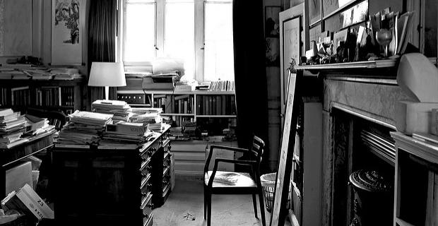
Research Methods: JDoc 2001-2010
N=367
Theoretical approach, 38%
Content analysis, 14%
Questionnaire, 13.8%
Experiment, 13.4%
Interview, 13.4%
(Chu, 2015)
Image: https://www.flickr.com/photos/jaypeg/3658793747 by Jaypeg / CC BY-NC 2.0
Notes:
Image: https://www.flickr.com/photos/jaypeg/3658793747 by Jaypeg / CC BY-NC 2.0
“The LIS field is maturing in terms of research method selection and application in that a greater number and wider variety of research methods are used in all the research publications this study examines. All the methods reported in the 1162 scholarly publications in a sense constitute a toolbox of research methods. Scholars are no longer limited to the research methods traditionally applied in LIS explorations (e.g., questionnaire and historical method). Researchers can instead choose research methods from this expanded toolbox according to their study objectives” (Chu, 2015, p. 40).
Chu, H. (2015). Research Methods in Library and Information Science: A Content Analysis. Library & Information Science Research 37(1), 36-41.

Slide 11
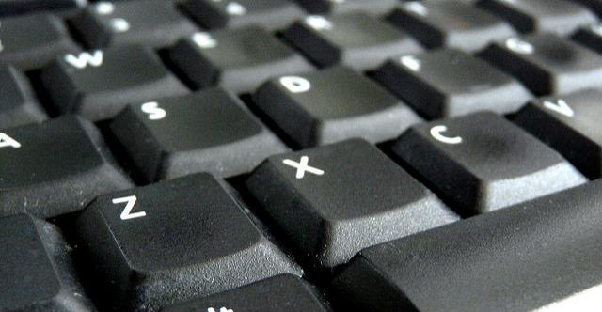
Research Methods: JASIS&T 2001-2010
N=554
Experiment, 31%
Bibliometrics, 23%
Questionnaire, 14%
Content analysis, 13%
Theoretical approach, 12%
(Chu, 2015)
Image: https://www.flickr.com/photos/judy-van-der-velden/5588900332 by Judy van der Velden / CC BY-NC-ND 2.0
Notes:
Image: https://www.flickr.com/photos/judy-van-der-velden/5588900332 by Judy van der Velden / CC BY-NC-ND 2.0
Chu, H. (2015). Research Methods in Library and Information Science: A Content Analysis. Library & Information Science Research 37(1), 36-41.

Slide 12
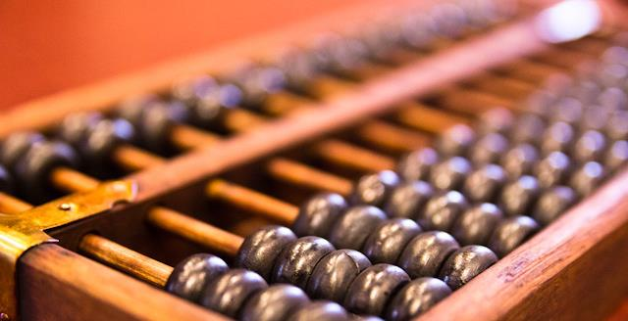
Research Methods: LISR 2001-2010
N=241
Content analysis, 30%
Questionnaire, 28%
Interview, 20%
Theoretical approach, 15%
Experiment, 9%
(Chu, 2015)
Image: https://www.flickr.com/photos/stevendepolo/6752594589 by Steven Depolo / CC BY 2.0
Notes:
Image: https://www.flickr.com/photos/stevendepolo/6752594589 by Steven Depolo / CC BY 2.0
Chu, H. (2015). Research Methods in Library and Information Science: A Content Analysis. Library & Information Science Research 37(1), 36-41.

Slide 13
Research Methods: JAL 2004-2013
Method | Percentage (n=346)
Questionnaire | 47.6
Test or Quiz | 2.6
Diary | 0.6
Content Analysis | 27.2
Semi-structured Interviews | 14.0
Analysis of existing statistics | 6.6
Citation Analysis | 6.3
Focus Group Interview | 5.7
Observation | 4.3
Log Analysis | 3.4
Task Analysis | 2.9
(Luo & McKinney, 2015)
Notes:
Questionnaire: a standard survey questionnaire, 47.6
A test or quiz in the questionnaire format, usually used in experimental or quasi-experimental deign, 2.6
Diary, a type of self-administered questionnaire often used to record frequent or contemporaneous events or experiences, 0.6
Content analysis, 27.2
Semi-structured or in-depth interview, 14.0
Analysis of existing statistics (e.g. results from previous surveys, or circulation statistics), 6.6
Citation analysis, 6.3
Focus group interview, 5.7
Observation, including both quantitative and qualitative observation, 4.3
Log analysis, 3.4
Task analysis — the analysis of the completion of search tasks, 2.9
Luo, L., & McKinney, M. (2015). JAL in the Past Decade: A Comprehensive Analysis of Academic Library Research. The Journal of Academic Librarianship 41(2),123-129.

Slide 14
Research Methods by Popularity, 2010-2015
Method | Percentage (n=2460)
Bibliometrics | 16.6
Other Methods | 12.8
Theoretical Approach | 10.3
Questionnaire | 10.3
Content Analysis | 8.0
Mixed Methodology | 6.6
Webometrics | 5.4
Big data, TDM | 4.9
Interview | 3.7
Experiment | 2.6
Not mentioned | 14.5
(Jasiewicz, J., In press)
Notes:
Methodology of articles published in top LIS research journals, as determined by analysis of article abstracts.
Jasiewicz, J. (In Press). Social science research methods in library science between 2010 and 2015. A bibliometric analysis.

Slide 15
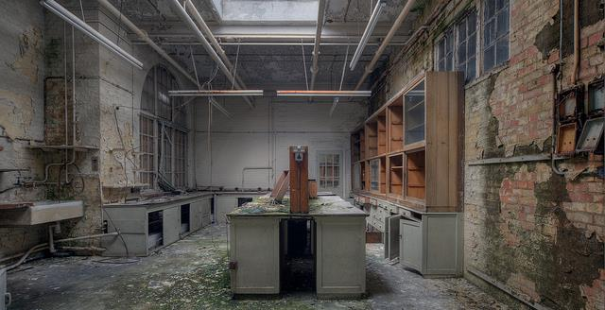
Image: https://www.flickr.com/photos/howzey/7386743932 by Paul / CC BY-NC-ND 2.0
Methods Mentioned Less than 1%
Historical method (1.0%)
Observation (0.8%)
Ethnography/field study (0.8%)
Focus groups (0.6%)
Transaction log analysis (0.3%)
Delphi study (0.3%)
Research diary/Journal (0.2%)
Think aloud protocol (0.1%)
n=2460
(Jasiewicz, J., In press)
Notes:
Image: https://www.flickr.com/photos/howzey/7386743932 by Paul / CC BY-NC-ND 2.0
Methodology of articles published in top LIS research journals, as determined by analysis of article abstracts.
Jasiewicz, J. (In Press). Social science research methods in library science between 2010 and 2015. A bibliometric analysis.

Slide 16
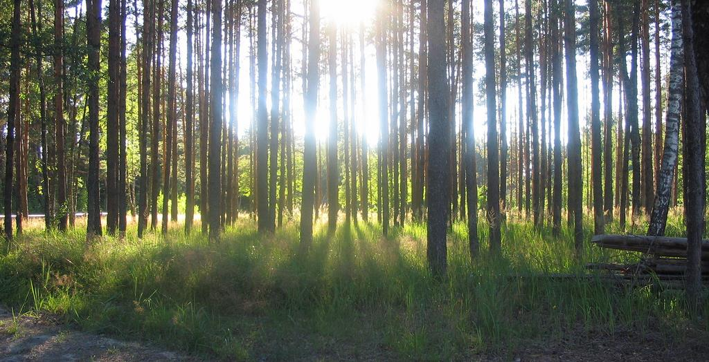
“To identify how and why people get information, it is necessary first to listen.”
(Connaway, 2017)
Image: https://www.flickr.com/photos/pjotr_savitski/2701378287 by Pjotr Savitski / CC BY 2.0
Notes:
Image: https://www.flickr.com/photos/pjotr_savitski/2701378287 by Pjotr Savitski / CC BY 2.0
“Unless we understand students’ lives, we will not be able to fit within their natural information flows. Opportunities become clearer when we begin by simply walking on campus, sitting in on classes, and strolling through the library, student centers, and other campus locations. These actions allow librarians to observe, listen, and note how students and faculty are communicating, studying, learning, teaching, and interacting in everyday life situations.“
Connaway, L. S. (2017, June 19). Putting the library in the life of the user: Listen, then lead, to promote a unique and compelling role for academic libraries. Guest of Choice, Choice360 blog. Retrieved from http://www.choice360.org/blog/putting-the-library-in-the-life-of-the-user

Slide 17
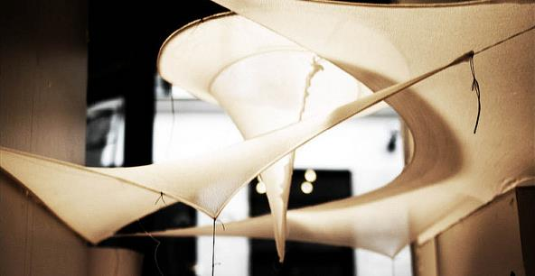
Information Behaviour Research Methods: JASIST, Information Research 2012-2013 JDOC, iConference Proceedings 2013-2014
Interviews, 51
Surveys, 34
Content Analysis, 28
(Greifeneder, 2014)
Image: https://www.flickr.com/photos/hdaparis/11288970914 by Hugh Dutton Associes / CC BY-NC-ND 2.0
Notes:
Image: https://www.flickr.com/photos/hdaparis/11288970914 by Hugh Dutton Associes / CC BY-NC-ND 2.0
Greifeneder, E. (2014). Trends in information behaviour research. In Proceedings of ISIC, the Information Behaviour Conference, Leeds, 2-5 September, 2014: Part 1. http://InformationR.net/ir/19-4/isic/isic13.html
“Forty-five percent of all studies in the sample applied a mixed-method approach.”
“Only 11 studies (7%) combined more than two methods. 69% of mixed-method approaches were a qualitative-qualitative combination and 31% were a quantitative-qualitative combination. Not a single study combined a quantitative with another quantitative method.”
“Interviews, surveys and content analyses were the most frequently used methods in the last years. It was also obvious that traditional qualitative research, making use of interviews, observations, focus groups or diaries (marked in blue in figure 1) still dominate information behaviour research. Anderson's expectation that these methods will vanish was clearly proven wrong.”

Slide 18
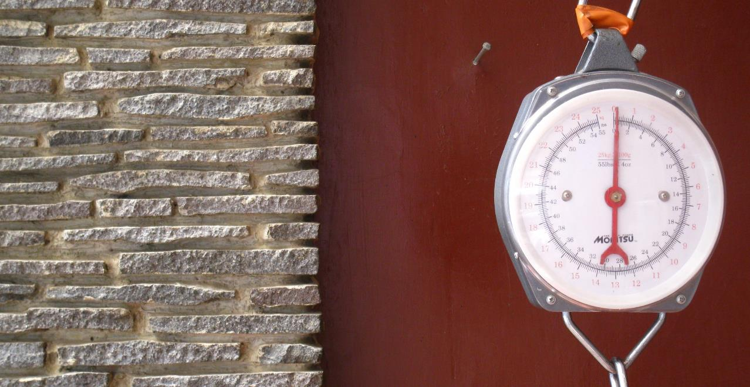
Information Behaviour Research Methods: JASIST, Information Research 2012-2013 JDOC, iConference Proceedings 2013-2014
Methods used less than five times:
Delphi studies (Poirier & Robinson, 2014)
Eye-tracking (e.g. Balatsoukas & Ruthven, 2012; Wildemuth, 2009)
Log file analysis (Jiang, 2014)
Participatory designs
(Greifeneder, 2014)
Image: https://www.flickr.com/photos/ikhlasulamal/4538617347 by Ikhlasul Amal / CC BY-NC 2.0
Notes:
Image: https://www.flickr.com/photos/ikhlasulamal/4538617347 by Ikhlasul Amal / CC BY-NC 2.0
Greifeneder, E. (2014). Trends in information behaviour research. In Proceedings of ISIC, the Information Behaviour Conference, Leeds, 2-5 September, 2014: Part 1. http://InformationR.net/ir/19-4/isic/isic13.html
“Forty-five percent of all studies in the sample applied a mixed-method approach.”
“Only 11 studies (7%) combined more than two methods. 69% of mixed-method approaches were a qualitative-qualitative combination and 31% were a quantitative-qualitative combination. Not a single study combined a quantitative with another quantitative method.”
“Interviews, surveys and content analyses were the most frequently used methods in the last years. It was also obvious that traditional qualitative research, making use of interviews, observations, focus groups or diaries (marked in blue in figure 1) still dominate information behaviour research. Anderson's expectation that these methods will vanish was clearly proven wrong.”

Slide 19
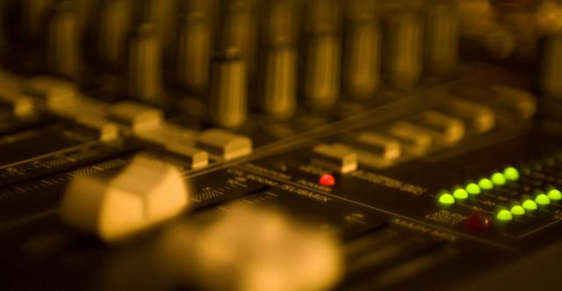
Information Behaviour Research Methods: JASIST, Information Research 2012-2013 JDOC, iConference Proceedings 2013-2014
Mixed Methods, 45%
More than two methods, 7%
Qualitative-Qualitative, 69%
Quantitative-Qualitative, 31%
Quantitative-Quantitative, 0%
(Greifeneder, 2014)
Image: https://www.flickr.com/photos/viatorci/3176779507 by David Torcivia / CC BY 2.0
Notes:
Image: https://www.flickr.com/photos/viatorci/3176779507 by David Torcivia / CC BY 2.0
Greifeneder, E. (2014). Trends in information behaviour research. In Proceedings of ISIC, the Information Behaviour Conference, Leeds, 2-5 September, 2014: Part 1. http://InformationR.net/ir/19-4/isic/isic13.html
“Forty-five percent of all studies in the sample applied a mixed-method approach.”
“Only 11 studies (7%) combined more than two methods. 69% of mixed-method approaches were a qualitative-qualitative combination and 31% were a quantitative-qualitative combination. Not a single study combined a quantitative with another quantitative method.”
“Interviews, surveys and content analyses were the most frequently used methods in the last years. It was also obvious that traditional qualitative research, making use of interviews, observations, focus groups or diaries (marked in blue in figure 1) still dominate information behaviour research. Anderson's expectation that these methods will vanish was clearly proven wrong.”

Slide 20
Define the problem

Slide 21
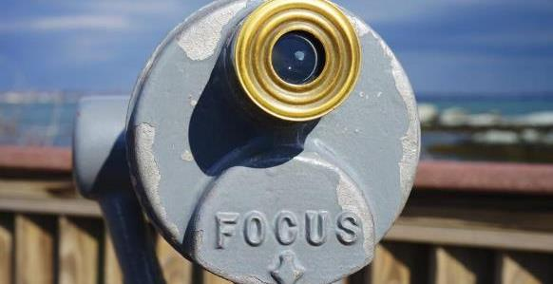
Define the problem
Image: https://www.flickr.com/photos/iain/13298441884 by Iain Farrell / CC BY-ND 2.0
User in context
Community perspective
Ask the right question(s)
Notes:
Image: https://www.flickr.com/photos/iain/13298441884 by Iain Farrell / CC BY-ND 2.0
First step in the process is about defining the problem, which is about finding focus.
We’re talking about ethnography today, so you shouldn’t be surprised to see that our focus is the user.
In this step, we want to learn about users and our communities.
And we need to figure out what questions to ask.

Slide 22
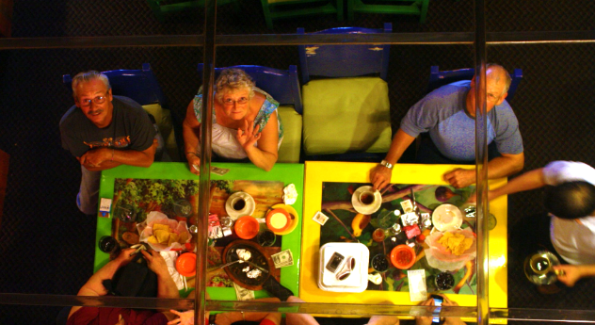
Image: https://www.flickr.com/photos/sugarhiccuphiccup/4843083598 by Troy Tolley / CC BY-ND 2.0
Define the problem: User in context
Notes:
Image: https://www.flickr.com/photos/sugarhiccuphiccup/4843083598 by Troy Tolley / CC BY-ND 2.0
It should be obvious to be thinking about users, but…
Because we’re thinking about libraries and library service all the time, it’s easy to become too focused on ourselves, our organizations and our processes.
We want to serve our patrons, our students, our customers, so we need to FOCUS on them.
Don’t forget about the context!
People exist in complex contexts – they have different families and traditions, backgrounds and challenges – and, as a result, have different needs, perspectives and behaviors.
As we’re developing our focus, we want to be thinking about how we can learn about people and their lives.

Slide 23
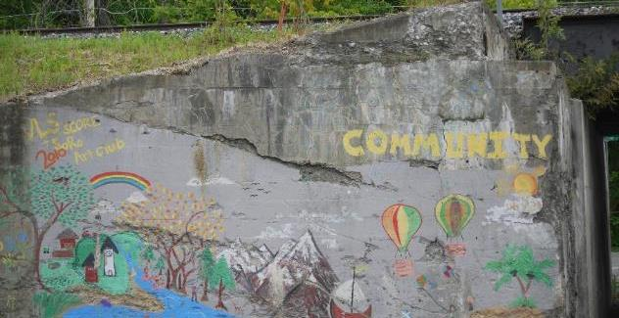
Define the problem: Community perspective
Image: https://www.flickr.com/photos/grongar/8736701984 by Rebecca Siegel / CC BY 2.0
Notes:
Image: https://www.flickr.com/photos/grongar/8736701984 by Rebecca Siegel / CC BY 2.0
People have their personal contexts, but also their community contexts
Other services – e.g., rec centers, museums, parks
Social issues – e.g., opioid crisis
Political issues – e.g., funding issues
What is going on in the community? How are community issues impacting people’s lives? Where does the library fit in?
Also, coming from a public library perspective, we offer so many services and most people only use a small sample of what we offer
Upper middle class folks don’t use free printing for job seekers
Empty-nesters don’t come to story times
If we focus only on what people PERSONALLY value, we’re only seeing part of the story.
If we focus on what is of value to the community as a WHOLE, those upper middle class folks and empty nesters probably support free resume printing and storytimes.

Slide 24
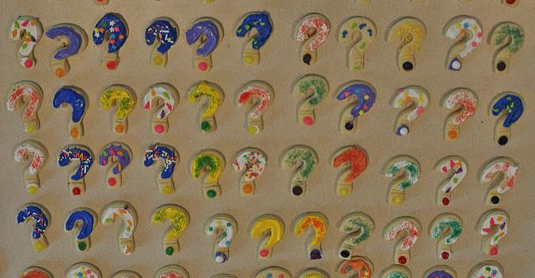
Define the problem: Ask the right question(s)
Image: https://www.flickr.com/photos/mcleod/7150176087 by Scott McLeod / CC BY 2.0
Notes:
Image: https://www.flickr.com/photos/mcleod/7150176087 by Scott McLeod / CC BY 2.0
Here, as we’re defining the problem, you may be asking yourself questions like
when should we staff our reference desk?
how should we furnish our study rooms?
what topics should we focus on for programming?
what new services should we offer?
But these are NOT the right questions to pose to your users.
As much as we may wish it were so, the library is not the center of people’s lives.
You are a library expert.
You know about staffing models and limitations.
You know about the furniture Demco offers.
You hear about the buzz around wireless hotspots, or makerspaces or 3D printers.
Your users are the experts in their own lives.
Separate your overarching research question from the question(s) that you post to your users.
The right questions will focus on your audience in the context of their everyday lives and within your community. You should NOT be asking them how to do your job.
The idea of a “stupid question” sounds harsh, but I’m going to give you an example later of a stupid question I myself asked.

Slide 25
ACTIVITY
Practice Generating Questions

Slide 26
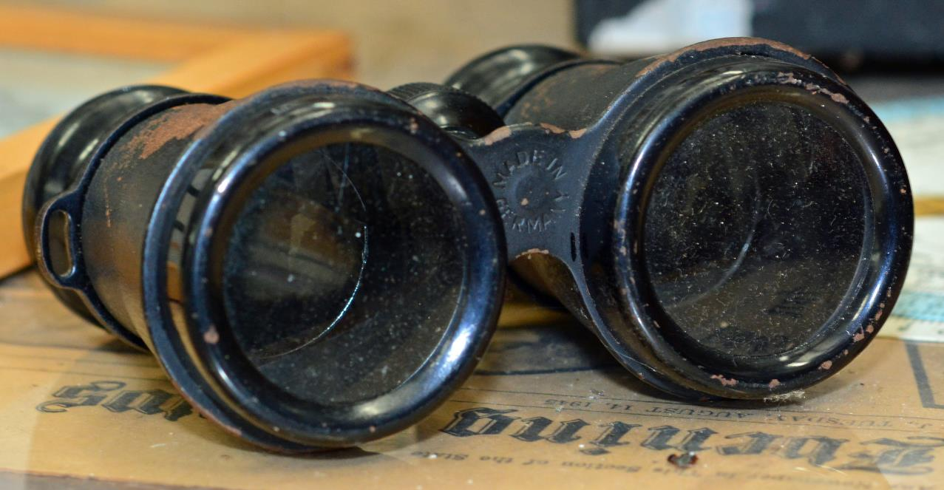
Ethnographic Research
“…a way of seeing how individuals interact and behave in situations by utilizing different qualitative data collection and analysis methods.”
(Connaway and Radford 2017, 263)
Image: https://www.flickr.com/photos/pmillera4/13570027834/ by Peter Miller / CC BY-NC-ND 2.0
Notes:
Image: https://www.flickr.com/photos/pmillera4/13570027834/ by Peter Miller / CC BY-NC-ND 2.0
“The study of the culture and social organisation of a particular group, as well as the published result of such study” (Khoo, Rozaklis, and Hall 2012, 83).
Because ethnographic methods focus on directly observing, recording, and explaining what people are doing in practice, they are a particularly good strategy for approaching difficult and complex questions like understanding the myriad ways people approach searching for information (Asher 2017, 263).
Asher, Andrew. 2017. “On Ethnographic Research: How do Students Find the Information They Need?” In Research Methods for Library and Information Science, 6th ed., edited by Lynn Silipigni Connaway and Marie L. Radford, 263. Westport, CT: Libraries Unlimited.
Connaway, Lynn Silipigni, and Marie L. Radford. 2017. Research Methods for Library and Information Science, 6th ed. Westport, CT: Libraries Unlimited.
Khoo, Michael, Lily Rozaklis, and Catherine Hall. 2012. “A Survey of the Use of Ethnographic Methods in the Study of Libraries and Library Users.” Library and Information Science Research 34, no. 2: 82-91.

Slide 27
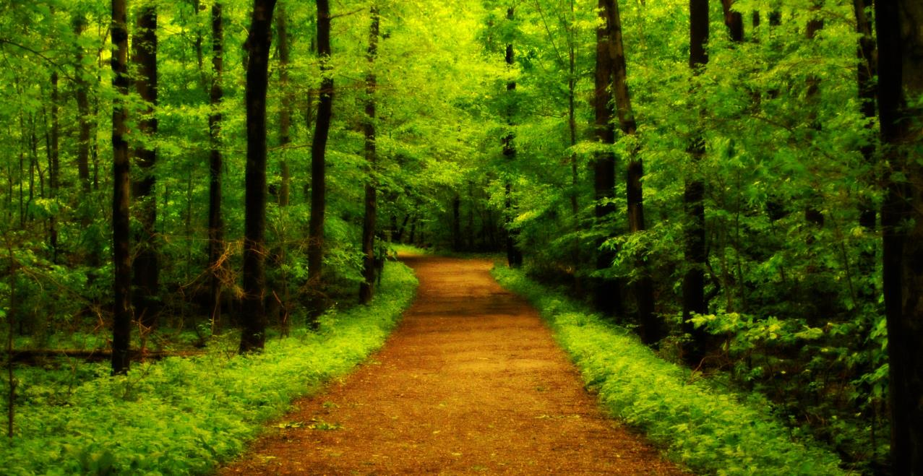
Qualitative Research Definition
A type of scientific research that:
Seeks answers to a question
Systematically uses predefined set of procedures to answer question
Collects evidence
Produces findings that:
Are not determined in advance
Apply beyond immediate boundaries of study
Image: https://www.flickr.com/photos/katesheets/5772901616/ by katesheets / CC BY-NC 2.0
Notes:
Image: https://www.flickr.com/photos/katesheets/5772901616/ by katesheets / CC BY-NC 2.0

Slide 28
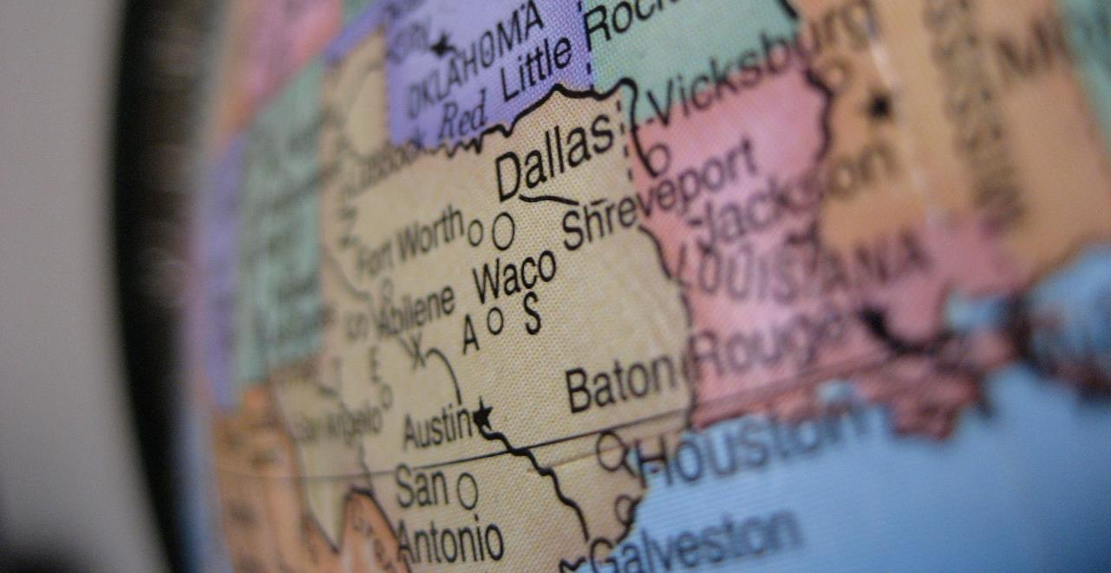
What is Qualitative Research?
“…a situated activity that locates the observer in the world. It consists of a set of interpretive, material practices that make the world visible. These practices transform the world. They turn the world into a series of representations, including field notes, interviews, conversations, photographs, recordings, & memos to the self.
At this level, qualitative research involves an interpretive, naturalistic approach to the world. This means that qualitative researchers study things in their natural settings, attempting to make sense of, or to interpret, phenomena in terms of the meanings people bring to them.”
(Denzin and Lincoln 2005)
Image: https://www.flickr.com/photos/ddrmaxgt37/387453140/ by Arun Venkatesan / CC BY-NC 2.0
Notes:
Image: https://www.flickr.com/photos/ddrmaxgt37/387453140/ by Arun Venkatesan / CC BY-NC 2.0
The content for this slide is from Marie L. Radford, Ph.D. qualitative research methods lecture notes.
Denzin, Norman K., and Yvonna S. Lincoln. 2005. The Sage Handbook of Qualitative Research, 4th ed. Thousand Oaks, CA: Sage Publications.

Slide 29
Ethnographic Data collection tools and methods: Interviews

Slide 30
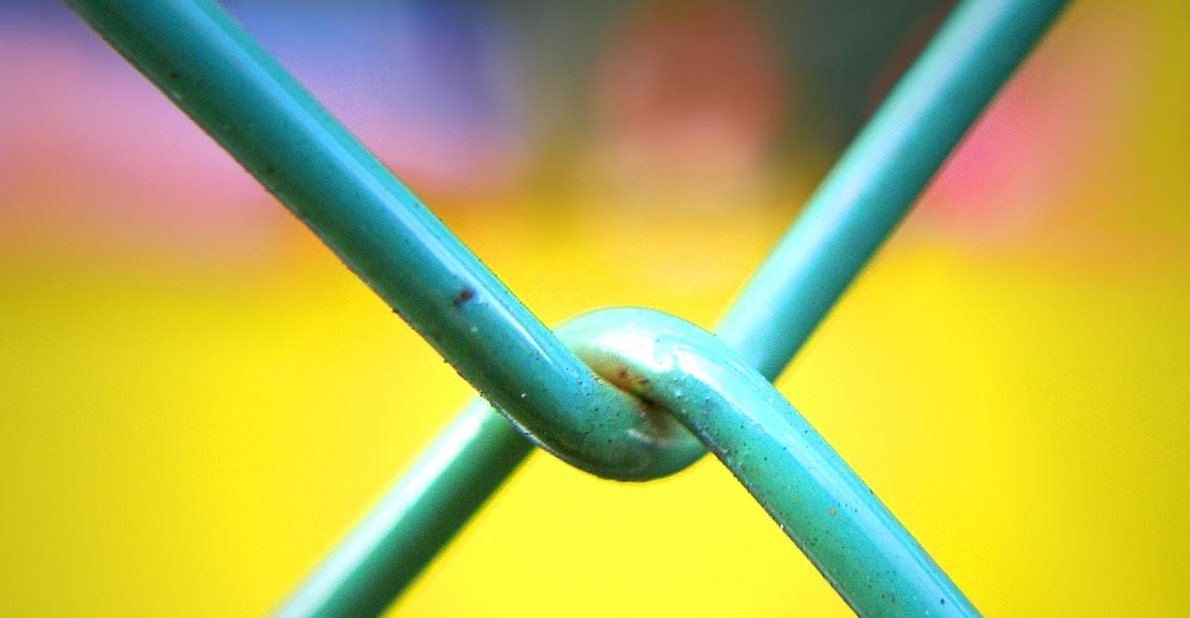
Ethnographic Data Collection
Interviews
Diaries
Observation
Usability Testing
Image: https://www.flickr.com/photos/28481088@N00/3091698923/ by tanakawho / CC BY-NC 2.0
Notes:
Image: https://www.flickr.com/photos/28481088@N00/3091698923/ by tanakawho / CC BY-NC 2.0
“For me, the power of ethnographic research derives from its synthetic approach of integrating multiple data sources to create interpretive understandings of social and cultural processes.”
~Andrew Asher, in Connaway & Radford (2017), page 264
Asher, Andrew. 2017. “On Ethnographic Research: How do Students Find the Information They Need?” In Research Methods for Library and Information Science, 6th ed., edited by Lynn Silipigni Connaway and Marie L. Radford, 264. Westport, CT: Libraries Unlimited.

Slide 31

Ethnographic Interviews
Incredibly detailed data
Time consuming
Establishing rapport
Selecting research participants
Transcribing observations & conversations
Image: https://www.flickr.com/photos/nordforsk/32225539214/ by NordForsk / CC BY-NC-ND 2.0
Notes:
Image: https://www.flickr.com/photos/nordforsk/32225539214/ by NordForsk / CC BY-NC-ND 2.0
Ethnographic interviews are immersive. Generally the interviewee is in their natural habitat. The interviewer is observing them in this habitat. The interviewer is asking pointed questions about what the respondent is doing and feeling. These are typically conducted one on one.
Connaway, L. S., & Radford, M. L. (2017). Research Methods for Library and Information Science, 6th ed. Westport, CT: Libraries Unlimited.
Khoo, M., Rozaklis, L., & Hall, C. (2012). A survey of the use of ethnographic methods in the study of libraries and library users. Library and Information Science Research, 34(2), 82-91.

Slide 32
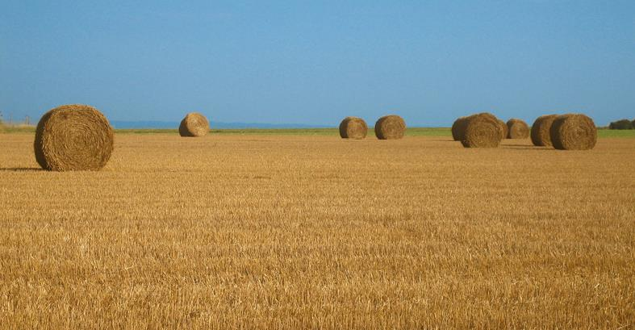
Conducting the Interview
Thematizing: Clarifying the interview’s purpose
Designing: Defining the interview’s purpose
Interviewing: Conducting the interview
Transcribing: Creating a written verbatim text of the interview
Analyzing: Figuring out the meaning of data
Verifying: Determining the reliability & validity of the data
Reporting: Telling others about the findings
(Connaway and Radford 2017, 244)
Image: https://www.flickr.com/photos/meanestindian/903380690/ by Meena Kadri / CC BY 2.0
Notes:
Image: https://www.flickr.com/photos/meanestindian/903380690/ by Meena Kadri / CC BY 2.0
“Thematizing: Clarifying the interview’s purpose and the concepts to be explored.
Designing: Defining the interview’s purpose and the concepts to be considerations.
Interviewing: Conducting the interview.
Transcribing: Creating a written verbatim text of the interview.
Analyzing: Figuring out the meaning of data in relation to the study’s research questions.
Verifying: Determining the reliability and validity of the data.
Reporting: Telling others about the findings.” (Connaway and Radford 2017, 244)
Connaway, Lynn Silipigni, and Marie L. Radford. 2017. Research Methods for Library and Information Science, 6th ed. Westport, CT: Libraries Unlimited.

Slide 33
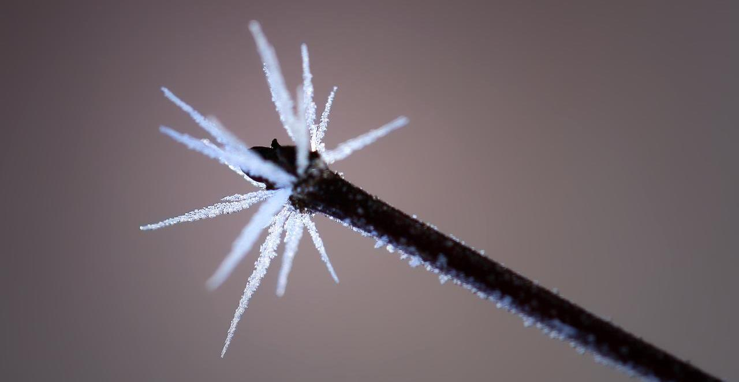
V&R Semi-Structured Interview Questions
5. Have there been times when you were told to use a library or virtual learning environment (or learning platform), and used other source(s) instead?
6. If you had a magic wand, what would your ideal way of getting information be? How would you go about using the systems and services? When? Where? How?
Image: https://www.flickr.com/photos/photophilde/4353228184 by photophilde / CC BY-SA 2.0
Notes:
Image: https://www.flickr.com/photos/photophilde/4353228184 by photophilde / CC BY-SA 2.0
1. Describe the things you enjoy doing with technology and the web each week.
2. Think of the ways you have used technology and the web for your studies. Describe a typical week.
3. Think about the next stage of your education. Tell me what you think this will be like.
4. Think of a time when you had a situation where you needed answers or solutions and you did a quick search and made do with it. You knew there were other sources but you decided not to use them. Please include sources such as friends, family, teachers, coaches, etc.
5. Have there been times when you were told to use a library or virtual learning environment (or learning platform), and used other source(s) instead?
6. If you had a magic wand, what would your ideal way of getting information be? How would you go about using the systems and services? When? Where? How?
White, David S., and Lynn Silipigni Connaway. 2011-2014. Visitors & Residents: What Motivates Engagement with the Digital Information Environment. Funded by JISC, OCLC, and Oxford University. http://www.oclc.org/research/activities/vandr/.

Slide 34
ACTIVITY
Interviewing & Listening Skills

Slide 35
ACTIVITY
Mapping the Hilton Sydney

Slide 36
Ethnographic Data collection tools and methods: diaries

Slide 37

Diaries
Keep directions minimal and open
Offer participants a variety of ways to report
Written
Photo
Video
Audio
Data can be rich and detailed, but is self-reported
Does not require researcher presence
(Connaway and Radford, 2017)
Image: https://www.flickr.com/photos/10154402@N03/8421806383 by Bruce Guenter / CC BY 2.0
Notes:
Image: https://www.flickr.com/photos/10154402@N03/8421806383 by Bruce Guenter / CC BY 2.0
Connaway, L. S., & Radford, M. L. (2017). Research Methods for Library and Information Science, 6th ed. Westport, CT: Libraries Unlimited.

Slide 38
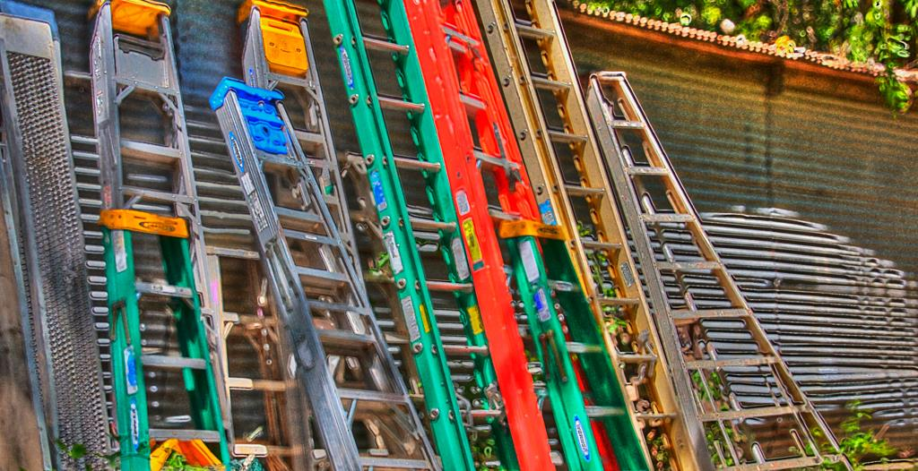
V&R Diary Template
Explain a time in the past month when you were SUCCESSFUL in completing an ACADEMIC assignment. What steps did you take?
Think of a time fairly recently when you struggled to find appropriate resources to help you complete an ACADEMIC assignment. What happened?
Notes:
Image: https://www.flickr.com/photos/elliotmar/8913124849 by Elliot Margolies / CC BY-NC-ND 2.0
Explain a time in the past month when you were SUCCESSFUL in completing an ACADEMIC assignment. What steps did you take?
Think of a time fairly recently when you struggled to find appropriate resources to help you complete an ACADEMIC assignment. What happened?
Explain a time in the past month when you were successful in getting what you needed in a PERSONAL situation. What steps did you take?
Explain a time in the past month when you were NOT successful in getting what you needed in a PERSONAL situation. What steps did you take?
Tell me something interesting that has happened in the past month in the social media that you used for ACADEMIC purposes.
Tell me something interesting that has happened in the past month in the social media that you used for PERSONAL situations.
What do you have to add to our discussion today about how you got information in the past month for both PERSONAL and ACADEMIC situations?
White, D. S., & Connaway, L. S. (2011-2014). Visitors & Residents: What Motivates Engagement with the Digital Information Environment. Funded by JISC, OCLC, and Oxford University. http://www.oclc.org/research/activities/vandr/.

Slide 39
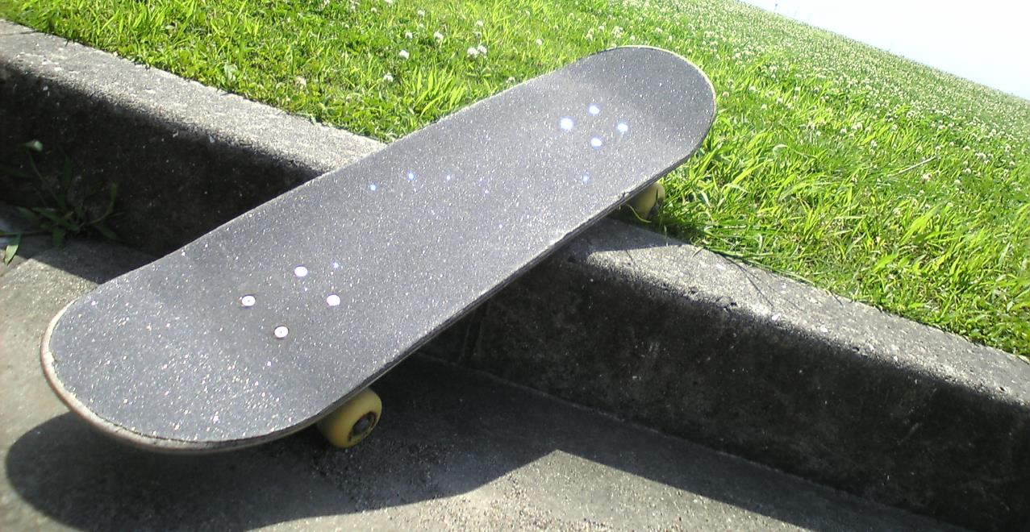
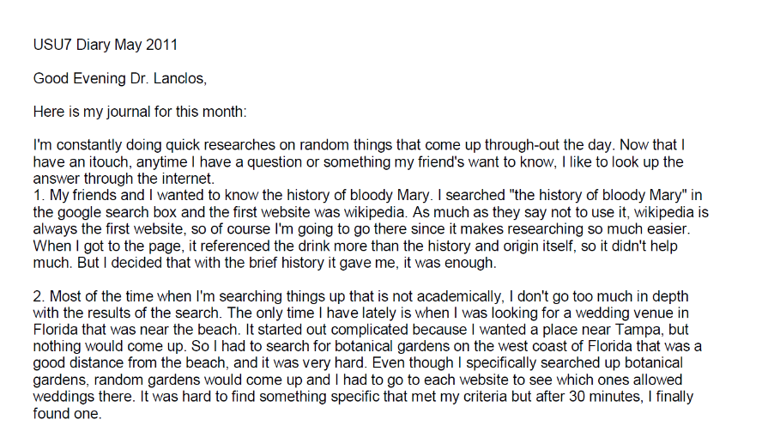
Example: Digital Visitors and Residents Diaries
Notes:
Image: https://www.flickr.com/photos/dancingpapa2007/3674686528 by Naoki Tomeno / CC BY 2.0
Screenshot: USU7 Emg Dry1 Ph1 (Digital Visitors and Residents, USU7, Female, Age 19)
“March was a little more serious. We’re nearing election time and all that jazz, and this is the first election I’ll be able to vote in, so I’ve been doing a bit of reading on a few of the candidates (not much, mind you). As a side note, I’m kind of debating whether or not I should actually vote in this election since I have such little knowledge on the candidates.” (Digital Visitors and Residents, USU12, Male, Age 19) USU12 Est Dry2 Ph2
“Um they do have a search box but I didn’t—I didn’t use that. Um I pretty much just, I pretty much just clicked links.” (Digital Visitors and Residents, USU12, Male, Age 19, 30:37) USU12 Est Follup Int1 Ph3
White, D. S., & Connaway, L. S. (2011-2014). Visitors & Residents: What Motivates Engagement with the Digital Information Environment. Funded by JISC, OCLC, and Oxford University. http://www.oclc.org/research/activities/vandr/.

Slide 40
V&R Diary Follow-Up Interviews
Explain a time in the past month when you were SUCCESSFUL in completing an ACADEMIC assignment. What steps did you take?
Think of a time fairly recently when you struggled to find appropriate resources to help you complete an ACADEMIC assignment. What happened?
Explain a time in the past month when you were successful in getting what you needed in a PERSONAL situation. What steps did you take?

Slide 41
LUNCH
Return at 13:00

Slide 42
Ethnographic Data collection tools and methods: Usability testing

Slide 43
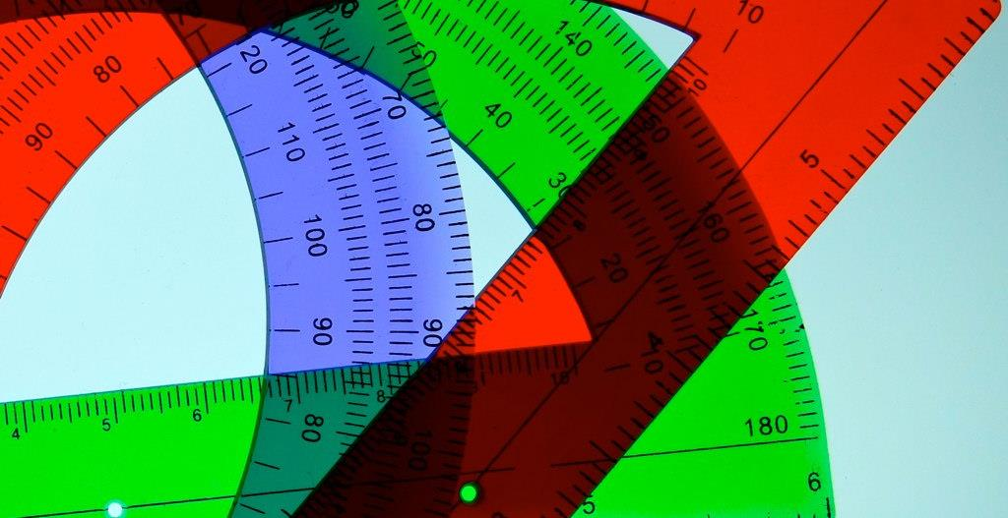
Image: https://www.flickr.com/photos/deanhochman/14481958642/ by Dean Hochman / CC BY 2.0
Usability Testing
Degree to which a user can successfully learn & use a product to achieve a goal
Evaluation research methodology
Observation & analysis of user behavior while users use a product or product prototype to achieve a goal
(Dumas and Redish 1993, 22)
Notes:
Image: https://www.flickr.com/photos/deanhochman/14481958642/ by Dean Hochman / CC BY 2.0
Dumas, Joseph S., and Janice C. Redish. 1993. A Practical Guide to Usability Testing. Portland, OR: Intellect Books.

Slide 44

Comprised of three parts:
Pre-session interview
Scenario and task structured test
Post-session survey
(Tang 2017, 278)
Usability Testing: Components
Image: https://www.flickr.com/photos/78428166@N00/8120708019/ by Tony Alter / CC BY 2.0
Notes:
Image: https://www.flickr.com/photos/78428166@N00/8120708019/ by Tony Alter / CC BY 2.0
Tang, Rong. 2017. “Usability Research.” In Research Methods for Library and Information Science, 6th ed., edited by Lynn Silipigni Connaway and Marie L. Radford, 277-278. Westport, CT: Libraries Unlimited.

Slide 45
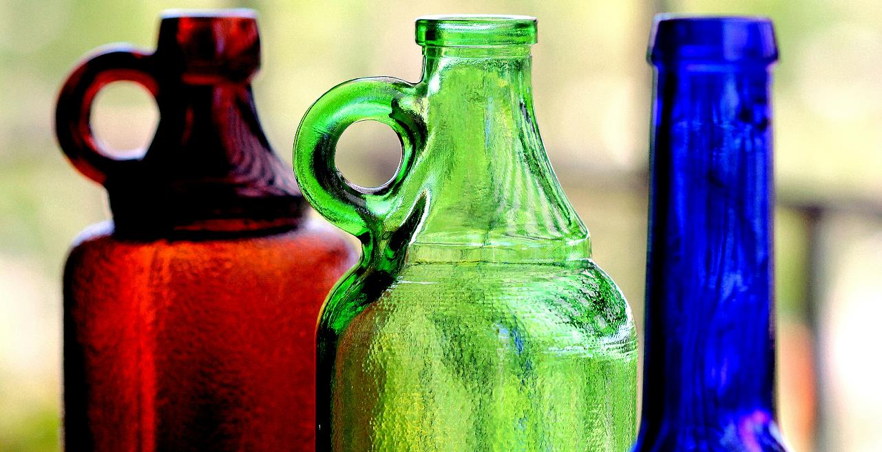
Image: https://www.flickr.com/photos/marcelxxl/14217231657/ by M.G.N. – Marcel / CC BY-NC-ND 2.0
V&R Mapping App Usability Testing
TASK
Think of around 10 websites you use or online activities that you regularly perform. Place each of these websites or activities on the map in a way that represents how you feel you use them (as a 'Visitor' or as a 'Resident') and the typical context in which you use them ('Personal' or 'Institutional’).
PROCEDURE
Read the task aloud
Using the app, complete the task while thinking aloud
Indicate when they felt they had completed the task
Notes:
Image: https://www.flickr.com/photos/marcelxxl/14217231657/ by M.G.N. – Marcel / CC BY-NC-ND 2.0
White, David S., and Lynn Silipigni Connaway. 2011-2014. Visitors & Residents: What Motivates Engagement with the Digital Information Environment. Funded by JISC, OCLC, and Oxford University. http://www.oclc.org/research/activities/vandr/.

Slide 46
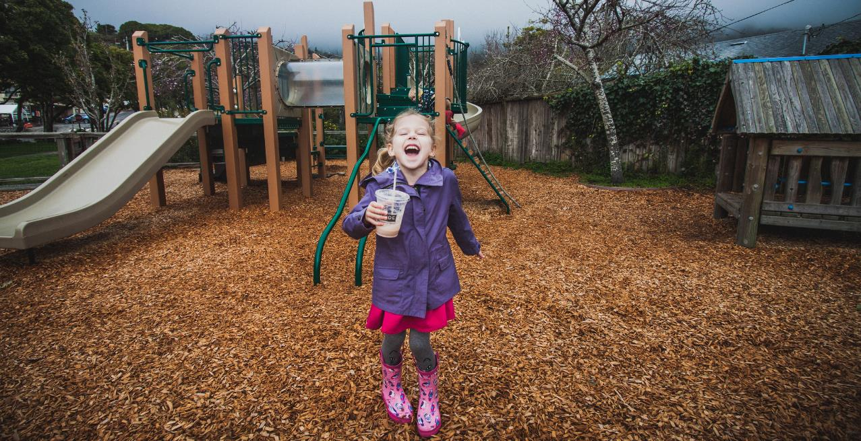
Usability Testing: Methodology
Artificial environment (laboratory)
Maintain more control
May provide more specific data on a particular feature
Natural environment
Better holistic representation of real people doing real work
(Tang 2017, 278)
Image: https://www.flickr.com/photos/carnesaurus/32160924864/ by Stinson Beach Playground / CC BY-NC-ND 2.0
Notes:
Image: https://www.flickr.com/photos/carnesaurus/32160924864/ by Stinson Beach Playground / CC BY-NC-ND 2.0
Key tip: A major lesson I learned over the years of conducting usability research is that in addition to producing results and recommendations that are practical for stakeholders, it is necessary to pay attention to the scholarly value of your work. Relevant theoretical frameworks might be applied to guide you through analyzing the interplay among behavior variables and interaction patterns (Tang 2017, 278).
Tang, Rong. 2017. “Usability Research.” In Research Methods for Library and Information Science, 6th ed., edited by Lynn Silipigni Connaway and Marie L. Radford, 277-278. Westport, CT: Libraries Unlimited.

Slide 47
Ethnographic Data collection tools and methods: observations

Slide 48
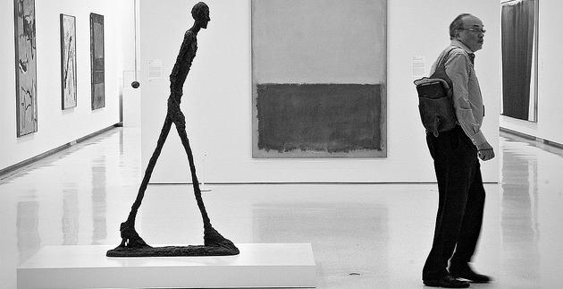
Image: https://www.flickr.com/photos/anjan58/7346141798 by anjan58 / CC BY-NC-ND 2.0
Observation
“Perhaps the most convenient method of studying the consequences of this law will be to follow the reader from the moment he enters the library to the moment he leaves it…”
(Ranganathan 1931, 337)
Notes:
Image: https://www.flickr.com/photos/anjan58/7346141798 by anjan58 / CC BY-NC-ND 2.0
Save time of the reader, previously #4, is now more important (#1) (107)
Connaway, L. S., & Faniel, I. M. (2014). Reordering Ranganathan: Shifting user behaviors, shifting priorities. Dublin, OH: OCLC Research. http://www.oclc.org/content/dam/research/publications/library/2014/oclcresearch-reordering-ranganathan-2014.pdf.
Ranganathan, S. R. (1931). The five laws of library science. London: Edward Goldston, Ltd.

Slide 49
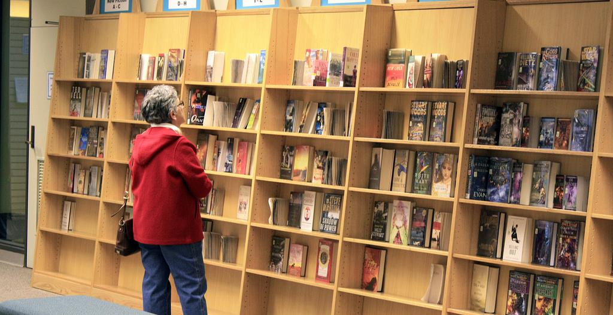
Participant/Immersive Observations
Move into the setting as deeply as possible
Disturb participants as little as possible
Participant observation
Open, direct interaction & observation as part of the group
(Connaway & Radford, 2017)
Image: https://www.flickr.com/photos/njla/3306454031/ by NJLA: New Jersey Library Association / CC BY-NC-ND 2.0
Notes:
Image: https://www.flickr.com/photos/njla/3306454031/ by NJLA: New Jersey Library Association / CC BY-NC-ND 2.0
Example of participant observation: researcher appears to reference librarians as a patron.
Connaway, L. S., & Radford, M. L. (2017). Research Methods for Library and Information Science, 6th ed. Westport, CT: Libraries Unlimited.

Slide 50
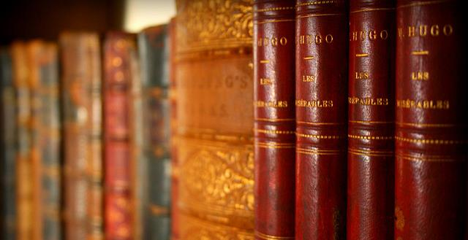
Unstructured vs. Structured Observations
Image: https://www.flickr.com/photos/jafsegal/5438336871 by Juan Antonio Segal / CC BY 2.0
Unstructured observation
No predetermined categories of behavior
Flexible, exploratory
Notes should be recorded as soon as possible
Structured observation
Predeveloped observational categories
Rating scales and/or checklists
Audio and/or video recording
(Connaway and Radford, 2017)
Notes:
Image: https://www.flickr.com/photos/jafsegal/5438336871 by Juan Antonio Segal / CC BY 2.0
Connaway, L. S., & Radford, M. L. (2017). Research Methods for Library and Information Science, 6th ed. Westport, CT: Libraries Unlimited.

Slide 51

Image: https://www.flickr.com/photos/28481088@N00/14270095212 by tanakawho / CC BY 2.0
Unstructured Observations
Obtrusive vs. Unobtrusive
Active vs. Passive
Improve accuracy by:
Comparing data from two sources
Avoiding interpretation
Not taking behavior for granted
Getting feedback from participants
(Connaway & Radford, 2017)
Notes:
Image: https://www.flickr.com/photos/28481088@N00/14270095212 by tanakawho / CC BY 2.0
Connaway, L. S., & Radford, M. L. (2017). Research Methods for Library and Information Science, 6th ed. Westport, CT: Libraries Unlimited.

Slide 52
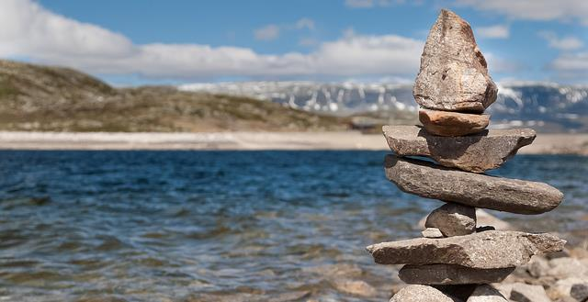
Image: https://www.flickr.com/photos/fng_photo/32806522008 by fnugry / CC BY-NC 2.0
Structured Observations
More formal, quantitative
Develop observational categories
Define appropriate, measurable actions
Establish units of time or length of observations
Anticipate patterns
Determine frame of reference
Select a rating scale
Create a checklist sheet if applicable
(Connaway & Radford, 2017)
Notes:
Image: https://www.flickr.com/photos/fng_photo/32806522008 by fnugry / CC BY-NC 2.0
Connaway, L. S., & Radford, M. L. (2017). Research Methods for Library and Information Science, 6th ed. Westport, CT: Libraries Unlimited.

Slide 53

Image: https://www.flickr.com/photos/larrywkoester/21500417954 by Larry Koester / CC BY 2.0
WebJunction Observations
Scenario and Task 1
You are interested in taking free courses from the WebJunction course catalog. Please go to the first task.
Please go to webjunction.org before proceeding You are interested in participating in free courses and webinars offered by WebJunction. A. Find where you can enroll in free library-specific courses and webinars.
(Connaway and Radford, 2017, p. 274)
Notes:
Image: https://www.flickr.com/photos/larrywkoester/21500417954 by Larry Koester / CC BY 2.0
Task 1 Usability Questions: From WebJunction.org, is the user able to easily:
Navigate to learn.wenjunction.org in order to access the course catalog?
Find the link to the catalog?
Task 1 Quantitative Measures: User completes task correctly by
(A1) Opening the “Find Training” menu (Y or N)
(A2) Clicking the link “Go to Courses” to get to the course catalog option (Y or N)
OR
(B1) Entering search terms to get to the course catalog option (Y or N)
Connaway, L. S., & Radford, M. L. (2017). Research Methods for Library and Information Science, 6th ed. Westport, CT: Libraries Unlimited.

Slide 54
ACTIVITY
Unstructured Observations

Slide 55
Unstructured Observation Discussion
What’s going on here? See with new eyes.
How did you experience this active observation?
What were the challenges/difficulties with this type of data collection?
What was good about this type of data collection?

Slide 56
Ethnographic Data collection tools and methods: Mapping

Slide 57
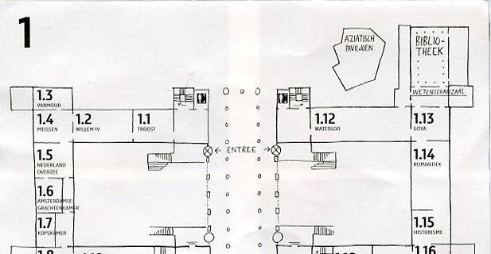
Image: https://www.flickr.com/photos/dutchsimba/15704925354 by Dutch Simba / CC BY-NC-ND 2.0
Cognitive Mapping
Participant draws a map of the area of interest
Fast and easy to conduct
Small time commitment from participants
Can be ambiguous or difficult to interpret
Notes:
Image: https://www.flickr.com/photos/dutchsimba/15704925354 by Dutch Simba / CC BY-NC-ND 2.0
Asher, A. & Miller, S. (2011). So You Want to Do Anthropology in Your Library? Or a Practical Guide to Ethnographic Research in Academic Libraries. Chicago: The ERIAL Project.

Slide 58
Mapping Diaries
Give participants a map & ask them to record their movements
Can use maps as basis for individual interviews
Image from Clark (2007), “Mapping Diaries, or Where Do They Go All Day?”, p. 49
Notes:
Clark, K. (2007). Mapping Diaries, or Where Do They Go All Day? In N. Foster & S. Gibbons (Eds.), Studying Students: The Undergraduate Research Project at the University of Rochester. Chicago: Association College and Research Libraries.

Slide 59
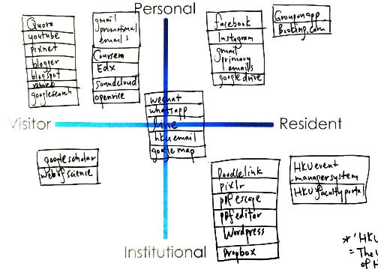
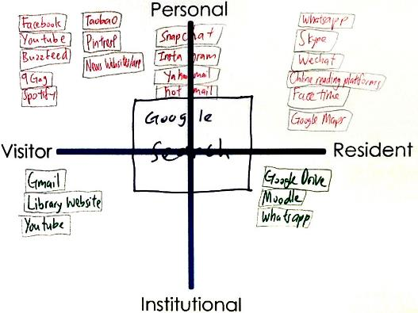
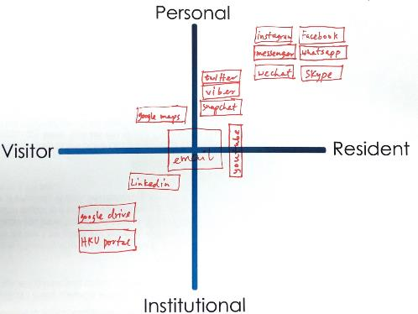
Mapping
Visitors and Residents Sample Maps
Notes:
Quadrant 1:
HKU, 1st year undergrad
Realized I am not that hard working
In desperation when I have to directly go to library website
Google search: usually don’t login, just search, more on visitor side
Snapchat …Hotmail : Not too often do sharing
A way to release my burden
FB try not to post/share, look at what my friends share
Quadrant 2:
HKU, upper undergrad
Library- Borrow book for personal
Google drive – only for group project (visitor)
Social media apps make us anti – social
Quadrant 3:
HKU, faculty researcher and/or scholar
Research assistant
Least Digital footprint as possible, substantial, good thing to live (the left side of the map)
Middle – use a lot in work, create contacts
Use HKU specific apps for work, wordpress, create webpage
Learn about yourself: need to learn more & contribute more in digital footprint (at work and in personal)
White, D. S., & Connaway, L. S. (2011-2014). Visitors & Residents: What Motivates Engagement with the Digital Information Environment. Funded by JISC, OCLC, and Oxford University. http://www.oclc.org/research/activities/vandr/.

Slide 60
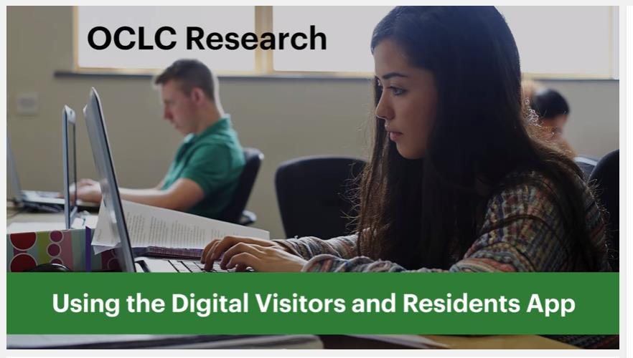
Play
Notes:
OCLC Research. 2016. Using the Digital Visitors and Residents App. YouTube video. May 5. https://www.youtube.com/watch?v=6ai0ZO3lDR4.

Slide 61
ACTIVITY
V&R Mapping Exercise

Slide 62
ethnographic Data Analysis Tools and Methods

Slide 63
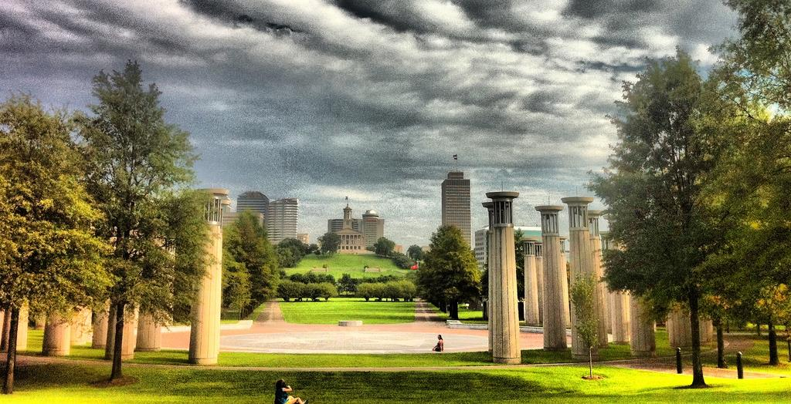
Ethnographic Analysis
Use people’s own categories
Avoid assuming what one will find
Complementary to quantitative methods
Retain ‘richness’/‘thick description’
Numerous compatibility
(Asher 2017, 264)
(Connaway and Radford 2017, 282)
Image: https://www.flickr.com/photos/respres/6041698098/ by Jeff Turner / CC BY 2.0
Notes:
Image: https://www.flickr.com/photos/respres/6041698098/ by Jeff Turner / CC BY 2.0
Ethnographic research methods seek to use people’s own categories of analysis as a way of understanding social and cultural processes on their own terms. Researchers using ethnographic approaches must be careful to avoid making assumptions about what they will find, to suspend judgment about people’s actions, and to attend to both people’s own explanations of the processes being studied as well as analytical or theoretical explanations. While ethnographic methods usually emphasize qualitative data, they should not be seen as opposed to quantitative approaches to research, but instead as a different, and often complementary, way of gathering evidence and discovering meaning within the complexities of human behavior (Asher 2017, 264).
Asher, Andrew. 2017. “On Ethnographic Research: How do Students Find the Information They Need?” In Research Methods for Library and Information Science, 6th ed., edited by Lynn Silipigni Connaway and Marie L. Radford, 264. Westport, CT: Libraries Unlimited.
“The data collection methods discussed above are used in ethnographic research studies. The data analysis methods used for the qualitative data collected in diaries, journals, interviews, and mapping are the same as those discussed in chapters 7 and 8. The data must be interpreted in a manner that retains their richness. This “thick description,” including group interactions, is one of their advantages of the ethnographic approach. The ethnographic summary and the content analysis approach of open and thematic coding are not conflicting means of analysis. If quantitative data are collected in the interviews and FtF survey questions, the data analysis methods should be compatible. The analyses most likely will include descriptive statistics but may include inferential statistics, which are discussed in chapter 6.” (Connaway and Radford 2017, 282)
Connaway, L. S., & Radford, M. L. (2017). Research Methods for Library and Information Science, 6th ed. Westport, CT: Libraries Unlimited.

Slide 64
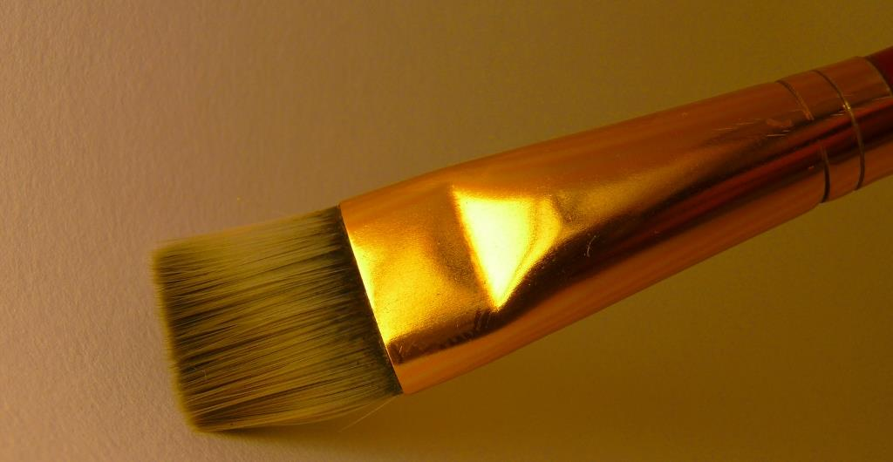
Computer-Assisted Qualitative Data Analysis Software (CAQDAS)
Contain all data sources
Creating & applying codes
Queries
Visualizations
Reports
(Connaway and Radford 2017)
Image: https://www.flickr.com/photos/flakepardigm/4687752030/ by Tyler Nienhouse / CC BY 2.0
Notes:
Image: https://www.flickr.com/photos/flakepardigm/4687752030/ by Tyler Nienhouse / CC BY 2.0
“The CAQDAS packages help to provide a place to contain all data sources and have multiple affordances, especially for large data sets common in qualitative projects. There is a growing number of these products available, in both proprietary and open source versions. Proprietary products include ATLAS.ti, Dedoose, HyperRESEARCH, MAXQDA, Nvivo, QDA Minder Qiqqa, and Xsight. Open source software includes Aquad, Coding Analysis Toolkit, Compendium, and RQDA.” (Connaway and Radford 2017, 290)
“Common features of all these packages include creating and applying codes. Some...have advanced features that support such enhancements as enabling queries (to explore data to discover patterns, connections, etc.), supporting visualizations (to create charts, models, maps, and cluster analyses), and delivering reports (to document and export findings).” (Connaway and Radford 2017, 290)
Connaway, L. S., & Radford, M. L. (2017). Research Methods for Library and Information Science, 6th ed. Westport, CT: Libraries Unlimited.

Slide 65

Draw on data...in service of developing new conceptual categories
Develop inductive abstract analytic categories through systematic data analysis
Emphasize theory construction rather than description or application of current theories
(Connaway and Radford 2017)
Grounded Theory
Image: https://www.flickr.com/photos/adambindslev/4727853016/ by Adam Bindslev / CC BY-NC 2.0
Notes:
Image: https://www.flickr.com/photos/adambindslev/4727853016/ by Adam Bindslev / CC BY-NC 2.0
“1. Conduct data collection and analysis simultaneously in an iterative process.
2. Analyze actions and processes rather than themes and structure.
3. Use comparative methods.
4. Draw on data (e.g., narratives and descriptions) in service of developing new conceptual categories.
5. Develop inductive abstract analytic categories through systematic data analysis.
6. Emphasize theory construction rather than description or application of current theories.
7. Engage in theoretical sampling.
8. Search for variation in the studied categories or process.
9. Pursue developing a category rather than covering a specific empirical topic.” (Connaway and Radford 2017, 297)
Connaway, L. S., & Radford, M. L. (2017). Research Methods for Library and Information Science, 6th ed. Westport, CT: Libraries Unlimited.

Slide 66
Theme | Sub-theme | Sub-theme | Sub-theme | Definition | Example
Place (I)
 | Internet (I.A) |  |  | Online, unspecified | “I will go online for the subject because I know the what's online will be of better quality and more relevant to the specification than what's in the book” (2UKU2).
 |  | Search Engine (I.A.1) |  | Unspecified or unlisted search engine (i.e., Bing) | “Or I’ll go back to the search engine and start again and look at all the other options that I’m able to look at” (UKS4).
 |  |  | Google (I.A.1.a) |  | “I would start by Googling definitely” (2UKS2).
 |  | Social Media (I.A.2) |  | Unspecified or unlisted social media (i.e., LinkedIn) | “Well, I like social media, but I don't know if anything would change anything about my academics … um, the only thing that I can think of that I'll probably ever be able to think of, is the detrimental effect it has on my academics because it distracts me” (USG2).
 |  |  | Facebook (I.A.2.a) |  | “When I'm doing homework or coursework or something, I'll always have Facebook and Twitter open, for example, as well” (2UKS2).
 |  |  | Twitter (I.A.2.b) |  | “Twitter, I don't use it educationally at all” (2UKS2).
 | Library (I.B) |  |  | Unspecified library | “I think first of all I would search on Google Scholar to see whether there is an e-version. Because I’m pretty comfortable reading online. And if there is not, then I will go to the library. Yes. When I have to” (UKG1).
 |  | Academic (I.B.1) |  |  | “The majority of the journal articles that we would read are online although frequently books are still not converted into e-books yet, so they’re frequently found in the education library” (UKG2).
Visitors and Residents
Codebook Excerpt
Notes:
Image: https://www.flickr.com/photos/eberg/5930730983/
This is just a very small part of our codebook from Visitors & Residents. Here we have a parent-node of Place and its child-nodes or sub-nodes of Internet, Library, Home, School, and Other. Within those we have even more child-nodes. As we code, we want to be as specific as possible.

Slide 67
Theme | Sub-theme | Sub-theme | Definition | Example
Sources (II) |  |  | Unspecified source | “I spent a few weeks struggling to find a part time job for the Christmas holidays. I mainly searched the internet but also search for help from my university, asked friends, walked the streets handing out my CV etc.” (UKG303).
 | Human (II.A) |  | Unspecified human source | “So the ideal way is to ask and receive an answer, just like in human to human interaction” (UKF401).
 |  | Mother (II.A.1) | [If “parents” stated, code for Mother and Father] | “…had a chat with my mother on the phone” (UKG320).
 |  | Father (II.A.2) | [If “parents” stated, code for Mother and Father] | “Parents…they know me the best so I know that they would have my best interests at heart…” (UKS125).
 |  | Extended Family (II.A.3) | Siblings, cousins, relatives, children, spouses. [If “family” stated, code for Mother, Father, and Extended Family] | “Seek friends and families help because they are trustworthy” (UKS108).
 | Digital (II.B) |  | Unspecified or unlisted digital source | “The idea of having the desired information in front of your eyes as and when I need it. This is, of course, something made possible by technology such as Google Glass” (UKG303).
 |  | E-books (II.B.1) |  | “I do not like e-readers. For me personally, I need to feel the pages of a book in my fingers for it too be real” (USS116).
 |  | Academic (I.B.1) |  | “The majority of the journal articles that we would read are online although frequently books are still not converted into e-books yet, so they’re frequently found in the education library” (UKG2).
Visitors and Residents
Codebook Excerpt
Notes:
Image: https://www.flickr.com/photos/69502532@N00/2947286593/
Here is another small snippet. This just shows how many sub-nodes we have for Human Sources, which has yielded a lot of interesting data for us and we will very likely be using in some of our upcoming papers and presentations.
When we started back several years ago, we started with Emerging participants which are our last year high school students and first year university students from the US and UK and we didn’t have any of them mention Librarians. However, even now, we are still finding just how important Humans are as Sources for information and help to all our participants.

Slide 68
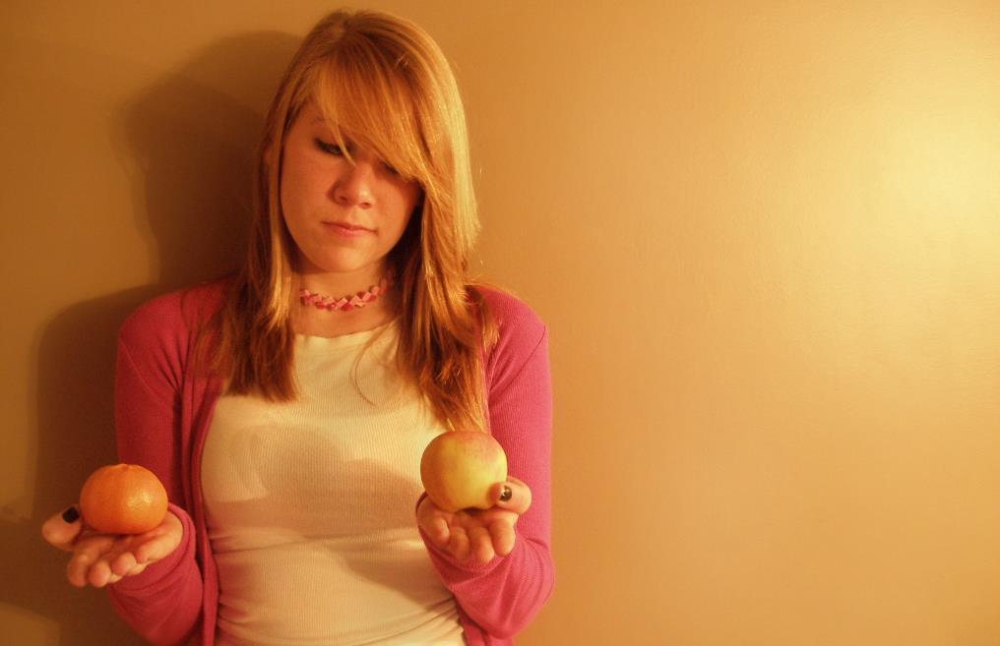
“A major strategy for analysis of qualitative data is the use of the constant comparative method, which embraces ‘constant comparisons’ defined as ‘the analytic process of comparing different pieces of data against each other for similarities and differences.’”
(Connaway and Radford 2017, 298)
Image: https://www.flickr.com/photos/carleycomartin/4030726428/ by Carley Comartin / CC BY-NC 2.0
Notes:
Image: https://www.flickr.com/photos/carleycomartin/4030726428/ by Carley Comartin / CC BY-NC 2.0
“A major strategy for analysis of qualitative data is the use of the constant comparative method, which embraces “constant comparisons” defined as “the analytic process of comparing different pieces of data against each other for similarities and differences.” It requires the researcher to ask continually: “What is this piece of data saying?” “Is this different from or similar to the next segment?” This involves comparing and aggregating pieces of data on the basis of similar characteristics and beginning the process of sorting these into interim groups or emerging themes.” (Connaway and Radford 2017, 298)
Connaway, L. S., & Radford, M. L. (2017). Research Methods for Library and Information Science, 6th ed. Westport, CT: Libraries Unlimited.

Slide 69
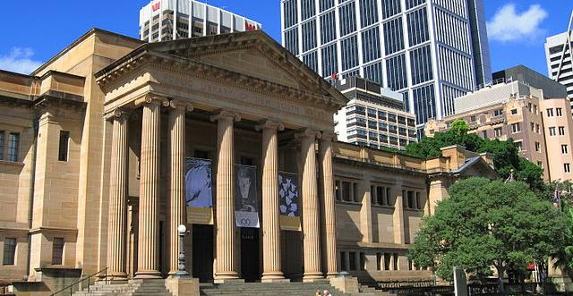
Conversation Analysis
Context & social conduct
Discourse Analysis
The library within a larger social & cultural context
(Connaway and Radford 2017)
Image: https://commons.wikimedia.org/wiki/File:StateLibraryOfNewSouthWales1_gobeirne.jpg by Greg O'Beirne / CC BY-SA 3.0
Notes:
Image: https://commons.wikimedia.org/wiki/File:StateLibraryOfNewSouthWales1_gobeirne.jpg by Greg O'Beirne / CC BY-SA 3.0 (Mitchell Library, State Library of New South Wales, Sydney, Australia)
“Conversation analysis (CA) is an approach to analyzing talk that is captured in natural settings and has become well established in the disciplines of communication, sociology, linguistics, ethnomethodology, ethnography, and social psychology....It highlights the importance of context and revealing regularities of social conduct through examining particular episodic interactions.” (Connaway and Radford 2017, 312)
“Budd had divided discourse analysis (DA) into two different approaches: CA in the form of “linguistic-based analysis,” which is discussed above, and “culturally or socially based discursive practices,” such as those that Foucault has developed...The overarching premise of DA is to question and explore the relationship of the library as an institution and/or LIS as a field of research within a larger social and cultural context.” (Connaway and Radford 2017, 312-313)
Connaway, L. S., & Radford, M. L. (2017). Research Methods for Library and Information Science, 6th ed. Westport, CT: Libraries Unlimited.
Budd, John M. 2006. “Discourse Analysis and the Study of Communication in LIS.” Library Trends 55, no. 1: 65-82.

Slide 70
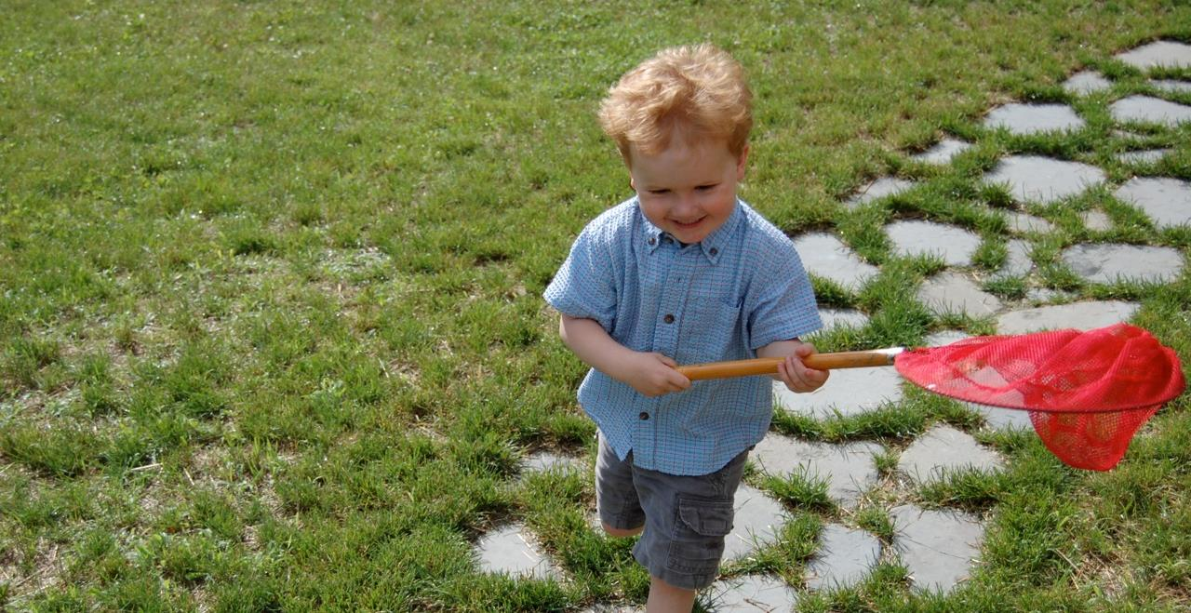
Challenges: Ethnographic Research
Data collection & analysis
Costs and time
Bias
Sampling
Not generalizable
Image: https://www.flickr.com/photos/therichbrooks/2600080329/ by Rich Brooks / CC BY 2.0
Notes:
Image: https://www.flickr.com/photos/therichbrooks/2600080329/ by Rich Brooks / CC BY 2.0
Ethnographic research is time-consuming
Staff time needed for collection, analysis, and presentation is expensive
Need staff who are trained or need to train staff
Bias presents a threat to validity , particularly the interviewer because of over-reacting to responses, etc.
If samples are small and non-representative, results aren’t generalizable.
- In some collection methods (observation), may not be able to gather demographic data or choose your sample at all.
Connaway, L. S., & Radford, M. L. (2017). Research Methods for Library and Information Science, 6th ed. Westport, CT: Libraries Unlimited.

Slide 71
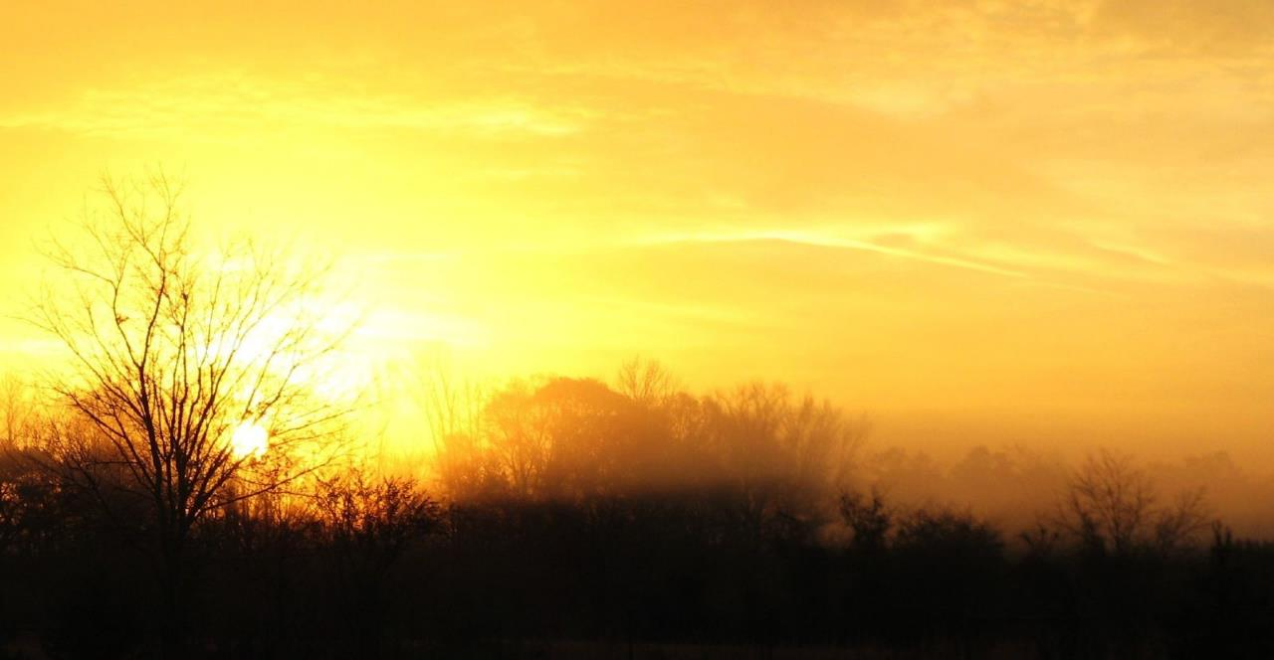
Opportunities: Ethnographic Research
Rich data and thick description
Can answer why and how questions
Provides information to support decisions about resources and services
Can help motivate and increase buy-in for change
Provides the opportunity to build relationships
(Connaway and Radford, 2017; Asher and Miller, 2011)
Image: https://www.flickr.com/photos/dougww/2132598574 by Doug Waldron / CC BY-SA 2.0
Notes:
Image: https://www.flickr.com/photos/dougww/2132598574 by Doug Waldron / CC BY-SA 2.0
Asher, A. & Miller, S. (2011). So You Want to Do Anthropology in Your Library? Or a Practical Guide to Ethnographic Research in Academic Libraries. Chicago: The ERIAL Project.
Connaway, L. S., & Radford, M. L. (2017). Research Methods for Library and Information Science, 6th ed. Westport, CT: Libraries Unlimited.

Slide 72
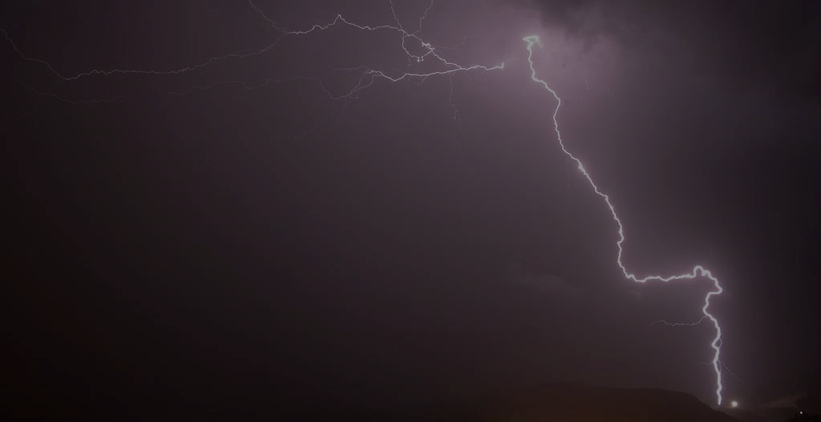
Image: https://flic.kr/p/AuDyn by Pete Hunt / CC BY-NC 2.0
“The creative process is not like a situation where you get struck by a single lightning bolt. You have ongoing discoveries, and there are ongoing creative revelations. Yes, it's really helpful to be marching toward a specific destination, but, along the way, you must allow yourself room for your ideas to blossom, take root, and grow.”
–Carlton Cuse
Notes:
Image: https://flic.kr/p/AuDyn by Pete Hunt / CC BY-NC 2.0
https://www.brainyquote.com/quotes/quotes/c/carltoncus644835.html

Slide 73
Acknowledgements
I would like to thank Brittany Brannon for her assistance in preparing this presentation.

Slide 74
References
Asher, A. & Miller, S. (2011). So You Want to Do Anthropology in Your Library? Or a Practical Guide to Ethnographic Research in Academic Libraries. Chicago: The ERIAL Project.
Asher, A. (2017). On ethnographic research: How do students find the information they need? In Research Methods for Library and Information Science, 6th ed., edited by L. S. Connaway and M. L. Radford, 264. Westport, CT: Libraries Unlimited.
Budd, J. M. (2006). Discourse analysis and the study of communication in LIS. Library Trends 55, 1: 65-82.
Case, D. O., & Given, L. S. (2016). Looking for information: A survey of research on information seeking, needs, and behaviour. Bingley, UK: Emerald.
Chu, H. (2015). Research Methods in Library and Information Science: A Content Analysis. Library & Information Science Research 37(1), 36-41.
Clark, K. (2007). Mapping Diaries, or Where Do They Go All Day? In N. Foster & S. Gibbons (Eds.), Studying Students: The Undergraduate Research Project at the University of Rochester. Chicago: Association College and Research Libraries.
Connaway, L. S. (2017, June 19). Putting the library in the life of the user: Listen, then lead, to promote a unique and compelling role for academic libraries. Guest of Choice, Choice360 blog. Retrieved from http://www.choice360.org/blog/putting-the-library-in-the-life-of-the-user
Connaway, L. S., & Faniel, I. M. (2014). Reordering Ranganathan: Shifting user behaviors, shifting priorities. Dublin, OH: OCLC Research. http://www.oclc.org/content/dam/research/publications/library/2014/oclcresearch-reordering-ranganathan-2014.pdf.

Slide 75
References
Connaway, L. S., & Radford, M. L. (2017). Research Methods for Library and Information Science, 6th ed. Westport, CT: Libraries Unlimited.
Denzin, N. K., & Lincoln, Y. S. (2005). The Sage Handbook of Qualitative Research, 4th ed. Thousand Oaks, CA: Sage Publications.
Dumas, J. S., & Redish, J. C. (1993). A Practical Guide to Usability Testing. Portland, OR: Intellect Books.
Greifeneder, E. (2014). Trends in information behaviour research. In Proceedings of ISIC, the Information Behaviour Conference, Leeds, 2-5 September, 2014: Part 1. http://InformationR.net/ir/19-4/isic/isic13.html
Jasiewicz, J. (In Press). Social science research methods in library science between 2010 and 2015. A bibliometric analysis.
Khoo, M., Rozaklis, L., & Hall, C. (2012). A survey of the use of ethnographic methods in the study of libraries and library users. Library and Information Science Research, 34(2), 82-91.
Luo, L., & McKinney, M. (2015). JAL in the Past Decade: A Comprehensive Analysis of Academic Library Research. The Journal of Academic Librarianship 41(2),123-129.
Matusiak, K. K. (2017). Studying information behavior of image users: An overview of research methodology in LIS literature, 2004-2015. Library and Information Science Research 39 (1), 53–60.

Slide 76
References
McKechnie, L. M., Baker, L., Greenwood, M., & Julien, H. (2002). Research method trends in human information behaviour literature. The New Review of Information Behaviour Research: Studies of Information Seeking in Context (Proceedings of ISIC 2002), 3, 113-125.
Polkinghorne, D. (1983). Methodology for the human sciences: Systems of inquiry. Albany, NY: State University of New York Press.
Powell, R. (1999). Recent Trends in Research: A Methodological Essay. Library & Information Science Research 21(1), 91-119.
Ranganathan, S. R. (1931). The five laws of library science. London: Edward Goldston, Ltd.
Runes, D. D. (Ed.). (2001). The dictionary of philosophy. New York, NY: Citadel Press.
Tang, R. (2017). Usability research. In Research Methods for Library and Information Science, 6th ed., edited by L. S. Connaway and M. L. Radford, 277-278. Westport, CT: Libraries Unlimited.
White, David S., and Lynn Silipigni Connaway. 2011-2014. Visitors & Residents: What Motivates Engagement with the Digital Information Environment. Funded by JISC, OCLC, and Oxford University. http://www.oclc.org/research/activities/vandr/.

Slide 77
Questions & Discussion
Lynn Silipigni Connaway, PhD
Director of Library Trends and
User Research, OCLC
connawal@oclc.org
@LynnConnaway

