Slide 1
Beyond the Survey: Using Qualitative Research Methods to Support Evidence-Based Practice
Lynn Silipigni Connaway, PhD
Director of Library Trends and User Research, OCLC
connawal@oclc.org
@LynnConnaway

Slide 2
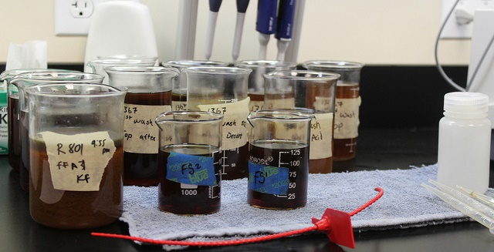
When put on the spot and asked to define “research,” what would you say?
Image: https://www.flickr.com/photos/unitedsoybean/10478827635 by United Soybean Board / CC BY 2.0
Notes:
Image: https://www.flickr.com/photos/unitedsoybean/10478827635 by United Soybean Board / CC BY 2.0

Slide 3
Investigation
Data Collection
Experimentation
What about answering question(s)?
Data Analysis
Testing

Slide 4
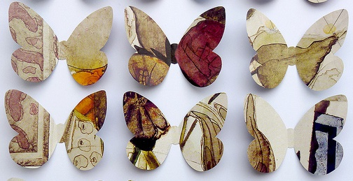
Survey Method
The most widely used data collection method?
Image: https://www.flickr.com/photos/24174659@N06/5223344188 by Mel Edwards / CC BY-NC 2.0
Notes:
Image: https://www.flickr.com/photos/24174659@N06/5223344188 by Mel Edwards / CC BY-NC 2.0
What do you think is the most widely used data collection method in LIS research?

Slide 5
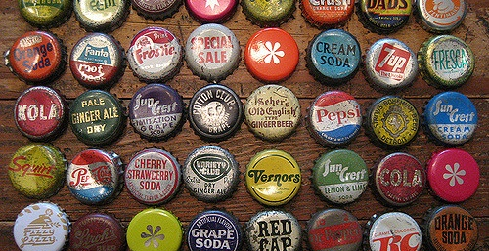
The data collection methods you choose depend on your questions
Image: https://www.flickr.com/photos/fragmented/3612117941 by maura / CC BY-NC-ND 2.0
Notes:
Image: https://www.flickr.com/photos/fragmented/3612117941 by maura / CC BY-NC-ND 2.0

Slide 6
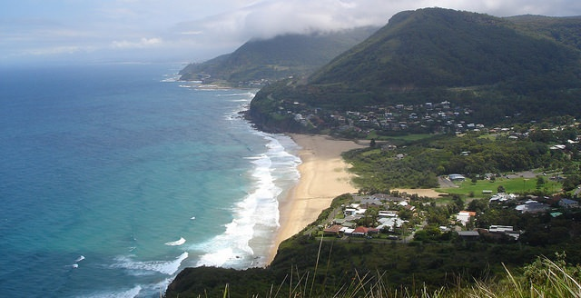
Sense-Making
User-centered research identifies how and why individuals make sense of their environments
(Dervin, 1992)
(Dervin, Connaway, & Prabha, 2003-2005)
Image: https://www.flickr.com/photos/dgmckelvey/34932578244 by David McKelvey / CC BY-NC-ND 2.0
Notes:
Image: https://www.flickr.com/photos/dgmckelvey/34932578244 by David McKelvey / CC BY-NC-ND 2.0 (Stanwell Park from Bald Hill Lookout, Stanwell Tops, New South Wales, Australia)
Tuesday keynote speaker, Genevieve Bell, mentioned sense making in the context of machines and AI.
Dervin, B., Connaway, L. S., & Prabha, C. (2003-2005). Sense-making the information confluence: The hows and the whys of college and university user satisficing of information needs. Funded by the Institute for Museums and Library Services (IMLS). Retrieved from http://www.oclc.org/research/activities/past/orprojects/imls/default.htm
Dervin, B. (1992). From the mind’s eye of the user: The sense-making qualitative-quantitative methodology. In J.D. Glazier and R.R. Powell (Eds.), Qualitative research in information management. Englewood, CO: Libraries Unlimited, 61-84.

Slide 7
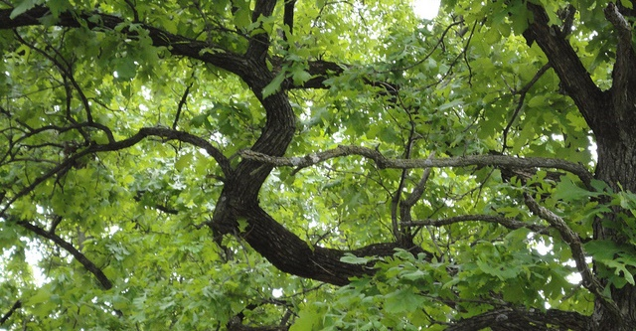
Image: https://www.flickr.com/photos/84149403@N08/7698154972 by Natasha Hanova / CC BY-NC 2.0
Why qualitative research?
Gathers rich, descriptive data
Answers “How?” and “Why?”
Supports decision-making
Can help motivate and increase buy-in
Helps build relationships
(Connaway & Radford, 2017)
Notes:
Image: https://www.flickr.com/photos/84149403@N08/7698154972 by Natasha Hanova / CC BY-NC 2.0
Connaway, L. S., & Radford, M. L. (2017). Research methods for library and information science (6th ed.). Westport, CT: Libraries Unlimited.

Slide 8
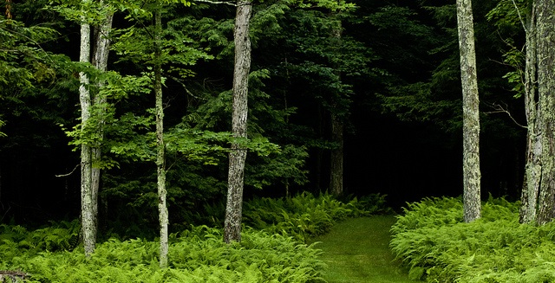
Qualitative research:
Tends to use multiple methods
Is open to developing new approaches
(Connaway & Radford, 2017)
Image: https://www.flickr.com/photos/freezr/5962512620 by Nekenasoa / CC BY 2.0
Notes:
Image: https://www.flickr.com/photos/freezr/5962512620 by Nekenasoa / CC BY 2.0
Connaway, L. S., & Radford, M. L. (2017). Research methods for library and information science (6th ed.). Westport, CT: Libraries Unlimited.

Slide 9
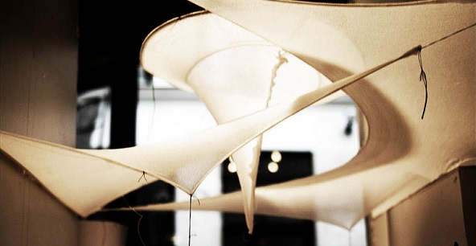
Image: https://www.flickr.com/photos/hdaparis/11288970914 by Hugh Dutton Associes / CC BY-NC-ND 2.0
Any combination of research methods
  Qualitative
  Quantitative
  Participatory
  Action
  Design
Equal attention to all stages of research process
Findings should be iterative & informative
Mixed Methods Research
(Kazmer, 2017, pp. 232-233)
Notes:
Image: https://www.flickr.com/photos/hdaparis/11288970914 by Hugh Dutton Associes / CC BY-NC-ND 2.0
“Mixed methods research is often thought of as quantitative/qualitative, but other approaches are important to consider: participatory, action, design, etc. Don't think of mixed methods as "survey plus interview" (or worse, "survey with open-ended questions tacked onto the end").
Mixed methods should be deeply integrated, and not parallel tracks that don't intersect. Mixing methods effectively means equal attention to all stages of the research process, from problem statement or hypothesis through analysis; don't focus on the data collection methods to the detriment of the other phases.
And rather than quantitative findings followed by a few attractive quotes from the qualitative data organized according to "themes," the findings from mixed methods should be iterative and mutually-informing.
Very few people can do mixed methods research alone, so embrace cooperative research. Each person needs to understand all the methods being used, but it's natural that each person will have more expertise in one area. Find research partners who have a deep and true appreciation for your contributions; mixed methods research just to satisfy a funding agency is never as fulfilling or productive as it could be. Work closely together so that the overall research design doesn't privilege one method over another just for the sake of method, but so that the combined approach will answer the research questions and allow you to effect change in the world.”
Kazmer, M. (2017). Mixed methods. In L. S. Connaway & M. L. Radford (Eds.), Research methods for library and information science (6th ed., pp. 232-233). Westport, CT: Libraries Unlimited.

Slide 10
Interviews

Slide 11
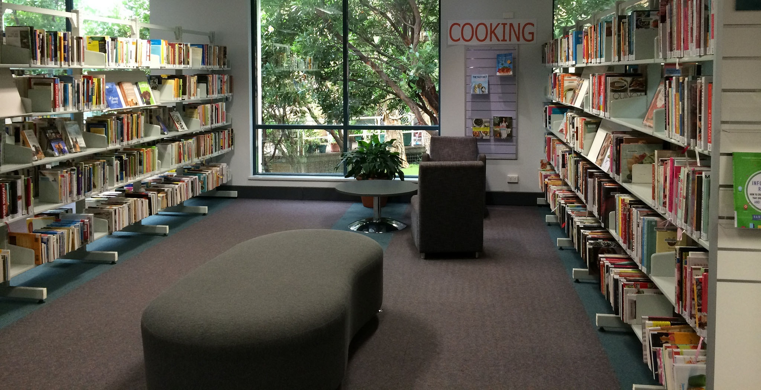
Types of Interviews
Structured
Semi-structured
Formats:
  Individual
    Face-to-face
    Telephone
    Skype
  Focus Group Interviews
Image: h / ttps://www.flickr.com/photos/publiclibrariesnsw/29760437411/ by State Library of NSW Public Library Services / CC BY 2.0
Notes:
Image: https://www.flickr.com/photos/publiclibrariesnsw/29760437411/ by State Library of NSW Public Library Services / CC BY 2.0
Sutherland Library, NSW, 30 April 2015. Sutherland, NSW, Australia.
Connaway, L. S., & Radford, M. L. (2017). Research methods for library and information science (6th ed.). Westport, CT: Libraries Unlimited.

Slide 12

Image: https://www.flickr.com/photos/andrewoffield/4434702020/ by Shadow-or-Light / CC BY-NC-ND 2.0
Semi-structured Interviews
Incredibly detailed data
Time consuming
  Establishing rapport
  Selecting research participants
  Transcribing observations & conversations
Notes:
Image: https://www.flickr.com/photos/andrewoffield/4434702020/ by Shadow-or-Light / CC BY-NC-ND 2.0
The State Library of New South Wales - Sydney, Australia
Connaway, L. S., & Radford, M. L. (2017). Research methods for library and information science (6th ed.). Westport, CT: Libraries Unlimited.

Slide 13
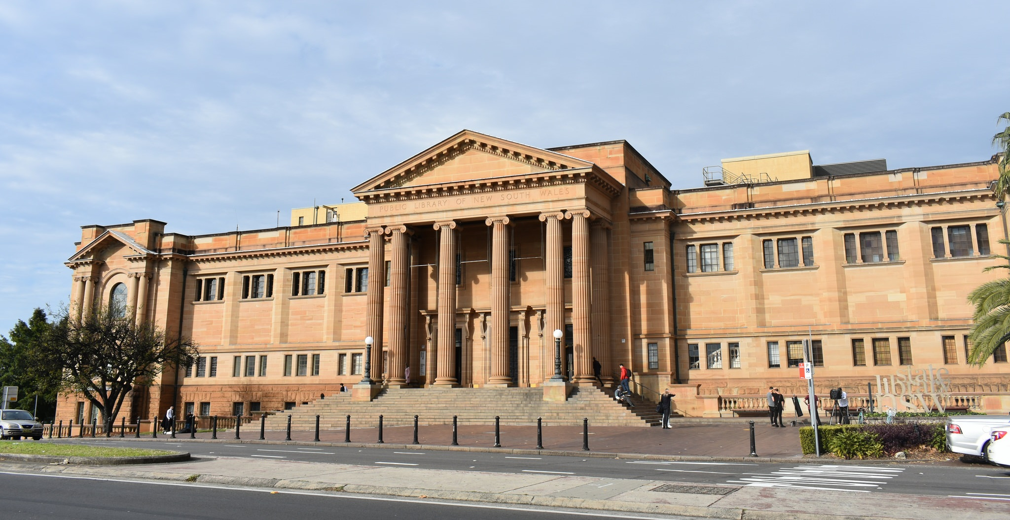
Public Libraries Respond to the Opioid Crisis with Their Communities
How did your library decide to offer this program/these services?
How did you go about building awareness, understanding, support for the program inside your organization? Outside your organization?
With whom did you work with to make this program/these services happen?
How did you find the resources needed to support this work?
What feedback/reactions did you get from the community?
What feedback/reactions did the local media have about the offering of this program/these services?
What challenges and new opportunities arose as you worked with other community services?
Image: https://www.flickr.com/photos/duluoz_cats/35585698740/ by duluoz cats / CC BY-NC-ND 2.0
Notes:
Image: https://www.flickr.com/photos/duluoz_cats/35585698740/ by duluoz cats / CC BY-NC-ND 2.0
The State Library of New South Wales - Sydney, Australia.

Slide 14
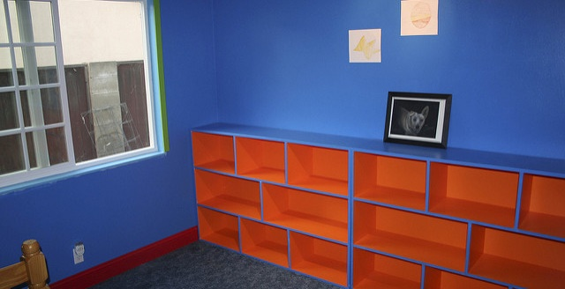
“Different agencies were invited by the mayor. We asked the opioid users and homeless if there was one thing that they want most people to know and it was, ‘I am a human being.’” (Community partner)
Image: https://www.flickr.com/photos/gr8matt/2448448396 by Matt Grant / CC BY-NC 2.0
“I think the opioid use has a huge stigma and the perception is very negative. I think some people do not think it is safe to come to the Central Library. There was a (the local) news report that had people stop bringing children’s groups to the library.”
(Frontline staff)
Notes:
Image: https://www.flickr.com/photos/gr8matt/2448448396 by Matt Grant / CC BY-NC 2.0

Slide 15
Connaway, L. S., Kitzie, V., Hood, E. M. & Harvey, W. (2017). The many faces of digital visitors & residents: Facets of online engagement. With contributions from A. Benedetti, A. Canals, L. Gregori, E. O. Espinet, D. Lozano, M. Man, J. C. Morales, S. G. Ricetto, R. Melgrati, E. M. Méndez Rodríguez, A. Sada, P. Sidorko, P. Sirito, V. Steel, T. van der Werf, and E. Woo. Dublin, OH: OCLC Research. doi:10.25333/C3V63F
https://www.oclc.org/content/dam/research/publications/2017/oclcresearch-many-faces-digital-vandr-a4.pdf.
Notes:
Connaway, L. S., Kitzie, V., Hood, E. M. & Harvey, W. (2017). The many faces of digital visitors & residents: Facets of online engagement. With contributions from A. Benedetti, A. Canals, L. Gregori, E. O. Espinet, D. Lozano, M. Man, J. C. Morales, S. G. Ricetto, R. Melgrati, E. M. Méndez Rodríguez, A. Sada, P. Sidorko, P. Sirito, V. Steel, T. van der Werf, and E. Woo. Dublin, OH: OCLC Research. doi:10.25333/C3V63F
https://www.oclc.org/content/dam/research/publications/2017/oclcresearch-many-faces-digital-vandr-a4.pdf.

Slide 16

Visitor Mode
Resident Mode
Functional use of technology
Formal need
Invisible online presence
Internet is a toolbox
Visible and persistent online presence
Collaborative activity online
Contribute online
Internet is a place
(White and Connaway 2011-2014)
Image: https://www.flickr.com/photos/28481088@N00/11186264874 by tanakawho / CC BY 2.0
Notes:
Image: https://www.flickr.com/photos/28481088@N00/11186264874 by tanakawho / CC BY 2.0
Visitors: functional use of technology, often linked to formal need (such as use of software for specific coursework, or organizing meetings through email contact); less visible/more passive online presence, more likely to favor face-to-face interactions (even as they use the internet to organize/schedule those interactions)

Slide 17
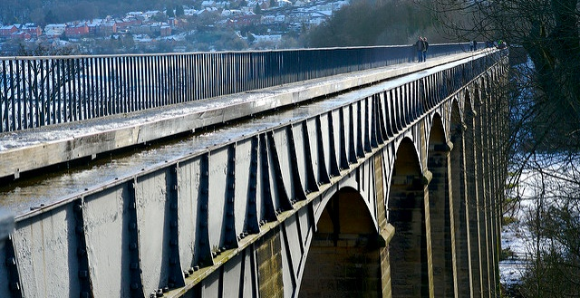
V&R Semi-Structured Interview Questions
2. Think of the ways you have used technology and the web for your studies. Describe a typical week.
3. Think about the next stage of your education. Tell me what you think this will be like.
Image: https://www.flickr.com/photos/richardleonard/386901216 by Richard Leonard / CC BY 2.0
Notes:
Image: https://www.flickr.com/photos/richardleonard/386901216 by Richard Leonard / CC BY 2.0
1. Describe the things you enjoy doing with technology and the web each week.
2. Think of the ways you have used technology and the web for your studies. Describe a typical week.
3. Think about the next stage of your education. Tell me what you think this will be like.
4. Think of a time when you had a situation where you needed answers or solutions and you did a quick search and made do with it. You knew there were other sources but you decided not to use them. Please include sources such as friends, family, teachers, coaches, etc.
5. Have there been times when you were told to use a library or virtual learning environment (or learning platform), and used other source(s) instead?
6. If you had a magic wand, what would your ideal way of getting information be? How would you go about using the systems and services? When? Where? How?
White, D. S., & Connaway, L. S. (2011-2014). Visitors & Residents: What motivates engagement with the digital information environment. Funded by JISC, OCLC, and Oxford University. http://www.oclc.org/research/activities/vandr/

Slide 18
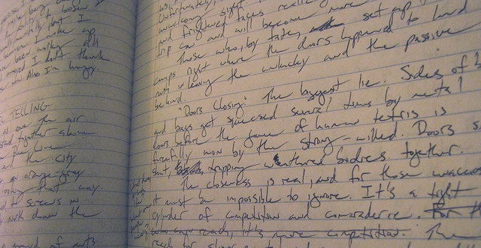
Image: https://www.flickr.com/photos/ulianne/18048364701 by Julianne / CC BY-NC-ND 2.0
“Wikipedia… it’s perfect, because it gives you the words, the things, the technical words that you need to look, keywords, so Wikipedia is always, always the first step.”
(UOCG1, Male, Age 35-44, Professions and Applied Sciences)
Notes:
Image: https://www.flickr.com/photos/ulianne/18048364701 by Julianne / CC BY-NC-ND 2.0
In relation to Wikipedia, we have to mention the research project leaded by Eudard Aibar, a UOC researcher. In that project ……..
In our study we find that people consult Wikipedia when they need to be introduced to a new subject, or to find definitions or concrete concepts.
“I always read everything I am looking for …the first thing that I learned during my degree, the first thing you have to look for always is a central or a first approach. Wikipedia it’s perfect, because it gives you the words, the things the technical words that have to look, keywords, so Wikipedia is always, always the first step.” UOC Barcelona (Universitat Oberta de Catalunya) (UOCG1, Embedding, Male, Age 35-44, Professions and Applied Sciences)
“I used to seek information in Wikipedia, even my colleagues said that there are wrong things on it…but I said Enciclopedia Larousse [Traditional encyclopedias] also have mistakes…the only difference is that it is printed and is impossible to correct the mistakes once you have the printed version…Mistakes are not about technology, they are about people.”
“I use Wikipedia as a guide, to introduce myself to a topic…but then I browse the references…or I go to Google to make a more concrete search.” (UOCU5, Female, First semester Student, 30, Education)
Wikipedia
Sources AND Educational Stage By Sources Non-Aggregated
Experiencing Interviews
Sources: Wikipedia
UC3M Madrid: 9, 90%
US: 1, 20%
UK: 4, 80%
UOC Barcelona: 6, 67%

Slide 19
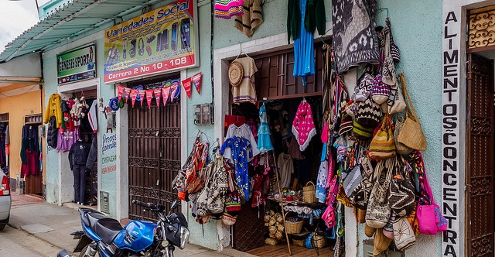
The Learning Black Market
“It’s like a taboo I guess with all teachers, they just all say – you know, when they explain the paper they always say, ‘Don’t use Wikipedia.’”
(Digital Visitors and Residents, USU7, Female, Age 19, Political Science)
Image: https://www.flickr.com/photos/alschim/16160481959 by Alexander Schimmeck / CC BY-NC-ND 2.0
Notes:
Image: https://www.flickr.com/photos/alschim/16160481959 by Alexander Schimmeck / CC BY-NC-ND 2.0
“I go to Wikipedia, scroll down to the bottom, and there’s like references that Wikipedia used and I click on those references and like check those links. Cause I’m like ‘that’s the fastest way to find a good link.’ Cause like if I’m gonna search like, I don’t know heart attack cases or something. Like that’s gonna take me forever to find like, a good website, or book to talk about what I’m looking for when I can just type in Wikipedia like, heart attacks or something, scroll to the bottom, there’s already books and websites there for me.” (Digital Visitors and Residents, 2USU1, Emerging, Male, Age 18, Engineering)

Slide 20
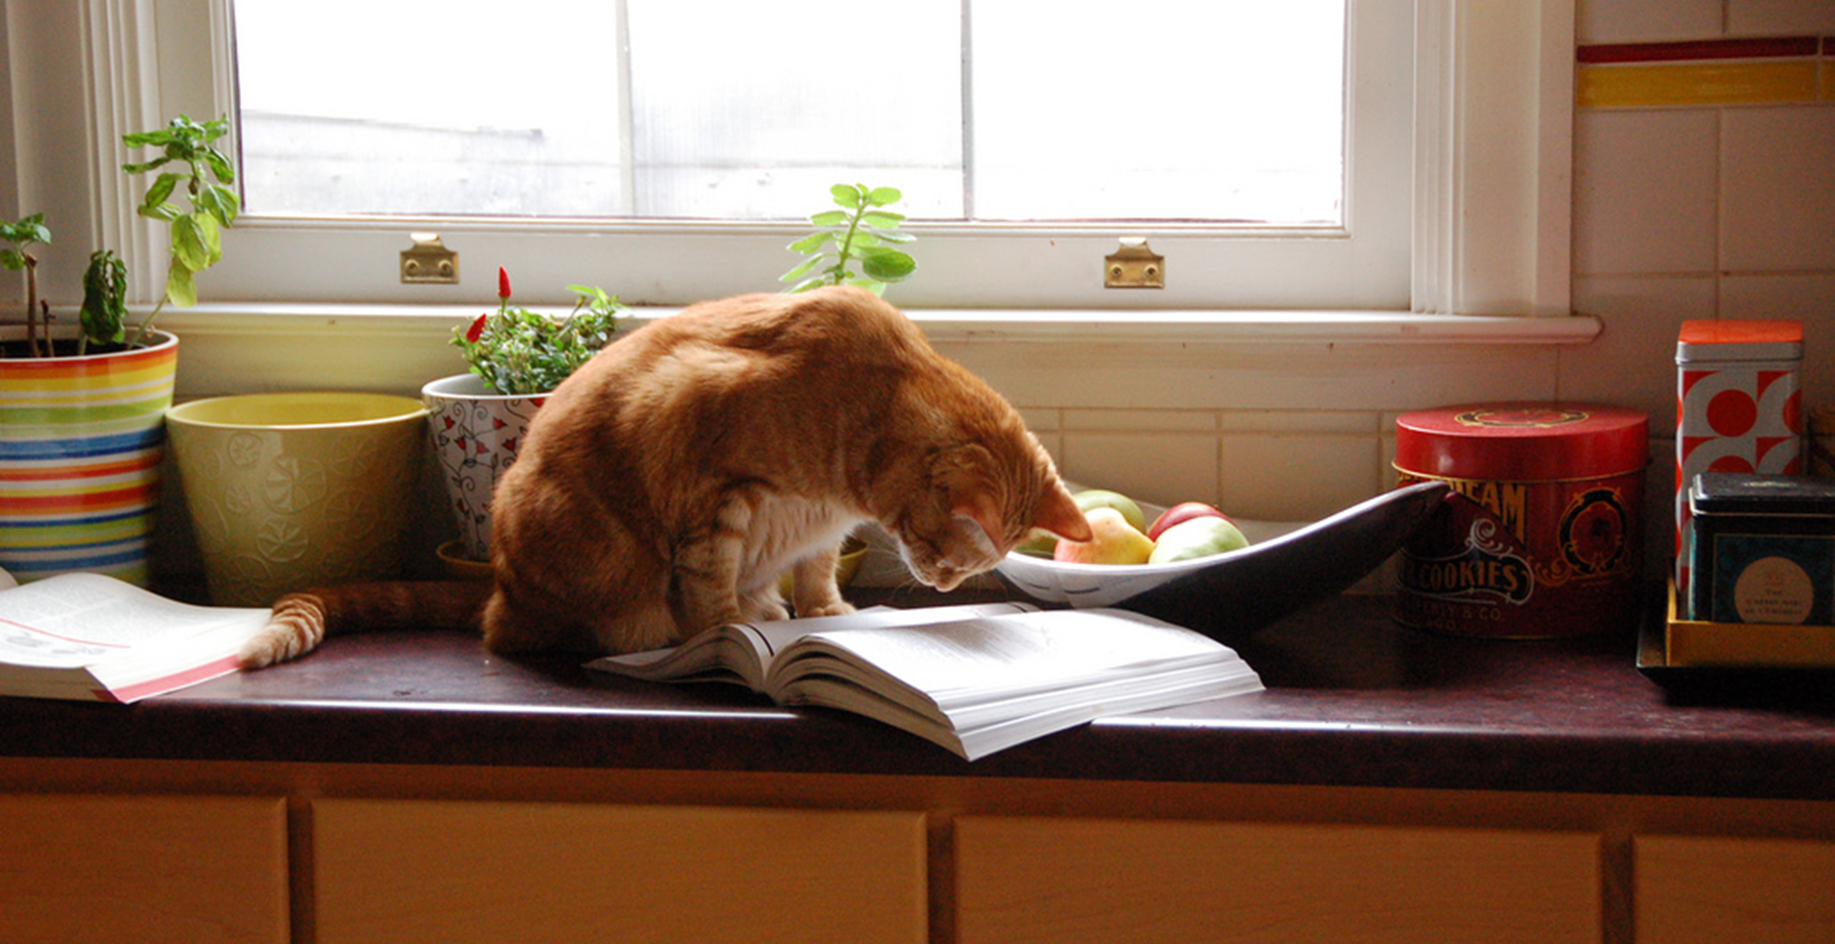
“Convenient” Isn’t Always Simple
“At first I started looking online, and it was a little bit overwhelming…I ended up reaching into my mom’s cupboard and using a recipe that I found in one of her old cookbooks. The recipe was just what I was looking for...”
(Digital Visitors and Residents, USS3, Emerging, Female, Age 17, High School Student)
Notes:
Image: http://www.flickr.com/photos/95792332@N00/3226023555 by Jacob Davies / CC BY-SA 2.0
“This morning I was looking for a homemade bread recipe that I could use to bake and then blog about. (I just started my own food blog: gritsgonegreen.wordpress.com). At first I started looking online, and it was a little bit overwhelming. There were so many different recipes with different flavors and crazy combinations. The one thing that was good about looking at the online recipes was viewing the user comments and seeing how people liked or disliked each recipe. I ended up reaching into my mom’s cupboard and using a recipe that I found in one of her old cookbooks. The recipe was just what I was looking for: it was a simple homemade white bread. I was about to search on the internet how to knead and punch bread, but I flipped the page, and there was a whole glossary of bread making terms. I must admit, I was a little bit surprised by the amount of information and instruction found in the cookbook. I thought I was going to have to look up an instructional video online.” (Digital Visitors and Residents, USS3, Emerging, Female, Age 17, High School Student)

Slide 21
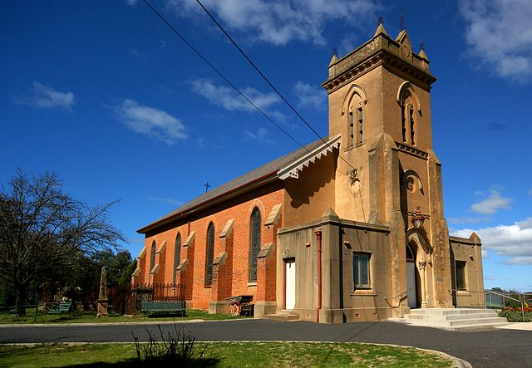
“You spend many hours with Saint Google. We entrust ourselves to Saint Google and that solves it for us.”
(Digital Visitors & Residents, UOCFI6, Male, Age 53, Arts & Humanities)
Image: https://commons.wikimedia.org/wiki/File:Holy_Trinity_Church_was_the_first_inland_church_in_Australia.jpg by Ian Sutton / CC BY 2.0 (Holy Trinity Anglican Church, Kelso, New South Wales, Australia)
Notes:
Image: https://commons.wikimedia.org/wiki/File:Holy_Trinity_Church_was_the_first_inland_church_in_Australia.jpg by Ian Sutton / CC BY 2.0 (Holy Trinity Anglican Church, Kelso, New South Wales, Australia)

Slide 22
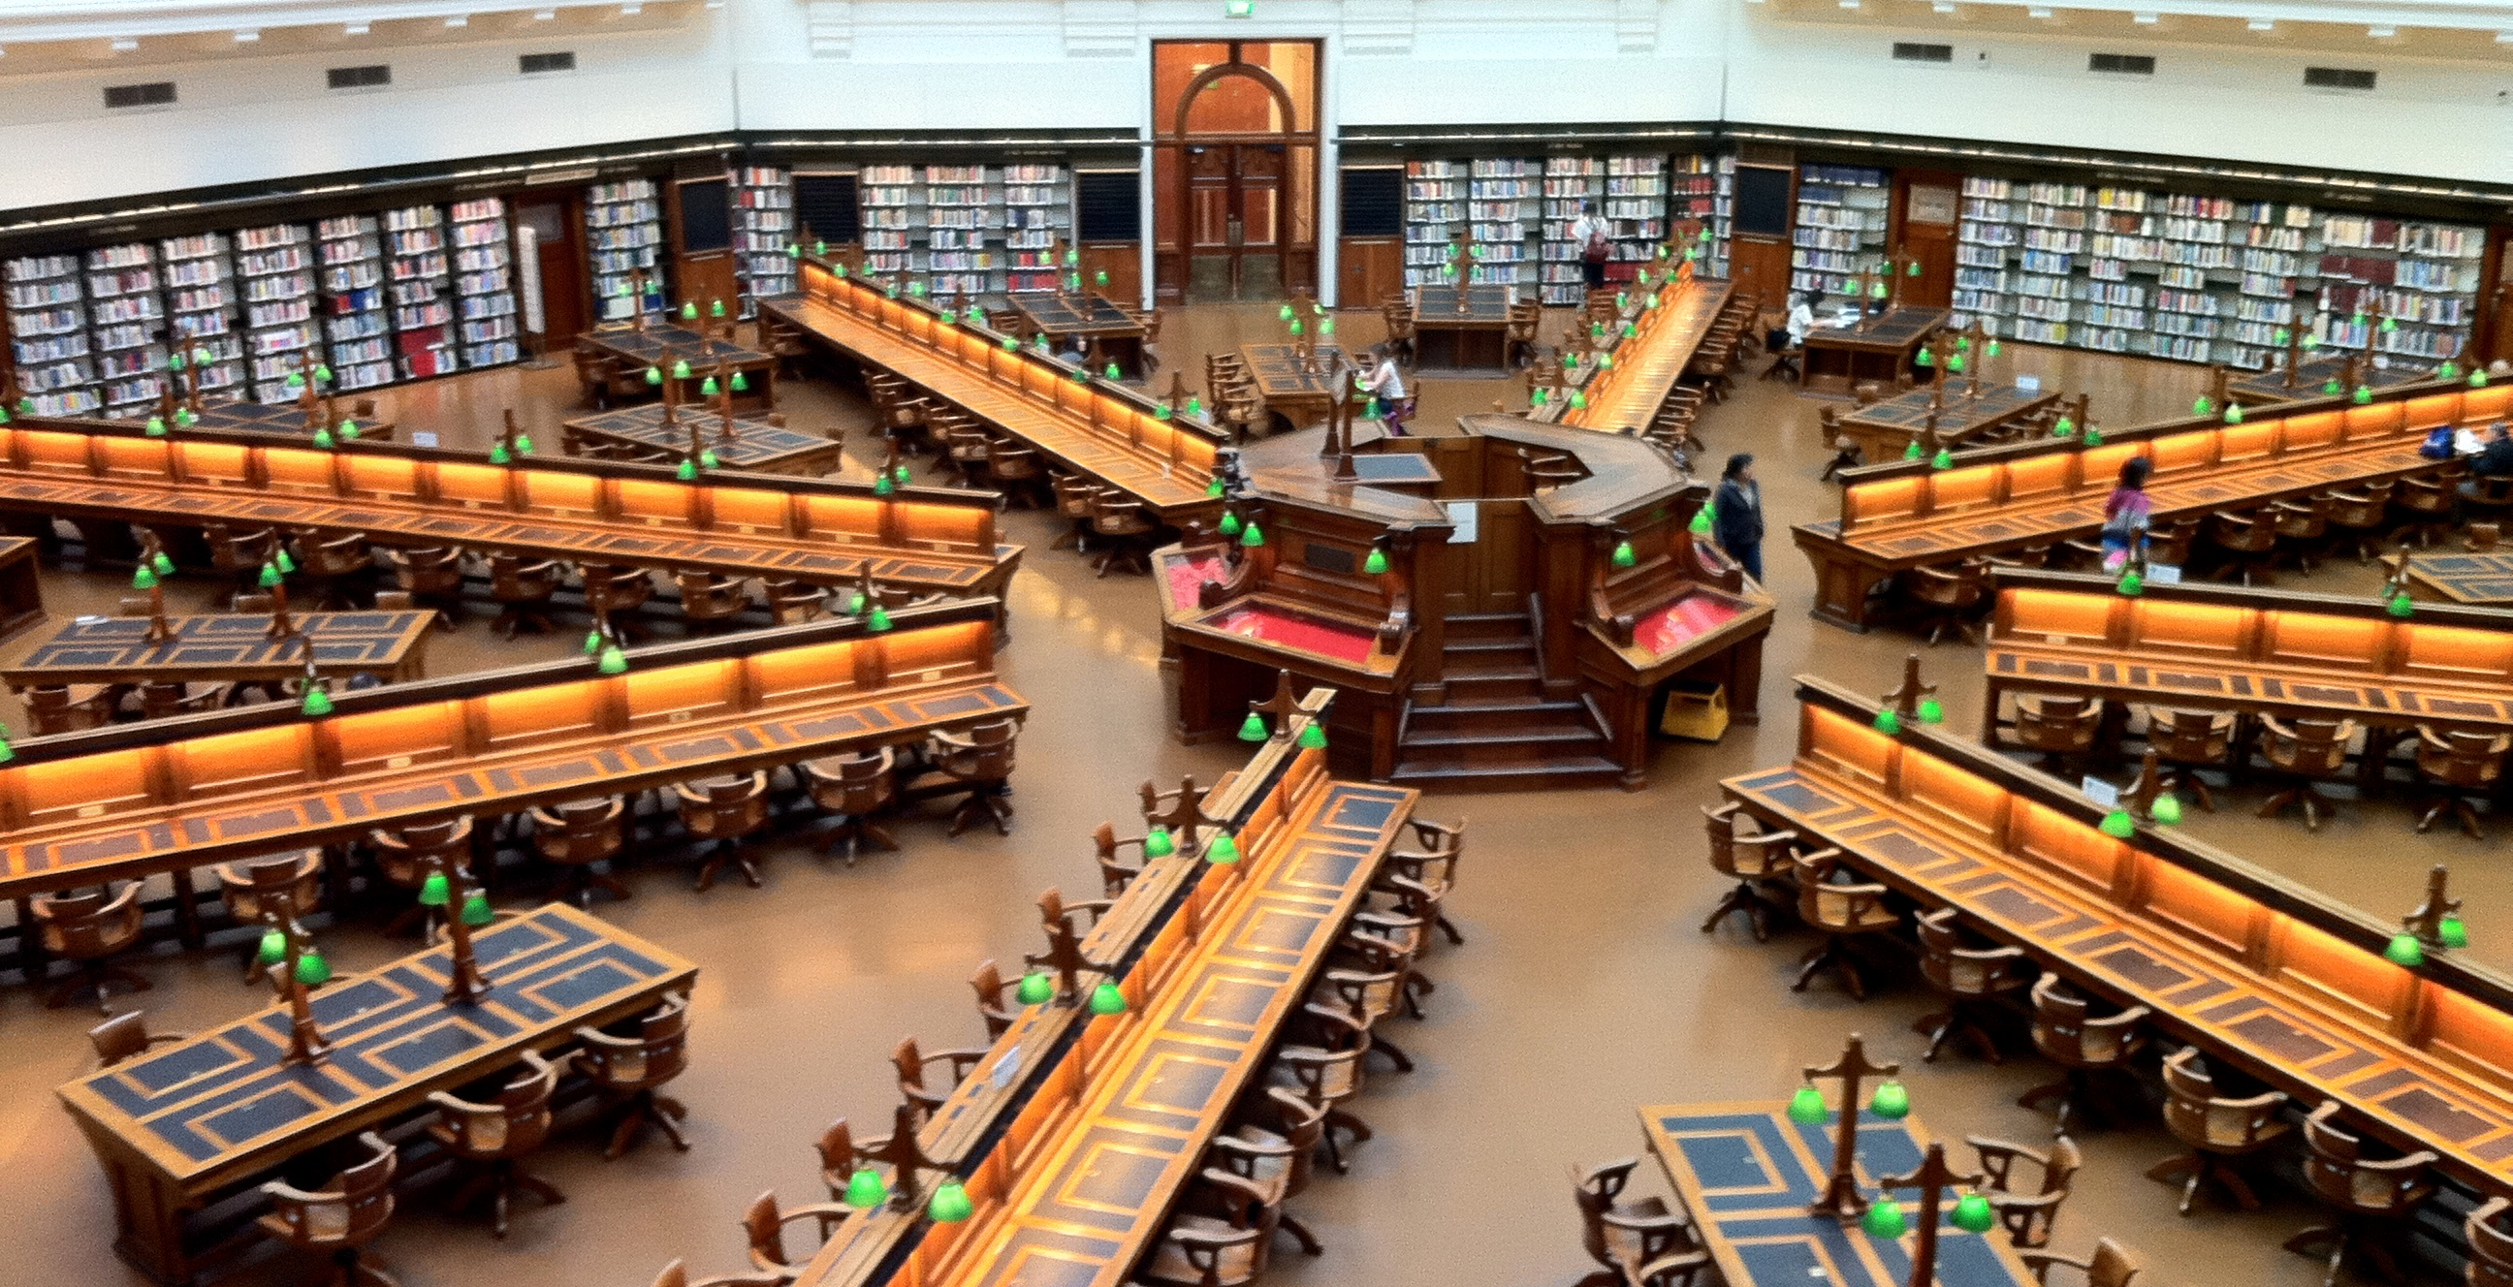
ACRL Value of Academic Libraries:
Action-oriented Research Agenda
  Association of College and Research Libraries. (2017). Academic Library Impact: Improving Practice and Essential Areas to Research, researched by Lynn Silipigni Connaway, William Harvey, Vanessa Kitzie, and Stephanie Mikitish.
  Project page: http://www.oclc.org/research/themes/user-studies/acrl-agenda.html
Image: https://www.flickr.com/photos/volker-kannacher/5464198864/ by Volker Kannacher / CC BY-ND 2.0
Notes:
Image: https://www.flickr.com/photos/volker-kannacher/5464198864/ by Volker Kannacher / CC BY-ND 2.0
The State Library of Victoria. Melbourne, VIC, Australia.
Association of College and Research Libraries. (2017). Academic Library Impact: Improving Practice and Essential Areas to Research, researched by Lynn Silipigni Connaway, William Harvey, Vanessa Kitzie, and Stephanie Mikitish. http://www.oclc.org/research/themes/user-studies/acrl-agenda.html

Slide 23
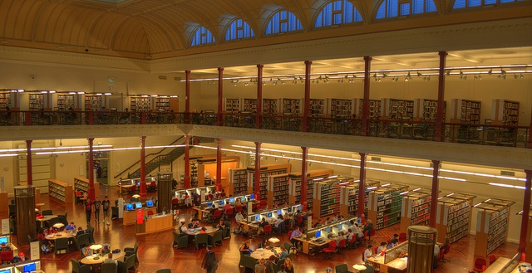
Provost Semi-Structured Interviews
What challenges do you see in the way the library staff communicates with the academic community, including students, faculty, and administration?
What do you think would facilitate communication between the library staff and your academic community, including students, faculty, and administration?
Image: https://www.flickr.com/photos/indigoskies/6791740490 by Indigo Skies Photography / CC BY-NC-ND 2.0
Notes:
Image: https://www.flickr.com/photos/indigoskies/6791740490 by Indigo Skies Photography / CC BY-NC-ND 2.0 (State Library of Victoria)
Association of College and Research Libraries. (2017). Academic Library Impact: Improving Practice and Essential Areas to Research, researched by Lynn Silipigni Connaway, William Harvey, Vanessa Kitzie, and Stephanie Mikitish. http://www.oclc.org/research/themes/user-studies/acrl-agenda.html

Slide 24
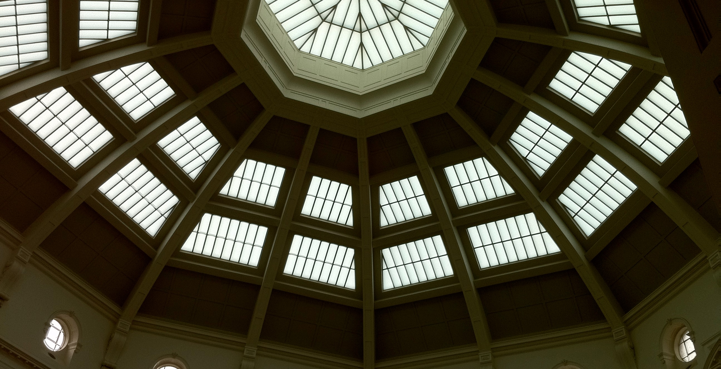
Communication
“[Librarians] have to be able to sell to the deans that this is something valuable that the deans want to be a part of, and the deans are going to be impacted by their faculty feeling like that this is a worthy thing because if we use money for one thing, we can’t use if for something else. I think customer service…becomes really important in this kind of environment.
(Provost Interviewee PP07, Research University, Secular, Public)
Image: https://www.flickr.com/photos/volker-kannacher/5464199416/ by Volker Kannacher / CC BY-ND 2.0
Notes:
Image: https://www.flickr.com/photos/volker-kannacher/5464199416/ by Volker Kannacher / CC BY-ND 2.0
The State Library of Victoria. Melbourne, VIC, Australia.
“[Librarians] have to be able to sell to the deans that this is something valuable that the deans want to be a part of, and the deans are going to be impacted by their faculty feeling like that this is a worthy thing because if we use money for one thing, we can’t use if for something else. I think customer service…becomes really important in this kind of environment.
(Provost Interviewee PP07, Research University, Secular, Public)
Association of College and Research Libraries. (2017). Academic Library Impact: Improving Practice and Essential Areas to Research, researched by Lynn Silipigni Connaway, William Harvey, Vanessa Kitzie, and Stephanie Mikitish. http://www.oclc.org/research/themes/user-studies/acrl-agenda.html

Slide 25

Image: https://www.flickr.com/photos/lifeofrobert/3894022267 by *Robert* / CC BY-SA 2.0
Focus Group Interviews
Group interviews
A lot of data in little time
Small time commitment for participants and researchers
Possibility of “groupthink” or self-censoring in the group setting
(Asher & Miller, 2011, 15)
Notes:
Image: https://www.flickr.com/photos/lifeofrobert/3894022267 by *Robert* / CC BY-SA 2.0
“Suggested guidelines include the following:
This is an open, safe, and secure forum.
Confidentiality of others should be respected.
All suggestions are acceptable.
Be patient with fellow group members (speak one at a time, no interruptions).
Be an active listener and participant.
Ask questions if necessary.” (Connaway & Radford, 2017, 252-253)
Asher, A., & Miller, S. (2011). So you want to do anthropology in your library? Or a practical guide to ethnographic research in academic libraries. Chicago: The ERIAL Project.
Connaway, L. S., & Radford, M. L. (2017). Research methods for library and information science (6th ed.). Westport, CT: Libraries Unlimited.

Slide 26
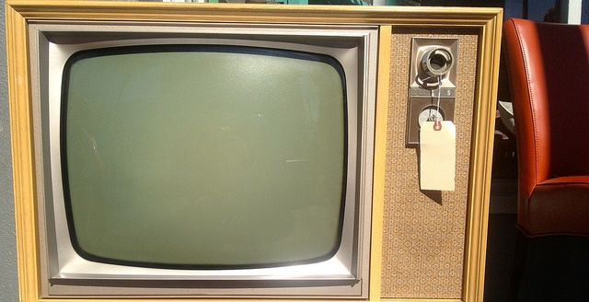
ACRL Research Agenda
If you had a magic wand, how would you better communicate and make your administration, faculty, and students more aware of the services the library offers and their impact on student learning and success?
What else would you like to share about:
  How your library supports the mission of your larger institution?
  How you communicate this support to your institution’s administration?
  How you articulate value to your institution’s administration?
Image: https://www.flickr.com/photos/lynnfriedman/8649862101 by Lynn Friedman / CC BY-NC-ND 2.0
Notes:
Image: https://www.flickr.com/photos/lynnfriedman/8649862101 by Lynn Friedman / CC BY-NC-ND 2.0
Association of College and Research Libraries. (2017). Academic Library Impact: Improving Practice and Essential Areas to Research, researched by Lynn Silipigni Connaway, William Harvey, Vanessa Kitzie, and Stephanie Mikitish. http://www.oclc.org/research/themes/user-studies/acrl-agenda.html

Slide 27
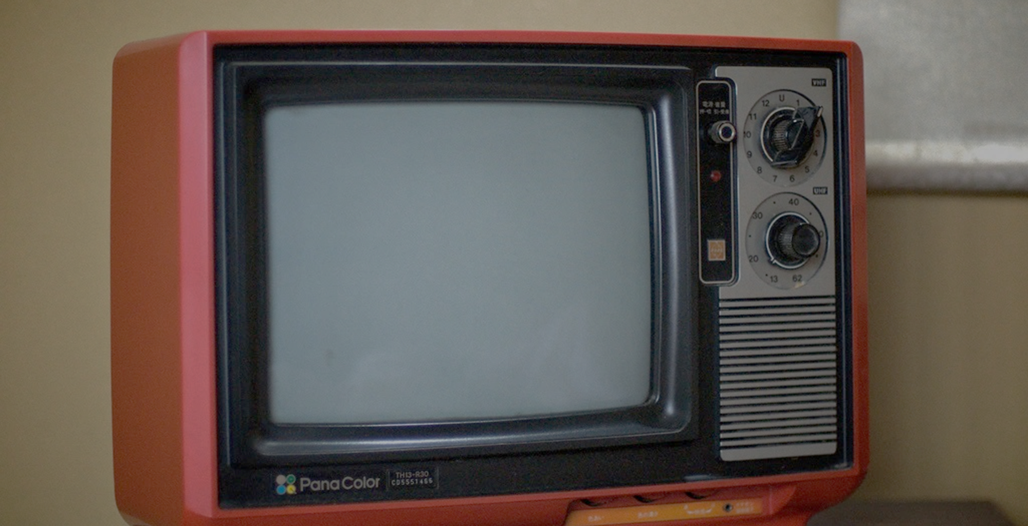
“…the whole kind of conversation around fake news is this really important example of how important it is in our daily life and civic health in order to bring critical skills to bear on understanding information and being able to critically evaluate the source of that.”
(Advisory Member LM03, Research University, Secular, Private)
Image: https://www.flickr.com/photos/mxmstryo/3507201141/ by mxmstryo / CC BY 2.0
Notes:
Image: https://www.flickr.com/photos/mxmstryo/3507201141/ by mxmstryo / CC BY 2.0
“If I’m understanding you correctly, the whole kind of conversation around fake news is this really important example of how important it is in our daily life and civic health in order to bring critical skills to bear on understanding information and being able to critically evaluate the source of that.” (Advisory Member LM03, Research University, Secular, Private)
Association of College and Research Libraries. (2017). Academic Library Impact: Improving Practice and Essential Areas to Research, researched by Lynn Silipigni Connaway, William Harvey, Vanessa Kitzie, and Stephanie Mikitish. http://www.oclc.org/research/themes/user-studies/acrl-agenda.html

Slide 28
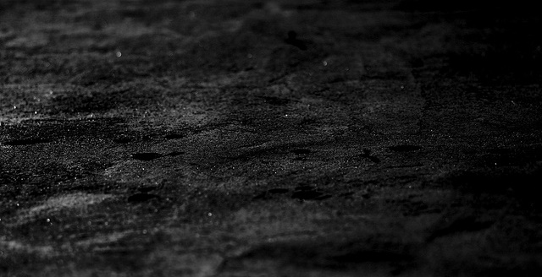
Seeking Synchronicity:
Evaluating Virtual Reference Services from User,
Non-User, and Librarian Perspectives
Funded by IMLS, OCLC, and Rutgers University
Four phases:
  Focus group interviews
  Analysis of 850 QuestionPoint live chat transcripts
  Online surveys
    137 VRS Users
    175 VRS librarians
    184 VRS Non-users
  Telephone interviews
    76 VRS Users
    100 VRS librarians
    107 VRS Non-users
Image: https://www.flickr.com/photos/pagedooley/7427165626 by Kevin Dooley / CC BY 2.0
Notes:
Image: https://www.flickr.com/photos/pagedooley/7427165626 by Kevin Dooley / CC BY 2.0
Synthesizing “Seeking Synchronicity”
Going back to 2005, our research of the use of virtual reference (VR) has had one primary goal: to deliver research-based recommendations that will improve the service that information professionals provide. The purpose of this publication is to distill several years’ and several hundred pages’ worth of work into a few very specific, easily digestible, actionable suggestions for how you can sustain and develop your VR services and systems (Radford and Connaway 2005–2008a).
As stated, this publication boils down many research projects done by many researchers, at OCLC, Rutgers University and elsewhere. For those of you interested in the long version, please take some time with the bibliography at the end of this work and especially check out the Seeking Synchronicity website http://www.oclc.org/research/activities/synchronicity/). For those of you who want the “abridged version of the short version,” here it is—what we learned, presented so you can quickly understand and apply our research findings to immediately improve your VR experiences.
What went into the original research
The project “Seeking Synchronicity: Evaluating Virtual Reference Service from User, Non-User, and Librarian Perspectives” was funded by the Institute of Museum and Library Services (IMLS); Rutgers, The State University of New Jersey; and OCLC Online Computer Library Center, Inc. It consisted of four phases of data collection and analysis, lasting from October 1, 2005 to March 29, 2008 (Radford and Connaway 2005–2008a). It used a logical sequence in the process of data collection, with each phase informing the next. A range of qualitative and quantitative methods of analysis were used.
Phase I:
We conducted a total of eight focus group interviews, two each with VRS librarians and users, and four with non-users. Three of the non-user focus group interviews were with the youngest members of the “Millennial” Generation, born between 1979 and 1994. The responses from the youngest Millennials, used here for those ages 12–18 and known as “screenagers,” (Rushkoff 1996) suggested that this group had different expectations for services and systems than the other demographic groups. The focus group sessions were transcribed, and we extracted major themes from the data. Results were used to inform construction of the online survey and telephone
interview instruments. Millennials also were specifically recruited for the online surveys and telephone interviews.
Phase II:
We gathered VRS transcripts from the 24/7 Reference Cooperative and OCLC QuestionPointdatabases in two subphases. From July 2004 through June 2005, a random sample of 25 transcripts was taken each month from a database of nearly 264,000 VRS sessions. In addition to these 300 transcripts, a second random sample of approximately 50 transcripts was taken from a database of more than 250,000 VRS sessions for each month between December 2005 and November 2006, resulting in an additional 550 transcripts. The VRS transcripts contained a wealth of information,and these data were used to expand existing coding schemes and to construct new ones. The transcripts were analyzed for the following: interpersonal communication behaviors, accuracy, type of question, subject of question, length of interaction, type of library, wait time, and query clarification behaviors and techniques. As a direct result of the transcript analysis, we created and applied two new coding schemes, including the Query Clarification Coding Scheme and the Ready Reference Accuracy Coding Scheme.
Phase II:
We developed online survey instruments from focus group interview data, and from the initial research questions. A separate online survey was developed and pretested for each of the three cohort groups—VRS librarians, users of VRS and non-users of VRS. Participants completed a total of 496 online surveys. The respondents in each demographic category provided answers for questions that resulted in both quantitative and qualitative data.
Phase IV:
Telephone interview questions for all three groups were developed from participant responses in the focus group interviews and to the online surveys, as well as from the initial research questions. We then developed a separate set of interview questions and pretested for each of the three study groups. A total of 283 telephone interviews were completed.
Radford, M. L., and Connaway, L. S. (2005–2008). Seeking synchronicity: Evaluating virtual reference services from user, non-user, and librarian perspectives. Funded by the Institute of Museum and Library Services (IMLS). https://www.oclc.org/research/publications/all/synchronicity.html.

Slide 29
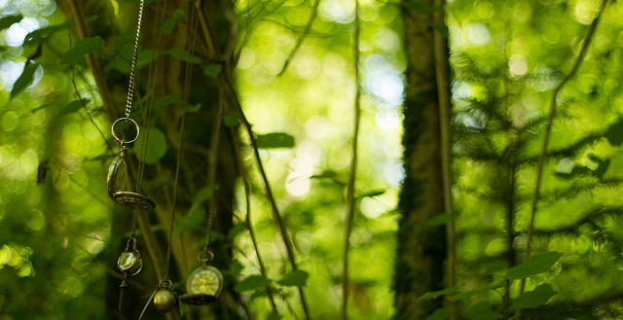
VRS User Focus Group Questions
What do you like best about VRS?
What don’t you like about VRS?
What most influences your decision to use VRS?
How would you like to see VRS improved?
How would you compare your VRS experiences to face-to-face, email, or phone interactions with librarians?
When you decide to seek help from a librarian, how do you decide which format to use?
Image: https://www.flickr.com/photos/151072996@N08/36066193431 by melisa launay / CC BY-ND 2.0
Notes:
Image: https://www.flickr.com/photos/151072996@N08/36066193431 by melisa launay / CC BY-ND 2.0
Radford, M. L., and Connaway, L. S. (2005–2008). Seeking synchronicity: Evaluating virtual reference services from user, non-user, and librarian perspectives. Funded by the Institute of Museum and Library Services (IMLS). https://www.oclc.org/research/publications/all/synchronicity.html.

Slide 30
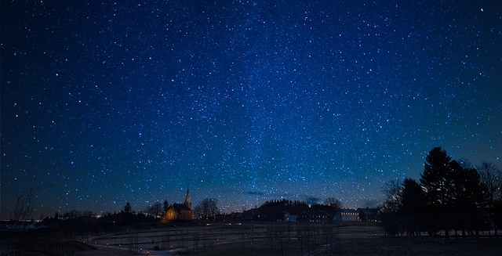
Image: https://www.flickr.com/photos/jonasbg/16616901033 by Jonas Grimsgaard / CC BY-NC-ND 2.0
“I was on the site (VR) at 2 or 3 in the morning and it felt personalized. I don’t know, I felt like I was the only person the other person had to talk to and they took the time out.”
(Seeking Synchronicity focus group participant)
Notes:
Image: https://www.flickr.com/photos/jonasbg/16616901033 by Jonas Grimsgaard / CC BY-NC-ND 2.0
Radford, M. L., and Connaway, L. S. (2005–2008). Seeking synchronicity: Evaluating virtual reference services from user, non-user, and librarian perspectives. Funded by the Institute of Museum and Library Services (IMLS). https://www.oclc.org/research/publications/all/synchronicity.html.

Slide 31

“I’ve always thought that the library was a good source if you have a few months to spend on a paper.”
(Seeking Synchronicity focus group participant)
Image: https://www.flickr.com/photos/hinnosaar/4802911749 by Marti & Toomas Hinnosaar / CC BY 2.0
Notes:
Image: https://www.flickr.com/photos/hinnosaar/4802911749 by Marti & Toomas Hinnosaar / CC BY 2.0
Radford, M. L., and Connaway, L. S. (2005–2008). Seeking synchronicity: Evaluating virtual reference services from user, non-user, and librarian perspectives. Funded by the Institute of Museum and Library Services (IMLS). https://www.oclc.org/research/publications/all/synchronicity.html.

Slide 32
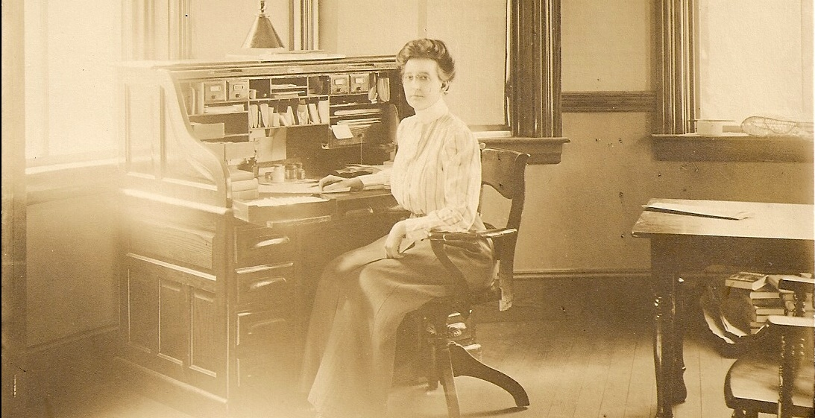
Image: https://www.flickr.com/photos/derrypubliclibrary/3762251190 by derrypubliclibrary / CC BY 2.0
“It’s like, it’s like, you don’t want to go “So which shelf are you pointing at?” Because, I mean, once they do their famous point, it’s just like…”
(Seeking Synchronicity focus group participant)
Notes:
Image: https://www.flickr.com/photos/derrypubliclibrary/3762251190 by derrypubliclibrary / CC BY 2.0
“And then cause you’ve already asked them, you don’t want to feel like you’re pestering them too much so you don’t go and ask them again. It’s like, it’s like, you don’t want to go “So which shelf are you pointing at?” Because, I mean, once they do their famous point, it’s just like…(laughs)” (Seeking Synchronicity, Focus Group 6 participant, Female, High School Student)
Radford, M. L., and Connaway, L. S. (2005–2008). Seeking synchronicity: Evaluating virtual reference services from user, non-user, and librarian perspectives. Funded by the Institute of Museum and Library Services (IMLS). https://www.oclc.org/research/publications/all/synchronicity.html.

Slide 33
diaries

Slide 34

Diaries
Keep directions minimal and open
Offer participants a variety of ways to report
  Written
  Photo
  Video
  Audio
Data can be rich and detailed, but is self-reported
Does not require researcher presence
(Connaway & Radford, 2017)
Image: https://www.flickr.com/photos/10154402@N03/8421806383 by Bruce Guenter / CC BY 2.0
Notes:
Image: https://www.flickr.com/photos/10154402@N03/8421806383 by Bruce Guenter / CC BY 2.0
Connaway, L. S., & Radford, M. L. (2017). Research methods for library and information science (6th ed.). Westport, CT: Libraries Unlimited.

Slide 35
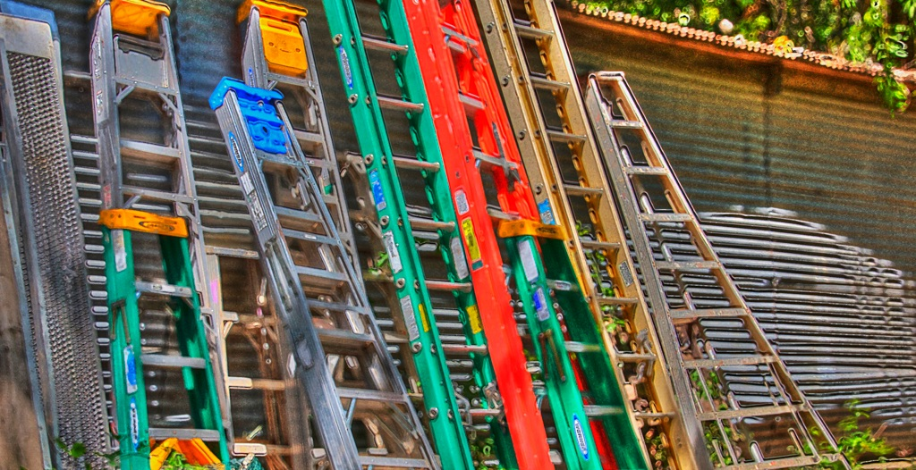
V&R Diary Template
Explain a time in the past month when you were SUCCESSFUL in completing an ACADEMIC assignment. What steps did you take?
Think of a time fairly recently when you struggled to find appropriate resources to help you complete an ACADEMIC assignment. What happened?
Notes:
Image: https://www.flickr.com/photos/elliotmar/8913124849 by Elliot Margolies / CC BY-NC-ND 2.0
Explain a time in the past month when you were SUCCESSFUL in completing an ACADEMIC assignment. What steps did you take?
Think of a time fairly recently when you struggled to find appropriate resources to help you complete an ACADEMIC assignment. What happened?
Explain a time in the past month when you were successful in getting what you needed in a PERSONAL situation. What steps did you take?
Explain a time in the past month when you were NOT successful in getting what you needed in a PERSONAL situation. What steps did you take?
Tell me something interesting that has happened in the past month in the social media that you used for ACADEMIC purposes.
Tell me something interesting that has happened in the past month in the social media that you used for PERSONAL situations.
What do you have to add to our discussion today about how you got information in the past month for both PERSONAL and ACADEMIC situations?
White, D. S., & Connaway, L. S. (2011-2014). Visitors & Residents: What motivates engagement with the digital information environment. Funded by JISC, OCLC, and Oxford University. http://www.oclc.org/research/activities/vandr/

Slide 36
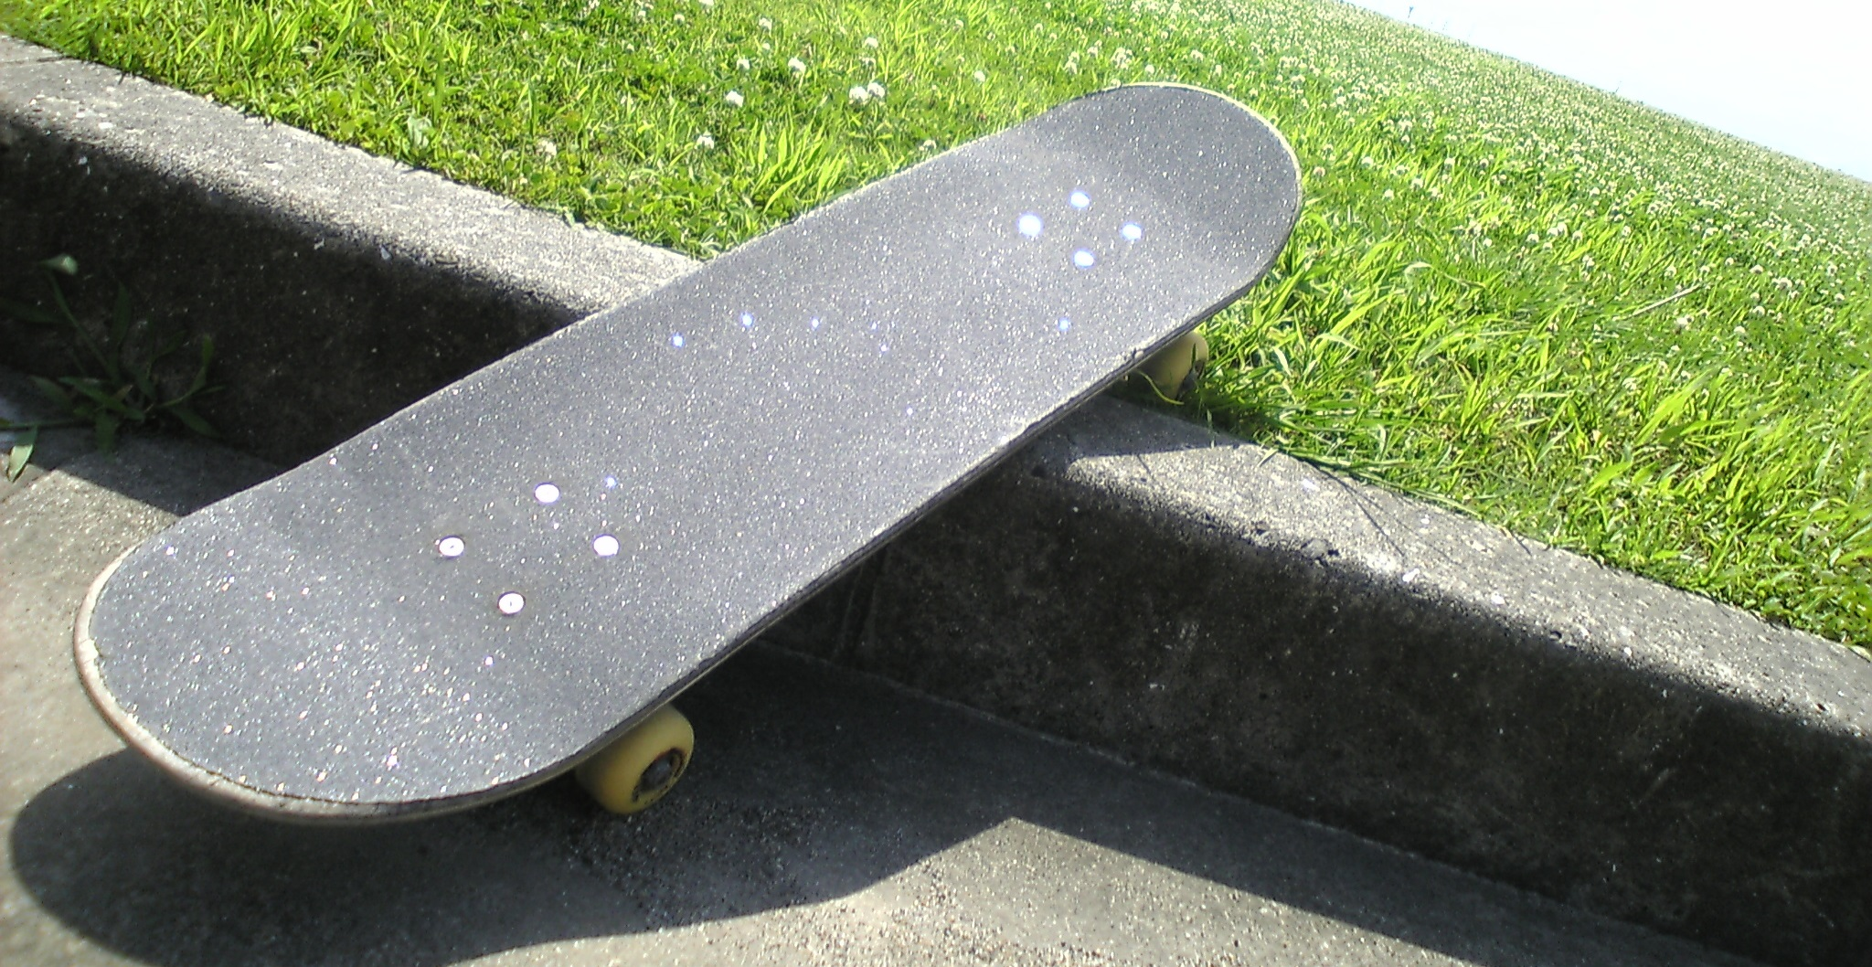
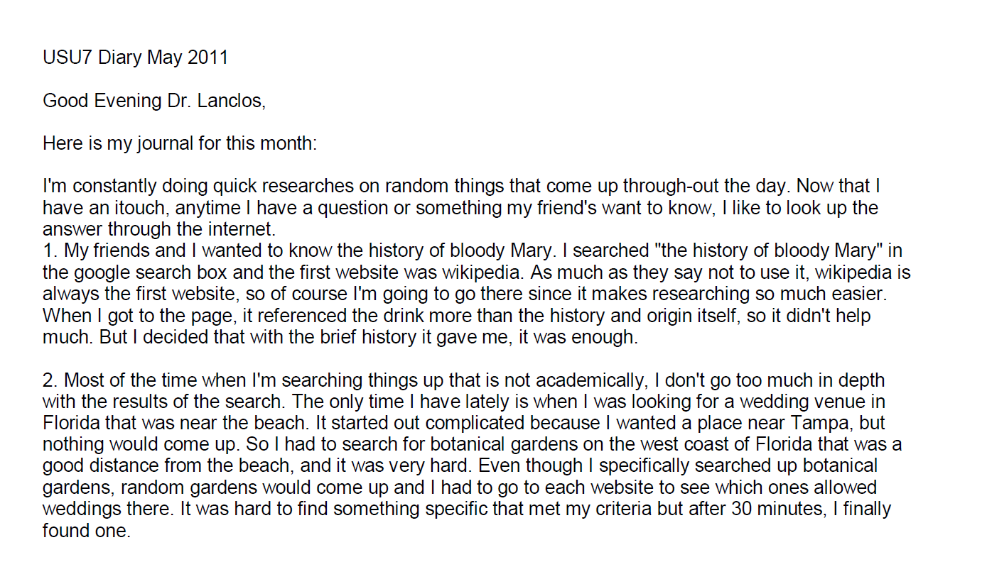
Example: Digital Visitors and Residents Diaries
Notes:
Image: https://www.flickr.com/photos/dancingpapa2007/3674686528 by Naoki Tomeno / CC BY 2.0
Screenshot: USU7 Emg Dry1 Ph1 (Digital Visitors and Residents, USU7, Female, Age 19)
“March was a little more serious. We’re nearing election time and all that jazz, and this is the first election I’ll be able to vote in, so I’ve been doing a bit of reading on a few of the candidates (not much, mind you). As a side note, I’m kind of debating whether or not I should actually vote in this election since I have such little knowledge on the candidates.” (Digital Visitors and Residents, USU12, Male, Age 19) USU12 Est Dry2 Ph2
“Um they do have a search box but I didn’t—I didn’t use that. Um I pretty much just, I pretty much just clicked links.” (Digital Visitors and Residents, USU12, Male, Age 19, 30:37) USU12 Est Follup Int1 Ph3
White, D. S., & Connaway, L. S. (2011-2014). Visitors & Residents: What motivates engagement with the digital information environment. Funded by JISC, OCLC, and Oxford University. http://www.oclc.org/research/activities/vandr/

Slide 37
Observations

Slide 38
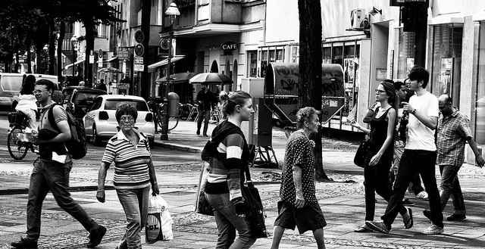
Image: https://www.flickr.com/photos/anjan58/7346141798 by anjan58 / CC BY-NC-ND 2.0
Observation
“Perhaps the most convenient method of studying the consequences of this law will be to follow the reader from the moment he enters the library to the moment he leaves it…”
(Ranganathan, 1931, 337)
Notes:
Image: https://www.flickr.com/photos/anjan58/7346141798 by anjan58 / CC BY-NC-ND 2.0
Save time of the reader, previously #4, is now more important (#1) (107)
Connaway, L. S., & Faniel, I. M. (2014). Reordering Ranganathan: Shifting user behaviors, shifting priorities. Dublin, OH: OCLC Research. http://www.oclc.org/content/dam/research/publications/library/2014/oclcresearch-reordering-ranganathan-2014.pdf
Ranganathan, S. R. (1931). The five laws of library science. London: Edward Goldston, Ltd.

Slide 39
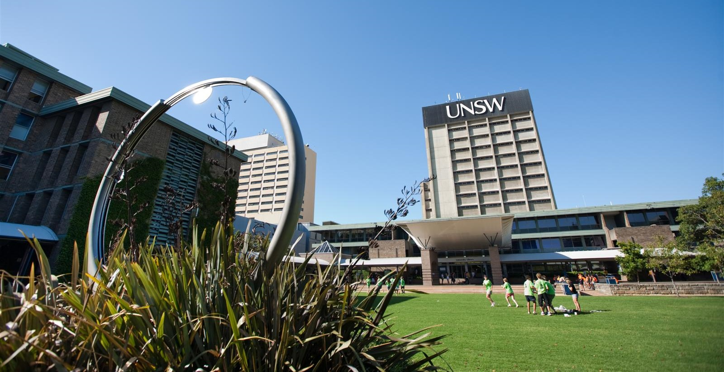
Participant/Immersive Observations
Move into the setting as deeply as possible
Disturb participants as little as possible
Participant observation
  Open, direct interaction and observation as part of the group
Structured vs. unstructured
(Connaway & Radford, 2017)
Image: https://www.flickr.com/photos/njla/3306454031/ by NJLA: New Jersey Library Association / CC BY-NC-ND 2.0
Notes:
Image: https://www.flickr.com/photos/unsw/3751669200/ by unsw.flickr / CC BY 2.0
(UNSW Library Lawn with clock and library tower. Kensington, NSW, Australia)
Example of participant observation: researcher appears to reference librarians as a patron.
Connaway, L. S., & Radford, M. L. (2017). Research methods for library and information science (6th ed.). Westport, CT: Libraries Unlimited.

Slide 40
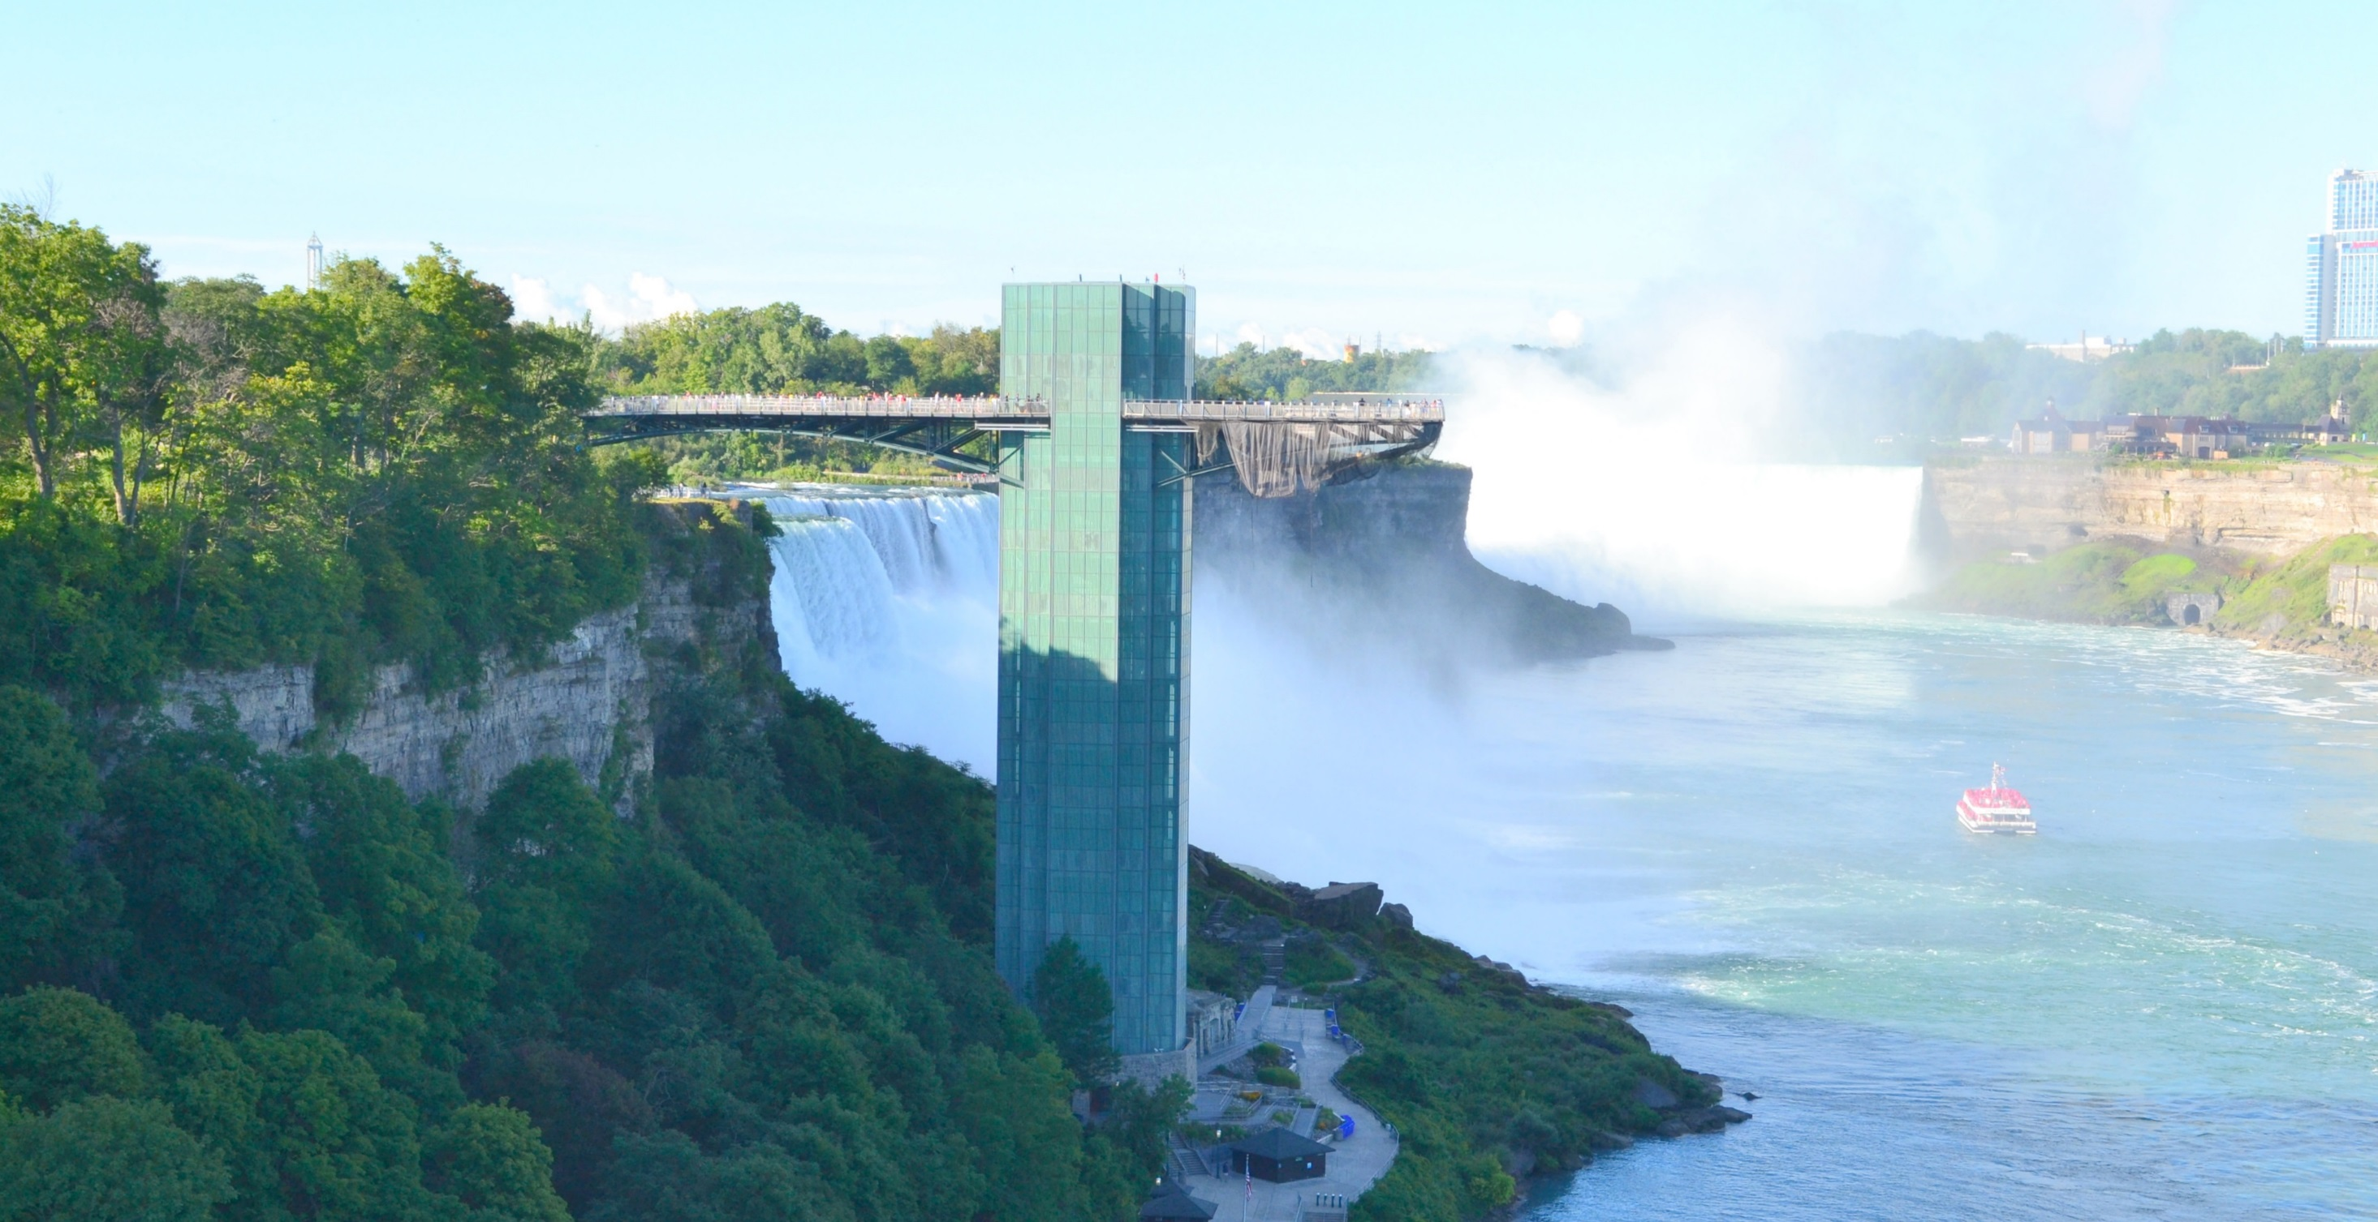
WebJunction Structured Observations
Scenario and Task 1
You are interested in taking free courses from the WebJunction course catalog. Please go to the first task.
Please go to webjunction.org before proceeding You are interested in participating in free courses and webinars offered by WebJunction. A. Find where you can enroll in free library-specific courses and webinars.
(Connaway & Radford, 2017, p. 274)
Notes:
Image: https://www.flickr.com/photos/larrywkoester/21500417954 by Larry Koester / CC BY 2.0
Task 1 Usability Questions: From WebJunction.org, is the user able to easily:
Navigate to learn.wenjunction.org in order to access the course catalog?
Find the link to the catalog?
Task 1 Quantitative Measures: User completes task correctly by
(A1) Opening the “Find Training” menu (Y or N)
(A2) Clicking the link “Go to Courses” to get to the course catalog option (Y or N)
OR
(B1) Entering search terms to get to the course catalog option (Y or N)
Connaway, L. S., & Radford, M. L. (2017). Research methods for library and information science (6th ed.). Westport, CT: Libraries Unlimited.

Slide 41
Mapping

Slide 42
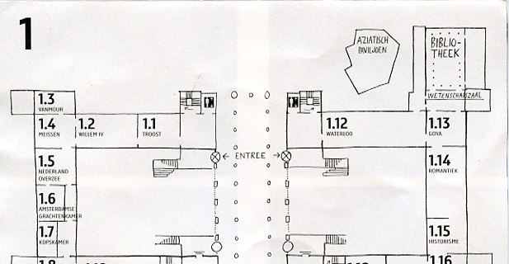
Image: https://www.flickr.com/photos/dutchsimba/15704925354 by Dutch Simba / CC BY-NC-ND 2.0
Cognitive Mapping
Participant draws a map of the area of interest
Fast and easy to conduct
Small time commitment from participants
Can be ambiguous or difficult to interpret
Notes:
Image: https://www.flickr.com/photos/dutchsimba/15704925354 by Dutch Simba / CC BY-NC-ND 2.0
Asher, A., & Miller, S. (2011). So you want to do anthropology in your library? Or a practical guide to ethnographic research in academic libraries. Chicago: The ERIAL Project.

Slide 43
Mapping Diaries
Give participants a map & ask them to record their movements
Can use maps as basis for individual interviews
(Clark, 2007, p. 49)
Notes:
Clark, K. (2007). Mapping diaries, or where do they go all day? In N. Foster & S. Gibbons (Eds.), Studying Students: The Undergraduate Research Project at the University of Rochester. Chicago: Association College and Research Libraries.

Slide 44
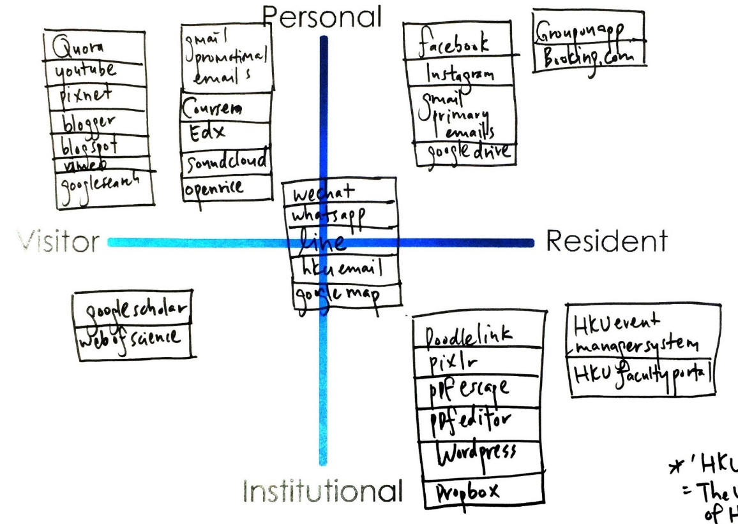
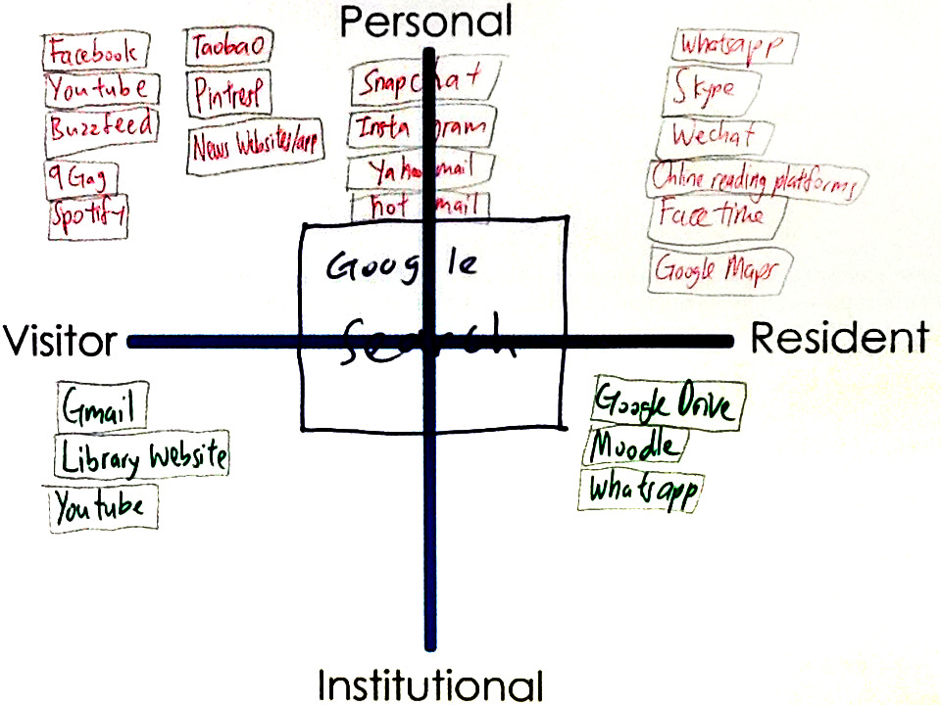
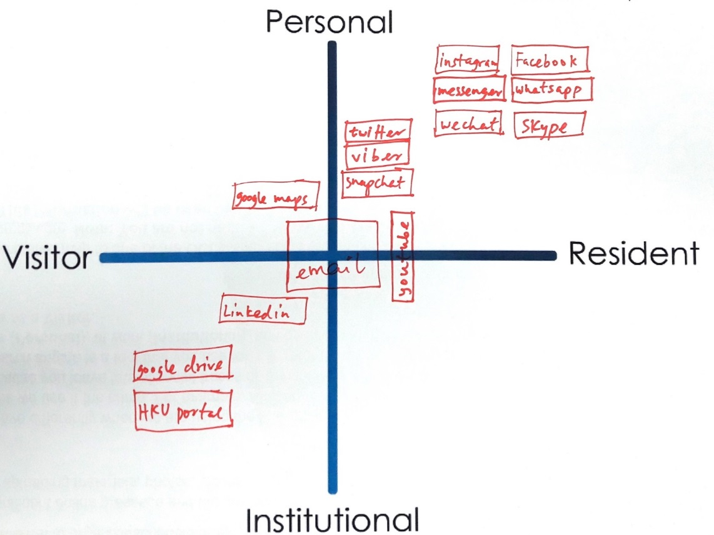
Mapping
Visitors and Residents Sample Maps
Notes:
Quadrant 1:
HKU, 1st year undergrad
Realized I am not that hard working
In desperation when I have to directly go to library website
Google search: usually don’t login, just search, more on visitor side
Snapchat …Hotmail : Not too often do sharing
A way to release my burden
FB try not to post/share, look at what my friends share
Quadrant 2:
HKU, upper undergrad
Library- Borrow book for personal
Google drive – only for group project (visitor)
Social media apps make us anti – social
Quadrant 3:
HKU, faculty researcher and/or scholar
Research assistant
Least Digital footprint as possible, substantial, good thing to live (the left side of the map)
Middle – use a lot in work, create contacts
Use HKU specific apps for work, wordpress, create webpage
Learn about yourself: need to learn more & contribute more in digital footprint (at work and in personal)
White, D. S., & Connaway, L. S. (2011-2014). Visitors & Residents: What motivates engagement with the digital information environment. Funded by JISC, OCLC, and Oxford University. http://www.oclc.org/research/activities/vandr/

Slide 45
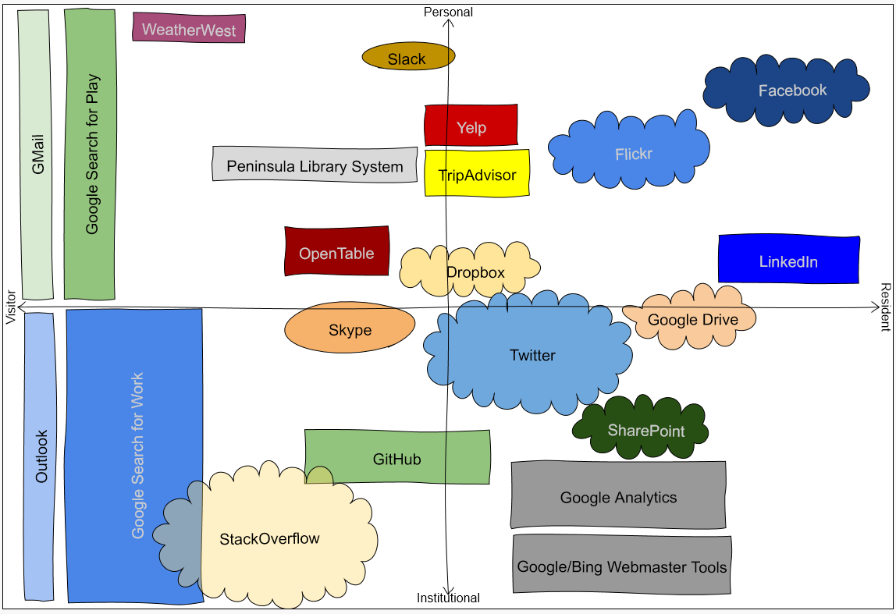

http://oc.lc/vrmap
Notes:
1. To use the app, go to “http://oc.lc/vrmap” – you can do it on paper
If you like it, share it!

Slide 46
Novel mixed Methods

Slide 47


Researching Students’ Information Choices (RSIC): Determining Identity and Judging Credibility in Digital Spaces
4-year IMLS funded National Leadership Grant #LG-81-15-0155
Research questions:
  Do STEM students differentiate among different types of digital resources at point of selection?
  How do STEM students determine the credibility of digital resources?
Image: https://www.maxpixel.net/Australia-Skyline-Architecture-City-Port-Sydney-3939261 / Public Domain
http://guides.uflib.ufl.edu/RSIC
Notes:
Image: https://www.maxpixel.net/Australia-Skyline-Architecture-City-Port-Sydney-3939261 / Public Domain (Sydney Port Skyline)
This research project is a 4-year IMLS-funded project that started December 1, 2015
Our focus is on students working in the science, technology, engineering, and mathematics (STEM) disciplines. The students range from grade school to graduate school.
Back in 2007 Williams and Rowland published a literature review about the information behavior of young people. A key conclusion was that the “Google generation are format agnostic and have little interest in the containers (reports, book chapters, encyclopedia entries).” They went on to say that this area is “still wide open” and “a hugely important issue for libraries and publishers.”
Motivated by this conclusion and prior work by our collaborators at the University of Florida, we posed the research questions you see.
Buhler, A., Cataldo, T. T., Faniel, I. M., Connaway, L. S., Valenza, J. K., Graff, R., Elrod, R., Putnam S., Cyr C., Towler, C., Hood, E., Fowler R., Howland S., Brannon B, Langer, K., Kirlew, S. (2015-2018). Researching students’ information choices: Determining identity and judging credibility in digital spaces. IMLS Grant Project LG-81-15-0155. http://guides.uflib.ufl.edu/RSIC.

Slide 48
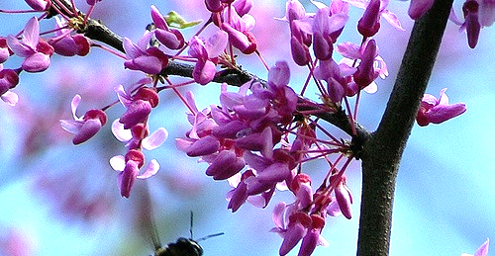
Image: https://www.flickr.com/photos/davidjthomas/1355156359 by Dave Thomas / CC BY-NC 2.0
Student Perspectives
“What’s a preprint?”
“I don’t really know if New York Times is a journal or a magazine.”
“I know this is a blog because it’s by a person that wrote it.”
“This is a journal … because of the feel of it looking like a scholarly article.”
“This one’s a blog. Or is it a journal. Or is it a book? It’s a journal.”
“This shouldn’t be so hard.”
Notes:
Image: https://www.flickr.com/photos/davidjthomas/1355156359 by Dave Thomas / CC BY-NC 2.0
Buhler, A., Cataldo, T. T., Faniel, I. M., Connaway, L. S., Valenza, J. K., Graff, R., Elrod, R., Putnam S., Cyr C., Towler, C., Hood, E., Fowler R., Howland S., Brannon B, Langer, K., Kirlew, S. (2015-2018). Researching students’ information choices: Determining identity and judging credibility in digital spaces. IMLS Grant Project LG-81-15-0155. http://guides.uflib.ufl.edu/RSIC.

Slide 49
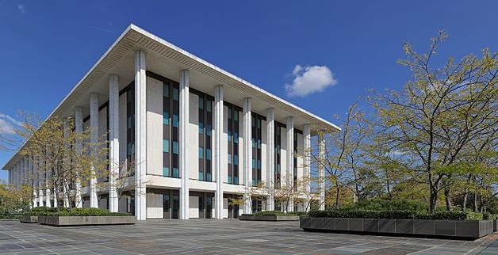
Image: https://www.flickr.com/photos/felipe_gabaldon/3290155994 by Felipe Gabaldon / CC BY 2.0
WorldCat Discovery & Access
Mixed-methods research
  Combine log analysis with user interviews
Two types of log analysis
  Match session log with user
    Use as guide for interview questions
  Aggregate statistics
    Categorized types of “requests” and “click events”
    Divided by type of institution
Notes:
Image: https://commons.wikimedia.org/wiki/File:National_Library_of_Australia,_ACT_-_perspective_controlled.jpg by Thennicke / CC BY-SA 4.0 (National Library of Australia)

Slide 50
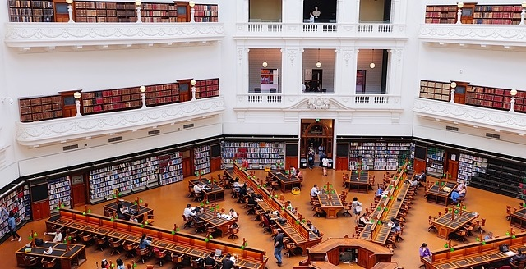
“…so looking at it had the poetic forms and then we've got the call number. So I knew that it was on the shelf so I could read it and read it effectively. That must be what it was because otherwise, I would have done an ILL request, and it would be in my office…”
(Faculty Member)
Image: https://www.maxpixel.net/State-Library-Of-Victoria-Melbourne-Australia-1956331 / Public Domain
Notes:
Image: https://www.maxpixel.net/State-Library-Of-Victoria-Melbourne-Australia-1956331 / Public Domain
This was a participant whose search lasted one minute and there were no clicks in the log that looked like a request to access either physically or electronically.
“Oh! I see. Now, I know why I picked this one because we had it in the stacks, that's what it was. So I-- goodness, I must have gone and gotten it. Yep, that's what it was. So I went and I looked and I saw-- so looking at it had the poetic forms and then we've got the call number. So I knew that it was on the shelf so I could read it and read it effectively. That must be what it was because otherwise, I would have done an ILL request, and it would be in my office, and that's, what might be, happened.” (GCF12 26:58)

Slide 51
Challenges and Opportunities

Slide 52
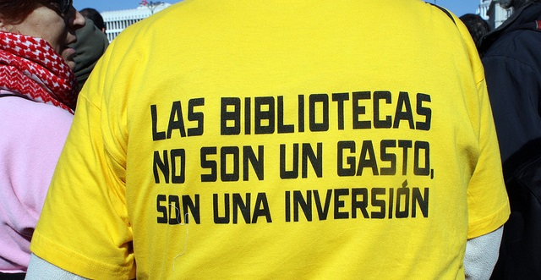
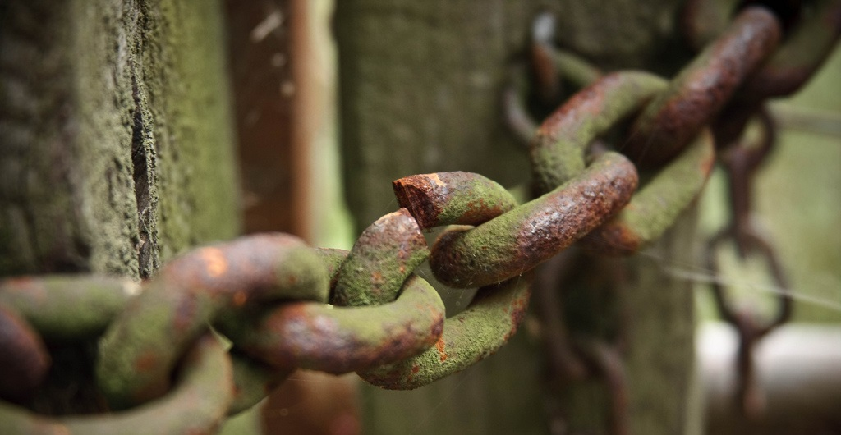
Image: https://www.flickr.com/photos/smithser/3870653508/ by Brian Smithson / CC BY 2.0
Challenges: Research Environment
Reduced funding opportunities
Scholarly value
Practical implications
Weak relationships with other disciplines
Limited communication of research and outputs
Inconsistent quality
Notes:
Image: https://www.flickr.com/photos/smithser/3870653508/ by Brian Smithson / CC BY 2.0
Reduced Funds
Scholarly Value
Theoretical framework
Practical Implications
Link between research and practice
Weak relationships between LIS and other research communities
Communicating research and outputs
Besides traditional dissemination by presentation and publication we should consider
Blogs
Social media
Conferences
Webinars
Quality
Research methods

Slide 53
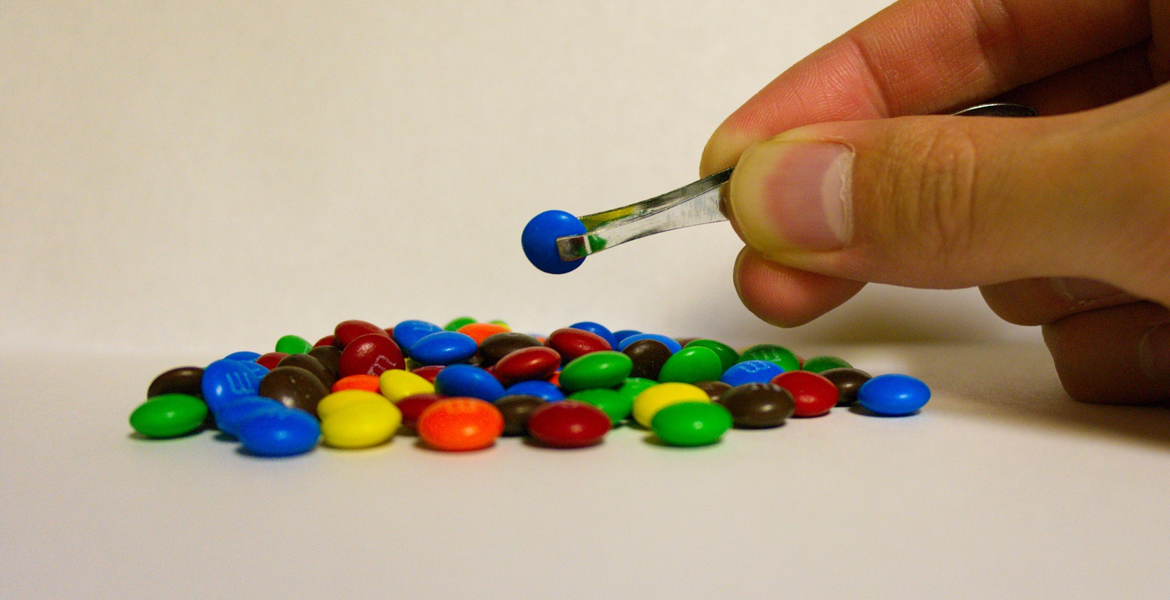
Challenges: Research Environment
Data collection and analysis
  Costs
  Bias
  Inaccurate and incomplete
Sampling
Massive amounts of data
Evolving technologies
Image: https://www.flickr.com/photos/travisjuntara/8146930619/ by Travis Juntara / CC BY 2.0
Notes:
Image: https://www.flickr.com/photos/travisjuntara/8146930619/ by Travis Juntara / CC BY 2.0
Bias presents a threat to validity , particularly the interviewer because of over-reacting to responses, etc.
Massive amounts of data
Interviews
Logs
Evolving Technology
Data on Wiki’s that is no longer available
Switching data platforms

Slide 54
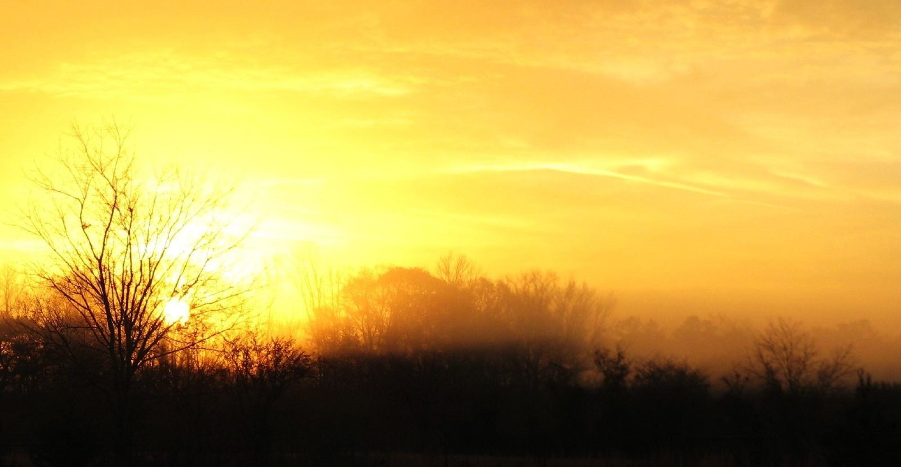
Image: https://www.flickr.com/photos/dougww/2132598574 by Doug Waldron / CC BY-SA 2.0
Opportunities: Qualitative Research
Rich data and thick description
Can answer why and how questions
Provides information to support decisions about resources and programs
Strategic planning from a user perspective
Can help motivate and increase buy-in for change
Provides the opportunity to build relationships
(Connaway & Radford, 2017; Asher & Miller, 2011)
Notes:
Image: https://www.flickr.com/photos/dougww/2132598574 by Doug Waldron / CC BY-SA 2.0
Asher, A., & Miller, S. (2011). So you want to do anthropology in your library? Or a practical guide to ethnographic research in academic libraries. Chicago: The ERIAL Project.
Connaway, L. S., & Radford, M. L. (2017). Research methods for library and information science (6th ed.). Westport, CT: Libraries Unlimited.

Slide 55
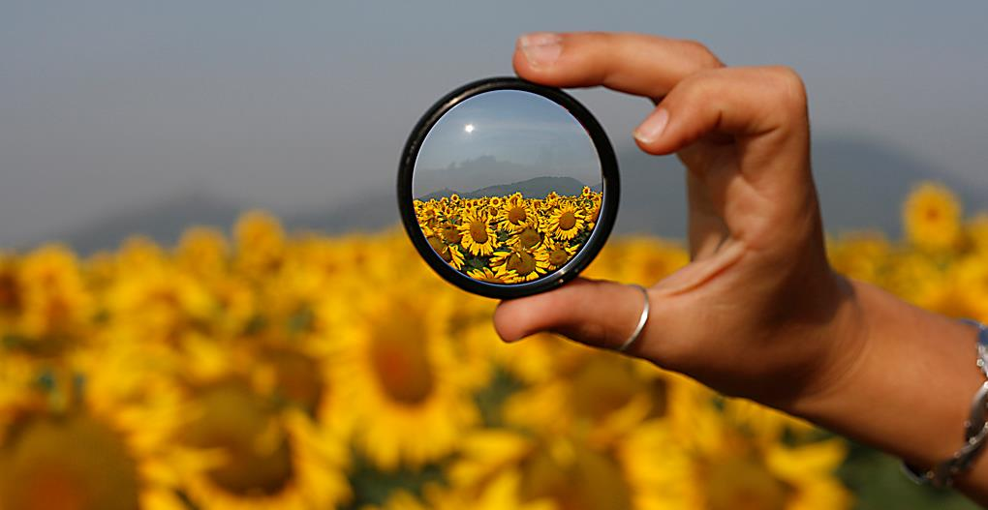
“By focusing on relationship building instead of service excellence, organizations can uncover new needs and be in position to make a stronger impact.”
(Mathews, 2012)
Image: https://www.flickr.com/photos/marcomagrini/698692268/ by marco magrini / CC BY-NC-ND 2.0
Notes:
Image: https://www.flickr.com/photos/marcomagrini/698692268/ by marco magrini / CC BY-NC-ND 2.0
Mathews, B. (2012). Think like a startup: A white paper to inspire library entrepreneurialism. http://chronicle.com/blognetwork/theubiquitouslibrarian/2012/04/04/think-like-a-startup-a-white-paper/.

Slide 56
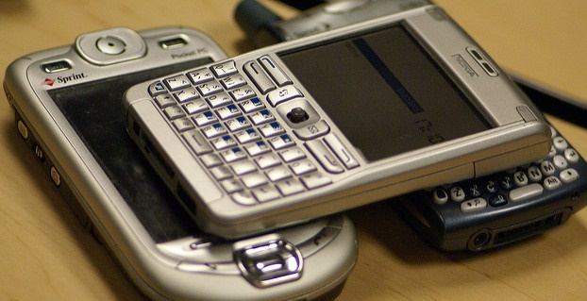
95% of teens have access to a smartphone; 89% have their own (twice as many as 2012)
Teens report being online constantly
Teens prefer YouTube, Instagram, and Snapchat
  Facebook use has fallen dramatically
(Pundsack, 2018)
Image: https://www.flickr.com/photos/sklathill/259516828 by Vincent Diamante / CC BY-SA 2.0
Notes:
Image: https://www.flickr.com/photos/sklathill/259516828 by Vincent Diamante / CC BY-SA 2.0
Pundsack, K. (2018). Teens and social media: Studies show shift in platforms and preferences. Public Libraries 57(6): 9-10.

Slide 57
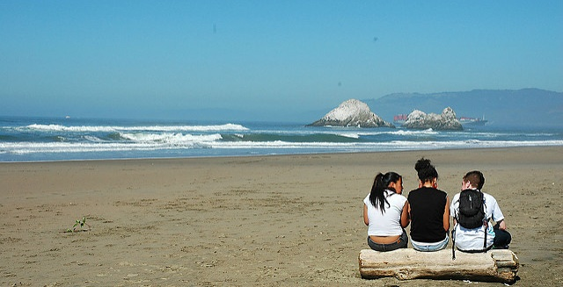
Be Proactive!
Study young people to plan services
They don’t adopt every new technology
They use what’s familiar and what their peers use
Notes:
Image: https://www.flickr.com/photos/mysiann/426156120 by Mysi Ann / CC BY-SA 2.0

Slide 58
Acknowledgements
I would like to thank Brittany Brannon for her assistance in preparing this presentation.

Slide 59
References
Asher, A., & Miller, S. (2011). So you want to do anthropology in your library? Or a practical guide to ethnographic research in academic libraries. Chicago: The ERIAL Project.
Association of College and Research Libraries. (2017). Academic Library Impact: Improving Practice and Essential Areas to Research, researched by Lynn Silipigni Connaway, William Harvey, Vanessa Kitzie, and Stephanie Mikitish. http://www.oclc.org/research/themes/user-studies/acrl-agenda.html
Clark, K. (2007). Mapping diaries, or where do they go all day? In N. Foster & S. Gibbons (Eds.), Studying Students: The Undergraduate Research Project at the University of Rochester. Chicago: Association College and Research Libraries.
Connaway, L. S. (2017, June 19). Putting the library in the life of the user: Listen, then lead, to promote a unique and compelling role for academic libraries. Guest of Choice, Choice360. Retrieved from http://www.choice360.org/blog/putting-the-library-in-the-life-of-the-user
Connaway, L. S., & Faniel, I. M. (2014). Reordering Ranganathan: Shifting user behaviors, shifting priorities. Dublin, OH: OCLC Research. http://www.oclc.org/content/dam/research/publications/library/2014/oclcresearch-reordering-ranganathan-2014.pdf
Connaway, L. S., & Radford, M. L. (2017). Research methods for library and information science (6th ed.). Westport, CT: Libraries Unlimited.

Slide 60
References
Dervin, B., Connaway, L. S., & Prabha, C. (2003-2005). Sense-making the information confluence: The hows and the whys of college and university user satisficing of information needs. Funded by the Institute for Museums and Library Services (IMLS). Retrieved from http://www.oclc.org/research/activities/past/orprojects/imls/default.htm
Dervin, B. (1992). From the mind’s eye of the user: The sense-making qualitative-quantitative methodology. In J.D. Glazier and R.R. Powell (Eds.), Qualitative research in information management. Englewood, CO: Libraries Unlimited, 61-84.
Dumas, J. S., & Redish, J. C. (1993). A practical guide to usability testing. Portland, OR: Intellect Books.
Kazmer, M. (2017). Mixed methods. In L. S. Connaway & M. L. Radford (Eds.), Research methods for library and information science (6th ed., pp. 232-233). Westport, CT: Libraries Unlimited.
Miles, M. B., & Huberman, A. M. (1994). Qualitative data analysis: A sourcebook. Beverly Hills: Sage Publications.
Mathews, B. (2012). Think like a startup: A white paper to inspire library entrepreneurialism. http://chronicle.com/blognetwork/theubiquitouslibrarian/2012/04/04/think-like-a-startup-a-white-paper/.
Polkinghorne, D. (1983). Methodology for the human sciences: Systems of inquiry. Albany, NY: State University of New York Press.

Slide 61
References
Pundsack, K. (2018). Teens and social media: Studies show shift in platforms and preferences. Public Libraries 57(6): 9-10.
Radford, M. L., and Connaway, L. S. (2005–2008). Seeking synchronicity: Evaluating virtual reference services from user, non-user, and librarian perspectives. Funded by the Institute of Museum and Library Services (IMLS). https://www.oclc.org/research/publications/all/synchronicity.html.
Ranganathan, S. R. (1931). The five laws of library science. London: Edward Goldston, Ltd.
Runes, D. D. (Ed.). (2001). The dictionary of philosophy. New York: Citadel Press.
Tang, R. (2017). Usability research. In L. S. Connaway & M. L. Radford (Eds.), Research methods for library and information science (6th ed., pp. 277-278). Westport, CT: Libraries Unlimited.
Webb, E. J., Campbell, D. T., Schwartz, R. D., & Sechrest, L. (1966). Unobtrusive measures: Nonreactive research in the social sciences (Vol. 111). Chicago: Rand McNally.
White, D. S., & Connaway, L. S. (2011-2014). Visitors & Residents: What motivates engagement with the digital information environment. Funded by JISC, OCLC, and Oxford University. http://www.oclc.org/research/activities/vandr/

Slide 62
Questions & Discussion
Lynn Silipigni Connaway, PhD
Director of Library Trends and
User Research, OCLC
connawal@oclc.org
@LynnConnaway

