Slide 1
Code4Lib 2019 ● February 21, 2019
Wikibase Lessons Learned
Jeff Mixter
Software Engineer
OCLC Research

Slide 2
Context for Wikibase

Slide 3
About the Pilot Project
The objective was to evaluate a framework for reconciling, creating, and managing bibliographic and authority data as entities and relationships

Slide 4
Phase II Partners (May ‘18 – Sep ‘18)
American University
Brigham Young University
Cleveland Public Library
Gale Cengage
Harvard University
Michigan State University
National Library of Medicine
North Carolina State University
Northwestern University
Princeton University
Smithsonian Library
Temple University
University of Minnesota
University of New Hampshire
Yale University
Pilot participants
Phase I Partners (Dec ’17 - Apr ‘18)
Cornell University
University of California, Davis

Slide 5
The Pilot by the Numbers
144
1,221,961
Listserv posts
Entities
324
12,489
OCLC Comm Ctr posts
28
Edits
Meetings
Notes:
Edits = Human edits since May

Slide 6
Wikibase overview

Slide 7
First, ask yourself “Why?”
Using Wikidata may be your best choice
Wikidata: Indigenous peoples of North America
Others are running their own Wikibase instances
FactGrid, a database for historians
For our project we ran our own Wikibase to:
evaluate the software framework,
control new and changing properties,
and honor requests from participants not to share data (yet).
But we linked items and properties to their Wikidata equivalents, for potential synchronization with Wikidata down the road.
Notes:
About the “Wikidata: Indigenous peoples of North America” project, from the site:
“The aim of the project is to create a database of information related to Indigenous peoples of North America. Like the allied project, WikiProject Indigenous peoples of North America, this project aims to encompass all historic, ethnic, and cultural aspects of the many groups collectively described as Indigenous peoples of North America, including Aboriginal (First Nations, Métis and Inuit) peoples in Canada, Kalaallit of Greenland, Native Americans in the United States, and Indigenous peoples of Mexico (parts of Mexico within the Mesoamerican culture areas are often excluded from North America).
This project has been launched in 2017 as a side product of a project by the Association of Research Libraries (ARL) in cooperation with the York University Libraries. As part of the work of this project, data models for contemporary Indigenous people are being developed. The project is focused on ingesting data into Wikidata as well as looking at ways to bring data (roundtrip) the data back to research libraries, cultural heritage institutions and communities.”
About FactGrid, from their blog:
“The FactGrid is a joint venture of the Gotha Research Centre at the University of Erfurt and Wikimedia Germany. We are trying to provide database services for historical research on a collaborative larger platform using Wikimedia’s wikibase technology — the software which is centrally used by Wikidata.”

Slide 8
Disambiguating Wiki*
Wikipedia – a multilingual web-based free-content encyclopedia
Wikidata.org - a collaboratively edited structured dataset used by Wikimedia sister projects and others

Slide 9
Disambiguating Wiki*
Wikipedia – a multilingual web-based free-content encyclopedia
MediaWiki - a free and open-source wiki software
Wikidata.org - a collaboratively edited structured dataset used by Wikimedia sister projects and others
Wikibase - a MediaWiki extension to store and manage structured data

Slide 10
MediaWiki Features
Search/Autosuggest/APIs
Multilingual UI
Wikitext editor
Change history
Discussion pages
Users and rights
Watchlists
Maintenance reports
Etc.

Slide 11
MediaWiki+Wikibase Features
Search/Autosuggest/APIs/Structured Data/Structured Data Query
Multilingual UI
Structured data editor
Change history
Discussion pages
Users and rights
Watchlists
Maintenance reports
Etc.

Slide 12
Wikibase out-of-the-box advantages
Open source
An all-purpose data model that takes knowledge diversity, sources, and multilingual usage seriously
Collaborative – can be read and edited by both humans and machines
User-defined properties
Version history

Slide 13
Functional use cases

Slide 14
Use case: Manual data entry
Wikibase provides the default technology for creating and editing entities.
It has a powerful and well-tested set of features that speed the data entry process and assist with quality control and data integrity.

Slide 15
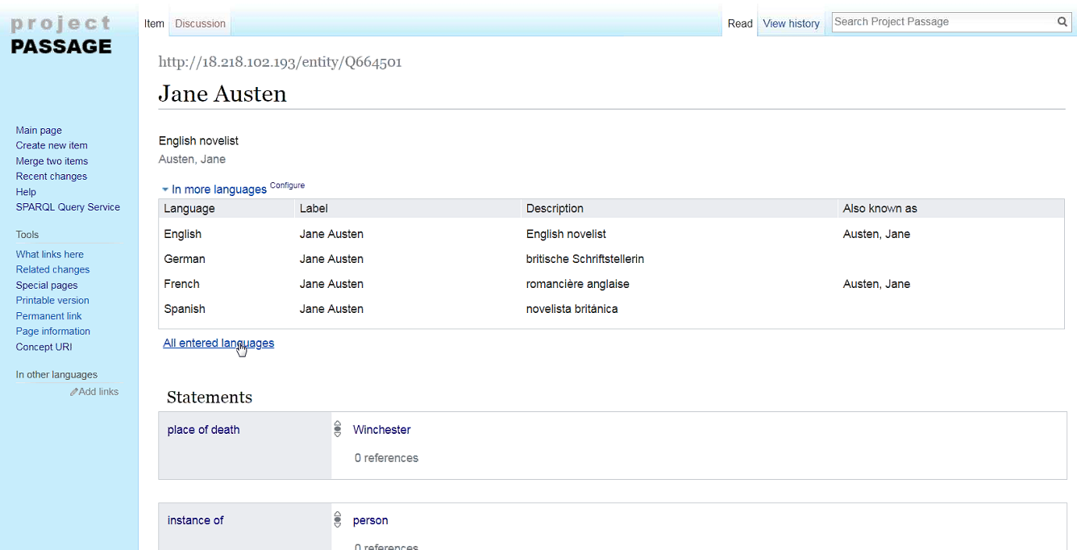

Slide 16
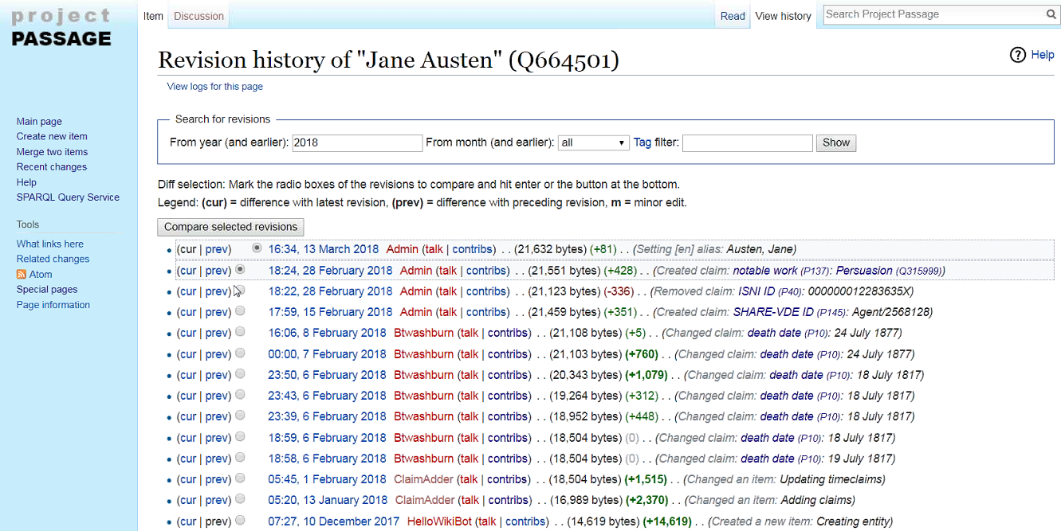

Slide 17
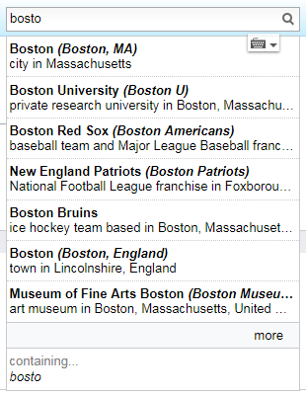
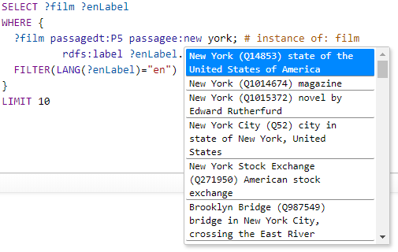
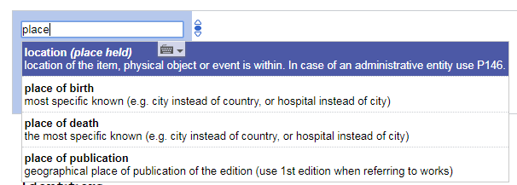
Use case: Autosuggest
Searching for entities as you type is supported by the Mediawiki API. This feature is found in both the Wikibase editing UI and in the SPARQL Query Service UI.

Slide 18
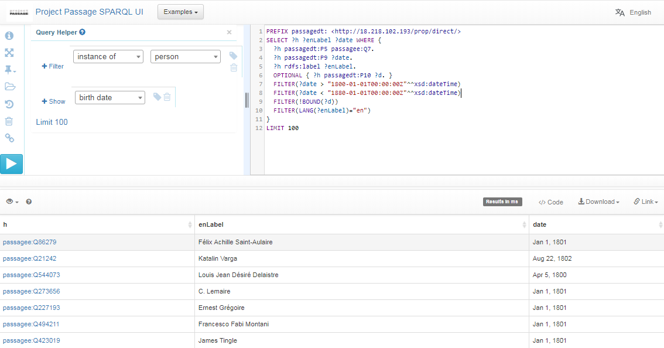
Use case: Complex queries
SPARQL is a semantic query language for databases.
The Pilot SPARQL endpoint included a user-friendly interface for constructing queries.
With SPARQL you can extract semantically-rich data using queries composed of logical combinations of triples.
In this example SPARQL query, items describing people born between 1800 and 1880, but without a specified death date, are listed, in support of data quality improvements.

Slide 19
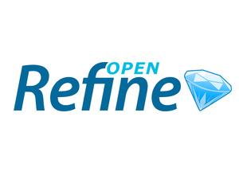
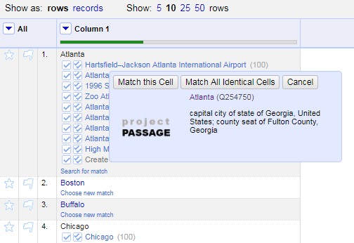
Use case: Reconciliation
Reconciling strings to a ranked list of potential entities was a key use case to support.
We tested an OpenRefine-optimized Reconciliation API endpoint for this use case.
The Reconciliation API used the Mediawiki API and SPARQL endpoint in a hybrid tandem to find and rank matches.

Slide 20
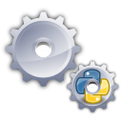
Use case: Batch loading
For batch loading new items and properties, and subsequent batch updates and deletions, we used Pywikibot.
It is a Python library and collection of scripts that automate work on MediaWiki sites. Originally designed for Wikipedia, it is now used throughout the Wikimedia Foundation's projects and on many other wikis.

Slide 21
Wikibase takeaways

Slide 22
Some Lessons Learned | And Remedies Applied
The Mediawiki-based API is not sufficient for reconciliation | Provided an OpenRefine API for matching by class and properties
The Wikibase data model for dates is capable but not user friendly | Document techniques for entering dates, mapping to LC's EDTF patterns
The Wikibase UI doesn’t pull in more contextual information from related resources on the web | Prototyped an “Explorer” UI that uses system data to connect to Dbpedia, Geonames, etc.
Autosuggested links weren't working well for personal names in indirect order | Added more aliases to Wikibase to improve autosuggest matching, based on headings in VIAF
It wasn’t clear how to handle creative works and editions in Wikibase | Provided guidance and examples, beginning with works and translations, excluded editions
The data modeling wasn’t in place for common cataloging scenarios | Conducting a series of “office hours” where we work through what’s needed with partners
Notes:
Library Idiosyncrasies
Problem: Wikibase was not designed for library data use
Inverted name order was problematic for reconciliation/lookup
Date qualifiers in authority headings did not work well in Wikibase model
Solution:
Add additional label variations as alternative labels
Separate concerns and allow birthdate statements to be queried independent of the name string during reconciliation
Problem: Wikidata model was not sufficient for library data modeling
How to describe a Creative Works in Wikibase?
How to work with dates that are vague or incomplete
Solutions:
Hold bi-weekly office hours to discuss modeling issues and walk through modeling examples
Document the date problems and provide best practices for data entry based on LC’s EDTF Spec

Slide 23
Some Wikidata/Wikibase Caveats | And Potential Remedies
Property and Item entity identifiers are opaque. That’s OK within Wikibase, not OK outside. | When publishing and syndicating data, labels and equivalent item and property identifiers from other systems can be provided
If using Wikidata, you may lose URI branding, provenance, and authority of your data. | In a separate instance of Wikibase, you can brand your own URIs and maintain provenance.
Anyone can say anything about anything, which can lead to data quality issues that are hard to spot and problematic to clean up. | In a separate instance of Wikibase, its community can publish data quality guidelines and set constraints in the system.
The data model can be difficult to understand, where the same things can be said in many different ways. | In a separate instance of Wikibase, its community can set and govern the data model.
The Wikibase UI makes it hard to create many different related entities at the same time. | We prototyped a web app for importing data to Wikibase that helped with this.
Unclear if Wikibase can scale to handle 1B+ entities | We’ve had useful discussions with MediaWiki and Wikidata, scoping our work accordingly
Notes:
Wikidata
Problem: WikiData is too open/large
Wikidata does not support URI branding
Anyone can say anything about anything
Wikidata data model is complex
Solutions:
Deploy a local version of Wikibase
Problem: Technical limitations
Can the platform scale
Solutions:
Started a dialogue with MediaWiki and Wikidata folks

Slide 24
Getting started with Wikibase
Wikimedia Deutschland provides a GitHub repository with Docker images, including:
Wikibase software,
a Blazegraph triplestore,
a MySQL database,
a SPARQL Query UI,
the Quickstatements data loading extension, and more.
Notes:
The easiest way to get started exploring Wikibase is by installing it with this set of Docker images, made available by Wikimedia Deutschland via their GitHub repository:
https://github.com/wmde/wikibase-docker
What is Docker?
From https://opensource.com/resources/what-docker
“Docker is a tool designed to make it easier to create, deploy, and run applications by using containers. Containers allow a developer to package up an application with all of the parts it needs, such as libraries and other dependencies, and ship it all out as one package. By doing so, thanks to the container, the developer can rest assured that the application will run on any other Linux machine regardless of any customized settings that machine might have that could differ from the machine used for writing and testing the code.
In a way, Docker is a bit like a virtual machine. But unlike a virtual machine, rather than creating a whole virtual operating system, Docker allows applications to use the same Linux kernel as the system that they're running on and only requires applications be shipped with things not already running on the host computer. This gives a significant performance boost and reduces the size of the application.”
What is GitHub?
From https://www.atlassian.com/git/tutorials/what-is-git
“By far, the most widely used modern version control system in the world today is Git.”
From https://guides.github.com/activities/hello-world/
“What is GitHub?
GitHub is a code hosting platform for version control and collaboration. It lets you and others work together on projects from anywhere.”

Slide 25
Getting started with Wikibase
Wikibase for Research Infrastructure — Part 1
By Matt Miller
https://medium.com/@thisismattmiller/wikibase-for-research-infrastructure-part-1-d3f640dfad34
Wikibase docker images
By Addshore
https://addshore.com/2017/12/wikibase-docker-images/
“Using Wikibase as a platform for library linked data management and discovery”
An OCLC Developer Network webinar
https://github.com/OCLC-Developer-Network/devconnect_2018_wikibase/wiki
Notes:
The easiest way to get started exploring Wikibase is by installing it with this set of Docker images, made available by Wikimedia Deutschland via their GitHub repository:
https://github.com/wmde/wikibase-docker
What is Docker?
From https://opensource.com/resources/what-docker
“Docker is a tool designed to make it easier to create, deploy, and run applications by using containers. Containers allow a developer to package up an application with all of the parts it needs, such as libraries and other dependencies, and ship it all out as one package. By doing so, thanks to the container, the developer can rest assured that the application will run on any other Linux machine regardless of any customized settings that machine might have that could differ from the machine used for writing and testing the code.
In a way, Docker is a bit like a virtual machine. But unlike a virtual machine, rather than creating a whole virtual operating system, Docker allows applications to use the same Linux kernel as the system that they're running on and only requires applications be shipped with things not already running on the host computer. This gives a significant performance boost and reduces the size of the application.”
What is GitHub?
From https://www.atlassian.com/git/tutorials/what-is-git
“By far, the most widely used modern version control system in the world today is Git.”
From https://guides.github.com/activities/hello-world/
“What is GitHub?
GitHub is a code hosting platform for version control and collaboration. It lets you and others work together on projects from anywhere.”

