Slide 1
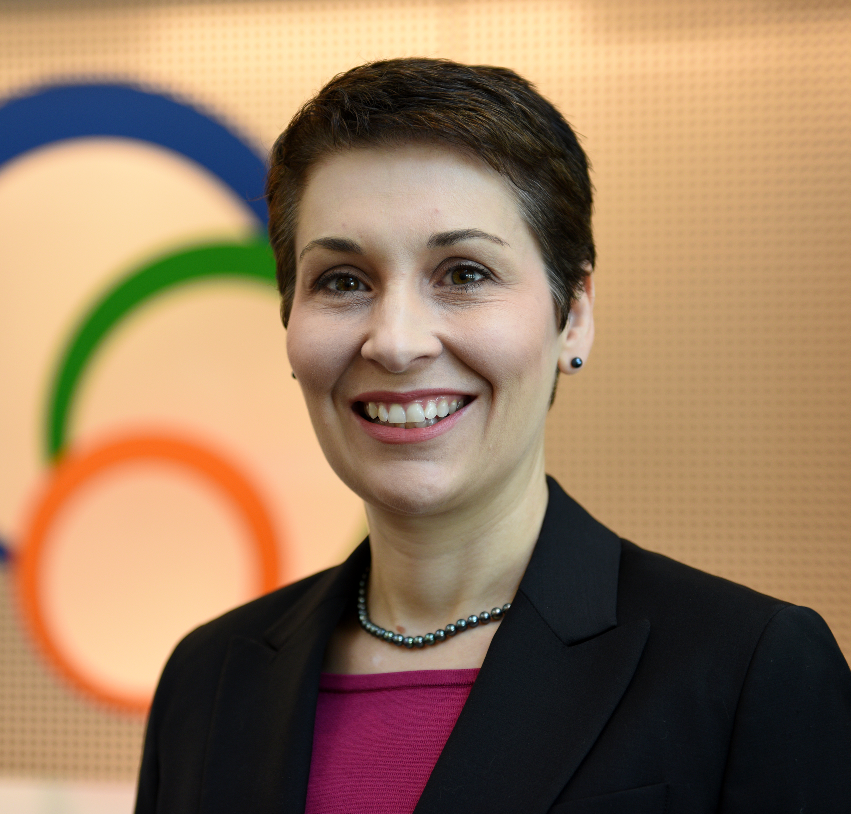
Rebecca Bryant, PhD
Senior Program Officer, OCLC Research
bryantr@oclc.org @RebeccaBryant18
https://orcid.org/0000-0002-2753-3881

Slide 2
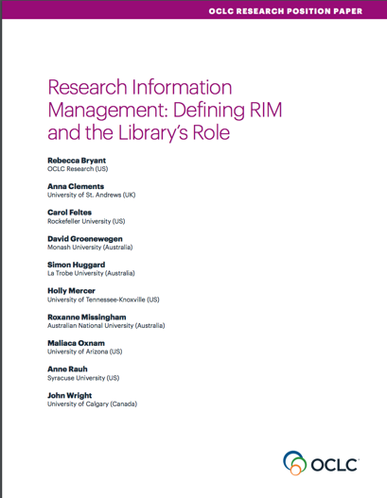

Defining RIM and the Library‘s Role
oc.lc/rim

Slide 3
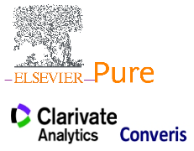

Research Information Management
Research Information: Metadata about research activities and outputs (e.g. projects, publications, …)
Research Information Management (RIM):
Aggregation, curation, & utilization of research information
(e.g. in CRIS systems)
oc.lc/rim
Notes:
These are called CRIS systems in Europe, but they are often called other things in other parts of the world, particularly in the North America, where we might be referring to these by other names like “Faculty Activity Reporting” system or “Researcher Profile system.” The goals and even processes may vary, but the central effort of metadata collection is the same.

Slide 4

What is Research Information Management (RIM)?
The aggregation, curation, & utilization of metadata about research activities
Overlapping terms:
  CRIS (Current Research Information System)
  RIS (Research Information System)
  RNS (Research Networking System)
  RPS (Research Profiling System)
  FAR (Faculty Activity Reporting)
oc.lc/rim
Notes:
So one of the outputs we’ve had this year has been a position paper entitled, “Research Information Management, Defining Rim and the Library’s Role.” In our position paper, I worked closely with a working group of librarians from OCLC Research Library Partnership member institutions, and we had representation from librarians on three continents, we had a good representation of practice. It also included Anna Clements from St Andrews, who is also an active euroCRIS board member.
In this report, we offered a holistic definition of research information management (RIM) as the aggregation, curation, and utilization of metadata about research activities. One of my goals with this position paper was to provide a model for understanding different practices, as RIM practices vary widely by locale. Our model includes overlapping terms like CRIS and RIS, which are commonly used in Europe, as well as other practices like Research Profiling or Research Networking, which we see more commonly used in the Americas. It also synthesize the value proposition of libraries in RIM service provision.
You can access this report, as well as our other RIM publications, at oc.lc/rim

Slide 5
. . . In other words, RIM systems are used to collect the scholarly output of an institution.
And allow it to be combined with other information collected on campus.
oc.lc/rim
“RIM Metadata” by OCLC Research, from Research Information Management: Defining RIM and the Library’s Role (doi.org/10.25333/C3NK88), CC BY 4.0
Notes:
Regardless of the use, we define RIM as the collection of metadata, which almost always includes publications, but increasingly includes research data sets, preprints, and other outputs. It is also increasingly attempting to connect these outputs to grants, funders, equipment. We also see the collection of instructional history, PhD advisees, and service activities in RIM. We want to frame RIM as the collection of metadata because it can help to separate RIM practices from specific systems—and it can help practitioners with different uses to see the similarities of their activities.

Slide 6
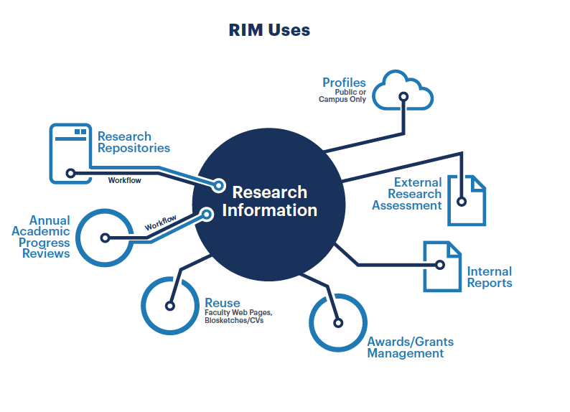
. . . In other words, RIM systems are used to collect the scholarly output of an institution.
And allow it to be combined with other information collected on campus.
oc.lc/rim
“RIM Uses” by OCLC Research, from Research Information Management: Defining RIM and the Library’s Role (doi.org/10.25333/C3NK88), CC BY 4.0
Notes:
We developed a second model that describes RIM uses. In general, if an institution is aggregating research metadata at least one of these uses, we would include it within our RIM model. In this way we unite CRIS type activities, so commonly seen in Europe, with other uses like supporting academic progress review workflows or displaying public profiles for institutional reputation management/public profiles, which are more prominent in the United States.
I expect this model to evolve over time, and it should work to represent new, extensible practices in research information management.

Slide 7
Libraries and RIM
“Libraries in Research Information Management” by OCLC Research, from Research Information Management: Defining RIM and the Library’s Role (doi.org/10.25333/C3NK88), CC BY 4.0
oc.lc/rim
Notes:
Why libraries and RIM? Importance of RIM for libraries and consequently for our research. (content from white paper)
(talk about this at some length without more slides)

Slide 8

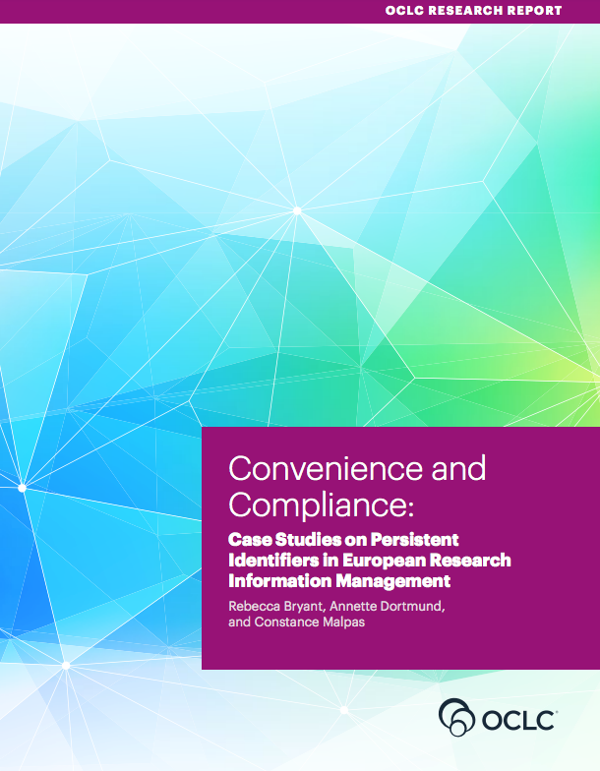
OCLC Research publications on Research Information Management
oc.lc/rim
Notes:
An area of recent research for OCLC is research information management, as we recognize this as an important emerging service categories for libraries. We’ve been developing an arc of research to describe, explain, and document international practices in research information management.
In October we released a position paper on research information management, which I’ll talk a bit more about in a minute.
In December we also published a research report, conducted in collaboration with LIBER, documenting case studies in persistent identifiers in research information management.
We have also been collaborating with euroCRIS on an international survey on Research Information Management Practices.

Slide 9
Practices and
Patterns
oc.lc/rim
Notes:
Based on this work, we at OCLC Research partnered with RLP libraries and euroCRIS for a survey on international practices in RIM [which builds upon previous euroCRIS/EUNIS research].
Our main goal was to identify some global trends and to lay the foundation for future quantitative research in the field.
Obviously, the survey cannot (and does not intend to) reveal all the nuances of specific geographic environments,
[rather lay the foundation for national or regional follow-up surveys on specific questions.
To collect data about RIM practices worldwide, in order to identify national and regional practices
To gather evidence on the increasing role played by research libraries in RIM practices
To inform the research community about the goals, purposes, and scope of RIM practices
To examine and report on the institutional stakeholders, workflows, interoperability, and standards in use.
To serve as a foundation for future research. ]

Slide 10
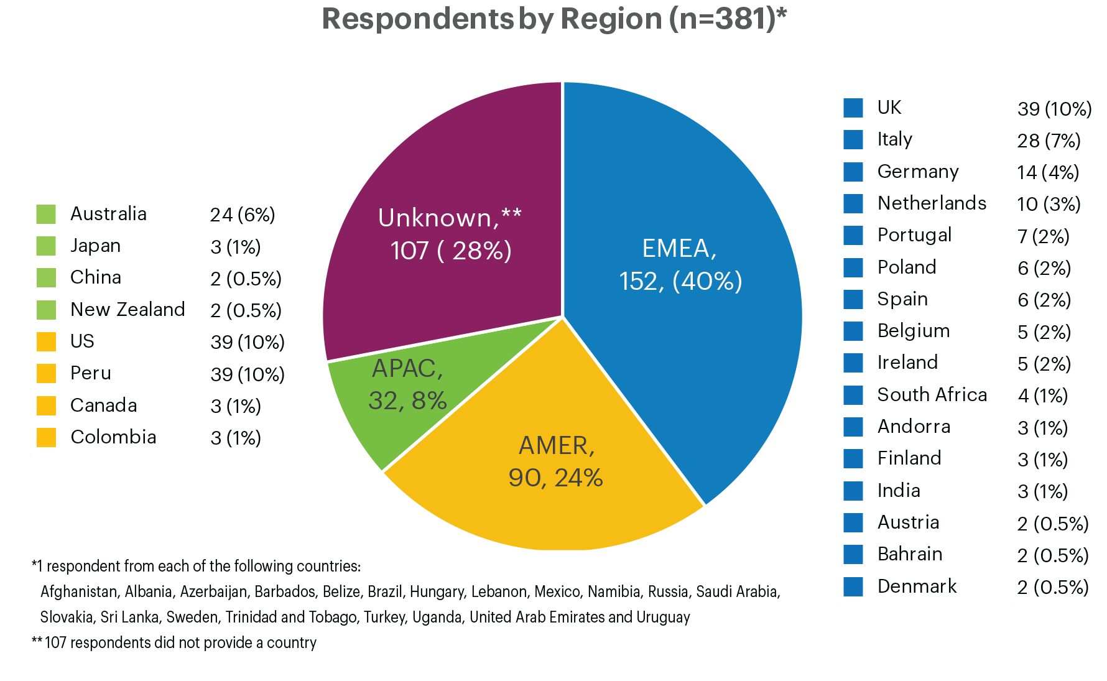

RIM Survey responses: geographic overview
381 survey respondents from 44 countries
Europe, Middle East, & Africa
Asia-Pacific
Americas
“Total number of survey respondents, by broad region” by OCLC and euroCRIS, Practices and Patterns in Research Information Management: Findings from a Global Survey (DOI:10.25333/BGFG-D241), CC BY 4.0

Slide 11
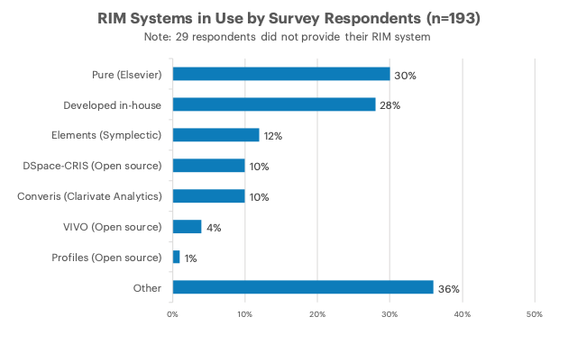
Practices and Patterns in Research Information Management: Findings from a Global Survey (DOI:10.25333/BGFG-D241), CC BY 4.0
Notes:
****Read the following (from the next slide) while allowing participants to continue viewing this slide:*******
Note that we invited research institutions at any stage of RIM adoption to participate
58% indicated they have a live RIM system, and another 13% are in process of implementation.
Reveals a quickly shifting landscape, with many institutions currently exploring RIM
> 200 institutions with an active RIM provides a significant sample
More synthesis may reveal regional differences
Diversity of RIM systems in use
Elsevier Pure and locally-developed systems have highest adoption
The “Other” category is also significant, featuring entries like IRIS (Italy), ResearchMaster (Aus/NZ), OMEGA-PSIR (Poland), InfoEd

Slide 12
Research Information Management at the University of Minnesota
Expertise Discovery to System of Record (and back again)

Slide 13
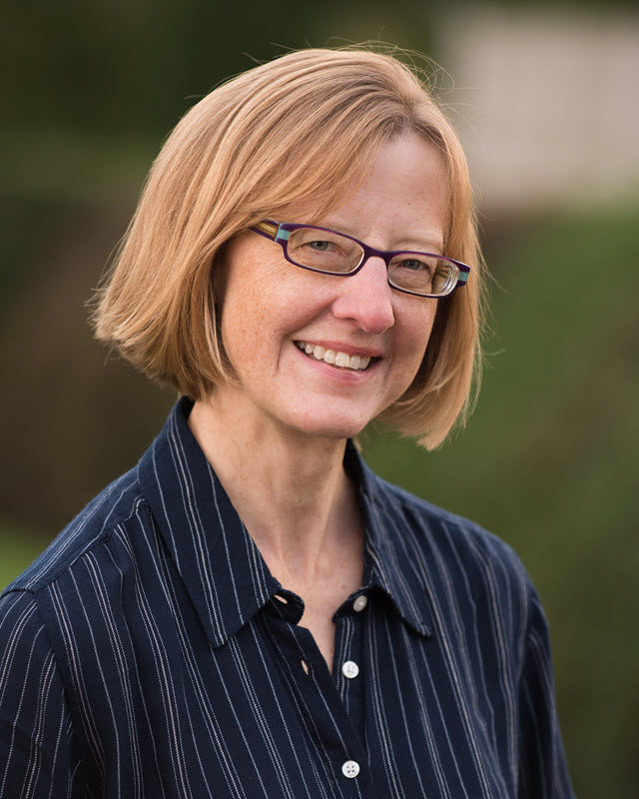
Jan Fransen
Service Lead for Research Information Management Systems
University of Minnesota Libraries
Fransen@umn.edu

Slide 14



70,963 Twin Cities Students, Faculty, and Staff
Professional
3,761
Faculty
3,709
Non-Degree
3,365
Undergraduate
28,638
Graduate
12,046
Staff (all types)
19,444
Notes:
The University of Minnesota is a Carnegie Research One institution, with large numbers of undergraduates, graduate students, and faculty members. We also have a sizeable number of professional and non-degree-seeking students and, of course, staff members of all types.
We’re a land grant institution, here to serve the citizens of the state as well as our direct affiliates.
In an institution that big, we’re always looking for ways to both keep track of what the many entities and individuals that make up the University are doing, and to tell the stories of that work to the whole community.

Slide 15
Who can help?
Need some entity on campus that
  Understands the scholarly publication world
  Knows how to curate and archive data
  Has figured out how to implement standards so data are consistent
  Has expertise in helping people search for and find what they need
Notes:
I pulled this slide from a presentation I did for Libraries staff back in 2015, when I’d first started working in this space. (read slide)

Slide 16
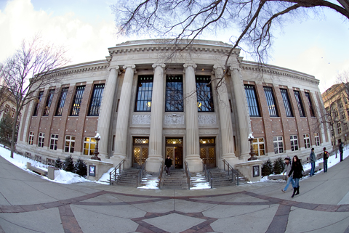
Notes:
The answer, of course, is the Libraries. This is exactly in our wheelhouse.

Slide 17
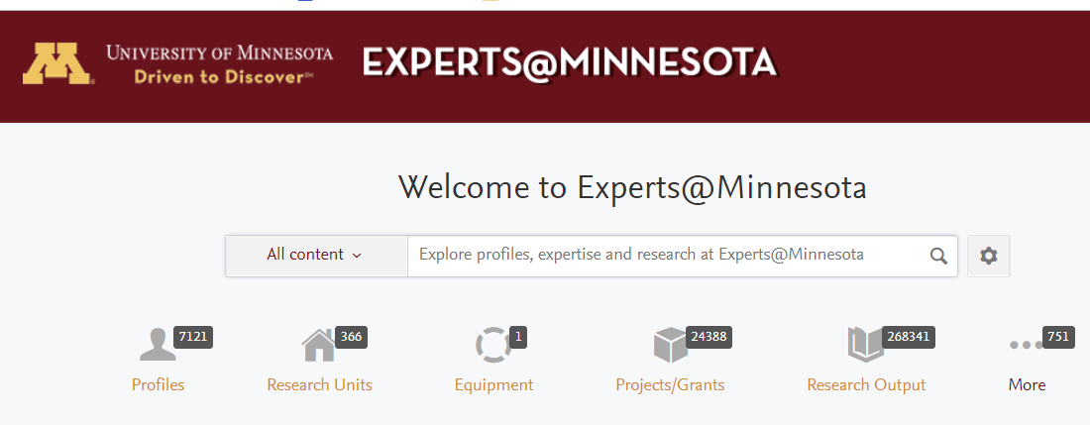
https://experts.umn.edu
Based on Elsevier Pure (since 2015)
Originally Elsevier SciVal Experts (2012-15 pilot)
Covers all five University of Minnesota campuses
  Faculty
  Researchers (including post docs)
  Graduate students who are employed in research-related positions
  Staff members who are likely to publish research (like librarians)
Notes:
Of course the Deans of the academic colleges weren’t thinking that deeply about bibliographic data in 2012 when they asked the Libraries to license and administer SciVal Experts. They wanted that product from Elsevier, and the Libraries were already working with Elsevier.
Experts@Minnesota is our implementation of Elsevier’s Pure. We currently have about 7,000 profiles include faculty, researchers, and a lot of staff members like me who publish research in our fields of expertise but are not strictly researchers.

Slide 18
Structure
Pilot (three years)
Now
Requested by Deans
Just Twin Cities
Funding by VP for Researcher, Libraries, and individual colleges
Administered by Libraries
Regular communications from VPR and Dean of Libraries
All five campuses
Centrally funded
Administered by the Libraries
Due to staff changes, limited involvement from OVPR
  We still consider them our partners
E-mail communications, user support, and marketing by Libraries
Notes:
This gives you a sense of how we progressed from a pilot to a service.

Slide 19
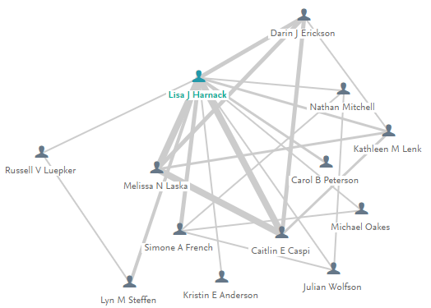
Intent: Connect Researchers with Each Other
Notes:
When we first launched Experts@Minnesota, we had one goal in mind: We wanted to help researchers at the University of Minnesota put together teams made up of other U of M researchers, ideally across disciplines.

Slide 20
Is Experts@Minnesota helping people find each other?
Maybe…
We don’t have a good way to determine whether new collaborations formed BECAUSE of Experts@Minnesota
(But we hope so)
And we do have anecdotes!
Notes:
Now, when you start with a goal in mind, it’s nice to have some way of assessing whether you are meeting that goal. In this case, I can’t say that we do. We don’t really have a measure of how readily people were finding each other before 2012 versus now, and we only have anecdotes to tell us that people have used Experts@Minnesota as one tool to use when identifying collaborators.

Slide 21
What DO we know?
We’ve collected bibliographic information on 265,000+ publications and other research outputs for 8200+ current and former UMN researchers
We have details like
  Author names, University IDs, and department affiliations (for virtually all)
    So we can derive inter- and intra-discipline collaborations
  Publication
    And with that we can often get Open Access status, SHERPA/RoMEO color, etc.
  Citation counts and alternative metrics
    So we can get a sense of what’s “trending”

Slide 22
As the data improves..
Use grows and use cases expand

Slide 23
Current Challenges
Finding out what people are doing (and helping them do even more)
Spreading the word to those who aren’t doing it yet

Slide 24
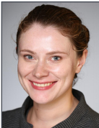
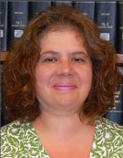
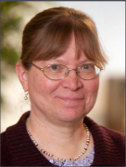






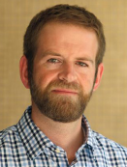











































Luckily we have a secret weapon
Notes:
Luckily we have a secret weapon. These are our liaison librarians. They each support several academic departments or programs on campus. They understand the scholarly communication practices of the disciplines they support, and they have good personal relationships with both faculty and support staff throughout their departments.

Slide 25
Research Service Coordinators
Liaison Librarians
RIM Support Team
Research Information Management Service Lead
Email support
Special projects
Connectors: Liaisons to Support Team and Service Lead
Connectors: University staff and researchers to Support Team and Service Lead
They make sure liaisons are ready to have conversations
One coordinator for each of 6 discipline-specific units
6 people library staff, 1 5 hr/wk data remediator
4 rotate primary responsibility for email support
Notes:
This gives you a sense of how we’re currently organized. I’m the Service Lead, and I’ve got a bit more detail about what I do on the next slide. The RIM Support Team handles a lot of the day to day support, and gets pressed into service for special projects, like adding publications for a center that aren’t coming in automatically from Scopus. Two have been working in this space and with the product for longer, so they act as “Tier 2” support for more complicated issues. The other four take turns handling questions for a week at a time. We only see a couple of questions in a typical week. Six liaison librarians are also Research Service Coordinators. Their focus is on making sure everyone in their unit knows enough about all of the Libraries research services to have conversations with people in their assigned departments and refer as needed. If they spot a need or get questions they can’t answer, liaisons can contact me or the Support Team. If someone in a college or department contacts the support team or me directly, we’ll typically loop in the liaison so they know what’s going on.

Slide 26
Service Lead and Developer Roles
Administrator / Communicator (1 FTE)
  Test/verify
    Synchronizations and imports from other sources (internal and external)
    New features in the platform
    Define data remediation projects
  Communicate
    With the vendor about what’s working, what isn’t, and what we need
    With researchers who have profiles
    With administrative staff making use of/adding to the data
    With Libraries staff (lead RIM Support Team, coordinate with Research Service Coordinators)
Developer (1 FTE for 2 years)
  Automate synchronization with PeopleSoft HR and Financial data sources
  Design an internal Oracle database (Experts Data Warehouse) and automate updates from Experts@Minnesota to ExpertsDW
Notes:
This is just a bit more about what I do. My job only recently became primarily about Research Information, but I’d now consider myself a full FTE. We also have a developer who has been working on data flows between University PeopleSoft systems and Pure, and between Pure and our internal Oracle database, the Experts Data Warehouse.

Slide 27
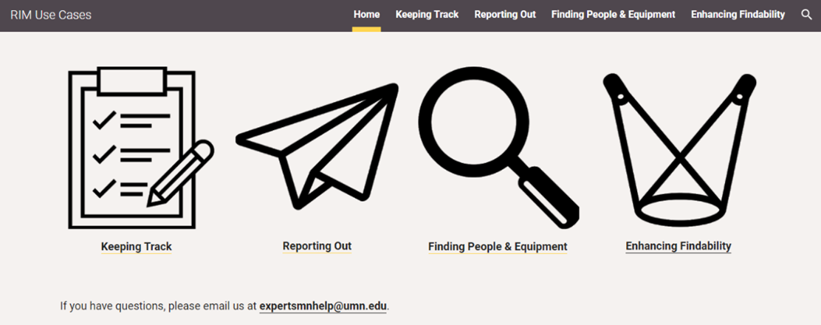
Notes:
We’ve found a lot of ways to use research information and our RIM system at Minnesota. It’s a challenge, though, to keep everyone informed and make sure liaisons have the information they need to have those conversations. We recently started a website to help.

Slide 28
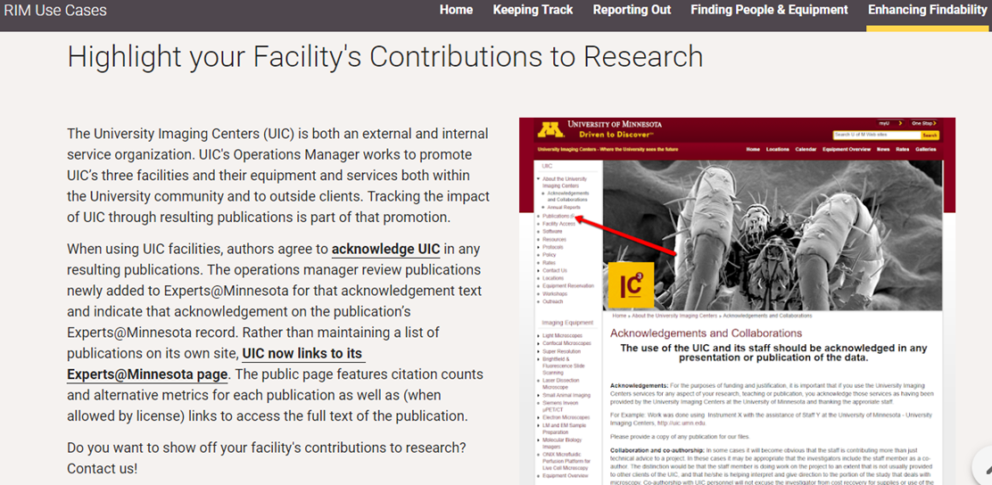
Notes:
We’ve been documenting use cases in long Google documents, but now we’re working to make them a bit more consumable. Each use case on the website poses a problem and summarizes how Experts@Minnesota or research information was used to provide a solution. Each story ends with a Contact Us link that right now sends an email but will eventually go to an intake form to collet specific information so we can craft the right solution with the right people involved.

Slide 29
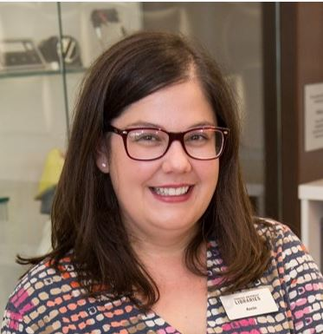

Anne E. Rauh
Interim Head of Collections and Research Services
Syracuse University Libraries
aerauh@syr.edu
Notes:
Stu

Slide 30

Syracuse University
Private research university
In the 2015 Carnegie Classification of Institutions of Higher Education, moved from R2 to R1
15,000 undergraduates
5,000 graduate students
Notes:
Stu

Slide 31
Why
Notes:
Stu

Slide 32
Initial Project Goals
Find Expertise
Grow Collaboration
Propel Research
Notes:
Discuss background of selection process
Who was consulted
When were stakeholders identified
Discuss Syracuse ‘Team Approach’
To our audience assess your readiness, staffing and project goals to ensure success.

Slide 33
Challenge 1: Identifying Expertise
No systematic way to identify which faculty do what research
No expertise database
No way to see interdepartmental or cross-college collaborations
Notes:
We can tell the story of Peter being a new VPR and not having a tool to look at research holistically

Slide 34
Challenge 2: Matching Funding
No systematic way to align funding opportunities with researchers
University’s other funding search mechanisms require significant researcher effort

Slide 35
Challenge 3: Reduce Burden
Reduce duplicate efforts to maintain publication records and grant information across campus
Reduce faculty time spent keeping multiple profiles up to date
Facilitate outsiders to quickly find experts or potential collaborators
Potential for simplifying data collection and reporting for internal and external requests
Notes:
Stu

Slide 36
How
Notes:
Stu

Slide 37
Team Responsibilities
Office of Research
Office of Sponsored Programs
Libraries
Understanding of research infrastructure
Access to HR data
Master profile list maintenance
Data hierarchy structures
Promote networking to facilitate research growth
Understanding of funding landscape
Campus research funding data
Promote the usage of the Funding Discovery module
Understanding of scholarly publishing
XML support
Hands-on training
Scopus expertise
API integration of other data sources (WorldCat, Web of Science, etc.)
Promote tool as system of record
Notes:
Annie – the project team is made up of colleagues from three units, each with different contributions to the project, but also with different main goals, which has been complicated…
Routine maintenance: - libraries
corrections
One-on-one trainings
Local press releases
General questions
Annual maintenance – office of research
Three times per year in January, May, and September
Master list updates
Add newly hired faculty
Add faculty who have requested inclusion
Remove departed faculty
Request PRS from Elsevier

Slide 38
Rollout Timeline
2015 – product investigation and contracting
January 2016 – revised project team assembled
Winter / Spring 2016 – initial data loads, hierarchy development, account creation, local branding, and help documentation
May 2016 – faculty rollout

Slide 39
Inclusion Criteria
Current employee of Syracuse University
Active publishing record as determined by
  Scopus Profile
  CV or personal / department website
Willingness to manage profile inputs
Endorsement by college ADR
Concurrence by VPR
Notes:
Initial rollout included tenure track STEM faculty and some additional social science departments
Additional faculty can request to be added using the following criteria
Criteria #1 (payroll driven, not emeriti or courtesy appointment, due to physical proximity to ESF and SUNY upstate we have a lot of collaborations and some shared resources, have had requests from faculty at both institutions to be included
You will get questions on how the initial profiles were selected. Be perfectly transparent!

Slide 40
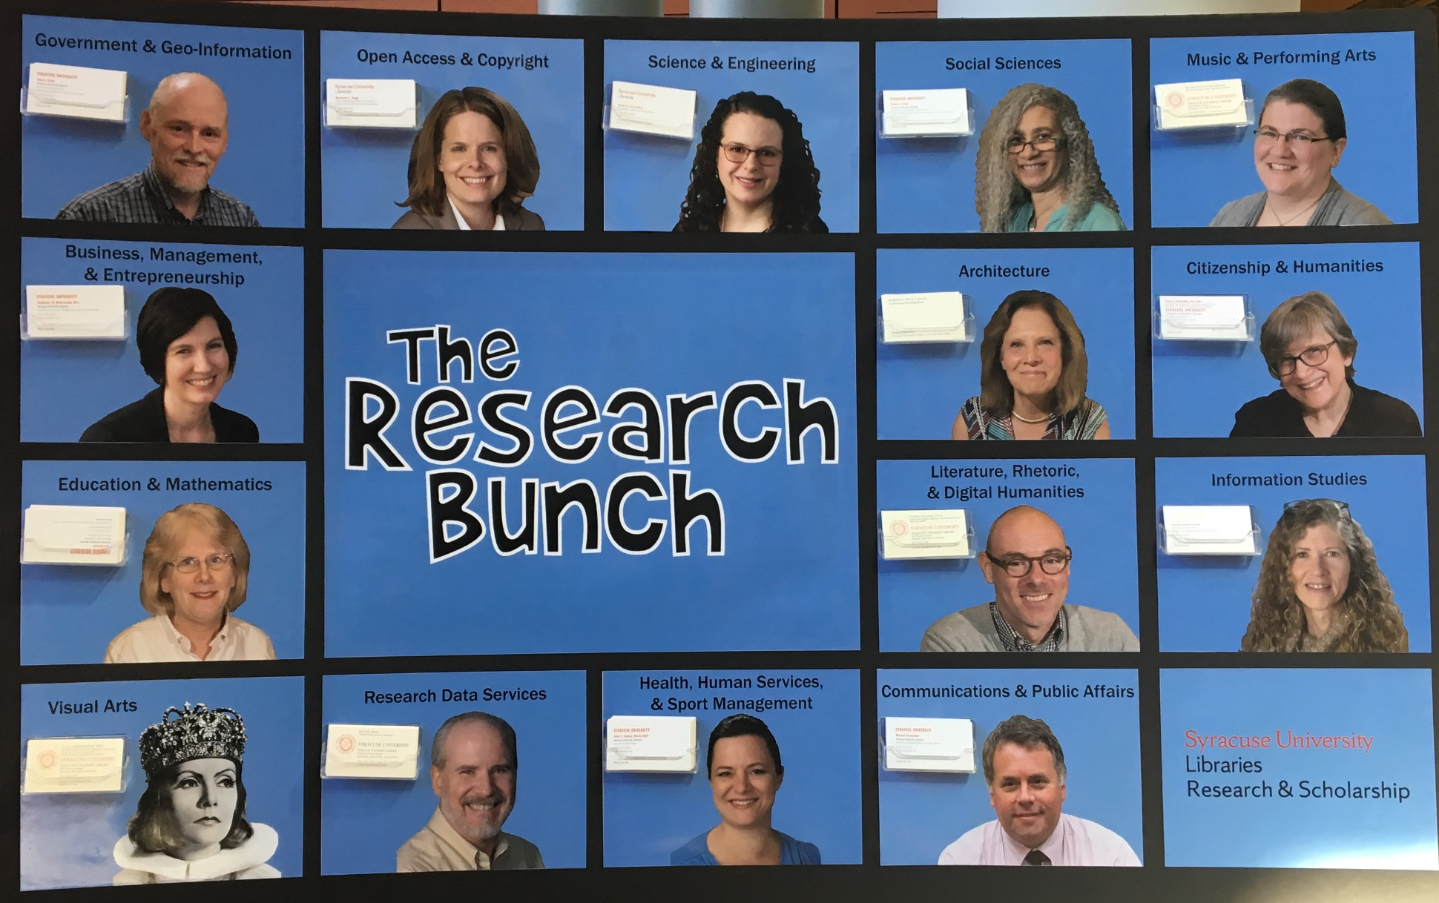
Expanding the Libraries Team
Notes:
In 2018, we renewed Pure, and moved out of the initial three year pilot phase. Within the Libraries, it was determined that supporting Experts@Syracuse would become part of the liaison librarian role.

Slide 41
Team Training Plan
September 2018 – outlined annual goal
January 2019 – end user and train-the-trainer sessions with Pure Customer Consultant
February 2019 – group work sessions
April 2019 – additional group work session
June 2019 – assessment data due
Notes:
Annual assessment goal
Include subject librarians
Add bio
Add five activities or research outputs about themselves

Slide 42
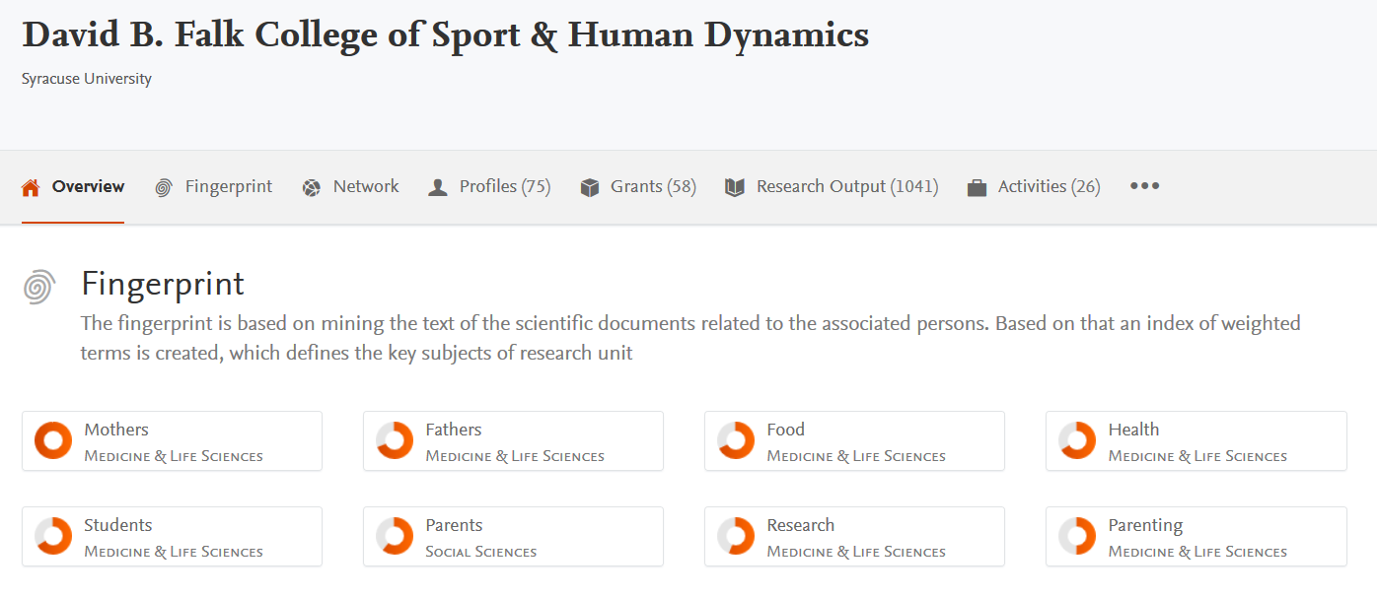
Interdisciplinary College

Slide 43
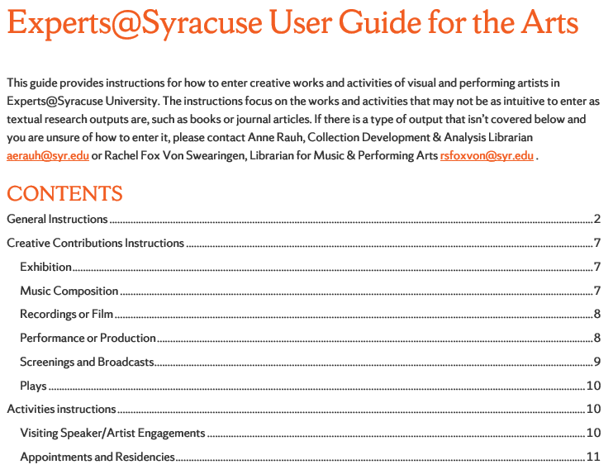
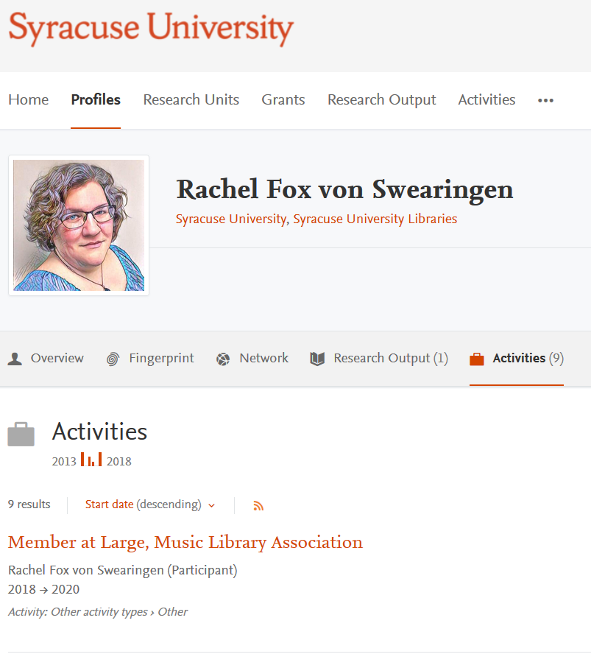
Visual and Performing Arts

Slide 44
Case Study
Notes:
Five years after launching a new online faculty activity reporting and annual evaluation system at the University of Arizona, what does examination of the benchmark data tell us? Is the data captured in the system useful? The system uses faculty self-report of activity data, including scholarly contributions, combined with integrations of core campus data systems. How does the record of faculty scholarly achievements compare to other licensed tools and services? Is the self-report of faculty activities effective? The system captures information about our faculty not previously recorded. What has the system taught us? How can we creatively employ this data, coupled with existing data sources to create new analytical discovery tools? As we continue to assess and analyze data from the system, we’d like to share our experiences and findings to date.
UA Vitae is a shared effort from the Office of the Provost, University Libraries, University Analystics and Information Research, Office of Research, Discovery and Innovation and University Information and Technology Services. This session will be useful for anybody interested in research information management, faculty activity reporting, profile and/or institutional reporting systems.

Slide 45
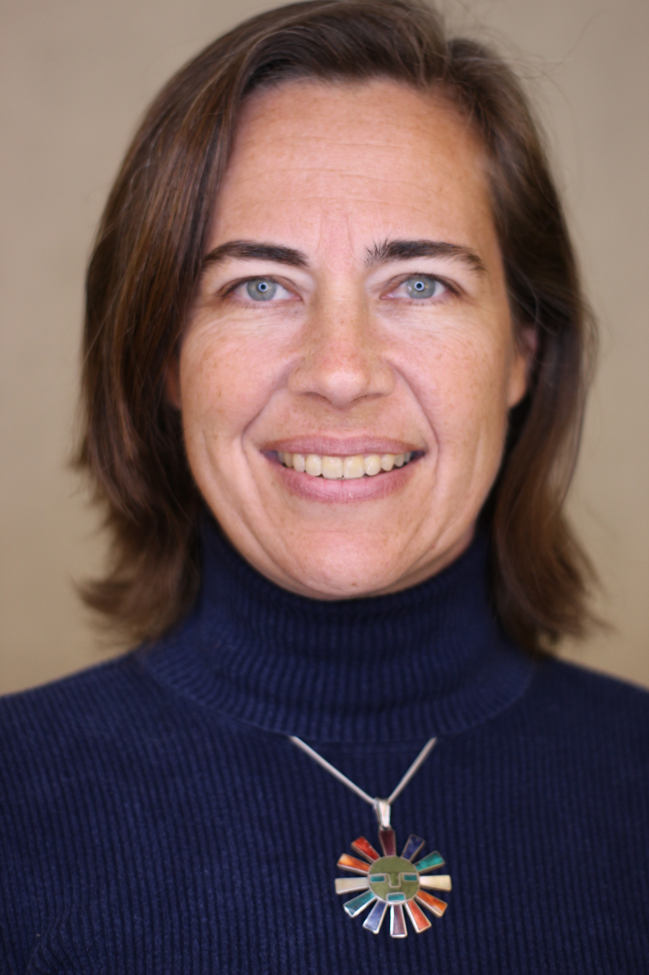
Maliaca Oxnam
Office of Digital Innovation & Stewardship
University Libraries, University of Arizona
maliaca@email.arizona.edu
@maliaca

Slide 46
Overview
Who is the University of Arizona?
What was our intention with RIM?
What is in the system and what does it look like?
Benefits and Impacts
Who Owns This on Campus?
Opportunities for Libraries in the RIM Space

Slide 47
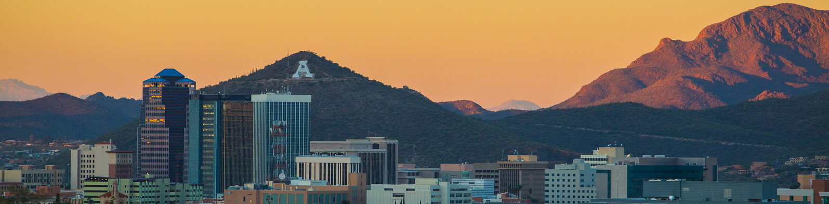
University of Arizona (in Numbers) – 2017-2018
STUDENTS
Undergraduate | 35,123
Graduate | 8,106
First Professional | 1,602
Total | 44,831
NUMBER OF ACADEMIC PROGRAMS OFFERED
Bachelors | 130
Masters | 143
Research Scholarship (Doctoral) | 93
Specialist/Professional | 6
Total | 372
Source: http://factbook.arizona.edu/2017-18/at_a_glance

Slide 48
University of Arizona (in Numbers) – 2017-2018
22 colleges/faculty units with ~95 departments
2 Separate Colleges of Medicine – Tucson and Phoenix
“Responsibility Centered Management” campus
22 colleges/faculty units with ~95 departments
2 Separate Colleges of Medicine – Tucson and Phoenix
“Responsibility Centered Management” campus
Source: http://factbook.arizona.edu/2017-18/at_a_glance

Slide 49

UA (in Numbers) – Fall 2017
 | Men | Women | Total
Administrator | 95 | 97 | 192
Faculty | 1,750 | 1,340 | 3,090
Tenure Track Dept. Head | 63 | 22 | 85
Non-Tenure Track Dept. Head | 10 | 4 | 14
Tenure Track Faculty | 993 | 542 | 1,535
Other Instructional Faculty | 451 | 538 | 989
Research Faculty | 100 | 53 | 153
Clinical Faculty | 133 | 181 | 314
Other Appointed | 1,779 | 2,353 | 4,132
Continuing Professional | 96 | 101 | 197
Academic Service Professional | 1,448 | 2,086 | 3,534
Post Doc | 228 | 146 | 374
Clinical Assistant | 7 | 20 | 27
Classified Staff | 2,229 | 3,237 | 5,466
Graduate Assistants and Associates | 1,460 | 1,283 | 2,743
Total | 7313 | 8310 | 15623
Source: http://factbook.arizona.edu/2017-18/employees

Slide 50
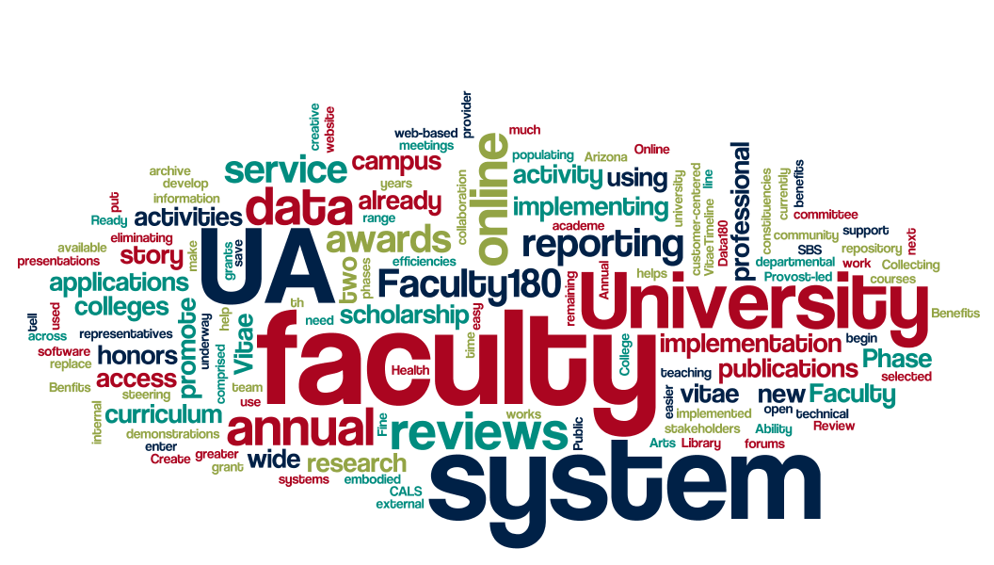
Our RIM story began in 2012…
Notes:
Maliaca

Slide 51
What was our intention?
Move current annual review processes to an online reporting system.
  Not to change processes, but change the tool utilized
  Do away with paper-based systems, hidden in filing cabinets
Make results of the annual review process available to immediate dept/college administrators
Align the annual review process with the promotion and tenure system
Reduce redundancy in reporting known data (e.g. course data, sponsored projects)

Slide 52
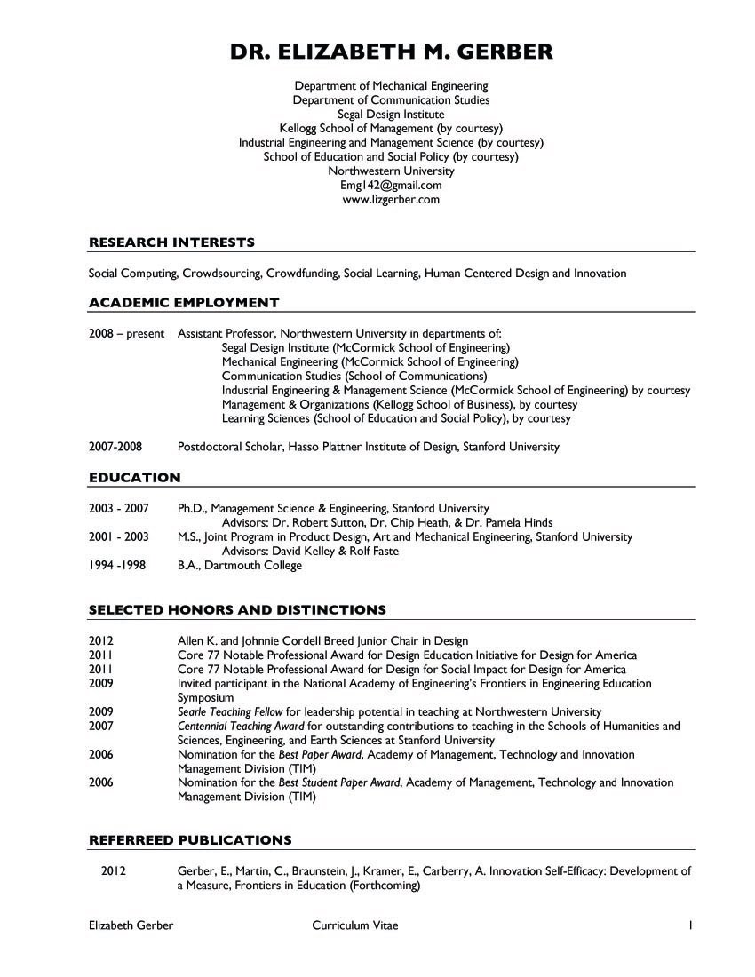
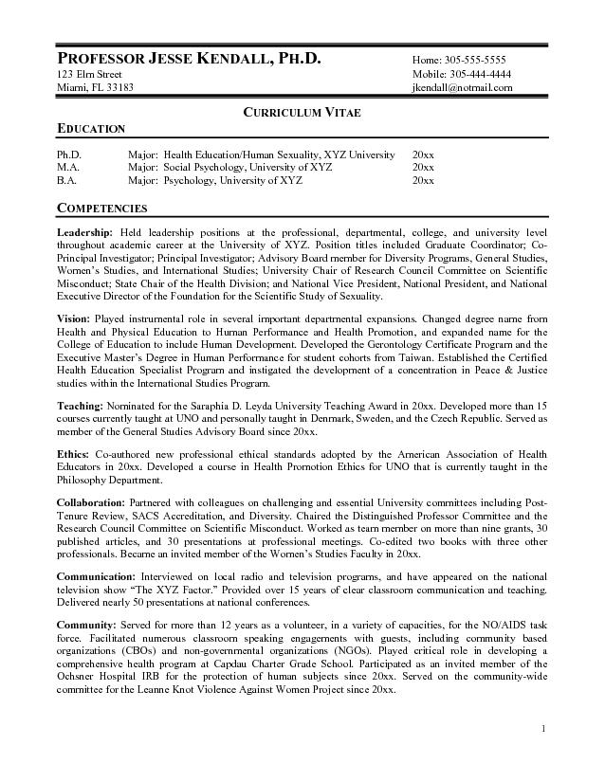
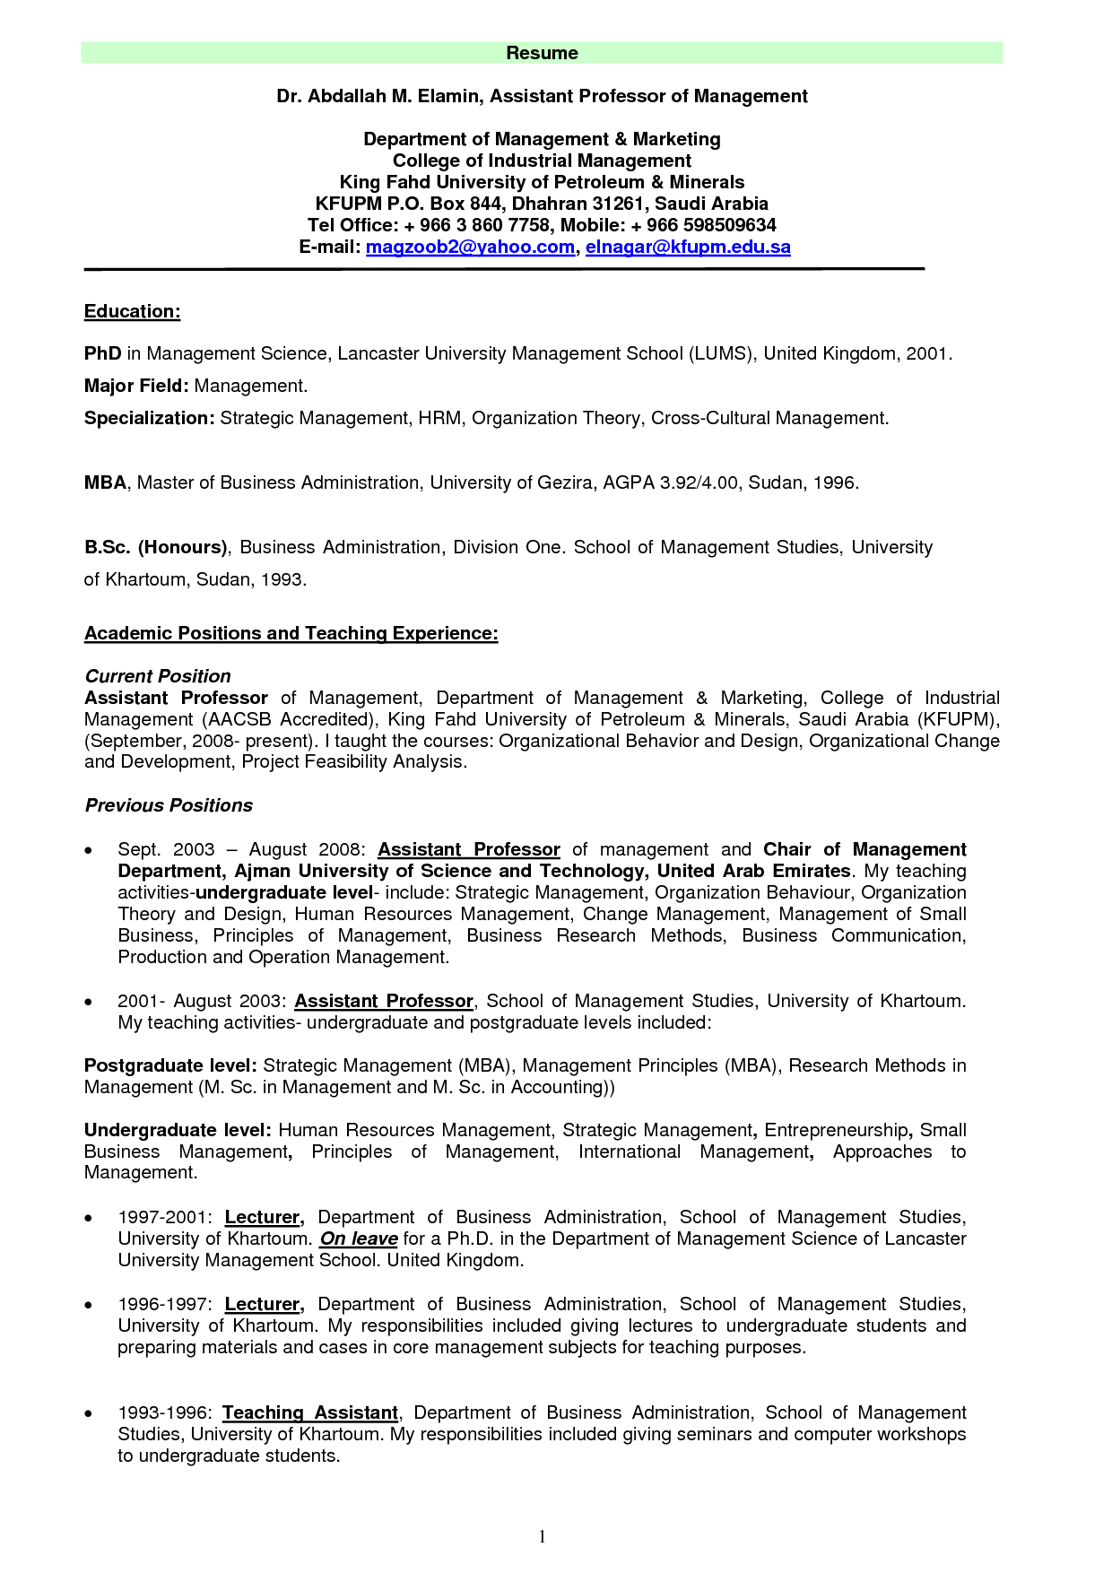
Evolving Data Tension
vs.
DATA

Slide 53
What is a Faculty Evaluation and Activity Reporting System?
F. E. A. R. S. ≠ Good thing

Slide 54

Phases & Timeline
Phase I: 2013 – Pilots
  Replaced online reporting applications used in SBS, CALS, Fine Arts, the College of Public Health and College of Medicine Phoenix.
Phase II: 2014 – Main University Roll-Out
  18 colleges; ~84 departments (not including Med)
  Non-academic units
Phase III: 2015 – Colleges of Medicine & Law
uavitae.arizona.edu
2013
Phase I Pilots
2014
Main University Roll-Out
2015
College of Medicine
College of Law
2016
College of Nursing

Slide 55
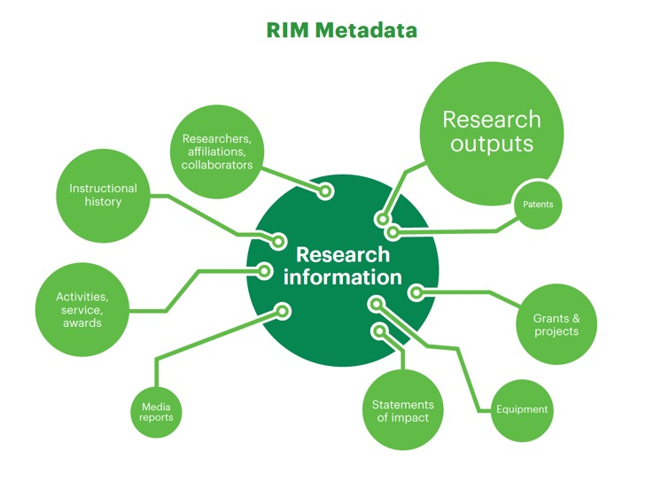
Research Information Management: Defining RIM and the Library’s Role, 2018. https://www.oclc.org/content/research/publications/2017/oclcresearch-defining-rim.html

Slide 56
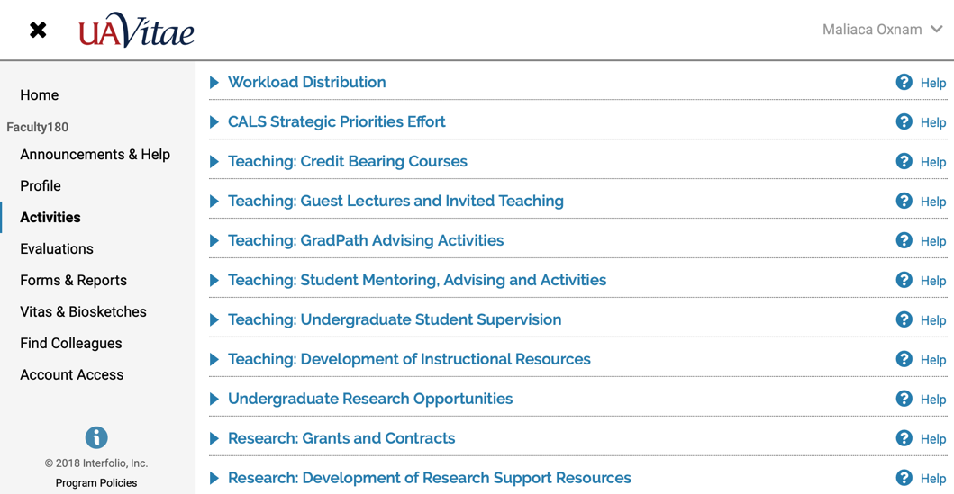
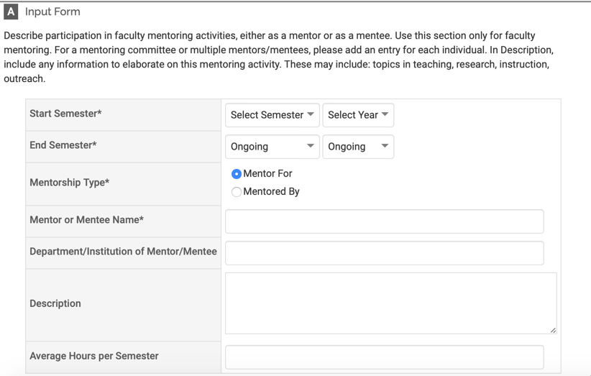
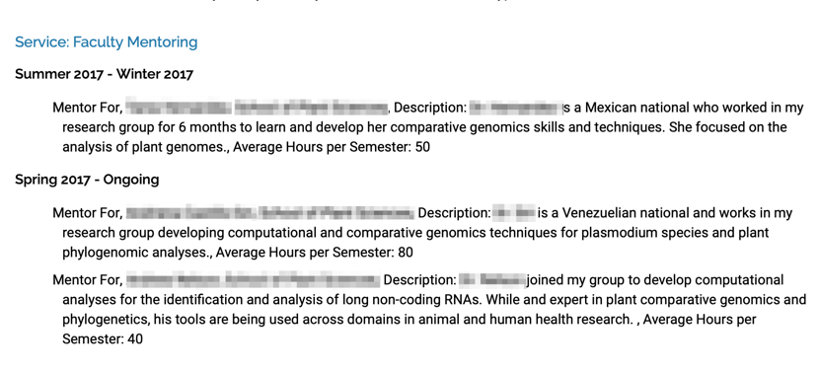
Interfolio’s F180 System
https://www.interfolio.com/products/faculty180/

Slide 57
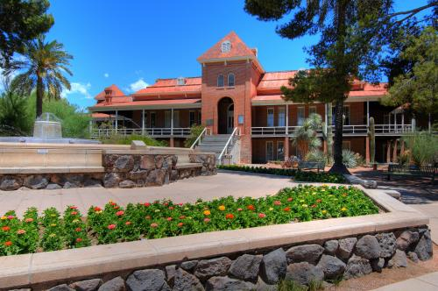


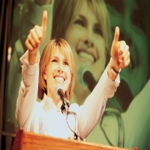


Institutional Benefits of System
Supports promotion of the work and scholarship of UA faculty to both the internal University community and our external constituencies.
Better communication and reporting of departmental impact to community
Enhance public value of institution
Support multiple program accreditation processes
Demonstrate UA commitment to community engagement
Better alignment between annual reporting and P&T
Notes:
System benefits also support UA Strategic Goals
Engaging
Innovating
Partnering

Slide 58
Faculty Benefit Highlights
Allows faculty to do more with the data put into the system.
Reduces need for multiple entry of information
Reduces the need to enter data already available on courses, grants, and other activities
Data transparency
High quality (and multiple) curriculum vitae print-out/format options
Ability to archive presentations, creative works, and research data in the a central repository
Facilitates the complete AR workflow from data capture to review.

Slide 59
Will faculty enter data?

Slide 60
Impacts
Improved data quality!
We have more data!
  Moved from paper CVs to individual data elements (= reuse!)
  Supplemental data for institutional data records
  Enabled us to create new services (e.g. Profiles)
Gave reason for depts/colleges to evaluate current review process and data points used in evaluation
  Streamlined or removed duplicate reporting
Allows standardization for activity reporting (e.g. Accreditation Reports, Program Review, Workload Equity conversations)

Slide 61
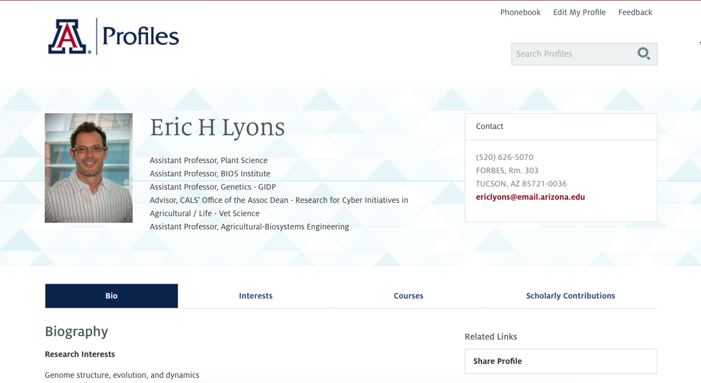
Source: https://profiles.arizona.edu/person/ericlyons

Slide 62

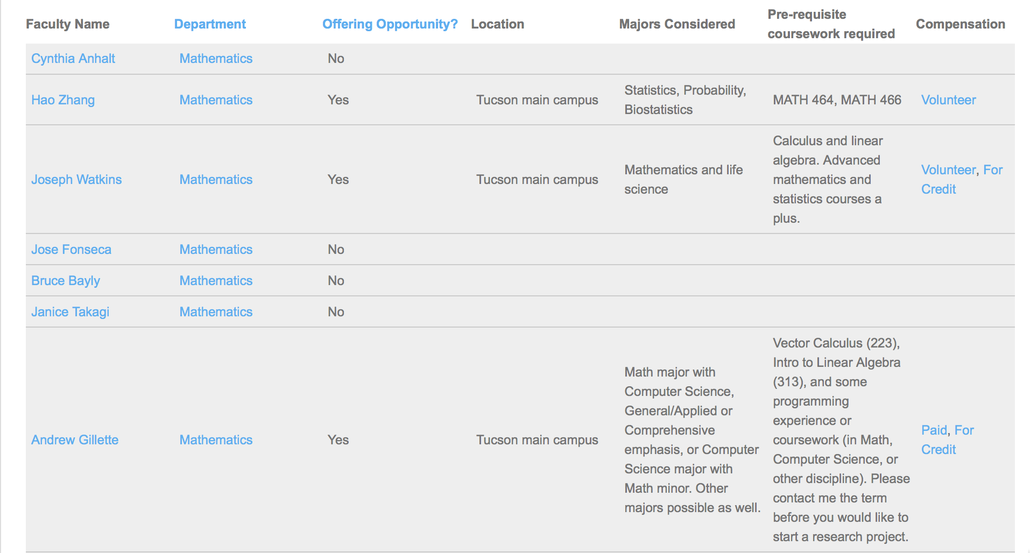
All data fed from UA Vitae

Slide 63
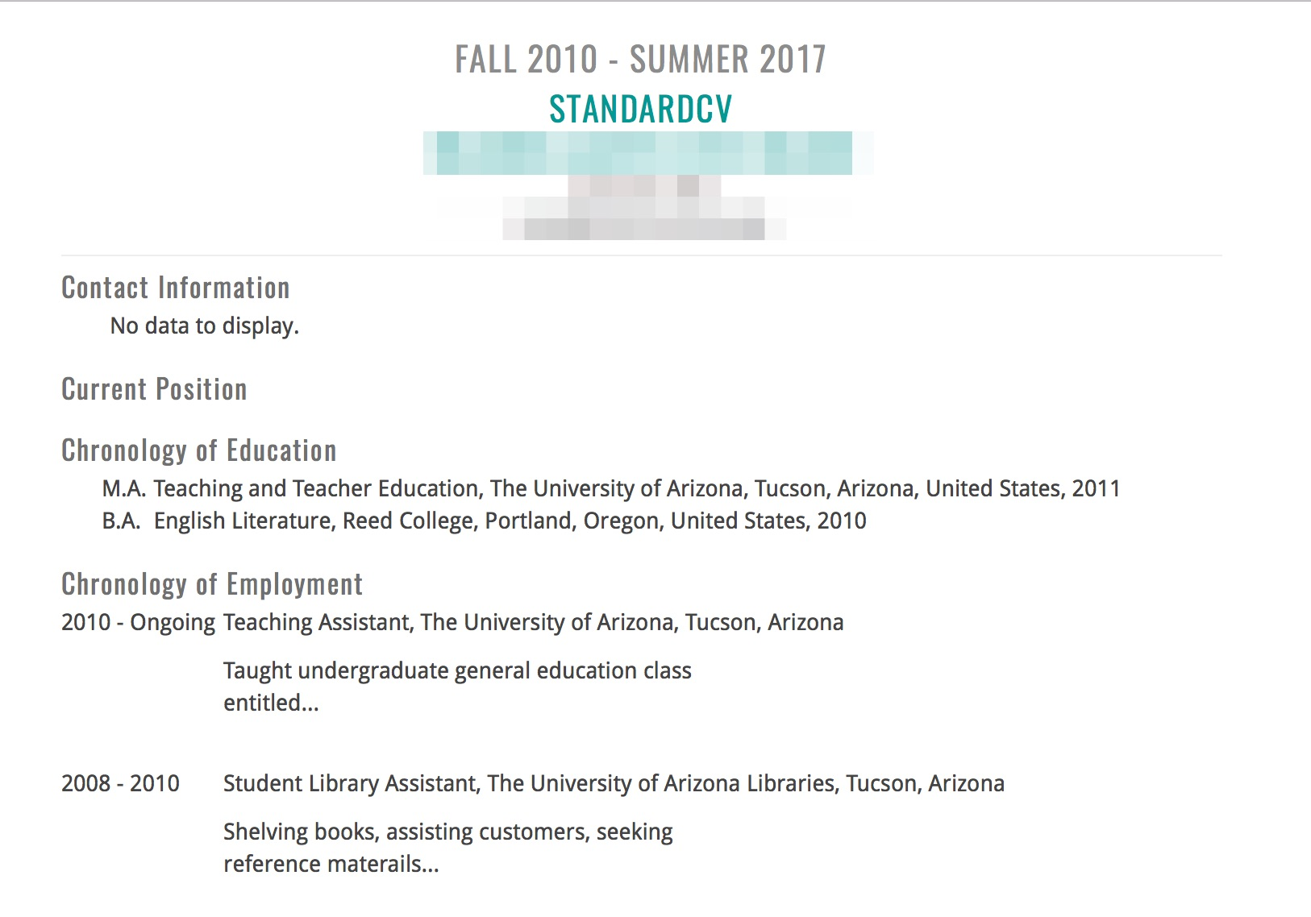
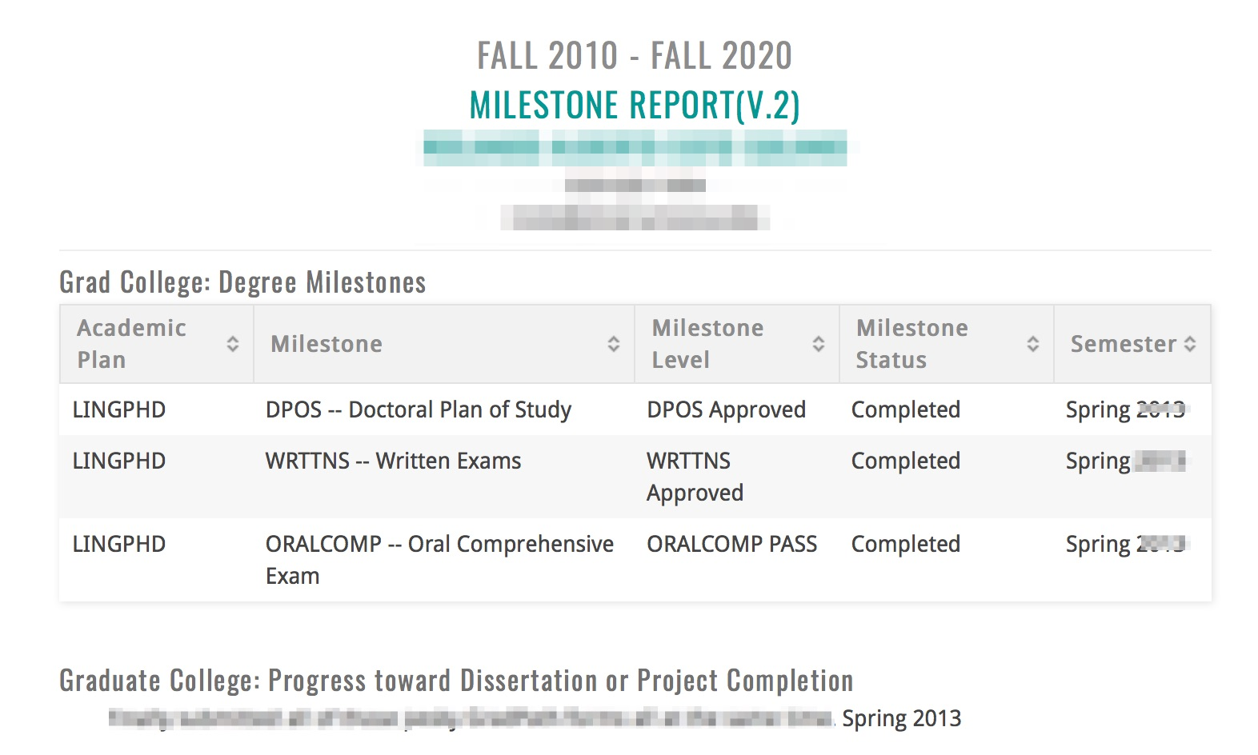
Grad College (Pilot)

Slide 64
So Who Owns This on Campus?
Provost’s Office
[Vice Provost for Faculty Affairs]
University Information &Technology Services
University Libraries
Other Key Stakeholders
Institutional Assessment & Analytics
Deans & Dept Heads
Graduate College
Office of Research
Centers and Institutes
UA Global

Slide 65

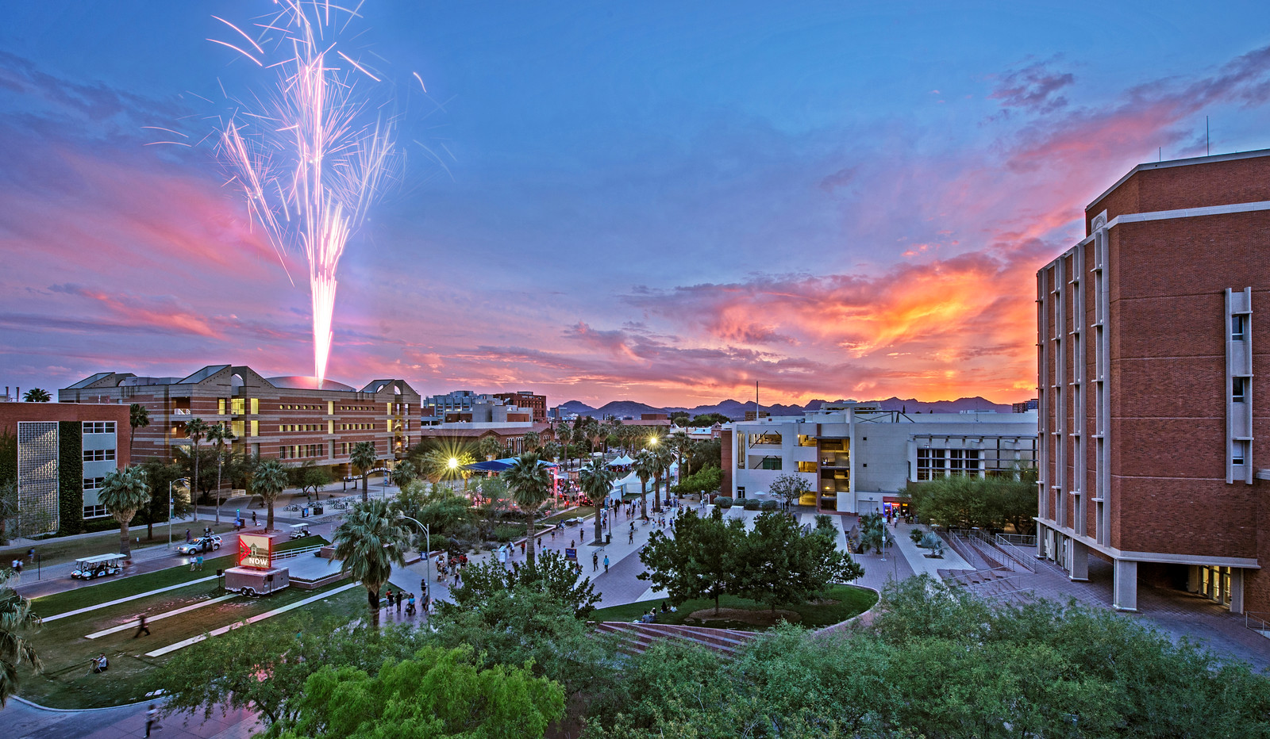
Library Opportunities: Pre-Implementation
Research and Data Analysis
Evaluating product coverage (scholarly record)
Licensing Expertise & Negotiation
Creating Conversation & Holistic Perspective
Point-of-Need Education
Scholarly Communication
Copyright
Digital Preservation
Data Visualization
Evaluating licenses and data use rights

Slide 66
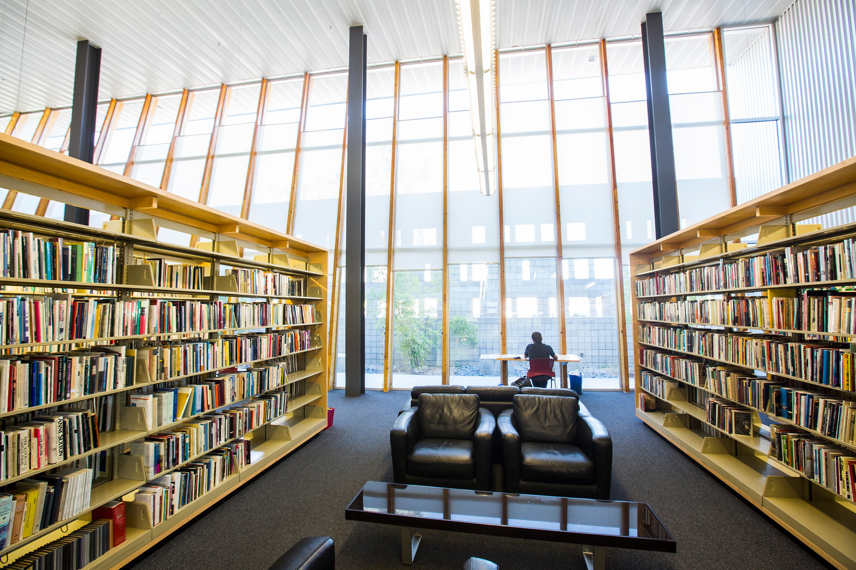
Library Opportunities: Implementation
Researcher Identity/Impact and Publication Data Expertise
Metadata Expertise & System Integrations
Data Analysis & Assessment
Awareness of Faculty Cultures and Needs
Service-Oriented Approaches
Training/Instruction Expertise & SpacE

Slide 67
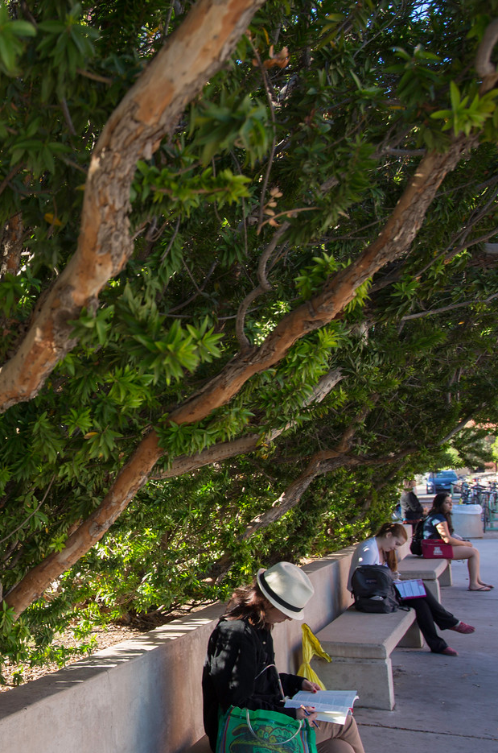
Library Opportunities:
Long-Term
Stewardship and Data Governance
Appropriate Use of Data for Public View
Data Sensitivities
Economic Value and Leverage
Researcher Identification
Scholarly Management
Training & Instruction
Scholarly Communications & Copyright Issues
Bibliographic Management Services
Indexes and Bibliographic Tools
Import/Export Services
Open/Restricted Access
Researcher Identity
Researcher Impact
Expertise Networks
Researcher Impact
Digital Preservation
Repository Integrations
Data Analysis & Visualization
Data Reporting
Business Intelligence
Research Opportunities
Expert Finding
Network Analysis

Slide 68
Questions?
Maliaca Oxnam
Office of Digital Innovation & Stewardship
University Libraries, University of Arizona
maliaca@email.arizona.edu
@maliaca

Slide 69
Questions
Why should a librarian support this kind of work?
What are you going to need to learn?
How do we support colleagues to take on this work?
Notes:
Facilitated by Rebecca to other panelists. 10 minutes total.
Why a librarian should support this kind of work? (Maliaca)
What are you going to need to learn? (Jan)
How do we support colleagues to take on this work? (Annie)
Where the line for each of you on support vs data entry? (each should be considering this. Short 30 second answers).

Slide 70
References
Bryant, Rebecca, Anna Clements, Carol Feltes, David Groenewegen, Simon Huggard, Holly Mercer, Roxanne Missingham, Maliaca Oxnam, Anne Rauh and John Wright. 2017. Research Information Management: Defining RIM and the Library’s Role. Dublin, OH: OCLC Research. doi:10.25333/C3NK88
Bryant, Rebecca, Annette Dortmund, and Constance Malpas. 2017.
Convenience and Compliance: Case Studies on Persistent Identifiers in European Research Information. Dublin, Ohio: OCLC Research. doi:10.25333/C32K7M
Bryant, Rebecca, Anna Clements, Pablo de Castro, Joanne Cantrell, Annette Dortmund, Jan Fransen, Peggy Gallagher, and Michele Mennielli. 2018. Practices and Patterns in Research Information Management: Findings from a Global Survey. Dublin, OH: OCLC Research. https://doi.org/10.25333/BGFG-D241
Ribeiro, Lígia, Pablo De Castro, and Michele Mennielli. “EUNIS-EuroCRIS Joint Survey on CRIS and IR,” 2016. http://www.eurocris.org/news/cris-ir-survey-report.

