Slide 1
Dialnet code: a bridge that joins many ways
Antonio Calderón-Rehecho
Authorities and indentifiers: how to move forward?: An OCLC Research mini Symposium (3 December 2019)

Slide 2
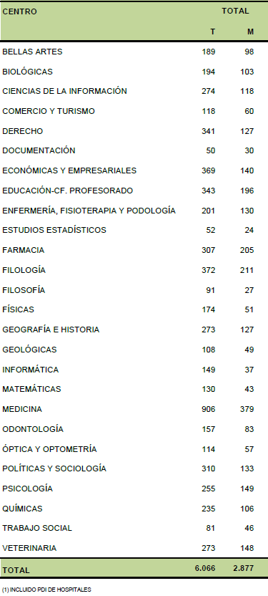
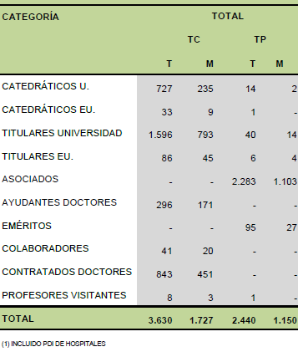
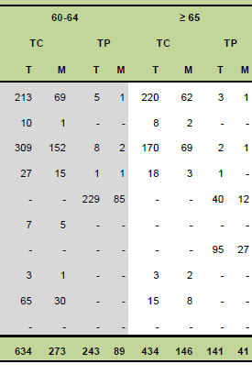
Full time
All Women

Slide 3
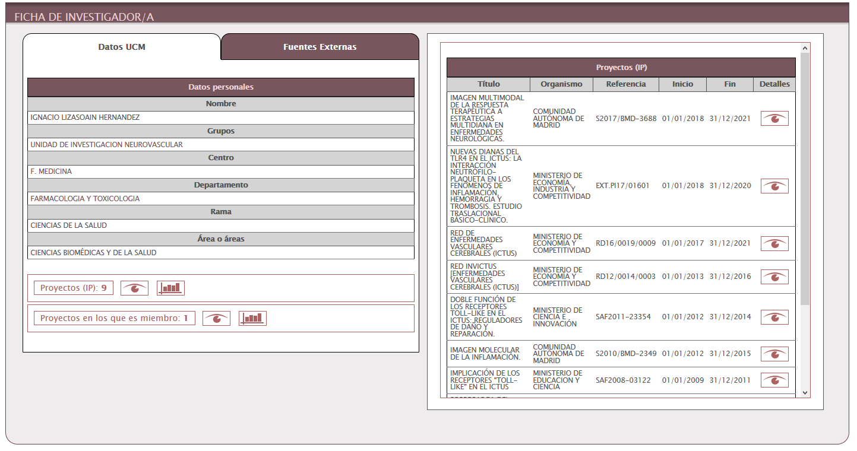
Do we have a CRIS?
In the beginning

Slide 4
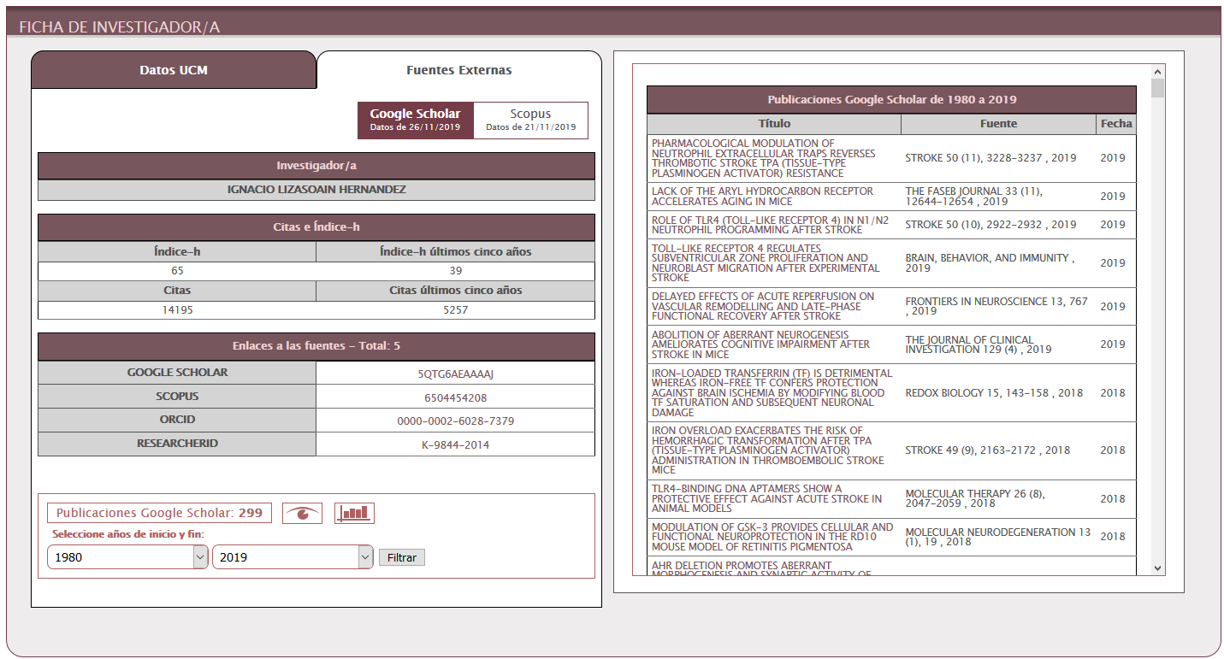

Slide 5
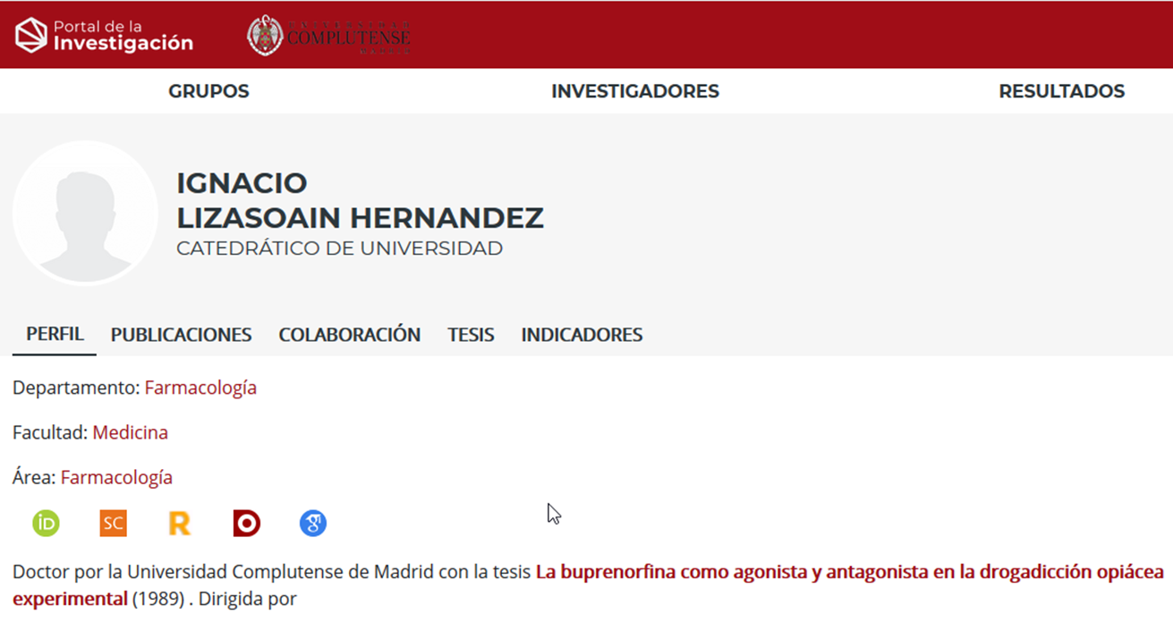
Our researchers in…
(with identified code)
Scopus: 3.407
ORCID: 1.918
Scholar: 1.777
ResearcherID: 578
Dialnet: 5.365

Slide 6
Spanish Journals in
126 JCR 1.448 GSM
380 WoS 3.436 MIAR
571 SJR 5.738 DIALNET
Humanities: 2.628
Social Sciences: 3.705
Some of them are multidisciplinary

Slide 8
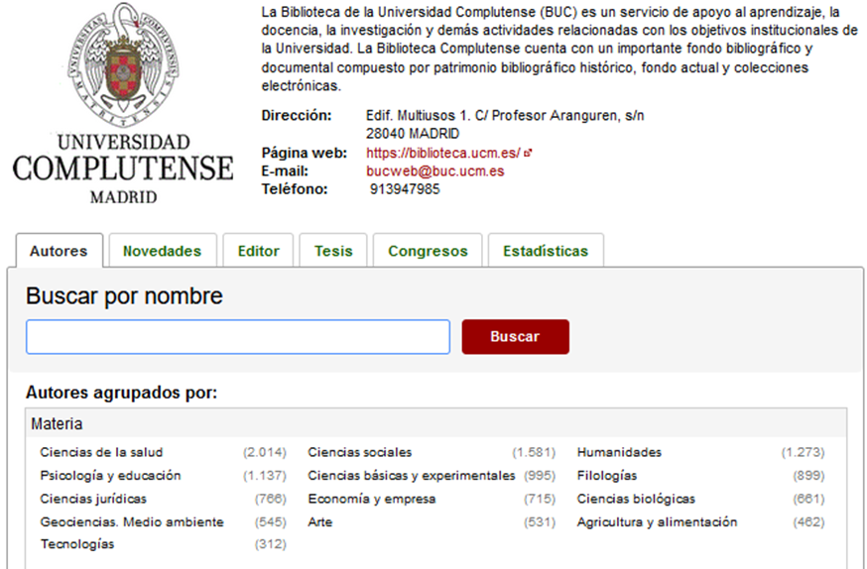
Not all are working now!
Retirees
Deaths
Only during a time
Duplicates
Not all working now are identified

Slide 9
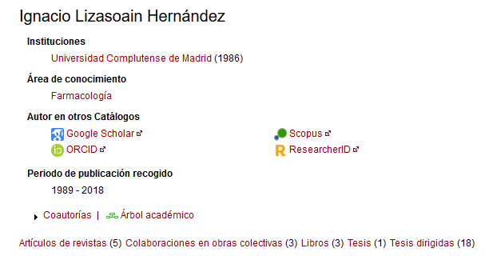
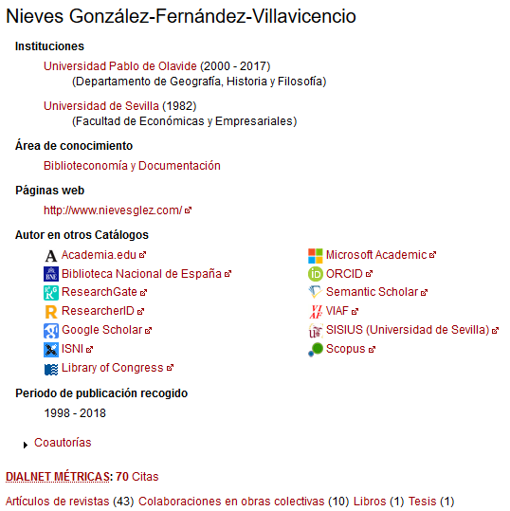
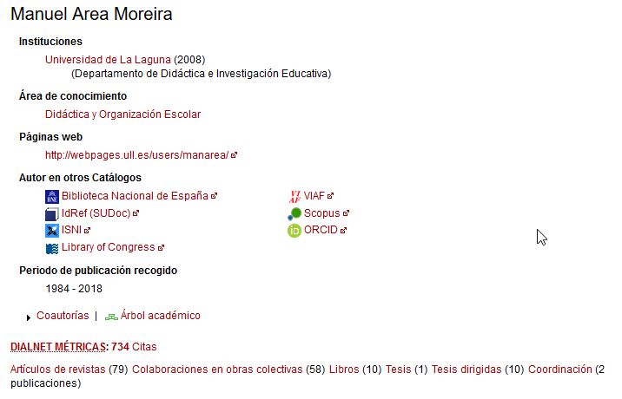
Medicine
(ours)
Library Science
Education

Slide 10
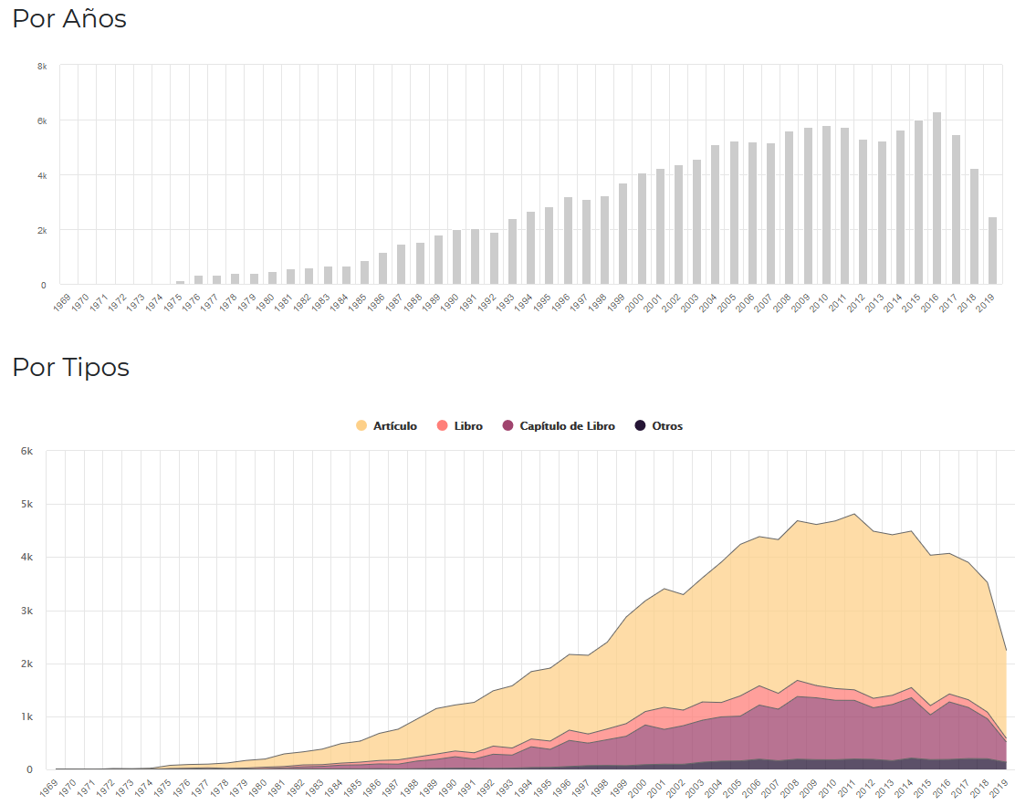
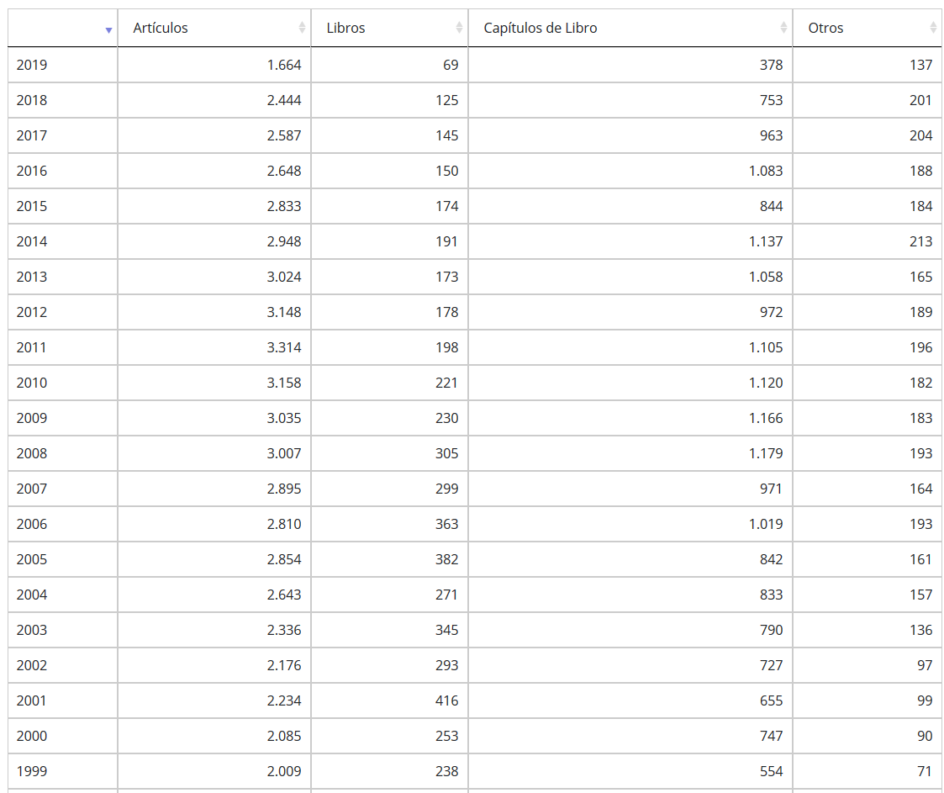
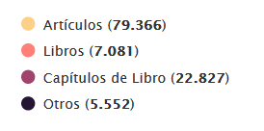

Slide 11
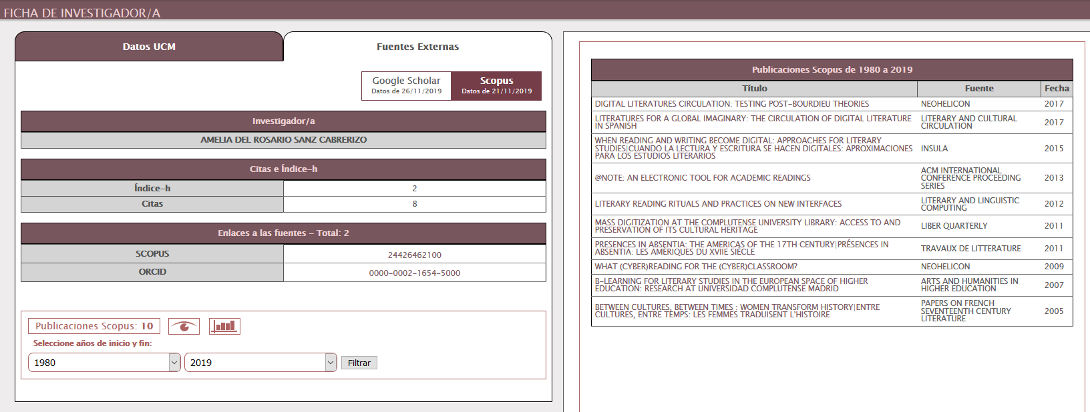
First:
After join:

Slide 12
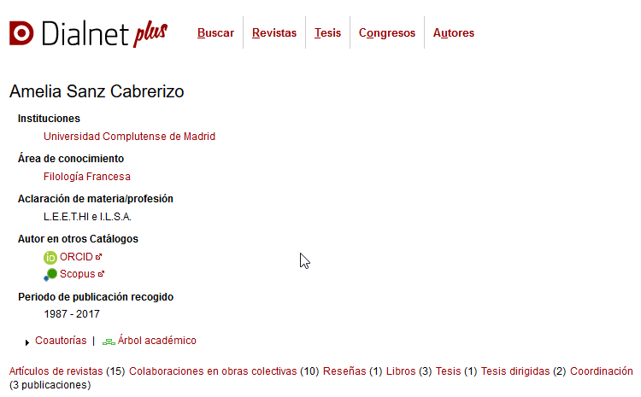
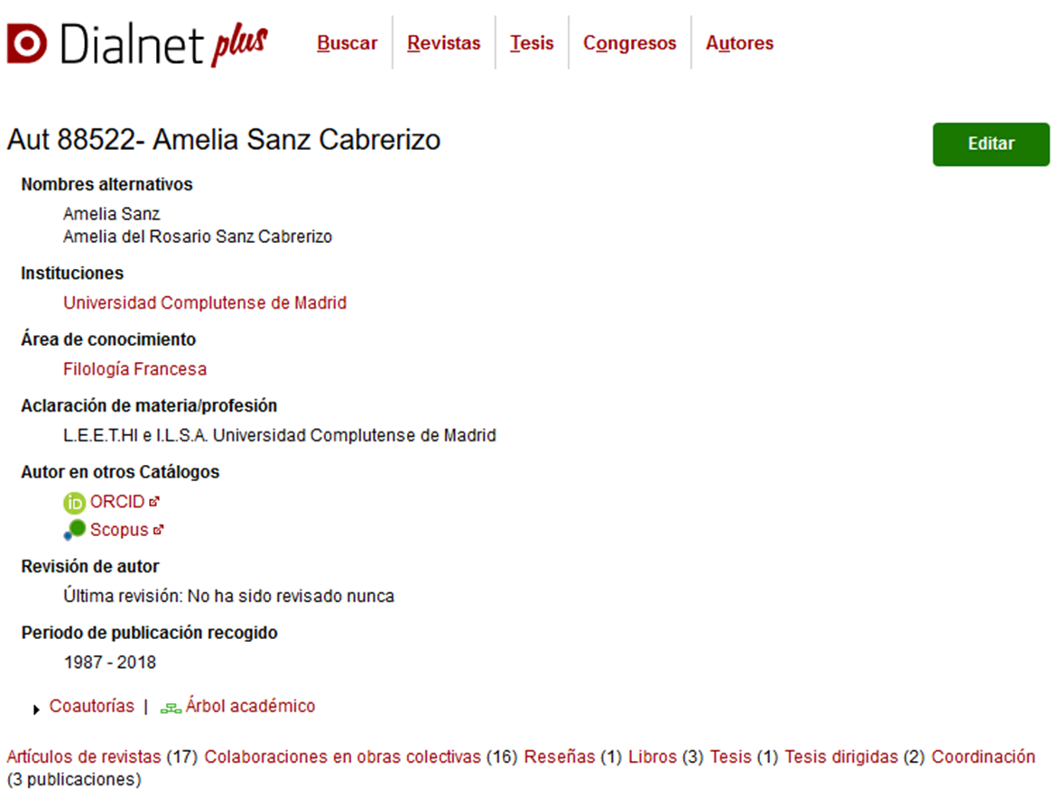

Slide 13
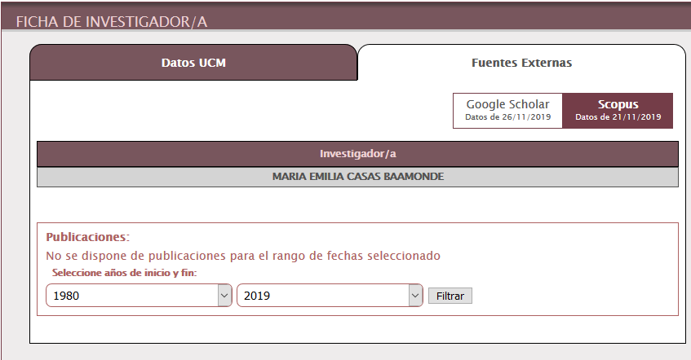
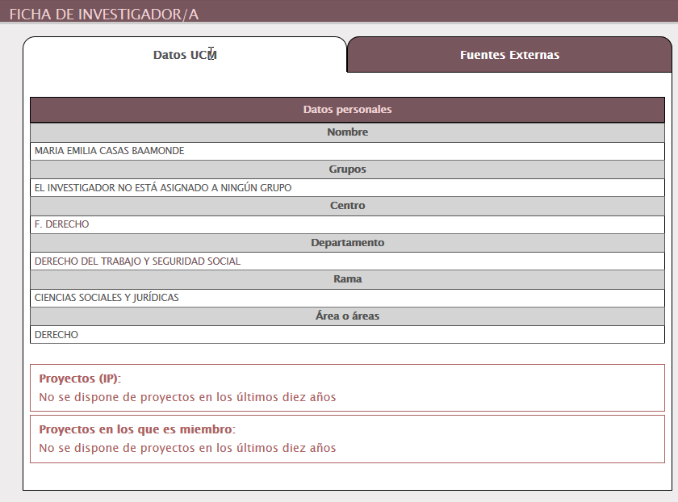
LAW: A forgotten world

Slide 14
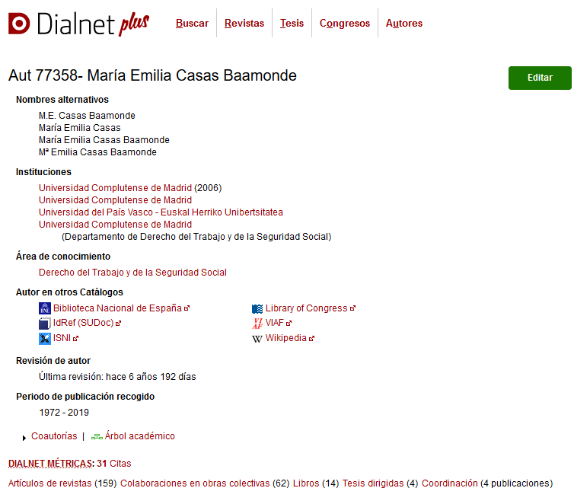
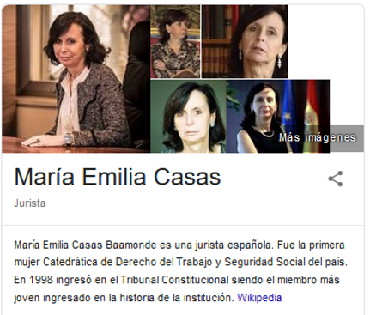
María Emilia Casas Baamonde (León, 1950) is a Spanish jurist. She was the first woman Professor of Labour Law and Social Security in the country.
In 1998, she joined the Constitutional Court as the youngest member in the institution's history.
In 2004 she was the first woman to preside over the Constitutional Court of Spain (2004-2011). During her presidency, progress was made in anti-discrimination and equality law.
Translated with www.DeepL.com/Translator (free version)

Slide 15
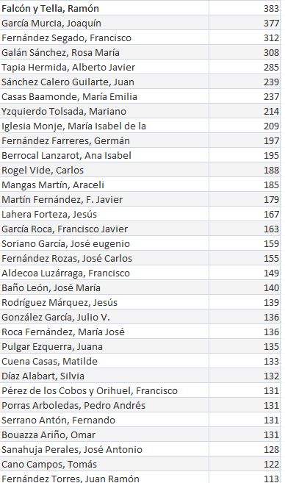
Researchers with Dialnet code
AREA | Documents
CIVIL LAW | 2228
LABOUR LAW AND SOCIAL SECURITY LAW | 2205
ADMINISTRATIVE LAW | 2041
COSNTITUTIONAL LAW | 1884
FINANCIAL AND TAX LAW | 1723
COMMERCIAL LAW | 1707
INTERNATIONAL PUBLIC LAW AND INTERNATIONAL RELATIONS | 1442
PROCEDURAL LAW | 1007
ECCLESIASTICAL LAW OF THE STATE | 670
CRIMINAL LAW | 632
HISTORY OF LAW AND INSTITUTIONS | 545
PHILOSOPHY OF THE LAW | 503
PRIVATE INTERNATIONAL LAW | 412
ROMAN LAW | 257
Documents in Dialnet: 17.256
“Old” figures
2019 November

Slide 16
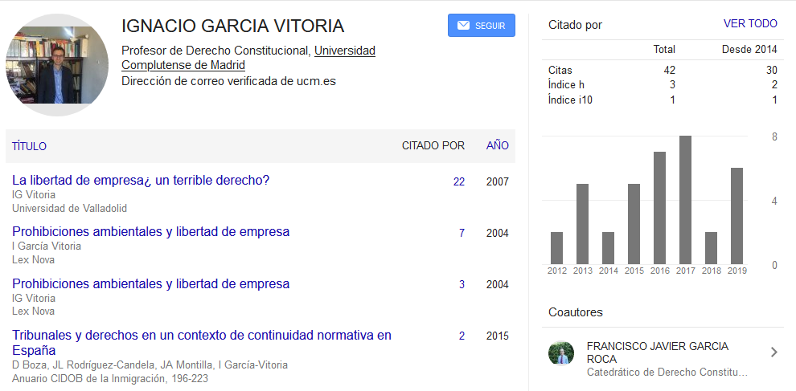
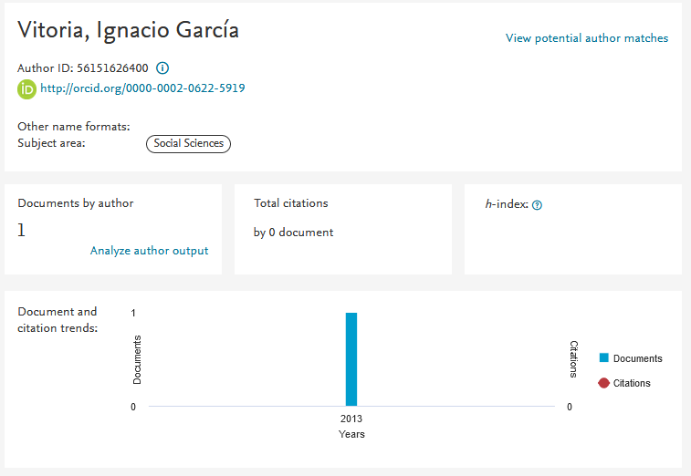
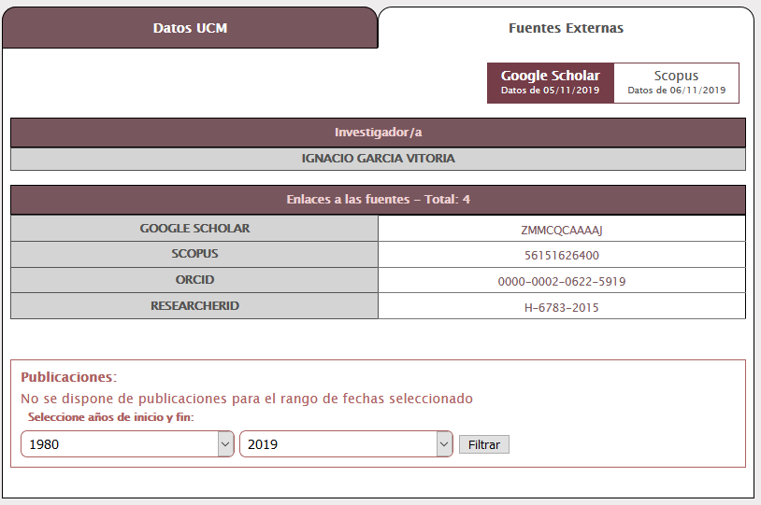
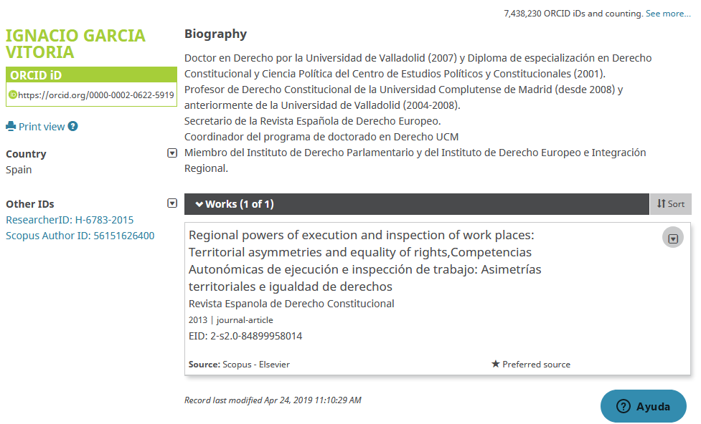
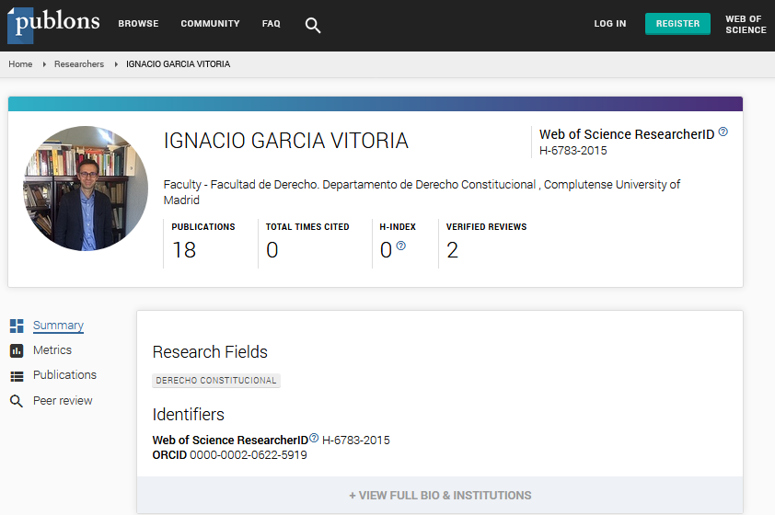
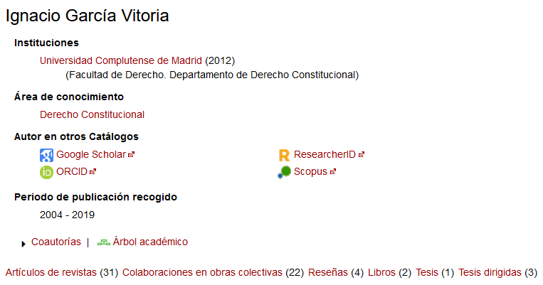

Slide 17
In our “CRIS”:
A new tab
A new identifier
Now: 114.826 documents + 28.074 Thesis

Slide 18
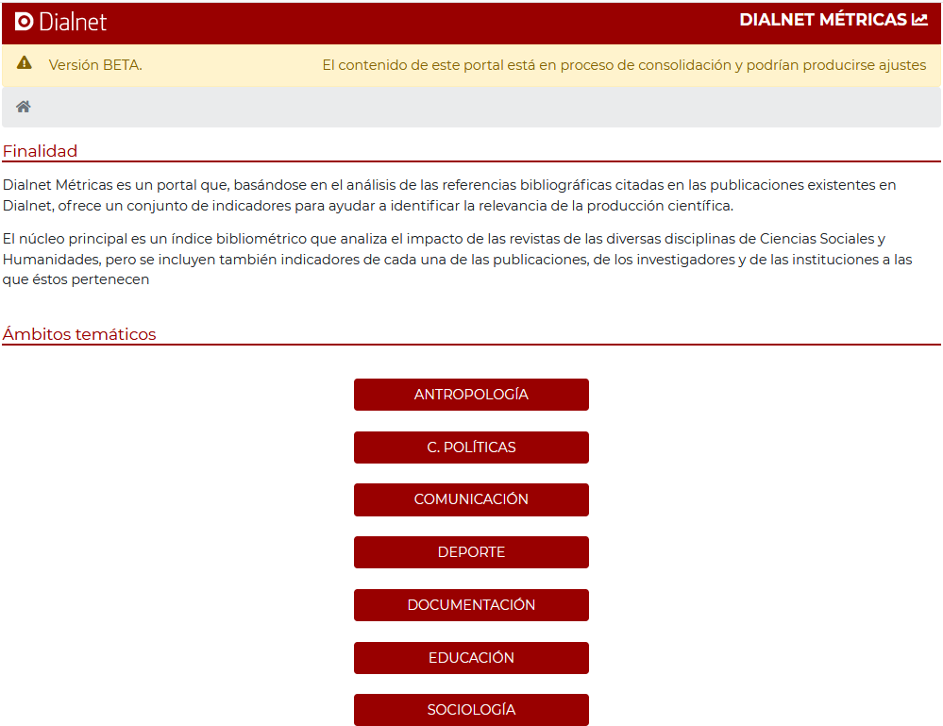

Slide 19
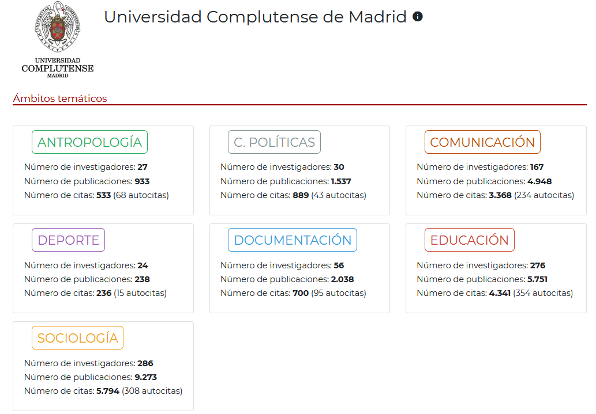

Slide 20
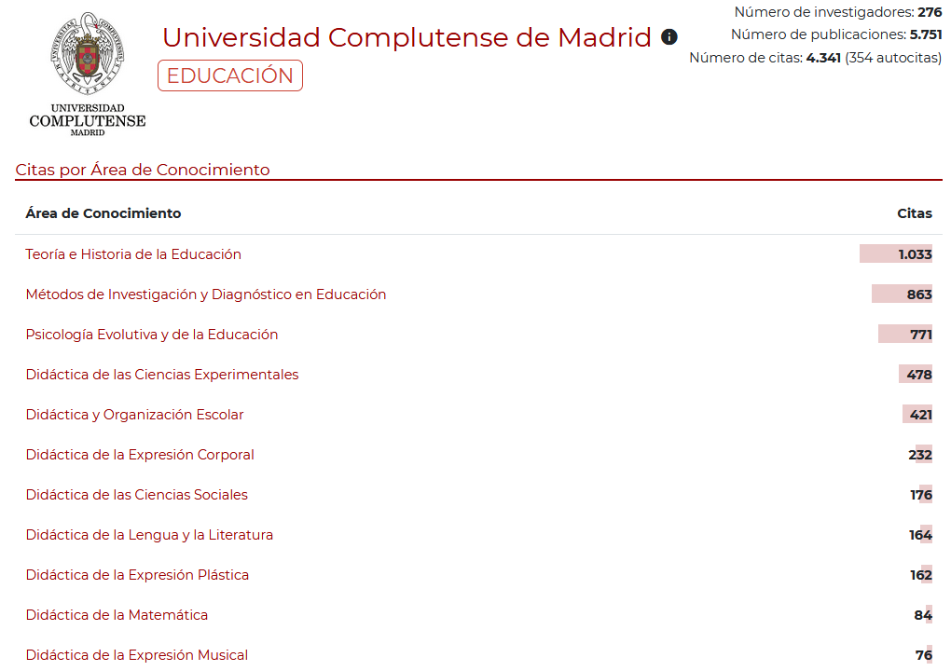

Slide 21
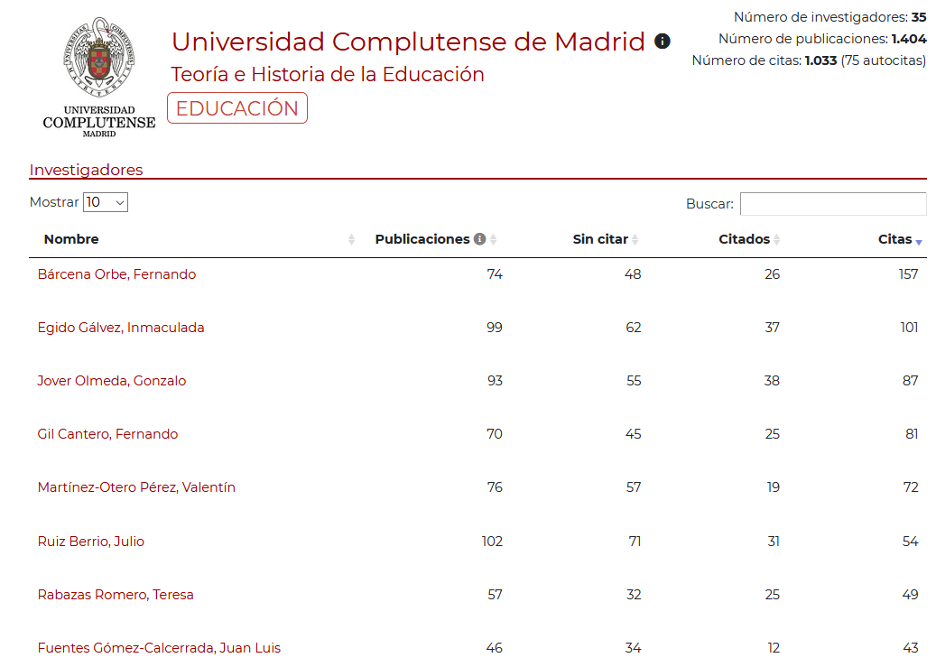

Slide 22
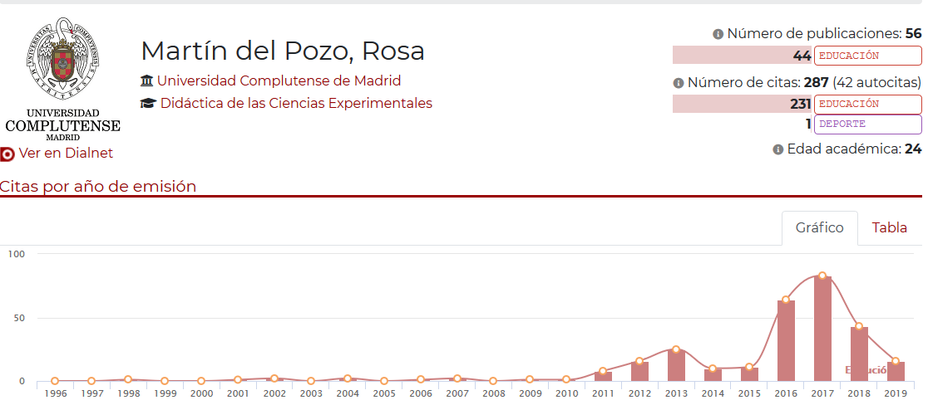
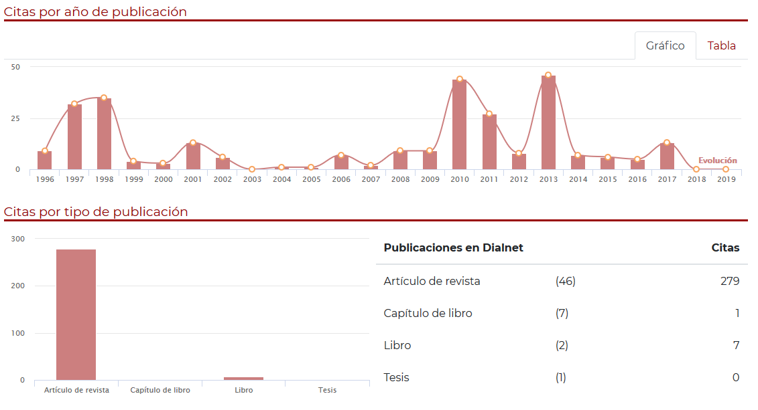
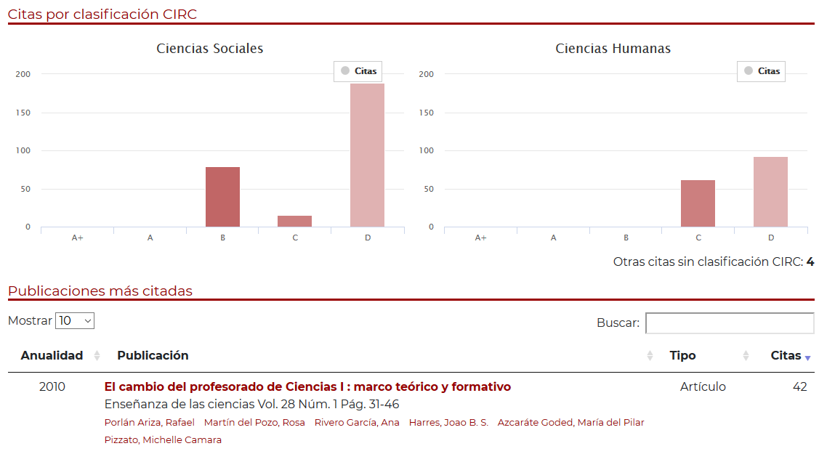
2
1
3

Slide 23
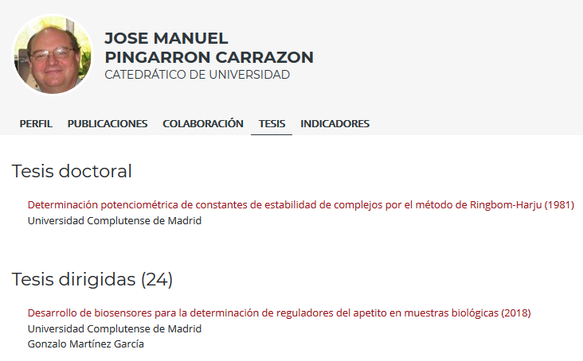
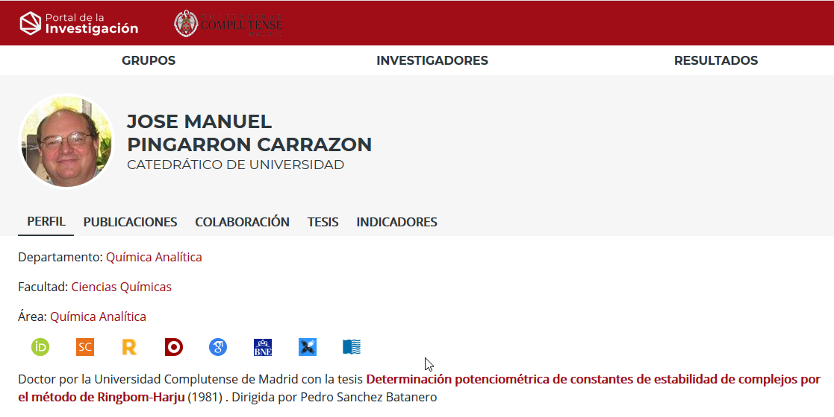
What for “scientists”?
His Dissertation
Chemistry
Doctoral thesis Director
Doctoral thesis Board
Secretary of State for Universities
Ours: Complutense University

Slide 24
Dialnet code is very useful for us for diferent reasons, in many ways:
For university: a much better CRIS. About 150.000 documents included. People happier.
For Social Sciences and Humanities researchers:
Their research becomes visible
They can get metrics indicators on their production
For all (“scientists” too): Thesis
and link to other identifiers.

Slide 25
Thanks!!!
acaldero@ucm.es

