Slide 1
Responding to Researcher Needs Through Continuous Skills Development: A Case Study of the University of Miami Libraries
Cameron Riopelle, PhD
Head of Data Services
University of Miami Libraries

Slide 2
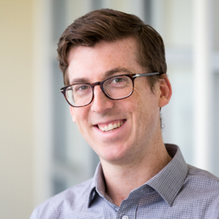
Goals of presentation
PRIMARY:
I will share about how I work to actively develop new skills and knowledge needed to support RDM services in a rapidly evolving ecosystem.
SECONDARY: I will provide an overview of how the University of Miami has developed robust research data management services in response to the needs of researchers.
This is both a subjective case study and an opportunity for discussion and mutual learning
Every institution is distinct and is composed differently than others
University of Miami is a medium-sized private university with a strong marine/atmospheric science program and a medical campus

Slide 3
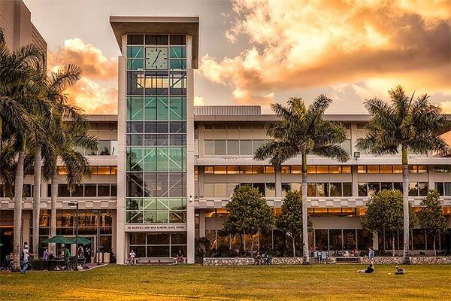

Slide 4
Goal of Data Services
Data services triangulates between data curation/management, software instruction, and research methods.
Goal: To support researchers working with data within different disciplines, software, and research methods.
So how do we work toward this goal?
Notes:
(We're moving beyond the data curation aspect of data services. We want to bring in the idea of support for data analysis as well as the ap? and bring traditional values to our library patrons. This may seem like a big leap to support the research process in terms of analysis, however we already are prepared to help with this. We are teaching workshops and have consultations for use in data analysis, and in order to do that we have to have awareness of research methods so we can teach the software. We need to go the extra step forward to support data analysis, which is of course added value to researchers and brings them back to us.)

Slide 5
Data Services at the University of Miami Libraries
Our Research Data Management bundle:
CURATION: Data management plan (DMP) review, DOI assignment, assistance with data deposit process, Esploro (Ex Libris) RIS (in progress)
EDUCATION: Workshop series (GIS, data management, research methods software, visualization)
EXPERTISE: Consultations, Digital Scholars’ Lab (specialized computing lab), Learning Commons, open office hours
Our history:
Data Services for 2 years, GIS Services for 4 years, newly merged
Our staffing:
Head of Data Services
GIS Librarian
GIS & Data Specialist
Biomedical Data Librarian* (search opening)
Research Data Scientist (joint appointment with Center for Computational Studies)

Slide 6
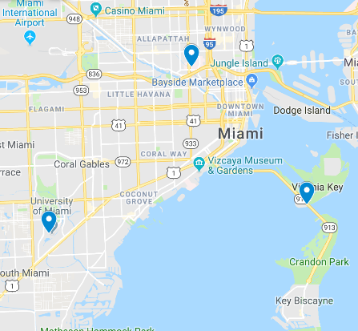
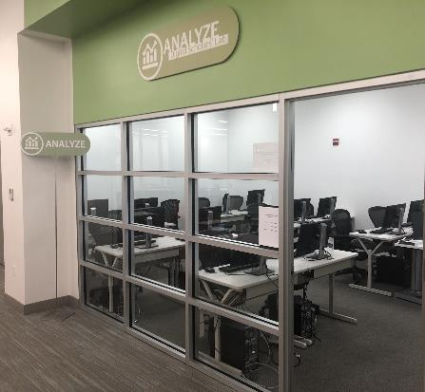
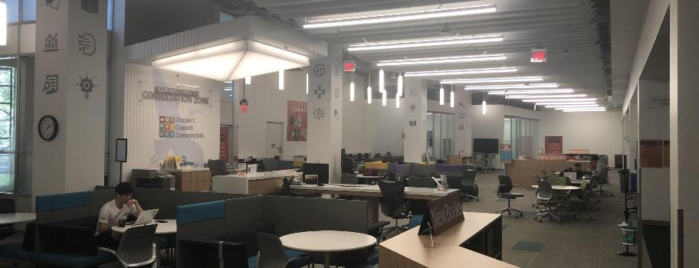
Spaces of Data Services

Slide 7
The State of Data Services at the University of Miami
Things we are doing well
Stats + survey workshops, GIS course supports, consultations (+400 data services a year, +800 GIS including license administration)
Things we are working on
Improving DS lab, increasing staffing (Biomedical Data Librarian), data collections plan
Things we are not doing (but should)
Workshops on qualitative research software
More data visualization that is narrative/storytelling in nature

Slide 8
A Philosophy of Data Services
Data services operates at intersection of data curation, research methods, and disciplinary knowledge
DATA CURATION: “Traditional” approach to data services and still important
RESEARCH METHODS: Bringing in applied methods to make DS continuously relevant
DISCIPLINARY KNOWLEDGE: The knowledge the researcher/student/faculty member brings to the table and not necessarily your job to know
The right approach can differ from field to field.
It’s ok not to wear the expert hat here.

Slide 9
Becoming Data Services
FREE VS. COST-RECOVERY
Cost-Recovery: Better tech, better capacity to upgrade
Free: Can be egalitarian, create equity, given social and cultural context, word of mouth
Learning how to set boundaries and standards of workflow
WELCOMING: Go for “Meet Halfway” Attitude, positionality, microaggressions, emotional communications, insignificant findings
USEFUL: People must want to come back a second time. Not a one-time service.
Relevant: Keep up-to-date, know something to start
Comprehensive: Must expand knowledge at or near pace of research world, must have awareness of what is happening in research

Slide 10
Keeping up-to-date with Research
The Universe Metaphor
Research constantly expanding, boundaries expanding.
The Surfing Metaphor
We exist at the edge of these boundaries, as that’s where uncertainty is. Finding balance.
Must be comfortable with uncertainty.
Must be comfortable with not being “expert.”

Slide 11
Assessing Need
Examples of Direct requests: Nvivo, Tableau, REDCap
Examples of Indirect requests: help with data management, help with learning a stats program, help with replicating a study

Slide 12
Training
Make room for training
Research day?
Use the summer for extra training
Projects are good ways to learn
Low stakes
Known short timeline until completion
Use methodology sections of peer-reviewed articles
Try to be your own best practices
Reinforce general good computing skills and data management practices
Using fake data can be very useful for learning and for situations in which you cannot use or see the real data (e.g., human subjects)

Slide 13
A consultative process
POSSIBLE SCENARIOS
Meet (evaluate, listen) → immediate resolution
Meet (evaluate, listen) → prepare, study → Second meeting → … →
Meet (evaluate, listen) → refer
Meet (evaluate, listen) → decline to help (possibly refer)
The prep and study increases possibility for future immediate resolution
The act of referral can lead to further acts of referral back to you
Resolution often leads to a second visit anyway for new and emerging issues

Slide 14
A Situation
“I am currently studying the movements of large coastal sharks in Biscayne Bay, FL, via passive acoustic biotelemetry and would like help quantifying the: i) residency; ii) site fidelity; and iii) activity spaces (minimum convex polygons) of these animals utilizing R software.”
Where do you begin? What do we know?
Solution must use R
Solution has something to do with measuring residency, site fidelity, and activity spaces (minimum convex polygons)
Two paths: start with R packages, or start with the literature

Slide 15
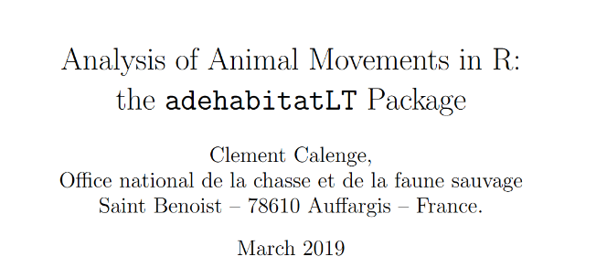
Two paths
“We used a hierarchical, first-difference, correlated, random-walk, switching SSM (hDCRWS) [43]. This model allows for estimate parameters jointly across multiple individual tracks.”
https://www.ncbi.nlm.nih.gov/pmc/articles/PMC5567640/
https://www.whoi.edu/cms/files/patterson_movement_state_space_models_tree_57192.pdf
Finally, leads to:
https://rdrr.io/cran/bsam/man/fit_ssm.html
Both paths should be made clear to the researcher and ideally should reinforce each other
https://cran.r-project.org/web/packages/adehabitatLT/vignettes/adehabitatLT.pdf

Slide 16
Another Situation
“I am looking for some help in designing and conducting a propensity score analysis study with administrative data we have collected and to link for children in early learning programs, their participation, attendance and school outcomes.”
Questions:
What program(s) do they know?
What program(s) do they have?
How can data services help?
After the first meeting, it turns out the researcher has Stata and wants to confirm that this is possible
The meeting ends up being a demo of how to do propensity matching in Stata using sample data following: https://www.stata.com/meeting/italy14/abstracts/materials/it14_grotta.pdf
I was not allowed to look at the data since it was human subjects (and children) and I was not on the IRB

Slide 17
Approaches to working with researchers
Take an attitude of “meeting them halfway”
Don’t overpromise
Don’t solely take on the expert identity
The first consultative meeting should be framed as evaluative in nature

Slide 18
The question of value
Value to peers
Demystifying data
Value to researchers
Value to research enterprise

Slide 19
Closing Thoughts
Back to the Philosophy of Data Services
Universe metaphor
Surfing metaphor
Stay afloat. Let others stay afloat.
Keep on training
Make room for training
The invisible labor of training should be encouraged by department and administration

Slide 20
Questions?
Thank you very much!

