Slide 1
Achieving Privacy
in the Age of Analytics
Skills, Strategies, and Ethical Approaches
OCLC Research Library Partnership
Works in Progress Webinar
Scott W. H. Young, Sara Mannheimer, & Jason A. Clark
Montana State University
Notes:
Scott begins

Slide 2
Outline
Project Background
Creative Process
Project Outcomes
Future Directions
Discussion and Idea Generation

Slide 3
Discussion
What are the key barriers to privacy action?
Which Pathways to Action look most promising?
How could you see yourself or your organization getting involved further in turning the Pathways from idea into action?

Slide 4
Project
Background

Slide 5
Background — Need

Slide 6
Background — Need
Libraries need web analytics

Slide 7
Background — Need
The usage measurement statistics generated from web tracking software help tell a story of value and impact for library stakeholders, including funding agencies, university administrators, and community boards. Analytics also serve a crucial role for tuning, tailoring, and improving services to better help library users.

Slide 8
Background — Need
Libraries understand that
users need privacy.

Slide 9
Background — Need
Libraries have historically offered safe spaces of intellectual freedom underpinned by a commitment to privacy in the pursuit of information, yet the widespread implementation of commercial analytics packages such as Google Analytics on library websites may conflict with the library profession’s long-held values of privacy and intellectual freedom.

Slide 10
Background — Project Title
A National Forum
on Web Privacy
and Web Analytics

Slide 11
Background — Funding
Notes:
Scott begins

Slide 12
Background — Personnel
Scott Young, PD
Sara Mannheimer, co-PD
Jason Clark, co-PD
Lisa Janicke Hinchliffe, Project Analyst
Jacqueline Frank, Forum Facilitator
David Swedman, Grants Coordinator

Slide 13
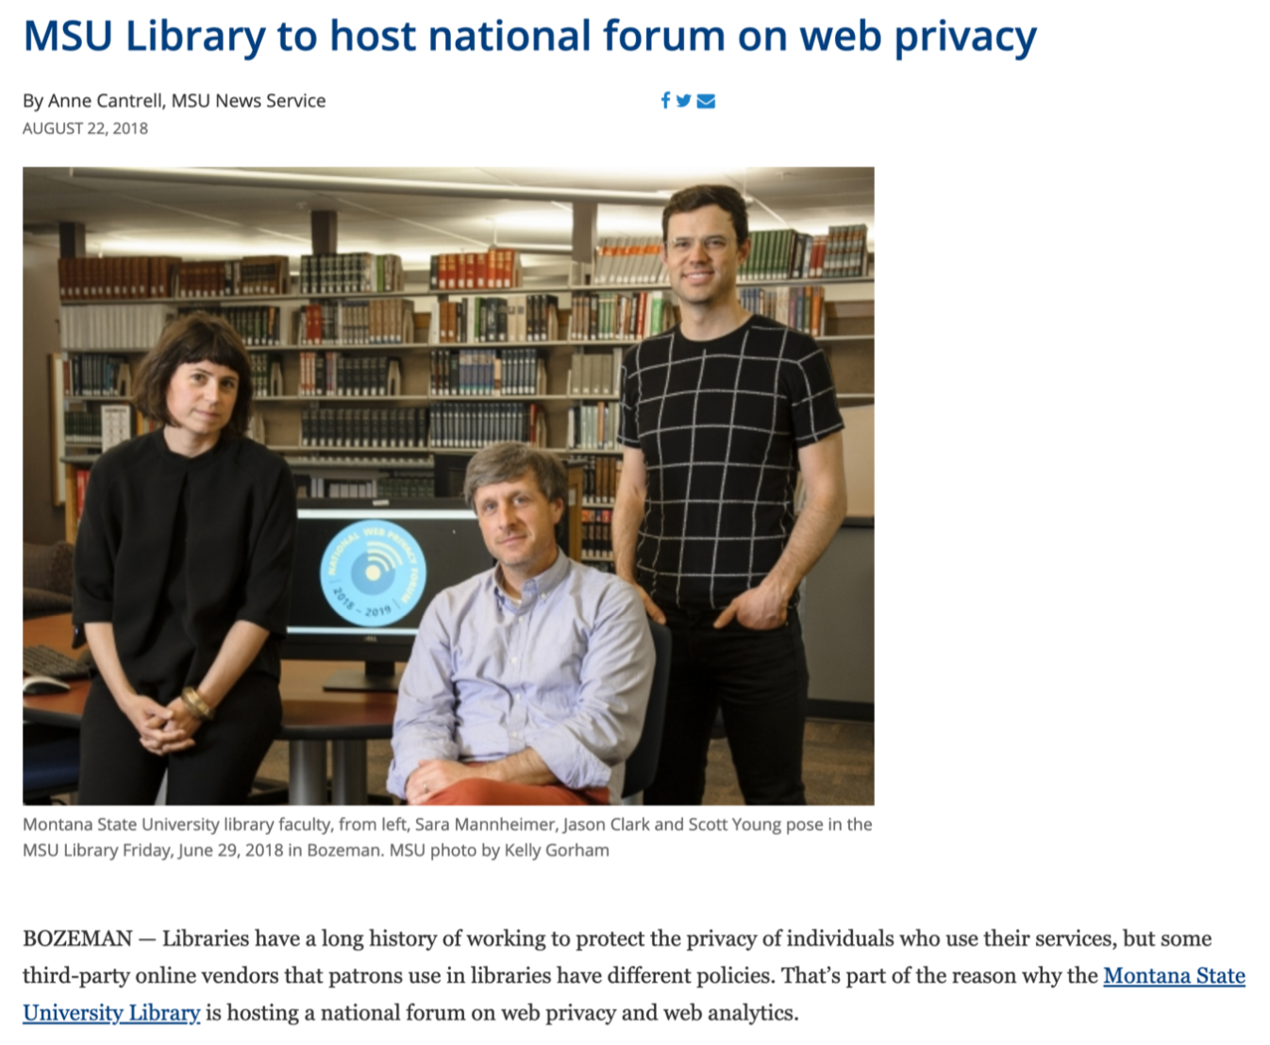

Slide 14
Background — Goals
Critically address web analytics practices
Develop a roadmap towards privacy-aware, values-driven analytics

Slide 15
Background
_lib.montana.edu/privacy-forum_

Slide 16
Project
Process

Slide 17
Process — Participants

Slide 18
Andrew Asher, Assessment Librarian, Indiana University
Tyler Bass, Computer Science Undergraduate Student, Montana State University
Erin Baucom, Digital Archivist, University of Montana
Steve Borrelli, Head of Library Assessment, Penn State University
Deborah Caldwell-Stone, Deputy Director, ALA OIR
Danielle Cooper, Senior Researcher, Ithaka S+R
Edward M. Corrado, Acting UL, Naval Postgraduate School
Tristan Denyer, UX, UI, and Product Designer
Alex Dolan-Mescal, Design Consultant and UX Designer on DocNow
Emily Drabinski, Coordinator of Library Instruction, LIU Brooklyn
Tabatha Farney, Web Services Librarian, UCCS
Susanna Galbraith, Virtual Services Librarian, Health Sciences Library, McMaster University
Anne T. Gilliland, Scholarly Communications Officer, UNC
Chris Gilliard, Professor of English, Macomb Community College
Cody Hanson, Director of Web Development, University of Minnesota
Margaret Heller, Digital Services Librarian, Loyola University Chicago
Lisa Janicke Hinchliffe, Professor/Coordinator for Information Literacy Services and Instruction, University of Illinois at Urbana-Champaign
Magera Holton, Co-Founder and Designer, Related Works
Qiana Johnson, Collection and Organizational Data Analysis Librarian, Northwestern University
Anne Klinefelter, Director of the Law Library, UNC
Manisha Khetarpal, Librarian, Maskwacis Cultural College
Martha Kyrillidou, Principal, QualityMetrics
Nettie Lagace, Associate Director for Programs, NISO
Topher Lawton, Instructional Technology and Assessment Librarian, Georgetown University
Monica Maceli, Assistant Professor, School of Information, Pratt Institute
Mark Matienzo, Collaboration & Interoperability Architect, Stanford University
Donovan Pete, Diné Graphic and Web Designer, Program Supervisor, Torreon Community Library
Matthew Regan, Instructional Services Program Leader, Montana State University
Rebecca Ricks, Ford-Mozilla Open Web Fellow, Human Rights Watch
Yasmeen Shorish, Data Services Coordinator, JMU
Maura Smale, Chief Librarian, New York City College of Technology
Santi Thompson, Head of Digital Research Services, University of Houston
Bonnie Tijerina, Librarian, Entrepreneur and Library Community Convener, and Data & Society Fellow
Ken Varnum, Senior Program Manager, University of Michigan
Kelvin Watson, Director, Broward County Libraries
Jaci Wilkinson, Web Services Librarian, University of Montana
Becky Yoose, Library Applications and Systems Manager, Seattle Public Library
Katie Zimmerman, Scholarly Communications & Licensing Librarian, MIT
Angela Zoss, Assessment and Data Visualization Analyst, Duke

Slide 19
Process — Pre-Forum Survey

Slide 20
Process — Pre-Forum Survey
http://doi.org/10.5281/zenodo.3240729

Slide 21
Process — Pre-Forum Survey
Major Themes
Partnerships and Collaborations
Privacy, Equity, and Justice
Policies and Statements
Practical Guidelines
Outreach and Education Models
Analytics Tools

Slide 22
Process — Forum Event
Notes:
Structured, facilitated, creative thinking design exercies.

Slide 23
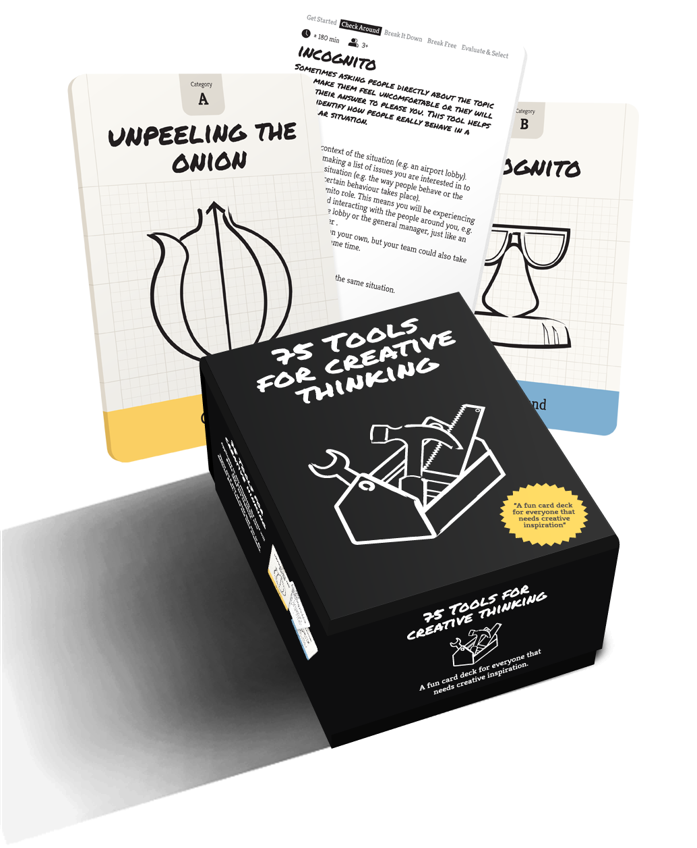
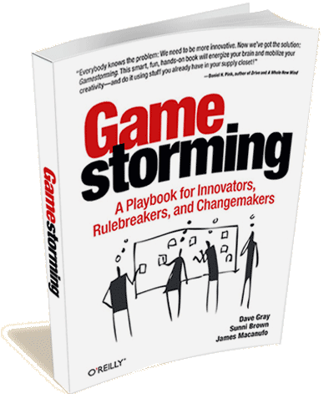
Process — Forum Event

Slide 24
Process — Design Activities

Slide 25
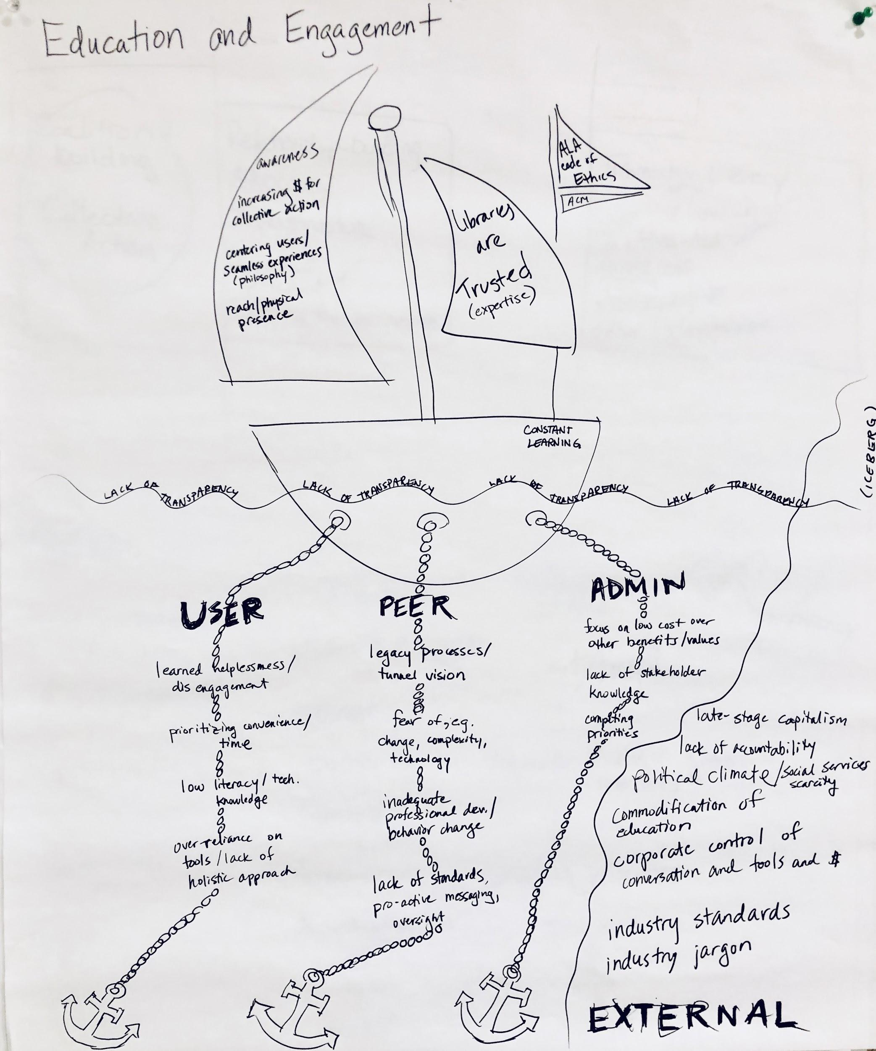

Slide 26
Float Your Boat

Slide 27
Float Your Boat
Draw a boat. The boat represents “privacy education and engagement”

Slide 28
Float Your Boat
Draw a boat. The boat represents “privacy education and engagement”
Attach anchors and sails to the boat.
The anchors represent obstacles and challenges.
The sails represent strengths and aptitudes.

Slide 32
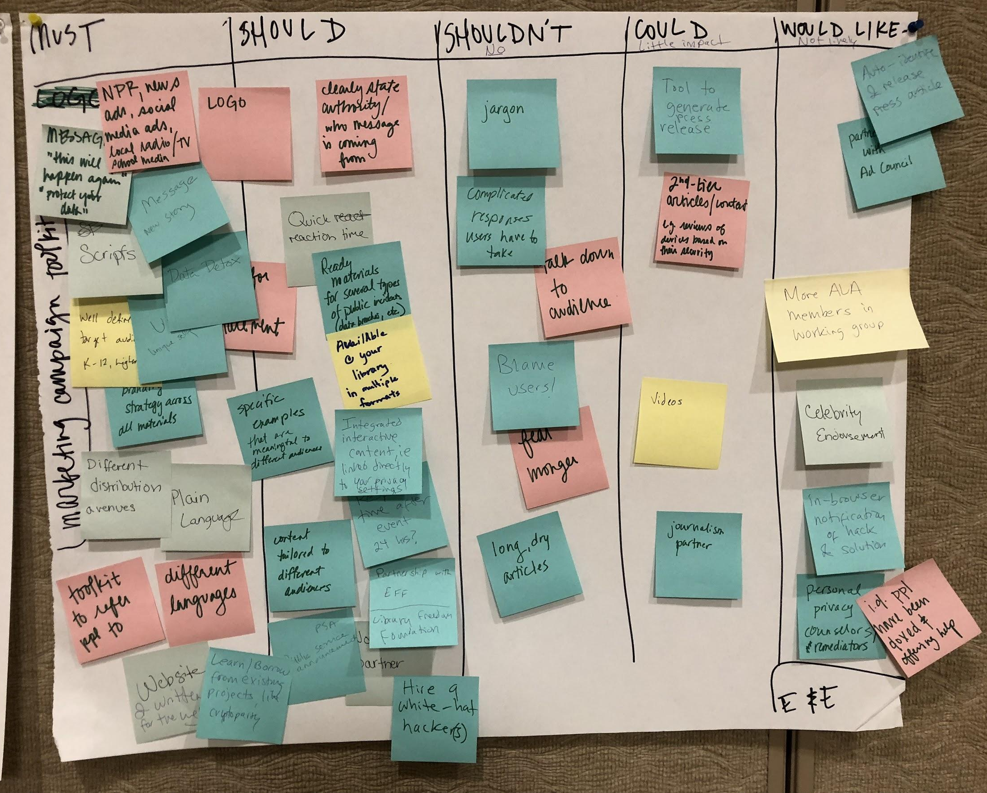
Notes:
Once we had an idea of the main challenges and strengths, we completed a series of exercises that allows us to create ideas for products or services that could address the challenges. In this instance, we played a game called MoSCoW...

Slide 33
MoSCoW
Must have
Should have
Shouldn’t have
Could have
Would like but won’t get

Slide 34
Project
Outcomes
Notes:
Sara picks up

Slide 35
Outcomes

Slide 36
Outcomes
What we produced
White Paper
Action Handbook
8 Pathways to Action

Slide 37
Outcomes
_lib.montana.edu/privacy-forum_

Slide 38
White Paper
A detailed overview of the Forum and its outcomes

Slide 39
Action Handbook
Practical recommendations for implementing privacy-oriented analytics practices

Slide 40
Action Handbook
Practical recommendations for implementing privacy-oriented analytics practices
Technical and Social action items

Slide 41
Action Handbook
Google Analytics Implementation
Many libraries have installed Google Analytics with the default configuration.

Slide 42
Public by default, private through effort.
— danah boyd

Slide 43
Action Handbook
Google Analytics Implementation
Many libraries have installed Google Analytics with the default configuration.
A few easy-to-implement changes can add benefits to the performance and the privacy of your website.
forceSSL
anonymizeIP
Minimal Google Analytics snippet (https://minimalanalytics.com/)

Slide 44
Action Handbook
Alternative Analytics
Matomo
Countly
SimpleAnalytics
Open Web Analytics
Server Logs

Slide 45
Action Handbook
Staff Skills and Competencies
Core Privacy Concepts
Information security management and governance, including frameworks, controls, cryptography and identity, and access management (IAM).
Understanding privacy vulnerabilities
Cloud computing and network vulnerabilities, web browser vulnerabilities
Auditing data
Developing information lifecycle plans, data identification and classification systems, data flow diagrams, data retention and deletion
Preparing data
Pseudonymizing Personally Identifiable Information

Slide 46
Action Handbook
Privacy Indicators
1—Collect only the data needed for your use case.
2—Support analytics tools that allow retention and downloading of your own data in open formats.
3—Support analytics tools that allow the setting of a data retention strategy and enable the complete removal of data.
4—Implement analytics tools that allow for pseudonymization and the removal of personally identifiable information.
5—Implement analytics tools that have support for emerging international privacy standards (e.g., General Data Protection Regulation).

Slide 47
Pathways to Action

Slide 48
Pathways to Action
Privacy Certification
Analytics Dashboard
Leadership Training Module
Tribal Organizations
Model License
Research Institute
Policy Workshops
Assessment Toolkit

Slide 49
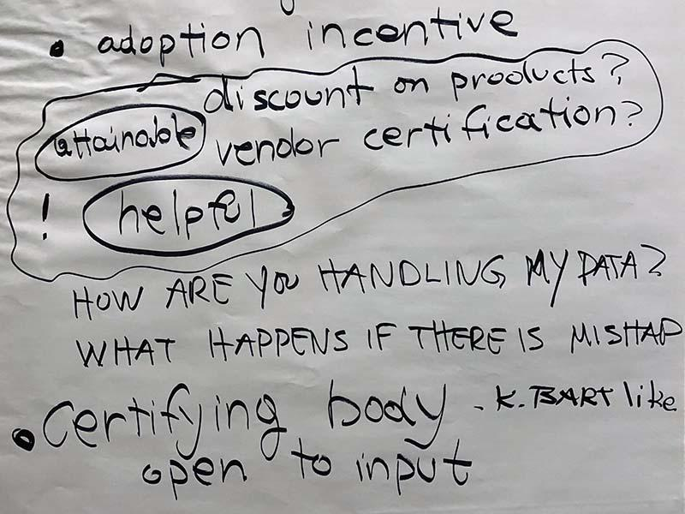
Pathway — Privacy Certification
A Privacy Certification System to establish stratified data privacy standards for libraries and their information vendors.

Slide 50
Pathway — Privacy Certification

Slide 51
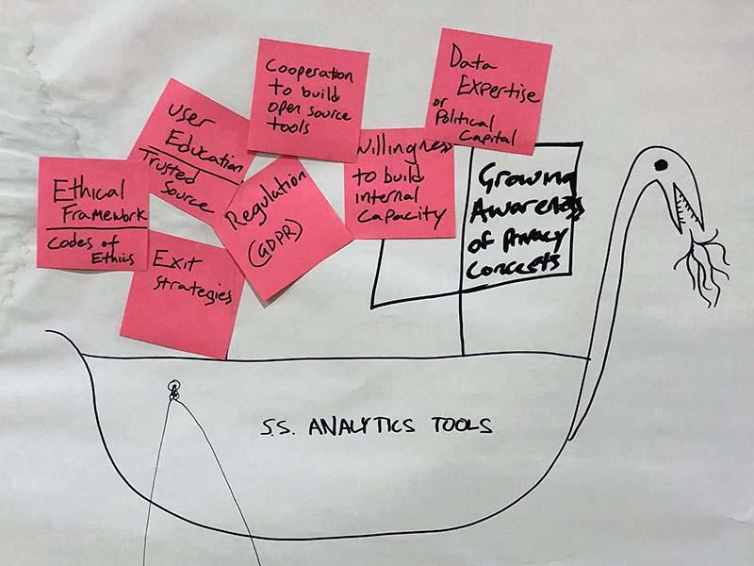
Pathway — Analytics Dashboard
A simple, lightweight analytics framework and dashboard to show only necessary data points

Slide 52
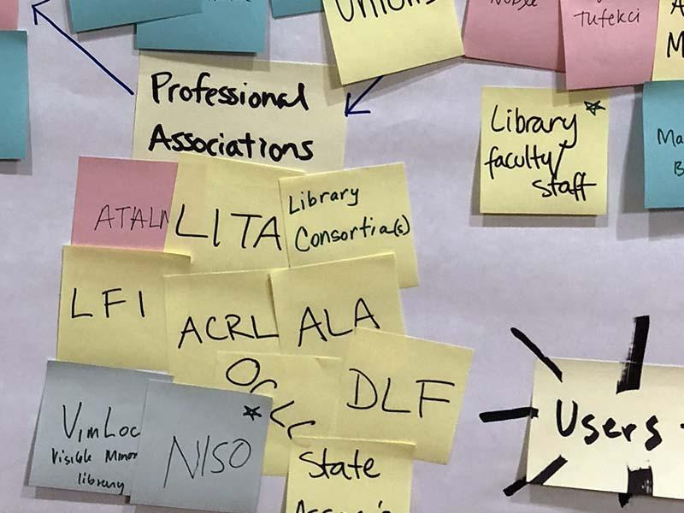
Pathway — Leadership Training
A privacy-focused ethics and equity module for leadership training programs

Slide 53
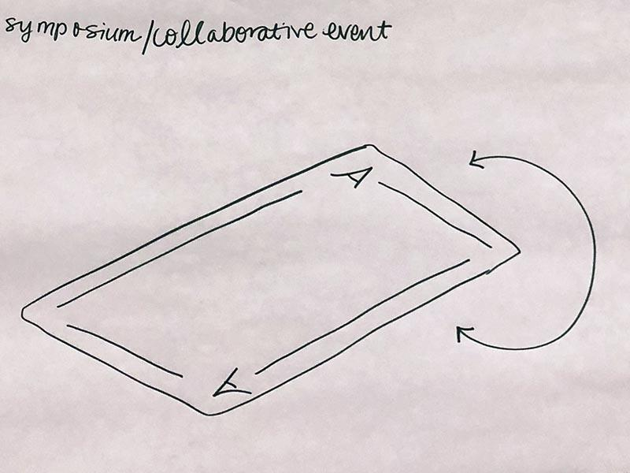
Pathway — Tribal Organizations
How does privacy and surveillance affect tribal communities? What is privacy to tribal members?
How can tribal organizations implement culturally appropriate web analytics and web privacy practices?

Slide 54
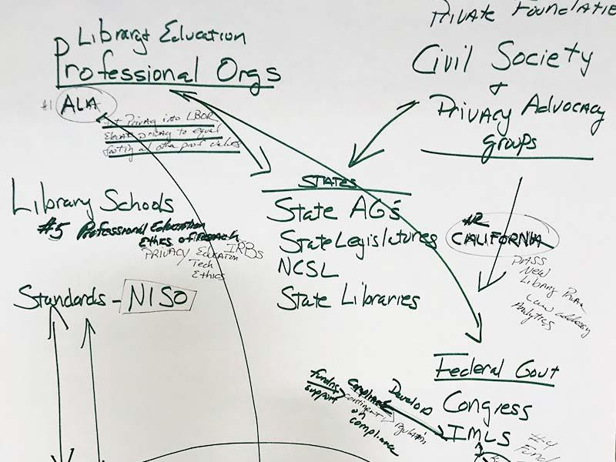
Pathway — Model License
Equip libraries with model licensing language that can promote patron privacy in third-party systems.
Notes:
https://docs.google.com/document/d/1XIeQQjMp6IW7EO-75Y4MAuKufFgkgl_Yt0pjAWtStwE/edit
Add notes for progress Lisa has made

Slide 55
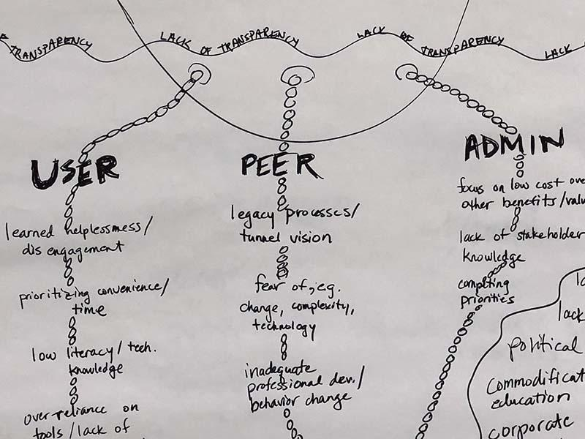
Pathway — Research Institute
Support evidence-based privacy advocacy
“Redefining metrics in a way that redefines success.”

Slide 56
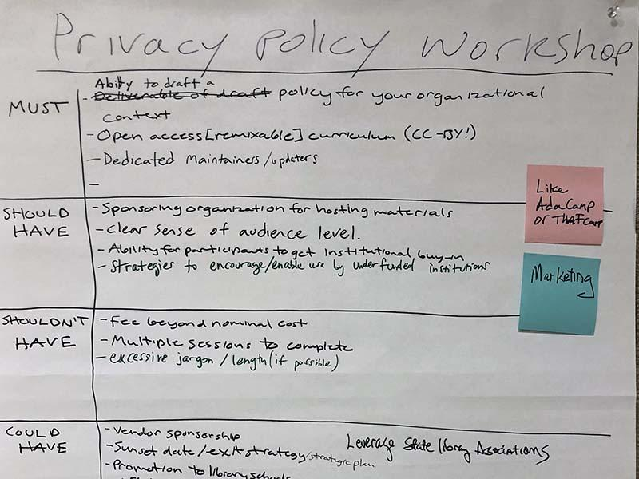
Pathway — Policy Workshops
Professional development workshops for library workers on writing and implementing library privacy policies

Slide 57
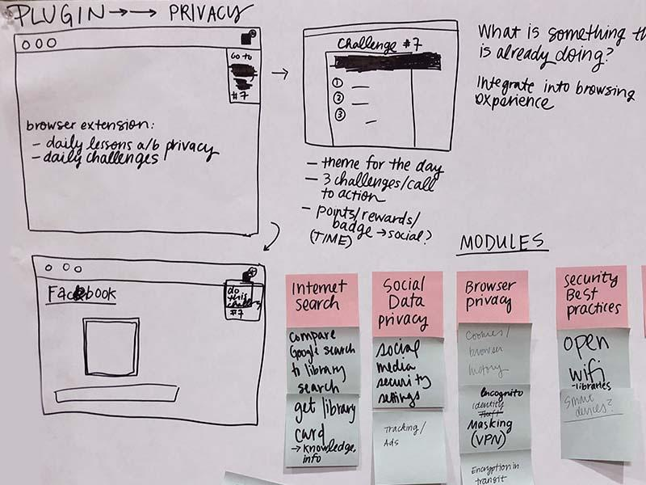
Pathway — Assessment Toolkit
Tools and best practices for implementing privacy-aware and user-conscious assessment

Slide 58
Future
Directions
Notes:
Scott picks up

Slide 59
Directions

Slide 60
Directions
Facilitate the realization of one or more of these Pathways

Slide 61
Directions
Facilitate the realization of one or more of these Pathways
Community effort to achieve community goals

Slide 62
Directions
_lib.montana.edu/privacy-forum

Slide 63
Directions
_lib.montana.edu/privacy-forum
osf.io/gnfpu/

Slide 65
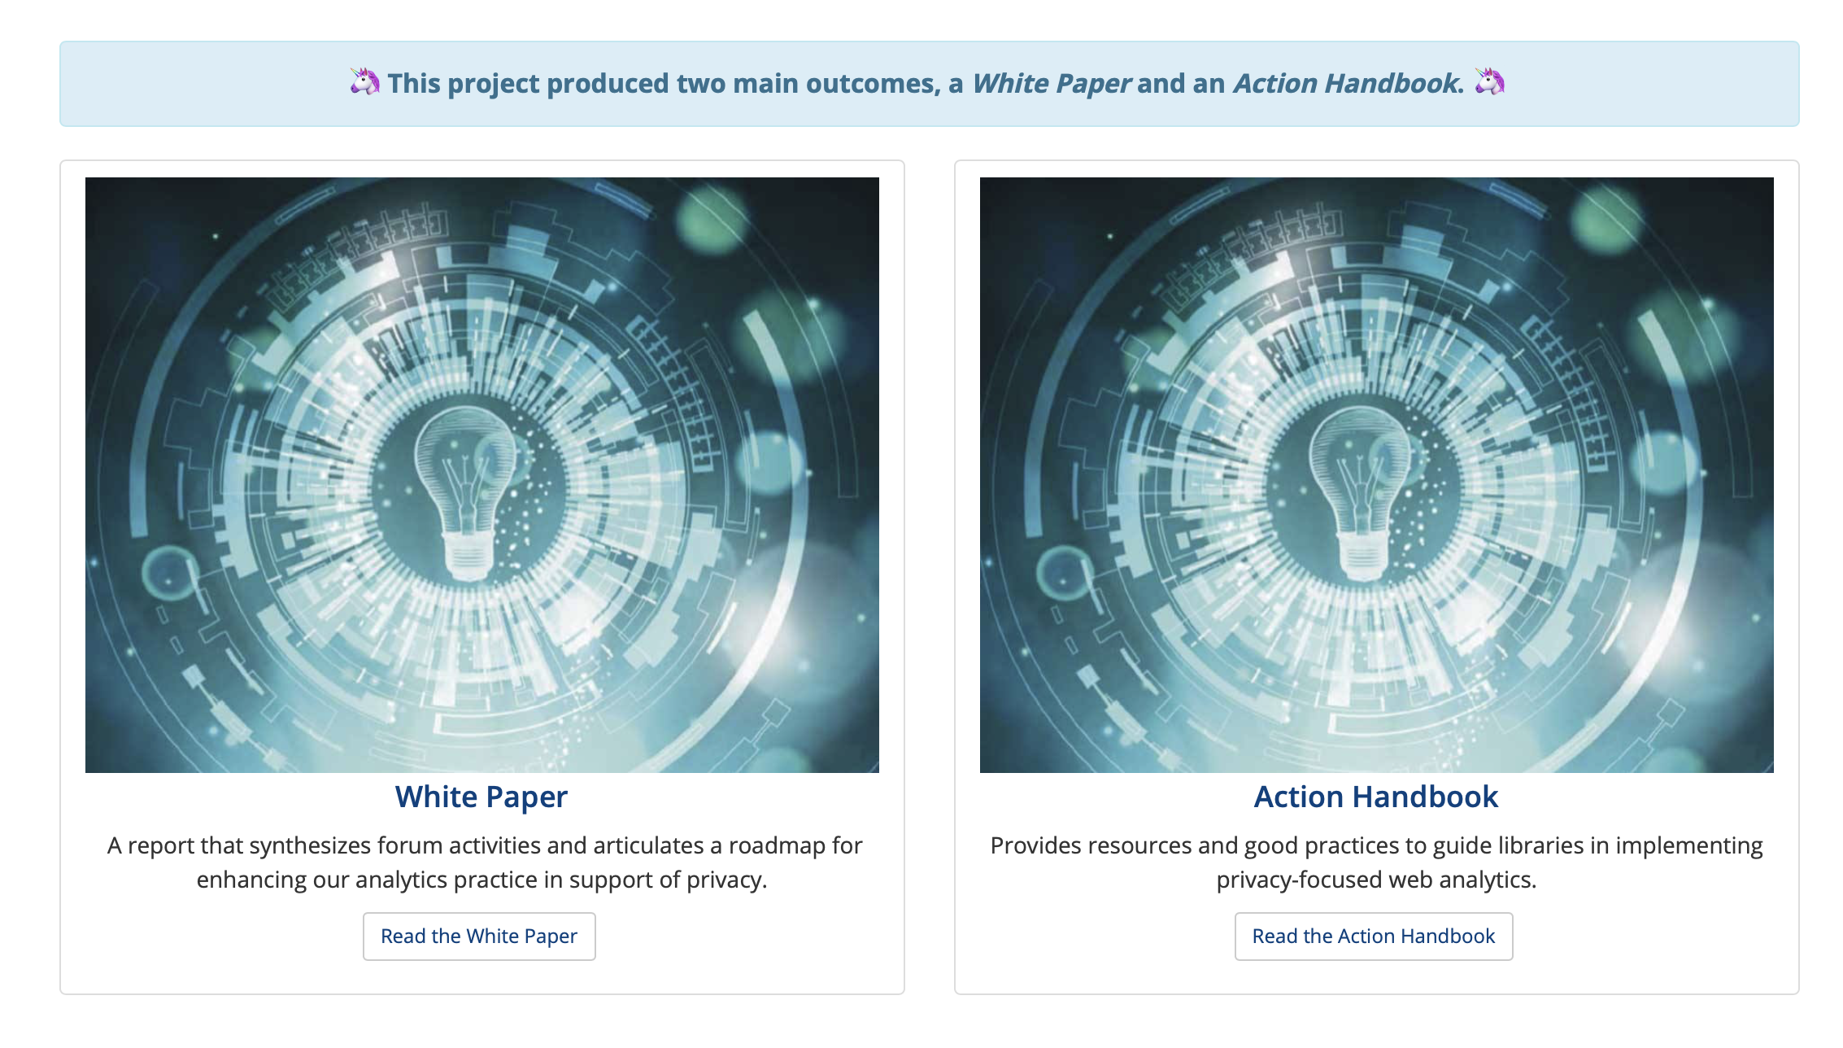

Slide 67
Directions
Visit our project website
View our Pathways and our Action Handbook and consider taking action in your context
_lib.montana.edu/privacy-forum_

Slide 68
Thank you

Slide 69
Discussion

Slide 70
Discussion
What are the key barriers to privacy action?
Which Pathways to Action look most promising?
How could you see yourself or your organization getting involved further in turning the Pathways from idea into action?

