Slide 1
OCLC RLP Works-in-Progress Webinar • July 9, 2019
The SHARES Sharing Special Collections Working Group: an update

Slide 2
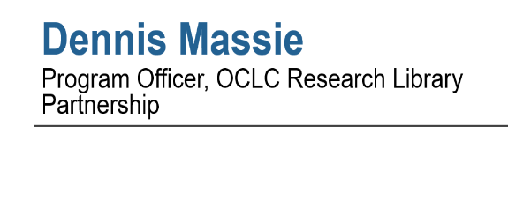

Slide 3
Today’s agenda
Back story (Dennis)
Working group and survey (Brian)
Survey results: demographics (Richard)
Survey results: current practice and workflows (Ralph)
Survey results: open-ended responses (Lesliediana)
Next steps (Brian)
Q&A and discussion

Slide 4
Dennis Massie
Program Officer, OCLC Research Library Partnership
Back story

Slide 5
Third time’s the charm for this WG?
2002-2003, ILL practitioners gathered excellent examples of “here’s how to care for our special stuff you borrowed” collateral
2009-2012, teams of special collections and ILL staff, conducted a survey, created tools, worked closely with the RBMS task force revising the ACRL guidelines on sharing special collections
2018-2019 ?

Slide 8
2018-2019 SHARES Policy Rethink
Encourage evidence-based
processes
Build in flexibility
Enhance access
Embrace local procedures that add value
Mitigate international sharing costs

Slide 9
2018-2019 SHARES Policy Rethink
Encourage evidence-based
processes
Many have adopted 16-week loan periods
Opt-in reciprocal no-charge for copies
Reciprocal onsite borrowing, sharing special collections
Pretty much anyone can order pretty much anything
Build in flexibility
Enhance access
Embrace local procedures that add value
Borrow once, buy if cheaper
Mitigate international sharing costs

Slide 10
2018-2019 SHARES Policy Rethink
Encourage evidence-based
processes
Many have adopted 16-week loan periods
Opt-in reciprocal no-charge for copies
Reciprocal onsite borrowing, sharing special collections
Pretty much anyone can order pretty much anything
Build in flexibility
Enhance access
Embrace local procedures that add value
Borrow once, buy if cheaper
Mitigate international sharing costs

Slide 11
Brian Miller
Head, Interlibrary Services, The Ohio State University Libraries
Working group and survey

Slide 12
SHARES ILL-Special Collections Survey
Goal: Determine current state of sharing special collections through ILL within SHARES
Survey designed in Qualtrics
16 questions: mostly multiple choice, but one open-ended
Anonymous
Open Dec 21, 2018, to Jan 31, 2019
Emailed survey link to SHARES-L
Notes:
By membership agreement, SHARES libraries have liberal lending policies with one another and generously agree to fill requests for normally non-circulating material. But what we didn’t know was how much SHARES members extend that generosity to their special collections materials. And in order to promote sharing special collections, we needed to gain an understanding of the extent to which special collections were or were not already being shared. So our working group developed a survey to measure the current state of sharing special collections. And this sharing might include the scanning of articles or chapters within works, digitizing entire items that are out-of-copyright, or lending a physical item.
Richard and I designed the survey in Qualtrics and then the whole working group helped us refine the questions and tweak potential reply options. The survey had 16 questions, was mostly multiple choice, but we did have an open-ended question where folks could give us any feedback on sharing special collections. The survey was anonymous, but respondents could provide their symbol if they wanted. And we opened the survey on Dec 21 of last year by announcing it on the SHARES email listserv and keeping it open through the end of this past January. We sent several reminders to the listserv throughout the month of January, and Dennis also promoted it at ALA Midwinter when some members met in person.

Slide 13
Richard Zwiercan
Art, Architecture & Design Librarian, University of Nevada, Las Vegas
Survey results: demographics

Slide 14
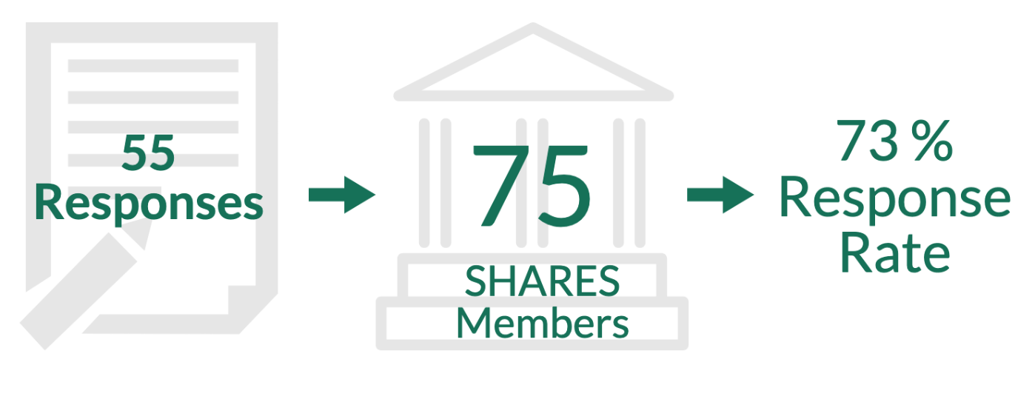
Number of Respondents
Notes:
The 75 SHARES members are taken from the main institution, not branches of the shares libraries

Slide 15
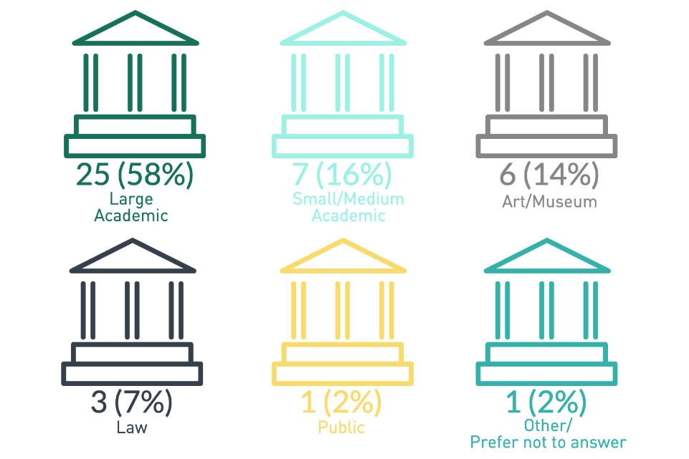
Respondents by Library Type

Slide 16
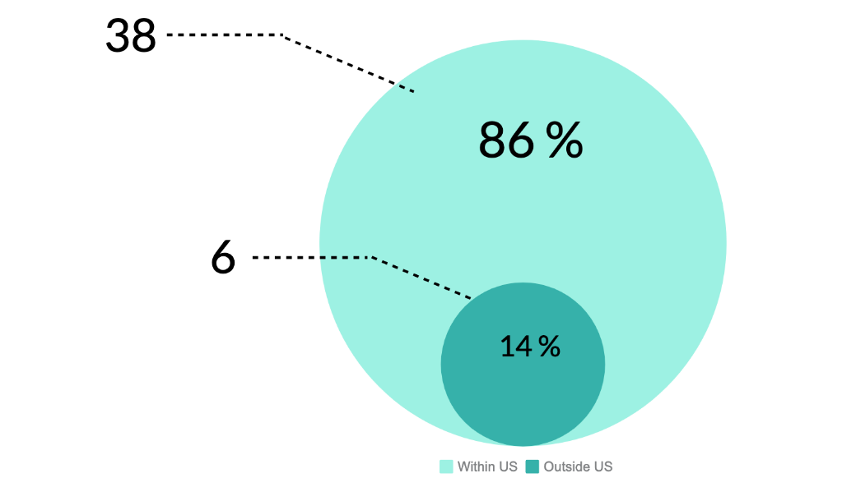
Respondents by Location
Notes:
Within the US representation the bell curve
That doesn’t mean that the input from outside the US has less impact

Slide 17
Ralph Baylor
Head of Interlibrary Loan, Frick Art Reference Library
Survey results: current practice and workflows

Slide 18
Facilities

Slide 19
Q1: How many distinct special collections administrative units are there in your symbol’s library system?
Notes:
Mention
The higher number of separately administered units indicates that the ILL staff needs to interact with more special collections staff, potential each with different policies and willingness to lending or copying items from their collection.
The majority of respondents have between zero to 2 units (38 respondents) but 14 respondents have 3 or more separately special collections administrative units

Slide 20
Q2: Does you library have a supervised and secure special collections reading room?
Notes:
Mention
Most respondents do have supervised or special collections reading room.
Having a special collections or supervised reading room allows for XXXX(follow-up with documention)

Slide 21
Q3: When your special collections unit(s) receive requests directly, do they route them to your ILL department for processing?
Notes:
Mention:
For the majority of respondents Special Collections units manage all ILL requests they receive, very few route requests for copies, loans, or digitization to ILL.
Several respondents marked that some but not all units route requests to ILL potentially leading to confusion over why one unit may do it versus another
For those who marked Other as a response, many stated that requests made by individuals contacting the special collections unit where handled but the unit while those made by academic or research institutions where routed to the ILL department.

Slide 22
Copies

Slide 23
Q4: How many of your distinct special collections units selectively fill ILL lending copy requests for chapters/articles (non-returnables)?
Notes:
Mentioned
The majority of respondents indicated that their special collections units fill at least some copy requests with only 6 stating that their special collections units do not fill ILL requests for non-returnables
This is significant progress over the past several years. (documentation)

Slide 24
Q5: Who receives, scans, and delivers the ILL copy requests for special collections chapters/articles at your institution?
Notes:
Mention
The indicates that there is already collaboration between ILL and special collections unit within many insitutions

Slide 25
Q6: Which groups of requesting libraries do you selectively fill copy requests for articles/chapters from special collections through ILL?

Slide 26
Digitization

Slide 27
Q7: Do you digitize entire special collections works on-demand from selective ILL requests you receive for out-of-copyright works?

Slide 28
Loans

Slide 29
Q8: How many of your distinct special collections units does your ILL office work to fill selective lending loan requests (returnables)?

Slide 30
Q9: Who pulls, assesses, processes, and ships the ILL loan requests (returnables) for special collections at your institution?

Slide 31
Q10: Which group of libraries do you fill selective loan requests for physical special collections items through ILL?

Slide 32
Shipping

Slide 33
Q11: If you lend physical special collections items, how often do you set the following shipping restrictions as a condition of the loan?

Slide 34
Q12: What shipping method do you usually use for sending physical special collections items (returnables)?

Slide 35
Lesliediana Jones
Head of Document Services/Research Librarian, George Washington University Law School Library
Survey results: open-ended responses

Slide 36
Q13 Share additional feedback
Lending allowed
Lending possibilities
Scan
ILL and Special Collections separate
Lending not allowed

Slide 37
Lending Allowed
Yes to SHARES
Is your library the right type?

Slide 38
Lending Possibilities
Case-by-case
Conditions must be met

Slide 39
Scan/Digitize
Item of a specific type
Imaging services

Slide 40
ILL and Special Collections separate
And never the twain shall meet
Everything is special

Slide 41
Lending not allowed
Good luck!
Too much work

Slide 42
Brian Miller
Head, Interlibrary Services, The Ohio State University Libraries
Next steps

Slide 43
Next steps
1. Develop framework for sharing special collections between SHARES members
Create common protocols with shared expectations
Have flexibility for different types of local workflows
Involve special collections folks in the discussion
2. SHARES Best Practices Working Group: develop potential steps SHARES members might take to implement the framework.
3. SHARES Executive Group: amplify work, develop any needed training, and guide any process resulting in changes to SHARES policies.
Notes:
The next step for our SHARES Sharing Special Collections Working Group is to use what we learned from the survey to develop a framework for sharing special collections between SHARES members. What are the expectations we share that can become our protocols? And those expectations will not just exist for all of us acting as lenders; they’ll also apply to us as borrowers, too, so that lenders can be assured and confident that their materials are going to be handled in an appropriate way by the requesting library and their user. The protocols we develop also need to allow for workflow flexibility at each institution where decision-making, scanning, and even packaging authority may reside with different departments needing to work together. And certainly, we can’t impose any protocols upon our libraries’ special collections units but must involve them in the conversation along with the ILL folks and incorporate all their feedback in what we develop, too. And we still need to figure out exactly how we’re going to do that.
And after the framework is completed by our working group, the separate SHARES Best Practices Working Group then takes over to develop specific steps libraries can take to implement the framework allowing for localized options. And these options could be anything from who approves the loan/scan to who does the scanning, digitizing, or packaging, to what item-specific loan restrictions there might be and what paperwork should accompany any loans.
And then finally, the SHARES Executive Group as our leadership body will amplify and publicize all of our work, develop any needed training (like on digitizing standards or proper packaging techniques), and guide any process related to updating our official SHARES policies.
So all-in-all a very ambitious agenda – but we’ve got devoted people AND we’ve gotten receptive feedback from the membership that wants to see this happen.

Slide 44
Questions/Discussion
Brian Miller
Miller.2507@osu.edu
Richard Zwiercan
Richard.zwiercan@unlv.edu
Ralph Baylor
Baylor@frick.org
Lesliediana Jones
ljones@law.gwu.edu
Dennis Massie
massied@oclc.org

