Slide 1
CONTENTdm User Group Meeting ● August 7, 2019
Introducing the CONTENTdm Linked Data Pilot Project
Bruce Washburn
Jeff Mixter
Mario Einaudi
OCLC Research
OCLC Research
The Huntington Library, Art Collections, and Botanical Gardens

Slide 2
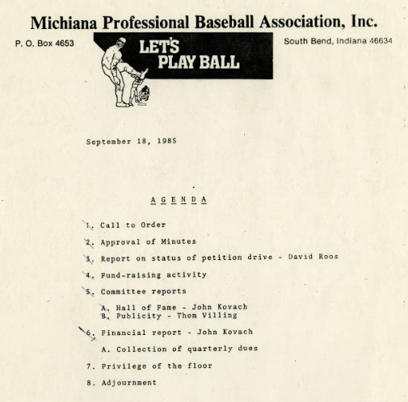
Agenda
Recent CONTENTdm Linked Data Research
  Harvesting and indexing CONTENTdm IIIF Manifests
  Looking for structured data
  Building a cross-institution discovery interface
An overview of the CONTENTdm Linked Data Pilot Project
  Acting on recent research findings
  Deliverables for the 3 project phases
An Early Adopter’s View
Introducing the Pilot Project Participants
Discussion
MPBA meeting agenda, September 18, 1985
South Bend Baseball Collection
Saint Joseph County Public Library
https://cdm16827.contentdm.oclc.org/digital/collection/p16827coll14/id/85/

Slide 3
RECENT CONTENTdm Linked Data Research

Slide 4
3 Hypotheses
CONTENTdm metadata can be harvested
CONTENTdm discovery is enhanced by aggregation
Structured, linked data can be derived from CONTENTdm fields mapped to Dublin Core

Slide 5
1: CONTENTdm metadata can be harvested
True
CONTENTdm metadata was extracted from 13 million items
All string metadata was indexed as keywords

Slide 6
1: CONTENTdm metadata can be harvested
However …
Metadata is based on locally defined fields
Metadata sometimes describes the physical object, sometimes the digital object, sometimes the technical details of the digital object … no way to easily differentiate those 3 modes.

Slide 7
2: CONTENTdm discovery is enhanced by aggregation
True
An aggregated index across hosted collections provides one-stop-searching by keywords, something we haven’t seen before for CONTENTdm.
We’re finding unexpected things in unexpected places.

Slide 8
2: CONTENTdm discovery is enhanced by aggregation
However …
When viewed across all hosted institutions and collections, CONTENTdm metadata can appear inconsistent and unpredictable.
Discovery expectations shaped by Europeana and DPLA in our domain, and by Amazon et al in the wider world, cannot be met given how CONTENTdm descriptive metadata is currently created.

Slide 9
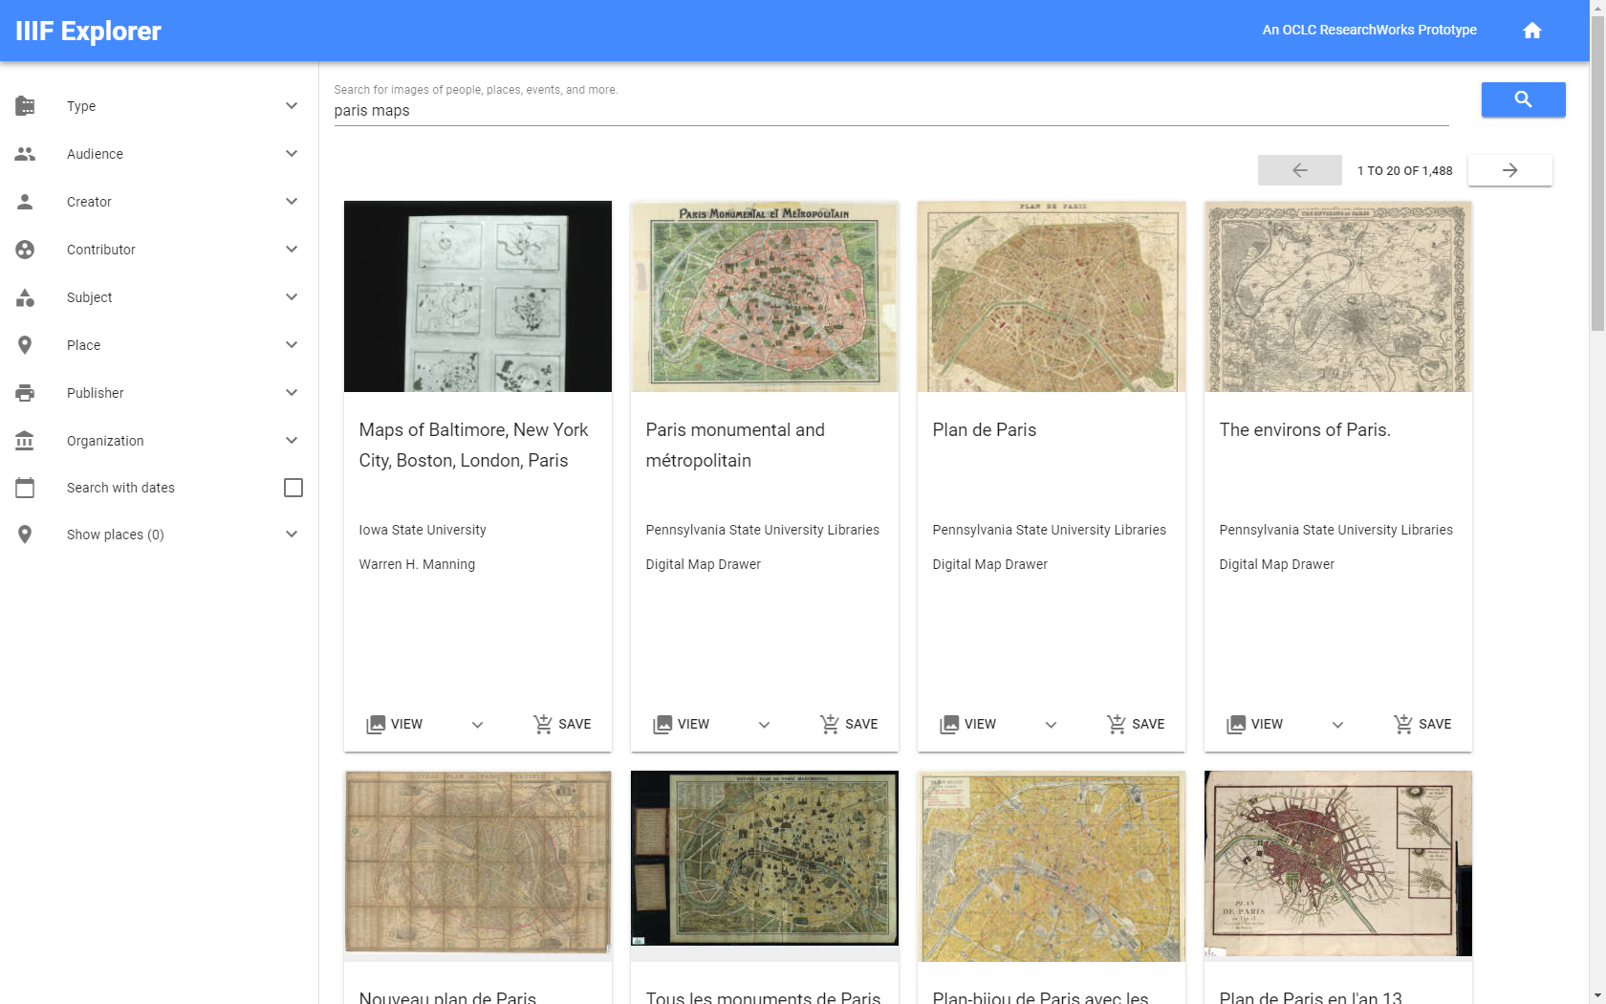
https://researchworks.oclc.org/iiif-explorer/
Notes:
This mapping provides authority control for searching based on URIs rather than strings. E.g., a search for all records mapped to the AAT URI for “letters (correspondence)”.

Slide 10
3: Structured, linked data can be derived from CONTENTdm fields mapped to Dublin Core
Not Quite
CONTENTdm fields can be mapped to any Dublin Core element.
We looked closely at DC Type, Format, Medium, Temporal, Spatial, and Audience.

Slide 11
3: Structured, linked data can be derived from CONTENTdm fields mapped to Dublin Core
Because ...
Mapping practices are inconsistent, and unevenly applied across the data.
Success of automated reconciliation processes is strongly dependent on the quality of source data.
Remedying data quality issues requires attention upstream and domain expertise.

Slide 12
Successes
Original field string | DC Type | LC TGM Term | Getty AAT Term
black-and-white negatives | Image | Negatives | black-and-white negatives
9 1/2 x 7 pen & ink drawing | Image | Drawings | pen and ink drawings
programs (documents) | Text | Documents | programmes (documents)
1 letter (2 p.) | Text | Correspondence | letters (correspondence)
Notes:
Cataloging in fields mapped to DC Format, Medium, and Type overlapped to a significant degree. We combined these values and reconciled them with the Getty Art & Architecture Thesaurus (for more granular terms and with the LC Thesaurus of Graphic Materials (for higher-level terms) and mapped preferred matches to top-level categories from DC Types.
35% of records are not mapped to a primary type.

Slide 13
Not so successful
Original date string | Problem
13492 | Numeric values that do not represent dates
november 10 to 15, 1930; nineteen forties | Many variations of date range syntax
6th mo 30th 1815; nineteen fifty-six, a.d. | Many variations of date syntax
maryland. Governor; indiana--indianapolis | Strings that do not represent time periods
march; november | Strings that represent one part of a date
wootton, richard t. (1959-1964) | Fields mapped to DC Temporal that represent a person
civil rights era; devonian; middle woodland; wwii; era of contemporary and hip hop gospel; impressionist | Many variations of time periods, many lacking date ranges
Notes:
Lack of constraints and control over how date information is provided and how fields are mapped to DC equivalents in CONTENTdm leads to potentially useful metadata that resists automated sense-making.

Slide 14
Semantic challenges
Geo-Coordinates
39.768074,-86.16198
39.762053,-86.151266
39.768628,-86.15603
https://cdm17308.contentdm.oclc.org/digital/iiif-info/postcard/128/manifest.json
http://www.digitalindy.org/cdm/compoundobject/collection/postcard/id/128
Notes:
https://cdm17308.contentdm.oclc.org/digital/iiif-info/postcard/128/manifest.json

Slide 15
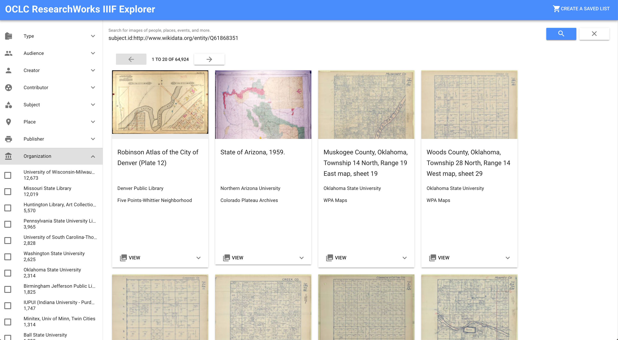

Slide 16
AN OVERVIEW OF the CONTENTdm Linked Data Pilot Project

Slide 17
Acting on recent research findings
Aggregation adds value
Structured data can be reconciled with existing vocabularies. Quick win: URI-based retrieval, aka authority control for searching
Generally-speaking, CONTENTdm data is too varied and incomplete to support downstream reconciliation.
The potential for deep and meaningful discovery can be realized if data is provided as structured, linked data by its source.

Slide 18
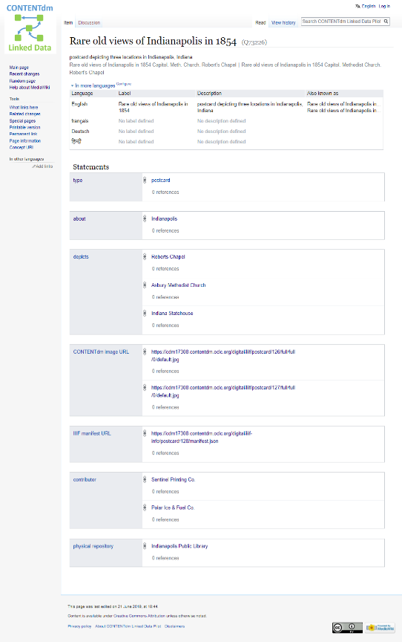
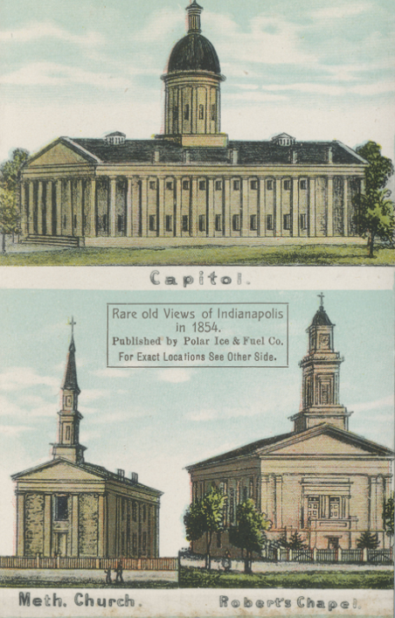
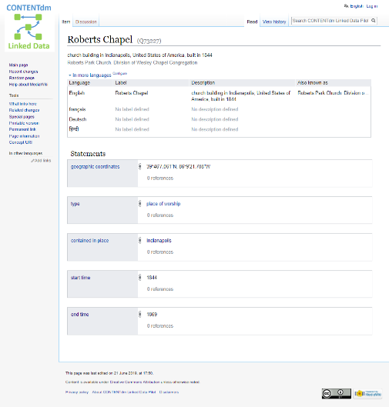
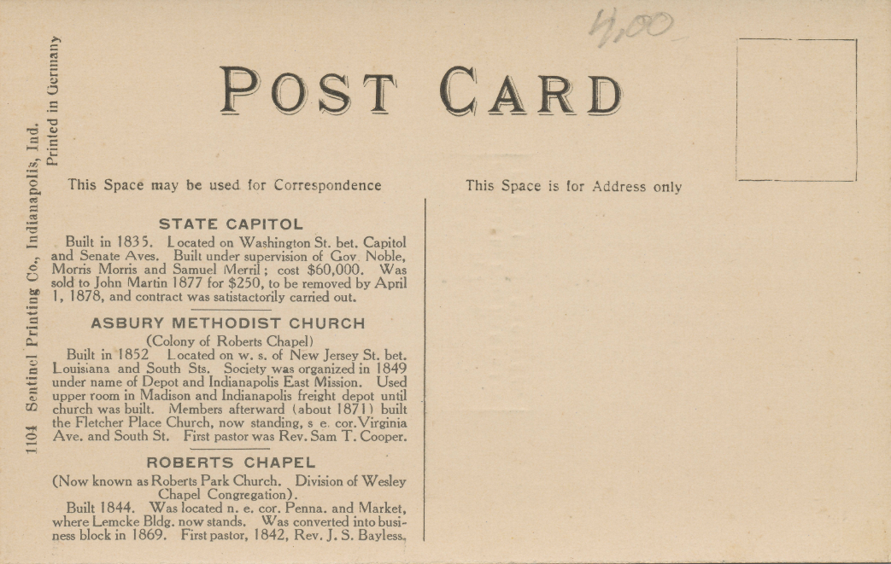
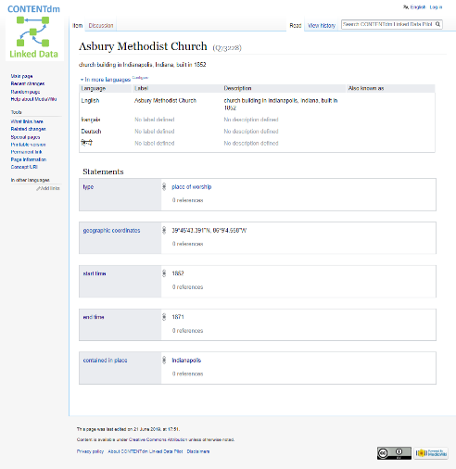
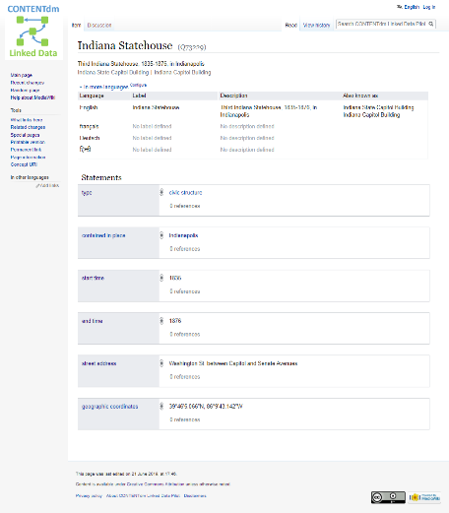
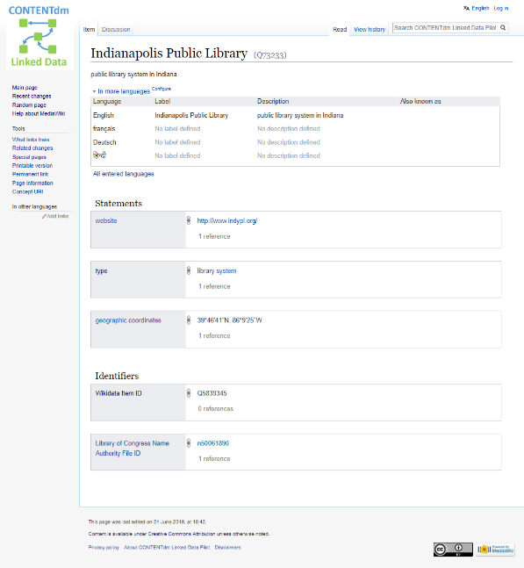
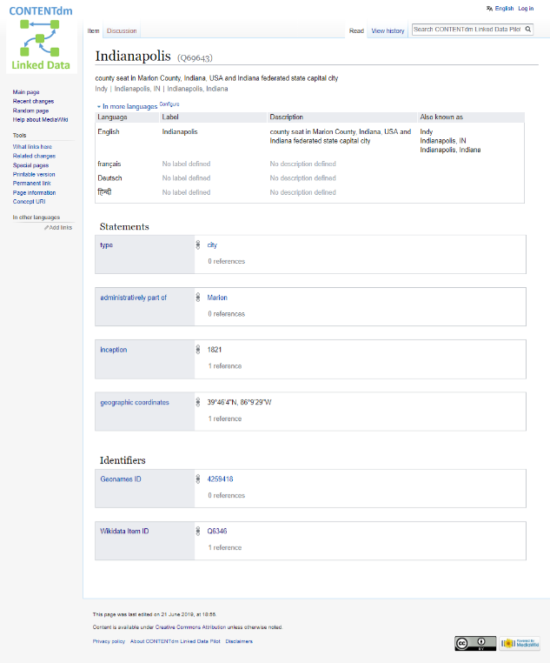
PLACE OF WORSHIP
depicts
POSTCARD
CONTENTdm image URL
PLACE OF WORSHIP
CIVIC STRUCTURE
about
held by
LIBRARY SYSTEM
CITY
contained in place
contained in place
Notes:
When record-oriented data shifts to an entity-oriented framework, the relationships between creative works and related entities become clearer, and data management for separate entities becomes potentially much more efficient, interoperable, and extensible.

Slide 19
Deliverables for the 3 Pilot Project Phases
Phase 1
  Map CONTENTdm data to Wikibase
  Work with CONTENTdm content owners
  Add context to the CONTENTdm production user interface, based on information found through Wikibase connections to external sources
Phase 2
  Evaluate Wikibase as a platform for creating and managing CONTENTdm metadata
Phase 3
  Evaluate Wikibase as a platform on which to build CONTENTdm discovery interfaces

Slide 20
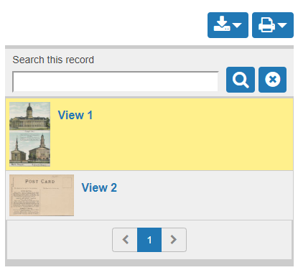
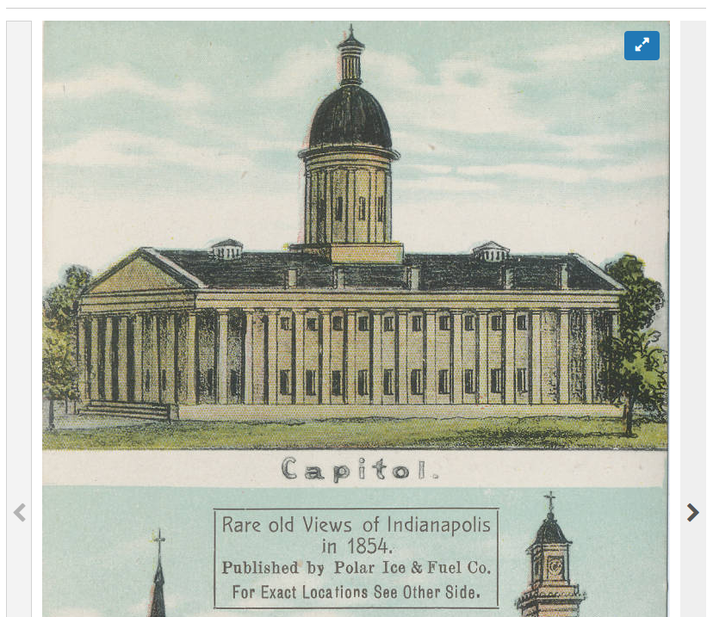
Phase 1:
Map CONTENTdm data to Wikibase
Work with CONTENTdm content owners
CONTENTdm
Transformation & Mapping
Wikibase

Slide 21
Phase 1:
Map CONTENTdm data to Wikibase
Work with CONTENTdm content owners
Add UI context found through Wikibase connections to external sources
CONTENTdm
Transformation & Mapping
Wikibase
CONTENTdm
Javascript Plug-in
Indianapolis
Indianapolis is the capital of the US state of Indiana, and the county seat of Marion County, Indiana. As of the 2010 United States Census, the city's population is 829,718. It is Indiana's largest city and, as of the 2010 U.S. Census, is the 12th largest city in the U.S. , the second largest city in the Midwest, the second most populous state capital, and the most populous state capital east of the Mississippi River.
From: DBPedia

Slide 22
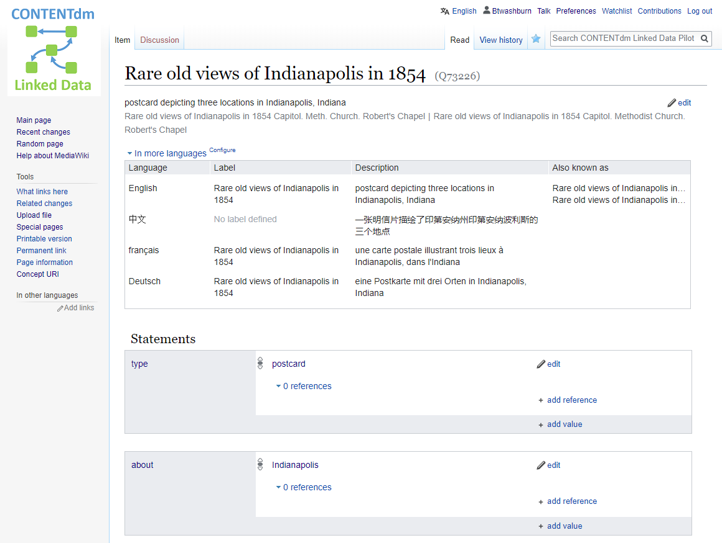
Phase 2:
Evaluate Wikibase as a platform for creating and managing CONTENTdm metadata
Wikibase

Slide 23
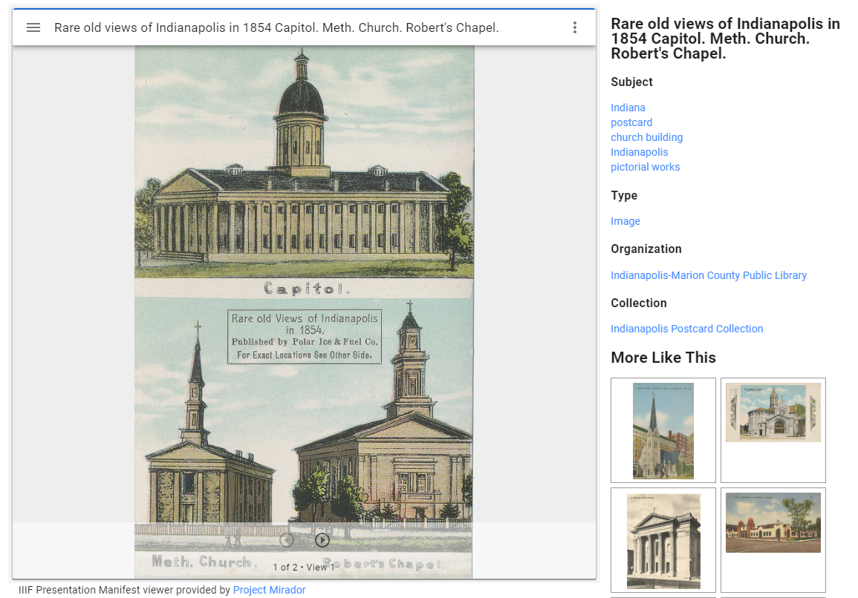
Phase 3:
Evaluate Wikibase as a platform on which to build CONTENTdm discovery interfaces
Wikibase

Slide 24
An EARLY Adopter’s View

Slide 25


Phase 1 workflow
CONTENTdm
Propose collections
from CONTENTdm to test
Import Metadata
into OpenRefine
Cleanup, analyze, and transform
metadata, column by column, in OpenRefine
Propose data model extensions
for review and addition to the data model
Build creative work entities
based on data from OpenRefine
Reconcile the related items
in OpenRefine using external authority control systems
Create Wikibase entities for reconciled items
Connect creative work entities to related entities
Download Metadata
from CONTENTdm
Review the Wikibase entities
for quality enhancement and visualization opportunities
Add context to the CONTENTdm UI
using Javascript plug-ins and Wikibase data
CONTENTdm
Legend
Pilot Project Partner
Pilot Partner + OCLC Team
CONTENTdm
OCLC Team
Notes:
The workflow for transitioning to Linked Data will be evolving throughout Phase 1.
The workflow involves several sequential steps, and 3 primary systems: CONTENTdm for exporting data, OpenRefine for cleaning, analyzing, transforming, and reconciling data, and Wikibase for creating and managing linked data.
At the outset, it will be a manual, hands-on process. Over time we expect to develop tools and routines that will help automate the process, and we will see efficiencies gained as the data model and data within the Wikibase becomes richer.
These 11 steps outline the current sequence, with primary responsibilities distributed across the pilot partner sites, the OCLC teams, and a mix of the two.
There are opportunities for early returns on the investment in Phase 1, with some potential for cleaned up or enriched data being generated that can be applied to the current CONTENTdm instance, and the opportunity to leverage data in the Wikibase to embed more contextual data about an item in the CONTENTdm Responsive User Interface, using its Javascript plug-in feature.

Slide 26

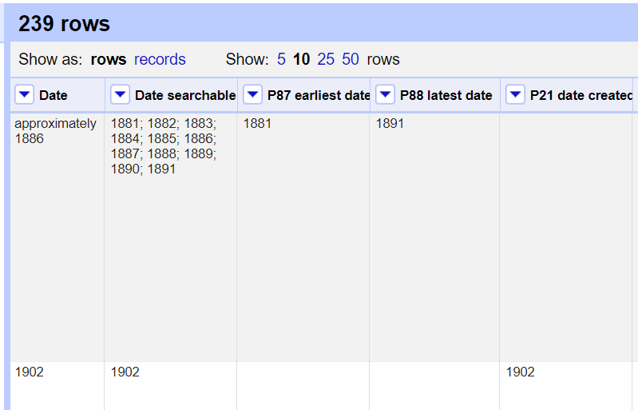
Transforming strings to things in OpenRefine
Notes:
The OpenRefine application is a primary tool for cleaning up, analyzing, and transforming data.
Here’s one example, where CONTENTdm fields that may hold “approximate” date strings, and a corresponding fields that hold a searchable string of dates within a range, can be transformed into more semantically rich earliest and latest dates, which can improve discovery and data interoperability when these properties for the creative work are added to the Wikibase system.

Slide 27
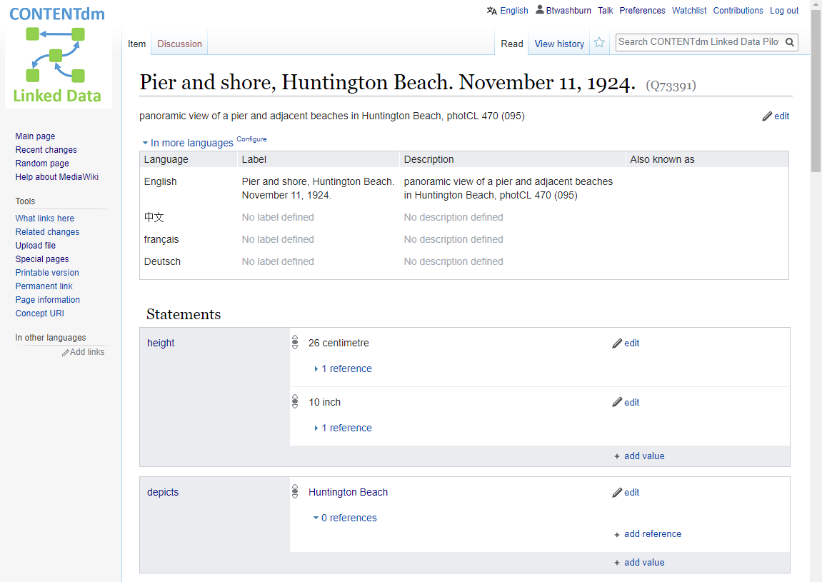
Connecting and Visualizing Related Entities
Notes:
The point of linked data is to activate the connections between things.
Looking at the Verner Photographs collection in Wikibase, the descriptions of the photograph entities can note a depicted place …

Slide 28
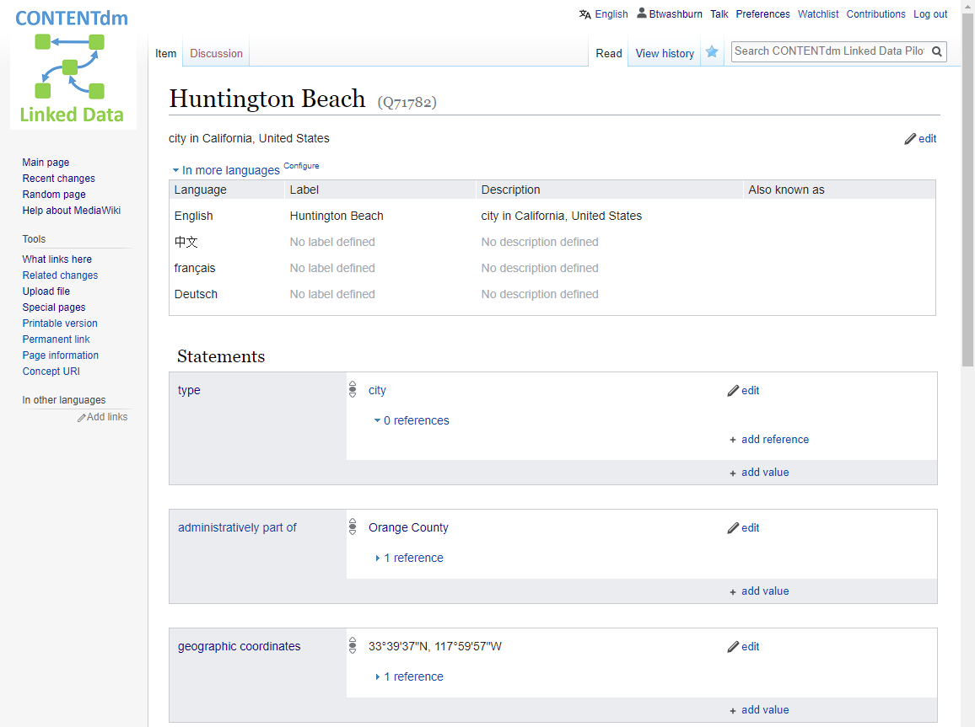
Connecting and Visualizing Related Entities
Notes:
which links to a description of that place. The place entity has its own properties, for example geographic coordinates, wholly separate from the description of the photograph.

Slide 29
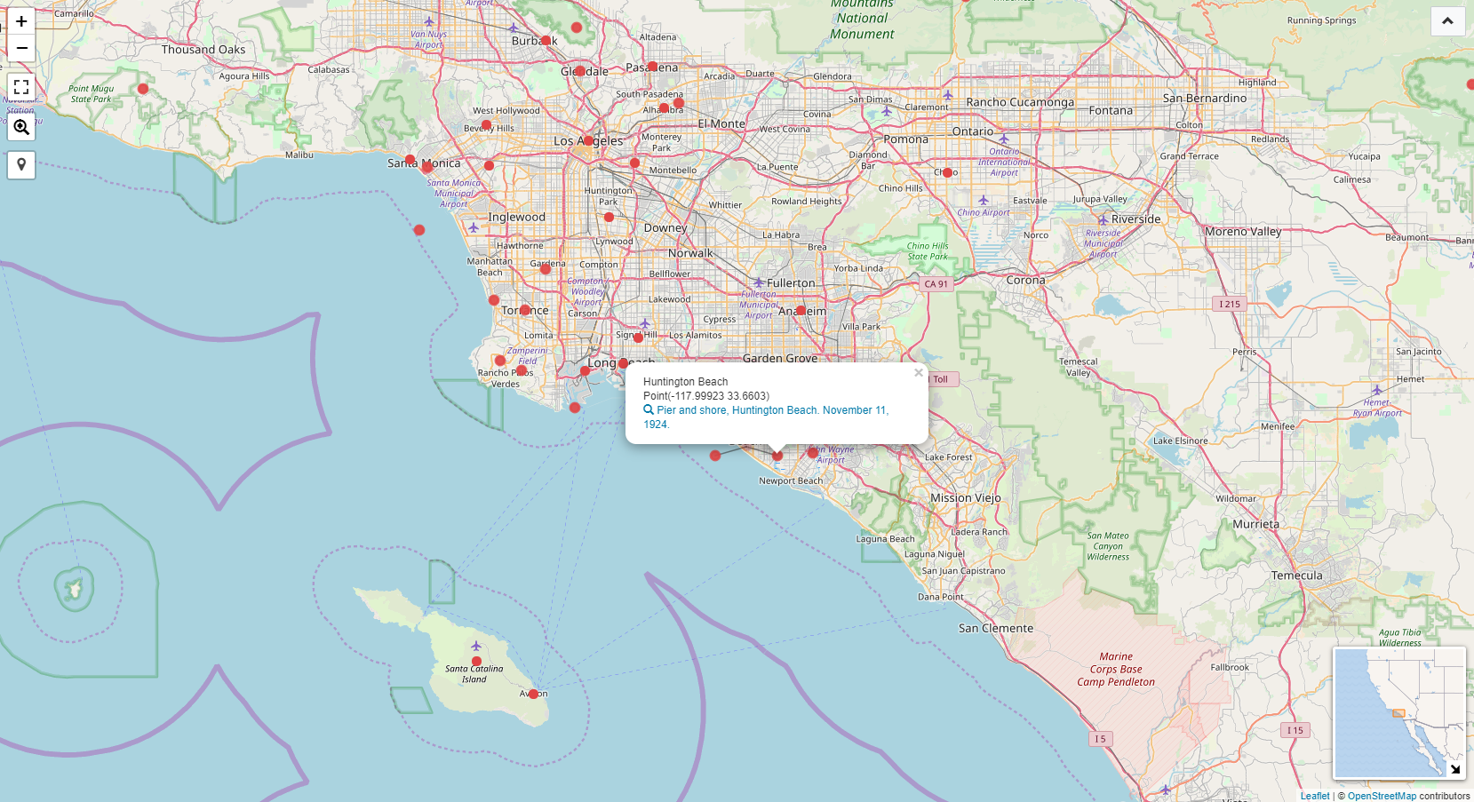
Notes:
Once we’ve made this connection between the photographs and the places they depict, and once we’ve included geo-location data in the place entity descriptions, the opportunity to visualize that location data and the relationship between depicted places and the photographs can be realized using tools built into the Wikibase Query environment. This map is one such example.

Slide 30
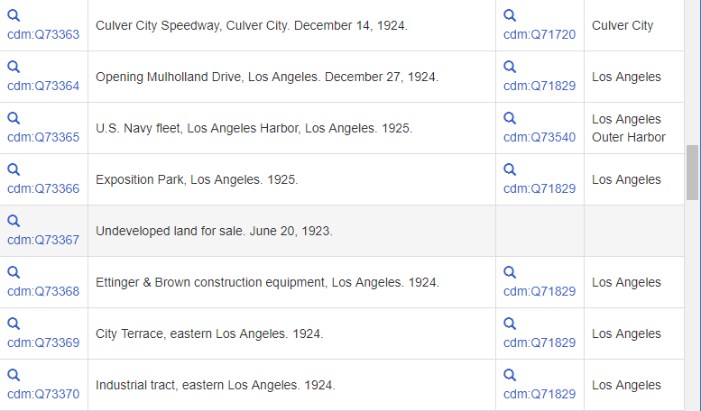
Data Queries and Quality Assessment
Notes:
The Wikibase environment provides a powerful SPARQL Query tool for interrogation the data. “SPARQL” is a language designed for sending logical queries to a database of linked data “triples”, also known as a “triplestore”.
In this example, a query is sent to list all the photographs in the Verner Photographic Negatives collection, to highlight any that lack a “depicts” statement.

Slide 31
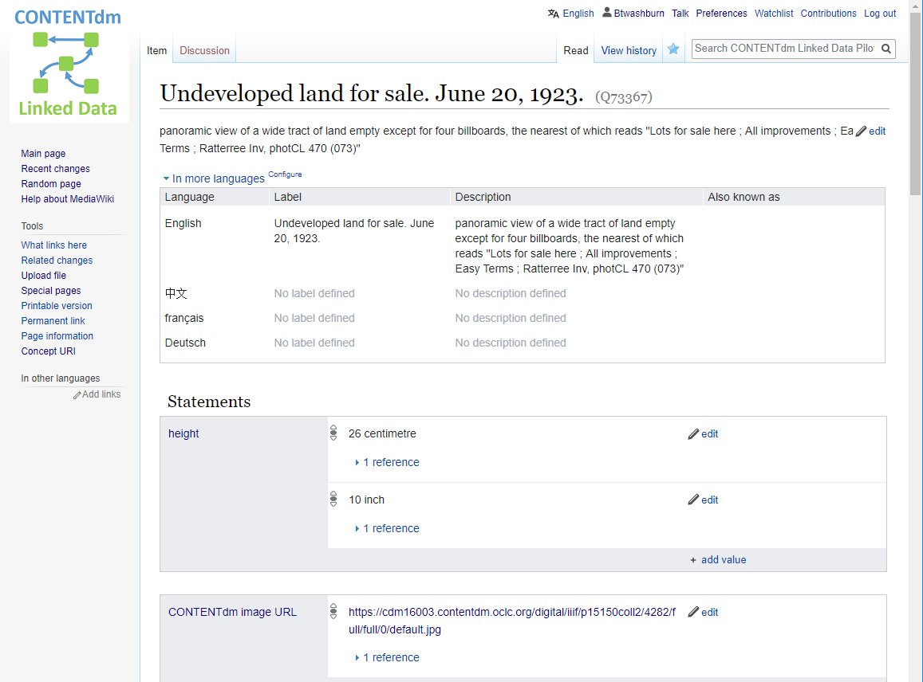
Data Queries and Quality Assessment
Notes:
The Wikibase environment provides a powerful SPARQL Query tool for interrogation the data.
In this example, a query is sent to list all the photographs in the Verner Photographic Negatives collection, to highlight any that lack a “depicts” statement.
Linking from the photograph that lacked a “depicts” statement to the description of the photograph in the CONTENTdm Wikibase, a link to the image …

Slide 32
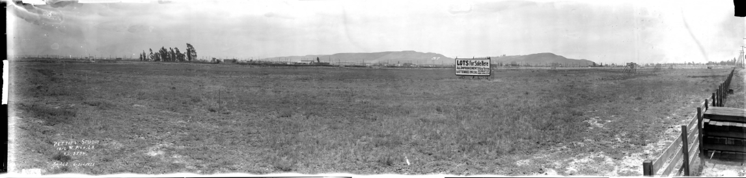
Data Queries and Quality Assessment
Notes:
The Wikibase environment provides a powerful SPARQL Query tool for interrogation the data.
In this example, a query is sent to list all the photographs in the Verner Photographic Negatives collection, to highlight any that lack a “depicts” statement.
Linking from the photograph that lacked a “depicts” statement to the description of the photograph in the CONTENTdm Wikibase, a link to the image …
provides a full view of the panoramic photograph …

Slide 33
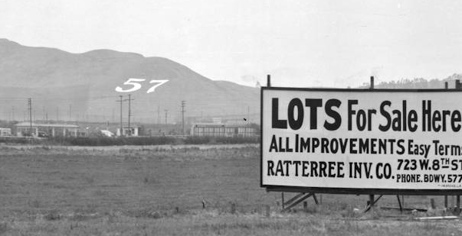
Data Queries and Quality Assessment
Notes:
The Wikibase environment provides a powerful SPARQL Query tool for interrogation the data.
In this example, a query is sent to list all the photographs in the Verner Photographic Negatives collection, to highlight any that lack a “depicts” statement.
Linking from the photograph that lacked a “depicts” statement to the description of the photograph in the CONTENTdm Wikibase, a link to the image …
provides a full view of the panoramic photograph …
and at higher-resolution shows a distinctive number “57” on the far hillside, a novelty that may help in determining the location.

Slide 34
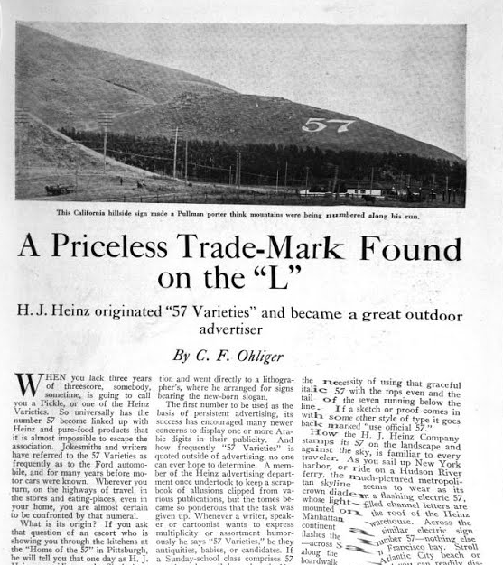
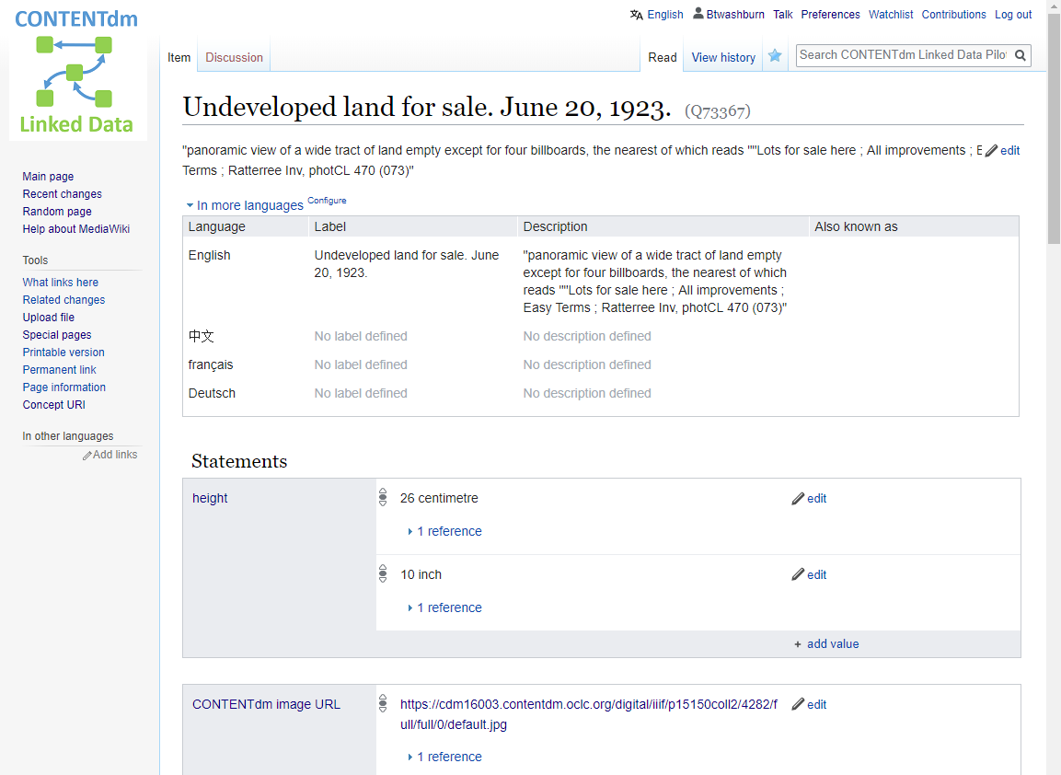
Data Queries and Quality Assessment
“Aside from the painted signboards and cut out 57's along the main railroad lines are to be found these giant numerals built of concrete into the faces of hills and mountains. Horseshoe Curve on the Pennsylvania wouldn't seem like Horseshoe Curve without the Heinz contribution to the scenery. There is the 57 mountain at Salt Lake City (Helper, Utah?) The King's Highway of California picks its way among mountainous 57s. Most spectacular of these is a ground sign with 125 foot figures Illuminated with powerful flood lights. (Baldwin Hills 57) It glistens out through the night to be read by automobilists and patrons of the railroads and interurban car lines.”
-- A Priceless Trademark Found on the "L" (Elevated Rail). Ohliger, C.F. 1919. Printers' Ink Monthly. N.W. Ayer & Son. Pg. 57.
Notes:
The Wikibase environment provides a powerful SPARQL Query tool for interrogation the data.
In this example, a query is sent to list all the photographs in the Verner Photographic Negatives collection, to highlight any that lack a “depicts” statement.
Linking from the photograph that lacked a “depicts” statement to the description of the photograph in the CONTENTdm Wikibase, a link to the image …
provides a full view of the panoramic photograph …
and at higher-resolution shows a distinctive number “57” on the far hillside, a novelty that may help in determining the location.
Research on the web uncovers an article from Printers’ Ink Monthly in 1919 about these large advertisements placed throughout the US by the Heinz company, noting one in Baldwin Hills (near Culver City in California) that was illuminated by flood lights.

Slide 35
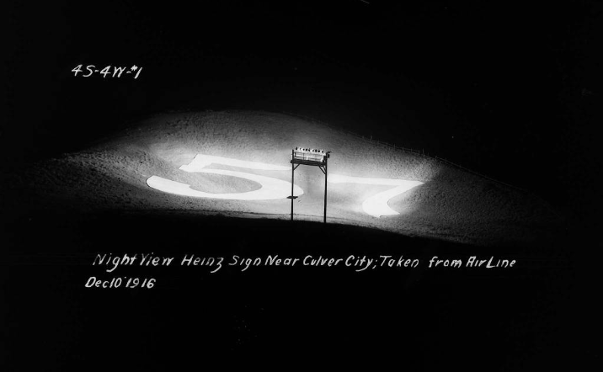
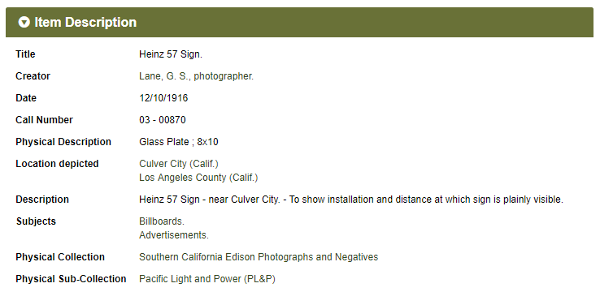
Data Queries and Quality Assessment
“Aside from the painted signboards and cut out 57's along the main railroad lines are to be found these giant numerals built of concrete into the faces of hills and mountains. Horseshoe Curve on the Pennsylvania wouldn't seem like Horseshoe Curve without the Heinz contribution to the scenery. There is the 57 mountain at Salt Lake City (Helper, Utah?) The King's Highway of California picks its way among mountainous 57s. Most spectacular of these is a ground sign with 125 foot figures Illuminated with powerful flood lights. (Baldwin Hills 57) It glistens out through the night to be read by automobilists and patrons of the railroads and interurban car lines.”
-- A Priceless Trademark Found on the "L" (Elevated Rail). Ohliger, C.F. 1919. Printers' Ink Monthly. N.W. Ayer & Son. Pg. 57.
Notes:
The Wikibase environment provides a powerful SPARQL Query tool for interrogation the data.
In this example, a query is sent to list all the photographs in the Verner Photographic Negatives collection, to highlight any that lack a “depicts” statement.
Linking from the photograph that lacked a “depicts” statement to the description of the photograph in the CONTENTdm Wikibase, a link to the image …
provides a full view of the panoramic photograph …
and at higher-resolution shows a distinctive number “57” on the far hillside, a novelty that may help in determining the location.
Research on the web uncovers an article from Printers’ Ink Monthly in 1919 about these large advertisements placed throughout the US by the Heinz company, noting one in Baldwin Hills (near Culver City in California) that was illuminated by flood lights.
The mention of floodlights provides another possible clue. A separate Huntington Digital Library collection, the archive from Southern California Edison, documents all things electrical from hydroelectric dams to lighting. Sure enough, there are photographs documenting the installation of the floodlights for the hillside sign, including one illustrating it illuminated. The location depicted in the SCE images are identified as Culver City.

Slide 36
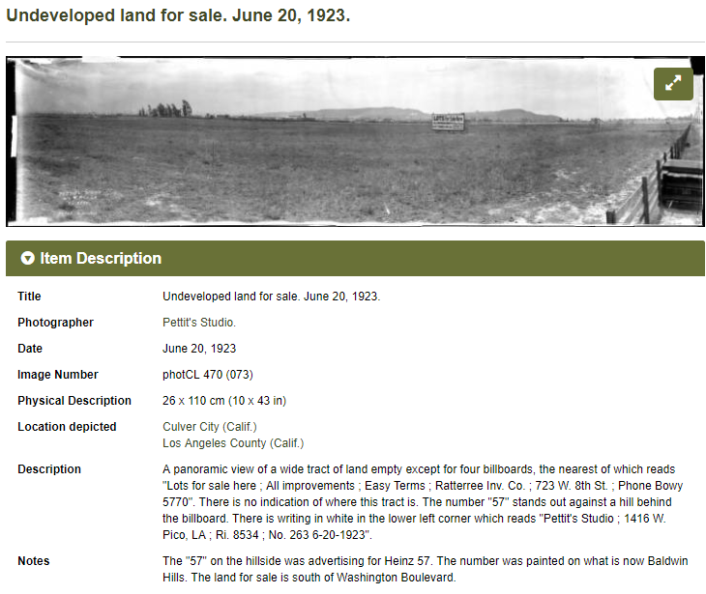
Data Queries and Quality Assessment
“Aside from the painted signboards and cut out 57's along the main railroad lines are to be found these giant numerals built of concrete into the faces of hills and mountains. Horseshoe Curve on the Pennsylvania wouldn't seem like Horseshoe Curve without the Heinz contribution to the scenery. There is the 57 mountain at Salt Lake City (Helper, Utah?) The King's Highway of California picks its way among mountainous 57s. Most spectacular of these is a ground sign with 125 foot figures Illuminated with powerful flood lights. (Baldwin Hills 57) It glistens out through the night to be read by automobilists and patrons of the railroads and interurban car lines.”
-- A Priceless Trademark Found on the "L" (Elevated Rail). Ohliger, C.F. 1919. Printers' Ink Monthly. N.W. Ayer & Son. Pg. 57.
Notes:
The Wikibase environment provides a powerful SPARQL Query tool for interrogation the data.
In this example, a query is sent to list all the photographs in the Verner Photographic Negatives collection, to highlight any that lack a “depicts” statement.
Linking from the photograph that lacked a “depicts” statement to the description of the photograph in the CONTENTdm Wikibase, a link to the image …
provides a full view of the panoramic photograph …
and at higher-resolution shows a distinctive number “57” on the far hillside, a novelty that may help in determining the location.
Research on the web uncovers an article from Printers’ Ink Monthly in 1919 about these large advertisements placed throughout the US by the Heinz company, noting one in Baldwin Hills (near Culver City in California) that was illuminated by flood lights.
In a different Huntington Library collection focusing on photographs from Southern California Edison includes other photographs of this hillside sign, including one depicting it illuminated, with the location depicted identified as Culver City.
And with that verifiable data, the description for this panorama in the Verner Photographic Negatives collection can be supplemented with the location depicted and a note about the sign. [It is hoped that similar data from cleanup and reconciliation can also be brought back into the live CONTENTdm collection, with the understanding that with the creation of data for Wikibase entities some items teased apart will not go back together....]

Slide 37
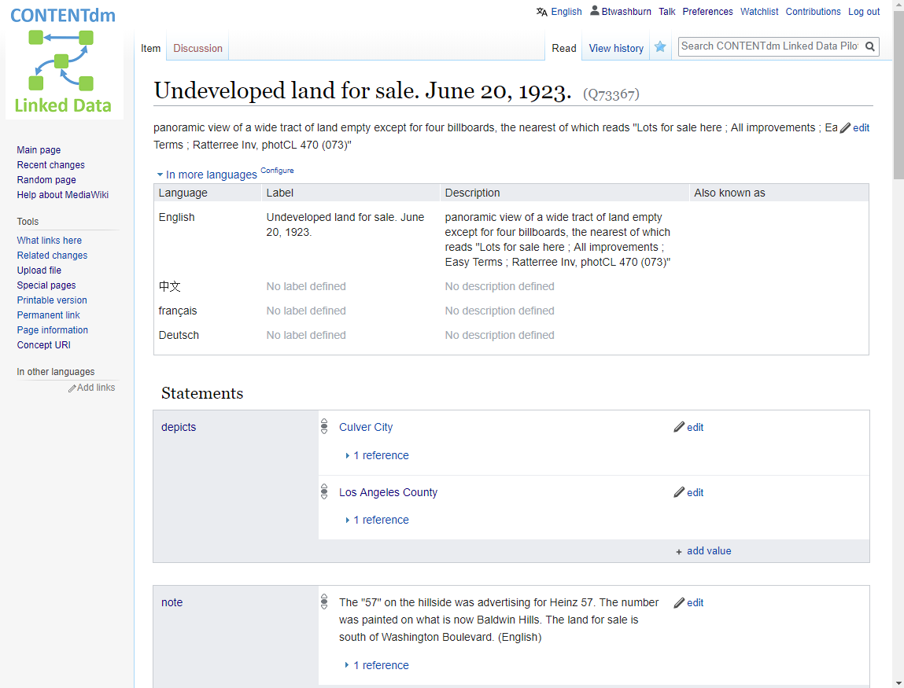
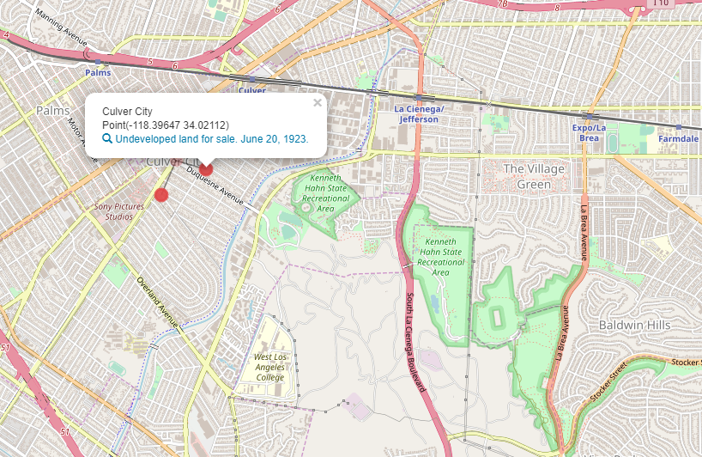
Data Queries and Quality Assessment
“Aside from the painted signboards and cut out 57's along the main railroad lines are to be found these giant numerals built of concrete into the faces of hills and mountains. Horseshoe Curve on the Pennsylvania wouldn't seem like Horseshoe Curve without the Heinz contribution to the scenery. There is the 57 mountain at Salt Lake City (Helper, Utah?) The King's Highway of California picks its way among mountainous 57s. Most spectacular of these is a ground sign with 125 foot figures Illuminated with powerful flood lights. (Baldwin Hills 57) It glistens out through the night to be read by automobilists and patrons of the railroads and interurban car lines.”
-- A Priceless Trademark Found on the "L" (Elevated Rail). Ohliger, C.F. 1919. Printers' Ink Monthly. N.W. Ayer & Son. Pg. 57.
Notes:
The Wikibase environment provides a powerful SPARQL Query tool for interrogation the data.
In this example, a query is sent to list all the photographs in the Verner Photographic Negatives collection, to highlight any that lack a “depicts” statement.
Linking from the photograph that lacked a “depicts” statement to the description of the photograph in the CONTENTdm Wikibase, a link to the image …
provides a full view of the panoramic photograph …
and at higher-resolution shows a distinctive number “57” on the far hillside, a novelty that may help in determining the location.
Research on the web uncovers an article from Printers’ Ink Monthly in 1919 about these large advertisements placed throughout the US by the Heinz company, noting one in Baldwin Hills (near Culver City in California) that was illuminated by flood lights.
In a different Huntington Library collection focusing on photographs from Southern California Edison includes other photographs of this hillside sign, including one depicting it illuminated, with the location depicted identified as Culver City.
And with that verifiable data, the description for this panorama in the Verner Photographic Negatives collection can be supplemented with the location depicted and a note about the sign. [It is hoped that similar data from cleanup and reconciliation can also be brought back into the live CONTENTdm collection, with the understanding that with the creation of data for Wikibase entities some items teased apart will not go back together....]
Additions to the CONTENTdm description for this photograph can also be evaluated for inclusion in the corresponding Wikibase description of the work, which in turn will be reflected in the map visualization based on Wikibase data (though we haven’t yet established automated processes for that type of synchronization.)

Slide 38
Introducing the PILOT PROJECT Participants

Slide 39
Project Participants
Cleveland Public Library
  Chatham Ewing
Huntington Library, Art Collections, and Botanical Gardens
  Mario Einaudi
University of Minnesota
  Jason Roy, Jolie Graybill, Greta Bahnemann

Slide 40
OCLC Pilot Project Team
Digital Collection Services
Taylor Surface
  Senior Product Manager
Shane Huddleston
  Product Manager
Hanning Chen
  Product Analyst
Membership & Research
Eric Childress
  Community Manager
Mercy Procaccini
  Program Officer
Jeff Mixter
  Lead Software Engineer
Bruce Washburn
  Principal Engineer

Slide 41
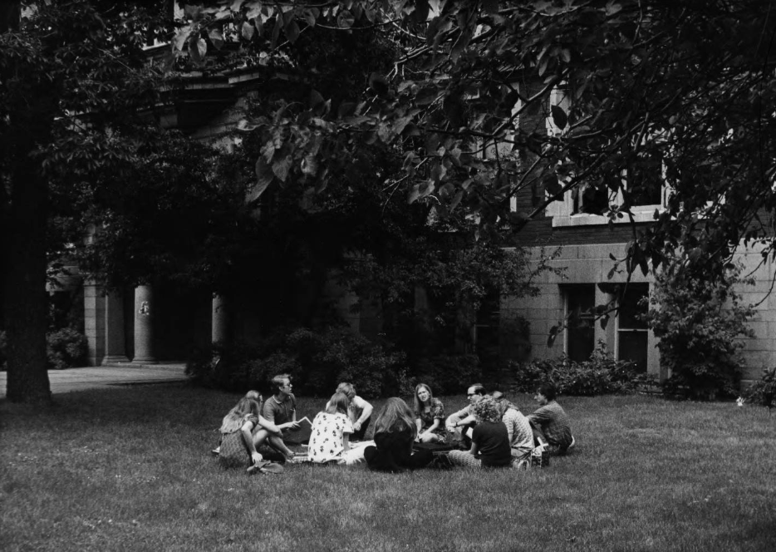
DISCUSSION
“Students. Outdoor Discussion Group.” University of Minnesota Archives Photograph Collection
https://umedia.lib.umn.edu/item/p16022coll175:1581

Slide 42
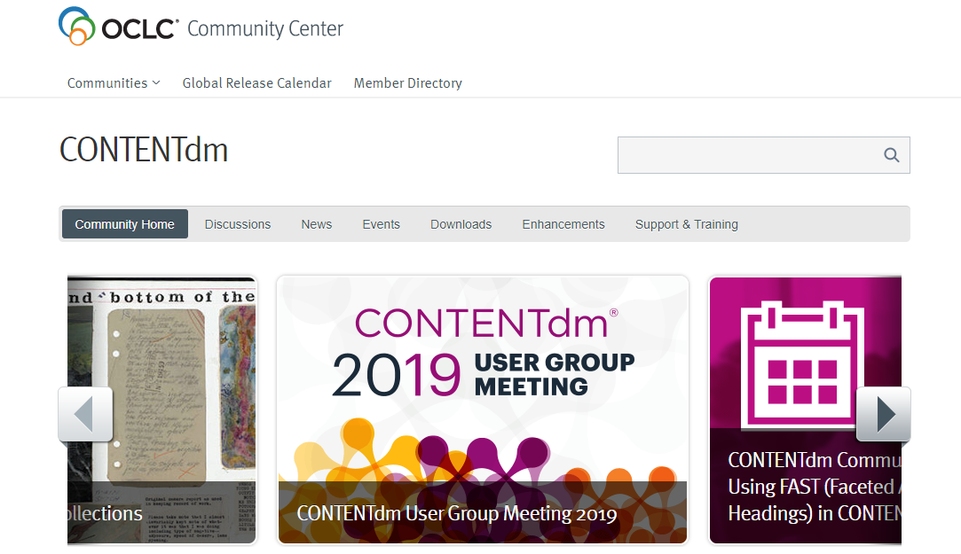
Continue connecting
Notes:
The CONTENTdm community in the OCLC Community Center offers current CONTENTdm subscribers the opportunity to:
Connect with each other through the discussion forum and webinars
Stay up to date on OCLC news and release information
Share ideas new features in CONTENTdm & comment on others’ ideas

Slide 43

Making the most of the community
Request credentials
oc.lc/cdm19request
Sign in and complete your profile
Subscribe to news & discussions
Start or respond to a discussion thread
Connect with peers at virtual events
Submit and rate ideas for product features
Notes:
Few quick steps you can take to make the most of the CDM community
Request credentials for access if you don’t have them already, right now, on your mobile device at oc.lc/cdm19request
Then sign in and complete your profile so you can continue connecting beyond this meeting with other CDM users worldwide
Subscribe to news & discussions to receive notifications of new discussion posts and news updates from OCLC
Start or respond to discussion threads
Connect with your peers by attending virtual events, in fact, we are planning on reprising the most popular sessions from this meeting as virtual sessions so folks who could not attend can benefit from the information shared – AND attendees can see that concurrent session they missed because there was too much good programming!
Submit and rate ideas for product features in our enhancement suggestion area

