Slide 1
Works in Progress: Democratizing Access to Large Datasets through Shared Infrastructure
This project was made possible in part by the Institute of Museum and Library Services LG-70-18-0202. Presented by Jamie Wittenberg. Contact: jvwitten@iu.edu

Slide 2
A Big Data Problem in Research Libraries

Slide 3
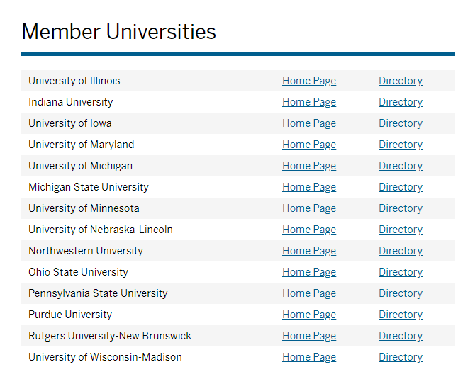

Slide 4
The Case for Clarivate Analytics’ XML Data
Member institutions had previously spent $1.1 Million on the data
The XML data could not be re-purposed
Without the same data, researchers could not replicate findings
Discounted pricing was available to all members when buying as a consortium via the libraries large scale acquisitions program
Big Data purchases via the member libraries was a first and new strategic initiatives were encouraged by the Library Directors
As informational professionals librarians need to fill this space and be seen as partners for the research community

Slide 5
Shared Big Data Gateway Origins
Big Data hosting is cumbersome, expensive, and requires technological expertise
Robert McDonald, former Associate Dean for Research and Technology at IU, suggested a shared hosting solution for all BTAA institutions
BTAA staff presented the solution to the Library Directors
Indiana University and Indiana University Network Science Institute completed the application for the Institute of Museum and Library Services (IMLS) grant

Slide 6
Data Enclave Video
https://www.youtube.com/watch?time_continue=2&v=33ev6Rzhd0A

Slide 8
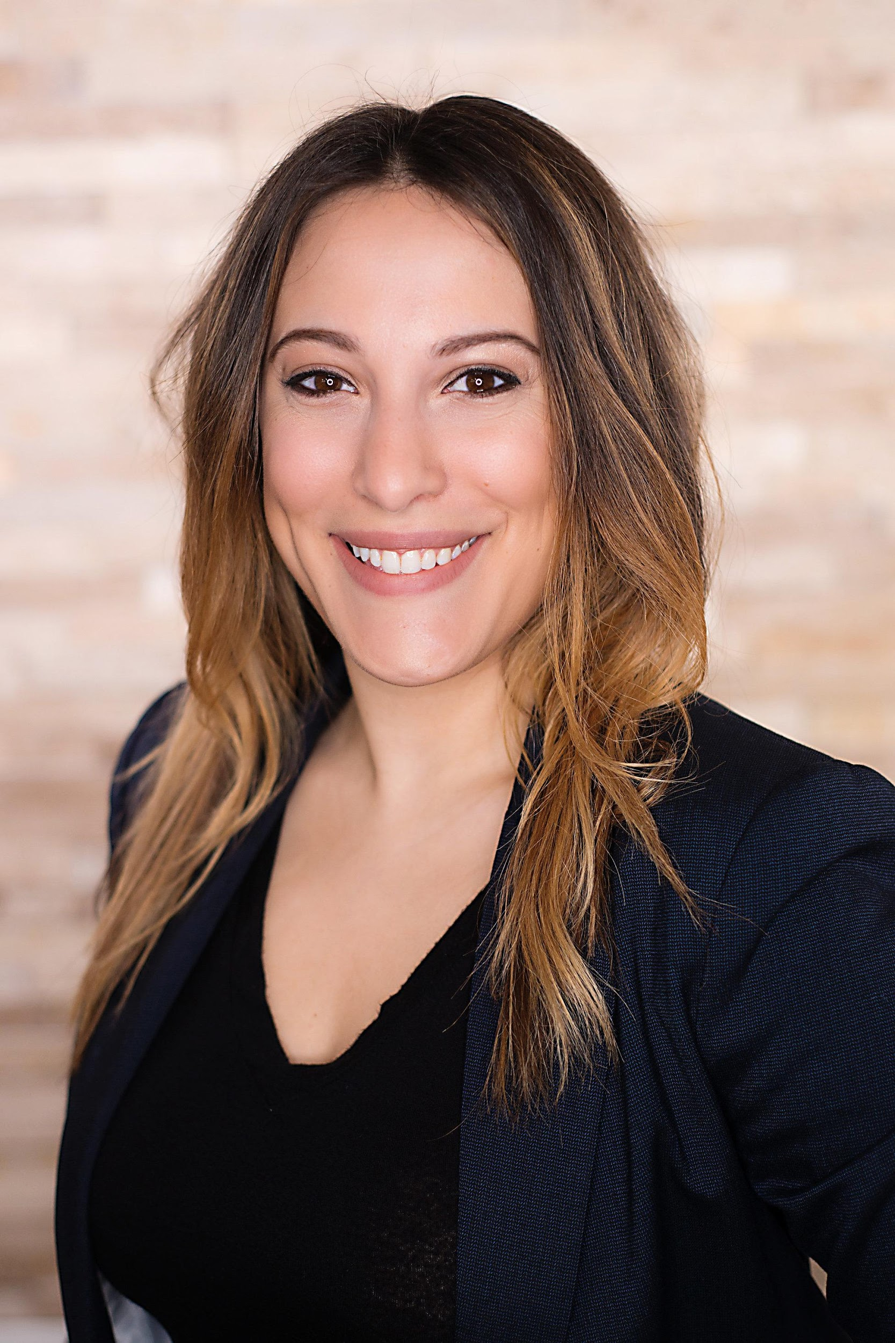
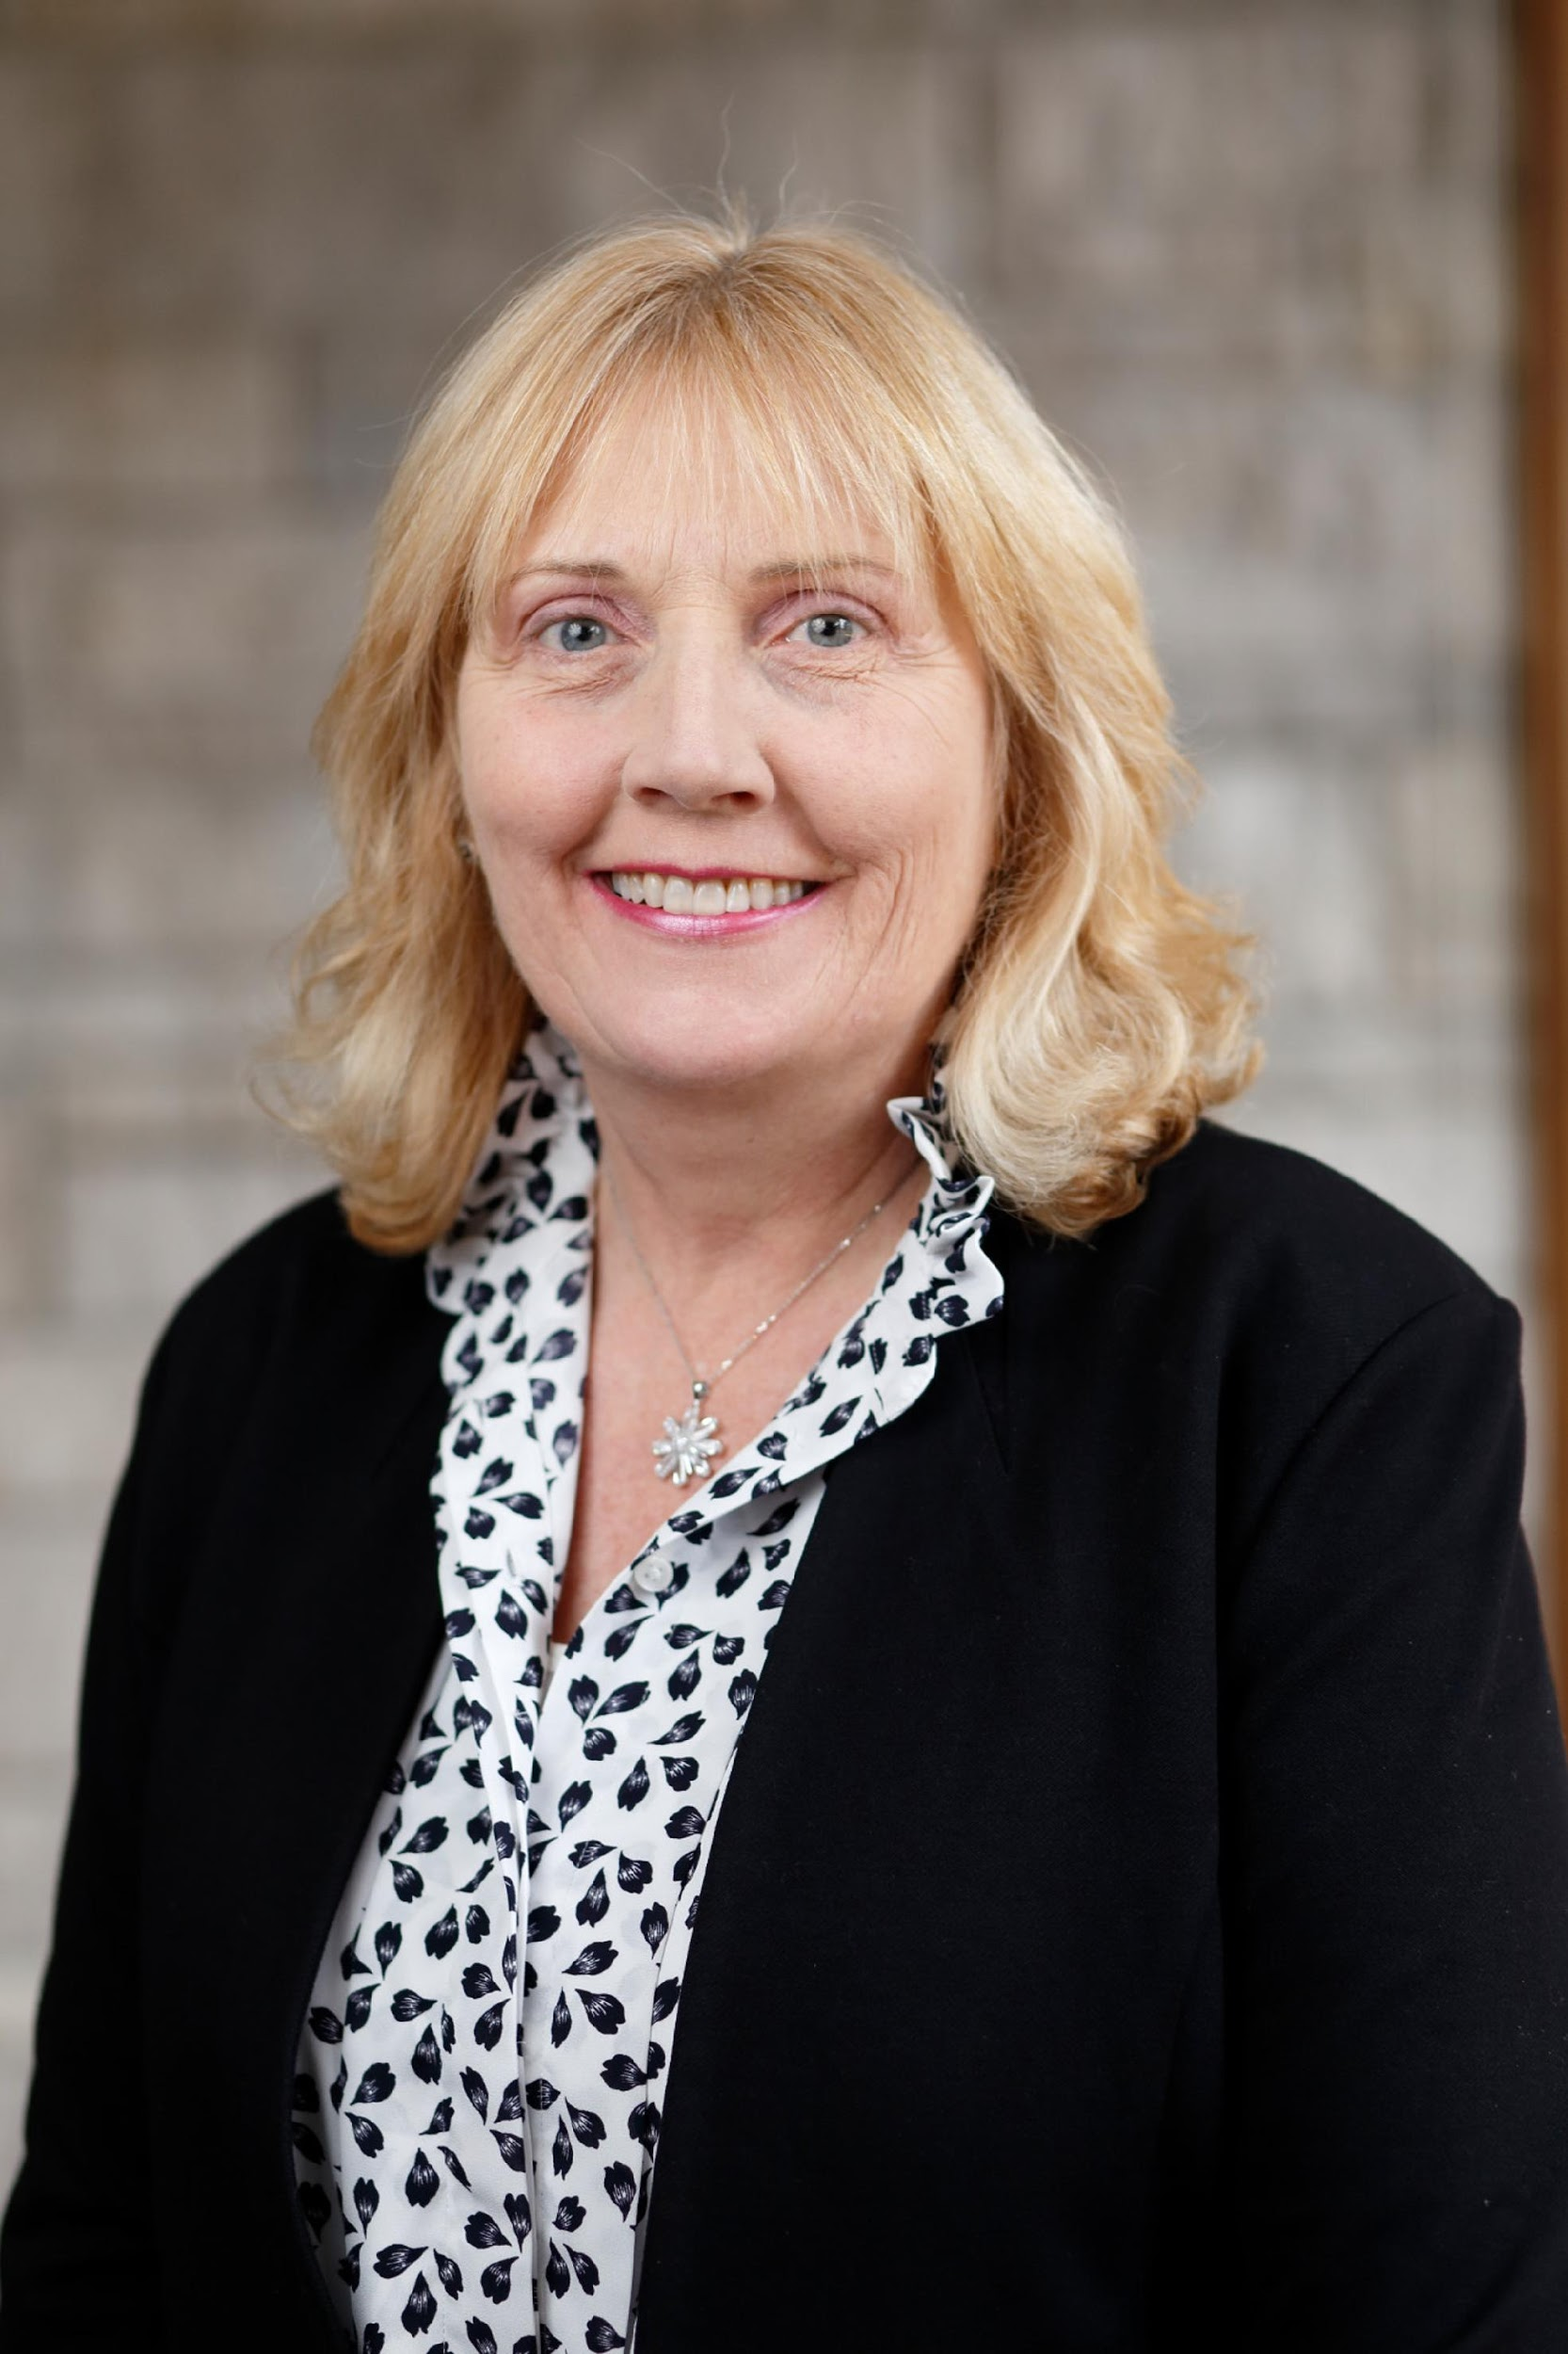
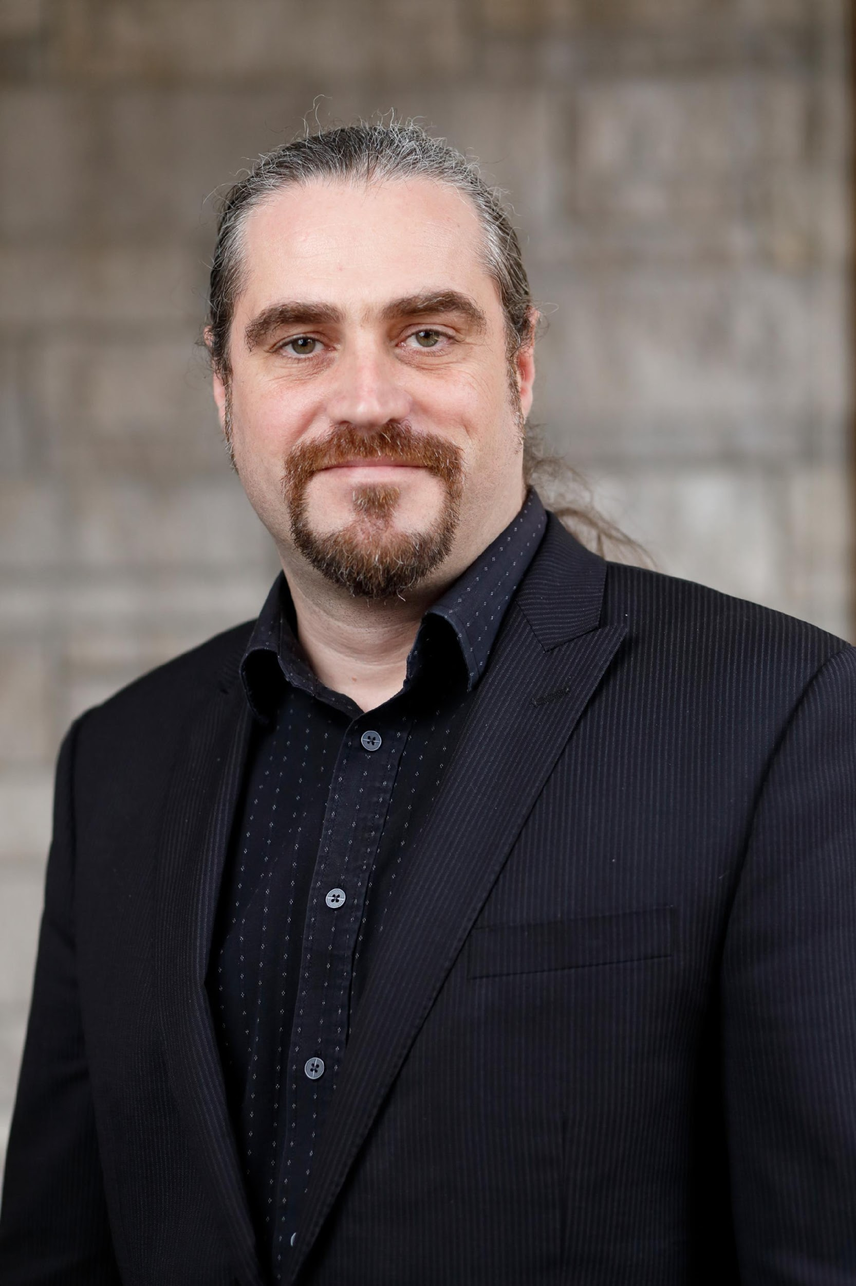
CADRE Project Leadership

Slide 9
Partners

Slide 10
Project Constituents
Primary constituents
Academic research libraries; science of science researchers and students; library and information science researchers
Secondary constituents
Public libraries; teaching colleges; researchers in other areas (computer science); researchers who need to visualize large networks; research & development
Tertiary constituents
Administrative bibliometric; instructors; general public

Slide 11
Goals
Produce the initial SBD-Gateway platform with the capability to host as a minimum three datasets (e.g., Web of Science, Microsoft Academic Graph, U.S. Patent and Trademark data);
01
Engage the library and research community to identify and prioritize additional features, datasets, and other improvements to SBD-Gateway;
02
Recruit enough library partners to sustain the SBD- Gateway for at least three years beyond the two year IMLS grant period;
03
Create a community of active researchers who use the platform and value its role in facilitating their research and collaborations.
04

Slide 12
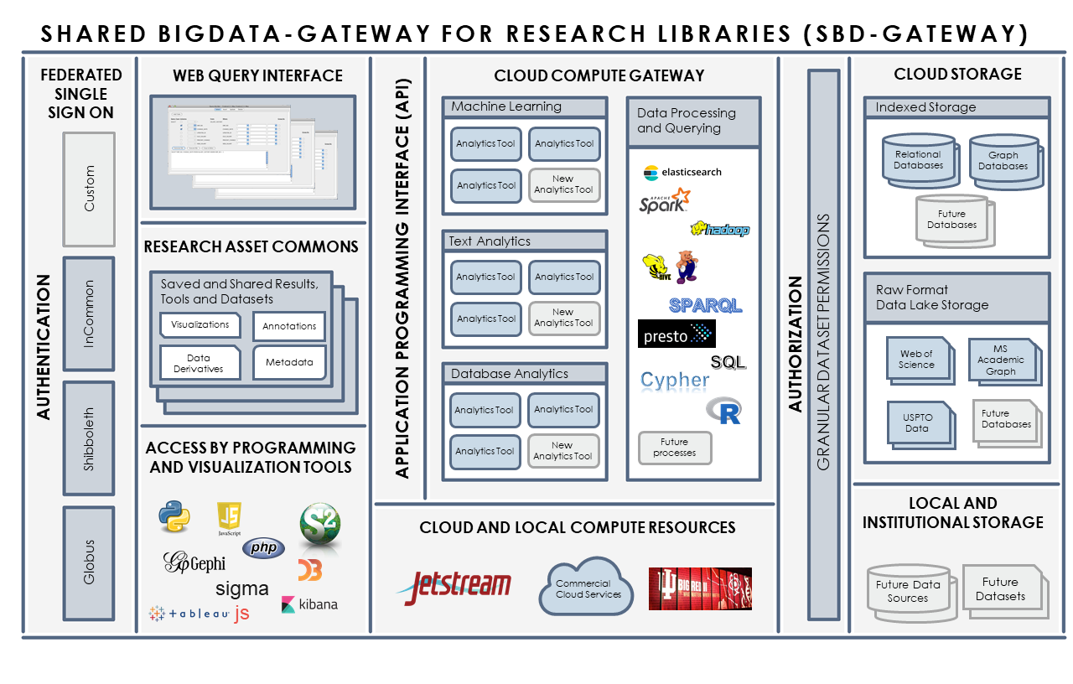

Slide 13
Project Goals – Research Asset Commons
Federated Login
Access from any affiliated institution using in-house credentials (inCommon, Shibboleth etc.)
Restricted access to proprietary resources, based on login credentials
Collaboration
Ability to save and share with specific users, community or the public metadata, queries, results, annotations, visualizations, algorithms, code, containers and virtual machines
Community building and collaboration based around same data access privileges and goals
Reproducibility, Replicability, Provenance and Transparency
Use of the same, well documented original datasets
DOIs identifying any and every data change or permutation
Saved and shared workflows a pipelines
Ability to publish using unique identifiers lеading back to Research Asset Commons

Slide 14
Graphical User Interface

Slide 15
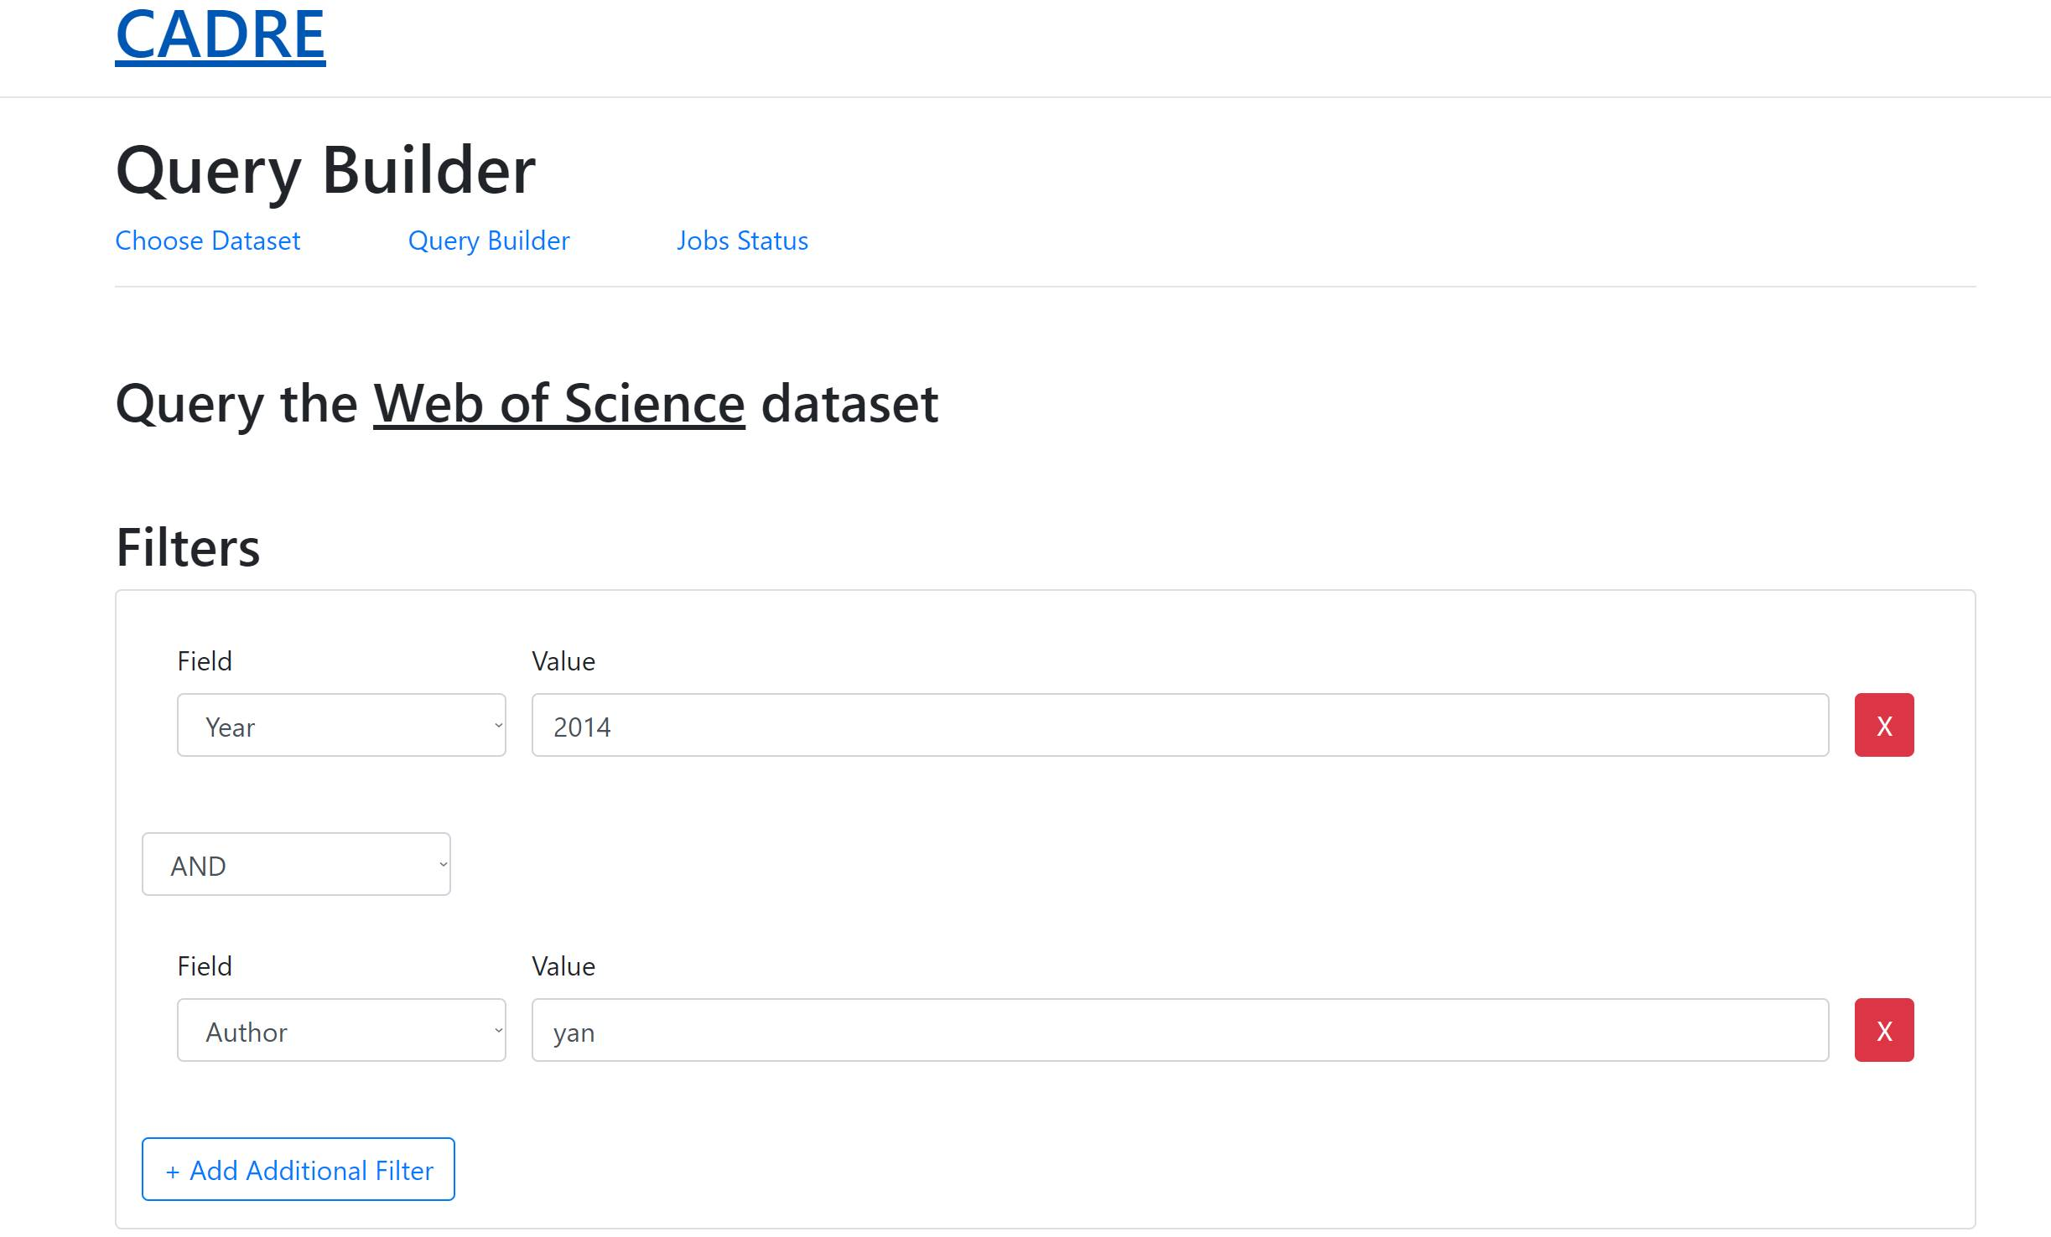

Slide 16
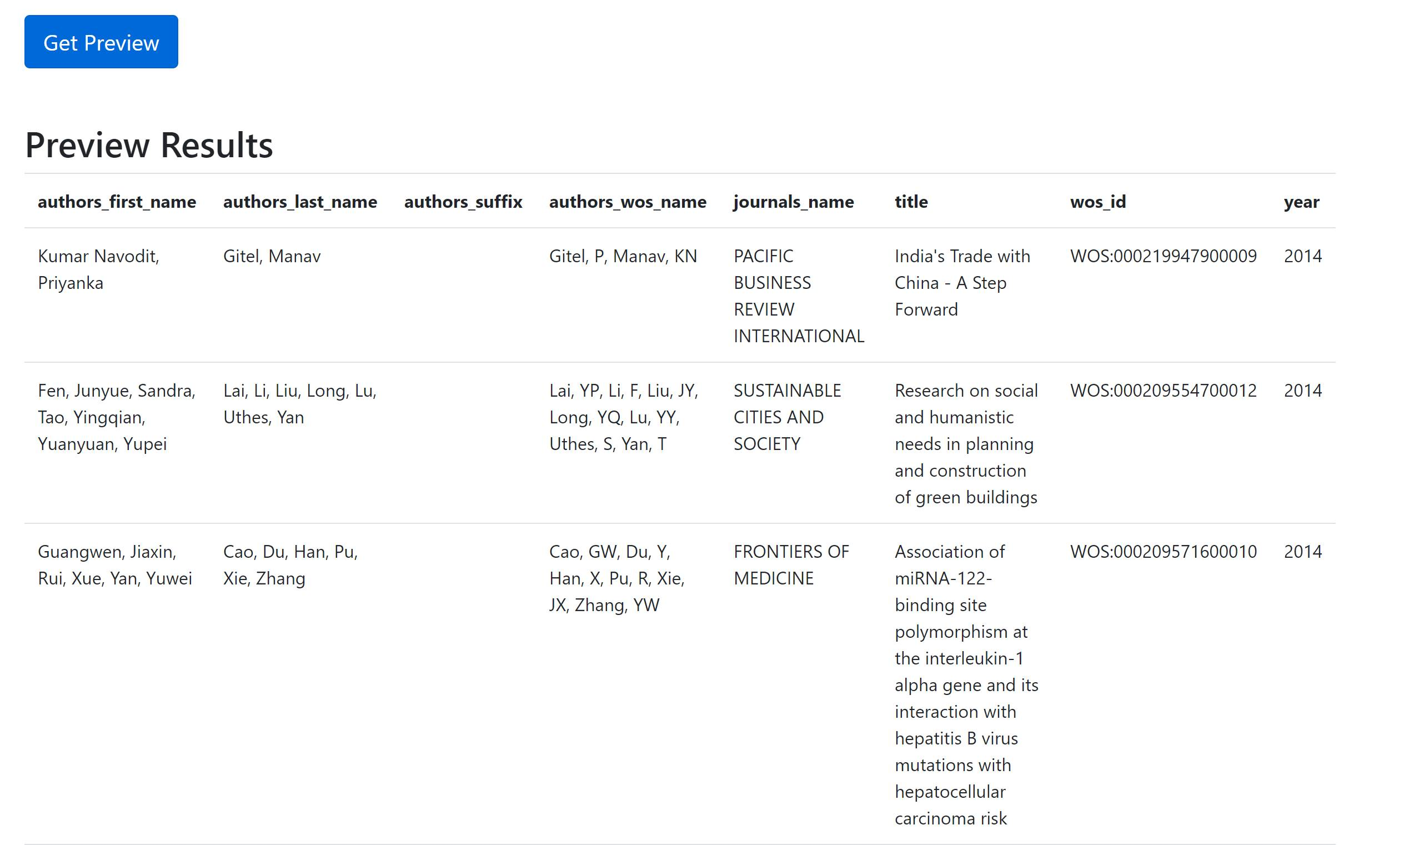

Slide 17
CADRE Fellows

Slide 18
Utilizing Data Citation for Aggregating, Contextualizing, and Engaging with Research Data in STEM Education Research
Researchers: Michael Witt, Loran Carleton Parker, Ann Bessenbacher
Affiliation: Purdue University

Slide 19
Understanding citation impact of scientific publications through ego-centered citation networks
Researchers: Yi Bu, Chao Min, Ying Ding
Affiliation: Indiana University Bloomington and Nanjing University

Slide 20
MCAP: Mapping Collaborations and Partnerships in SDG Research
Researchers: Jane Payumo, Devin Higgins, Scout Calvert, Guangming He
Affiliation: Michigan State University

Slide 21
Measuring and Modeling the Dynamics of Science Using the CADRE Platform
Researchers: Russell Funk, Michael Park, Thomas Gebhart, Britta Glennon, Julia Lane, Raviv Murciano-Goroff, Matthew Ross, Jina Lee, Erin Leahey
Affiliation: University of Minnesota, University of Pennsylvania, New York University, Boston University, University of Arizona

Slide 22
The global network of air links and scientific collaboration – a quasi-experimental analysis
Researchers: Katy Börner, Adam Ploszaj, Lisel Record, Bruce Herr II
Affiliation: Indiana University Bloomington and University of Warsaw

Slide 23
Comparative analysis of legacy and emerging journals in mathematical biology
Researchers: Marisa Conte, Samuel Hansen, Scott Martin, Santiago Schnell
Affiliation: University of Michigan and University of Michigan Medical School

Slide 24
Systematic over-time study of the similarities and differences in research across mathematics and the sciences
Researcher: Samuel Hansen
Affiliation: University of Michigan

Slide 25
Sustainability

Slide 26
Cloud Computing Time

Slide 27
Tiered Membership

Slide 28
Get Involved
Blog
Listserv
Fellowships
Contribute

Slide 29
Contact Us

