Slide 1
SÉMINAIRE UNIVERSITÉ DE LILLE - DÉPARTEMENT SID
12 December 2019
OCLC – a brief introduction

Slide 2

Titia van der Werf
OCLC Research Europe
titia.vanderwerf@oclc.org
With gratitude to Prof. Widad Mustafa El Hadi for presenting the following slides in my absence.

Slide 3
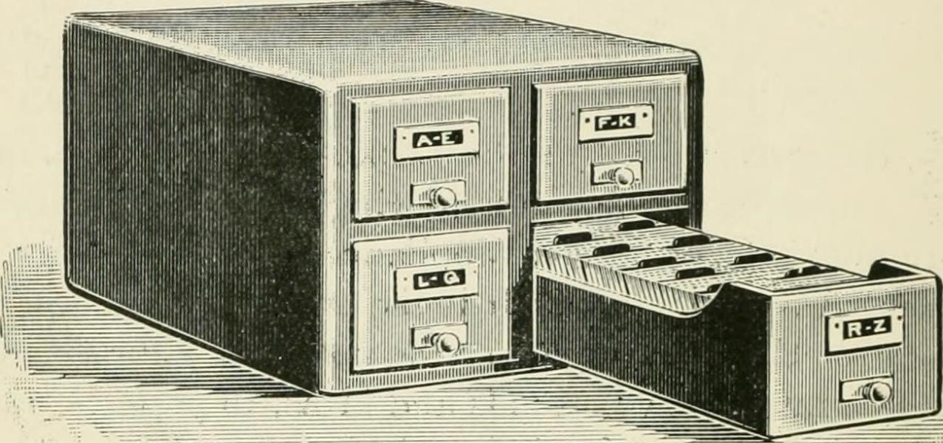
The Ohio Computer Library Center
Notes:
Back in 1967, the Ohio Computer Library Center (OCLC) was founded by 54 Ohio colleges and universities. A computerised system was developed for shared cataloging and resource sharing. The aim? To bring cost savings to those who took part. It was especially important that there were little to no barriers to entry, as the more libraries who participated, the greater the ability to share workload and the more useful the services became in terms of saving time and money.
In many respects, Fred Kilgour, the first OCLC president, realised that if libraries were going to collaborate on creating records and sharing items, they would be doing this predominantly for the cost savings. But for this to work, it was important that the few were not profiting from the work of the many.

Slide 4
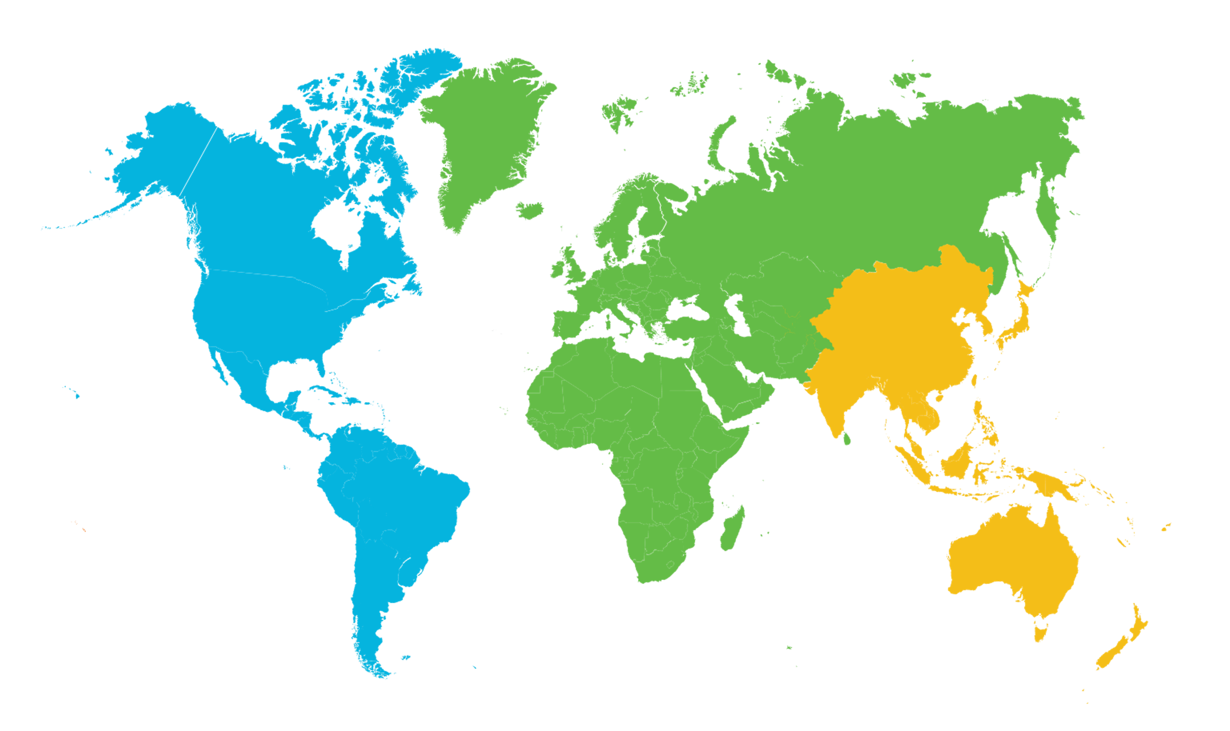
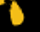
Global and Regional Councils
Europe,
Middle East, Africa
Regional Council (EMEA)
All countries in Europe,
the Middle East and Africa
11 delegates
Americas
Regional Council (ARC)
United States,
Canada, Caribbean,
Latin America
32 delegates
Asia Pacific
Regional Council (APRC)
China, Korea, Japan,
Australia, New Zealand,
Pakistan, India and other
territories west of Hawaii
5 delegates
Notes:
So in 1977, the governance structure was created to make sure member library interests were represented at all levels of the organisation. One of the most fundamental ways that libraries engage with this process is by exercising their rights as members.
The governance structure consists of three regional councils representing the three regions (Asia Pacific, EMEA and Americas) which makes up the Global Council. The Board of Trustees is composed of professionals and global council delegates – and they are not shareholders.
So OCLC is governed by libraries, for libraries.

Slide 5
A global network of libraries
18,000
member libraries
worldwide who elect
48
delegates to Global
Council, who elect
6
members of the 15-member
OCLC Board of Trustees
Notes:
This has led to OCLC becoming the global network of libraries it is today: with approximately 18,000 members across 121 countries.
Additionally, the organisation became a not-for-profit, to ensure revenues generated were invested back into the community – through Research activities and Community services.
[Figures current as of 3/11/19]

Slide 6
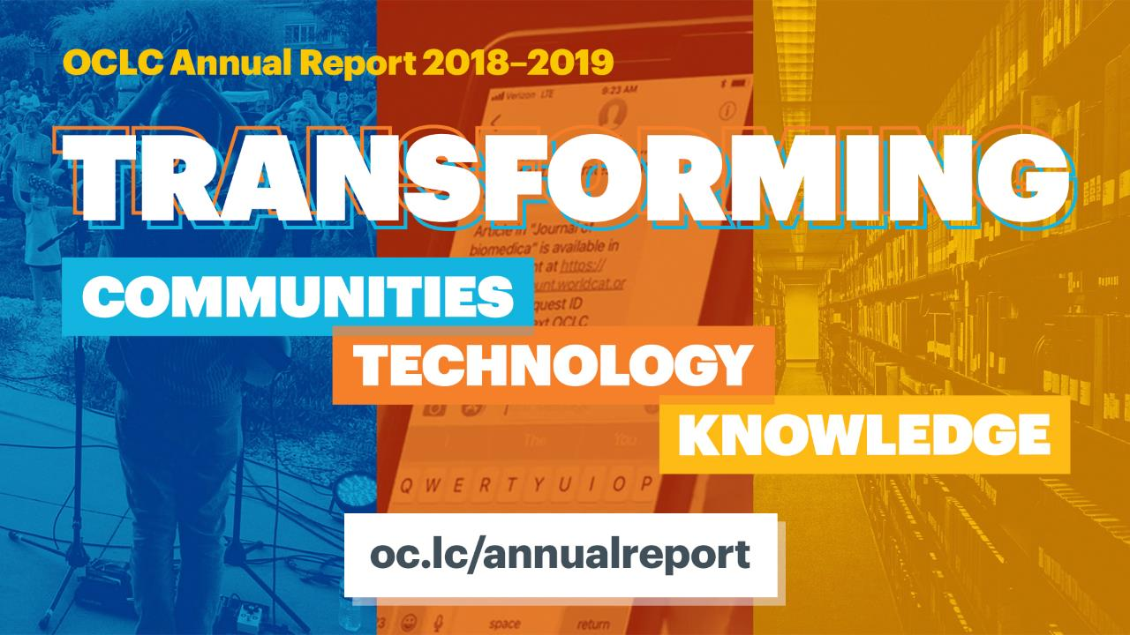
Notes:
OCLC released its 2018-2019 annual report in November 2019. It is available online at the URL shown on this slide. The theme of the report is “Transforming Communities, Technology and Knowledge.” Please take a few minutes to review the report for the most recent update on OCLC and its activities.

Slide 7
Innovative products
and services
Notes:
An important part of OCLC’s role as a cooperative is to work with member libraries to deliver innovative products and services.
This is a high-level introduction and not the place to give an overview – suffice to say here that OCLC provides support for most if not all library workflows and needs. It has different products for research libraries and for public libraries because their needs and workflows are quite different..

Slide 8
464
million records
2.8
billion holdings
WorldCat gets
one new record
every second
As of November 2019
Notes:
WorldCat deserves a special mention here: it is a truly unique asset to the library community and it continues to grow in scale and in richness every year. ​Did you know that a new record is added to WorldCat every second?​
​​

Slide 9
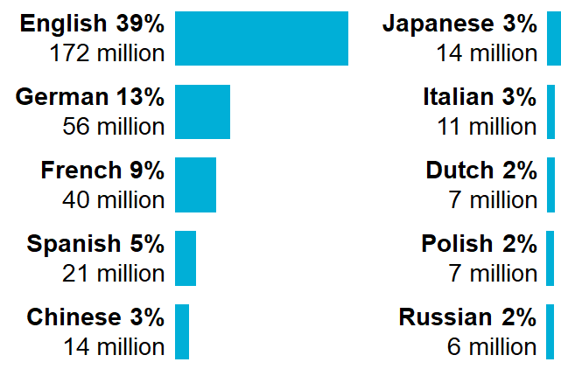
WorldCat is global
Top 10 languages
483
177 million
12
languages
represented
in WorldCat
7
As of October 2019
Notes:
WorldCat has items in more than 480 languages.
​Language Count as of October 2019​​
​
​
​

Slide 10

Notes:
WorldCat not only contains records contributed by libraries. OCLC partners with 350 publishers and content aggregators - nearly 100 of which provide fully or hybrid peer-reviewed OA materials, including books, journals, dissertations and audiovisual materials. Through these partnerships, WorldCat is a primary resource for the discovery of open content and licensed materials.
Libraries want OCLC to play a role in supporting their Open Content efforts; this was a finding from a recent (2018) OCLC Research survey into libraries’ open content activities.

Slide 11
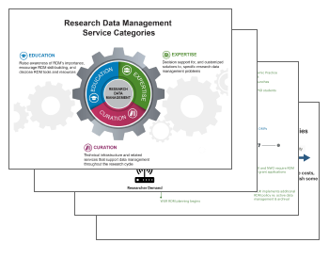
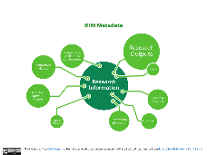
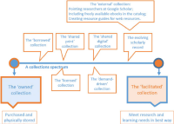
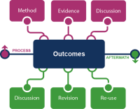
OCLC Research
OCLC Research is a community resource for the advancement of libraries and librarianship
Notes:
OCLC Research works for the library community world-wide, not just for the innovation of OCLC products and services. Since 1978, this division explores and studies topics that are important to libraries and it does this – not in an ivory-tower. OCLC researchers work closely together with libraries and other stakeholders. To help libraries move forward with confidence and strategically in a world that is changing rapidly. The research has made technological advances in library services possible and has improved the productivity of librarians and library users.

Slide 12

Notes:
Also part of OCLC Research is WebJunction: a learning platform that builds the knowledge, skills and confidence library staff need to keep their libraries moving forward. WebJunction offers a catalog of more than 300 online courses and webinar recordings - for free - on new and emerging library services, programs and issues. To date, WebJunction has reached more than 140,000 learners

Slide 13

oc.lc/opioid-report
Notes:
Through a grant from the Institute of Museum and Library Services, OCLC and the Public Library Association have conducted research into how public libraries are supporting their communities through the opioid crisis, and how libraries are partnering with organizations to meet local needs. The research has resulted in a summary report and eight research-based case studies highlighting varying opioid response efforts across the US. A call-to-action white paper will also be published as part of the project outputs.
Additional information about the project can be found online at oc.lc/opioid-crisis.

Slide 14
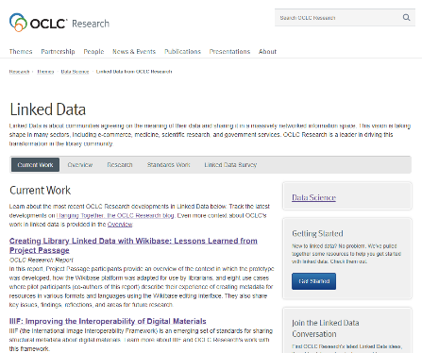
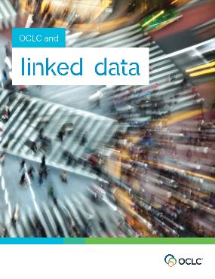
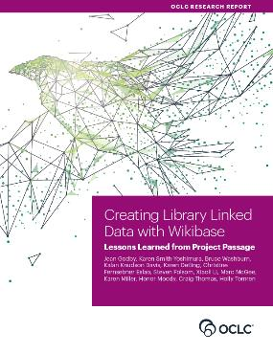
Linked data resources
https://www.oclc.org/research/themes/data-science/linkeddata.html
Notes:
If you would like to learn more about OCLC’s work with Linked Data, please visit the OCLC Research web page.
This year we published the findings and lessons learned with a linked data prototype called “Project Passage” – using WikiBase.
We also exchanged lessons learned with ABES and BnF in France, as they also worked on a Proof-of-Concept for a National Entities File.

Slide 15
THANK YOU
Titia van der Werf
titia.vanderwerf@oclc.org
Notes:
There is so much more to say!!!
Please do not hesitate to contact me if you have questions.

