Slide 1
Works in Progress Webinar | 10 December 2019
Radical Access: Leveraging Creative Commons Licenses to Open up Archives
Maureen Callahan
Sophia Smith Collections Archivist, Smith College Special Collections
Heather Briston
Head of Curators and Collections and UCLA University Archivist, UCLA Library Special Collections

Slide 2
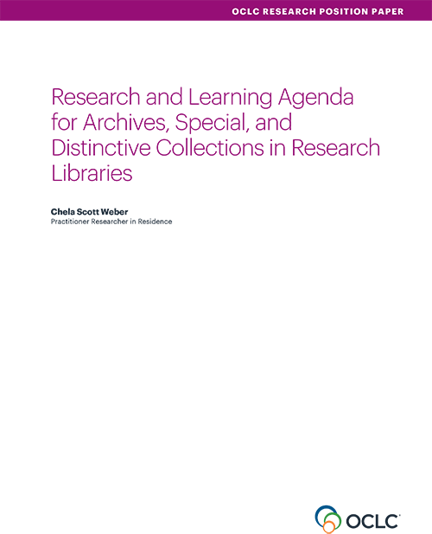
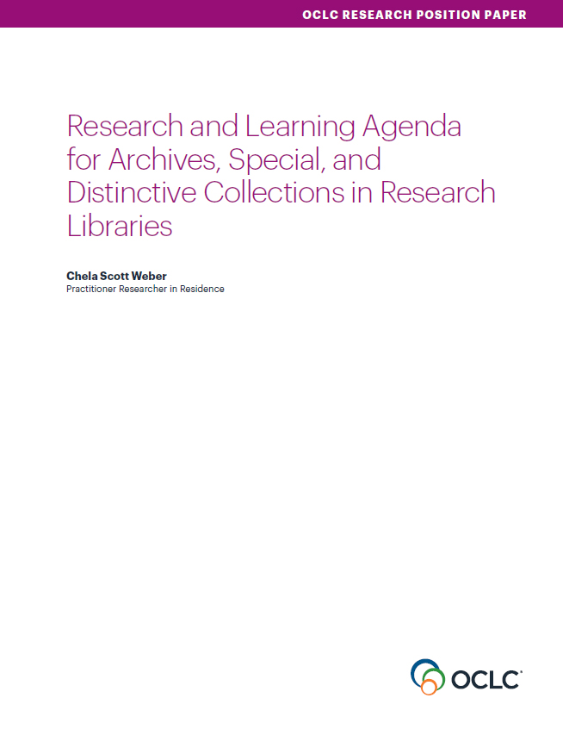
Our Work in Archives, Special, and
Distinctive Collections:
oc.lc/rlp-agenda
Notes:
OCLC Research has a long history of work in the area of archives, special, and distinctive collections in research libraries. We work in special collections because they are an important sight of knowledge creation, made possible by library’s commitment to the stewardship of their distinctive collections. The unique nature of material in special collections can make scaling a challenge, and we work to identify areas of common need and patterns of innovation to help libraries scale learning and expertise with these collections.
In October, we released the Research & Learning Agenda for Archives, Special, and Distinctive Collections.
articulates the shared challenges and opportunities research libraries are are facing in this sphere and suggests approaches for working on them together.
The agenda will guide OCLC Research work in this area in the future, and we hope it will also serve to frame larger conversations and spur action across the field
This year, OCLC RLP will be presenting a number of webinars that respond to issue surfaced during our work on the agenda.

Slide 3
Access to Collections
“Decisions throughout the stewardship process can serve to support or impede open access to our collections. In order to make the broadest portion of our archives and special collections accessible online in both traditional ways and for emerging computational methodologies, intentional practice in our legal agreements is key to privileging access whenever feasible.”
Notes:
Active, intentional practice to open up collections
More nuanced ways to honor and support the wishes and rights of collection donors
Can help to anticipate and support future uses we can’t yet identify, like computational access we are now trying to contend with

Slide 4
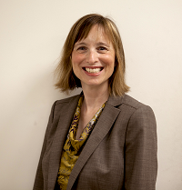
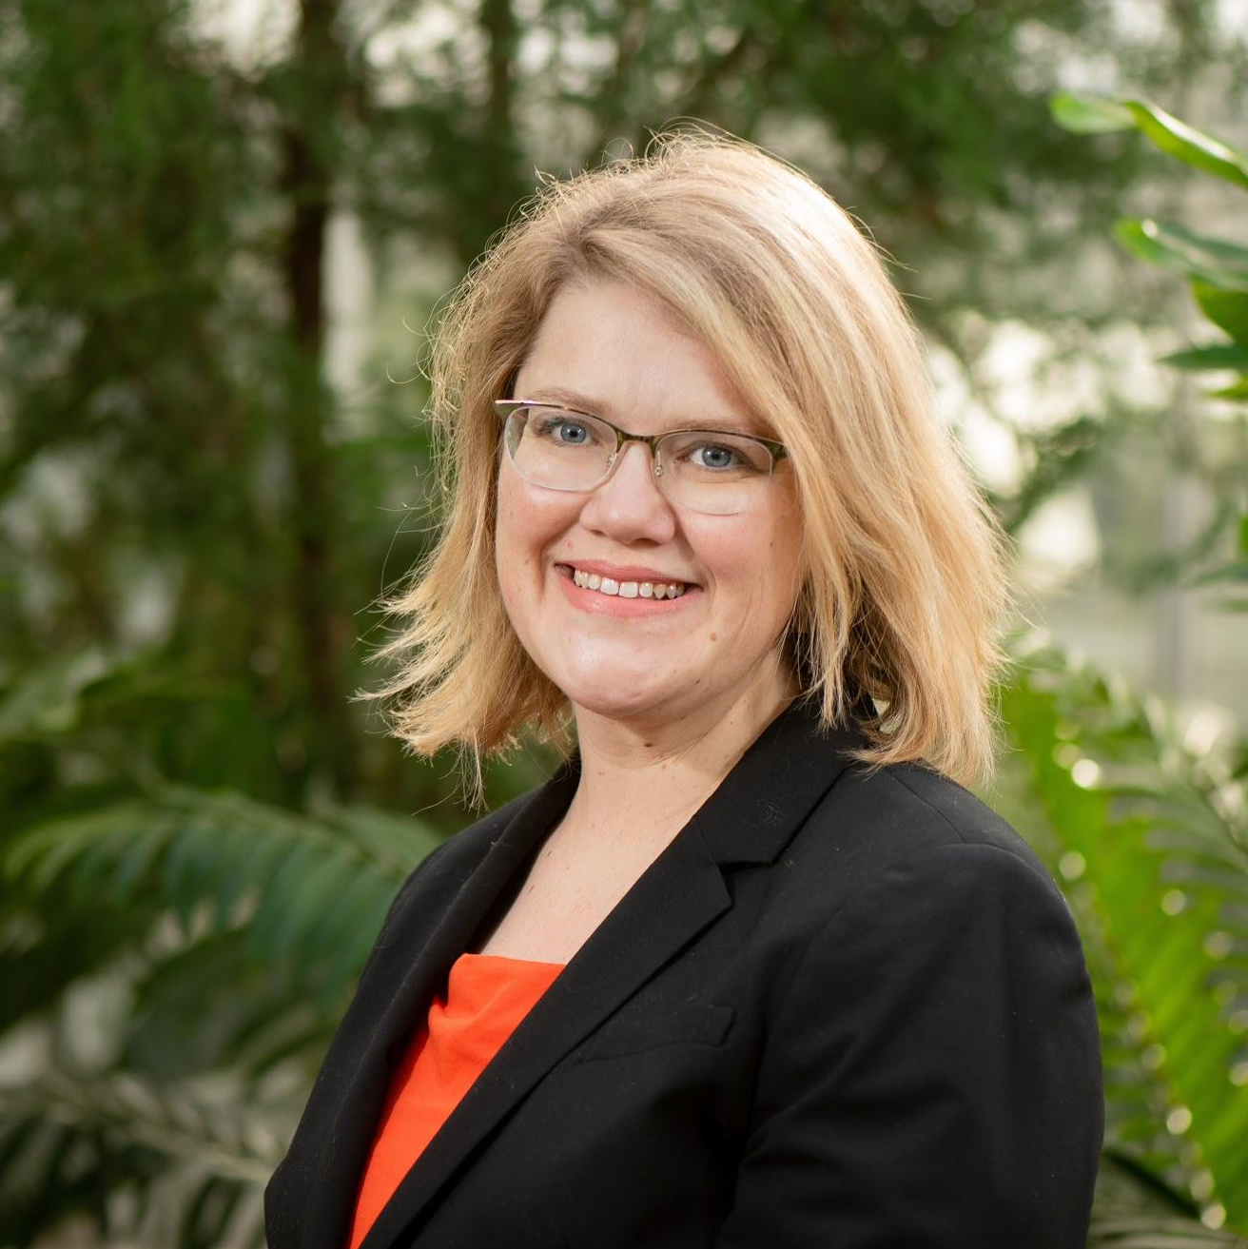

Heather Briston
Head of Curators and Collections
and UCLA University Archivist
UCLA Library Special Collections
hbriston@library.ucla.edu
Maureen Callahan
Sophia Smith Collection Archivist
Smith College Special Collections
mcallahan@smith.edu
@meau
Notes:
Very excited to bring these two expert speakers to you today
Heather
Heather Briston is the Head of Curators and Collections, with responsibility to lead collection development activities, and UCLA University Archivist in the UCLA Library Special Collections. Previously, she was the Head of Public Services for UCLA Library Special Collections, the Corrigan Solari University Historian and Archivist at the University of Oregon, and also an archivist at the University of California, Berkeley Environmental Design Archives. She received her MSI (Archives and Records Management) from the University of Michigan, a Juris Doctor from Syracuse University, focusing on intellectual property law, and a BA in International Relations from Michigan State University. She is a member and past chair of the Society of American Archivists’ Working Group on Intellectual Property, and the Secretary of the International Council on Archives Section on Archives in Universities and Research Institutes. She has taught over twenty workshops for the Society of American Archivists focusing on legal issues in archives. She is the author of “Understanding Copyright Law” in Trends in Archives Practice: Rights in the Digital Era, and several book chapters addressing legal issues in archival collections.
Maureen
Maureen Callahan is the steward of the Sophia Smith Collection of Women's History at Smith College, a repository that documents the ways that people have changed the world on behalf of women and other gender minorities. In her role, she manages long-term donor relationships and collects records of current work in women's movements. Maureen had previously worked in archival technologies and technical services at Yale University, New York University, and Princeton University. She is a graduate of the University of Michigan and Bryn Mawr College.

Slide 5
Radical Access:
Leveraging Creative Commons Licenses to Open up Archives
Notes:
Maureen owns this slide

Slide 6
Shared Assumptions & Values
1
Copyright, use, and our missions
Notes:
Maureen owns this slide

Slide 7
Common ground
We respect the law.
We support our users.
Archives and special collections library hold an extremely important place in society.
We need the best tools available to us to support our missions.
Notes:
Maureen

Slide 8
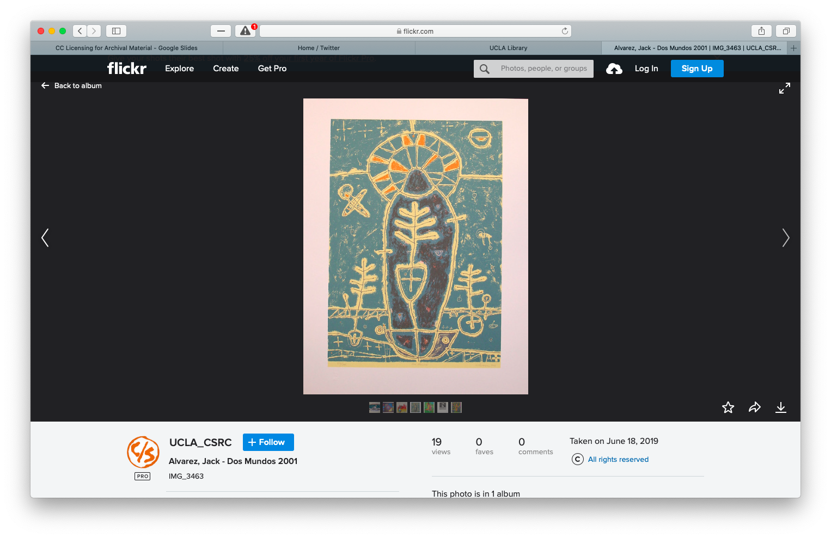
What are our shared missions?
We want for researchers to be able to encounter histories that are important to them.
We want for records to be used and re-used to make sense of the past and create new knowledge.
We want for this to be easy.
Screenshot of UCLA’s Chicano Studies Research Center Flickr page
Record/image by Alvarez, Jack - Dos Mundos 2001.
Notes:
Maureen

Slide 9
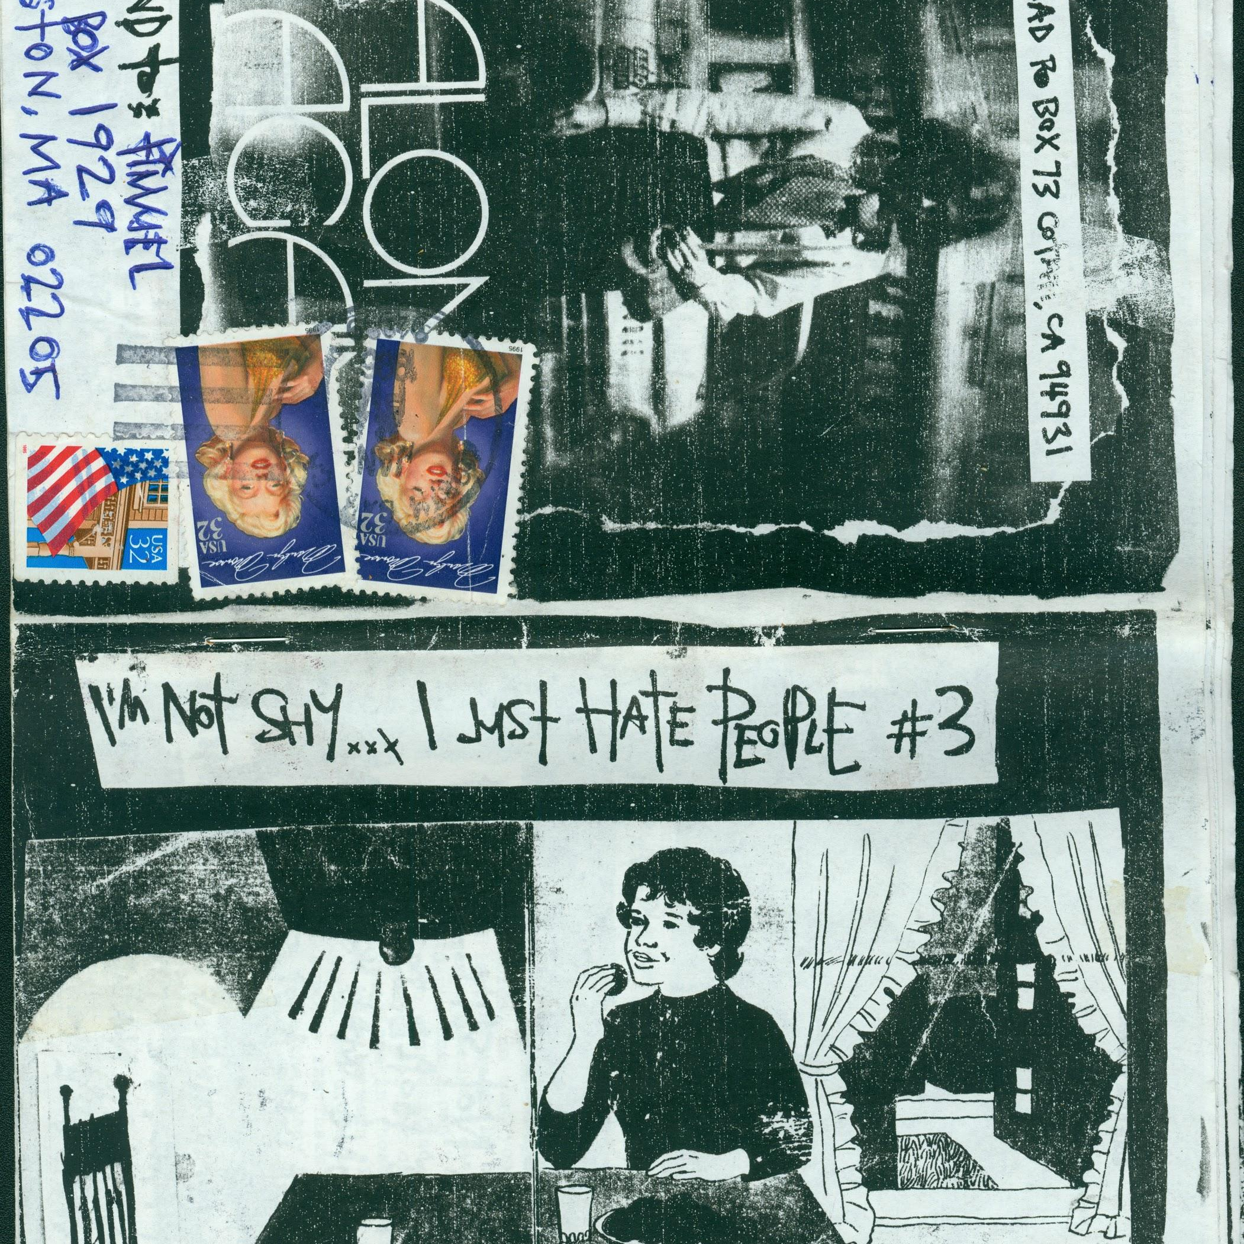
We need liberation from the current copyright regime.
I’m Not Shy… I Just Hate People number 3 by Toad
Sophia Smith Collection Zines Collection. Smith College Special Collections.
Notes:
Maureen

Slide 10
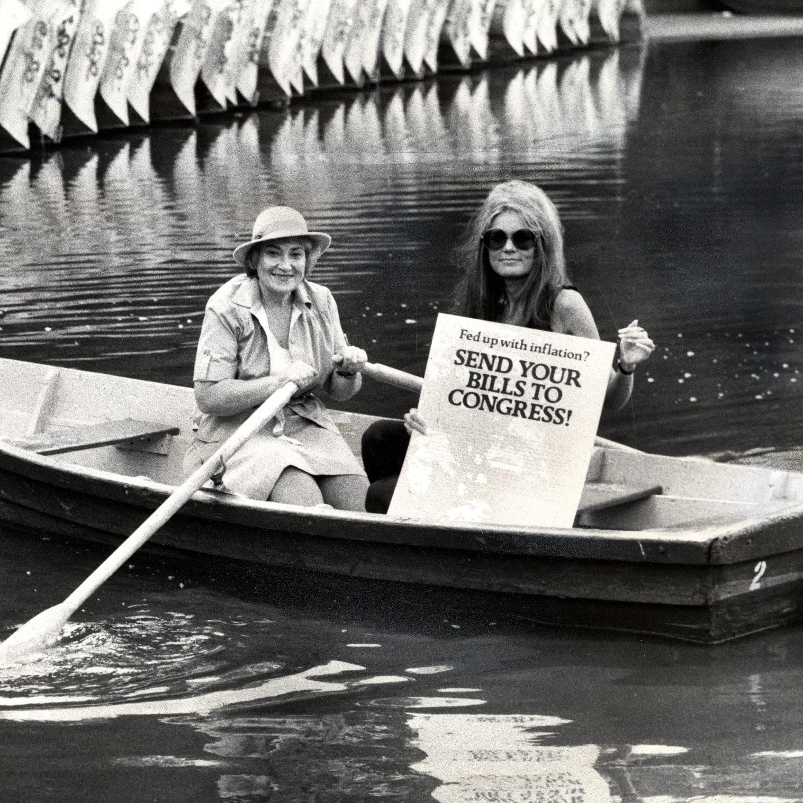
What is copyright for?
[The Congress shall have power] “To promote the progress of science and useful arts, by securing for limited times to authors and inventors the exclusive right to their respective writings and discoveries.”
Gloria Steinem and Bella Abzug, Photographer unknown.
Gloria Steinem papers. Box: 215, Folder: 4. Smith College Special Collections.
Notes:
Heather

Slide 11
When is something governed by copyright?
There is an expression of an idea.
The expression of the idea is in a fixed form.
The copyright term has not expired.
The copyright owner has not given away their copyright.
Ownership of copyright is independent of ownership of the physical work.
Copyright may be transferred as property
  Must be transferred in a writing or via a will.
Notes:
Heather

Slide 12
Materials Not Covered by Copyright
Ideas, processes or devices
Titles of works
Recipes and lists of ingredients
Blank books, forms, charts, etc.
Facts and data; historical facts
Works of U.S. government employees as part of their official duties
Laws and judicial opinions
Works that aren’t the result of human authorship
Materials in the public domain
  Copyright Expired
  Dedicated to the public domain
Slavish copies of 2D items: Bridgeman Art Library v Corel Corp, 36 FSupp 2d 191 (SDNY 1999)
Notes:
Heather

Slide 13
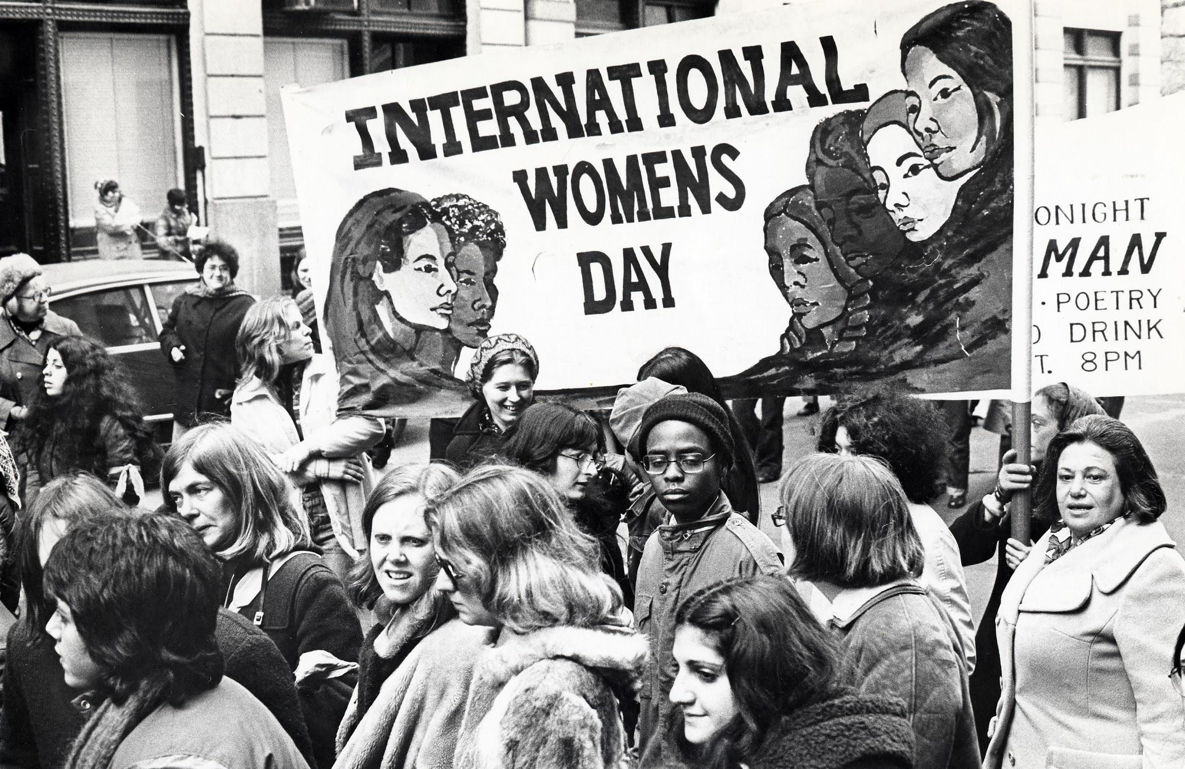
Copyright terms are very long.
Where does that leave us and our researchers?
International Women’s Day. Diana Davies, photographer
Diana Davies papers. Smith College Special Collections.
Notes:
Heather

Slide 14
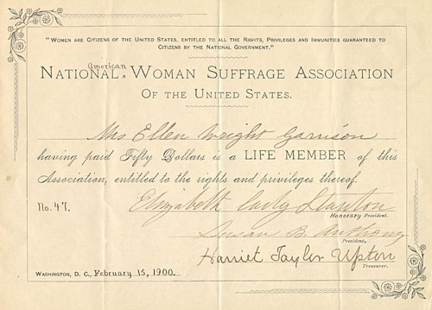
Ellen Wright Garrison’s membership certificate for the National American Woman Suffrage Association
Garrison Family papers. Smith College Special Collections.
Notes:
Maureen

Slide 15
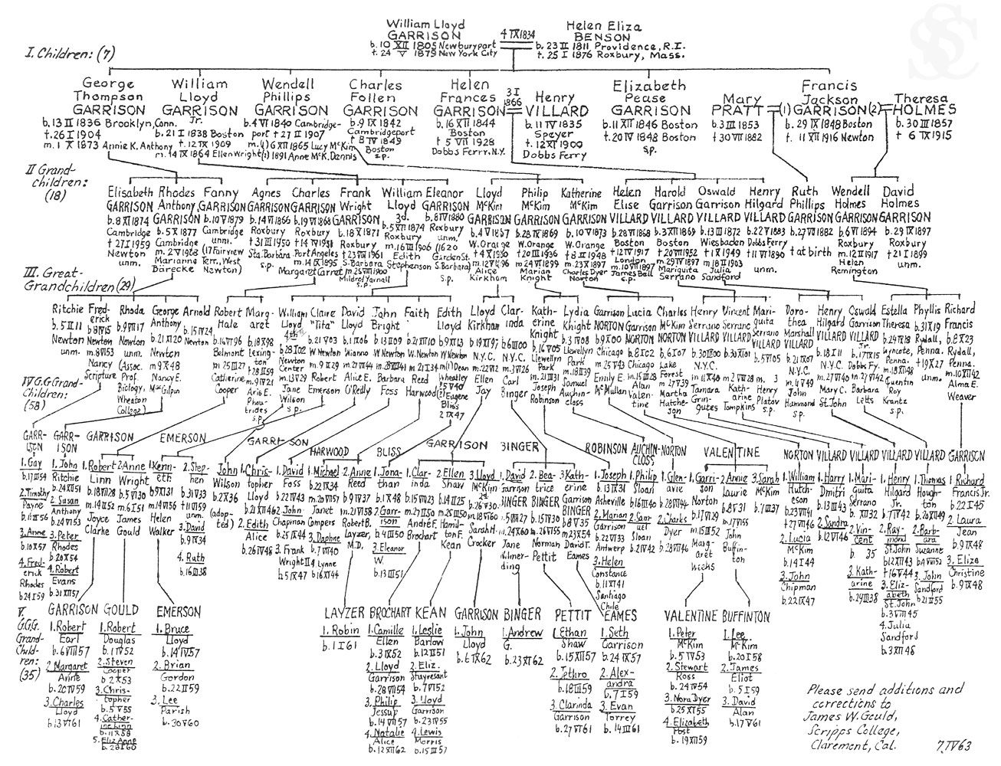
Copyright expires… next year
Notes:
Maureen

Slide 16
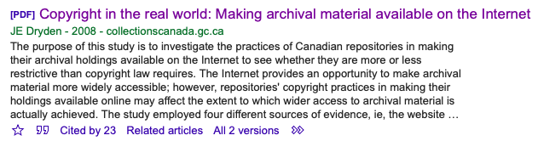

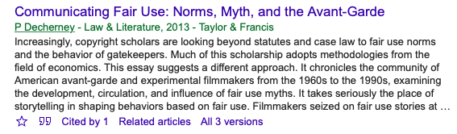
Fair use! Fair use?
Notes:
Heather

Slide 17
Our professional organizations can help us.
Codes of best practices examples
American U’s Washington School of Law
  Best Practices in Fair Use for Orphan Works
  Best Practices for Documentary Film Making
  Best Practices for Fair Use in Online Video
  Best Practices for Fair Use for Visual Arts
Harvard’s Berkman Center
  The Right to Teach: An Educational Fair Use Project
Society of American Archivists
  Orphan Works: Best Practices
ARL
  Code of Best Practices in Fair Use for Academic and Research Libraries
Notes:
Heather

Slide 18
Negotiating for Use and Re-Use
2
Helping creators understand their options
Notes:
Maureen

Slide 19

Multiple streams to access —
The collecting stream
Negotiating open licenses
Freely sharing public domain and open-licensed materials
Researchers can reuse special collections materials with clarity and confidence
Notes:
Maureen

Slide 20
Negotiating deeds of gift/sale. Creators may:
Do nothing, and thereby keep copyright. We tend to affirm copyright in our agreements.
Give copyright to us or to a third party.
Give copyright to the public domain via a CC0 license.
Keep copyright, but license it for use with a Creative Commons attribution license.
Choose any of these options, with a different option at the time of the creator’s death / a future date.
Notes:
Maureen

Slide 21
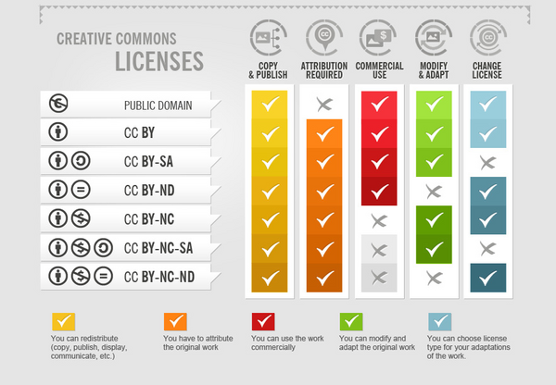
Notes:
Maureen

Slide 22
How to write this into your deed of gift or sale agreement
CC-BY
The Donor indicates an express wish to retain full ownership of any and all copyrights currently controlled by the Donor in the Materials, but the Donor grants the Donee a nonexclusive right to authorize all uses of these materials for research, scholarly, or other purposes pursuant to a Creative Commons Attribution 4.0 International license.
Notes:
Maureen

Slide 23
How to write this into your deed of gift or sale agreement
CC0
The Donor indicates an express wish to transfer, convey, and assign to the public domain all intellectual property rights the Donor controls and/or owns in the Materials. The transfer of rights will be marked by a Creative Commons CC0 license.
Notes:
Maureen

Slide 24
How to have this conversation
Mutual informed consent
What’s important to creators?
  What are their fears?
  What are their hopes for how their materials will be used?
Be very, very clear about your mission and your desires
🐔🐔 WILL COME HOME TO ROOST (if you keep your donors under-informed)
Notes:
Maureen

Slide 25
Explaining licenses
If someone is intent on keeping copyright
Talk about why. Unpublished records may be less monitizable than creators anticipate.
Make sure that they understand what their responsibility is going to be if they retain copyright.
No matter what, include a plan for intellectual property for after their death.
Notes:
Heather

Slide 26
Talking with Counsel
Articulate the risk assessment.
Articulate how your actions support your mission.
Lay out your argument for which Creative Commons license selected and why.
Notes:
Heather

Slide 27
Creative Commons in Archival Description
3
Spreading the good news to researchers
Notes:
Maureen

Slide 28
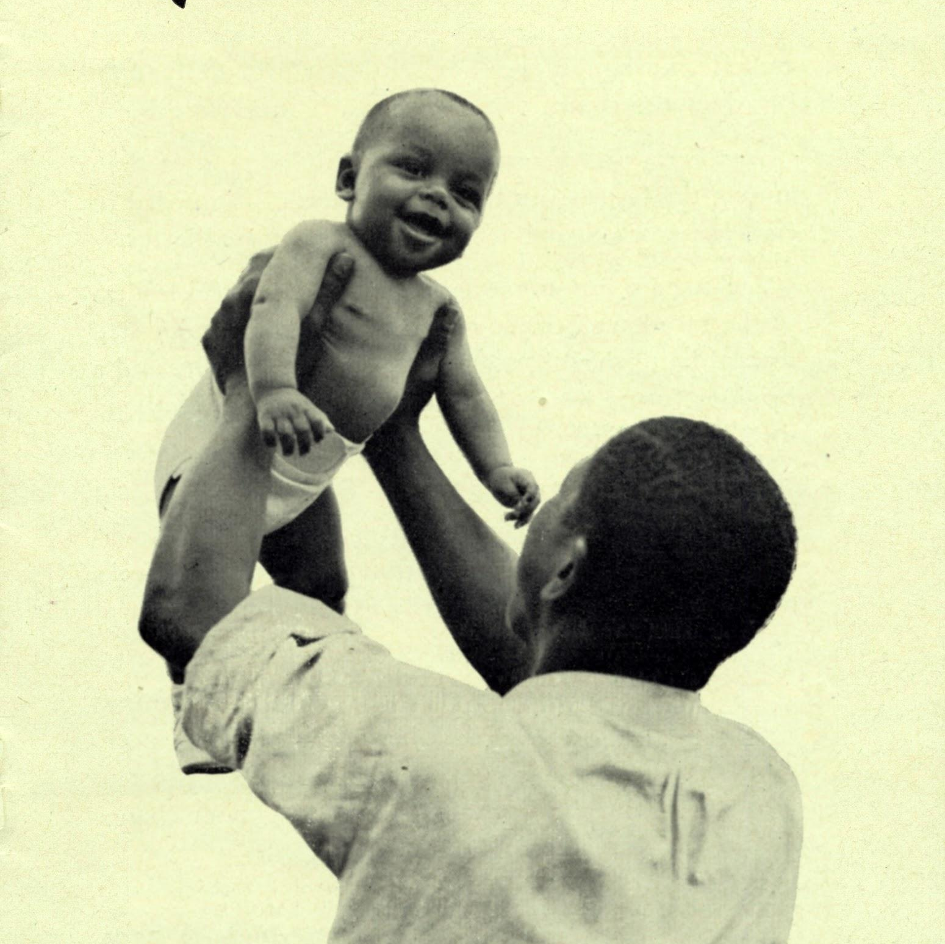
How does this fit into our descriptive programs?
It’s really exactly the same as before.
This is explained in a Conditions Governing Reproduction and Use element
DACS 4.4
EAD <userestrict/>
MARC 540
Planned Parenthood family planning brochure
Planned Parenthood Records. Smith College Special Collections
Notes:
Maureen

Slide 29
What do we tell our researchers?
Our conditions governing reproduction and use notes should be strong and clear, with a link to the relevant license.
If the donor has assigned a CC0 license, explain that the donor has relinquished all copyright, and the researcher can do what she pleases with the materials under this license.
Other Creative Commons licenses allow for extensive re-use without the need for permission; explain (when relevant) extra requirements.
Notes:
Maureen

Slide 30
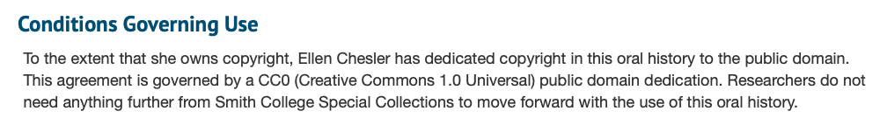
Creative Commons in finding aids
Notes:
Maureen

Slide 31
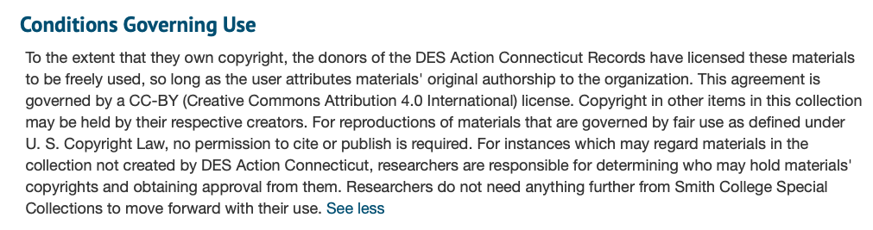
Creative Commons in finding aids
Notes:
Maureen

Slide 32
Creative Commons Benefits
4
External use and internal efficiency
Notes:
Heather

Slide 33
Benefits for research and instruction
Encourage use of collections widely in both research and teaching.
How to talk to users about Creative Commons
  Insure all front line staff are empowered and have a shared understanding.
  Some may still need reassurance that they have permission to use.
  Everyone comes away happy!
Notes:
Heather

Slide 34
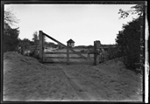
Los Angeles Times Photographic Archives
Online portion licensed under a CC-by license.
This work is licensed under a Creative Commons Attribution 4.0 International License.
Boundary gate, Campo [1927] (US/Mexico Border) Los Angeles Times Photographic Archives, Collection 1492
Notes:
Heather

Slide 35
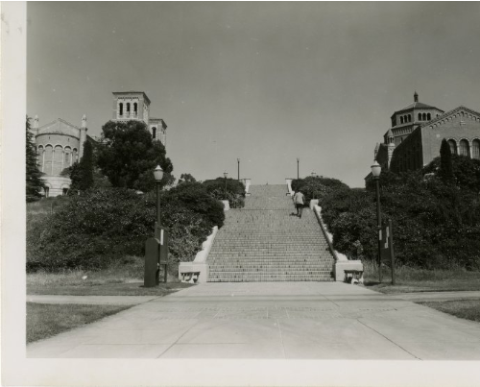
UCLA Historic Photographs
Online portion licensed under a CC-by-nc license.
This work is licensed under a Creative Commons Attribution-NonCommercial 4.0 International License.
View of Royce Hall, Janss Steps, and Powell Library, UCLA Campus, ND. University Archives Photographic Collection. UARS 100
Notes:
Heather

Slide 36
What happens next?
Talk with folks at your repositories about recent acquisitions. Review how you framed your conversations about copyright/use.
Review your boilerplate donor/seller agreements. What would it take to update them to add the option for Creative Commons licenses?
At the next staff meeting make sure everyone is comfortable and knowledgeable explaining copyright and Creative Commons to researchers.
Review duplication and permission forms; is the language up to date?
Notes:
Heather

Slide 37
Thanks!
We love your questions!
You can find us at:
hbriston@library.ucla.edu
@meau • mcallahan@smith.edu

Slide 38
For further information:
Association of Research Libraries, Special Issue on Special Collections and Archives in the Digital Age.
Research Library Issues 279 (June 2012) at https://publications.arl.org/rli279/
Behrnd-Klodt, Menzi L. and Christopher J. Prom, eds. Rights in the Digital Era. Chicago: Society of American Archivists, 2015.
Hirtle, Peter, “Copyright Term and the Public Domain,” http://copyright.cornell.edu/resources/publicdomain.cfm.
Hirtle, Peter B., Emily Hudson, and Andrew T. Kenyon, Copyright and Cultural Institutions: Guidelines for
Digitization for U.S. Libraries, Archives, and Museums. NY: Cornell University, 2009.

