Slide 1
Authorities and Identifiers Mini-symposium, Barcelona, Spain
3 December 2019
From Authorities to Identifiers—
Bridging the Silos
Karen Smith-Yoshimura
OCLC Research
Notes:
In this presentation I will share my understanding of the evolving ecosystem of name disambiguation and its strategy with regards to identifier support and transitioning to next generation metadata.

Slide 2
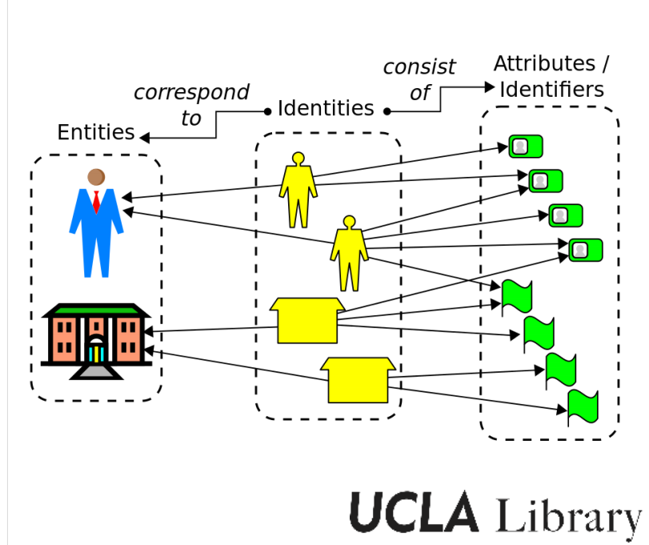
Modeling ‘Person’ Entities
Image source: http://downloads.alcts.ala.org/ce/20171206_NACO_Authority_Control_Identity_Management_Slides.pdf
Notes:
Common across authorities and Identities: An entity, real thing (e.g., person or organization) has an identity that is described in a database record or document containing attributes (or properties). The document has an identifier.
But:
Library authority files focus on the curation of name strings that can differentiate one entity from another.
Identity descriptions have a richer set of properties appropriate for the type of resource (e.g., geographic location for a place, name and birth date for a person). They can be used for disambiguation by human readers or a machine process.
These benefits underlie many arguments for adopting linked data.
Since entities are real world objects, data can be accumulated from multiple sources inside and outside the library community.
The entity description is persistent and is embedded in a network of links to other entities.
The data can be consumed and interpreted by machine processes,
The promise of identity management also underlies the library community’s interest in Wikibase and Wikidata. Program for Cooperative Cataloging has launched an Identity Task Group that will explore the implications of the Wikibase software in upcoming pilots.
Implications:
For the library resource description workflow: More authoritative descriptions can be created for the benefit of the global library community
For the library patrons: “Identity management creates an incentive to create an identifier at the start of one’s career, to facilitate accurate, efficient gathering of researcher output. In the authority-management workflow, the incentive is to wait, because the author may change the preferred form of his/her name.” (John Riemer, UCLA. Other arguments are listed in the ALCTS presentation linked here.)

Slide 3
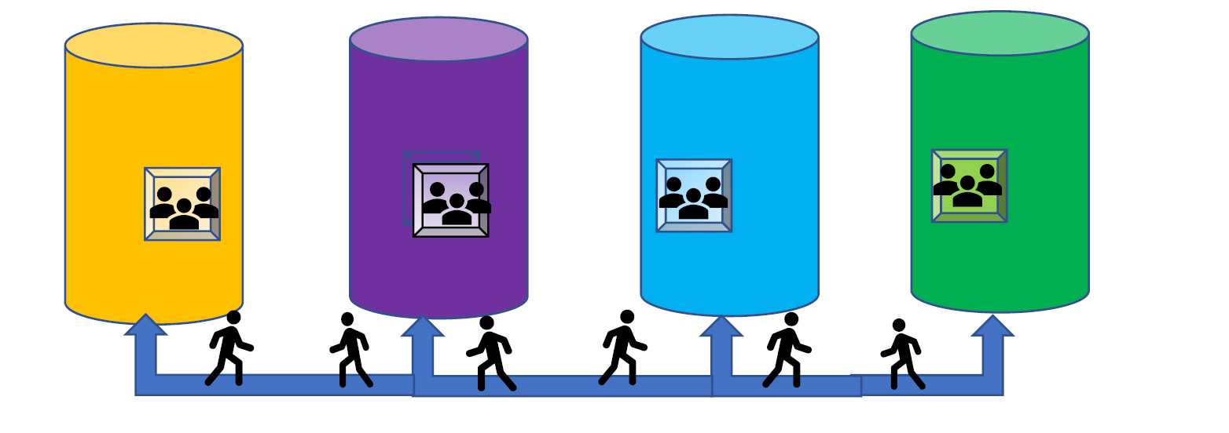
Moving between the Silos
Research
Information
Library Catalog
Archives
Digital Collections
Notes:
Research libraries commonly have “silos of data” each with its own content descriptions and practices and managed by different staff on various systems that do not share data among them. The New York Public Library referred to this as their “archipelago of systems” – a string of “islands” of systems that do not interoperate with each other.
Identifiers can help link content between and among these silos.

Slide 4
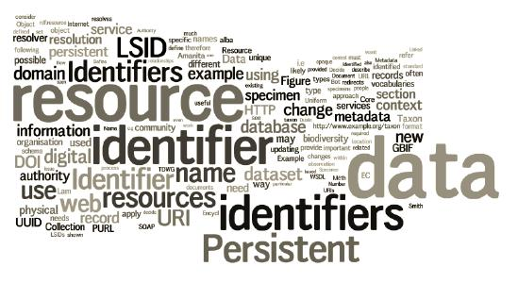
Identifier vs. Authority
http://imsgbif.gbif.org/CMS/W_TR_EventDetail.php?image=Thumbnail&recid=185
Notes:
One key change in the evolution of our ecosystem is shifting our thinking from authorities to identifiers
In our traditional work, we have focused on the creation of unique text strings to differentiate the names that surface in our cataloging
As we shift towards creating web friendly, linked data to represent these entities two changes must occur
Shift from the creation of authorities as text strings to a representation of the people themselves
Shift from the requiring the creation of a complex authority record to the rapid assignment of identifier
In the past, our metadata departments have focused on the cataloging of bibliographic resources and we have been more or less successful in creating authorities for a high percentage of their authors
But cataloging portfolios explode with the need to manage authors of articles (ie, researchers) and anything else the university throws at us, this labor intensive process of authority record creation must be modified
By shifting to the use of identifiers we solve the double dilemma of needing to make our data more web friendly and being able to create these control structures expeditiously
Adapted from Philip E. Schreur, Assistant University Librarian for Technical and Access Services, Stanford University in the 2014 OCLC Research webinar, Registering Researchers in Authority Files (https://www.oclc.org/research/events/2014/11-13.html)

Slide 5
Researcher Identifier ≠ Name Authorities
 | Traditional Name Authorities | Researcher Identifier Systems
Primary Stakeholders | Libraries | Publishers, Researchers, Funders, Libraries
Internal standardization/integration | Standardized and well integrated within libraries but new models are emerging | Fragmented. Some well-integrated communities of practice.
Organization | Primarily top-down, careful controlled entry from participating organizations | Varies: top down, bottom-up, middle out; often individual contributors
External integration | Very limited: High barriers to entry, few simple API’s | Varies, but more open. Some services offer simple open API’s; integration with web 2.0 protocols (e.g. OpenId)
Works Covered | Primarily books & other works traditionally catalogued by libraries | Journal articles; Grants; Datasets
People covered | Authors and people written about represented in the library catalogs | Authors of research articles, fundees, members of research institutions – international
Key record criterion | Persistent and unambiguous identifier with a preferred label for the community served | Persistent and unambiguous identifier for an individual contributor
Notes:
An earlier OCLC Research Registering Researchers in Authority Files Task Group analyzed the differences between traditional name authorities work and researcher identifier systems. The key commonality was the need to disambiguate names.
From slide prepared by Dr. Micah Altman, MIT, for CNI presentation March 2014.

Slide 6
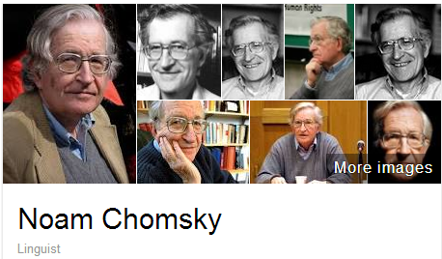
A scholar may be published under
many forms of names
Works translated into 50 languages
(WorldCat)
Νόαμ Τσόμσκι
নোম চম্‌স্কি
ནམ་ཆོམ་སི་ཀེ།
નોઆમ ચોમ્સ્કી
नोआम चाम्सकी
Նոամ Չոմսկի
ノーム・チョムスキー
ნოამ ჩომსკი
Ноам Чомски
ನೋಅಮ್ ಚಾಮ್ಸ್ಕೀ
노엄 촘스키
നോം ചോംസ്കി
ਨੌਮ ਚੌਮਸਕੀ
Ноам Хомский
诺姆·乔姆斯基
Also published as:
Avram Noam Chomsky
N. Chomsky
نعوم تشومسكي
נועם חומסקי
Journal articles
Notes:
Noam Chomsky is a scholar widely translated. WorldCat has records for his works in fifty languages. But only some of the forms of his name are represented as “preferred forms” in national authority files (shown on the left). The forms on the right are from wikidata. The Library of Congress/NACO authority file can support only a few of the scripts shown, representing these scripts with romanizations.
Note that the “N. Chomsky” form used in journal articles <click> is generally not included in national authority files. Chomsky happens to have a rather unique name, but for many others it would be a challenge to match up the abbreviated journal citation form with the fuller forms of name. This illustrates the futility of relying on text string matching to determine if two authors represent the same person or not.

Slide 7




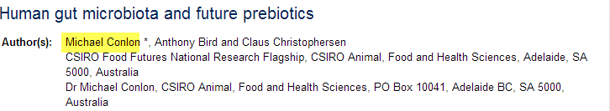
Same name, different people
Conlon, Michael. 1982. Continuously adaptive M-estimation in the linear model. Thesis (Ph. D.)--University of Florida, 1982.
Notes:
Michael Conlon was a member of an OCLC Research Library Partners task group, an expert in biomedial informatics at the University of Florida. There is another Michael Conlon in the UK who writes articles on European taxes. Obviously two different people. Then there’s an article on microbiota in the Australian journal Microbiology written by a Michael Conlon. The same Michael Conlon as the U. Florida one or a different one based in Australia? Without other metadata, it is difficult to tell. (Turns out, it’s yet another Michael Conlon. There are four Michael Conlons who write in the same field!)
Michael Conlon is a rather uncommon name. But consider that in China 275 million people have the surname of Li, Wang or Zhang. And that’s not including the millions of overseas Chinese. The chances ethnic Chinese having the same name—especially in the abbreviated form used in journal articles– is high. We need other identifying attributes such as institutional affiliation and discipline (if not photos) to disambiguate names.

Slide 8

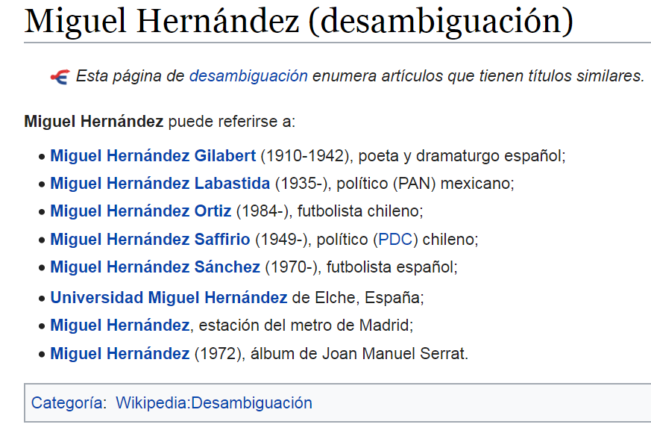
Wikipedia Disambiguates Names
Notes:
The intellectual work to disambiguate names is common to both authority and identity management work. This is an example of how Wikipedia disambiguates names.

Slide 9
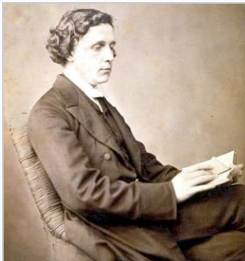

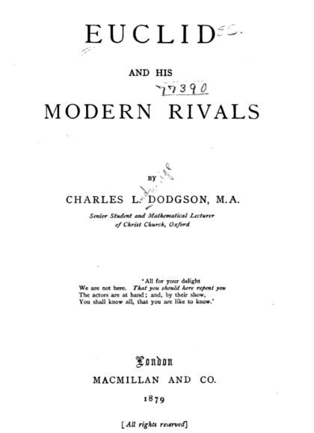



One person, two identities
Charles L. Dodgson
Lewis Carroll
J. K. Rowling
Robert Galbraith
Notes:
But a person may also have two separate identities. Two examples: Charles Dodgson wrote mathematical works, but used a different name, Lewis Carroll for his Alice in Wonderland series. Some authority files conflate the two, and say that Lewis Carroll wrote “Euclid and his Modern Rivals” even though the author’s name on the piece is Charles Dodgson.
A more controversial contemporary example is J.K. Rowling, who became famous with her Harry Potter series. But she also wrote a Cormoran Strike series under the name “Robert Galbraith” which she had wished to remain unlinked to J.K. Rowling, and brought legal action against The Sunday Times which revealed the connection, noting that she would have liked to remain anonymous for a while longer.
There are examples of researchers who write in more than one discipline, under different names which they don’t wish to be linked, under the belief that their credibility would be undercut if their audiences knew, for example, that a physicist wrote an economics paper, or vice-versa.
There is a more fundamental need for some identities to be kept private. People who write in areas of conflict under an assumed name could face dire consequences if their true identities were revealed – and in some cases, their friends and families as well.

Slide 10

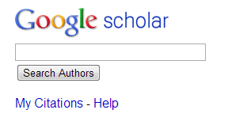











One researcher may have many profiles or identifiers…
(from an email signature block)
Profiles: Academia / Google Scholar / ISNI / Mendeley / MicrosoftAcademic / ORCID / ResearcherID / ResearchGate / Scopus / Slideshare / VIAF / Worldcat
Notes:
Some researchers already have multiple identifiers. This is an example from a signature block in an email. The researcher includes twelve different identifiers or profiles he’s represented in. This also fragments his Web presence.
To recap the problem statement:
A given scholar can be represented by different forms of the name, all of which may not be included in authority files.
Two or more researchers may have the same name, and we need other attributes to disambiguate them.
Some people may have multiple identities, and some of them are meant to be kept private.
Some researchers already have multiple identifiers.

Slide 11
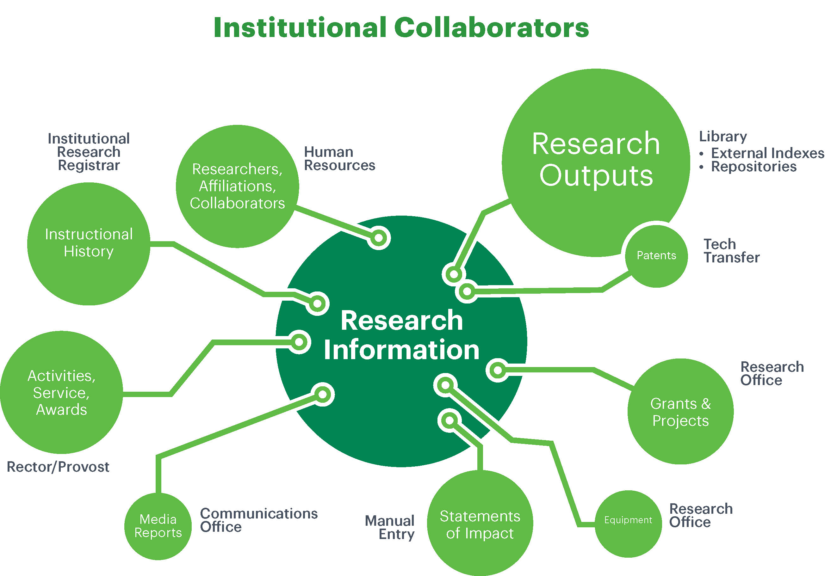
Institutional Collaborators
(Bryant et al., 2017)
Notes:
Researchers are not the only stakeholders who need identifiers. Research Information Management involves numerous institutional stakeholders as well, as identified by my colleague Rebecca Bryant and her co-authors.
When the OCLC Research Registering Researchers in Authority Files Task Group wrote up the needs identified from the perspective of different actors or stakeholders, one common task was to disambiguate names.
Bryant, R., Clements, A., Feltes, C., Groenewegen, D., Huggard, S., Mercer, H., … Wright, J. (2017). Research information management: Defining RIM and the library’s role. Dublin, OH: OCLC Research. doi:10.25333/C3NK88.

Slide 12
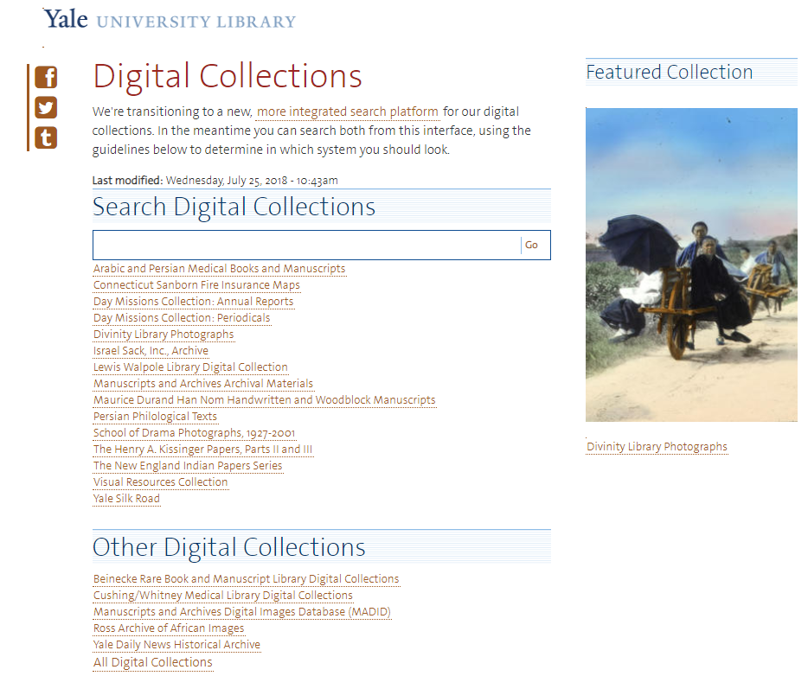
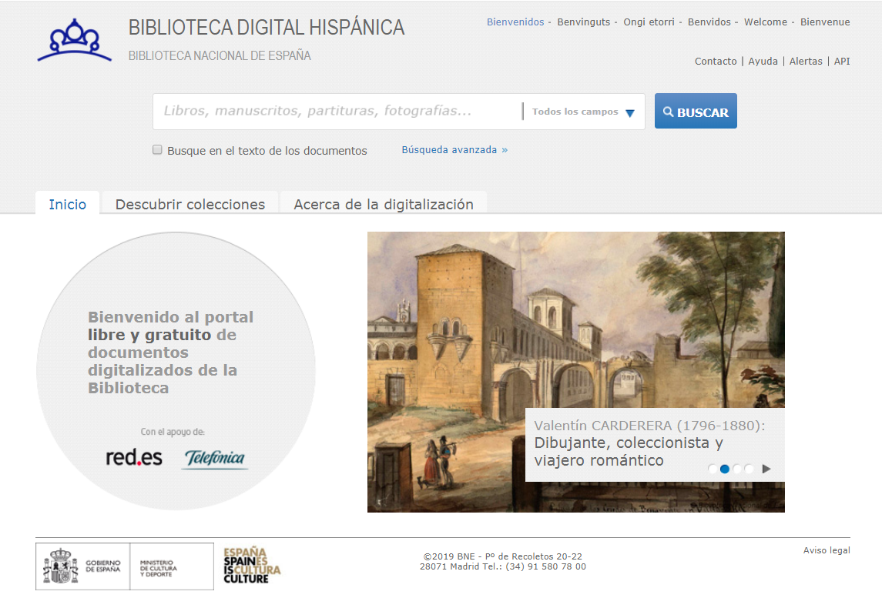
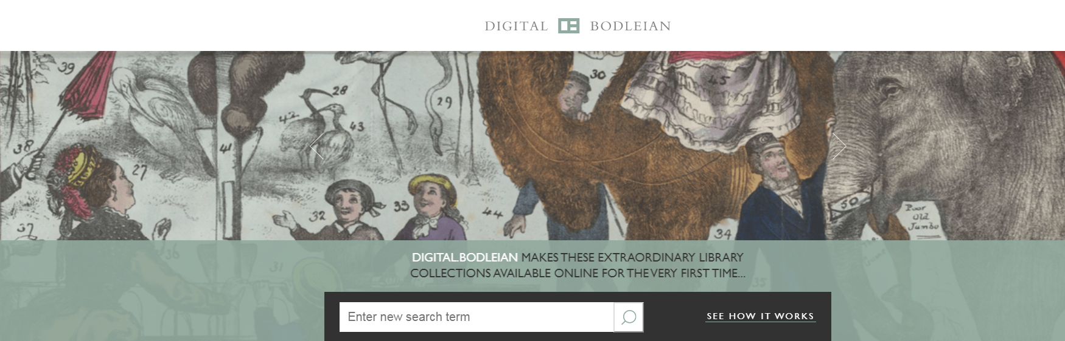
Notes:
The exploding role in identity management also surfaces in library digital collections, which also must deal with “person entities”. Some like Yale’s are also silo’ed in discrete digital collections. The metadata and names associated with the objects depicted in these images are often managed by staff separate from the library catalog.

Slide 13
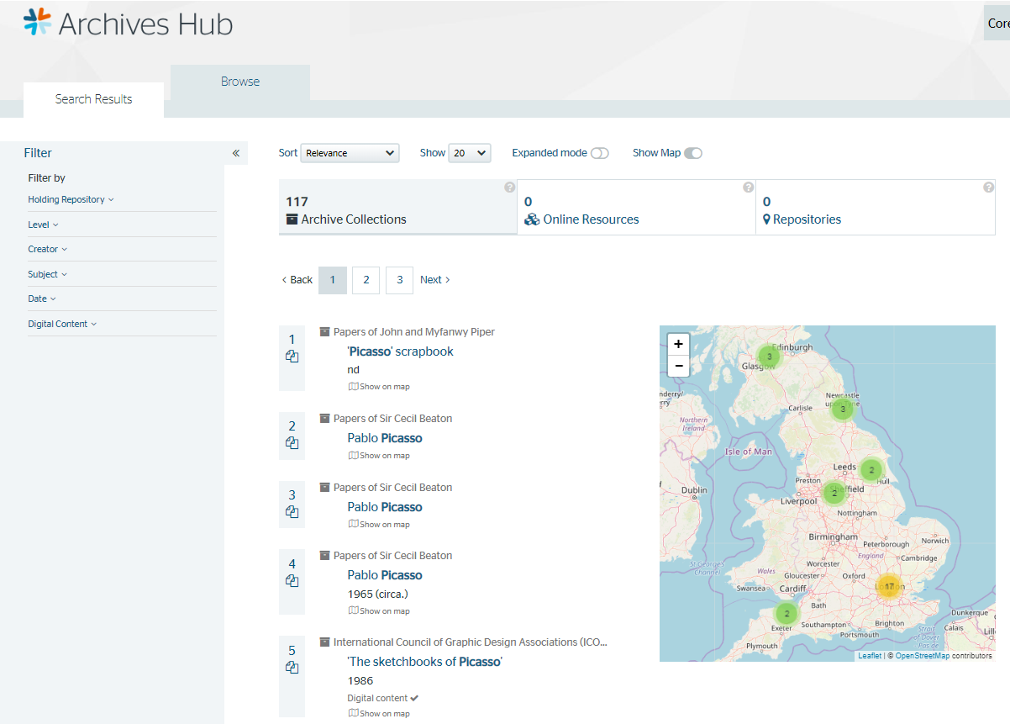
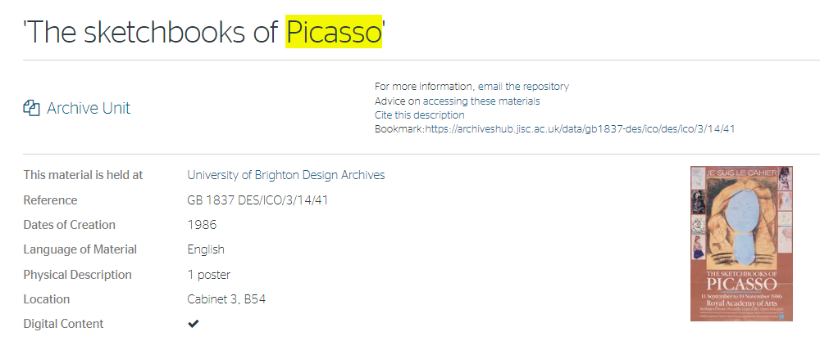
Notes:
Names are also prevalent in archival descriptions. Archives Hub brings together descriptions of thousands of the UK’s archive collections representing over 330 institutions across the country. These archival collections may also include digitized materials, as shown here. <click>

Slide 14

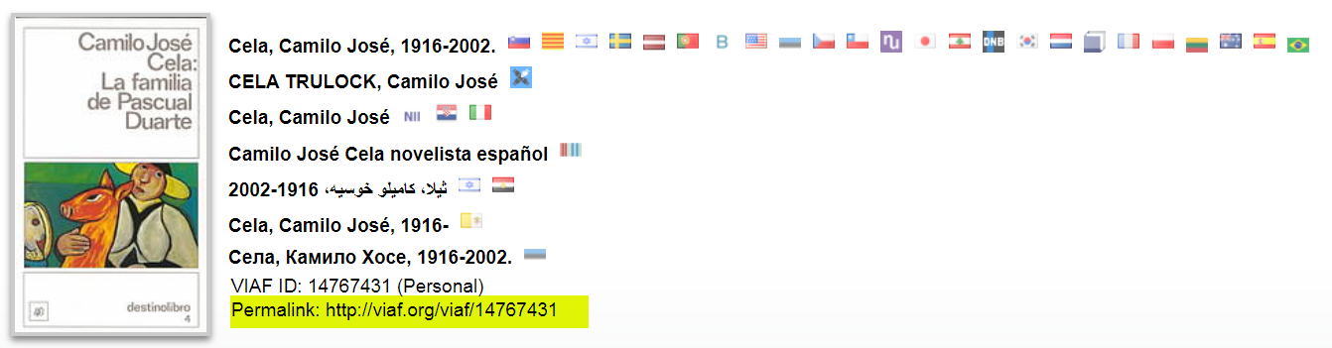
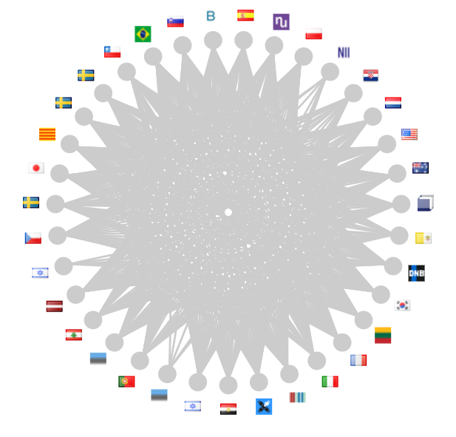
From Authorities to Identifiers
Notes:
33 different organizations – including the National Library of Spain – have an authority record for Nobel Prize for Literature laureate José Camilo Cela represented in the Virtual International Authority File (VIAF). Each one has its own identifier along with the preferred form of name (here we see one form in Arabic from the National Library of Israel and the Library of Alexandria in Egypt, and one in Cyrillic contributed by the National Library of Estonia. All of them are brought together by a single VIAF cluster identifier, highlighted here.
<click> Note also that there are two sources from Spain: the authority records from the National Library of Catalonia and the National Library of Spain. The implication: Individual libraries in Spain can take advantage of these sources and contributing to either of them would eventually result in their also being represented by a VIAF cluster identifier.

Slide 15
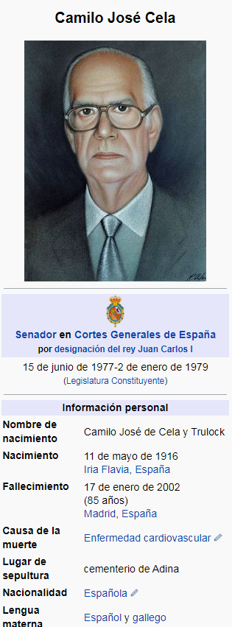
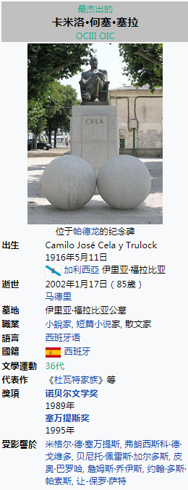
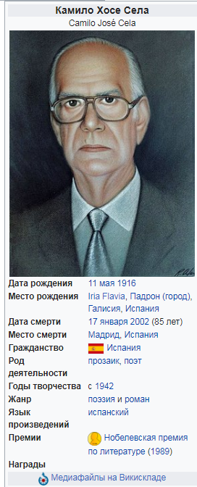
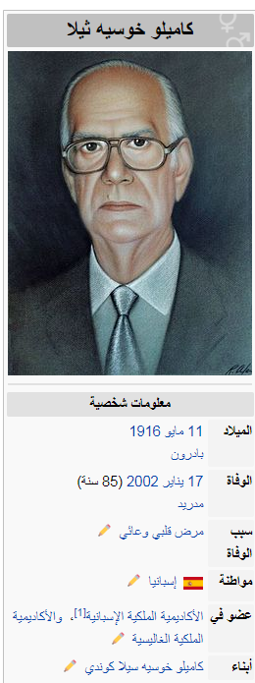
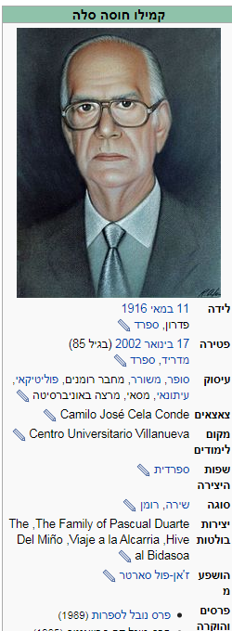
Same Wikidata Identifier
Notes:
Wikidata has 55 identifiers associated with the entity José Camilo Cela. Wikidata is the underlying platform for all language Wikipedias, and we can see the metadata associated with the same entity. Each entity has a Wikidata Identifier and thus serves as a bridge to the other identifiers. These are Wikipedia information boxes with the data represented in Wikidata – Spanish, Chinese, Russian, Arabic, and Hebrew. All are tied to the same Wikidata identifier--representing the same entity—but the information is presented in the preferred language and script of the user.

Slide 16






Wikidata entry also links to
other identifiers like…
identificador del Diccionario Biográfico Español
Internet Movie Database
catàleg de les biblioteques
Notes:
These are some of the 55 identifiers that the Wikidata entry for José Camilo Celo links to . Not all are authority files. Wikidata thus serves as an “identifier hub.”

Slide 17
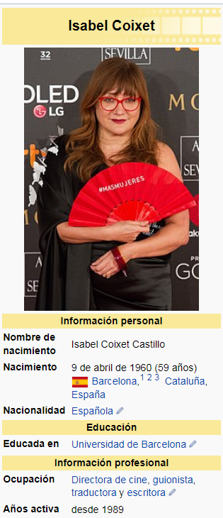
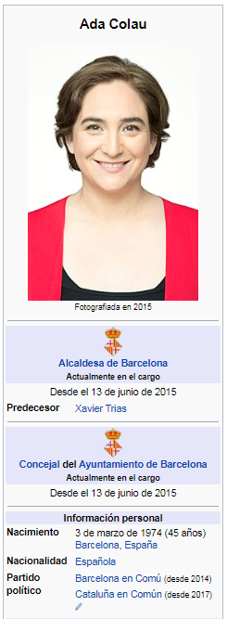
Notes:
Next time you look up a person in Wikipedia, scroll to the bottom – you may see a link to your authority record!

Slide 18
















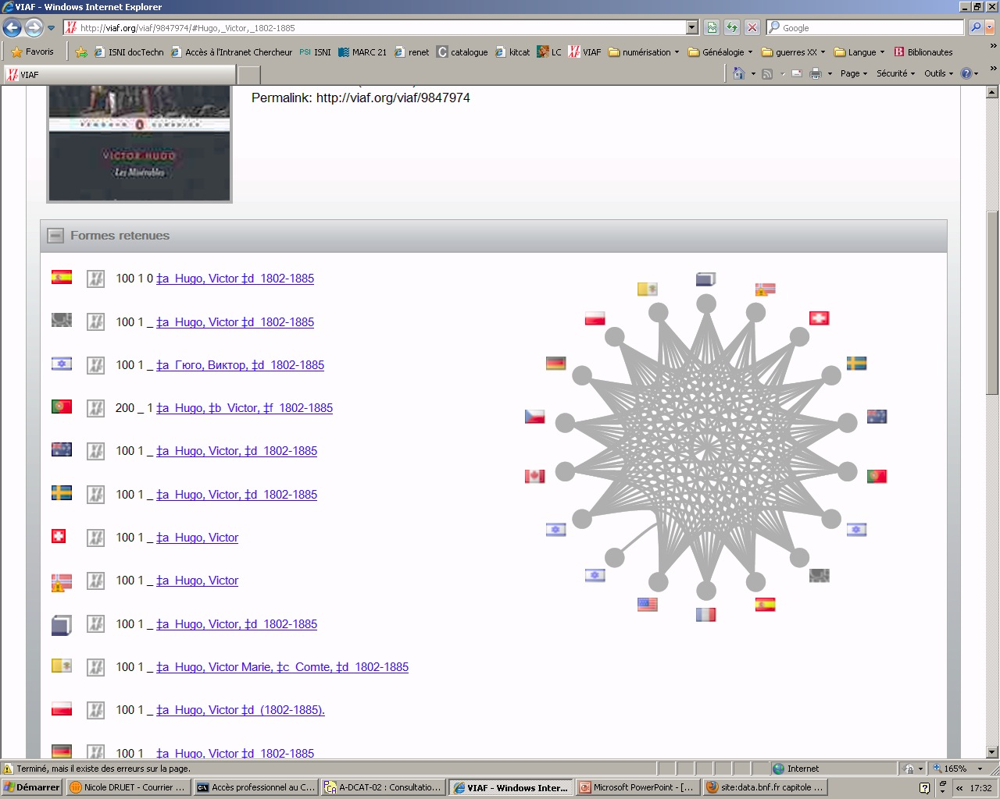



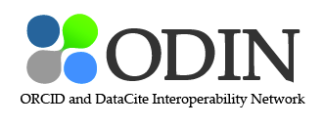









The problem ISNI wants to solve
Text Rights
Trade Sources
Music Rights
Other future cultural heritage sources
Encyclopaedias
Libraries
Researchers & Professional
Notes:
The International Standard Name Identifier (ISNI) also aspires to be an « identity hub » across domains, aggregating names from different types of resources, not just researchers, not just libraries. This universality fits libraries’ needs for identity management.
From Andrew MacEwan, British Library & ISNI International Agency, in the OCLC Research webinar, Registering Researchers in Authority Files (https://www.oclc.org/research/events/2014/11-13.html)

Slide 19
“Identifiers are glue for institutions and
funders.”
“Identifiers provide: the capacity for data to be authenticated, trusted and re-used at a scale needed for contemporary use cases.”
Daniel Hook
Digital Science
Notes:
From the OCLC Research webinar, Registering Researchers in Authority Files (https://www.oclc.org/research/events/2014/11-13.html)

Slide 20
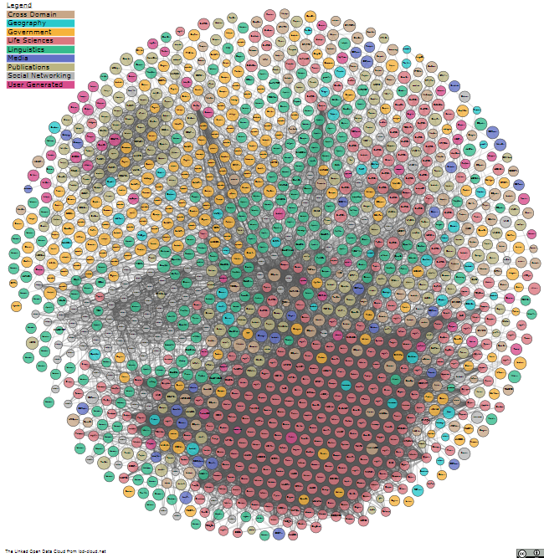
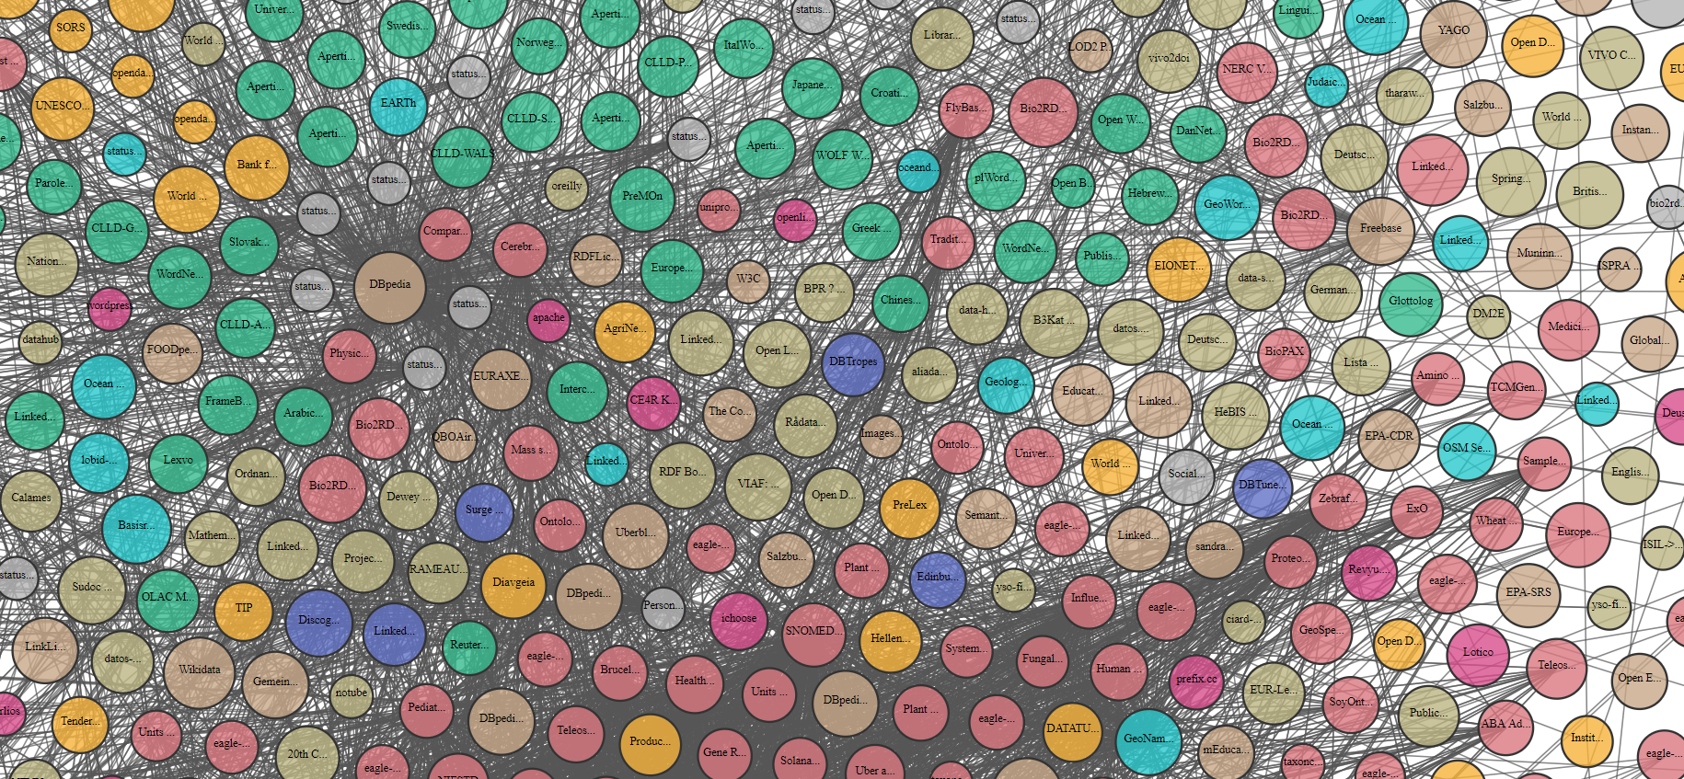
Bridging the Domains
From lod-cloud.net
Notes:
Identifiers are also the “glue” for the Semantic Web.
The Linked Open Data cloud dataset currently contains 1,239 datasets with 16,147 links (as of March 2019). Three that I’ve pointed out here by the yellow arrows, from left to right, are Wikidata, the Virtual International Authority File (VIAF), and datos.bne.es, the linked data from the National Library of Spain which includes 4 million authority records and 2.4 million bibliographic records.
By contributing to or re-using identifiers in existing “identity hubs”, your data could be included in these bridges among different domains.

Slide 21
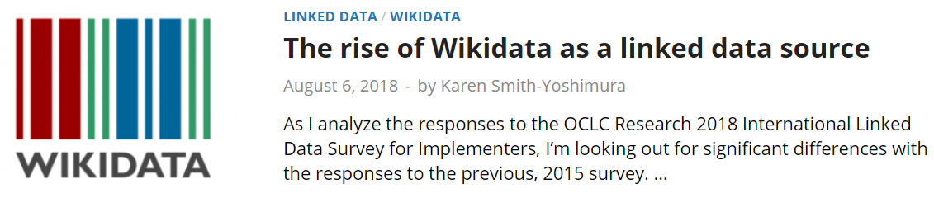
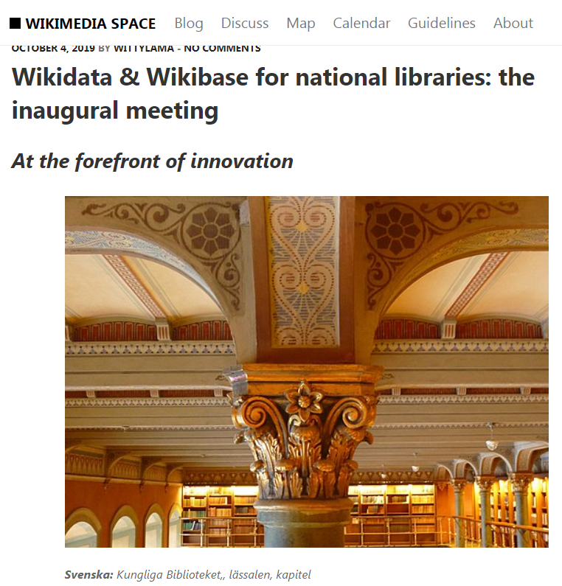
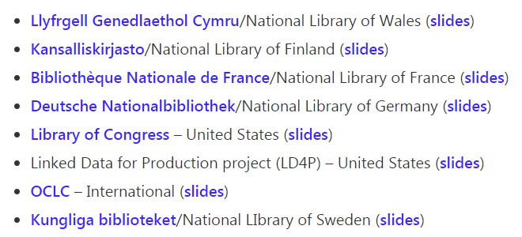
http://hangingtogether.org/?p=6775
https://space.wmflabs.org/2019/10/04/wikidata-wikibase-for-national-libraries-the-inaugural-meeting/
Notes:
Wikidata has become a major source of linked data as shown in the previous slide, and as noted in the HangingTogether blog post summarizing the results of OCLC Research’s 2018 International Linked Data Survey for Implementers. In the three years since the previous survey was conducted, Wikidata rose from being the 15th ranked data source consumed by linked data implementations to #5. Since then a number of national libraries have installed separate Wikibase instances – the platform underlying Wikidata – and held its first inaugural meeting, “Wikidata & Wikibase for national libraries” in Stockholm last September, where some participants demonstrated their implementations.
The Program for Cooperative Cataloging has launched a “Task Group on Identity Management in Name Authority Cooperative program, NACO to “provide leadership for the shift in authority control from an approach primarily based on creating text strings to one focused on managing identities and entities.” It plans to launch a “Wikidata or Wikibase pilot” to explore their capabilities compared to current authority file work.
Contributing factors to this rise in Wikidata/Wikibase interest: The ease of creating and enhancing the metadata associated with an entity, the granularity you can include, and the relationships you can establish compared to traditional authority files. Identifiers can provide far more flexibility in displaying labels or text strings in the preferred language and writing system of the user than relying on the authority files’ “preferred form of name”.

Slide 22
Include identifiers in the metadata
you create now
The more your identifiers link to
other identifiers, the better!
Notes:
We will continue to work in an environment with lots of different identifiers. But the more you use identifiers that link to one or more “identifier hubs” the more your data can be exposed and re-used.

Slide 23
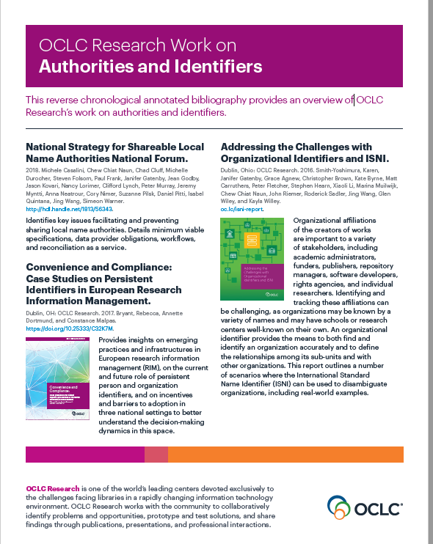
Notes:
OCLC Research has done a lot of work in the area of authorities and identifiers, and I refer you to our annotated bibliography handout for more information.

Slide 24

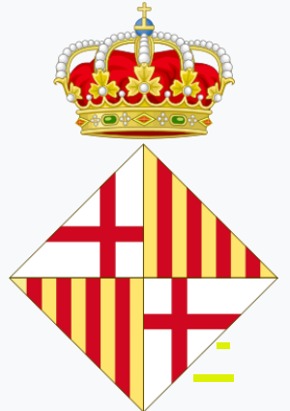

Authorities and Identifiers Mini-symposium, Barcelona, Spain
3 December 2019
Thank you!
Contact: Karen Smith-Yoshimura
San Francisco – the Sister City
of Barcelona!
smithyok@oclc.org
@KarenS_Y
oc.lc/linkeddataresearch
©2018 OCLC. This work is licensed under a Creative Commons Attribution 4.0 International License. Suggested attribution: “This work uses content from From Authorities to Identifiers—Bridging the Silos © OCLC, used under a Creative Commons Attribution 4.0 International License: http://creativecommons.org/licenses/by/4.0/.”

