Slide 1
Works in Progress Webinar • 21 November 2019
An innovative approach to scalable semantic embedding
Rob Koopman¹ and Shenghui Wang^{1,2}
¹ OCLC EMEA, Leiden, The Netherlands
² University of Twente, Enschede, The Netherlands

Slide 2
Why do we need semantic embedding?
Many tasks could be improved by semantic embedding
Information retrieval
Entity disambiguation
De-duplication
Recommendation
Clustering
Subject prediction
...

Slide 3
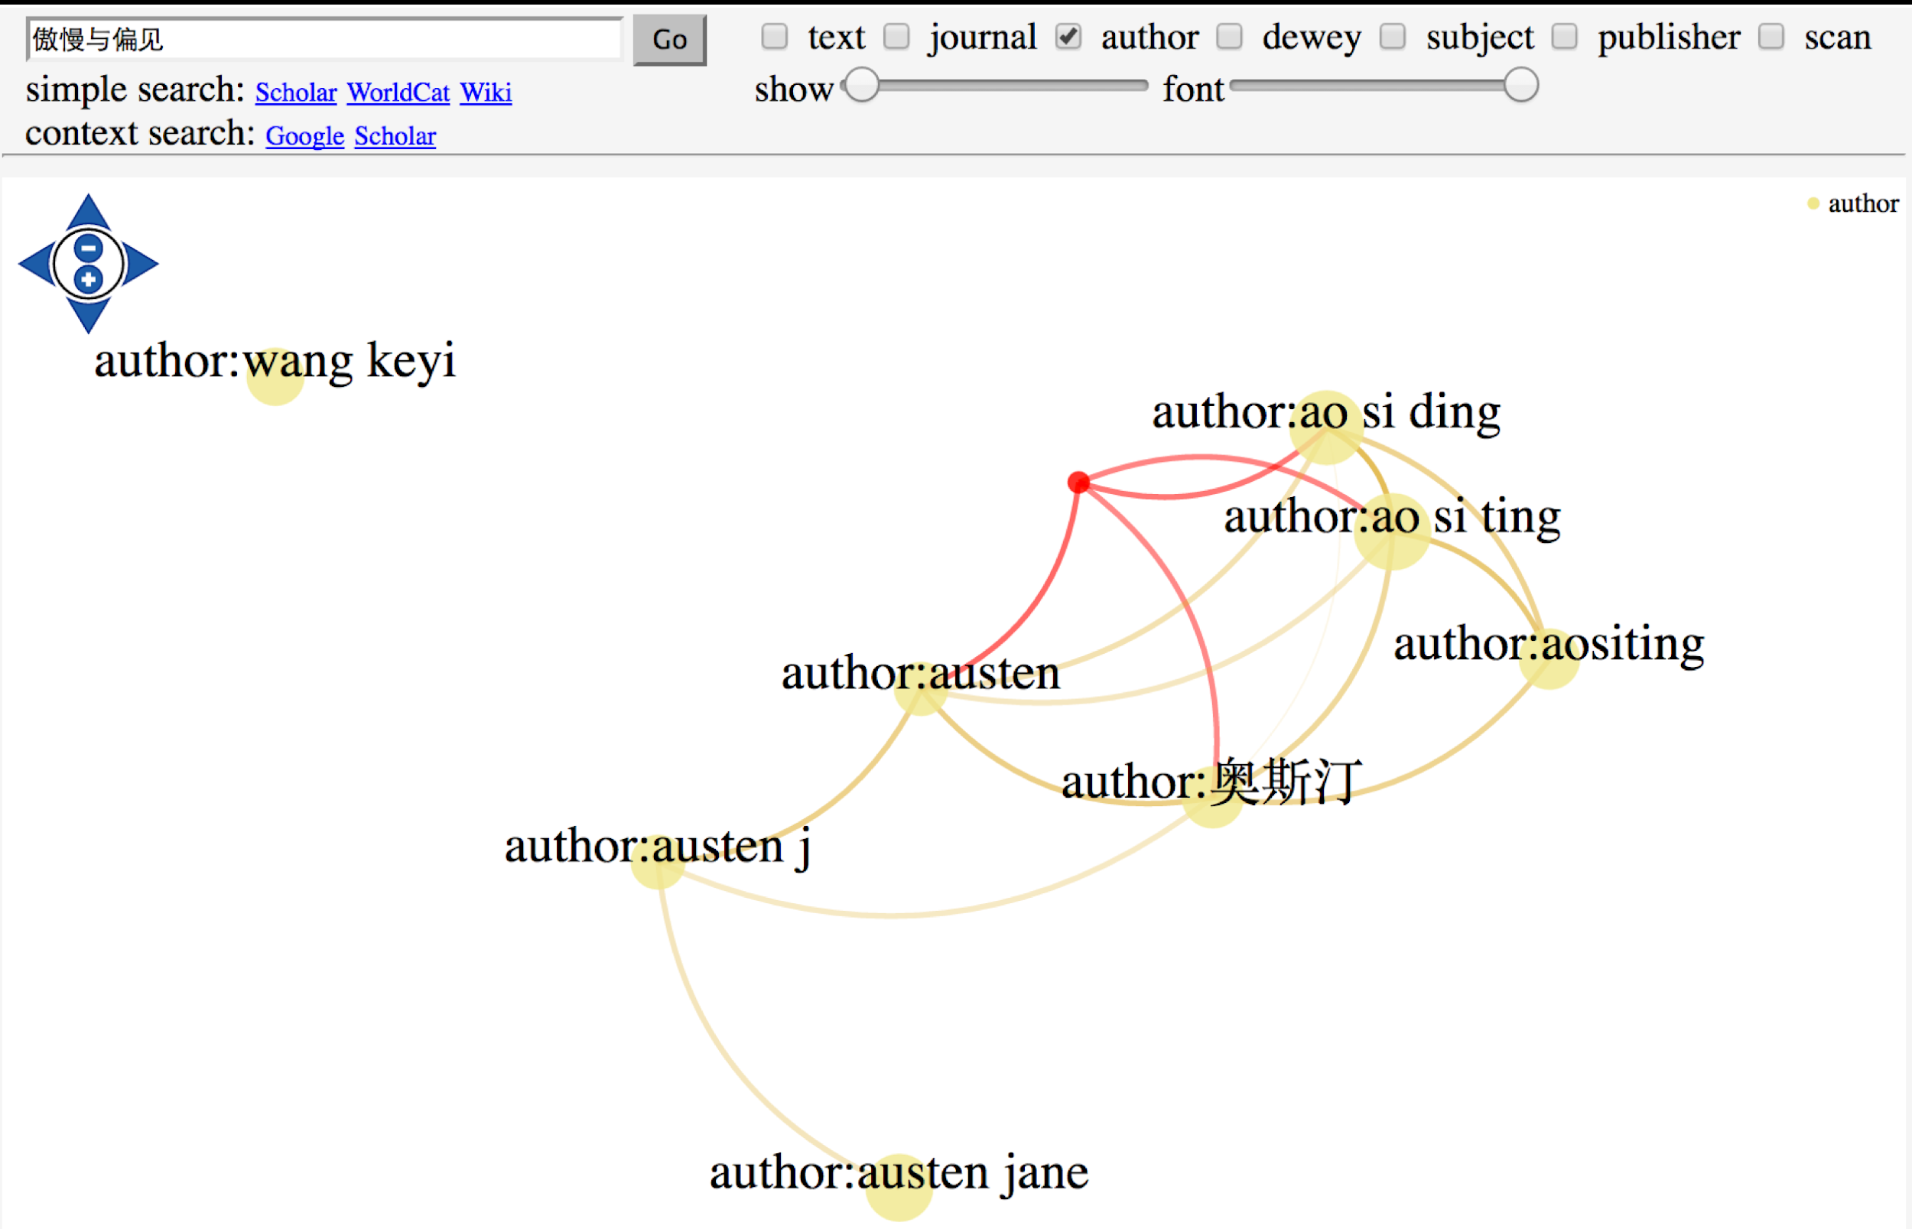
Notes:
A simple example: search “Pride and Prejudice” in Chinese, for the most related authors, semantic embedding helps to retrieve variations of transliterated author name that are found in WorldCat.

Slide 4
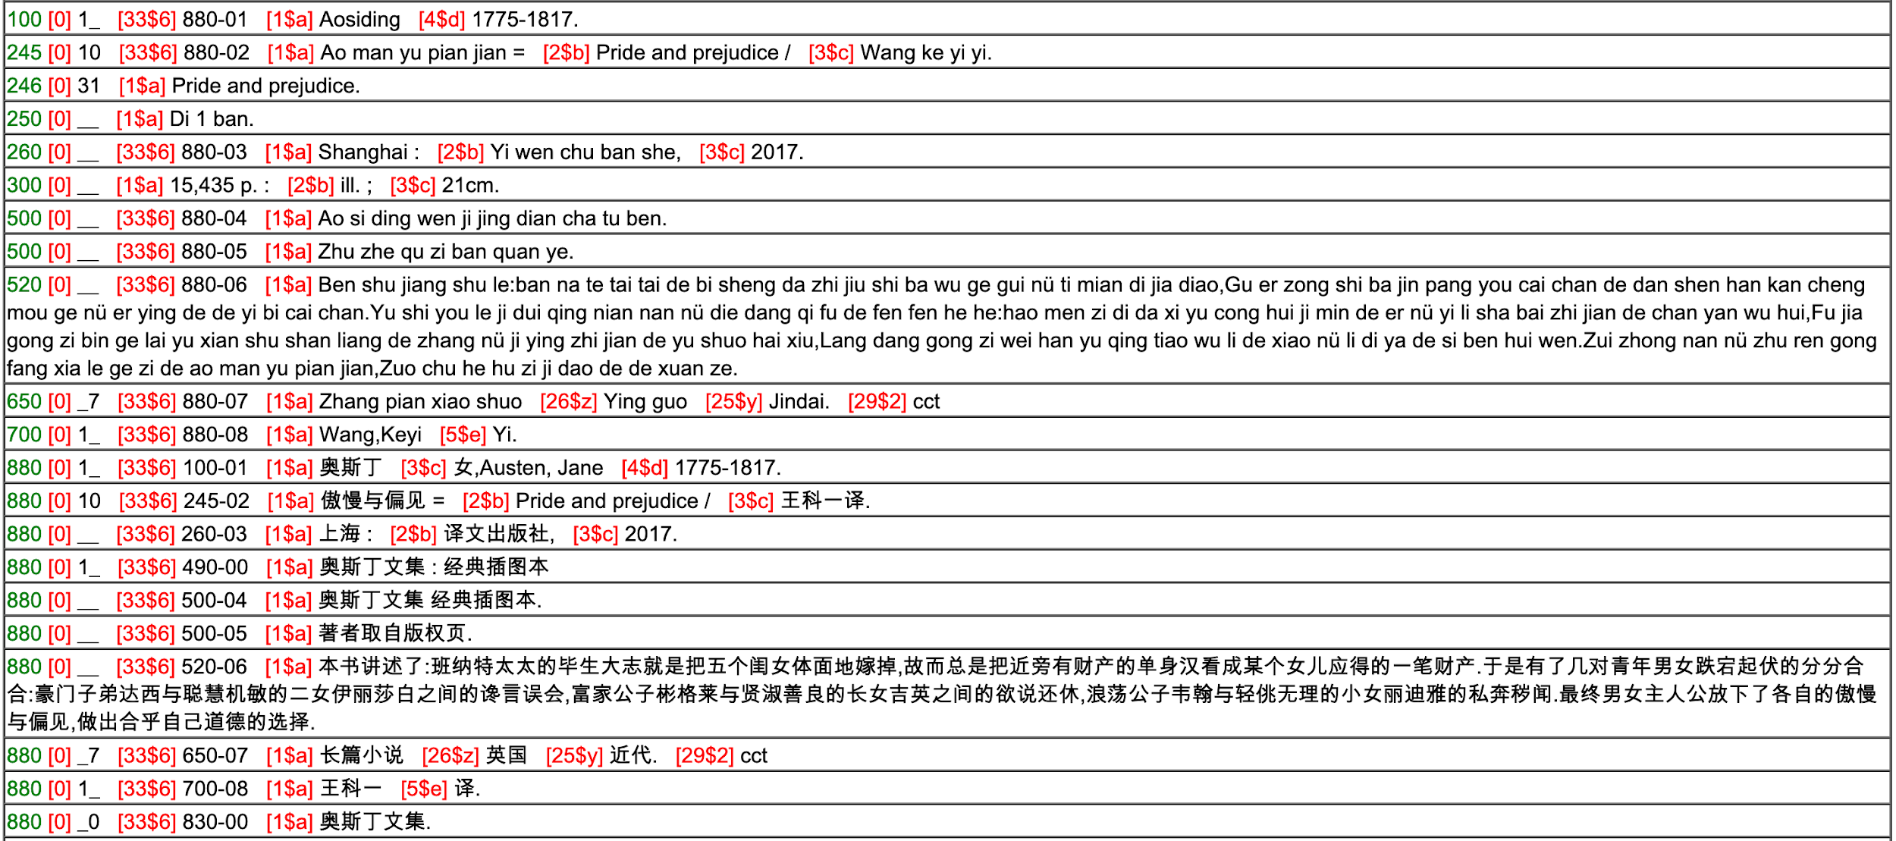

Slide 5
Foundation for semantic embedding
Distributional Hypothesis (Harris, 1954)
“words that occur in similar contexts tend to have similar meanings”
Statistical Semantics (Weaver, 1955, Firth 1957)
“a word is characterized by the company it keeps”

Slide 6
An example by Stefan Evert: what is bardiwac?
He handed her her glass of bardiwac.
Beef dishes are made to complement the bardiwacs.
Nigel staggered to his feet, face flushed from too much bardiwac.
Malbec, one of the lesser-known bardiwac grapes, responds well to Australia’s sunshine.
I dined on bread and cheese and this excellent bardiwac.
The drinks were delicious: blood-red bardiwac as well as light, sweet Rhenish.

Slide 7
An example by Stefan Evert: what is bardiwac?
He handed her her glass of bardiwac.
Beef dishes are made to complement the bardiwacs.
Nigel staggered to his feet, face flushed from too much bardiwac.
Malbec, one of the lesser-known bardiwac grapes, responds well to Australia’s sunshine.
I dined on bread and cheese and this excellent bardiwac.
The drinks were delicious: blood-red bardiwac as well as light, sweet Rhenish.
⇒ ‘bardiwac’ is a heavy red alcoholic beverage made from grapes

Slide 8
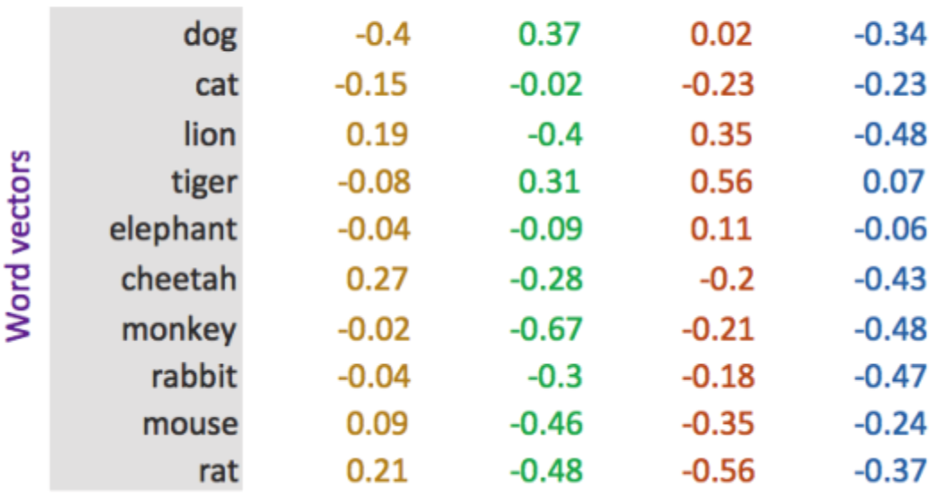
Semantic embedding
Words/documents are represented as vectors of numbers that represent their meaning.
https://medium.com/@jayeshbahire/introduction-to-word-vectors-ea1d4e4b84bf

Slide 9
Semantic embedding
Semantically similar words are mapped to nearby points, that is, “are embedded nearby each other”
A desirable property: computable similarity

Slide 10
Embedding approaches
Global co-occurrence count-based methods (e.g. LSA)
Based on statistics of how often some word co-occurs with its neighbour words in a large text corpus
Dimensionality reduction methods
Local context predictive methods (e.g. word2vec)
Learning to predict a word from its neighbours or vice versa
More complex and powerful deep learning models for embedding words, sentences and documents
Notes:
Term embedding
Much research has adopted the notion of Statistical Semantics (Furnas et al., 1983; Weaver, 1955) or in Linguistics the Distributional Hypothesis (Harris, 1954; Sahlgren, 2008). Various distributional semantic models have been proposed to represent (embed) words in a continuous vector space where semantically similar words are mapped to nearby points (‘are embedded nearby each other’). The approaches fall into two main categories (Baroni et al., 2014). First, methods based on global co-occurrence counts (e.g., Latent Semantic Analysis (Dumais, 2005)) which compute statistics of how often some word co-occurs with its neighbour words in a large text corpus, and then use dimensionality-reduction methods (e.g., Singular-Value Decomposition (Trefethen and Bau III, 1997), Random Projection (Achlioptas, 2003; Johnson and Lindenstrauss, 1984; QasemiZadeh et al., 2017)) to map the co-occurrence statistics of each word to a small, dense vector. Second, local context predictive methods (e.g. neural probabilistic language models) which directly try to predict a word from its neighbours or vice versa in terms of learned small, dense embedding vectors. The recent successes in the latter models, e.g. Word2Vec (Mikolov et al., 2013; Baroni et al., 2014) have initiated the development of more complex models with deep learning, such as FastText (Bojanowski et al., 2016), ElMO (Peters et al., 2018). However, that also brings high computational cost and complex parameters to optimise.
Document embedding
There are currently many competing deep learning schemes for learning sentence/document embeddings, such as Doc2Vec (Le and Mikolov, 2014), lda2vec (Moody, 2016), FastText (Bojanowski et al., 2016), Sent2Vec (Pagliardini et al., 2018), InferSent (Conneau et al., 2017), etc. These are generally powerful, but are comparatively computationally very expensive. A simple baseline such as averaged word embeddings is fast and still gives strong results in the annual Semantic Textual Similarity task, as reported by Cer et al. (2017). However, assigning the proper weights to words when calculating the sentence/document embedding is non-trivial.

Slide 11
Weaknesses of deep learning
Pre-trained word embeddings may not capture domain-specific semantics
Medical information retrieval, special collection exploration, etc.
Computationally expensive to train from scratch
Often requiring GPUs
Complex optimisation, difficult to find the optimal hyperparameter settings
Standard benchmarks and evaluation methods often do not answer practical needs
So what is a good cost function?
Notes:
The recent success of local context predictive models such as Word2Vec has initiated the development of more complex and powerful deep learning models for embedding words, sentences and documents. The resulting embeddings combine compactness and discriminating ability, but the associated computational requirements are substantial (often requiring powerful machines with GPUs) and the optimal hyperparameter settings are not easy to find. It is, therefore, more common that embeddings are pre-trained on large corpora and plugged into a variety of downstream tasks, as in sentiment analysis, classification, translation, and so on. However, such transfer learning might fail to capture domain-specific semantics, which can be crucial for certain applications, such as medical information retrieval, special collection exploration, etc. Standard benchmarks and evaluation methods often do not answer practical needs either.
Unfortunately, most libraries and even large-scale aggregators do not have the processing capacity nor the skills to embrace powerful deep learning and therefore stick with the traditional keyword-based approach. In our quest for practical solutions to support libraries in this field, we revisit the global co-occurrence based embedding and propose a conceptually simple and computationally lightweight approach.

Slide 12
Can we have a method that is:
Fast and Discriminative?

Slide 13
Ariadne semantic embedding
Fast random projection to compute term embeddings
Orthogonal projection to increase discrimination
Term weight assignment for better text embeddings
Koopman, R., Wang, S., Englebienne, G.: Fast and Discriminative Semantic Embedding. In Proceedings of the 13th International Conference on Computational Semantics - Long Papers. pp. 235-246. ACL, Gothenburg, Sweden (May 2019)

Slide 14
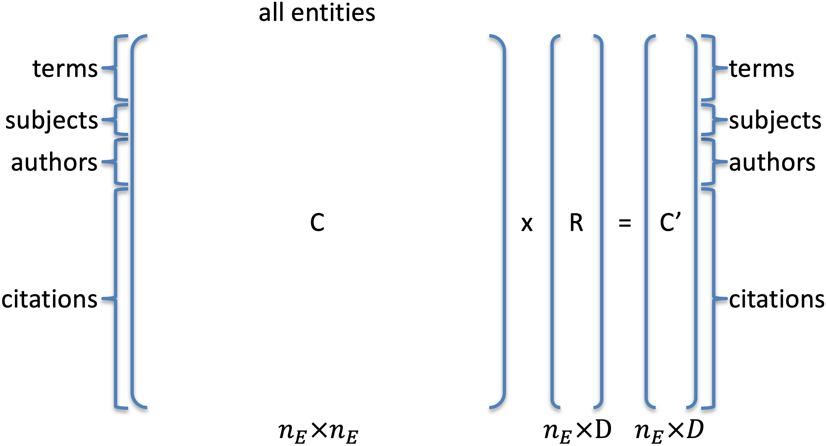
Fast random projection

Slide 15
Discriminative embeddings
We do not use heuristics to filter out stop words
Task-specific, dataset-specific, …
Most terms end up being similar to average language vector $\vec{v_{a}}$
$\vec{v_{a}}$corresponds closely to stop words

Slide 16
Discriminative embeddings
We do not use heuristics to filter out stop words
Task-specific, dataset-specific, …
Most terms end up being similar to average language vector $\vec{v_{a}}$
$\vec{v_{a}}$corresponds closely to stop words
Our solution:
Cancel out the average language vector from the embeddings (Orthogonal Projection)
Use the original similarity to$\vec{v_{a}}$ to inform the importance of terms
(Term weight assignment)

Slide 17
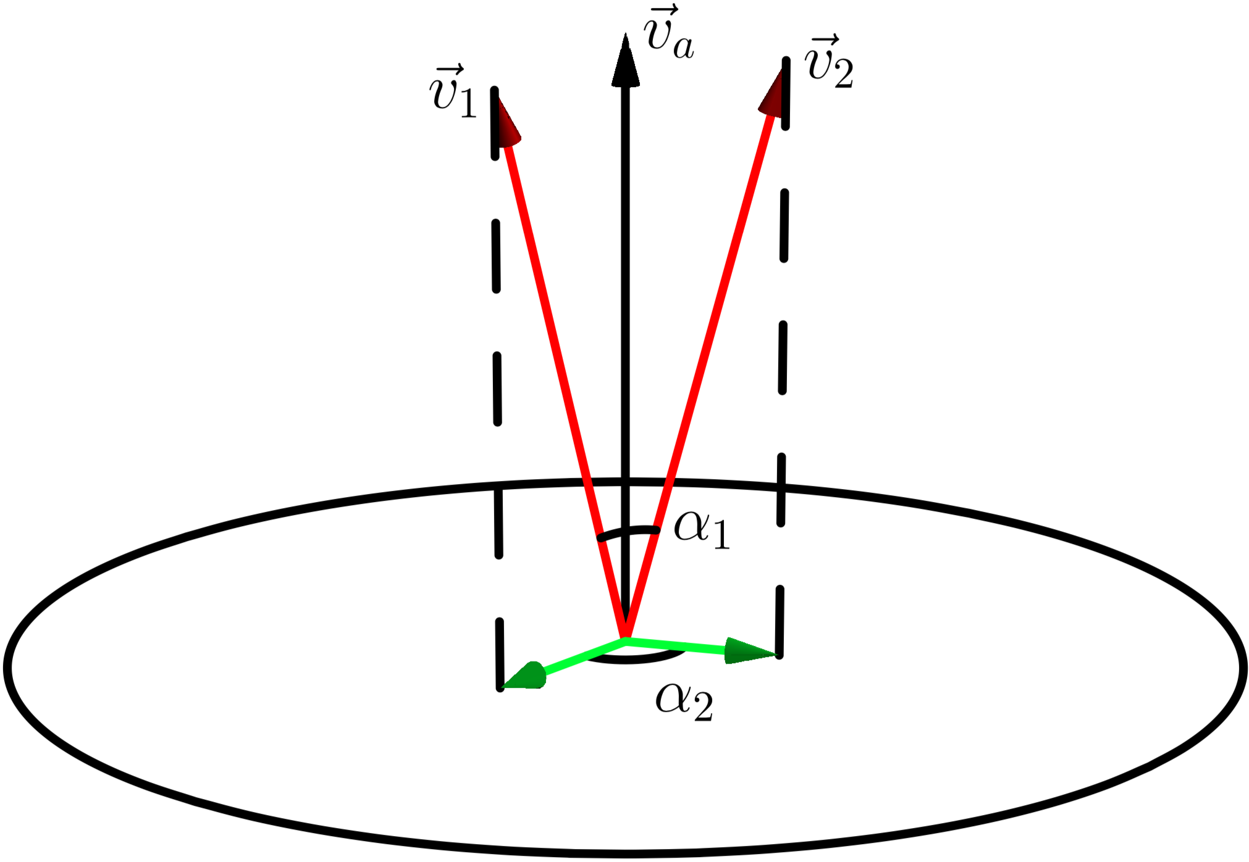
Orthogonal projection
Vectors are projected on the orthogonal hyperplane to an average language vector
Removing the stop-wordiness improves the discriminating power
Projected vectors are normalized

Slide 18
Document Embedding: Term weights
The more similar to the average vector, the less weight it gets
No need to remove stop words
Crucial to get distinctive document embeddings (weighted average)

Slide 19
Compare with the state-of-the-art
We compared our method with a few document embedding methods including Doc2Vec (Google), fastText (Facebook), Sent2Vec (Pagliardini,et.al 2017)
Two datasets: simple English Wikipedia and a subset of MEDLINE
The same server with 2 Intel Xeon Silver 4109T 8-core processors and 384GB memory
The minimum document frequency is 10
The dimensionality of embeddings is 256

Slide 20
Evaluation using STS benchmark
Semantic Textual Similarity (STS)
3.600 | A group of men play soccer on the beach. | A group of boys are playing soccer on the beach.
5.000 | One woman is measuring another woman's ankle. | A woman measures another woman's ankle.
4.200 | A man is cutting up a cucumber. | A man is slicing a cucumber.
1.500 | A man is playing a harp. | A man is playing a keyboard.
1.800 | A woman is cutting onions. | A woman is cutting tofu.

Slide 21
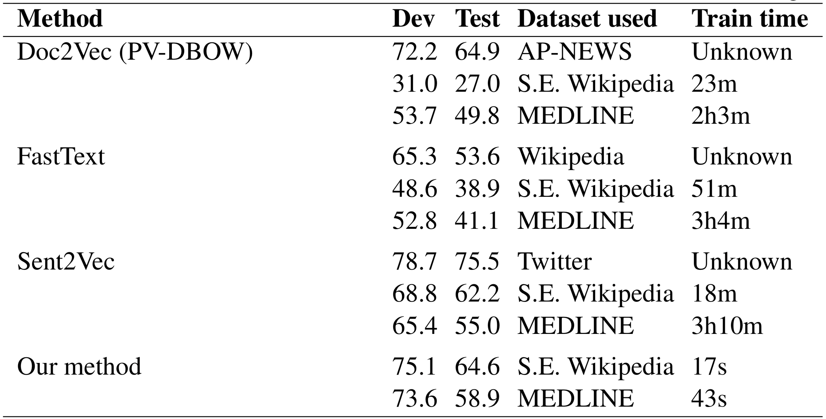
Semantic Textual Similarity (STS) benchmark
Notes:
The Semantic Textual Similarity (STS) Benchmark is a SemEval task organized between 2012 and 2017. It consists of 8628 pairs of English sentences, selected from image captions, news headlines and user forums. The similarity between these sentence pairs was annotated using a five point scale via crowdsourcing (Agirre et al., 2016). Participating systems calculate the similarity between these sentence pairs and are evaluated based on their Pearson correlation with the gold standard STS annotations.

Slide 22
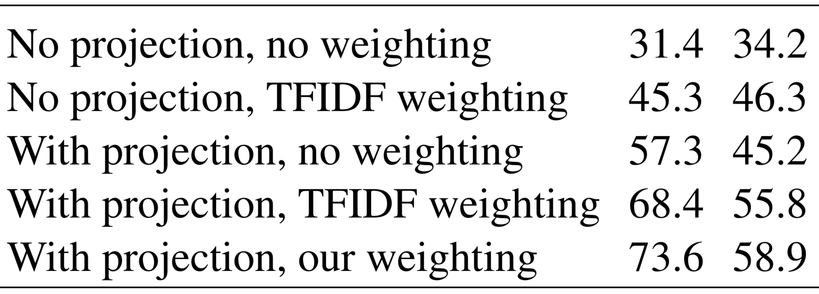
Effect of orthogonal projection and weighting

Slide 23
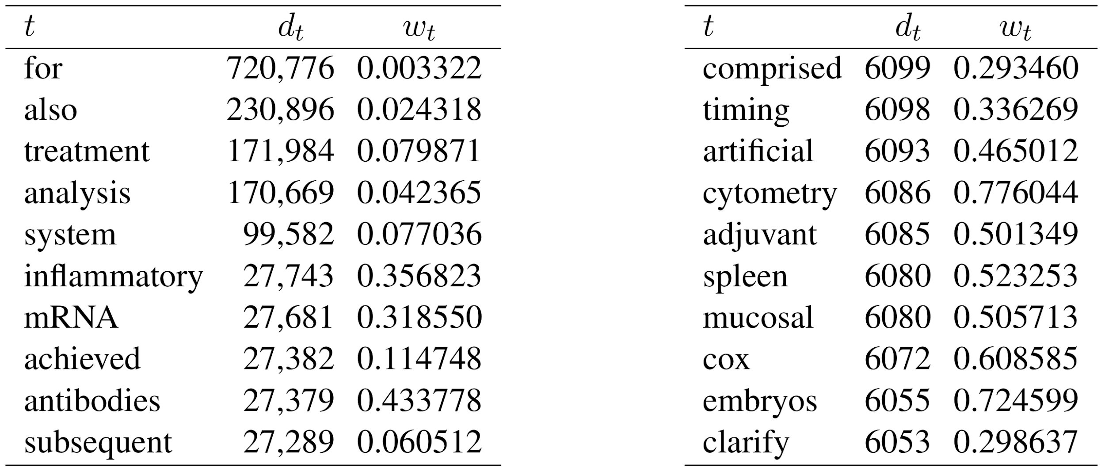
Document frequencies vs assigned weights
Notes:
“antibodies” is equally frequent with “achieved” and “subsequent”, but it has a much higher weight

Slide 24
What can we do with semantic embedding?
Information retrieval
Entity disambiguation
De-duplication
Recommendation
Clustering
Subject prediction
...

Slide 25
Topic extraction in Scientometrics
Gläser, A. Scharnhorst, W. Glänzel (eds.) Same data – different results? Towards a comparative approach to the identification of thematic structures in science, Special Issue of Scientometrics (2017):
Koopman, Rob, Shenghui Wang, and Andrea Scharnhorst. "Contextualization of topics—browsing through the universe of bibliographic information." DOI 10.1007/s11192-017-2303-4
Koopman, Rob, and Shenghui Wang. "Mutual information based labelling and comparing clusters." DOI 10.1007/s11192-017-2305-2
Wang, Shenghui, and Rob Koopman. "Clustering articles based on semantic similarity." DOI 10.1007/s11192-017-2298-x
Velden, Theresa, Kevin W. Boyack, Jochen Gläser, Rob Koopman, Andrea Scharnhorst, and Shenghui Wang. "Comparison of topic extraction approaches and their results." DOI 10.1007/s11192-017-2306-1.

Slide 26
Automatic subject prediction
Naive similarity based method
A document is likely to be indexed with subjects that are most related to it (i.e. with highest cosine similarities)
Nonparametric (neighbourhood based) method
A document is likely to be indexed similarly to the documents that are similar to it
Wang S., Koopman R., Englebienne G. (2019) Non-Parametric Subject Prediction. In: Doucet A., Isaac A., Golub K., Aalberg T., Jatowt A. (eds) Digital Libraries for Open Knowledge. TPDL 2019. Lecture Notes in Computer Science, vol 11799. Springer, Cham

Slide 27
Experiment: Medline
Metadata of one million Medline articles with abstract
The training set contains 147,837 unique frequent MeSH subjects
Each article is indexed with, on average, 16 MeSH subjects
10,000 articles for testing
Measure precision/recall of top N predictions

Slide 28
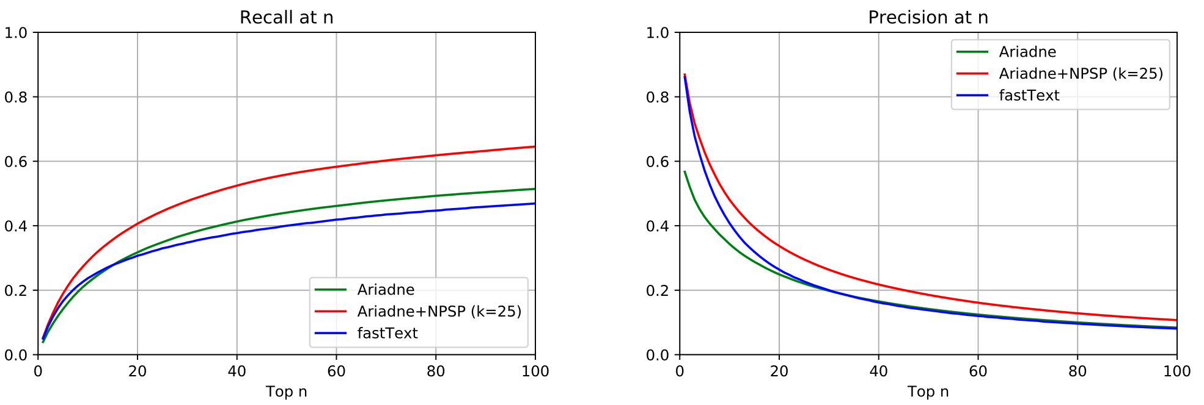
Recall and precision @ n: Medline

Slide 29
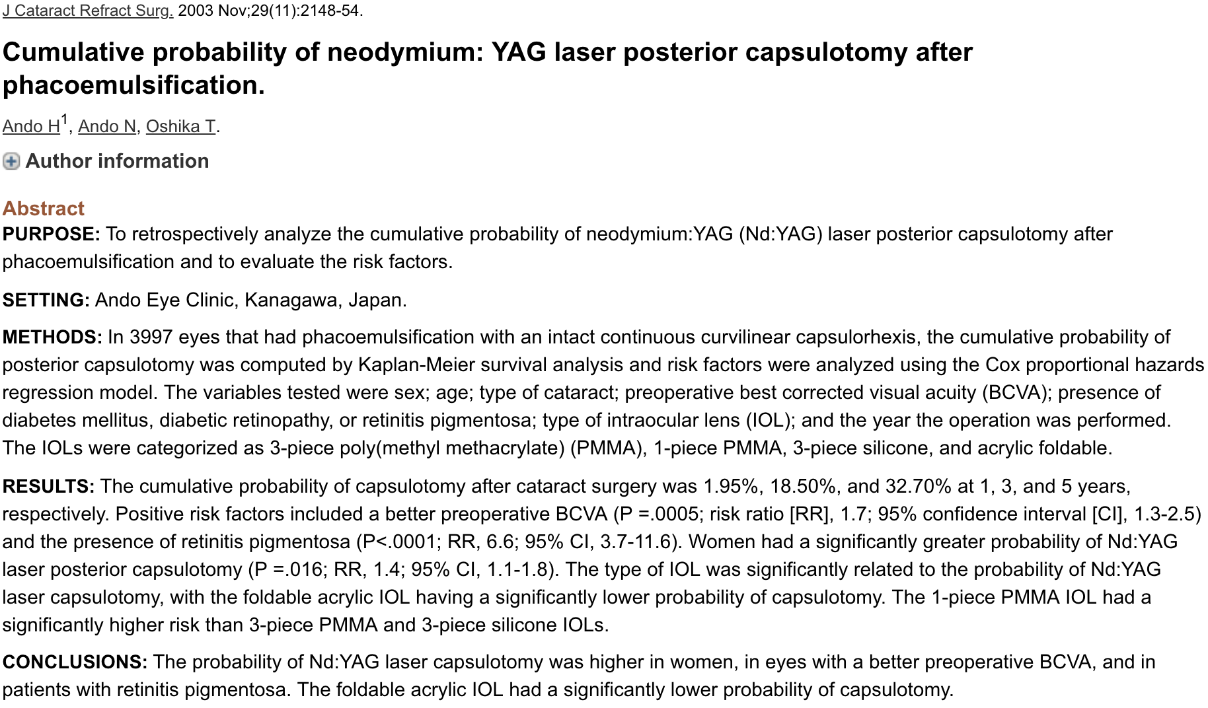
Example
https://www.ncbi.nlm.nih.gov/pubmed/14670424

Slide 30
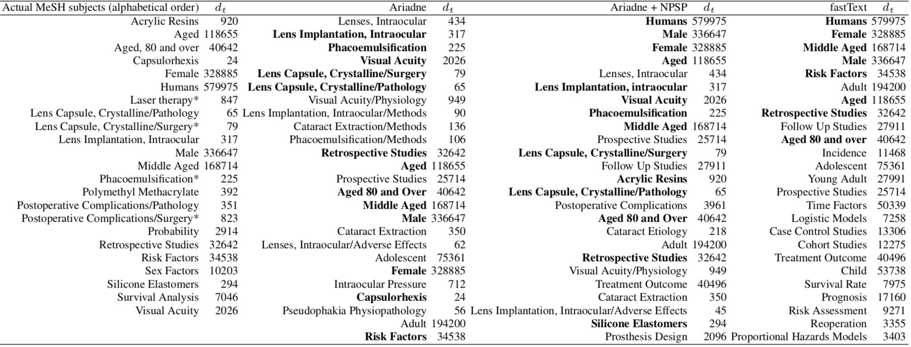
Comparing Ariadne, Ariadne+NPSP and fastText
Notes:
fastText only predicts highly frequent subjects correctly but not useful
Ariadne predicts very specific subjects, many are highly related but not chosen by domain experts
Ariadne+NPSP balances between common subjects and specific ones.
Precision and recall are not good measures

Slide 31
Experiment: Astro
111k articles published in 59 Astronomy and Astrophysics journals (Downloaded from http://www.topic-challenge.info/)
95% for training, 5% for testing
Measure precision/recall of top N predictions
Notes:
This is to show that our method could be used for predicting other types of entities.

Slide 32
Recall and precision @ n: Astro -- Subject

Slide 33
Recall and precision @ n: Astro -- Citation

Slide 34
Recall and precision @ n: Astro -- Author

Slide 35
Lorentz workshop: ICT with Industry 2019
KB (National Library of the Netherlands) explores NLP and ML methods for (semi-) automatic cataloguing
Task: automatically assign Brinkman subjects to PhD dissertations
Dataset:
The Brinkman thesaurus containing 14.7K keywords
40K PhD dissertations from six Dutch universities
23.9K with manually assigned Brinkman keywords

Slide 36
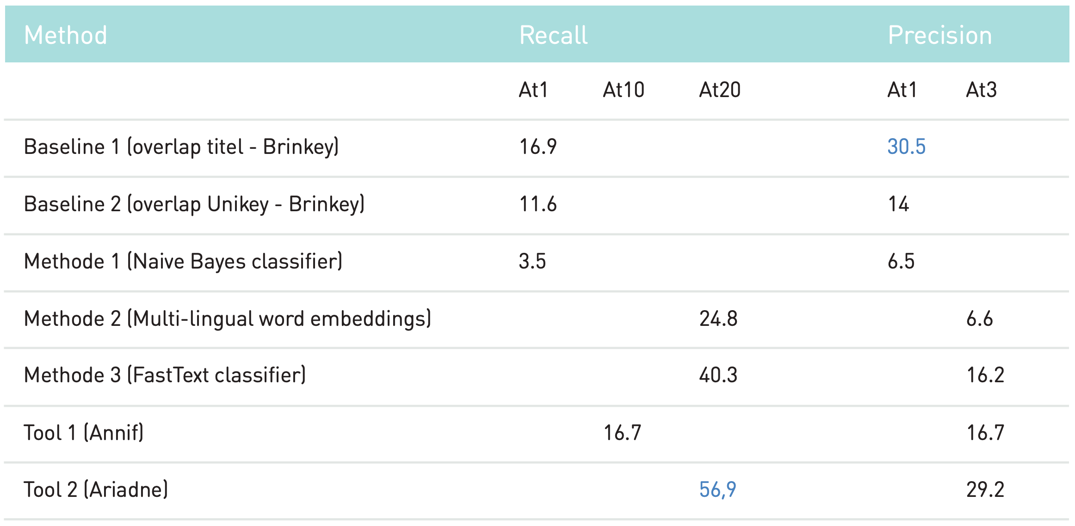
https://www.kb.nl/en/news/2019/kb-explores-artificial-intelligence-to-generate-metadata

Slide 37
Ongoing collaboration
A Pilot project with German National Library (DNB)
DNB provides the Integrated Authority File (GND), all the Table of Content files, and the complete metadata including manually assigned DDC subject categories, DDC basic numbers and GND subjects
We apply our prediction method and conduct automatic evaluation
DNB conducts manual evaluation
We jointly makes plans based on the results

Slide 38
Preliminary results
 | Average length | Average precision | Average recall
DNB intellectually assigned subjects | 3.6
DNB automatically assigned subjects | 4.5 | 30.6 | 37.6
Ariadne predictions | Top 1 | 60.6 | 24.1
 | Top 2 | 49.3 | 35.7
 | Top 3 | 41.8 | 42.8
 | Top 4 | 36.7 | 47.9
 | Top 5 | 33.1 | 51.9
DNB intellectually assigned DDC subject categories | 1.3
DNB automatically assigned DDC subject categories | 1.3 | 68.8 | 69.9
Ariadne predictions | Top 1 | 70.5 | 58.6
 | Top 2 | 56.4 | 76.2
DNB intellectually assigned DDC basic numbers | 1.1
Ariadne predictions | Top 1 | 41.3 | 39.3
 | Top 2 | 31.0 | 52.5

Slide 39
Demo

Slide 40
Summary
An efficient method that computes Random Projection based embedding
An effective approach to optimize the discriminative power of term embeddings and consequent document embeddings
We can leverage semantic embeddings to help with many tasks in libraries and other cultural heritage institutes.

Slide 41
Publications about Ariadne:
Wang, S., Koopman, R., Englebienne, G. Non-Parametric Subject Prediction. In: Doucet A., Isaac A., Golub K., Aalberg T., Jatowt A. (eds) Digital Libraries for Open Knowledge. TPDL 2019. Lecture Notes in Computer Science, vol 11799. Springer, Cham (2019)
Wang, S.,Koopman, R. A Two-step approach towards subject prediction. In Proceedings of the 17th International Conference on Scientometrics & Informetrics. Research-in-progress papers. Rome Italy (2019)
Koopman, R., Wang, S., Englebienne, G. Fast and discriminative semantic embedding. In: Proceedings of the 13th International Conference on Computational Semantics - Long Papers. pp. 235–246. ACL, Gothenburg, Sweden (2019)
Wang, S.,Koopman, R.. Embed first, then predict. Knowledge Organization, 46(5), pp 364-370 (2019)
Koopman, R., Wang, S.. An innovative approach to scalable semantic embedding. Presented at the IFLA WLIC 2019 pre-conference satellite meeting: “Data intelligence in libraries: The actual and artificial perspectives”. (2019)
Wang, S., Koopman, R., van der Werf, T., Godby, J. An innovative approach to scalable semantic search. Presented at the NSF-supported conference Artificial Intelligence for Data Discovery and Reuse. May 2019, Carnegie Mellon University. (2019)
Koopman, R., Wang, S., Scharnhorst, A.: Contextualization of topics – browsing through the universe of bibliographic information. Gläser, A. Scharnhorst, W. Glänzel (eds.) Same data – different results? Towards a comparative approach to the identification of thematic structures in science, Special Issue of Scientometrics (2017)
Koopman, R., Wang, S.: Mutual information based labelling and comparing clusters. Gläser, A. Scharnhorst, W. Glänzel (eds.) Same data – different results? Towards a comparative approach to the identification of thematic structures in science, Special Issue of Scientometrics (2017)
Wang, S., Koopman, R.: Clustering articles based on semantic similarity. Gläser, A. Scharnhorst, W. Glänzel (eds.) Same data – different results? Towards a comparative approach to the identification of thematic structures in science, Special Issue of Scientometrics (2017)
Velden, T., Boyack, K., van Eck, N., Glänzel, W., Gläser, J., Havemann, F., Heinz, M., Koopman, R., Scharnhorst, A., Thijs, B., Wang, S.: Comparison of topic extraction approaches and their results. Gläser, A. Scharnhorst, W. Glänzel (eds.) Same data – different results? Towards a comparative approach to the identification of thematic structures in science, Special Issue of Scientometrics (2017)

Slide 42
Thank you!
Rob Koopman (rob.koopman@oclc.org)
Shenghui Wang (shenghui.wang@{oclc.org, utwente.nl})

