Slide 1
Works In Progress Webinar: Managing Archival Technical Services with Agile Software Development Methods at Ohio State University Libraries
Morag Boyd – Acquisitions & Discovery Strategist Cate Putirskis – Archival Description & Access Unit Lead Russell Schelby – Lead, Applications Development November 14, 2019

Slide 2
Setting the Stage
The Ohio State University Libraries
Seven special collections in three buildings
2011-2016 Strategic Plan
Position distinctive collections, spaces and services in user's pathways, in both physical and virtual environments, to promote intellectual inquiry and encourage lifelong learning
Increase the scale and scope of distinctive and digital collections and enhance access to and usage of these materials to support research and anytime, anywhere learning
Creation of one central Processing Program
Notes:
Morag (1 min.)
Brief History(tie in to strategic directions, ability to request resources)

Slide 3
Goals
All collections discoverable by researchers
Consolidation to supported tool set
Standards based description that could interoperate across discovery and management tools
Minimum description for everything
All collection material managed appropriately

Slide 4
The Gap
History of decentralized archival and artifact management
Several systems and standards/practices
Often multiple tools within one unit
Some data sources had no public access
Balancing needs of multiple collections units and curators
Unprocessed collections
High volume of collecting
Implementation of off-site storage
Limited resources

Slide 5
Archival Technical Services at OSU Libraries
Accessioning (including coordinating transport of materials to us & completing legal and gift paperwork)
Enhancement work (including processing and other iterative improvements, corrections/updates requests, etc.)
Exposing backlogs (creating/migrating description for legacy holdings, remediating discrepancies across data sources, etc.)
Logistics (shelving and storage management, archival CMS management, online description publishing & maintenance, conservation/housing activities, ordering archival supplies, etc.)
Policy Management (writing and maintaining manuals, documentation, and workflows; archival training for colleagues, etc.)
Notes:
Cate (1 minute)
Centralized department performing comprehensive technical services for all of our SC unit partners—but, we’re not organizationally a part of their departments, and they’re not part of ours
We do a little (or a lot) of all of the traditional archival tech services “things” (x7) = ~35 discreet queues of work to manage
P.S. every SC did whatever TS stuff they did before us differently, so we have the ongoing challenge of not just aligning the past with archival standards, but also just defining our local standards and transitioning the way 1-7 units are used to doing/seeing any one thing

Slide 6
Archival Description & Access Unit
Challenges:
Inconsistent staffing
Staff generally new to the profession
Lots of dependency on student support, etc.
New staff + new department = continual work in progress
But also: opportunity to be experimental in our solutions
Notes:
Cate (1 minute)
Department staff population always in flux; fewest = 1 / most = 11 (mostly term/temp)
First archival job for most folks, so always learning/growing together
Also supported by undergrad students (could always use more, but how many can we realistically supervise? Most was 19); grad students, interns
Common experience: might sound like a lot of staff/students, but never a week where we haven’t had more work to do than folks to do it
i.e. Agile isn’t just for large departments—if you have this same challenge, regardless of the size of your department, Agile is for you
So: how do we prioritize across what our SC colleagues want/need X our staffing at any given time X our internal priorities? (P.S. don’t lose track of anything!)

Slide 7
Similar Situations
Archival Description & Application Development
Project vs. Maintenance
Disparate Clients
Changing Priorities
Large Backlogs
Uncertain Effort
Notes:
(Russell 2min) Application Development and Archival Description already had an ongoing dialog. So once we started to look at it, we started to find lots of similarities in the two teams' situations.
* Project VS Maintenance - Build a Room Reservation System, but also add this login, update that software, change that header graphic...
Sounds like...
Process this 300 foot collection, but also accession this donation, fix this finding aid, order new archival supplies.
* Disparate Clients, who aren't concerned with what other folks have asked for
* Changing Priorities; both teams are in similar service positions in the Libraries, we have to respond to organizational priorities
* Large Backlogs: Job Security, yes. A Customer Challenge, also yes.
* Uncertain Effort: this is a big one. In IT, troubleshooting and development 20% of the problems take up 80% of the time, and you usually don't know which.
In Archival Description, I am lead to understand that you never _really_ know what you're going to find when you open a box.
%%

Slide 8
Box surprise!

Slide 9
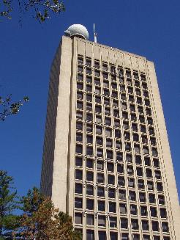
Agile, Briefly.
Software Method
Software Method
Agile Versioned Software
Waterfall Well-Defined Product
This Photo by Unknown author is licensed under CC BY-SA.
Notes:
(Russell 1min)
We absolutely don't have time to teach you agile methodology, but we can give you the flavor:
* Agile was developed by software teams to plan just enough work to meet the next set of requirements.
* Compare this to Waterfall, where you plan every single feature of a project, how much time each action will take, who will do it... Great for buildings, not necessarily for software.
% Agile Manifesto https://www.agilealliance.org/agile101/the-agile-manifesto/

Slide 10
Agile, Briefly.
Software Method
Scrum vs Kanban
Software Method
Scrum vs Kanban
Sprints: limited period of work
Projects ==> Scrum
Tasks ==> Kanban
Notes:
(Russell 1min)
Some terminology -
* Sprints are limited period of work
I favor two week sprints.
Shorter periods and your meeting to work ratio becomes unfavorable.
Longer periods and you are planning work that might not be important then: less Agile, more Waterfall.
* For projects with multiple actors, I favor planning sprint work with the Scrum method.
This involves the group deciding what work they can do in the next Sprint
* For large queues of tasks, related or unrelated, I favor Kanban.
This involves the group organizing the tasks into queues by priority - the more valuable, the higher on the list.
The work proceeds by selecting the most important ticket and working on it until it is done or you are unable to do more.
% Mike Cohn - Scrum Intro https://www.mountaingoatsoftware.com/agile/new-to-agile-or-scrum
% Kanbanzie - Beginner Kanban https://kanbanize.com/kanban-resources/getting-started/what-is-kanban/

Slide 11
Agile, Briefly.
Software Method
Scrum vs Kanban
Agile Roles
Software Method
Scrum vs Kanban
Agile Roles
Scrum Master or Leader of Boards
Service Owner or Board Leader
Product Owner or Stakeholders
Notes:
(Russell 1min)
Some roles:
* Scrum Master OR Leader of Board Leaders - Leads the entire process
* Service Owner OR Board Leader - Leads the organization of the tickets for a set of work
* Product OwnerPR/ Stakeholders - People who help decide importance of the tasks

Slide 12
Agile, Briefly.
Software Method
Scrum vs Kanban
Agile Roles
Project As Cake
Notes:
(Russell 1min)
When we decided to start preparing the AD&A team in June of 2017 we committed to a day-long training session in Scrum planning.
To give us a generic and common metaphor, we decided to have our project be baking 15 cakes.
This included planning types, flavors, sizes, and transportation.
Did I know that several of the staff had professional experience baking cakes? No. It unexpectedly complicated my clever metaphor, but we were still able to work through an entire sprint planning session, simulated cake baking project, and were able to demonstrate how the team could use these techniques in planning a processing or rehousing project.
This training session was enough to get the AD&A team started on their journey; I helped set up their project management software, offered the occasional advice, but primarily they worked through the process as a team.
%%

Slide 13
Why Agile for Archival Work?
Value of assigning People to Work instead of Work to People
Most value sooner: priorities are set together with partners; work is done when “good enough” because iteration is part of the workflow
Agile is the workflow realization of MPLP iteration concepts
Notes:
Cate (2 minutes)
The priorities are the priorities, and volumes fluctuate; reality is that these do not neatly align with territorial staffing structures
(i.e. if this month we have 3 FTE of accessioning priorities and 1 FTE designated as the ‘accessioning archivist,’ we are guaranteed to fail (in meeting our priorities) before we even start)
So, value in diminishing position boundaries
(i.e. everyone doesn’t need to know everything about how to do everyone else’s job, but there should be nothing only one person knows how to do)
Bonus benefit: peer training & cross-training (the more you know about what your colleagues are doing, the better you understand the impacts of your work on them—and vice versa)
ALSO: when everyone shares ownership of the priorities (tix for a defined time period) and the knowledge to accomplish them, stuff gets done because the only true obstacle left is overcommitting as a whole team
i.e.: we are determining what work needs to be done in a defined period, and then assigning people to the work—instead of continuously funneling all of any one type of work to a person because that person does that work
Agile is meant to participatory—decisions are made by gathering input from stakeholders, and the intent is to deliver back results incrementally, but as soon as there is an MVP (and then iterate over time)
So, everyone wins together: SC colleagues get more, sooner (and it’s what they want) / ADA gets more done, more efficiently / and: clear workflows exists for how to iterate to the next version or level of work on a project
…Agile in operation is the workflow realization of how MPLP encourages archivists to take on the common problem of more work than people

Slide 14
Implementation: First Attempt
Scrum
Things tried:
Sprints/sprint planning
Planning Poker
Daily stand-ups
Sprint reviews
Bi-weekly report outs to partners
Notes:
Cate (3 minutes)
Goal: fit Agile around everything we’re already doing—nothing about the archival work or our base workflows changed
Started with Scrum
Turned all our lists/post-its/etc. in tickets—(700?)
Sprints: 2 weeks, everyone comes to sprint planning with their time available for the two weeks ahead, browse the tickets and estimate time for each, and then someone in the group claims it (when you run out of hours, you run out of the chance to claim tickets) i.e. planning poker
This is fun but endlessly frustrating—the reality of archives is no project ever takes the time you plan it to take
Daily stand-ups: yesterday/today/challenges
These are fun and beneficial—the more you know about what your colleagues are up to, the better you can do your own work—also, we find and fix the shortages, etc. together before they become true roadblocks (teamwork)
Sprint reviews: review our claimed tickets and check in on progress…surprise, we NEVER finished a plan sprint. Never even got close….why? (coming back to that!)
After sprint review, list out all finished and in-progress work and send to all our SC colleagues. Tells them what we did for them AND what we did for all their colleagues. Quickly helped SC individuals recalibrate their expectations when they started to see how their piece of our workload fit into the whole (i.e. we accession for everyone, so our time goes to some for everyone, no matter how many each SC person has in our queue)
Overall results: Agile is helping ADA get more done in a better way, but Scrum mostly doesn’t fit—have to fix some things

Slide 15
Implementation: Second Attempt
Kanban
Things kept from Scrum:
Sprints—kind of
Daily stands-ups
Bi-weekly reporting out
Things added:
Functional area/project boards
WIP (Works in Progress) limits
Tracking Progress/Blocked status
Notes:
Cate (3 minutes)
Goal: keep the good stuff, fix the problems
Scrum wasn’t all bad! We liked:
Sprints: checking in on our progress as a team every two weeks is the right frequency—generally can catch and fix things when they’re small problems before they become big problems / identify trends/training needs more quickly / everyone stays aware of and engaged in overall individual and team progress
Daily stand-ups: similarly, when we start the day generally on the same page, we’re more ready to work through it collaboratively – also, when we need to make changes on short notice, we problem-solve together how to cover things, etc.
Bi-weekly reporting out: good for us, good for our partners
Kanban instead of Scrum (turns out, it is impossible to plan two weeks of archival work)
Instead of one big pool of tickets, one Kanban for each type (and, organize each into queue order, so that the priorities are always at the top and always next up—surprise! lesson from Scrum: when tickets are mostly a free-for-all, no one takes the hard/boring/otherwise undesirable one)
Every queue has a staff member who owns it “Board Leader”—organizes priorities, owns assigning the work, owns finished product. Anyone can still work on tix in that queue, but each queue now has leadership
WIP limits: surprise! lesson from Scrum: because things keep getting blocked, we keep starting more new things…and with no incentive to finish, things sit on the boards forever. Especially the things no one really wants to do. WIP limits mean once you start something, you have to work on it until it is either done or truly blocked externally (info, supplies, etc.)
Blocked: keeping track of what you can’t do (and why) is revolutionary. Especially when it allows you to easily communicate this back to others.

Slide 16
Implementation: Quality Control
Kanban emphasizes a strong QC (or, QA—Quality Assurance) process
QC is time well spent:
Catches more errors before work is considered “done”
Builds individual knowledge
Builds collaborative skills
Finds shared misunderstandings quickly
Notes:
Cate (3 minutes)
QC: brought to Agile from our existing workflow, made infinitely stronger by Agile (especially in Kanban)
We need to review work anyways
When the supervisor is the only one doing it, it’s both a bottleneck (oops, Scrum…), and not as beneficial as it could be
Humans do work, so humans make mistakes—other humans doing the same work are adept at spotting mistakes
Again: the more you know about what your colleagues do, the better QC contributor you can be
Peer QC builds/strengthens an Agile team—giving feedback helps you work together better AND forces you to solidify your own knowledge
Supervisor QC after peer QC:
Lesser load for supervisor
Find shared misunderstandings quickly and fix them quickly—for everyone (keeps the team’s knowledge universal and cohesive)
Requests for corrections from SC way down—we don’t catch everything, but we catch most things, and it’s way more efficient to invest a little time in QC now than it is to release an inferior product and have to clean it up later when we’re no longer familiar with the collection
If you take nothing else away—if Agile really isn’t for you—consider strengthening your QC procedures (lots of benefits just from this)

Slide 17
Tools
White Boards Bulletin Boards
This Photo by Unknown author is licensed under CC BY-SA.
Notes:
(Russell 1 min) When we've talked about different 'Boards', we're basically talking about different ways to segment and follow the progress of your work. In IT we have a Project board and a Maintenance board; in AD&A they have Accessioning, Processing, Backlog boards that come and go as they are needed. You could also use a whiteboard, post-its, a bulletin board -- In fact, that would be the best way to start to prototype and document your workflows.

Slide 18
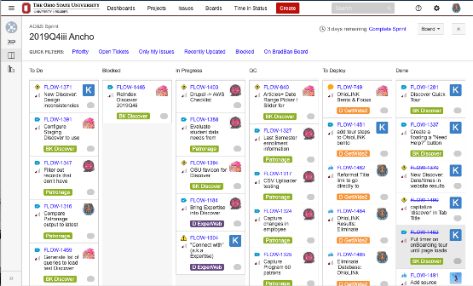
Tools
White Boards Bulletin Boards
Software Boards
Notes:
(Russell 30 sec.)
We use Atlassian Jira Software to track our issues both in IT and in AD&A. There are several options, PivotalTracker, ActiveCollab, OpenProject.
%Jira Software https://www.atlassian.com/software/jira

Slide 19
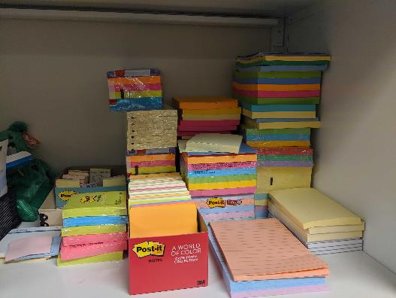
Tools
White Boards Bulletin Boards
Software Boards
Scaling
Notes:
(Russell 30 seconds)
One of the important reasons that we use software to track our progress is the scale of our backlogs.
Each of our groups have thousands of tasks that we're keeping track of, and this really doesn't scale with post-its
%%

Slide 20
Results
Productivity gains
More projects completed sooner
People spending time more effectively
Transparency
Communication
Periodic sprint reports to wide range of stakeholders
Notes:
Morag (1 min)
Productivity, Transparency, Communication, Planning (Morag)
- Email to Spec Coll and other stakeholders: History librarian, Preservations & Digitization, AD&S, Administrators, etc.

Slide 21
Results: Partner Relationship
Special Collections units gained
Clearer understanding of what is being done
Demonstrated improved productivity
Understanding of a range of activities and priorities across all units
Notes:
Morag (1 min)
what did Special Collections get out of this? How did we get buy-in? (Morag)

Slide 22
Results: Administration and Planning
Projections of work and resources to achieve goals
Enabled term and permanent staff positions
Leveraging expertise and collaboration towards aspirational future state
Identify and eliminate duplicative work
Notes:
Morag (1 min)
what this looks like from the Admin seats& why are we sticking with this?(Morag)

Slide 23
Notes:
Empower knowledge creators; leverage distinctive collections for use
Model excellence: increase effectiveness and agile planning and operations
% Strategic Plan https://library.osu.edu/strategic-directions

Slide 24
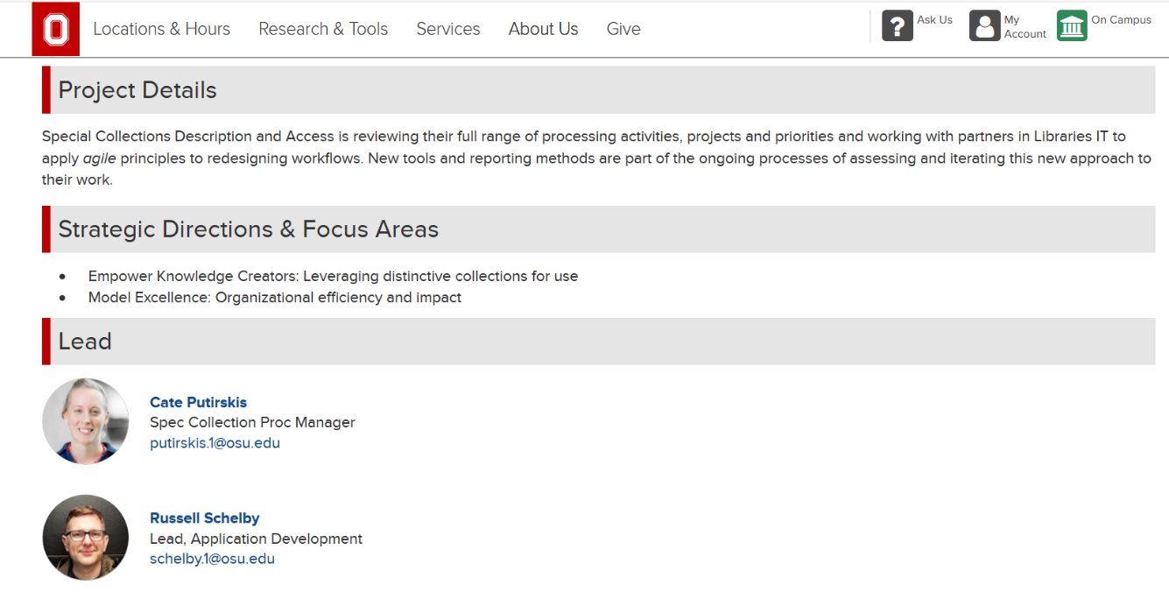
https://library.osu.edu/strategic-directions/current-initiatives/agile-processing-for-special-collections
Notes:
% Current Initiative https://library.osu.edu/strategic-directions/current-initiatives/agile-processing-for-special-collections

Slide 25
Archivists: Is Agile Worth It?
Agile looks different for everyone, but has something for everyone
Can improve transparency and communication
Fairly easy to learn
Improves output, decreases time from start to finish of most projects
Notes:
Cate (2 minutes) [Service Provider & Service Consumer can be friends?]
Agile is flexible: what works for us may not work for you
Scrum is probably better if you have fewer variables or otherwise more predictability in your work
Kanban is probably better if you have a complex environment
Agile doesn’t have to be for a team—still effective to track and manage projects and work in a solo setting
But, for a team: forces team to work as a team, which is mostly a good thing
Something for everyone: planners, organizers, communicators, decision-makers, folks who have trouble keeping track of things, folks who just like to know what’s going on (pretty good tool for improving transparency and communication, which are wins for most people)
Shared decision-making—also a good thing for most people
Does require a mind shift, but when it’s built around what you’re already doing, the fit is natural
Took staff in our unit about 30 days to get used to and comfortable with Agile
Drastic increase in efficiency and output; within 6 months of adopting Agile, our output had doubled, despite our base workload also increasing
No gaps in service during staff transitions—even when someone is new, they’re never the only one doing something, so their area(s) of work aren’t lagging or not being done because of position vacancies
Bottom line: Agile has improved our unit operations so dramatically that we could not go back to a traditional archival staffing model and maintain the same productivity, transparency, etc.

Slide 26
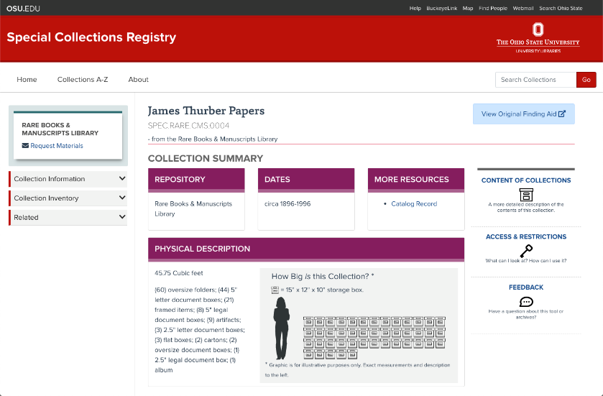
Building Relationships
Time Investment
Talk About Projects
Talk About Not-Projects
Complex Collaboration
Notes:
Cate (1 min)
*As a unit, ADA can do our best archival work when we know how it’s going to interact with the archival web environment IT builds and maintains, etc.
•Creates a shared space where archivists and developers can have a productive conversation—we don’t know how to do each others’ jobs, but we do understand the product of each others’ work
•Having Agile partners is also really valuable: we are always learning from each others’ very different Agile set-ups how to improve each of our own
%%
(Russell 1min) )
To do this, we had to take the time to talk about our projects together, and the not-projects – the pain points that each of our teams were having. It is a big investment, but it is really an investment.
* Complex Collaboration -- Together we can do complex projects; our teams had to work closely to develop our Amalgamated Collection Experience; The implementation of this ACE Project wouldn't even have been apparent without the long-standing relationship that we developed.
* ACE is an improved presentation of archival description that integrates content from digital collections, the catalog, and more!
% https://library.osu.edu/collections/

Slide 28
Thank You! Questions?
Morag Boyd boyd.402@osu.edu
Cate Putirskis putirskis.1@osu.edu
Russell Schelby schelby.1@osu.edu
Notes:
? I think this isn’t for me / I’m a single archivist? Still a good way to manage priorities
? What did IT bring back from relationship? Domain Expertise, recruiting & hiring practices

