Slide 1
NISO Webinar: Implementing Library Linked Data – 13 November 2019
What are the “entities that matter?” And how much should we say about them?
Jean Godby
Senior Research Scientist, OCLC Research

Slide 2
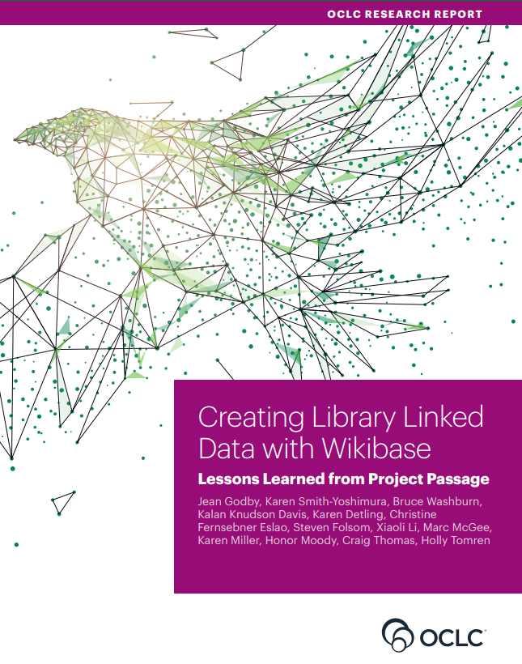
Goals for today
Discuss highlights
of the report
Answer the question(s) in the title
List some imperatives for follow-up
Notes:
https://www.oclc.org/content/dam/research/publications/2019/oclcresearch-creating-library-linked-data-with-wikibase-project-passage.pdf

Slide 3
Motivations for the study
Provide a sandbox for a hands-on test of linked-data creation in the library resource-description workflow
Evaluate Wikibase as a platform for this work
Advance PCC’s strategic goals identified for Linked Data in the plan for 2018-2021
Notes:
1. Sandbox: A place for hands-on experimentation. How do I create a linked data representation for the resource I am looking at right now? How does this process compare with the method I may have already used to describe the resource? Pilot tests of original description with linked data have been conducted by the Library of Congress and other libraries, but this one has a different focus. The is an open-ended exploration that meets catalogers where they are – with resources on their to-do lists, which can be described either in the existing paradigm or a new one.
Wikibase: The open-source software package that powers Wikidata.
Wikidata or Wikibase? Practitioners are being encouraged to evaluate both, and to base their decision on use cases. We chose Wikibase for the Passage study because it enabled us to create a fully configurable environment for experimentation.
* Many features for editing and crowdsourcing
* Many technical features (mature end-to-end system, native multilingual support, full support for linked data creation)
* Dataset. Wikidata has hundreds of thousands of real-world object descriptions, to which library-community and other identifiers have already been applied.
* An abstraction layer– These features are mostly hidden from human users. This means that metadata librarians are free to concentrate on the work they want to do, not the technical details of a linked data implementation.
3. This work aligns with PCC goals: PCC strategic directions for 2018-2021
• Accelerate the movement toward ubiquitous identifier creation and identity management at the network level by increasing the numbers and proportions of entities receiving persistent identifiers. Expand the use of linked data value vocabularies to augment, and replace existing metadata practices.

Slide 4
Pilot Participants
American University
Brigham Young University
Cleveland Public Library
Cornell University Library
Harvard University
Michigan State University
National Library of Medicine
North Carolina State University
Northwestern University
Princeton University
Smithsonian Library
Temple University
UC Davis Library
University of Minnesota
University of New Hampshire
Yale University
Notes:
The pilot ran from January to July 2018 with participants from the libraries listed on the screen.

Slide 5
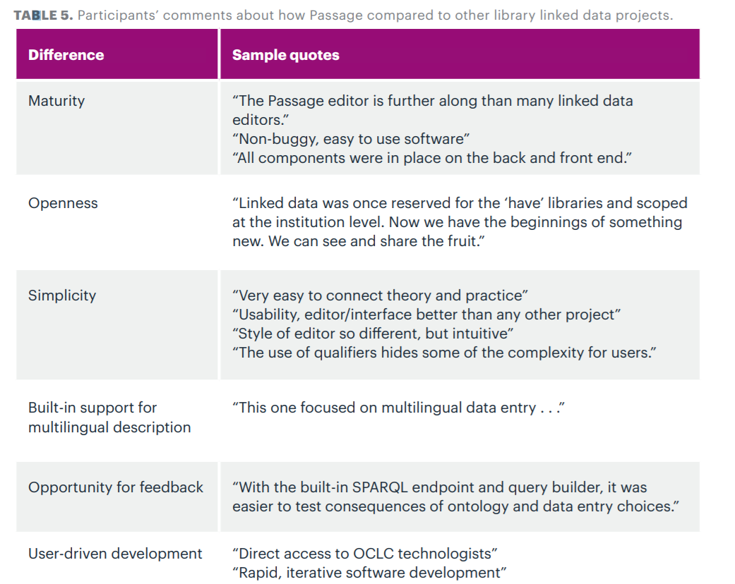
Source: Passage report
Table 5
Notes:
We asked participants at the beginning and end of the pilot how the Passage experience differed from other library linked data efforts. Some responses are shown. This table is published in the report.
Not shown:
* Focus on new description (not conversion)
* Pilot design – interactive development
The bottom line is that because Project Passage is built on the mature Wikibase software platform, users could interact with a richly featured environment for viewing, editing, and creating linked data descriptions.
Users also expressed appreciation for the close interaction with OCLC staff. There were many opportunities, but the virtual office hours were the favorite. In these sessions, someone – usually a pilot participant – led a discussion about resource description task. They celebrated successes. They asked questions and raised issues. Some of the rich discussion from these sessions was captured in the “case studies” section of the report.

Slide 6
The resource description workflow in Passage
Notes:
For pilot participants, Passage was a hands-on resource description exercise with a locally installed Wikibase instance that had been with data imported from Wikidata, VIAF, FAST, and WorldCat. At the beginning of the pilot Passage dataset was seeded with about 1 million Wikidata pages (or “Item entities”) that also contained identifiers from these library-community resources. More data would be bulk-loaded later in the pilot, but the study focused on the editing experience. It was both simple and complex. The editing enviroment was intuitive and easy to learn, but also sometimes challenging.

Slide 7
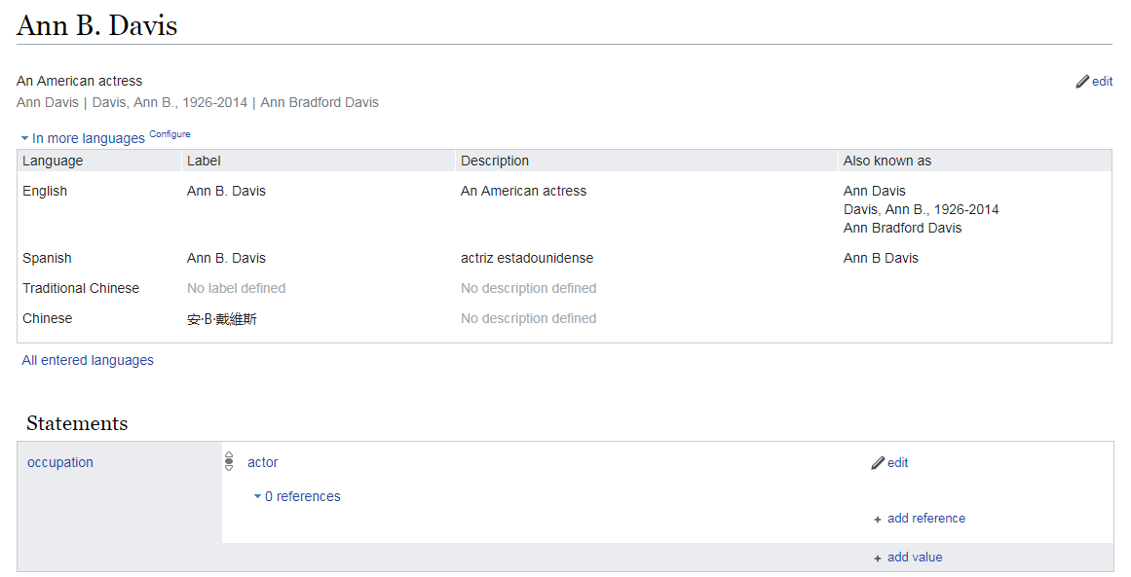
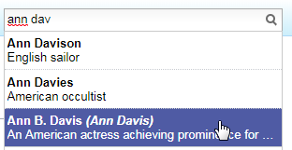
The Wikibase editing interface
Label
http://18.218.102.193/entity/Q1224734
Page URL
Fingerprint data: Label, Description, Also known as
Structured data
Notes:
The Wikibase editing workflow has three steps.
Identify the thing of interest – a Wikibase item entity. This means “creating a new item” entering a label such as “Ann B. Davis” into an HTML form. The system responds by assigning an identifier (Q1224734) and creating a page URL. Ann B. Davis was an American actress who was best known for her role as the housekeeper in The Brady Bunch, a popular TV sitcom in the 1970s.
Add fingerprint data, as shown in the middle of the screen – They’re just labels, but they do a lot of work. Fingerprint data is expressed in the user’s chosen language—in this example, English. Fingerprints consist of the label, plus a description (“An American Actress”) and “Also known as” labels (Ann Davis, Ann Bradford Davis). Fingerprint data is used for searching and disambiguation, as shown in the inset. It is also used to prevent duplicates from being added to the system. Like a human fingerprint, Wikibase fingerprints must be uniquely associated with an entity.
Step 3. Add structured data -- simple statements that can be interpreted by machine processes. An example is shown at the bottom of the image: Ann B. Davis has the occupation “actor”.

Slide 8
The Wikibase editing interface
Label; RWO name; (un) controlled heading
http://18.218.102.193/entity/Q1224734
Identifier; globally unique URI for a real-world object
Fingerprint data: heading , note, alternate heading
Structured data
A “triple”
<Ann B. Davis><occupation><actor>
Notes:
* Wikibase concepts can also be mapped to key linked-data concepts (shown in green).
* And to library-authority file concepts (shown in blue).
These alignments have inspired members of the library community to take a hard look at Wikidata or Wikibase as a solution for fast-tracking the creation and maintenance of library authority files in a linked data environment. In the process, library data is “entified.” And authority management evolves into identity management. Facilitating this change is part of the charge for several task groups in the PCC. More on this point at the end of this presentation.

Slide 9
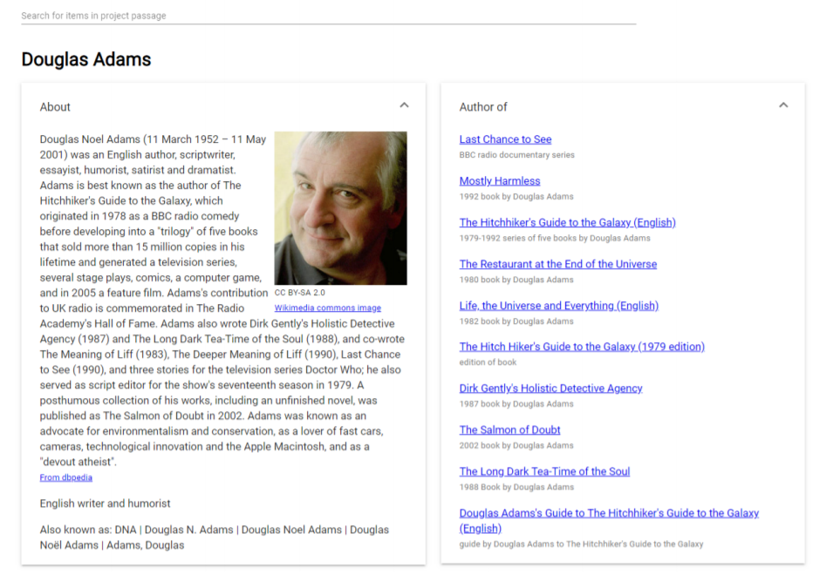
The Passage Explorer
Notes:
During the Passage pilot, OCLC developed two utilities that were compatible with the Wikibase software package.
The Passage Explorer is shown here. It is an end-user discovery interface with a now-familiar tile or Bento-box design. The interface is built in real time from multiple sources to fill in a human-readable display that invites further exploration. In this example, information about the British science fiction writer Douglas Adams is extracted from Wikipedia and Dbpedia to fill in the panels on the left. On the right, a list of books authored by Douglas Adams, including Hitchhiker’s Guide to the Galaxy, is extracted from a SPARQL query issued on the Passage dataset (which includes Item entities exported from Wikidata). The user can click on any of the links to continue exploring.

Slide 10
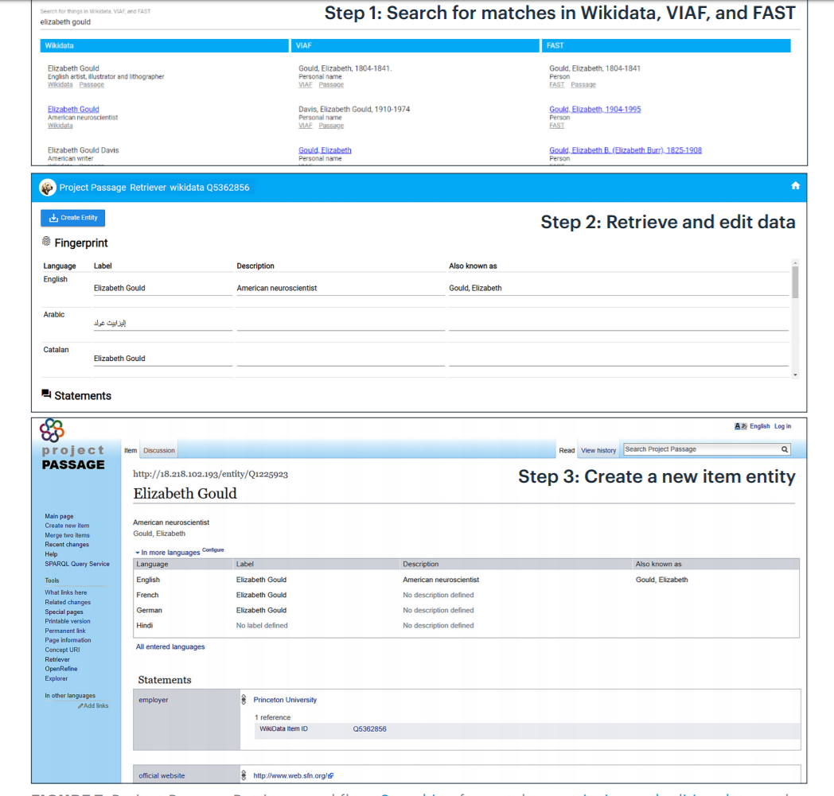
The
Passage
Retriever
Image source:
the Passage report,
figure 7
Notes:
Source: Passage Report, Figure 7

Slide 11
The
Passage
Retriever
Image source:
the Passage report,
figure 7
Notes:
The Passage Retriever was developed to support a slightly more complex workflow than the one I have described so far. If I want to create a new item entity, I would like to check known sources first to find out if it has already been defined. If so, I would like to import that data into Passage as a first draft for my description. That’s what this image illustrates. This is Figure 7 in the report. It shows the steps for creating an item entity for the Elizabeth Gould, an American neuroscientist.
In Step 1, the Retriever searches Wikidata, VIAF and FAST for the label. If found, the data is retrieved from those sources to create a list for the editor to choose from. In addition to the neuroscientist, the Retriever found Elizabeth Gould the artist and writer, as well several other Elizabeth Goulds who had a range of lifespan dates over the 19th and 20th centuries.
In Step 2, the user selects the neuroscientist, and in Step 3 the data is normalized and imported into a Passage item entity. The user can now finish filling in the item entity form as I described previously.

Slide 12
Three takeaways about editing in Wikibase
Editing in Wikibase is a realistic solution for defining entities and relationships that are important to library resource description.
The result can be expressed in a form that software processes inside and outside the library community can interpret.
This simple and intuitive editing interface enables users to create and consume linked data. They can accomplish this goal without having to write software or manipulate raw RDF.
Notes:
Realistic: Wikibase is richly featured, and it already exists.
The result is actionable model of our domain. Our data is ‘entified.’ It weaves libraries into the web, where most users begin their search for information. This is a long-term goal in the transition from current standards to linked data.
To get these benefits, all the human editor has to do is initialize an HTML form, add a set of labels, then add a set of structured statements. That’s pretty easy.

Slide 13
Studies in resource description
Notes:
For pilot participants, Passage was a hands-on resource description exercise with a locally installed Wikibase instance that had been with data imported from Wikidata, VIAF, FAST, and WorldCat. At the beginning of the pilot Passage dataset was seeded with about 1 million Wikidata pages (or “Item entities”) that also contained identifiers from these library-community resources. More data would be bulk-loaded later in the pilot, but the study focused on the editing experience.
Editing was both simple and complex. The editing environment was intuitive and easy to learn. We all learned a lot. The rich discussion that took place in the office hours was one of the highlights of the Passage experience.

Slide 14
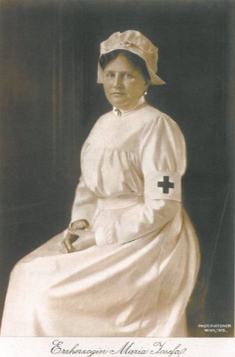
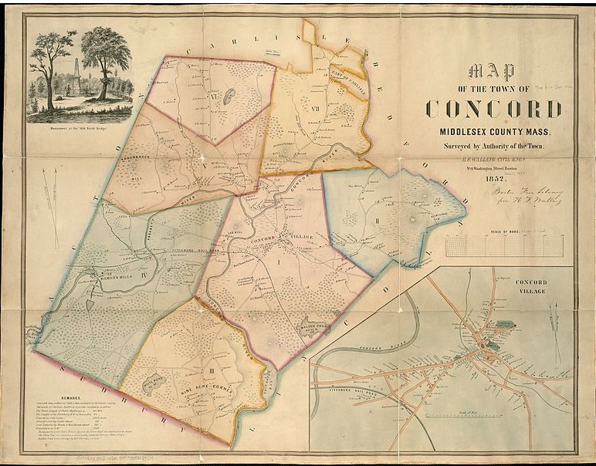
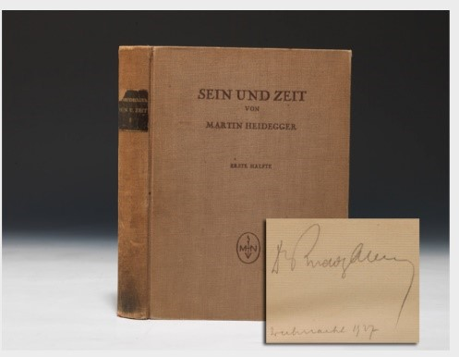
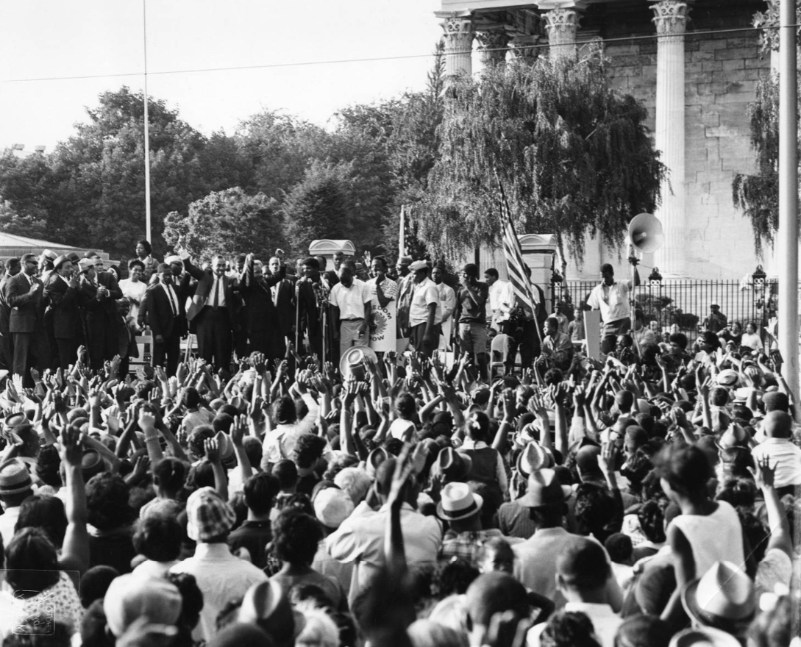
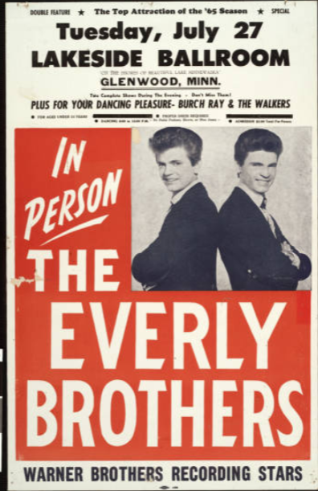
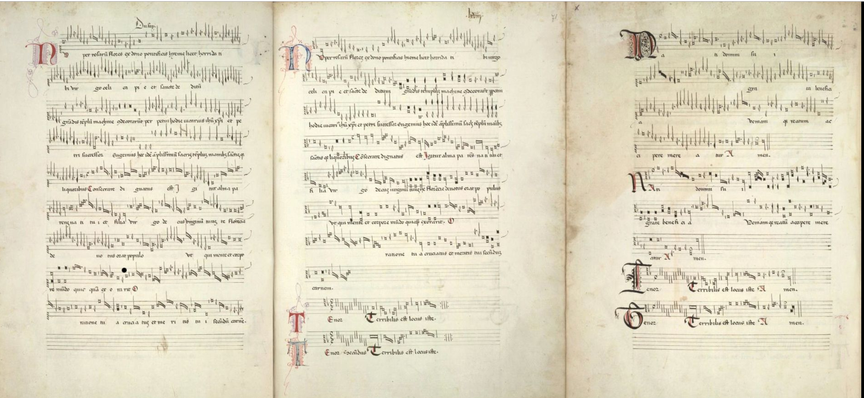
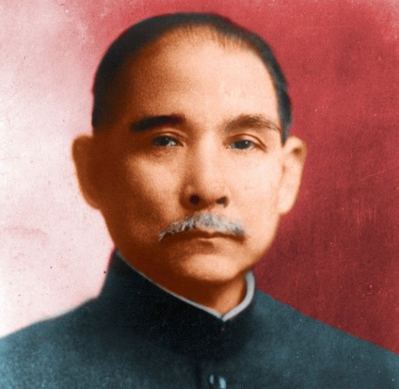
Some “Items of interest”
Notes:
Pilot participants selected the people, places, things, and creative works they wanted to describe and share with the group. These are the Wikibase “items of interest” described in the report.
Some are shown here: a map, a work of German philosophy that had been translated many times, photographs of famous people and historical figures and a musical score. These are the case studies that are described in detail in the middle pages of the report. They are also the empirical grounding for the more wide-ranging reflection captured in the final sections of the report. But our engagement with the Wikibase editing environment didn’t stop here. I can speak for my colleagues at OCLC and say that these examples became patterns or archetypes in a pool of common knowledge that demanded follow-up study. I’ll touch on some of this new work at the end of this presentation.
In the next few slides, I’ll discuss two examples that reveal especially interesting insights about the nature of the resource-description task in Wikibase—and the value and possible limits of structured data.

Slide 15
A poster for an Everly Brothers concert
Label: Everly Brothers performance poster, Lakeside Ballroom, Glenwood, Minn., July 27, 1965
Description: Everly Brothers performance poster, appearing with Burch Ray and the Walkers at the Lakeside Ballroom, Glenwood, Minn., July 27, 1965
Also known as: In Person, the Everly Brothers
Source: Kalan Davis, University of Minnesota Library
Image source: Minnesota Reflections Digital Library
Notes:
The first is a poster that is an item in the Minnesota Reflections Digital Library. This resource was described in the Passage pilot by Kalan Davis, University of Minnesota Library.
What is remarkable about it:
A famous rock and roll duo who performed in the 1950s and 1960s had a concert in a small city in Lakeside Ballroom in Glennwood, MN. That’s a west-central Minnesota that has never had more than 2600 residents, according to Wikipedia.
The historic Lakeside Ballroom stood for 90 years on the shore of Lake Minnewaska.
In the 1960s it was a performance venue that attracted some nationally-known performers.
The problem: many of the entities in the context of the poster were not “notable”, at least by Wikidata’s standards. To describe this poster, it was necessary to define several other item entities. They are underlined in the slide.
A convention established in the pilot was to use the fingerprint data to list the important entities for the item of interest. If they don’t have a Wikibase item entity, you need to create one. For example, Burch Ray and the Walkers was a rock and roll band formed in 1961 in Miles City, Montana.

Slide 16
A photograph of a demonstration
Title: Cecil B. Moore at Girard College.
Description: Cecil B. Moore, President of the local chapter of the NAACP, addresses civil rights demonstrators at Girard College in Philadelphia on August 3, 1965.
Subject: civil and political rights; demonstration
https://digital.library.temple.edu/digital/collection/p15037coll17/id/37/rec/2
Notes:
This resource was described in the Passage pilot by Holly Tomren, Temple University Library.
From the digital library item description:
Shown
From the collection description
The John W. Mosley collection of the Charles L. Blockson Afro-American Collection at Temple University Library is one of the most prestigious collections of African American artificats in the U.S. It contains over 500,000 items.
https://www.cla.temple.edu/africology-and-african-american-studies/blockson-collection/

Slide 17
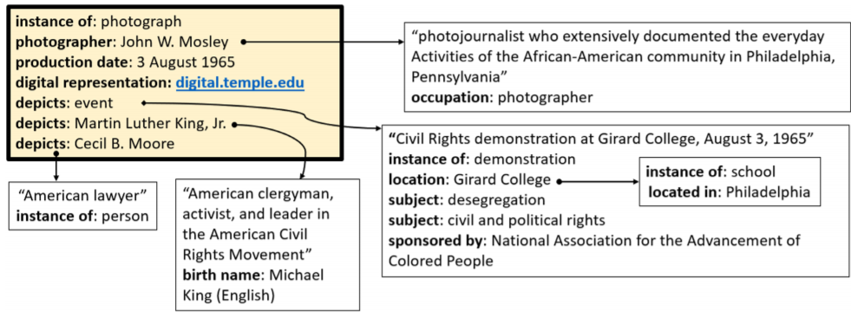
A photograph of a demonstration
Content
Institutional context
Notes:
The superimposed images are taken from Figures 25 and 27 in the Passage report. They show two contexts for creating structured data for the photograph. They are represented as knowledge graphs.
The first image shows content relationships—such as the place, time and date of the gathering, a civil rights demonstration at Girard college in Philadelphia in 1965. The statements also identify two famous people: Cecil B. Moore (who is addressing the crowd) and Martin Luther King. The exercise revealed a lot of discomfort about how to represent the content. The “depicts” property was good for picking out who or what is “in” the photo but not for stating *what* this scene is about. The “subject” statements--about desegregation and civil and political rights—seemed better suited for this more abstract purpose.
Fingerprint data was another place to add context. Note how descriptive they are. This exercise raised issues about how to build interpretive context for items in a collection. Should this context be created in structured data? If it doesn’t go there, the only other place to put it is fingerprint data. Would narrative or expository text be a better solution?
This photograph is also an item in a collection within a research institution. This context is shown in the second image. The Passage descriptions for the archive were a by-product of the need to describe the photograph. The image can be found more easily with structured data that identifies the institutional context for the item. And this one is especially complex.

Slide 18
What are the entities that matter, and how much should we say about them?
Where do you stop?
…Actually, where do you start?
Structured data works well for verifiable facts.
What form should the description take?
But do opinions and interpretation need a different treatment?
…And who will do the work?
Notes:
And now, finally, I can answer the question in the title of this presentation.
Starting and stopping: This is a difficult question when the deliverable is no longer a record, but a piece of a knowledge graph. In the previous slide, the statements in the yellow background are simply the focus--the items of interest--in a given resource description task. They’re not special in any other way.
Kalan, reflecting on the experience of describing the Everly Brothers poster, points to an answer.
“As we catalog in this new environment, we are forced to think through the answer to the question: What entities matter to this object?” Identifying “the entities that matter” will drive the construction of the future bibliographic universe. This imperative will perhaps supersede the traditional rationale for bibliographic description, which focuses on the ‘item in hand’ and is informally referred to Cutter’s now-infamous “cult of the title page.”
Second row: expressions of discomfort about how to format the description to reproduce (and improve upon) human-readable records, which are more compact and readable. Holly, reflecting on this experience:
Descriptions in Passage can “cascade”, which is a different approach to description than traditional flat record-based cataloging. The original descriptions in Temple’s digital library included a variety of subject headings. In Passage, however, some of those subject headings were not applied to the description of the photograph itself, but to the entities depicted in the photograph, whether they were persons, events, or places. In some cases the original “subject” could be three or four “skips” away from the photograph description.”
Third row: Doing the work: Descriptions of individual items in a collection support knowledge discovery and are one of the biggest benefits of linked data, but librarians don’t typically do too much at this level. Perhaps in the future, subject matter experts will do this work instead, in coordination with library staff. A section of Passage report discusses this topic.
But one thing is clear: These are foundational questions. The very fact that they were being asked in the Passage pilot is evidence that the creation of entities and relationships in a knowledge graph represents a paradigm shift in how library resources are described. At the end of the report. the authors reflected on what that shift looks like by taking stock. What are the new tasks? What tasks are obsolete? And what stays the same?

Slide 19
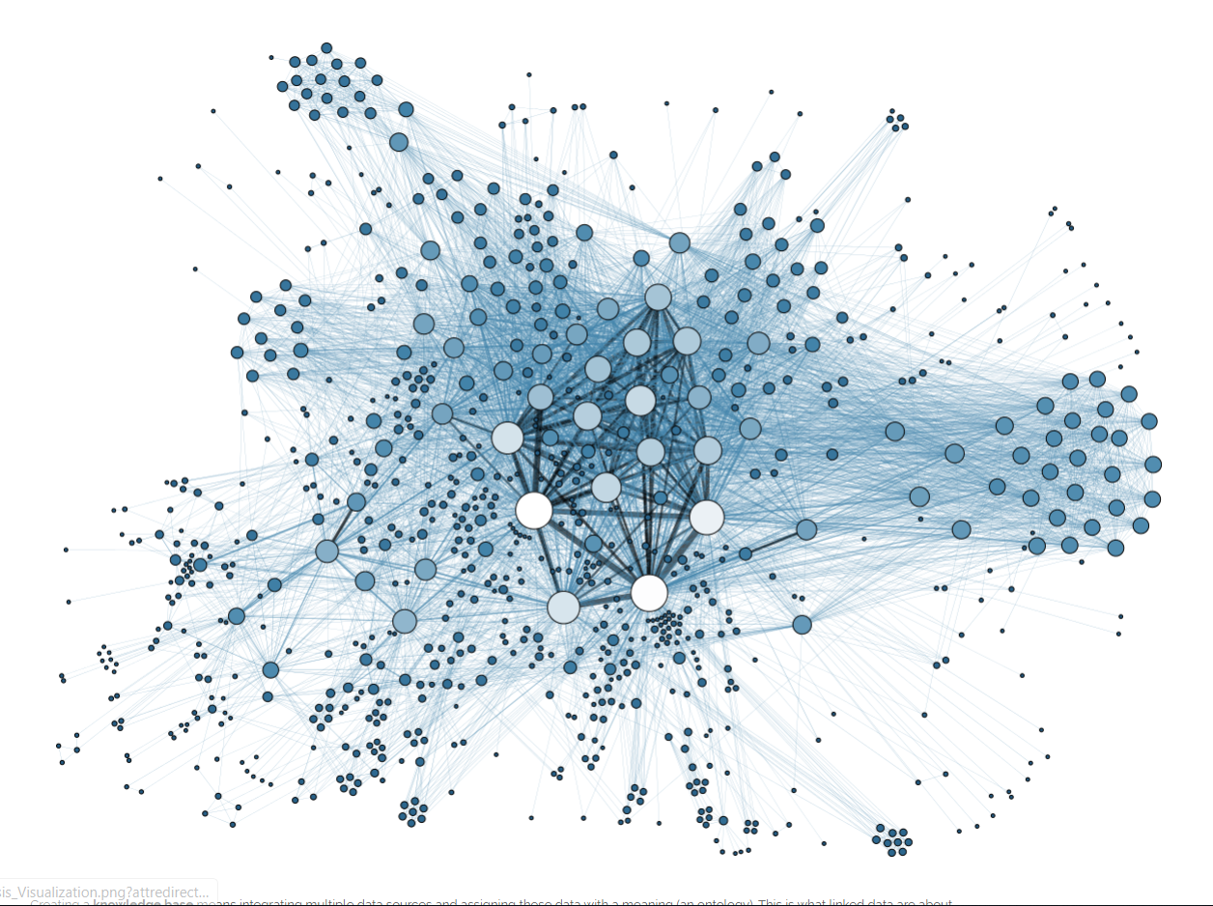
A more realistic visualization of Linked Data
source: http://sites.linkeddata.center/blog/archive/1-2-3linkedopendataarehere
Notes:
There is no item of interest. It’s just a cloud of nodes and edges. The yellow boxes I’ve shown simply indicate where someone decides to work on the graph right now. Identifying that place to work, how to fill it out, and how to make use of the results can be exciting. But disorienting, too.

Slide 20
After Passage: Two “what’s” and a “how”
Notes:
But next steps are already being taken. Some are identified in the report. All need coordinated community effort. I’ll close by talking about two what’s and a how that OCLC is involved in.

Slide 21
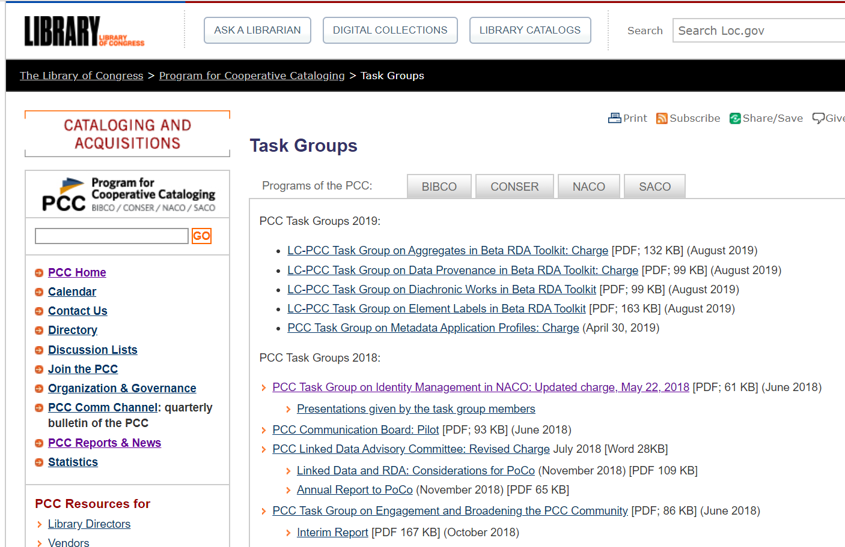
PCC Task Group on Identity Management in NACO
Notes:
First step: Define and advocate for best practices that will help practitioners determine what to describe, how to start and stop, and how much detail to give. The Passage report suggests that a good starting point for this discussion is a concept in current practice: bibliographic significance.
Much of this discussion is happing in the PCC Task Group on Identity Management in NACO.
https://www.loc.gov/aba/pcc/taskgroup/task-groups.html
https://www.loc.gov/aba/pcc/taskgroup/PCC-TG-Identity-Management-in-NACO-rev2018-05-22.pdf
http://www.ala.org/alcts/confevents/upcoming/webinar/120617
Purpose of the group: “Provide leadership for the shift in authority control from an approach primarily based on creating text strings to one focused on managing identities and entities.”
Part of this leadership is the conduct of pilot studies. OCLC is working with this group to design two studies:
URIs in MARC -- Making connections between the current standard and the linked data environment. If Wikidata and Wikibase URIs are in MARC records, how to we take advantage of them?
Wikidata or Wikibase pilot – Involve a larger audience in the sandbox experience described in the Passage report.

Slide 22
https://www.oclc.org/research/partnership/working-groups/archives-special-collections-linked-data-review.html
Notes:
Second step: Domain-specific exploration.
The OCLC Research Library Partnership has recently formed a working group on the impact of linked data on archives and special collections. But all resource types need this kind of attention.

Slide 23
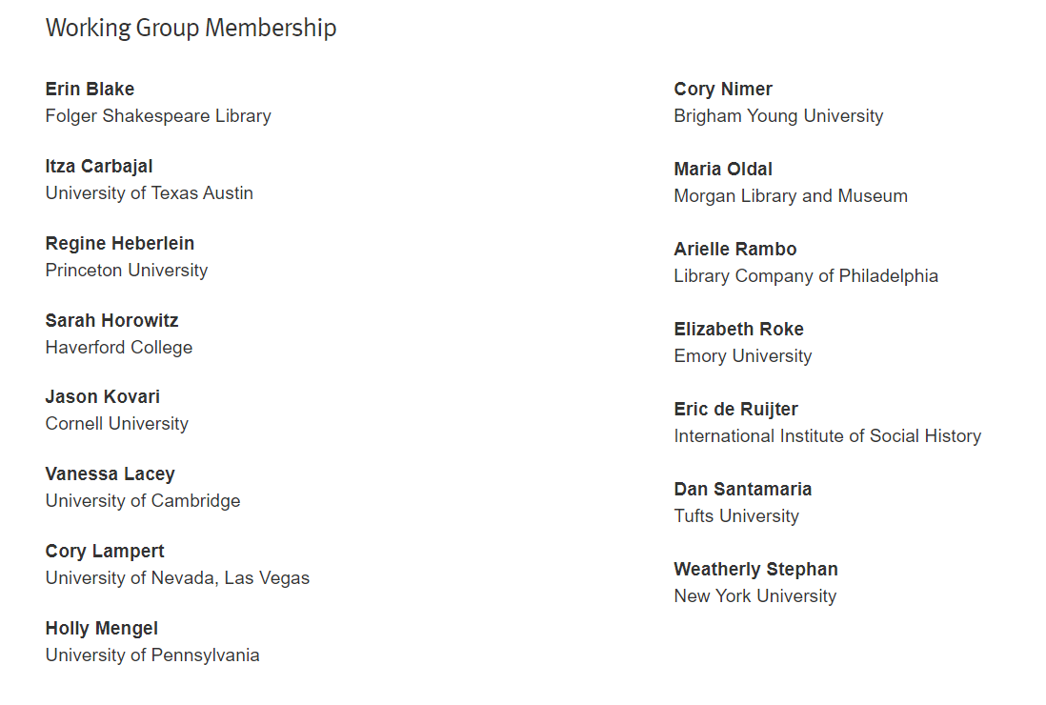
https://www.oclc.org/research/partnership/working-groups/archives-special-collections-linked-data-review.html
Notes:
Current membership will discuss the big questions: What are the pain points in current practice? What is the potential for linked data to address these problems and take archival description to a new level?

Slide 24
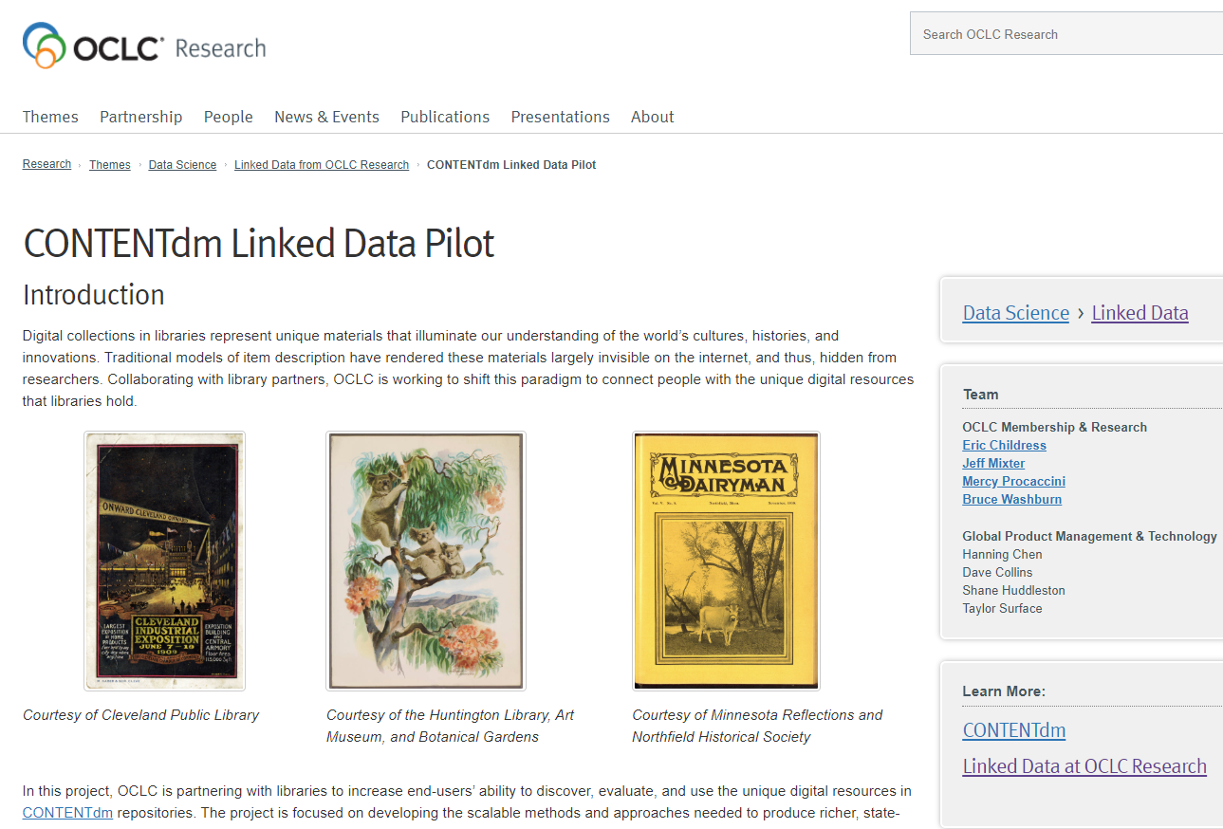
https://www.oclc.org/research/themes/data-science/linkeddata/contentdm-linked-data-pilot.html
Notes:
Bruce Washburn, Jeff Mixter, and Mario Einaudi. Introducing the CONTENTdm Linked Data Pilot. https://www.oclc.org/content/dam/research/presentations/2019/Mixter-Washburn-Intro-CONTENTdm-Linked-Data-Pilot-08072019.pptx
The CONTENTdm Linked Data pilot picks up where the Passage discussion about image objects. This work promises to advance our understanding of how images should be curated in a linked data environment.
Among the goals:
Add context to the CONTENTdm production user interface, based on information found through Wikibase connections to external sources
Evaluate Wikibase as a platform for creating and managing CONTENTdm metadata
Evaluate Wikibase as a platform on which to build CONTENTdm discovery interfaces
The CONTENTdm Linked Data pilot is currently underway with several partners in the library community: Cleveland Public Library, Huntington Library, University of Minnesota.

Slide 25
“In this project, OCLC is partnering with libraries to increase end-users’
ability to discover, evaluate, and use the unique digital resources in
CONTENTdm repositories.”
“The project is focused on developing the scalable methods and
approaches needed to produce richer, state-of-the-art machine
representations of entities and relationships to make visible
connections that were formerly invisible.”
Notes:
https://www.oclc.org/research/themes/data-science/linkeddata/contentdm-linked-data-pilot.html

Slide 26
Linked Data Research
at OCLC
Jean Godby
Senior Research Scientist
godby@oclc.org

Slide 27
NISO Webinar: Implementing Library Linked Data
Special thanks to the participants in Project Passage,
and to the coauthors of the report.
Jean Godby
Senior Research Scientist
godby@oclc.org

