Slide 1



Health Librarians ● 23 October 2019
Public Libraries Respond to the Opioid Crisis with Their Community
Lynn Silipigni Connaway, PhD
Director of Library Trends and User Research
connawal@oclc.org
@LynnConnaway

Slide 2

    More than 130 people die in the U.S. everyday from an opioid overdose.
(Rudd, 2016)
Photo by nosheep is licensed under Pixabay
Notes:
I’m going to start with a staggering statistic. In 2017, more than 130 people died everyday from an opioid-related overdose in the United States. That’s over 47,600 people a year. In 2014, this number was 28,647 – this is a 66% increase in just three years, and it is indeed an epidemic. Overall, drug overdoses have killed more than 70,000 Americans.
More than 20 percent of patients who have been prescribed opioids misuse them, and the Midwest saw a 70 percent increase in opioid overdoses from July 2016 through September 2017
The story here in Mexico is remarkably different, and truly, I hope it stays that way, because this is a terrible weight on American communities. In Mexico there were just 378 reported opioid-related overdose deaths in 2016 for the entire year
Drug overdose deaths | drug overdose | CDC injury center. (2018, December 21). Retrieved June 10, 2019, from https://www.cdc.gov/drugoverdose/data/statedeaths.html
Rudd, R. A. (2016). Increases in drug and opioid-involved overdose deaths — united states, 2010–2015. MMWR. Morbidity and Mortality Weekly Report, 65. https://doi.org/10.15585/mmwr.mm655051e1
Goodman-Meza, D., Medina-Mora, M. E., Magis-Rodríguez, C., Landovitz, R. J., Shoptaw, S., & Werb, D. (2019). Where is the opioid use epidemic in mexico? A cautionary tale for policymakers south of the us–mexico border. American Journal of Public Health, 109(1), 73–82. https://doi.org/10.2105/AJPH.2018.304767
Scholl, L. (2019). Drug and opioid-involved overdose deaths — united states, 2013–2017. MMWR. Morbidity and Mortality Weekly Report, 67. https://doi.org/10.15585/mmwr.mm6751521e1

Slide 3
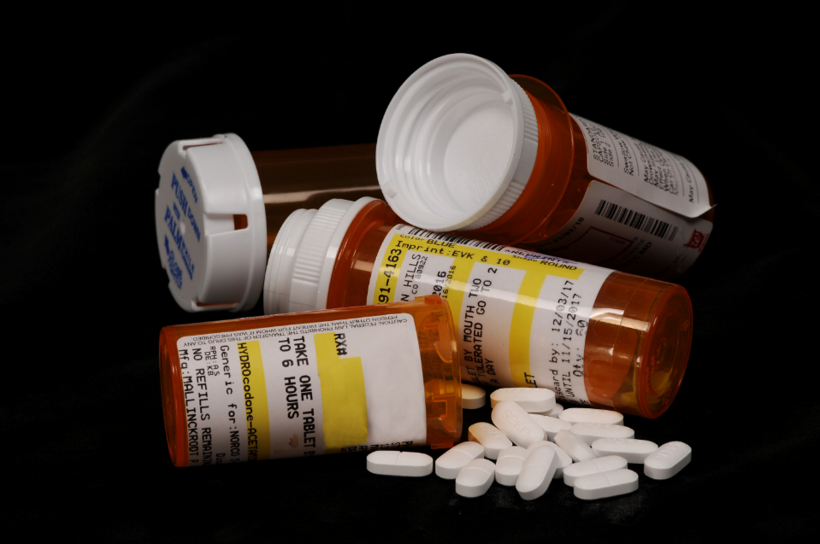
Misuse of prescription opioids costs $78.5 billion a year.
(Florence, Luo, Xu, & Zhou, 2016)
Opioids by K-State Research and Extension is licensed under CC BY2.0
“Opioids” by K-State Research and Extension is licensed under CC By 2.0
Notes:
More than 20 percent of patients who have been prescribed opioids misuse them, and the Centers for Disease Control and Prevention has estimated that misuse of prescription opioids costs $78.5 billion a year. This is the cost for treatment for those experiencing addiction, emergency services for people who overdose, and policing efforts.
This is a massive problem in the United States and it is impacting people deeply. It is very difficult at this point to not know someone who has been affected by this crisis – people have lost their children, their parents, their friends – or they know someone who has. It is simply devastating. Libraries are on the front line of the crisis as a welcoming public space.
Florence, C., Luo, F., Xu, L., & Zhou, C. (2016). The economic burden of prescription opioid overdose, abuse and dependence in the united states, 2013. Medical Care, 54(10), 901–906. https://doi.org/10.1097/MLR.0000000000000625

Slide 4

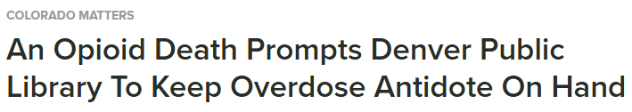




Notes:
So you may be asking, “What does this have to do with libraries?”
These are just a few headlines from news media in the United States about the impact that this crisis is having on U.S. public libraries. Over the past few years, stories like these have been common, as communities face the realities of opioid addiction and overdose – and libraries certainly have not been spared.
Headlines like these, as well as ongoing concerns and questions raised by library staff in all the places that they meet, such as at conferences and in meetings as well as in the online space through listservs and emails, prompted us to look at how we could capture and share how libraries are responding to the opioid epidemic with their communities.

Slide 5
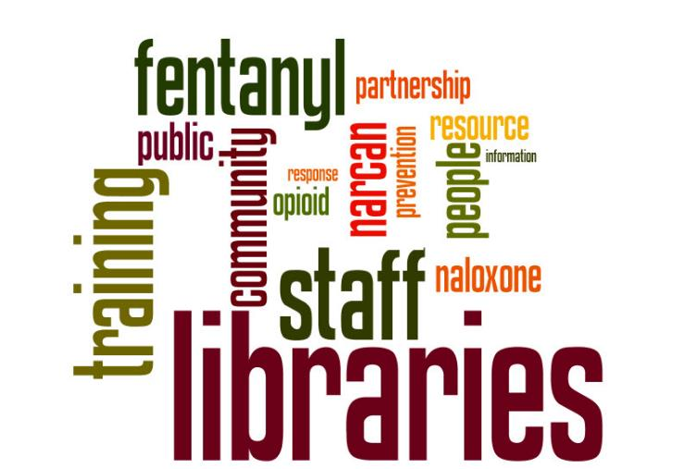
Notes:
How we got started.
These concerns that we heard from library staff prompted OCLC and PLA to partner on offering a free, online townhall in September 2017. This was open to everyone, and it was an opportunity to hear about how this crisis was impacting libraries. We invited speakers ranging from library staff who were creating responses to community partners who had suggestions and ideas for approaches to share their ideas in this webinar, These words on the screen were some of the most common that surfaced in the chat between participants. You’ll note the focus on things like training, staff, and community. As well as things like fentanyl which is often combined with opioids and can be deadly, as well as naloxone and it’s namebrand, “Narcan.” Libraries are responding, but support is needed. Libraries need and want guidance.
From this webinar, OCLC and PLA decided that we needed to and wanted to do more to address these concerns in the community, so we partnered together on project called “Libraries Respond to the Opioid Crisis with their Communities”

Slide 6

Project partners
OCLC
  Global library cooperative providing technology services, research, and learning programs
Public Library Association
  Largest association dedicated to the needs of public library professionals in the U.S. and Canada
Notes:
The Public Library Association (PLA) is the largest association dedicated to supporting the unique and evolving needs of public library professionals. In collaboration with its parent organization, the American Library Association, PLA strives to help its members shape the essential institution of public libraries by serving as an indispensable ally for public library leaders.
OCLC is a nonprofit global library cooperative providing shared technology services, original research and community programs so that libraries can better fuel learning, research and innovation.
Together, we have the capacity, reach, and networks to research, synthesize, and disseminate project learnings to strengthen libraries and their role in the community.

Slide 7

Project funder
The Institute of Museum and Library Services is the primary source of federal support for U.S. libraries and museums. IMLS funds projects that advance the role of libraries as community anchors, and demonstrate collaborative approaches, have the potential for national impact, and focus on timely issues.
Notes:
In the United States, the Institute of Museum and Library Services (or IMLS), is the primary funder of U.S. libraries and museums. Most public libraries get their money from local government, but they also benefit from the funding that is provided at the national level. IMLS awards grants to organizations to fund projects that will help to strengthen libraries and museums, and are the primary funder for this project.
With this project, IMLS saw the urgent needs surrounding the opioid crisis and wanted to focus on the value of community-based cross-sector responses.

Slide 8
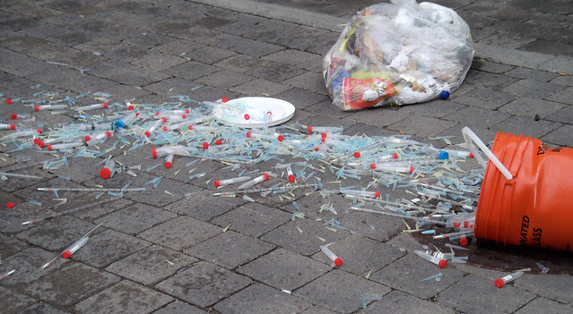
“Obviously, our biggest challenge is that people
keep dying and we can’t work fast enough.”
- Community Partner Director
Syringes by Sam Nabi is licensed under CC BY 2.0
Notes:
At the core of this problem are people in our communities who are dying from opioid overdoses. And that concern is something that we have heard as we embarked on the journey for this project. And there is also the impact that this has on the family and friends – the people who love this person who has an addiction or who has died from their addiction or an overdose.
This is a community-wide problem and it requires community-wide responses.

Slide 9
PROJECT GOALS & ACTIVITIES
Notes:
The next few slides represent a few examples of the types of programming and services that we found in the libraries that were interviewed for these case studies.

Slide 10
Project goals
Identify and share knowledge and resources that will help public libraries and community partners develop effective strategies to address substance misuse
Notes:
This project has three overarching goals.
The first is that we want to help public library directors and staff to make informed decisions about strategies, policies, and activities. Taking what we learn from the experiences of others and then promoting their lessons learned to strengthen the efforts of others.
As a profession, libraries are extremely generous when it comes to sharing their ideas and resources, and we aim to capitalize on that to help others more quickly develop their own responses. It is something that comes up very often, “how do we avoid reinventing the wheel.”

Slide 11
Project goals
Raise awareness among other sectors that libraries, in their role as community anchors, make powerful partners
Notes:
One of the requirements of this research is that the libraries that we are profiling are all involved in supporting their community with the help of local partners. They are seeking out the strengths of other organizations in the community and working together on solutions and opportunities. What we are hearing is that the idea of partnering with libraries to meet community needs isn’t always at the top of the minds of these partners, and we want to work to change that. We want to encourage the inclusion of libraries as key partners, resulting in stronger coalitions and networks. We want libraries to have a seat at the table in addressing these issues that have deep impact on the community, such as the opioid epidemic.

Slide 12
Project goals
Shift traditional systems of practice that result in siloed efforts and limited impact
Notes:
There was always be another issue on the horizon, something else that we need to be engaged in and responding to. And we will go further if we do this together. Working with partners isn’t a new concept – it’s well accepted as a valuable approach when you can find the right partner. And while partnerships may not always be possible, perhaps because of time, or subject matter, or even location. But, when it works successfully, it means that we can equip libraries—and their partners—to deal not just with current needs, but with future challenges, as well.
The development of relationships and infrastructure that can support changes and needs is something that can live well beyond a single project or activity. How do we invest in infrastructure that can benefit us in the years to come?

Slide 13
Project Activities
Case study research in eight libraries (Sept 2018 – June 2019)
Cross-sector discussions (Oct – Nov 2019)
Call-to-action white paper (Dec – Jan 2020)
Dissemination to the field (Oct 2019 – Mar 2020)

Slide 14
Methodology
Notes:
The next few slides represent a few examples of the types of programming and services that we found in the libraries that were interviewed for these case studies.

Slide 15
Case studies
Produce eight case studies that explore a diverse set of communities in which the library is an active partner in response to the opioid epidemic
Notes:
I’ll focus the majority of the conversation today about this deliverable for the project, which is the creation of the case studies which will profile how libraries are responding to the opioid crisis with community partners.
This work is just about to wrap up and we’ll be publishing the case studies and the findings this summer.

Slide 16
Criteria considered for site selection
Diversity of community size, region, geographic distribution, and demographics
Diversity of service population size
Health data: uninsured rate, opioid prescribing rate,
drug overdose death and mortality rate
Must have worked with community partners on programs/services related to the opioid crisis
Represent a range of community interventions
Notes:
There were a range of factors going in to which libraries to select to participate. There are many libraries across the country that are doing some form of opioid-related programming, but we were looking for diversity in both the types of programming and the communities that they serve. These are some of the key data points that we looked at.
The biggest challenge was finding libraries serving smaller communities which could also meet the other criteria, such as working with a partner. The case studies include libraries that serve a community of just over 16,000, all the way up to over 800,000. They represent a range of different resources, different staff and different communities.

Slide 17
Case study sites
Everett, WA
Salt Lake, UT
New Orleans, LA
Peoria, IL
Kalamazoo, MI
Blount County, TN
Twinsburg, OH
Barrington, RI

Slide 18
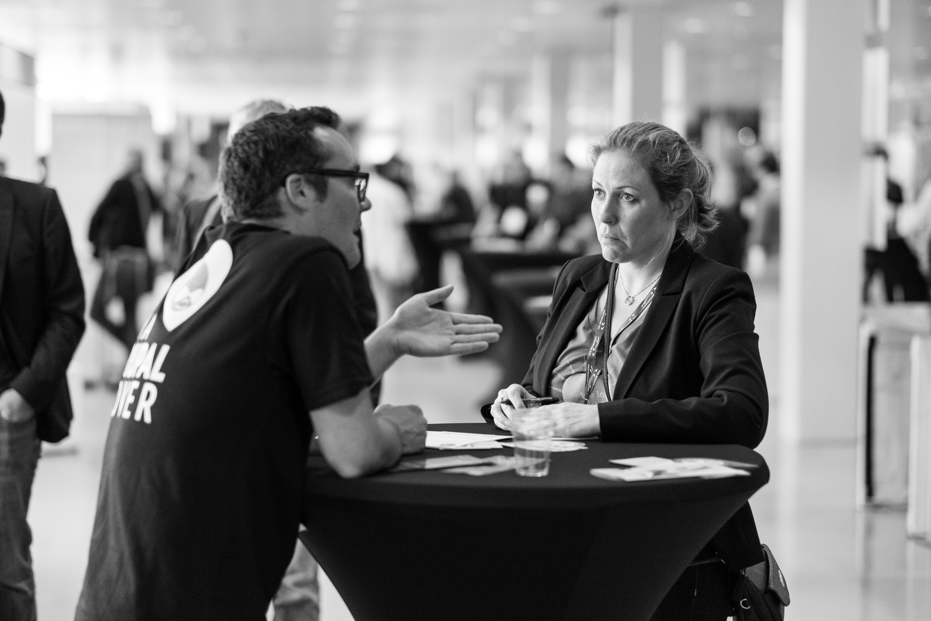
Image: https://www.flickr.com/photos/borisbaldinger/15222127749 by Boris Baldinger / CC by 2.0
Data collection
8 in-depth case studies drawing on partnerships
  Internal and external document review
  Up to 9 semi-structured recorded interviews
  Library Director/Deputy Director
  Library Administrator/Manager
  Library Frontline Staff
  Community Partner Director
  Community Partner Frontline Staff
  Community Member (up to three per location)
(Leedy & Ormrod, 2016)
Notes:
The case studies will explore the local conditions that led to the library responding to the opioid crisis with community partners; how and with whom the response has been implemented; what the results have been and how those have been measured; what have been the experiences along the way; and what challenges, needs, and opportunities remain. Case study research enables in-depth data to be gathered “for the purpose of learning more about an unknown or poorly understood situation.” The case study approach will foster a detailed and deep exploration of the above-mentioned areas of inquiry and accommodate emergent learning that arises.
Citation: Leedy, Paul D., & Ormrod, J.E. (2016). Practical Research: Planning and Design, 11th ed. Boston: Pearson.
Image: https://www.flickr.com/photos/borisbaldinger/15222127749 by Boris Baldinger / CC by 2.0

Slide 19

Image by rawpixel from Pixabay
Data analysis
Interviews transcribed
Code book developed from
interview transcript emerging themes
Transcripts, code book, and coding input in NVivo
NVivo used for data analysis
Notes:
Image by rawpixel from Pixabay

Slide 20
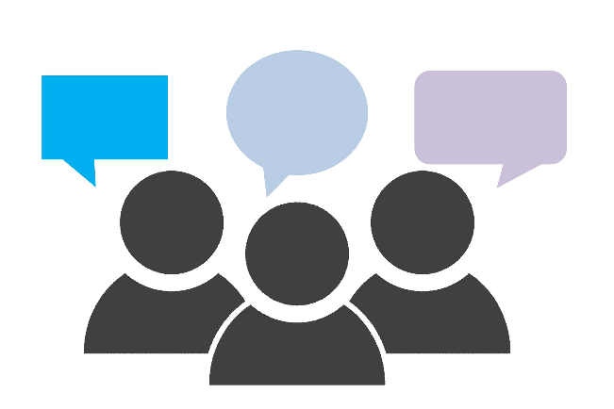
Interview questions
Image by Tumisu from Pixabay
Notes:
I wanted to share a few examples of the kinds of questions that we asked during the interviews. With most interviews, we had no more than 14 main questions, plus some prompts to dig in a little deeper if there was an opportunity. Most of the interviews with library and community partner staff lasted around 45 minutes. Interviews with community members were closer to 15 minutes.

Slide 21
Interview questions – library staff
How did your library decide to offer this program/these services?
How did the library go about building awareness, understanding, support for the program inside your organization? Outside your organization?
What is the impact of the library offering this program/these services in response to the opioid crisis?
Notes:
For the library staff, we aimed to interview the library director, a manager, and a frontline staff member. In some very small libraries, this could all be one person! They really don’t have a large staff. But, in most of the case studies for this project, we were able to talk to someone in each of these roles. These are a few examples of questions that were asked of everyone who worked at the library, so we could better understand how the program started and evolved.

Slide 22
Interview questions – library board
Why do you think it's important for the library to be involved in this work?
What do you think contributed to the success of the work?
Did the board play a role in addressing the responses to the media reactions? (if any)
Notes:
We also interviewed library board members, because we were interested in understanding their stance on the opioid response programming, particularly because it is sometimes seen as sensitive. We sought to understand why they thought the work was important and how the board was involved in supporting the program efforts, whether that was through securing funding, or helping with responses to questions from community members or the media.

Slide 23
Interview questions – partners
Are you more or less likely to partner with the library in the future? Why?
What makes the library a strong partner in an effort like this?
What made you decide to partner with the library on this program/service?
Notes:
For a library’s community partner, we wanted to interview both the director of the organization and a frontline staff member who was involved in the planning and execution. The goal of the questions was to better understand what made the partnership effective and how we could advocated for similar partnerships.

Slide 24
Interview questions – community members
What programs/services related to opioid prevention or treatment have you accessed or used at the library?
What other programs/services besides this one offered at the library have you used?
What has been your overall experience interacting with the library for these programs and services?
Notes:
And finally, we sought to interview members in the community who had participated in the programs and services connected to the opioid response. We also wanted to understand how these community members had used the library in the past, and what their overall experience was like.

Slide 25
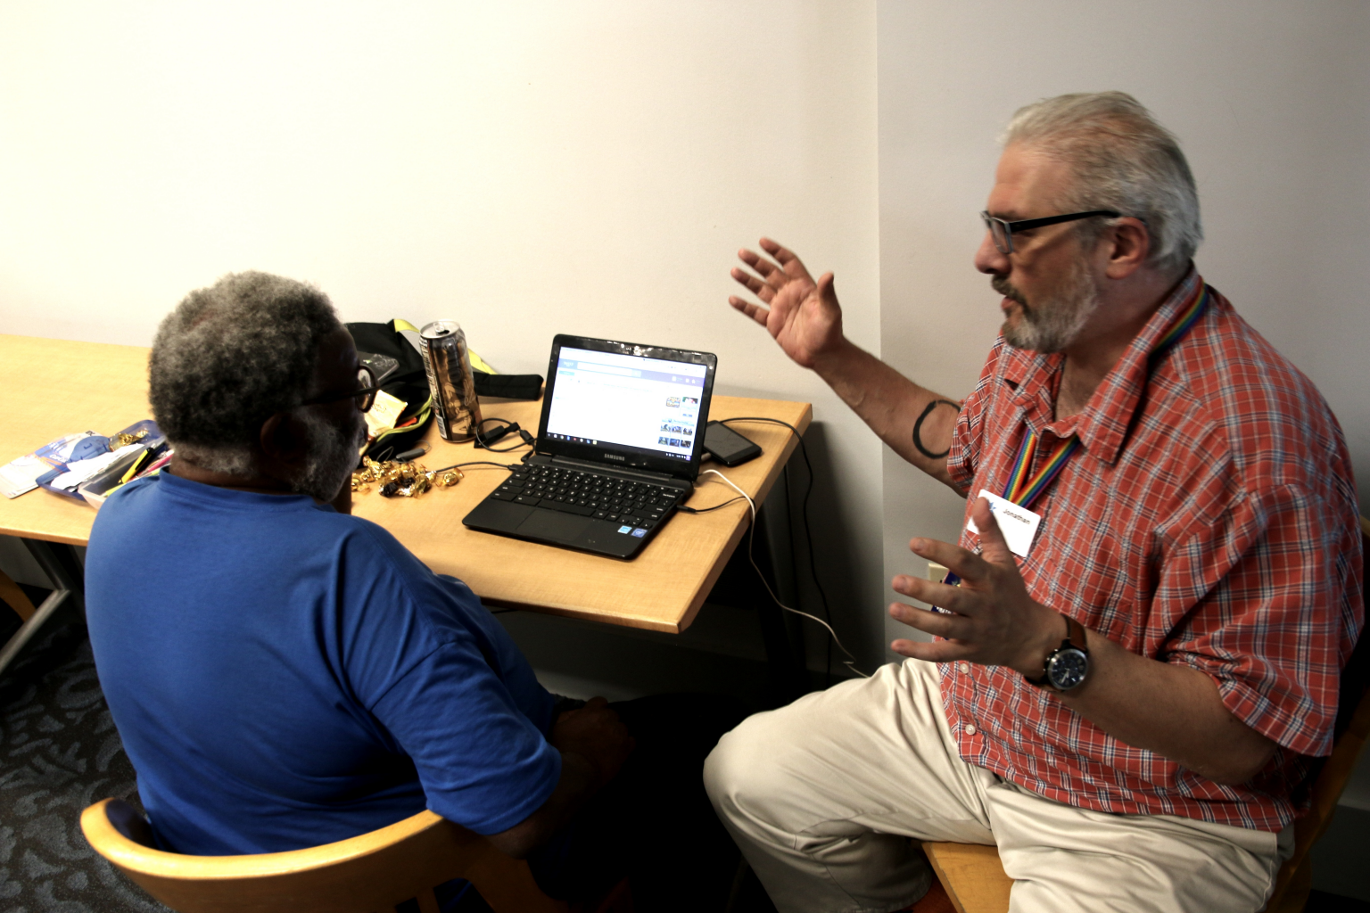
Pre-testing the protocols
Denver Public Library, Community Resource Program
Served as pre-test location for the interview protocol
Provided feedback on the development of the case study for use in the final research outputs.
Photo courtesy: Giles Clasen
Notes:
The director of the Denver Public Library, Michelle Jeske, and a member of the Community Resource Program, Elissa Hardy, have both served on the project’s steering committee and provided invaluable support as we navigate this project. Denver served as a pre-test location for the interview protocol, so that we could make any adjustments before taking this out on the field. We also turned their interviews into a profile so that we can share their ongoing efforts with the library community.

Slide 26
Types of programs and services
Naloxone training, staff and patrons
Community reads and author talks
Changes to physical layouts in bathrooms
Peer navigators
Deterra disposal bags
Recovery Court
Awareness and information campaigns
Mental health and substance abuse related health programming
Notes:
Through our research, a range of programming and services were surfaced. This is helpful for the field to see a range of activities and options. There is no one-size or prescription for how to handle this. Each library has a different community and different needs, so what fits one, will not necessarily work in others.
What we did find though, is that this range includes activities and programming that can fit all kinds of communities and budgets. For example, hosting an community reads event where everyone reads the same book and then the library hosts a discussion is something that many libraries can do, and it doesn’t require a major investment, and it is well-aligned with other programming that the library already offers. This aspect of flexibility and adaption is something that we see as being essential to encouraging libraries to adopt these programming opportunities. We have to be willing to let people determine what is best for them locally, and supporting that as much as we can.
These responses range from ones that are high-touch, involving trained staff and detailed partnership – such as peer navigator programs, which connect people with lived experience, people who have dealt with their own addictions or overdoses all the way through to lower-touch examples such as providing medication disposal bags to patrons which can be used to safely dispose of unused or unwanted prescription medications so that they can’t be abused.

Slide 27
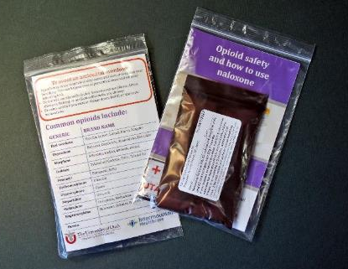
Libraries’ role in their community’s opioid crisis
Connect people to information and resources
Equip people with knowledge and skills
Respond to community needs
Photo: courtesy Peoria Public Library
Notes:
This organizes the information about the types of programs and services in a different way.
Programs like book discussions, awareness campaigns, and health programming Connect people to information and resources
Programs like Recovery Court equip people with knowledge and skills
Peer navigator support, Deterra bags, and naloxone access respond to community needs
Unsurprisingly, programs and activities work best for both library staff and the community, when they’re a natural extension of what libraries do well in their communities. Many of the interviewees for the project felt that their response was aligned with the information needs of their communities.

Slide 28
PROGRAMMING EXAMPLES
Notes:
The next few slides represent a few examples of the types of programming and services that we found in the libraries that were interviewed for these case studies.

Slide 29
Opioid response activities
Notes:
There were eight different categories of activities identified through the research. Several libraries were engaged in more than one activity.

Slide 30
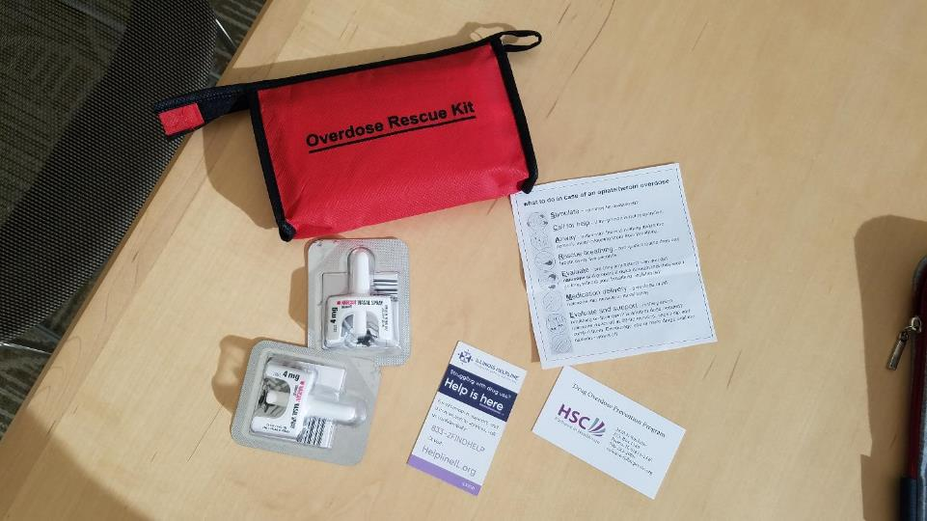
Peoria Public Library
Overdose Rescue Kit
Includes Narcan, instructions for use and information for more help
Photo courtesy: Peoria Public Library
Notes:
Just a few examples of the naloxone training and distribution efforts in libraries.
This is an Overdose Rescue kit – courtesy of Peoria Public Library. It contains several doses of Narcan, which is the opioid overdose reversal drug, naloxone, which can be administered to someone to revive them from an overdose. It also includes instructions for using the Narcan, and what to do to get more help.

Slide 31
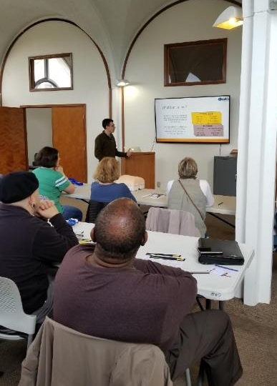
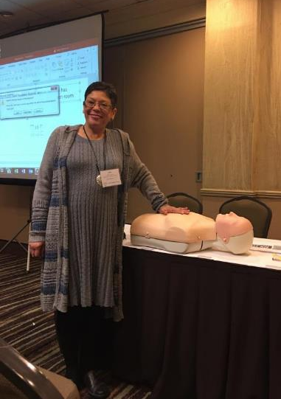
New Orleans Public Library, “Bystander Training”
Provides first aid training, including an opportunity to practice administering naloxone
Photos courtesy: New Orleans Public Library
Notes:
The New Orleans Public Library has rolled out training on how to use the opioid overdose antidote, naloxone, into a training that they offer in partnership with the local health department. The program is called “Bystander Training” and it also includes how to perform CPR, and how to stop bleeding after trauma. This approach of including the naloxone training with other common health concerns helps to reduce the stigma of a drug overdose and gives people the opportunity to understand more about how addictions to opioids form and why it is impacting so many people.
The health department provides all of the trainers for these events, and both organizations help to promote the training. The library is scheduling these events in different locations around their system to help reach more community members.

Slide 32
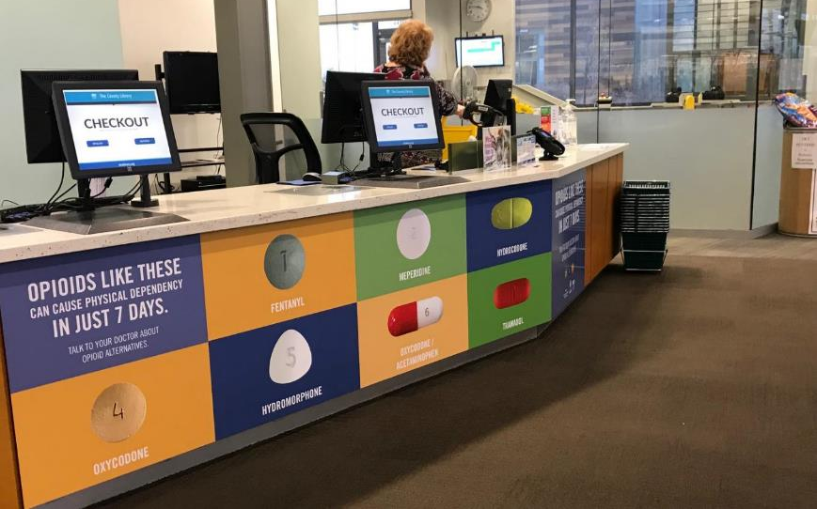
Salt Lake County Library System
Use Only As Directed, public awareness campaign
“Opioids like these can cause physical dependency in just 7 days.”
Photo courtesy: Salt County Library System
Notes:
This is a large display right at the checkout desk of the public library in Salt Lake County Utah. This is an example of community education events and campaigns; this one encourages the community to both recognize what an opioid can look like as well as to increase awareness about the potential hazards.
This display cannot be missed if you are in the library, and it sparks conversation with patrons, as well as in families. Staff noted that children have asked about the “candy” in the pictures. Which is a good reminder to parents that children often don’t realize a pill is a potentially dangerous medication.
This same library also has a large display (see next slide)

Slide 33

Salt Lake County Library System
Use Only As Directed, public awareness campaign.
7,000 opioid prescriptions are written everyday in Utah
Photo courtesy: Salt Lake County Library System
Notes:
This is another example of the public awareness campaign at the Salt Lake Library System. Hanging from the ceiling when you enter the library is 7,000 paper pill bottles, the kind that you would get a prescription in from the pharmacy. This represents the 7,000 prescriptions for opioids that are written everyday in the state. Every day.
In 2016, there were 6,305 drug overdose deaths in Utah. (1)
This display and the one on the previous page were funded entirely by their partners at the health department. The library didn’t need to pay for anything, but they did provide the space to make the display possible. And everyday, hundreds of people walk through the doors of the library and can see these displays and have an opportunity to learn about how the opioid epidemic is affecting their community and maybe learn how to protect themselves and the people they love.
Stats of the state of Utah. (2019, May 24). Retrieved June 10, 2019, from https://www.cdc.gov/nchs/pressroom/states/utah/utah.htm

Slide 34
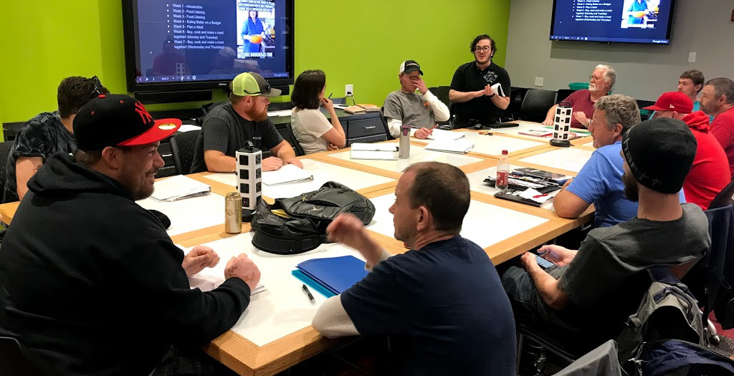
Blount County Public Library, life skills training course
Recovery Court participants attending training sessions at the public library
Photo courtesy: Blount County Public Library
Notes:
An example of social services and recovery support is through the Life Skills Training course offered in Tennessee in partnership with the Recovery Court.

Slide 35
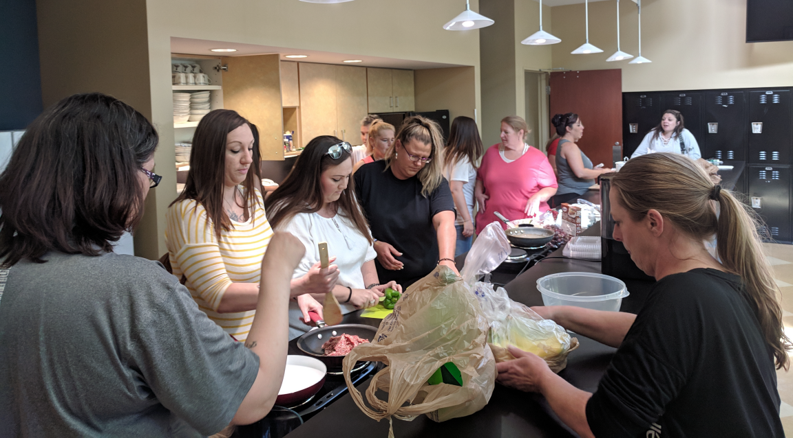
Blount County Public Library, life skills training course
Recovery Court participants attending training on nutrition at the library.
Photo courtesy: Blount County Public Library
Notes:
This is another photo from Blount County. These participants are working on the nutrition model which is part of the curriculum. At the end of the module, the students go shopping for ingredients and prepare a meal for the class. It’s a great example of an active curriculum where students are engaged in the work.

Slide 36
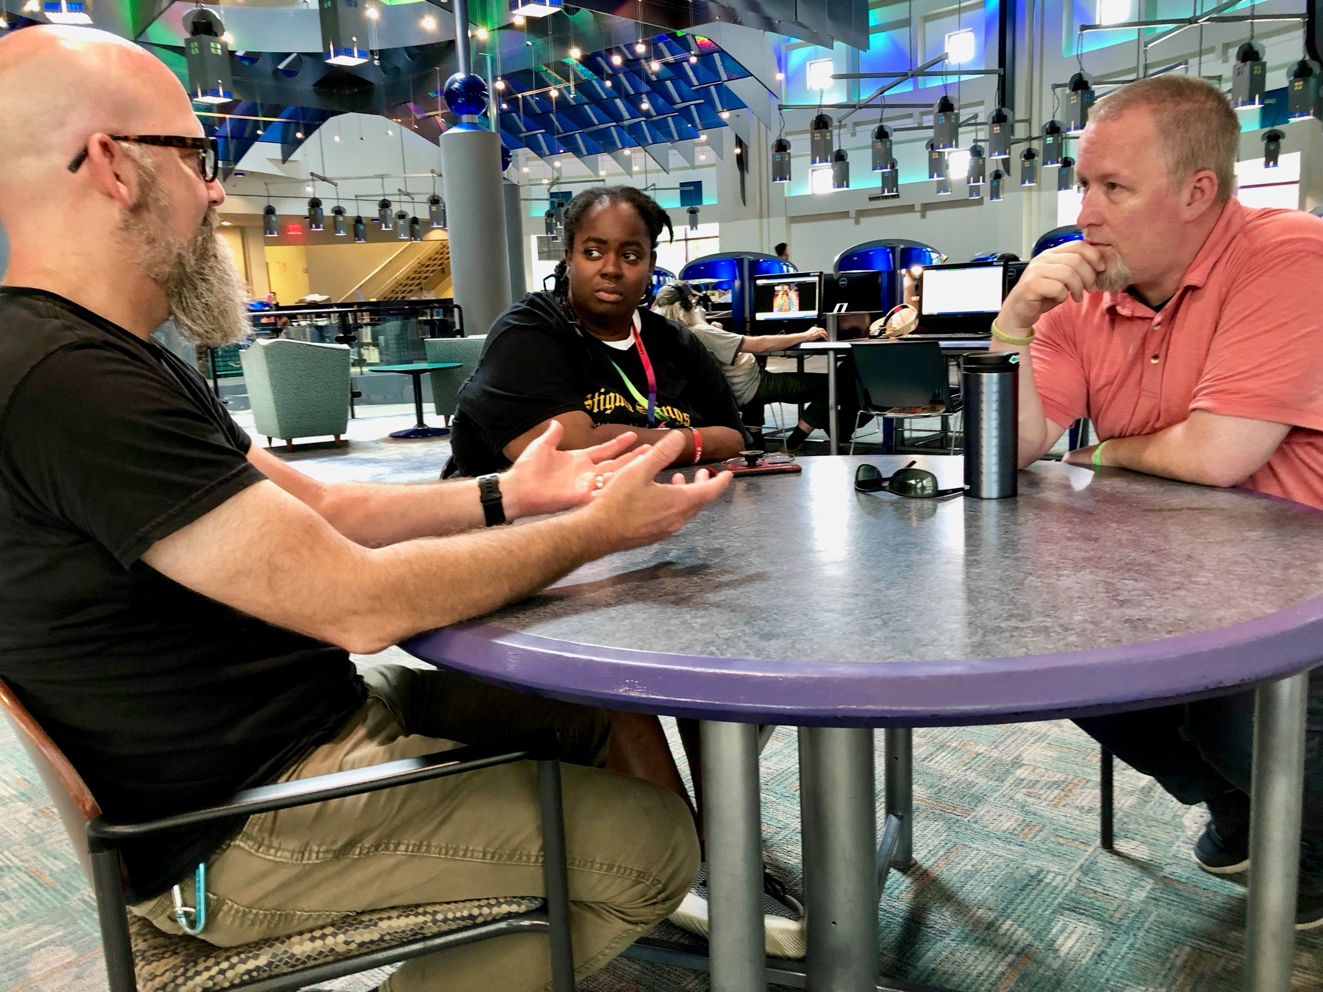
Kalamazoo Public Library,
Peer Navigator Program
Provides access to peer navigators to help community members by providing support and connecting them to public services
Photo courtesy: Kalamazoo Public Library
Notes:
Another example of social services and recovery support is available through the Kalamazoo Public Library. The Southwest Michigan Recovery Institute provides access to peer navigators. These peer navigators work in the library and look for opportunities to provide some support. Some days this could be with giving them access to a phone to make a call, or it may be connecting them to a local shelter or housing assistance. And sometimes, they are literally just someone to talk to. With compassion and patience.

Slide 37
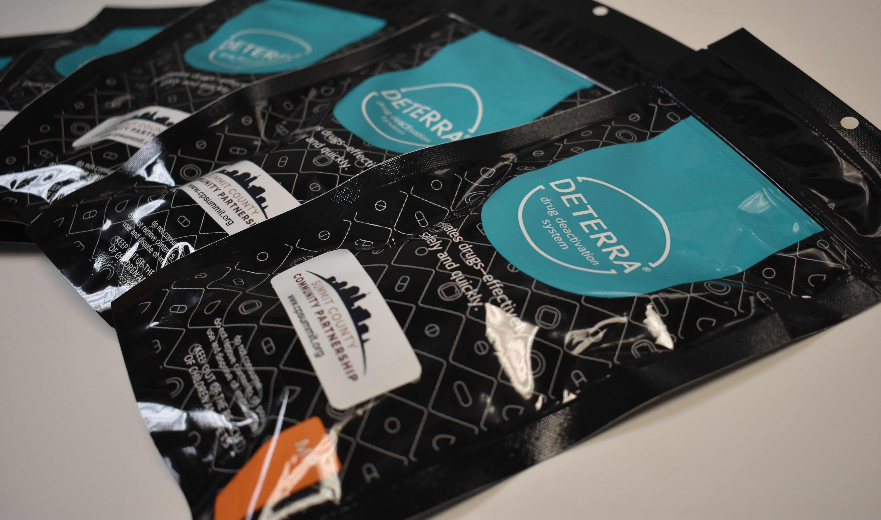
Deterra drug deactivation system.
These bags provide a safe way to dispose of unused prescription and over-the-counter medications.
Notes:
Medication disposal is a preventative measure that is being take by some libraries. One aspect of prevention is removing unused medication from the home. These bags are available from the Twinsburg Public Library, and a user can put any unwanted pills into the pouch, add water and seal the pouch and it renders the pills inactive.

Slide 38
Types of partners
Health Departments
the most common partnership, and is also well-aligned with the needs of the crisis
Recovery Court
focused on improving the lives of individuals who were in prison on drug offenses
Non-profit organizations
Recovery Institute, places peer navigators into the community
Utah Naloxone, gets overdose antidote, naloxone, in the community
Notes:
Libraries working with health departments came up in several of the case studies that we conducted. It’s a natural fit because of the type of activities and concerns that surface with addiction and overdose. These are government-funded organizations that often have responsibility for public health concerns, which would include the opioid epidemic.
Another example we found was a library partnering with Recovery Court – this type of court is focused on addressing individuals who have been in prison for drug offenses. Through this partnership the library provides life skills training to participants in Recovery Court. This life skills training includes things like managing your finances, finding a job, cooking healthy meals. The library designed the curriculum for these classes and offers all of the training. It was well-aligned with the training that the library already provided in the community and it is a highly-valued partnership.
Other examples of partnerships include those with non-profit organizations that are working in this area. One example includes an organization in Utah that provides the opioid overdose antidote naloxone for free and the library then distributes it to the public. Another organization helps to place peer navigators in the community, to help people access local services more readily.

Slide 39
research findings
Notes:
The next few slides represent a few examples of the types of programming and services that we found in the libraries that were interviewed for these case studies.

Slide 40
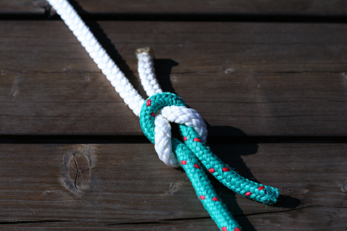
“We're so grateful to libraries for their willingness to do this because it is sensitive messaging. We understand that…culturally it has got a lot of stigma associated with it and a lot of misinformation and that can be a delicate thing. But their willingness to address that, and to become ambassadors, and to help eliminate some of that misinformation is a huge benefit to the community as a whole.”
- Community Partner
Image by Chris Wolf / Pixabay

Slide 41
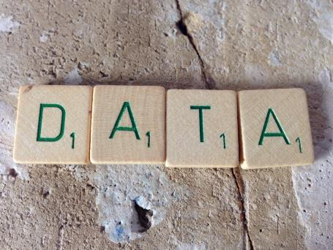
Outputs reported
Increased community resources
Developed new partnerships
Positive impact on patrons’ lives
Increased community awareness and knowledge
Reached other libraries and community organizations
Addressed stigma
Increased positive perception of library
Research Data Management by janneke staaks is licensed under CC BY 2.0
Notes:
A few key outputs resulted from the opioid response activities and were mentioned by interviewees. The most commonly mentioned output was an increase in the number of resources available for the community. This included things like naloxone kits, distributed books, and Deterra bags. Other key outputs were the development of new partnerships, reaching other libraries and community organizations, and addressing stigma.

Slide 42
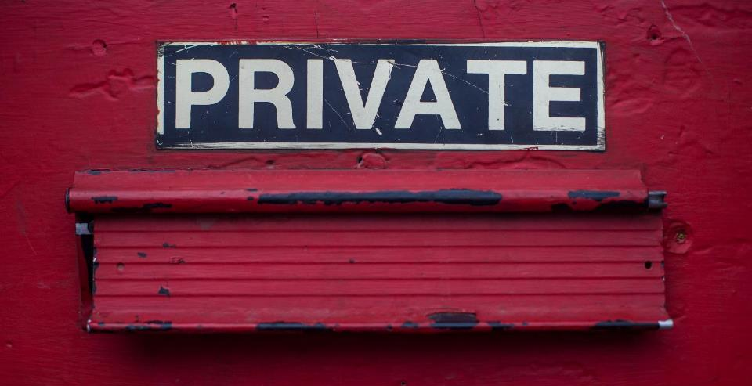
“People addicted to opiates are less likely to talk about that than people who have other addictions to other substances.”
– Community Partner Director
“There's other people that are very, very guarded. So just ask something like, ‘What's your name?’ And they see me write that down, I could lose trust right there.”
– Community Partner, Frontline Staff
Image by Dayne Topkin / Unsplash
Notes:
We did find that formal evaluation was lacking for most of these programs, primarily because of a concern around privacy. These are a few quotes from interviewees about evaluating these services. They shared that seeking help for an issue related to opioid misuse can be a highly sensitive request. And again, the stigma attached to drug use is real, and there can be perceived consequences from individuals who are seeking information – whether it’s an individual who needs help, or someone who is seeking support for a friend or family member. This concern absolutely plays out in how libraries are collecting information about patrons using services connected to the opioid crisis.
Interviewees indicated that confidentiality is critical to being able to provide services, which has made capturing any information about the long-term impact of their efforts very difficult. Instead, we found that more libraries focusing on the number of people served and capturing anecdotal information from staff as it becomes available.

Slide 43
The power of partnership
Amplify impact of collective efforts
Leveraging a partner’s resources/assets to strengthen the program/initiative—or even make it possible
Work in an area or topic where libraries might be unfamiliar/uncomfortable
Develop relationships that can be activated for future issues/projects
Notes:
Looking more at the partnerships, some of the advantages outlined here won’t come as a surprise. These are exactly the kinds of things that surface when organizations collaborate successfully, and it is certainly what we are seeing in this project as well.
One of the key parts of this work is that these relationships won’t just serve the needs of the opioid crisis, but rather, this can be something that has lasting impact as trust develops between organizations who can rely on each other as the needs in the community change.

Slide 44
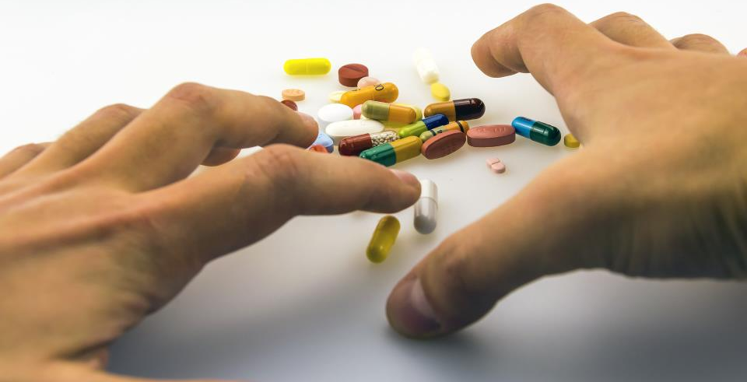
“I feel that there's been a lot of progress. And for a guy like me, who has been to prison, who's suffered, struggled with using for a long time, I'm hanging out with librarians, the police. I'm still alive. I still know people that use, and I don't use, but I'm still talking to those people…But now, there are people that have historically not liked people like me, treating me like a human, and giving me the opportunity to be a human, instead of just a junkie. And that is absolutely phenomenal.”
- Community member using the library services
Image by Emilian Danaila from Pixabay
Notes:
I mentioned that part of the interview protocol is talking to community members who used the services provided by the library and their partners. We recruited community members from each location, and interviewed up to three of them about their experiences.
I wanted to share a few of these because they can be quite impactful and give you a sense of how important this work can be. This quote is from a community member who was sees the opportunity to hang out with librarians and be treated like a human as phenomenal.

Slide 45
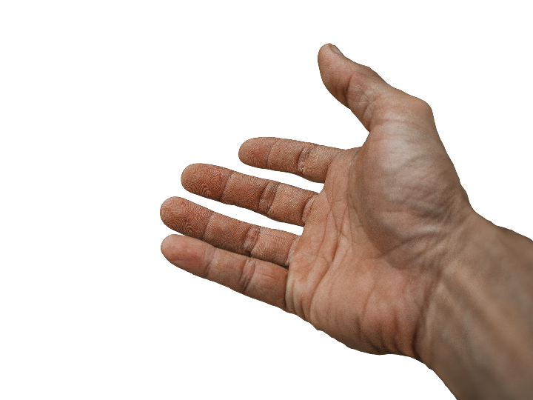
“It benefits me because I feel more prepared to help someone. I think anytime you feel more prepared and trained, you're much more likely to help someone.”
- Community member who received naloxone
from the library
Image by truthseeker08 from Pixabay
Notes:
This quote came from a community member who received training on how to administer naloxone, which can reverse an opioid overdose. This perceived sense of being better prepared to help someone is huge. Knowing that naloxone is available and how to use it can lead to helping someone survive an overdose.

Slide 46

“I'm a pastor in a neighborhood where there are lots of drugs, and some of my congregation have family members who are abusing drugs. Two years ago, we actually had someone die outside of our gates from an overdose. We want to be able to assist our family members, but also our communities, and help the persons who are addicted to substance, particularly opioids.”
– Community member who participated in response training
Photo by Nina Strehl on Unsplash
Notes:
This community member also spoke to the importance of being trained and aware of ways that you can help people who are addicted. He has felt this need directly when someone died outside of his church two years ago. By participating in the training provided by the library and their partner, he was able to get more information to support his community and possibly prevent another tragedy.

Slide 47

“It's refreshing, and to admit, I'm comfortable with talking with people like [the peer navigators] instead of talking with people that have not been in this situation that I've been in. They have a tendency to talk down to me or they really don't understand the road that we've been on and the road that we're on now.”
- Community member who engaged with peer navigators
Photo by Joshua Ness on Unsplash
Notes:
And finally, this was shared with someone who has been speaking with a peer navigator who works out of the library. The interviewee shared that the access to a peer navigator makes a difference in his willingness to share his story and ask someone for help. He valued the fact that peer navigator has had experiences similar to his own and that made him more relatable to the patron.
In the past, he felt that people without that shared experience would talk down to him and really couldn’t understand where he was coming from and the road that he had traveled. But a peer navigator is someone who has been there and that makes a difference to him.

Slide 48
Next steps

Slide 49
Virtual discussions
Through virtual discussion, gather additional insights and resources from government agencies, public health and human services organizations, philanthropic and community organizations, and library leaders
October – November 2019
Notes:
Because partnerships are such an important part of this work, we want to engage organizations from outside the library field in hearing about what is happening in libraries around the opioid crisis and look for opportunities on how we can all work together in addressing the crisis. Later this summer, we will be inviting organizations to participate in an online webinar where we will encourage the attendees to share their thoughts about the case studies, and to share resources that they think will benefit libraries and the public.

Slide 50
Call-to-action white paper
Synthesize the research and cross-sector perspectives into a call-to-action white paper that offers resources and recommendations for how libraries might respond to the opioid epidemic in their local communities
January 2020
Notes:
In the fall, we will publish a call-to-action white paper that will combine the findings of the case studies and the cross-sector discussions. This is an opportunity for us to highlight the various programs and services that libraries might consider offering. The goal here will be to make sure that libraries can see the value in this and see the kinds of partners that might be able to help them. There isn’t a single solution to this epidemic and each library will need to identify their own path.

Slide 51

“So I hope … that this study is just another piece of proof that this is something that we need to do.”
- Community Partner, Frontline Staff
Photo by PublicDomain Pictures on Pixabay
Notes:
One of the interviewees shared this with the research staff. And it really speaks to the importance of both the research and what is happening. Through the call-to-action white paper, and in presentations like these, we want to help more libraries and more organizations to find the opportunity to work together and help to address this crisis.

Slide 52
Share findings
Broadly share the information with public library directors and their staff so that they can more confidently make better-informed decisions about their libraries’ strategies, policies, and activities in relation to the opioid epidemic in their communities
October 2019 – March 2020
(https://digitalcommons.du.edu/collaborativelibrarianship/vol11/iss1/8/)
Notes:
Our first public webinar is later this month on October 30, where we will share much of the same information that I have been able to share with you today. While the timezone difference will make participation for you at some crazy hour, the webinar will be recorded and available for free for anyone to watch and share.
Also, as part of the project, we published an article in the Journal of Collaborative Librarianship in the spring of this year and will be publishing a part two early next year. Both articles are freely available for download.
Coleman, M., & Connaway, L. S. (2019). Public libraries respond to the opioid crisis in collaboration with their communities: An introduction. Collaborative Librarianship, 11(1), article 8. [Available: https://digitalcommons.du.edu/collaborativelibrarianship/vol11/iss1/8]

Slide 53
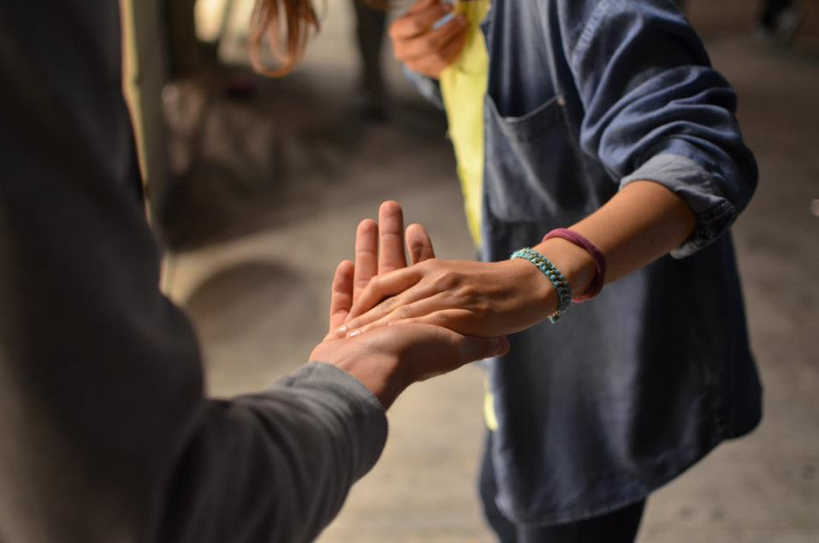
“Be open. Be open to people, to being human, because a drug addict is a person, and they are suffering. And I guarantee there's a whole group of people connected to them that are suffering too. It's sometimes hard to see when you're dealing with it in the moment, but it's real.”
- Library Board member
Image by Rémi Walle / Unsplash
Notes:
Finally, I’ll leave you with something that one of our interviewees, a library board member, shared when asked what they would recommend to people who are just getting started in this area.
Be open. Be open to people, to being human, because a drug addict is a person, and they are suffering. And I guarantee there's a whole group of people connected to them that are suffering too. It's sometimes hard to see when you're dealing with it in the moment, but it's real.”
You’ll be able to read the case studies from this project this summer, and the call to action white paper in the fall.
Thank you.

Slide 54
Wikipedia + Libraries: Health and Medical Information
WebJunction Webinar and Online Course, OCLC

Slide 55


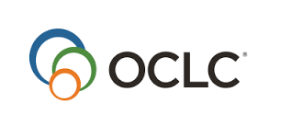

Wikipedia + Libraries: Better Together
Strengthening ties between
public libraries and Wikipedia
Kansas City Jazz Wikipedia Edit-a-thon-2, Clint Ashlock, CC BY-SA 4.0;
Image
Notes:
OCLC’s WebJunction program has been exploring how public librarians use and strengthen Wikipedia. It began in 2017 with an online course Wikipedia + Libraries: Better Together, which helped US public library staff recognize the shared mission, vision, and community backing between libraries and Wikipedia. The course ran for 9 weeks in September to November 2017.
The project was funded by the John S. and James L. Knight Foundation and the Wikimedia Foundation

Slide 56
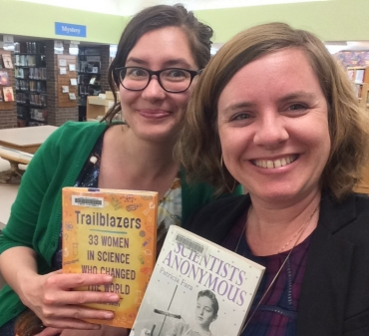
Wikipedian + librarian = Wikibrarian!
Use in informational literacy training
Advise faculty, school administrators
Guide students and researchers
Host editathons
Add local knowledge
Participate in #1lib1ref events
Join Wikimedia projects
oc.lc/oclc-wikilib
Photo courtesy of Allison Frick.
Notes:
The Wikipedia + Libraries course strengthened ties between US public libraries and Wikipedia, to expand public access to authoritative information and serve public libraries’ diverse communities. Participants in the course went on to use Wikipedia for information literacy training and community-building, and many became Wikipedia editors, contributing their librarian expertise to improve the resource.
Resources and stories are available on WebJunction at oc.lc/oclc-wikilib
Allison Frick (left) and Christina Riehman-Murphy, a librarian at Penn State, partnered to organize an information literacy event focused on women in science. Credit: Courtesy Allison Frick.

Slide 57
Why does Wikipedia matter for
health and medical information?
Photo by rawpixel on Pixabay
Notes:
Now WebJunction has partnered with the National Network of Libraries for Medicine (NNLM), with funding from the Mid-Continental Region (NNLM-MCR) to train public library staff to strengthen Wikipedia as a resource for health and medical information, both for patrons and for the health and medical community.
Library staff who have engaged with Wikipedia in a variety of ways may still be skeptical about using it as a resource for health and medical information. However, knowing the extent to which people turn to Wikipedia for this kind of information reinforces the need to meet patrons where they are and guide them smartly and safely.

Slide 58

Wikipedia is among the largest and most frequently used online references
Sources: Foster, 2017; Heilman and West, 2015
“Native plus sized woman” by Allgo for Unsplash
Notes:
Wikipedia is among the largest and most frequently used online references for health and medical information seekers,
It has 223,784 health & medical articles in 281 languages; over 34,000 just in English language
Research shows that people go to Wikipedia to look for information on health and medical topics for themselves and for friends and family. Patients and their caregivers, friends and family will seek out health and medical information to scaffold and inform their encounters with medical providers, both before and after diagnoses (Foster 2017).
Foster, D.M. 2017. “Being Sick Online: Exchanges of Medical Knowledge on the Internet.” Dissertation. University of Michigan.

Slide 59
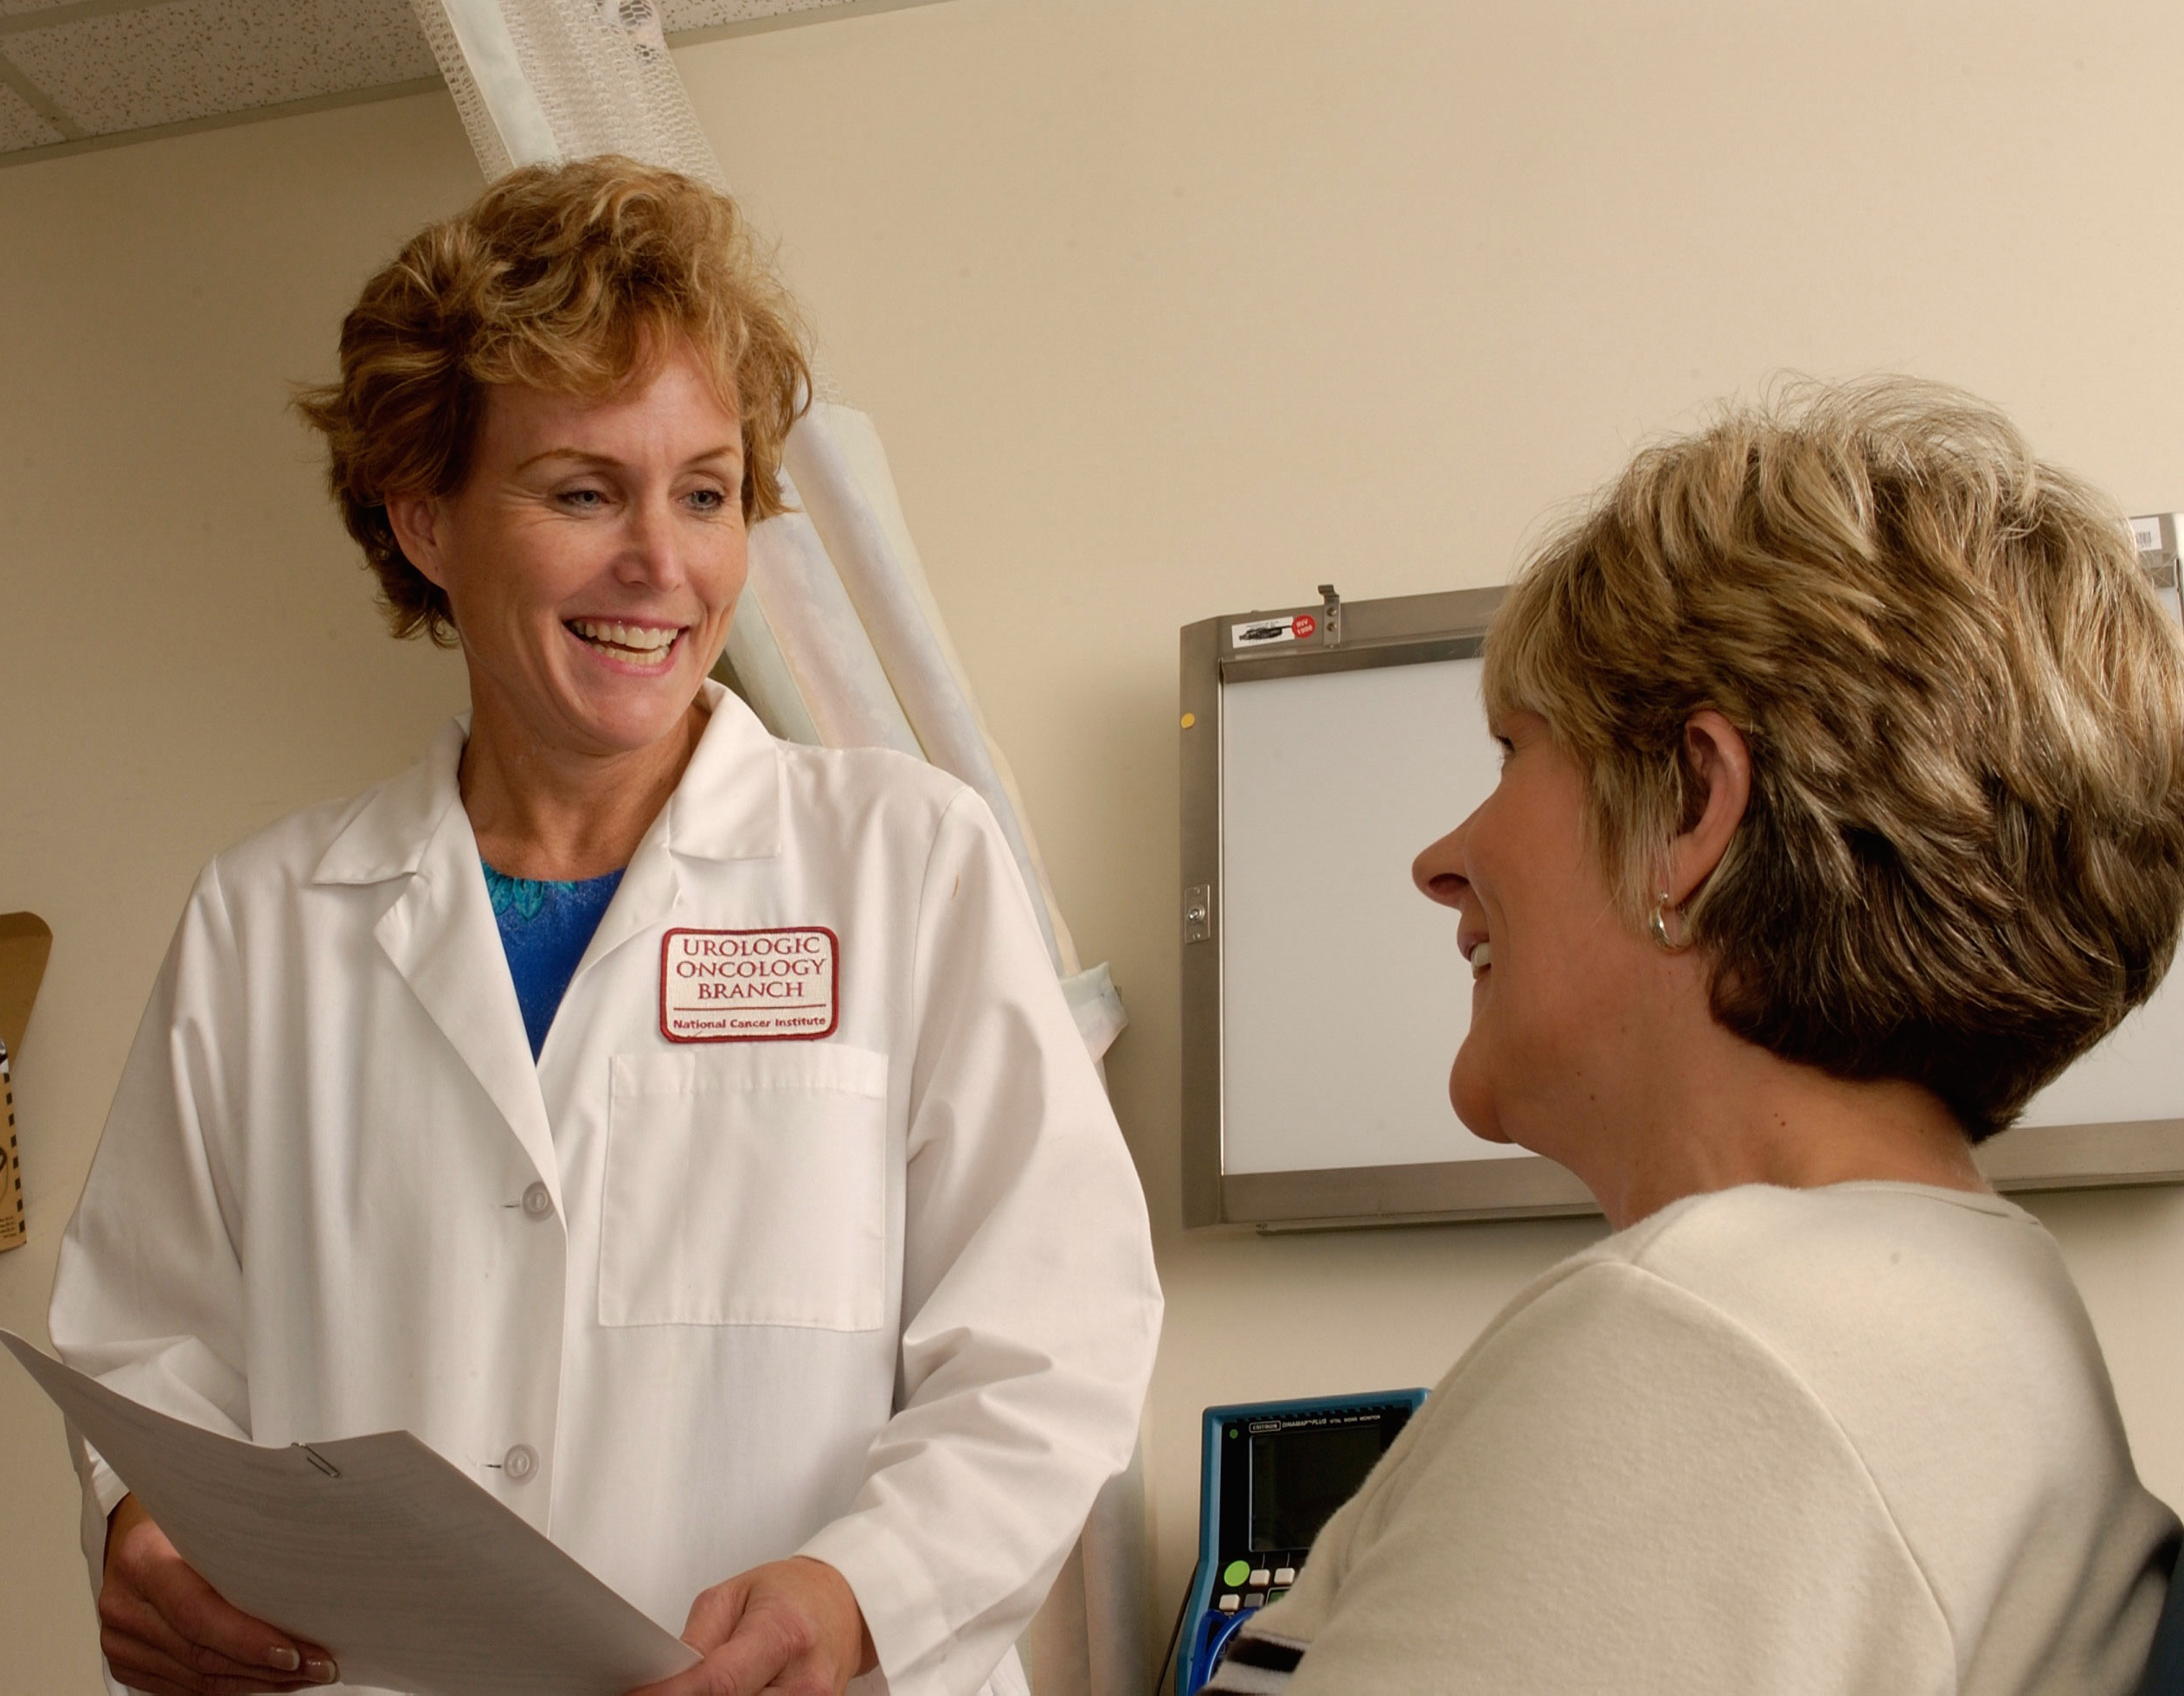
50% of doctors & 70% of early career doctors use Wikipedia for their jobs
“Doctor consults with patient.” National Institute of Health. ID: 4187 Wikimedia Commons. Public Domain
Sources: Hughes, 2009; Matheson, 2017
Notes:
However patients and their friends and family are not the only people using the free encyclopedia.
50% of doctors use Wikipedia on the job; 70% of early career doctors go there
those in the medical field, including, doctors, students, and policy-makers consult WIkipedia. Research on why doctors and medical students use Wikipedia suggests that convenience is an important feature, though the issue of readability comes up as well in subject-by-subject studies (Hughes et al. 2009; Matheson and Matheson-Monnet 2017).
Hughes, Benjamin, Indra Joshi, Hugh Lemonde, and Jonathan Wareham. 2009. “Junior Physician’s Use of Web 2.0 for Information Seeking and Medical Education: A Qualitative Study.” International Journal of Medical Informatics 78 (10): 645–55. https://doi.org/10.1016/j.ijmedinf.2009.04.008.

Slide 60
How can libraries support health information seekers?
Guide appropriate use of via Wikipedia – a great first stop
Participate in or host health editathons, #1lib1ref
Improve health-related Wikipedia articles
  Add citations to high-quality references
  Improve readability (curse of knowledge)
Get to know medical Wikipedians
Connect with NNLM consumer health initiatives
Notes:
Librarians play an important role in showing info seekers how Wikipedia is a great first step, but not the only step in finding information, and that finding the in-depth and reliable information found in references is as important as the article text.
Understanding the core principles and knowing how to read the signs and signals in Wikipedia content will enable library staff to guide patrons to verifiable information and build their own health info literacy skills.
Librarians can also strengthen the resources by adding citations and verifying references to health and medical articles

Slide 61
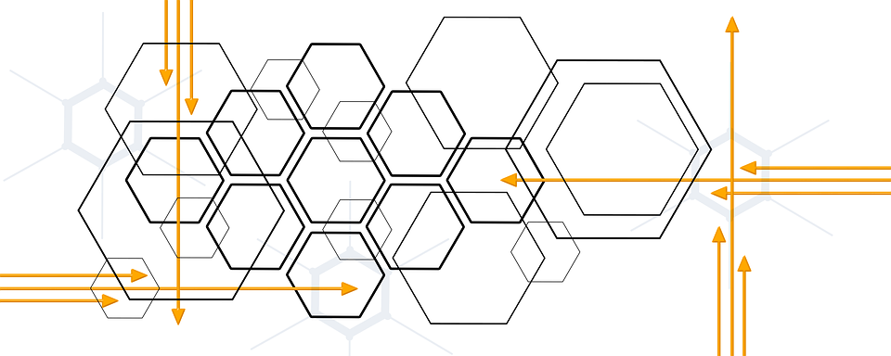
Intersection of Wikipedia, Libraries,
and Health Information
Armed with knowledge of its inner workings,
library staff join the Wikipedia community to
strengthen Wikipedia as a
health information resource for all.
Image: Integration by geralt on Pixabay
Notes:
So WebJunction’s Wikipedia + Libraries: Health and Medical Information course finds the intersection of where library staff can work with the Wikipedia community and with NNLM to strengthen Wikipedia as a health and medical information resources for all.
You can get a more detailed overview of what the course covers by watching the 1-hour webinar Why Wikipedia Matters for Health and Medical Information: https://www.webjunction.org/events/webjunction/why-wikipedia-matters-for-health-and-medical-information.html
The course is restricted to 100 participants; it launched with the first of four live sessions on October 8.

Slide 62

“By focusing on relationship building instead of service excellence, organizations can uncover new needs and be in position to make a stronger impact.”
(Mathews 2012)
Image: https://www.flickr.com/photos/baraapics/9432989091/ by baraa_kell/CC BY 2.0
Notes:
Mathews, Brian. 2012. Think Like a Startup: A White Paper to Inspire Library Entrepreneurialism. http://chronicle.com/blognetwork/theubiquitouslibrarian/2012/04/04/think-like-a-startup-a-white-paper/.
Image: https://www.flickr.com/photos/baraapics/9432989091/ by baraa_kell/CC BY 2.0

Slide 63
Questions and Discussion
Lynn Silipigni Connaway
oc.lc/opioid-crisis
Director of Library Trends and User Research
connawal@oclc.org
@LynnConnaway
Notes:
You can learn more about this project at the URL oc.lc/opioid-response. All of the project case studies and the summary report are now available for downloading from the project website. We will also collect any other project-relevant materials and resources here, as well.

