Slide 1
Melbourne, Australia • ASIS&T • 21 October 2019
There is a Method to It: Making Meaning in Information Research through a Mix of Paradigms and Methods
Lynn Silipigni Connaway, Ph.D.
Ixchel Faniel, Ph.D.
Director of Library Trends and User Research, OCLC
Senior Research Scientist, OCLC
Bhuva Narayan, Ph.D.
Elham Sayyad-Abdi, Ph.D.
Transdisciplinary Researcher, UTS
Information Researcher

Slide 2
Prevalence of Survey Research
“Survey research is one of the most popular methods used in the LIS literature.”
(Case & Given, 2016)
Image: https://www.flickr.com/photos/froderik/9355085596/ by Fredrik Rubensson/CC BY-SA 2.0
Notes:
Case, D. O., & Given, L. S. (2016). Looking for information: A survey of research on information seeking, needs, and behaviour. Bingley, UK: Emerald.
Image: https://www.flickr.com/photos/froderik/9355085596/ by Fredrik Rubensson/CC BY-SA 2.0

Slide 3
Image: https://www.flickr.com/photos/anjan58/7346141798 by anjan58 / CC BY-NC-ND 2.0
“Perhaps the most convenient method…will be to follow the reader from the moment he enters the library to the moment he leaves it…”
(Ranganathan, 1931, 337)
Notes:
Ranganathan, S. R. (1931). The five laws of library science. London: Edward Goldston, Ltd.
Image: https://www.flickr.com/photos/anjan58/7346141798 by anjan58 / CC BY-NC-ND 2.0

Slide 4
Information Behaviour Research Methods: JASIST, Information Research 2012-2013 JDOC, iConference Proceedings 2013-2014
Interviews, 51
Surveys, 34
Content Analysis, 28
(Greifeneder, 2014)
Image:https://www.flickr.com/photos/kmakice/4390520785/by Kevin Makice/CC BY-NC-SA 2.0
Notes:
Image:https://www.flickr.com/photos/kmakice/4390520785/by Kevin Makice/CC BY-NC-SA 2.0
Greifeneder, E. (2014). Trends in information behaviour research. In Proceedings of ISIC, the Information Behaviour Conference, Leeds, 2-5 September, 2014: Part 1. http://InformationR.net/ir/19-4/isic/isic13.html
“Interviews, surveys and content analyses were the most frequently used methods in the last years. It was also obvious that traditional qualitative research, making use of interviews, observations, focus groups or diaries still dominate information behaviour research. Anderson's expectation that these methods will vanish was clearly proven wrong.”

Slide 5
Information Behaviour Research Methods: JASIST, Information Research 2012-2013 JDOC, iConference Proceedings 2013-2014
Methods used less than five times:
Delphi studies (Poirier & Robinson, 2014)
Eye-tracking (e.g. Balatsoukas & Ruthven, 2012; Wildemuth, 2009)
Log file analysis (Jiang, 2014)
Participatory designs
(Greifeneder, 2014)
Image:https://www.flickr.com/photos/novecentino/50011555/by Gorgio Montersino/CC BY-SA 2.0
Notes:
Image: https://www.flickr.com/photos/novecentino/500115755/by Gorgio Montersino/CC BY-SA 2.0
Greifeneder, E. (2014). Trends in information behaviour research. In Proceedings of ISIC, the Information Behaviour Conference, Leeds, 2-5 September, 2014: Part 1. http://InformationR.net/ir/19-4/isic/isic13.html

Slide 6
Information Behaviour Research Methods: JASIST, Information Research 2012-2013 JDOC, iConference Proceedings 2013-2014
Mixed Methods, 45%
More than two methods, 7%
Qualitative-Qualitative, 69%
Quantitative-Qualitative, 31%
Quantitative-Quantitative, 0%
(Greifeneder, 2014)
Image:https://www.flickr.com/photos/csb13/37236019891/by Chris Blakeley/CC BY-NC-ND 2.0
Notes:
Image:https://www.flickr.com/photos/csb13/37236019891/by Chris Blakeley/CC BY-NC-ND 2.0
Greifeneder, E. (2014). Trends in information behaviour research. In Proceedings of ISIC, the Information Behaviour Conference, Leeds, 2-5 September, 2014: Part 1. http://InformationR.net/ir/19-4/isic/isic13.html
“Forty-five percent of all studies in the sample applied a mixed-method approach.”
“Only 11 studies (7%) combined more than two methods. 69% of mixed-method approaches were a qualitative-qualitative combination and 31% were a quantitative-qualitative combination. Not a single study combined a quantitative with another quantitative method.”

Slide 7
Qualitative and mixed-method studies are not as prevalent in information behavior studies but demonstrate a greater variety of research strategies and data collection techniques.
(Matusiak, 2017; McKechnie et al., 2002)
Image:https://www.flickr.com/photos/gawthrop/8274121366/by Peter Gawthrop/CC BY-NC 2.0
Notes:
Image:https://www.flickr.com/photos/gawthrop/8274121366/by Peter Gawthrop/CC BY-NC 2.0
Matusiak, K. K. (2017). Studying information behavior of image users: An overview of research methodology in LIS literature, 2004-2015. Library and Information Science Research 39 (1), 53–60.
McKechnie, L. M., Baker, L., Greenwood, M., & Julien, H. (2002). Research method trends in human information behaviour literature. The New Review of Information Behaviour Research: Studies of Information Seeking in Context (Proceedings of ISIC 2002), 3, 113-125.

Slide 8
Call for Qualitative and Mixed Methods Research
Rich data and thick description
Answer how and why questions
Can support decision-making for resources and programs
Strategic planning from a user perspective
Can help motivate and increase buy-in for change
Provides opportunity to build relationships
(Connaway & Radford, 2017; Asher & Miller, 2011)
Image: https://www.flickr.com/photos/ihardlyflickr/2253071281/ by Mason Bryant/CC BY-SA 2.0
Notes:
Asher, A., & Miller, S. (2011). So you want to do anthropology in your library? Or a practical guide to ethnographic research in academic libraries. Chicago: The ERIAL Project.
Connaway, L. S., & Radford, M. L. (2017). Research methods for library and information science (6th ed.). Westport, CT: Libraries Unlimited.
Image: https://www.flickr.com/photos/ihardlyflickr/2253071281/ by Mason Bryant/CC BY-SA 2.0

Slide 9
Research team
Lynn Silipigni Connaway
Director of Library Trends and User Research
connawal@oclc.org
@LynnConnaway
Christopher Cyr
Associate Research Scientist
cyrc@oclc.org
@ChrisCyr19
Brittany Brannon
Research
Support Specialist
brannonb@oclc.org
Peggy Gallagher
Market Analysis Manager
gallaghp@oclc.org
@PeggyGal1
Erin Hood
Research Support Specialist
hoode@oclc.org
@ErinMHood1

Slide 10
Research Methodology
Discovery system logs combined with semi-structured interviews
Image:https://www.flickr.com/photos/gawthrop/8274084522/by Peter Gawthrop/CC BY-NC 2.0
Notes:
Image:https://www.flickr.com/photos/gawthrop/8274084522/by Peter Gawthrop/CC BY-NC 2.0

Slide 11
Theoretical Background
Log analysis to collect large amounts of unbiased user data
(Jansen 2006, Connaway and Radford 2017)
Logs used to study how people use online systems
Catalog Search failure rates
Behavior of digital library users
Use of e-journals
User experience with video and music streaming services
(Hunter 1991; Jamali, Nicholas, and Huntington 2005; Lamkhede and Das 2019; Nouvellet, et al. 2019)
Image: https://www.flickr.com/photos/gawthrop/8272965471/by Peter Gawthrop/CC BY-NC 2.0
Notes:
Image: https://www.flickr.com/photos/gawthrop/8272965471/by Peter Gawthrop/CC BY-NC 2.0
Jansen, Bernard J. 2006. “Search Log Analysis: What It Is, What’s Been Done, How to Do It.” Library and Information Science Research 28, no. 3: 407–432.
Connaway, Lynn Silipigni, and Marie L. Radford. 2017. Research Methods in Library and Information Science, 6th ed. Santa Barbara, CA: Libraries Unlimited.
Hunter, Rhonda N. 1991. “Successes and Failures of Patrons Searching the Online Catalog at a Large Academic Library: A Transaction Log Analysis.” RQ 30, no. 3: 395–402. https://www.jstor.org/stable/25828813.
Jamali, Hamid R., David Nicholas, and Paul Huntington. 2005. “The Use and Users of Scholarly E-Journals: A Review of Log Analysis Studies.” Aslib Proceedings 57, no. 5: 554–571. https://doi.org/10.1108/00012530510634271.
Lamkhede, Sudarshan, and Sudeep Das. 2019. “Challenges in Search on Streaming Services: Netflix Case Study.” In the Proceedings of SIGIR ’19, July 21–25, 2019, Paris, France. https://arxiv.org/pdf/1903.04638.pdf.
Nouvellet, Adrien, Florence D’Alché-Buc, Valérie Baudouin, Christophe Prieur, and François Roueff. 2019. “A Quantitative Analysis of Digital Library User Behaviour Based on Access Logs.” Qualitative and Quantitative Methods in Libraries 7, no. 1: 1–13.

Slide 12
Theoretical Background
Problems with log analysis
Ambiguity of log events
Actions not captured in logs
Combining log analysis with user interviews
Asked questions about search and analyzed transaction logs
(Connaway, Budd, and Kochtanek 1995)
No indication that combining search logs with individual interviews has been used since
Image:https://www.flickr.com/photos/gawthrop/8273046981/ by Peter Gawthrop/CC BY-NC 2.0
Notes:
Image:https://www.flickr.com/photos/gawthrop/8273046981/ by Peter Gawthrop/CC BY-NC 2.0
Connaway, Lynn Silipigni, John M. Budd, and Thomas R. Kochtanek. 1995. “An Investigation of the Use of an Online Catalog: User Characteristics and Transaction Log Analysis.” Library Resources and Technical Services 39, no. 2: 142–152.

Slide 13
Discovery and Access Project: How do academic library users navigate the path from discovery to access?
What do academic users do when searches don't result in fulfillment?
What differentiates searches that lead to access from searches that don’t?
What demographic characteristics influence the access of users?
How does access correlate with success?
Image:https://www.flickr.com/photos/gawthrop/8274042600/by Peter Gawthrop/CC BY-NC 2.0
Notes:
Image:https://www.flickr.com/photos/gawthrop/8274042600/by Peter Gawthrop/CC BY-NC 2.0

Slide 14
Worldcat discovery
Search log analysis
“Log analysis is everything that a lab study is not.”
(Jansen 2017, 349)
Notes:
We started by analyzing the data that was already available to us—search logs from WorldCat Discovery.
Benefit: “One gets real behaviors from real users using real systems interacting with real information. Log analysis is everything that a lab study is not.” (Jansen 2017, 349)
Caveat: Log data is trace data, meaning it is a trace left behind of what a user did, and it must be interpreted.
Jansen, Bernard J. 2017. “Log Analysis.” In Research Methods for Library and Information Science, 6th ed., edited by Lynn Silipigni Connaway and Marie L. Radford, 348-349. Santa Barbara, CA: Libraries Unlimited.

Slide 15
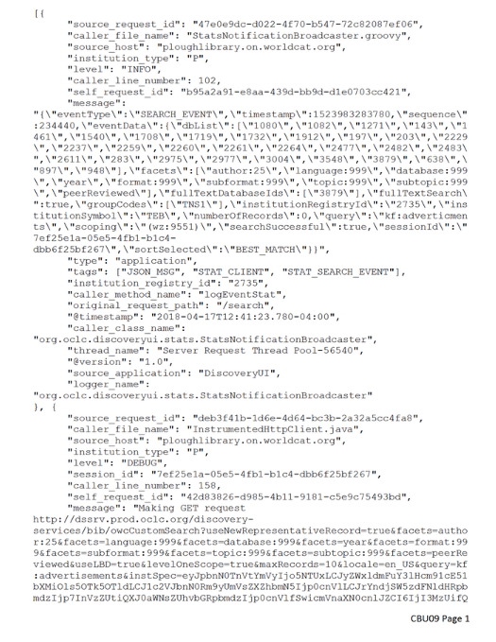
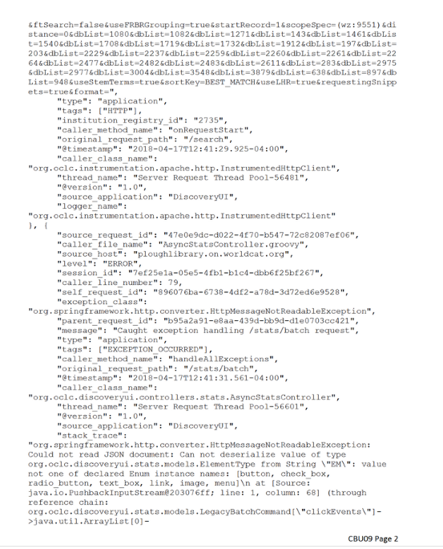
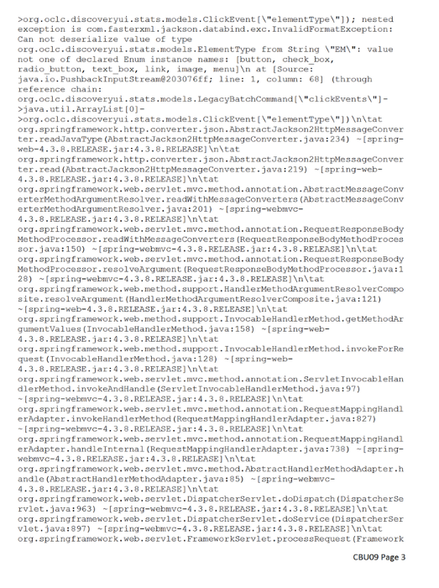
What do the raw logs tell us?
Did a keyword search but mistyped it
Had 0 results
Redid keyword search with correct spelling
Had 759,902 results
Began typing in additional keyword
Selected one of the autosuggested keyword phrases
Had 1,761 results
Notes:
One of the first things that we had to establish was what the search logs could tell us about user behavior. So we looked manually at some logs to determine what type of information we could glean. The logs could tell us:
Type of search (index)
Search terms/string
Elements of the system interacted with, in this case the autosuggest feature
Evolution of searches in a search session
Part of this process was working with libraries to recruit participants so we could connect logs with the users who created them. Logs in the system are anonymous—they can’t be tied to the user who generated them. The participants we recruited gave us the ID from their search, which we then used to pull all of the log events associated with that search.
On the left-hand side of this slide you can (maybe) see the search log for this participant, CBU09. What we found in interpreting the logs was that this participant started with a mistyped keyword search that returned 0 results. They corrected their spelling and returned over 700,000 results. They then began typing an additional word into their keyword search and selected one of the autosuggested keyword phrases, returning just under 2,000 results. Once we had interpreted the participant logs, we used that information to build an interview protocol. Peggy will talk about the interview process a little later.
CBU09 - Female, 19-25, undergraduate, humanities, Christian Brothers University

Slide 16
Ways of evolving a search
Corrected search
Shows greater than 90% similarity with the previous search string
Shows 80–90% similarity with the previous search string, with the first string contained in the second, or an index change
Refined search
New search
Shows less than 80% similarity with the previous search string
Notes:
One of the things that CBU09’s search session demonstrates are the different ways in which users can go about evolving a search during a single session. In order to perform bulk analysis of the search logs, which we wanted to do to be able to provide context for our interview data, we needed to be able to distinguish those different techniques quantitatively.
Based on quantitative analysis that was manually reviewed, we established the three categories you see here.
A corrected search was defined as being more than 90% similar to a previous search string. That primarily includes misspellings, as seen in step 2 of CBU09’s search.
A refined search was defined at 80-90% similarity, but in manually reviewing, we also determined the need to include any instance in which the first search string was contained in the second search string or the search string remained the same but the index was changed. You saw this in steps 3 and 4 of CBU09’s search.
The final category we established was a new search, which showed less than 80% similarity with the previous search string. We want to emphasize that this does not necessarily mean that they began searching for a different topic or type of material (although it certainly could). Instead, it represents a search where they changed tactics and began searching using a new or meaningfully different search string.

Slide 17
Summary of results
Average of 5 minutes per session
Average of 2.2 searches per session
Average of 5.1 words per search
12% of sessions had search refinements
33% of sessions had multiple searches
n=282,307 sessions
Image:https://www.flickr.com/photos/claudine/8344927130/claundice/CC BY-SA 2.0
Notes:
Image:https://www.flickr.com/photos/claudine/8344927130/claundice/CC BY-SA 2.0
Once we had established those categories, we could begin looking at the overall patterns in our search logs. For the bulk log analysis, we looked at all of the logs in the Discovery system for April of 2018. We found that on average, a search session lasted 5 minutes and contained just over two searches, with an average of about 5 words per search. Twelve percent of sessions showed search refinements and 33% of sessions showed multiple searches.

Slide 18
Types of Requests
Search results
The user made a request for search results. This could include a new search, refinement of an existing search, or the addition of limiters.
Physical access options
Some users left the system after looking at holdings, where they were able to identify the physical item call number and/or location. These users were categorized as having the option to physically access the item.
Online access attempt
The user clicked an item or made a request to digitally access the full text of the item.
Attempt to save
The user attempted to export or otherwise save the citation.
Physical access attempt
The user clicked an item or made a request to place a hold on a physical copy of the item.
Notes:
Log events for last requests and for the full sessions were categorized in the following way:
Online Access Attempt: The user clicked an item or made a request to digitally access the full text of the item.
Physical Access Attempt: The user clicked an item or made a request to place a hold on a physical copy of the item.
Physical Access Option: Some users left the system after looking at holdings. In these cases, users were in a place in the system where they were able to identify the physical item call number and/or location. The interviews revealed that at least some of the participants looked for the item on the library shelf at this point. Since logs cannot reveal what users did after leaving the system, these users were categorized as having the option to physically access the item.
Attempt to Save: The user made an attempt to export or otherwise save the citation.
Search Results: The user made a request for search results. This could include a new search, refinement of an existing search, or the addition of limiters.
Other: These requests and click events did not fit cleanly into any category, and there were no overarching themes to them.

Slide 19
While search results account for more than half (54%) of all click events, they account for more than a third (39%) of last requests
Notes:
While 54% of the total click events were to generate search results, only 39% of users left on a search results page. More than 50% of users left the system with a request to access an item online, an attempt to access an item physically, or an option to find its physical location. This discrepancy between all request categories and last request categories suggests that users were more likely to leave the system on a successful note. However, it cannot be determined whether the access attempts were successful, so conclusions must be made cautiously.

Slide 20
Probability of fulfillment
Number of searches | 2
Number of search refinements | 0
Words per search | 2
Results per search | 1000
Keyword limiter (1 if yes, 0 if no) | 1
Author limiter (1 if yes, 0 if no) | 0
Title limiter (1 if yes, 0 if no) | 0
Chance of Fulfillment | 69.09%
Number of searches | 2
Number of search refinements | 0
Words per search | 7
Results per search | 1000
Keyword limiter (1 if yes, 0 if no) | 1
Author limiter (1 if yes, 0 if no) | 0
Title limiter (1 if yes, 0 if no) | 0
Chance of Fulfillment | 70.32%
Number of searches | 2
Number of search refinements | 0
Words per search | 2
Results per search | 1000
Keyword limiter (1 if yes, 0 if no) | 1
Author limiter (1 if yes, 0 if no) | 1
Title limiter (1 if yes, 0 if no) | 0
Chance of Fulfillment | 84.76%

Slide 21
User interviews
“User interviews can help capture search and discovery behavior as the user understands it, rather than as a computer system understands it.”
(Connaway, Cyr, Brannon, Gallagher, and Hood 2019)
Notes:
As mentioned earlier, our methodology consisted of both bulk log analysis and user interviews. We conducted semi-structured interviews, using the critical incident technique. How many of you are familiar with the critical incident technique? For those of you who aren't familiar with it, the critical incident technique is a methodology in which a subject is asked to reflect on a specific incident and discuss the cause, description and outcome of the incident as well as his/her feelings and perceptions of the situtation.
Connaway, Lynn Silipigni, Chris Cyr, Brittany Brannon, Peggy Gallagher, and Erin Hood. 2019. “Speaking on the Record: Combining Interviews with Search Log Analysis in User Research.” ALISE/ProQuest Methodology Paper Competition Award Winner.
Go over methodology (semi-structured interviews with critical incident technique)
Connaway, Lynn Silipigni, and Marie L. Radford. 2018. Survey Research. Webinar presented by ASIS&T, January 23. https://www.slideshare.net/LynnConnaway/survey-research-methods-with-lynn-silipigni-connaway and https://www.youtube.com/watch?v=4dlpAT7MXh0 .

Slide 22
Example questions
“Please tell us what you were looking for and why you decided to do an online search.”
“Did the item you were searching for come up in your search results? In other words, did you find it?”
“I’d like to understand how you felt about your search experience overall. Would you say you were delighted with your search experience?”
Image:https://www.flickr.com/photos/mattknox/2842537496/ by Matthewknox/CC BY-NC-ND 2.0
Notes:
Image:https://www.flickr.com/photos/mattknox/2842537496/ by Matthewknox/CC BY-NC-ND 2.0
We developed specific protocols for each of our interviewees based on what we learned from their search logs. The protocols included some standard questions such as what they were looking for and why, whether they were successful – for example, if they were doing a known-item search, did the item appear in their search results, and whether they were delighted and/or frustrated with their search experience.

Slide 23
What do the interviews tell us?
What the logs told us:
Began keyword search but mistyped it
Had 0 results
Redid keyword search with correct spelling
Had 759,902 results
Began typing in additional keyword
Selected one of the autosuggested phrases
Had 1,761 results
Notes:
Looking again at the same interviewee – CBU09 – we knew from the search log what she did: she misspelled her search term, corrected the spelling, had over half a million results, refined her search by additional another search phrase, had nearly 2,000 results and then that was it. She appears to have abandoned the search.
CBU09 - Female, 19-25, undergraduate, humanities, Christian Brothers University

Slide 24
What do the interviews tell us?
Just starting work on a paper on a broad topic; didn’t yet have a direction for the paper
Was overwhelmed with number of search results
Abandoned “library search” to do “Google searching” to better determine a direction for the paper
Later came back to the library search and found it useful
Also received help from student workers in the library
Felt “prepared” to use the library search due to 1st-year library instruction
What the logs told us:
Began keyword search but mistyped it
Had 0 results
Redid keyword search with correct spelling
Had 759,902 results
Began typing in additional keyword
Selected one of the autosuggested phrases
Had 1,761 results
Notes:
What we learned from her interview, however, was that she was just getting started searching for resources for a paper and hadn't yet narrowed down her topic. She was overwhelmed by how many search results she got, and so she did indeed abandon the library search. However, she came back to the library search tool at a later time, after she had done some Googling and honed in on her topic. She told us how she found the library search tool very helpful once she knew what she wanted to write about, and that she appreciated the help she received from some student workers. She also mentioned that because of the library instruction she had received in her first year, she felt confident in using the library.
CBU09 - Female, 19-25, undergraduate, humanities, Christian Brothers University

Slide 25
Interview coding themes
Search strategies
Decision-making factors
Item formats
Evaluation of resources
Liked or
desired features
Feelings of frustration and delight
Influence of librarian
Notes:
So, once we had conducted all of our interviews, we reviewed the interview transcripts, developed a code book and then had two different team members code each of the interviews. The themes that emerged from the interviews tended to fall into seven different categories.
Interviewees talked about the various search strategies they used and the factors that went into their decision-making process on which resources they wanted to access. As we've learned in several other studies over the years, convenience and ease of access are major factors. They talked about the formats they were most interested in – PDFs being the most mentioned. They talked about how they evaluate resources such as considering the type of study involved from a particular article and whether the article was peer-reviewed. They mentioned features they like about the current library search tool as well as features they wished it had. Many of them talked about being satisfied with their search experience but wouldn't go as far as saying they were delighted by it and spoke of some of their frustrations with the top frustration being too many search results. And many of them spoke favorably about the impact of working with a librarian for receiving library instruction on their confidence in their information-seeking abilities.

Slide 26
Methodology
Challenges and Benefits
“The methodology used for this study also could be extended beyond discovery systems. Other computerized activities that leave digital traces could be studied using interview protocols based on log analysis.”
(Connaway, Cyr, Brannon, Gallagher, and Hood 2019)
Notes:
Connaway, Lynn Silipigni, Chris Cyr, Brittany Brannon, Peggy Gallagher, and Erin Hood. 2019. “Speaking on the Record: Combining Interviews with Search Log Analysis in User Research.” ALISE/ProQuest Methodology Paper Competition Award Winner.

Slide 27
Challenges of methodology
(Tandem use of log data and user interviews)
Resource intensive
Time consuming
Multiple team members
Multiple IRBs
High level of expertise required
Image:https://www.flickr.com/photos/queenscollege/3309770091/ by Queen’s College/CC BY 2.0
Notes:
Image:https://www.flickr.com/photos/queenscollege/3309770091/ by Queen’s College/CC BY 2.0

Slide 28
Benefits of methodology
(Tandem use of log data and user interviews)
Provide context for quantitative data
Clarify qualitative data
Most effective when digital traces are present
Inform development of literacy instruction
Image:https://www.flickr.com/photos/pipwilson/2347270176/by Pip Wilson/CC BY-NC-ND 2.0
Notes:
Image:https://www.flickr.com/photos/pipwilson/2347270176/by Pip Wilson/CC BY-NC-ND 2.0

Slide 29
Acknowledgements
We would like to thank the librarians and library users who participated in this research.
We also thank additional OCLC staff who assisted with the project: Jay Holloway and Ralph LeVan for assisting with data collection and analysis and Nick Spence for his assistance in preparing this presentation.

Slide 30
References
Asher, A., & Miller, S. (2011). So you want to do anthropology in your library? Or a practical guide to ethnographic research in academic libraries. Chicago: The ERIAL Project.
Case, D. O., & Given, L. S. (2016). Looking for information: A survey of research on information seeking, needs, and behaviour. Bingley, UK: Emerald.
Connaway, Lynn Silipigni, John M. Budd, and Thomas R. Kochtanek. 1995. “An Investigation of the Use of an Online Catalog: User Characteristics and Transaction Log Analysis.” Library Resources and Technical Services 39, no. 2: 142–152.
Connaway, Lynn Silipigni, Chris Cyr, Brittany Brannon, Peggy Gallagher, and Erin Hood. 2019. “Speaking on the Record: Combining Interviews with Search Log Analysis in User Research.” ALISE/ProQuest Methodology Paper Competition Award Winner.
Connaway, Lynn Silipigni, and Marie L. Radford. 2017. Research Methods in Library and Information Science, 6th ed. Santa Barbara, CA: Libraries Unlimited.
Connaway, Lynn Silipigni, and Marie L. Radford. 2018. Survey Research. Webinar presented by ASIS&T, January 23. https://www.slideshare.net/LynnConnaway/survey-research-methods-with-lynn-silipigni-connaway and https://www.youtube.com/watch?v=4dlpAT7MXh0 .
Greifeneder, E. (2014). Trends in information behaviour research. In Proceedings of ISIC, the Information Behaviour Conference, Leeds, 2-5 September, 2014: Part 1. http://InformationR.net/ir/19-4/isic/isic13.html
Hunter, Rhonda N. 1991. “Successes and Failures of Patrons Searching the Online Catalog at a Large Academic Library: A Transaction Log Analysis.” RQ 30, no. 3: 395–402. https://www.jstor.org/stable/25828813.

Slide 31
References
Jamali, Hamid R., David Nicholas, and Paul Huntington. 2005. “The Use and Users of Scholarly E-Journals: A Review of Log Analysis Studies.” Aslib Proceedings 57, no. 5: 554–571. https://doi.org/10.1108/00012530510634271.
Jansen, Bernard J. 2006. “Search Log Analysis: What It Is, What’s Been Done, How to Do It.” Library and Information Science Research 28, no. 3: 407–432.
Jansen, Bernard J. 2017. “Log Analysis.” In Research Methods for Library and Information Science, 6th ed., edited by Lynn Silipigni Connaway and Marie L. Radford, 348-349. Santa Barbara, CA: Libraries Unlimited.
Lamkhede, Sudarshan, and Sudeep Das. 2019. “Challenges in Search on Streaming Services: Netflix Case Study.” In the Proceedings of SIGIR ’19, July 21–25, 2019, Paris, France. https://arxiv.org/pdf/1903.04638.pdf.
Matusiak, K. K. (2017). Studying information behavior of image users: An overview of research methodology in LIS literature, 2004-2015. Library and Information Science Research 39 (1), 53–60.
McKechnie, L. M., Baker, L., Greenwood, M., & Julien, H. (2002). Research method trends in human information behaviour literature. The New Review of Information Behaviour Research: Studies of Information Seeking in Context (Proceedings of ISIC 2002), 3, 113-125.
Nouvellet, Adrien, Florence D’Alché-Buc, Valérie Baudouin, Christophe Prieur, and François Roueff. 2019. “A Quantitative Analysis of Digital Library User Behaviour Based on Access Logs.” Qualitative and Quantitative Methods in Libraries 7, no. 1: 1–13.
Ranganathan, S. R. (1931). The five laws of library science. London: Edward Goldston, Ltd.

Slide 32
Questions & Discussion
Lynn Silipigni Connaway, PhD
connawal@oclc.org
@LynnConnaway
Ixchel Faniel, Ph.D.
Senior Research Scientist, OCLC
Elham Sayyad-Abdi, Ph.D.
Information Researcher
Bhuva Narayan, Ph.D.
Transdisciplinary Researcher, UTS

