Slide 1
Digital Preservation 2019 -- October 17, 2019
Socializing Context in Research Data Reuse
Elizabeth Yakel, Ph.D.
Ixchel M. Faniel, Ph.D.
Professor
University of Michigan,
School of Information
yakel@umich.edu
Senior Research Scientist
OCLC Research
fanieli@oclc.org
@imfaniel

Slide 2
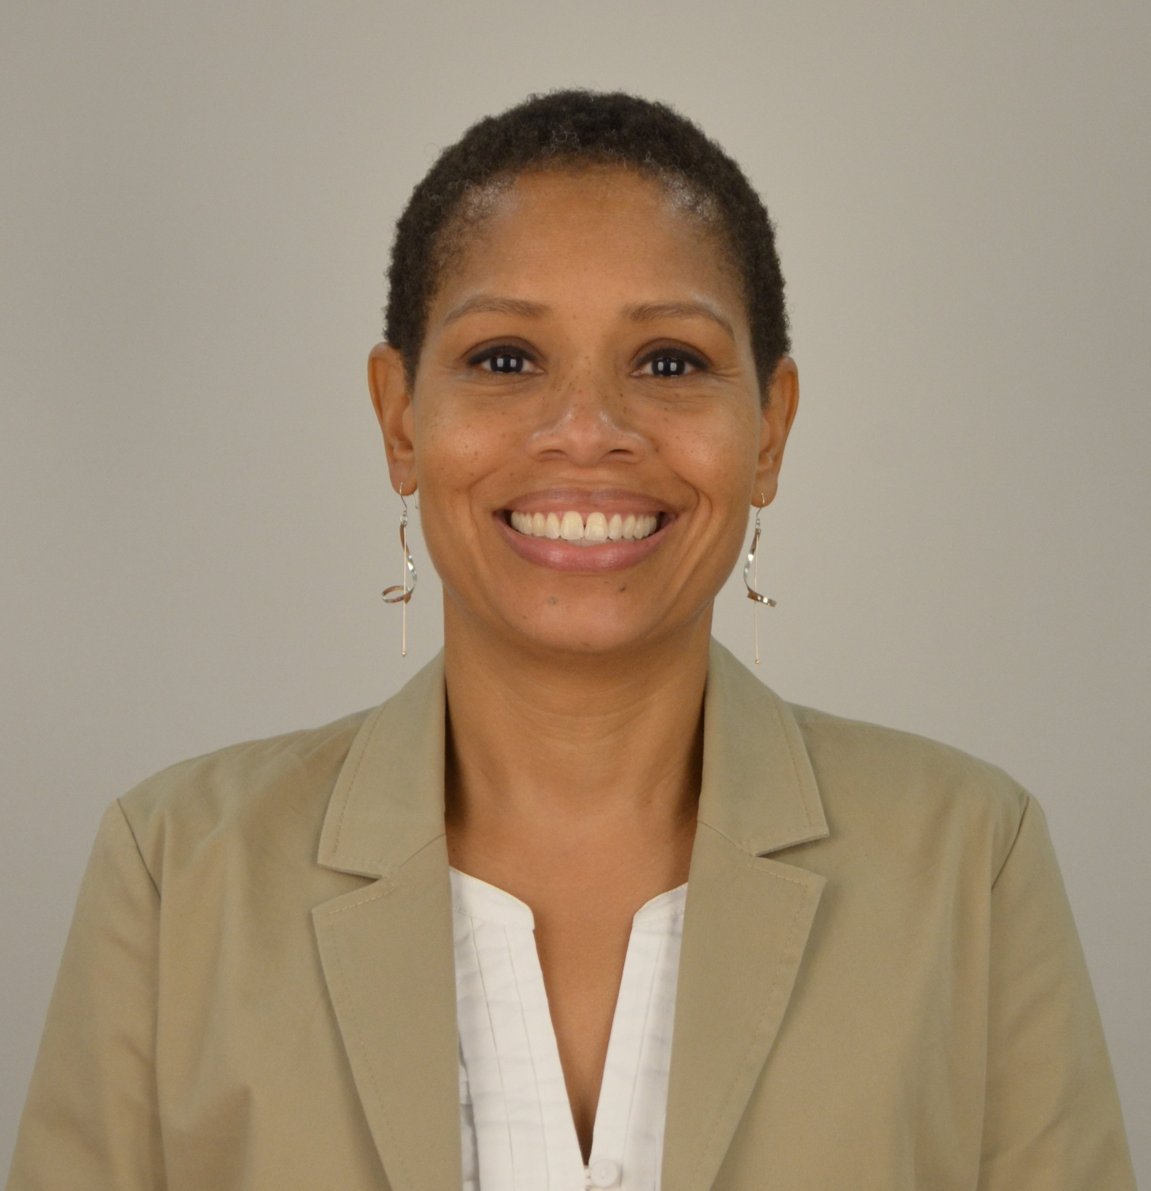
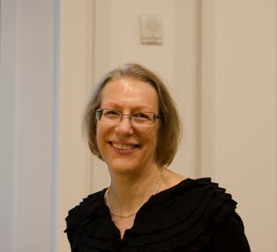
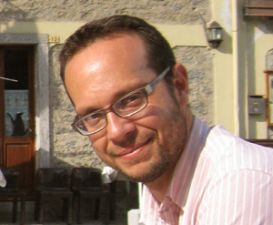
The DIPIR Project was made possible by a National Leadership Grant from the Institute of Museum and Library Services, LG-06-10-0140-10, “Dissemination Information Packages for Information Reuse” and support from OCLC Online Computer Library Center, Inc., and the University of Michigan.

Slide 3
Data reuse lets researchers do
cool things.
“In 2005, a team of marine biologists…used inflation-adjusted pricing data from the New York Public Library’s (NYPL) collection of 45,000 restaurant menus, among other sources, to confirm the commercial overharvesting of abalone stocks along the California coast beginning in the 1920s…”.
(Enis, 2015)
Photo Credit: http://www.flickr.com/photos/25869855@N04/6357282813 by Christopher John SSF / CC BY 2.0

Slide 4
But data reuse is hard.
“[It] is a lot harder than a lot of people think because it’s not just about getting the data and getting some kind of file that tells you what it is, you really have to understand all the detail of an actual experiment that took place in order to make proper use of it usually. And so it’s usually pretty involved…”.
- Earthquake Engineering Researcher, 10
(Faniel & Jacobsen, 2010)

Slide 5
Research QUestions

Slide 6
Research Questions
Our Interest
Data reuse research
Digital curation research
Disciplines curating & reusing data
What types of context information do researchers need, where do they get it, and why do they need it when deciding whether to reuse data?
How do researchers’ reasons for needing different types of context information vary across disciplinary communities?
(Faniel & Yakel, 2011)

Slide 7
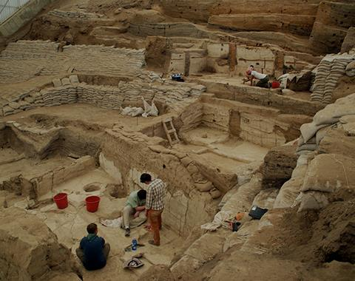
Today’s Focus: The Data Reuser
Context information needed
Its direct vs. indirect relationship with the data
Sources of context information
Tracking, linking, and curating varied sources
Reasons context information needed
Role of data quality in the data reuse process
Photo credit: https://www.flickr.com/photos/catalhoyuk/9184503529 by Jason Quinlan / CC BY-NC-SA 2.0

Slide 8
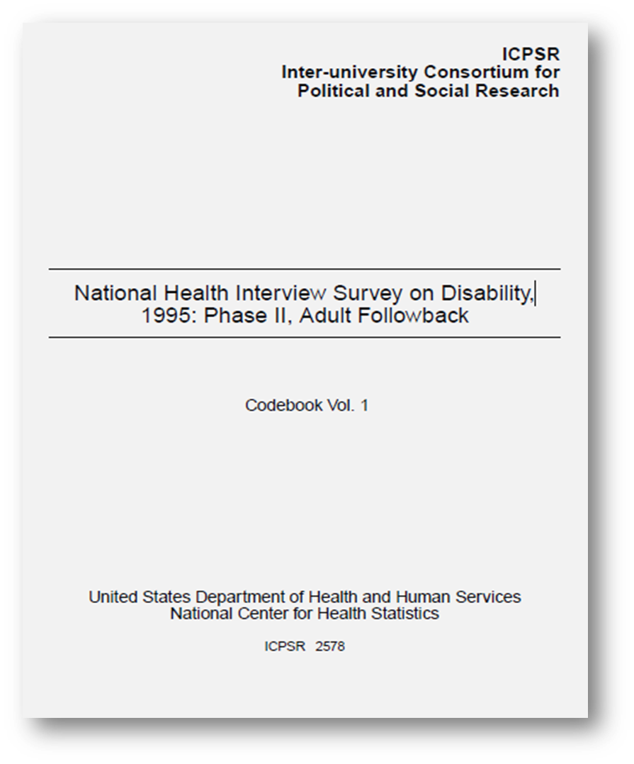
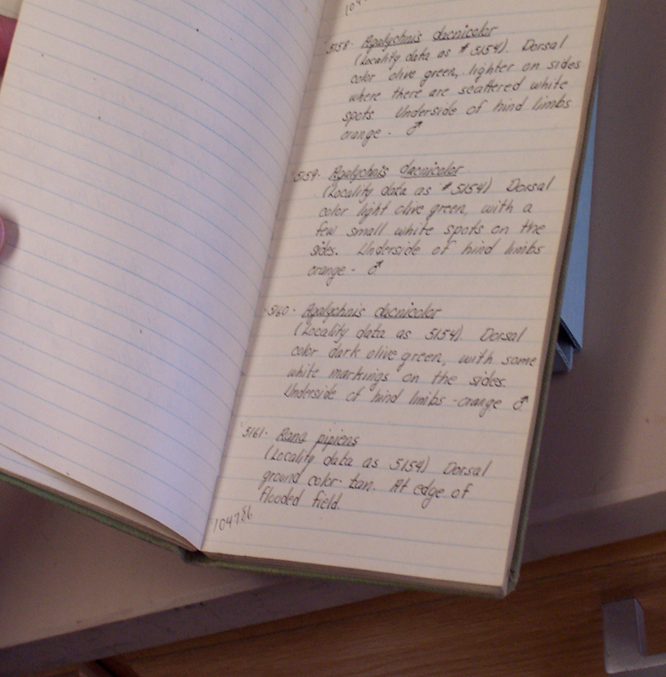
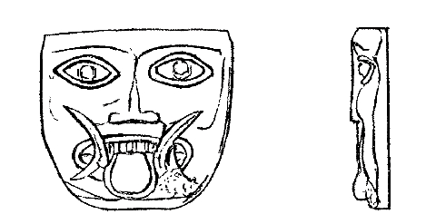
Cross-disciplinary Context Model
Contextual information reusers need
Places reusers seek
contextual information
“If it’s somebody whose training I don’t know about, I’m going to be less likely to use their dataset because I'm not sure how reliable it is.” (Archaeologist 06)
“our wolf data are not making a lot of sense…so going back to the field notes sometimes can help.” (Zoologist 07)
ICPSR National Health Interview Survey on Disability, 1995. https://bit.ly/33BetHR
Photo credit: field notebook, DIPIR team at the University of Michigan Museum of Zoology
Reasons reusers require contextual information
My definition, my theory fit the definition of what they were using to code.” (Social Scientist 02)
Photo credit: https://opencontext.org/media/A53B38E4-9A6C-4DD1-D88F-310C20A1AA88 by Anthony Tuck / CC BY 4.0

Slide 9
Methodology

Slide 10
DIPIR Methodology
 | ICSPR | Open Context | UMMZ
Phase 1: Project Start up
Interview Staff | 10 | 4 | 10
Phase 2: Collecting and analyzing user data
Interview Reusers | 43 | 22 | 27
Survey Reusers | 1480
Web analytics |  | server logs
Observe Reusers |  |  | 13
Phase 3: Mapping data’s context to reusers’ needs and reasons for those needs

Slide 11
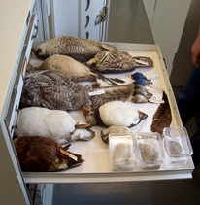
Interviews and Observations
Data Collection
92 interviews
13 observations of researchers at the University of Michigan Museum of Zoology
Data Analysis
1st cycle qualitative coding
Based on interview protocol
Themes from the literature
Additional codes arising from the interviews
2nd cycle axial coding for context
Detailed context needed
Place get context
Reason need context
Photo credit: museum specimens, DIPIR team at the University of Michigan Museum of Zoology

Slide 12
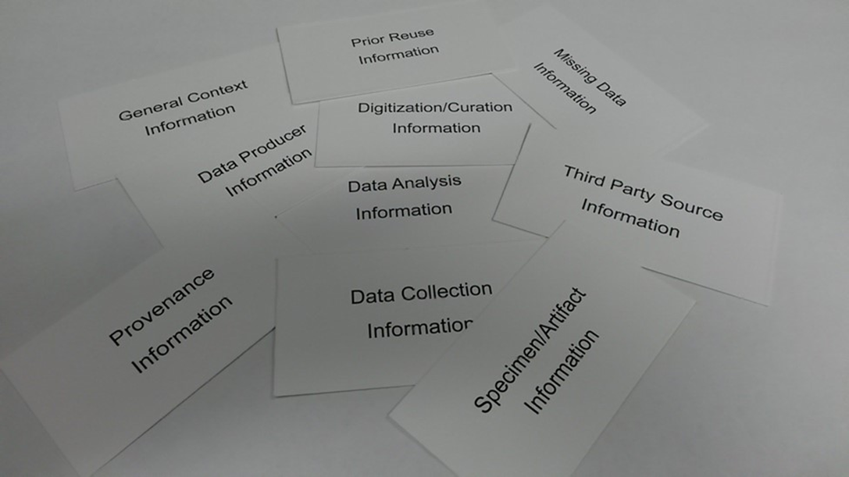
Findings: Contextual Information Needed
Photo credit: workshop cards, DIPIR team

Slide 13
Defining Context and Contextual Information
Context of the data
Significant properties of data (Hedstrom & Lee, 2002)
Context (Lee, 2011)
representations or relational entities of the target entity,
factors external to but potentially acting upon the target entity,
perceptions of the user of a target entity.
Context identified by the data reuser (Faniel, Frank, and Yakel, 2019)
Meaningful use of research data

Slide 14
Reusability: Role of Context Information
(Faniel, Frank, & Yakel, 2019)

Slide 15
Disciplinary Differences: Context Information
Social Scientists | Zoologists | Archaeologists
Data Collection | Specimen | Artifact
Data Analysis | Data Collection | Data Collection
Data Producer | Provenance/Data Producer | Provenance/Data Producer
Prior Reuse | Digitization / Curation | Digitization / Curation
Missing Data / Repository | Repository | Repository

Slide 16
Findings: Reasons for Needing Contextual Information

Slide 17
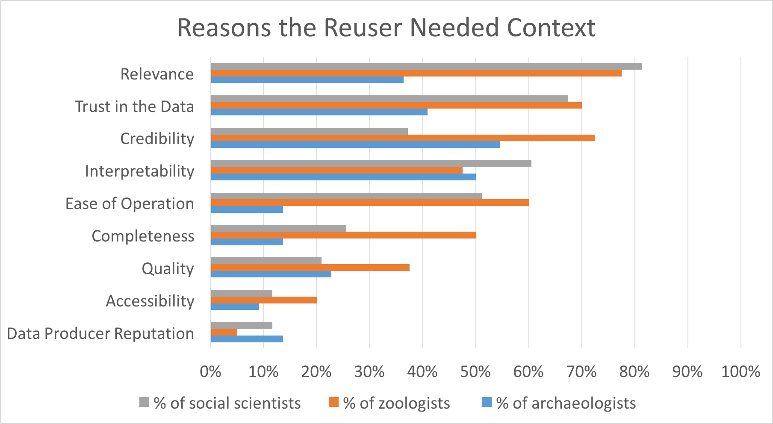
(Yakel, Faniel, & Frank, Unpublished Mss.)

Slide 18
Disciplinary Differences: Reasons
Social Scientists | Zoologists | Archaeologists
Relevance | Relevance | Credibility
Trust | Credibility | Interpretability
Interpretability | Trust | Trust
Ease of Operation | Ease of Operation | Relevance

Slide 19
Relevance
Research objectives of the data producer: “It's about how much that dataset fits your concept of what your theory is, it's your operationalization...But what is important to me is this is like what they're getting at get at what I'm trying to get at. So, it's my theory.” (Quantitative Social Scientist 3)
Research objectives of the data reuser “…the reason why is that for what we're looking to do in this particular case is really tied to a very specific time slice. And so we wanted to have records that were very temporally precise...And so we have to do that assessment for each data point…How to make that relevant to the question we're asking because fitness for reuse is not a given, its question dependent.” (Zoologist 7)

Slide 20
Credibility
Data Reliability
Validity
Authority
Objectivity
Believability
Verifiability
Accuracy
Credibility
(Wang and White, 1999; Wang & Strong, 1996; Barry, 1994; Herring, 2001; Rieh, 2002; Wang & Soergel, 1998; Huang et al., 2012; Stvilia et al., 2014)

Slide 21
Credibility Found in Contextual Information

Slide 22
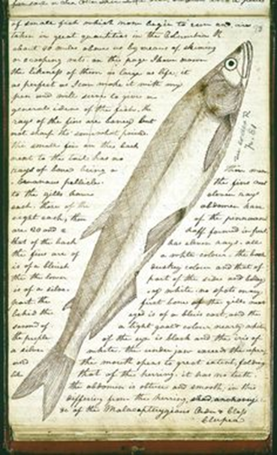
Credibility: Artifact and Specimen Information
Provenance: “So, …to know that I wasn't …including data from something that I already have data from because these things get traded around. And when you don't have a museum number that goes with it, you don't have a picture of it, it’s just like from such and such a county… I don't know, unless I can double-check it somehow.” (Archaeologist 23)
Specimen information: “One project…during my dissertation was measuring body size of squirrels…fossil squirrels and modern squirrels of the same species…The relationship…the standard estimates of lengths in the lower jaw…that's correlated with body mass…I validated it or verified it by correlating my tooth row measurements with the measurements that had been collected by the field researchers that were on the tag and that were in the database.” (Zoologist 4)
Photo credit: https://diglib.amphilsoc.org/ islandora/object/codex-j%3A-093 by Lewis Meriwether, from APS / Open Access

Slide 23
Trust
Data collection information: “He produced a map in which he had points for every weather station that he sampled, so that both maps gave me a very tangible notion of what are the areas where I could trust the data, the data were based on lots of information, based on lots of weather stations, and what are the areas that had poor weather station coverage, therefore, I shouldn't trust the data so much. So, that was the most important part for me.” (Zoologist 9)
Prior reuse: “It has been around since 1968. It's heavily used. The dataset has been examined for problems like people dropping out of the study…. How does that affect the representativeness of the sample, okay? We have some people who are no longer participants. What does it do to the sample? …Well, we've had a lot of work investigating all of these questions on PSID so these characteristics are pretty well known. It's extremely trustworthy dataset.” (Quantitative Social Scientist 27)

Slide 24
Trust Markers

Slide 25
Interpretability
Data collection information: “Frequently in archaeology, after you document something, you then destroy it. So, the visual documentation usually and the written documentation has to make sense together and they have to make sense separately. And then there has to be a way to make sure that whatever visual documentation you created and your written documentations are inseparably linked…” (Archaeologist 3)
Data collection information: That comes with investing time in the dataset. You have reached that decision prior to investing a lot of time and understanding how it's put together, what all the variables are, how do you actually use it because the different datasets will have different statistical issues that just comes, so at some point, you have to invest the time. So, that’s where I'm at.” (Quantitative Social Scientist 27)

Slide 26
Ease of Operation
Data collection information: “I…was going back through and trying to find some records for fossil sites back to that paleo stuff…I'd say it takes me as much time to do that as it does to work with these repositories. The simple reason is that, it's just so much more laborious and that is do effectively data reconciliation between what’s written in different formats, …different ways …of expressing time or location and then I have to go look up where this Siberian cave is and find a source from the internet that allows me to georeference that site effectively.” (Zoologist 7)
Data collection information: “Are the variable the variables that you need? Does the geography of one dataset match the geography of the other dataset which can get tainted. For instance, sometimes link county or state or metropolitan data to another data file and in that particular metropolitan areas, the boundaries change from time to time, so you have to be careful about that…We rely on the documentation in order to understand what we're looking at or what we're getting.” (Social Scientist 38)

Slide 27
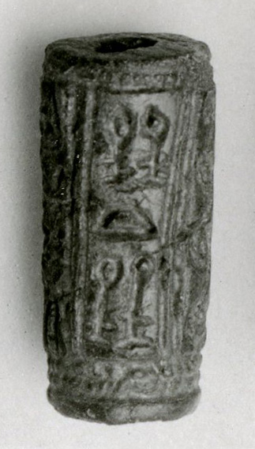
Discussion / Conclusion
Reasons
Clarify context needs
Provide data curation librarians with information for data management plans, data sharing guidelines
Focus curatorial effort
Reasons are social, reasons are nuanced
Disciplinarily specific
Meaningful reuse of data
Photo credit: https://commons.wikimedia.org/wiki/ File:Cylinder_seal_MET_26-7-25.jpg by MET Museum / CC0 1.0

Slide 28
Acknowledgements
This research was made possible in part by a National Leadership Grant from the Institute of Museum and Library Services, LG-06-10-0140-10, “Dissemination Information Packages for Information Reuse.” There was additional support from OCLC Online Computer Library Center, Inc., and the University of Michigan.
PI: Ixchel Faniel, Ph.D., Senior Research Scientist OCLC Research; Co-PI: Elizabeth Yakel (University of Michigan)
Partners: Nancy McGovern, Ph.D. (MIT), Eric Kansa, Ph.D. (Open Context), William Fink, Ph.D. (University of Michigan Museum of Zoology)
OCLC Fellow: Julianna Barrera-Gomez
Faculty: Ji-Hyun Kim (Ewha Womans University)
Researchers: Christopher Cyr (OCLC), Sarah Whitcher Kansa (Open Context)
Doctoral Students: Rebecca Frank (now Assistant Professor at Humboldt University, Berlin) , Adam Kriesberg (now Assistant Professor at Simmons University, Boston) , Morgan Daniels, Ayoung Yoon ((now Assistant Professor at Indiana University Purdue University, Indianapolis), Kathleen Fear (Medical Center University of Rochester)
Master’s Students: Alexa Hagen, Jessica Schaengold, Gavin Strassel, Michele DeLia, Mallory Hood, Annelise Doll, Monique Lowe
Undergraduate: Molly Haig

Slide 29
References
Barry, C.L. (1994). User-defined relevance criteria: An exploratory study. Journal of the American Society for Information Science, 45(3), 149–159.
Enis, M. (2015, July 13). Wisdom of the crowd | Digital collections. Library Journal. Retrieved from http://lj.libraryjournal.com/2015/07/technology/wisdom-of-the-crowd-digital-collections/#.
Faniel, I. M., & Jacobsen, T. E. (2010). Reusing scientific data: How earthquake engineering researchers assess the reusability of colleagues’ data. Computer Supported Cooperative Work (CSCW), 19(3–4), 355–375. https://doi.org/10.1007/s10606-010-9117-8
Faniel, I. M., & Yakel, E. (2011). Significant properties as contextual metadata. Journal of Library Metadata, 11(3–4), 155–165. https://doi.org/10.1080/19386389.2011.629959
Faniel, I., Frank, R. and Yakel, E. (2019). Context from the data reuser’s point of view. Journal of Documentation, 75(6), 1274-1297. https://doi.org/10.1108/JD-08-2018-0133. Post-print: https://www.oclc.org/research/publications/2019/context-from-data-reuser-point-of-view.html.
Hedstrom, M., & Lee, C. A. (2002). Significant properties of digital objects: Definitions, applications, and implications. Proceedings of the DLM-Forum 2002, 218–227. Barcelona: Office for Official Publications of the European Communities.
Huang, H., Stvilia, B., Jörgensen, C., & Bass, H.W. (2012). Prioritization of data quality dimensions and skills requirements in genome annotation work. Journal of the American Society for Information Science and Technology, 63(1), 195–207.

Slide 30
References
Lee, C. A. (2011). A framework for contextual information in digital collections. Journal of Documentation, 67(1), 95–143. https://doi.org/10.1108/00220411111105470
Rieh, S.Y. (2002). Judgment of information quality and cognitive authority in the Web. Journal of the American Society for Information Science and Technology, 53(2), 145–161.
Stvilia, B., Hinnant, C.C., Wu, S., Worrall, A., Lee, D.J., Burnett, K., . . . Marty, P.F. (2014). Research project tasks, data, and perceptions of data quality in a condensed matter physics community. Journal of the Association for Information Science and Technology. doi:10.1002/asi.23177
Wang, P., & Soergel, D. (1998). A cognitive model of document use during a research project. Study I. Document selection. Journal of the American Society for Information Science, 49(2), 115–133.
Wang, P.L., & White, M.D. (1999). A cognitive model of document use during a research project. Study II. Decisions at the reading and citing stages. Journal of the American Society for Information Science, 50(2), 98–114.
Wang, R.Y., & Strong, D.M. (1996). Beyond accuracy: What data quality means to data consumers. Journal of Management Information Systems, 12(4), 5–33.
Yakel, Faniel, & Frank. Unpublished manuscript.

