Slide 1



Shepherdstown, WV ● 16 October 2019
Public Libraries Respond to the Opioid Crisis with Their Communities

Slide 2
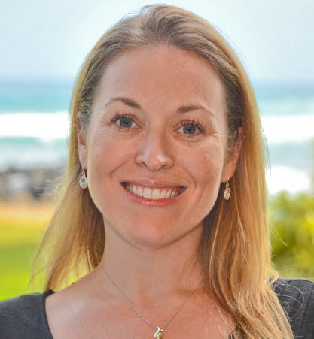
Kendra Morgan
Senior Program Manager, WebJunction

Slide 3
Long distance
Notes:
I’ve been lucky enough to travel to West Virginia in the past and work with the Executive Director of the West Virginia Library Commission, Karen Goff. But unfortunately, it wasn’t an option for today’s session. So I’m joining you from my office in Seattle and I’m really grateful for the opportunity to speak with you all today.

Slide 4
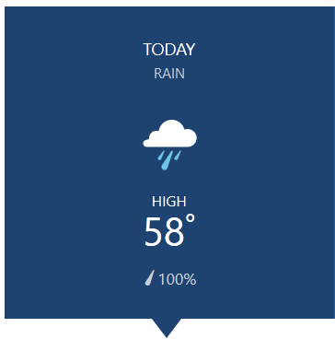
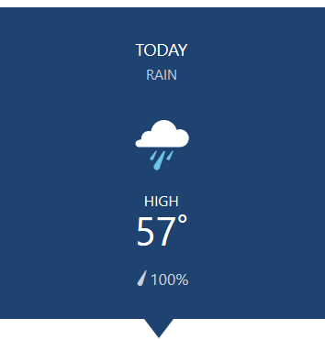
Seattle Shepherdstown
Notes:
QUICK SHIFT
I do want to share that while we are separated by about 2,700 miles, we are still having a pretty similar day!

Slide 5
Seattle Shepherdstown
Notes:
Look at this. 100% chance of rain a temperature difference of 1 degree! So, we’ve got that in common today…even if we can’t be in the same room.

Slide 6
Opioids & libraries

Slide 7
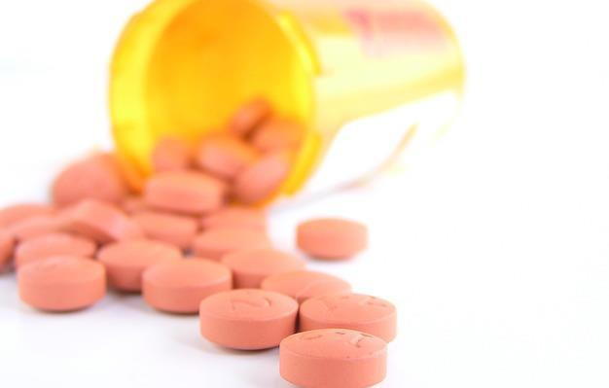
More than 130 people die in the U.S. everyday from an opioid overdose.
(Rudd, 2016)
Photo by nosheep is licensed under Pixabay
Notes:
Why are we talking about opioids here today? Well, more than 130 people die everyday from an opioid-related overdose in the United States. That’s over 47,600 people a year, out of a total of 70,000 total deaths by drug overdose. Those are stats from 2017 – these numbers have been rising significantly over several years, with the impact spreading across all age groups, racial/ethnic groups, community sizes and locates, and turning some states and regions into full-on epidemics.
While death is the most severe impact, there is also rampant misuse of opioids. -- More than 20 percent of patients who have been prescribed opioids misuse them.
This situation underscores the urgent need for federal, state, and local efforts to formulate prevention, response, and treatment strategies, and strengthened public health and public safety partnerships.
Drug overdose deaths | drug overdose | CDC injury center. (2018, December 21). Retrieved June 10, 2019, from https://www.cdc.gov/drugoverdose/data/statedeaths.html
Rudd, R. A. (2016). Increases in drug and opioid-involved overdose deaths — united states, 2010–2015. MMWR. Morbidity and Mortality Weekly Report, 65. https://doi.org/10.15585/mmwr.mm655051e1
Goodman-Meza, D., Medina-Mora, M. E., Magis-Rodríguez, C., Landovitz, R. J., Shoptaw, S., & Werb, D. (2019). Where is the opioid use epidemic in mexico? A cautionary tale for policymakers south of the us–mexico border. American Journal of Public Health, 109(1), 73–82. https://doi.org/10.2105/AJPH.2018.304767
Scholl, L. (2019). Drug and opioid-involved overdose deaths — united states, 2013–2017. MMWR. Morbidity and Mortality Weekly Report, 67. https://doi.org/10.15585/mmwr.mm6751521e1

Slide 8

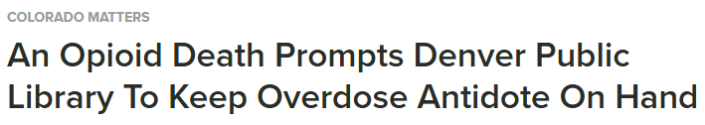




Notes:
As you likely know now, libraries in communities that have been impacted by the opioid epidemic are experiencing its direct effects.
And we’ve seen headlines like these from news media.
High-profile stories like these, as well as ongoing concerns and questions raised by library staff, leaders, boards, and support organizations, led OCLC and PLA to join forces to learn more about the issue and how our organizations might help libraries navigate the crisis.

Slide 9
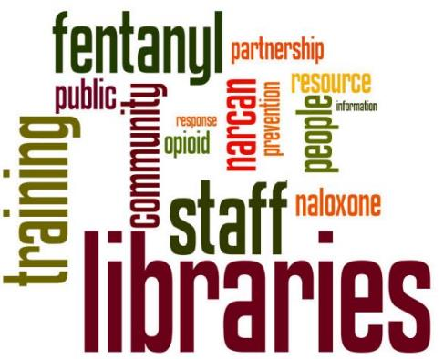

Notes:
In September 2017 we partnered on a WebJunction-hosted virtual townhall. This even included invited speakers from libraries and community partners who had stories and resources to share, This wordcloud includes the topics surfaced in the chat space during the town hall--things like training, staff, and community, as well as some of the synthetic opioids and overdose reversal medications.
We had over 700 people attend this webinar and hundreds more watch the recording. And this is a TOUGH topic. It’s not light, it’s not filled with laughs and sweet pictures of storytimes or people learning computer skills – the kinds of stories that we love to see and share about libraries. But I can tell you, that there are libraries all over this country that are seeking to help their communities and make a difference. And they are digging into this tough topic and making a difference.

Slide 10
Public Libraries Respond to the Opioid Crisis with their Communities
IMLS National Leadership Grant LG-00-18-0298-18
Notes:
From this webinar, OCLC and PLA decided that we needed to and wanted to do more to address these concerns in the community, so we developed a research and programming proposal, which was funded by an IMLS National Leadership Grant this past summer. The title of the project is “Libraries Respond to the Opioid Crisis with their Communities” and it runs through the end of 2019. This project combines the expertise and capacity of OCLC’s Research division, the free and open learning platform of OCLC’s WebJunction platform, the advocacy and policy capacities of PLA, and the reach and network of both organizations.

Slide 11
Project goals
Collect and share knowledge, resources
Raise awareness among other sectors
Address siloed approaches
Notes:
This project has three overarching goals.
The first is that we want to help public library directors and staff to make informed decisions about strategies, policies, and activities. Taking what we learn from the experiences of others and then promoting their lessons learned to strengthen the efforts of others.
Second, Despite the news media stories about libraries and opioids, libraries are still largely overlooked when it comes to organizing city-wide responses to the issue. The project aims to raise awareness among the key sectors and organizations involved in formulating strategies and interventions that public libraries are a key local partner.
And finally, for issues that are as broad and complex as opioid epidemic, a library trying to “go it alone” might work in some cases, but partnerships and collaboration can help extend resources and impact further, faster. So this project was designed to highlight strategies that take libraries out of their siloes and visibly working with community partners to achieve aligned outcomes. The development of relationships and infrastructure that can support changes and needs is something that can live well beyond a single project or activity. How do we invest in infrastructure that can benefit us in the years to come?

Slide 12
Project activities
Case study research
Cross-sector discussions
Call-to-action white paper
Dissemination to the field
Notes:
The project consists of four main deliverables, listed here. Today I’ll share some of these activities and what the project team is discovering along the way.

Slide 13
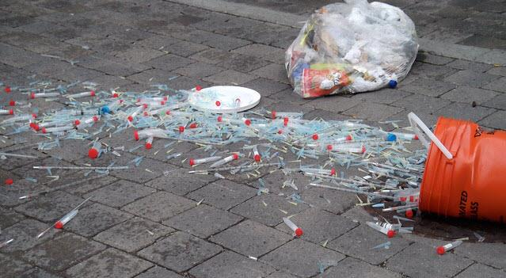
“Obviously, our biggest challenge is that people keep dying and we can’t work fast enough.”
- Community Partner Director
“Syringes” by Sam Nabi is licensed under CC BY 2.0
Notes:
This quote came from interviews that we conducted recently with libraries and the community partners in our work to create a series of case studies addressing the opioid issue. At the core of this problem is the fact that people in our communities are dying from opioid overdoses. And that concern is something that we have heard as we embarked on the journey for this project. And there is also the impact that this has on the family and friends – the people who love this person who is dealing with substance misuse, or who has died from an overdose.
This is truly a community-wide problem and it requires community-wide responses.

Slide 14
CASE study research

Slide 15
Goal of case studies
Explore a diverse set of communities in which the library is an active partner in response to the opioid epidemic.
Notes:
I’m going to describe how we developed the case studies that were the first deliverable of the grant project. We’ve completed all of the data collection and will be publishing both the case studies and the summary report findings later this month.
Case study research enables in-depth data to be gathered “for the purpose of learning more about an unknown or poorly understood situation.” For this project, we explored the local conditions that led to the library responding to the opioid crisis with community partners; how and with whom the response has been implemented; what the results have been and how those have been measured; what have been the experiences along the way; and what challenges, needs, and opportunities remain.

Slide 16
Criteria considered for site selection
Diversity of community size, region, geographic distribution, and demographics
Diversity of service population size
Health data: uninsured rate, opioid prescribing rate, drug overdose death and mortality rate
Must have worked with community partners on programs/services related to the opioid crisis
Represent a range of community interventions
Notes:
There are many libraries across the country that are doing some form of opioid-related programming, but we were looking for diversity in both the types of programming and the communities that they serve. This slides shows some of the factors we looked at when selecting communities to study.

Slide 17
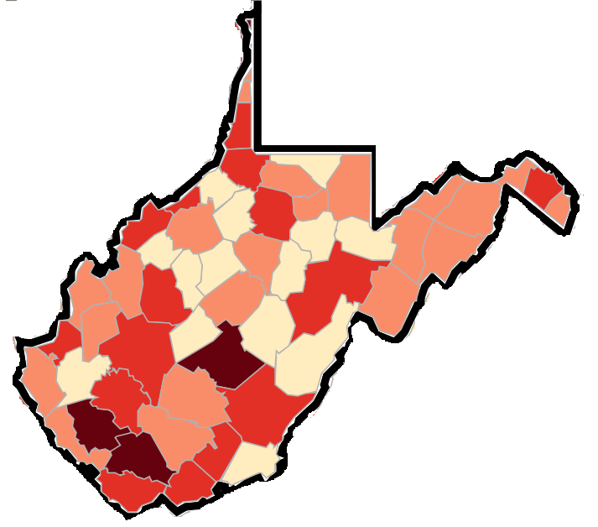
County prescribing rates
2017 opioid prescribing rate per 100 persons
<57.2
57.2 – 82.3
82.4 – 112.5
>112.5
Notes:
The reach of this epidemic is deep – and in many cases devastating. One of the data points that we used in our research to understand the communities that we were considering for the research was a tool from Centers for Disease Control – the CDC which shows County Prescribing Rates for opioids. The lighter colors on the map show rates of less than 57 prescriptions for every 100 people. The darkest color are rates above 112 prescriptions per 100.
This information can sometimes be helpful when talk to your board or stakeholders about community concerns and issues. But, our research also took us to places with lower prescribing rates and in affluent communities. They still acknowledge that there is an issue impacting the community and that it’s an issue that the library can help to support around information and resources.

Slide 18
Case study sites
Everett, WA
Salt Lake, UT
New Orleans, LA
Peoria, IL
Kalamazoo, MI
Blount County, TN
Twinsburg, OH
Barrington, RI
Notes:
Here are the sites that were studied. These locations range in size from around 16,000 people to over 800,000. They represent a range of different resources, different library infrastructures, and different communities.
You’ll note that there is a cluster of states on the map, including Illinois, Michigan, Ohio and Tennessee – and this is in part because these areas have been heavily hit by the crisis.
The fact that these examples represent a range of community interventions is also important – the case studies represent a variety of partnerships that come with different strengths and capacity. Our goal was to show that this can take many different forms and can be helpful to libraries in communities with different needs and there isn’t a single way to do this – you can create your own path.

Slide 19
Types of partners
Health Departments
the most common partnership, and is also well-aligned with the needs of the crisis
Recovery Court
focused on improving the lives of individuals who were in prison on drug offenses
Non-profit organizations
Recovery Institute, places peer navigators into the community
Utah Naloxone, gets overdose antidote, naloxone, in the community
Notes:
Libraries working with health departments came up in several of the case studies that we conducted. It’s a natural fit because of the type of activities and concerns that surface with addiction and overdose. These are government-funded organizations that often have responsibility for public health concerns, which would include the opioid epidemic.
Another example we found was a library partnering with Recovery Court – this type of court is focused on addressing individuals who have been in prison for drug offenses. Through this partnership the library provides life skills training to participants in Recovery Court. This life skills training includes things like managing your finances, finding a job, cooking healthy meals. The library designed the curriculum for these classes and offers all of the training. It was well-aligned with the training that the library already provided in the community and it is a highly-valued partnership.
Other examples of partnerships include those with non-profit organizations that are working in this area. One example includes an organization in Utah that provides the opioid overdose antidote naloxone for free and the library then distributes it to the public. Another organization helps to place peer navigators in the community, to help people access local services more readily.

Slide 20
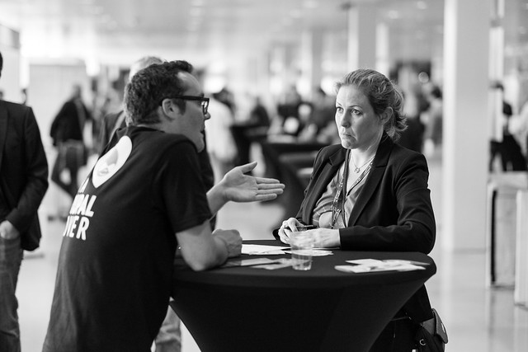
“Interview” by Boris Baldinger is licensed under CC by 2.0
Data collection
Internal and external document review
Up to 9 semi-structured recorded interviews
Library Director/Deputy Director
Library Administrator/Manager
Library Frontline Staff
Community partner director
Community partner frontline staff
Up to 3 community members
(Leedy & Ormrod, 2016)
Notes:
Outline of the data collection…
Citation: Leedy, Paul D., & Ormrod, J.E. (2016). Practical Research: Planning and Design, 11th ed. Boston: Pearson.
Because each location is different in terms of the available staff, there may not have been nine people to interview, which was expected. Image: https://www.flickr.com/photos/borisbaldinger/15222127749 by Boris Baldinger / CC by 2.0

Slide 21
Interview Questions
What makes the library a strong partner in an effort like this?
How did your library decide to offer this program/service?
Community Partner
Library Staff
What has been your overall experience interacting with the library for these programs and services?
Why do you think it's important for the library to be involved in this work?
Library Board
Community Member
Notes:
There were four different groups of interviewees: library staff, library board members, staff at the community partner organizations and community members/patrons. With most interviews, we had no more than 14 main questions, plus some prompts to dig in a little deeper if there was an opportunity. Most of the interviews with library and community partner staff lasted around 45 minutes. Interviews with community members were closer to 15 minutes.
Here are examples of the questions that we asked.

Slide 22
PROGRAMMING & Services EXAMPLES

Slide 23
Types of programs and services
Naloxone training, staff and patrons
Community reads and author talks
Changes to physical layouts in bathrooms
Peer navigators
Deterra disposal bags
Recovery Court
Awareness and information campaigns
Mental health and substance abuse related health programming
Notes:
Through our research, a range of programming and services were surfaced.
There are high-touch responses that involved trained staff and a detailed partnership – such as peer navigator programs, which connect patrons in need to information and ideas about services available in the community. Often these peer navigators come with “lived experience”, and have dealt with their own addictions or overdoses.
There are lower-touch examples such as providing medication disposal bags to patrons which can be used to safely dispose of unused or unwanted prescription medications so that they can’t be abused.
There were examples of activities and programming that can fit all kinds of communities and budgets. For example, hosting an community reads event where everyone reads the same book and then the library hosts a discussion is something that many libraries can do, and it doesn’t require a major investment, and it is well-aligned with other programming that the library already offers.
There is no one-size or prescription for how to handle this. Each library has a different community and different needs, so what fits one, will not necessarily work in others. OCLA and PLA are coming away from this research effort understanding that it is important to let libraries and their communities determine what is best for them locally, and we can focus on providing the information, resources, and capacity to help those libraries make well-informed decisions.

Slide 24
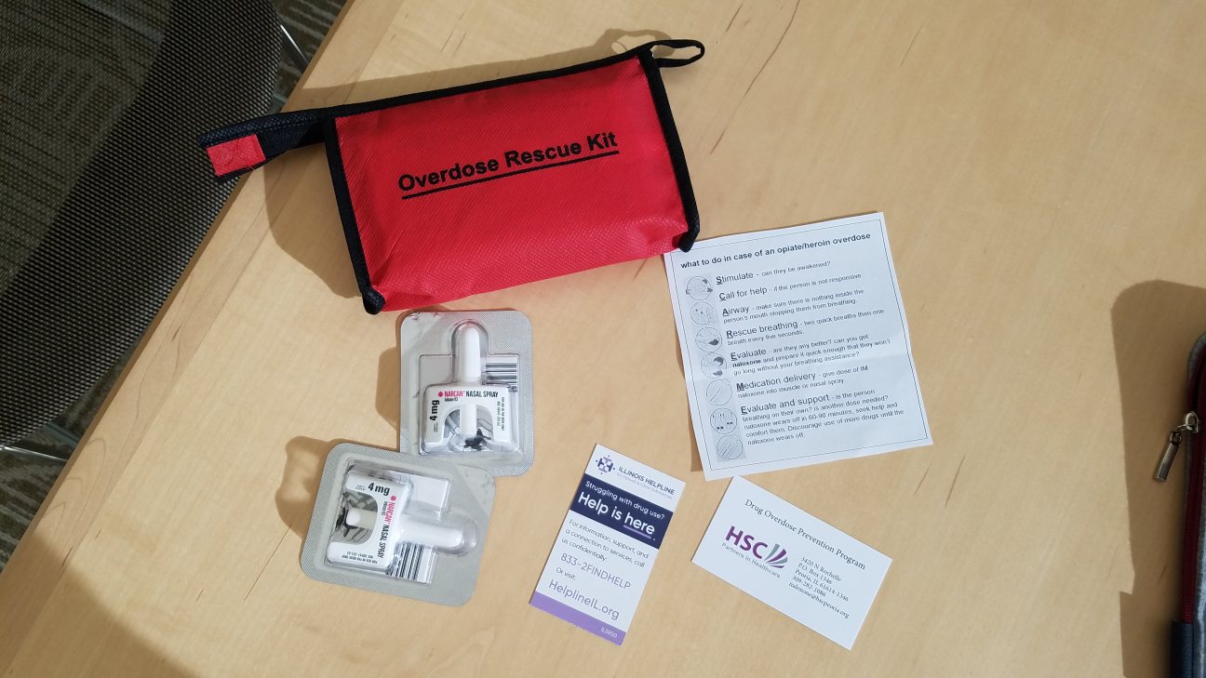
Peoria Public Library
Overdose Rescue Kit
Includes Narcan, instructions for use and information for more help.
Photo courtesy: Peoria Public Library
Notes:
Peoria Public Library has Overdose Rescue kits. These contain several doses of Narcan, which is the opioid overdose reversal drug, naloxone, which can be administered to someone to revive them from an overdose. It also includes instructions for using the Narcan, and what to do to get more help.

Slide 25
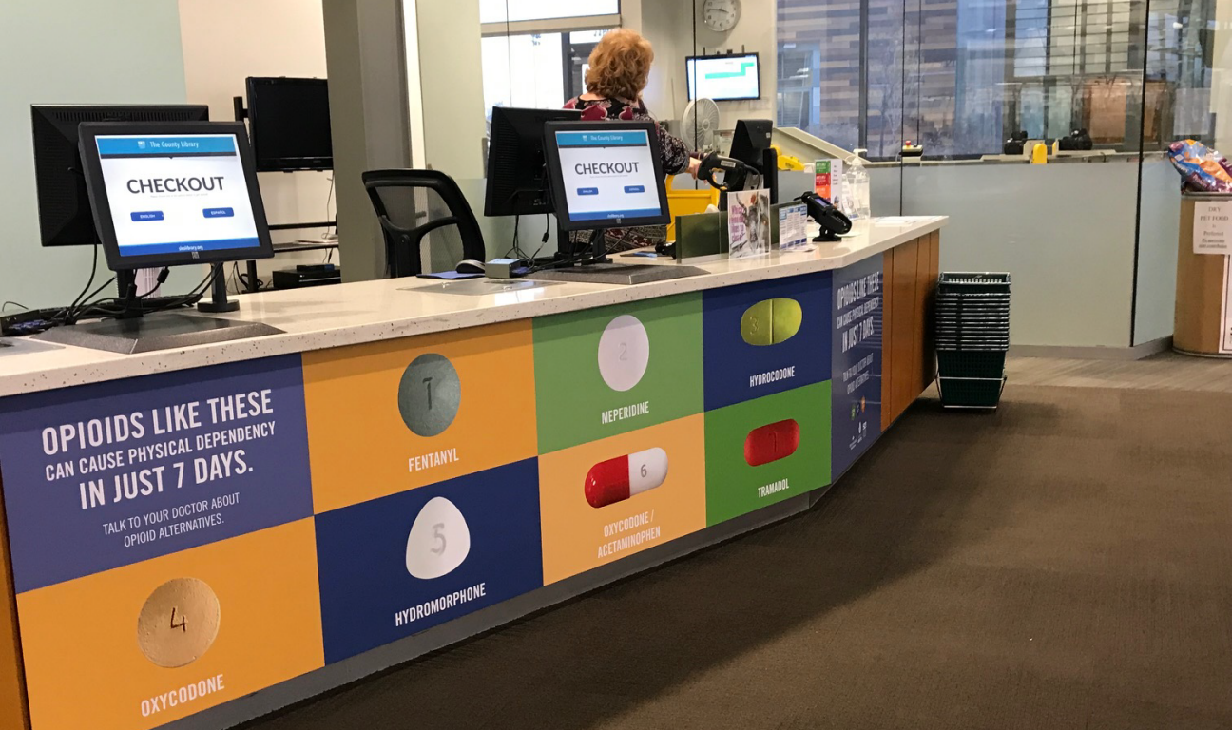
Salt Lake County Library System
Use Only As Directed, public awareness campaign.
“Opioids like these can cause physical dependency in just 7 days.”
Photo courtesy: Salt County Library System
Notes:
Salt Lake County Utah has a large display right at the checkout desk of the public library, to help community members recognize what an opioid looks like and increase awareness about their potential hazards.
This display sparks conversation with patrons, as well as in families. Staff noted that children have asked about the “candy” in the pictures. Which is a good reminder to parents that children often don’t realize a pill is a potentially dangerous medication.
This sign states that “opioids can cause physical dependency in just 7 days” and encourages people to talk to doctors about alternatives.
This same library also has a large display (see next slide)

Slide 26
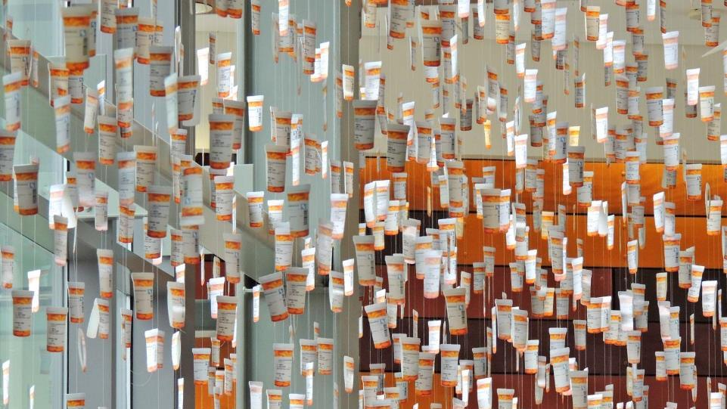
Salt Lake County Library System
Use Only As Directed, public awareness campaign.
7,000 opioid prescriptions are filled everyday in Utah.
Photo courtesy: Salt Lake County Library System
Notes:
Hanging from the ceiling of the library’s entrance. It’s 7,000 paper pill bottles, the kind that you would get a prescription in from the pharmacy. This represents the 7,000 prescriptions for opioids that are filled everyday in the state. Every day.
In 2016, there were 6,305 drug overdose deaths in Utah. (1)
These displays were funded entirely by the health department. The library didn’t need to pay for anything, but they did provide the space for the displays to greet the hundreds of people who walk through the doors of the library each day, to learn about how the opioid epidemic is affecting their community and maybe learn how to protect themselves and the people they love.
Stats of the state of Utah. (2019, May 24). Retrieved June 10, 2019, from https://www.cdc.gov/nchs/pressroom/states/utah/utah.htm

Slide 27
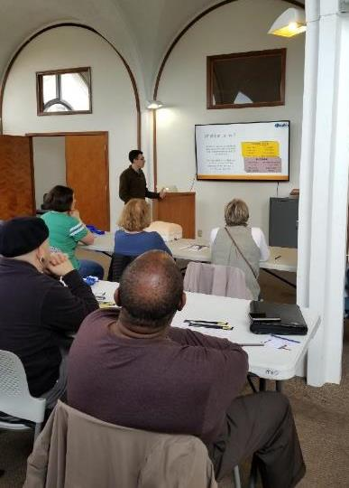
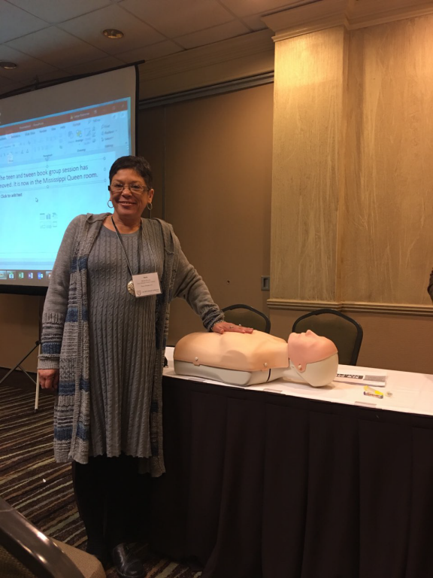
New Orleans Public Library, “Bystander Training.”
Provides first aid training, including an opportunity to practice administering naloxone.
Photos courtesy: New Orleans Public Library
Notes:
The New Orleans Public Library has rolled out its “Bystander Training” program in partnership with the local health department. People learn how to use naloxone, plus how to perform CPR and how to stop bleeding after trauma. This approach of including the overdose reversal training with other common health concerns helps to reduce the stigma of a drug overdose and gives people the opportunity to understand more about how addictions to opioids form and why it is impacting so many people.
The health department provides all of the trainers for these events, and both organizations help to promote the training. The library is scheduling these events in different locations around their system to help reach more community members.

Slide 28
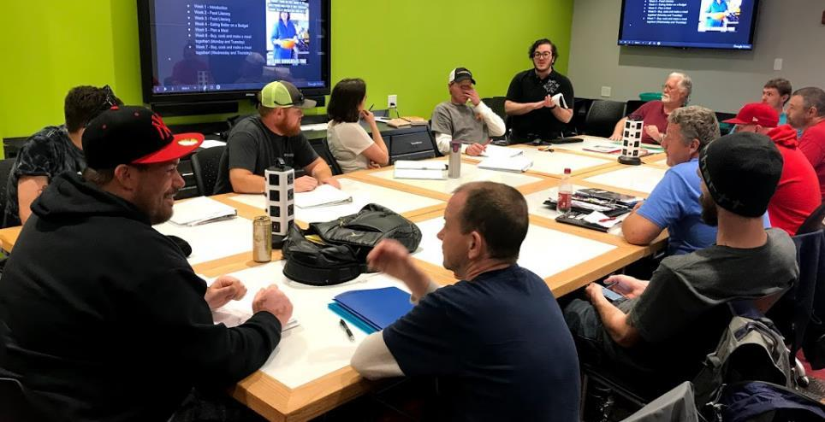
Blount County Public Library, life skills training course.
Recovery Court participants attending training sessions at the public library.
Photo courtesy: Blount County Public Library
Notes:
At the Blount County Public Library in Tennessee, the staff lead courses on life skills for participants in the local Recovery Court. The library adapted curriculum that they had for the general public to meet specific needs of the Recovery Court participants and have evolved the training based on feedback and needs of the program.

Slide 29
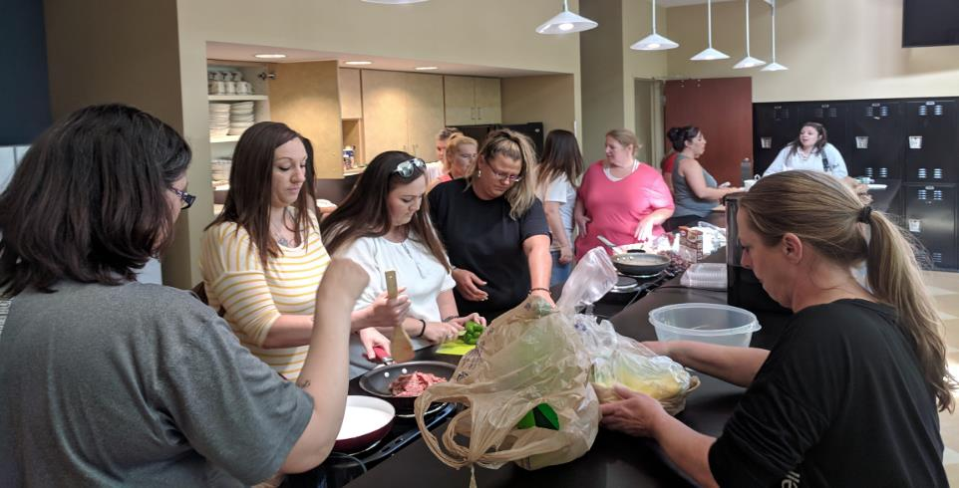
Blount County Public Library, life skills training course.
Recovery Court participants attending training on nutrition at the library.
Photo courtesy: Blount County Public Library
Notes:
This is another photo from Blount County. These participants are working on the nutrition model which is part of the curriculum. At the end of the module, the students go shopping for ingredients and prepare a meal for the class. It’s a great example of an active curriculum where students are engaged in the work.

Slide 30
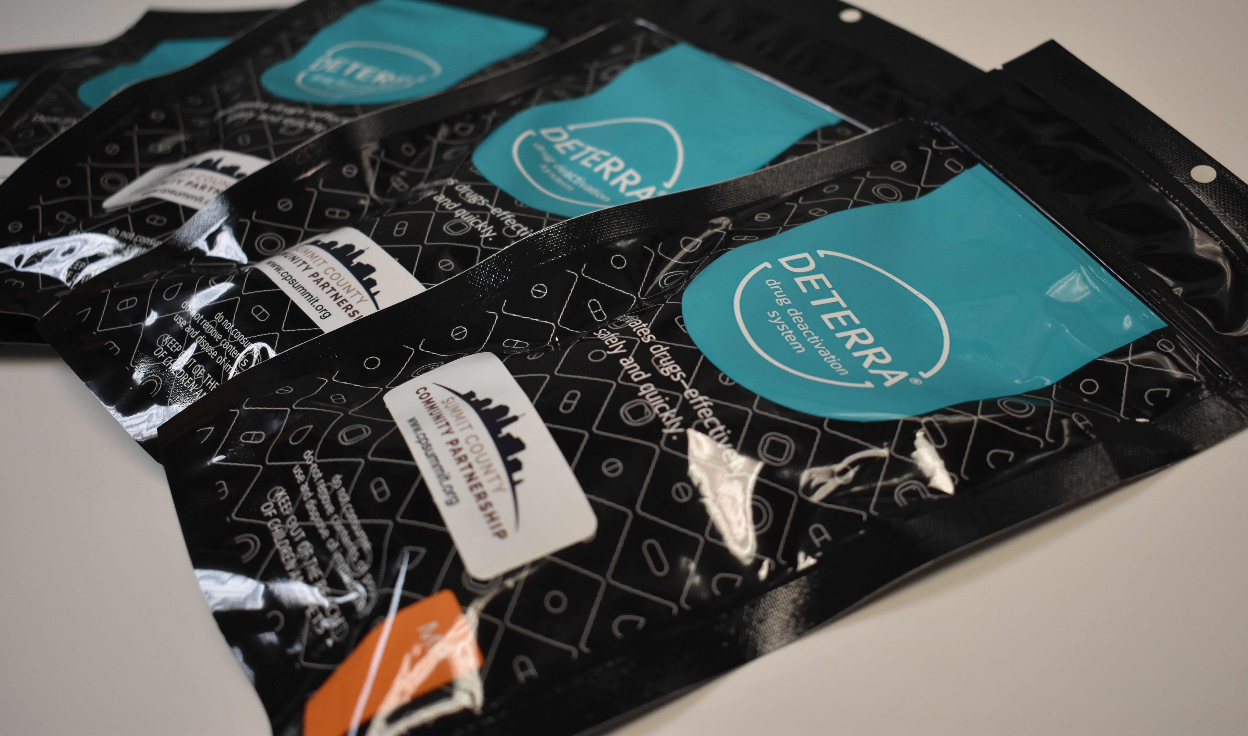
Deterra drug deactivation system.
These bags provide a safe way to dispose of unused prescription and over-the-counter medications.
Notes:
Medication disposal is a preventative measure that is being take by some libraries. One aspect of prevention is removing unused medication from the home. These bags are available from the Twinsburg Public Library, and a user can put any unwanted pills into the pouch, add water and seal the pouch and it renders the pills inactive.
Salt Lake County also promotes drug take back days and disposal options, and shares the statistic that “74% of Utahns with an opioid addiction get them from a friend or family member. Don’t leave expired or unused meds lying around. “

Slide 31
research findings
Notes:
The next few slides represent a few examples of the types of programming and services that we found in the libraries that were interviewed for these case studies.

Slide 32

Outputs reported
Increased community resources
Developed new partnerships
Positive impact on patrons’ lives
Increased community awareness and knowledge
Reached other libraries and community organizations
Addressed stigma
Increased positive perception of library
Research Data Management by janneke staaks is licensed under CC BY 2.0
Notes:
A few key outputs resulted from the opioid response activities and were mentioned by interviewees. The most commonly mentioned output was an increase in the number of resources available for the community. This included things like naloxone kits, distributed books, and Deterra bags. Other key outputs were the development of new partnerships, reaching other libraries and community organizations, and addressing stigma.

Slide 33
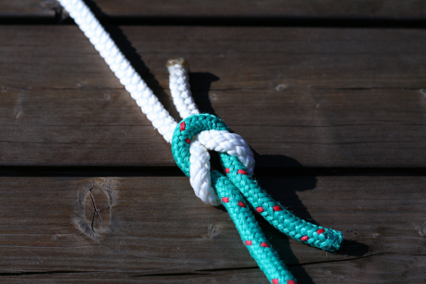
“We're so grateful to libraries for their willingness to do this because it is sensitive messaging. We understand that…culturally it has got a lot of stigma associated with it and a lot of misinformation and that can be a delicate thing. But their willingness to address that, and to become ambassadors, and to help eliminate some of that misinformation is a huge benefit to the community as a whole.”
- Community Partner
Image by Chris Wolf / Pixabay
Notes:
The partnerships have all been well received, with both library staff and the staff at their partner organizations expressing appreciation for the respective skills and resources that they contributed to serving the community. And this is an example of what we heard from partners about the value of these partnerships.

Slide 34
Opportunities and challenges
Stigma
Notes:
Stigma. Interviewees at six of the research locations shared how the strong stigma around substance misuse in the community impacted their work. The libraries and their partners feared how patrons with substance use disorder would be perceived by other library patrons, and some library staff shared that some patrons are concerned that the library may no longer be safe because the new programming served populations with substance use disorder. As a result, some libraries intentionally reframed their work from opioid overdose or misuse prevention to wellness with a goal of encouraging more attendance, and others did not advertise the programming broadly to the public to keep potential pushback to a minimum.
We have a lot of opportunity as a country, and as individuals to change how we talk about substance misuse, the language that we use and the efforts that we make. There are so many different aspects of this crisis, from how dependency starts, to how we provide access to information, to how we treat those seeking information and/or treatment, to how we treat and support individuals like the children, the family and friends of individuals who are facing substance misuse. The stigma is real, and we can do better.

Slide 35
Opportunities and challenges
Stigma
Funding
Notes:
Funding. Let’s face it – when doesn’t funding come it? This is no exception. Many of the community partners brought up the need for additional funding to hire more staff to dedicate toward direct program implementation and promotion and to buy more resources like naloxone kits and Deterra bags to distribute to the public. Library interviewees also would welcome additional funding for more programming and speakers.

Slide 36
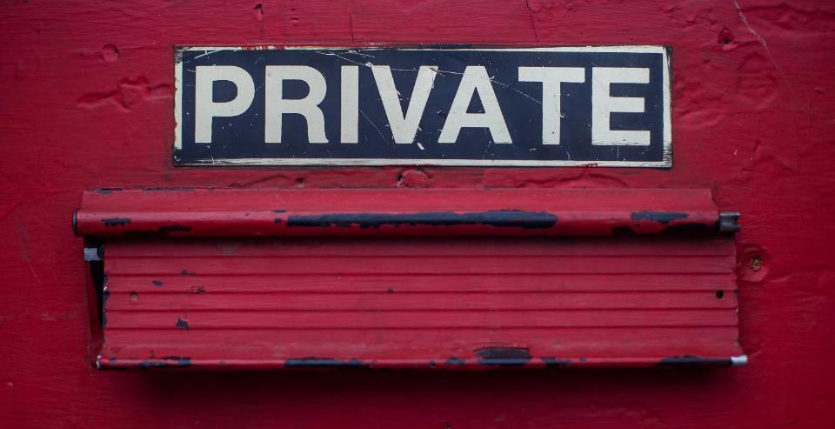
“Opiate addicts or people addicted to opiates are less likely to talk about that than people who have other addictions to other substances.” – Community Partner Director
“There's other people that are very, very guarded. So just ask something like, ‘What's your name?’ And they see me write that down, I could lose trust right there.”
– Community Partner, Frontline Staff
Image by Dayne Topkin / Unsplash
Notes:
Another key challenge that was mentioned was the importance of privacy and evaluation. These are a few quotes from interviewees about evaluating these services in libraries and in general. They shared that seeking help for an issue related to opioid misuse can be a highly sensitive request. And again, the stigma attached to drug use is real, and there can be perceived consequences from individuals who are seeking information – whether it’s an individual who needs help, or someone who is seeking support for a friend or family member. This concern absolutely plays out in how libraries are collecting information about patrons using services connected to the opioid crisis.
Interviewees indicated that confidentiality is critical to being able to provide services, which has made capturing any information about the long-term impact of their efforts very difficult. Instead, we found that more libraries focusing on the number of people served and capturing anecdotal information from staff as it becomes available.

Slide 37
The power of partnership
Amplify impact of collective efforts
Leveraging a partner’s resources/assets to strengthen the program/initiative—or even make it possible
Work in an area or topic where libraries might be unfamiliar/uncomfortable
Develop relationships that can be activated for future issues/projects
Notes:
A major opportunity that surfaced was the value of looking more at the partnerships. And some of the advantages outlined here won’t come as a surprise. These are exactly the kinds of things that surface when organizations collaborate successfully, and it is certainly what we are seeing in this project as well.
One of the key parts of this work is that these relationships won’t just serve the needs of the opioid crisis, but rather, this can be something that has lasting impact as trust develops between organizations who can rely on each other as the needs in the community change. This will not be the last public health crisis that our communities face – our populations are impacted by chronic diseases such as diabetes and heart disease. We also struggle with promoting and maintaining healthy lifestyles. So, there are many many opportunities here to think about the broader implications of providing resources and information that build a healthy community.

Slide 38
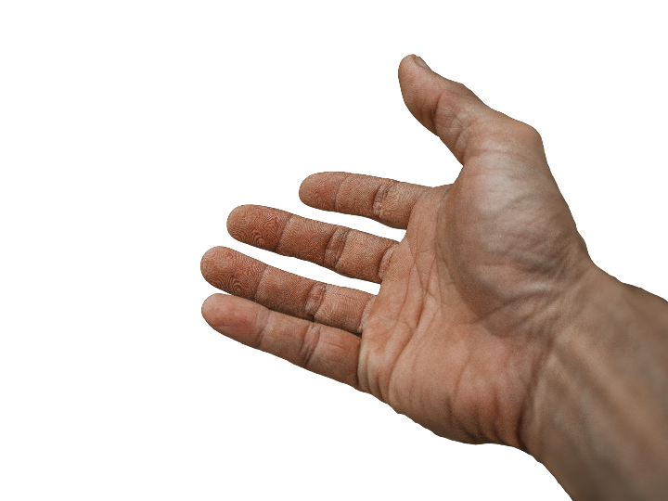
“It benefits me because I feel more prepared to help someone. I think anytime you feel more prepared and trained, you're much more likely to help someone.”
- Community member who received naloxone from the library
Image by truthseeker08 from Pixabay
Notes:
This quote came from a community member who received training on how to administer naloxone, which can reverse an opioid overdose. This perceived sense of being better prepared to help someone is huge. Knowing that naloxone is available and how to use it can lead to helping someone survive an overdose.

Slide 39
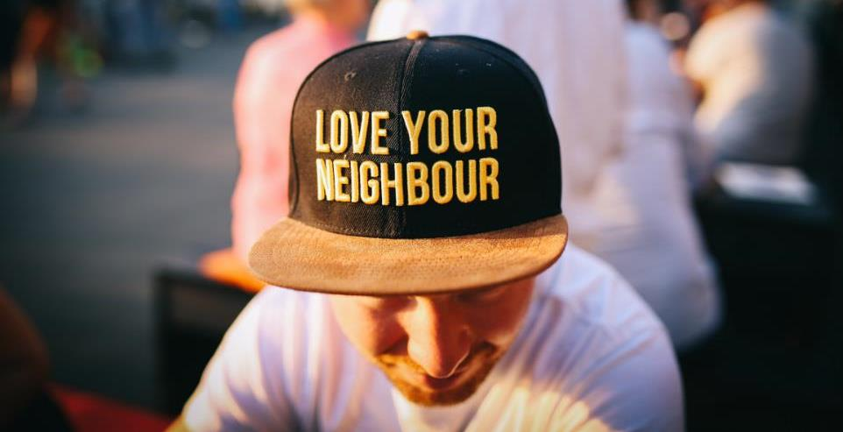
“I'm a pastor in a neighborhood where there are lots of drugs, and some of my congregation have family members who are abusing drugs. Two years ago, we actually had someone die outside of our gates from an overdose. We want to be able to assist our family members, but also our communities, and help the persons who are addicted to substances, particularly opioids.”
– Community member who participated in response training
Photo by Nina Strehl on Unsplash
Notes:
This community member also spoke to the importance of being trained and aware of ways that you can help people who are addicted. He has felt this need directly when someone died outside of his church two years ago. By participating in the training provided by the library and their partner, he was able to get more information to support his community and possibly prevent another tragedy.

Slide 40
Next steps

Slide 41

Next steps
Virtual cross-sector discussions
Call-to-action white paper
WebJunction webinars
Notes:
Out project is engaging organizations from outside the library field so that they are aware of what libraries are doing, what they could do, and what they need. This summer, we are inviting representatives from these organizations to attend a virtual meeting to discuss the case studies, and to share resources from their sector that can assist libraries and the public.
This fall, we will combine the findings of the case studies and the cross-sector discussions into a call-to-action white paper, which will highlight the various programs and services that libraries might consider. The goal here will be to make sure that libraries can see the value in this and see the kinds of partners that might be able to help them. There isn’t a single solution to this epidemic; each library will need to identify their own path.
And, closer to the end of the year we’ll host webinars via WebJunction to share out the final findings and resources generated by the project. We hope you’ll join us then!

Slide 42

“So I hope … that this study is just another piece of proof that this is something that we need to do.”
- Community Partner, Frontline Staff
Photo by PublicDomain Pictures on Pixabay
Notes:
One of the interviewees shared this with the research staff. And it really speaks to the importance of both the research and what is happening. Through the call-to-action white paper, and in presentations like these, we want to help more libraries and more organizations to find the opportunity to work together and help to address this crisis.

Slide 43
More information
Project website: oc.lc/opioid-crisis
Join our Facebook group
Sign up for WebJunction’s newsletter, Crossroads to learn about future webinars and new content
Notes:
And before we move into an opportunity for discussion and questions, we’ll leave you with a few options for keeping in touch with us about the project.
There is a project website as well as facebook group, and you can find out more about the Facebook group through the project website. We also encourage you to sign-up for the WebJunction newsletter which will have information about the project deliverables as they are released. PLA will also be sharing content through their channels.

Slide 44
WVLA Conference
Questions and Discussion
Project website: oc.lc/opioid-crisis

Slide 45
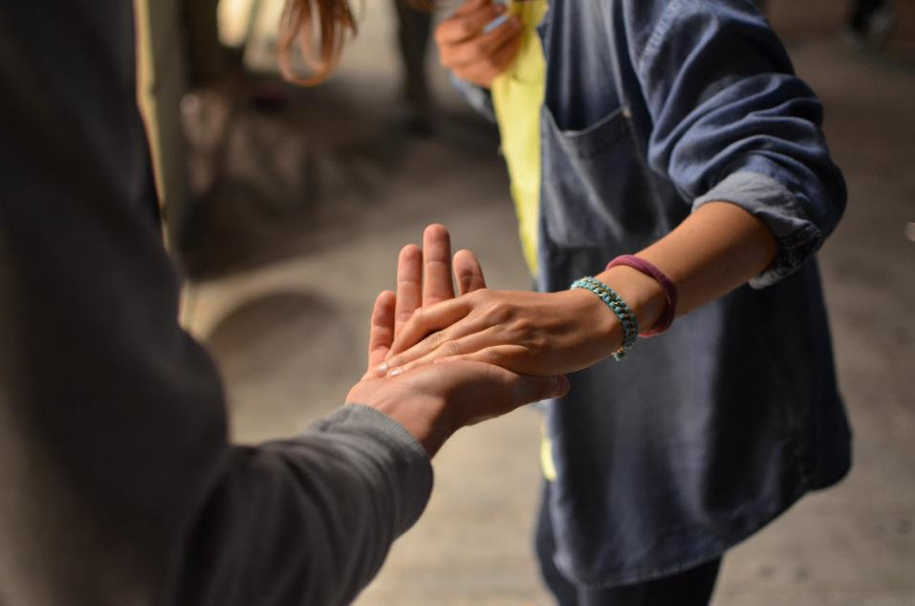
“Be open. Be open to people, to being human, because…[this] is a person, and they are suffering. And I guarantee there's a whole group of people connected to them that are suffering too. It's sometimes hard to see when you're dealing with it in the moment, but it's real.”
- Library Board Member
Image by Rémi Walle / Unsplash
Notes:
Finally, I’ll leave you with something that one of our interviewees, a library board member, shared when asked what they would recommend to people who are just getting started in this area.
Be open. Be open to people, to being human, because [this] is a person, and they are suffering. And I guarantee there's a whole group of people connected to them that are suffering too. It's sometimes hard to see when you're dealing with it in the moment, but it's real.”
You’ll be able to read the case studies from this project this summer, and the call to action white paper in the fall.
Thank you.

Slide 46
References
Drug overdose deaths | drug overdose | CDC injury center. (2018, December 21). Retrieved June 10, 2019, from https://www.cdc.gov/drugoverdose/data/statedeaths.html
Florence, C., Luo, F., Xu, L., & Zhou, C. (2016). The economic burden of prescription opioid overdose, abuse and dependence in the united states, 2013. Medical Care, 54(10), 901–906. https://doi.org/10.1097/MLR.0000000000000625
Goodman-Meza, D., Medina-Mora, M. E., Magis-Rodríguez, C., Landovitz, R. J., Shoptaw, S., & Werb, D. (2019). Where is the opioid use epidemic in Mexico? A cautionary tale for policymakers south of the US–Mexico border. American Journal of Public Health, 109(1), 73–82. https://doi.org/10.2105/AJPH.2018.304767
Leedy, P.D. & Ormrod, J.E. (2016). Practical Research: Planning and Design, 11th ed. Boston: Pearson.
Rudd, R. A. (2016). Increases in drug and opioid-involved overdose deaths — united states, 2010–2015. MMWR. Morbidity and Mortality Weekly Report, 65. https://doi.org/10.15585/mmwr.mm655051e1
Scholl, L. (2019). Drug and opioid-involved overdose deaths — united states, 2013–2017. MMWR. Morbidity and Mortality Weekly Report, 67. https://doi.org/10.15585/mmwr.mm6751521e1
Stats of the state of Utah. (2019, May 24). Retrieved June 10, 2019, from https://www.cdc.gov/nchs/pressroom/states/utah/utah.htm

