Slide 1
Partnering across campus to enhance institutional reputation: A case study from the University of Nevada, Las Vegas
OCLC Works in Progress Webinar
October 15, 2019

Slide 2
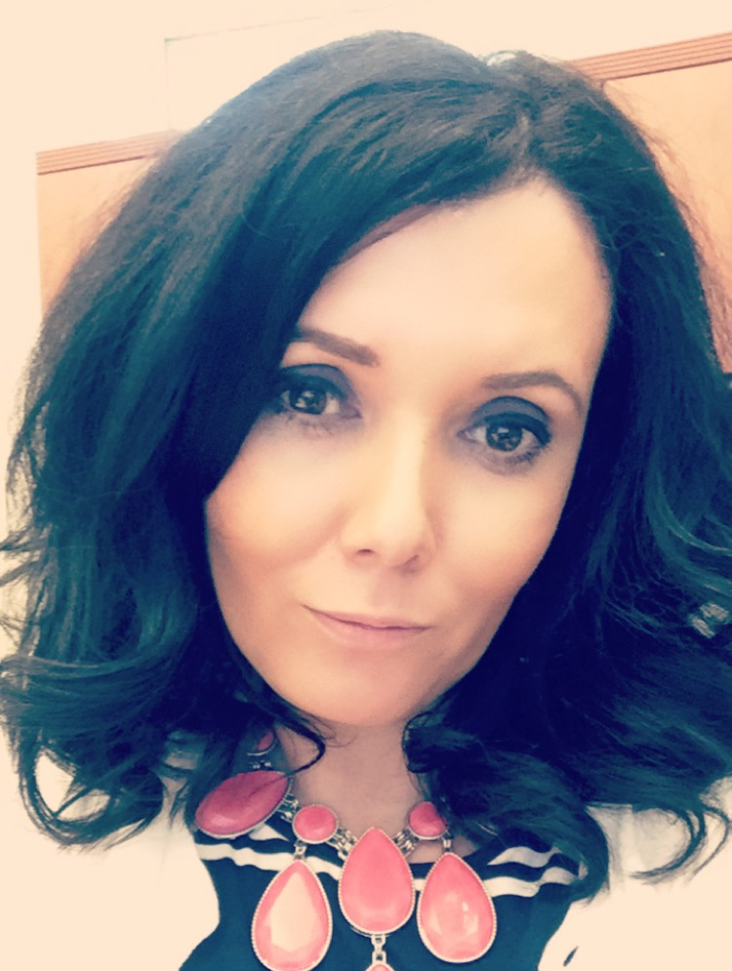
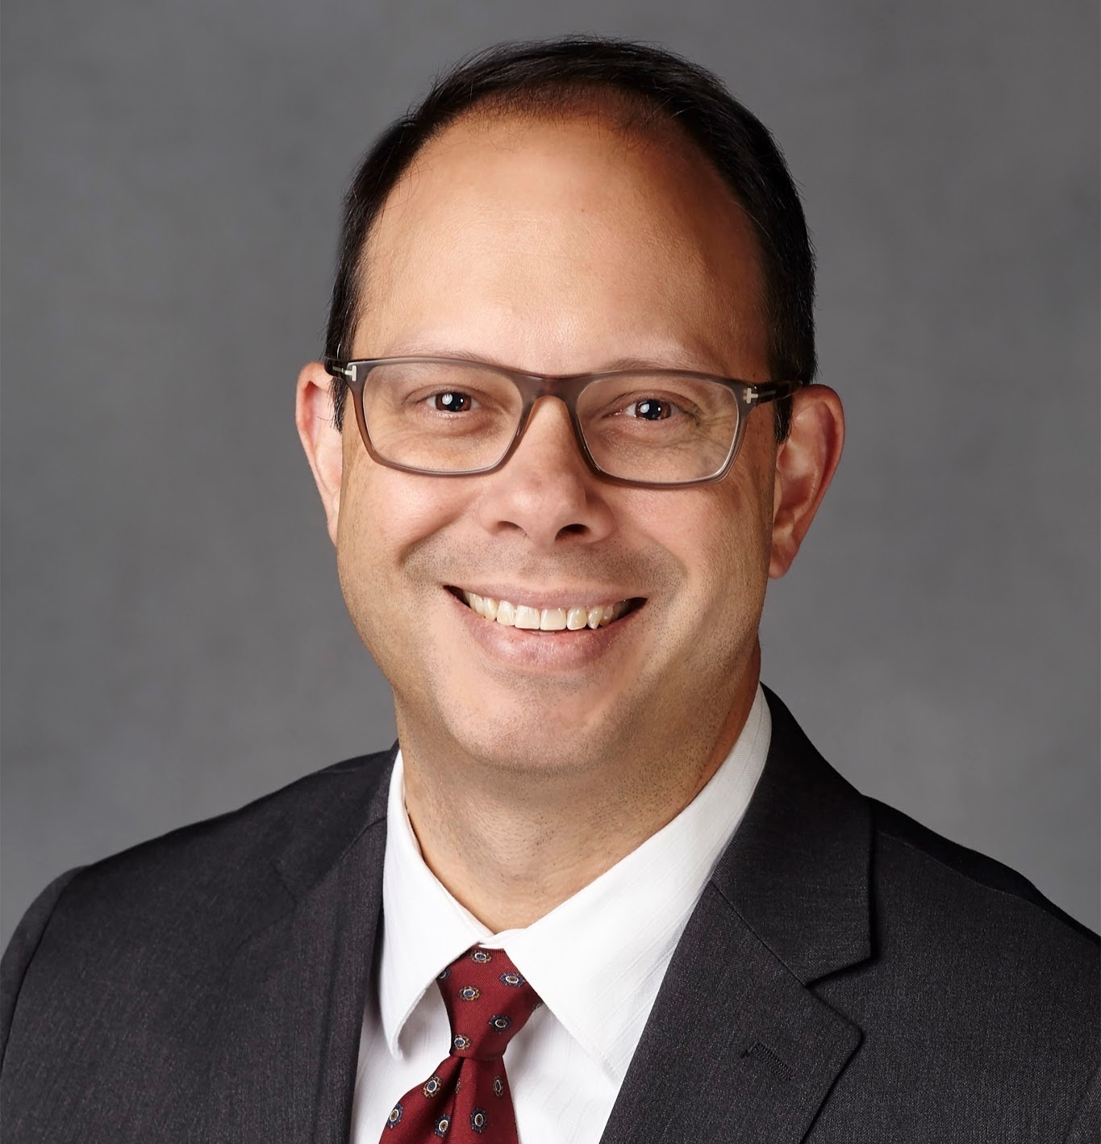
Annette Day
Director, Collections, Acquisitions and Discovery
UNLV Libraries
ORCID iD: https://orcid.org/0000-0002-8405-4780
John Novak
Collection Development Strategies Librarian
University of Maryland Libraries
Formerly
Head, Scholarly Communication Initiatives
UNLV Libraries
ORCID iD: https://orcid.org/0000-0003-4761-5400
Notes:
Introductions….

Slide 3
“In research universities today, there is a growing need to provide an array of research support services such as research data management, research information management, open access repositories and monitoring, and much more. Operating in this enterprise ecosystem is challenging, in great part because most stakeholders know little about the operations of other units, making it difficult to effectively engage, identify points of common interest, and collaborate to support research services.”
- Rebecca Bryant, Hanging Together August 2019
Notes:
Start with a quote from Rebecca Bryant’ on August’s hanging together blog as it really provides a great outline for what we’ll be talking about today. “ In research universities today, there is a growing need to provide an array of research support services such as research data management, research information management, open access repositories and monitoring, and much more. Operating in this enterprise ecosystem is challenging, in great part because most stakeholders know little about the operations of other units, making it difficult to effectively engage, identify points of common interest, and collaborate to support research services.“ -
In this presentation we’ll talk about some directions and projects that saw the Libraries engage and collaborate in various ways with different campus stakeholders. Through that work we found the Libraries could play an essential connector role - articulating for campus stakeholders a clear point of common and shared interest. The Libraries worked with various stakeholders on campus in different venues and for different purposes (which we’ll describe in this presentation) and through that work, recurring themes of how to gain a better understanding of the work of UNLV researchers and how to track and measure the outputs and impacts of UNLV researchers’ work kept coming up as needs and directions of the different stakeholder groups.
These stakeholder groups weren’t always working collaboratively or aware of the work or needs of each other and so today we’ll describe a lot of “joining the dots” between conversations across campus and how we have managed to help focus a conversation for the institution by bringing clarity to the questions on the table and highlighting the need for collaborative solutions with examples of potential ways to develop those solutions including helping campus understand what research information management is and how developing an infrastructure to support RIM would be hugely beneficial.
This work and UNLV’s direction in this area is still very much a work in progress - we also don’t have a neatly wrapped conclusion where UNLV now has a full and robust research information management infrastructure. But we do know that campus is more engaged and collaborative around this issue with a better understanding of need and on the path with potential. And we hope that by describing our activities and chain of events, how we identified and developed relationships, how we articulated the value and purpose of the Libraries in this space will be helpful for others trying to navigate across their campus.

Slide 4
About UNLV
Founded 1957
30,000 FTE
MSI, HSI, AANAPISI Serving Institution
U.S. News & World Report’s most diverse universities for undergraduates
30% First Generation
Medical School
Research Expenditures
$66 million (NSF reported - 2017)
2025 aim of $150 million
Attained R1 status in 2018
Strategic Plan - Top Tier
Notes:
Here is the slide where we could lay out a bit of context about UNLV
Make up of student body - diversity/first gen -
In 2015, UNLV achieved designations as an Asian-American and Native-American, Pacific Islander-Serving Institution (AANAPISI), and as a Hispanic Serving Institution (HSI).
It’s a young university - which is important as it’s still growing and trying to establish organizational capacity and frameworks that effectively and sustainably support the work of a large university (i.e. individuals carry a lot of load, when one leaves it can put things back to the beginning) Perhaps explain about turnover in VPR and FA offices here or leave to later slide???
Maggie’s analogy about UNLV being an adolescent is a good one. UNLV has all the enthusiasm, energy and dreams associated with being an adolescent but that means it doesn’t always exhibit common sense or spend the time to put the necessary infrastructure and frameworks in place (or realize the need for them) before it pursues a new direction/challenge. This is good and bad - it means that campus is very open to ideas and collaboration but it sometimes runs before it walks.
Top Tier is an effort to manage our growth in a more strategic way, recognizing the gaps we have in infrastructure and communication and the need to develop from our adolescent approach. Top Tier is something that will talk about a lot in this presentation and we’ll provide a bit more context to it in later slides

Slide 5
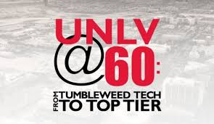
Top Tier
“By 2025, UNLV will be recognized as a top tier public university in research, education, and community impact.”
Pathway Goals
Research, Scholarship and Creative Activity
Student Achievement
Academic Health Center
Community Partnerships
Infrastructure and Shared Governance
Notes:
What is Top Tier and why is it important …..
The Top Tier initiative has provided a framework, context and to be honest leverage for much of the work described in this presentation, That’s why it figures as a large element in telling this story and is really the motivator for many of the activities and conversations that were happening on campus.
Top Tier is a large cross-organizational strategic planning effort which began in 2014. The stated vision of this initiative is for UNLV to be recognized as a Top Tier public university in research, education, and community impact by 2025. In 2014 one element of this goal was to achieve an R1, Highest Research Activity Carnegie Classification which was achieved in 2018 (we got there early) but that does not signal the end of Top Tier as the purpose is much broader to establish and sustain excellence in identified thematic areas or pathway goals of teaching, research, community partnerships and an integrated academic health center with a fully accredited medical school that supports the health care needs of the region. Infrastructure and shared governance underpins it all and is an element of the four pathway goals.
These pathway goal areas were established in 2015 and at that time each goal was described with action items and key measures of success for those action items, so that progress to each pathway goal could be measured.A series of committees and sub-committees were then tasked with the work of achieving those goals, action items and metrics. Those appointed to the committee were assigned for their skills and expertise, and identified through their work on existing campus committees, campus positions held, or named by their Dean as representatives for a specific area. UNLV Libraries’ faculty and staff have well established relationships across campus through committee service and effective outreach and were represented in all pathway goal areas but for the focus of this presentation we will describe the work of one sub-committee chaired by me in the Research, Scholarship and Creative Activity goal area.

Slide 6
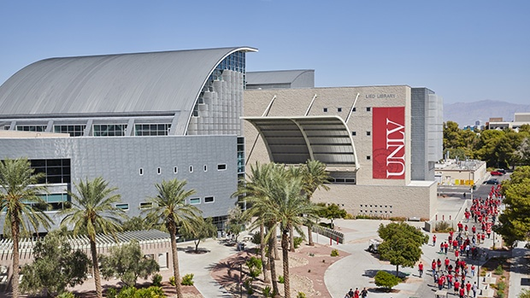
About UNLV Libraries
Notes:
Pulled this from an old presentation we did - can delete if irrelevant - As I mentioned a moment ago as an MSI with a large proportion of first generation students - retention progression and completion (RPC) are big challenges for UNLV. Keeping our students in school and supporting them through their academic experience to graduation is a constant challenge. So our library, our services and the roles that our librarians and staff play have been primarily centered on student success, contributing to helping students acquire the skills they need to be successful academically and to function in a campus environment. In fact The UNLV University Libraries is a nationally recognized leader in information literacy, and is cited as one of the Association of College & Research Libraries’ exemplary programs for information literacy best practices

Slide 7
UNLV Libraries Strategic Framework 2015-2019
University Libraries contributes throughout the research lifecycle, from identification of opportunity to dissemination of results
Optimize data discovery, interaction and reuse through services and tools.
Provide integrated support of knowledge and scholarship production in the digital environment through provision of dedicated spaces, innovative tools and skilled assistance for researchers.
Identify opportunities to advise and assist faculty with research data management (RDM),including the creation of complex data management plans and the sharing, description and preservation of their data. Develop specific Libraries’ roles and services in support of RDM.
Enable the dissemination, preservation and discovery of UNLV-produced research and scholarship through Digital Scholarship @ UNLV and other platforms.
Provide scholarly communications assistance (bibliometrics, copyright, digital publishing, open access) tools and training to facilitate researchers in making the best decisions regarding the creation, dissemination, evaluation and preservation of their research outputs.
Notes:
Will need to edit these strategic goals to highlight what is relevant but the purpose of this slide is to show our directions and the things that we were working on that informed our conversations, highlighted to campus where we had knowledge and skills and facilitated our involvement on a number of campus initiatives.
Briefly mention what this meant in terms of actual directions
IR
ORCID
RDM
Bibliometrics

Slide 8
Entities in the Campus Research Enterprise
Researchers: those who do the research
Faculty
Administrative Staff: those who manage research activity at different levels
Office of Research; Office of Faculty Affairs, OIT
Strategists and Disseminators: those who work at the university level but who are not directly involved in research activity
Communications
Librarians exist in all three areas.
Adapted from Rumsey, S. (2010). A case analysis of registering research activity for institutional benefit.
International Journal of Information Management, 30(2), 174–179 and
Day, Annette. 2018. “Research Information Management: How the Library Can Contribute to the Campus Conversation.” New Review of Academic Librarianship 24 (1): 23–34
Notes:
In your environment you would want to make sure that you talk to people across the spectrum because you need to be know by all these people…. Need to liaise with broader scope than just those that do the research - not just the “traditional” liaison with faculty.
In this slide, we should talk about what each of these entities in the RIM enterprise want to get out of a RIM system.
Researchers - want a place to store data, want it automated as much as possible, and reduce redundancy when asked for updates on their activities from folks in the next two categories.
Administrative Staff - want a place where they can pull up-to-date information about research activity quickly. Also want a comprehensive picture of research activity and a low maintenance and secure data infrastructure to handle this data. Also want to see impact and collaborators, in order to predict growth areas and create reports such as ROI.
Strategists and Disseminators: want to push data to external community in order to amplify accomplishments of the university (inside/out collecting).

Slide 9
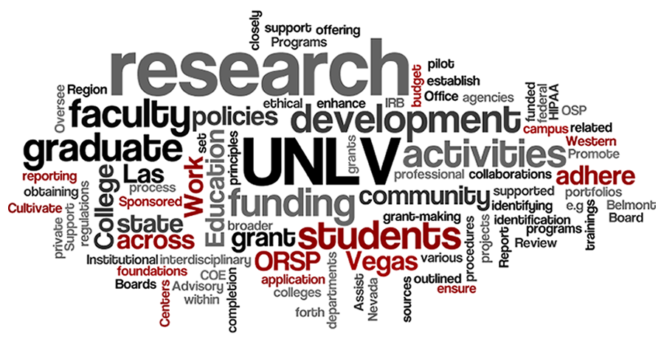
Campus Stakeholders, Connections and Conversations
Division of Research and Economic Development
VP Research
Office of Sponsored Programs
Associate Deans for Research
Office of Faculty Affairs
Faculty Activity Reporting
Provost
Office of the President
Deans
Department Chairs
Individual Researchers
Notes:
This our reality and where we were ….So we’ve explained a little about the UNLV environment and the Libraries directions and focus but how did we get to a space of identifying a shared, common need around impact of UNLV research and facilitating conversations and highlighting collaborative solutions to further campus directions in this area.
To do this it will be helpful to understand who were the stakeholders in the conversation and expand on how and why the Libraries was interacting with them activities led to a common shaped the conversation led us to existing campus connections and the venues we used for outreach and discussion. Some of those on the list were outcomes of others e.g. we were put on committees because of outreach and discussion we had pursued with stakeholders.
Division of Research and Economic Development - The Libraries had begun working with OSP an office of this division around OA mandates and RDM and DMP toolkit. Creating guided and presentations for faculty on these issues. This division is central to Top Tier achievement and with increasing research expenditures and increasing the impact of UNLV research as key elements of Top Tier. This has opened up conversations and opportunities with this Division
Associate Deans for Research - As part of my role I participate in a monthly meeting of Associate Deans for Research, led by the VPR for research and focused on discussing ways to strengthen UNLV’s research activities. The Libraries is an academic unit on campus equivalent to a college and so this meeting is a place where the Libraries has an assigned seat at the table. Conversations led by the libraries in these meetings focused on OA, IR, RDM, creating an online presence for faculty e.g. google scholar, academia.edu , ORCID and tracking of faculty impact. In particular the ADRs are tasked with oversight and support of research in their colleges so they are frequently asked to assess impact and have all sorts of metrics that they try to pull together e.g. one ADR was talking about how they were looking at the number of highly impactful research articles produced by a faculty to identify high producing researchers and assign teaching load accordingly.
In 2017 a new VPR came to UNLV from the UC system and she has set about creating a real paradigm shift in UNLV research by working to create more incentives and developing a research excellent program to centralize and strengthen support of researchers in developing, writing and getting grants.
As mentioned earlier UNLV is a relatively new university with a developing and evolving infrastructure and a university where research has not always been an emphasis. The new VPR has found this challenging and has received some push back from faculty and so she has been actively looking for partners and support across campus that shares her vision and has been advocating for and developing services in support of research. The Libraries checks those boxes (see discussions at ADRs) and subsequently the VPR has connected with us and looks to us as a partner on the same wavelength with us to fulfill many of her goals. She and the Dean are looking at the possibility of a jointly funded position to support RDM.
Office of Faculty Affairs - The Office of Faculty Affairs at UNLV reports to the Provost, as does the Libraries and the office is dedicated to supporting our faculty at every stage of their academic careers. This includes administering PT processes but also managing faculty annual activity reporting and this is the office that oversees the faculty reporting system - which was Digital Measures but is now Interfolio Faculty180.
Provost/Associate Vice Provost - Although both the entities above are part of the Provost’s office - the Dean of the Libraries reports to the Provost and so has been having concurrent and separate conversations with the Provost about how the Libraries can support the research enterprise and Top Tier goals. The provost became very invested in the term “reputation management” as an emphasis for managing and increasing faculty’s online presence so that UNLV reputation and research would have a broader reach and impact. She gave the Libraries a new position for this.
Office of the President - Periodically the president’s office would ask the Libraries for reports on citation counts and impact. Veer between using us and academic analytics for this data. Top Tier highlighted a need to more systematically gather and report this data - more on that later.
Deans - Libraries Dean is a member of Dean’s Council and in that venue and in that venue questions about faculty activity and tracking and measurement came up in light of tracking productivity and supporting growth for Top Tier
Departments and Individual Faculty - Department Chairs and individual faculty work with our subject liaisons for a variety of their libraries needs as you would expect. Pertinent to this presentation are outreach around OA, RDM and bibliometrics.
As the Libraries was hearing these conversations it was obvious that the same issues were arising in different venues with different stakeholder groups. The Libraries knew that we had knowledge and skills that could inform solutions and discussions in a positive way. As described in earlier slides the emphasis of library strategic directions coalesce well with the needs expressed in these conversations.
Although from a Libraries perspective it was obvious to us what we could bring to the discussion and how this was very clearly an area where our expertise made sense, we realized that others may not see it as such an obvious connection.
So it was important that during these conversations we highlighted our skills and expanded those discussions to presentations and outreach opportunities bringing in other colleagues as appropriate and impactful.
We could look back on what we did as a planned and strategic approach but honestly it was just a matter of regularly expressing the skills and tools that the Libraries could and did bring to the issues and challenges articulated in these different venues so that campus colleagues recognized we had authority in this area. At this stage we weren’t talking specifically about RIM as a concept or a solution but instead offering up ideas that could be utilized to help with the specific challenges that we we were hearing about. We found in several cases that people were more interested in having their particular issue/problem solved (or at least discussed) and the idea of trying to tie it to broader infrastructure needs and system development wasn’t something that resonated easily. SO focusing on “what we can do for you” as an approach was how we started our conversations and situating ourselves in this space. .
____________________________________________________________________________
Let’s make this the stakeholder slide and describe who they are and how we interacted with them - then we can go into more detail in later slides on specific ones….
So we’ve explained a little about the UNLV environment and the Libraries directions and focus but how did these things come together to facilitate a campus conversation that highlighted shared needs and interests around measuring impact of UNLV research and the potential benefits of RIM systems and practices at UNLV.
Should this go before the RIM section? You could talk about our overall strategy for connections and conversations, then we can talk about the RIM and Digital Measures in slides together. You can also group the top tier mission with your work on these committees and the ADR as another set of slides.So we’ve explained a little about the UNLV environment and the Libraries directions and focus but how did these things come together to facilitate a campus conversation that highlighted shared needs and interests around measuring impact of UNLV research and the potential benefits of RIM systems and practices at UNLV.
Firstly it’s key to understand our existing campus connections and how important they were in understanding the campus needs and leveraging the Libraries position.
As part of my role I participate in a monthly meeting of Associate Deans for Research, led by the VPR for research and focused on discussing ways to strengthen UNLV’s research activities. The Libraries is an academic unit on campus equivalent to a college and so this meeting is a place where the Libraries has an assigned seat at the table. Regular themes that surfaces in that meeting included …..
Faculty reporting needs - colleges needing to understand the level of activity of their faculty in terms of research outputs and a need to measure the impact/importance of those outputs
Faculty wanting to promote and share their research but really not sure how to do that effectively - should they create an academia.edu account or google scholar etc. Confusion over several local “expert profile” options
Lack of awareness of funding mandate compliance
These conversations were fueled by the Top Tier initiative as described previously increasing research activity and impact was a central goal of that initiative, and to do that effectively colleges obviously need a better understanding of how to track, measure, assess their faculty’s research and potentially look for ways to increase its access and reach.
Along with that describe digital measures concerns and dissatisfaction that surface through ADRs and across campus in faculty senate, in leadership meetings (there used to be these monthly campus meetings held by Greg Brown that were targeted at dept chairs)
Along with these venues the Dean was having similar conversations and hearing similar things at the Dean/Provost level meetings - we want reports on publications, we want to know how to measure and assess scholarly outputs and we want to do it quickly...

Slide 10
Timeline
Fall 2014
Digital Measures Faculty Advisory Committee
Associate Deans For Research
Fall 2015
UNLV joins ORCID via consortia license
Spring 2017
UNLV becomes beta partner with Dimensions
Top Tier Committee
Fall 2018
Institutional Reputation Committee
Data Governance Committee
Research Technology Group
Spring 2019
InterFolio implemented and mandatory for all faculty reporting
Summer 2019
Recruitment for Scholarly Communication Librarian for Research Infrastructure
ORCID mandated on internal OSP routing form

Slide 11
Top Tier Committee
“Develop an information and data management infrastructure to support research and creative activities and maintain existing key measure report for Research and Graduate Studies.”
Management of institution wide data on Research/Scholarship/Creative Activity
Management of data produced through Research/Scholarship/Creative Activity
Notes:
“The subcommittee had cross -organizational membership with representation
from the Division of Research and Economic Development, this Division includes
several key offices - Research Integrity, Sponsored Programs, Economic Development
and Undergraduate Research. Additional membership came from the UNLV
Libraries and the Graduate College. The subcommittee was chaired by a librarian,
a recognition of the Libraries’ previous efforts to develop campus wide understanding
and facilitate coordinated discussion on issues related to scholarly communication,
scholarly impact and data management. The Libraries’ efforts gained traction
by building deeper campus awareness of key issues but no coordinated and actionable
cross-campus directions were determined.”Describe that work and who was involved as this jumpstarted many conversations and actually didn’t really have a focus on RIM/impact that was a direction I took it in based on my understanding of what was needed.

Slide 12
Key Metrics
At least $120M/year of research expenditures by 2025
Increase commercially sponsored research, where appropriate, to at least five percent of total research expenditures by 2025.
At least 200 doctoral degrees granted annually by 2025
At least 120 non-faculty researchers with PhDs employed by UNLV by 2025.
Rankings by the Carnegie Foundation for Advancement of Teaching, federal agencies, and other organizations (i.e., NSF, National Research Council, etc.), particularly Research University/Very High status.
Impact of scholarship and creative activities in the academic and artistic communities, e.g.
Publications in journals with significant impact, such as those tracked by the Web of Science or equivalent indices.
Citations.
Invited or peer-reviewed presentations at premier academic conferences and symposia.
Books published with scholarly, peer-reviewed presses.
Commissioned and/or invited artistic exhibitions or performances.
Philanthropic support for our research, scholarship, and creative activities.
Increase breadth and depth of graduate and undergraduate student participation in research, e.g.
Articles (single-authored or co-authored with faculty members).
Presentations at academic conferences (singly or with faculty members).
Number of students working in laboratories.
Patents, startups, and other intellectual property developed by students or students jointly working with faculty.
Increase breadth and depth of economic and cultural impact of the university’s activities on our community - impact of campus/community cultural events, increased engagement with K-12 education, partnerships with nonprofits and public institutions, invention disclosures, patents applied for and granted, licensing deals, number of startups, other intellectual property, revenues, and jobs created from innovations initiated at UNLV.
The number of master’s and professional degrees granted per year, as appropriate for individual academic units.

Slide 13
Categories of Data
Research Funding
Degrees Awarded
Faculty Research Measures
Graduate and Undergraduate Research Measures
Organizational Research Measures
Demographics
External Impact on the Community

Slide 14
Define and Investigate
What is the data point we are collecting to track the key measure?
Example: If the key measure is ”At least $120M/year of research expenditures by 2025” then we need data points that track research dollars.
Is the data point clearly defined and comprehensive? If not, work with appropriate campus entities to clarify and define.
Example: Does research expenditures provide the full picture of research effort at UNLV. Tracking dollars awarded and grant submissions would help provide a fuller picture.
Is the data point currently collected? If so
Who collects the data point?
Individual, Academic College or Department; University Office
Is the data collected on a regular schedule? If not, what schedule should be utilized for reporting?
Is the data reported out beyond the collecting unit?
Where is the data stored?
Are there additional measures not listed that should be captured?

Slide 15
Category: Faculty Research Measures

Slide 16
What We Found and Next Steps
Siloed Data
Little Interoperability
No defined data “custodians”
Recommendations
Centralized and Intentional Approach
Faculty Reporting System
Defined Leadership
Next Steps
More targeted committee created
Additional Stakeholders
VP OIT
Director of Faculty Affairs
Decision Support
Notes:
The findings (Appendix A) highlighted organizational issues around siloed data
capture and lack of clarity on data stewards, data stakeholders and data reporting
schedules. It was clear that there was no centralized approach to gathering and
reporting on all the identified metrics. There was no one campus unit or department
responsible for gathering, storing or reporting the full breadth of the data.
Instead, individual colleges and administrative units collected the data for their
local purposes and it varied as to whether that data was shared beyond the collecting
unit. If it was distributed further, the group could not ascertain that it was
done on a regular and consistent basis unless needed for national reporting. Several
different systems were used to store the data and to generate reports or analysis.
There was no operational interoperability between the systems.
Targeted committees brought in more relevant stakeholders including those from OIT, Decision Support and Faculty Affairs - the latter being responsible for the campus faculty reporting system. The next iterations of the committee really just built on and re-emphasized the work of my original committee which included the need for a centralized reporting system and the recommendation that it should be the Faculty Annual Reporting system and that campus resources (staff, skills, money) should be put forth in building needed integrations with other systems to achieve interoperability needed to automate data input where feasible. The adoption of ORCID to assist with these integrations was also a recommendation - as well as developing a more formal structure around data oversight at UNLV. The committee requested that campus and the Top Tier oversight group review the governance and resources committed to information and data management. - Campus wide - data oversight committee was formed...

Slide 17
Faculty Activities Reporting (FAR)
UNLV Environment
DM adopted in 2014
Voluntary Implementation
Siloed system
No 3rd party integrations (at that time)
Move to Interfolio/ Faculty 180 in FY19
Notes:
In the Fall of 2014, I was asked to be the Libraries representative on the faculty advisory committee for Digital Measures. FY 15 would be the first year Digital Measures was to be used for our FAAR - the Faculty Annual Achievement Report. It was to replace our home-grown PDF form which had been used in years prior. [maybe detail this a bit more]
For those of you who don’t know, Digital Measures is a web-based faculty reporting system. UNLV moved to this online form for the following reasons:
easier and enhanced ability to access and run reports on faculty work
Ability to pre-populate the report for faculty, allowing for reduced faculty work and better information.
Integrate data about faculty from different systems across campus.
Implementing Digital Measures was rocky in the beginning.
In the first rollout though, Schools and Colleges across campus could opt-out of using Digital Measures. And many did. Less than 50% of eligible faculty used Digital Measures. By FY 19, the number was just above 50% adoption.
When half the campus is using the system, you are not utilizing the reporting system to its full capabilities. Unable to comprehensive reports, and the job of Faculty Affairs was split between personalizing our Digital Measures instance for our campus and advocating faculty to use DM.
Our digital information storage and retrieval environment also hindered the effectiveness and use of Digital Measures on campus. To be effective in the research information management environment, the different information systems that hold data need to be able to push and pull information between themselves. In other words, interoperability between systems is necessary. Unfortunately, we had different systems on campus, including homegrown systems for sponsored programs, that did not exchange information efficiently.
3rd party integrations were also minimal. Digital Measures did not connect with Scopus, Web of Science, or ORCID. Without an ability to feed information into Digital Measures, faculty were left to input citations of their work.
For Fiscal Year 2020, the campus has decided to try a different web-based faculty reporting system - Faculty 180. When I left UNLV in July, Faculty Affairs was in the process of migrating and populating faculty data into this new system.

Slide 18
Digital Measures Faculty Advisory Committee
Started in August 2014.
Job of members
Vet changes to DM system before implementation
Communicate and contact School/College faculty with info about DM
Inform department chairs/deans of training opportunities
Work with Faculty Affairs to get customized reports for School/College
One faculty representative per School/College
Notes:
In the Fall of 2014, I was the Libraries representative on the faculty advisory committee for Digital Measures. Since Librarians at UNLV are faculty, I was on this committee to represent Library faculty interests. This committee was also charged with
Vetting proposed changes to the Digital Measures system before its implementation
Communicate and contact library faculty with information about Digital Measures
Inform department chairs about training opportunities
Work with Faculty Affairs to get customized reports
Had campuswide representation, for each College/School had one representative on this committee. We met monthly.

Slide 19
Challenges Implementing New FAR System
Faculty
Skeptical, wary of change
Suspicious how data would be used
Low adoption rates
Faculty Affairs
Not changing process, but the tool. Tried to mirror the pdf form.
Supporting two promotion and tenure formats
Reporting still incomplete due to low adoption.
Staff stretched, a lot to handle.
Notes:
While a member of the advisory committee, these were some of the challenges I overheard and viewed. Participating on this committee provided me with firsthand knowledge of the different stakeholders in the research information management process.
For the other faculty members on the advisory committee, I saw aversion to change. For many, the PDF forms worked fine for them and they didn’t want to learn a new system.
There were also a lot of conversations about who had access to the data and how it would be used. This really surprised me, but maybe it shouldn’t have. I heard concerns such as “How far up the administrative chain could someone access a faculty member’s annual report, or how long would the data stay in the system?” In a way, it was a fear of big brother.
It was also illuminating because one of the main selling points of a web-based faculty reporting system was to reduce faculty burden by having them input the data once and never being asked to submit that information again when redundant reports were generated by administration. But in many ways, it was the inefficiency and the siloed information of PDF reports that the faculty liked.
From the Faculty Affairs side, they really did their best to assuage and accommodate faculty. As best as they could, they personalized Digital Measures to mirror the PDF forms that faculty had filled out. This means that a lot of effort was spent making minor changes to Digital Measures to get it to work like the PDF form instead of spending time investigating how to make reporting work in a digital environment.
Second, Faculty Affairs saw Digital Measures as solving a reporting problem but didn’t quite see the bigger picture of this system within Research Information Management. In other words, there was not much done to integrate this system with HR information or Office of Sponsored programs; instead, this system solved their specific problem about generating reports but not the campus problem of having siloed systems.
Third, they made DM voluntary. At first, only ⅓ of the campus participated and by the end of last year, only ½ the campus used Digital Measures. This means that we haven’t been able to fully utilize the power of a web-based system. This also stretches staff capacity, for not only do they need to implement this system and make improvements, they have to advocate to faculty on why they should adopt this. At the time of this writing, it will be mandatory for all faculty to use the new reporting system, so hopefully this problem will be solved shortly.

Slide 20
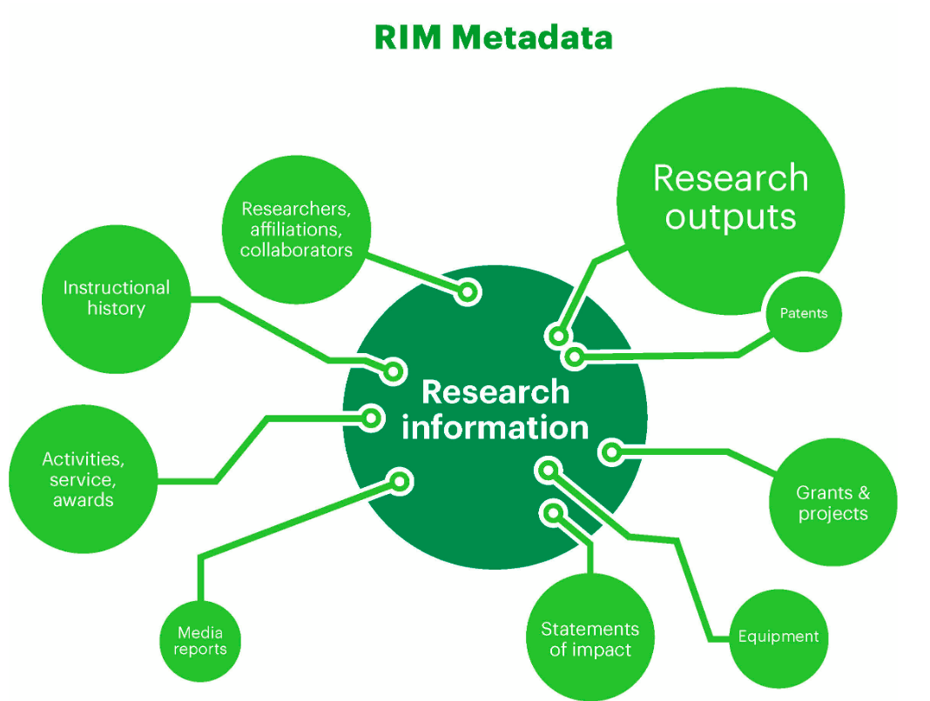
Libraries’ Participation in the FAR Discussions
Brought FAR into a holistic model of RIM
Connections with other campus systems
IR as part of RIM model
UNLV Bibliography
Research Information Management: Defining RIM and the Library’s Role.
Dublin, OH: OCLC Research. https://doi.org/10.25333/C3NK88
Notes:
I feel that the Libraries brought a unique and helpful perspective into these conversations. Unlike other faculty members, who were mainly interested in how their work would be reported, I was able to plug the FAR process into a holistic model of research information management.
I first made my case about using data from the FAR to populate the IR. If the FAR was the personnel data portion in the RIM lifecycle, I showed how the IR could be the public expression of the RIM by showing the world the accomplishments of our faculty. For those familiar with OCLC publications, I saw this as the inside/out model of collecting, taking what we do on the inside and sharing it with the world.
To do this effectively though, the FAR would have to automate and get quality information from other systems on campus. Not only would this make it easier for faculty, it would start connecting this reporting system to different information systems on campus.
Integrations, connections, for me, are a key component in any FAR system. So I happily volunteered to investigate and test integrations for the FAR.
This included WoS and Scopus incorporation into our system.
And we established a campus license for ORCID.
The goal with ORCID was to have it be a bridge between the different information silos on campus, to not only push information into the FAR but to pull it from the FAR and update it in different parts of the RIM - like the IR.
Hired two visiting librarians to help investigate implementing ORCID. Turned out were not able to make it a bridge, but we learned a lot about ORCID that would be valuable later (and that I’ll discuss in a later slide).
While working on the big picture, I did not dismiss the concerns of faculty of Office of Faculty Affairs and the Libraries worked to make it easier to use the current FAR, Digital Measures.
I created information pages to help faculty fill in the scholarly reporting section of the FAR.
Annette and our Dean bought data from WoS to populate the FAR with a 10 year history of UNLV scholarship. This would be authoritative data that faculty would not have to fill in retrospectively.

Slide 21
Other Opportunities, Investigations, Conversations
Notes:
I would be remiss to say that everything we participated on was a success. But I can say that the Libraries were visible participants in our willingness to explore and be ahead of the curve on other RIM initiatives.
We were at the forefront on Researcher IDs, not only working with ORCID but we also investigated proprietary IDs such as the Scopus Author ID, Web of Sciences ResearcherID, and Google Scholar profiles.
For Scopus, I became the administrator of the Institutional Profile Wizard, allowing me the ability to reconcile Scopus Author ID issues for UNLV researchers.
Worked with vendors to get list of UNLV Researchers with IDs
Our work eventually led to a policy of having ORCIDs be required by Office of Research in . . . ????
We met with Office of Faculty Affairs to investigate managing parts of the FAR process, especially around the publication process. This would have required more staff or student assistance, but it would have allowed us to dedupe duplicate notifications of publications and quality control the faculty entries in this area. This offer was not accepted in the end, but it did show our seriousness in this area of RIM.
When Office of Faculty Affairs investigated a new decision, we were not part of the team that determined the next system. We were, however, asked to test out and provide feedback on the various systems, especially in terms of scholarship.
I joined the Dimensions Advisory Board to develop a tool that would help universities track their research and grant output. This led to several, one-on-one conversations with the VPR (Vice President for Research) about how the libraries could use other tools to plug information into different information management systems across campus.
Presented to ADRs about this product in May 2019, touching on this product, getting information about research at the School/College level.

Slide 22
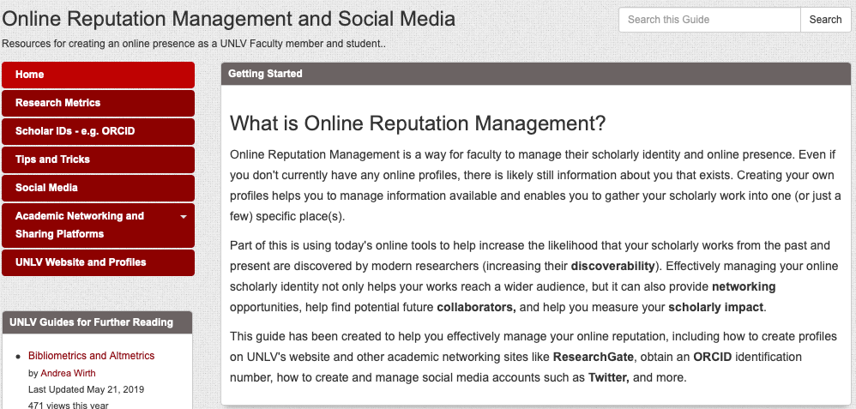
Scholarship Visibility and Impact Committee
Full Libguide available at: https://guides.library.unlv.edu/reputation-management
Notes:
I would like to think that this is a tale of success begets success.
In the Fall of 2018, I was asked to join a committee about online reputation that eventually became the Scholarship Visibility and Impact Committee. This committee was formed by the Senior Vice Provost on campus and the members included four faculty members (including myself) as well as a representative from Faculty Affairs, the Graduate College, OIT, and Campus Communications.
My work with the FAR system, author identifiers, and research information management prepared me well to participate in the kickoff meeting. I would like to think my contributions were valued and I was asked to co-chair this committee.
In my role, I wrote the charge with feedback from members, led discussions, and produced results. Specifically, this committee was charged with developing resources to guide and inform faculty and graduate students on how they can increase the visibility and impact of their work. Our group focused on the four areas of metrics, scholar IDs, managing an online presence, and social media.
In many ways, goals of this group similar to Libraries role in research information management - track output, document it, and make it visible.
As co-chair, I was deeply involved in all the discussions and solutions of this committee and articulated a space for the Libraries to contribute. The Libraries are central to the short and long-term solutions for managing UNLV researchers online reputation. The Libraries has agreed to host a library guide on best practices for enhancing researchers visibility and impact, we passed out a handout and were part of new faculty orientation on this subject, and we agreed to teach open workshops on this.
Long term - reputation management position.
I was also able to meet with our Senior Vice Provost monthly to provide updates on the committee and check-in with him on our committee’s progress and questions. Having this meeting time is valuable, for it’s an opportunity to demonstrate the work that we do and our commitment, and hopefully will lead to future opportunities. Provost touches more faculty than we do. Strategic conversation.

Slide 23
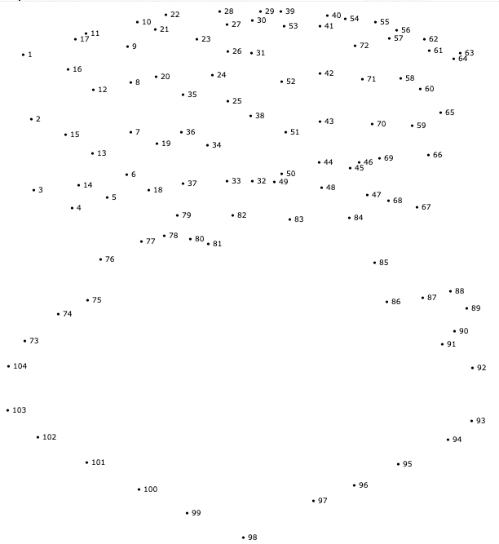
Connecting the Dots
Notes:
As you have heard, conversations at UNLV around research information management and reputation management occur all over campus and at different levels. Sometimes there is coordination between the different venues for conversation, sometimes there is not.
For us, the difficulty was joining up the dots and make sure that individual conversations tied into a bigger effort at campus-wide management of research information and reputation. It seems easy, for in a perfect world we should be able to say “hey everyone, you are all trying to achieve the same thing so let’s gather everyone together, develop some shared goals, and pursue a solution.”
Unfortunately, it didn’t happen this way. When Annette and I looked back over the past five years of conversations, we never came across a “lightbulb” moment where campus said aha! this all makes sense. Instead, our strategy was to be persistent and consistent in the different committees, venues, and conversations we were involved in. As we’ve talked about, we positioned the Libraries as experts in managing research output. That is, we are good at discovering, sharing, and preserving accurate information about our faculty’s scholarly and creative activities which benefits our faculty and campus administration.
Our other strategy was getting a set at the table. Five years ago, we were very fortunate that our Libraries Dean saw research information management as a direction for the Libraries and recognized the benefits for us being in this space. Our Dean was key in pulling together shared meetings with key stakeholders who could shape and define direction around the RIM enterprise. Annette and I have meet with the VPR, Provost, the Senior Provost and VP for Faculty Affairs, and the Associate Deans for Research about research information management and reputation management during this time.
Libraries had representation at many levels in the top tier and the research information management system discussions.
Chaired a few committees and led discussions
Diffuse conversations and activities happening all over the place. How did we focus a discussion and pull together stakeholders. How did we help inform the different stakeholder groups of their common needs and identify points of common interest?? So this is the tricky bit that in a perfect world we would be able to tie up neatly with us successfully saying “hey guys” you are all trying to achieve the same thing so let’s get everyone together, develop some shared goals and pursue a solution.
Alas it didn’t really happen that way. It was an iterative process with no real actual “lightbulb” moment. Instead it was a matter of making it a priority to consistently share across the committees/venues/conversations that we were in - telling stakeholders that they weren’t the only ones invested in finding paths forward and offering to connect them with other stakeholders and committees. Our goal was to pull together shared meetings with key stakeholders who could shape and carry the direction forward. The Libraries Dean was our go-to for making this happen as she had the ability to pull together VPR, Provost, Senior provost and Vp for Faculty Affairs and she brought us along to those meetings for consistency of conversation. Of course it helped that the Libraries Dean was invested in this as a direction for the Libraries and recognized the benefits of us being in this space and we’ll talk more about that in a later slide.
The outcomes of these efforts are still a work in progress. As i said it was an iterative process and it hasn’t really reached a full conclusion yet! So while we see progress we also feel some frustration about not being able to push something/anything fully across the finish line. - What we recognize as positive outcomes from the many conversations and committees is that we helped facilitate a better understanding of the issues and challenges around research impact and the benefits of RIM. Leadership at the University understands where they want to be and why it will be beneficial and are taking incremental steps to get there. Outcomes from the conversations that are positives and are instigated by the stakeholders in campus leadership that we worked with include ….
Mandatory adoption of the new Faculty Reporting System
ORCID on the OSP routing form
More targeted committees trying to focus on this solution
John’s reputation/impact group
Research technology
Position to help Libraries with reputation management/impact/ORCID
By being consistently present and consistently offering up our knowledge, skills and the tools for potential solutions we have nudged the conversation forward incrementally and we will take that as a win!
Not all stakeholders wanted to be part of a broader conversation some were more interested in trying to figure out a timely solution for their immediate need and weren’t interested in being part of a broader conversation which they saw (and rightly so) as being slow moving, bogged down in campus committee bureaucracy. They wanted to seek an independant solution that they could control and manage for their areas rather than wait for a campus solution. They also felt a general solution might not take into account the specificities of their discipline - So the Libraries is working with several campus Deans and ADR’s to help them generate and track their college scholarship and impact measures (can cite guy in education as an example) using standard tools and the IR (workshops, consultations, annual reports) . As this is an iterative process we use these examples to feed back into higher level conversations (through our Dean) to continually highlight a need and that a centralized solution should be sought. Everyone creating their own path is not the most efficient way and of course metrics may be measured in different ways across the different stakeholder groups meaning pulling together statistics from these groups at a campus level would be challenging.
______________________________________________________________________________________________________________________
Diffuse conversations and activities happening all other the place. How did we focus a discussion and pull together stakeholders. How did we help inform stakeholders of their common needs and identify points of common interest??
This is the difficult bit that i think people are interested in!!!
Joining the dots…..
Realized the Libraries had key role to play here in facilitating a diffuse conversation
Steps included ..
Articulating the issues/challenges/concerns that we had been hearing about from several different areas of campus in a consistent way that brought stakeholders together (need to elaborate more on this as this is probably the central part of the webinar!)
Who were the stakeholders and how did we approach them and get them to listen
What venues did we utilize
What strategies did we employ - what worked and what didn’t
Offering solutions
Work of Annette’s Top Tier group identified the data that was or could be collected to answer some of the questions about faculty research and impact. Needed to find solutions to make that work more strategically
Home-grown options - IR, ORCID as plumbing to facilitate interoperability he paths to learn more about potential solutions
Bringing in vendors (symplectic elements and Pure) to show what is out there as an “out of the box” solution
Enhancements to DM
Purchasing backfiles of UNLV faculty data, desire for including past outputs of UNLV researchers for analysis

Slide 24
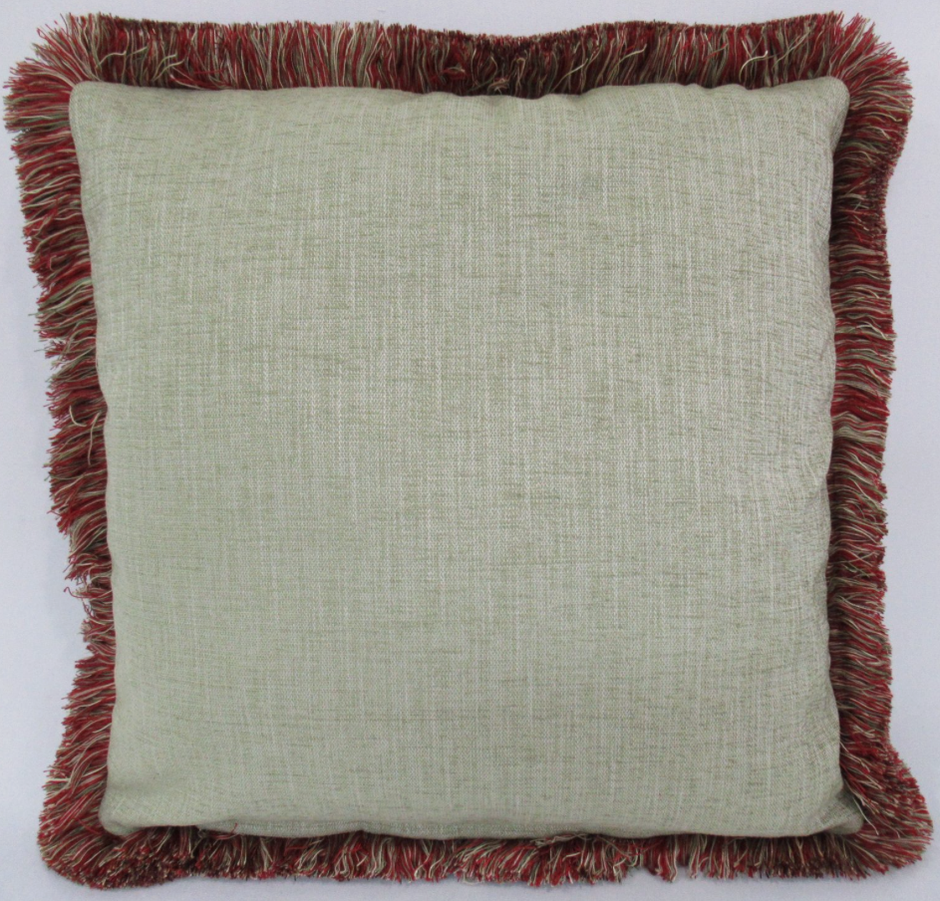
A Work in Progress!
FAR system use mandatory
New Library position created (funded by the Provost!)
ORCID support
Online Reputation Management
ORCID iDs mandatory on OSP routing forms
Libraries involved on more committees
Research Technology
Data Governance
Better Results are What Happens when Preparation Meets Opportunity
Notes:
A Work in Progress!
Using FAR system now mandatory
Maybe divide into 2 groups so tangible outcomes such as new position, mandatory FAARs etc and opportunities to further collaborate both on impact/RIM stuff and other related areas?
Or as I covered the first group in the previous slide - perhaps call this additional opportunities and focus on that section here.
New Libraries position funded by the Provost
ORCID
Reputation Management
ORCID is mandatory on OSP routing forms
UNLV Folio implemented
RIM philosophy
More committees with Libraries input
Research Technology
Data Governance
Central part of discussion - we have a seat with our name on it/
Established strong partnerships
Although these things don’t all point to success in terms of an institutional impact project i.e. there still is no defined methodology for doing this. They do point to success for the Libraries as a key collaborative, campus partner in UNLV efforts to develop as a research university. Key elements of infrastructure are here.
Libraries position in this space was understood resulting in campus partnerships and further seats at tables
Dimensions/ Sponsored programs conversations about tools
UNLV Folio
Research Excellence program
IR in the workflow
Faculty research on the internet. Increasing ORCID use and realizing the potential of this tool. Great strides, much more work day.

Slide 25
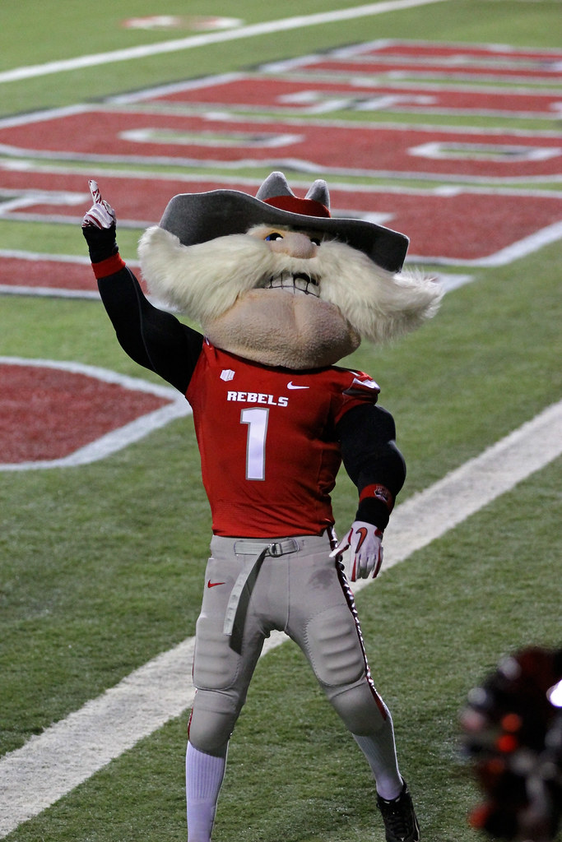
Benefits for the Libraries
A new value proposition for the Libraries
Reframe view of Libraries
Traditional
Collections
Course design and instructional support
Research Support
New Space
Research Information Infrastructure
Reputation Management
Utilize existing tools/services in new ways
IR
Databases
Instruction
Notes:
As the previous timeline shows, it was a five year process to reach where we are at today. A lot of work. But if you believe that the Libraries should be in this space to advise and provide leadership in research information management, as we do, then there are benefits for the libraries.
We demonstrated our value to campus by helping the campus reach its Top Tier and research enterprise goals. Our participation in these conversations moved us to a space where campus recognizes us as a partner in research and looks to us to offer expertise and lead in some areas which we’ve seen. This is evidenced in the new position the Libraries recieved from the Provost focusing on reputation management, ORCID, and scholarly impact along with the various committees that both Annette and I chaired along the way.
We believe that the Libraries successes also reframed how the Libraries could contribute to campus success.
In the past, faculty identified the Libraries with Collections, Information Literacy, and reference support.
Now the Libraries are also identified as key players in terms of research information infrastructure, reputation management and research support.
And this new space or aspect of the Libraries allows us to use our tools and expertise in new ways.
Databases now are now a part of the research information infrastructure, feeding in authoritative citation and impact information into campus systems.
We are using our instruction skills to develop best practices and teach how to cultivate your researcher identity
And we have expanded the role of the IR to be part of this research information management lifecycle, helping us contribute to the inside/out model, where we take the work of UNLV researchers and share our contributions with a global audience, preserve this work for future generations of visitors, and measure the impact of UNLV scholarship.
Integral partner in conversation showing further awareness of skills of staff and relevant services it provides to campus.
Highlight are unique expertise and the key role it plays in the RIM
Entering a conversation and providing leadership on campus.
So why did we and why are we still sticking this out and going through multiple iterations of the same conversation over and over again??
For us it afforded obvious opportunities to highlight libraries skills and relevance in ways that were outside the University’s traditional view of us which has focused on our collections and student success with info lit integration into the curriculum.
This allowed us to show how we could align with the campus mission of Top Tier and increasing research expenditures, research outputs and impacts in very clear ways. It moved us to a space where campus recognizes us as a partner in research and looks to us to offer expertise and lead in some areas which we’ve seen with the new position from the Provost focusing on reputation management/ORCID/impacts. And it provided us an opportunity to reframe some of our library services in new ways such as the role of the IR in rep management, the use of and addition of databases such as Dimensions to help with grant finding and the value of some of our instruction/workshops that can be used to support researchers in these areas.
Relevance to campus we are mission critical in many ways outside of info lit and collections
Help campus solve a key issue
Position the library in a new campus partnership that shows our skills and leadership away from traditional such as collections and instruction
Utilize services/tools already in the Libraries in new, expanded ways
Can talk about my role on the reputation enhancement committee as chair. I can even talk about this more in a slide above about partnering across the campus (

Slide 26
Links to Referred Resources
Bryant, Rebecca, Anna Clements, Carol Feltes, David Groenewegen, Simon Huggard, Holly Mercer, Roxanne Missingham, Maliaca Oxnam, Anne Rauh, and John Wright. 2017. Research Information Management: Defining RIM and the Library’s Role. Dublin, OH: OCLC Research. https://doi.org/10.25333/C3NK88.
Day, Annette. 2018. “Research Information Management: How the Library Can Contribute to the Campus Conversation.” New Review of Academic Librarianship 24 (1): 23–34. https://doi.org/10.1080/13614533.2017.1333014
Online Reputation Subject Guide: https://guides.library.unlv.edu/reputation-management
Research Information Management: Defining RIM and the Library’s Role. https://doi.org/10.25333/C3NK88
Rumsey, S. (2010). A case analysis of registering research activity for institutional benefit.
International Journal of Information Management, 30(2), 174–179. https://doi.org/10.1016/j.ijinfomgt.2009.12.004
UNLV Bibliography: https://digitalscholarship.unlv.edu/unlv_bibliography/

