Slide 1
Works in Progress Webinar • 10 October 2019
What Data Reusers Want and How Curators Can Use it to Their Advantage
Ixchel M. Faniel
Lisa Johnston
Senior Research Scientist
OCLC Research
fanieli@oclc.org
@imfaniel
Director, Data Repository
University of Minnesota
ljohnsto@umn.edu
@ifylawwt

Slide 2
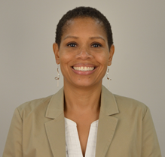
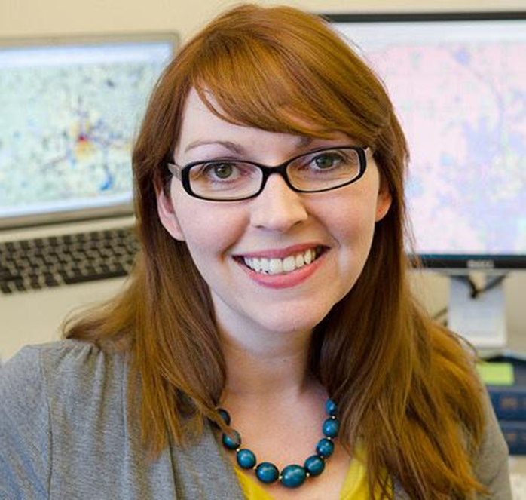
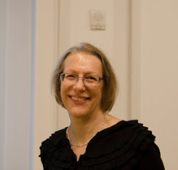
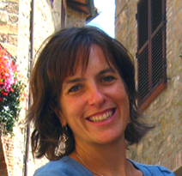
The Webinar Panel
Ixchel M. Faniel
Senior Research Scientist
OCLC Research
fanieli@oclc.org
@imfaniel
Lisa Johnston
Director, Data Repository
University of Minnesota
ljohnsto@umn.edu
@ifylawwt
Elizabeth Yakel
Senior Associate Dean for Academic Affairs and Professor of Information University of Michigan School of Information
yakel@umich.edu
@yakel
Sarah Whitcher Kansa
Managing Editor
Open Context
sarahkansa@gmail.com
@opencontext

Slide 3
FAIR Data Principles
“The intent is that these may act as a guideline for those wishing to enhance the reusability of their data holdings. Distinct from peer initiatives that focus on the human scholar, the FAIR Principles put specific emphasis on enhancing the ability of machines to automatically find and use the data, in addition to supporting its reuse by individuals.”
(Wilkinson et al., 2016)
Notes:
Wilkinson, M. D., Dumontier, M., Aalbersberg, Ij. J., Appleton, G., Axton, M., Baak, A., … Mons, B. (2016). The FAIR Guiding Principles for scientific data management and stewardship. Scientific Data, 3, 160018. https://doi.org/10.1038/sdata.2016.18

Slide 4
The Study
What types of context information do researchers need when deciding whether to reuse data?
How do researchers’ need for different types of context information vary across disciplinary communities?
n=105
This study is from the Dissemination Information Packages for Information Reuse (DIPIR) Project: https://www.oclc.org/research/themes/user-studies/dipir.html.
(Faniel, Frank, & Yakel, 2019)
Notes:
Faniel, I., Frank, R. and Yakel, E. (2019). Context from the data reuser’s point of view. Journal of Documentation, 75(6), 1274-1297. https://doi.org/10.1108/JD-08-2018-0133. Post-print: https://www.oclc.org/research/publications/2019/context-from-data-reuser-point-of-view.html.
105 Data Reusers
43 quantitative social scientists
21 experts, 22 novices
22 archaeologists
40 zoologists
27 interviewed, 13 observed in museums

Slide 5
Reusability: Role of Context Information
Repository Information
Provenance
Reputation and History
Curation and Digitization
Data Reuse Information
Prior reuse
Terms of Use
Advice on reuse
Data Production Information
Data Collection
Specimen and Artifact
Data Producer
Data Analysis
Missing Data
Research Objectives
(Faniel, Frank, & Yakel, 2019)
Notes:
Faniel, I., Frank, R. and Yakel, E. (2019). Context from the data reuser’s point of view. Journal of Documentation, 75(6), 1274-1297. https://doi.org/10.1108/JD-08-2018-0133. Post-print: https://www.oclc.org/research/publications/2019/context-from-data-reuser-point-of-view.html.

Slide 6
Reusability: Role of Context Information
(Faniel, Frank, & Yakel, 2019)
Notes:
Faniel, I., Frank, R. and Yakel, E. (2019). Context from the data reuser’s point of view. Journal of Documentation, 75(6), 1274-1297. https://doi.org/10.1108/JD-08-2018-0133. Post-print: https://www.oclc.org/research/publications/2019/context-from-data-reuser-point-of-view.html.

Slide 7
Data Collection Information
“So a lot of datasets will say that they have some crime information, and you look into it, and it's… ‘Have you gotten into a fight? Did you skip school?’... we're looking for something a little bit more serious than that.”
- Social scientist 33
(Faniel, Frank, & Yakel, 2019)
Notes:
Faniel, I., Frank, R. and Yakel, E. (2019). Context from the data reuser’s point of view. Journal of Documentation, 75(6), 1274-1297. https://doi.org/10.1108/JD-08-2018-0133. Post-print: https://www.oclc.org/research/publications/2019/context-from-data-reuser-point-of-view.html.

Slide 8
Specimen/Artifact Information
“If some fish is identified as X, and it's from Y, and X doesn't occur in Y, then I would say, ‘Okay, well that's wrong’...But it’s all based on experience, just focusing on a particular group of fish for the last six or seven years.”
- Zoologist 08
(Faniel, Frank, & Yakel, 2019)
Notes:
Faniel, I., Frank, R. and Yakel, E. (2019). Context from the data reuser’s point of view. Journal of Documentation, 75(6), 1274-1297. https://doi.org/10.1108/JD-08-2018-0133. Post-print: https://www.oclc.org/research/publications/2019/context-from-data-reuser-point-of-view.html.

Slide 9
Specimen/Artifact Information
“So I was contacting him for other specific information. Where was this found, what period did it date to, and what artifacts were found with it because that's often not cataloged along this primary zooarchaeological data nor do you have access to field notes or anything like that.”
- Archaeologist 02
(Faniel, Frank, & Yakel, 2019)
Notes:
Faniel, I., Frank, R. and Yakel, E. (2019). Context from the data reuser’s point of view. Journal of Documentation, 75(6), 1274-1297. https://doi.org/10.1108/JD-08-2018-0133. Post-print: https://www.oclc.org/research/publications/2019/context-from-data-reuser-point-of-view.html.

Slide 10
Data Producer Information
“A lot of that data …[w]as collected by a single man…who is a quite well-known and well-respected…”
- Zoologist 11
“So there is this whole context issue of...who excavates well...Turks do things differently than those trained in Germany versus those trained in France versus those trained in the US.”
- Archaeologist 13
(Faniel, Frank, & Yakel, 2019)
Notes:
Faniel, I., Frank, R. and Yakel, E. (2019). Context from the data reuser’s point of view. Journal of Documentation, 75(6), 1274-1297. https://doi.org/10.1108/JD-08-2018-0133. Post-print: https://www.oclc.org/research/publications/2019/context-from-data-reuser-point-of-view.html.

Slide 11
Provenance Information (as Traceability)
“…it [the sequence data] was uploaded to GenBank as a particular species. It turns out it is not that species. So, we encounter problems of misidentifications, lack of voucher specimens for which someone could go back and assess or assure that that is what species they're saying it is.”
- Zoologist 20
(Faniel, Frank, & Yakel, 2019)
Notes:
Faniel, I., Frank, R. and Yakel, E. (2019). Context from the data reuser’s point of view. Journal of Documentation, 75(6), 1274-1297. https://doi.org/10.1108/JD-08-2018-0133. Post-print: https://www.oclc.org/research/publications/2019/context-from-data-reuser-point-of-view.html.

Slide 12
Provenance Information (as Source)
“I mean, they are in the business of global developments, so you would trust that they're committed to providing high quality data. So due to the reputation as a leading global development institution, you assume that trust, you assume that credibility follows over into their data.”
- Social scientist 25
(Faniel, Frank, & Yakel, 2019)
Notes:
Faniel, I., Frank, R. and Yakel, E. (2019). Context from the data reuser’s point of view. Journal of Documentation, 75(6), 1274-1297. https://doi.org/10.1108/JD-08-2018-0133. Post-print: https://www.oclc.org/research/publications/2019/context-from-data-reuser-point-of-view.html.

Slide 13
Repository Reputation and History Information
“Well, it's like I said, the two biggest sources came from our collection, and the collection in Monroe which are both major repositories for Louisiana fishes and have had experts in those collections that have long standing histories and are well-respected.”
- Zoologist 15
(Faniel, Frank, & Yakel, 2019)
Notes:
Faniel, I., Frank, R. and Yakel, E. (2019). Context from the data reuser’s point of view. Journal of Documentation, 75(6), 1274-1297. https://doi.org/10.1108/JD-08-2018-0133. Post-print: https://www.oclc.org/research/publications/2019/context-from-data-reuser-point-of-view.html.

Slide 14
Prior Reuse Information
“…all of the secondary data that I used is federally funded, is nationally representative, and is very widely used among the fields that I'm working in so I've never had to make like an independent judgment of, ‘Do I trust this survey or not?’...I just rely on the collective judgment to say that this a trustworthy survey.”
- Social scientist 37
(Faniel, Frank, & Yakel, 2019)
Notes:
Faniel, I., Frank, R. and Yakel, E. (2019). Context from the data reuser’s point of view. Journal of Documentation, 75(6), 1274-1297. https://doi.org/10.1108/JD-08-2018-0133. Post-print: https://www.oclc.org/research/publications/2019/context-from-data-reuser-point-of-view.html.

Slide 15

DIPIR Project Members
(LG-06-10-0140-10)
PI: Ixchel Faniel (OCLC)
Co-PI: Elizabeth Yakel (University of Michigan)
Partners: Nancy McGovern, Ph.D. (MIT), Eric Kansa, Ph.D. (Open Context), William Fink, Ph.D. (University of Michigan Museum of Zoology)
Faculty: Ji-Hyun Kim (Ewha Womans University)
Researcher: Christopher Cyr (OCLC), Sarah Whitcher Kansa (Open Context)
OCLC Fellow: Julianna Barrera-Gomez
Doctoral Students: Rebecca Frank, Adam Kriesberg, Morgan Daniels, Ayoung Yoon, Anthea Josias
Master’s Students: Alexa Hagen, Jessica Schaengold, Gavin Strassel, Michele DeLia, Kathleen Fear, Mallory Hood, Annelise Doll, Monique Lowe, Pearl Ko, Daniel Delmanaco
Undergraduates: Molly Haig
https://www.oclc.org/research/themes/user-studies/dipir.html
Notes:
We’ve also had the opportunity to work with a great group of students, faculty, researchers, and fellows that I can’t say enough good things about when it comes to their contributions as team members and collaborators.

Slide 16
What can curators learn and apply?

Slide 17
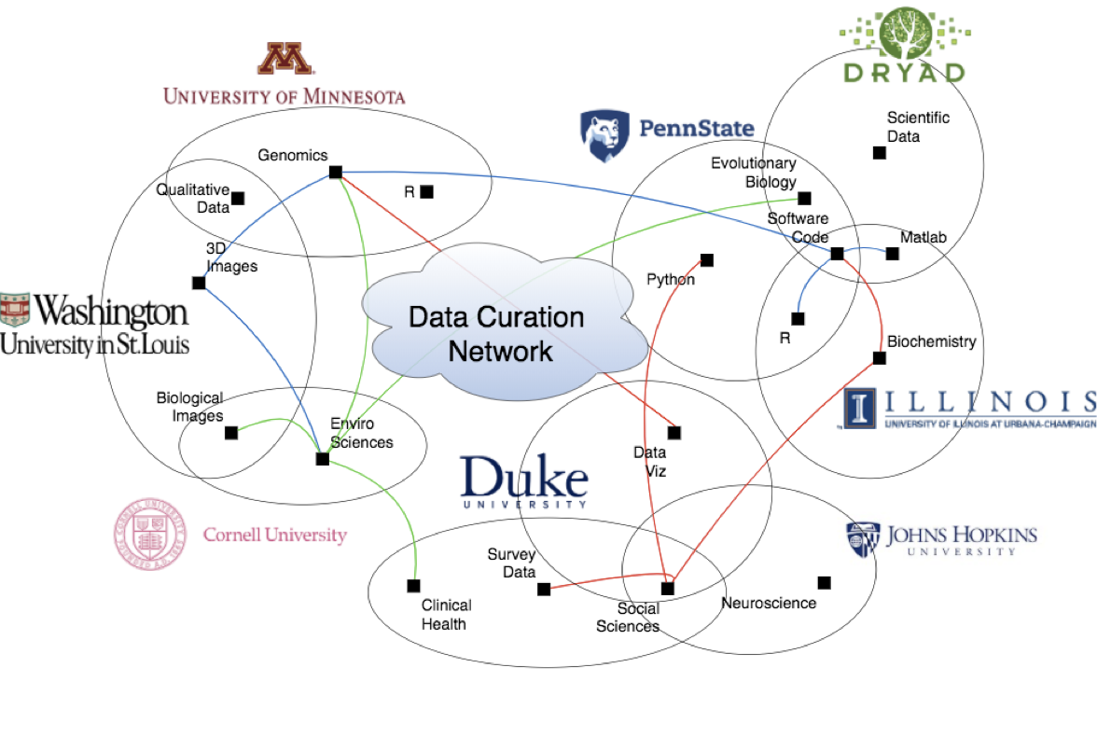


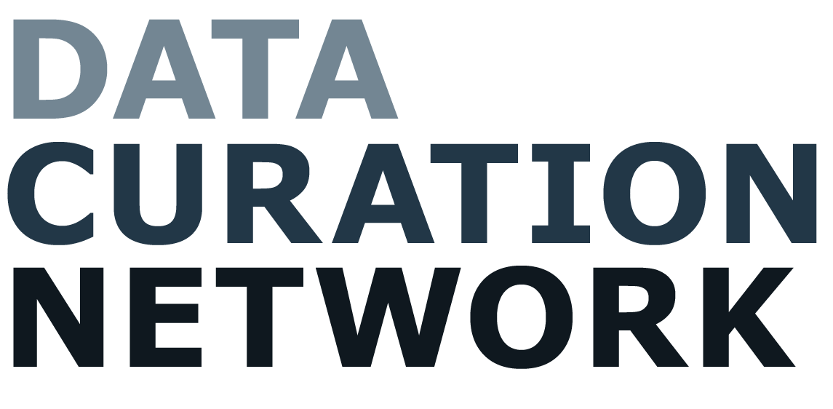

Platform for sharing expert data curator staff
Operational Jan 2019
10 institutions
  25 curators
  10 repository directors
Funding by Alfred P Sloan Foundation
Standard procedures with annual training
https://datacurationnetwork.org
Notes:
Thanks Ixchel! I’m the director of the DRUM at Minnesota. We have been a fully curated data repository since 2015. But today I’m also representing a larger group of data curation experts, as PI of the DCN.
Each of the data repositories represented in the DCN receive a wide range of datasets from neuroscience to entomology data and in all file types/formats (such as Python files or 3d Images). We cant each hire curators skilled in all those various types. So, with our network, funded by the Sloan foundation, we have a platform to connect data curators across our institutions who are most skilled in these specialized data types to curate the data regardless of their final repository destination.

Slide 18
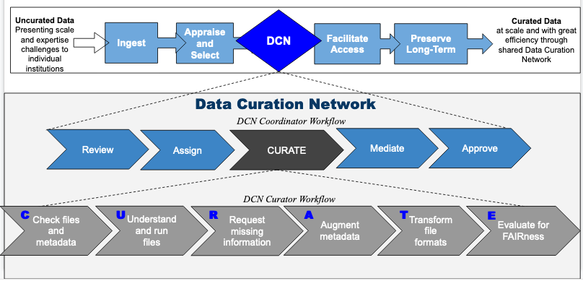
From Local to Collaborative
DCN = Human layer in local repository stack
DCN workflow is platform agnostic
Local repository responsible for
  Ingest, local policy adherence, (accept/reject), risk avoidance, etc.
  Services such as DOI, metadata brokerage, storage, preservation, etc.
https://datacurationnetwork.org
Notes:
The DCN exists as a seamless “human layer” in the local repository stack. Each partner institution receives their own data and archives it locally. They decide what to accept and when to send to the DCN for curation. They also provide repository services of storage, preservation.

Slide 19
From Local to Collaborative
https://datacurationnetwork.org
Notes:
Then once a dataset is submitted to the DCN, our coordinator reviews the contents and assigns to one of our curators for review. Curators apply a standard set of procedures, called CURATE steps, that were the result of our research into the most important, or minimum levels of curation needed for any given dataset. Then it goes back to the local IR for publication and long-term preservation and access.

Slide 20
Value of Curation
Data Curation – ​The encompassing work and actions taken by curators of a data repository or archive in order to provide meaningful and enduring access to research.
based in archival theory
enable data discovery and retrieval (FAIR)
maintains data quality,
adds value, and
provides for re-use over time
example curation activities include: authentication, archiving, metadata creation, digital preservation, and file transformation
Notes:
We do this because we think that data curation adds value to the data. The practices and skills that we apply are based in archival theory and facilitate data discovery, retrieval, and ensure that the data are FAIR. Curation activities include reviewing data for completeness and applying quality assurance measures, while making decisions and taking actions that impact the overall usefulness of data over time.

Slide 21







Planning Phase (2016-18)
Researcher
Focus Groups
Developed a collaborative staffing model for curating self deposit data
Interviewed 91 faculty about their data curation habits and needs.
2016
2017
6 Members
Notes:
The DCN began in 2016 with 6 institutions. We started with a very important research question: what are the most impactful actions that curators might take and result in more usable data. We did this by running curation pilots, surveying data repositories nationwide, and hosting a series of research focus groups to better align our practices around their needs.

Slide 22
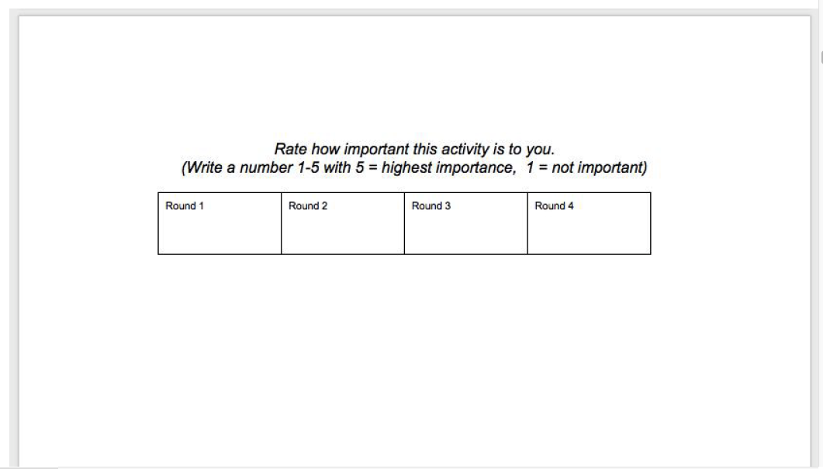
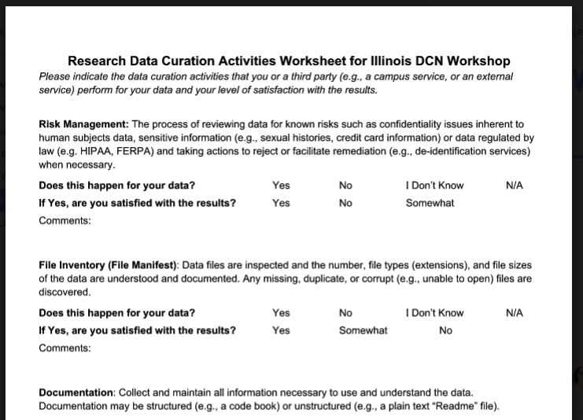
Focus Groups: Method
File renaming
File Inventory or Manifest
File validation
Metadata
Metadata Brokerage
Rights Management
Risk Management
…...more
Code review
Contextualize
Documentation
Embargo
File Format Transformations
Persistent Identifier
Quality Assurance
Use Analytics
We identified and defined 47 Data Curation Activities
Full list of activities: http://bit.ly/DCNcurationActivities
Focus Group Discussion, Card Rating Exercise, and Worksheet Protocol
Notes:
Let me tell you a little about those focus groups. First we identified a set of 47 data curation activities that were happening at various repositories. After sharing those definitions with researchers we asked them to rate each activity on a scale of 1-5 for importance. We did this in 6 different focus groups across 6 academic institutions.

Slide 23
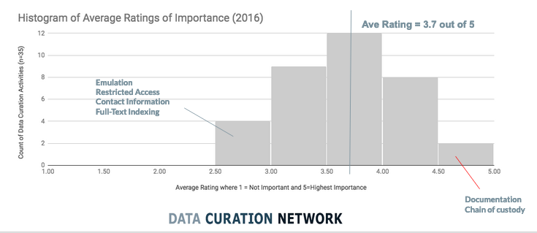
Focus Groups Results (n=91)
Notes:
The results were mostly positive in terms of how important the data curation activities were to our researchers with an average importance of 3.7 out of 5 for the 47 areas we tested.

Slide 24
Focus Groups Results (n=91)
Most Important Activities* (4 out of 5)
(Create) Documentation (4.6)
Secure Storage (4.4)
Quality Assurance (4.3)
Persistent Identifier (4.3)
Software Registry (4.1)
Data Visualization (4.0)
File Audit (4.0)
(Create) Metadata (4.0)
Versioning (3.9)
Contextualization (3.9)
Code Review (3.9)
File Format Transformations (3.9)
* Rated by more than one DCN focus group from our 2016 Study
Notes:
But what is interesting is if you look at the most important activities, the things researchers really care about and break this out to what was happening or not for their data.

Slide 25
Focus Groups Results (n=91)
Most Important Activities* (4 out of 5)
(Create) Documentation (4.6)
Secure Storage (4.4)
Quality Assurance (4.3)
Persistent Identifier (4.3)
Software Registry (4.1)
Data Visualization (4.0)
File Audit (4.0)
(Create) Metadata (4.0)
Versioning (3.9)
Contextualization (3.9)
Code Review (3.9)
File Format Transformations (3.9)
* Rated by more than one DCN focus group from our 2016 Study
Does this happen for your data?
Persistent Identifier (37% happens)
Software Registry (41% happens)
File Audit (16% happens)
Contextualization (38% happens)
Code Review (38% happens)
Notes:
Now we see that there were several areas that are of great importance, but were not happening for the majority of our researchers, like DOIs for data, auditing files for completeness, or contextualizing the data within a larger body of work. Here we saw opportunities for the DCN to provide new value add services.

Slide 26
Focus Groups Results (n=91)
Most Important Activities* (4 out of 5)
(Create) Documentation (4.6)
Secure Storage (4.4)
Quality Assurance (4.3)
Persistent Identifier (4.3)
Software Registry (4.1)
Data Visualization (4.0)
File Audit (4.0)
(Create) Metadata (4.0)
Versioning (3.9)
Contextualization (3.9)
Code Review (3.9)
File Format Transformations (3.9)
* Rated by more than one DCN focus group from our 2016 Study
Is so, are you satisfied with the result?
Documentation (26% satisfied),
Secure storage (38% satisfied),
Quality Assurance (14% satisfied),
Data Visualization (12.5% satisfied),
Metadata (29% satisfied)
Versioning (13% Satisfied)
File Format Transformations (29% satisfied)
Notes:
Additionally, there were several very important activities that did happen for their data, but researchers were not satisfied with the results. Here we saw an opportunity for the DCN to provide stronger services to assist with documentation, quality assurance, data visualization, and file format transformation.

Slide 27


Planning Phase (2016-18)
Researcher
Focus Groups
Implementation Phase (2018-21)
PIs drafted a model for how the DCN would work based on research and pilots.
Interviewed 91 faculty about their data curation habits and needs.
Trained 25 data curators and launched the DCN Jan 1, 2019
2016
2017
2018
2019
2019
2020
2020
6 Members
8 Members
Notes:
This these data in hand, we launched our implementation phase in 2018 with 8 partners and after 6 months of prep and training, we got the network up and running fully in January 2019! Today we are curated data across the DCN partner institutions which has….

Slide 28


Planning Phase (2016-18)
Researcher
Focus Groups
Implementation Phase (2018-21)
Education
Developed a collaborative staffing model for curating self deposit data
Interviewed 91 faculty about their data curation habits and needs.
Trained 25 data curators and launched the DCN Jan 1, 2019
Workshops/primers extend the DCN mission reaching over 150.
2016
2017
2018
2019
2019
2020
2020
6 Members
8 Members
10 Members
Notes:
…grown to include 2 new partners continuing our sustainability goals of slowing expanding our ability to curate a wider variety of data. And today over 50 datasets have gone through the workflow and are expanding each month.
Since launching the DCN, we continue to adjust our workflow and best practices based on the experts in the network. Each year we hold an annual in person training event for data curators in the DCN. And in order to share our training and skill development with a broader librarian audience we have an IMLS grant led by Cynthia Hudson Vitale at Penn State, that will enable us to reach over 150 librarians with our specialized data curation workshop.
We are also teaching workshops for curators external to the DCN with a grant from the IMLS that will allow our standardized training to reach over 150 people. Let me show you what that looks like…

Slide 29
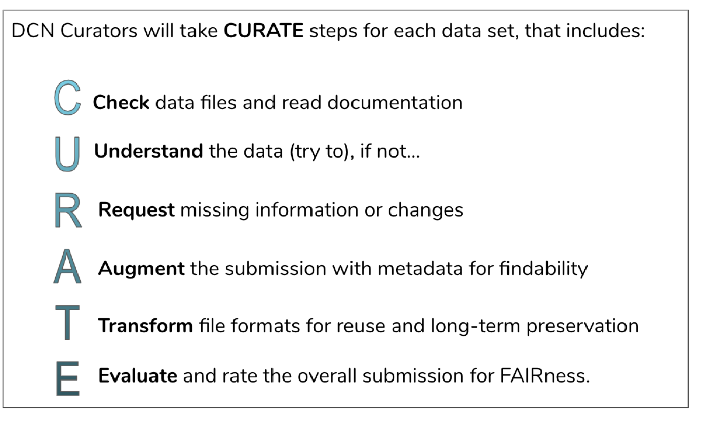
https://datacurationnetwork.org
Notes:
This is where we teach our CURATE steps.

Slide 30
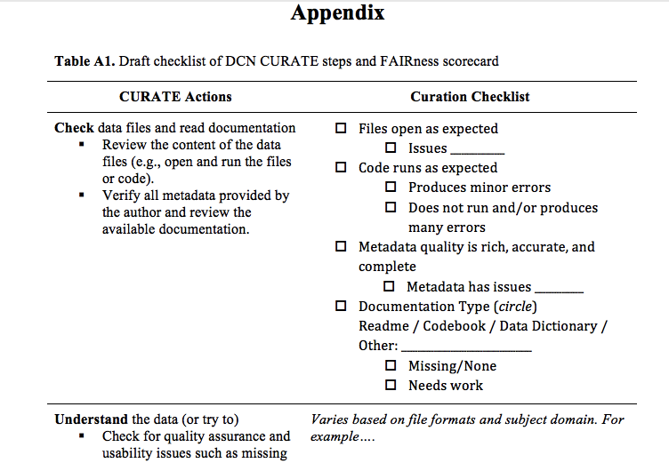
https://datacurationnetwork.org
Notes:
Each step has its own checklist accompanying the step to represent actions that any generic dataset might need, but for specific file types (GIS, Python files) these steps might go beyond the generic. For these, we have….

Slide 31

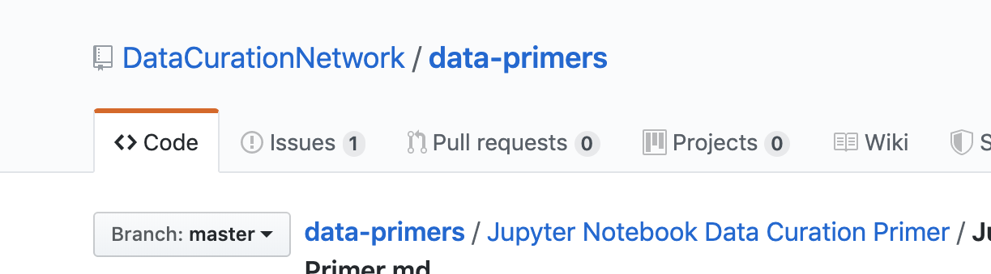
https://datacurationnetwork.org
Notes:
“Data curation primers” these are the outputs from our workshops, we have published one round of primers and will publish at least two more before the grant is finished. Here, attendees from the workshop, after received general training in the CURATE steps where they apply these to 5 different data types, are challenged to research and document how one might curate a more specialized format, such as Jypiter notebooks, like this one here. Then the result is published as a GIThub object that can be updated and edited over time.
Let’s take a closer look at the CURATE steps and think about how they relate to the research Ixchel presented earlier.

Slide 32
Questions for you to consider
As I review the CURATE steps, ask yourself…
  Are data curators doing enough to enable reuse?
  This work is time-consuming and expensive. Is it worth it?
  How can data curators help researchers create better data?

Slide 33
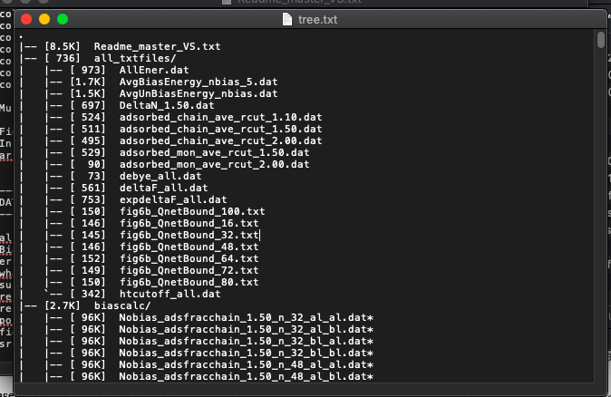
C- Check Step
Local working copy
File manifest (tree)
Missing files
Duplicate files

Slide 34
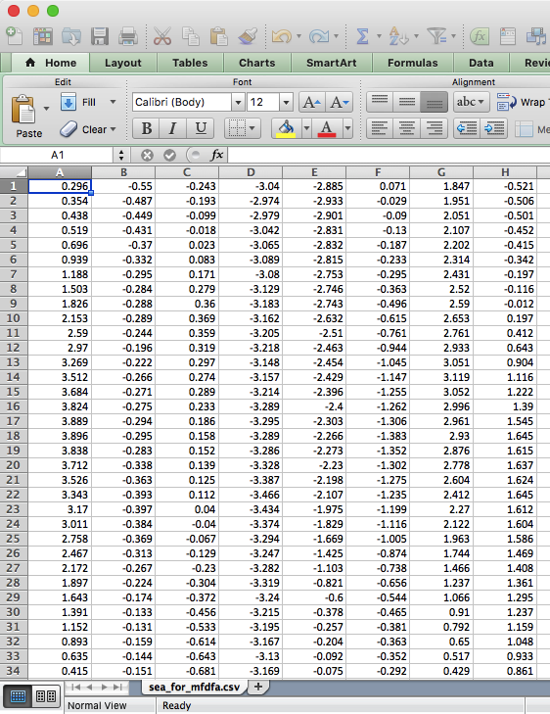
U- Understand Step
Identify missing documentation
Try to be the first user of the data
Relationship between files
Collection methodology (read article)

Slide 35
R- Request Step
Hum_Jap_FullState_19Feb2019.gri is listed in your documentation but missing from the zipped folder.
There are two files named "CarImp_SppBox_gjamPredictObj.rda" Are these duplicate files?
The xxx_coordinates.csv files aren't included in the DRUM Data.xlsx file list. Should we add them?
There is also one xml in the folder - "hops Tif Projection Stack.tif.aux.xml" - should this be added to the documentation somewhere or removed from the submission?
Some specific pieces of information I think would be useful are:
  Variable definitions for xxx_coordinates.csv files, ENM Eval Model Results.csv, and Tiffs
  A little more information about the source of the Current and Future Bioclimatic Variables input files. For example, there are multiple products from WorldClim. Which resolution data are you using? Including a link to where you accessed the data would be fantastic.
  The version of MaxEnt you used to run the models
Ask questions
Request missing information from author
Make changes (document)

Slide 36
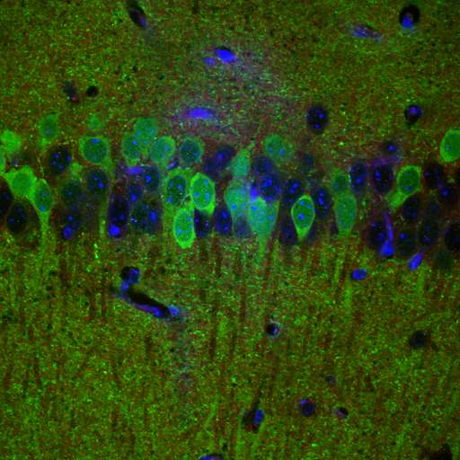
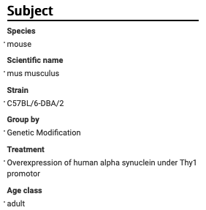
A- Augment Step
Create/augment Metadata
Standardize terms
Linked data (ORCIDs)

Slide 37
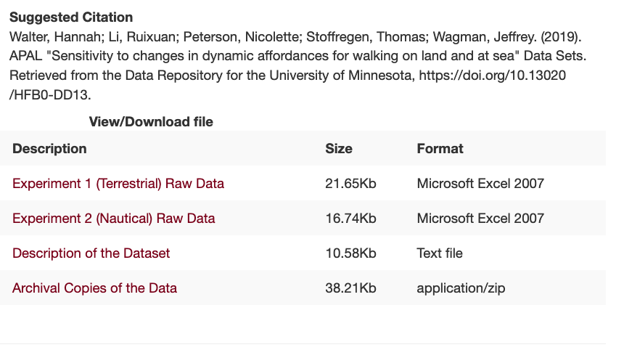
T- Transform Step
Convert files to preservation friendly formats
Create derivatives for access and discovery
Excel Archival Tool http://z.umn.edu/exceltool

Slide 38
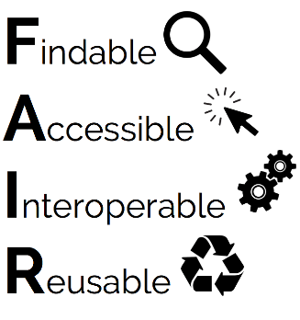
E- Evaluate Step
Confirm recommended changes were made
Ensure published data are FAIR
One more step
  Document your work
  D step = CURATED!

Slide 39
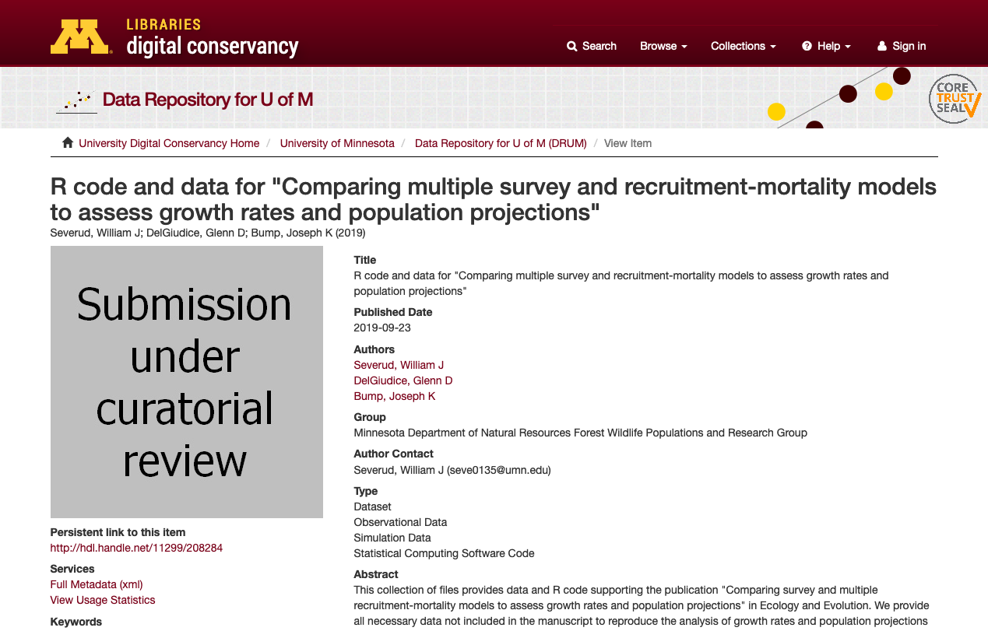
Curators’ Role in Enabling Reuse
Pragmatic approach
  Context for reuse is often missing
  Curators are unable to create a perfect dataset
  Ideal world: Curators should be working up front on the data collection
  We understand how people will use the data
Once producers go through the process, they submit better data
FAIR? Repositories aim to make data FAIR but curators test/prove it!
Notes:
Over 50 datasets curated by the DCN since January 1, 2019. Collectively we have curated
Pragmatic approach
Context for reuse is often missing
Curators are unable to create a perfect dataset
Ideal world: Curators should be working up front on the data collection
We understand how people will use the data
Once producers go through the process, they submit better data
FAIR? Repositories aim to make data FAIR but curators test/prove it!

Slide 40
Curatorial Crosswalk
Context Information | Curation Activities
Data Collection | Request, Augment - Ask for methods, use readme, link to paper
Specimen and Artifact | Augment - Augment w/ domain specific metadata
Data Producer | Augment – Require contact info, ORCID, link to CVs or author profiles
Data Analysis
Missing Data | Check, Understand - Verify that codes for missing data are labeled properly
Research Objectives
Provenance | Check, Understand, (Document) - Identify source(s) and link out
Repository Reputation and History | Clear policies, Certification – CoreTrustSeal, TDR
Curation and Digitization
Prior Reuse | Track/monitor reuse, PlumX/Altmetrics
Advice on Reuse
Terms of Use

Slide 41
References
Faniel, I., Frank, R. and Yakel, E. (2019). Context from the data reuser’s point of view. Journal of Documentation, 75(6), 1274-1297. https://doi.org/10.1108/JD-08-2018-0133. Post-print: https://www.oclc.org/research/publications/2019/context-from-data-reuser-point-of-view.html.
Wilkinson, M. D., Dumontier, M., Aalbersberg, Ij. J., Appleton, G., Axton, M., Baak, A., … Mons, B. (2016). The FAIR Guiding Principles for scientific data management and stewardship. Scientific Data, 3, 160018. https://doi.org/10.1038/sdata.2016.18
Data Curation Network: A Cross-Institutional Staffing Model for Curating Research Data. (2018). International Journal of Digital Curation. Vol 13 No 1. https://doi.org/10.2218/ijdc.v13i1.616.
Johnston, LR, Carlson, J, Hudson-Vitale, C, Imker, H, Kozlowski, W., Olendorf, R, Stewart, C. (2018). How Important is Data Curation? Gaps and Opportunities for Academic Libraries. Journal of Librarianship and Scholarly Communication, 6 (1), eP2198. http://doi.org/10.7710/2162-3309.2198.
– Related Dataset and Interview Protocol: https://doi.org/10.13020/D6PQ30.

Slide 42
Our Panel’s Next Webinar
31 October 2019 • 11:00AM EDT
Designing, Timing, and Determining the Feasibility of Curatorial Interventions to Support Data Reuse
Elizabeth Yakel
Sarah Whitcher Kansa
Professor and Senior Associate Dean of Academic Affairs
University of Michigan, School of Information
Director of the Alexandria Archive Institute
Managing Editor for Open Context
yakel@umich.edu
@yakel
sarahkansa@gmail.com
@opencontext

