Slide 1
25 September 2019
The Shift to Open at University and Research Libraries Worldwide
Works in Progress Webinar for
the OCLC Research Library Partnership
Titia van der Werf
OCLC Research, Europe
Notes:
Thank you for joining us today. In this Webinar I will present work in progress on the topic of Open, the Shift to Open as a trend, and how libraries are responding to this trend.

Slide 2

Titia van der Werf
RLP Program Officer, OCLC Research Europe
Notes:
I am Titia van der Werf, program officer at OCLC Research, in Leiden the Netherlands – and it is not coincidental that we have started work on this topic from our base in Europe, as it is the region where Open Access and Open Science are gaining traction.

Slide 3
A global network of libraries
18,000
member libraries
worldwide who elect
48
delegates to Global
Council, who elect
6
members of the 15-member
OCLC Board of Trustees
Notes:
Indeed, it was OCLC’s Regional Council for Europe, the Middle East and Africa that encouraged us in 2017 to identify topics of interest from this region and include them in our Research Agenda. Open Access was one of these topics. And it was the Global Council which expressed interest, last year, in exploring the impact and use of Open Access in libraries. This illustrates nicely how the OCLC cooperative influences and guides our work at OCLC Research.
OCLC is member-governed. Its 18,000 member libraries worldwide elect 48 delegates to OCLC's Global Council, who in turn elect six members of the 15-member OCLC Board of Trustees.
[Figures current as of 3/11/19]

Slide 4



OCLC Global Council Program Committee
Rupert Schaab
(EMEA)
Debbie Schachter
Chair (ARC)
Tuba Akbaytürk
(EMEA)
Kuang-hua Chen
(APRC)
Notes:
The Global Council appointed a Program Committee to lead the work on this topic and it was decided to conduct a global survey.

Slide 5
The open content survey
Notes:
I will give a short overview of the survey purpose and methodology and then I will share some of the findings as they relate to Research Libraries.

Slide 6
Purpose
To engage a global audience of librarians in a joint exercise, asking them to:
map and align their library’s open content efforts
assess their library’s open content efforts
to explore their library’s current investments in this type of content
Notes:
Defining the purpose and the scope of the topic was a crucial exercise. Our aim was to engage librarians in a joint exercise to map and assess their open content efforts and to explore their current investment in this type of content. We also hoped to identify areas where librarians could work together with OCLC to leverage their efforts and to widen access to free, online content.

Slide 7
Methodology
Not only OA – also other freely available online open content
Acknowledging the continuum of openness
Global survey
All library types
Online survey promoted via GC delegate networks and RLP
Notes:
The scope was intentionally broad. Not just OA publications, also all other types of open content: pre-prints and green-OA, digitized open collections from heritage institutions, open government data and research data, software and tools, gray literature, Open Educational Resources, etc. We wanted to hear the voices of all library types across the world and capture the diversity of their perspectives. We wanted to bring together the voices from across the content-silos and workflow silos of the institutional repositories, e-resources management, Digital Libraries, Data Services, etc. The survey was promoted as widely as possible through the networks of the Global Council delegates, the RLP and relevant mailing-lists from LIBER, COAR, GreyNet, etc.

Slide 8
Methodology
Survey data collected November 12, 2018 – January 31, 2019
The pool of respondents was self-selected: 705 respondents from 82 different countries completed, or partially completed, the survey
Notes:
Within a short timeframe of 2½ months we received 705 responses from 82 countries, which is quite a successful harvest. And, also important to note, the respondents were self-selected. We will see that the sample is therefore not representative for all library types and world regions or even countries. Nevertheless, the data collected is useful and meaningful if you slice it and dice it.

Slide 9
Open Content activity categories
1 Advocacy and policies promoting open content = awareness-raising, legislation, mandates, regulations, policies, standardization, staff training.
2 Publishing open content = library as a publisher of open content.
3 Digitizing collections = digitize and make collections available online as open collections; rights clearance.
4 Data services = publishing open datasets
(government data; research data; etc.)
5 Supporting authors/researchers/teachers in creating open content = provide guidance and training; help with OA-funding and/or negotiating discounts.
6 Bibliometrics = collect metrics to help measure OA-impact;
7 Supporting users/instructing/digital literacy programs = provide instruction and help with the selection, evaluation and use of open content; etc.
8 Selecting open content not managed by the library = select and validate open content to include in libguides, catalogues and discovery tools. E-resource management for OA; checking license terms of use; link to archive or last-resort copy; etc.
9 Promoting the discovery of open content = make open content easy to find and use; enable OA-buttons and copy-request buttons in discovery and ILL-workflows; etc.
10 Deep interactions with open content = platforms/labs to interact with open collections or open datasets; NLP tools for close-reading; etc.
Notes:
In order to be able to map and align Open Content activities and efforts, we identified a set of 14 activity categories from which the survey respondents could chose. The first 6 categories relate to “Producing Open Content”, the following 4 categories relate to “Making Open Content discoverable and reusable” and …

Slide 10
Open Content activity categories
11 Institutional repository = maintain an archive for depositing, preserving and disseminating the intellectual output of your parent institution – grey literature, “green-OA”, open research datasets, open software tools, etc. – and making these outputs discoverable and re-usable as open content.
12 Digital collections library = maintain a digital library for storing, preserving and disseminating your library’s digitized collections and making these collections discoverable and re-usable as open content.
13 Born-digital (legal) deposit / web-archive = maintain an archive for preserving and long-term access to born-digital open content, including scientific OA-publications, as part of your library’s collection tasks and responsibilities.
14 Assessment = measure usage of open content in your library’s (dissemination and discovery) services; gather user feedback.
Notes:
… the categories 11-13 relate to maintaining operational repository and archiving systems of open content and making disseminating that content. The last category is Assessment, which relates to all the previous 13 activity categories and measuring use and successfulness of these services.

Slide 11
Concerning these 14 activity categories, we asked…
Where are you invested?
Is there identified funding for the activities?
Where are you successful?
Where do you want to accelerate impact of services?
What is the right scale (institutional, regional, national, global)?
Where do you see a role for OCLC?
Where is the work of OCLC Research likely to help you make more impact?
Notes:
Concerning these 14 activity categories, we asked:
Where are you invested?
Is there identified funding for the activities?
Where are you successful?
Where do you want to accelerate impact of services?
What is the right scale (institutional, regional, national, global)?
Where do you see a role for OCLC?
Where is the work of OCLC Research likely to help you make more impact?
We hoped that these questions would trigger the respondents to think about Open Content as being a part of their “normal” workflows and what it entails to make that part more explicit. And, we hoped that they would find this a useful exercise. And they did!

Slide 12
Has trying to make your investment in open content activities more explicit, been a useful exercise to you?
Why or why not?
Notes:
We asked: “Has trying to make your investment in open content activities more explicit, been a useful exercise to you? Why or why not?” and twice as many respondents found it a useful exercise as those who did not.

Slide 13
It has brought home that this is not something we're able to quantify at the moment (UL, UK)
No, it is too entangled with others support activities to make it more explicit. Though it is useful to take into account maintaining a RIS and institutional repository has become a substantial activity over the last 10 years (about 15% of budget) (UL, NLd)
Notes:
Those who did not find it a useful exercise said they haven’t tried or are just beginning with their efforts to make Open Content investments more explicit (22%) and they also found they were unable to make investments more explicit because Open Content is incorporated in existing services and is thought of as normal workflow activity (16%).

Slide 14
Yes. This survey give us a nice opportunity to think about our open access policy, to brainstorm about our open content activities (measuring success and identifying areas for improvement). This was a very interesting exercise. Thank you for that. (UL, France)
It would be great being able to capture every expenditure item on Open Content in the budget. This is because it becomes useful for advocacy for increased funding (UL, Ghana)
Yes, it has helped to highlight where some of this activity is taking place, and that it is embedded in more areas of Library Services than we were aware of; open content is treated the same way as paid for content in many respects (for example when switching on for discovery services, or including in information literacy teaching), but this still counts as investment in open content activities. (UL, UK)
Yes, this has been a useful exercise. It would appear that the arbitrarily more successful initiatives related to open content have dedicated FTEs attached to various related responsibilities. (UL, Canada)
Notes:
Those who felt making investment in open content activities more explicit had been a useful exercise, said it increases the awareness/promotion/support (21%) and visibility/usage (meets users’ needs) (18%) related to open content.

Slide 15
Useful to see we are well on the way to 2.5% contribution level! (UL, US)
Yes. This survey give us a nice opportunity to think about our open access policy, to brainstorm about our open content activities (measuring success and identifying areas for improvement). This was a very interesting exercise. Thank you for that. (UL, France)
It would be great being able to capture every expenditure item on Open Content in the budget. This is because it becomes useful for advocacy for increased funding (UL, Ghana)
Yes, it has helped to highlight where some of this activity is taking place, and that it is embedded in more areas of Library Services than we were aware of; open content is treated the same way as paid for content in many respects (for example when switching on for discovery services, or including in information literacy teaching), but this still counts as investment in open content activities. (UL, UK)
Yes, this has been a useful exercise. It would appear that the arbitrarily more successful initiatives related to open content have dedicated FTEs attached to various related responsibilities. (UL, Canada)
Notes:
Finally, one University Librarian from the US said it had been useful to see they were well on the way to 2.5% contribution level – referring to the “2.5% commitment” discussion in the USA and the call for action to every academic library to dedicate 2.5% of its budget to supporting a common infrastructure for open scholarly communications.

Slide 16
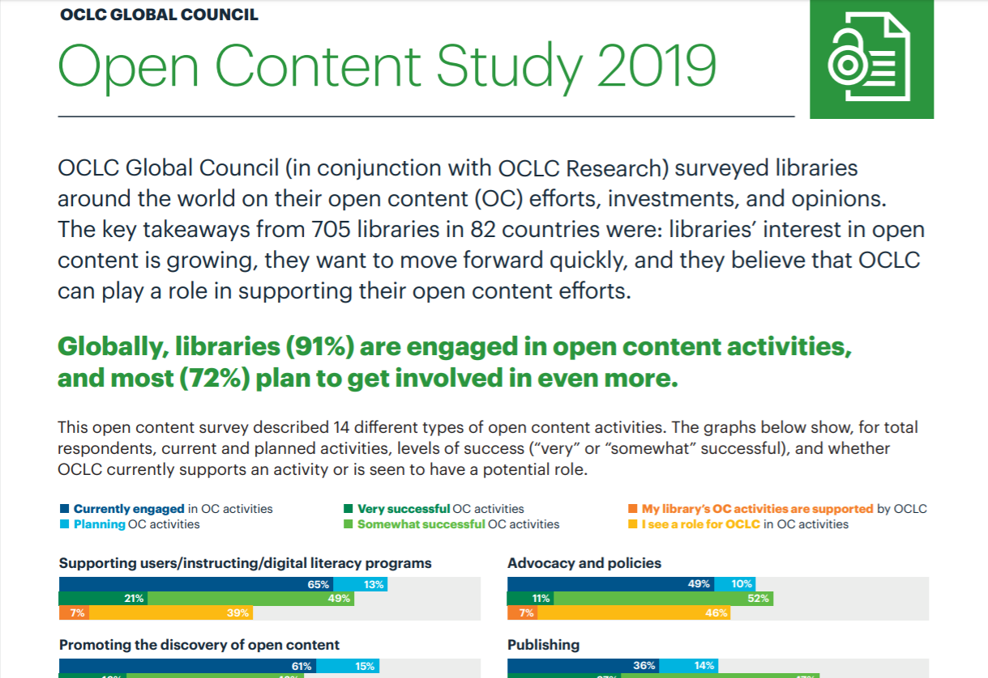
SURVEY FINDINGS PUBLISHED
oc.lc/oa
Notes:
The results of the survey have been summarized in a 2-pages leaflet that you can find online at: https://www.oclc.org/content/dam/oclc/services/brochures/216262-WWAE_Open-Content-survey-results.pdf
The main takeaway is that globally, libraries are already invested in Open Content and their interest in Open Content is growing. They want to move forward quickly – and in Asia Pacific and Europe more so than in other regions. They also believe that OCLC can play a role in supporting their Open Content efforts.

Slide 17
University & Research Libraries
Notes:
Let’s take a deep dive now and look at the data from the University & Research Libraries.

Slide 18
Total Responses by Library Type
Research & University:
511 responses from 69 countries
n = 705
Notes:
As you can see, nearly ¾ (72%) of the respondents are University & Research Libraries. This group is clearly the majority segment of our sample. Therefore it makes sense to just focus on the responses from this group. With 511 respondents from 69 countries – this group provides an insightful and current snapshot of the state of open content support in higher education and research.

Slide 19
University & Research Libraries Responses by Region
Countries by region, with number of respondents >14
Americas (236) |  | EMEA (201) |  | Asia Pacific (74)
United States | 204 | UK | 33 | Australia | 19
Canada | 21 | Germany | 19 | Philippines | 16
 |  | Turkey | 17
 |  | France | 15
 |  | Netherlands | 15
Notes:
But, as you can see on this slide, not all regions are equally well represented and - within the regions - not all countries are equally well represented.
In the table you can see the countries by region where the number of respondents is larger than 14.
So, the Research Library respondents from the Americas come overwhelmingly from the States; 2/3 of respondents from the EMEA region come from European countries; nearly half of the respondents from Asia Pacific come from Australia and the Philippines.
We should also understand that a given number of respondents is not necessarily equally representative across countries. So, for example, 15 respondents from the Netherlands is quite representative as there are only so many universities in the Netherlands – whilst 15 respondents from France is much less representative for a country with over 500 research libraries.
I will share the findings relating to the University & Research Libraries as a group, but please be aware that there are significant differences by country. We have no time today to look at the data at the country level, but these will be presented in subsequent publications and presentations.

Slide 20
Interpretative framework
Notes:
Looking at the data and the charts across all 14 service categories can be quite overwhelming and difficult to interpret. What is the data telling us?
I have decided to group the open content activity categories in a way that might inform our thinking about collection directions.

Slide 21
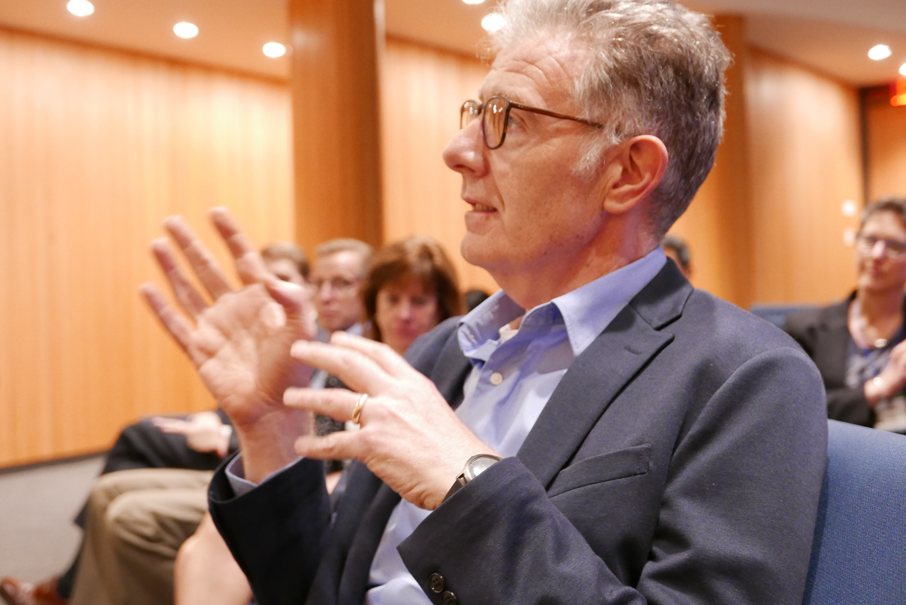
Readings from “The Book of Dempsey”
Notes:
Lorcan Dempsey has presented and published about the three collection directions in the past years and I propose to use his typology as a framework to interpret the survey data.

Slide 22
Three collection directions
The collective collection
Reconfiguration
of library collaboration
by network/digital environment.
The inside out collection
Reconfiguration
of research work
by network/digital environment.
The facilitated collection
Reconfiguration
of the information space
by network/digital environment.
Notes:
The three collection types are: 1) the Collective Collection, 2) the Inside-out Collection and 3) the Facilitated Collection.
All three have emerged through reconfigurations by the network/digital environment in which libraries operate – and, by the Shift to Open, a trend I will talk shortly about at the end of my presentation.

Slide 23
The Collective Collection
“One important trend is that libraries and the organizations that provide services to them will devote more attention to system-wide organization of collections—whether the “system” is a consortium, a region or a country.
….a more systemic perspective is now emerging and we have been using the phrase “collective collection” to evoke this more focused attention on collective development, management and disclosure of collections across groups of libraries at different levels.”
Dempsey, Lorcan. 2013. The Emergence of the Collective Collection: Analyzing Aggregate Print Library Holdings. http://www.oclc.org/content/dam/research/publications/library/2013/2013-09intro.pdf
Notes:
The Collective Collection is emerging from the reconfiguration of library cooperation – where libraries see their collection as part of a system-wide collection – within a consortium, a region, a country – and they collaborate to manage their collections as a Collective Collection. Typically, we have seen these types of collaborations emerge around print collections – with shared cataloguing, shared ILL, shared agreements for retention and preservation of last resort copies. With regards to Open Content, we are seeing increased interest in collaboration around digitized collections: collaboratively deciding what to digitize - based on what others have digitized too avoid duplication of effort – and sharing the effort of maintaining open collections. HathiTrust is a good illustration of this.

Slide 24
Library Open Content activities (in order of maturity)
The collective collection
1. Digital Libraries
2. Digitizing Collections
3. Deep-interactions with open content
Notes:
Mapping the 14 Open Content activity categories to the Collective Collection concept, I will focus on these three activities relating to digitized collections:
Maintaining and operating a Digital Library system
Digitizing collections and making them online accessible, free from rights restrictions
Making these open collections reusable for digital scholarship by use of advanced technologies that allow deep-interactions with the Open Content
You will notice that the 3 activity types are listed in order of maturity.

Slide 25
The collective collection
Notes:
Indeed, activities like Digitizing and Digital Libraries have been around for more than 3 years, whilst deep-interactions with the content is a relative newcomer. As you can see, the more mature services also have more stable sources of income, with budget line items and/or FTE staff allocations and they are considered to be very successful by 30% or more of the respondents – which is a high score and based on measured success indicators.
Deep-interactions with Open Content is, unsurprisingly, not yet considered as successful and is less well resourced – but, it is a category that 18% of the respondents plan to invest in – which is relatively high – and 59% want to accelerate the impact, which is also high.

Slide 26
Library Open Content activities (in order of maturity)
The collective collection
Digital Libraries
well-resourced, very successful, accelerate
most suitable for a consortial/national/global scale
2. Digitizing collections
well-resourced, very successful, accelerate
3. Deep-interactions with open content
least mature, less successful, accelerate,
most planned (18%), highest score for OCLC role (63%)
Notes:
So, in summary: Digitizing print collections and making them available as open collections in a digital library is a set of activities in which respondents indicate they are deeply-invested: it is well-resourced, mature, very successful and respondents want to accelerate the impact.
Deep-interactions with the open content of digitized collections is top-op-mind: relatively new, not yet very successful but respondents clearly indicate they see the potential for accelerating impact in this direction.
The Open Content activities relating to the collective collection are also, according to the respondents, relatively more suitable for collaboration at a scale beyond the institutional and local scale: with Digital Libraries most frequently noted as an activity most suitable for a consortial/national or global scale.

Slide 27
The Inside Out Collection
“Libraries increasingly support the creation, curation and discoverability of institutional creations (research data, preprints, scholarly profiles, academic profiles, digitized special collections, …). The university wishes to share these materials with the rest of the world.”
Dempsey, L., 2016. Library collections in the life of the user: two directions. LIBER Quarterly, 26(4), pp.338–359. DOI: http://doi.org/10.18352/lq.10170
Notes:
The Inside-out Collection is emerging from the reconfiguration of academic research itself – and it is an area where libraries take up new roles to support the creation, curation, and discovery of institutional outputs. These are Research Support activities centered around research outputs such as publications, research data, software, tools, etc. and they also include Research Information Management (RIM) activities centered around the management and analytics of these outputs. With regards to Open Content, we see that libraries’ involvement tends to emphasize support of Open Access practices, with institutional repositories as early examples of library efforts to collect pre-prints of research outputs.

Slide 28
Library Open Content activities (in order of maturity)
Institutional repository => most resourced, most successful, accelerate
Support authors/producers => less well resourced, accelerate
Publish OC => well-resourced, accelerate
RDM/Data services => less successful, significantly higher score for acceleration
The inside out collection
Library Open Content activities (in order of maturity)
Institutional repository
2. Support authors/producers
Publish open content
Bibliometrics
Data services/RDM
Notes:
Mapping the 14 Open Content activity categories to the Inside-out Collection concept, I will focus on these five activities relating to research support:
1. Institutional repository
2. Supporting authors/producers of Open Content
3. Publishing Open Content
4. Bibliometrics
5. Data services/RDM
Again, these activities are listed here in order of maturity.

Slide 29
The inside out collection
Notes:
IRs are the only category for which more than 50% of the respondents indicate they have a budget line item and 40% indicate they have dedicated staff – so in that sense, it is the most resourced OC activity: it is most assured of money, personnel and materials, that it needs to function properly.
Supporting authors with OA-publishing and licenses, etc. and teachers with OER: is not so well resourced, but an activity which 63% of respondents engage in and would like to accelerate.
Publishing is relatively well-resourced and successful and an activity which more than 57% want to accelerate.
Bibliometrics does not stand out in the comparison and enjoys a relatively high FTE staff allocation.
Although respondents report that data services/RDM have relatively not been that successful yet, this activity is well resourced and 77% of the respondents want to accelerate its impact – that is significantly high.

Slide 30
Library Open Content activities (in order of maturity)
Institutional repository => most resourced, most successful, accelerate
Support authors/producers => less well resourced, accelerate
Publish OC => well-resourced, accelerate
RDM/Data services => less successful, significantly higher score for acceleration
The inside out collection
Library Open Content activities (in order of maturity)
Institutional repository
most resourced, most successful
2. Support authors/producers
less-well resourced, accelerate (63%)
Publish open content
well-resourced, successful
Bibliometrics
  average
Data services/RDM
well-resourced, less-successful
significantly higher score for acceleration (77%)
Notes:
This is a recap for the Open Content activities relating to the Inside-out Collection:
1. Institutional repository: most resourced, most successful
2. Support authors/producers: less-well resourced, accelerate (63%)
3. Publish open content: well-resourced, successful
4. Bibliometrics: average
5. Data services/RDM: least mature and less-successful, BUT well-resourced and significantly higher score for acceleration (77%)
All in all respondents indicate they are investing in the inside out collection, not only currently but they intend to continue doing so in the future and accelerate all their OC-related activities in this area.

Slide 31
The Facilitated Collection
Increasingly, the library does not assemble collections for local use, but facilitates access to a coordinated mix of local, external and collaborative services assembled around user needs and available on the network.
Dempsey, L., 2016. Library collections in the life of the user: two directions. LIBER Quarterly, 26(4), pp.338–359. DOI: http://doi.org/10.18352/lq.10170
Notes:
Finally, we have the Facilitated Collection. This Collection type is emerging from the reconfiguration of the information space, where we see new OA-tools and popular services emerge – like ResearchGate, Academia.eu and GoogleScholar – that facilitate free access to scientific content. In this space, libraries are also players that facilitate access to free external resources and their services are increasingly competing with the ones offered by the new players. As Lorcan Dempsey has pointed out in his LIBER article: Discovery often happens elsewhere, often far beyond the own collection – there is no longer a 1-to-1 relation between the library collection and discovery – and for libraries, making greater investment in discoverability and meeting user needs becomes much more important.

Slide 32
Library Open Content activities (in order of maturity)
1. Support users/digital literacy => right scale, second-best in comparison with supporting producers of OC
2. Select Open Content
NOT managed by my library => least planned, least resourced (16%), near least successful (16%), lowest score for acceleration
3. Promote the discovery of OC => near least resourced (17%), least successful (15%), accelerate
Library Open Content activities (in order of maturity)
The facilitated collection
Support users/digital literacy
2. Select Open Content NOT managed by my library
3. Promote the discovery of Open Content
Notes:
So again, mapping the 14 Open Content activity categories to the Facilitated Collection concept, I will focus on these three activities relating to promoting and making external Open Content discoverable:
1. Supporting users and helping them to find, evaluate and use Open Content
2. Selecting Open Content NOT managed by my library – this is a selection of the external collection and including it in the library catalogue or Discovery service or pointing to it in LibGuides
3. Promoting the discovery of OC – this is about privileging Open Content in Discovery and Fulfillment.
In order of maturity, supporting users with Open Content comes first.

Slide 33
Library Open Content activities (in order of maturity)
1. Support users/digital literacy => right scale, second-best in comparison with supporting producers of OC
2. Select Open Content
NOT managed by my library => least planned, least resourced (16%), near least successful (16%), lowest score for acceleration
3. Promote the discovery of OC => near least resourced (17%), least successful (15%), accelerate
The facilitated collection
Notes:
What is most striking about this slide, is that regarding both activities: 1) Selecting Open Content NOT managed by my library and 2) Promoting the discovery of Open Content, 36% of the respondents engaged in those activities indicate that they have no source of investment – and if we add up the “No source of investment” option and the “Not sure” option, the percentage increases to around 50%. This is the highest score for all the 14 Open Content activity categories!
In addition, both activities score relatively low on successfulness.
However, when asked if they would like to accelerate the impact of these two activities, the first one scored lowest of all categories and across all regions (with 39%) whilst the second one scored quite high, with a comfortable 61%.

Slide 34
Library Open Content activities (in order of maturity)
1. Support users/digital literacy => right scale, second-best in comparison with supporting producers of OC
2. Select Open Content
NOT managed by my library => least planned, least resourced (16%), near least successful (16%), lowest score for acceleration
3. Promote the discovery of OC => near least resourced (17%), least successful (15%), accelerate
Library Open Content activities (in order of maturity)
The facilitated collection
Support users/digital literacy
second-best in comparison with supporting producers of OC
2. Select Open Content NOT managed by my library
least planned, least resourced
near least successful (16%)
lowest score for acceleration
3. Promote the discovery of OC
near least resourced,
least successful, yet high score for acceleration
Notes:
If we compare (1) Supporting users/consumers of Open Content with (2) Supporting authors/producers of Open Content, we can see that supporting consumers is somewhat second-best compared to supporting producers. It scores lower on investment, successfulness, comfort level on impact and the need to accelerate.
We have already seen that Selecting Open Content not managed by my library scores lowest in many respects and Promoting the discovery of Open Content scores equally low - yet, 61% want to accelerate the latter.
So all in all respondents indicate that the Open Content activities around the Facilitated Collection are less successful and less well resourced and they do not consider these activities as-suitable for acceleration as those around the Inside out Collection or the Collective Collection.

Slide 35
Findings
Libraries are most invested in Open Content activities relating to:
  Inside-out collection
  Collective collection
where they are more confident to achieve impact.
BUT. . .
Notes:
In short, the survey is telling us that libraries are mostly invested in Open Content activities relating to Inside out collection (IRs, Data Services, Publishing) and those relating to the collective collection (Digital Libraries and Digitizing) BUT …

Slide 36
Findings
Libraries are most invested in Open Content activities relating to:
  Inside-out collection
  Collective collection
where they are more confident to achieve impact.
BUT. . .
… there are significant gaps in
Facilitated collection
“just because something is OA doesn’t mean it’s accessible”
Notes:
… Open Content activities relating to the Facilitated Collection seem to be suffering from lack of resources, unclear funding and priorities. So there is a gap here that seems to suggest that facilitating access to Open Content NOT managed by the library is less important, less-top-of-mind to University & Research Libraries, as a group.
However, we all know that just because something is Open Access doesn’t mean it is accessible. Think of all the different OA- and free versions of papers available on the Web, and the difficulties for users to chose from and to understand the differences. Think of the pay-walled infrastructures and services, those requiring authorization and blocking 1-click access to Open Content. All examples of serious barriers to open access. We are seeing researchers and students increasingly turning to alternative sources, shadow libraries – like SciHub -, where access is more convenient and effective.

Slide 37
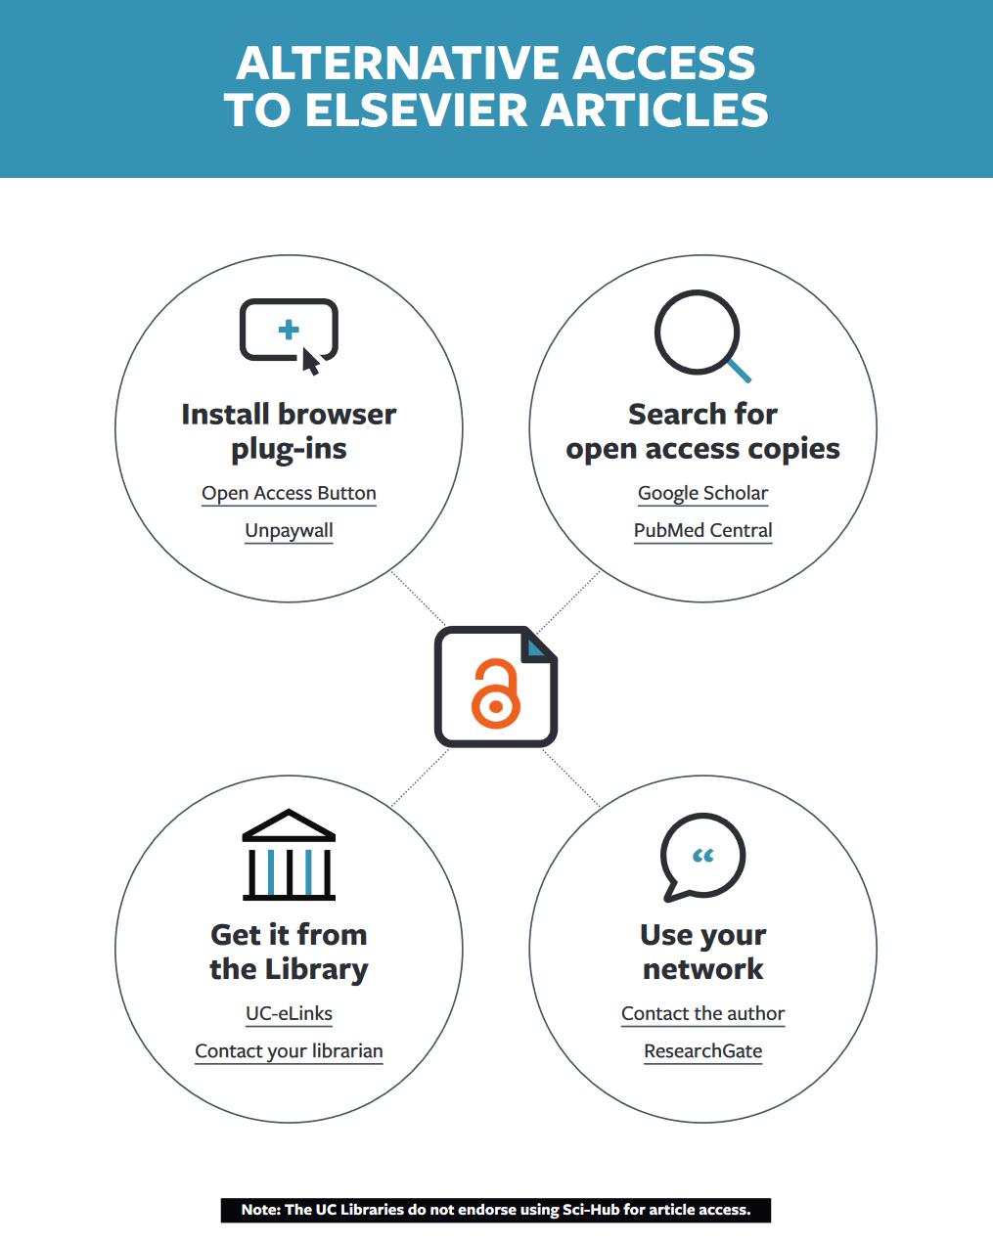
Example of the facilitated collection
http://orweblog.oclc.org/the-facilitated-collection-redux-a-note-on-collections-as-a-service-the-university-of-california-and-elsevier/
Notes:
So while we thought that the Facilitated Collection might be the next trend in research libraries, the survey data does not support this assumption.
Although there is nice anecdotal evidence: this slide shows an example highlighted by Lorcan Dempsey in a blog on the Facilitated Collection. He looks at how the University of California, having terminated its contract with Elsevier Science Publisher, is supporting its community for alternate access to content published in Elsevier Journals. The University of California gives guidance by supporting users to find OA resources with the use of OA Button and Unpaywall, pointing them to various pre-print archives or article supply via ILL, or contacting authors directly via scholarly networking sites such as ResearchGate. And this might become a new trend, as more libraries cancel their big deals with publishers…

Slide 38
“What this means is that the library view is shifting somewhat from management of a locally acquired collection to facilitating access to a broader range of scholarly resources. (…)
The facilitated collection becomes a more important part of what a library does in this diversified context.”
- Lorcan Dempsey
http://orweblog.oclc.org/the-facilitated-collection-redux-a-note-on-collections-as-a-service-the-university-of-california-and-elsevier/
Notes:
… but for now, this is not what the survey data is telling us … and we need to grow a better understanding of the forces at play that make Research Libraries respond the way they do. That is why I have been looking more closely at the Shift to Open trend.

Slide 39
The trend of The shift to open
Notes:
The Shift to Open is a trend that has accelerated the Open Access movement and many of the other Open movements – since the beginning of this century and it is affecting the public sector and the academic sector most. It emphasizes Openness and Reusability and it is this prioritization of Openness over Access that makes the Shift to Open an interesting trend to explore more in depth.

Slide 40

Open Government Data
https://www.oecd.org/gov/open-government.htm
Notes:
For example, the objective of the Open Government Data Initiatives is to “unlock the data” held by public institutions and to realize the potential of innovation and economic growth. The OGD laws and policies require all non-sensitive government data to be made available in open and machine-readable formats by default. Policies have been promulgated worldwide, from Norway to Peru, and the effects are percolating down from central government to all the layers of the public sector – including public funded libraries.
National libraries, have made their authority files and national bibliography data openly available for unrestricted reuse and this has had an impactful effect on them. The OGD-policies have also spurred cultural institutions on to make their digitized collections available in the public domain, as open collections – this is especially the case in Europe, where Europeana played an important catalyst role.
So we have seen in the last decade or so, a significant shift within library land, from closed to open with the release of significant amounts of library metadata and collections.

Slide 41


G.emmerich
https://creativecommons.org/licenses/by-sa/3.0/legalcode
(https://commons.wikimedia.org/wiki/File:Open_Science_Logo_v2.jpg), „Open Science Logo v2“
(https://commons.wikimedia.org/wiki/File:Open_Science_Logo.jpg), „Open Science Logo“
Notes:
In Open Science likewise, the shift from closed to open data is being promoted by policies at all levels: institutional, national, regional, international.
In its broadest sense, open science is about the transition to open research practices, open scholarly communications and open participation in research. Essentially, it is about reforming scientific practice and breaking down IP-barriers. Like with OGD, it is about creating access to data/content that would otherwise be closed, and in doing so, dramatically lowering reuse costs. Here too, we have witnessed a significant shift within library land, from pay-to-read to pay-to-publish content and the release of significant amounts of research datasets.

Slide 42
Regional surveys on RL priorities (2017-18)
Notes:
It is a balancing act for research libraries in deciding how much of their attention and effort should go into supporting Open Practices in each of all the stages of the research process. As we can see from these RLP-survey findings from the past 2 years, many university libraries - in regions where open science policies are actively pursued - are turning their attention to Open Access Publishing, Research Data Management (RDM) and Supporting Digital Scholarship and Digital Humanities, all three of which they consider to be top priorities and most challenging or ripe for innovation.
We can see that some of these priorities are reflected in the Open Content activity categories considered ripe for acceleration, such as: Data Services/RDM and Deep-interactions with Open Content.

Slide 43
To be published end of 2019
The Shift to Open: a trend essay
“Librarians’ mission is to ensure universal and equitable access to knowledge. Openness is a relatively new addition to librarians’ vocabulary and its growing influence seems to outstrip the core value of access. The ‘shift to open’ is an intriguing trend within our digital society.
This essay will explore the characteristics of the shift to open and how it is affecting library directions and services.”
Notes:
The Shift to Open leads libraries to shift and refocus their strategic directions and activities. It also leads to the availability of much larger quantities of content being available as open content on the web. This necessarily affects library collections and services. So exploring the characteristics of the Shift to Open trend will help us understand better libraries choices and investment in Open Content.

Slide 44
Publications in progress
Essay on the Shift to Open (End 2019)
Report on Open Content support by Research Libraries (Beginning 2020)
Dataset will be publicly available at:
  oc.lc/research
Follow our blog at Hangingtogether.org
Notes:
Here is the timeline for the planned publications on this topic:
A trend essay on the Shift to Open (end of this year)
A Report on Open Content Support by Research Libraries – based on the survey findings – (beginning next year)
The dataset of the survey results.
Please follow the Hangingtogether.org blog of OCLC Research to learn more about the work we do on this topic.

Slide 45
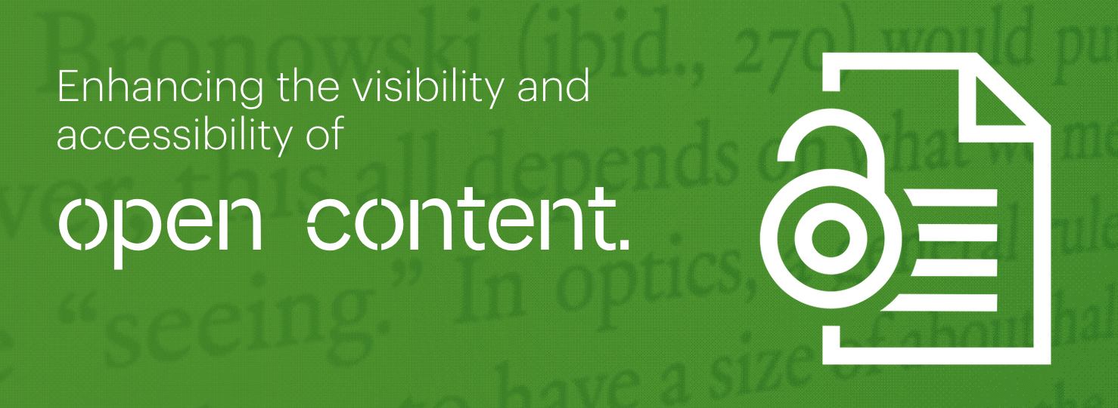
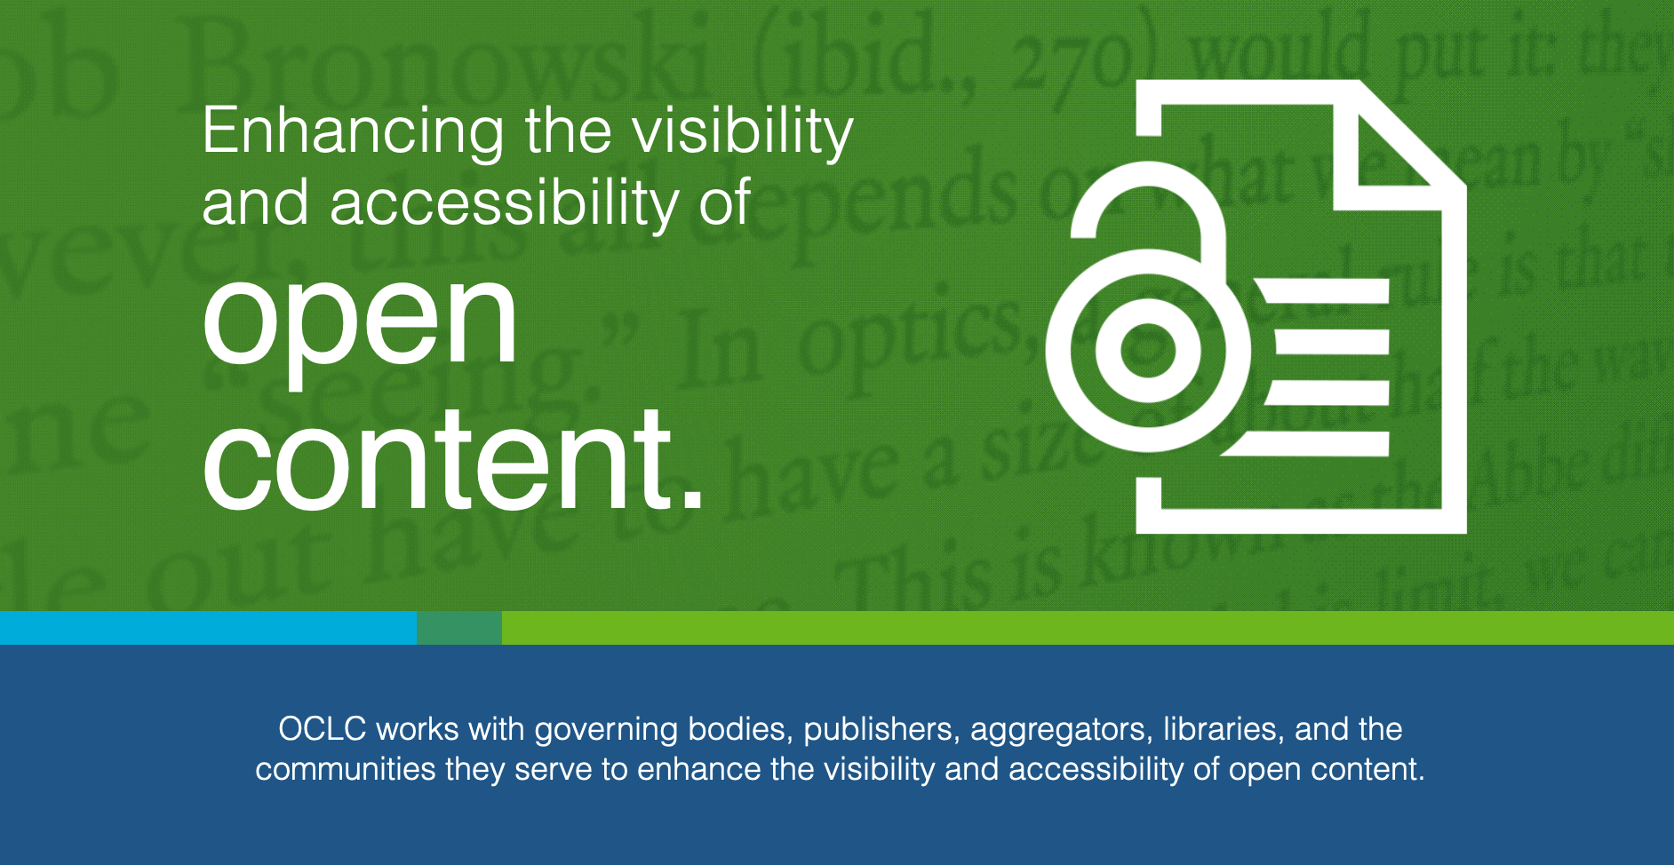
Stay up to date at https://oc.lc/open
Notes:
Please also visit OCLC’s OA web page (oc.lc/oa) where you can learn more about what OCLC is doing in this area and stay up to date on new developments, activities and events. OCLC is committed to improving visibility and access of open content materials and engage with the community in these questions.

Slide 46
Questions?

