Slide 1
LAC IFLA – Athens, Greece
26 August 2019
“It [library tour] wasn't what do you do when you need to make a literature review…”
Proactively Positioning the Library in the Life of the User
Lynn Silipigni Connaway, PhD
Director of Library Trends and User Research
connawal@oclc.org
@LynnConnaway

Slide 2
“66% of people polled worldwide said they could not live without the Internet.”
(Hutt 2019)
“33% of UK internet users did a ‘digital detox’ at some point in 2015.”
(Hutt 2019)
“Estimates place the number of internet users worldwide in the region of 3.6 billion – around half the world’s population – while Facebook has more than 2 billion active monthly users.”
(Constine 2019)
Image: https://www.flickr.com/photos/pedrosimoes7/149752714/ by Pedro Ribeiro Simos / CC BY 2.0
Notes:
Image: https://www.flickr.com/photos/pedrosimoes7/149752714/ by Pedro Ribeiro Simos / CC BY 2.0
“Estimates place the number of internet users worldwide in the region of 3.6 billion – around half the world’s population – while Facebook has more than 2 billion active monthly users.”
Constine, Josh. "Facebook Now Has 2 Billion Monthly Users... and Responsibility." TechCrunch. June 27, 2017. Accessed July 10, 2019. https://techcrunch.com/2017/06/27/facebook-2-billion-users/.
The UK, while having fewer internet users than more populous countries such as India, China, the US and Brazil, was placed second, with 78% unable to contemplate getting by without it.
China, which has the highest number of internet users of any country – 731 million as of March 2017 – is third, with 77%.
Clement, J. "Number of Internet Users in Selected Countries 2019." Statista. May 2019. Accessed July 10, 2019. https://www.statista.com/statistics/262966/number-of-internet-users-in-selected-countries/.
66% of people polled worldwide said they could not live without the Internet 33% of UK internet users did a “digital detox” at some point in 2015 The age group most likely to take a break were 16 to 24 year olds.
In the UK adults now spend an average of 25 hours online per week, up from nine hours in 2005. This figure increased to 29 hours for young people aged 16-24, according to a survey by the country’s communications regulator Ofcom.
As a result of their digital detox, more than a third said they felt more productive, almost a third found it liberating and a quarter enjoyed life more. Although 16% said they experienced a “fear of missing out”, known as FOMO, and 15% felt lost and 14% cut off.
Hutt, Rosamond. "A Third of UK Internet Users Have Taken a Digital Detox – Do You Need One?" World Economic Forum. August 4, 2014. Accessed July 10, 2019. https://www.weforum.org/agenda/2016/08/a-third-of-uk-internet-users-have-taken-a-digital-detox-do-you-need-one/.

Slide 3
Internet
“Regarding health affairs, I usually don’t search on Internet because… you have a pain on a finger and then you end up [thinking] you have bubonic plague…is not reliable …improbable things become sure. For this affair, I would use personal contacts.”
(Digital Visitors and Residents, UOCG3, Male, Age 26-34, Arts/Humanities)
“Probably a laptop is the bare minimum I'm going to need because, for the most part, at this point in my life, I need Internet access in some fashion. Although later on, a phone's probably going to replace that because you need that for a job.”
(Researching Students’ Information Choices, H05, Male, Age 16, High School Student)
Image: https://www.flickr.com/photos/cocca/5298761720/ by Nigel Wilson / CC BY-ND 2.0
Notes:
Image: https://www.flickr.com/photos/cocca/5298761720/ by Nigel Wilson / CC BY-ND 2.0
Participants mentioned that they often value human sources because they mistrust information published online. Per participant UOCG3: “Regarding health affairs, I usually don’t search on Internet because… you have a pain on a finger and then you end up [thinking] you have bubonic plague…is not reliable…improbable things become sure. For this affair, I would use personal contacts.”
White, David S., and Lynn Silipigni Connaway. 2011-2014. Digital Visitors and Residents: What Motivates Engagement with the Digital Information Environment. Funded by JISC, OCLC, and Oxford University. http://www.oclc.org/research/activities/vandr.html.
S2 04:45
Probably a laptop is the bare minimum I'm going to need because, for the most part, at this point in my life, I need Internet access in some fashion. Although later on, a phone's probably going to replace that because you need that for a job.
Buhler, Amy G., Tara T. Cataldo, Ixchel M. Faniel, Lynn Silipigni Connaway, Joyce K. Valenza, Randy Graff, Rachael Elrod, Samuel Putnam, Christopher Cyr, Christine Towler, Erin M. Hood, Robin Fowler, Brittany Brannon, Kailey Langer, and Shakiyl Kirlew. Researching Students’ Information Choices: Determining Identity and Judging Credibility in Digital Spaces. 2015-2018. IMLS Grant Project LG-81-15-0155. http://guides.uflib.ufl.edu/RSIC.

Slide 4
“Millennials and the post-millennial generation are more connected than any other age group, but the rise of social media has coincided with increased levels of depression, anxiety and loneliness among young people.”
(Twenge 2017)
Image: https://www.flickr.com/photos/dbuc/2762623821/ by Daniel John Buchanan / CC BY-NC-ND 2.0
Notes:
Image: https://www.flickr.com/photos/dbuc/2762623821/ by Daniel John Buchanan / CC BY-NC-ND 2.0
“Millennials and the post-millennial generation are more connected than any other age group, but the rise of social media has coincided with increased levels of depression, anxiety and loneliness among young people.”
Twenge, Jean. "This Is How the Smartphone Changed an Entire Generation." World Economic Forum. August 30, 2017. Accessed July 10, 2019. https://www.weforum.org/agenda/2017/08/how-the-smartphone-changed-an-entire-generation.

Slide 5
Social Media Presence
“More than half of 18- to 49-year-olds in the U.S. are either light viewers of TV or do not subscribe to TV; but over 90 percent of these people watch YouTube.”
(Pattillo 2018, 340)
“68 percent of all U.S. adults are Facebook users, while 28 percent use Instagram, 26 percent use Pinterest, 25 percent use LinkedIn and 21 percent use Twitter.”
(Pattillo 2017, 56)
Image: https://www.flickr.com/photos/29574156@N04/14252326465/ by Bart / CC BY-NC 2.0
Notes:
Image: https://www.flickr.com/photos/29574156@N04/14252326465/ by Bart / CC BY-NC 2.0
“Facebook continues to be America’s most popular social networking platform by a substantial margin: Nearly eight-in-ten online Americans (79 percent) now use Facebook, more than double the share that uses Twitter (24 percent), Pinterest (31 percent), Instagram (32 percent) or LinkedIn (29 percent). On a total population basis (accounting for Americans who do not use the Internet at all), that means that 68 percent of all U.S. adults are Facebook users, while 28 percent use Instagram, 26 percent use Pinterest, 25 percent use LinkedIn and 21 percent use Twitter.”
Shannon Greenwood, Andrew Perrin, and Maeve Duggan, “Demographics of Social Media Users in 2016,” Pew Research Center, November 11, 2016, www.pewinternet.org/2016/11/11/social-media-update-2016 (retrieved December 6, 2016)
Quoted in Gary Pattillo. 2017. “Fast Facts.” College & Research Libraries News 78, no. 1: 56.
“More than half of 18- to 49-year-olds in the U.S. are either light viewers of TV or do not subscribe to TV; but over 90 percent of these people watch YouTube.”
YouTube, “Video Is Everywhere—Helping Brands Find Their Audience in the Era of Convergence,” Official YouTube Blog, April 29, 2018, https://youtube.googleblog.com/2018/04/video-is-everywhere-helping-brands-find.html (retrieved May 3, 2018).
Quoted in Gary Pattillo. 2018. “Fast Facts.” College & Research Libraries News 79, no. 6: 340.

Slide 6
Centrality of Google & Search Engines
“I probably would have gone straight to Google Scholar, or Web of Science, or some other database… If it was a topic I was knowledgeable on I wouldn't have messed around with Google. I would have gone straight to something I could trust.”
(Researching Students’ Information Choices, U29, N/A, Age 18, Chemical Sciences)
“I avoid using the search engines our library has purchased because they're frequently, in my experience, very clumsy and frustrating.”
(Digital Visitors and Residents, MMF22, Age 45-54, Male, Arts and Humanities)
Image: https://www.flickr.com/photos/kmacelwee/23886631424/ by Kent MacElwee / CC BY-NC-ND 2.0
Notes:
Image: https://www.flickr.com/photos/kmacelwee/23886631424/ by Kent MacElwee / CC BY-NC-ND 2.0
S2 62:41
I probably would have gone straight to Google Scholar, or Web of Science, or some other database. I'm not sure why I actually like the other databases. Yeah. I probably would have done that. If it was a topic I was knowledgeable on I wouldn't have messed around with Google. I would have gone straight to something I could trust.
Buhler, Amy G., Tara T. Cataldo, Ixchel M. Faniel, Lynn Silipigni Connaway, Joyce K. Valenza, Randy Graff, Rachael Elrod, Samuel Putnam, Christopher Cyr, Christine Towler, Erin M. Hood, Robin Fowler, Brittany Brannon, Kailey Langer, and Shakiyl Kirlew. Researching Students’ Information Choices: Determining Identity and Judging Credibility in Digital Spaces. 2015-2018. IMLS Grant Project LG-81-15-0155. http://guides.uflib.ufl.edu/RSIC.
Well, the way you phrased that is interesting. So as a general rule, even when doing research for teaching my courses, I avoid-- that's the right verb. I avoid using the search engines our library has purchased because they're frequently, in my experience, very clumsy and frustrating. I've had long discussions with our librarians at Mount St. Mary's about this and we definitely are experiencing a kind of cognitive disconnect in terms of what they claim are the functionality or utilities of these tools versus what my students and I experience. I think that the librarian at the Mount specifically asked me to participate in this to sort of get on record my frustrations. So that's why I'm giving you guys this hour, because the librarians specifically asked me to. I conducted a Lemon Laws search just because in order to sign up, you all needed that search code or whatever it is that I had to copy and paste and move over, and that was a topic that was on my mind at the moment. But we could also, if you like, talk about why, when doing research to teach my courses, I often find the databases frustrating.
White, David S., and Lynn Silipigni Connaway. 2011-2014. Digital Visitors and Residents: What Motivates Engagement with the Digital Information Environment. Funded by JISC, OCLC, and Oxford University. http://www.oclc.org/research/activities/vandr.html

Slide 7
“You spend many hours, with Saint Google. We entrust ourselves to Saint Google, and that solves it for us.”
(Digital Visitors and Residents, UOCFI6, Male, Age 53, Arts & Humanities)
Image: https://www.flickr.com/photos/captspaulding/26494138569/ by Capt Spaulding / CC BY-NC-ND 2.0
Notes:
Image: https://www.flickr.com/photos/captspaulding/26494138569/ by Capt Spaulding / CC BY-NC-ND 2.0
“You spend many hours, with Saint Google. We entrust ourselves to Saint Google, and that solves it for us.”
(UOCFI6, Male, Age 53, Arts and Humanities)
White, David S., and Lynn Silipigni Connaway. 2011-2014. Visitors & Residents: What Motivates Engagement with the Digital Information Environment. Funded by JISC, OCLC, and Oxford University. http://www.oclc.org/research/activities/vandr.html.

Slide 8
Formats of Resources
“Print books continue to be more popular than e-books or audio books.”
(Perrin 2016, 2)
“…around half of newspaper readers consume newspapers only in their printed form. They are more likely to often watch local TV news than those newspaper readers who access the paper online instead of or in addition to the print edition.”
(Barthel 2016)
Image: https://www.flickr.com/photos/archer10/2215901880/ by Dennis Jarvis / CC BY-SA 2.0
Notes:
Image: https://www.flickr.com/photos/archer10/2215901880/ by Dennis Jarvis / CC BY-SA 2.0
““Print books continue to be more popular than e-books or audio books. Fully 65 percent of Americans have read a print book in the last year, more than double the share that has read an e-book (28 percent) and more than four times the share that has consumed book content via audio book (14 percent). Some 73 percent of Americans report that they have read at least one book (in any format) in the last year.” When reading e-books, more Americans are reading them on tablets and cellphones rather than dedicated e-readers.”
Perrin, Andrew. 2016. “Book Reading 2016.” Pew Research Center, September 1. http://www.pewinternet.org/2016/09/01/book-reading-2016/.
Quoted in Gary Pattillo. 2016. “Fast Facts.” College & Research Libraries News 77, no. 9: 472.
“Data from Pew Research Center and other sources show that around half of newspaper readers consume newspapers only in their printed form. They are more likely to often watch local TV news than those newspaper readers who access the paper online instead of or in addition to the print edition. This difference persists even when controlling for age.”
Barthel, Michael. 2016. “Around Half of Newspaper Readers Rely Only on Print Edition.” Pew Research Center, January 6, www.pewresearch.org/fact-tank/2016/01/06/around-half-of-newspaper-readers-rely-only-on-print-edition.

Slide 9
“Oh, this is a book, so I can't get this unless it's in a library. So I can't use that.”
(Researching Students’ Information Choices, H12, Female, Age 15, High School Student)
“I didn't look at this probably because I just noticed that it said Google Books. Just wasn't interested in using an entire book or going through an entire book.”
(Researching Students’ Information Choices, G04 Female, Age 22, Physical Sciences)
Image: https://www.flickr.com/photos/berylm/6656243821/ by Beryl McMillan
Notes:
Image: https://www.flickr.com/photos/berylm/6656243821/ by Beryl McMillan
S2 20:46
Yeah. I don't know if I would trust that. Okay. Encyclopedia. Oh, this is a book, so I can't get this unless it's in a library. So I can't use that. Severe declines in Everglades mammals linked to pythons. So this is another one. In this Science for a Changing World. This seems somewhat credible, so-- it says research news. Declines in formerly common mammals in Everglades National Park. That's linked to the presence of invasive Burmese pythons. So it has little things here with the pictures, and-- so, yeah, there's a study. This is a study. And they even have quotes, so it looks-- by director, so maybe researcher [laughter]. Scientist. This looks really official and really thought out like they know their stuff. Yeah. I would use this, which is this one. Okay. Taking over the Everglades. Time. Hmm. I'm not sure. Burmese pythons are your normal predators-- squeezing their prey. So a new study published in here confirms what the scientists feared. They even have a little video which is nice if it's good. Can I play it?
Buhler, Amy G., Tara T. Cataldo, Ixchel M. Faniel, Lynn Silipigni Connaway, Joyce K. Valenza, Randy Graff, Rachael Elrod, Samuel Putnam, Christopher Cyr, Christine Towler, Erin M. Hood, Robin Fowler, Brittany Brannon, Kailey Langer, and Shakiyl Kirlew. Researching Students’ Information Choices: Determining Identity and Judging Credibility in Digital Spaces. 2015-2018. IMLS Grant Project LG-81-15-0155. http://guides.uflib.ufl.edu/RSIC.
S2 89:48
Invasive Pythons in the US. I didn't look at this probably because I just noticed that it said Google Books. Just wasn't interested in using an entire book or going through an entire book. Potential Problems of Removing One Invasive Species at a Time. I don't know that I looked at this one. But after clicking on it, it specifically says up top, "Not peer reviewed." Which right there isn't something I'd particularly want to include. Ah, I did look at this one. It also talks about how we're moving one species versus two co-occurring species can have an impact on the environment, but it just didn't seem to have anything particularly relevant to the Everglades. All right, hit next.
Buhler, Amy G., Tara T. Cataldo, Ixchel M. Faniel, Lynn Silipigni Connaway, Joyce K. Valenza, Randy Graff, Rachael Elrod, Samuel Putnam, Christopher Cyr, Christine Towler, Erin M. Hood, Robin Fowler, Brittany Brannon, Kailey Langer, and Shakiyl Kirlew. Researching Students’ Information Choices: Determining Identity and Judging Credibility in Digital Spaces. 2015-2018. IMLS Grant Project LG-81-15-0155. http://guides.uflib.ufl.edu/RSIC.

Slide 10
The Library as Place
“I think most people just think of the library as a place for books, and I think you have to just let them know that this is a place where more things can happen. And that it’s your library, it’s your community place— it can be a meeting space, it can be a study space, it can be just a relaxation space—you know, it’s nice to just in a chair read the newspaper.”
(Digital Visitors and Residents, Faculty, Female, Age 55-64)
Image: https://www.flickr.com/photos/kbovard/255211788/ by Kevin Bovard / CC BY-NC-ND 2.0
Notes:
Image: https://www.flickr.com/photos/kbovard/255211788/ by Kevin Bovard / CC BY-NC-ND 2.0
How would it be different?
It would just help people become more engaged—I think most people just think of the library as a place for books, and I think you have to just let them know that this is a place where more things can happen. And that it’s your library, it’s your community place— it can be a meeting space, it can be a study space, it can be just a relaxation space—you know, it’s nice to just in a chair read the newspaper. I think if we just push that more, the amenities at the library. WL-FF5-04
White, David S., and Lynn Silipigni Connaway. 2011-2014. Digital Visitors and Residents: What Motivates Engagement with the Digital Information Environment. Funded by JISC, OCLC, and Oxford University. http://www.oclc.org/research/activities/vandr.html

Slide 11
“I personally feel like when I’m at the library, I’d rather keep my head down and I feel that most people are here for that.”
(Digital Visitors and Residents, Faculty, Male, Age 25-34)
Image: https://www.flickr.com/photos/vintzileos/249964421/ by Giorgos~ / CC BY-NC-ND 2.0
Notes:
Image: https://www.flickr.com/photos/vintzileos/249964421/ by Giorgos~ / CC BY-NC-ND 2.0
Do you interact with other library patrons? How so?
Sometimes- I’ve run into a couple of my friends here before – so, stuff like that happens, but with complete strangers, probably not so much. Other than to smile, maybe, and say “Hey” (demonstrates polite wave/greeting). I personally feel like when I’m at the library, I’d rather keep my head down and I feel that most people are here for that, and it feels kind of awkward to-- (Unintelligible, reference to interrupting another person’s library use). I don’t mind chit-chatting in a normal circumstance but I don’t think that the library is the most appropriate place for that. WL-FM2-26
White, David S., and Lynn Silipigni Connaway. 2011-2014. Digital Visitors and Residents: What Motivates Engagement with the Digital Information Environment. Funded by JISC, OCLC, and Oxford University. http://www.oclc.org/research/activities/vandr.html

Slide 12
Satisficing…What is enough information?
“I really wouldn't use 20 sources online. I usually just look for a few, and if that's not enough information for me to do a research project, then I'd go to the library and get a book.”
(Researching Students’ Information Choices, Undergraduate, Female, Age 18, Life Sciences)
“So that's my thinking when I do this, is that I need to make sure that I have enough information and enough sources to make a paragraph. And if I don't, then I just don't use it.”
(Researching Students’ Information Choices, High School, Male, Age 12)
Image: https://www.flickr.com/photos/134376586@N07/35335151321/ by ewf.gloria / CC BY-NC 2.0
Notes:
Image: https://www.flickr.com/photos/134376586@N07/35335151321/ by ewf.gloria / CC BY-NC 2.0
Yes. Sometimes, I won't always choose dot org or dot gov because you can't always find all the sources you need. So I'll read them to see if they can help, but if they really can't, then I most likely won't use them because I've learned that if you have a topic you have to type or write about, it's good to have a source that has a lot of information than a little bit. Because if you want to use your paragraph on that, you have to have enough information to have a paragraph. So that's my thinking when I do this, is that I need to make sure that I have enough information and enough sources to make a paragraph. And if I don't, then I just don't use it. Take a look. Python Patrol. "An organization in the Everglades dedicated to the capture and removal of Burmese pythons." Solutions. Snake traps. I think this would be about coming together. So using snake traps. Okay. H02,
Buhler, Amy G., Tara T. Cataldo, Ixchel M. Faniel, Lynn Silipigni Connaway, Joyce K. Valenza, Randy Graff, Rachael Elrod, Samuel Putnam, Christopher Cyr, Christine Towler, Erin M. Hood, Robin Fowler, Brittany Brannon, Kailey Langer, and Shakiyl Kirlew. Researching Students’ Information Choices: Determining Identity and Judging Credibility in Digital Spaces. 2015-2018. IMLS Grant Project LG-81-15-0155. http://guides.uflib.ufl.edu/RSIC.
Realistic. I really wouldn't use 20 sources online. I usually just look for a few, and if that's not enough information for me to do a research project, then I'd go to the library and get a book. But I think that the combination of a few really good sources that I recognize and textbooks is better than having 20 sources where a few of them are kind of not as familiar, or maybe material sources are not as good as textbooks. U03
Buhler, Amy G., Tara T. Cataldo, Ixchel M. Faniel, Lynn Silipigni Connaway, Joyce K. Valenza, Randy Graff, Rachael Elrod, Samuel Putnam, Christopher Cyr, Christine Towler, Erin M. Hood, Robin Fowler, Brittany Brannon, Kailey Langer, and Shakiyl Kirlew. Researching Students’ Information Choices: Determining Identity and Judging Credibility in Digital Spaces. 2015-2018. IMLS Grant Project LG-81-15-0155. http://guides.uflib.ufl.edu/RSIC.

Slide 13
Notes:
Image: Oxford Dictionaries, November 15, 2016, 9:00PM, https://twitter.com/oxfordwords/status/798752580872437760?lang=en.
“Oxford Dictionaries 2017 word of the year is “youthquake.” the word “post-truth” as the Word of the Year 2016 (Oxford Living Dictionaries 2017). Oxford Dictionaries states that the word first was used in 1965 by Diana Vreeland, editor-in-chief of Vogue, “to describe the youth-led fashion and music movement of the swinging sixties. The word heavily was used in June with the UK’s general election” (English Oxford Living Dictionaries 2017).”
Connaway, L. S. (2017, August 25). Can you believe it? How to determine credibility in the era of fake news. Inside ASIS&T President’s Column, August 2017.
English Oxford Living Dictionaries. 2016. “Word of the Year 2016 Is…” Accessed August 23, 2017. https://en.oxforddictionaries.com/word-of-the-year/word-of-the-year-2016.
English Oxford Living Dictionaries. 2017. “Word of the Year 2017 Is…” Accessed March 25, 2018. https://en.oxforddictionaries.com/word-of-the-year/word-of-the-year-2017.

Slide 14
Notes:
Image: Oxford Dictionaries, November 15, 2016, 9:00PM, https://twitter.com/oxfordwords/status/798752580872437760?lang=en.
“Oxford Dictionaries 2017 word of the year is “youthquake.” the word “post-truth” as the Word of the Year 2016 (Oxford Living Dictionaries 2017). Oxford Dictionaries states that the word first was used in 1965 by Diana Vreeland, editor-in-chief of Vogue, “to describe the youth-led fashion and music movement of the swinging sixties. The word heavily was used in June with the UK’s general election” (English Oxford Living Dictionaries 2017).”
Connaway, L. S. (2017, August 25). Can you believe it? How to determine credibility in the era of fake news. Inside ASIS&T President’s Column, August 2017.
English Oxford Living Dictionaries. 2016. “Word of the Year 2016 Is…” Accessed August 23, 2017. https://en.oxforddictionaries.com/word-of-the-year/word-of-the-year-2016.
English Oxford Living Dictionaries. 2017. “Word of the Year 2017 Is…” Accessed March 25, 2018. https://en.oxforddictionaries.com/word-of-the-year/word-of-the-year-2017.

Slide 15
The Learning Black Market/ Wikipedia Shaming
“The reason why I didn't pick the Wikipedia for the Burmese pythons in Florida was because my teachers always talk about how you shouldn't use Wikipedia because they give you false information. And so I didn't want to see what they had to talk about.”
(Researching Students’ Information Choices, Middles School, Female, Age 13)
“Because teachers don't like Wikipedia, even though I feel like Wikipedia's a good place to go if you know how to use it.”
(Researching Students’ Information Choices, Undergraduate, Male, Age 20, Life Sciences)
Image: https://www.flickr.com/photos/youngrobv/509340902/ by youngrobv / CC BY-NC 2.0
Notes:
Image: https://www.flickr.com/photos/youngrobv/509340902/ by youngrobv / CC BY-NC 2.0
Buhler, Amy G., Tara T. Cataldo, Ixchel M. Faniel, Lynn Silipigni Connaway, Joyce K. Valenza, Randy Graff, Rachael Elrod, Samuel Putnam, Christopher Cyr, Christine Towler, Erin M. Hood, Robin Fowler, Brittany Brannon, Kailey Langer, and Shakiyl Kirlew. Researching Students’ Information Choices: Determining Identity and Judging Credibility in Digital Spaces. 2015-2018. IMLS Grant Project LG-81-15-0155. http://guides.uflib.ufl.edu/RSIC.

Slide 16
Motivation & Behaviors Change Based on context & situation
“At first I started looking online, and it was a little bit overwhelming…I ended up reaching into my mom’s cupboard and using a recipe that I found in one of her old cookbooks. The recipe was just what I was looking for...”
(Digital Visitors and Residents, US High School, Emerging, Female, Age 17)
Image: https://www.flickr.com/photos/davidstanleytravel/40046740253/ by David Stanley / CC BY 2.0
Notes:
Image: https://www.flickr.com/photos/davidstanleytravel/40046740253/ by David Stanley / CC BY 2.0
“This morning I was looking for a homemade bread recipe that I could use to bake and then blog about. (I just started my own food blog: gritsgonegreen.wordpress.com). At first I started looking online, and it was a little bit overwhelming. There were so many different recipes with different flavors and crazy combinations. The one thing that was good about looking at the online recipes was viewing the user comments and seeing how people liked or disliked each recipe. I ended up reaching into my mom’s cupboard and using a recipe that I found in one of her old cookbooks. The recipe was just what I was looking for: it was a simple homemade white bread. I was about to search on the internet how to knead and punch bread, but I flipped the page, and there was a whole glossary of bread making terms. I must admit, I was a little bit surprised by the amount of information and instruction found in the cookbook. I thought I was going to have to look up an instructional video online.” (Digital Visitors and Residents, USS3, Emerging, Female, Age 17, High School Student)
White, David S., and Lynn Silipigni Connaway. 2011-2014. Digital Visitors and Residents: What Motivates Engagement with the Digital Information Environment. Funded by JISC, OCLC, and Oxford University. http://www.oclc.org/research/activities/vandr.html.

Slide 17
More than 130 people die in the U.S. everyday from an opioid overdose.
(Rudd, 2016)
Photo by nosheep is licensed under Pixabay
Notes:
I’m going to start with a staggering statistic. In 2017, more than 130 people died everyday from an opioid-related overdose in the United States. That’s over 47,600 people a year. In 2014, this number was 28,647 – this is a 66% increase in just three years, and it is indeed an epidemic. Overall, drug overdoses have killed more than 70,000 Americans.
More than 20 percent of patients who have been prescribed opioids misuse them, and the Midwest saw a 70 percent increase in opioid overdoses from July 2016 through September 2017
The story here in Mexico is remarkably different, and truly, I hope it stays that way, because this is a terrible weight on American communities. In Mexico there were just 378 reported opioid-related overdose deaths in 2016 for the entire year
Drug overdose deaths | drug overdose | CDC injury center. (2018, December 21). Retrieved June 10, 2019, from https://www.cdc.gov/drugoverdose/data/statedeaths.html
Rudd, R. A. (2016). Increases in drug and opioid-involved overdose deaths — united states, 2010–2015. MMWR. Morbidity and Mortality Weekly Report, 65. https://doi.org/10.15585/mmwr.mm655051e1
Goodman-Meza, D., Medina-Mora, M. E., Magis-Rodríguez, C., Landovitz, R. J., Shoptaw, S., & Werb, D. (2019). Where is the opioid use epidemic in mexico? A cautionary tale for policymakers south of the us–mexico border. American Journal of Public Health, 109(1), 73–82. https://doi.org/10.2105/AJPH.2018.304767
Scholl, L. (2019). Drug and opioid-involved overdose deaths — united states, 2013–2017. MMWR. Morbidity and Mortality Weekly Report, 67. https://doi.org/10.15585/mmwr.mm6751521e1

Slide 18
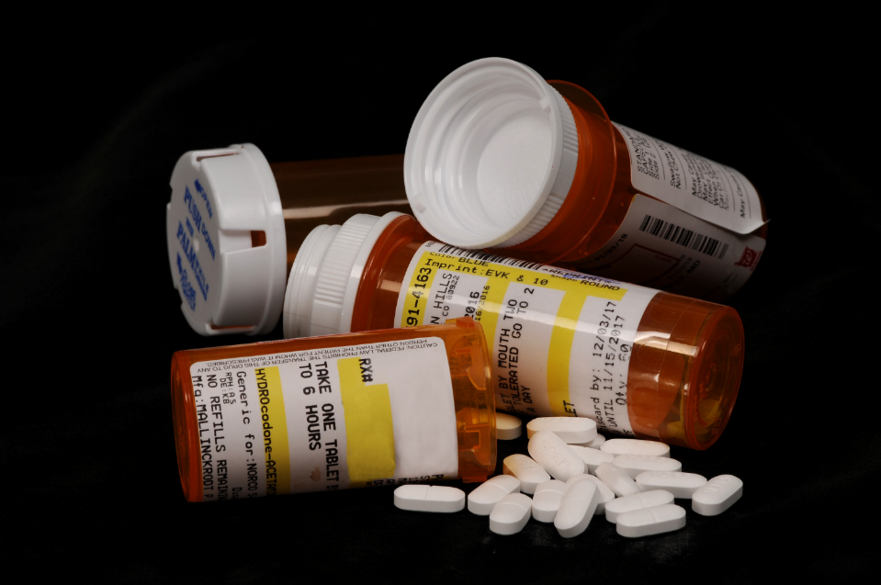
Misuse of prescription opioids costs $78.5 billion a year.
(Florence, Luo, Xu, & Zhou, 2016)
Opioids by K-State Research and Extension is licensed under CC BY2.0
“Opioids” by K-State Research and Extension is licensed under CC By 2.0
Notes:
More than 20 percent of patients who have been prescribed opioids misuse them, and the Centers for Disease Control and Prevention has estimated that misuse of prescription opioids costs $78.5 billion a year. This is the cost for treatment for those experiencing addiction, emergency services for people who overdose, and policing efforts.
This is a massive problem in the United States and it is impacting people deeply. It is very difficult at this point to not know someone who has been affected by this crisis – people have lost their children, their parents, their friends – or they know someone who has. It is simply devastating. Libraries are on the front line of the crisis as a welcoming public space.
Florence, C., Luo, F., Xu, L., & Zhou, C. (2016). The economic burden of prescription opioid overdose, abuse and dependence in the united states, 2013. Medical Care, 54(10), 901–906. https://doi.org/10.1097/MLR.0000000000000625

Slide 19
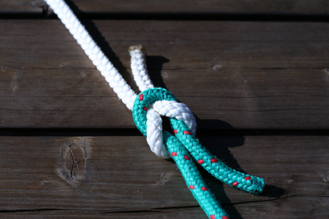
“We're so grateful to libraries for their willingness to do this because it is sensitive messaging. We understand that…culturally it has got a lot of stigma associated with it and a lot of misinformation and that can be a delicate thing. But their willingness to address that, and to become ambassadors, and to help eliminate some of that misinformation is a huge benefit to the community as a whole.”
- Community Partner
Image by Chris Wolf / Pixabay

Slide 20
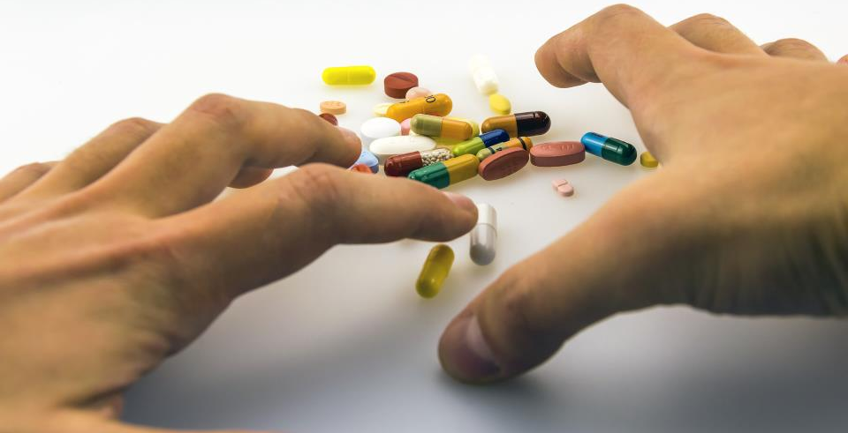
“I feel that there's been a lot of progress. And for a guy like me, who has been to prison, who's suffered, struggled with using for a long time, I'm hanging out with librarians, the police. I'm still alive. I still know people that use, and I don't use, but I'm still talking to those people…But now, there are people that have historically not liked people like me, treating me like a human, and giving me the opportunity to be a human, instead of just a junkie. And that is absolutely phenomenal.”
- Community member using the library services
Image by Emilian Danaila from Pixabay
Notes:
I mentioned that part of the interview protocol is talking to community members who used the services provided by the library and their partners. We recruited community members from each location, and interviewed up to three of them about their experiences.
I wanted to share a few of these because they can be quite impactful and give you a sense of how important this work can be. This quote is from a community member who was sees the opportunity to hang out with librarians and be treated like a human as phenomenal.

Slide 21
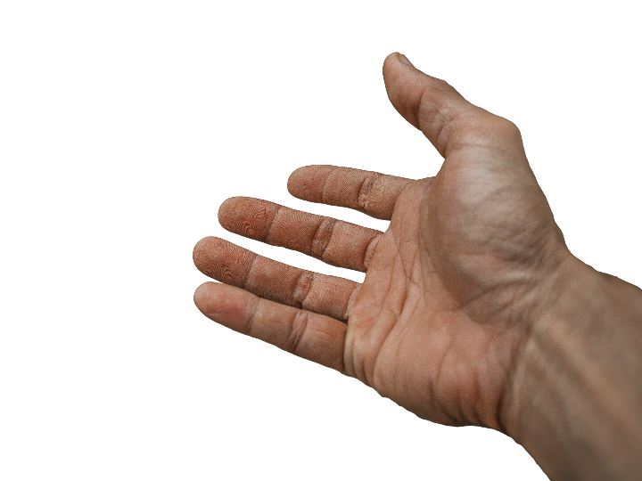
“It benefits me because I feel more prepared to help someone. I think anytime you feel more prepared and trained, you're much more likely to help someone.”
- Community Member who received naloxone from the library
Image by truthseeker08 from Pixabay
Notes:
This quote came from a community member who received training on how to administer naloxone, which can reverse an opioid overdose. This perceived sense of being better prepared to help someone is huge. Knowing that naloxone is available and how to use it can lead to helping someone survive an overdose.

Slide 22
“Be open. Be open to people, to being human, because a drug addict is a person, and they are suffering. And I guarantee there's a whole group of people connected to them that are suffering too. It's sometimes hard to see when you're dealing with it in the moment, but it's real.”
- Library Board Member
Image by Rémi Walle / Unsplash
Notes:
Finally, I’ll leave you with something that one of our interviewees, a library board member, shared when asked what they would recommend to people who are just getting started in this area.
Be open. Be open to people, to being human, because a drug addict is a person, and they are suffering. And I guarantee there's a whole group of people connected to them that are suffering too. It's sometimes hard to see when you're dealing with it in the moment, but it's real.”
You’ll be able to read the case studies from this project this summer, and the call to action white paper in the fall.
Thank you.

Slide 23
Need to provide services for what people actually do, need, and expect
The workflow context
Convenience & context switching
Fragmentation is a deterrent
The personal context
Relationship – sharing – engagement
The environmental context
Spaces and places
(Dempsey 2015)
Image: https://www.flickr.com/photos/stevo44/2792707771/ by stephen frith / CC BY-SA 2.0
Notes:
Image: https://www.flickr.com/photos/stevo44/2792707771/ by stephen frith / CC BY-SA 2.0
Dempsey, Lorcan. 2015. “Environmental Trends and OCLC Research.” Presented at the University of Notre Dame, Notre Dame, Indiana, September 28. http://www.oclc.org/content/dam/research/presentations/dempsey/dempsey-notre-dame-oclc-research-2015.pptx.

Slide 24
What Can we do?

Slide 25
Compelling Evidence for Academic Library Contributions to Student Learning and Success
Students receiving information literacy instruction during their initial coursework perform better in their courses than students who do not
Students who used the library in some way achieved higher levels of academic success (e.g., GPA, course grades, retention) than students who did not use the library.
Academic library partnerships with other campus units yield positive benefits for students (e.g., higher grades, academic confidence, retention).
Library instruction improves students’ achievement of institutional core competencies and general education outcomes.
Library research consultations boost student learning.
(Brown and Malenfant 2017)
Image: https://www.flickr.com/photos/felix-lange/26028182137/ by Felix Lange / CC BY-NC 2.0
Notes:
The higher education community now has compelling assessment findings that tell a strong story about the multiple ways that academic libraries are contributing to student learning and success. While each institutional context is unique and the AiA project findings about library impact are not generalizable to all academic settings, the demonstrations of positive connections between the library and aspects of student learning and success in five areas are particularly noteworthy.
2. Library use increases student success. Several AiA studies point to increased academic success when students use the library. The analysis of multiple data points (e.g., circulation, library instruction session attendance, online database access, study room use, interlibrary loan) shows that students who used the library in some way achieved higher levels of academic success (e.g., GPA, course grades, retention) than students who did not use the library.
3. Collaborative academic programs and services involving the library enhance student learning. Academic library partnerships with other campus units, such as the writing center, academic enrichment, and speech lab, yield positive benefits for students (e.g., higher grades, academic confidence, retention).
4. Information literacy instruction strengthens general education outcomes. Several AiA projects document that library instruction improves students’ achievement of institutional core competencies and general education outcomes. The project findings demonstrate different ways that information literacy contributes to inquiry-based and problem-solving learning, including effective identification and use of information, critical thinking, ethical reasoning, and civic engagement.
5. Library research consultations boost student learning. One-on-one or small-group reference and research assistance with a librarian enhances academic success, as documented by such factors as student confidence, GPAs, and improved achievement on course assignments.
Having overall consistent assessment findings of library impact in these five areas—across a body of over 200 projects—is strong in part because of the variation. Each setting is unique; each library program and service differed in its design and implementation (as appropriate for that unique local context); students had many difference characteristics and backgrounds; there was a multiplicity of methods for investigating the library impact on students.
Association of College and Research Libraries. Academic Library Impact on Student Learning and Success: Findings from Assessment in Action Team Projects. Prepared by Karen Brown with contributions by Kara J. Malenfant. Chicago: Association of College and Research Libraries, 2017.
Image: https://www.flickr.com/photos/felix-lange/26028182137/ by Felix Lange / CC BY-NC 2.0

Slide 26
“Our experience with a proactive chat model… showed us that there is indeed a ready-made market for our services right on our own library pages...”
(Zhang and Mayer 2014, 205)
Embedded librarianship
…be where our users need us
Image: https://www.flickr.com/photos/rinhello/5439213075/ by Alessio MumboJombu / CC BY-ND 2.0
Notes:
Image: https://www.flickr.com/photos/rinhello/5439213075/ by Alessio MumboJombu / CC BY-ND 2.0
“Our experience with a proactive chat model at John Carroll University showed us that there is indeed a ready-made market for our services right on our own library pages, and that our users will ask us questions when we approach them.” (Zhang and Mayer 2014, 205)
Zhang, Jie, and Nevin Mayer. 2014. “Proactive Chat Reference: Getting in the Users’ Space.” College & Research Libraries News 75, no. 4: 202-205

Slide 27
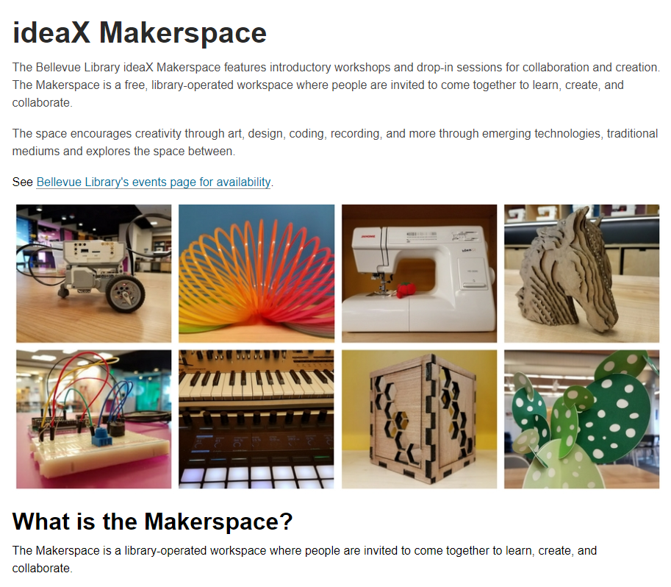
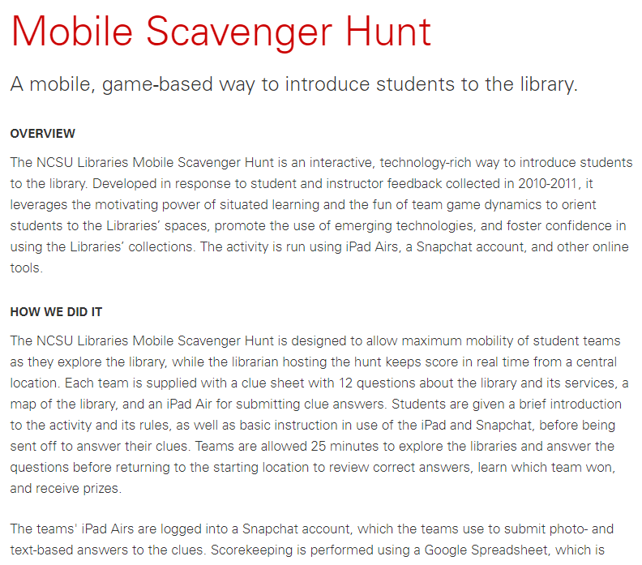
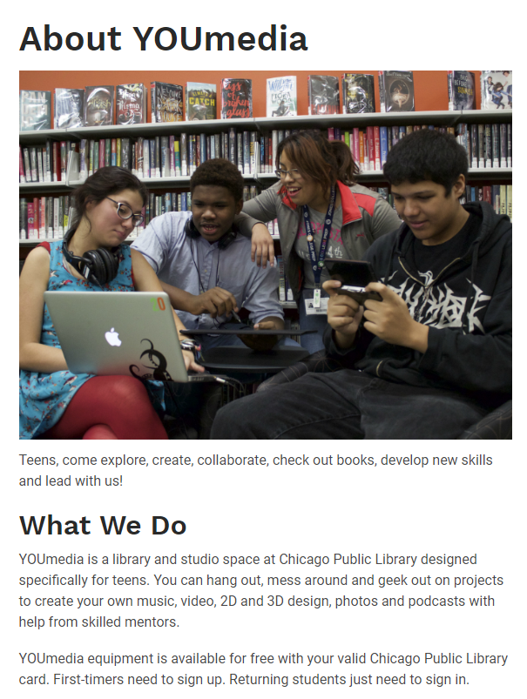
Initiatives
Notes:
Image: King County Library System. "IdeaX Makerspace." https://kcls.org/makerspace/.
Image: Chicago Public Library. “About YOUmedia” https://www.chipublib.org/youmedia-teens/
Image: NC State University Library. “Mobile Scavenger Hunt” https://www.lib.ncsu.edu/projects/mobile-scavenger-hunt
Image: https://www.flickr.com/photos/karmor/16450327942/ by John Karwoski / CC BY-NC-ND 2.0

Slide 28
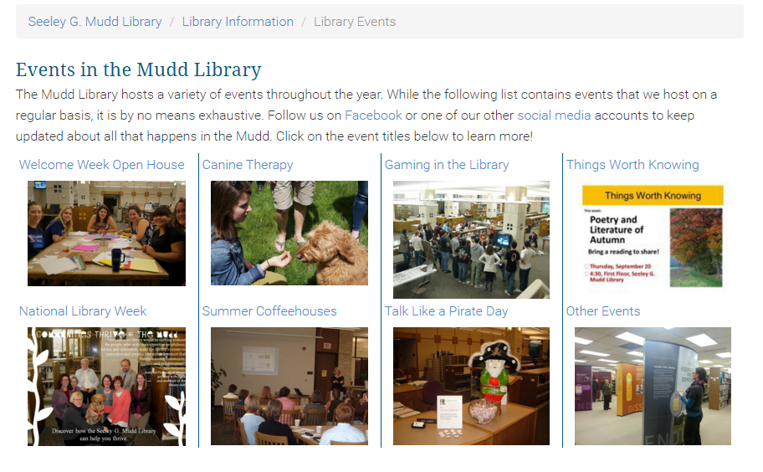
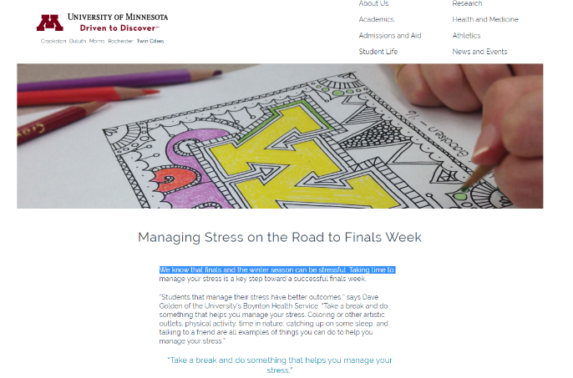
Image: https://www.flickr.com/photos/pamontgo/24475306709/ by Andy Montgomery / CC BY-SA 2.0
Notes:
Image: Lawrence University. “Library Events.” https://www.lawrence.edu/library/about/events.
Image: University of Minnesota. “Managing Stress on the Road to Finals Week.” https://twin-cities.umn.edu/managing-stress-road-finals-week.
Image: https://www.flickr.com/photos/pamontgo/24475306709/ by Andy Montgomery / CC BY-SA 2.0

Slide 29
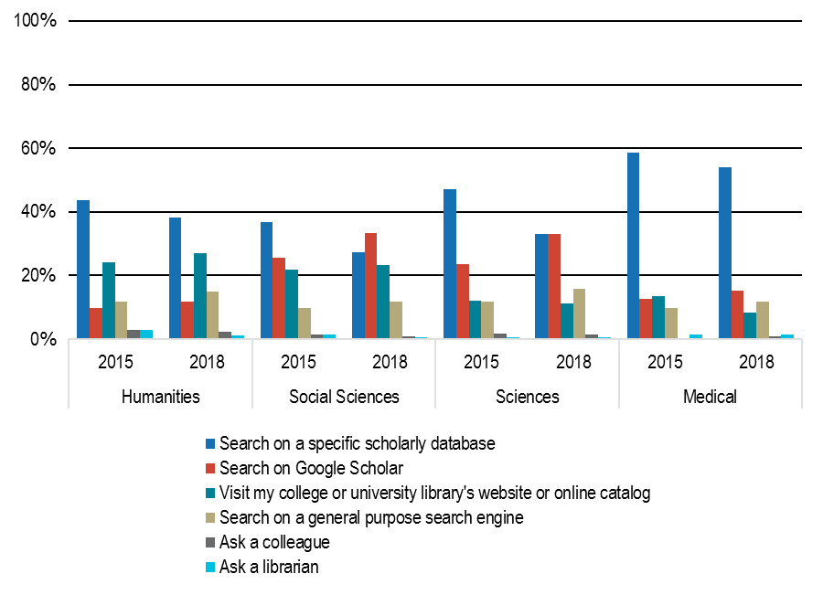
“Discovery starting points are shifting towards Google Scholar and other general search engines.”
(Blankstein and Wolff-Eisenberg 2019, 4)
“In the 2018 survey, 33% of scientists reported starting with Google Scholar compared to 23% in 2015.”
(Blankstein and Wolff-Eisenberg 2019, 9)
Image: https://www.flickr.com/photos/lichtc/4252173556/ by kegger / CC BY-NC-ND 2.0
Notes:
Image: https://www.flickr.com/photos/lichtc/4252173556/ by kegger / CC BY-NC-ND 2.0
The shift towards Google Scholar from 2015 to 2018 has primarily been driven by scientists and social scientists (see Figure 3). In the 2018 survey, 33% of scientists reported starting with Google Scholar compared to 23% in 2015. Conversely, scientists have considerably decreased their use of specific scholarly databases, though this does remain as the most frequent starting point for discovery; approximately 47% of scientists indicated specific scholarly databases as their starting point in 2015 compared to 33% in the current survey cycle. Likewise, in 2015, 26% of social scientists reported using Google Scholar as their starting point compared to 33% in 2018; 37% reported starting with a specific scholarly database in 2015 compared to 27% in 2018. Shifts in behavior of this magnitude were not observed for humanists and medical faculty.
Blankstein, Melissa and Christine Wolff-Eisenberg. "Ithaka S+R US Faculty Survey 2018." Ithaka S+R, April 12, 2019, 9. Accessed July 11, 2019. https://doi.org/10.18665/sr.311199.
• Discovery starting points are shifting towards Google Scholar and other general search engines. While specific scholarly databases remain the most frequent starting point for research, faculty are increasingly beginning their exploration of scholarly literature with Google Scholar and other general-purpose search engines.
Blankstein, Melissa and Christine Wolff-Eisenberg. "Ithaka S+R US Faculty Survey 2018." Ithaka S+R, April 12, 2019, 4. Accessed July 11, 2019. https://doi.org/10.18665/sr.311199.

Slide 30
“Although some of them[students] know how to use specialized databases, they often turn to general search engines because ‘it's faster and I know I'll find it quicker.’ If the university has not had a particular resource, they do not hesitate to find another way to get it.”
(Visitors and Residents, Project Team member, Universidad Carlos III de Madrid)
Image: https://www.flickr.com/photos/91954855@N05/9129298151/ by Mike Hewitt / CC BY-NC-ND 2.0
Notes:
Image: https://www.flickr.com/photos/91954855@N05/9129298151/ by Mike Hewitt / CC BY-NC-ND 2.0
“The students are completely unaware of the resources that the university
has in repositories, databases, etc. on their subjects. Most of the
interviewees do not know the possibility of consulting books in full text,
being able to develop bibliographies or access remotely the funds using
virtual contexts of the campus of its university. Although some of them
know how to use specialized databases, they often turn to general search
engines because ‘it's faster and I know I'll find it quicker.’ If the university
has not had a particular resource, they do not hesitate to find another way
to get it.”
V&R Project Team member
UC3M (Universidad Carlos III de Madrid)

Slide 31
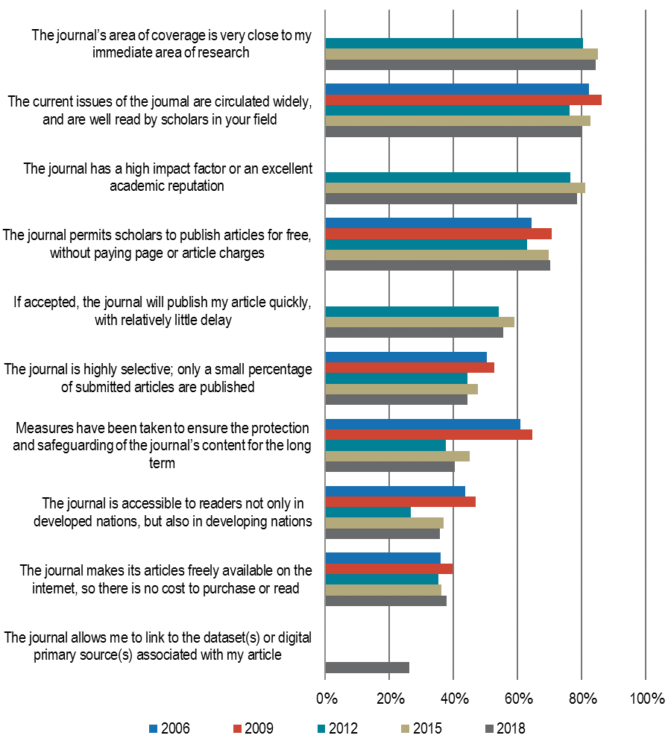
“While faculty are increasingly interested in an open access publication model, traditional scholarly incentives continue to motivate their decision-making.”
(Blankstein and Wolff-Eisenberg 2019, 4)
Image: https://www.flickr.com/photos/pedrosz/34930231294/ by Pedro Szekely / CC BY-SA 2.0
Notes:
Image: https://www.flickr.com/photos/pedrosz/34930231294/ by Pedro Szekely / CC BY-SA 2.0
While faculty are increasingly interested in an open access publication model, traditional scholarly incentives continue to motivate their decision-making. Approximately two-thirds of respondents in this survey cycle indicated they would be happy to see the traditional subscription-based publication model replaced entirely by an open access system, which represents a greater share of respondents compared to the previous survey cycle. However, only four in ten faculty indicate open access characteristics of journals as highly influential in publication decisions.
Blankstein, Melissa and Christine Wolff-Eisenberg. "Ithaka S+R US Faculty Survey 2018." Ithaka S+R, April 12, 2019, 4. Accessed July 11, 2019. https://doi.org/10.18665/sr.311199.

Slide 32
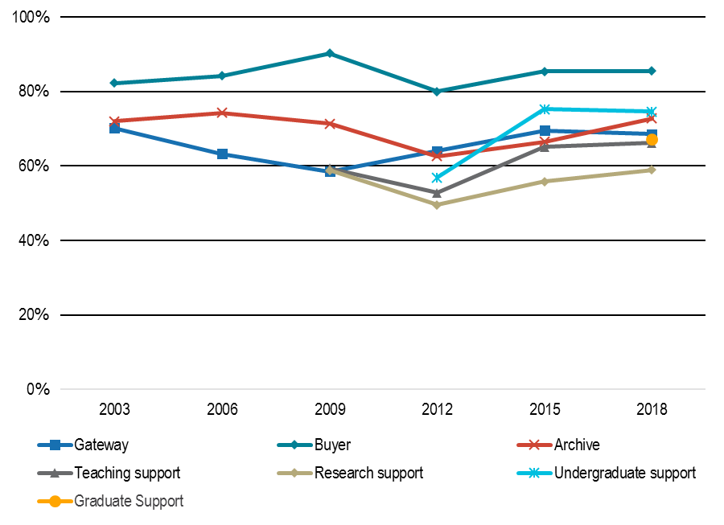
“The role of the library in archiving materials is increasingly important.”
(Blankstein and Wolff-Eisenberg 2019, 5)
“Approximately 73% of faculty indicated the library’s role as a repository of resources as highly important compared to 67% of faculty in 2015.”
(Blankstein and Wolff-Eisenberg 2019, 61)
Image: https://www.flickr.com/photos/darioruglioni/2716616818/ by dariorug / CC BY 2.0
Notes:
Image: https://www.flickr.com/photos/darioruglioni/2716616818/ by dariorug / CC BY 2.0
While responses to the 2018 survey cycle remain relatively similar to 2015, the most notable difference from last survey cycle is respondent endorsement of the archive role. Approximately 73% of faculty indicated the library’s role as a repository of resources as highly important compared to 67% of faculty in 2015.
Blankstein, Melissa and Christine Wolff-Eisenberg. "Ithaka S+R US Faculty Survey 2018." Ithaka S+R, April 12, 2019, 61. Accessed July 11, 2019. https://doi.org/10.18665/sr.311199.
The role of the library in archiving materials is increasingly important. While faculty maintain that the library’s most important function is as the buyer of resources they need, they are finding the library’s ability to serve as a repository of resources increasingly important.
Blankstein, Melissa and Christine Wolff-Eisenberg. "Ithaka S+R US Faculty Survey 2018." Ithaka S+R, April 12, 2019, 5. Accessed July 11, 2019. https://doi.org/10.18665/sr.311199.

Slide 33
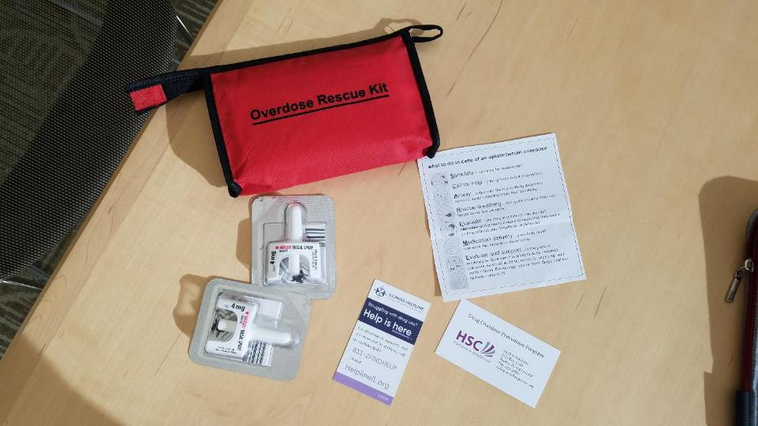
Peoria Public Library
Overdose Rescue Kit
Includes Narcan, instructions for use and information for more help
Photo courtesy: Peoria Public Library
Notes:
This is an Overdose Rescue kit – courtesy of Peoria Public Library. It contains several doses of Narcan, which is the opioid overdose reversal drug, naloxone, which can be administered to someone to revive them from an overdose. It also includes instructions for using the Narcan, and what to do to get more help.

Slide 34
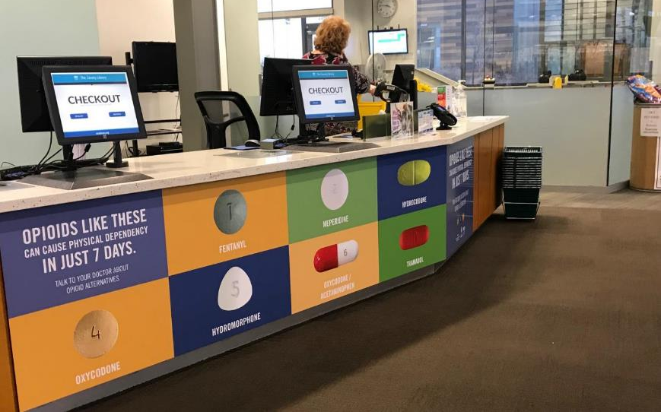
Salt Lake County Library System
Use Only As Directed, public awareness campaign
“Opioids like these can cause physical dependency in just 7 days.”
Photo courtesy: Salt County Library System
Notes:
This is a large display right at the checkout desk of the public library in Salt Lake County Utah. This is an example of encouraging the community to both recognize what an opioid can look like as well as to increase awareness about the potential hazards.
This display cannot be missed if you are in the library, and it sparks conversation with patrons, as well as in families. Staff noted that children have asked about the “candy” in the pictures. Which is a good reminder to parents that children often don’t realize a pill is a potentially dangerous medication.
This same library also has a large display (see next slide)

Slide 35
Salt Lake County Library System
Use Only As Directed, public awareness campaign.
7,000 opioid prescriptions are written everyday in Utah
Photo courtesy: Salt Lake County Library System
Notes:
This is another example of the public awareness campaign at the Salt Lake Library System. Hanging from the ceiling when you enter the library is 7,000 paper pill bottles, the kind that you would get a prescription in from the pharmacy. This represents the 7,000 prescriptions for opioids that are written everyday in the state. Every day.
In 2016, there were 6,305 drug overdose deaths in Utah. (1)
This display and the one on the previous page were funded entirely by their partners at the health department. The library didn’t need to pay for anything, but they did provide the space to make the display possible. And everyday, hundreds of people walk through the doors of the library and can see these displays and have an opportunity to learn about how the opioid epidemic is affecting their community and maybe learn how to protect themselves and the people they love.
Stats of the state of Utah. (2019, May 24). Retrieved June 10, 2019, from https://www.cdc.gov/nchs/pressroom/states/utah/utah.htm

Slide 36
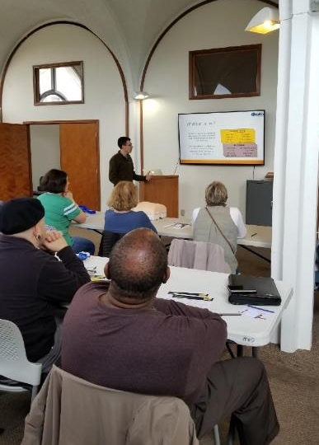
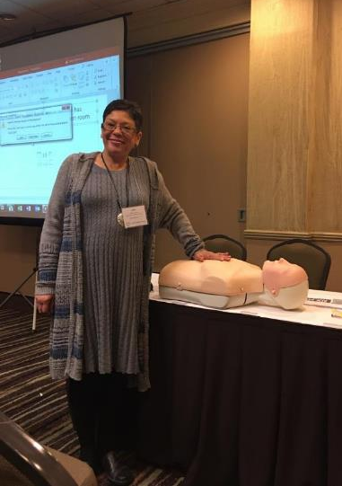
New Orleans Public Library, “Bystander Training”
Provides first aid training, including an opportunity to practice administering naloxone
Photos courtesy: New Orleans Public Library
Notes:
The New Orleans Public Library has rolled out training on how to use the opioid overdose antidote, naloxone, into a training that they offer in partnership with the local health department. The program is called “Bystander Training” and it also includes how to perform CPR, and how to stop bleeding after trauma. This approach of including the naloxone training with other common health concerns helps to reduce the stigma of a drug overdose and gives people the opportunity to understand more about how addictions to opioids form and why it is impacting so many people.
The health department provides all of the trainers for these events, and both organizations help to promote the training. The library is scheduling these events in different locations around their system to help reach more community members.

Slide 37
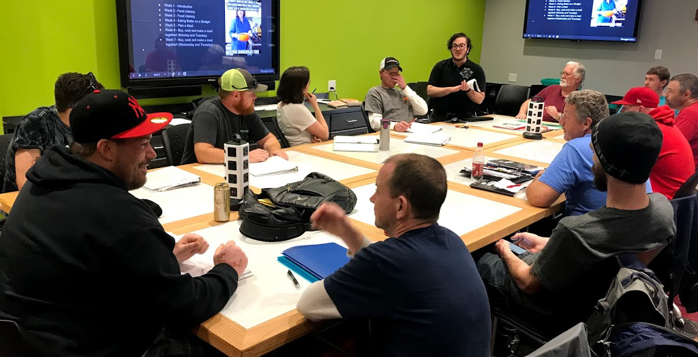
Blount County Public Library, life skills training course
Recovery Court participants attending training sessions at the public library
Photo courtesy: Blount County Public Library

Slide 38
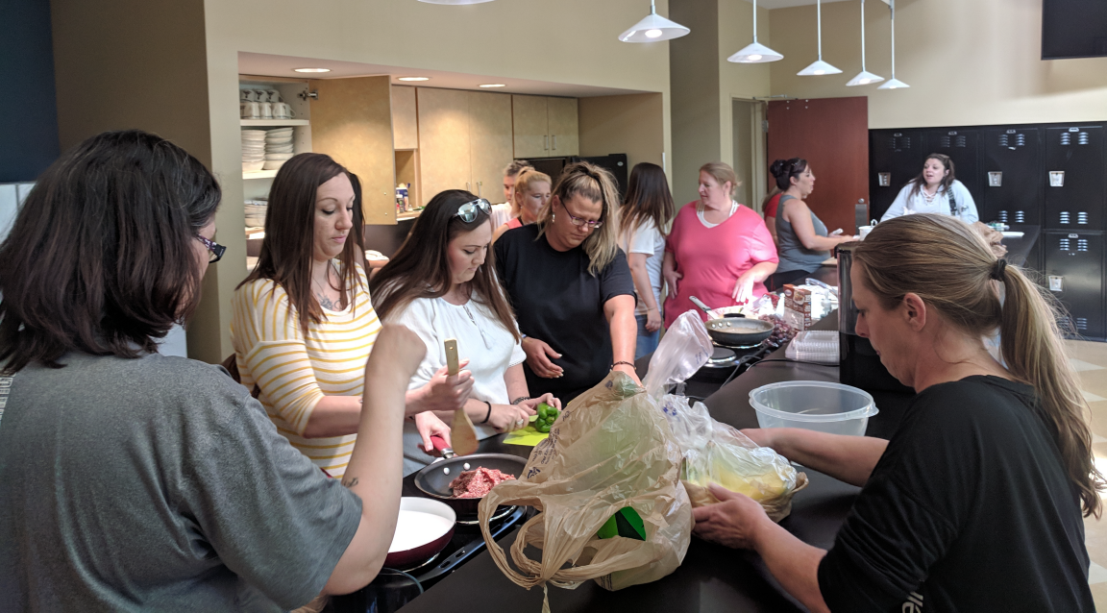
Blount County Public Library, life skills training course
Recovery Court participants attending training on nutrition at the library.
Photo courtesy: Blount County Public Library
Notes:
This is another photo from Blount County. These participants are working on the nutrition model which is part of the curriculum. At the end of the module, the students go shopping for ingredients and prepare a meal for the class. It’s a great example of an active curriculum where students are engaged in the work.

Slide 39
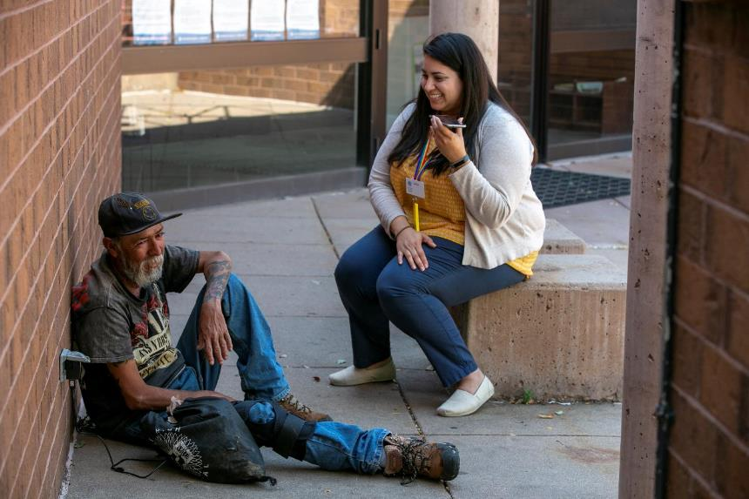
Denver Public Library, Community Resource Program
Provides access to peer navigators to help community members by providing support and connecting them to public services
Photo courtesy: Giles Clasen
Notes:
One of the most impactful programs that we learned about is the Denver Public Library’s Community Resource Program. This was originally designed to help with patrons who were experiencing homelessness, and as the opioid epidemic became more prevalent, the library shifted to also work with patrons on opioid-related issues.
A powerful aspect of the Denver program is that it includes the use of peer navigators. These peer navigators are staff members who have what is called “lived experience.” They may have formerly experienced homelessness, or addiction themselves, and now they have an opportunity to work helping others. They are able to use their experiences to connect to people and provide access to services that the library and their partners offer.
These peer navigators go out and meet people and introduce themselves and look for opportunities to provide some support. Some days this could be with giving them access to a phone to make a call, or it may be connecting them to a local shelter or housing assistance. And sometimes, they are literally just someone to talk to. With compassion and patience.

Slide 40
“Library is a growing organism.”
(Ranganathan 1931)
Image: https://www.flickr.com/photos/pamontgo/15696166320/ by Andy Montgomery / CC BY-SA 2.0
Notes:
Image: https://www.flickr.com/photos/pamontgo/15696166320/ by Andy Montgomery / CC BY-SA 2.0
Ranganathan, S. R. 1931. The Five Laws of Library Science. London: Edward Goldston, Ltd.

Slide 41
References
Association of College and Research Libraries. Academic Library Impact on Student Learning and Success: Findings from Assessment in Action Team Projects. Prepared by Karen Brown with contributions by Kara J. Malenfant. Chicago: Association of College and Research Libraries, 2017.
Barthel, Michael. “Around Half of Newspaper Readers Rely Only on Print Edition.” Pew Research Center, January 6, 2016, www.pewresearch.org/fact-tank/2016/01/06/around-half-of-newspaper-readers-rely-only-on-print-edition.
Blankstein, Melissa, and Christine Wolff-Eisenberg. “Ithaka S R US Faculty Survey 2018.” Ithaka S+R, April 12, 2019, 4. doi:10.18665/sr.311199
Buhler, Amy G., Tara T. Cataldo, Ixchel M. Faniel, Lynn Silipigni Connaway, Joyce K. Valenza, Randy Graff, Rachael Elrod, Samuel Putnam, Christopher Cyr, Christine Towler, Erin M. Hood, Robin Fowler, Brittany Brannon, Kailey Langer, and Shakiyl Kirlew. Researching Students’ Information Choices: Determining Identity and Judging Credibility in Digital Spaces. 2015-2018. IMLS Grant Project LG-81-15-0155. http://guides.uflib.ufl.edu/RSIC.
Constine, Josh. “Facebook Now Has 2 Billion Monthly Users... and Responsibility.” TechCrunch, June 27, 2017. https://techcrunch.com/2017/06/27/facebook-2-billion-users/.
Dempsey, Lorcan. “Environmental Trends and OCLC Research.” Presented at the University of Notre Dame, Notre Dame, Indiana, September 28, 2015. http://www.oclc.org/content/dam/research/presentations/dempsey/dempsey-notre-dame-oclc-research-2015.pptx.

Slide 42
References
Gary Pattillo. “Fast Facts.” College & Research Libraries News 77, no. 9 (2016): 472.
Gary Pattillo. “Fast Facts.” College & Research Libraries News 78, no. 1 (2017): 56.
Gary Pattillo. “Fast Facts.” College & Research Libraries News 79, no. 6 (2018): 340.
Hutt, Rosamond. “A Third of UK Internet Users Have Taken a Digital Detox – Do You Need One?” World Economic Forum, August 4, 2014. https://www.weforum.org/agenda/2016/08/a-third-of-uk-internet-users-have-taken-a-digital-detox-do-you-need-one/.
Ranganathan, S. R. The Five Laws of Library Science. London: Edward Goldston, Ltd., 1931.
Twenge, Jean. “This Is How the Smartphone Changed an Entire Generation.” World Economic Forum, August 30, 2017. https://www.weforum.org/agenda/2017/08/how-the-smartphone-changed-an-entire-generation.
White, David S., and Lynn Silipigni Connaway. Digital Visitors and Residents: What Motivates Engagement with the Digital Information Environment. 2011-2014. Funded by JISC, OCLC, and Oxford University. http://www.oclc.org/research/activities/vandr.html.
Zhang, Jie, and Nevin Mayer. “Proactive Chat Reference: Getting in the Users’ Space.” College & Research Libraries News 75, no. 4 (2014): 202-205

Slide 43
Thank You!
Lynn Silipigni Connaway, PhD
Senior Research Scientist
connawal@oclc.org
@LynnConnaway

