Slide 1
Works in Progress Webinar | 22 August 2019
Scaling Software Preservation and Emulation Services: Introduction to the EaaSI Program of Work
Seth Anderson
Software Preservation Program Manager, Yale University Library

Slide 2
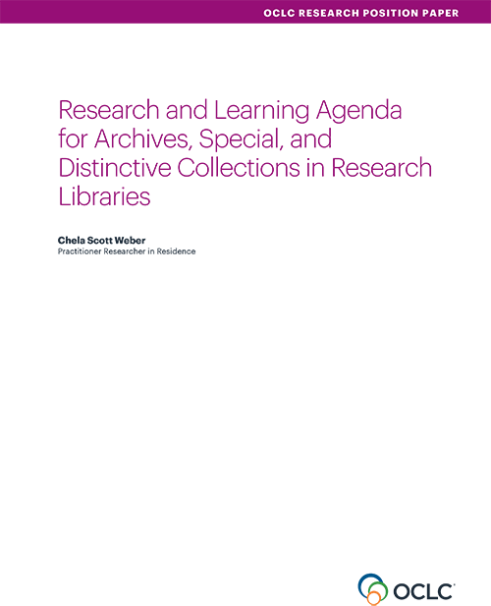
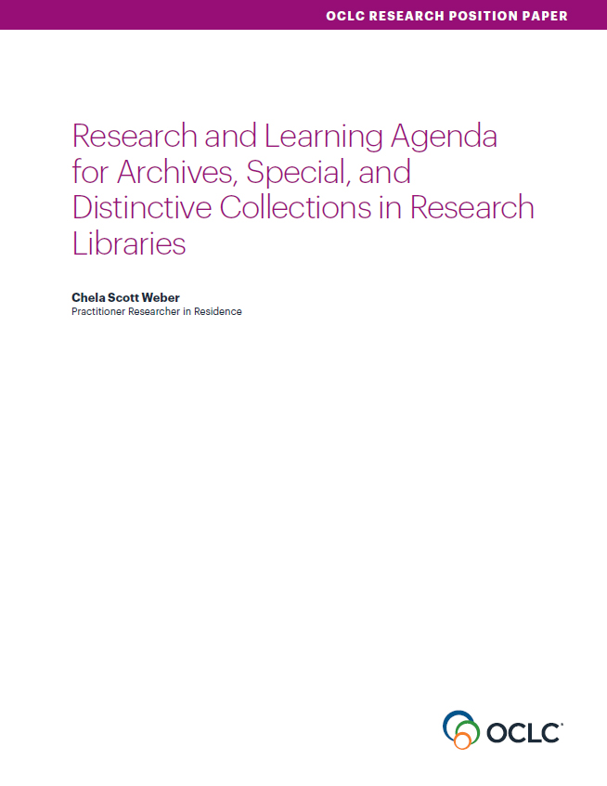
Our Work in Archives, Special, and
Distinctive Collections:
oc.lc/rlp-agenda
Notes:
OCLC Research has a long history of work in the area of archives, special, and distinctive collections in research libraries. We work in special collections because they are an important sight of knowledge creation, made possible by library’s commitment to the stewardship of their distinctive collections. The unique nature of material in special collections can make scaling a challenge, and we work to identify areas of common need and patterns of innovation to help libraries scale learning and expertise with these collections.
In October, we released the Research & Learning Agenda for Archives, Special, and Distinctive Collections.
articulates the shared challenges and opportunities research libraries are are facing in this sphere, and suggests approaches for working on them together.
The agenda will guide OCLC Research work in this area in the future, and we hope it will also serve to frame larger conversations and spur action across the field
This year, OCLC RLP will be presenting a number of webinars that respond to issue surfaced during our work on the agenda.

Slide 3
Access to Collections
“Our evolving collections, as well as increasingly sophisticated users and research methodologies, necessitate rethinking the goals and scope of our access and discovery systems.”
Notes:
Earlier webinar on CaD
Recent webinar on the CADRE project to give computational access to research data sets shows that this is an issue we’re grappling with across the library

Slide 4
Access Needs for Born Digital
“Access systems for born-digital records are in their infancy, and many practitioners feel overwhelmed by both the needs and possibilities of such systems.”
Notes:
Much work thus far has concentrated on capture of files from physical media and the actions necessary to ensure their authenticity and preservation. Work is needed now on all of the activities that come before and after the capture process, from appraisal and donor relations to reading room access.
Access is one of the key areas where work is needed.
Complex born-digital objects with many software dependencies might require emulation environments to be fully understood as research objects, while word processing documents may be best served in a similar way to digital surrogates."

Slide 5
Next Steps for Born Digital
“One person cannot be entirely responsible for a robust and responsible electronic records program. It must become a distributed responsibility, and all aspects of the archival enterprise must be reconsidered to account for this.”
Notes:
“What was an emerging need less than a decade ago is a vital and varied need now, with both nascent and mature programs puzzling through how best to collect, preserve, and make accessible born-digital archival records.”
Both explore a distributed model, across many institutions, to help address complex needs, reduce risk, and lighten the load of individual institutions.

Slide 6
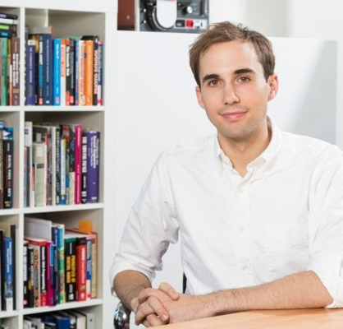
Seth Anderson
Software Preservation Program Manager,
Yale University Library

Slide 7



Scaling Software Preservation and Emulaton Infrastructure
An intro to the EaaSI program of work
Seth Anderson, Yale University Library
OCLC Research Library Partnership
Works in Progress Webinar
August 22, 2019

Slide 8
What is
Emulation-as-
a-Service?

Slide 9








Simplifies access to various emulators
EaaS
Notes:
The software uses a variety of open source emulators in the backend

Slide 10
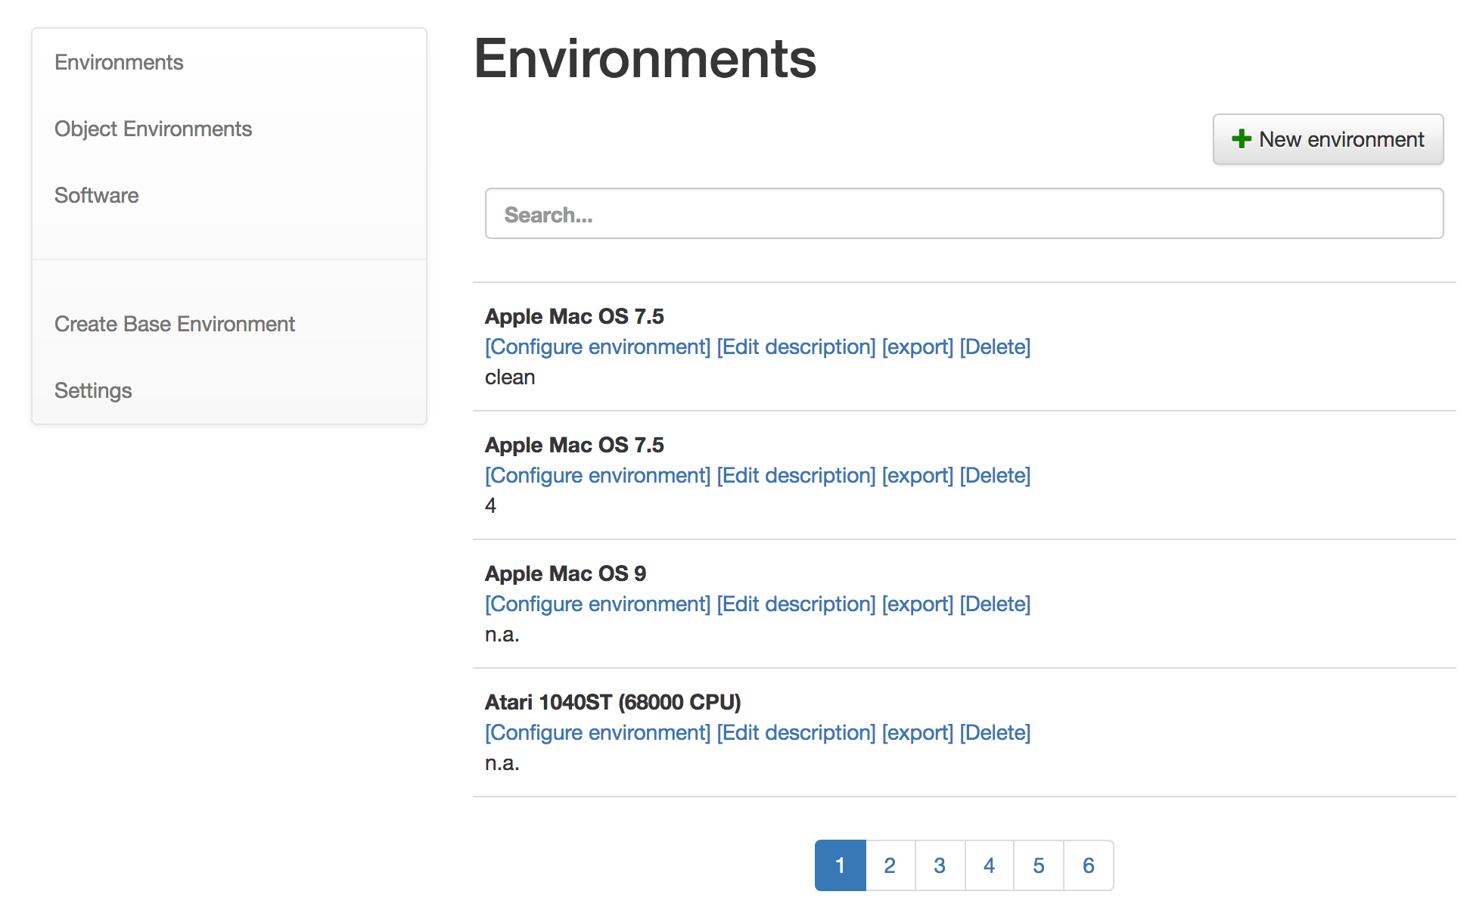
Enables management of persistent emulation environments
Notes:
Users are able to save and return to emulation environments

Slide 11
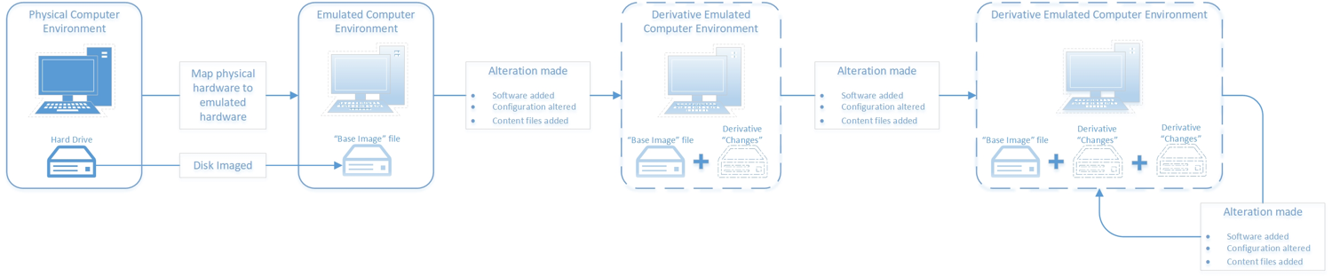
Enables economies of scale by managing disk images
Notes:
Also manages generation of underlying disk images and derivatives - limiting the overall storage requirements of emulation

Slide 12

Notes:
The team at Freiburg’s work over the last decade is incredible
But implementing EaaS at an appropriate scale still faces numerous hurdles
Enter the EaaSI project
Emulation-as-a-Service Infrastructure

Slide 13


Distributed Mgmt
A network of distributed nodes, each contributing to the EaaSI service and the software development roadmap.
Notes:
Establishing a community around the use of emulation

Slide 14

EaaSI Nodes
Carnegie Mellon University
University of Virginia
University of Notre Dame
UC-San Diego
Stanford University
Apply to be a node this Fall!

Slide 15

Sharing
In-network sharing of software installation materials and configured environments.
Yale University Library will contribute at least 3000 pre-configured software applications running in configured environments.

Slide 16

Documentation/
Discovery
Incorporating services developed by Wikidata for Digital Preservation
Comprehensive, open, machine-readable documentation
Defining profile for description of software and computer environments
Notes:
Generating metadata specification to support discovery and improve overall documentation related to computer history and enable system functionality
Plan to contribute as much as we can to Wikidata knowledge base - making linked open data

Slide 17
Software Family | Open Office
Software Family Version | 1.1
Software Product | OpenOffice.org Drawing
Software Product Version | 1.1.2
Date Published | 2004
Developer | Sun Microsystems
Configured Language | English
File Format (Read) | Text documents, Spreadsheets, Presentations, Drawings, Web pages, Master documents, Formulas, OpenOffice.org 1.0 Text Document (*.sxw), OpenOffice.org 1.0 Text Document Template (*.stw), Microsoft Word 97/2000/XP (*.doc) Microsoft Word 97/2000/XP Template (*.dot), Microsoft Word 6.0/95 (*.doc), Microsoft 95 Template (*.dot)...
More examples at bit.ly/eaasi_metadata_example
EaaSI - Example Metadata

Slide 18
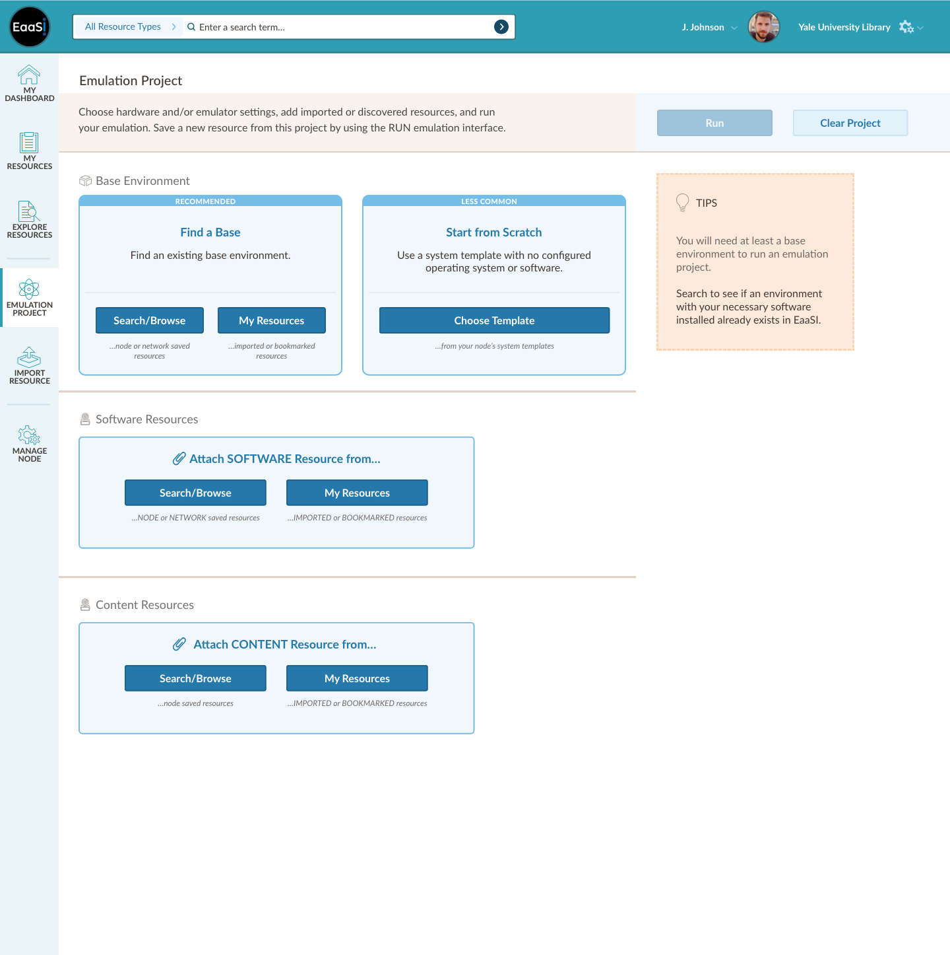
EaaSI UI Wireframe

Slide 19

Access
Emulated CD-ROM environment sharing service
Virtual Reading Rooms Service
Scientific Software Portal
API to automatically render objects in original software via emulation
Notes:
Creating multiple services on top of the underlying EaaSI infrastructure to illustrate application of emulation for access in various disciplines/use cases

Slide 20

Our Team
Euan Cochrane Principal Investigator
Seth Anderson Program Manager
Ethan Gates Software Preservation Analyst
Klaus Rechert & Oleg Stobbe (OpenSLX) Technical Architecture and Development
PortalMedia UX/UI Development
Jessica Meyerson (Educopia/SPN) Communications/Outreach
Kat Thornton (Data Current/WikiDP) Semantic Architect

Slide 21
Fair use applies to institutions making software available on a cooperative basis to broaden research opportunities, including off-premises access using technology such as Emulation as a Service…
– ARL Code of Best Practices in Fair Use for Software Preservation
Notes:
Quick point on the legal context of the EaaSI Network service
REcent work at UVA, with the support of Association of Research Libraries, included definition of a best practice for the type of network framework established by EaaSI
According to the legal experts making and vetting these recommendations, fair use should cover the exchange of proprietary software in the EaaSI framework

Slide 22

Project planning and requirements gathering
EaaSI beta release and testing
UI development and UVI prototype
Phase 1 (Jan-Jun 2018)
Phase 3 (Jan-Mar 2019)
Phase 5 (Jul-Sep 2019)
Phase 2 (Jul-Dec 2018)
Phase 4 (Apr-Jun 2019)
EaaSI Network prototype development
Public sandbox and beta update
Notes:
IN the next three months we plan to turn our focus to UX/UI improvements
With new vendor partners PortalMedia
Will also continue work with partners to test and review review Network functionality
Student workers are now beginning to configure environments within Yale’s EaaSI node

Slide 23
Project planning and requirements gathering
EaaSI beta release and testing
UI development and UVI prototype
Phase 1 (Jan-Jun 2018)
Phase 3 (Jan-Mar 2019)
Phase 5 (Jul-Sep 2019)
Phase 2 (Jul-Dec 2018)
Phase 4 (Apr-Jun 2019)
EaaSI Network prototype development
Public sandbox and beta update
Notes:
IN the next three months we plan to turn our focus to UX/UI improvements
With new vendor partners PortalMedia
Will also continue work with partners to test and review review Network functionality
Student workers are now beginning to configure environments within Yale’s EaaSI node

Slide 24
Project planning and requirements gathering
EaaSI beta release and testing
UI development and UVI prototype
Phase 1 (Jan-Jun 2018)
Phase 3 (Jan-Mar 2019)
Phase 5 (Jul-Sep 2019)
Phase 2 (Jul-Dec 2018)
Phase 4 (Apr-Jun 2019)
EaaSI Network prototype development
Public sandbox and beta update
Notes:
IN the next three months we plan to turn our focus to UX/UI improvements
With new vendor partners PortalMedia
Will also continue work with partners to test and review review Network functionality
Student workers are now beginning to configure environments within Yale’s EaaSI node

Slide 25
Project planning and requirements gathering
EaaSI beta release and testing
UI development and UVI prototype
Phase 1 (Jan-Jun 2018)
Phase 3 (Jan-Mar 2019)
Phase 5 (Jul-Sep 2019)
Phase 2 (Jul-Dec 2018)
Phase 4 (Apr-Jun 2019)
EaaSI Network prototype development
Public sandbox and beta update
Notes:
IN the next three months we plan to turn our focus to UX/UI improvements
With new vendor partners PortalMedia
Will also continue work with partners to test and review review Network functionality
Student workers are now beginning to configure environments within Yale’s EaaSI node

Slide 26
Project planning and requirements gathering
EaaSI beta release and testing
UI development and UVI prototype
Phase 1 (Jan-Jun 2018)
Phase 3 (Jan-Mar 2019)
Phase 5 (Jul-Sep 2019)
Phase 2 (Jul-Dec 2018)
Phase 4 (Apr-Jun 2019)
EaaSI Network prototype development
Public sandbox and beta update
Notes:
IN the next three months we plan to turn our focus to UX/UI improvements
With new vendor partners PortalMedia
Will also continue work with partners to test and review review Network functionality
Student workers are now beginning to configure environments within Yale’s EaaSI node

Slide 27
Project planning and requirements gathering
EaaSI beta release and testing
UI development and UVI prototype
Phase 1 (Jan-Jun 2018)
Phase 3 (Jan-Mar 2019)
Phase 5 (Jul-Sep 2019)
Phase 2 (Jul-Dec 2018)
Phase 4 (Apr-Jun 2019)
EaaSI Network prototype development
Public sandbox and beta update
Notes:
IN the next three months we plan to turn our focus to UX/UI improvements
With new vendor partners PortalMedia
Will also continue work with partners to test and review review Network functionality
Student workers are now beginning to configure environments within Yale’s EaaSI node

Slide 28
Learn more
Register at bit.ly/eaasi-webinar-series-registration
EaaSI Webinar Series
Sept 12 and Oct 10
SPN Stacktrace Newsletter
Open Source
Software Sandbox
Call for new node partners
Sign up at bit.ly/spn_stacktrace
At bit.ly/eaasi_sandbox
Fall 2019
1
2
3
4

Slide 29


A Very Special Thanks to our Funders...
Notes:
A huge thanks to our funders
Mellon Foundation and Sloan Foundation
For their generous support

Slide 30
Thanks!
You can find me at
@sth_rbrt & seth.r.anderson@yale.edu
And more EaaSI at
softwarepreservationnetwork.org/eaasi
And follow our hashtag on Twitter at #eaasi

