Slide 1
Where’s the Instructor? Effective Design for Asynchronous Learning
Betha Gutsche, WebJunction Programs Manager, OCLC
CE Forum, August 20, 2019

Slide 2

Agenda
Morning
Welcome and introductions
What’s good about asynchronous learning?
Instructional design – the basics
Embedding the instructor in self-paced design
Afternoon
Embedding the instructor in self-paced design (continued)
To quiz or not to quiz?
Augmenting the learning experience
Closing
Image: Coffee on Pixabay

Slide 3

Who’s in the room?
Share something you’ve learned recently
and how you learned it

Slide 4
What’s Good About
Asynchronous Learning?
Notes:
Re: definition of asynchronous
Asynchronous simply means “not occurring at the same time”
***ASK: is a webinar synch or Asynch?

Slide 5

Training formats
Face-to Face
Live Online
Asynchronous Instructor-led
Self-Paced
Image: Spotlight on Pixabay
Notes:
From f2f to live-online to self-paced – the continuum
Comparison of training formats: f2f, live-online, asych instructor-led, self-paced;
*E-Learning Modes on WJ: https://www.webjunction.org/documents/webjunction/elearning-modes-webjunction-2014.html
Focus on S-P for this workshop because it’s the most demanding; ***clarify: this is asynchronous without the instructor

Slide 6
Self-Paced Learning is AWESOME!
Seriously DISagree!
Totally
agree!
Notes:
***activity: E-learning is awesome! Rating: totally agree, seriously disagree; somewhere in the middle?
stand on one side or the other (no neutral);
Disagree side tell other side why; Agree side respond to each negative with a positive

Slide 7
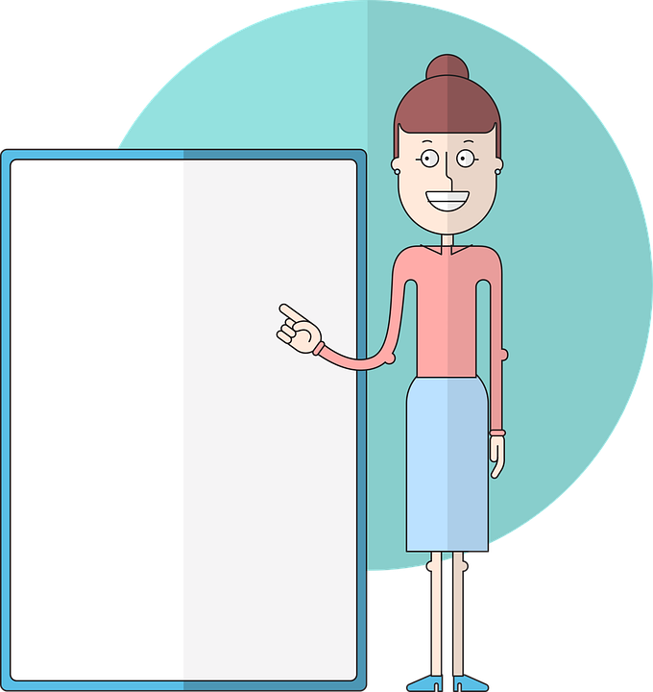
Advantages of self-paced learning
Administrative Perspective
Saves time and money
Cost-effective coverage
Provides consistent instruction delivered across a system or state
Image: by GraphicMama Team on Pixabay
Notes:
Admin perspective can still come from a negative mindset: “we’re doing self-paced because we can’t afford f2f

Slide 8

Advantages of self-paced learning
Learner Perspective
Convenient: fits with individual schedules; 24/7 365 access
Accommodates different learning styles
Allows autonomy
Equalizing
Image: by GraphicMama Team on Pixabay
Notes:
For learners
Convenient to learner, learn when it fits with individual schedules; 24/7 365 access
Accommodates different learning styles: learning at different speeds, levels; skim or dig deep; go through the same learning content multiple times; easy to go back and refresh on key points; better ability to focus, avoid “distractions” of the classroom
Allows autonomy: learners have more control over how they progress through the content
Equalization: 1) Supports introverts, those who need time to absorb and reflect; 2) equalizing effect of forum discussions; access to quality content and great teachers for all learners

Slide 9
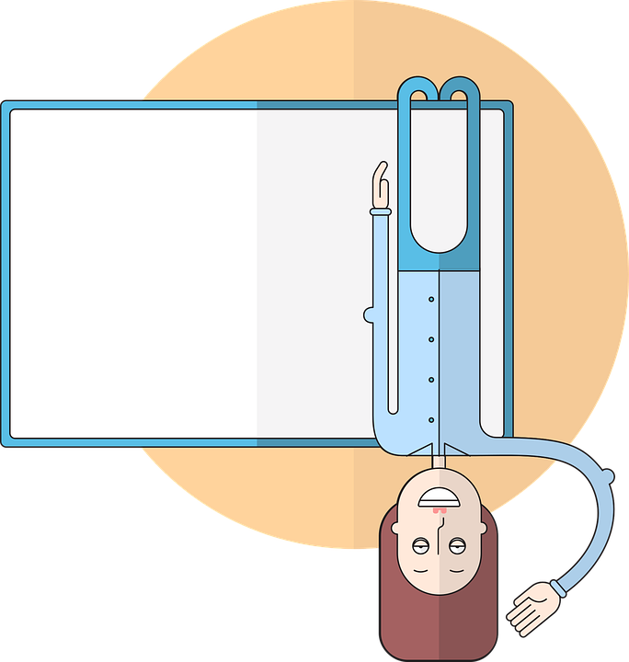
Advantages of self-paced learning
Environmental Perspective
Uses 90% less electricity
Reduces CO2 emissions by up to 85% per student
-Open University Study, 2013
E-learning is eco-friendly!!!
Image: by GraphicMama Team on Pixabay
Notes:
***question from survey: “When is asynchronous learning a poor choice?”
What do you think? Let’s discuss
It may need to be blended with live online or f2f
Environment
https://www.flicklearning.com/assets/images/blog/2015/Is-elearning-environmentally-friendly-infographic.pdf

Slide 10
Instructional Design – the Basics

Slide 11
The instructional designer crafts
a learning experience that guides the learner through a relevant context
to make decisions applicable to
their real-world work.
(paraphrased from Tom Kuhlman, Rapid E-Learning Blog)
Notes:
*Tom Kuhlman, Rapid E-Learning Blog: https://blogs.articulate.com/rapid-elearning

Slide 12


What do we know about adult learners?
Self-directed;
autonomous
Connect to past
experience
Need relevance
Task-oriented; learn by doing
Application to real world
Notes:
Adult learners:
Self-directed: adults are accustomed to moving through the world with some level of autonomy; they appreciate opportunities to explore.
Daniel Pink: Drive –autonomy is one of 3 primary motivators
Past experience: adults bring a rich array of past experiences to any new situation; the brain learns most powerfully when it can connect new information and concepts to that which is already known and understood.
Relevance: adults need to know why the new information is relevant; how it will make their lives and work better.
Task-oriented: everyone—not just adults—learns by doing. Being able to practice or apply new information, including making mistakes, is the most effective way to solidify the learning.
Immediate application: especially in workplace learning, adult learners want to be able to apply new knowledge immediately for problem-solving
***activity: ask: for f2f, how do you design for adult learner?;
write on FLIP CHART;
***ask which of these could you do in self-paced?

Slide 13
A fresh take on learning styles
Active learners
like hands-on activities
Sensitive learners
more interested in facts
Visual learners
like images, videos, graphs, diagrams
Sequential learners
prefer linear storytelling
Reflective learners
need time to process
Intuitive learners
more interested in concepts
Verbal learners
like to rephrase learning in own words
Global learners
prefer to see big picture first
Active learners
like hands-on activities
Sensitive learners
more interested in facts
Visual learners
likes images, videos, charts
Sequential learners
Prefer linear storytelling
Notes:
Familiar learning styles: visual, auditory, kinesthetic
A different angle:
Active and reflective learners. Active learners thrive in a situation with hands-on activities, while reflective learners need time to process new information on their own.
Sensitive and intuitive learners. Sensitive learners tend to be more interested in facts, while intuitive learners typically show interest in abstract concepts and need to find connections between concepts.
Visual and verbal learners. While a visual learner will prefer to engage with videos, images or charts, a verbal learner will retain information if they rephrase it in their own words.
Sequential and global learners. Sequential learners retain information more effectively when linear storytelling is used. On the other hand, global learners need to see the big picture first and can then learn about the details.
Not entirely either/or –not trying to put people into categories; more about considering a variety of ways that people learn
Source: Understanding Learning Styles: https://www.lambdasolutions.net/blog/science-of-elearning-understanding-how-learners-engage-with-content#

Slide 14

Design from empathy
“Great designers are great empathizers.
It’s what separates a design that has soul from one that’s simply
well-realized.”
⎯Paul Backett, Industrial Designer
Notes:
General idea of user-centered design
Empathy involves more than just analyzing an audience or users, assessing their learning needs
You are attempting to understand what it is like to be in their job and to have their challenges.
Trying to understand the universe of your target audience
Empathy may even involve collaborating and co-designing with the audience. ---prototyping and revising
Invoke this every step of the way
Paul Backett quote: https://www.core77.com/posts/20375/research-learning-extreme-empathy-by-paul-backett-20375
Image from Pixabay: https://cdn.pixabay.com/photo/2019/05/05/22/59/empathy-4181896__340.png

Slide 15


Work
with the elephant
Rider:
the conscious, verbal, thinking brain
Elephant:
the automatic, emotional, visceral brain
Notes:
Elephant-rider metaphor
The metaphor describes how our unconscious capacities guide and control our conscious cognitive deliberations.
Origin: Jonathan Haidt professor of social psychology at the University of Virginia who studies morality and emotion. Book: The Happiness Hypothesis
Elephant is the emotional side –responding in terms of deep-seated emotions like fear, insecurity, desire to be liked, included; likes immediate gratification
Rider is the rational side – thinking long-term, planning, deferring gratification for larger goals
Rider may seem to be in control but in reality they are outmatched by size and weight of the elephant
SME & designer tendency: talk to the rider = information dump, comprehensive coverage, lists to memorize (commands, policies, etc.)
Important to develop learning strategies to design for and motivate the elephant

Slide 16
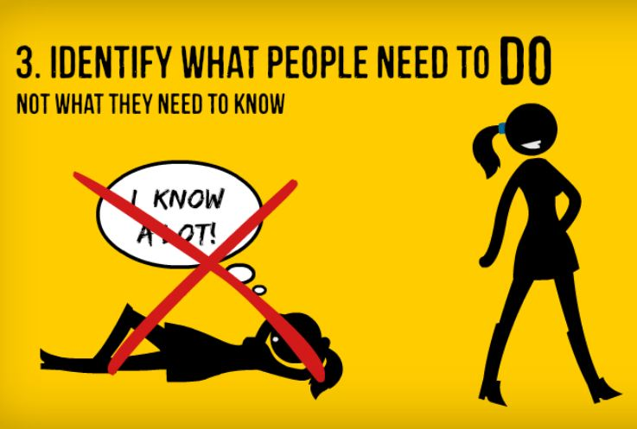
Learning objectives
Rule
of
thumb
Image from Training Designer’s Guide ebook by Cathy Moore
Notes:
From Cathy Moore ebook: Training Designer’s Guide to Saving the World: https://s3.amazonaws.com/cathymooremedia/training-designers-guide.pdf

Slide 17

The Good Learning Objective
“As a result of this course, learners will be able to...”
Understand how libraries use learning circles
Plan and implement learning circles at their libraries around topics of interest to their patrons
Yawn
Yay!
Notes:
Writing learning objectives:
Identify the learning gap –what knowledge, skill, motivation does the learner need to acquire
Emphasize what learner will be able to DO; use of action verbs
NOT an outline, NOT linear; NOT a 1:1 relationship with the content
***activity: write at least one LO for your topics
***Popcorn example sharing

Slide 18
Embedding the Instructor in Self-Paced Learning

Slide 19
4 Key Principles
1
Guide the learner
Show rather than tell
Provide a relevant context to connect the learning to the real world
Design experiences not information
2
3
4
Notes:
Guide the learner
What do learners need to do? How to allow them to practice “doing” in the course
Application in the real world of the learner’s work
Experiences that are memorable; standalone info is not
These align with characteristics of adult learners
They include strategies to reduce cognitive load on the learner
This is all strategy to embed the instructor into the design of the course

Slide 20
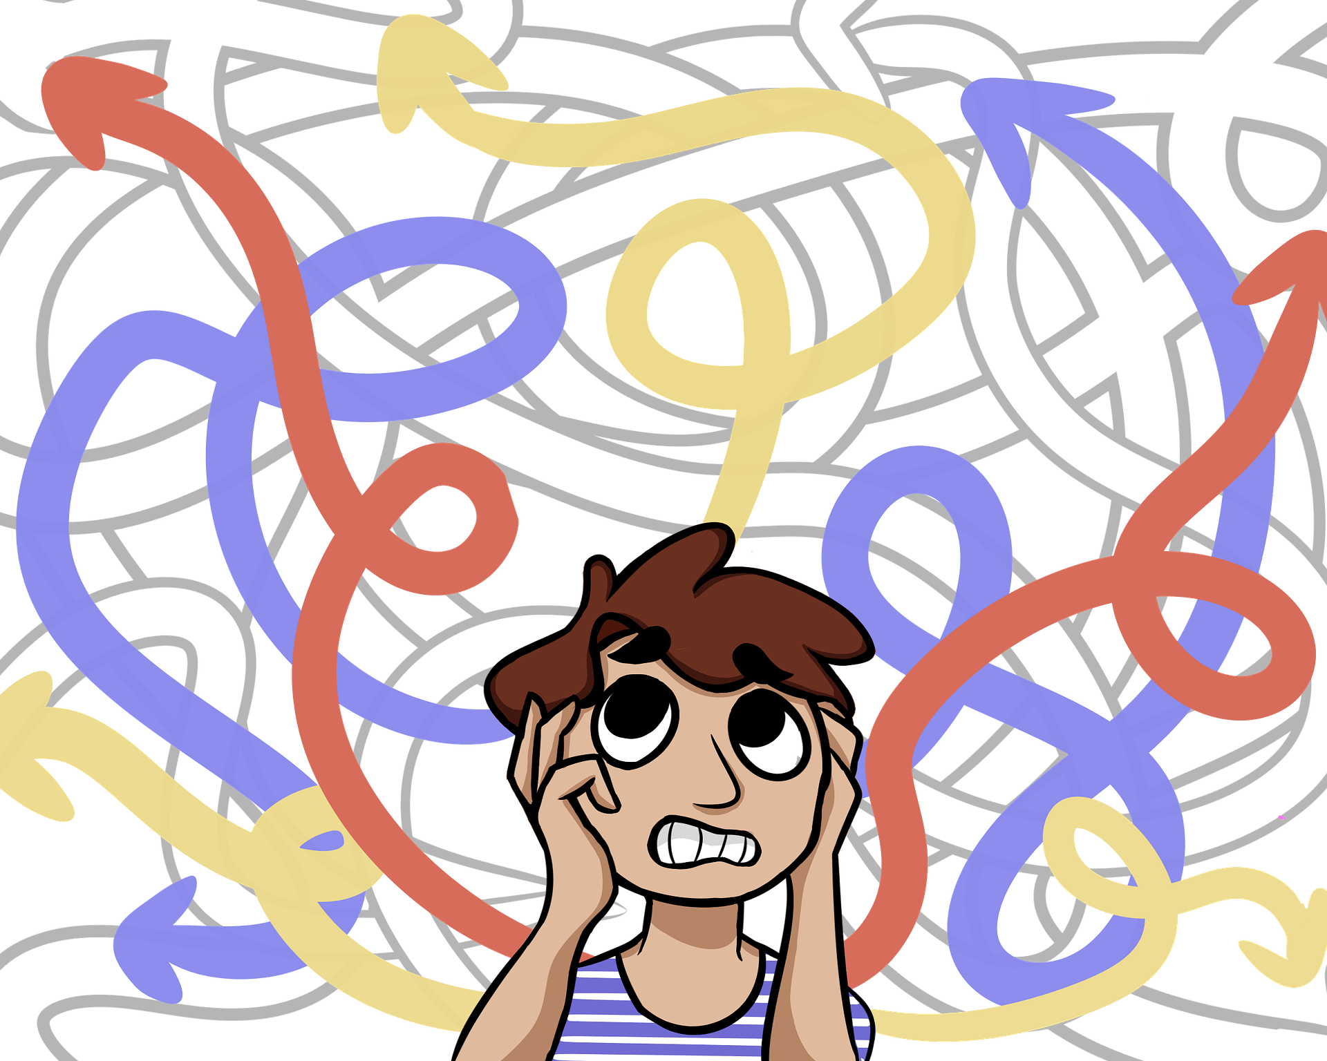
Guide the learner
1
and beware of
cognitive overload
Image: by Mmillustrates on Pixabay
Notes:
It’s always critical to provide a clear learning path for the user.
We are often tempted to include everything we know about a topic, to pile on resources and multiple aspects to make sure the learner doesn’t miss any gems of knowledge
This is what Heath brothers refer to as the “curse of knowledge”
AND this can result in cognitive overload
“Cognitive Load Theory suggests that if the cognitive load exceeds our processing capacity, we will struggle to complete the activity successfully.”
Brain-fry on Pixabay: https://pixabay.com/illustrations/unordered-chaos-3192273/

Slide 21
Find the 20%
What the topic landscape covers
What are additional resources
What there’s time to cover
Focus on what’s most critical for the learner to be able to apply what they’re learning
What they’ll remember
What they’ll USE
DESIGN STARTS HERE
Adapted from Bozarth, J. (2008). From Analysis to Evaluation: Tools, Tips, and Techniques for Trainers
Notes:
When designing training, it’s customary to start outlining the topic, which results in a linear progression of information
Instead, start at the center –based on learning objectives, what will provide the knowledge and skills learner need to actually apply the learning?
focus on what’s most important; not overwhelm them with info and choices
Build the course around that core
You may end up scrambling the order of your original outline
This may reduce the content to about 20% of where you started. Build the course around that 20%
What to do with other 80%?
Some of it will be “as needed” information to support activities
Provide “deeper dive” pathways (additional resources) for the learners who want to go deep into a topic
Put it into another training – may have started with way too much for one training
***group activity
Using the sample outline for Project Ready
Break it down
what is one objective; what do you want learners to be able to do?
To achieve that objective, what’s the most essential knowledge or skill that you need to convey?

Slide 22
Simple clarity
Organize it
first
then this
and next
…finally
Make it BOLD
or
Underlined
Point
1
at it
2
3
ZOOM in on it
4
Notes:
MORE strategies for guiding the learner and easing cognitive load
You don’t need fancy graphics or interactions to direct the learner’s attention to what’s important
Signal what’s important by bolding, underlining, zooming in.

Slide 23


Chunk the content
Click on a planet
for one bite-size bit of information
Notes:
Breaking content into smaller chunks is another strategy for avoiding overloading working memory; the smaller chunks are easier to commit to memory
It’s a simple idea but there is some structure to the chunks
In Brain Rules, Dr. John Medina suggests gearing content chunks for the average 10-minute attention span.
But this is not a rigid rule
Ex: videos or recorded webinars: break 1-hr into shorter segments but if a topic needs more time, go with it
The segments should be organized and clear how they relate to the overall topic
Sorting items into categories is a form of chunking
Emphasize the continuity of the chunks --define patterns or similarities
In self-paced content structure, the chunks can each branch off from a main page that the learner keeps coming back to
Review each chunk before moving to the next
Planet demo: https://storylinec.s3.eu-central-1.amazonaws.com/SLC+%23235/story_html5.html

Slide 24

Scaffolding and sequencing
Image: Achievement by Tumisu on Pixabay
Notes:
Scaffolding aids the learner in the construction of new knowledge
Scaffolding: moving the learner progressively toward stronger understanding of the subject
Sequencing, a form of scaffolding, can help students to learn independently, without necessarily needing the help of their teacher for each stage
supports to move learner from where they are to where they need to be:
Start with simple examples, gradually increase the complexity
Cover one big concept at a time …and breaking it down (chunking)
Describe processes or concepts in multiple ways
***examples: Early Literacy Planning Tool for Supercharged Storytimes, which presented a large body of information one concept at a time with multiple entry points
Newbie: pick ONE strategy and try it
Some exp: check the things already doing and try something new
More exp: be more intentional about what already doing; devise your own strategies that achieve the defined early literacy goal
And remember the elephant!!
***retrieval practice: write down the 5 characteristics of adult learners without looking at your notes

Slide 25
☺ LUNCH ☺

Slide 26
Embedding the Instructor in Self-Paced Learning
Continued…

Slide 27
5-Minute Design

Slide 28
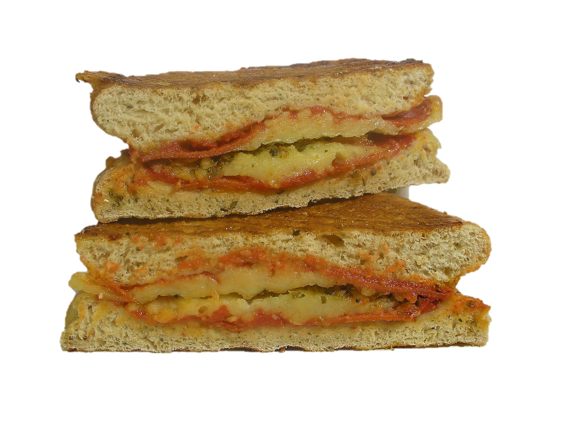
How to make a toasted cheese sandwich
DRAW instructions for someone who has never made a toasted cheese sandwich before
Work together at each table
You have 5 minutes
Image: Toast-Heat-Sandwich by mp1746 on Pixabay
Notes:
Based on How to Make Toast challenge?
https://www.drawtoast.com/gallery.html#.XUSkhHtlA2w
How to visualize a process for clarity and understanding, without sacrificing unique and important attributes.
Directions:
Each table work together to create instructions for how to make a toasted cheese sandwich
FOR someone who has never done this before (think of a visitor from a very different culture, such as a Amazon Rain Forest tribal member
***Large Post-it
Use drawings rather than text
You have 5 minutes
***What questions do you have before we begin?

Slide 29
Critique the instructions
What’s missing?
Where do you need more detail or information?
Where is there too much information?
What would you omit?
Write comments on the drawings
Image: Toast-Heat-Sandwich by mp1746 on Pixabay
Notes:
Hand your instructions to another table
That table will review instructions and ID where they need more instruction (or TMI)
Write notes on the instructions
3-5 minutes
Hand back to originator table
DEBRIEF - you just practiced the second principle (SHOW rather than tell)
Working with constraints, you have to get creative and focus on what’s essential

Slide 30
Show rather than tell
2
Use the power of images and graphics
Use short videos from subject matter experts
Create how-to tutorials that demonstrate a process
Notes:
Draw on the power of images to convey information and to tap into emotions.
Literally embed the instructor in the course through videos …but keep them as short and chunked as possible
Create how-to tutorials that demonstrate a process; think of al the YouTube videos we use for just-in-time learning

Slide 31
Show it! Make it actionable
2
Example:
How to replace printer ink
Putting ink cartridges in a Canon printer
Open the ink tray in the center of your printer. Make sure the printer is plugged in and turned on. The cartridge holder will slide into the middle of your operations tray when you open the operation lid on top of the printer.
Remove existing ink cartridges from the printer. Press down on the ink cartridge you want to remove. The cartridge lock lever will click, dislodging the cartridge. Pull it the rest of the way out.
Insert your new ink cartridges. Gently slide the new cartridge into the ink slot with the ink nozzles facing away from you.
Notes:
Trying to tell all about a process with text is a recipe for losing learner attention and losing learner success;
That’s why most “how to assemble” instructions are mostly pictures and diagrams
Example: how to clear a printer jam: Wikihow: https://www.wikihow.com/Clear-a-Paper-Jam

Slide 32



Show it! And make it actionable
Example:
How to replace printer ink
Images from https://www.wikihow.com/Put-Ink-Cartridges-in-a-Printer
Notes:
Show it clearly with photos, illustrations and diagrams
help learners be able to practice the action(s) to gain skill or knowledge
This may seem obvious for self-paced learning. But I’ve encountered many courses that involve reading and reading screen after screen –now showing, no doing
Example: https://www.wikihow.com/Put-Ink-Cartridges-in-a-Printer

Slide 33
Show it! And make it actionable
Example:
How to replace printer ink
Lift the lid to open the ink tray in the center of your printer.
Remove existing ink cartridges from the printer.
Insert your new ink cartridges.
Images from https://www.wikihow.com/Put-Ink-Cartridges-in-a-Printer
Notes:
It’s not all show and NO Tell –the combination of image and text is powerful
Even better to combine text and images = ***DUAL CODING
Pictures alone don’t allow for important details
WikiHow does this effectively
Example: https://www.wikihow.com/Put-Ink-Cartridges-in-a-Printer

Slide 34

Provide a relevant context
3
Connect learning
to the real world
Use problem-based strategies
Photo: reference librarian helps a patron by NJLA on Flickr CC BY-NC-ND 2.0
Notes:
Cognitive-Load theory:
We make sense of new material by referencing mental models of pre-existing knowledge.
The brain organizes new information around this pre-existing knowledge.
The more context you can provide to something already familiar, the better the learner will be able to integrate new knowledge.
So help the learner construct new mental models by connecting learning to something already familiar with, on the job or in personal life
Metaphors and analogies are helpful for connecting more abstract information to something familiar and concrete.
Try to make experiences personal and relatable.
Example: Supercharged emphasis on “you already do great storytimes”
Photo: reference librarian helps a patron by NJLA on Flickr: https://www.flickr.com/photos/njla/4014538946/

Slide 35
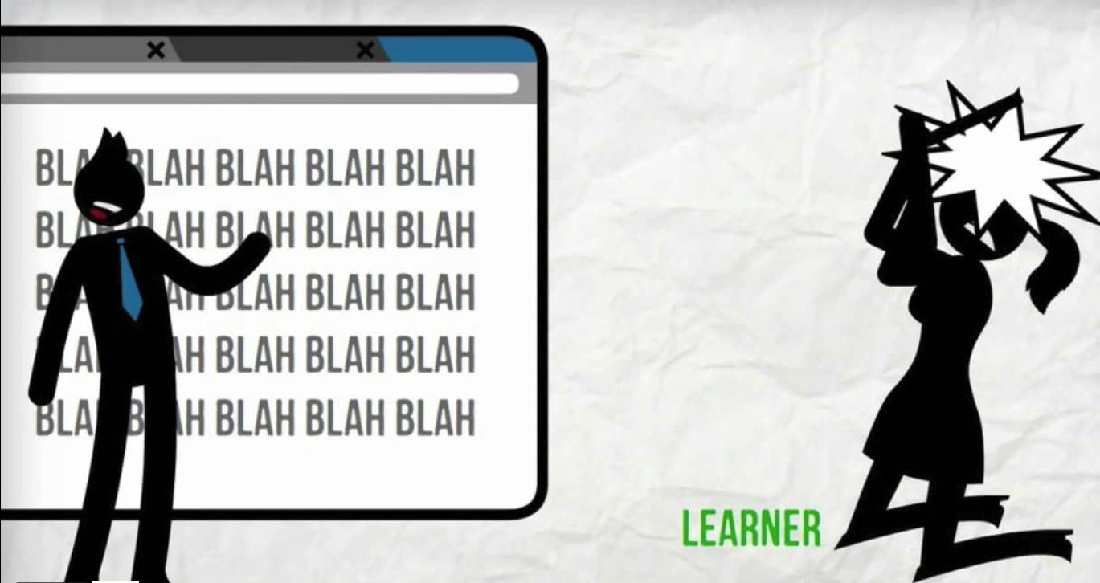
Design experiences not information
4
TMI!
Image screenshot from Save the World video by Cathy Moore
Notes:
The fourth principle is closely related to the third
There is too much instruction that comes in the form of an information fire hose ----blah blah blah
Remember cognitive overload
Provide learning experiences that allow for the application of new information; testing the new mental models
Adult learner characteristics ---Adults (everyone) learn by doing; they are task-oriented AND they like autonomy
Blah blah blah does not honor autonomy
Ask learners to do the actual thing they are learning, practice
In real situation
Or simulated situation with peers

Slide 36
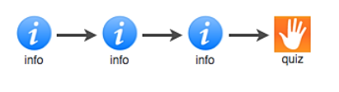
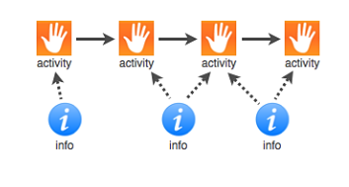
Linear, information-based
Activity-based, information as needed
Image from Training Designer’s Guide ebook by Cathy Moore
Notes:
Goal is not to stuff people with knowledge but to help them take action
Move away from linear, information-based training (info > info > info > quiz) to scenario and activity-based learning, with information provided as needed.
problem-based learning has been shown to enhance learner control over their learning, increase content retention, and improve attitudes toward learning.
SO… create activities –i.e., challenges or problems to solve;
make information an optional part of the activity for the user to access as needed (help and learning supports).

Slide 37
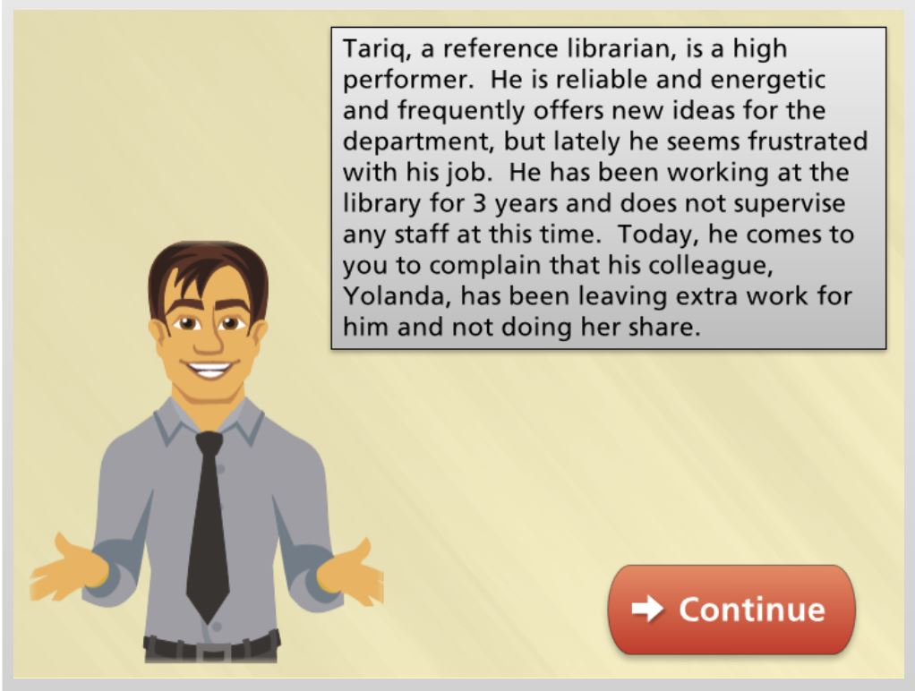
Creating scenarios – the story
The Situation
Define the objectives.
Identify the situation.
Identify the problem.
Identify a realistic trigger event.
Define the choices.
Image screenshot from Providing Constructive Employee Feedback, WebJunction course
Notes:
These problem-based activities are often presented as scenarios
Create challenges or problems to solve that are based on actual situations the learner may encounter on the job.
Provide access to information, help and learning supports as the user needs the resources to make decisions in the scenario.
Define the objectives. What do you want students to learn by working through the scenario?
Identify the situation. Describe a real-life situation in which learners could apply the intended objective.
Identify the problem. The primary goal of a scenario is to teach learners how to resolve a problem. Select the problem/challenge that best addresses the objectives and that will be appealing and relevant to learners.
Identify a realistic trigger event. The trigger event is the conflict or crisis that arises in the scenario, the point at which the learner has to choose how to respond.
Define the choices. Typically, 3-5 choices are offered for each trigger event. One will be the optimal choice, with the other two being less desirable choices. Aim to craft choices that really challenge the learner to think; avoid overly obvious wrong choices.

Slide 38
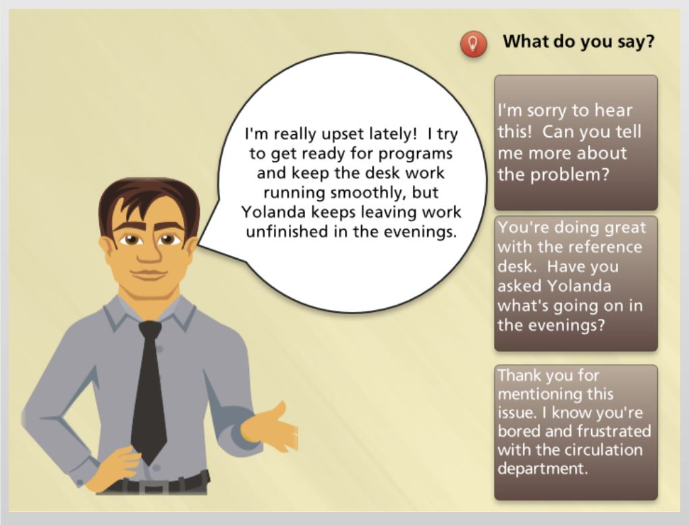
The Trigger
1
The Choices
2
3
Image screenshots from Providing Constructive Employee Feedback, WebJunction course
Notes:
Aim to craft choices that really challenge the learner to think; avoid overly obvious wrong choices.

Slide 39
Creating scenarios – basic structure
Choice
Consequence
Challenge
Choice
Consequence
Choice
Consequence
Notes:
Structure: Challenge > Choices > Consequences

Slide 40
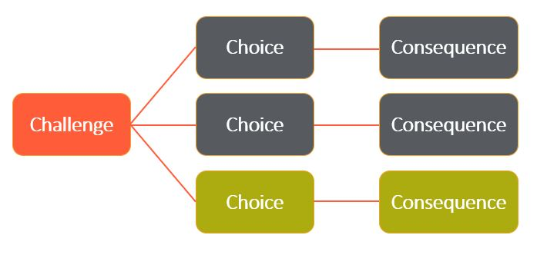

Branching scenarios
This could go on forever!
Notes:
Branching scenarios can get way too complicated by the third level. See the resource list for more in-depth on branching scenarios

Slide 41
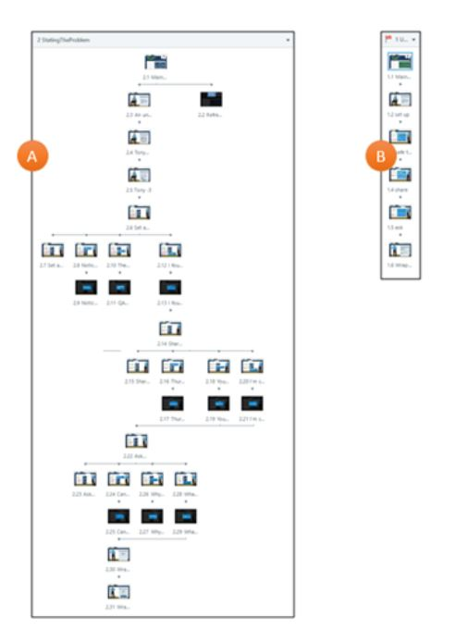
A note about course authoring tools
Interactions built in
PowerPoint
Interactions built in Storyline
Notes:
Mention tools like Articulate
Instructional design is not necessarily tech-driven
Refer to workbook for list of tools

Slide 42
To Quiz or Not to Quiz?
Quizzes, application, and self-reflection

Slide 43

Rethinking quizzes – the power of recall
Retrieval practice
Brain dump on paper
Low-stakes quizzes
flashcards
“Self-testing is one of the strongest study techniques there is.”
Notes:
The logic of the power of recall:
The brain wants to trim unnecessary information
So, when lots of bits of information enter the brain as new short-term learning, most are quickly trimmed and don’t get stored as long-term learning.
For long-term learning, your brain needs to go through the cycle of ‘forgetting a bit and learning a bit more’ numerous times. So recall that occurs in short bursts over time is more effective than in a single, long session.
Testing by trying to recall what was learned will increase the storage and retrieval strength of what you already remembered.
(from How We Learn: the surprising truth about when, where, and why it happens; Benedict Carey)
“Self-testing is one of the strongest study techniques there is.”
Retrieval practice is the act of trying to recall information without having it in front of you. Recall strategies include:
After completing a lesson, ask learners to do a brain dump on paper ⎯write down as much as they can remember. Asking students to retrieve broadly encourages them to think about multiple aspects of the material. Repeat this at a later time.
Use low-stakes quizzes, i.e., grades or certificate are not dependent on quiz scores; include constructive feedback about learners’ choices.
Create flashcards for key points to remember. Urge learners to go through the cards on at least three different occasions and say each answer out loud; shuffle the deck each time to make the practice less predictable.

Slide 44
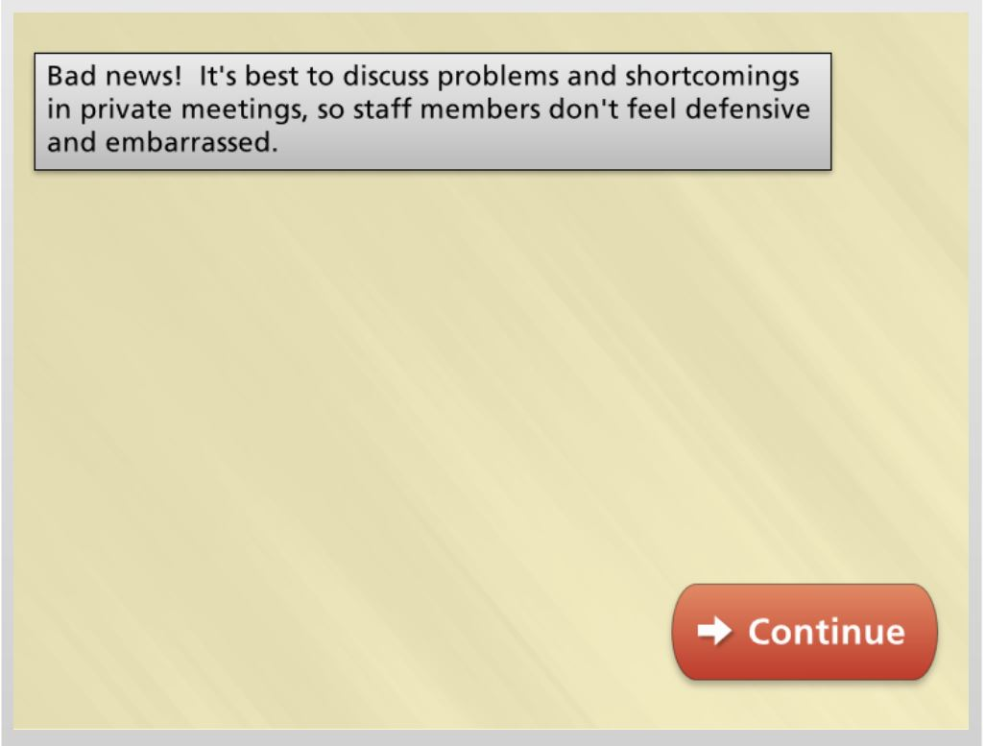
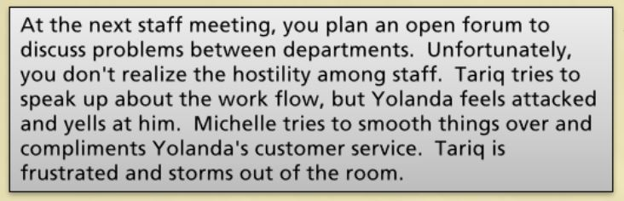

Time for the consequences
Turn feedback into a learning opportunity
Image screenshot from Providing Constructive Employee Feedback, WebJunction course
Notes:
Step 6 in the scenario-writing process is another form of assessment
The consequences for each choice made in the scenario is an opportunity for learning by making mistakes
Turn feedback into effective instructional tools. For each “wrong” choice in the scenario you created on page 8 of the workbook, provide a thoughtful explanation of why it was not the optimal choice. Suggest alternate ways to arrive at solutions.
Avoid negative statements or unconstructive “correct” or “incorrect” feedback. Phrase feedback to reinforce rather than discourage learning. The learner should not feel penalized for making a less-than-great choice.
For the optimal choice, say more than “that’s correct!” Reinforce why it was the best path to choose.
***activity: write consequence statements for the choices in your scenario

Slide 45
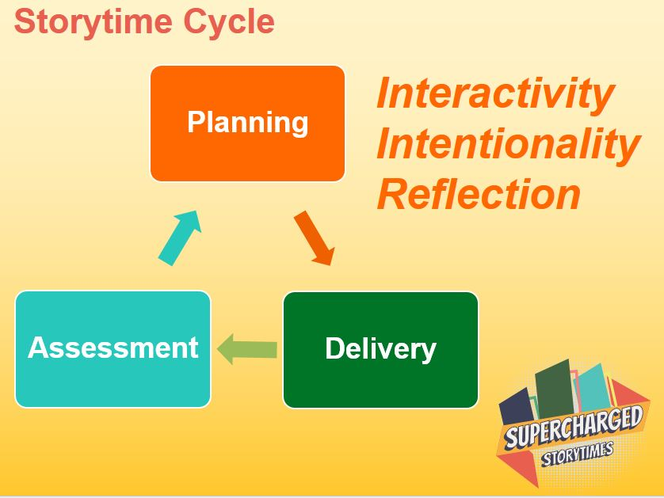
Application and self-reflection
Self-reflection worksheet
What early literacy strategies did I plan to do?
What behaviors did I observed in the children?
What worked well?
What might I do differently next time?
Learning isn’t learning until you apply it.
Notes:
A self-paced course does not have to be somehow divorced from real-life. It’s very reasonable to ask learners to take what they are learning, apply it to their work and then do a self-reflection on how it went.
Example: Supercharged Storytimes is structured around a cycle of planning using the Early Literacy Planning Tool, practicing new strategies (delivery) and filling out a self-reflection worksheet (assessment)
Self-reflection worksheet: https://www.webjunction.org/content/dam/WebJunction/Documents/webJunction/supercharged-storytimes/module4/storytime-self-reflection-worksheet.pdf
Questions (abbr):
What early literacy strategies and activities did I plan for my storytime? How was I successful in carrying out my plan? If they did not go as planned, why?
What early literacy behaviors did I see in the children as a result of my strategies?
How did I model intentionality for parents/caregivers and talk with them about early literacy? How did the adults respond?
What do I think went well in my storytime? And What might I do differently in future storytimes?

Slide 46
Augmenting the Learning Experience

Slide 47
4 ways to augment learning
1
The Learning Environment
Learner Guides
Discussion Forums
Facilitated Learning Groups
2
3
4

Slide 48

The Learning Environment
1
The asynchronous space does not have to be an empty and sterile space.
How do you enliven what may feel like an empty room?
Notes:
The asynchronous space does not have to be an empty and sterile space.
How do you enliven what may feel like an empty room?

Slide 49
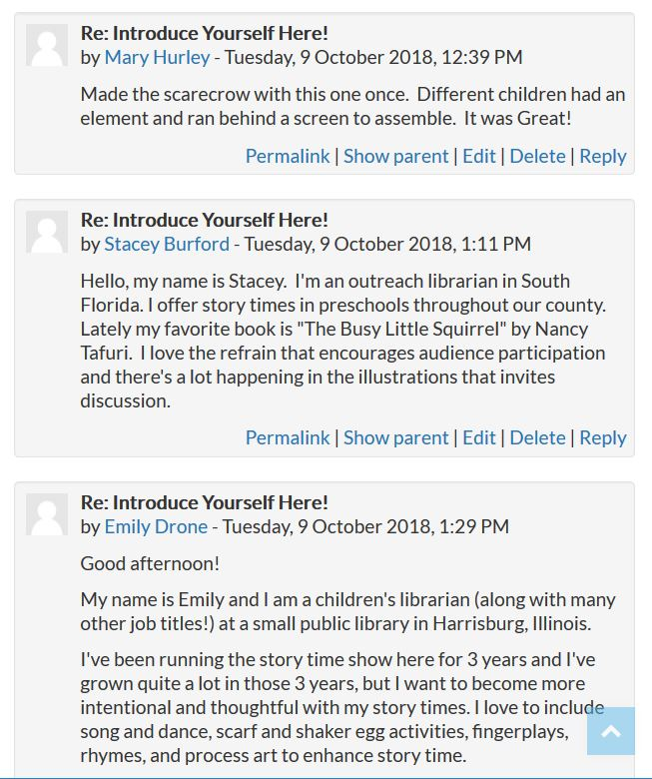

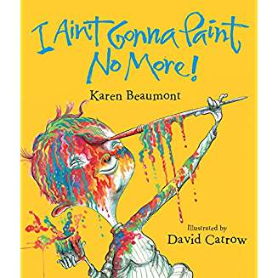




Add color, people, and sharing
Introduce yourselves!
Talk
Share favorite things
Share reflections
Notes:
Liven it up with color, art, videos …use your imagination.
when they enroll, ask learners to introduce themselves and share favorite things in a discussion forum (more about discussion forums in a bit)
Provide activities that require learners to interact in real-life, such as doing practice interviews or role-plays with colleagues.
Encourage learners to set up their physical environment to support learning, such as finding a quiet room, blocking out learning time on their calendars, and allowing enough time to concentrate.

Slide 50


Learner Guides
2
Power of the hand-brain connection for learning
Activates a unique neural circuit
Note-taking as a memory booster
Image: hand by HeatherPaque on Pixabay
Notes:
Learner Guides tap into the power of the hand-brain connection by providing a downloadable, printable study guide. It lets learners take notes and track their learning. A surprising number of people love the physicality of paper and pen.
Companion to the course content
Power of hand-brain connection for learning
Activates a unique neural circuit
Note-taking as a memory booster
Accommodates different learning “styles”
Image on Pixabay: https://pixabay.com/illustrations/hand-pencil-holding-sketch-drawing-1515895/

Slide 51
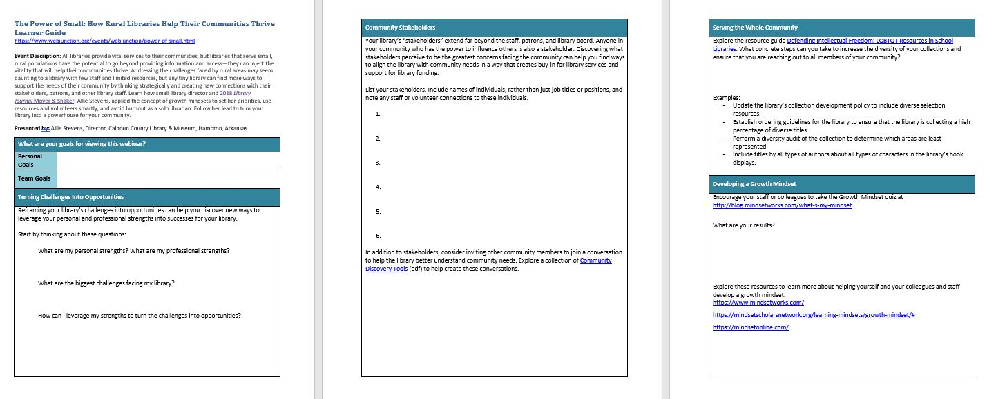
What to put in it?
Application
to own context
Personal
goals
Recall
lists
Next steps post-course
Thought-provoking questions
Example: WebJunction webinar Learner Guide
Notes:
WJ webinars all have learner guides
Echo key points of the topic
Provide questions and actions to put the topic into each attendee’s own context
Examples: WJ webinar LG; https://www.webjunction.org/content/dam/WebJunction/Documents/webJunction/2019-04/guide-power-of-small.docx

Slide 52
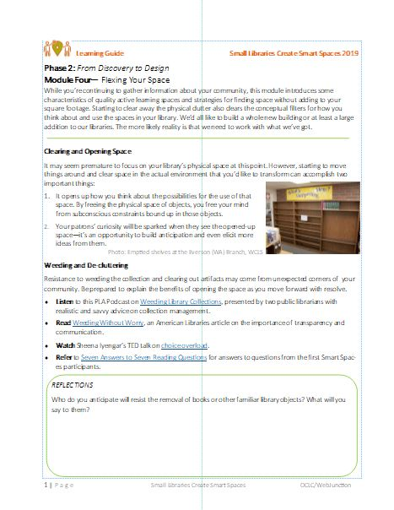
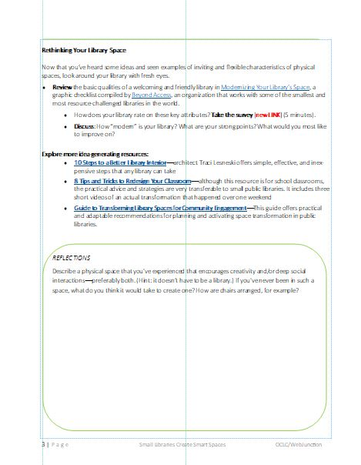
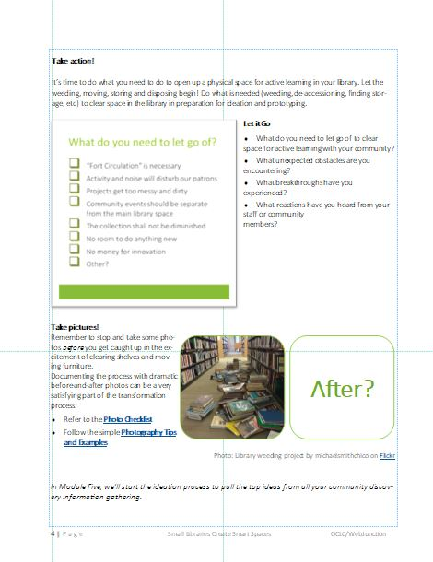
Another approach
Companion to learning community
Links to resources
Checklist activity
Photo challenge
Reflection questions
Example: Small Libraries Create Smart Spaces course, WebJunction
Notes:
Learner Guide for the Small Libraries Create Smart Spaces program
15-month guided exploration of design thinking strategies for library space and service transformation
Mirrors the content of the online learning environment, with some added reflection space and activities
14 of 15 current participants print them out; 2/3 put them all in a binder
Using for:
Easy access to the program content (don’t have to login online)
Tracking their progress
Something to show colleagues (who don’t have online access)
Recall, knowledge checks

Slide 53

Discussion Forums
3
Is it an echo chamber or a social space?
Notes:
What’s the point if it’s truly self-paced, i.e., NO instructor to chime in
Echo chamber or social space?
Facilitation
To require posts or not?
When to interject as SME or hold back
What is intention of discussion?
To see if learners know the right answer?
To encourage them to reflect and share experiences?

Slide 54

Facilitated Learning Groups
4
Taking the “solo” out of self-paced learning
Notes:
Also referred to as “learning circles,” facilitated groups re-introduce some advantages of synchronous learning:
learners motivating and keeping each other on track
collaboration on learning activities and application
providing each other with context for their learning
sharing individual insights and perceptions
See workbook resource list for links to WebJunction facilitator guides

Slide 55
Closing Thoughts

Slide 56
Thank you!
Please feel welcome to contact me
gutscheb@oclc.org

