Slide 1
SAA | 3 August 2019
Building Tools for Informed Decision-Making:
an update from the OCLC Research Collection Building & Operational Impacts Working Group
Chela Scott Weber
Sr. Program Officer
OCLC Research Library Partnership
Notes:
Thanks for having me here today. I’m excited to be here today representing the work of all of the members of our Operational Impact Working Group.

Slide 2
Presentation Overview
Background
Goals & Scope
Progress & Next Steps
Notes:
Today I’m here to present the work of the group to you all, and get your feedback about our next steps. I’ll start with some brief background, outline the goals and scope of our work, share progress so far and give you a preview of some of what will be released with the final report.

Slide 3
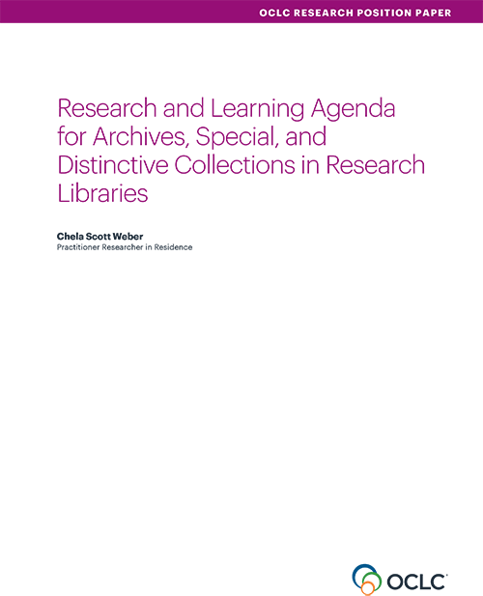
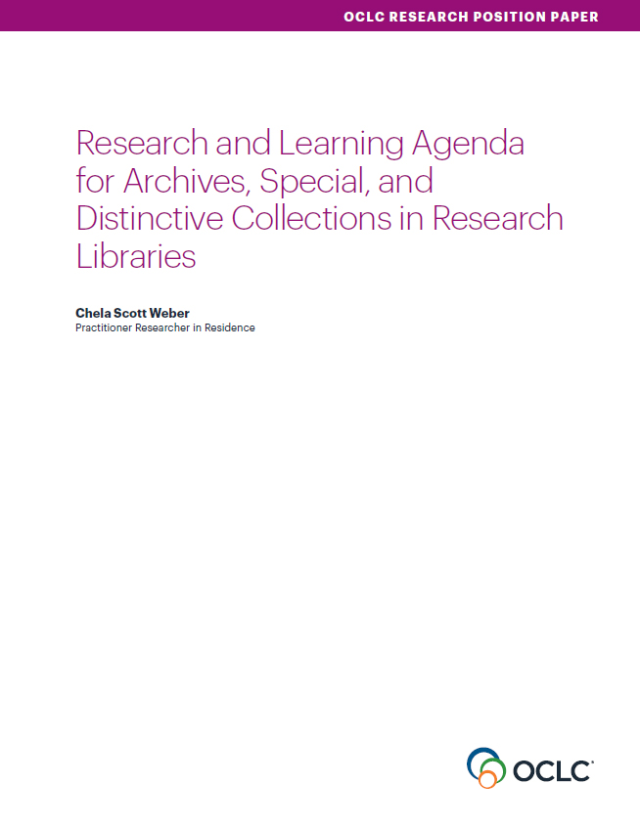
Our Work in Archives, Special, and
Distinctive Collections:
oc.lc/rlp-agenda
Notes:
OCLC Research has a long history of work in the area of archives, special, and distinctive collections in research libraries. We work in special collections because they are an important sight of knowledge creation, made possible by library’s commitment to the stewardship of their distinctive collections. The unique nature of material in special collections can make scaling a challenge, and we work to identify areas of common need and patterns of innovation to help libraries scale learning and expertise with these collections.
In October, we released the Research & Learning Agenda for Archives, Special, and Distinctive Collections.
articulates the shared challenges and opportunities research libraries are are facing in this sphere, and suggests approaches for working on them together.
The agenda is guiding OCLC Research work in this area, and the working group is a part of that

Slide 4
Responding to the Agenda
“With an ever-expanding universe of information to steward and sizable existing backlogs, it is time to re-emphasize the importance of appraisal.”
…
“Our continued backlogs and resource challenges require a renewed energy be put toward appraisal and reappraisal as part of comprehensive strategies to fulfill our stewardship obligations.”
Notes:
We see this working group as responding to multiple needs in the agenda:
Appraisal – The agenda calls for a renewed emphasis on appraisal being a key skill and activity, and a call for a renewed emphasis on and engagement with appraisal in our practice
Beyond appraisal, we think this work also addresses other issues raised in the agenda:
Advocacy
Data collection for reporting and assessment
Stewardship Responsibilities and Collection Management
Valuing special collections and the labor that goes into their responsible stewardship and care

Slide 5
Taking Action: Collection Building & Operational Impacts Working Group
“A key to making informed collection development, appraisal, and processing decisions is a strong understanding of the necessary institutional resources and capacity for the work to preserve, describe, store, and make accessible collection material.”
Notes:
Recognize the connection between the work of collection building and collection management, and our ultimate ability to live up to our obligations to our donors, collections, and users.
The working group was started in response to a presentation by Carrie Hintz at the RBMS conference last year. I saw Carrie give a presentation about work she’d been doing at Emory to think about operational impact and build processes for informed, shared collection making decisions. The response from the room in that presentation was engaged and enthusiastic, and it was clear to me that this was something that was timely and would be broadly useful across many institutions. Carrie had been working with colleagues at Duke, Yale, and Harvard on generalizing the tool. The group thought more input would be useful, and I was grateful that they agreed to collaborate.

Slide 6
Working Group Goals
explore the intersections between current collecting and collection management practices
seek ways to better integrate collection management considerations into the collection development process
bring together colleagues across these important, interdependent functions
Notes:
Working Group Goals
explore the intersections between current collecting and collection management practices
seek ways to better integrate collection management considerations into the collection development process
bring together colleagues across these important, interdependent functions

Slide 7
To Help Us All
assess total cost of ownership of collections
determine operational impact of collections
facilitate better communication across our orgs
enable informed decision-making in collection building
advocate for the necessary resources to steward our collections.
Notes:
We will create
a white paper, toolkit, and sample documentation
practical strategies for enacting responsible collecting
a toolkit to help institutions implement these strategies

Slide 8
Collection Building & Operational Impact
Working Group Members
Matthew Beacom
Yale University
Heather Briston
UCLA
Paul Constantine
University of Washington
Martha Conway
University of Michigan
Gordon Daines
Brigham Young University
Andra Darlington
Getty Research Institute
Audra Eagle Yun
University of California Irvine
Ed Galloway
University of Pittsburgh
Carrie Hintz
Emory University
Jasmine Jones
UCLA
Brigette Kamsler
George Washington University
Mary Kidd
New York Public Library
Sue Luftschein
University of Southern California
Nicholas Martin
New York University
Erik Moore
University of Minnesota
Susan Pyzynski
Harvard University
Andrea Riley
NARA
Gioia Stevens
New York University
Notes:
These are the members of our working group, all of whom have been making vital contributions to moving this forward.
It’s a great group, who hold a wide range of curatorial, collection management, and admin roles in both academic and independent research libraries
Grateful to everyone for the time and work they are putting in.

Slide 9
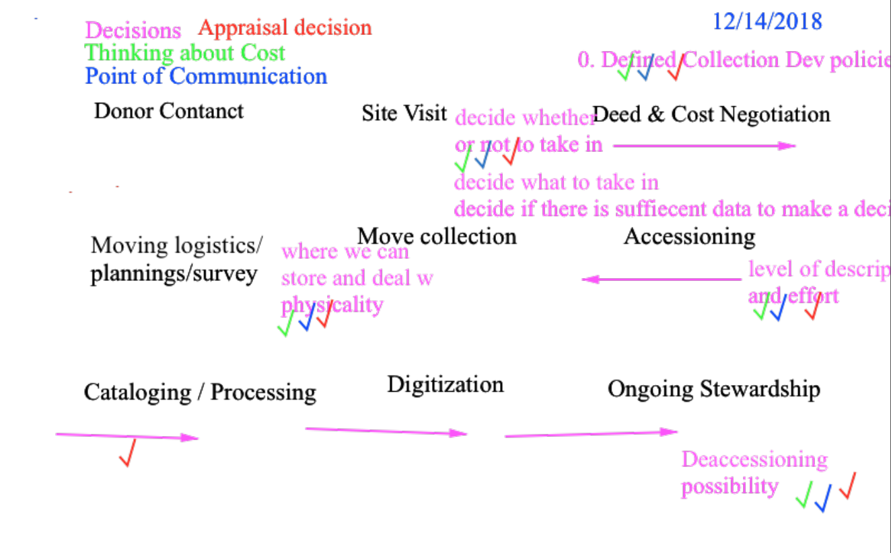
Notes:
We started our work with a workflow analysis, identifying points of decision making, communication, appraisal, and places where we think about labor and cost.
This work helped us realize that these points are present all across the lifecycle of acquisition and stewardship, as work happens iteratively over time.
It also helped to bring into relief the many factors and people involved in these processes.

Slide 10
Three Task Focused Subgroups
Annotated Bibliography
Communication Tools
Cost Estimation Tools
Notes:
That work led us to the creation of three focused subgroups
Lit review, to ground our work
Communication tools, to facilitate discussion of both tangible (labor, supply, and other costs) and intangible (research value, community and other relationships, etc) factors that are weighed in collection decisions
Cost Estimation tools, to facilitate estimation of the tangible costs of addressing collection needs

Slide 11

Annotated Bibliography Working Group
Led by Gordon Daines, Special Collections Dept Chair, L. Tom Perry Special Collections, Brigham Young University
Annotated Bibliography is available at: shorturl.at/gnT27
Completed their work in May 2019
Notes:
Annotated bibliography:
Led by Gordon Daines
Articles focus on the impact that each function has on other functions, interconnection between functions
Cost calculation, appraisal and tech services

Slide 12

Communication Tools Working Group
Led by Carrie Hintz, Head of Collection Services, Rose Library, Emory University
Work is ongoing
Notes:
Communication Tools:
Led by Carrie Hintz

Slide 13
The Communication Tools subgroup will create a suite of tools to assist selectors and other special collections professionals responsible for collection development to collect and share information regarding potential acquisitions with stakeholders. These tools will help repositories develop policies and best practices to support sound collection development, and will support selectors’ efforts to gather and share information about potential acquisitions, assess and communicate the impact an acquisition will have on repository staff and operations, to communicate with donors and administrators about the resources required to effectively steward a collection, and to articulate and promote the value that library workers’ labor and expertise bring to bear on collections and collecting decisions.
Notes:
The subgroup created this scoping statement, to help guide their work and priorities.
The Communication Tools subgroup will create a suite of tools to assist selectors and other special collections professionals responsible for collection development to collect and share information regarding potential acquisitions with stakeholders. These tools will help repositories develop policies and best practices to support sound collection development, and will support selectors’ efforts to gather and share information about potential acquisitions, assess and communicate the impact an acquisition will have on repository staff and operations, to communicate with donors and administrators about the resources required to effectively steward a collection, and to articulate and promote the value that library workers’ labor and expertise bring to bear on collections and collecting decisions.

Slide 14
Goals and Outcomes
Suite of tools to assist selectors, resource allocators, and technical services managers collaborate to select, resource, appraise, and steward new acquisitions
Notes:
Goals: Suite of tools to assist selectors, resource allocators, and technical services managers collaborate to select, resource, appraise, and steward new acquisitions

Slide 15
Workflow Analysis
Pre-Custodial
Acquisition and Transfer
Ongoing Stewardship
Notes:
Workflow analysis:
From the same workflow analysis exercise I showed earlier, we Identified three overarching lifecycle phases:
Pre-Custodial
Acquisition and Transfer
Ongoing Stewardship
Our tools would be mapped to these phases

Slide 16
Categorized
Policy and Local Practice
Collection Assessment Tools
Internal Communication and Advocacy
Donor and External Communication
Notes:
In each phase, we would consider needs for communication tools across these categories
Policy & Practice
Collection development policy templates, checklists, or examples
Levels of description document
Processing/Cataloging plan template
Checklist of pre-acquisition and acquisition steps
Documentation checklist
Transfer tools for electronic records
Internal Communication & Advocacy
Operational Impact Report
Digitization Consideration Form
Collection Assessment Tools
Background Research Form
Field Notes Template
Electronic records Survey
Talking Points document to guide conversations with donors
Ingest Checklist
Preservation Assessment Template
Internal Communication and Advocacy
Operational Impact Report
Digitization Consideration Report
Donor and External Communication
Information Packet for Potential Donors
Donor Communication Checklist

Slide 17
Timeline
Winter 2019: Draft sample workflows & identify where a communication tool could facilitate effective transfer of knowledge
Spring 2019: Identify the tools to create and call for community samples
Summer 2019: Create, modify, or identify and aggregate tools; refine and test tool suite
Fall 2019: Present tool suite to broader CBOI group, request feedback, refine as needed.
Notes:
Our current estimated timeline for the subgroup

Slide 18

Operational Impact Estimator Working Group
Led by Mary Kidd, Operations and Systems Coordinator, New York Public Library
Work is ongoing
Notes:
Operational Impact Estimator Working Group
Led by Mary Kidd

Slide 19
The Operational Impact Estimator, or OIE, will provide a total estimated dollar value for a single acquisition. The total estimate will encompass, mainly, the cost of labor, supplies and transport.
The tool will take on the form of a spreadsheet template. The user will input certain variables that will influence one or many calculations.
The tool will be tested by the smaller subgroup using example collections; from there, it will be presented to the greater CBOI working group and refined, and then shared widely.
Notes:
Scope statement for the estimator group
The Operational Impact Estimator, or OIE, will provide a total estimated dollar value for a single acquisition. The total estimate will encompass, mainly, the cost of labor, supplies and transport.
The tool will take on the form of a spreadsheet template. The user will input certain variables that will influence one or many calculations.
The tool will be tested by the smaller subgroup using example collections; from there, it will be presented to the greater CBOI working group and refined, and then shared widely.

Slide 20
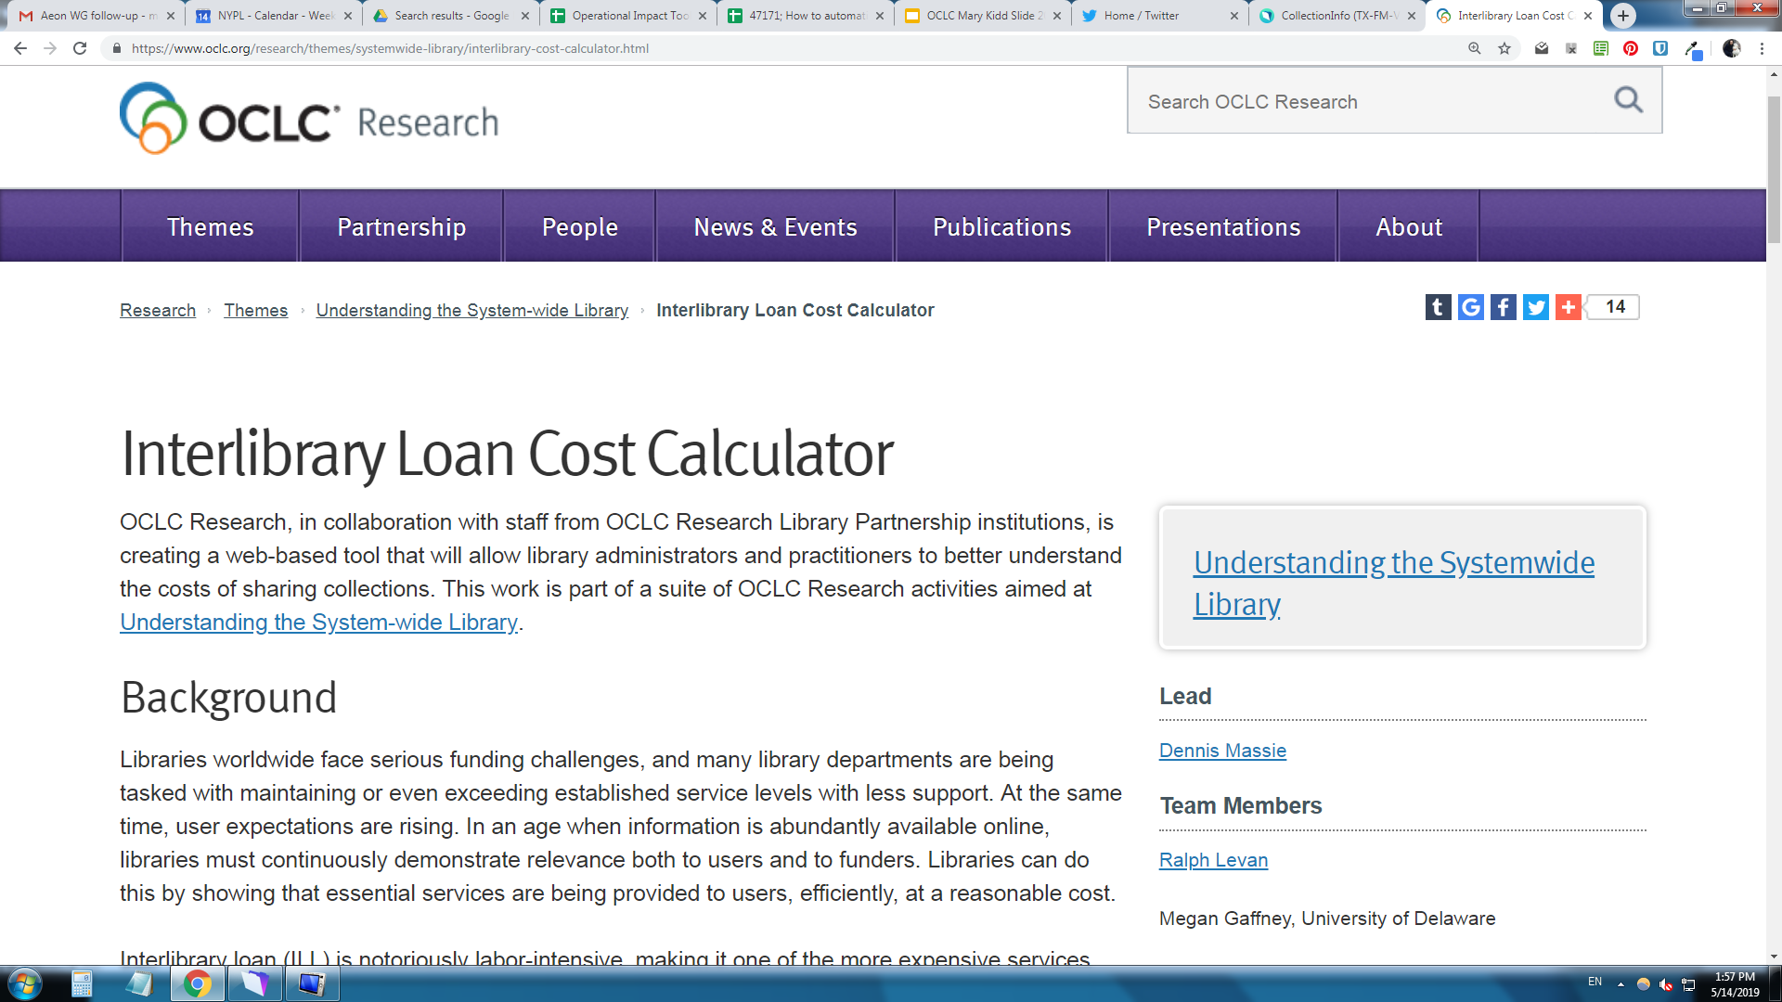
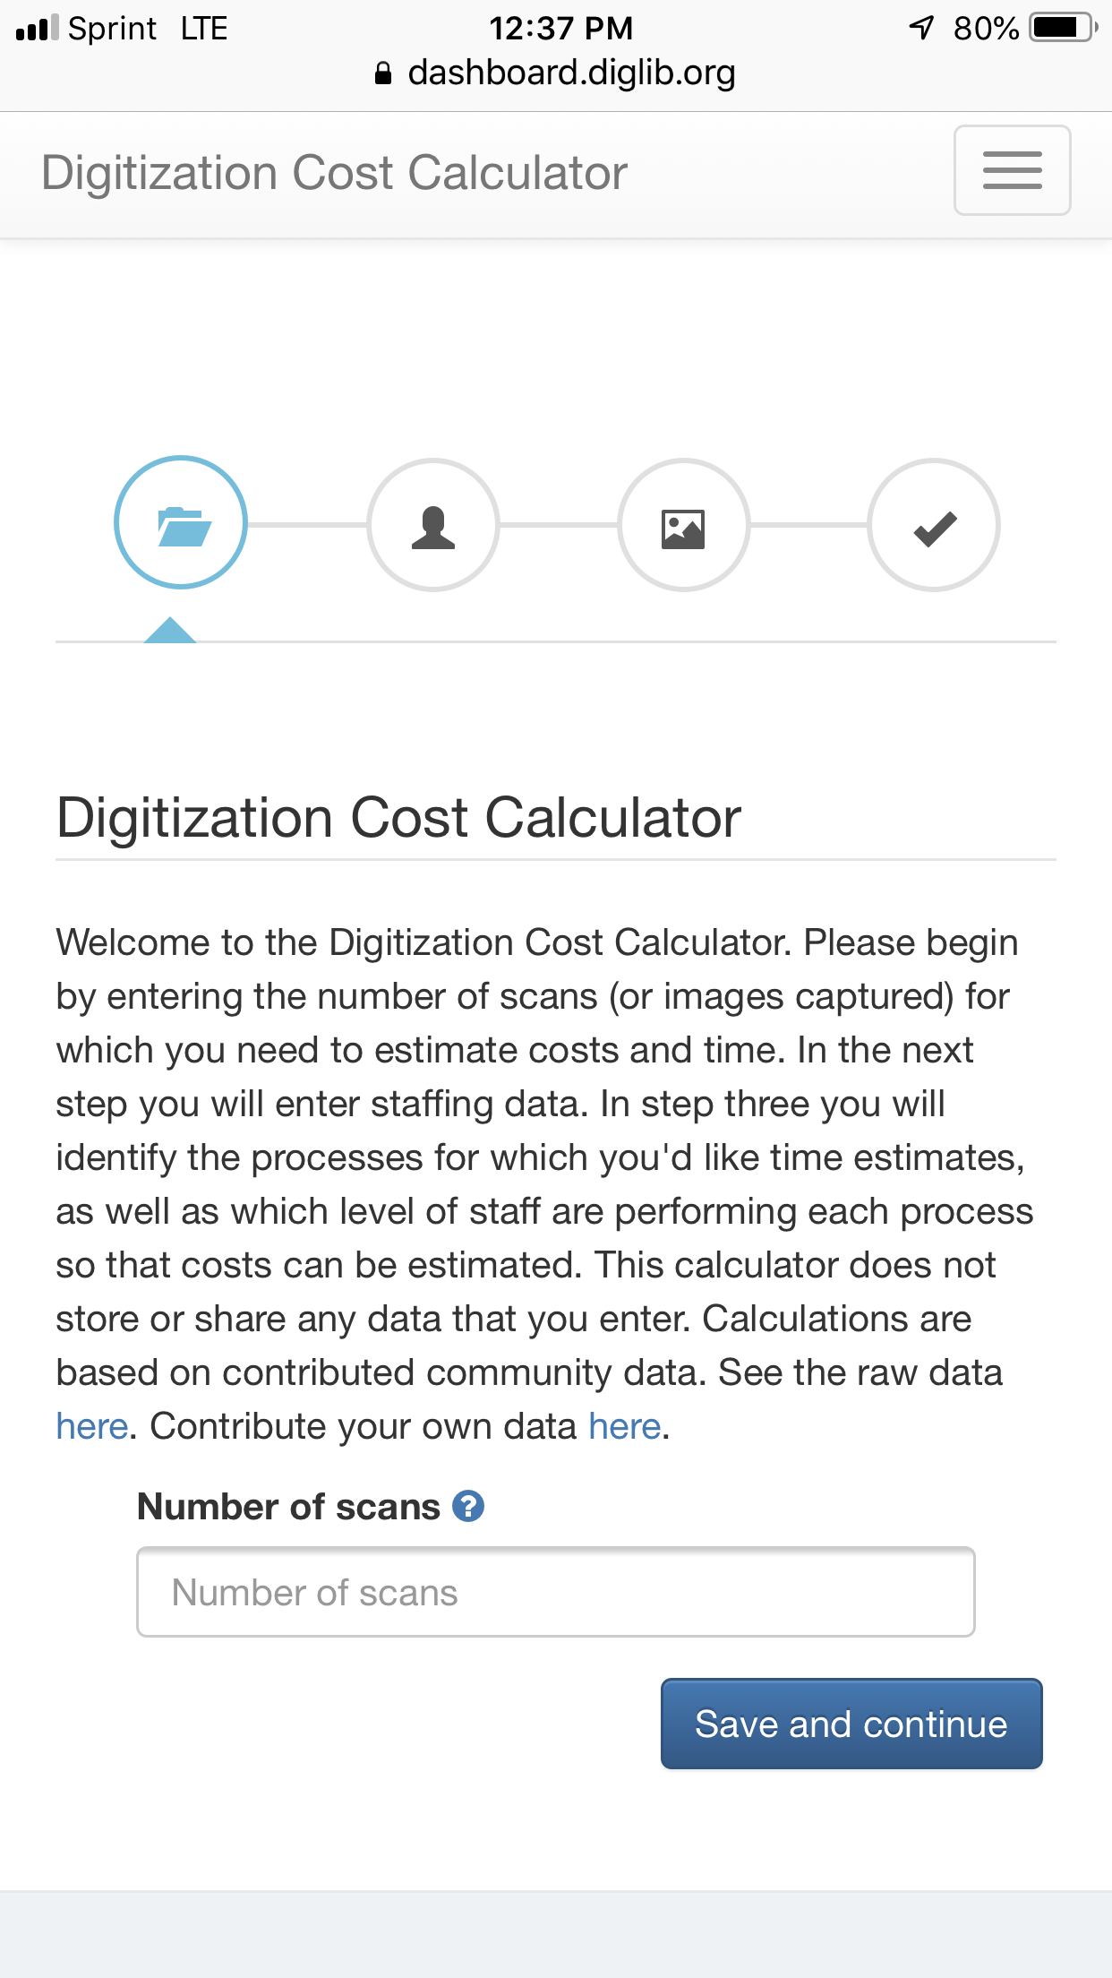
Existing Literature & Cost Calculation Tool Review
Notes:
Looked at tools that already existed, both for models and to help shape scope and not produce redundant work
We found tools like the excellent DLF digitization cost calculator

Slide 21
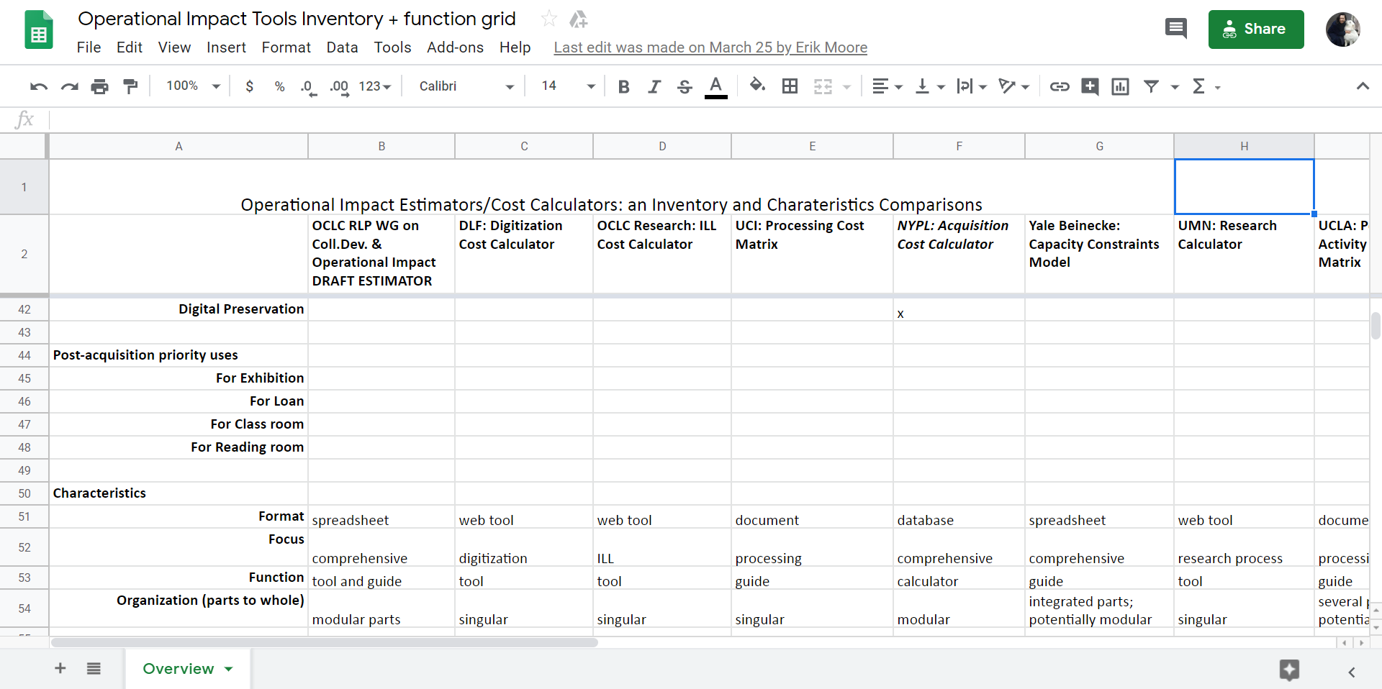
Scope & Functionality Review
Notes:
From our tool review, we built a matrix of both scope and functionality, both to identify models and to help shape our scope and not produce redundant work

Slide 22
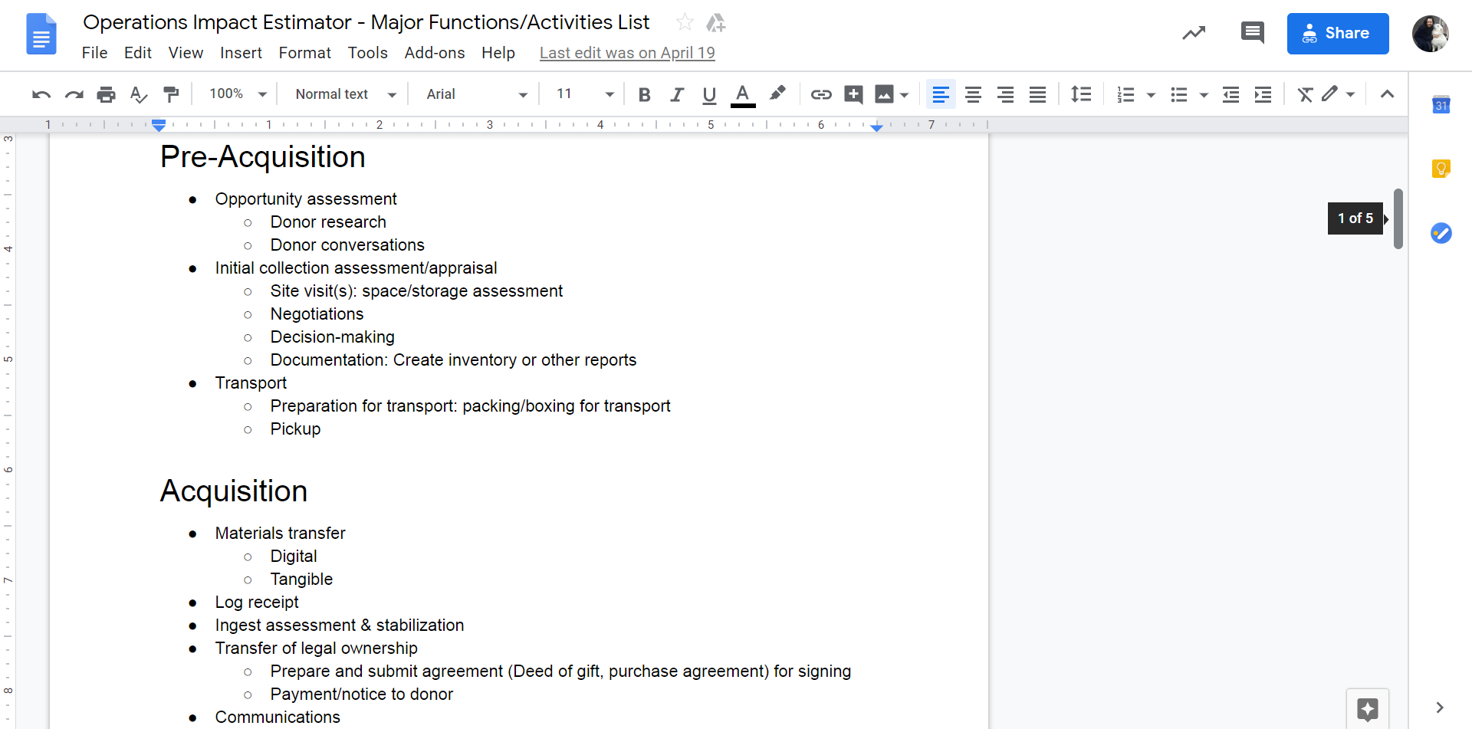
Identify Major Workflow Functions & Activities
Notes:
Major Functions & Activities – mirror the workflow used in the communication tools group
We identified major functions, their associated activities, and costs associated with that activity

Slide 23
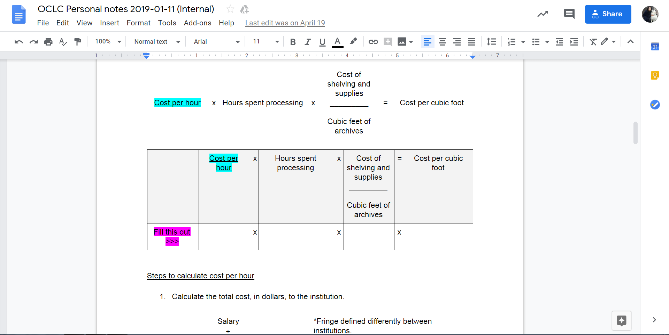
Calculation Building
Notes:
Calculation Building
From that thinking, we started building out calculations

Slide 24
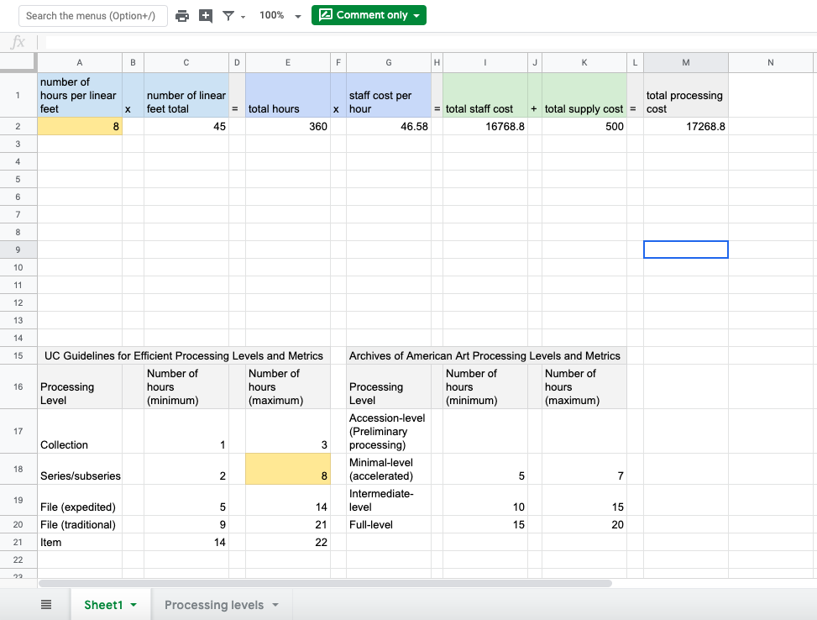
Draft Tool Preview
Notes:
Processing Levels
A major part of our calculations is identifying the processing or cataloging level at which the collection will be worked on
This is the processing levels for archival collections, and we are building a similar one for bibliographic cataloging

Slide 25
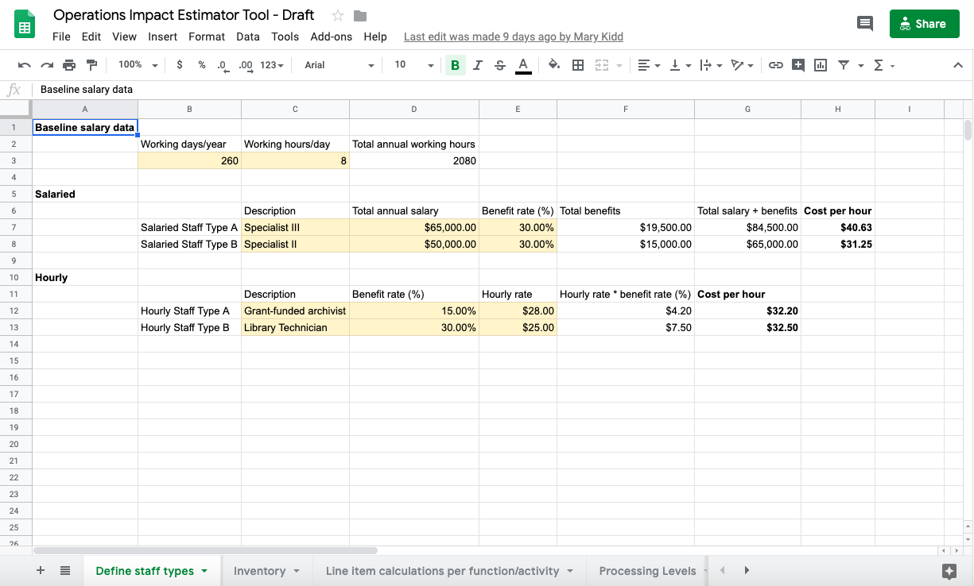
Draft Tool Preview
Notes:
Calculation Building – Define staff type
We begin our calculations by defining staff types who will work on a collection – we have calculations for hourly and salaried employees, and allow for variable rates of benefits, all broken down to an hourly increment to use in calculations

Slide 26
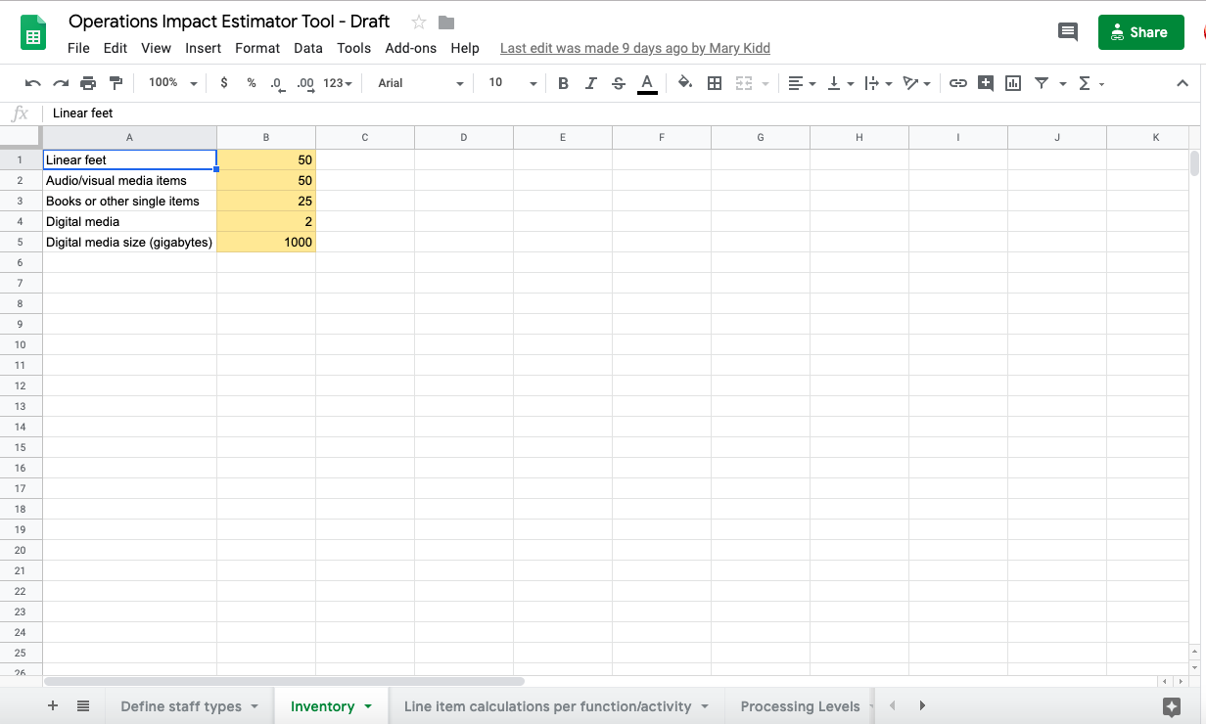
Draft Tool Preview
Notes:
Calculation Building – define inventory
The next step is to define the collection inventory
This is still very basic, we anticipate it might get more detailed as we test and iterate

Slide 27
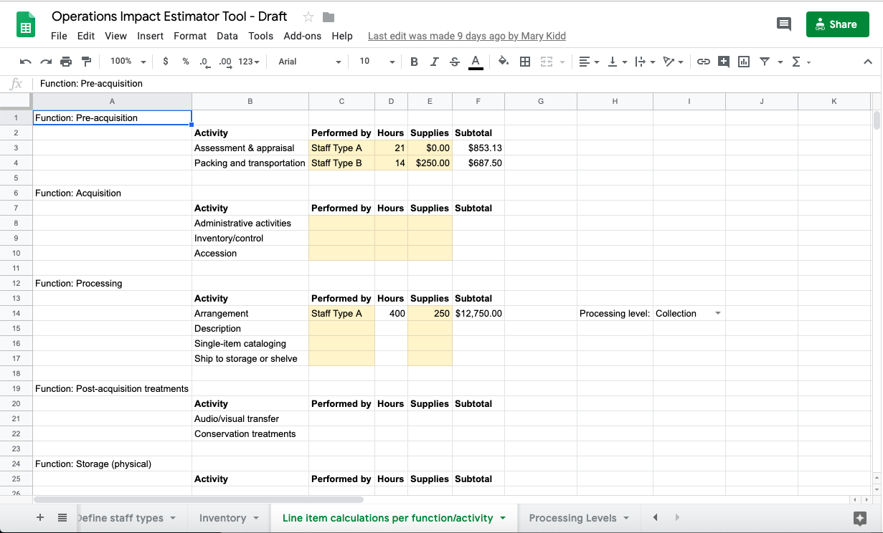
Draft Tool Preview
Notes:
Calculation Building – define hours, supplies, staff, type
Next you assign staff types to different activities, estimate number of hours of labor, and add supply costs. Processing and cataloging costs are estimated based on inventory and level of processing or cataloging effort

Slide 28
As an archivist, I want to be able to calculate the cost of processing a collection using different levels of processing on individual series, so that I can accurately reflect the cost of the effort that the curator and I have decided the research value of the collection warrants.
Draft Tool Testing with User Stories
Notes:
Calculation Building – Testing with user stories
Our next step is to test the current tool using user stories like the one on this slide to see if the tool works for different scenarios. I used this one on purpose because we know it doesn’t easily do this, and we’re going to have to work on that.

Slide 29
Action and Next Steps
Fall 2019: Working group testing of tools
Winter 2019: Public testing of tools and begin writing white paper
Spring/Summer 2020: Publication
Notes:
timeline – current estimates
Fall 2019: Working group testing of tools
Winter 2019: Public testing of tools and begin writing white paper
Spring/Summer 2020: Publication

Slide 30
Get Involved:
  Volunteer to be a tester
  Watch our update webinar for more detail oc.lc/wipwebinars
  Join the Primary Sources email list
  Keep an eye out on Hanging Together blog
  Be in touch! weberc@oclc.org
Notes:
Ways you can get involved

Slide 31


Notes:
Thank you!

