Slide 1
ALA 2019, Washington, DC June 23, 2019 Update on ACRL's Value of Academic Libraries Initiative: Communicating Assessment Results to Stakeholders Stephanie Mikitish, Ph.D., Library of Congress Lynn Silipigni Connaway, Ph.D., OCLC Marie L. Radford, Ph.D. Rutgers University Vanessa Kitzie, Ph.D., University of South Carolina Diana Floegel, MLIS, Doctoral Student, Rutgers University Laura Costello, MLIS, Doctoral Student, Rutgers University
Notes:
SM

Slide 2
Today’s Agenda
Assessment defined
Stakeholder categories
Common concerns/goals of stakeholders
Library data
Communication channels/methods/strategies
Group activity
Notes:
SM

Slide 3
Assessment
Notes:
SM

Slide 4
Assessment Defined
Interpreting
Analyzing
Collecting
Process of…
Defining
Selecting
Designing
Collecting
Analyzing
Interpreting
Using
Information to increase service/
Program effectiveness
Notes:
From IES (2011)
SM

Slide 5
Stakeholders
Notes:
LSC

Slide 6
Stakeholder categories
Type | Definition | Examples
Steering/ executive | Leaders who develop, coordinate, & gather feedback | Task force members, officials
Advisory | Members who gather feedback & speak for their groups | Representatives (e.g., school board), policymakers, researchers, teachers, parents, students
Associations | Engage, promote, & gather feedback regarding library | ACRL, ALA
Notes:
From IES (2011)
LSC

Slide 7
Stakeholder categories
Market name | Definition | Examples
Customer | Use library’s resources | Adults, children, students
Internal | Employees | Librarians, staff, pages
Supplier/ Alliance | Provide resources to library | Publishers, vendors, board members, provosts, CAOs
Referral | Refer customers to library | Parents, teachers, faculty
Recruitment | Are or refer potential library employees | MLIS/MI students, interns
Influence | Affect institution | Accreditors, governing bodies, consortia
Notes:
Murray & Ireland (2017) on Payne, Ballantyne, & Christopher’s (2005) markets
customer [students]
internal [library employees]
supplier/alliance [publishers, vendors, provost/chief academic officer, university president, board members]
referral [customers and non-customers, faculty]
recruitment [potential employees]
influence [groups/individuals including student government, deans, CFOs, other libraries, consortia, associations]
LSC

Slide 8
Concerns/Goals of Stakeholders
Notes:
LSC

Slide 9
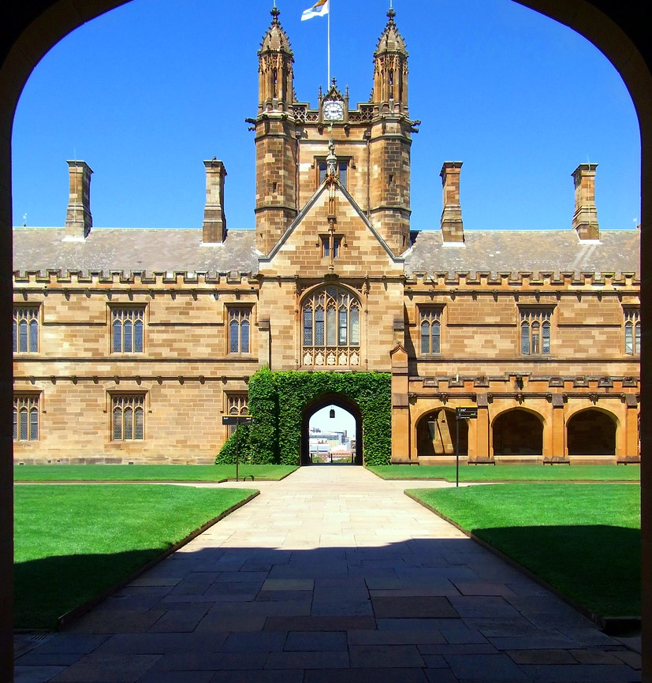
Stakeholder Concerns/Goals
Stewardship of funds
Effect on institutional objectives
Recruitment
Achievement
Retention
Job placement
Learning
Literacy
Learning
Notes:
2 basic ones according to Grieves (2017): value for money; value/impact in achieving institutional objectives
Libraries have been slow to frame things in these terms because according to Kelly & O’Gara (2018): “Far too often, libraries report and evaluate based on what has historically been done – collecting stats because they are available, because “we always have,” or because they answer a question the parent institution used to have”
Linking the library to these concerns/goals can be difficult! According to a study by Murray & Ireland (2017) of 68 university (Master’s as of 2013) library directors: “A final, strongly prevalent theme identified in this data was the lack of any known methods to document library impact on retention. Several respondents commented that, while they desire to initiate a process, they do not know how to start.”
LSC

Slide 10
Library data
Notes:
Kelly & O’Gara (2018): “libraries have access to more data than they can ever hope to use. That said, understanding the data that already exist, and what questions data can help to answer about the use of a collection, is key to developing a sound assessment approach”
VK

Slide 11
Library data
Important factors:
How is it measured, and why?
What is being done with it?
Based on the above, are there alternative data?
Data types: Qualitative, quantitative, and mixed
From data to narrative (Grieves, 2017)
Collection
Analytics
Insights
What data exist, and what questions do they answer?
Notes:
Grieves (2017): data vs analytics (evidence ordered by pattern/trend) vs insights (value/intelligence gained through analytics, the story/narrative)
Kelly & O’Gara (2018): data inventory fields: metric (name of thing being measured), category [e.g., collection, space, service], difficulty to obtain (1-5, easy-difficult), data source, compiled (how frequently), purpose; mapping assessment to tools/techniques and data fields: question, tools/techniques, readily available data, wish-list data
VK

Slide 12
Communication
Notes:
Grieves (2017): relationship management “Makes a conscious shift from the academic support role to one of expert, active and trusted partner”
Murray & Ireland (2017): reciprocal value propositions can make “’explicit the benefits expected to be gained and given up’ by all involved parties, may be informal or formal, allows for coordinated meaning-making, and serves as the basis of trust for longer=term relationships” (Ballantyne et al., 2011); ideally reciprocal rather than unidirectional
68/271 library directors/deans at public comprehensive US universities w/ a master’s level Carnegie classification as of Jan 2013
RQ1: How do academic library deans/directors document the impact of library services and resources on student retention?
Relating info lit efforts to retention; User/student satisfaction/feedback surveys on services/resources
RQ2: How do academic library deans/directors communicate the impact of library services and resources on student retention?
Often none!; Formal presentations and reports>annual reports>informal communication
VK

Slide 13
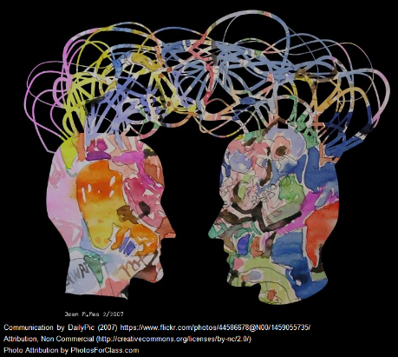
Communication methods
Factors to consider:
Platforms (e.g., electronic, physical)
Targeted audience
Findability (i.e., is it Google-able?)
Frequency
Notes:
Kelly & O’Gara (2018): “The choice of medium should be based on stakeholder preferences…When determining how results are communicated, consider what stakeholder actions the results should prompt. It can be helpful to think of communication as storytelling”
VK

Slide 14
Communication content
Name | Text | Image | Sound
Website
Report
Blog
Notes:
Twitter: http://www.stickpng.com/assets/images/580b57fcd9996e24bc43c53e.png
Instagram: https://diylogodesigns.com/wp-content/uploads/2016/05/instagram-Logo-PNG-Transparent-Background-download-768x768.png
Apple podcast: https://communities.apple.com/kb20181115/securedImage.jsp?productid=PODCASTSFORIOS&size=240x240
Facebook: https://www.jolttx.org/wp-content/uploads/2017/04/photos-facebook-logo-png-transparent-background-13-300x169.png
Checkmark: http://clipart-library.com/images/dc9rkjRc7.png
VK

Slide 15
Communication strategies
Primary Consideration – Stakeholder Group
Next – What are your assessment findings that are of greatest importance to groups?
Decide which data points are important for each group.
Think about their priorities - what in your data speaks to these?
Design visualizations that are attractive and can easily be grasped.
Bring data to life - select juicy quotes (or stats!) for illustrations that pertain to that group.
Which method will reach each group most effectively?
Notes:
VK

Slide 16
Group activity
Notes:
SM

Slide 17
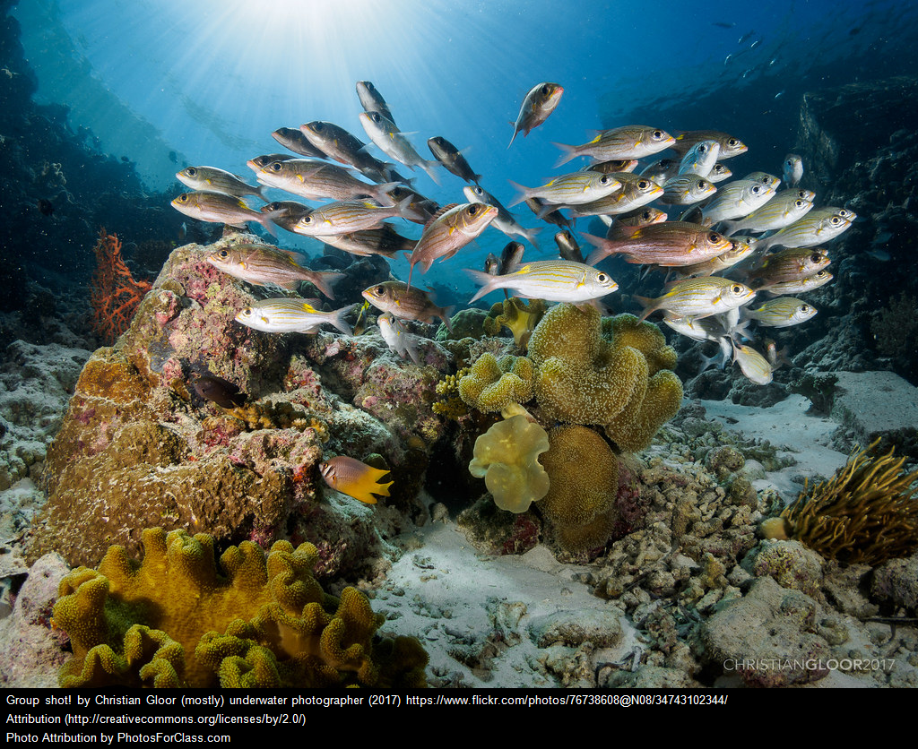
Group activity
Choose a group from worksheet
Individual work
Share with a partner
Report results
Notes:
SM

Slide 18
Closing

Slide 19
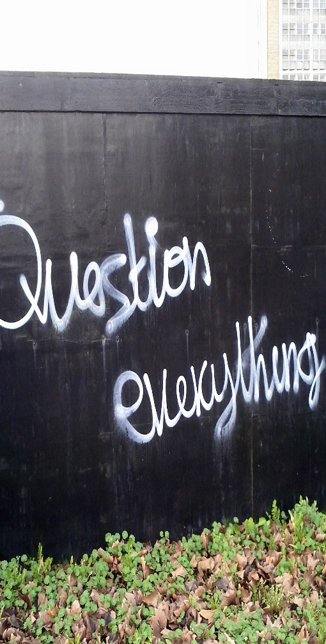
Thanks & Questions?
Stephanie Mikitish, Ph.D. (smik@loc.gov)
Lynn Silipigni Connaway, Ph.D. (connawal@oclc.org; @LynnConnaway)
Marie L. Radford, Ph.D. (mardford@rutgers.edu; @MarieLRadford)
Vanessa Kitzie, Ph.D. (kitzie@mailbox.sc.edu; @vkitzie)
Diana Floegel, Ph.D. student (diana.floegel@rutgers.edu; @floeginator)
Laura Costello, Ph.D. student (laura.costello@Rutgers.edu)

Slide 20
References
Identifying audience/stakeholders
Association of College and Research Libraries. (2017). Provost semi-structured individual interviews. In Academic library impact: Improving practice and essential areas to research (pp. 31-36). Prepared by L.S. Connaway, W. Harvey, V. Kitzie, and S. Mikitish. Chicago: Association of College and Research Libraries.
Murray, A. L., & Ireland, A. P. (2017). Communicating library impact on retention: A framework for developing reciprocal value propositions. Journal of Library Administration, 57(3), 311-326.
Robertson, M. (2015). Perceptions of Canadian provosts on the institutional role of academic libraries. College & Research Libraries, 76(4), 490-511.

Slide 21
References
Communication do’s/don’ts and best practices
Association of College and Research Libraries. (2017). Communicate the library's contributions. In Academic library impact: Improving practice and essential areas to research (pp. 45-50). Prepared by L.S. Connaway, W. Harvey, V. Kitzie, and S. Mikitish. Chicago: Association of College and Research Libraries.
Institute of Education Sciences. (2011). Stakeholder communication. SLDS Best Practices Brief, 1. Retrieved from https://nces.ed.gov/programs/slds/pdf/best_practices.pdf
Library communication examples
Grieves, K. (2018). Generating bespoke value and impact evidence to inform a thought leadership approach to service engagement at The University of Sunderland. Performance Measurement and Metrics, 19(1), 53-65.
Kelly, M., & O’Gara, G. (2018). Collections assessment: Developing sustainable programs and projects. The Serials Librarian, 74, 19-29.

