Slide 1
Design Thinking
Betha Gutsche
WebJunction Programs Manager
Notes:
Title: Design Thinking
Description: Apply core concepts to library programming, strategic planning and telling the library story

Slide 2
Betha Gutsche
WebJunction Programs Manager

Slide 3
Design Thinking is a process of
discovery
and
experimentation
Discover who your community is and what they value
Experiment to create services and programs to meet evolving needs
Notes:
Design thinking has gotten a lot of attention over the past few years. There are many “flavors” of it
There’s no single definition for design thinking. It’s an idea, a strategy, a method, and a way of seeing the world.
**Reference Design Thinking for Libraries Toolkit
It is not prescriptive; DT toolkit for libraries is a starting point, an illumination of how to use strategies and tools from perspective of the authors
The specific strategies used depend on the context
At its essence
It’s a process of discovery and experimentation
It’s about putting people at the center of our process, rather than systems or policies.
Stakeholders work collaboratively to discover what our communities want and experiment to create services, programs and processes to meet their changing needs.”
design thinking is a model that can be applied to a broad range of applications

Slide 4
Community Discovery
The community is the expert
Gaining a deep understanding of people and community
Notes:
In DT-Toolkit terminology, this is the Inspiration phase
DT is user-centered, and about centering the user in a library experience
--So It starts with discovering and understanding the community’s needs and interests
The “community is the expert” is a key principle.
And it continues with involving community members in planning, building and delivering programming in the smart spaces. There’s no point when you can say “I’m done with connecting with my community.” It’s a long-term relationship.
A community that feels invited to be integral to the process is a community of people who are invested in the success of the library.

Slide 5
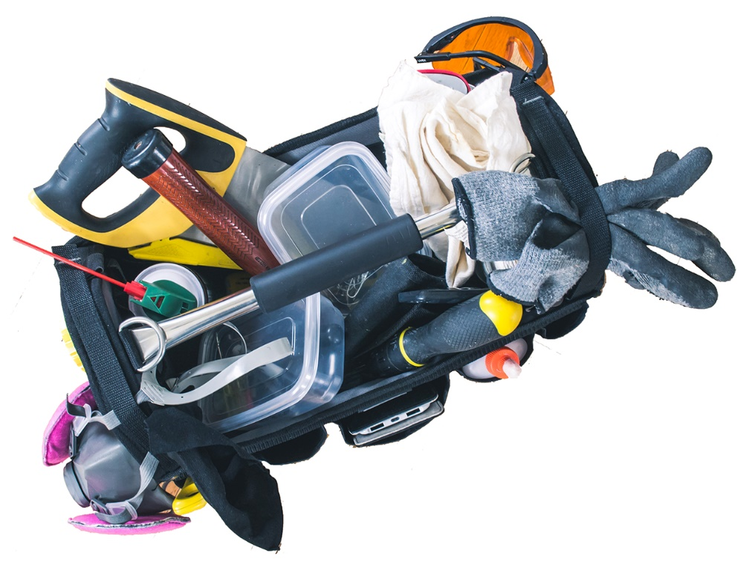
Tools for Discovery
It’s about connection and conversation
1. Interviews and focus groups
2. Visual tools
3. Interactive workshop tools
oc.lc/discovery-tools
Toolbag by steve_a_johnson on Pixabay
Notes:
Surveys are standard tool for gathering information about your community
Pros of surveys
Cast a wide net, offer online and on paper
Can collect quantitative data on a wide range of questions; filter by demographic; find comparisons and contrasts
Provide anonymity to survey takers
Cons of survey
Impersonal --The main limitation of the survey approach is that it generally avoids direct interaction between the library and its community members or member-to-member interaction.
People get survey fatigue
Some people intimidated by surveys
Surveys may be a good starting point for gathering information
BUT community analysis is not the same as community discovery
Community discovery is NOT intended to be a scientific, statistically rigorous analysis of the quantifiable needs of a community.
It’s primarily about CONNECTION and CONVERSATION
So how do you “connect in a different way”?
Try using one of these visually or personally engaging methods to get closer to a genuine connection with people.
LINK: https://learn.webjunction.org/pluginfile.php/64933/mod_label/intro/Basket%20of%20Discovery%20Tools.pdf
Look at three categories of tools
Photo: Toolbag by steve_a_johnson on Pixabay: https://pixabay.com/photos/wood-carpenter-equipment-tools-3293929/

Slide 6
Experimentation
Ideation
Prototyping
Iteration
Ideas by mohamed-hassan on Pixabay
Notes:
Design Thinking has a variety of processes to foster experimentation
IDEATION
To expand possibilities beyond the limitations of what you’ve already done or other constraints
PROTOTYPING
to avoid getting stuck on a path that isn’t working
ITERATION
To stay open to evolving needs

Slide 7
Transform Space for Active Learning
Design
Thinking
Notes:
Look at how DT is used in specific library applications
Small Libraries Create Smart Spaces project
With funding from IMLS and support from OCLC, WJ worked with 15 small and rural libraries to reimagine their use of space and reconfigure it for engaging the community in active learning.
First round was so successful that we received supplemental funding to work with 15 more libraries
I’ll share just one example

Slide 8
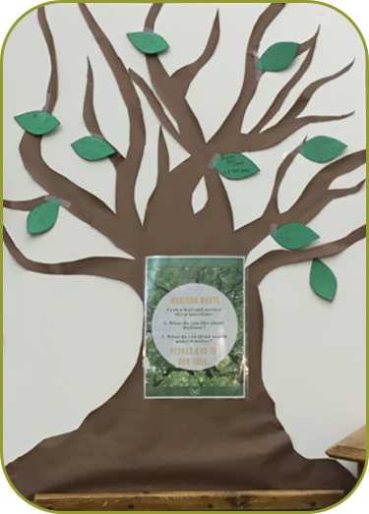
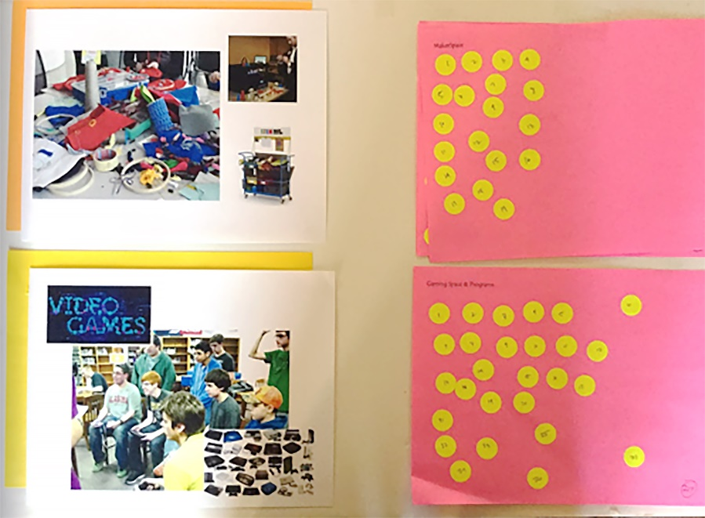
Discovery at Madison Public Library
WISH TREE
DOT BOARD
Grab a leaf and answer these questions:
What do you like about Madison?
What do you think would make it better?
Four choices
Gaming space
Teen space
Maker space
Business incubator
Notes:
Madison Public Library, SD
Discovery:
wish trees: asked two non-library questions
to get at the broader aspirations of the community; get beyond the conventional thinking of what a library is able to do
Dot boards:
from the community input, distilled four ideas to dot board: gaming space, teen space, maker space, and business incubator
The dot board was up in the library and at annual Madison Discovery Days where over a hundred people voted with dots for their 2 favorite spaces.​
Teen space and maker space were neck in neck, but teen space won.
Combo: have STEAM activities in our teen space

Slide 9
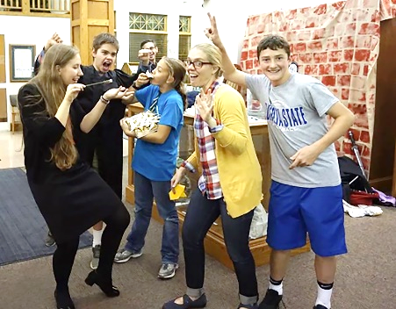
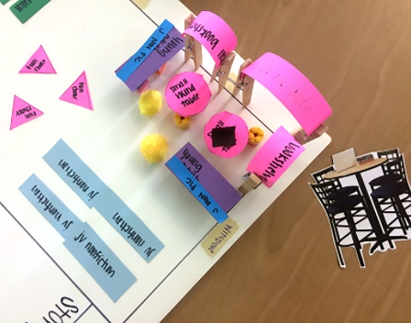
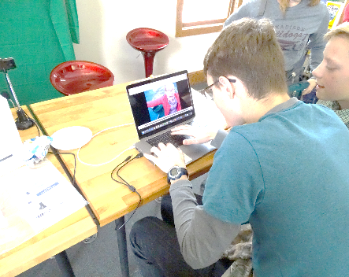
MPL Gets Experimental
Ideation brainstorm on community ideas
Action prototyping – teens stage a Harry Potter Party
Prototyping with paper and clothespins to create scale models
Teens are designing and delivering most of the programming
Notes:
Ideation, prototyping and iteration
Ideation
Community input from wish trees: Walmart and more shopping
Ideation session to explore possibilities related to that wish
Recognized the desire for activities for teens in the community
Prototyping
Scale model
Harry Potter Holiday Party = action prototyping

Slide 10
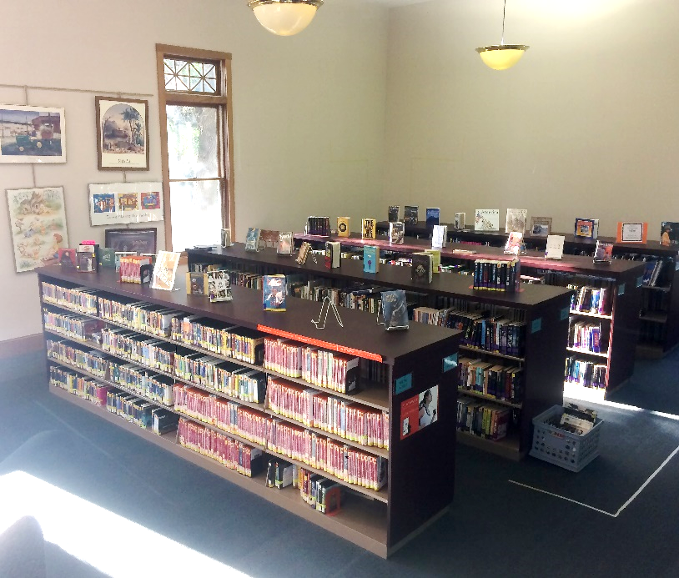
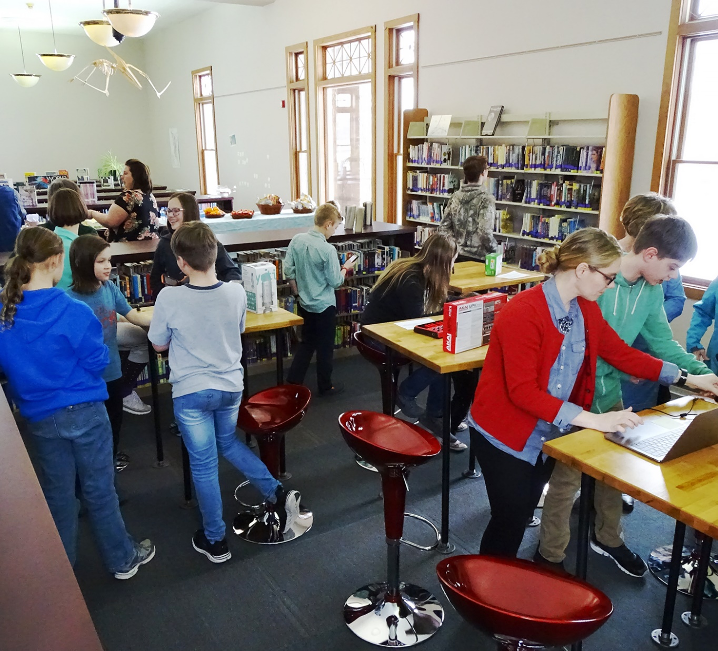
From static corner…
…to Teen Space, where teens own the programming
oc.lc/smartspaces
Notes:
Ownership

Slide 11
Create Flexible Strategic Planning
Design
Thinking
Notes:
SLCPL Strategic Planning in a Deeply Weird World: The Flexible Roadmap Field Guide Approach
Promo WJ Webinar: https://www.webjunction.org/events/webjunction/strategic-planning-in-a-deeply-weird-world.html
Realizing how hard it is to define a library strategic plan 3 to 5 years ahead in this “deeply weird world,” the leadership team at Salt Lake City Public Library decided to apply design-thinking principles to strategic planning; old approach was too rigid, needed something that was more flexible and more connected to the people the library intends to serve

Slide 12
Discovering Community in a New Way
DOING
THINKING
FEELING
“We must continually ask…
What are the needs and aspirations of our patrons and community?”
Notes:
An approach to Service design that is collaborative with the community;
Focus on doing, thinking, feeling
***learning about what people want to do, but also how they want to be treated
Inquiry process, using “My World map,” My Library Story,” “customer journey map” and “customer intercepts”
My World Map – life in general
Ask about people in their life
Ask about activities –how do you spend your time
Places in your life – where do you go?
Ask about goals, barriers,
what the library help you become?
My Library Story
The library is…
At the library, we…
The last time at the library, …
To meet my needs, the library could…
Customer Journey Map
Moment-by-moment description of a specific library visit
Focus on doing, thinking, feeling

Slide 13
Flexible and Experimental Roadmap
INCLUSIVE
Keep people at the center
PLAYFUL
Hold to your values
OPEN
Cultivate a leaning mindset
Let go of long range planning
CURIOUS
KIND
TOGETHER
Notes:
The new SLCPL strategic roadmap
Response to rapidly changing world where creating static 5-year plan is not effective
Experiential learning tool to “continually experiment and adapt to meet needs in a rapidly changing world
All staff participate in the co-creation of meaningful outcomes and experiences for the community
staff adopt a human-centered service design mindset and skillset.
Let go of long range planning; cultivate a learning mindset (be radically curious)
HOLD on to Values: inclusive, open, curious, playful, kind; we work together to make lives better
“It is very intentionally not a ‘plan’ but a flexible framework.” “we are learning to be in planning/learning mode all the time.”

Slide 14
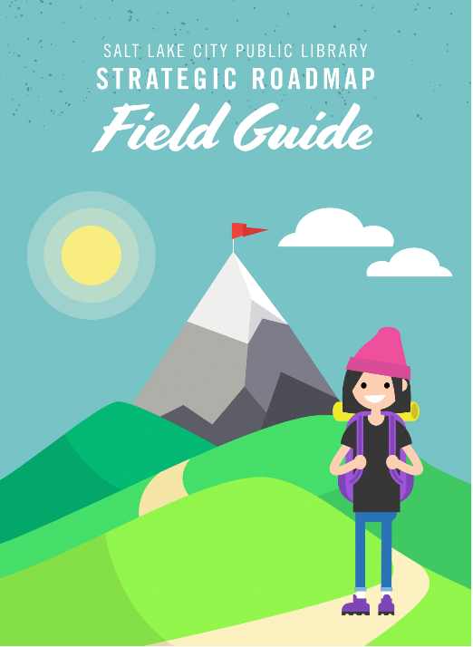
Flexible Framework
Supports all staff to ask:
“What outcomes and experiences are we wanting to create and for whom?”
Everyone is on the journey
oc.lc/wjwebinars
Notes:
Strategic Roadmap Field Guide: https://www.dropbox.com/sh/qjd414qqvsexg2b/AACGRROBdLH7cy9ZQMN2modka?dl=0&preview=SLCPL+Roadmap+Field+Guide+-+2018.pdf
A flexible framework for staff to understand and enhance customer experience
puts service design tools in hands of all staff
It’s a staff empowerment guide –embrace capacity-building; everyone on the journey
It supports staff to continually ask “what outcomes and experiences are we wanting to create and for whom?

Slide 15
Tell Impactful Library Stories
Design
Thinking
Notes:
As a creative problem solving model, Design thinking can also be applied to telling a more impactful library story.

Slide 16
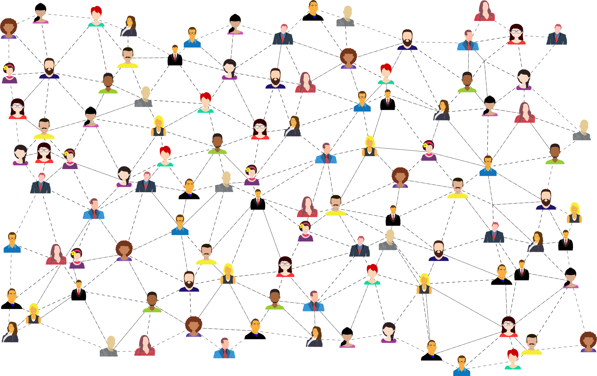
We have to pay attention in a fundamentally different way
Who Are You Talking To?
Networked by GDJ on Pixabay
Notes:
It also begins with strategies that will help you understand your community more deeply and discover the interests and aspirations of target audiences.
No community is monolithic; community is a mesh of individuals, with all their individual hopes, dreams, frustrations, and barriers;
Getting to a deeper understanding of who is in your community applies to communicating your value as much as to service and program design –it is a collaboration
Activities that illuminate where people go, what they do with their time, what are their goals and barriers –all will help shape stories that will resonate with community members
Getting clear about how the library helps people achieve their goals is a starting point for communicating library impact

Slide 17
Craft a Better Story
ARC Phoenix
oc.lc/arc19
Preconference: Design a Powerful Story: Applying Design Principles to Communicate Impact and Promote Value for Public Libraries
Design thinking for advocacy by Christine Prefontaine on Flickr CC BY-SA 2.0
Notes:
We all tend to get stuck in conventional thinking
Design Thinking offers an array of tools that will expand your thinking about possibilities and foster iterative experimentation with solutions.
It can lead to crafting powerful stories that communicate your value to community members and key stakeholders.
Register for ARC Phoenix pre-conference: oc.lc/arc19

Slide 18
Betha Gutsche
WebJunction Programs Manager
gutscheb@oclc.org

