Slide 1
RBMS | 19 June 2019
The Limits to Growth: an Introduction
Chela Scott Weber
Sr. Program Officer
OCLC Research Library Partnership
Notes:
I’m going to start us off today with some framing thoughts and an introduction, which my colleagues will build on in their presentations

Slide 2
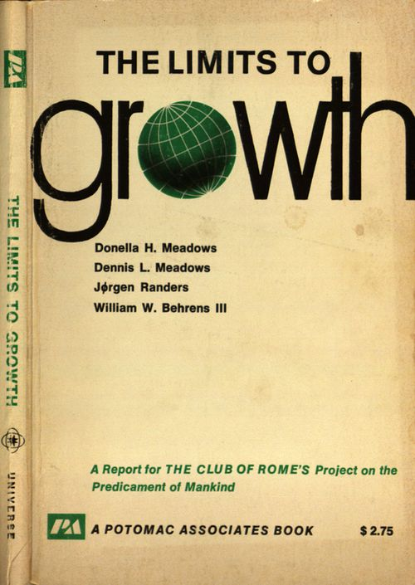
Notes:
In 1972, researchers from MIT published The Limits to Growth, sharing results of computer simulations predicting outcomes for the earth’s resources related to population and economic growth. If growth continued unchecked, they predicted “overshoot and collapse” of global systems by the late 21st century, but that a “sustainable world” was possible if growth patterns altered. Now a touchstone in the environmental movement, it sparked conversations about sustainability that continue today.

Slide 3
A CRISIS MOMENT
AND A CALL TO ACTION
Notes:
The Limits to Growth was a warning and call to action, that the world’s rate of consumption was outpacing our available resources.
It urged that there could be no more business as usual, we were quickly approaching a crisis moment. Growth patterns had to be altered to stay living within the means of our environmental resources, and to avoid “overshoot and collapse” of global systems and communities.
Today I’d like us to think about whether or not we are in our own crisis moment, relative to available resources and collection growth?
To add a little fuel to those thoughts, I offer some facts and figures to reflect on:
Space
2006 ARL Spec Kit survey indicated that 65% of responding ARL libraries are using offsite storage for special collections
2015 survey by McCann and Priddle indicated that 81% of respondents are using offsite for special collections
Backlogs
2009 OCLC report indicated that 50% of archival holdings, 68% of map, 75% of visual materials, and 15% of printed materials in our special collections did not have online catalog records. Certainly this has changed in the ensuing decade, but I’d be very surprised if we’ve fully addressed these backlogs.
Resource consumption in the era of climate change
Tansey has written that HVAC costs will only continue to grow as the environment warms and environmental disasters threaten our collections; insurance costs will grow as risk increases in some areas and collections continue to grow
We know that many repositories are reaching or beyond capacity of their storage spaces, and allocating resources to new facilities and to transportation between offsite storage and reading rooms
Server space and attendant energy consumption will continue to grow as born digital collections and digitization programs grow
Even with significant growth in collections, we recognize that our collections are not at all diverse, equitable, or representative

Slide 4
“over 29,000 linear feet of manuscripts and archives in over 5,500 collections…Among the [institution’s] treasures are approximately 700 cuneiform tablets; 160 medieval and renaissance illuminated manuscripts…”
“over thirteen million manuscripts, 350,000 volumes and bound periodicals, 250,000 images, and thousands of hours of audio tape...”
“On average, the library adds between 10,000 and 15,000 books, 1,200 feet of archival material, and more than 3,000 discrete manuscripts to its holdings each year.”
“over 33,000 books, 1600 archival collections, 1200 oral history interviews, 50,000 photographs, 8,000 artifacts, 300 paintings, and 2,000 maps …”
“over 350,000 volumes of books and other printed materials; more than 11,000 linear feet of archives, and over 100,000 individual and unique media elements”
Notes:
Growth imperative and how we talk about value, growth, improvement
We use growth as a metric of value, and our imperative to grow our collections hasn’t been closely examined
The 2009 survey I previously cited indicated a 50% growth of special collections between 1998-2009.
These are all quotes taken from the websites of special collections libraries – some where I have worked, some which employ many colleagues who I respect and admire – nearly all of speak about our collections in this way, using size and growth as short hand for value and prestige

Slide 5
Collective collections & Shared Print
Notes:
Responding to a crisis of competing resources of their own, our colleagues in the circulating library have developed sophisticated collective collection strategies and technologies as an alternative to building comprehensive collections, and may offer an example of how to rethink goals and value, do intense analysis, and build new models of shared responsibility and regional cooperation

Slide 6
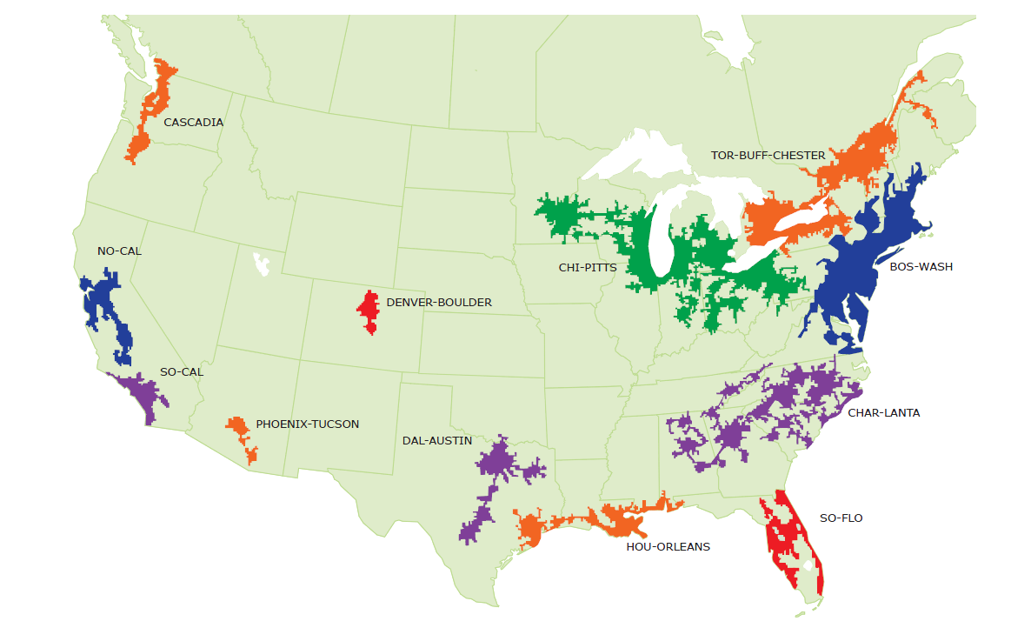
North American Mega-regions
Notes:
In 2012, some of my colleagues at OCLC did work to help us think about our collections collectively, and about what new models for collaboration might look like. They used Richard Florida’s megaregions – large networks of metropolitan regions tied together by infrastructure and circulation of labor and capital, seen in the map above – as a framework for visualizing our collective collections

Slide 7
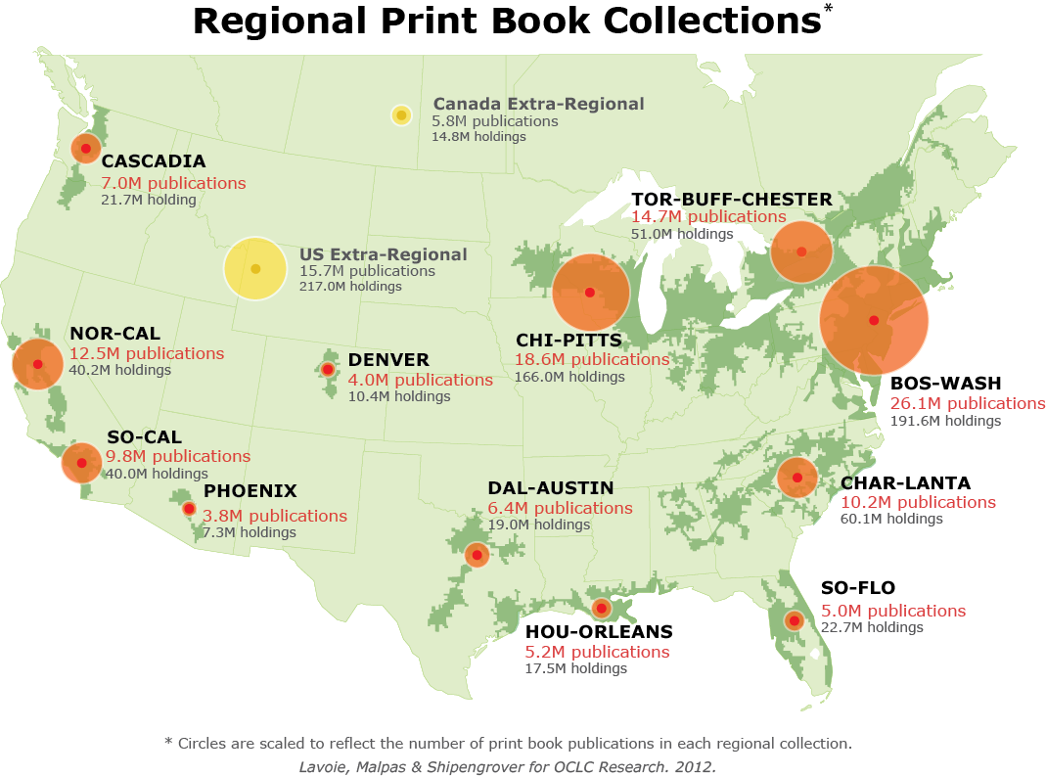
Regional Print Book Collections*
North American print book resource:
45.7 million distinct publications
889.5 million total library holdings
Notes:
Here you can see holdings data from WorldCat mapped to North American megaregions
45.7 million distinct publications
889.5 million total library holdings
Perhaps not surprisingly, the largest area of holdings in the Bosh-Wash region along the NE corridor

Slide 8
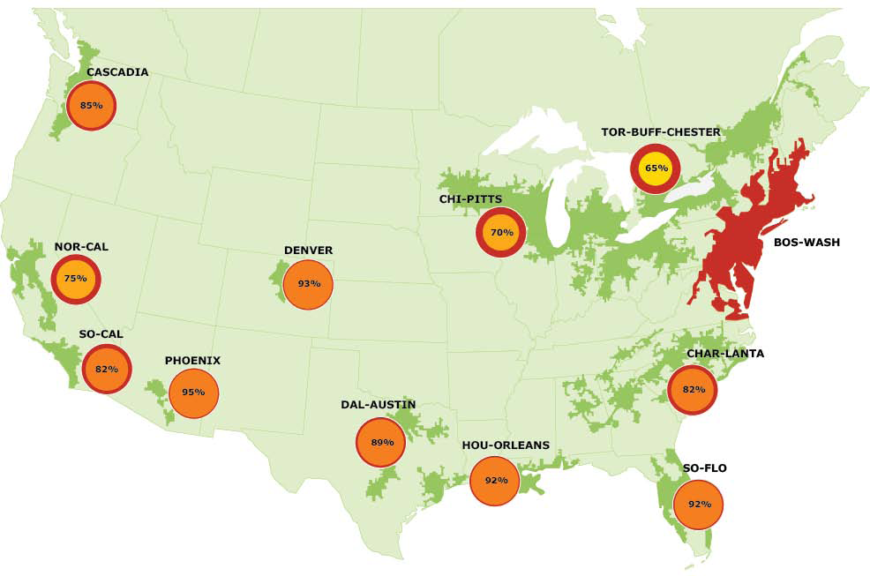
Overlap with BOS-WASH, by region
Lavoie, Malpas, and Shipengrover for OCLC Research, 2012.
Notes:
Here you can see the overlap of the holdings in Bos-Wash with other megaregion collections
You can also see, on both of these maps, how some of these megaregions are or might make sense for regional consortia for ILL and shared collection development.

Slide 9
What can we understand about special collections from looking at and thinking about them collectively, and what evolution of practice might that understanding support?
Notes:
Inspired by this work and by collective collections work more generally, with my colleagues Bruce Washburn and Brian Lavoie, I am in early stages of a research project to use World Cat holdings to identify and map special collections holdings.
We are interested in what we can understand about special collections from looking at and thinking about them collectively, and what evolution of practice might that understanding support.

Slide 10
Research Questions
Can we confidently identify special collections holdings among World Cat records?
What is “recipe” of metadata elements to best identify special collections holdings in among World Cat records?
Notes:
We’ve started this work with a few research questions:
Can we confidently identify special collections holdings among World Cat records?
What is the “recipe” of metadata elements that will best identify special collections holdings in World Cat?

Slide 11
What is the geographic distribution of special collections holdings in North America?
How scarce are are holdings in special collections in North American, and what is the distribution of duplication in holdings across institutions?
Research Questions
Notes:
What is the geographic distribution of special collections holdings in North America?
How scarce are holdings in special collections in North America, and what is the distribution of duplication in holdings across institutions?

Slide 12
Challenges (so far)
Definitional challenge: what do we consider special collections?
Data challenge: does our data support identifying special collections?
Notes:
As I said, we are in early stages of this work.
Definitional: what do we consider special collections
The tautological definition that it’s special if it’s in special collections isn’t especially useful for this data set, especially because most special collections don’t have their own OCLC or MARC institution code
Data: does our data support identifying special collections
We know we currently don’t have quite the right query parameters to confidently identify a significant majority of the special collections holdings in WorldCat, and are working on refining this. I welcome any discussion or suggestions anyone in the audience might have.

Slide 13
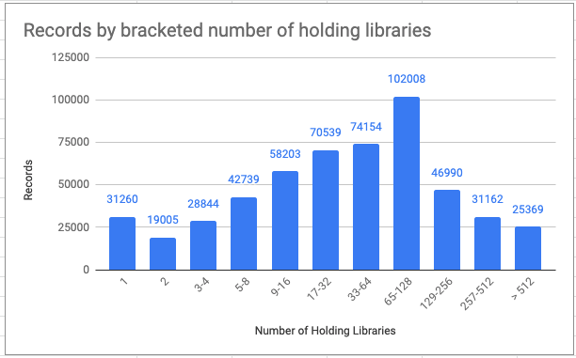
Notes:
So, this is a diagram of the holdings of a stand alone special collections repository at a major US ARL library, mapped in what Dan Cohen has dubbed the Wilkins Curve, after some work John Wilkins did comparing Hathi Trust holdings to individual research library holdings, back when John was the director of Hathi.
The X axis is the number of libraries that hold a particular record, the Y axis is the number of records held in this specific library.
We have more work to do before I can tell you if this is a typical Wilkins curve for special collections repositories.
But I’d like to ask us to reflect on this graph today, nonetheless. Given the way that we talk about rarity, scarcity, and value in special collections:
Is this what you would expect to see?
What do you think your institution look like?

Slide 14
Embedding Sustainability & Resiliency
In Our Practice
“Sustainability is not just about building design or waste streams—it is also about the acquisition, appraisal, processing, and outreach choices archivists make on a daily basis as part of professional practice.“
– Tansey, 2015
Notes:
Our colleague Eira Tansey, in a 2015 article in Sustainability: Science, Practice, and Policy wrote:
Sustainability is not just about building design or waste streams—it is also about the acquisition, appraisal, processing, and outreach choices archivists make on a daily basis as part of professional practice.
She goes on to say that:
Sustainability and resiliency in an archival context form a complementary relationship. Sustainable choices enable archives [and special collections] to be resilient in the face of climate-change threats. Sustainable archival [& special collections] practice means making present-day archival [& special collections] choices that enable future archivists [and special collections librarians] to carry out their jobs and ensures survival of cultural heritage.

Slide 15
William Stingone
New York Public Library
Associate Director, Preservation & Special Collections Processing
Shannon K. Supple
Smith College
Curator of Rare Books
Maureen Callahan
Smith College
Sophia Smith Collection Archivist
Notes:
Our panel today aims to think about what sustainable choices might look like, that could support resiliency for our repositories and our parent institutions in the long run. Today we will hear from three panelists who will explore our responsibilities related to resource allocation and collection growth in the age of climate change, imagine what it might look like to alter our growth patterns, and consider what we might lose or gain in the process.
Maureen Callahan
Shannon K. Supple
William Stingone

Slide 16


Notes:
Thank you!

Slide 17
Works Cited
Cohen, Dan. “Visualizing the Uniqueness, and Conformity, of Libraries – Dan Cohen.” Dancohen.Org (blog), December 13, 2012. http://dancohen.org/2012/12/13/visualizing-the-uniqueness-and-conformity-of-libraries/.
Dempsey, Lorcan, Brian Lavoie, Constance Malpas, Lynn Silipigni Connaway, Roger Schonfeld, JD Shipengrover, and Gunter Waibel. “Understanding the Collective Collection: Towards a System-Wide Perspective on Library Print Collections.” Dublin, OH: OCLC Research, 2013. https://www.oclc.org/research/publications/library/2013/2013-09r.html.
Dooley, Jackie, and Katherine Luce. “Taking Our Pulse: The OCLC Research Survey of Special Collections and Archives.” Dublin, OH: OCLC Research, 2010. http://www.oclc.org/content/dam/research/publications/library/2010/2010-11.pdf.
Priddle, Charlotte, and Laura McCann. “Off-Site Storage and Special Collections: A Study in Use and Impact in ARL Libraries in the United States.” College & Research Libraries 76, no. 5 (2015): 652–70. https://doi.org/10.5860/crl.76.5.652.
Tansey, Eira. “Archival Adaptation to Climate Change.” Sustainability: Science, Practice, & Policy 11, no. 2 (Fall 2015). https://doi.org/doi:10.7945/C2RC7N.

