Slide 1
Using Qualitative Methods for Library and Information Science Research:
An Interactive Workshop
Lynn Silipigni Connaway, PhD
Director of Library Trends and User Research, OCLC
connawal@oclc.org
@LynnConnaway

Slide 2
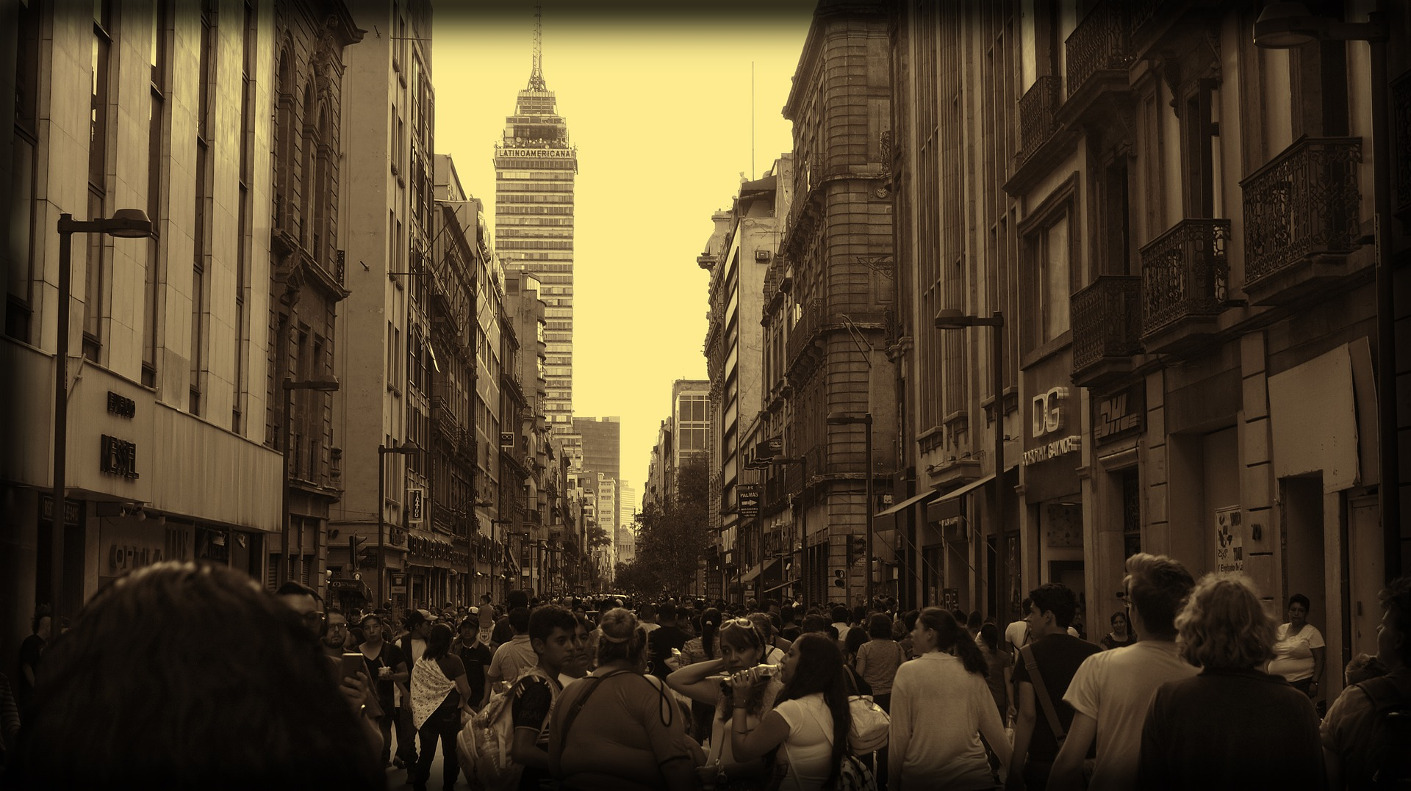
“Much of the library-related research has been applied research dealing with everything from evaluating e-collections, to assessment of reference services, to analyzing integrated library systems.”
(Connaway & Radford, 2017)
Image: https://pixabay.com/photos/mexico-city-mexico-city-mexican-2706607/ by Xavier Espinosa / Pixabay License
Notes:
Image: https://pixabay.com/photos/mexico-city-mexico-city-mexican-2706607/ by Xavier Espinosa / Pixabay License
Two types of research:
Basic:
“deriv[es] new knowledge and is at most only indirectly involved with how that knowledge will be applied to specific, practical, or real problems” (Connaway & Radford, 2017)
Produces generalizable findings; can be applied to a larger population than the sample
Applied:
Solves specific problems in real situations
Majority of LIS research
Basic and applied research are not dichotomous
Connaway, L. S., & Radford, M. L. (2017). Research methods in library and information science. Santa Barbara: Libraries Unlimited.

Slide 3

Image: https://pixabay.com/photos/books-students-library-university-1281581/ by Pexels / Pixabay license
Method: “Any procedure employed to attain a certain end” (e.g., focus groups)
Methodology: “A study of the plans which are used to obtain knowledge”
(Runes, 2001, 346)
(Polkinghorne, 1983, 5)
Notes:
Image: https://pixabay.com/photos/books-students-library-university-1281581/ by Pexels / Pixabay license
Methods and methodology:
Methods and methodology often used interchangeably when that’s not the case
Method:
“Any procedure employed to attain a certain end” (Runes, 2001, 346)
End is the data to be gathered and method is the means by which data is gathered
Quantitative (numbers), qualitative (participant accounts), mixed methods (e.g., combination of quant and qual)
Methodology:
Broader term than method
“A study of the plans which are used to obtain knowledge” as defined by (Polkinghorne, 1983, 5)
Strategies surrounding the use of multiple methods to achieve higher degrees of reliability and validity
Runes, D. D. (Ed.). (2001). The dictionary of philosophy. New York, NY: Citadel Press.
Polkinghorne, D. (1983). Methodology for the human sciences: Systems of inquiry. Albany, NY: State University of New York Press.
Connaway, L. S., & Radford, M. L. (2017). Research methods in library and information science. Santa Barbara: Libraries Unlimited.

Slide 4
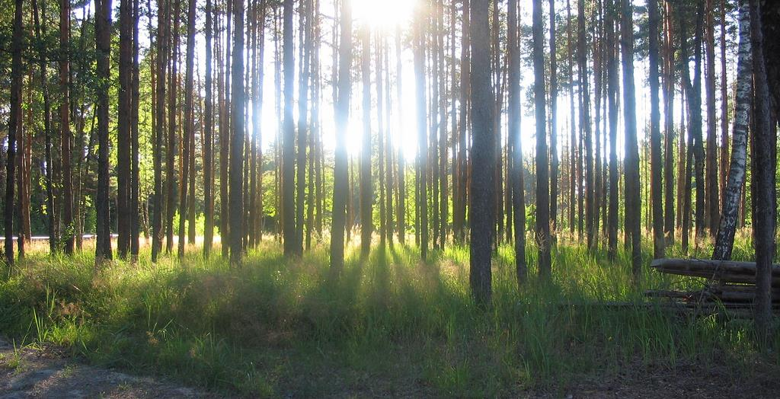
“To identify how and why people get information, it is necessary first to listen.”
(Connaway, 2017)
Image: https://www.flickr.com/photos/pjotr_savitski/2701378287 by Pjotr Savitski / CC BY 2.0
Notes:
Image: https://www.flickr.com/photos/pjotr_savitski/2701378287 by Pjotr Savitski / CC BY 2.0
“Unless we understand students’ lives, we will not be able to fit within their natural information flows. Opportunities become clearer when we begin by simply walking on campus, sitting in on classes, and strolling through the library, student centers, and other campus locations. These actions allow librarians to observe, listen, and note how students and faculty are communicating, studying, learning, teaching, and interacting in everyday life situations.“
Connaway, L. S. (2017, June 19). Putting the library in the life of the user: Listen, then lead, to promote a unique and compelling role for academic libraries. Guest of Choice, Choice360 blog. Retrieved from http://www.choice360.org/blog/putting-the-library-in-the-life-of-the-user

Slide 5
Define the problem

Slide 6
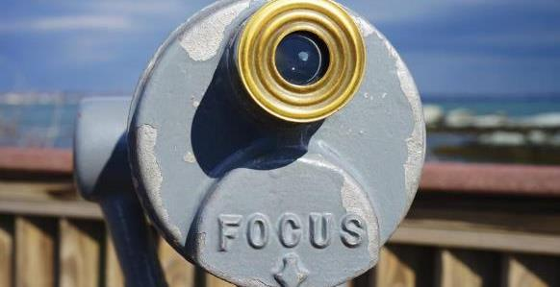
Define the problem
Image: https://www.flickr.com/photos/iain/13298441884 by Iain Farrell / CC BY-ND 2.0
User in context
Community perspective
Ask the right question(s)
Notes:
Image: https://www.flickr.com/photos/iain/13298441884 by Iain Farrell / CC BY-ND 2.0
First step in the process is about defining the problem, which is about finding focus.
We’re talking about ethnography today, so you shouldn’t be surprised to see that our focus is the user.
In this step, we want to learn about users and our communities.
And we need to figure out what questions to ask.

Slide 7
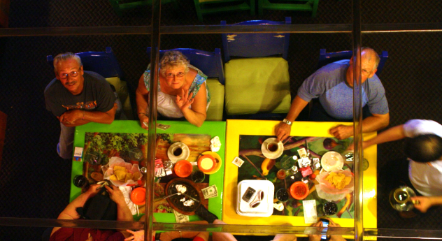
Define the problem: User in context
Image: https://www.flickr.com/photos/sugarhiccuphiccup/4843083598 by Troy Tolley / CC BY-ND 2.0
Notes:
Image: https://www.flickr.com/photos/sugarhiccuphiccup/4843083598 by Troy Tolley / CC BY-ND 2.0
It should be obvious to be thinking about users, but…
Because we’re thinking about libraries and library service all the time, it’s easy to become too focused on ourselves, our organizations and our processes.
We want to serve our patrons, our students, our customers, so we need to FOCUS on them.
Don’t forget about the context!
People exist in complex contexts – they have different families and traditions, backgrounds and challenges – and, as a result, have different needs, perspectives and behaviors.
As we’re developing our focus, we want to be thinking about how we can learn about people and their lives.

Slide 8
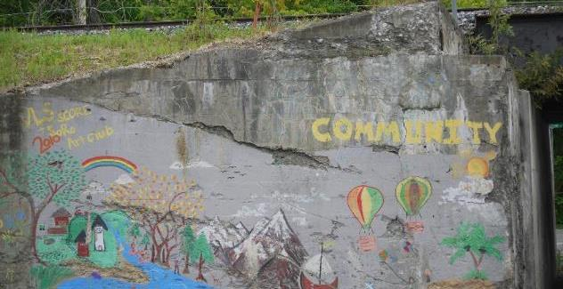
Define the problem: Community perspective
Image: https://www.flickr.com/photos/grongar/8736701984 by Rebecca Siegel / CC BY 2.0
Notes:
Image: https://www.flickr.com/photos/grongar/8736701984 by Rebecca Siegel / CC BY 2.0
People have their personal contexts, but also their community contexts
Other services – e.g., rec centers, museums, parks
Social issues – e.g., opioid crisis
Political issues – e.g., funding issues
What is going on in the community? How are community issues impacting people’s lives? Where does the library fit in?
Also, coming from a public library perspective, we offer so many services and most people only use a small sample of what we offer
Upper middle class folks don’t use free printing for job seekers
Empty-nesters don’t come to story times
If we focus only on what people PERSONALLY value, we’re only seeing part of the story.
If we focus on what is of value to the community as a WHOLE, those upper middle class folks and empty nesters probably support free resume printing and storytimes.

Slide 9
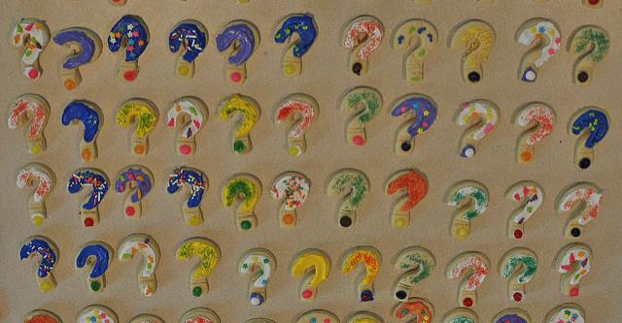
Define the problem: Ask the right question(s)
Image: https://www.flickr.com/photos/mcleod/7150176087 by Scott McLeod / CC BY 2.0
Notes:
Image: https://www.flickr.com/photos/mcleod/7150176087 by Scott McLeod / CC BY 2.0
Here, as we’re defining the problem, you may be asking yourself questions like
when should we staff our reference desk?
how should we furnish our study rooms?
what topics should we focus on for programming?
what new services should we offer?
But these are NOT the right questions to pose to your users.
As much as we may wish it were so, the library is not the center of people’s lives.
You are a library expert.
You know about staffing models and limitations.
You know about the furniture Demco offers.
You hear about the buzz around wireless hotspots, or makerspaces or 3D printers.
Your users are the experts in their own lives.
Separate your overarching research question from the question(s) that you post to your users.
The right questions will focus on your audience in the context of their everyday lives and within your community. You should NOT be asking them how to do your job.
The idea of a “stupid question” sounds harsh, but I’m going to give you an example later of a stupid question I myself asked.

Slide 10
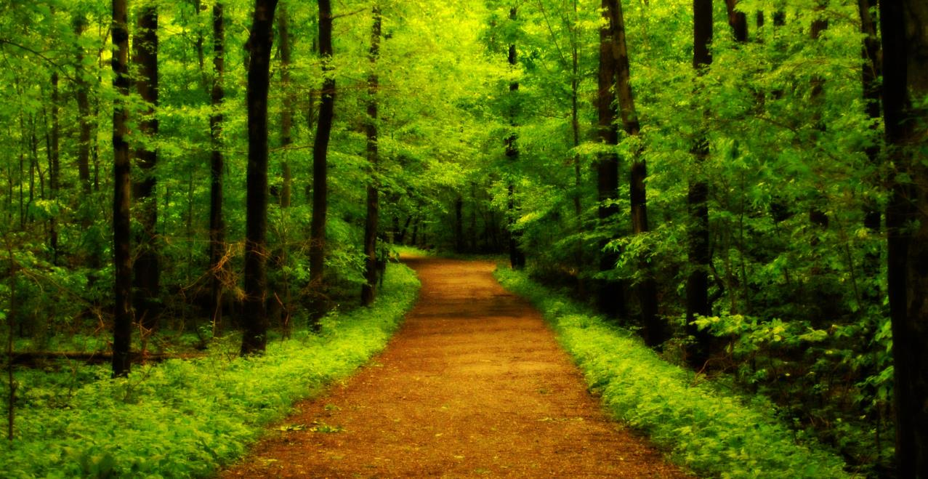
Qualitative Research Definition
A type of scientific research that:
Seeks answers to a question
Systematically uses predefined set of procedures to answer question
Collects evidence
Produces findings that:
Are not determined in advance
Apply beyond immediate boundaries of study
Image: https://www.flickr.com/photos/katesheets/5772901616/ by katesheets / CC BY-NC 2.0
Notes:
Image: https://www.flickr.com/photos/katesheets/5772901616/ by katesheets / CC BY-NC 2.0

Slide 11
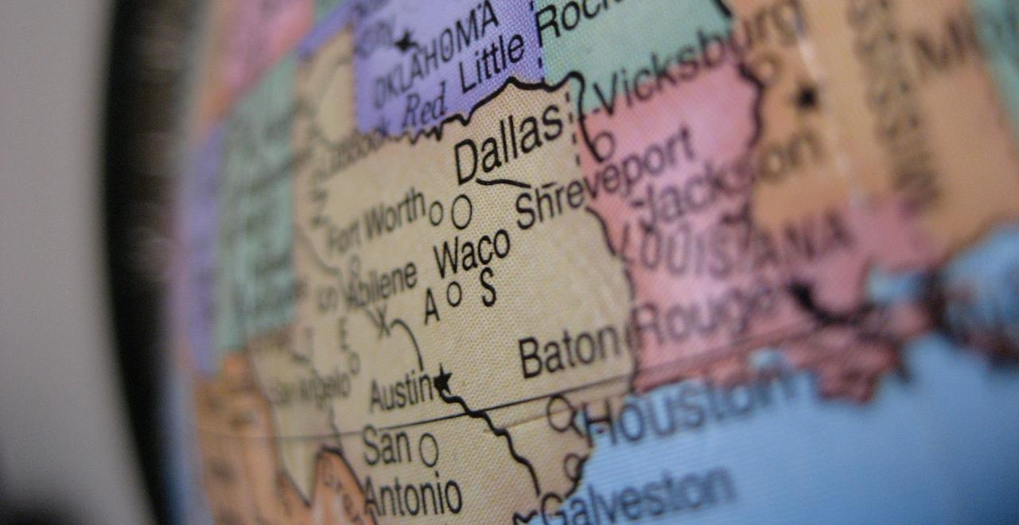
What is Qualitative Research?
“…a situated activity that locates the observer in the world. It consists of a set of interpretive, material practices that make the world visible. These practices transform the world. They turn the world into a series of representations, including field notes, interviews, conversations, photographs, recordings, & memos to the self.
At this level, qualitative research involves an interpretive, naturalistic approach to the world. This means that qualitative researchers study things in their natural settings, attempting to make sense of, or to interpret, phenomena in terms of the meanings people bring to them.”
(Denzin and Lincoln, 2005)
Image: https://www.flickr.com/photos/ddrmaxgt37/387453140/ by Arun Venkatesan / CC BY-NC 2.0
Notes:
Image: https://www.flickr.com/photos/ddrmaxgt37/387453140/ by Arun Venkatesan / CC BY-NC 2.0
The content for this slide is from Marie L. Radford, Ph.D. qualitative research methods lecture notes.
Denzin, Norman K., and Yvonna S. Lincoln. 2005. The Sage Handbook of Qualitative Research, 4th ed. Thousand Oaks, CA: Sage Publications.

Slide 12
Qualitative Research
Data collection Methods and Tools

Slide 13
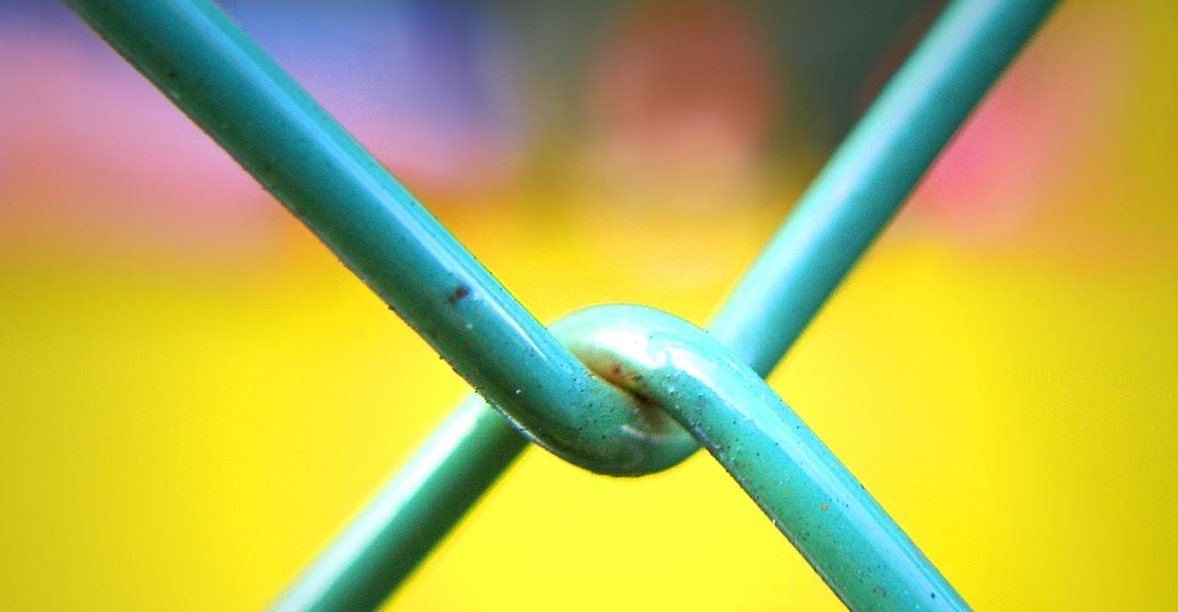
Qualitative Research Data Collection
Interviews
Diaries
Observation
Usability Testing
Image: https://www.flickr.com/photos/28481088@N00/3091698923/ by tanakawho / CC BY-NC 2.0
Notes:
Image: https://www.flickr.com/photos/28481088@N00/3091698923/ by tanakawho / CC BY-NC 2.0
“For me, the power of ethnographic research derives from its synthetic approach of integrating multiple data sources to create interpretive understandings of social and cultural processes.”
~Andrew Asher, in Connaway & Radford (2017), page 264
Asher, Andrew. 2017. “On Ethnographic Research: How do Students Find the Information They Need?” In Research methods for library and information science, 6th ed., edited by Lynn Silipigni Connaway and Marie L. Radford, 264. Santa Barbara: Libraries Unlimited.

Slide 14
Interviews
Conversation involving two or more people guided by a predetermined purpose.
Notes:
Adapted from
Lederman, L. C. (1996). Asking questions and listening to answers: A guide to using individual, focus group, and debriefing interviews. Dubuque, IA: Kendall/Hunt.

Slide 15
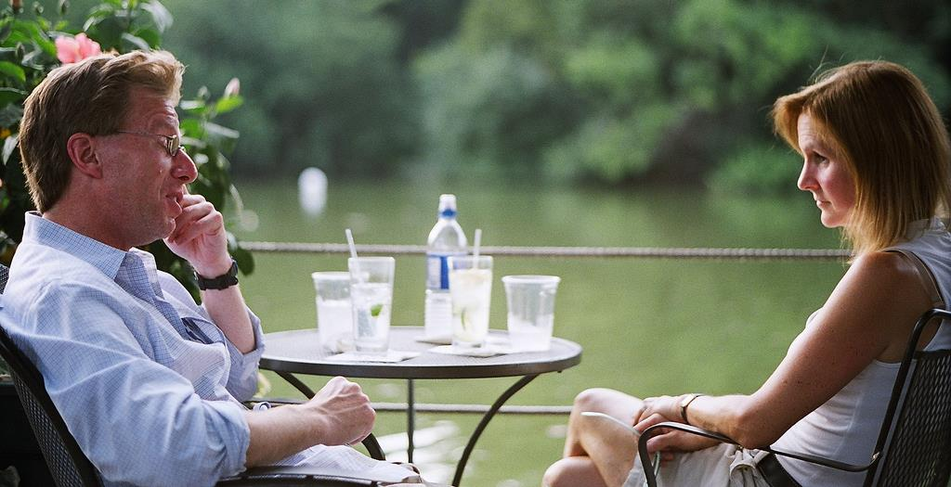
Types of Interviews
Structured
Semi-structured
Formats
Individual
Face-to-face
Telephone
Skype
Focus group interviews
Image: https://www.flickr.com/photos/allkindsofnew/9500650217 by Harold Navarro / CC BY-ND 2.0
Notes:
Image: https://www.flickr.com/photos/allkindsofnew/9500650217 by Harold Navarro / CC BY-ND 2.0

Slide 16
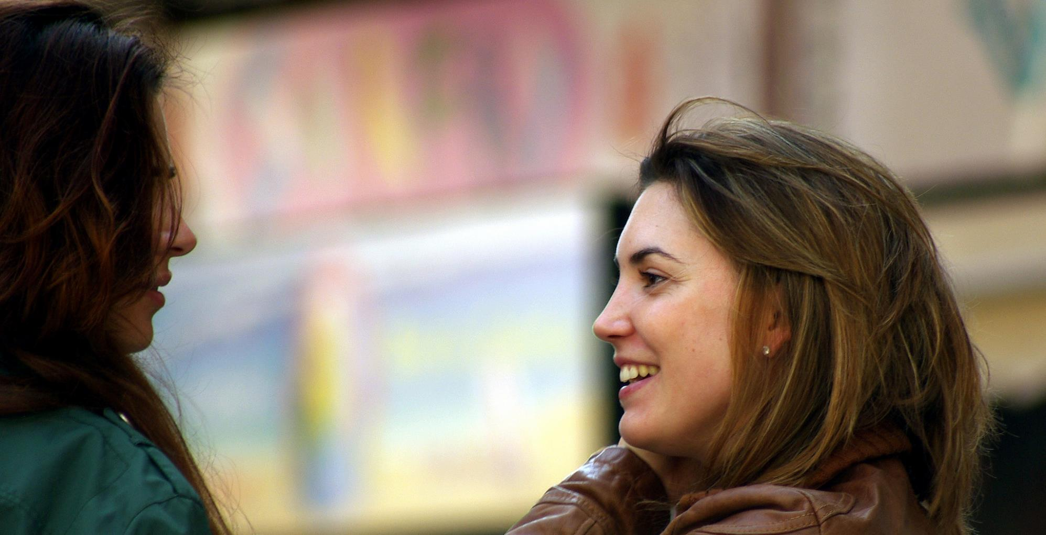
Image: https://www.flickr.com/photos/10332960@N03/13305699454 by John Blower / CC BY-NC-ND 2.0
Key components
Good questions
Good listening skills
Good interpersonal skills
Notes:
Image: https://www.flickr.com/photos/10332960@N03/13305699454 by John Blower / CC BY-NC-ND 2.0

Slide 17
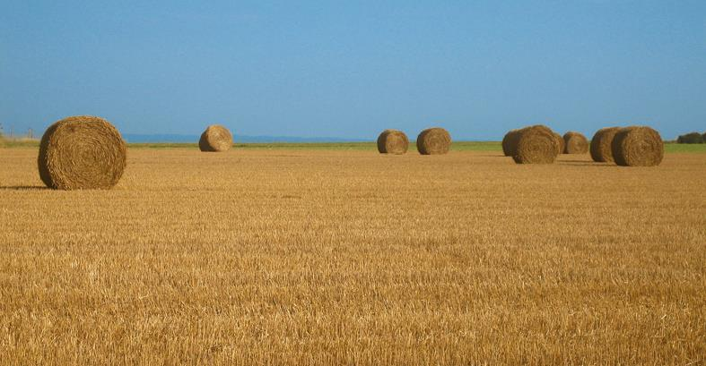
Conducting the Interview
Thematizing: Clarifying the interview’s purpose
Designing: Defining the interview’s purpose
Interviewing: Conducting the interview
Transcribing: Creating a written verbatim text of the interview
Analyzing: Figuring out the meaning of data
Verifying: Determining the reliability & validity of the data
Reporting: Telling others about the findings
(Connaway and Radford 2017, 244)
Image: https://www.flickr.com/photos/meanestindian/903380690 by Meena Kadri / CC BY 2.0
Notes:
Image: https://www.flickr.com/photos/meanestindian/903380690 by Meena Kadri / CC BY 2.0
“Thematizing: Clarifying the interview’s purpose and the concepts to be explored.
Designing: Defining the interview’s purpose and the concepts to be considerations.
Interviewing: Conducting the interview.
Transcribing: Creating a written verbatim text of the interview.
Analyzing: Figuring out the meaning of data in relation to the study’s research questions.
Verifying: Determining the reliability and validity of the data.
Reporting: Telling others about the findings.” (Connaway and Radford 2017, 244)
Connaway, L. S., & Radford, M. L. (2017). Research methods in library and information science. Santa Barbara: Libraries Unlimited.

Slide 18

Ethnographic Interview
Incredibly detailed data
Time consuming
Establishing rapport
Selecting research participants
Transcribing observations & conversations
Image: https://www.flickr.com/photos/nordforsk/32225539214 by NordForsk / CC BY-NC-ND 2.0
Notes:
Image: https://www.flickr.com/photos/nordforsk/32225539214 by NordForsk / CC BY-NC-ND 2.0
Ethnographic interviews are immersive. Generally the interviewee is in their natural habitat. The interviewer is observing them in this habitat. The interviewer is asking pointed questions about what the respondent is doing and feeling. These are typically conducted one on one.
Connaway, L. S., & Radford, M. L. (2017). Research methods in library and information science. Santa Barbara: Libraries Unlimited.
Khoo, M., Rozaklis, L., & Hall, C. (2012). A survey of the use of ethnographic methods in the study of libraries and library users. Library and Information Science Research, 34(2), 82-91.

Slide 19
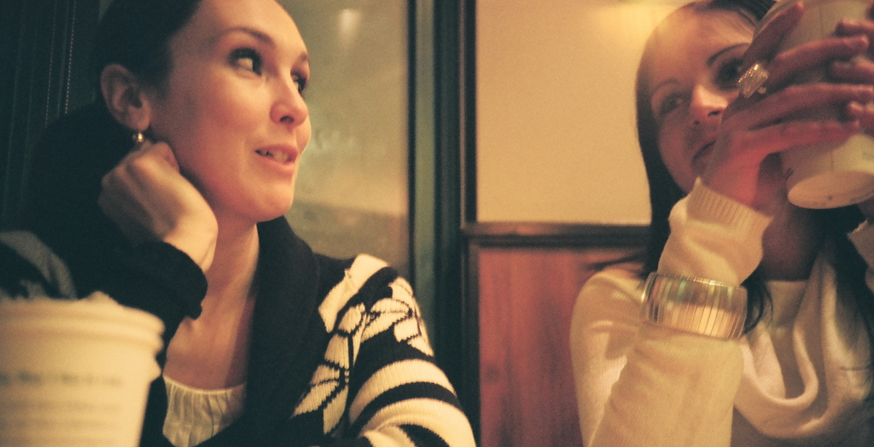
Respondent Interviews
In-depth
Social relationship/rapport between interviewee & interviewer
Rapport/relationship key element
Image: https://www.flickr.com/photos/anyalogic/2315310261 by Anna Levinzon / CC BY 2.0
Notes:
Image: https://www.flickr.com/photos/anyalogic/2315310261 by Anna Levinzon / CC BY 2.0
This type of interview is in-depth.
The interview centers around the interviewer and interviewee building a rapport.
This rapport allows the interviewee to feel comfortable and relaxed in the environment. This is key as it allows the interviewer to ask questions that may be considered personal.

Slide 20

Example:
Digital Visitors & Residents Informant Questions
1. Describe the things you enjoy doing with technology and the web each week.
2. Think of the ways you have used technology and the web for your studies. Describe a typical week.
3. Think about the next stage of your education. Tell me what you think this will be like.
(White & Connaway, 2011)
Image: https://pixabay.com/photos/library-la-trobe-study-students-1400313/ by Andrew Tan / Pixabay License
Notes:
Image: https://pixabay.com/photos/library-la-trobe-study-students-1400313/ by Andrew Tan / Pixabay License
The content for this slide is from Marquette Workshop Presentation
White, D. S., & Connaway, L. S. (2011-2014). Digital visitors and residents: What motivates engagement with the digital information environment. Funded by JISC, OCLC, and Oxford University. http://www.oclc.org/research/activities/vandr.html

Slide 21
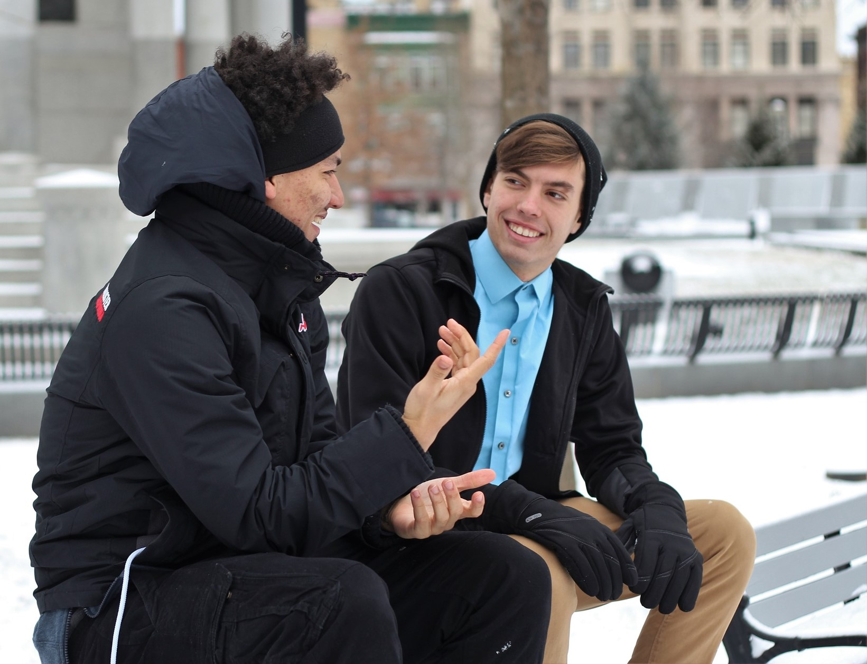
Narrative interviews
One-on-One environment
Unstructured
Interviewees are telling a story
Interviewer questions are minimal
https://pixabay.com/photos/friends-male-men-outside-winter-1209740 by Free-Photos / Pixabay License
Notes:
https://pixabay.com/photos/friends-male-men-outside-winter-1209740 by Free-Photos / Pixabay License
This type of interview is about letting the respondent tell a story. They are narrating the interview and there is not lot of input from the interviewer.
Interviewers keep their questions to a minimum so as not to lead the respondent.
It is unstructured.
These interviews are conducted one-on-one.

Slide 22
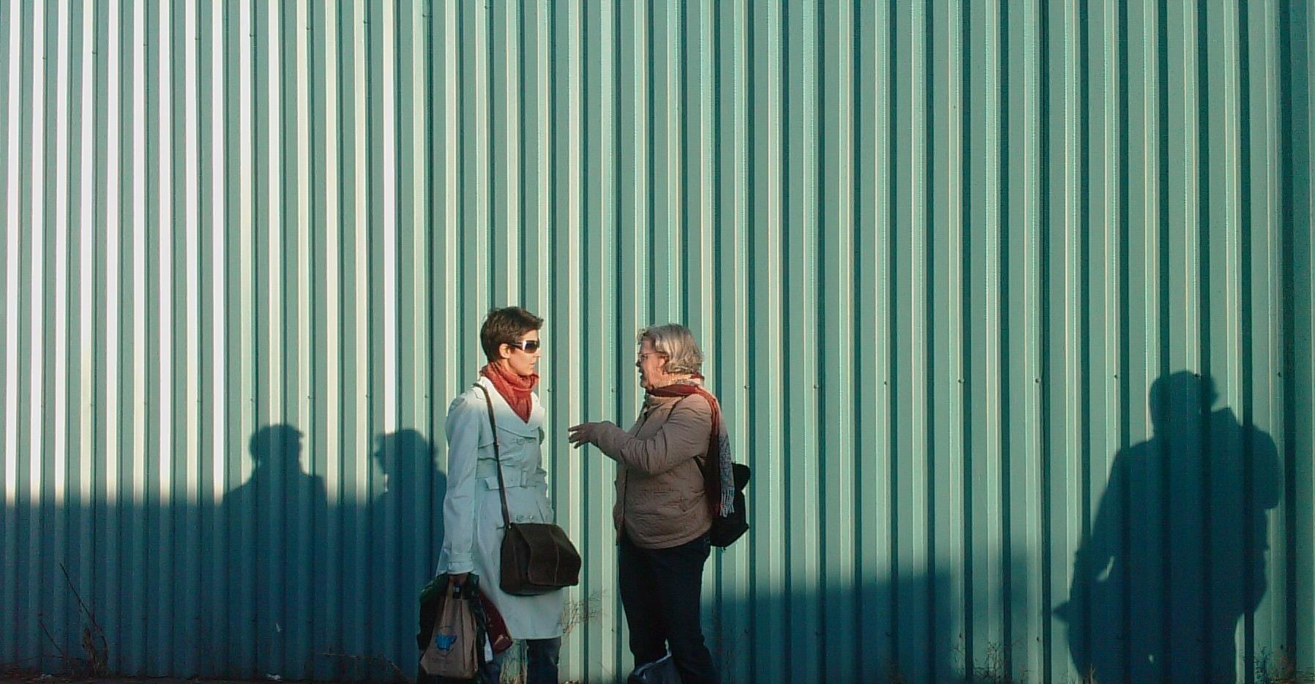
Neutral
“What are your impressions of Raynor Memorial Libraries?”
Leading
“You don’t like the librarians at Raynor Memorial Libraries, do you?”
Loaded
“How many other unreasonable requests have you made to our librarians?”
Neutral, Leading, & Loaded Questions
Image: https://www.flickr.com/photos/robwatling/5089229734 by Rob Watling / CC BY-NC-ND 2.0
Notes:
Image: https://www.flickr.com/photos/robwatling/5089229734 by Rob Watling / CC BY-NC-ND 2.0

Slide 23
ACTIVITY
Interviewing Exercise

Slide 24
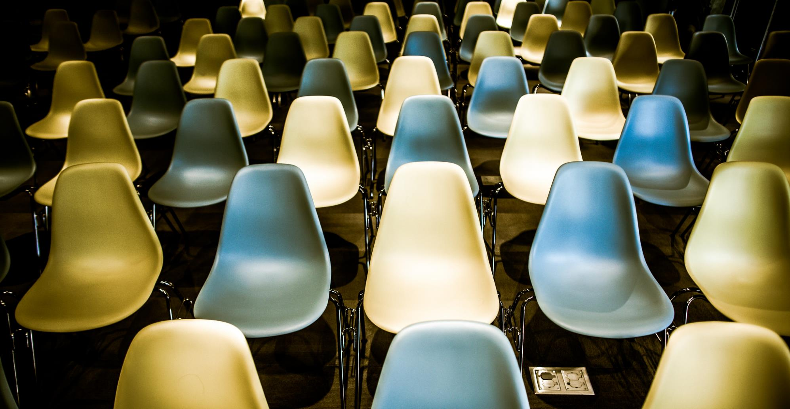
Image: https://www.flickr.com/photos/thomashawk/12012985364 by Thomas Hawk / CC BY-NC 2.0
Interviews: Advantages
Face-2-face interaction
In-depth information
Understand experiences & meanings
Highlight individual’s voice
Preliminary information to “triangulate”
Control sampling
Include underrepresented groups
Greater range of topics
Notes:
Image: https://www.flickr.com/photos/thomashawk/12012985364 by Thomas Hawk / CC BY-NC 2.0

Slide 25

Interviews: Disadvantages
Time Factors
Varies by # & depth
Staff intensive
Cost Factors
Higher the #, higher the cost
Additional Factors
Self-reported data
Errors in note taking possible
Image: https://www.flickr.com/photos/29668365@N08/2777606227 by D$\acute{\text{a}}$nae / CC BY 2.0
Notes:
Image: https://www.flickr.com/photos/29668365@N08/2777606227 by D$\acute{\text{a}}$nae / CC BY 2.0

Slide 26

Sampling for the Interview
Key features of qualitative sampling
Work with small samples of people nested in their context
Tend to be purposive rather than random
Often theory-driven
Actions involving the sampling for interview
Setting boundaries
Creation of a sampling frame
(Miles & Huberman, 1994)
(Miles & Huberman, 1994)
Image: https://www.flickr.com/photos/khouri/6793949601/ by Michael Cory CC BY-NC 2.0
Notes:
Image: https://www.flickr.com/photos/khouri/6793949601 by Michael Cory / CC BY-NC 2.0
Baik, E., Seol, K., Pichugin, A.E., & Sun, Si. Presentation 603: Qualitative Approaches Seminar Asking Questions - The Interview.
Miles, M., & Huberman, A. M. (1994). Qualitative data analysis: An expanded sourcebook (2nd ed.). Thousand Oaks, CA: Sage Publications.

Slide 27
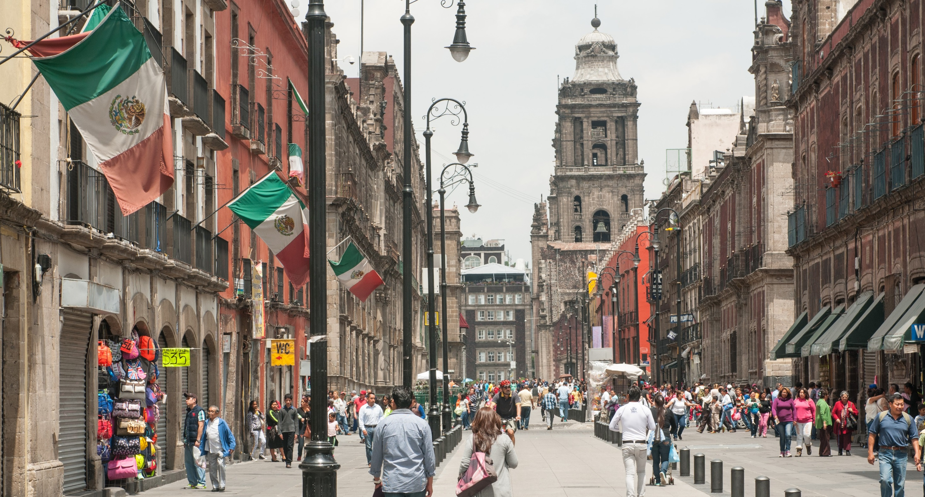
Image: https://commons.wikimedia.org/w/index.php?curid=42053729 by Ralf Roletschek / GNU FDL Version 1.2
Conducting the Interview
Recording the Interview
Note Taking can be done anywhere/ not depending on devices/ avoiding mechanical failure/ but a deterrent to mind wandering and distractions/ limitation on loss of data (can’t write down everything)
Audio Recording is capturing and preserving all interview discourses with little effort by the researcher/ engage in more fully in the conversation/ peruse the content of the talk and its paralinguistic aspects
(Lindlof & Taylor, 2010)
Notes:
Image: https://commons.wikimedia.org/w/index.php?curid=42053729 by Ralf Roletschek / GNU FDL Version 1.2
Baik, E., Seol, K., Pichugin, A.E., & Sun, Si. Presentation 603: Qualitative Approaches Seminar Asking Questions - The Interview.
Lindlof, T., & Taylor, B. (2010). Qualitative communication research methods (3rd ed.). Thousand Oaks, CA: Sage Publications.

Slide 28
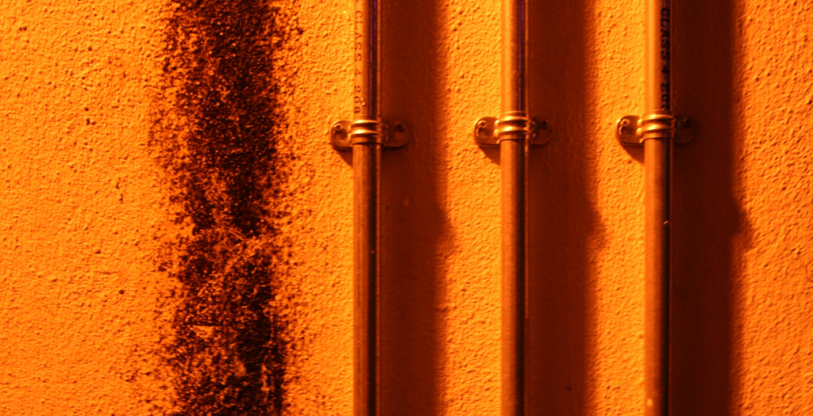
Conducting the Interview
Listening
Listening = the most crucial way to build rapport after an interview has started
Listening = paying attention
Active listening
as the conversation unfolds, you monitor your own understandings in relation to the possible meanings of what the person is saying
suggest questions that are urgent enough to warrant breaking into the subject’s talk
not being a caretaker for the audio recorder
(Lindlof & Taylor, 2010)
Image: https://www.flickr.com/photos/108404544@N07/12941711194 by Chris Searle / CC BY-NC-ND 2.0
Notes:
Image: https://www.flickr.com/photos/108404544@N07/12941711194 by Chris Searle / CC BY-NC-ND 2.0
Baik, E., Seol, K., Pichugin, A.E., & Sun, Si. Presentation 603: Qualitative Approaches Seminar Asking Questions - The Interview.
Lindlof, T., & Taylor, B. (2010). Qualitative communication research methods (3rd ed.). Thousand Oaks, CA: Sage Publications.

Slide 29
ACTIVITY
Listening Behaviors Exercise: Self-Assessment

Slide 30
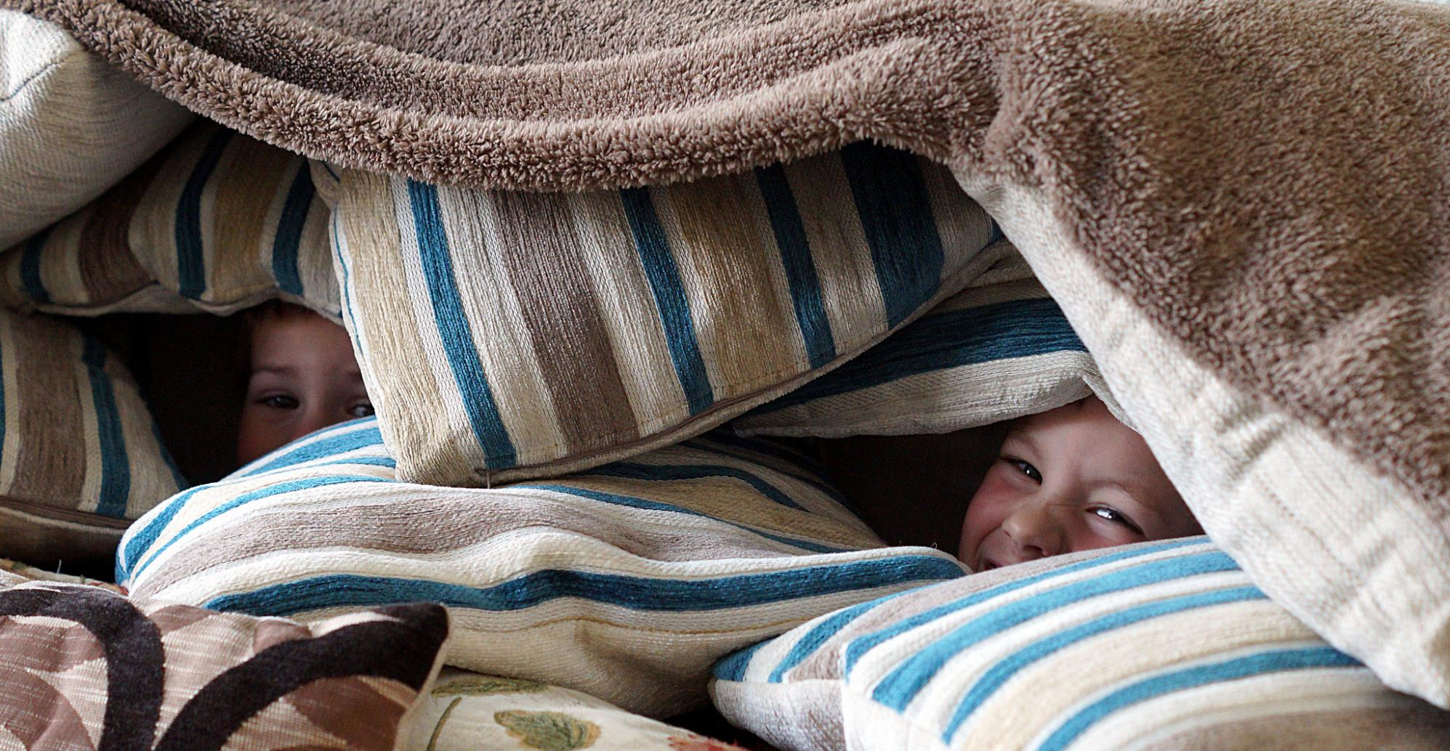
Image: https://www.flickr.com/photos/62833283@N00/17217078330 by Seamus McCauley / CC BY 2.0
Conducting Interviews
Obtain permission to use information
Report and/or publication
Create safe climate, assure confidentiality
Be prepared, flexible, & stay on task
Listen & know when to probe
Accept that some interviews won’t go well
Thank them!
Notes:
Image: https://www.flickr.com/photos/62833283@N00/17217078330 by Seamus McCauley / CC BY 2.0

Slide 31
Break Time!

Slide 32
“…interview of a group of 8 to 12 people representing some target group and centered on a single topic.”
Focus Group Interviews
(Zweizig, Johnson, Robbins, & Besant, 1996)
Notes:
Zweizig, D., Johnson, D. W., Robbins, J., & Besant, M. (1996). The tell it! manual. Chicago: ALA.

Slide 33
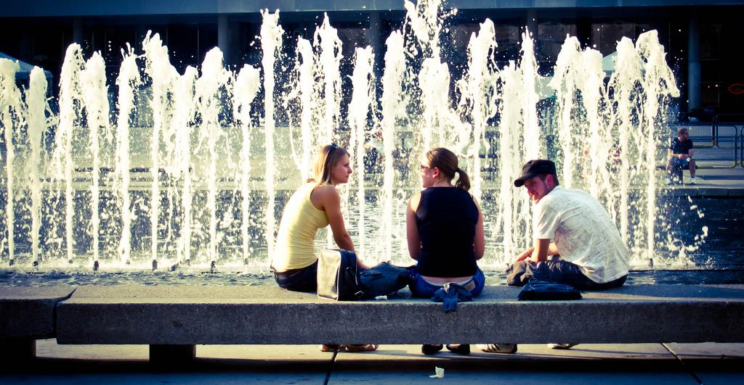
Focus Group Interviews: Advantages
Advantages of individual interviews plus…
Take less time.
Create synergy
Comments stimulate others
Unexpected insight
Access needs of under-served or underrepresented groups
Image: https://www.flickr.com/photos/bensonkua/4839019821/ by Benson Kua / CC BY-SA 2.0
Notes:
Image: https://www.flickr.com/photos/bensonkua/4839019821/ by Benson Kua / CC BY-SA 2.0
Create synergy
Comments stimulate others
Unexpected insight
More complete information
Elicit strong & common opinions
Less inhibiting, less formal

Slide 34
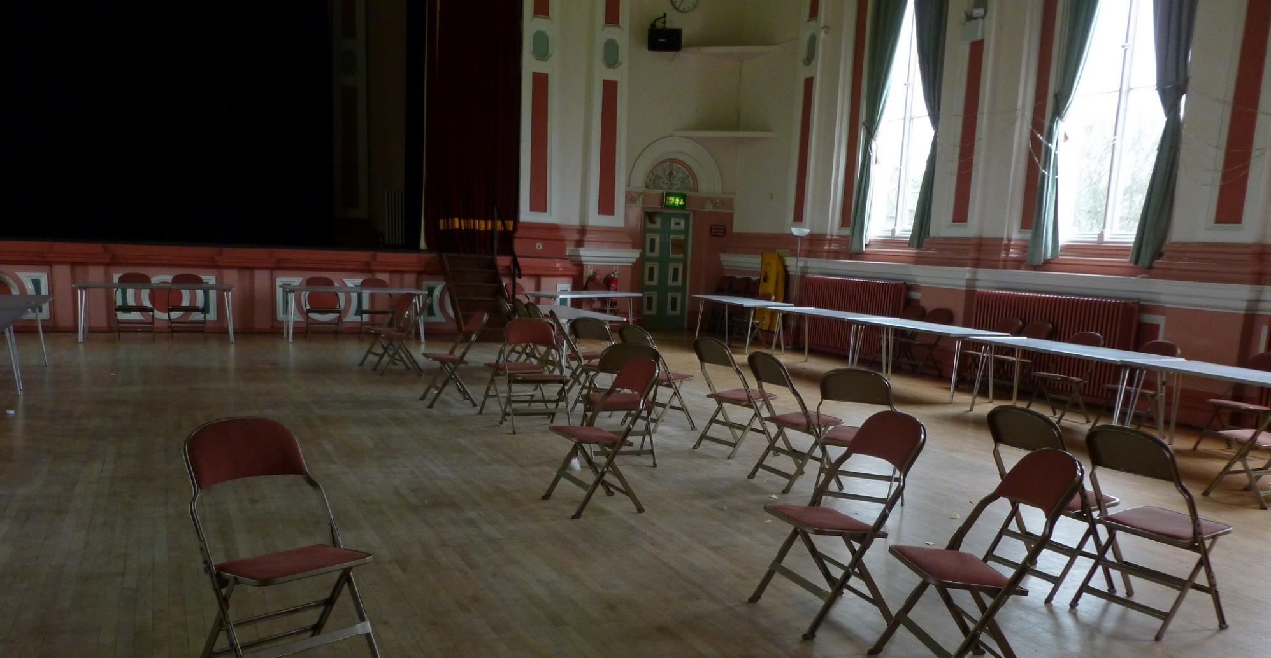
Focus Group Interviews: Disadvantages
Planning & administrative time
Experienced moderator required
See handout
Participants may be too quiet or too outspoken
Participants may not have sufficient time
Analysis, summarization & interpretation of responses difficult
Image: https://www.flickr.com/photos/17989497@N00/8651401959 by Monika / CC BY-SA 2.0
Notes:
Image: https://www.flickr.com/photos/17989497@N00/8651401959 by Monika / CC BY-SA 2.0

Slide 35
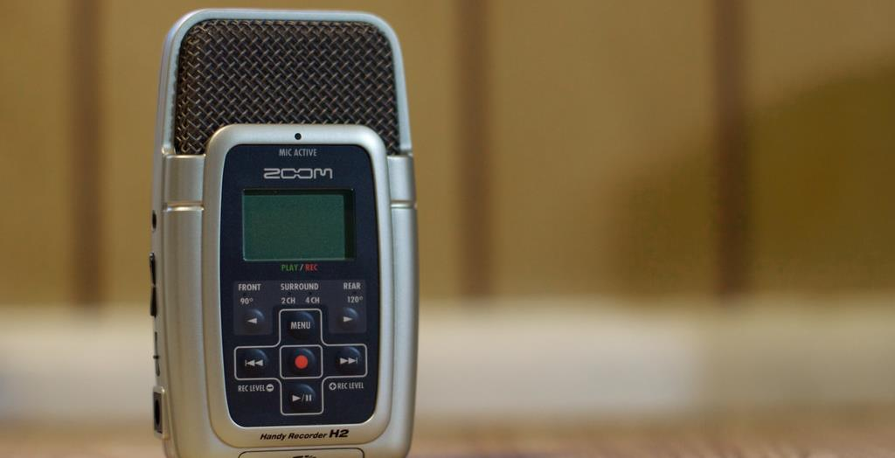
Conducting Focus Group Interviews
Obtain permission to use information & if taping
Report and/or publication
Enlist note-taker or, if recording, check equipment, bring back-up
Begin by creating safe climate
Image: https://www.flickr.com/photos/cogdog/5841058123 by Alan Levine / CC by 2.0
Notes:
Image: https://www.flickr.com/photos/cogdog/5841058123 by Alan Levine / CC by 2.0

Slide 36
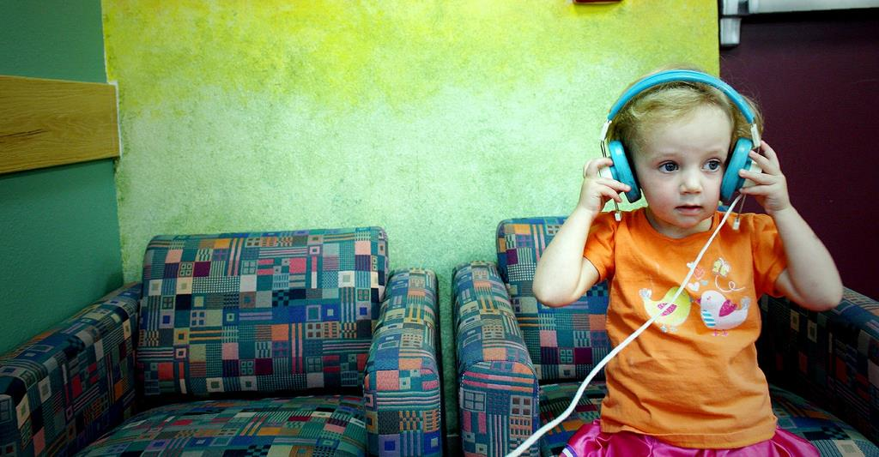
Conducting Focus Group Interviews
Help quiet people talk, limit talkative people
Design well constructed guide, including:
Introduction (purpose, ground rules)
Small set of questions (4 or 5 tops!)
Relevant major/probe questions
Effective listening essential
Image: https://www.flickr.com/photos/gozalewis/4776747298/ by timlewisnm CC BY-NC-ND 2.0
Notes:
Image: https://www.flickr.com/photos/gozalewis/4776747298 by timlewisnm/ CC BY-NC-ND 2.0

Slide 37
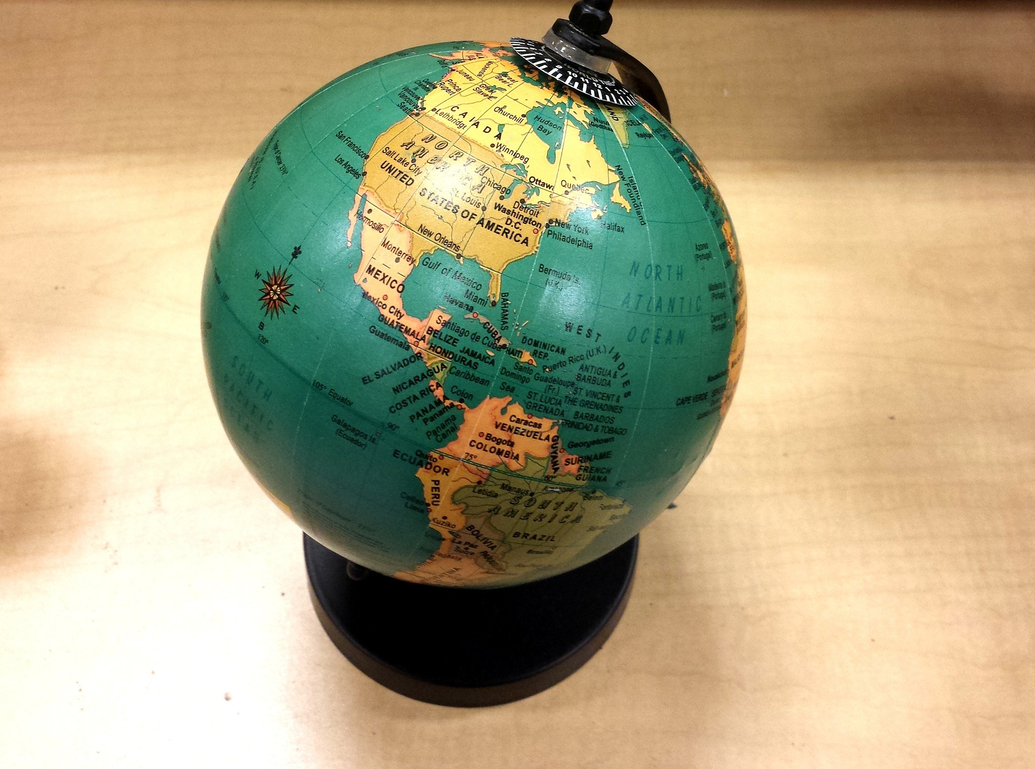
WorldCat.org Study Recruitment
Difficult
Little data of user-base
Participants across 3 continents
Hard-to-reach populations
Historians
Antiquarian booksellers
Non-probabilistic methods
Convenience sampling
Snowball sampling
(Connaway & Wakeling, 2012)
Image: https://pixabay.com/photos/school-geography-world-globe-earth-622766/ by DWilliams / Pixabay License
Notes:
Image: https://pixabay.com/photos/school-geography-world-globe-earth-622766/ by DWilliams / Pixabay License
Connaway, L. S., & Wakeling, S. (2012). To use or not to use Worldcat.org: An international perspective from different user groups. OCLC Internal Report.
To recruit the librarians, key contacts at participating institutions provided email addresses for suitable staff members, or distributed the invitations themselves. In both cases a standard email was used that informed potential participants of the focus group interview details, explained the aims of the research, and specified what would be required of participants.
Library contacts were used to identify the subject liaison librarian for History departments, which resulted in a limited number of introductions to historians. Invitation emails were sent to interested parties, but overall recruitment numbers were low. Antiquarian Booksellers required a different approach, since in most cases our library contacts were unable to help with this group. Booksellers were identified through their membership of professional bodies (the Australian & New Zealand Association of Antiquarian Booksellers, the Antiquarian Booksellers Association (UK), and the Antiquarian Booksellers' Association of America), whose websites include contact details for members. Emails were sent to all booksellers included in the online membership directories, explaining the research and inviting them to attend a session. While this approach was unsuccessful in Australia and the US, we were able to recruit enough UK-based booksellers to conduct a focus group interview session.
Students were recruited with fliers distributed around libraries, academic departments, and student library assistants.

Slide 38
Example:
WorldCat.org Focus Group Interview Questions
Tell us about your experiences with WorldCat.org
Broad introductory question to reveal the extent to which users have engaged with WorldCat.org, and the information-seeking contexts within which they use the system.
Purpose
Notes:
Connaway, L. S., & Wakeling, S. (2012). To use or not to use Worldcat.org: An international perspective from different user groups. OCLC Internal Report.
Flanagan, J. C. (1954). The critical incident technique. Psychological Bulletin, 51(4), 327-358.
1. Tell us about your experiences with WorldCat.org
A broad introductory question intended to reveal the extent to which users have engaged with WorldCat.org, and the information-seeking contexts within which they use the system.
2. Describe a time when you used WorldCat.org that you considered a success.
Explores the features and functions of WorldCat.org that participants view positively. Requiring participants to discuss a particular instance provides richer data about the range of uses of the system.
3. Describe a time when using WorldCat.org was unsuccessful – i.e., you did not get what you wanted.
Explores the features and functions (or lack thereof) of WorldCat.org that participants view negatively.
4. Think of a time when you did not find what you were looking for, but did find something else of interest or useful to your work?
Intended to encourage discussion about the role of serendipity in information seeking, and the extent to which WorldCat.org facilitates resource discovery .
5. If you had a magic wand, what would your ideal WorldCat.org provide?
Encourages participants to discuss potential improvements to WorldCat.org. The use of the phrase “magic wand” ensures that participants are not restricted by what they believe to be practical or realistic.
*Questions 2-4 employ the Critical Incident Technique

Slide 39
Example:
WorldCat.org Focus Group Interview Questions
If you had a magic wand, what would your ideal WorldCat.org provide?
Encourages participants to discuss potential improvements to WorldCat.org.
Purpose
Notes:
Connaway, L. S., & Wakeling, S. (2012). To use or not to use Worldcat.org: An international perspective from different user groups. OCLC Internal Report.
Flanagan, J. C. (1954). The critical incident technique. Psychological Bulletin, 51(4), 327-358.
The use of the phrase “magic wand” ensures that participants are not restricted by what they believe to be practical or realistic.

Slide 40

Individual Interviews & Focus Group Interviews
Analysis
Review notes/transcribe tapes
Ways to analyze:
Code data into pre-determined categories
Use data to identify categories
Use data for summary statements “capture the essence”
Compare all groups
Compile & summarize
Look for trends/patterns
Don’t overgeneralize from results
Image: https://www.flickr.com/photos/arwilkinson/10830400356 by Andy Wilkinson / CC BY-SA 2.0
Notes:
Image: https://www.flickr.com/photos/arwilkinson/10830400356 by Andy Wilkinson / CC BY-SA 2.0

Slide 41
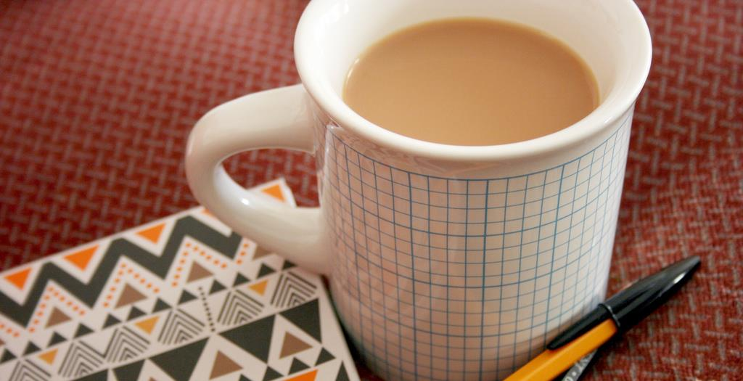
Individual Interviews & Focus Group Interviews Reporting Results
Parts of Report
List of issues
Explain how data collected/analyzed
Summary of findings: What was said on each issue?
Sample quotes (anonymous)
Interviewer’s impressions
Recommendations:
Short term (low hanging fruit)
Long term
Image: https://www.flickr.com/photos/jenosaur/4731463366 by jen Collins / CC BY-NC-ND 2.0
Notes:
Image: https://www.flickr.com/photos/jenosaur/4731463366 by jen Collins / CC BY-NC-ND 2.0

Slide 42
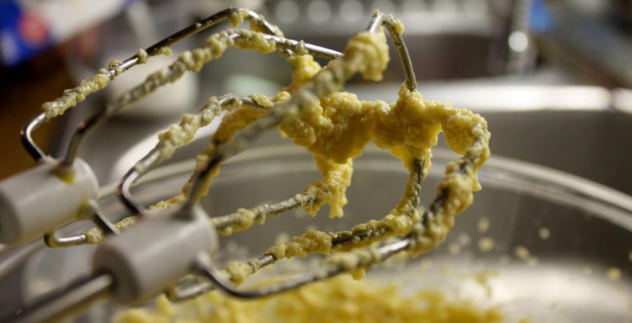
Individual Interviews & Focus Group Interviews
Limitations
Difficult to generalize
May not be representative
Analyzes perceptions, not facts
Subjective analysis (reliability)
Raw data could be misleading
Results can be limited by:
Poor/inexperienced moderator/ interviewer
Poorly constructed discussion guide/interview questions
Compensate by combining methods
Image: https://www.flickr.com/photos/furibond/3267102279 by jim / CC BY-SA 2.0
Notes:
Image: https://www.flickr.com/photos/furibond/3267102279 by jim / CC BY-SA 2.0

Slide 43
Systematic description focusing on designated aspects of behavior to test causal hypotheses.
Structured observations:
(Connaway & Radford, 2017, 272)
Notes:
Connaway, L. S., & Radford, M. L. (2017). Research methods in library and information science. Santa Barbara: Libraries Unlimited.

Slide 44
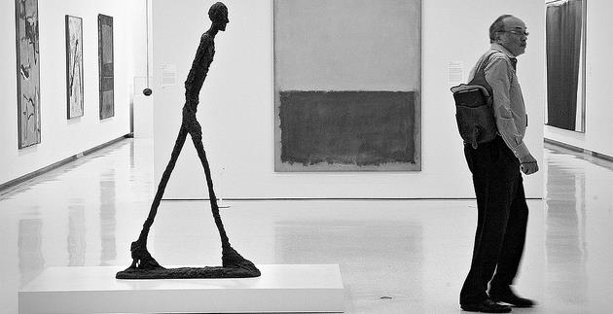
Image: https://www.flickr.com/photos/anjan58/7346141798 by anjan58 / CC BY-NC-ND 2.0
Observation
“Perhaps the most convenient method of studying the consequences of this law will be to follow the reader from the moment he enters the library to the moment he leaves it…”
(Ranganathan 1931, 337)
Notes:
Image: https://www.flickr.com/photos/anjan58/7346141798 by anjan58 / CC BY-NC-ND 2.0
Save time of the reader, previously #4, is now more important (#1) (107)
Connaway, L. S., & Faniel, I. M. (2014). Reordering Ranganathan: Shifting user behaviors, shifting priorities. Dublin, OH: OCLC Research. http://www.oclc.org/content/dam/research/publications/library/2014/oclcresearch-reordering-ranganathan-2014.pdf.
Ranganathan, S. R. (1931). The five laws of library science. London: Edward Goldston, Ltd.

Slide 45
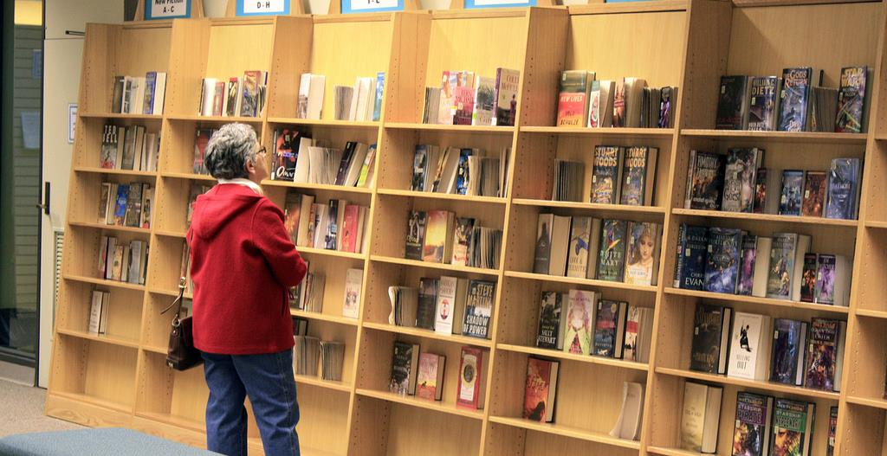
Participant/Immersive Observations
Move into the setting as deeply as possible
Disturb participants as little as possible
Participant observation
Open, direct interaction & observation as part of the group
(Connaway & Radford, 2017)
Image: https://www.flickr.com/photos/njla/3306454031/ by NJLA: New Jersey Library Association CC BY-NC-ND 2.0
Notes:
Image: https://www.flickr.com/photos/njla/3306454031/ by NJLA: New Jersey Library Association CC BY-NC-ND 2.0
Example of participant observation: researcher appears to reference librarians as a patron.
Connaway, L. S., & Radford, M. L. (2017). Research methods in library and information science. Santa Barbara: Libraries Unlimited.

Slide 46

Unstructured vs. Structured Observations
Image: https://www.flickr.com/photos/jafsegal/5438336871 by Juan Antonio Segal / CC BY 2.0
Unstructured observation
No predetermined categories of behavior
Flexible, exploratory
Notes should be recorded as soon as possible
Structured observation
Predeveloped observational categories
Rating scales and/or checklists
Audio and/or video recording
(Connaway and Radford, 2017)
Notes:
Image: https://www.flickr.com/photos/jafsegal/5438336871 by Juan Antonio Segal / CC BY 2.0
Connaway, L. S., & Radford, M. L. (2017). Research methods in library and information science. Santa Barbara: Libraries Unlimited.

Slide 47
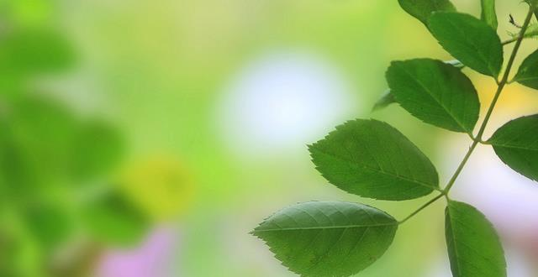
Image: https://www.flickr.com/photos/28481088@N00/14270095212 by tanakawho / CC BY 2.0
Unstructured Observations
Obtrusive vs. Unobtrusive
Active vs. Passive
Improve accuracy by:
Comparing data from two sources
Avoiding interpretation
Not taking behavior for granted
Getting feedback from participants
(Connaway & Radford, 2017)
Notes:
Image: https://www.flickr.com/photos/28481088@N00/14270095212 by tanakawho / CC BY 2.0
Connaway, L. S., & Radford, M. L. (2017). Research methods in library and information science. Santa Barbara: Libraries Unlimited.

Slide 48
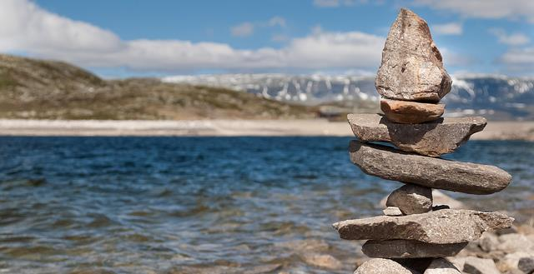
Image: https://www.flickr.com/photos/fng_photo/32806522008 by fnugry / CC BY-NC 2.0
Structured Observations
More formal, quantitative
Develop observational categories
Define appropriate, measurable actions
Establish units of time or length of observations
Anticipate patterns
Determine frame of reference
Select a rating scale
Create a checklist sheet if applicable
(Connaway & Radford, 2017)
Notes:
Image: https://www.flickr.com/photos/fng_photo/32806522008 by fnugry / CC BY-NC 2.0
Connaway, L. S., & Radford, M. L. (2017). Research methods in library and information science. Santa Barbara: Libraries Unlimited.

Slide 49
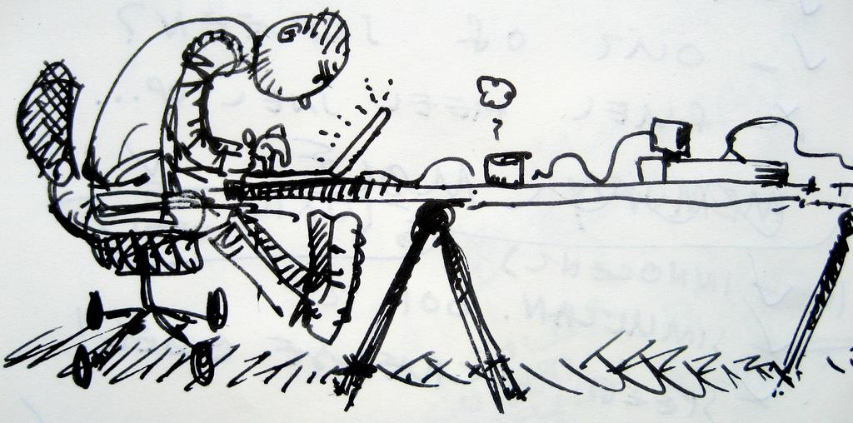
Usability Testing History
Human ethnographic observation
Ergonomics
Cognitive psychology
Became popular in 1980s
(Connaway & Radford, 2017, 277)
Image: https://www.flickr.com/photos/kaeru/1599676842 by Kars Alfrink / CC BY 2.0
Notes:
Image: https://www.flickr.com/photos/kaeru/1599676842 by Kars Alfrink / CC BY 2.0
Connaway, L. S., & Radford, M. L. (2017). Research methods in library and information science. Santa Barbara: Libraries Unlimited.

Slide 50
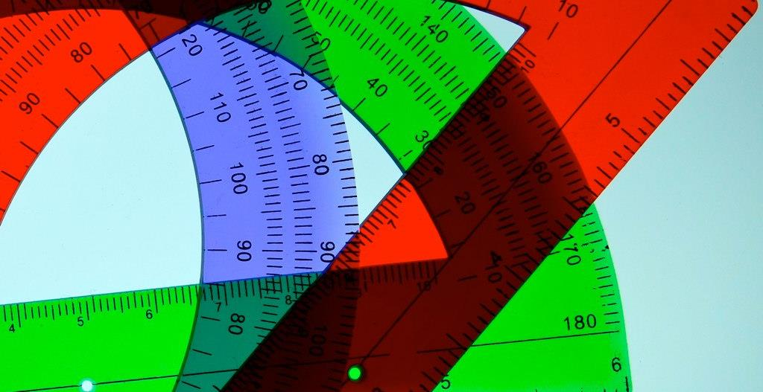
Image: https://www.flickr.com/photos/deanhochman/14481958642/ by Dean Hochman / CC BY 2.0
Usability Testing
Degree to which a user can successfully learn & use a product to achieve a goal
Evaluation research methodology
Observation & analysis of user behavior while users use a product or product prototype to achieve a goal
(Dumas and Redish 1993, 22)
Notes:
Image: https://www.flickr.com/photos/deanhochman/14481958642/ by Dean Hochman / CC BY 2.0
Dumas, Joseph S., and Janice C. Redish. 1993. A Practical Guide to Usability Testing. Portland, OR: Intellect Books.

Slide 51

Comprised of three parts:
Pre-session interview
Scenario and task structured test
Post-session survey
(Tang 2017, 278)
Usability Testing: Components
Image: https://www.flickr.com/photos/78428166@N00/8120708019/ by Tony Alter / CC BY 2.0
Notes:
Image: https://www.flickr.com/photos/78428166@N00/8120708019/ by Tony Alter / CC BY 2.0
Tang, Rong. 2017. “Usability Research.” In Research methods for library and information science, 6th ed., edited by Lynn Silipigni Connaway and Marie L. Radford, 277-278. Santa Barbara: Libraries Unlimited.

Slide 52
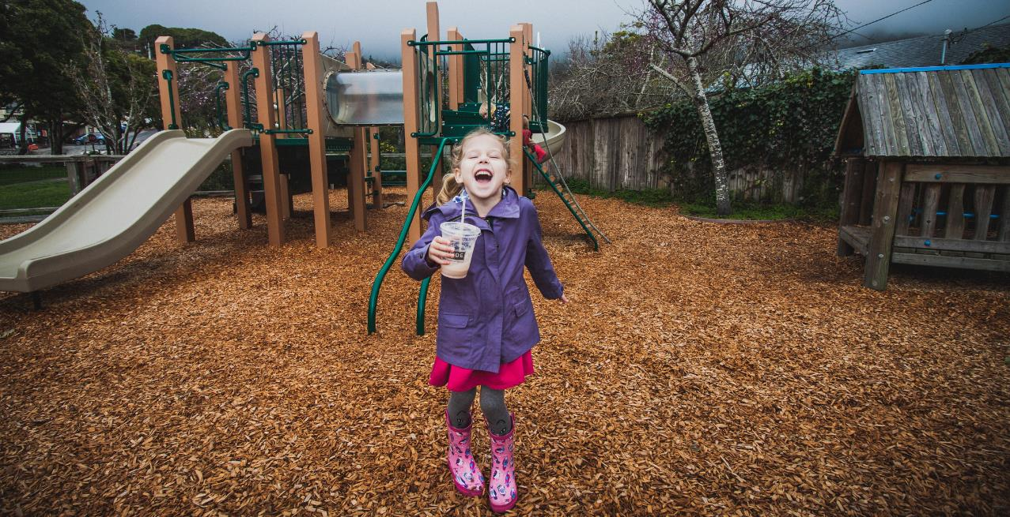
Usability Testing: Methodology
Artificial environment (laboratory)
Maintain more control
May provide more specific data on a particular feature
Natural environment
Better holistic representation of real people doing real work
(Tang 2017, 278)
Image: https://www.flickr.com/photos/carnesaurus/32160924864/ by Stinson Beach Playground / CC BY-NC-ND 2.0
Notes:
Image: https://www.flickr.com/photos/carnesaurus/32160924864/ by Stinson Beach Playground / CC BY-NC-ND 2.0
Key tip: A major lesson I learned over the years of conducting usability research is that in addition to producing results and recommendations that are practical for stakeholders, it is necessary to pay attention to the scholarly value of your work. Relevant theoretical frameworks might be applied to guide you through analyzing the interplay among behavior variables and interaction patterns (Tang 2017, 278).
Tang, Rong. 2017. “Usability Research.” In Research methods for library and information science, 6th ed., edited by Lynn Silipigni Connaway and Marie L. Radford, 277-278. Santa Barbara: Libraries Unlimited.

Slide 53
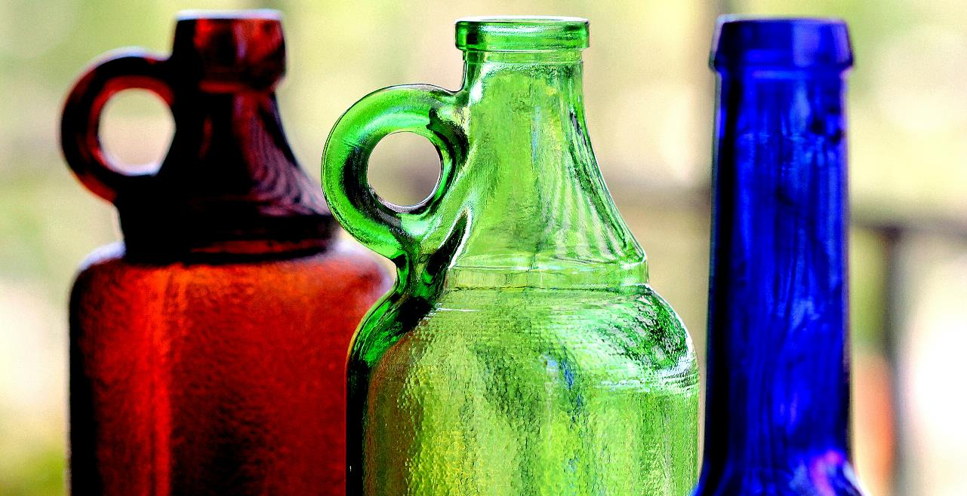
Image: https://www.flickr.com/photos/marcelxxl/14217231657/ by M.G.N. – Marcel / CC BY-NC-ND 2.0
V&R Mapping App Usability Testing
TASK
Think of around 10 websites you use or online activities that you regularly perform. Place each of these websites or activities on the map in a way that represents how you feel you use them (as a 'Visitor' or as a 'Resident') and the typical context in which you use them ('Personal' or 'Institutional’).
PROCEDURE
Read the task aloud
Using the app, complete the task while thinking aloud
Indicate when they felt they had completed the task
Notes:
Image: https://www.flickr.com/photos/marcelxxl/14217231657/ by M.G.N. – Marcel / CC BY-NC-ND 2.0
White, David S., and Lynn Silipigni Connaway. 2011-2014. Visitors & Residents: What Motivates Engagement with the Digital Information Environment. Funded by JISC, OCLC, and Oxford University. http://www.oclc.org/research/activities/vandr/.

Slide 54
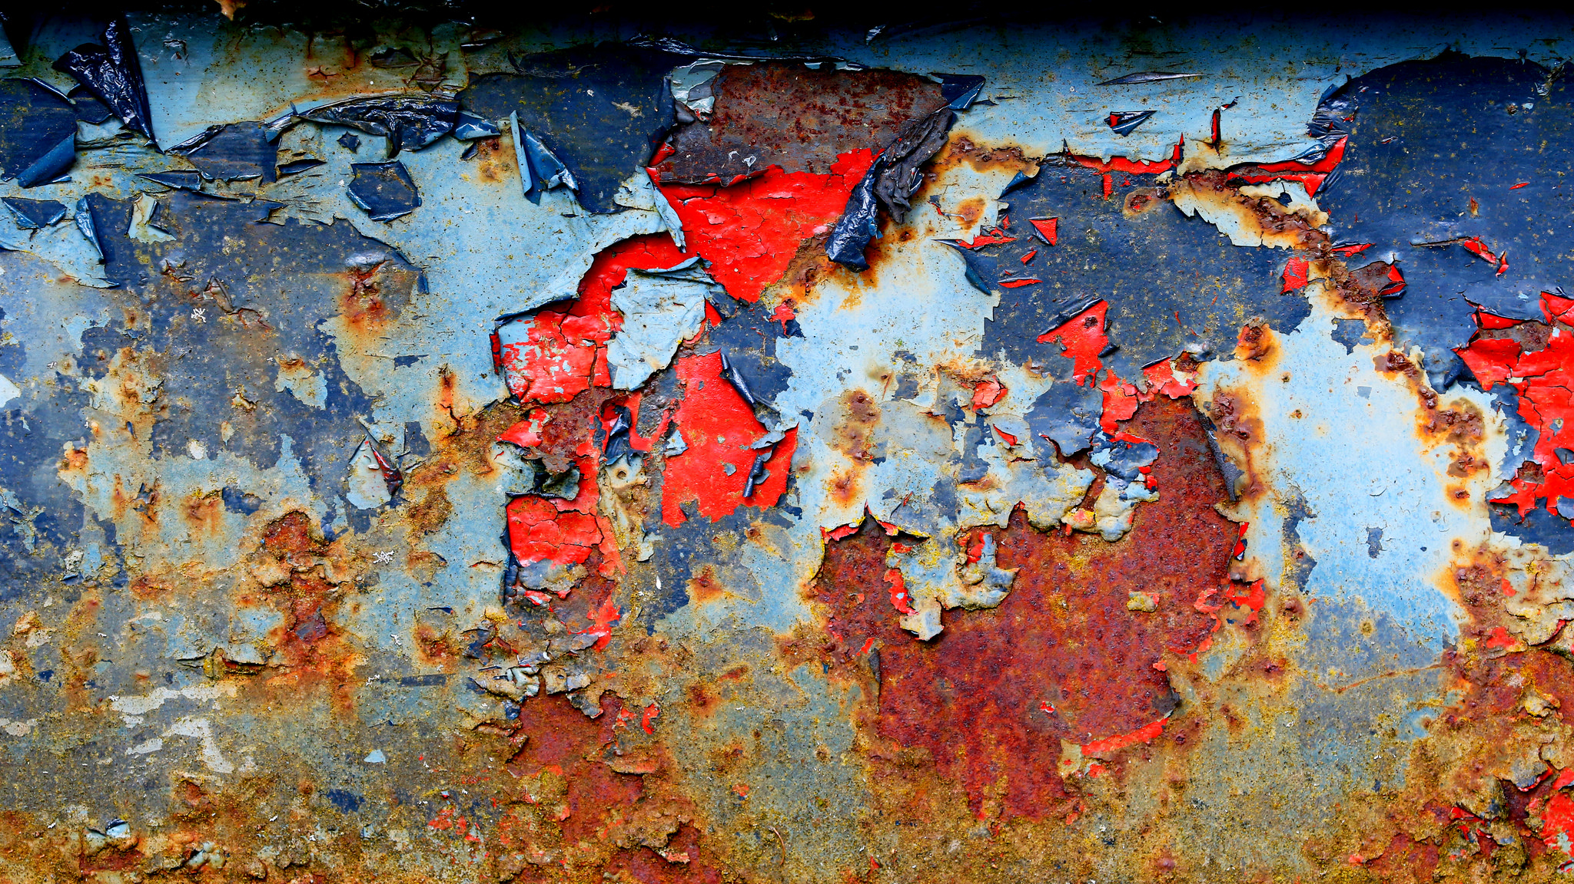
V&R Mapping App Usability Study Questions
Why did you select the shapes you did?
Why did you place them in these locations?
Were the tasks fun to do? Discuss your answer.
What would make it more fun?
What devices do you use to access the web?
If you could change this product in any way, what would you do?
Image: https://www.flickr.com/photos/glassholic/16948415183/ by Etienne / CC BY-NC-ND 2.0
Notes:
Image: https://www.flickr.com/photos/glassholic/16948415183/ by Etienne / CC BY-NC-ND 2.0
Some additional questions that are a little less generic:
Would it have been helpful to have a list of online services, apps, resources to use as examples or prompts?
Besides those you already mentioned or used in the app evaluation, what other sources, sites, apps, etc. do you use for academics, career, and professional interests?
What do you think about having access to a YouTube video instead of, or in addition to, the printed help we sent you?

Slide 55
Ethnographic research:
How individuals interact and behave
(Connaway & Radford, 2017, 263)
Notes:
Connaway, L. S., & Radford, M. L. (2017). Research methods in library and information science. Santa Barbara: Libraries Unlimited.
“The study of the culture and social organisation of a particular group, as well as the published result of such study” (Khoo, Rozaklis & Hall, 2012, p. 83).
Khoo, M., Rozaklis, L., & Hall, C. (2012). A survey of the use of ethnographic methods in the study of libraries and library users. Library and Information Science Research, 34(2), 82-91.

Slide 56
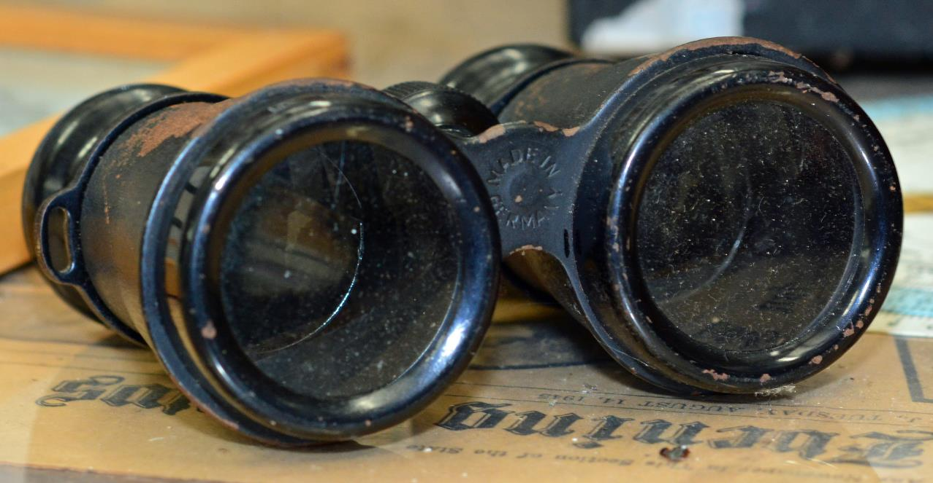
Ethnographic Research
“…a way of seeing how individuals interact and behave in situations by utilizing different qualitative data collection and analysis methods.”
(Connaway and Radford 2017, 263)
Image: https://www.flickr.com/photos/pmillera4/13570027834/ by Peter Miller / CC BY-NC-ND 2.0
Notes:
Image: https://www.flickr.com/photos/pmillera4/13570027834/ by Peter Miller / CC BY-NC-ND 2.0
“The study of the culture and social organisation of a particular group, as well as the published result of such study” (Khoo, Rozaklis, and Hall 2012, 83).
Because ethnographic methods focus on directly observing, recording, and explaining what people are doing in practice, they are a particularly good strategy for approaching difficult and complex questions like understanding the myriad ways people approach searching for information (Asher 2017, 263).
Asher, Andrew. 2017. “On Ethnographic Research: How do Students Find the Information They Need?” In Research methods for library and information science, 6th ed., edited by Lynn Silipigni Connaway and Marie L. Radford, 263. Santa Barbara: Libraries Unlimited.
Connaway, L. S., & Radford, M. L. (2017). Research methods in library and information science. Santa Barbara: Libraries Unlimited.
Khoo, Michael, Lily Rozaklis, and Catherine Hall. 2012. “A Survey of the Use of Ethnographic Methods in the Study of Libraries and Library Users.” Library and Information Science Research 34, no. 2: 82-91.

Slide 57
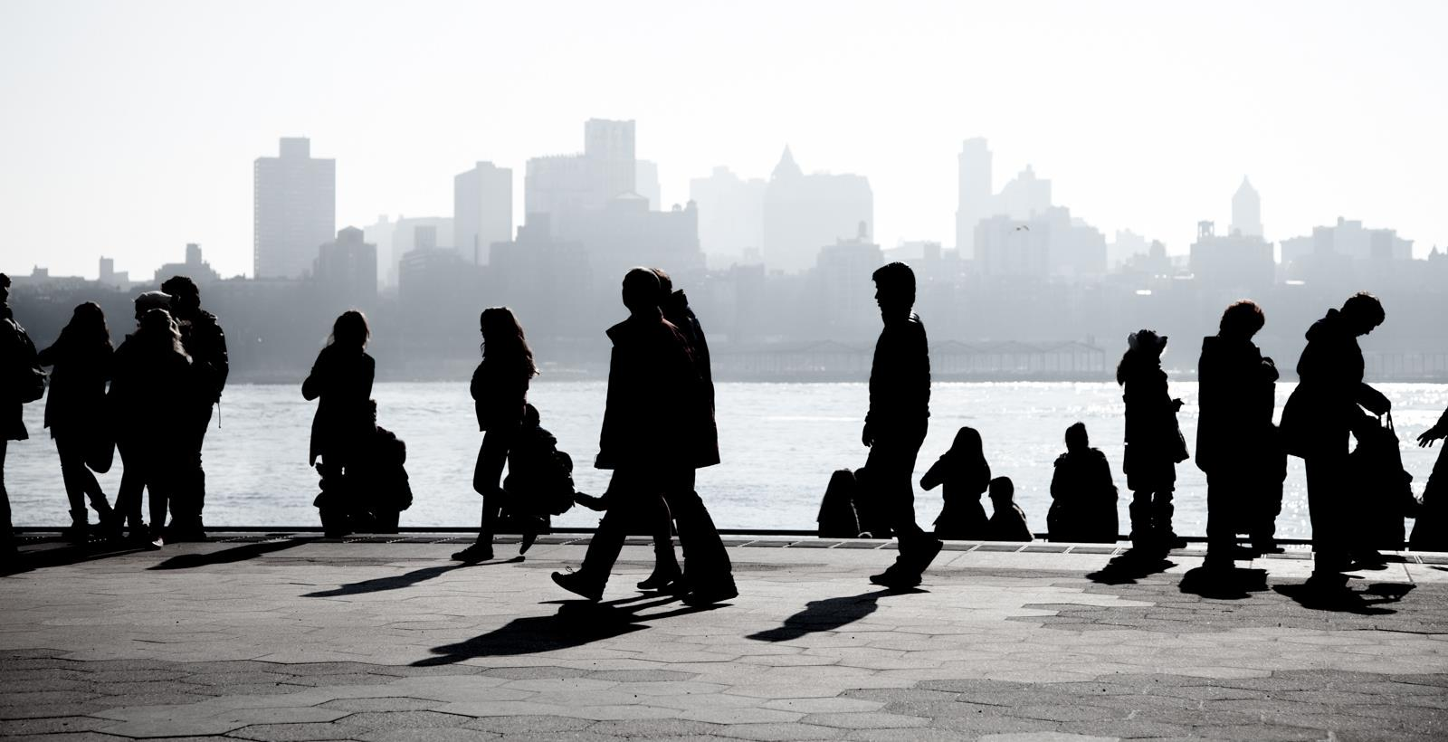
Ethnographic research
Incredibly detailed data
Time consuming
Establishing rapport
Selecting research participants
Transcribing observations & conversations
Keeping diaries
(Connaway & Radford, 2017, 254-255)
(Khoo, Rozaklis, & Hall, 2012, 83)
Image: https://www.flickr.com/photos/severalseconds/8476908394/ by shadow group / CC BY-NC-ND 2.0
Notes:
Image: https://www.flickr.com/photos/severalseconds/8476908394/ by shadow group / CC BY-NC-ND 2.0
Connaway, L. S., & Powell, R. R. (2010). Basic research methods for librarians (5th ed.). Littleton, CO: Libraries Unlimited.
Connaway, L. S., & Radford, M. L. (2017). Research methods in library and information science. Santa Barbara: Libraries Unlimited.
Khoo, M., Rozaklis, L., & Hall, C. (2012). A survey of the use of ethnographic methods in the study of libraries and library users. Library and Information Science Research, 34(2), 82-91.
“Wolcott described ethnography as “a way of seeing” (as indicated by the subtitle of his book, Ethnography: A Way of Seeing). He also referred to ethnography as a technique and not necessarily a method. Ethnography is a way of seeing how individuals interact and behave in situations by utilizing different qualitative data collection and analysis methods.” (Connaway & Radford, 2017, p. 263)
“Geertz believed that none of these approaches adequately defines the venture; rather, it is a kind of intellectual effort that is “an elaborate venture in ‘thick description.’” (Connaway & Radford, 2017, p. 263)
Ethnography
(From Basic Research Methods 5th Edition, p. 175-176)
Ethnography involves establishing rapport, selecting research participants, transcribing observations and conversations, and keeping diaries, although Geertz believes that none of these techniques or procedures adequately defines the venture. He believes ethnography is defined by the kind of intellectual effort it is, “an elaborate venture in ‘thick description.’ ”
Reality, as perceived by the observer, is described in such detail that the reader can experience the total event as if he or she had actually been involved in it.
Geertz, C. (1973). The interpretation of cultures: Selected essays. New York: Basic Books.

Slide 58
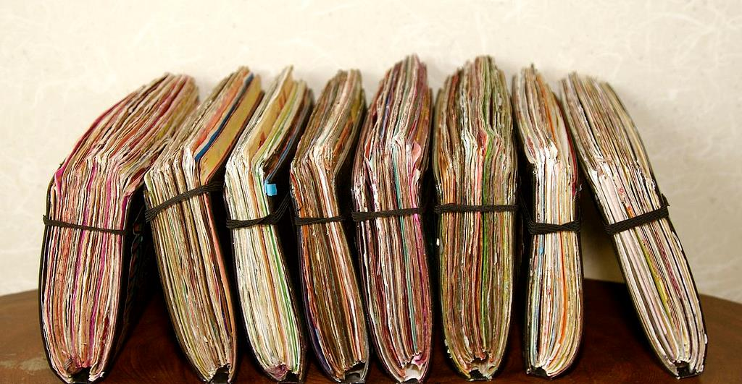
Image: https://www.flickr.com/photos/gbsk/4980421657/ by Barry Silver / CC BY 2.0
Diaries
Ethnographic data collection technique
Get people to describe what has happened
Center on defined events or moments
(Connaway & Radford, 2017)
Notes:
Image: https://www.flickr.com/photos/gbsk/4980421657/ by Barry Silver / CC BY 2.0
“The inclusion of diaries can broaden the amount of data collected, since the participants are creating the data without the immediate involvement of the researcher. Diaries enable the researchers to capture data from the participants’ daily lives that may not be readily available because the researchers cannot be with the participants during their everyday lives.” (Connaway & Radford, 2017, p. 270)
Connaway, L. S., & Radford, M. L. (2017). Research methods in library and information science. Santa Barbara: Libraries Unlimited.

Slide 59

Diaries
Keep directions minimal and open
Offer participants a variety of ways to report
Written
Photo
Video
Audio
Data can be rich and detailed, but is self-reported
Does not require researcher presence
(Connaway and Radford, 2017)
Image: https://www.flickr.com/photos/10154402@N03/8421806383 by Bruce Guenter / CC BY 2.0
Notes:
Image: https://www.flickr.com/photos/10154402@N03/8421806383 by Bruce Guenter / CC BY 2.0
Connaway, L. S., & Radford, M. L. (2017). Research methods in library and information science. Santa Barbara: Libraries Unlimited.

Slide 60

V&R Diary Template
Explain a time in the past month when you were SUCCESSFUL in completing an ACADEMIC assignment. What steps did you take?
Think of a time fairly recently when you struggled to find appropriate resources to help you complete an ACADEMIC assignment. What happened?
Image: https://www.flickr.com/photos/ahawkins/3182186456 by Amanda Hawkins /CC BY-NC-ND 2.0
Notes:
Image: https://www.flickr.com/photos/ahawkins/3182186456 by Amanda Hawkins /CC BY-NC-ND 2.0
Explain a time in the past month when you were SUCCESSFUL in completing an ACADEMIC assignment. What steps did you take?
Think of a time fairly recently when you struggled to find appropriate resources to help you complete an ACADEMIC assignment. What happened?
Explain a time in the past month when you were successful in getting what you needed in a PERSONAL situation. What steps did you take?
Explain a time in the past month when you were NOT successful in getting what you needed in a PERSONAL situation. What steps did you take?
Tell me something interesting that has happened in the past month in the social media that you used for ACADEMIC purposes.
Tell me something interesting that has happened in the past month in the social media that you used for PERSONAL situations.
What do you have to add to our discussion today about how you got information in the past month for both PERSONAL and ACADEMIC situations?
White, D. S., & Connaway, L. S. (2011-2014). Visitors & Residents: What Motivates Engagement with the Digital Information Environment. Funded by JISC, OCLC, and Oxford University. http://www.oclc.org/research/activities/vandr/.

Slide 61
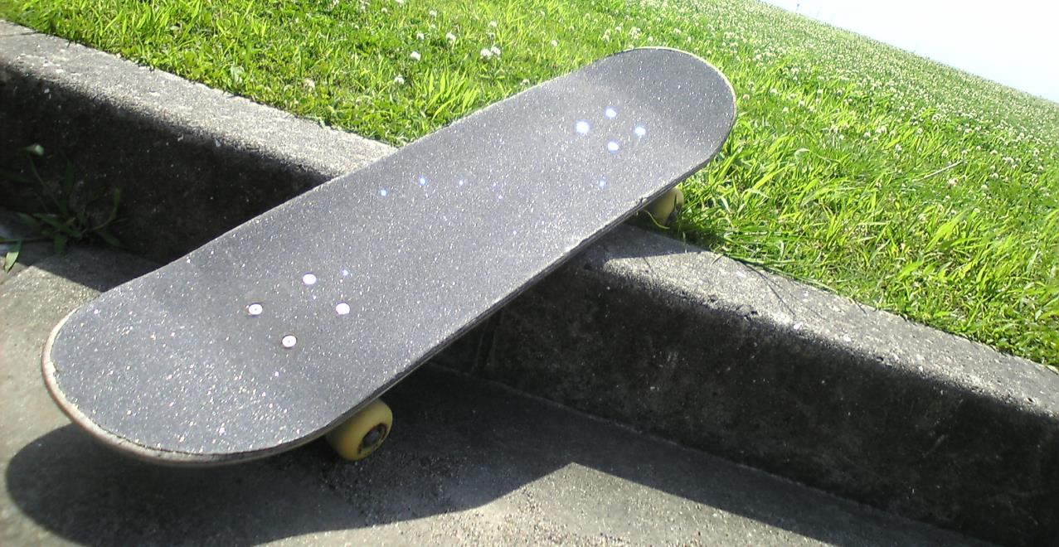
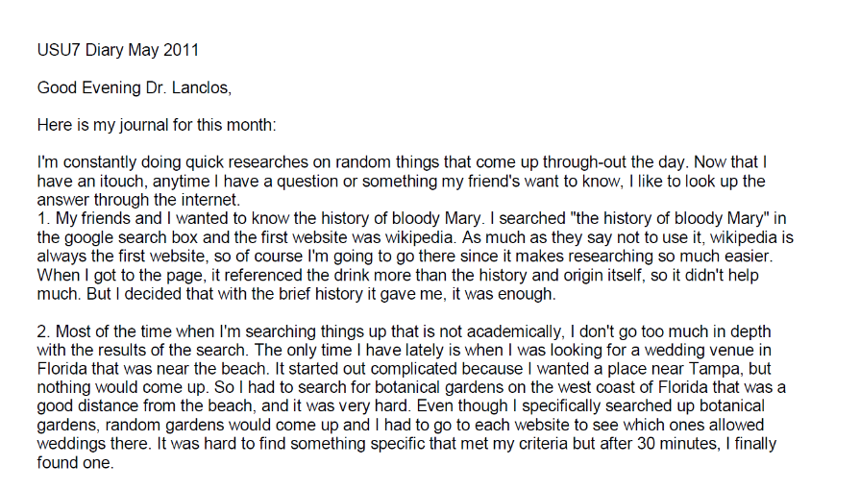
Example: Digital Visitors and Residents Diaries
Image: https://www.flickr.com/photos/dancingpapa2007/3674686528 by Naoki Tomeno / CC BY 2.0
Notes:
Image: https://www.flickr.com/photos/dancingpapa2007/3674686528 by Naoki Tomeno / CC BY 2.0
Screenshot: USU7 Emg Dry1 Ph1 (Digital Visitors and Residents, USU7, Female, Age 19)
“March was a little more serious. We’re nearing election time and all that jazz, and this is the first election I’ll be able to vote in, so I’ve been doing a bit of reading on a few of the candidates (not much, mind you). As a side note, I’m kind of debating whether or not I should actually vote in this election since I have such little knowledge on the candidates.” (Digital Visitors and Residents, USU12, Male, Age 19) USU12 Est Dry2 Ph2
“Um they do have a search box but I didn’t—I didn’t use that. Um I pretty much just, I pretty much just clicked links.” (Digital Visitors and Residents, USU12, Male, Age 19, 30:37) USU12 Est Follup Int1 Ph3
White, D. S., & Connaway, L. S. (2011-2014). Visitors & Residents: What Motivates Engagement with the Digital Information Environment. Funded by JISC, OCLC, and Oxford University. http://www.oclc.org/research/activities/vandr/.

Slide 62
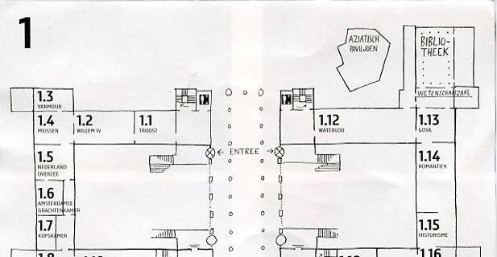
Image: https://www.flickr.com/photos/dutchsimba/15704925354 by Dutch Simba / CC BY-NC-ND 2.0
Cognitive Mapping
Participant draws a map of the area of interest
Fast and easy to conduct
Small time commitment from participants
Can be ambiguous or difficult to interpret
Notes:
Image: https://www.flickr.com/photos/dutchsimba/15704925354 by Dutch Simba / CC BY-NC-ND 2.0
Asher, A. & Miller, S. (2011). So You Want to Do Anthropology in Your Library? Or a Practical Guide to Ethnographic Research in Academic Libraries. Chicago: The ERIAL Project.

Slide 63
Mapping Diaries
Give participants a map & ask them to record their movements
Can use maps as basis for individual interviews
Image from Clark (2007), “Mapping Diaries, or Where Do They Go All Day?”, p. 49
Notes:
Clark, K. (2007). Mapping Diaries, or Where Do They Go All Day? In N. Foster & S. Gibbons (Eds.), Studying Students: The Undergraduate Research Project at the University of Rochester. Chicago: Association College and Research Libraries.

Slide 64
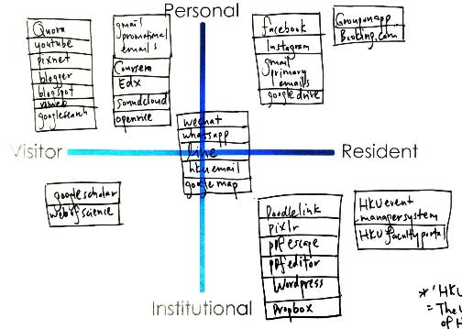
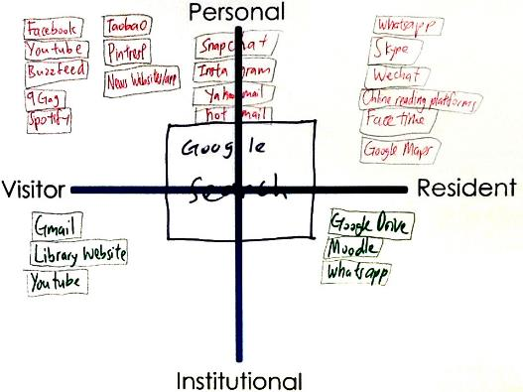
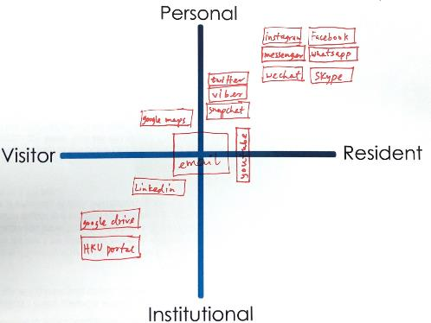
Mapping
Visitors and Residents Sample Maps
Notes:
Quadrant 1:
HKU, 1st year undergrad
Realized I am not that hard working
In desperation when I have to directly go to library website
Google search: usually don’t login, just search, more on visitor side
Snapchat …Hotmail : Not too often do sharing
A way to release my burden
FB try not to post/share, look at what my friends share
Quadrant 2:
HKU, upper undergrad
Library- Borrow book for personal
Google drive – only for group project (visitor)
Social media apps make us anti – social
Quadrant 3:
HKU, faculty researcher and/or scholar
Research assistant
Least Digital footprint as possible, substantial, good thing to live (the left side of the map)
Middle – use a lot in work, create contacts
Use HKU specific apps for work, wordpress, create webpage
Learn about yourself: need to learn more & contribute more in digital footprint (at work and in personal)
White, D. S., & Connaway, L. S. (2011-2014). Visitors & Residents: What Motivates Engagement with the Digital Information Environment. Funded by JISC, OCLC, and Oxford University. http://www.oclc.org/research/activities/vandr/.

Slide 65
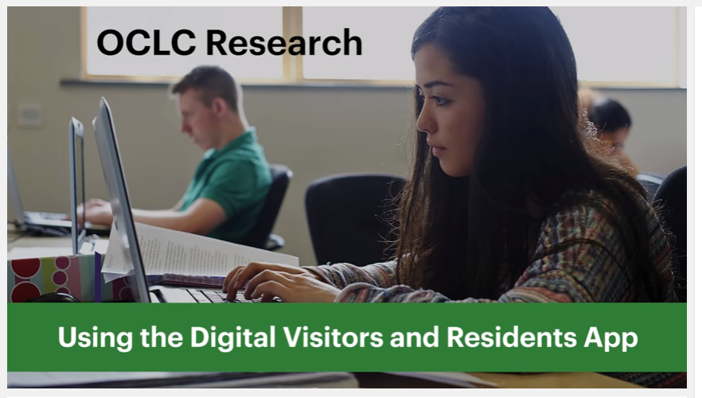
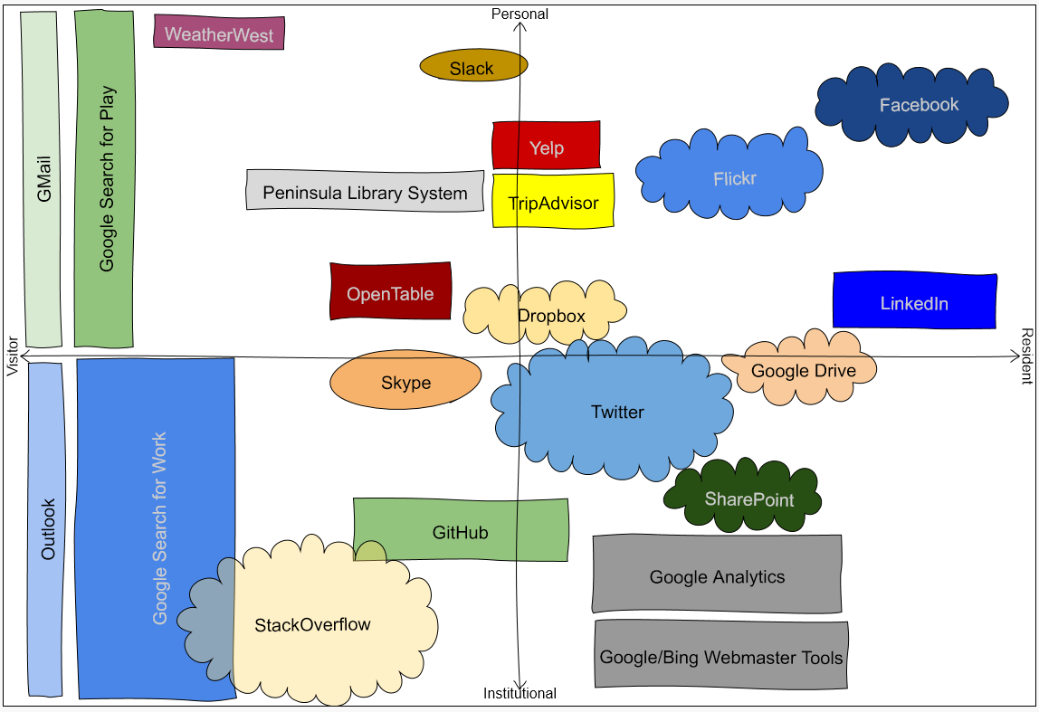
The App:
http://oc.lc/VRmap
Use It Now!
The Video:
https://youtu.be/6ai0ZO3lDR4
Play It Now!
Notes:
OCLC Research. (2016, May 5). Using the Digital Visitors and Residents app. [YouTube video]. [Available: https://www.youtube.com/watch?v=6ai0ZO3lDR4].
The app is available at http://oc.lc/vrmap.

Slide 66
ACTIVITY
V&R Mapping Exercise

Slide 67
Break Time!

Slide 68
summary of observations or data in such a manner that they provide answers to the hypothesis or research questions
Qualitative Research data Analysis:
(Connaway & Radford, 2017, 177)
Notes:
Connaway, L. S., & Radford, M. L. (2017). Research methods in library and information science. Santa Barbara: Libraries Unlimited.

Slide 69

Analysis
Collection of data affects analysis of data
Ongoing process
Feeds back into research design
Theory, model, or hypothesis must grow from data analysis
Image: https://www.flickr.com/photos/creatocrat/4423113441/ by creatocrat / CC BY-NC-ND 2.0
Notes:
Image: https://www.flickr.com/photos/creatocrat/4423113441/ by creatocrat / CC BY-NC-ND 2.0

Slide 70
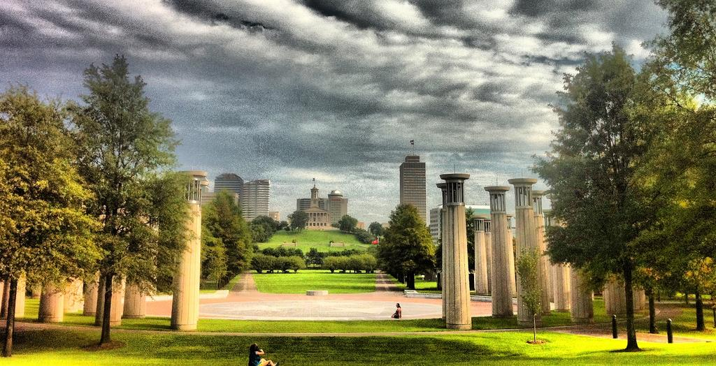
Ethnographic Analysis
Use people’s own categories
Avoid assuming what one will find
Complementary to quantitative methods
Retain ‘richness’/‘thick description’
Numerous compatibility
(Asher 2017, 264)
(Connaway and Radford 2017, 282)
Image: https://www.flickr.com/photos/respres/6041698098/ by Jeff Turner / CC BY 2.0
Notes:
Image: https://www.flickr.com/photos/respres/6041698098/ by Jeff Turner / CC BY 2.0
Ethnographic research methods seek to use people’s own categories of analysis as a way of understanding social and cultural processes on their own terms. Researchers using ethnographic approaches must be careful to avoid making assumptions about what they will find, to suspend judgment about people’s actions, and to attend to both people’s own explanations of the processes being studied as well as analytical or theoretical explanations. While ethnographic methods usually emphasize qualitative data, they should not be seen as opposed to quantitative approaches to research, but instead as a different, and often complementary, way of gathering evidence and discovering meaning within the complexities of human behavior (Asher 2017, 264).
Asher, Andrew. 2017. “On Ethnographic Research: How do Students Find the Information They Need?” In Research methods for library and information Science, 6th ed., edited by Lynn Silipigni Connaway and Marie L. Radford, 264. Santa Barbara: Libraries Unlimited.
“The data collection methods discussed above are used in ethnographic research studies. The data analysis methods used for the qualitative data collected in diaries, journals, interviews, and mapping are the same as those discussed in chapters 7 and 8. The data must be interpreted in a manner that retains their richness. This “thick description,” including group interactions, is one of their advantages of the ethnographic approach. The ethnographic summary and the content analysis approach of open and thematic coding are not conflicting means of analysis. If quantitative data are collected in the interviews and FtF survey questions, the data analysis methods should be compatible. The analyses most likely will include descriptive statistics but may include inferential statistics, which are discussed in chapter 6.” (Connaway and Radford 2017, 282)
Connaway, L. S., & Radford, M. L. (2017). Research methods in library and information science. Santa Barbara: Libraries Unlimited.

Slide 71

Draw on data...in service of developing new conceptual categories
Develop inductive abstract analytic categories through systematic data analysis
Emphasize theory construction rather than description or application of current theories
(Connaway and Radford, 2017)
Grounded Theory
Image: https://www.flickr.com/photos/adambindslev/4727853016/ by Adam Bindslev / CC BY-NC 2.0
Notes:
Image: https://www.flickr.com/photos/adambindslev/4727853016/ by Adam Bindslev / CC BY-NC 2.0
“1. Conduct data collection and analysis simultaneously in an iterative process.
2. Analyze actions and processes rather than themes and structure.
3. Use comparative methods.
4. Draw on data (e.g., narratives and descriptions) in service of developing new conceptual categories.
5. Develop inductive abstract analytic categories through systematic data analysis.
6. Emphasize theory construction rather than description or application of current theories.
7. Engage in theoretical sampling.
8. Search for variation in the studied categories or process.
9. Pursue developing a category rather than covering a specific empirical topic.” (Connaway and Radford 2017, 297)
Connaway, L. S., & Radford, M. L. (2017). Research methods in library and information science. Santa Barbara: Libraries Unlimited.

Slide 72
Theme | Sub-theme | Sub-theme | Sub-theme | Definition | Example
Place (I)
 | Internet (I.A) |  |  | Online, unspecified | “I will go online for the subject because I know the what's online will be of better quality and more relevant to the specification than what's in the book” (2UKU2).
 |  | Search Engine (I.A.1) |  | Unspecified or unlisted search engine (i.e., Bing) | “Or I’ll go back to the search engine and start again and look at all the other options that I’m able to look at” (UKS4).
 |  |  | Google (I.A.1.a) |  | “I would start by Googling definitely” (2UKS2).
 |  | Social Media (I.A.2) |  | Unspecified or unlisted social media (i.e., LinkedIn) | “Well, I like social media, but I don't know if anything would change anything about my academics … um, the only thing that I can think of that I'll probably ever be able to think of, is the detrimental effect it has on my academics because it distracts me” (USG2).
 |  |  | Facebook (I.A.2.a) |  | “When I'm doing homework or coursework or something, I'll always have Facebook and Twitter open, for example, as well” (2UKS2).
 |  |  | Twitter (I.A.2.b) |  | “Twitter, I don't use it educationally at all” (2UKS2).
 | Library (I.B) |  |  | Unspecified library | “I think first of all I would search on Google Scholar to see whether there is an e-version. Because I’m pretty comfortable reading online. And if there is not, then I will go to the library. Yes. When I have to” (UKG1).
 |  | Academic (I.B.1) |  |  | “The majority of the journal articles that we would read are online although frequently books are still not converted into e-books yet, so they’re frequently found in the education library” (UKG2).
Visitors and Residents
Codebook Excerpt
Notes:
https://www.oclc.org/content/dam/research/activities/vandr/resources/vandr-interview-diary-codebook.pdf.
This is just a very small part of our codebook from Visitors & Residents. Here we have a parent-node of Place and its child-nodes or sub-nodes of Internet, Library, Home, School, and Other. Within those we have even more child-nodes. As we code, we want to be as specific as possible.

Slide 73
Theme | Sub-theme | Sub-theme | Definition | Example
Sources (II) |  |  | Unspecified source | “I spent a few weeks struggling to find a part time job for the Christmas holidays. I mainly searched the internet but also search for help from my university, asked friends, walked the streets handing out my CV etc.” (UKG303).
 | Human (II.A) |  | Unspecified human source | “So the ideal way is to ask and receive an answer, just like in human to human interaction” (UKF401).
 |  | Mother (II.A.1) | [If “parents” stated, code for Mother and Father] | “…had a chat with my mother on the phone” (UKG320).
 |  | Father (II.A.2) | [If “parents” stated, code for Mother and Father] | “Parents…they know me the best so I know that they would have my best interests at heart…” (UKS125).
 |  | Extended Family (II.A.3) | Siblings, cousins, relatives, children, spouses. [If “family” stated, code for Mother, Father, and Extended Family] | “Seek friends and families help because they are trustworthy” (UKS108).
 | Digital (II.B) |  | Unspecified or unlisted digital source | “The idea of having the desired information in front of your eyes as and when I need it. This is, of course, something made possible by technology such as Google Glass” (UKG303).
 |  | E-books (II.B.1) |  | “I do not like e-readers. For me personally, I need to feel the pages of a book in my fingers for it too be real” (USS116).
 |  | Academic (I.B.1) |  | “The majority of the journal articles that we would read are online although frequently books are still not converted into e-books yet, so they’re frequently found in the education library” (UKG2).
Visitors and Residents
Codebook Excerpt
Notes:
Image: https://www.flickr.com/photos/69502532@N00/2947286593/
Here is another small snippet. This just shows how many sub-nodes we have for Human Sources, which has yielded a lot of interesting data for us and we will very likely be using in some of our upcoming papers and presentations.
When we started back several years ago, we started with Emerging participants which are our last year high school students and first year university students from the US and UK and we didn’t have any of them mention Librarians. However, even now, we are still finding just how important Humans are as Sources for information and help to all our participants.

Slide 74
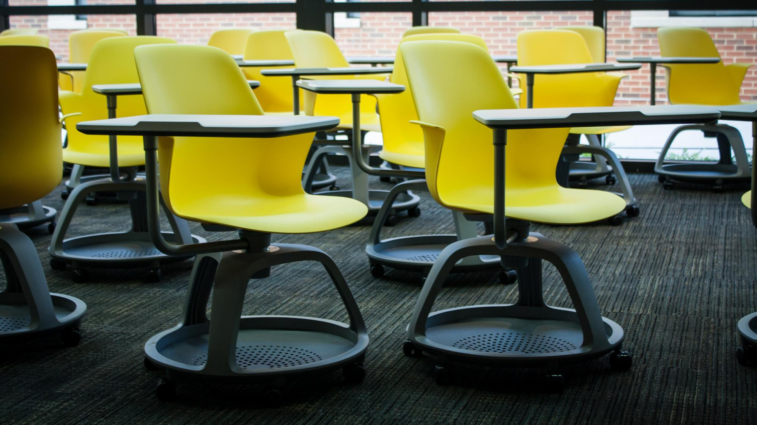
Example:
Direct Quotations Digital Visitors and Residents
“It’s like a taboo I guess with all teachers, they just all say – you know, when they explain the paper they always say, “Don’t use Wikipedia.”
(USU7, Female, Age 19)
Image: https://www.flickr.com/photos/derekbruff/11302153574/ by Derek Bruff / CC BY-NC 2.0
Notes:
Image: https://www.flickr.com/photos/derekbruff/11302153574/ by Derek Bruff / CC BY-NC 2.0
Covert online study habits
Wikipedia
Don’t cite
Widely used
Guilt
Students & teachers disagree
Quality sources
There is a “Learning Black Market”: learners use non-traditional sources but feel they cannot talk about them in an institutional context. Wikipedia usage is an example of this. (White & Connaway, 2011)
“I mean if teachers don’t like using Wikipedia they don’t want you to use Wikipedia. A lot of students will still use Wikipedia and then cite another source. As long as it has the same information and it is not word for word or anything they’ll use Wikipedia because it is the easiest thing to go look up on Wikipedia. It will give you a full in-depth detailed thing about the information. Teachers don’t just like it because it’s not the most reliable source since anyone can post something on there even though the site is monitored, it’s because it’s too easy.” (Digital Visitors and Residents, USU3 0:30:59, Male Age 19)
Students’ Perceptions of Teachers’ opinions of Wikipedia:
“Avoid it.” (Digital Visitors and Residents, UKS8 0:28:28.3, Female Age 16)
“They say it’s because anyone can make up – I mean, anyone can add information on there but I mean when I’ve actually looked into information it seemed the same as any information I find anywhere else. I mean, it’s not like if you look up fourth of July, it’s not like it gives you like some weird explanation of aliens or something.” (Digital Visitors and Residents, USU7 0:33:14, Female Age 19)
Students’ on Wikipedia:
“I use it, kind of like, I won't cite it on my papers but I, kind of, use it as a like, as a start off line. I go there and look up the general information, kind of, read through it so I get a general idea what it is. Then I start going through my research.” (Digital Visitors and Residents, USU7, 0:33:49, Female, Age 19)
“Everyone knows that you try not to use Wikipedia as a source because it is a cardinal sin.” (Digital Visitors and Residents, UKU3, 0:31:03, Female Age 19)
Student: “Ha ha.” I realised that there were some undergraduates that had some papers due yesterday because they were like “Oh, Wikipedia was down! Now where am I going to get my information?”
Interviewer: I know, now it’s not going to happen. But that’s not your problem because you don’t do that.
Student: Exactly. No. I like going to Wikipedia and going “Ha ha ha ha ha.” (Digital Visitors and Residents, USG5 , 0:57:26, Female, Age 30)
White, D. S., & Connaway, L. S. (2011-2014). Digital visitors and residents: What motivates engagement with the digital information environment. Funded by JISC, OCLC, and Oxford University. http://www.oclc.org/research/activities/vandr.html
Connaway, L. S., Lanclos, D., & Hood, E. M. (2013). “I find Google a lot easier than going to the library website.” Imagine ways to innovate and inspire students to use the academic library. In Proceedings of the Association of College & Research Libraries (ACRL) 2013 conference, 289-300. Retrieved from http://www.ala.org/acrl/sites/ala.org.acrl/files/content/conferences/confsandpreconfs/2013/papers/Connaway_Google.pdf
Connaway, L. S., Lanclos, D., White, D., Le Cornu, A., & Hood, E. M. (2013). User-centered decision making: A new model for developing academic library services and systems. IFLA Journal, 39(1), 30-36.
Connaway, L. S., White, D., Lanclos, D., & Le Cornu, A. (2013). Visitors and residents: What motivates engagement with the digital information environment? Information Research, 18(1). Retrieved from http://informationr.net/ir/18-1/infres181.html

Slide 75
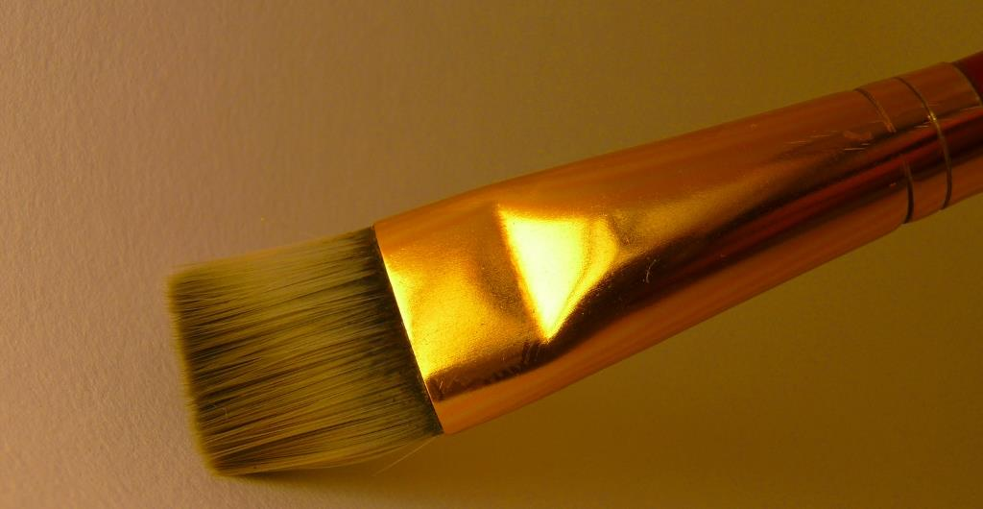
Computer-Assisted Qualitative Data Analysis Software (CAQDAS)
Contain all data sources
Creating & applying codes
Queries
Visualizations
Reports
(Connaway and Radford 2017)
Image: https://www.flickr.com/photos/flakepardigm/4687752030/ by Tyler Nienhouse / CC BY 2.0
Notes:
Image: https://www.flickr.com/photos/flakepardigm/4687752030/ by Tyler Nienhouse / CC BY 2.0
“The CAQDAS packages help to provide a place to contain all data sources and have multiple affordances, especially for large data sets common in qualitative projects. There is a growing number of these products available, in both proprietary and open source versions. Proprietary products include ATLAS.ti, Dedoose, HyperRESEARCH, MAXQDA, Nvivo, QDA Minder Qiqqa, and Xsight. Open source software includes Aquad, Coding Analysis Toolkit, Compendium, and RQDA.” (Connaway and Radford 2017, 290)
“Common features of all these packages include creating and applying codes. Some...have advanced features that support such enhancements as enabling queries (to explore data to discover patterns, connections, etc.), supporting visualizations (to create charts, models, maps, and cluster analyses), and delivering reports (to document and export findings).” (Connaway and Radford 2017, 290)
Connaway, L. S., & Radford, M. L. (2017). Research methods in library and information science. Santa Barbara: Libraries Unlimited.

Slide 76

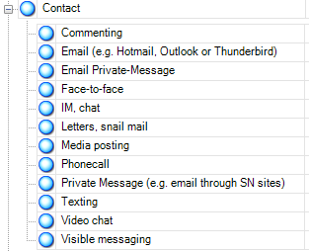
NVivo 10
Qualitative research software
Upload documents, PDFs, & videos
Create nodes & code transcripts
Merge files
Queries
Reports
Models
(QSR International, 2011)
Image: https://www.flickr.com/photos/mervynchua/5441109097/ by Mervyn Chua / CC BY-NC 2.0
Notes:
Image: https://www.flickr.com/photos/mervynchua/5441109097/ by Mervyn Chua / CC BY-NC 2.0
QSR International. (2011). NVivo 9: Getting started. Retrieved from http://download.qsrinternational.com/Document/NVivo9/NVivo9-Getting-Started-Guide.pdf
Screenshot of our codebook in Nvivo 9

Slide 77

“A major strategy for analysis of qualitative data is the use of the constant comparative method, which embraces ‘constant comparisons’ defined as ‘the analytic process of comparing different pieces of data against each other for similarities and differences.’”
(Connaway and Radford 2017, 298)
Image: https://www.flickr.com/photos/carleycomartin/4030726428/ by Carley Comartin / CC BY-NC 2.0
Notes:
Image: https://www.flickr.com/photos/carleycomartin/4030726428/ by Carley Comartin / CC BY-NC 2.0
“A major strategy for analysis of qualitative data is the use of the constant comparative method, which embraces “constant comparisons” defined as “the analytic process of comparing different pieces of data against each other for similarities and differences.” It requires the researcher to ask continually: “What is this piece of data saying?” “Is this different from or similar to the next segment?” This involves comparing and aggregating pieces of data on the basis of similar characteristics and beginning the process of sorting these into interim groups or emerging themes.” (Connaway and Radford 2017, 298)
Connaway, L. S., & Radford, M. L. (2017). Research methods in library and information science. Santa Barbara: Libraries Unlimited.

Slide 78

Challenges: Qualitative Research
Data collection & analysis
Costs and time
Bias
Sampling
Often not generalizable
Image: https://www.flickr.com/photos/therichbrooks/2600080329/ by Rich Brooks / CC BY 2.0
Notes:
Image: https://www.flickr.com/photos/therichbrooks/2600080329/ by Rich Brooks / CC BY 2.0
Ethnographic research is time-consuming
Staff time needed for collection, analysis, and presentation is expensive
Need staff who are trained or need to train staff
Bias presents a threat to validity , particularly the interviewer because of over-reacting to responses, etc.
If samples are small and non-representative, results aren’t generalizable.
In some collection methods (observation), may not be able to gather demographic data or choose your sample at all.
Connaway, L. S., & Radford, M. L. (2017). Research methods in library and information science. Santa Barbara: Libraries Unlimited.

Slide 79

Opportunities: Qualitative Research
Rich data and thick description
Can answer why and how questions
Provides information to support decisions about resources and services
Can help motivate and increase buy-in for change
Provides the opportunity to build relationships
(Connaway and Radford, 2017; Asher and Miller, 2011)
Image: https://www.flickr.com/photos/dougww/2132598574 by Doug Waldron / CC BY-SA 2.0
Notes:
Image: https://www.flickr.com/photos/dougww/2132598574 by Doug Waldron / CC BY-SA 2.0
Asher, A. & Miller, S. (2011). So You Want to Do Anthropology in Your Library? Or a Practical Guide to Ethnographic Research in Academic Libraries. Chicago: The ERIAL Project.
Connaway, L. S., & Radford, M. L. (2017). Research methods in library and information science. Santa Barbara: Libraries Unlimited.

Slide 80

Image: https://flic.kr/p/AuDyn by Pete Hunt / CC BY-NC 2.0
“The creative process is not like a situation where you get struck by a single lightning bolt. You have ongoing discoveries, and there are ongoing creative revelations. Yes, it's really helpful to be marching toward a specific destination, but, along the way, you must allow yourself room for your ideas to blossom, take root, and grow.”
–Carlton Cuse
Notes:
Image: https://flic.kr/p/AuDyn by Pete Hunt / CC BY-NC 2.0
https://www.brainyquote.com/quotes/quotes/c/carltoncus644835.html

Slide 81
Acknowledgements
I would like to thank Brittany Brannon and Brooke Doyle for their assistance in preparing this presentation.

Slide 82
References
Asher, A. (2017). On ethnographic research: How do students find the information they need? In Research methods for library and information science, 6th ed., edited by L. S. Connaway and M. L. Radford, 264. Santa Barbara: Libraries Unlimited.
Asher, A. & Miller, S. (2011). So You Want to Do Anthropology in Your Library? Or a Practical Guide to Ethnographic Research in Academic Libraries. Chicago: The ERIAL Project.
Baik, E., Seol, K., Pichugin, A.E., & Sun, Si. Presentation 603: Qualitative Approaches Seminar Asking Questions - The Interview.
Clark, K. (2007). Mapping Diaries, or Where Do They Go All Day? In N. Foster & S. Gibbons (Eds.), Studying Students: The Undergraduate Research Project at the University of Rochester. Chicago: Association College and Research Libraries.
Connaway, L. S. (2017, June 19). Putting the library in the life of the user: Listen, then lead, to promote a unique and compelling role for academic libraries. Guest of Choice, Choice360 blog. Retrieved from http://www.choice360.org/blog/putting-the-library-in-the-life-of-the-user
Connaway, L. S., & Faniel, I. M. (2014). Reordering Ranganathan: Shifting user behaviors, shifting priorities. Dublin, OH: OCLC Research. http://www.oclc.org/content/dam/research/publications/library/2014/oclcresearch-reordering-ranganathan-2014.pdf.
Connaway, L. S., Lanclos, D., & Hood, E. M. (2013). “I find Google a lot easier than going to the library website.” Imagine ways to innovate and inspire students to use the academic library. In Proceedings of the Association of College & Research Libraries (ACRL) 2013 conference, 289-300. Retrieved from http://www.ala.org/acrl/sites/ala.org.acrl/files/content/conferences/confsandpreconfs/2013/papers/Connaway_Google.pdf

Slide 83
References
Connaway, L. S., Lanclos, D., White, D., Le Cornu, A., & Hood, E. M. (2013). User-centered decision making: A new model for developing academic library services and systems. IFLA Journal, 39(1), 30-36.
Connaway, L. S., & Powell, R. R. (2010). Basic research methods for librarians (5th ed.). Littleton, CO: Libraries Unlimited.
Connaway, L. S., & Radford, M. L. (2017). Research methods in library and information science. Santa Barbara: Libraries Unlimited.
Connaway, L. S., & Wakeling, S. (2012). To use or not to use Worldcat.org: An international perspective from different user groups. OCLC Internal Report.
Connaway, L. S., White, D., Lanclos, D., & Le Cornu, A. (2013). Visitors and residents: What motivates engagement with the digital information environment? Information Research, 18(1). Retrieved from http://informationr.net/ir/18-1/infres181.html Denzin, N. K., & Lincoln, Y. S. (2005). The Sage Handbook of Qualitative Research, 4th ed. Thousand Oaks, CA: Sage Publications.
Dumas, J. S., & Redish, J. C. (1993). A Practical Guide to Usability Testing. Portland, OR: Intellect Books.
Flanagan, J. C. (1954). The critical incident technique. Psychological Bulletin, 51(4), 327-358.
Geertz, C. (1973). The interpretation of cultures: Selected essays. New York: Basic Books.

Slide 84
References
Khoo, M., Rozaklis, L., & Hall, C. (2012). A survey of the use of ethnographic methods in the study of libraries and library users. Library and Information Science Research, 34(2), 82-91.
Lederman, L. C. (1996). Asking questions and listening to answers: A guide to using individual, focus group, and debriefing interviews. Dubuque, IA: Kendall/Hunt.
Lindlof, T., & Taylor, B. (2010). Qualitative communication research methods (3rd ed.). Thousand Oaks, CA: Sage Publications.
Miles, M., & Huberman, A. M. (1994). Qualitative data analysis: An expanded sourcebook (2nd ed.). Thousand Oaks, CA: Sage Publications. OCLC Research. (2016). Using the Digital Visitors and Residents App. YouTube video. May 5. https://www.youtube.com/watch?v=6ai0ZO3lDR4. Polkinghorne, D. (1983). Methodology for the human sciences: Systems of inquiry. Albany, NY: State University of New York Press. QSR International. (2011). NVivo 9: Getting started. Retrieved from http://download.qsrinternational.com/Document/NVivo9/NVivo9-Getting-Started-Guide.pdf

Slide 85
References
Ranganathan, S. R. (1931). The five laws of library science. London: Edward Goldston, Ltd.
Runes, D. D. (Ed.). (2001). The dictionary of philosophy. New York, NY: Citadel Press.
Tang, R. (2017). Usability research. In Research methods for library and information science, 6th ed., edited by L. S. Connaway and M. L. Radford, 277-278. Santa Barbara: Libraries Unlimited. White, D. S., & Connaway, L. S. (2011-2014). Digital visitors and residents: What motivates engagement with the digital information environment. Funded by JISC, OCLC, and Oxford University. http://www.oclc.org/research/activities/vandr.html
Zweizig, D., Johnson, D. W., Robbins, J., & Besant, M. (1996). The tell it! manual. Chicago: ALA.

Slide 86
Questions & Discussion
Lynn Silipigni Connaway, PhD
Director of Library Trends and
User Research, OCLC
connawal@oclc.org
@LynnConnaway

