Slide 1


IWCS2019 • May 27, 2019
Fast and Discriminative Semantic Embedding
Rob Koopman¹, Shenghui Wang¹, and Gwenn Englebienne²
¹ OCLC Research
² University of Twente

Slide 2
WorldCat: The worldwide catalog of library resources
449,588,069 bibliographic records
2,768,437,518 holdings
494 languages
61% of WorldCat items are non-English
Notes:
OCLC is a global library cooperative that provides shared technology services, original research and community programs for its membership and the library community at large.

Slide 3
Why semantic embedding?
Many tasks could be improved by semantic embedding
Information retrieval
Entity disambiguation
De-duplication
Recommendation
Clustering
Subject prediction
...

Slide 4
Foundation for semantic embedding
Distributional Hypothesis (Harris, 1954)
“words that occur in similar contexts tend to have similar meanings”
Statistical Semantics (Weaver, 1955, Firth 1957)
“a word is characterized by the company it keeps”

Slide 5
Word embedding
Words are represented as vectors of numbers that represent the meaning of a word.
Semantically similar words are mapped to nearby points, that is, “are embedded nearby each other”
A desirable property: computable similarity

Slide 6
Embedding approaches
Global co-occurrence count-based methods (e.g. LSA)
  Based on statistics of how often some word co-occurs with its neighbour words in a large text corpus
  Dimensionality reduction methods
Local context predictive methods (e.g. word2vec)
  Learning to predict a word from its neighbours or vice versa
  More complex and powerful deep learning models for embedding words, sentences and documents
Notes:
Term embedding
Much research has adopted the notion of Statistical Semantics (Furnas et al., 1983; Weaver, 1955) or in Linguistics the Distributional Hypothesis (Harris, 1954; Sahlgren, 2008). Various distributional semantic models have been proposed to represent (embed) words in a continuous vector space where semantically similar words are mapped to nearby points (‘are embedded nearby each other’). The approaches fall into two main categories (Baroni et al., 2014). First, methods based on global co-occurrence counts (e.g., Latent Semantic Analysis (Dumais, 2005)) which compute statistics of how often some word co-occurs with its neighbour words in a large text corpus, and then use dimensionality-reduction methods (e.g., Singular-Value Decomposition (Trefethen and Bau III, 1997), Random Projection (Achlioptas, 2003; Johnson and Lindenstrauss, 1984; QasemiZadeh et al., 2017)) to map the co-occurrence statistics of each word to a small, dense vector. Second, local context predictive methods (e.g. neural probabilistic language models) which directly try to predict a word from its neighbours or vice versa in terms of learned small, dense embedding vectors. The recent successes in the latter models, e.g. Word2Vec (Mikolov et al., 2013; Baroni et al., 2014) have initiated the development of more complex models with deep learning, such as FastText (Bojanowski et al., 2016), ElMO (Peters et al., 2018). However, that also brings high computational cost and complex parameters to optimise.
Document embedding
There are currently many competing deep learning schemes for learning sentence/document embeddings, such as Doc2Vec (Le and Mikolov, 2014), lda2vec (Moody, 2016), FastText (Bojanowski et al., 2016), Sent2Vec (Pagliardini et al., 2018), InferSent (Conneau et al., 2017), etc. These are generally powerful, but are comparatively computationally very expensive. A simple baseline such as averaged word embeddings is fast and still gives strong results in the annual Semantic Textual Similarity task, as reported by Cer et al. (2017). However, assigning the proper weights to words when calculating the sentence/document embedding is non-trivial.

Slide 7
Weaknesses of deep learning
Pre-trained word embeddings may not capture domain-specific semantics
  Medical information retrieval, special collection exploration, etc.
Computationally expensive to train from scratch
  Often requiring GPUs
Complex optimisation, difficult to find the optimal hyperparameter settings
Standard benchmarks and evaluation methods often do not answer practical needs
  So what is a good cost function?
Notes:
The recent success of local context predictive models such as Word2Vec has initiated the development of more complex and powerful deep learning models for embedding words, sentences and documents. The resulting embeddings combine compactness and discriminating ability, but the associated computational requirements are substantial (often requiring powerful machines with GPUs) and the optimal hyperparameter settings are not easy to find. It is, therefore, more common that embeddings are pre-trained on large corpora and plugged into a variety of downstream tasks, as in sentiment analysis, classification, translation, and so on. However, such transfer learning might fail to capture domain-specific semantics, which can be crucial for certain applications, such as medical information retrieval, special collection exploration, etc. Standard benchmarks and evaluation methods often do not answer practical needs either.
Unfortunately, most libraries and even large-scale aggregators do not have the processing capacity nor the skills to embrace powerful deep learning and therefore stick with the traditional keyword-based approach. In our quest for practical solutions to support libraries in this field, we revisit the global co-occurrence based embedding and propose a conceptually simple and computationally lightweight approach.

Slide 8
Different contexts, different embeddings
What is young?
WorldCat | people, children, adolescents, nobleman, christians, pianists, siblings, vietnamese, clergyman, housekeeper
Medline | adults, children, people, women, men, adulthood, infants, athletes, girls, leaves, patients, mania, boys, chicks, calves
Art library | people, children, persons, adults, lady, women, gentlemen, artists, readers, folks, americans, memorial, girls, architects
Astrophysics | stars, supernova, stellar, clusters, massive star clusters, brown dwarf
Notes:
Just to show the problem of transferring learning

Slide 9
Can we have a method that is:
Fast and Discriminative?

Slide 10
Ariadne semantic embedding
Fast random projection to compute term embeddings
Orthogonal projection to increase discrimination
Term weight assignment for better text embeddings

Slide 11
1. Fast random projection

Slide 12
1. Fast random projection

Slide 13
1. Fast random projection

Slide 14
1. Fast random projection

Slide 15
1. Fast random projection

Slide 16
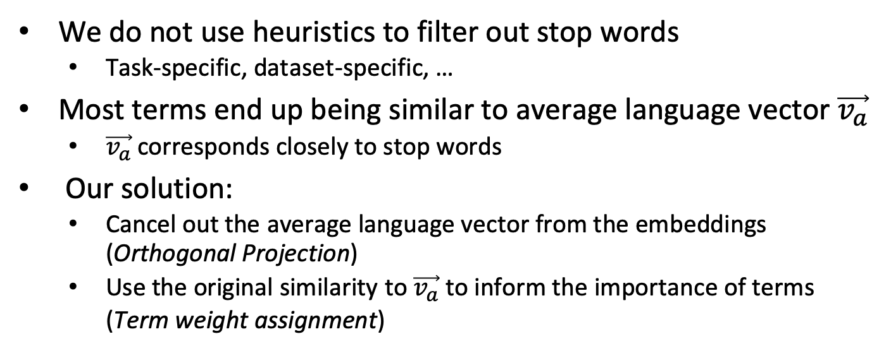
2. Discriminative
We do not use heuristics to filter out stop words
  Task-specific, dataset-specific, …
Most terms end up being similar to average language vector $\vec{v_{a}}$
  $\vec{v_{a}}$corresponds closely to stop words
Our solution:
  Cancel out the average language vector from the embeddings (Orthogonal Projection)
  Use the original similarity to$\vec{v_{a}}$ to inform the importance of terms
  (Term weight assignment)

Slide 17
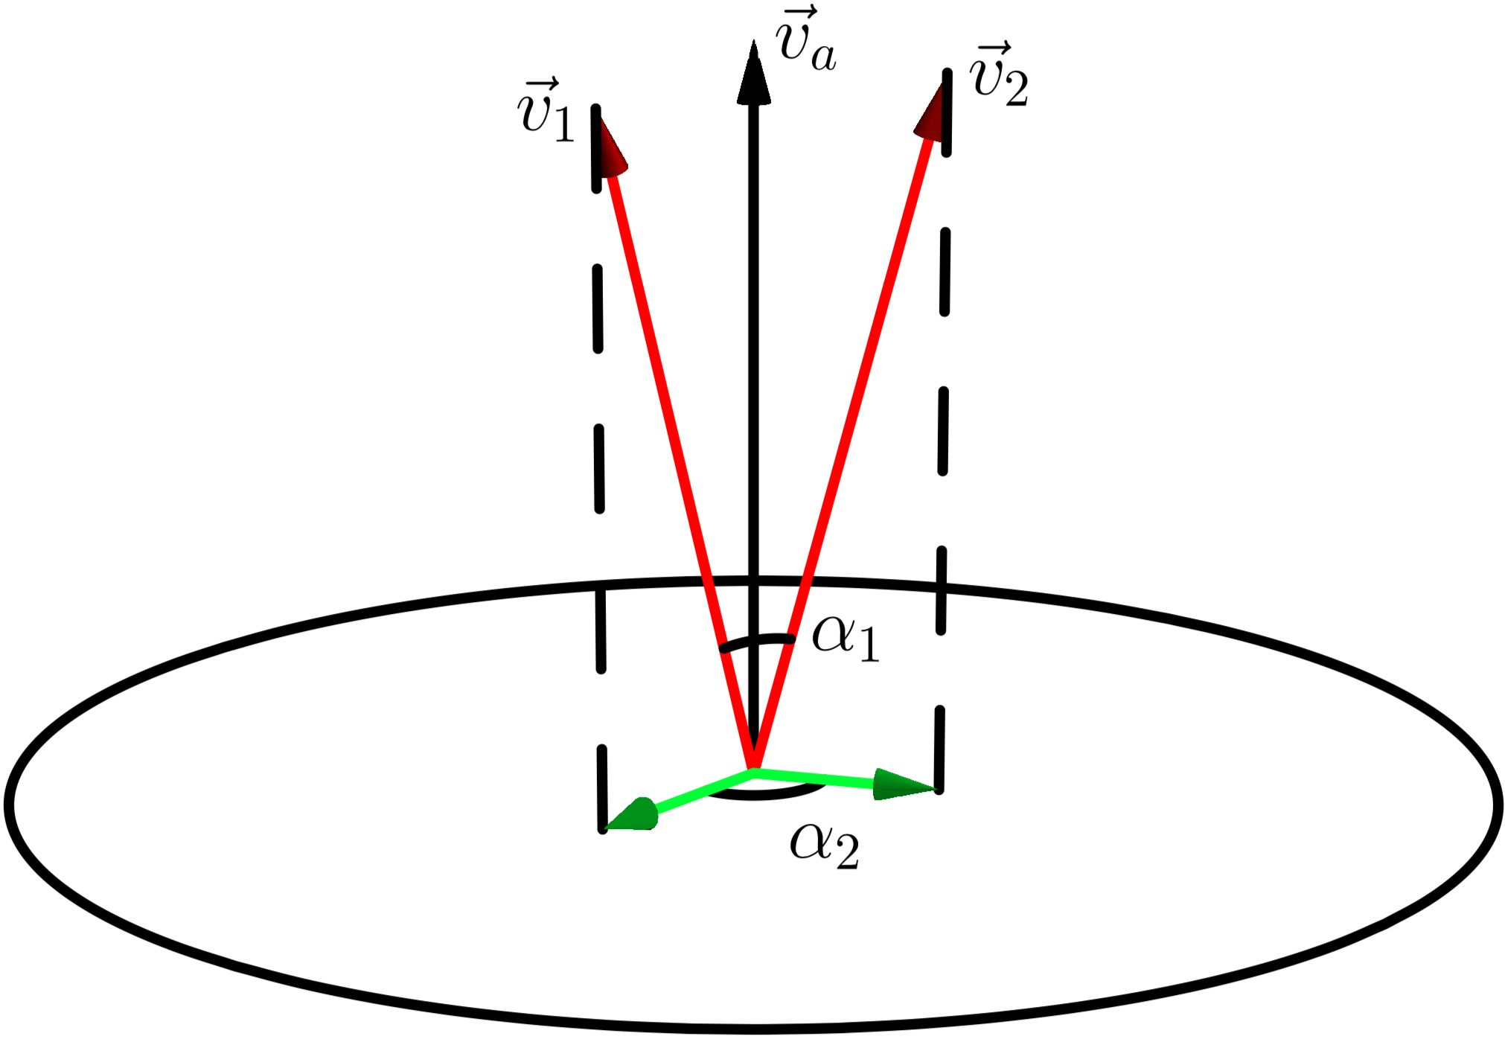
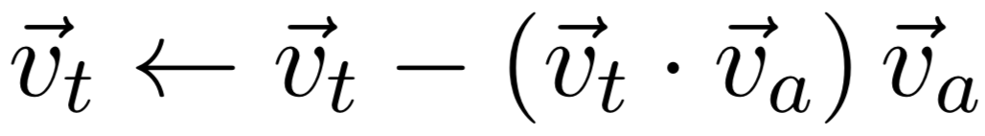
Orthogonal projection
Vectors are projected on the orthogonal hyperplane to an average language vector
        Removing the stop-wordiness improves the discriminating power
Projected vectors are normalized

Slide 18
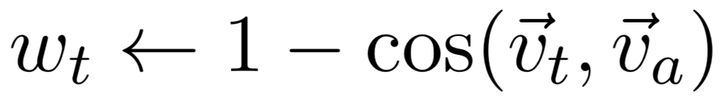
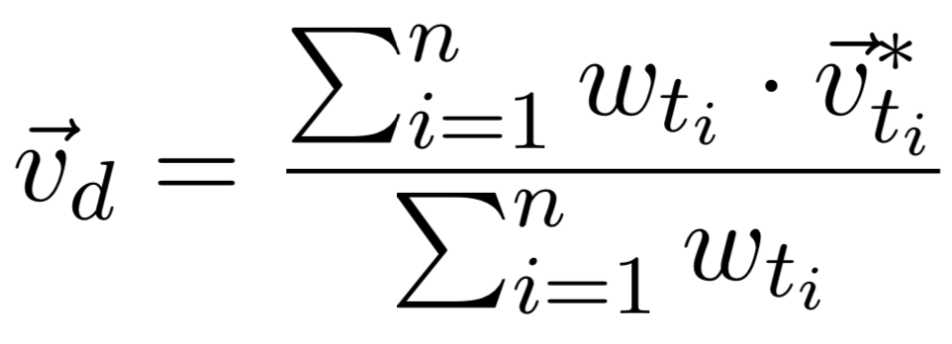
Document Embedding: Term weights
  The more similar to the average vector, the less weight it gets
  No need to remove stop words first
  Crucial to get distinctive document embeddings (weighted average)

Slide 19
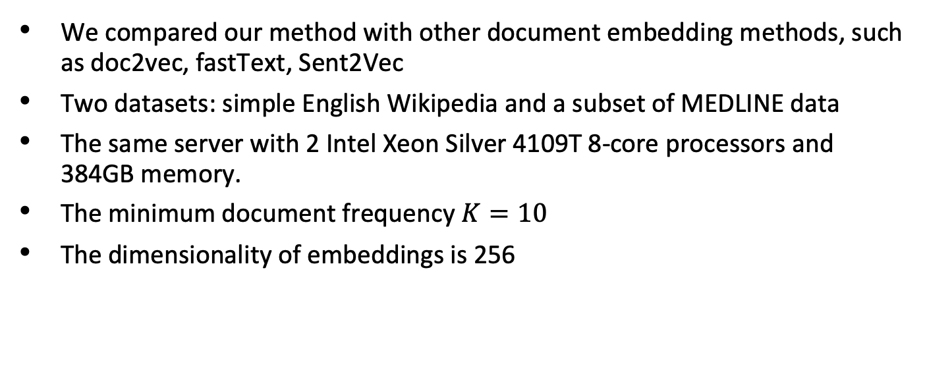
Experiments
We compared our method with other document embedding methods, such as doc2vec, fastText, Sent2Vec
Two datasets: simple English Wikipedia and a subset of MEDLINE data
The same server with 2 Intel Xeon Silver 4109T 8-core processors and 384GB memory.
The minimum document frequency $K=10$
The dimensionality of embeddings is 256

Slide 20
Experiment I
Semantic Textual Similarity (STS) benchmark
3.600 | A group of men play soccer on the beach. | A group of boys are playing soccer on the beach.
5.000 | One woman is measuring another woman's ankle. | A woman measures another woman's ankle.
4.200 | A man is cutting up a cucumber. | A man is slicing a cucumber.
1.500 | A man is playing a harp. | A man is playing a keyboard.
1.800 | A woman is cutting onions. | A woman is cutting tofu.

Slide 21
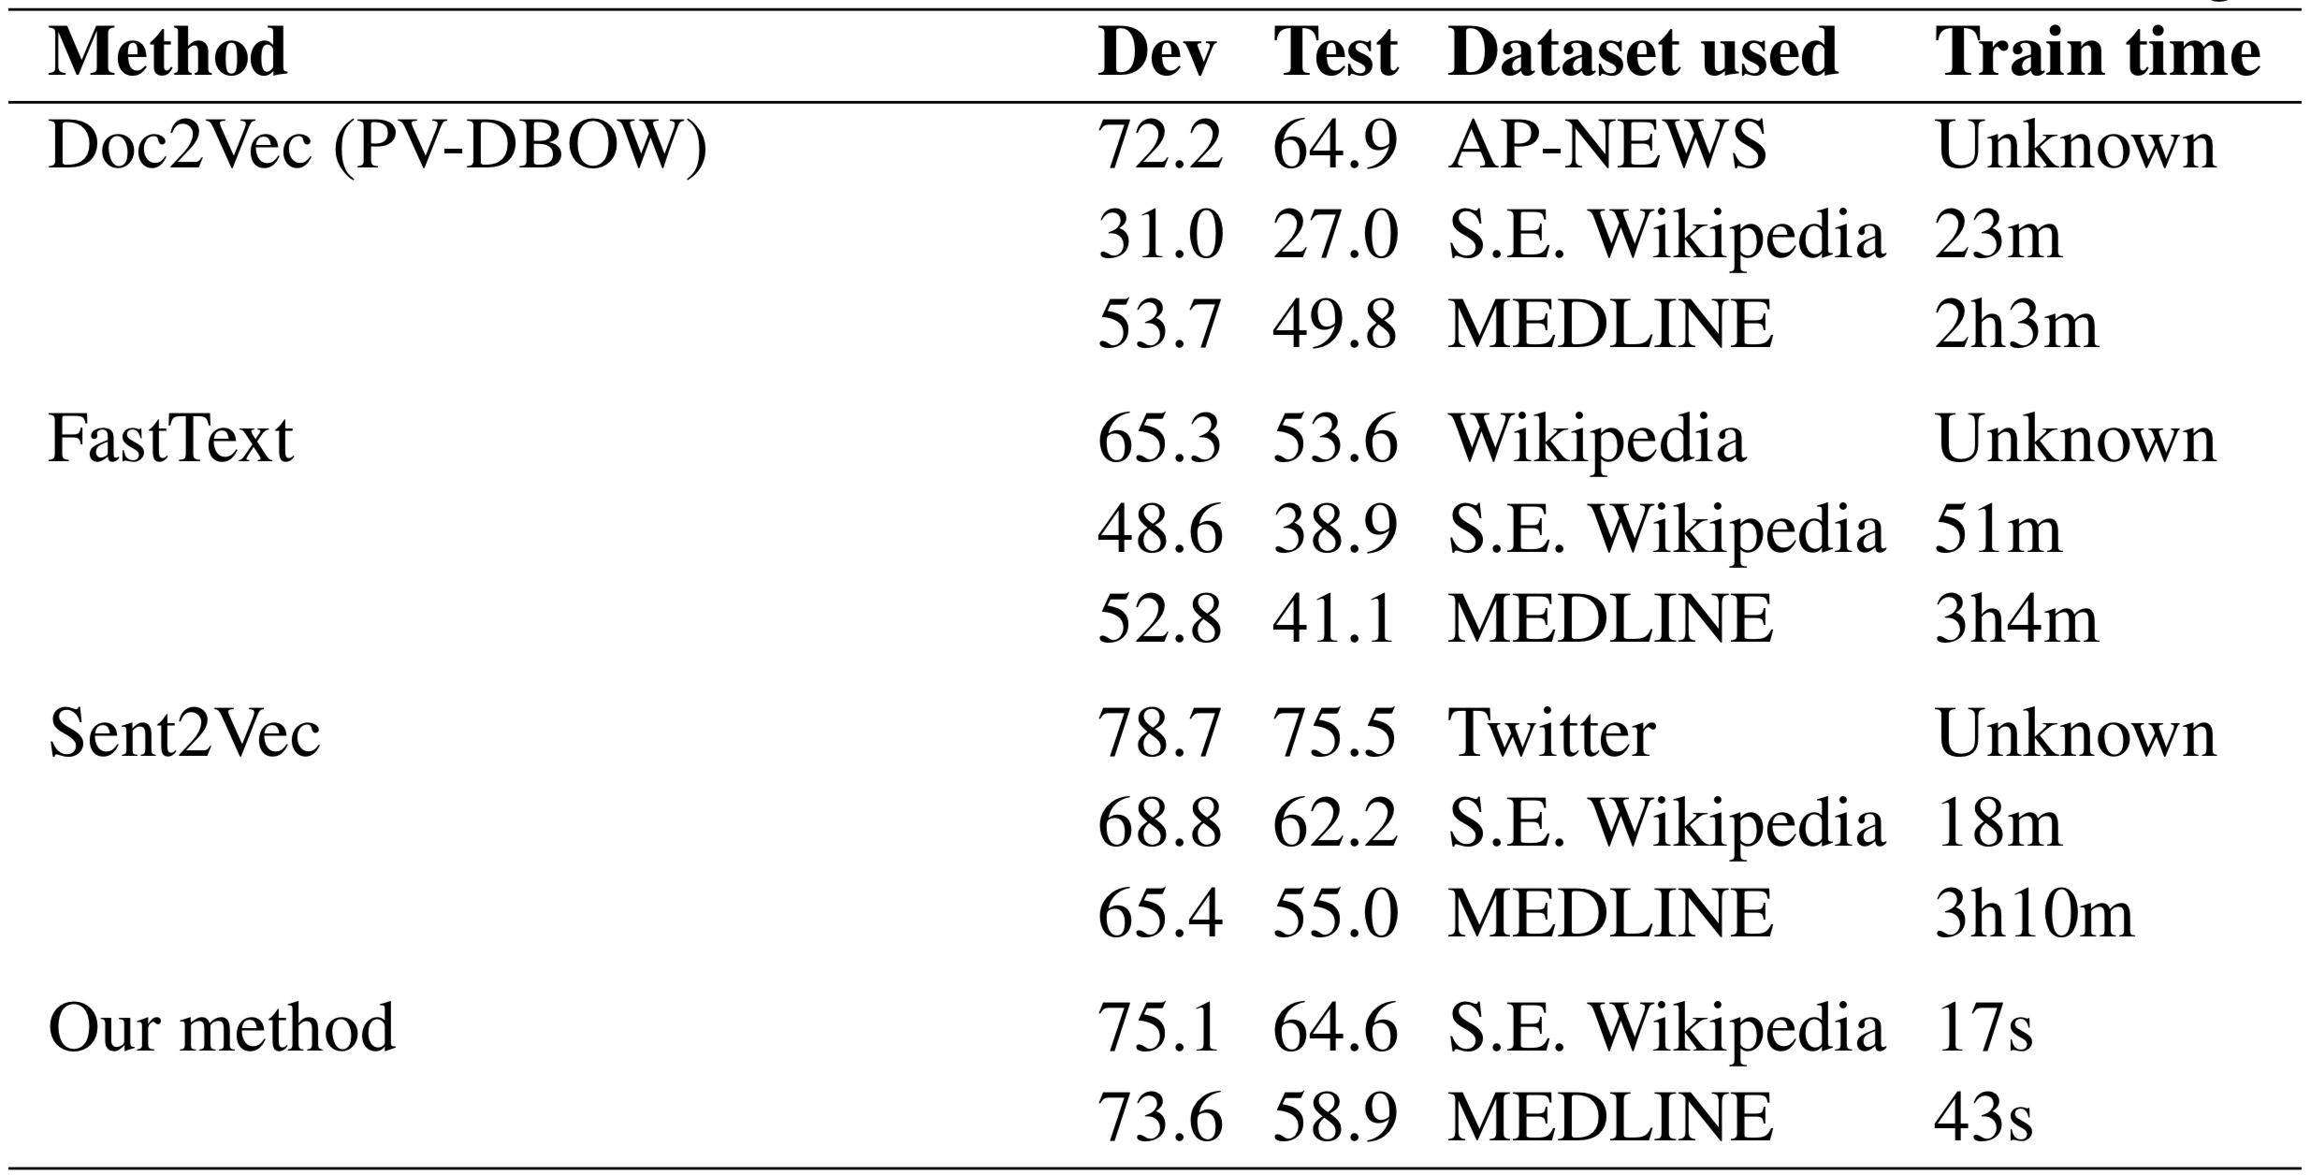
Semantic Textual Similarity (STS) benchmark
Notes:
The Semantic Textual Similarity (STS) Benchmark is a SemEval task organized between 2012 and 2017. It consists of 8628 pairs of English sentences, selected from image captions, news headlines and user forums. The similarity between these sentence pairs was annotated using a five point scale via crowdsourcing (Agirre et al., 2016). Participating systems calculate the similarity between these sentence pairs and are evaluated based on their Pearson correlation with the gold standard STS annotations.

Slide 22
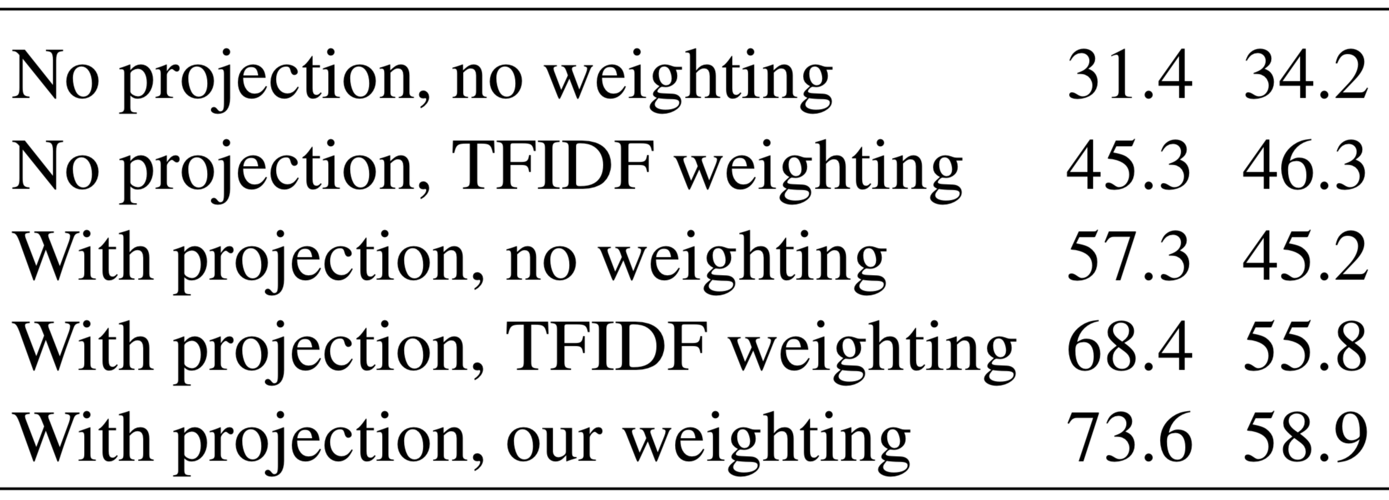
Effect of orthogonal projection and weighting

Slide 23
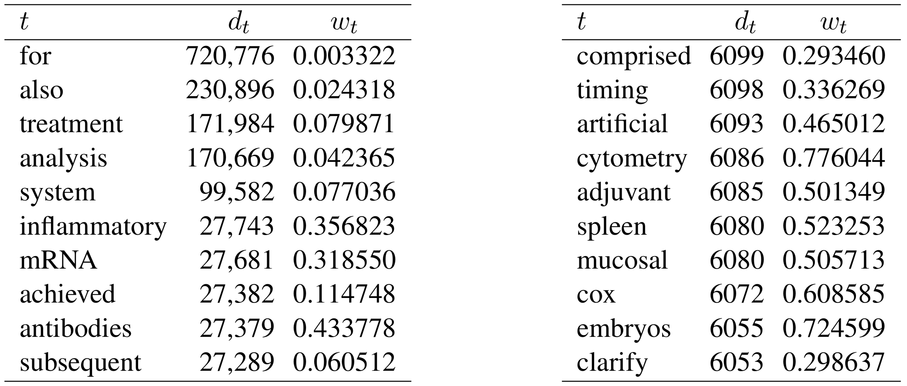
Document frequencies vs assigned weights

Slide 24
Experiment II: Predicting MeSH subjects
Metadata of one million Medline articles with abstract
The training set contains 147,837 unique MeSH subjects, on average 16 per article
10,000 articles for testing
Measure precision/recall of top N predictions

Slide 25
Similarity-based subject prediction
Subjects and documents are embedded in the same semantic space
A document is likely to be indexed with subjects that are most related to it (with highest cosine similarities)

Slide 26
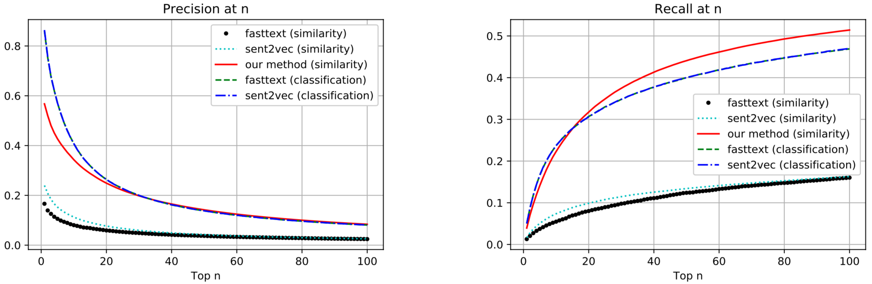
Precision and recall @ n: Medline

Slide 27
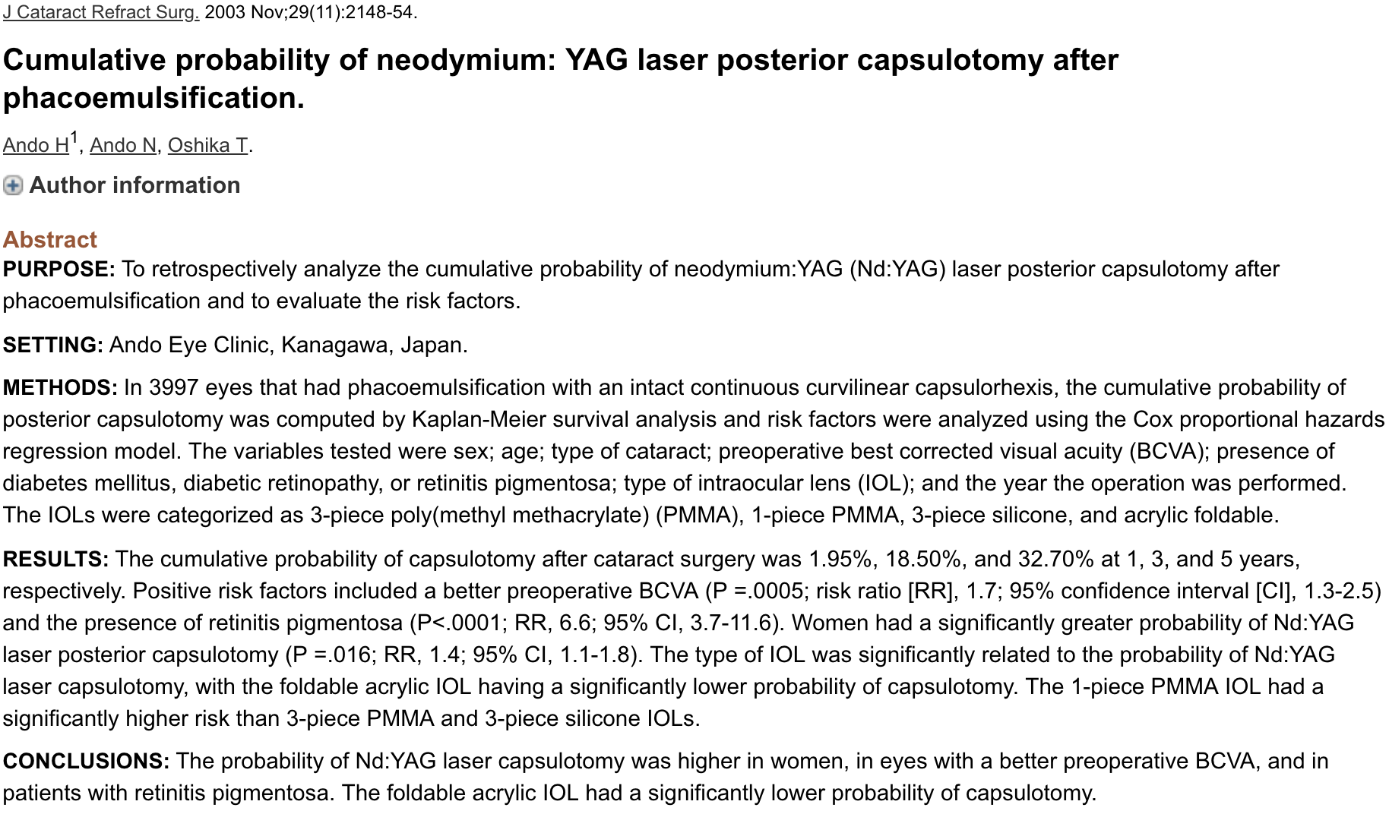
Example
https://www.ncbi.nlm.nih.gov/pubmed/14670424

Slide 28
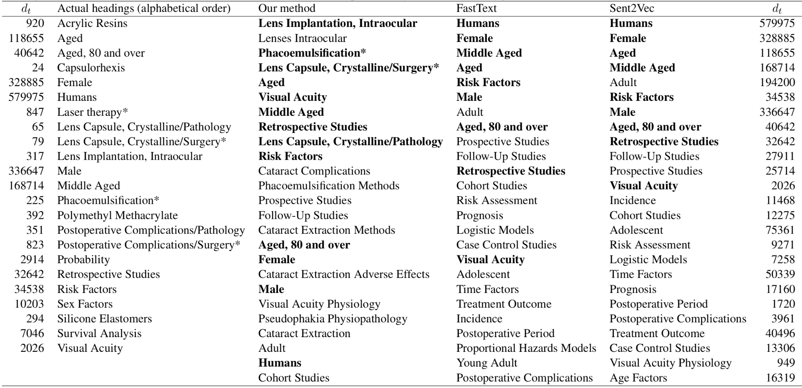
Comparing with FastText, Sent2Vec

Slide 30
Summary
A fast method that computes Random Projection based embedding
An effective approach to optimize the discriminative power of term embeddings and consequent document embeddings
On the whole, a practical method which requires no iterative parameter optimization and computes embeddings and associated weights in a single pass through the documents of the training corpus.

Slide 31
Future work
Take care of out-of-vocabulary terms
Involve human judgement
Develop more appropriate evaluation measures

Slide 32
Thank you!
Rob Koopman (rob.koopman@oclc.org)
Shenghui Wang (shenghui.wang@oclc.org)
Gwenn Englebienne (g.englebienne@utwente.nl)

Slide 33
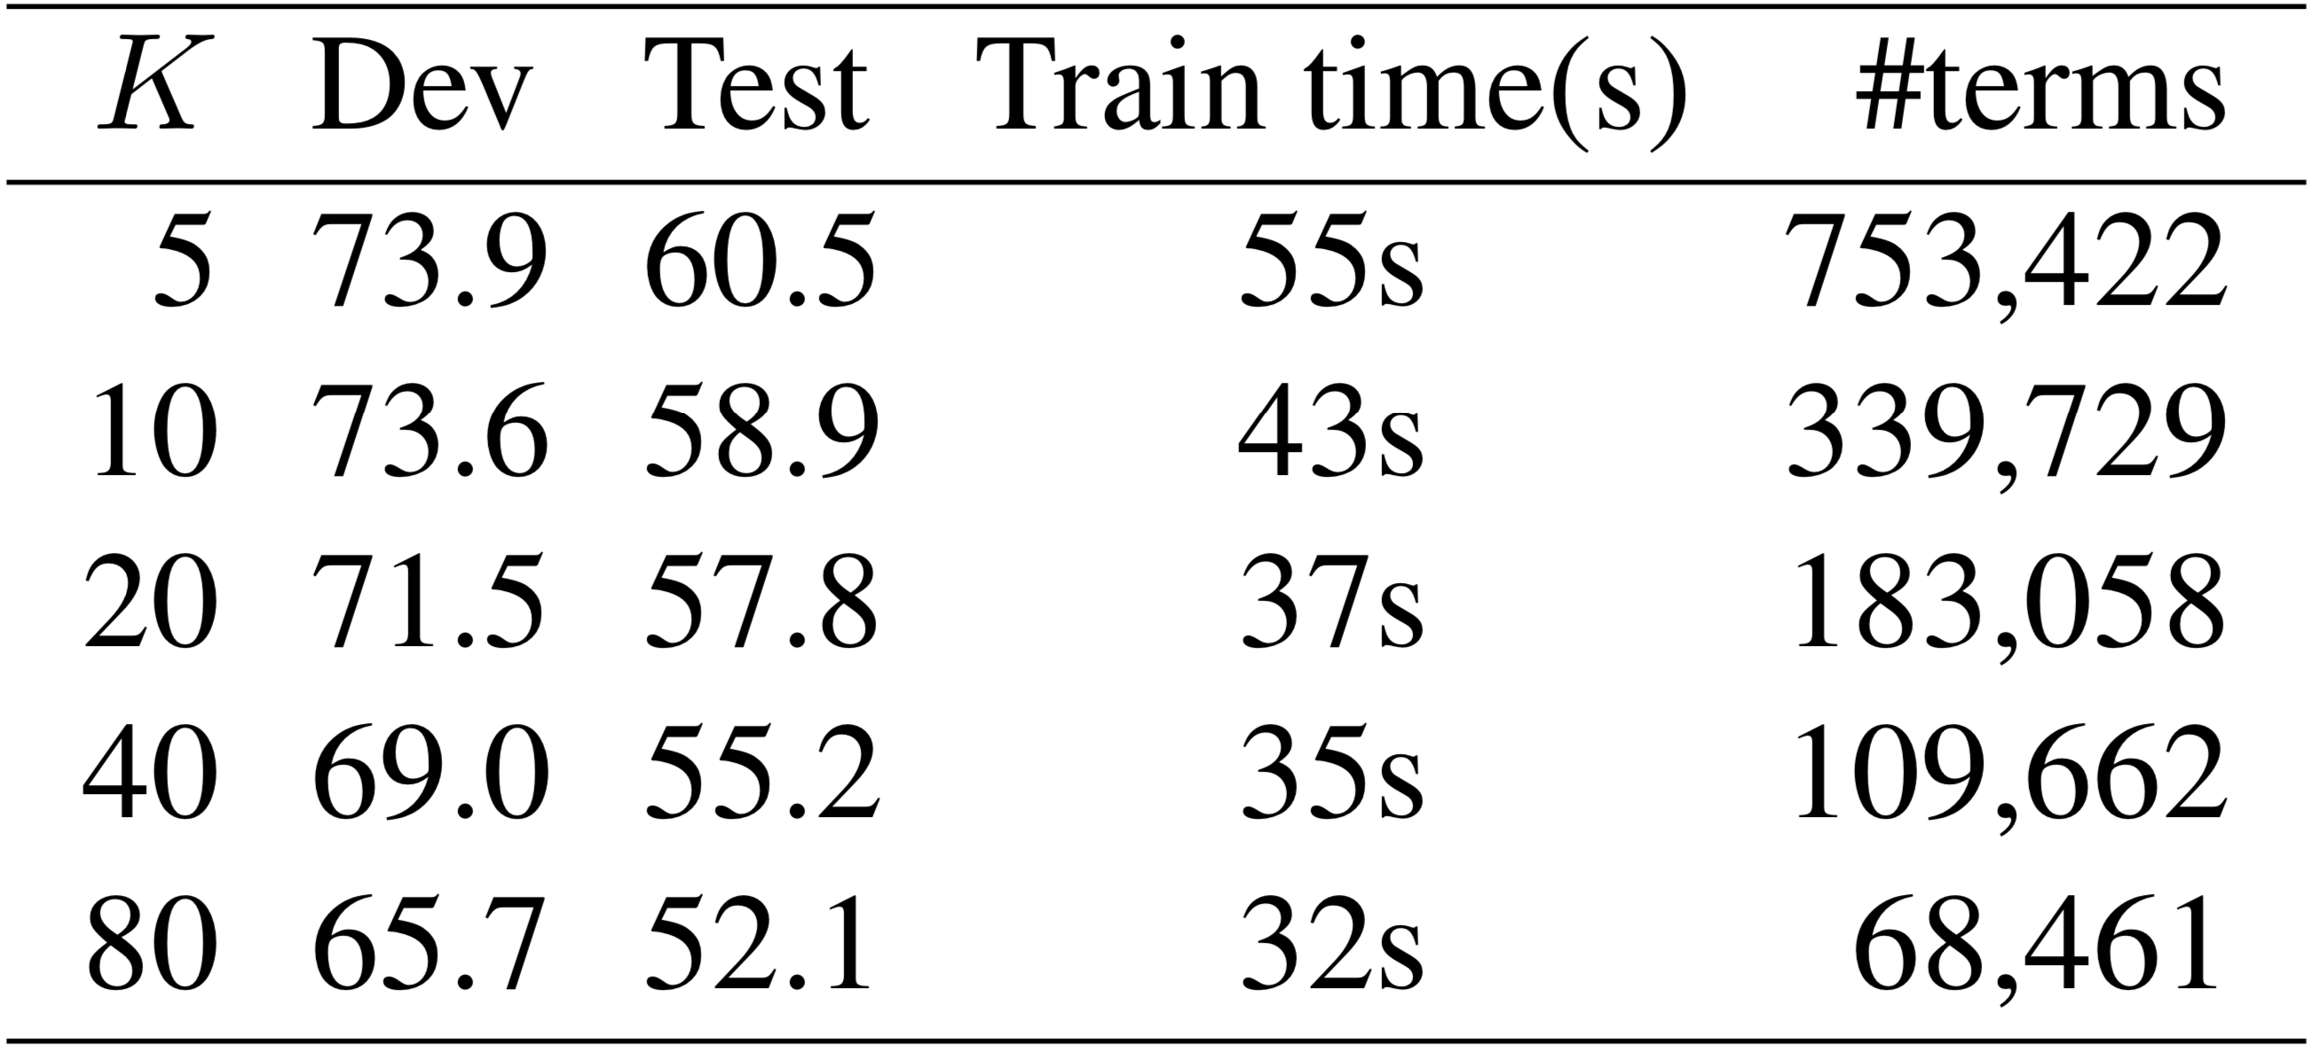

The effect of $K$ on the MEDLINE dataset

