Slide 1
2019 LD4 Conference on Linked Data in Libraries
OCLC Project Passage User Interface Assisting the cataloging workflow
May 11, 2019
Bruce Washburn
Principal Engineer, OCLC Research

Slide 2
About Project Passage
An OCLC Pilot Project, January - September 2018
16 OCLC Member Library participants
Evaluated Wikibase as a cataloging platform for library linked data
Passage Wikibase initialized with ~1M entities, representing overlaps between Wikidata, VIAF, and WorldCat
Passage project participants used the platform for cataloging, focusing on selected material types
Notes:
In this short presentation I will talk about OCLC’s Project Passage (https://www.oclc.org/research/themes/data-science/linkeddata/linked-data-prototype.html), a pilot project carried out in 2018 to evaluate a federated instance of the Wikibase platform for creating bibliographic linked data.

Slide 3
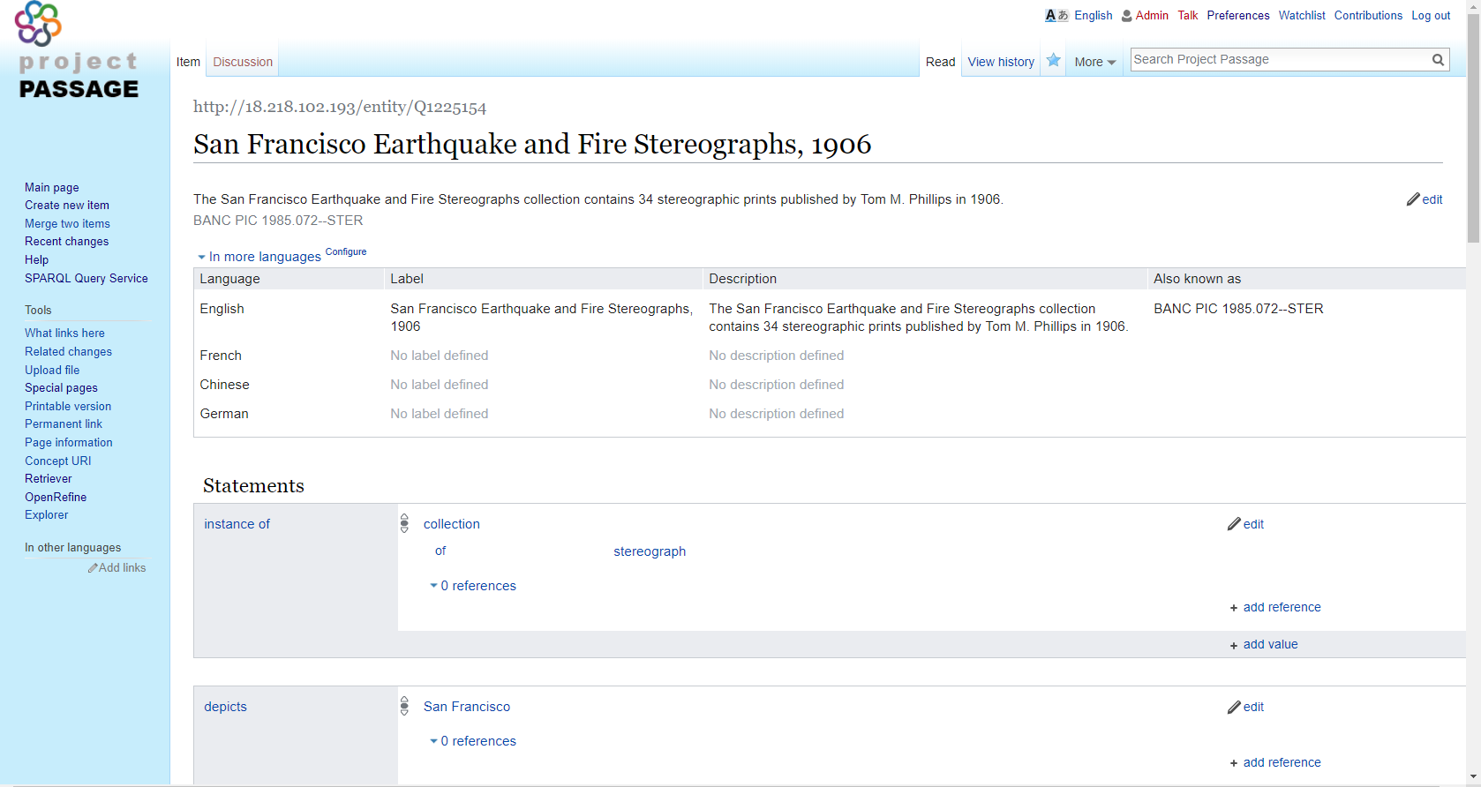
The Wikibase Cataloging Interface
Mature and well-tested
Used by thousands for editing Wikidata
The primary editing interface for Project Passage
Requires some initial orientation and practice
Notes:
The Wikibase software platform is mature and well-tested, having been in development and widely used since 2012.
For example, there are about 20,000 active users editing in Wikidata each month (which uses Wikibase), working in a global, decentralized network. https://stats.wikimedia.org/wikispecial/EN/TablesWikipediaWIKIDATA.htm#editor_activity_levels
We used the built-in web-based editor that is part of the Wikibase platform as the primary means of creating and updating data in Project Passage.
In our experience working with the Wikibase platform, and with the project participants, we noted that there was some initial orientation, training, and practice needed, to become acquainted with features of the user interface, but also to better understand the data architecture in an entity-oriented, rather than a record-oriented, cataloging environment.

Slide 4
The cataloging workflow is susceptible to interruption, depending on underlying data.
“The Missing Piece" by J. Sibiga Photography is licensed under CC BY-NC-ND 2.0
Notes:
An example: editing a description of a collection of photographs that depict various places.
If a description of the place doesn’t already exist in the system, the description of the work can stall until the place can be described in its own, separate, entity description, after which the collection description can link to the place using the “depicts” property.
Photo credit: “The Missing Piece” J. Sibiga Photography
https://www.flickr.com/photos/picturepurrfect685/4628679591
Attribution-NonCommercial-NoDerivs 2.0 Generic (CC BY-NC-ND 2.0)

Slide 5
Notes:
Here’s an example. We’re looking at a Project Passage entity description of an archival collection of stereographs.
The collection is the primary entity we’re describing, but the collection is related to other entities in the system, including events (the 1906 earthquake), organizations (the Bancroft library at UC Berkeley where the collection is held), and other forms of description (an online finding aid).

Slide 6
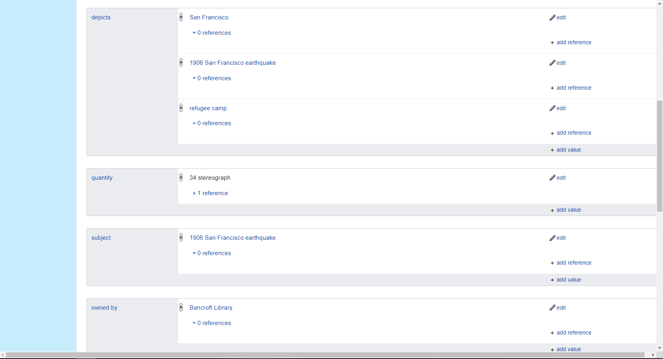
Notes:
There is also a property that connects the collection to other entities that the stereographs in the collection depict, including the city of San Francisco, the event of the 1906 earthquake, and refugee camps that were built after the event.
The archivists who maintain this collection have noted other places that are depicted, so this list can be extended in Project Passage description.

Slide 7
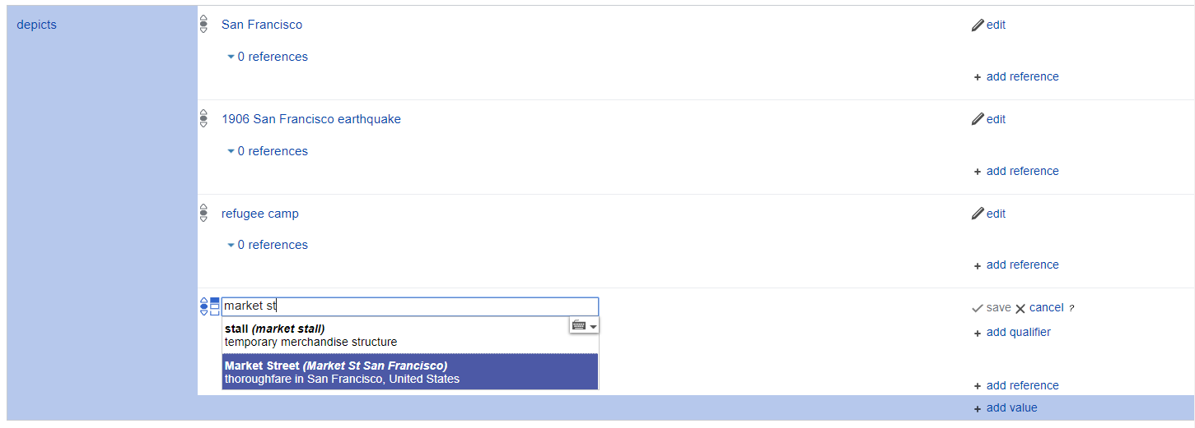
Notes:
One of those locations in Market Street in San Francisco. Using the Wikibase editing interface, a new “depicts” statement can be easily added, with the interface looking for and finding a separate entity description of Market Street in the Project Passage database.

Slide 8
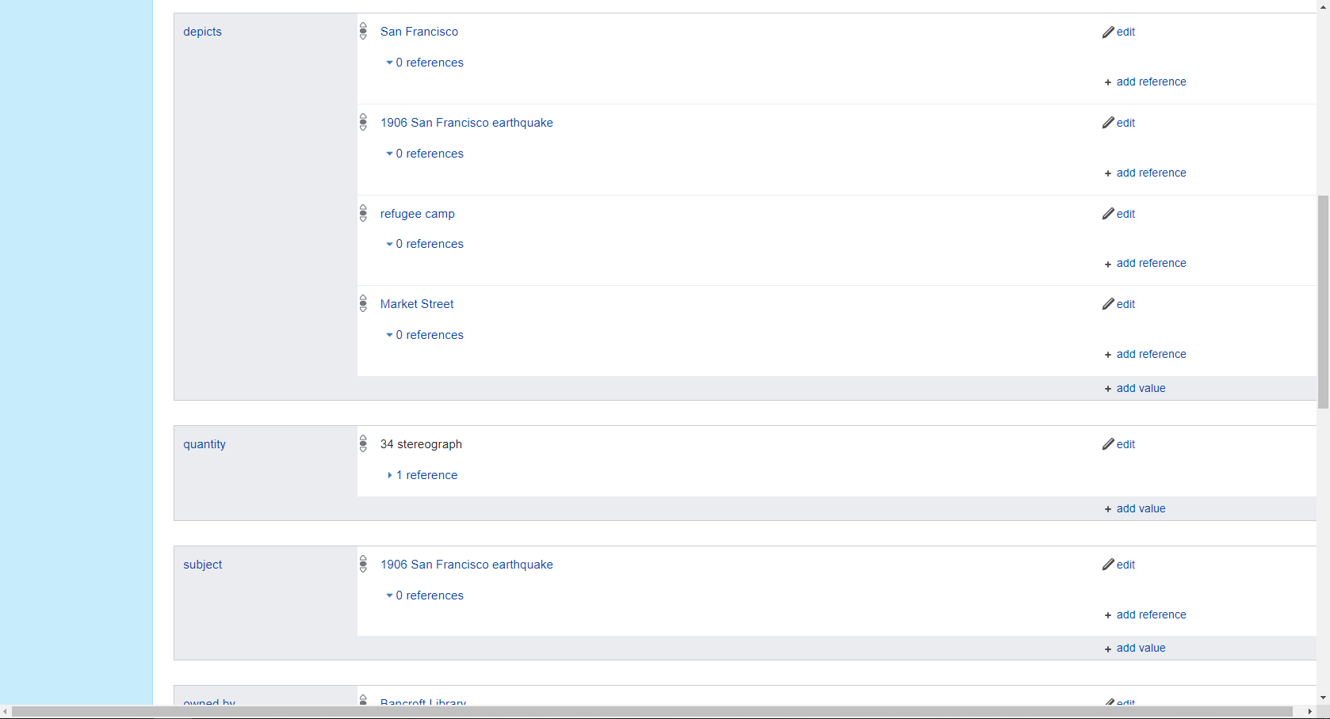
Notes:
Selecting the matching entity and clicking the “Save” link is all it takes to connect this collection to this place with a “depicts” relationship.

Slide 9
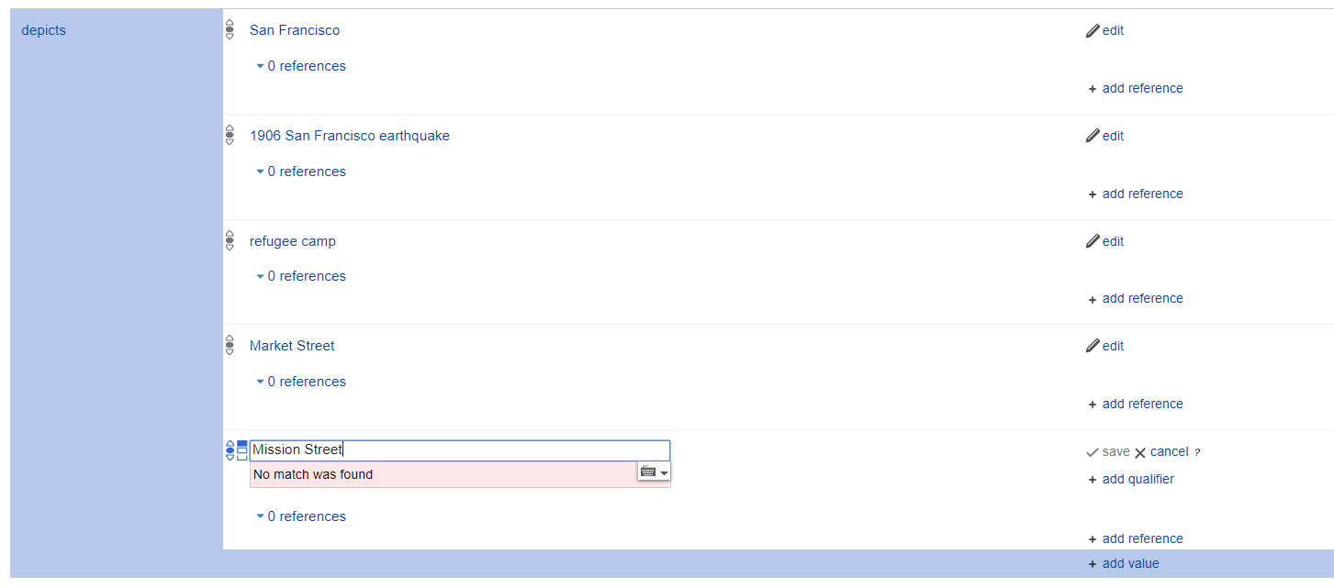
Notes:
The collection also depicts Mission Street. In this case, the Project Passage database doesn’t have an entity description for this location, and here is where the workflow stalls.
It’s kind of interesting that we’re stalled, as that highlights an important distinction between the Wikibase framework and some of the record-oriented, bibliographic frameworks we may be more accustomed to. There wouldn’t be anything in most cataloging or metadata documentation systems (using MARC, or EAD for finding aids, or CONTENTdm for digital content, for example) to stop us at this stage if we did not have an authoritative headings. We might not, in those systems, even have a way that the relationship between the work and the place is “depiction”. And if we wanted to tag the place we could add a MARC 651 field, or an EAD geogname element, or a Dublin Core Spatial Coverage element in CONTENTdm.
But in the Wikibase environment if we want to connect the collection to an entity for Mission Street, we need to either:
Note the missing entity, continue editing the Collection, and subsequently create the entity description and return the the collection entity and update it with a link
Put the Collection editing on hold while, in a parallel process, we create at least a stub description of the location so that it can be linked to the collection, noting the new location entity as something to improve later
There isn’t a way to simply add the string to the depicts relationship, and doing so would undermine the subsequent interoperability and power of the entity description.
In working with the Project Passage participants, we preferred the 2nd option, but wanted to streamline the process of adding the missing entity, and create more than just a stub description, in order to keep the cataloger’s attention on describing the work.

Slide 10
The Project Passage Retriever
Search for entity descriptions in Wikidata, VIAF, and FAST
Align the classes and properties for these 3 resources with Project Passage
Display data in a simple editing interface with tools to review, correct, and supplement imported data
Load the data into Project Passage
Notes:
Out of this need to streamline the editing workflow, these functional requirements emerged for a new application that would serve as a helper for creating new descriptions for entities not found in Project Passage but described in other resources, which we named the Project Passage Retriever.
This was designed as a companion application for the Wikibase Editor … imagine having two browser windows open, one for the Wikibase interface and another for the Passage Retriever. As the cataloger encountered the need to link a work description to another entity, like adding a “depicts” statement to the collection description for Mission Street, the Retriever would be asked to look for a description, map its data to the properties and classes defined in Project Passage, give the cataloger a way to review and amend the imported data, and a way to push the data into the Project Passage database.

Slide 11
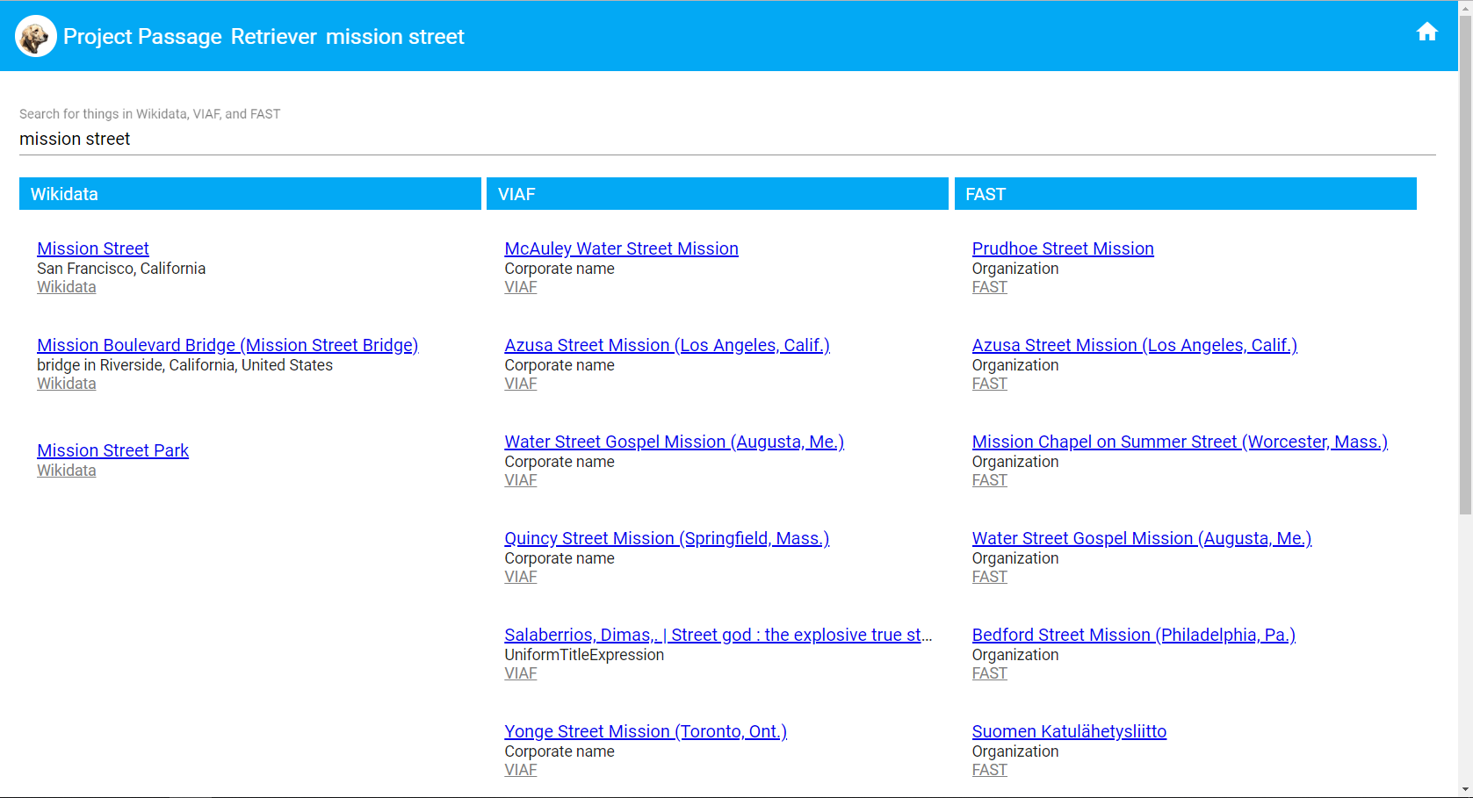
Notes:
Here’s a view the Project Passage Retriever, with search results for the keyword search “mission street”.
The Retriever uses the three different APIs that are available for Wikidata, VIAF, and FAST to look for matches.
It also uses the identifiers associated with the matching results to check in Project Passage, to make sure the entity isn’t already available there.
There is a match for Mission Street in the Wikidata results, so we’ll select that.

Slide 12
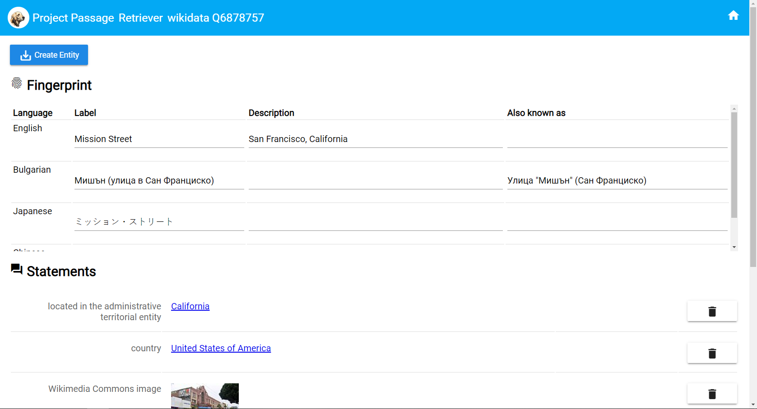
The Retriever
Federated searching of Wikidata, VIAF, and FAST
Built-in “crosswalks” to relate properties and classes in those systems and vocabularies to Project Passage
Cross-pollination of source data. E.g., including additional aliases from VIAF, for a Wikidata match.
A form-based UI for validating and improving imported data
A simple bot-based mechanism for adding data to the Passage Wikibase
Notes:
The Project Passage Retriever uses the Wikidata API to retrieve data for the entity description, and using a built-in “crosswalk” it looks for Wikidata properties that have an equivalent property in Project Passage.
Wikidata’s properties are far more extensive than those defined in Project Passage, so not all of the data from Wikidata will transfer, by design.
The Retriever displays the entity data in a web form, to allow for review and minor editing. For example, an incorrect or invalid statement can be deleted, or the descriptive “Fingerprint” data can be modified.
In this case we’d like improve the description, which doesn’t say what kind of a thing “Mission Street” is, and isn’t as accurate as it could be about the city where it is located. And to help with matching for searches or lookups that abbreviate the word “Street”, we can add an “also known as” string.

Slide 13
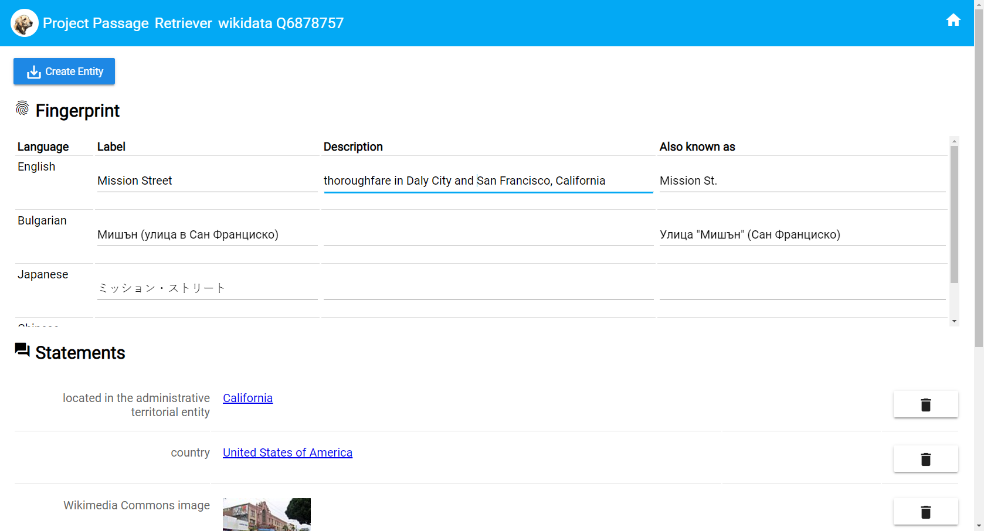
Notes:
The new description describes what kind of a “thing” Mission Street is (a “thoroughfare”) and notes that the street extends from Daly City to San Francisco. And the abbreviated form of the name is added.
(There is a missed opportunity here, where the Retriever should also be able to push those improvements back to Wikidata.)

Slide 14
Notes:
Scrolling down we can see the other statements that have been automatically fetched by the Retriever, including geo-location data and an identifier linking the Passage entity back to its Wikidata source.

Slide 15
Notes:
After review and editing, we’re ready to create the entity in Project Passage.
Click the “Create Entity” button in the upper left …

Slide 16
Notes:
… and its status changes while the data is being pushed to Project Passage by the Retriever application …

Slide 17
Notes:
… and finally replaced with a success message and link to the new identifier for the Entity in Passage

Slide 18
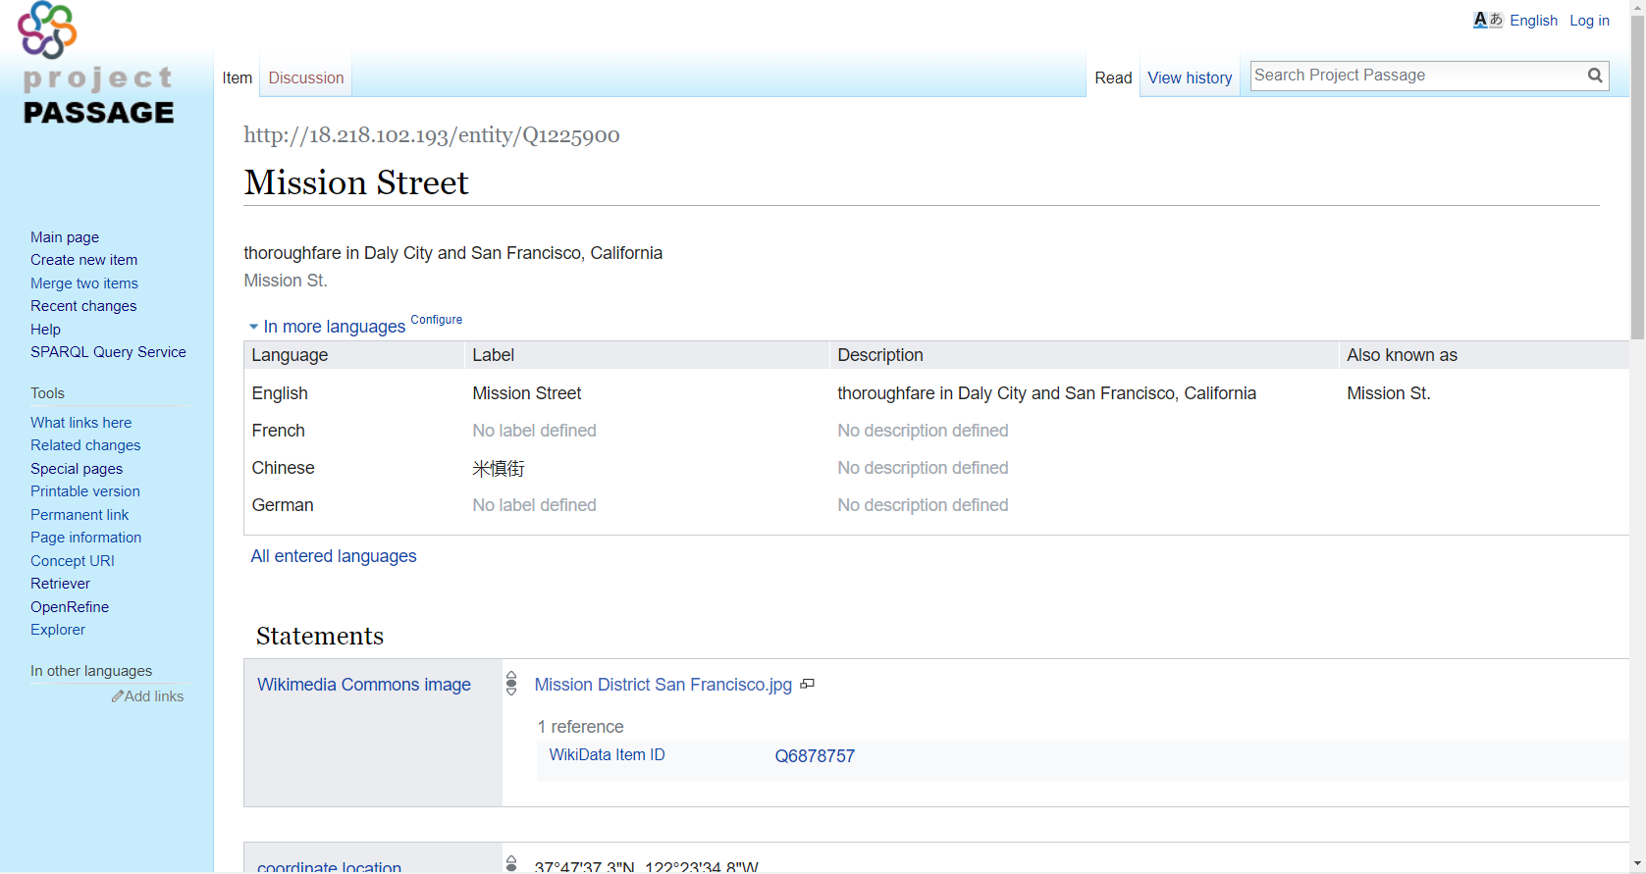
Notes:
Which is immediately available in the Wikibase user interface …

Slide 19
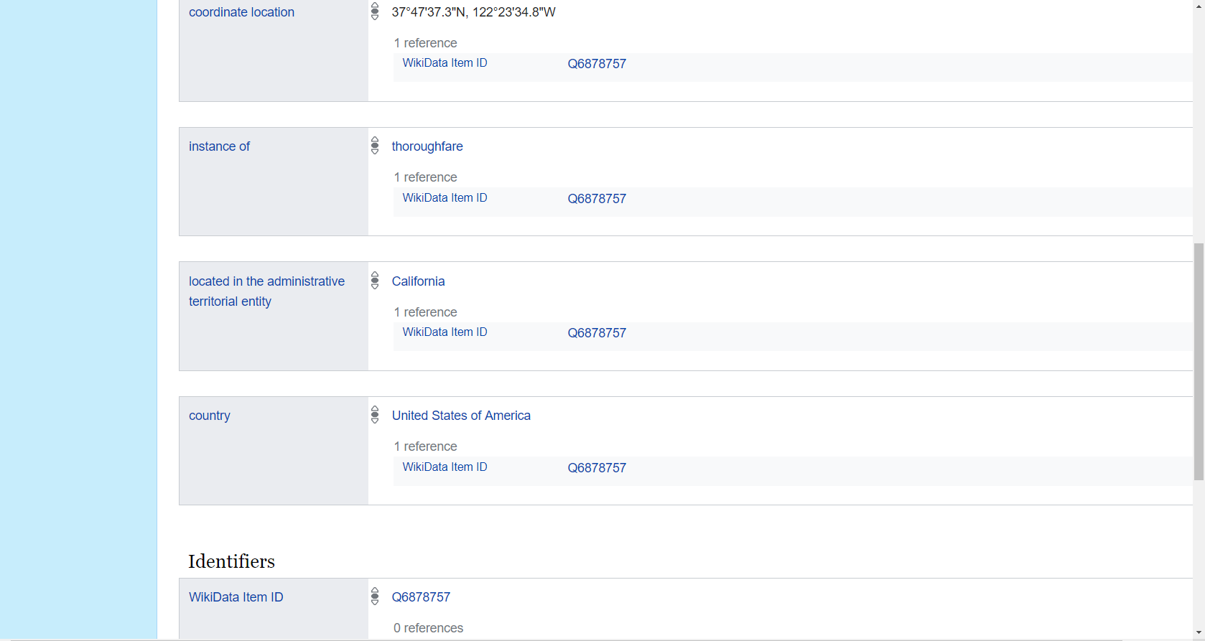
Notes:
… with the imported statements and data, including automatically generated references from the statements back to the Wikidata Item source.

Slide 20
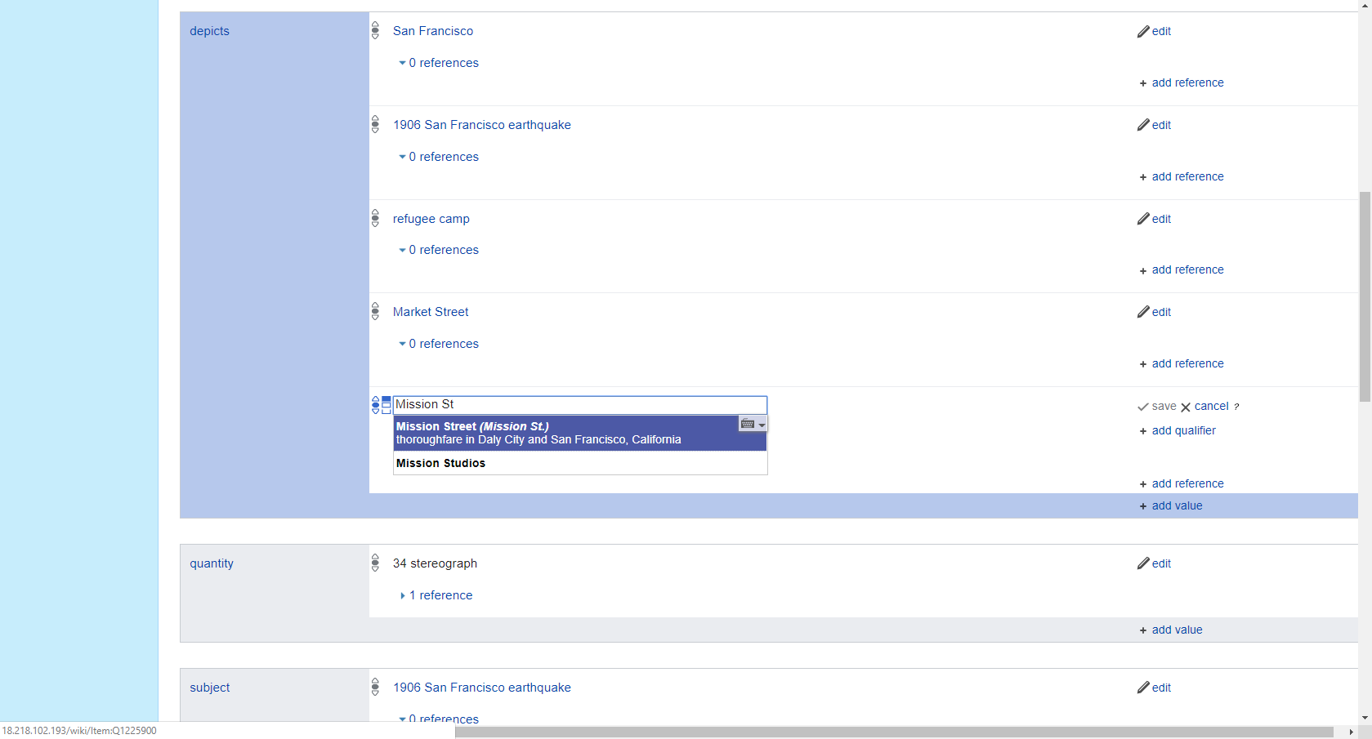
Notes:
Returning to our Wikibase editing session for the collection, now when we search for Mission St. we find it in Passage

Slide 21
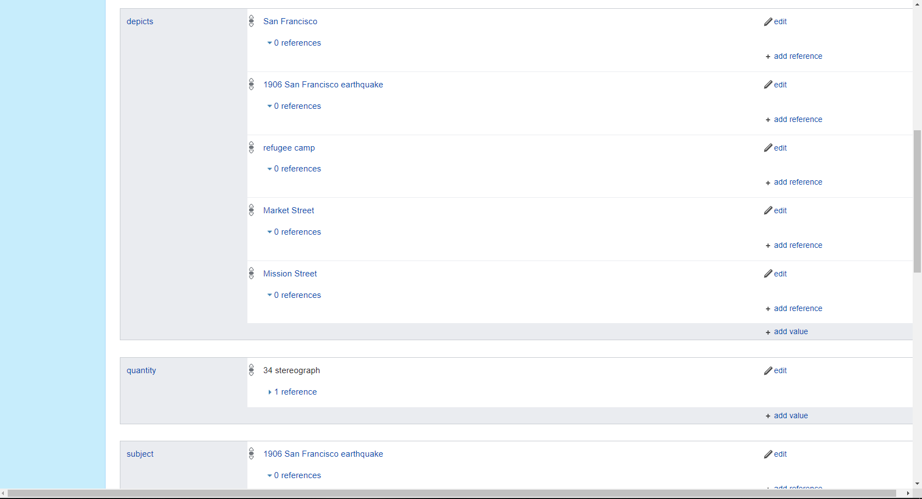
Notes:
And can easily link it with a “depicts” statement.

Slide 22
The Project Passage Retriever
Search for entity descriptions in Wikidata, VIAF, and FAST
Align the classes and properties for these 3 resources with Project Passage
Display data in a simple editing interface with tools to review, correct, and supplement imported data
Load the data into Project Passage
Notes:
Returning to the high-level functional requirements for the Passage Retriever, these can be thought of more generally …

Slide 23
The Project Passage Retriever
Federated search interface
Data model crosswalk
Cataloging user interface
Wikibase data loader
Notes:
With this perspective, the Retriever can be seen as more of a mix, including the features and behaviors of a federated search interface for finding matches in other authority systems, a crosswalk or mapping from external system vocabularies to our local vocabulary, a simple cataloging interface, and a batch data loader for Wikibase.

Slide 24
The Project Passage Retriever
Federated search interface
Data model crosswalk
Cataloging user interface
Wikibase data loader
Notes:
In building the Retriever application, I found that the 2nd and 3rd features were the most challenging. We had software solutions available from prior work that helped speed up the step of building a federated search interface that worked with the Wikidata, VIAF, and FAST APIs, and had previously built Wikibase data loading scripts using the Pywikibot library.

Slide 25
The Project Passage Retriever
Federated search interface
Data model crosswalk
Maintenance and synchronization challenges as external sources expand and data models change.
Cataloging user interface
Wikibase data loader
Notes:
For both items 2 and 3 in this list, there was a balancing act.
For the data model crosswalk, what are the best target systems to search, how many are too many to effectively manage (from the perspectives of performance and code complexity), and how do we keep the vocabulary mappings in synch as the external sources may change over time?

Slide 26
The Project Passage Retriever
Federated search interface
Data model crosswalk
Cataloging user interface
Simplify entity creation while allowing data review and editing
Import sufficient data for discovery and disambiguation while leveraging the network graph for a fuller description of the entity
Wikibase data loader
Notes:
For the cataloging user interface, where the point of the application is to quickly create a description that is better than a stub description, how much of the user’s time and attention do we want to have applied to the review and editing step (understanding that Wikibase will have a much fuller set of editing features to apply, once the description is entered)?
And how much data needs to be imported to support subsequent searching, selection, disambiguation, and duplicate detection, with the understanding that for some external sources a subsequent federated query can retrieve properties that were not imported, and any imported property will want to benefit from future updates and improvements made in its external source.

Slide 27
The Project Passage Retriever
Would a “Retriever” UI and server-side application be generally useful for federated Wikibases?
If so, how should the application be designed for optimal sharing and distribution?
Can data model crosswalks for the application be community-managed?

Slide 28
Contact
Bruce Washburn
OCLC Research
bruce_washburn@oclc.org
@btwashburn

