Slide 1
LD4 Boston
Ideation to Prototype: Turning new ideas into useful services
May 11, 2019
Andrew K. Pace, Executive Director, Technical Research, OCLC

Slide 2
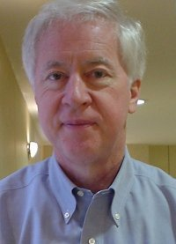
“Ideas are cheap.”
Thomas B. Hickey, Ph.D.
Chief Scientist, OCLC Research, 1977-2016

Slide 3
The problem is there’s already a way we do this.
The good news is there’s already a way we can do this.
Research Scientist
Excuse me. I’m right here! Does anyone care what I think?
Customer
Product Manager
Photo by rawpixel on Unsplash

Slide 4
5 steps of ideation & experimentation

Slide 5
Step 1: product vision statement
Project Passage: Linked Data Wikibase Prototype
Work with our members through a foundational shift in the collaborative work of libraries, communities of practice, and end-users—dramatically improving efficiency, embracing the inclusive, diverse, and earnest OCLC membership, and empowering a new and trusted knowledge work enabled by the web.

Slide 6
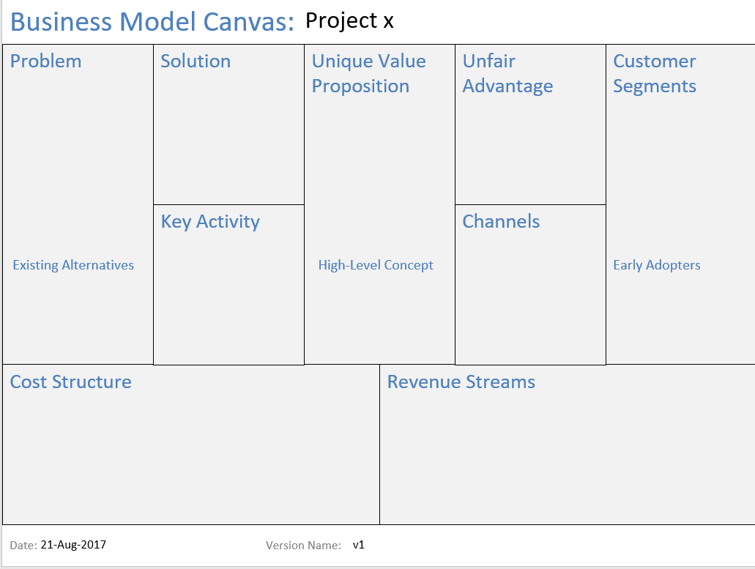
Step 2: justification
“Lean canvas”
Succinct business-focused view that helps you determine the real effort behind a good idea

Slide 7
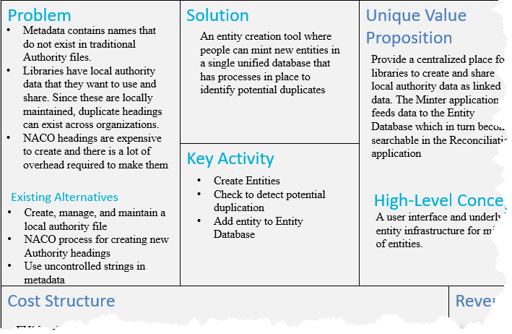
Quick-and-easy
This is a sniff-test, not a full business plan or market roll-out strategy
The more precisely right you try to be, the more precisely wrong you will be

Slide 8
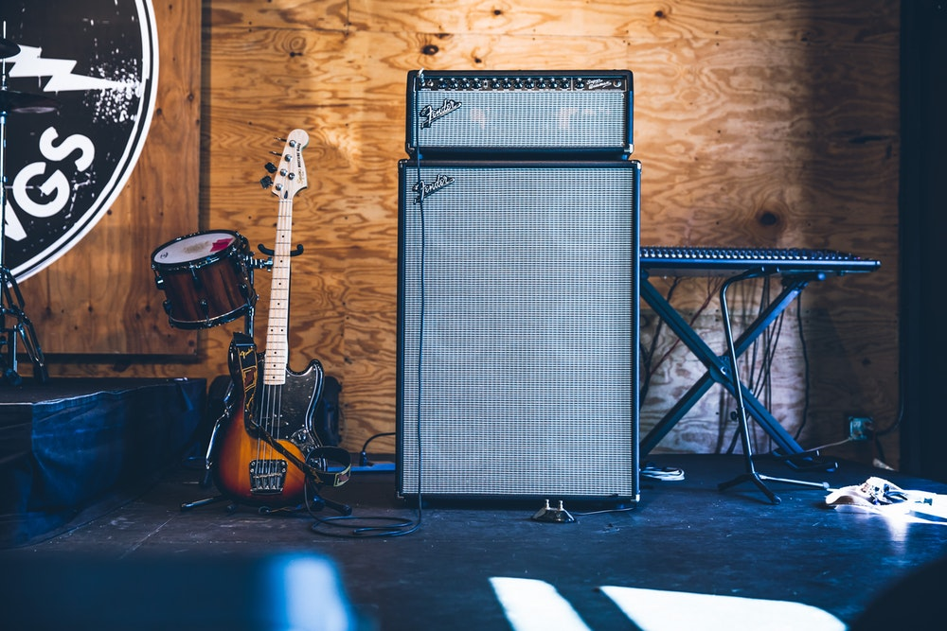
Step 3: Put the band together
“Happiness is best attained through fidelity to a worthy purpose.”
- Helen Keller
Photo by Austin Neill on Unsplash

Slide 9
“Project Passage”
Phase II Partners (May ‘18 – Sep ‘18)
American University
Brigham Young University
Cleveland Public Library
Harvard University
Michigan State University
National Library of Medicine
North Carolina State University
Northwestern University
Princeton University
Smithsonian Library
Temple University
University of Minnesota
University of New Hampshire
Yale University
Phase I Partners (Dec ’17 - Apr ‘18)
Cornell University
University of California, Davis
OCLC Research
OCLC Global Technolo-gies
OCLC Global Product Management

Slide 10
Step 4: Set Team Expectations
Demand participation
Expect resistance
Communicate frequently
Document everything
Set an end-date for experimentation
Photo by rawpixel on Unsplash

Slide 11
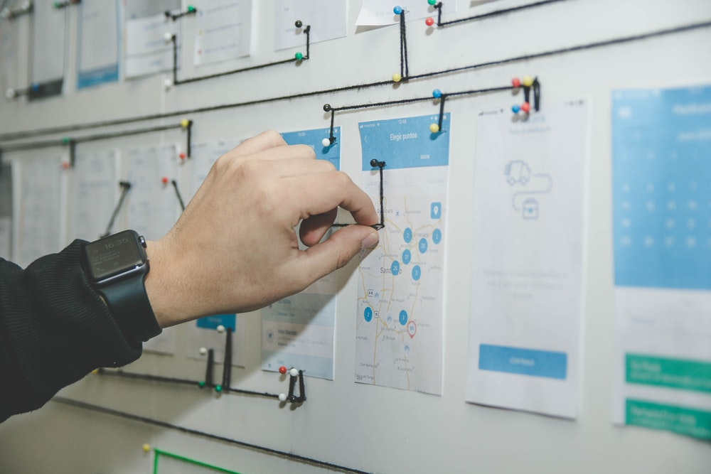
Step 5: Accept the outcome
Not every idea is a winner; fail fast and move on
You should be disappointed if you wind up with something that looks exactly like you expected to build from the start
If the plan for production looks different from your prototype, look back at your vision statement and lean canvas and see if they still hold true
Photo by NeONBRAND on Unsplash
Photo by Alvaro Reyes on Unsplash

Slide 12
BONUS STEP 6:
Make it repeatable

Slide 13
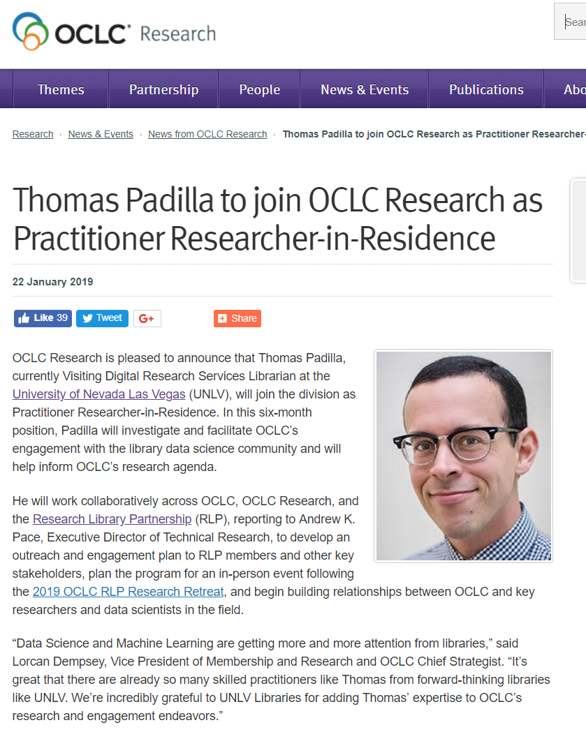
OCLC ResearchWorks
Shaping an applied research agenda
Engage the community—RLP Working Group
Convene a meeting—ResearchWorks
Develop a programmatic view of applied research at OCLC—Data Science & Machine Learning, Dataset creation, Applications, and APIs

Slide 14
ResearchWorks: Initiating an applied research agenda
Charting a path for library community engagement with data science and a range of computational methods
enhanced demonstration of impact
expanded discoverability
progress on global information equity
actionable insights that support sustainability and the realization of core values
ResearchWorks Working Group
Led by Thomas Padilla,
Practitioner Researcher-in-residence
Kenning Arlitsch, Montana State University
Jon Cawthorne, Wayne State University
Karen Estlund, Penn State University
Josh Hadro, IIIF Consortium
Bohyun Kim, University of Rhode Island
Trevor Owens, Library of Congress
Ben Schmidt, Northeastern University
Sarah Shreeves, University of Arizona
MacKenzie Smith, University of California Davis
Claire Stewart, University of Minnesota
Melissa Terras, University of Edinburgh
Diane Vizine-Goetz, OCLC Research
John Wilkin, University of Illinois at Urbana Champaign
Kate Zwaard, Library of Congress

