Slide 1
What are the ‘entities that matter’ to this object:
Explore
Reflections on the OCLC Linked Data Wikibase Pilot
Entity
Ecosystem
Mint
Relate
John Chapman and Jean Godby
LD4 Conference
May 11, 2019
Load
Reconcile
Retrieve

Slide 2
Review of the pilot
A.k.a. Project Passage
Ran from December 2017 through September 2018
16 OCLC Member libraries participated
The objective was to evaluate a framework for reconciling, creating, and managing bibliographic and authority data as linked data entities and relationships
The pilot Wikibase instance included 1.2M entities, mostly data representing overlaps between Wikidata, VIAF, and WorldCat
Notes:
This slide is for the historical record more than for you to read

Slide 3
Participating libraries
American University
Brigham Young University
Cleveland Public Library
Cornell University Library
Harvard University
Michigan State University
National Library of Medicine
North Carolina State University
Northwestern University
Princeton University
Smithsonian Library
Temple University
UC Davis Library
University of Minnesota
University of New Hampshire
Yale University
Notes:
Over the past year OCLC has explored the processes, systems, and practices for describing library resources using a linked data approach.
Utilizing the open-source Wikibase platform as a starting point the partners worked together to develop practices for editing entities and reconciling statements about those entities to authorities and other vocabularies. New ways to visualize the data were used to explore and new mechanisms were investigated to load data and retrieve data from external systems.

Slide 4
Prototype goals
Develop an entity ecosystem that facilitated…
Creation and editing of new entities
Connecting entities to the Web
Build a community of users who could..
Create/Curate data in the ecosystem
Imagine/propose workflow uses
Provide services to..
Reconcile data
Explore the data

Slide 5
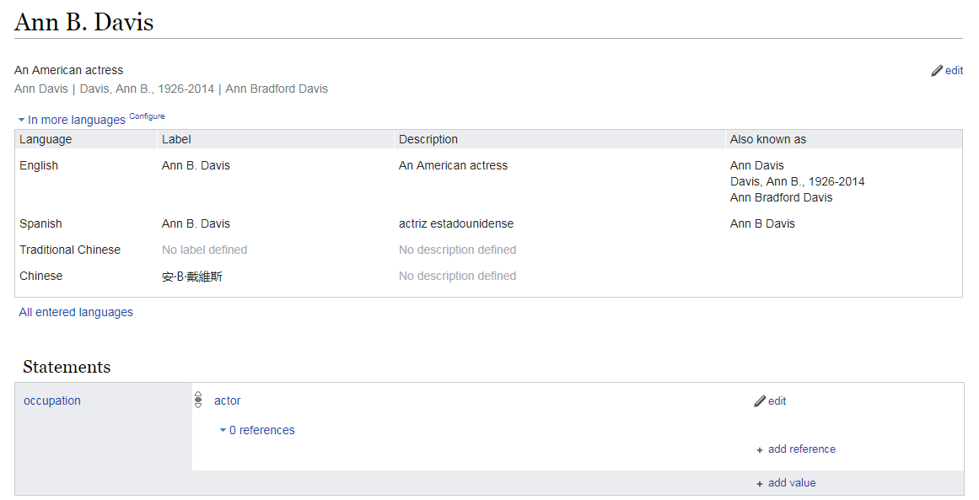
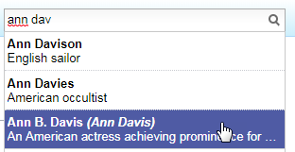
The Wikibase editing interface
http://18.218.102.193/entity/Q1224734
Page URL
Fingerprint data
Structured data for machine consumption
Notes:
A Wikibase item entity.
The editing task looks simple: Create human-readable labels for searching and disambiguation.
Create structured statements.

Slide 6
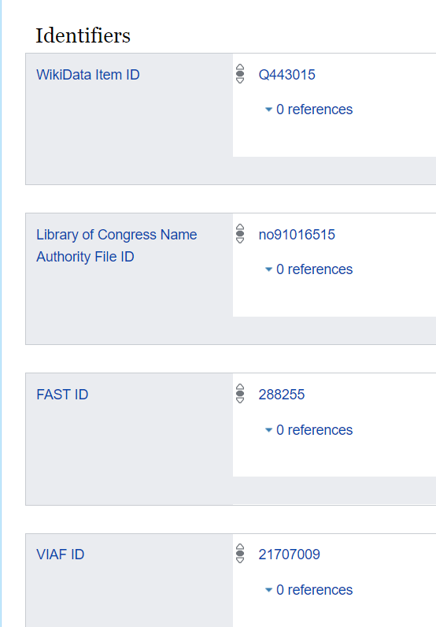
…mapped to authority-control concepts
Personal name; preferred name
http://18.218.102.193/entity/Q1224734
Alternate names
MARC Authority 024s
Notes:
A cataloger finds much that is familiar here.

Slide 7
…mapped to Linked Data concepts
Thing, entity, real-world object
http://18.218.102.193/entity/Q1224734
Globally unique, persistent URI
Structured data, or “triples”
Notes:
The Wikibase architecture empowers users to interact with a simple and intuitive editing interface to create and consume linked data. They can accomplish this ambitious goal without having to write software or manipulate raw RDF.
And the correspondences to library resource description concepts provide a pathway towards “entifying” library data.

Slide 8
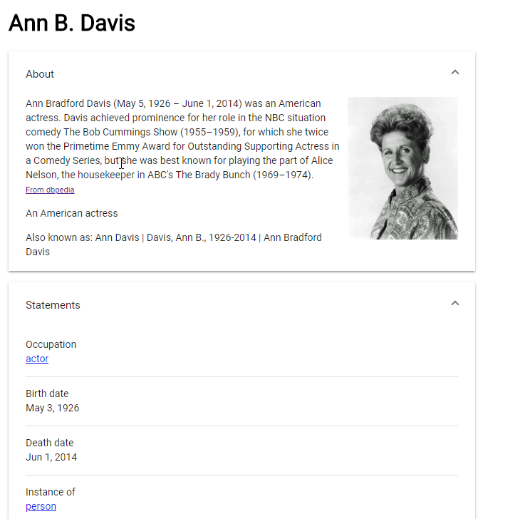
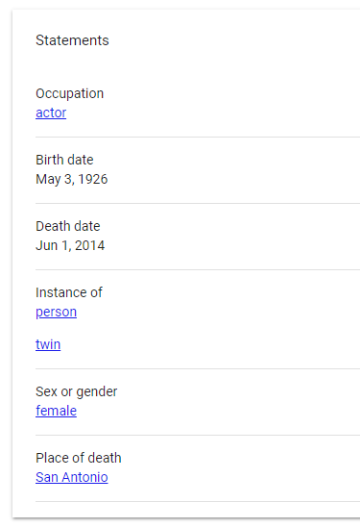
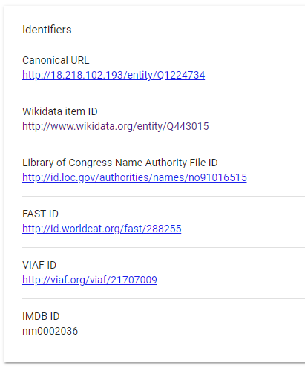
The Passage Explorer view
Notes:
One improvement we have added recently is a general search interface that pulls in entity information and data from other sources. Tt is also much more user friendly when it comes to searching. The dbpedia information [click] is being pulled in to enhance the description for Ann, including her picture. It also displays the statements and identifiers from our entity interface.

Slide 9
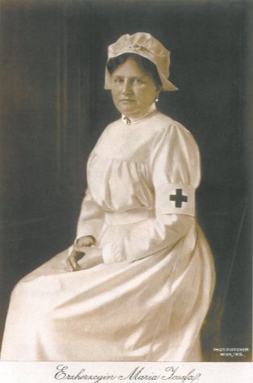
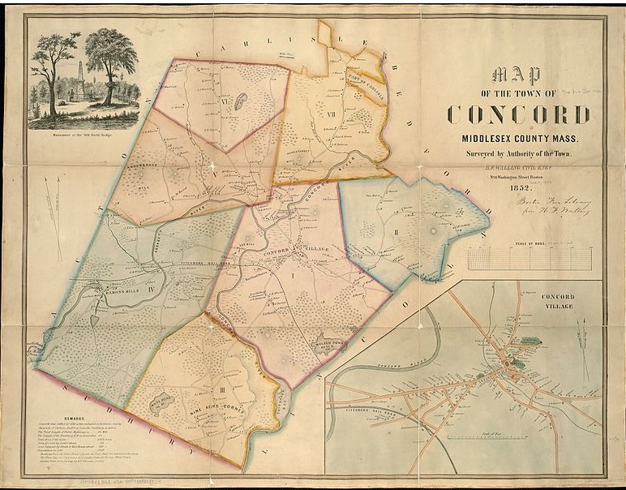
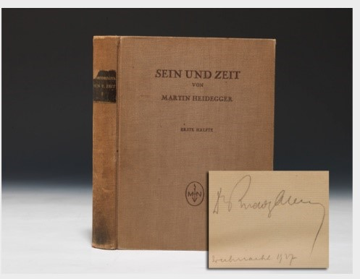
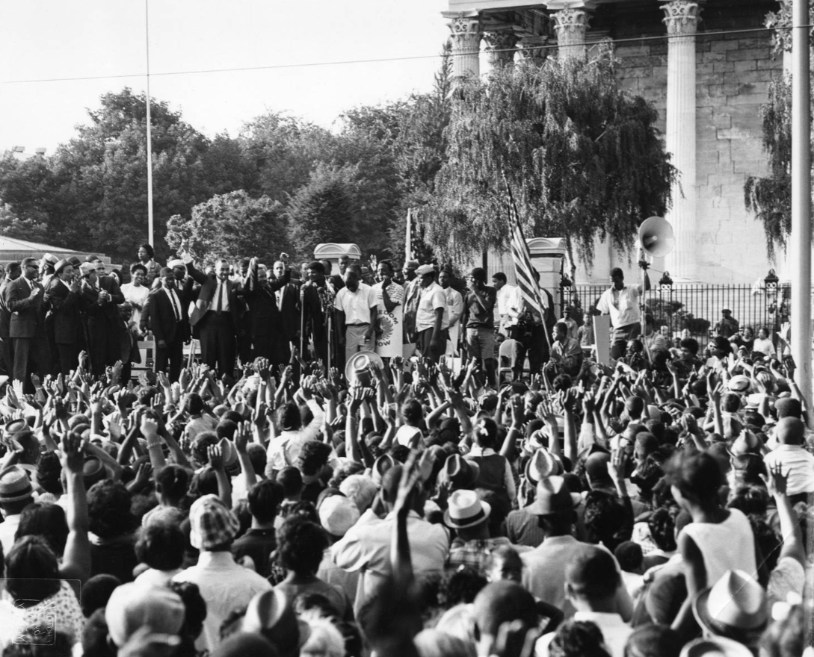
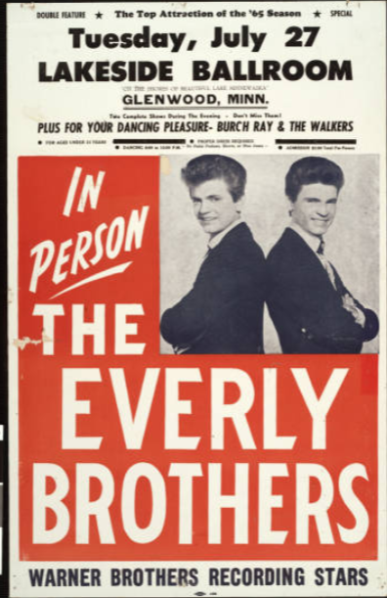
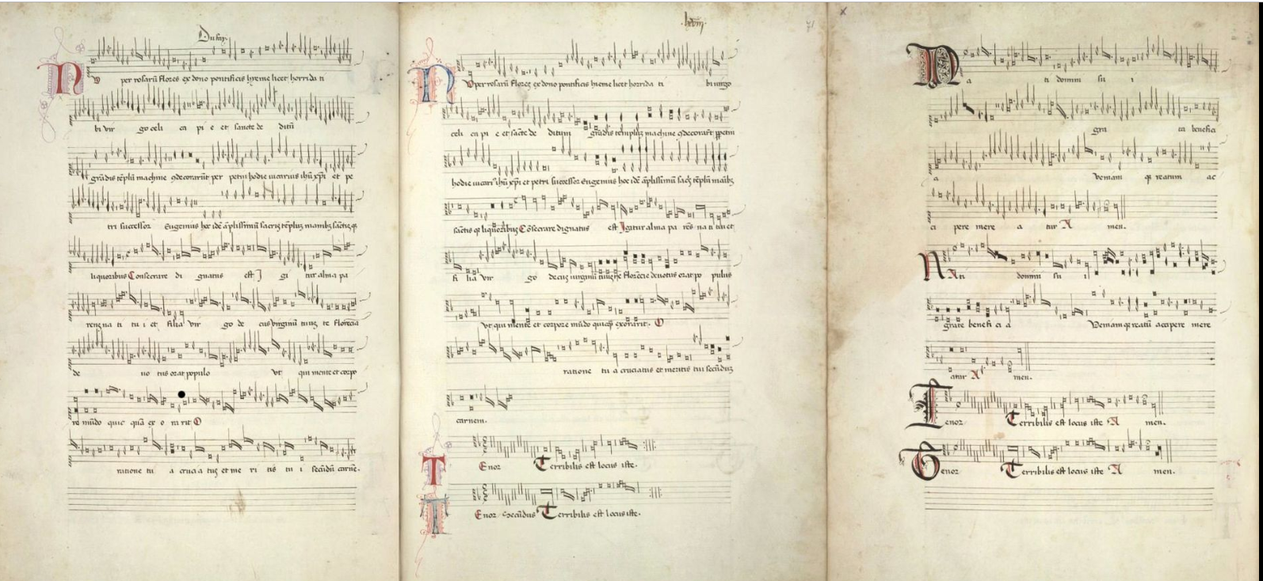
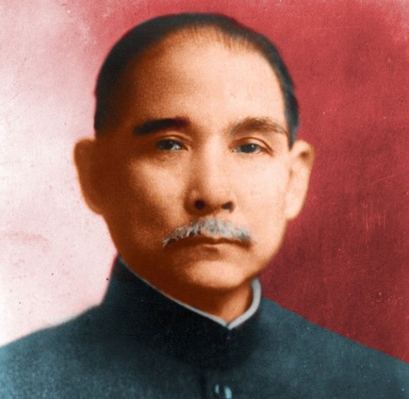
The case studies

Slide 10
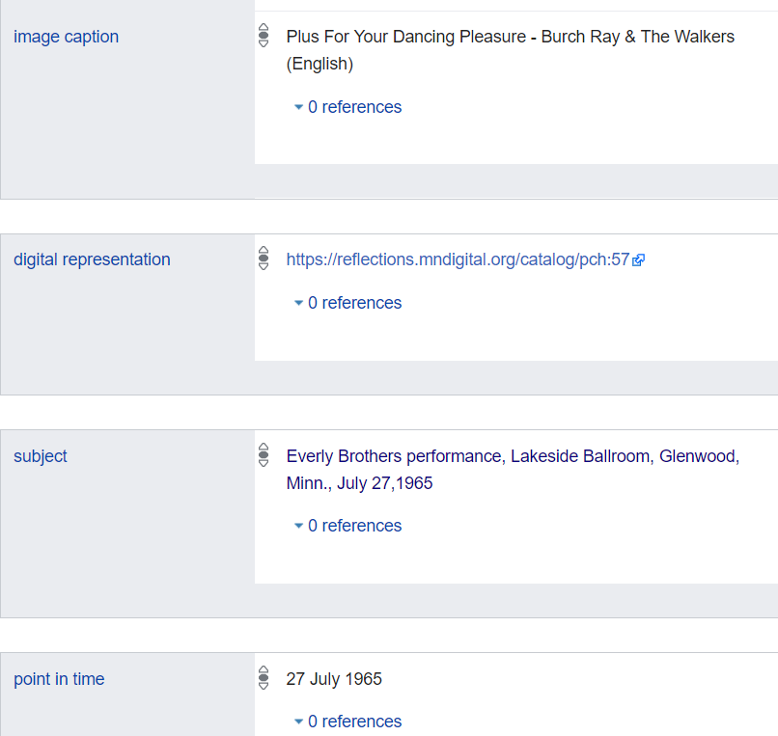
A poster for an Everly Brothers concert
Label: Everly Brothers performance poster, Lakeside Ballroom, Glenwood, Minn., July 27, 1965
Description: Everly Brothers performance poster, appearing with Burch Ray and the Walkers at the Lakeside Ballroom, Glenwood, Minn., July 27, 1965
Also known as: In person, the Everly Brothers
Label: Everly Brothers performance poster, Lakeside Ballroom, Glenwood, Minn., July 27, 1965
Description: Everly Brothers performance poster, appearing with Burch Ray and the Walkers at the Lakeside Ballroom, Glenwood, Minn., July 27, 1965
Also known as: In person, the Everly Brothers
Source: Kalan Davis, University of Minnesota Library
Notes:
Animation: A convention established in the pilot: use the fingerprint data to list the important entities for this object. If they don’t have a Wikibase item entity, create one.
Burch Ray and the Walkers, a rock and roll band formed in 1961 in Miles City, Montana
Kalan Davis, reflecting on this experience:
“As we catalog in this new environment, we are forced to think through the answer to the question: What entities matter to this object?” Identifying “the entities that matter” will drive the construction of the future bibliographic universe. This imperative will perhaps supersede the traditional rationale for bibliographic description, which focuses on the ‘item in hand’ and is informally referred to Cutter’s now-infamous “cult of the title page. ”

Slide 11
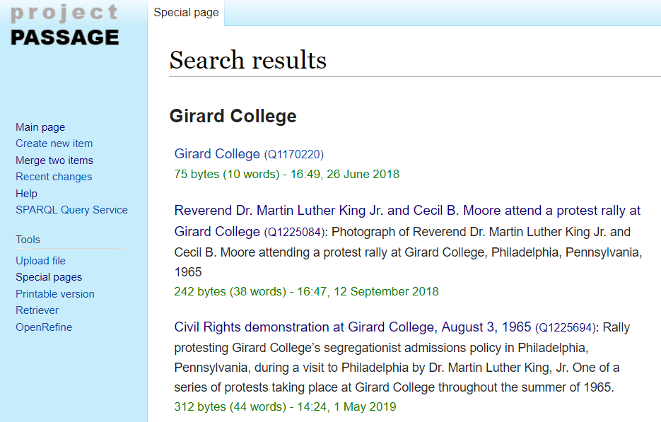
A civil rights demonstration at Girard College in 1965
Label: Reverend Dr. Martin Luther King Jr. and Cecil B. Moore attend a protest rally at Girard College
Description: Photograph of Reverend Dr. Martin Luther King Jr. and Cecil B. Moore attending a protest rally at Girard College, Philadelphia, Pennsylvania, 1965
Image source: Temple University Library
Source: Holly Tomren, Temple University Library

Slide 12
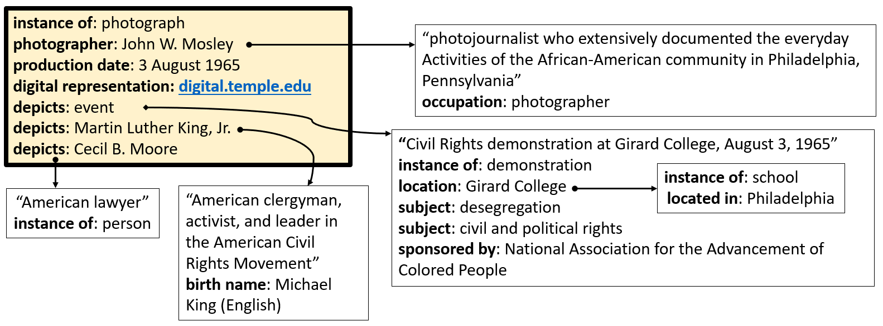
Two contexts captured in structured statements
Institutional context
Semantic context
Notes:
Describing the content was challenging
How do you say in a machine-processable way what this photograph is about? Martin Luther King and Cecil B. Rhoades attended this event
How do you convey this info to users?
The Harvard team raised other issues with structured data and What statements are we sure about? If we’re not sure, should they be rendered as structured data?
The institutional context is also complex but more easily expressed as structured data. This is a clearer win.
Temple U hosts the Charles L. Blockson Afro-American Collection, one of the nation's leading research facilities for the study of the history and culture of people of African descent. https://library.temple.edu/collections/blockson
It contains 500,000 physical items, some of which have been digitized.
This photo is in the collection of photos taken by John W. Mosley, which documents African American life in and around Philadelphia in the 1960s.

Slide 13
Specific “Lessons Learned” from pilot
The editing workflow appears (deceptively) simple.
The creation and consumption of Linked data is a mediated experience.
OCLC’s tools were a success.
Next R&D steps needed for archival and special collections material:
Model of archives
A configuration of data resources for narrative or expository text.
Scoping of structured data (focusing on discovery)
Notes:
Lessons:
The editing workflow looks deceptively simple. Looks can be deceiving.
The creation and consumption of Linked data is a mediated experience. Need tools for viewing the data and seeing work in progress.
OCLC’s tools were a success.
The study of archives and special collections identified many next steps to be undertaken in research and development.
Model of archives
A configuration of data resources for narrative or expository text.
Scoping of structured data (focusing on discovery)

Slide 14
Reflections and perspectives
Transitioning from records to graphs – paradigm shift
New tasks
Task that will likely become obsolete
What’s still necessary
Reinventing crowd-sourcing
Statement provenance
Balancing quality with anyone can say anything
New tools (to us) for managing quality

Slide 15
Learning, creating, amplifying
Surge in Wikidata across the community
PCC and LD4 activities
Specific library projects
OCLC’s activities, fostering ties between library and Wikimedia communities
Connecting Wikipedia and VIAF
Libraries Leverage Wikimedia training program
Collaborations for introducing Wikidata to librarians

Slide 16
What’s next?
The Report: out soon after ALA; between now and then some “teasers”
Continuing work with Wikibase: archival materials
Leveraging for archival materials using CONTENTdm
Connecting archival data to / with schema.org and wikidata models
Continued conversations and collaboration
PCC involvement
Committees and groups
New techniques, same goals
creating efficiencies through providing infrastructure and enabling communities

Slide 17
Linked data activities
Full report will be released soon and available at oc.lc/linked-data

Slide 18
Notes:
Use case: Use case: Manual data entry
For manual creation and editing of entities,
Wikibase is the default technology.
It has a powerful and well-tested set of features that speed the data entry process and assist with quality control and data integrity.
Phase 1 enhancements:
Improve left-hand navigation including access to URIs, Merging, and Creating
Add additional identifiers, properties, aliases
The prototype UI doesn't highlight connections to more information on the web/ Prototype a UI that uses system data to connect to Dbpedia, Geonames, etc.
The Wikibase "fingerprint" data, and its disambiguation role, is counter-intuitive (its role could be explained but remains a barrier to adoption)/ Create additional documentation which provides examples and more detailed information for adding labels, descriptions, and aliases in multiple languages, enhance indexing
A guided entry approach for entity creation and editing would result in a streamlined workflow/ Add partner recommendations and requests to list of prioritized enhancements

