Slide 1
Best Practices Exchange ● April 30, 2019
Adoption and Use of IIIF for Digital Resource Sharing in CONTENTdm
Shane Huddleston
Jeff Mixter
Product Manager
Software Engineer

Slide 2
IIIF Overview

Slide 3
IIIF International Image Interoperability Framework™
An emerging web standard for sharing information about images and other media​
Simplifies and standardizes the ways in which we ask for and consume media data
http://iiif.io/

Slide 4
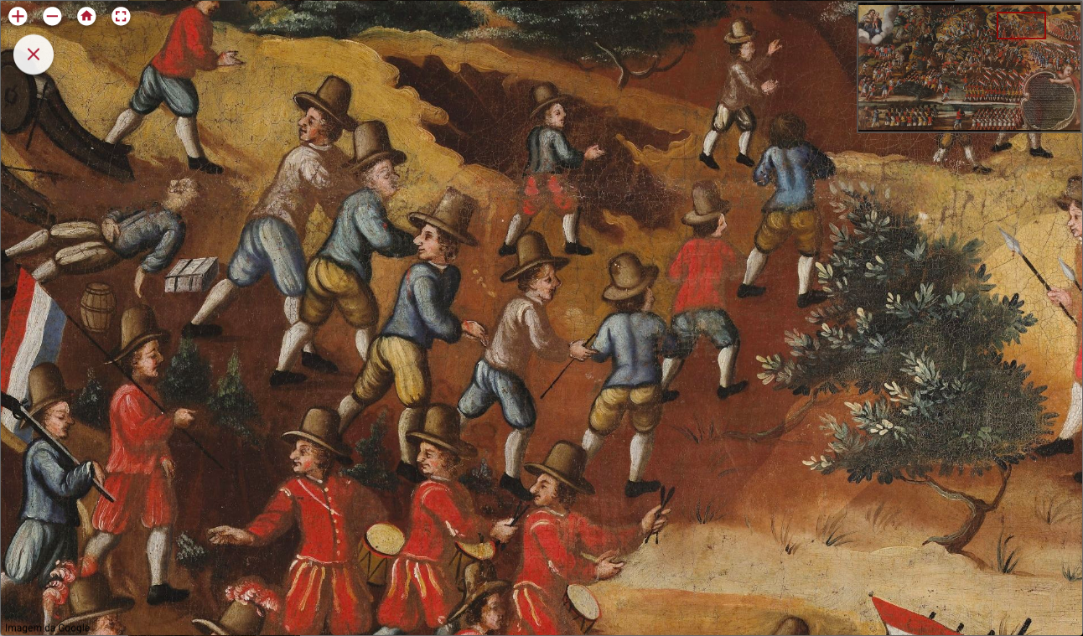
Notes:
Deep zoom image viewer from Museo Historico Nacional in Brazil.
http://mhn.acervos.museus.gov.br/reserva-tecnica/pintura-religiosa-ex-voto/

Slide 5
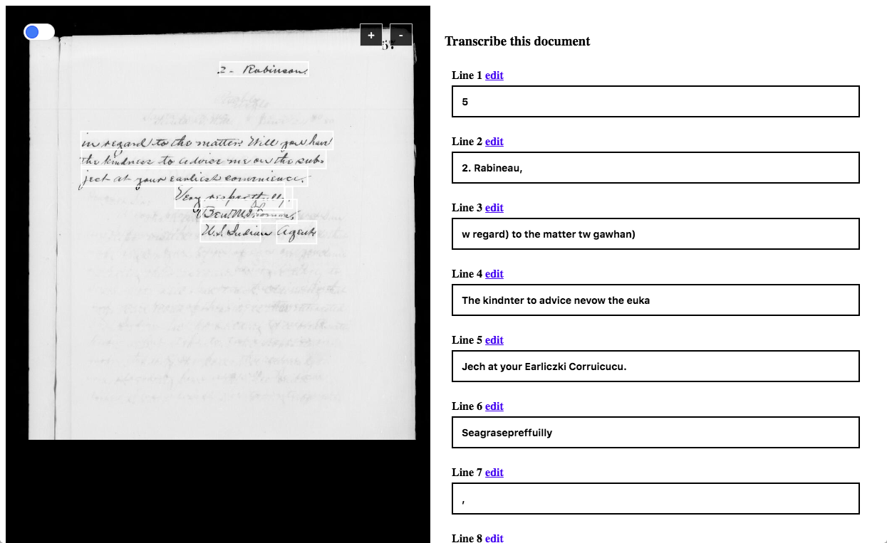
Notes:
Crowd-sourced transcription tools, e.g. this one from Digirati.
https://mcgrattan.org/transcribe?manifest=https://presley.glam-dev.org/iiif/customer/_roll_M-941_04_cvs-82-82/manifest&canvas=https://presley.glam-dev.org/iiif/customer/_roll_M-941_04_cvs-82-82/canvas/c82&type=fields

Slide 6
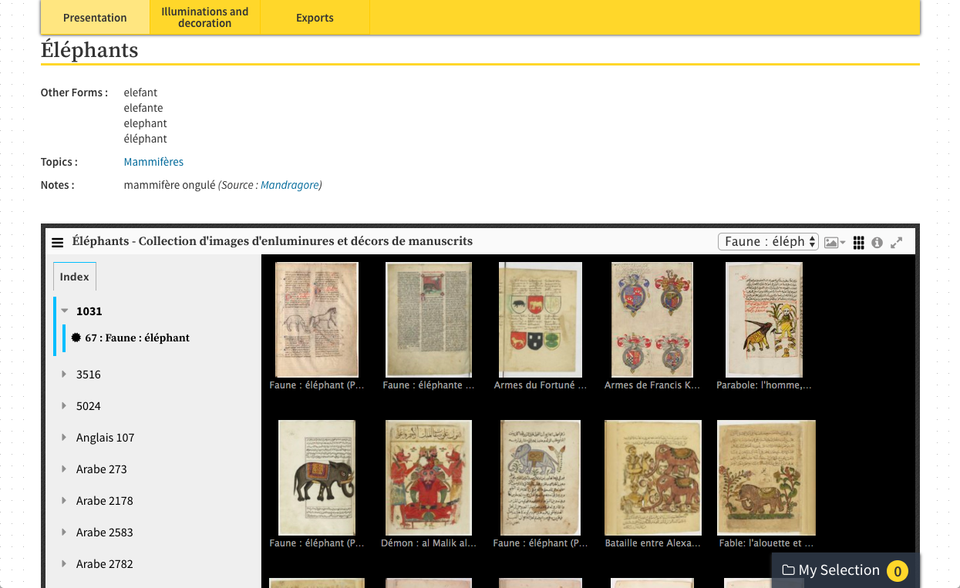
Notes:
Aggregations across repositories based on keywords or themes (from Biblissima).
http://beta.biblissima.fr/en/ark:/43093/desc8424ed0f857f095d4ffe3fe12c125f121ddbcdc6

Slide 7
IIIF Application Programming Interfaces (APIs)
The IIIF standard has 4 primary APIs:
Image
Presentation
Search
Authentication
Plus 1 in development phase:
Change Discovery
Notes:
Image API - A standard way to provide "technical" metadata about images
Presentation API - Provides structural data about images
Search – Provides mechanism for searching within items (manuscripts)
Authentication – Framework for managing rights/access. Not a replacement Oauth
Discovery – Will provide data aggregators can use to harvest IIIF materials and keep them up to date

Slide 8
The impact on OCLC

Slide 9
OCLC and IIIF today
53 IIIF Consortium members, including OCLC
IIIF Presentation & Image APIs built into CONTENTdm
30 million IIIF images in CONTENTdm sites
CONTENTdm uses IIIF OpenSeadragon viewer

Slide 10
IIIF working groups
Several IIIF Community Working Groups
Developing best practices for using IIIF
Ongoing enhancement of the APIs
OCLC staff active in IIIF working groups and committees

Slide 11
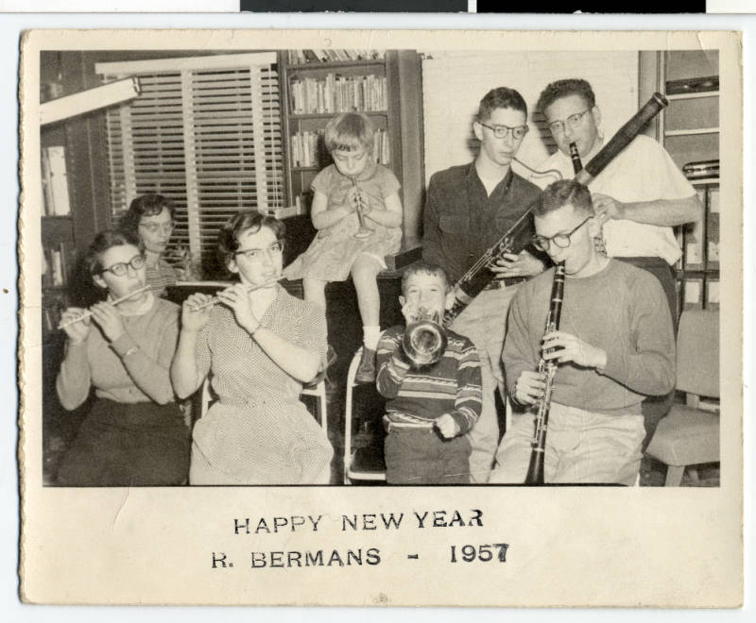
Cooperation
image from Minnesota Reflections: https://reflections.mndigital.org/catalog/jhs:450#/image/0

Slide 12
The value of open standards
Shared effort
Universal tools for image access
Digital content is portable across repositories
Reusable viewers and widgets
Open APIs support platform independence

Slide 13
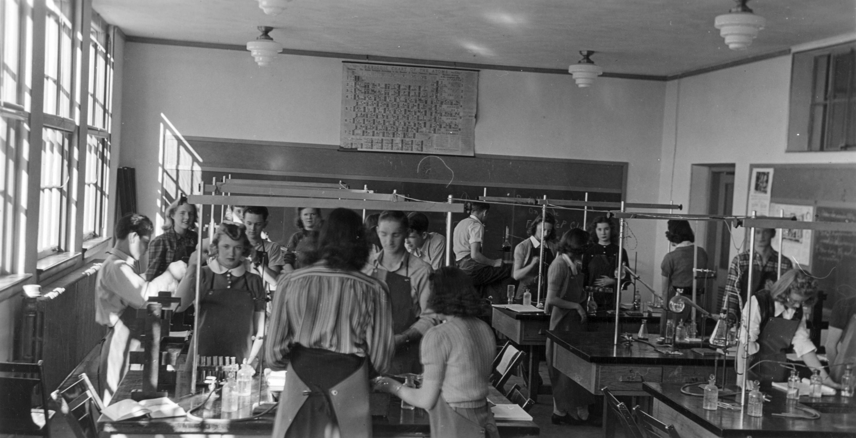
Catalysis
image from Denver Public Library: http://digital.denverlibrary.org/digital/iiif/p15330coll22/1751/full/full/0/default.jpg

Slide 14
Promoting action
Integrating the Mirador viewer
Harry Ransom Center's García Márquez collection (https://www.nytimes.com/2017/12/11/arts/gabriel-garcia-marquez-archive-online.html)
Huntington Library manuscripts
Cookbook recipe for CONTENTdm users
FromThePage transcription round-trip data service
WWI service cards at Alabama Department of Archives & History
IIIF-based viewer embedded in WorldCat Discovery

Slide 15
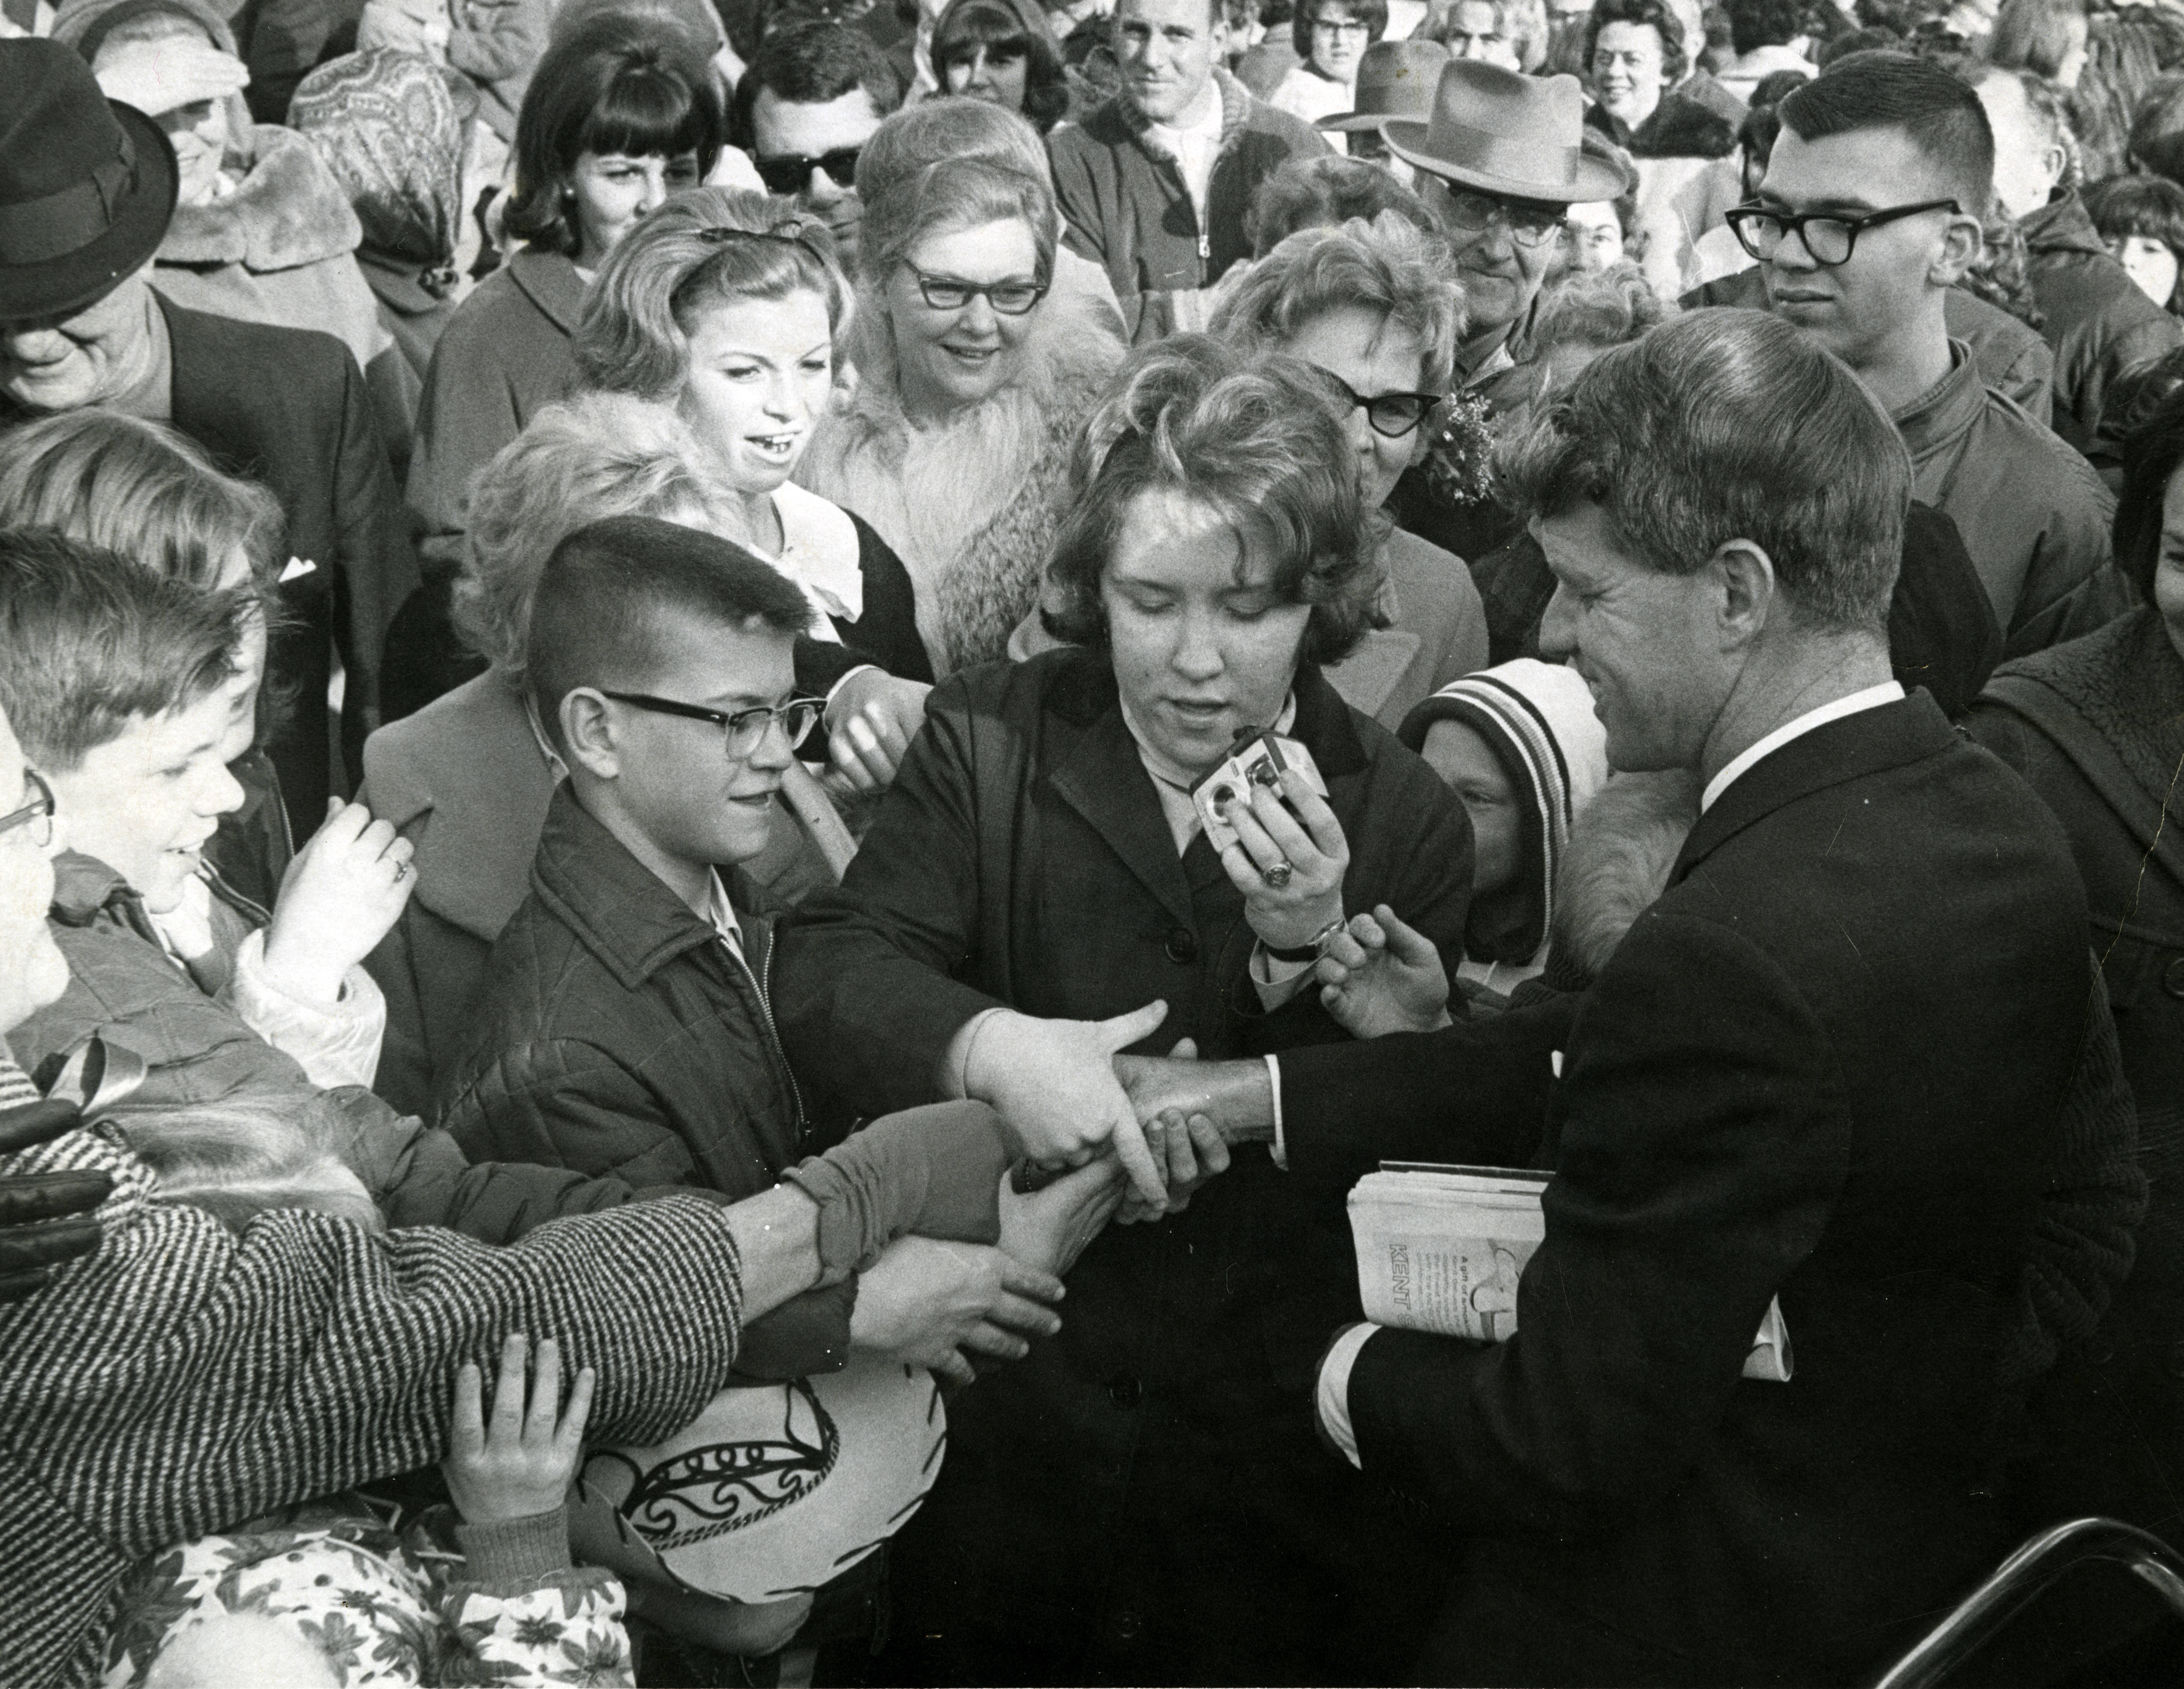
Enthusiasm
image from Denver Public Library: http://digital.denverlibrary.org/digital/iiif/p15330coll22/92976/full/full/0/default.jpg

Slide 16
So much is going on
A vibrant and active community:
Slack, listserv, group calls, conferences, meetups
Infrastructure, as well as experimentation:
Awesome IIIF list
Rapid growth in adoption:
More than 1 billion IIIF digital images

Slide 17
What’s next for OCLC?
Update and expand IIIF API support in CONTENTdm
Promote IIIF through webinars and workshops
Support user customizations based on IIIF
Share use cases between IIIF and CONTENTdm communities

Slide 18
Ongoing Iiif work

Slide 19
Discovery Working Group
The Discovery Group is focused on developing a Change Discovery API
Intra and Inter-domain discoverability
Current focus is how to improve discoverability and harvesting of IIIF materials by organizations with an interest/understanding of IIIF
Notes:
Discovery Working Group Charter - http://iiif.io/community/groups/discovery/charter/#communication-channels

Slide 20
Research plans
Continue the cross-divisional collaboration to prototype and test advances in IIIF integration
Change Discovery API
IIIF Data aggregation, normalization, and enhancement
IIIF Data search/discovery
“If we started over today, what would we do?”
– John Zimmer

Slide 21
IIIF R&D - IIIF Discovery API implementation
Problem: How to share IIIF material?
Based on the current Discovery Working Group Change Discovery API
Crawlable list of IIIF material that has been Created, Updated, and Deleted
Like a Site Map, OAI-PMH, or ResourceSync
Experimental service supports 13 Million CONTENTdm IIIF Manifests using Change Discovery API v0.3
https://researchworks.oclc.org/digital/discovery-index

Slide 22
{
"@context": ["http://iiif.io/api/discovery/0/context.json"],
"id": "https://researchworks.oclc.org/digital/activity-stream/collection/21058_FotosOC/1",
"type": "OrderedCollectionPage",
"partOf": {
"id": "https://researchworks.oclc.org/digital/activity-stream/collection/21058_FotosOC",
"type": "OrderedCollection"
},
"startIndex": 0,
"next": {
"type": "OrderedCollectionPage",
"id": "https://researchworks.oclc.org/digital/activity-stream/collection/21058_FotosOC/2"
},
"orderedItems": [{
"object": {
"type": "Manifest",
"id": "https://cdm21058.contentdm.oclc.org/digital/iiif-info/FotosOC/1/manifest.json",
"partOf": {
"type": "Document",
"id": "https://researchworks.oclc.org/digital/dataset/21058_FotosOC"
}
},
"actor": {
"type": "Organization",
"id": "http://viaf.org/viaf/145425848"
},
"summary": "Manifest created",
"endTime": "2018-05-04T20:12:40-04:00",
"type": "Create",
"id": "https://researchworks.oclc.org/digital/activity/52ef9e58-88bd-43e1-b654-cba09695048d"
},
Notes:
https://researchworks.oclc.org/digital/activity-stream/collection/21058_FotosOC/1

Slide 23
IIIF R&D – IIIF data harvesting
Problem: How to harvest and use IIIF data?
Harvest CONTENTdm IIIF data
Index keywords for searching and do basic data reconciliation/cleanup for faceting
Build a simple UI for search and discovery

Slide 24
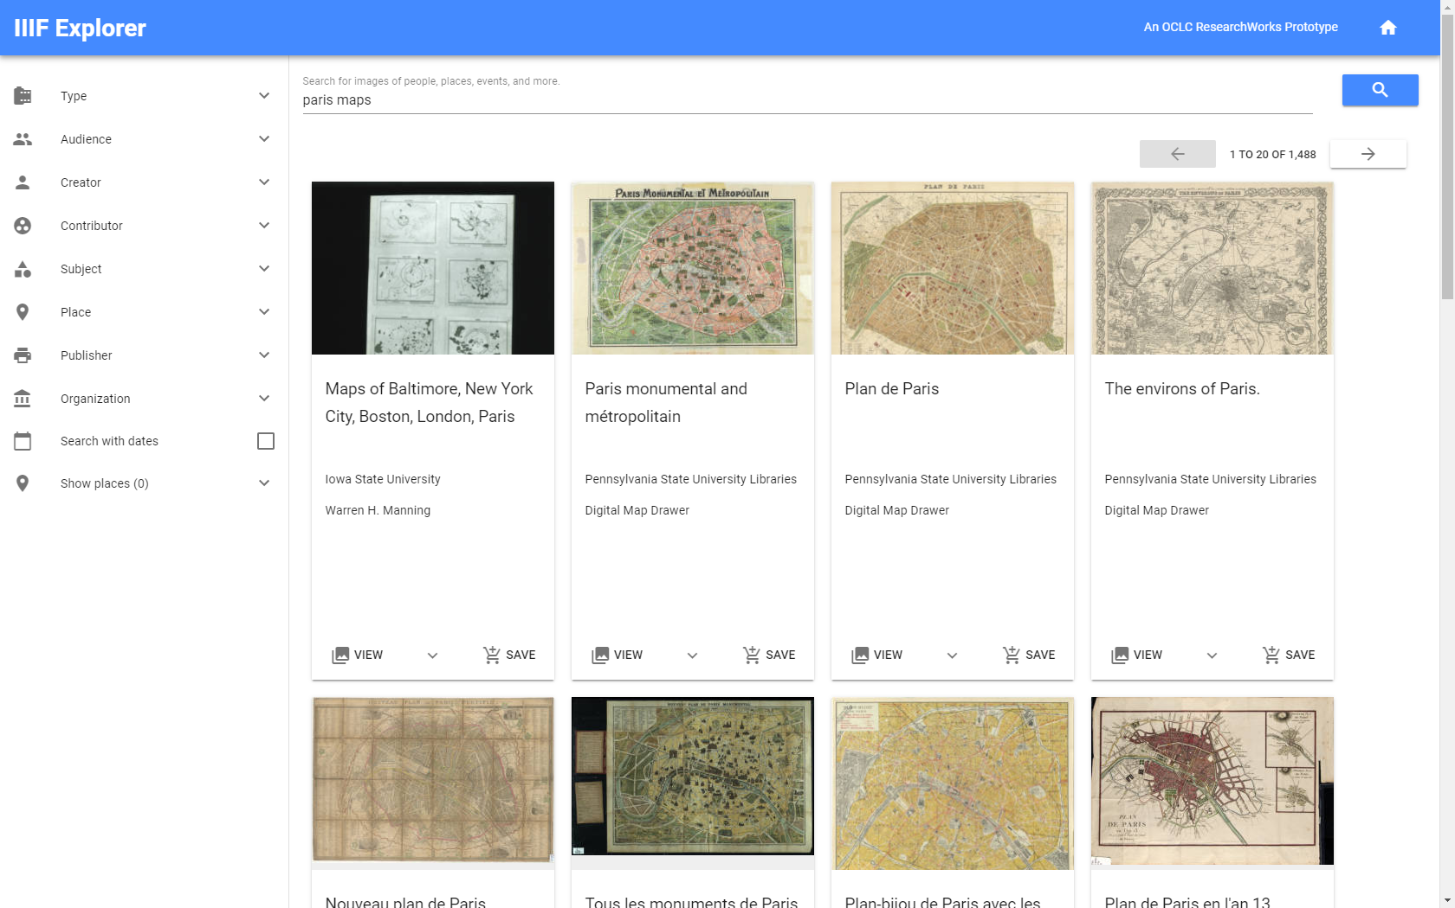

Slide 25
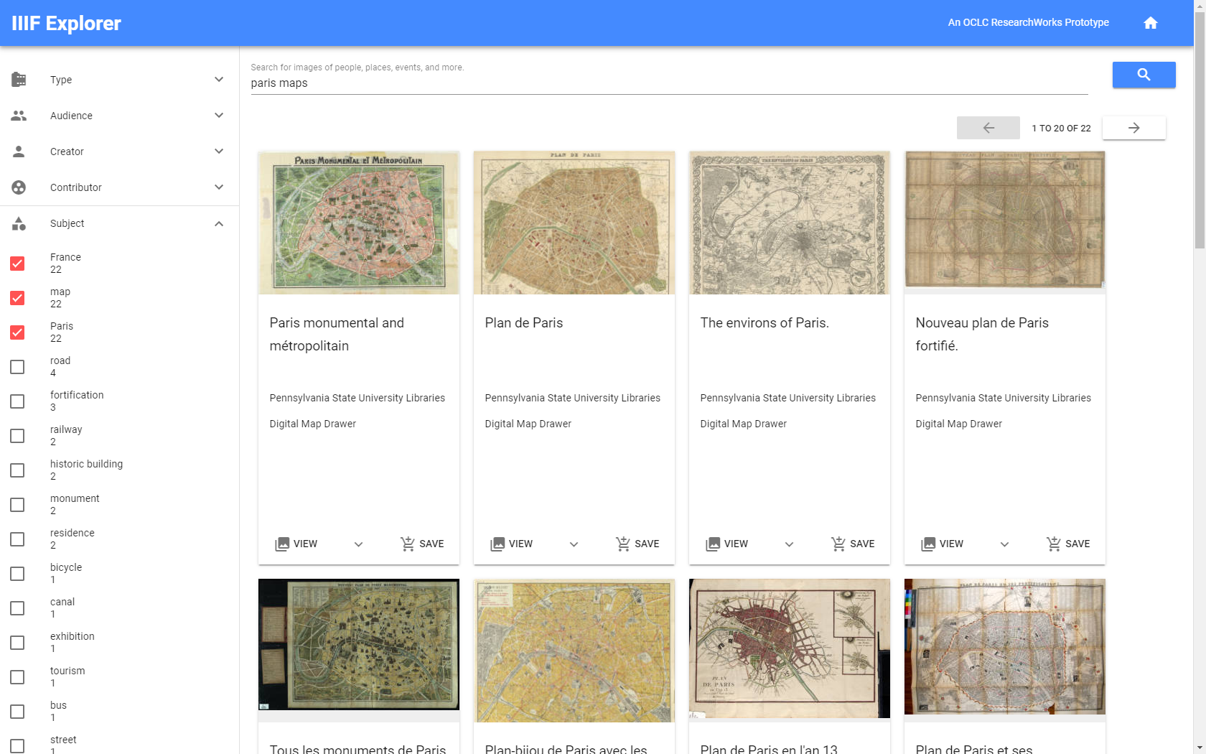

Slide 26
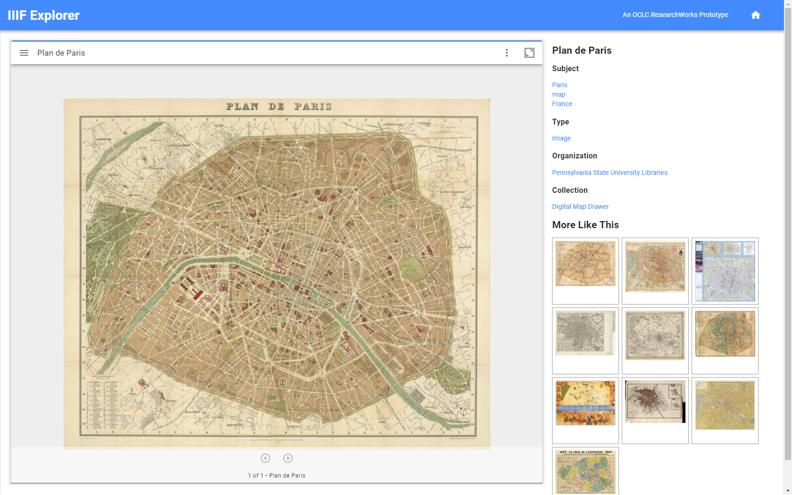

Slide 27
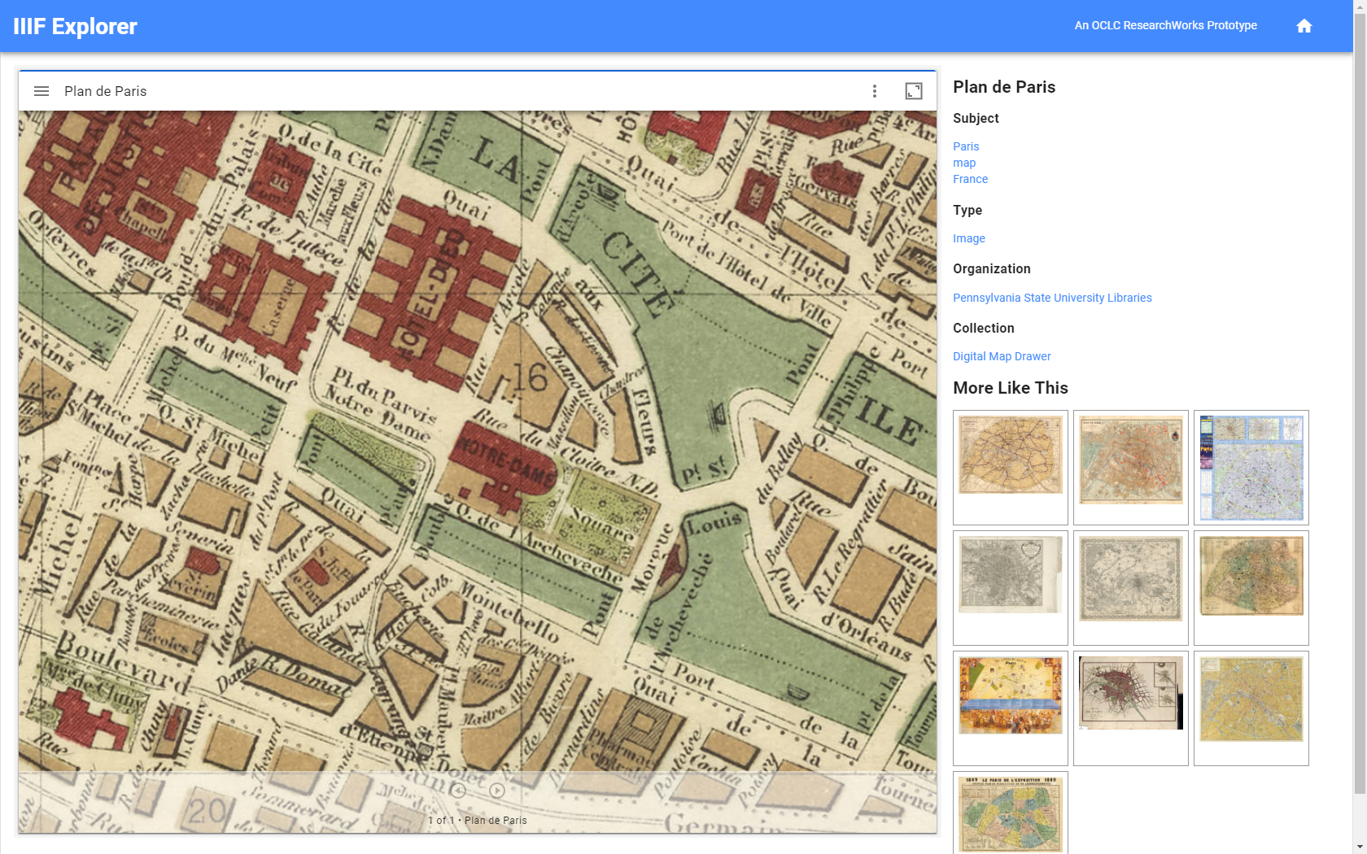

Slide 28
IIIF R&D – IIIF metadata
Problem: How to index heterogeneous metadata?
IIIF Metadata normalization and enhancement
Normalization
Enhancement
Produce normalized/enhanced index for all harvested data
Produce metadata mappings for reuse in external systems

Slide 29
Works in Progress
Questions?

