Slide 1
SUNY Buffalo • 27 March 2019
Exceeding Expectations:
Positioning the Library in the Community
Lynn Silipigni Connaway, PhD
Director of Library Trends and User Research
connawal@oclc.org
@LynnConnaway

Slide 2
(Merriam-Webster’s Words of the Year 2018, n.d.)
Notes:
Merriam-Webster’s Words of the Year 2018: Justice, plus pansexual, maverick, lodestar, and 7 more of our top lookups in 2018. (n.d.). https://www.merriam-webster.com/words-at-play/word-of-the-year-2018-justice/justice
“Our Word of the Year for 2018 is justice. It was a top lookup throughout the year at Merriam-Webster.com, with the entry being consulted 74% more than in 2017.
The concept of justice was at the center of many of our national debates in the past year: racial justice, social justice, criminal justice, economic justice. In any conversation about these topics, the question of just what exactly we mean when we use the term justice is relevant, and part of the discussion.
This year’s news had many stories involving the division within the executive branch of government responsible for the enforcement of laws: the Department of Justice, sometimes referred to simply as “Justice.” Of course, the Mueller investigation itself is constantly in the news, and is being carried out through the Justice Department. Another big news story included yet another meaning of the word justice, as a synonym or title for “judge,” used frequently during the Kavanaugh confirmation hearings for the Supreme Court.
Justice has varied meanings that do a lot of work in the language—meanings that range from the technical and legal to the lofty and philosophical. For many reasons and for many meanings, one thing’s for sure: justice has been on the minds of many people in 2018.”

Slide 3
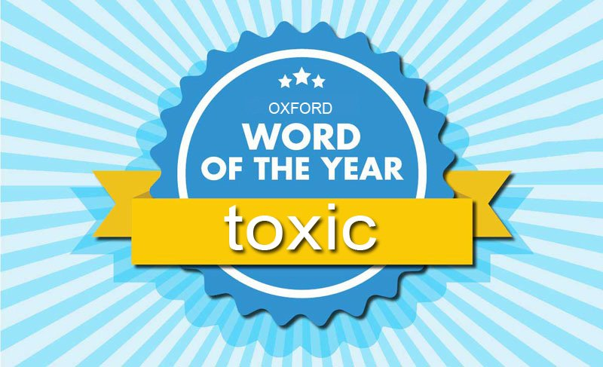
Image: https://twitter.com/oxfordwords/status/1062846136388476928 by Oxford Dictionaries
Notes:
Image: https://twitter.com/oxfordwords/status/1062846136388476928 by Oxford Dictionaries
Word of the Year 2018 is... (n.d.). https://en.oxforddictionaries.com/word-of-the-year/word-of-the-year-2018.
Oxford Dictionaries. (2018, November 14). The Oxford Word of the Year 2018 is… [Tweet]. Retrieved from https://twitter.com/oxfordwords/status/1062846136388476928.
“Why was toxic chosen as Word of the Year?
The Oxford Word of the Year is a word or expression that is judged to reflect the ethos, mood, or preoccupations of the passing year, and have lasting potential as a term of cultural significance.
In 2018, toxic added many strings to its poisoned bow becoming an intoxicating descriptor for the year’s most talked about topics. It is the sheer scope of its application, as found by our research, that made toxic the stand-out choice for the Word of the Year title.
Our data shows that, along with a 45% rise in the number of times it has been looked up on oxforddictionaries.com, over the last year the word toxic has been used in an array of contexts, both in its literal and more metaphorical senses.
Drawn from our corpus, the top 10 toxic collocates for the year – that is, words habitually used alongside toxic – are indicative of this.”

Slide 4
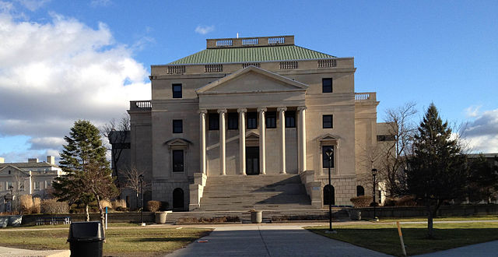
Image: https://commons.wikimedia.org/wiki/File:UB_health_sciences_library_straight.jpg by Davidhar / CC BY-SA 3.0
“Libraries must make visible the value they bring to their communities.” (Lankes, 2016, p. 153)
Notes:
Image: https://commons.wikimedia.org/wiki/File:UB_health_sciences_library_straight.jpg by Davidhar / CC BY-SA 3.0 (SUNY Buffalo Abbott Hall, home of the Health Sciences Library)
Lankes, R. D. (2016). The New Librarianship Field Guide. Cambridge: MIT Press.

Slide 5
Credibility & Information literacy

Slide 6
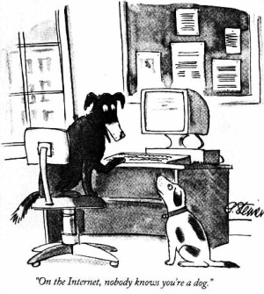
Image: https://en.wikipedia.org/wiki/File:Internet_dog.jpg
Determining trustworthy sources of information is even harder online
Notes:
Image: https://en.wikipedia.org/wiki/File:Internet_dog.jpg
As an elementary school student, I remember being taught how to determine trustworthy sources of information, including people. We were taught to find information about the author and who had referenced the author as well as learn more about the source document. This was taught before we ever had access to online sources, which can present even more challenges than the print environment. After all, a 1993 New Yorker cartoon at the onset of the internet age stated “on the internet, nobody knows you’re a dog.”
Connaway, L. S. (2017, August 25). Can you believe it? How to determine credibility in the era of fake news. Inside ASIS&T President’s Column, August 2017.
Steiner, P. (1993, July 5) On the internet. [Cartoon] The New Yorker. Retrieved from https://en.wikipedia.org/wiki/File:Internet_dog.jpg

Slide 7
Image: https://www.flickr.com/photos/15979685@N08/40248876364 by Eric Huybrechts / CC BY-NC-ND 2.0
I guess the scrutiny used to come in when I was just starting off a Google search, and then basically, when they taught us in school how to research a topic and to use the library-- I mean, I still kind of interrogate information, but I guess I'm a bit more liberal. I'm more willing to just take whatever I find as my information stock.
(Discovery & Access, Graduate Student)
Notes:
Image: https://www.flickr.com/photos/15979685@N08/40248876364 by Eric Huybrechts / CC BY-NC-ND 2.0
ULG02 32:37
Yeah. And I would have to say, so I'm a fourth-year medical student now. Because they have us do these presentations from year one, and over the years, it would be two-fold that-- this is the process of how I end up doing it. And then, secondly-- what was I going to say? I guess the scrutiny used to come in when I was just starting off a Google search, and then basically, when they taught us in school how to research a topic and to use the library-- I mean, I still kind of interrogate information, but I guess I'm a bit more liberal. I'm more willing to just take whatever I find as my information stock. Does that make sense?

Slide 8
Image: https://www.flickr.com/photos/31864518@N02/2983893564 by joebrian / CC BY 2.0
“I always stick with the first thing that comes up on Google because I think that’s the most popular site which means that’s the most correct”
(Digital Visitors and Residents, High School Student)
Notes:
Image: https://www.flickr.com/photos/31864518@N02/2983893564 by joebrian / CC BY 2.0
White, D. S., & Connaway, L. S. (2011-2014). Digital Visitors and Residents: What Motivates Engagement with the Digital Information Environment. Funded by JISC, OCLC, and Oxford University. http://www.oclc.org/research/activities/vandr.html.

Slide 9
Image: https://www.flickr.com/photos/crimfants/2488634205 by Paul / CC BY 2.0
“And YouTube videos, I've always watched YouTube, so that's highly credible.”
(Researching Students’ Information Choices, Elementary Student)
Notes:
Image: https://www.flickr.com/photos/crimfants/2488634205 by Paul / CC BY 2.0
Buhler, A., Cataldo, T. T., Faniel, I. M., Connaway, L. S., Valenza, J. K., Graff, R., Elrod, R., Putnam S., Cyr C., Towler, C., Hood, E., Fowler R., Howland S., Brannon B, Langer, K., Kirlew, S. (2015-2018). Researching students’ information choices: Determining identity and judging credibility in digital spaces. IMLS Grant Project LG-81-15-0155. http://guides.uflib.ufl.edu/RSIC.

Slide 10
“That's a YouTube video. No thank you. …anybody could have uploaded that.”
(Researching Students’ Information Choices, Graduate Student)
Image: https://www.flickr.com/photos/seun78/6141584289 by Seun Ismail / CC BY-NC-ND 2.0
Notes:
Image: https://www.flickr.com/photos/seun78/6141584289 by Seun Ismail / CC BY-NC-ND 2.0
Buhler, A., Cataldo, T. T., Faniel, I. M., Connaway, L. S., Valenza, J. K., Graff, R., Elrod, R., Putnam S., Cyr C., Towler, C., Hood, E., Fowler R., Howland S., Brannon B, Langer, K., Kirlew, S. (2015-2018). Researching students’ information choices: Determining identity and judging credibility in digital spaces. IMLS Grant Project LG-81-15-0155. http://guides.uflib.ufl.edu/RSIC.

Slide 11
Image: https://www.flickr.com/photos/arminhanisch/36169956372 by Armin Hanisch / CC BY-NC 2.0
“It depends. It depends who’s made the website or what I have been told about the website or whether I know about it at all. But — it sounds silly — but sometimes you can just tell whether a website looks reliable or not depending on how professional [it] looks and who’s written it.”
(Digital Visitors and Residents, Undergraduate Student)
Notes:
Image: https://www.flickr.com/photos/arminhanisch/36169956372 by Armin Hanisch / CC BY-NC 2.0
White, D. S., & Connaway, L. S. (2011-2014). Digital Visitors and Residents: What Motivates Engagement with the Digital Information Environment. Funded by JISC, OCLC, and Oxford University. http://www.oclc.org/research/activities/vandr.html.

Slide 12
Image: https://www.flickr.com/photos/dskley/13716083704 by Dennis Skley / CC BY-ND 2.0
“…the whole kind of conversation around fake news is this really important example of how important it is in our daily life and civic health in order to bring critical skills to bear on understanding information and being able to critically evaluate the source of that.”
(Academic Library Impact, Advisory Member)
Notes:
Image: https://www.flickr.com/photos/dskley/13716083704 by Dennis Skley / CC BY-ND 2.0
“If I’m understanding you correctly, the whole kind of conversation around fake news is this really important example of how important it is in our daily life and civic health in order to bring critical skills to bear on understanding information and being able to critically evaluate the source of that.” (Advisory Member LM03, Research University, Secular, Private; Action-oriented research agenda)
Association of College and Research Libraries. (2017). Academic library impact: Improving practice and essential areas to research. Prepared by L. S. Connaway, W. Harvey, V. Kitzie, & S. Mikitish. Chicago: Association of College and Research Libraries. Available: http://www.ala.org/acrl/sites/ala.org.acrl/files/content/publications/whitepapers/academiclib.pdf

Slide 13
Image: https://www.flickr.com/photos/deia/6461457 by Andreia Bohner / CC BY 2.0
“We should be helping people learn how to think, learn how to be skeptical, learn how to use critical thinking skills, learn how to be self-reflective. I think because those things are so much harder to assess and to demonstrate we have not done as good a job telling that story.”
(Academic Library Impact, Provost)
Notes:
Image: https://www.flickr.com/photos/deia/6461457 by Andreia Bohner / CC BY 2.0
“We should be helping people learn how to think, learn how to be skeptical, learn how to use critical thinking skills, learn how to be self-reflective. I think because those things are so much harder to assess and to demonstrate we have not done as good a job telling that story.” (Provost Interviewee PP10, College, Non-secular, Private; Action-oriented research agenda)
Association of College and Research Libraries. (2017). Academic library impact: Improving practice and essential areas to research. Prepared by L. S. Connaway, W. Harvey, V. Kitzie, & S. Mikitish. Chicago: Association of College and Research Libraries. Available: http://www.ala.org/acrl/sites/ala.org.acrl/files/content/publications/whitepapers/academiclib.pdf

Slide 14
Image: https://www.flickr.com/photos/27518426@N03/3617723004 by Pat Dalton... / CC BY-NC-ND 2.0
Academic Library Opportunities
Align with institutional priorities and contribute to the development of critical thinking skills
Notes:
Image: https://www.flickr.com/photos/27518426@N03/3617723004 by Pat Dalton... / CC BY-NC-ND 2.0

Slide 15
Image: https://www.flickr.com/photos/cogdog/41916051614 by Alan Levine / Public Domain
Take the lead in collaborating with other educators to incorporate critical literacy into the curriculum and promote information professionals’ expertise.
Notes:
Image: https://www.flickr.com/photos/cogdog/41916051614 by Alan Levine / Public Domain
Connaway, L. S. (2017, June 19). Putting the library in the life of the user: Listen, then lead, to promote a unique and compelling role for academic libraries. Guest of Choice, Choice360 blog. Retrieved from http://www.choice360.org/blog/putting-the-library-in-the-life-of-the-user

Slide 16
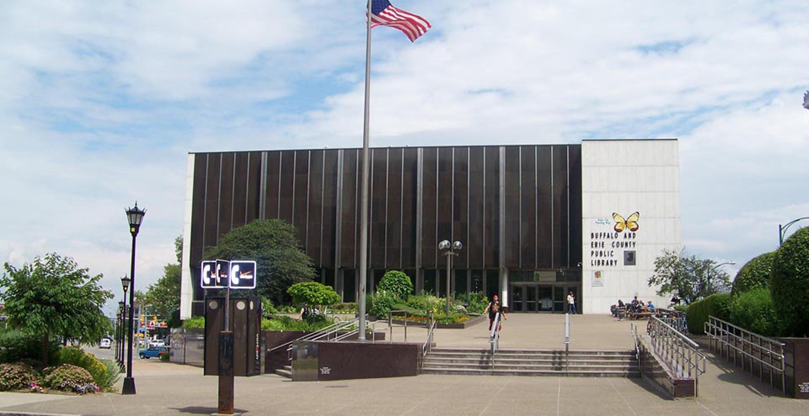
Image: https://www.buffalolib.org/sites/default/files/images/News%20Release/central.300.jpg, Buffalo and Erie County Public Library Press Image
Public Library Opportunities
Support of student information needs
Early-childhood literacy
Mobile outreach vehicles
(Ptacek, 2013)
Notes:
Image: https://www.buffalolib.org/sites/default/files/images/News%20Release/central.300.jpg, Buffalo and Erie County Public Library Press Image (Buffalo and Erie County Public Library, Central Library in downtown Buffalo)
“Two other crucial areas that will define the public library of the next decade are its role in supporting the information needs of K-12 students and its position to lead community efforts for early-childhood literacy.” (Ptacek, 2013, p. 119)
“Digital reference materials in public-library collections will be aggregated to fit specific needs or subject areas, and other library educational resources, such as instructional gaming software or the Kahn approach to independent learning, create services and resources perfectly suited to a public library-public school partnership...the library can provide materials and tutoring on test-taking techniques and other academic competencies required of youngsters who are entering the world of standardized tests...Some sites also offer smart tables that utilize subject-based software geared toward group study sessions.” (Ptacek, 2013, p. 119)
“...and public libraries are well positioned to use mobile outreach vehicles to reach home daycare providers, parents, and caregivers to provide reading-readiness programs for children under the age of five.” (Ptacek 2013, 120) “It is imperative that the public library remain relevant to the people it serves. In the future, libraries will be less about services and more about how to be of service.” (Ptacek, 2013, p. 120)
Ptacek, B. (2013). Chapter eighteen. In J. Janes (Ed.), Library 2020: Today’s Leadings Visionaries Describe Tomorrow’s Library (pp. 117-120). Lanham: Scarecrow Press.

Slide 17
Context & situation

Slide 18
Image: https://www.flickr.com/photos/stephspontaneous/2632755634 by stephanyann / CC BY-ND 2.0
In information seeking, convenience is key…
But it depends on context and situation.
Notes:
Image: https://www.flickr.com/photos/stephspontaneous/2632755634 by stephanyann / CC BY-ND 2.0
“Our research indicates that convenience significantly impacts people’s choices of technology and resources. Since convenience depends on the context and situation of one’s information need, there exists no one answer as to what makes a certain technology or resource convenient (Connaway 2016a, 2016b; Connaway and Dickey 2010; Connaway, Dickey, and Radford 2011).”
Connaway, L. S. (2017, June 19). Putting the library in the life of the user: Listen, then lead, to promote a unique and compelling role for academic libraries [blog post]. Guest of Choice, Choice360 blog. Retrieved from http://www.choice360.org/blog/putting-the-library-in-the-life-of-the-user
Connaway, L. S. (2016). “Is Anything More Important than Convenience?” Next, May 24, http://www.oclc.org/blog/main/is-anything-more-important-than-convenience/.
Connaway, L. S. (2016). “#Librariesinlife: The Convenience Imperative.” Next, March 7, http://www.oclc.org/blog/main/librariesinlife-the-convenience-imperative/.
Connaway, L. S., & Dickey, T. J. (2010). “The Digital Information Seeker: Report of Findings from Selected OCLC, RIN, and JISC User Behavior Projects.” http://www.jisc.ac.uk/media/documents/publications/reports/2010/digitalinformationseekerreport.pdf.
Connaway, L. S., Dickey, T. J., and Radford, M. L. (2011). “’If it is too inconvenient I’m not going after it:’ Convenience as a Critical Factor in Information-Seeking Behaviors.” Library & Information Science Research 33, no. 3: 179-190.

Slide 19
And so, it just depends on what I'm doing, whether it's a teaching research or a big research project.
(Fulfillment, Faculty Member)
Image: https://commons.wikimedia.org/wiki/File:O%27Brian_Hall_2009.jpg by James G. Miles / CC BY 2.0
Notes:
Image: https://commons.wikimedia.org/wiki/File:O%27Brian_Hall_2009.jpg by James G. Miles / CC BY 2.0 (SUNY Buffalo O’Brian Hall, home of the Charles B. Sears Law Library)
UMB04
My process. I'll do a quick scan like that and I'll normally save the citation. It's just one of the things that I collect. I use a whole different range of different citation collection tools, but I'll normally save the notation. It depends. If I'm searching for classes, I have a citation Mendeley class and so I'll actually put a reference there. If it's for my own research, I often just don't do that. I keep folders of references, so I just have pages of different headings and pages in Word Doc so that I can just collect things as I go. I also am a digital [HASS] researcher, so I use a bunch of different tools on things.
If I'm looking for something really, like I have in my DECRA, I actually use Voyant, which is a really nice text analysis tool that I use a lot. It will actually ... I can just dump the URL from the library or I can copy and paste the whole [corpus], and it will show me some of the relational text information that I might be after. And so, it just depends on what I'm doing, whether it's a teaching research or a big research project. But, for my research projects, I always use Voyant as my next tool, because not all authors or journal editors use appropriate keywords.

Slide 20
Image: https://commons.wikimedia.org/wiki/File:Karpeles_Library_and_Manuscript_Museum_Buffalo_NY_Sep_16.JPG by Pubdog / CC BY 2.0
So I have kind of just a default of all of my different searches that I do. So I start with the library, and then I do a PubMed search. I do an UpToDate search.
(Discovery & Access, Graduate Student)
Notes:
Image: https://commons.wikimedia.org/wiki/File:Karpeles_Library_and_Manuscript_Museum_Buffalo_NY_Sep_16.JPG by Pubdog / CC BY 2.0 (Karpeles Library and Manuscript Museum, Buffalo, NY)
ULG02 28:57
Yeah, yeah. So I have kind of just a default of all of my different searches that I do. So I start with the library, and then I do a PubMed search. I do an UpToDate search. Let's see. And from there, I just get a lot of different articles and just start [inaudible] through. And then obviously, I always do try to-- filter wise, I do try to filter relevant. So I don't actually [inaudible] the filter. It must be 2018, but in my head, if I'm going to use it, especially if it's the new recommendations these days, I always try to look-- I don't know, probably my threshold is 2015 [inaudible]. So basically, not super old. But if I do use super old, it's usually because it's when they first found the disease or the history of it.

Slide 21
Google is really zero-- it's the stuff that I don't even really consider as part of my research process…I just go straight to the library…Basically, I don't have to waste so much time going through different web links that show up.
(Discovery & Access, Graduate Student)
Image: https://commons.wikimedia.org/wiki/File:Lockwood.JPG by Breadchastick / CC BY 3.0
Notes:
Image: https://commons.wikimedia.org/wiki/File:Lockwood.JPG by Breadchastick / CC BY 3.0 (SUNY Buffalo Thomas B. Lockwood Memorial Library)
ULG02 34:17
Yeah, yeah. Yeah, so that's why I usually-- so as I was saying, the Google is really zero-- it's the stuff that I don't even really consider as part of my research process. Is to actually learn the words of how do I put in the [inaudible] to research what I use at the library database, and what kind of things do I go for? And then, I just go straight to the library down [inaudible]. Basically, I don't have to waste so much time going through different web links that show up.

Slide 22
“I’ve always thought that the library was a good source if you have a few months to spend on a paper.”
(Seeking Synchronicity focus group participant)
Image: https://www.flickr.com/photos/hinnosaar/4802911749 by Marti & Toomas Hinnosaar / CC BY 2.0
Notes:
Image: https://www.flickr.com/photos/hinnosaar/4802911749 by Marti & Toomas Hinnosaar / CC BY 2.0
Radford, M. L., & Connaway, L. S. (2005–2008). Seeking synchronicity: Evaluating virtual reference services from user, non-user, and librarian perspectives. Funded by the Institute of Museum and Library Services (IMLS). https://www.oclc.org/research/publications/all/synchronicity.html.

Slide 23
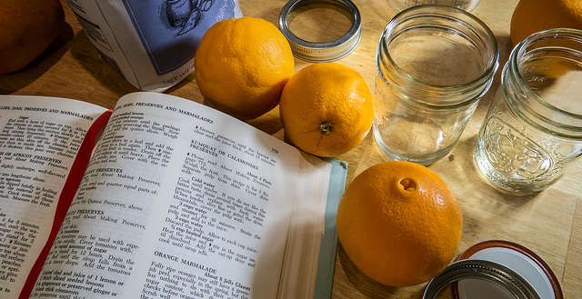
“Convenient” Isn’t Always Simple
“At first I started looking online, and it was a little bit overwhelming…I ended up reaching into my mom’s cupboard and using a recipe that I found in one of her old cookbooks. The recipe was just what I was looking for...”
(Digital Visitors and Residents, High School Student)
Image: https://www.flickr.com/photos/29233640@N07/8395962128 by Robert Couse-Baker / CC BY 2.0
Notes:
Image: https://www.flickr.com/photos/29233640@N07/8395962128 by Robert Couse-Baker / CC BY 2.0
“This morning I was looking for a homemade bread recipe that I could use to bake and then blog about. (I just started my own food blog: gritsgonegreen.wordpress.com). At first I started looking online, and it was a little bit overwhelming. There were so many different recipes with different flavors and crazy combinations. The one thing that was good about looking at the online recipes was viewing the user comments and seeing how people liked or disliked each recipe. I ended up reaching into my mom’s cupboard and using a recipe that I found in one of her old cookbooks. The recipe was just what I was looking for: it was a simple homemade white bread. I was about to search on the internet how to knead and punch bread, but I flipped the page, and there was a whole glossary of bread making terms. I must admit, I was a little bit surprised by the amount of information and instruction found in the cookbook. I thought I was going to have to look up an instructional video online.” (Digital Visitors and Residents, USS3, Emerging, Female, Age 17, High School Student)
White, D. S., & Connaway, L. S. (2011-2014). Digital Visitors and Residents: What Motivates Engagement with the Digital Information Environment. Funded by JISC, OCLC, and Oxford University. http://www.oclc.org/research/activities/vandr.html.

Slide 24
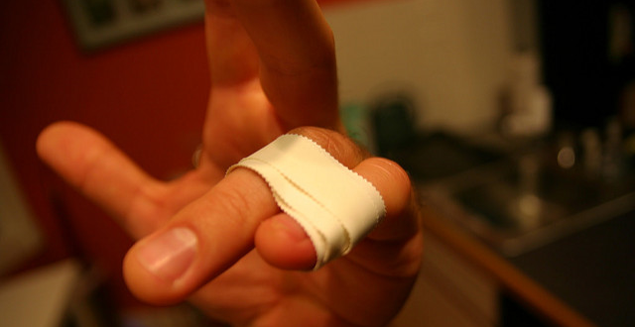
“Humans are a valued source of information.”
Image: https://www.flickr.com/photos/zachduffy/2634956354 by Zach Duffy / CC BY-NC-ND 2.0
(Connaway et al., 2017)
“Regarding health affairs, I usually don’t search on the internet because… you have pain in one finger and then you end up [thinking] you have the bubonic plague… For this situation, I would use personal contacts.” (Digital Visitors and Residents, Graduate Student)
Notes:
Image: https://www.flickr.com/photos/zachduffy/2634956354 by Zach Duffy / CC BY-NC-ND 2.0
Personal contacts are used for important matters, such as health questions, because people feels that expert advice is the best way to access the correct and contextualized information fulfill their needs.
Connaway, L. S., Kitzie, V., Hood, E. M., & Harvey, W. (2017). The Many Faces of Digital Visitors & Residents: Facets of Online Engagement. With contributions from A. Benedetti, A. Canals, L. Gregori, E. O. Espinet, D. Lozano, M. Man, J. C. Morales, S. G. Ricetto, R. Melgrati, E. M. Méndez Rodríguez, A. Sada, P. Sidorko, P. Sirito, V. Steel, T. van der Werf, & E. Woo. Dublin, OH: OCLC Research. doi:10.25333/C3V63F.
White, D. S., & Connaway, L. S. (2011-2014). Digital Visitors and Residents: What Motivates Engagement with the Digital Information Environment. Funded by JISC, OCLC, and Oxford University. http://www.oclc.org/research/activities/vandr.html.

Slide 25
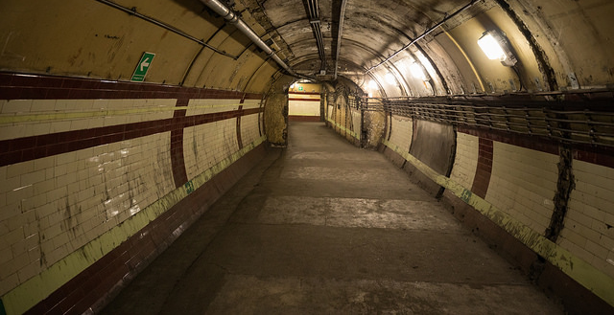
Image: https://www.flickr.com/photos/steve_way/38027571414 by steve_w / CC BY-NC-ND 2.0
“The students are completely unaware of the resources that the university has in repositories, databases, etc. on their subjects. Most of the interviewees do not know the possibility of consulting books in full text, being able to develop bibliographies or access remotely the virtual texts of the university campus.”
(V&R Project Team Member, Universidad Carlos III de Madrid)
Notes:
Image: https://www.flickr.com/photos/steve_way/38027571414 by steve_w / CC BY-NC-ND 2.0
Connaway, L. S., Kitzie, V., Hood, E. M., & Harvey, W. (2017). The Many Faces of Digital Visitors & Residents: Facets of Online Engagement. With contributions from A. Benedetti, A. Canals, L. Gregori, E. O. Espinet, D. Lozano, M. Man, J. C. Morales, S. G. Ricetto, R. Melgrati, E. M. Méndez Rodríguez, A. Sada, P. Sidorko, P. Sirito, V. Steel, T. van der Werf, & E. Woo. Dublin, OH: OCLC Research. doi:10.25333/C3V63F.
White, D. S., & Connaway, L. S. (2011-2014). Digital Visitors and Residents: What Motivates Engagement with the Digital Information Environment. Funded by JISC, OCLC, and Oxford University. http://www.oclc.org/research/activities/vandr.html.

Slide 26
Image: https://www.flickr.com/photos/johnloo/7424050476 by John Loo / CC BY 2.0
“Because, most likely, I won't be able to see the book, just a little abstract, and that might not be helpful because I won't get the entire information, just a part of it. That gets frustrating.”
(Researching Students’ Information Choices, Community College Student)
Notes:
Image: https://www.flickr.com/photos/johnloo/7424050476 by John Loo / CC BY 2.0
Buhler, A., Cataldo, T. T., Faniel, I. M., Connaway, L. S., Valenza, J. K., Graff, R., Elrod, R., Putnam S., Cyr C., Towler, C., Hood, E., Fowler R., Howland S., Brannon B, Langer, K., Kirlew, S. (2015-2018). Researching students’ information choices: Determining identity and judging credibility in digital spaces. IMLS Grant Project LG-81-15-0155. http://guides.uflib.ufl.edu/RSIC.

Slide 27
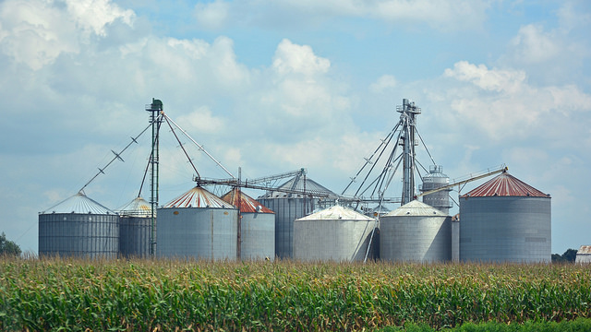
“Yes, it [Matrix film plug-in to brain] - sort of makes information gathering effortless and without having to sort of manually go through and separate the chaff from the wheat.”
(Digital Visitors and Residents, Undergraduate Student)
“People lack patience to wade through content silos…”
(Connaway 2015, 134)
Image: https://www.flickr.com/photos/pmillera4/12162109155 by Peter Miller / CC BY-NC-ND 2.0
Notes:
Image: https://www.flickr.com/photos/pmillera4/12162109155 by Peter Miller / CC BY-NC-ND 2.0
Connaway, L. S. (Ed.). (2015). The library in the life of the user: Engaging with people where they live and learn. Dublin, OH: OCLC Research. http://www.oclc.org/content/dam/research/publications/2015/oclcresearch-library-in-life-of-user.pdf.
UKU10: “I don’t know. Fantasy aside, probably like the Matrix, just have the plug-ins at the back of your head, I imagine.”
Interviewer: “Okay, yes. Okay, that’s fine. I mean that’s what we’re sort of wanting to know what people would actually like best.”
UKU10: “Yes, I suppose I only say that because of out of laziness and that I don’t want to have to go through reading books and searching web pages and…”
Interviewer: “So what would you want this little plug in in your head to give you?”
UKU10: “I don’t know sort of just tell me what I want to know without me having to do anything (Laughter) in essence but…”
Interviewer: “Okay, so you just – would it be able to read your mind and give you information?”
UKU10: “Yes, it - sort of make information gathering effortless and without having to sort of manually go through and separate the chaff from the wheat.”
Interviewer: “Yes. And you’d like that done for you sort of all of the relevant stuff.”
UKU10: “That’s sort of – I find that’s the biggest time consumer and obviously the most like taxing part of it.”
Interviewer: Do you think it’s where you learn most though?”
UKU10: “Oh I don’t know, that’s quite a good question, potentially – I don’t know, I’m not sure.” (Digital Visitors and Residents, UKU10, Establishing, Male, Age 20, Law)
White, D. S., & Connaway, L. S. (2011-2014). Digital Visitors and Residents: What Motivates Engagement with the Digital Information Environment. Funded by JISC, OCLC, and Oxford University. http://www.oclc.org/research/activities/vandr.html.

Slide 28
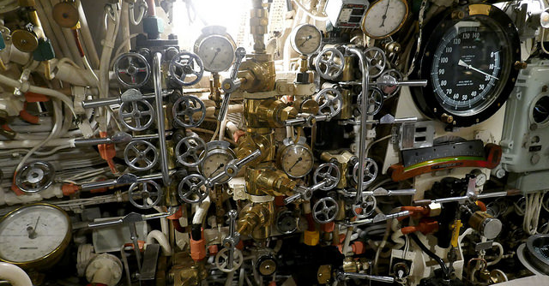
“…I just think it’s [VLE web site] too complicated and it’s limited, that I just carried on going on Google.”
(Digital Visitors and Residents, UKS6, Emerging, Female, Age 16, Secondary School Student)
Notes:
Image: https://www.flickr.com/photos/foilman/43074066991 by Henry Burrows / CC BY-SA 2.0
“Yes. It’s like for our extended project we have like tutorial sessions, and they gave us this website that you go on to like try and find useful resources, but I just think it’s too complicated and it’s limited, that I just carried on going on Google.” (Digital Visitors and Residents, UKS6, Emerging, Female, Age 16, Secondary School Student)
White, David S., and Lynn Silipigni Connaway. 2011-2014. Digital Visitors and Residents: What Motivates Engagement with the Digital Information Environment. Funded by JISC, OCLC, and Oxford University. http://www.oclc.org/research/activities/vandr.html.

Slide 29
“But the ease of using it was great…It was very delightful to be able to not have to go through a lot of hoops to get to what I was looking for, because figuring out the topic is complicated enough.”
(Discovery & Access, Undergraduate Student)
Image: https://www.flickr.com/photos/j0nny_t/128005448 by Jonny / CC BY-NC-ND 2.0
Notes:
Image: https://www.flickr.com/photos/j0nny_t/128005448 by Jonny / CC BY-NC-ND 2.0
Discovery and Access Interview CBU10
S2 24:33
Okay. So going back to your survey, then. So you didn't know the exact item you wanted to borrow, read or download immediately. And then we had asked did you accomplish what you were hoping to do, and you said yes, you did accomplish what you were hoping to do. So I'd like to talk to you a little bit about how you felt about your search experience. And what are some words you might use? For instance, would you say you were delighted by your search experience?
S3 25:23
Only because of [inaudible] paper research, I was really [inaudible] delighted. But the ease of using it was great. I didn't have to work too hard to find what I wanted. I just had to think about it, and make sure I was using the right word. It was really simple. I think that's the most important. So in that way, yes. It was very delightful to be able to not have to go through a lot of hoops to get to what I was looking for, because figuring out the topic is complicated enough.

Slide 30
Image: https://commons.wikimedia.org/wiki/File:Buffalo%26Erie_County_Historical_Society.jpg by Fortunate4now / Public Domain
“It was weirdly one of those situations where it was at the tail end of a project and not the beginning of a project where usually I wasn't really just open-minded looking for all sorts of information. I was kind of hunting. So that was a different kind of experience, yeah.” (Discovery & Access, Graduate Student)
Notes:
Image: https://commons.wikimedia.org/wiki/File:Buffalo%26Erie_County_Historical_Society.jpg by Fortunate4now / Public Domain (Buffalo and Erie County Historical Society, History Museum)
Discovery and Access Interview ULG03
S2 16:05
Thanks. Yeah. It looks like that there were 14 results once you did put in that disability online education choice. And so do you remember reviewing any of those or--?
S3 16:21
I think I might have. I usually go by the title. And then underneath the title you can see kind of like the source, what kind of journal it was or what year it was. So if the journal is specific to my field at all, if that rings any bells, then I usually investigate even if the title doesn't seem like a pure hit. So I think I fiddled around and I learned a lot of stuff, but it was weirdly one of those situations where it was at the tail end of a project and not the beginning of a project where usually I wasn't really just open-minded looking for all sorts of information. I was kind of hunting. So that was a different kind of experience, yeah.

Slide 31
Image: https://www.flickr.com/photos/stephanie_in_love/5341102160 by stephanie / CC BY 2.0
Academic Library Opportunities
Pop-up chat
Embedded librarians
Instruction
Space
Scholarly identity in social networks
RDM and research support
Notes:
Image: https://www.flickr.com/photos/stephanie_in_love/5341102160 by stephanie / CC BY 2.0

Slide 32
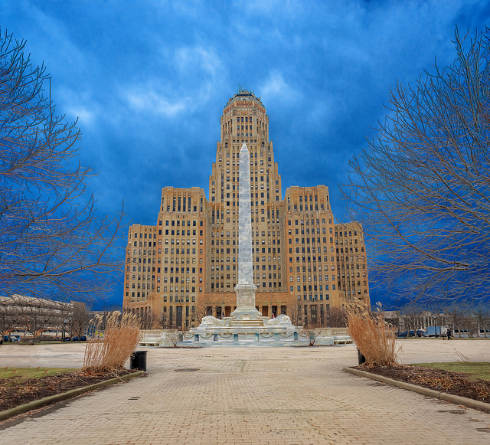
Public Library Opportunities: Centralized Services
Career centers
Passport services
Marriage licenses
Voter registration
Local government services
Income tax forms
Village post offices
(Hildreth, 2013)
Image: https://www.flickr.com/photos/kenlane/39207136290 by Ken Lane / CC BY-NC-SA 2.0
Notes:
Image: https://www.flickr.com/photos/kenlane/39207136290 by Ken Lane / CC BY-NC-SA 2.0 (Buffalo City Hall)
“Libraries are serving as portals for many public services, and that role will continue to expand as funding limitations impact in-person customer-service options and more public services are provided exclusively online. Many libraries will work with their local workforce boards to serve as career centers. Some libraries provide passport services, marriage licenses, voter registration, and local government services. The library assumed widespread responsibility from the United States Postal Service (USPS) for distributing income tax forms. Now the USPS is calling upon libraries to serve as “village post offices” in communities that may lose their local postal service, particularly in rural areas. Although the community-service priorities in 2020 may vary from those of today, libraries must be proactive in identifying those priorities and be as flexible as possible in cooperating with a wide variety of partners in providing those services.” (Hildreth 2013, 101)
Hildreth, S. (2013). Chapter fifteen. In J. Janes (Ed.), Library 2020: Today’s Leadings Visionaries Describe Tomorrow’s Library (pp. 99-103). Lanham: Scarecrow Press.

Slide 33
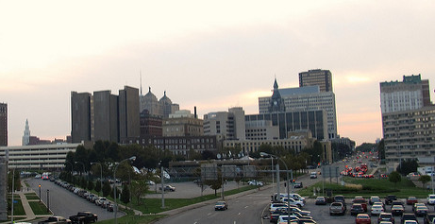
Image: https://www.flickr.com/photos/kenlund/7992624301 by Ken Lund / CC BY-SA 2.0
Public Library Opportunities: Centralized Place
Gathering place
Citizenship classes
ESL classes
Life-skills programs
Virtual learning
Public discourse
(Ptacek, 2013)
Notes:
Image: https://www.flickr.com/photos/kenlund/7992624301 by Ken Lund / CC BY-SA 2.0 (Downtown Buffalo skyline)
“As libraries become less about physical access to information, they are more likely to be valued for their importance to the community—as gathering place for civic, educational, and social engagement.” (Ptacek 2013, 118) “As new technologies become available, the library will be a place to go, either physically or virtually, to learn.” (Ptacek 2013, 118) “Citizenship classes, English as second language classes, and life-skills programs are all popular in KCLS libraries.” (Ptacek 2013, 118) “Libraries can also play a role in virtual learning.” (Ptacek 2013, 118)
“Public libraries are local, neutral, and respected for providing information that represents different viewpoints. Given its resources and community connections, it is the perfect arena to engage the community in civic discourse on important community issues. With the demise of local news sources, it would be reasonable to assume that local governments, service providers, and community leaders will turn to the library as a venue for discussion and feedback on issues that affect the public.” (Ptacek 2013, 119)
Ptacek, B. (2013). Chapter eighteen.” In J. Janes (Ed.), Library 2020: Today’s Leadings Visionaries Describe Tomorrow’s Library (pp. 117-120). Lanham: Scarecrow Press.

Slide 34
Relationship building

Slide 35
https://commons.wikimedia.org/wiki/File:Capen.JPG by Breadchastick / CC BY 3.0
“Knowledge is created through conversation—if you’re in the knowledge business, you’re in the conversation business.” (Lankes, 2016, p. 23)
Notes:
Image: https://commons.wikimedia.org/wiki/File:Capen.JPG by Breadchastick / CC BY 3.0 (SUNY Buffalo Capen Hall, houses the University Libraries administration, the Undergraduate Library, Science and Engineering Library, and Special Collections)
Lankes, R.. (2016). The New Librarianship Field Guide. Cambridge: MIT Press.

Slide 36
Image: https://www.flickr.com/photos/theloushe/3696494100 by Jessica Lucia / CC BY-NC-ND 2.0
“When I need a quick answer my preferred source is a person, because a person would interpret your need quickly and better than Internet.”
(Digital Visitors and Residents, Undergraduate Student)
Notes:
Image: https://www.flickr.com/photos/theloushe/3696494100 by Jessica Lucia / CC BY-NC-ND 2.0
“When I need a quick answer my preferred source is a person, because a person would interpret your need quickly and better than Internet. […] But when I don’t know anything about a subject, first I do a search on my own and then I asked an expert…but before I ask a person, I want to know a little about the subject…not to say the person “illuminate me, please”…if you have some basic knowledge you could to take more advantage of your contact.” (UOCU5, Female, Age 30, Education)
White, D. S., & Connaway, L. S. (2011-2014). Digital Visitors and Residents: What Motivates Engagement with the Digital Information Environment. Funded by JISC, OCLC, and Oxford University. http://www.oclc.org/research/activities/vandr.html.

Slide 37
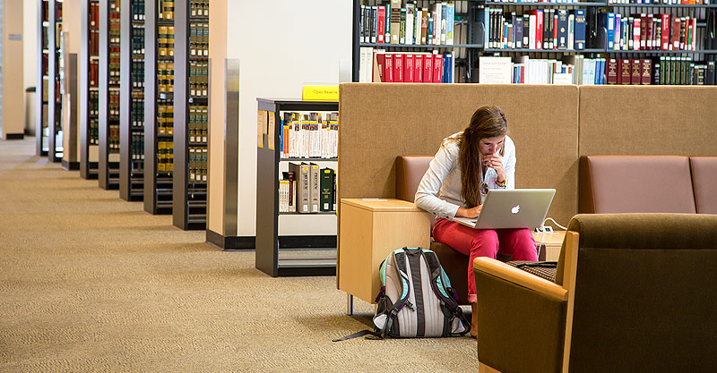
“I haven’t called them, I don’t think I’ve ever talked to the librarians here since I’m not in the building much.” (Digital Visitors and Residents, USU4, Emerging, Male, Age 19, Engineering)
Image: https://www.flickr.com/photos/usfca_webservices/10276115014 by Web Services / CC BY-NC-ND 2.0
Notes:
Image: https://www.flickr.com/photos/usfca_webservices/10276115014 by Web Services / CC BY-NC-ND 2.0
“I haven’t called them, I don’t think I’ve ever talked to the librarians here since I’m not in the building much.” (Digital Visitors and Residents, USU4, Emerging, Male, Age 19, Engineering)
White, D. S., & Connaway, L. S. (2011-2014). Digital Visitors and Residents: What Motivates Engagement with the Digital Information Environment. Funded by JISC, OCLC, and Oxford University. http://www.oclc.org/research/activities/vandr.html.

Slide 38
Image: https://www.flickr.com/photos/jeremybrooks/5970746062 by Jeremy Brooks / CC BY-NC 2.0
“If my other friends recommended it to me and used chat reference services themselves I might be convinced to try them...”
(Seeking Synchronicity, High School Student)
Notes:
Image: https://www.flickr.com/photos/jeremybrooks/5970746062 by Jeremy Brooks / CC BY-NC 2.0
“If my other friends recommended it to me and used chat reference services themselves I might be convinced to try them because I usually learn about all sorts of computer and technology-based things from my friends because I'm so inept in that area myself. Without them, I would have never gotten iTunes, AIM, Facebook and other items that I couldn't imagine living without now that I have them.” (Seeking Synchronicity, NOS-94938, Non-user Online Survey, Female, Age 15-18)
“I am sure there must be benefits from utilizing chat reference - but talking to strangers just seems risky, are you required to give them personal information? And how are you assured that information can not be abused in any way?” (Seeking Synchronicity, NOS-69925, Non-user Online Survey, Female, Age 36-45)
“I think chatting is a great way to get reference help. Its all a matter of how user friendly the whole set up is.” (Seeking Synchronicity, NOS-67135, Non-user Online Survey, Female, Age 19-28)
“If it was more safe. If there weren't any internet hunter or dangerous people on there.” (Seeking Synchronicity, NOS-33482, Non-user Online Survey, Female, Age 15-18)
“If i trusted the librarian enough to chat with me on the web.” (Seeking Synchronicity, NOS-89558, Non-user Online Survey, Female, Age 12-14)
“If I knew or had heard of the person on the other end.” (Seeking Synchronicity, NOS-95620, Non-user Online Survey, Female, Age 12-14)
Radford, M. L., & Connaway, L. S. (2005–2008). Seeking synchronicity: Evaluating virtual reference services from user, non-user, and librarian perspectives. Funded by the Institute of Museum and Library Services (IMLS). https://www.oclc.org/research/publications/all/synchronicity.html.

Slide 39
Image: https://www.flickr.com/photos/herry/15942622350 by Herry Lawford / CC BY 2.0
“I feel that there's been a lot of progress. And for a guy like me, who has been to prison, who's suffered, struggled with using for a long time, I'm hanging out with librarians, the police…there are people that have historically not liked people like me, treating me like a human, and giving me the opportunity to be a human, instead of just a junkie. And that is absolutely phenomenal.”
(Public Libraries Respond, Community Member)
Notes:
Image: https://www.flickr.com/photos/herry/15942622350 by Herry Lawford / CC BY 2.0
PPL_CM1_021319
I feel that there's been a lot of progress. And for a guy like me, who has been to prison, who's suffered, struggled with using for a long time, I'm hanging out with librarians, the police. I'm still alive. I still know people that use, and I don't use, but I'm still talking to those people, and I'm still frigging wild sometimes. But now, there are people that have historically not liked people like me, treating me like a human, and giving me the opportunity to be a human, instead of just a junkie. And that is absolutely phenomenal. That shit did not exist ten years ago, four years ago, any amount of time ago, but the ball has been rolling.
Connaway, L. S., Morgan, K., Allen, S. G., Clark, L., Coleman, M., Cyr, C., & Procaccini, M. (2018-2019). Public Libraries Respond to the Opioid Crisis with Their Communities. Funded by OCLC, PLA, and IMLS. https://www.webjunction.org/explore-topics/opioid-crisis.html

Slide 40
Image: https://www.flickr.com/photos/roberttea/10513802725 by Robert Tea / CC BY-NC-ND 2.0
“it has been really cool for me in my own journey, having the chance to tell my story, and build positive relationships with my community…for a guy that has struggled with that in the past, that's pretty powerful stuff. To even have open ears. The fact that the library even wants to do anything is a pretty big deal. The fact that they'll even listen to me…but they listened to me when I showed up and was like, ‘Let's talk.’”
(Public Libraries Respond, Community Member)
Notes:
Image: https://www.flickr.com/photos/roberttea/10513802725 by Robert Tea / CC BY-NC-ND 2.0
PPL_CM1_021319
I already kind of touched on it, and I know that personally, I mean, it has been really cool for me in my own journey, having the chance to tell my story, and build positive relationships with my community, and hopefully find an opportunity for somebody to learn something from maybe my mistakes, or something from what I've learned. I mean, that's been a pretty big deal, and I don't know how many people would be that affected by something like this, on a personal level like that, but I know, for me, it's been a pretty frigging big deal, to give me that. And I know for my growth, little things like that have just bolstered my foundation, my support, my peer network, my positive behavior. That's a reinforcement of positive behavior, and for a guy that has struggled with that in the past, that's pretty powerful stuff. To even have open ears. The fact that the library even wants to do anything is a pretty big deal. The fact that they'll even listen to me, like, "Hey, here's a thing." And I know that they can't listen to every frigging loony-toon felon that walks through the door, but they listened to me when I showed up and was like, "Let's talk."
Connaway, L. S., Morgan, K., Allen, S. G., Clark, L., Coleman, M., Cyr, C., & Procaccini, M. (2018-2019). Public Libraries Respond to the Opioid Crisis with Their Communities. Funded by OCLC, PLA, and IMLS. https://www.webjunction.org/explore-topics/opioid-crisis.html

Slide 41
“In the public library there are two or three people. I know the staff… Once I participated in a civil servant open examination and they helped me a lot.” (Digital Visitors and Residents, Undergraduate Student)
Image: https://www.facebook.com/ublibraries/photos/a.10150600709231728/10153808052686728/?type=1&theater by University at Buffalo Libraries
Notes:
Image: https://www.facebook.com/ublibraries/photos/a.10150600709231728/10153808052686728/?type=1&theater by University at Buffalo Libraries (SUNY Buffalo Libraries, Austin Flint Reading Room in Abbott Hall)
“My town is small. Few people live there. In the public library there are two or three people. I know the staff […] Once I participated in a civil servant open examination and they helped me a lot. […] Yes, I go there [to the library] every afternoon. Because I teach children, and I do it there. The public library has a pleasant atmosphere. I prefer doing it there. [...] [I have] Not [asked them for help for my studies] until now.” (UOCU1, Female, Age 22, Information Science and Communication Studies)
White, D. S., & Connaway, L. S. (2011-2014). Digital Visitors and Residents: What Motivates Engagement with the Digital Information Environment. Funded by JISC, OCLC, and Oxford University. http://www.oclc.org/research/activities/vandr.html.

Slide 42
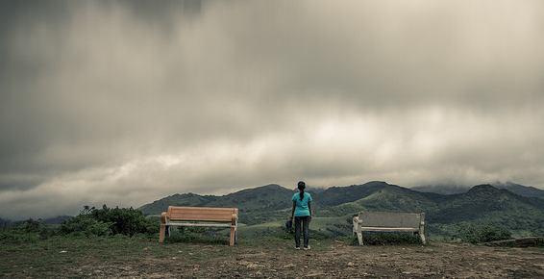
Image: https://www.flickr.com/photos/premnath/35054065142 by Premnath Thirumalaisamy / CC BY-NC-ND 2.0
It’s Time for a Change
“Librarians have an opportunity to become part of users’ social networks and to put resources in the context of users’ information needs.”
(Connaway, 2015, p. 23)
Notes:
Image: https://www.flickr.com/photos/premnath/35054065142 by Premnath Thirumalaisamy / CC BY-NC-ND 2.0
Connaway, L. S., & Faniel, I. M. (2015). Reordering Ranganathan: Shifting user behaviours, shifting priorities. SRELS Journal of Information Management 52(1), 3–23. http://i-scholar.in/index.php/sjim/article/view/60392/51360.
“The following sections will look at what today’s librarians, library researchers and information scientists have said about the changing roles of the five laws and also review relevant literature to show how the five laws still apply, but where, we believe, it’s time for a change in focus and emphasis.” (p. 3) “Librarians have an opportunity to become part of users’ social networks and to put resources in the context of users’ information needs.” (p. 23)
Connaway, L. S. (Ed.). (2015). The Library in the Life of the User: Engaging with People Where They Live and Learn. Dublin, OH: OCLC Research. http://www.oclc.org/content/dam/research/publications/2015/oclcresearch-library-in-life-of-user.pdf.

Slide 43
Image: https://www.flickr.com/photos/johnkay/3708208169 by Images by John ‘K’ / CC BY-NC-ND 2.0
“By focusing on relationship building instead of service excellence, organizations can uncover new needs and be in position to make a stronger impact.” (Mathews, 2012)
Notes:
Image: https://www.flickr.com/photos/johnkay/3708208169 by Images by John ‘K’ / CC BY-NC-ND 2.0
Mathews, B. (2012). Think Like a Startup: A White Paper to Inspire Library Entrepreneurialism. http://chronicle.com/blognetwork/theubiquitouslibrarian/2012/04/04/think-like-a-startup-a-white-paper/.

Slide 44
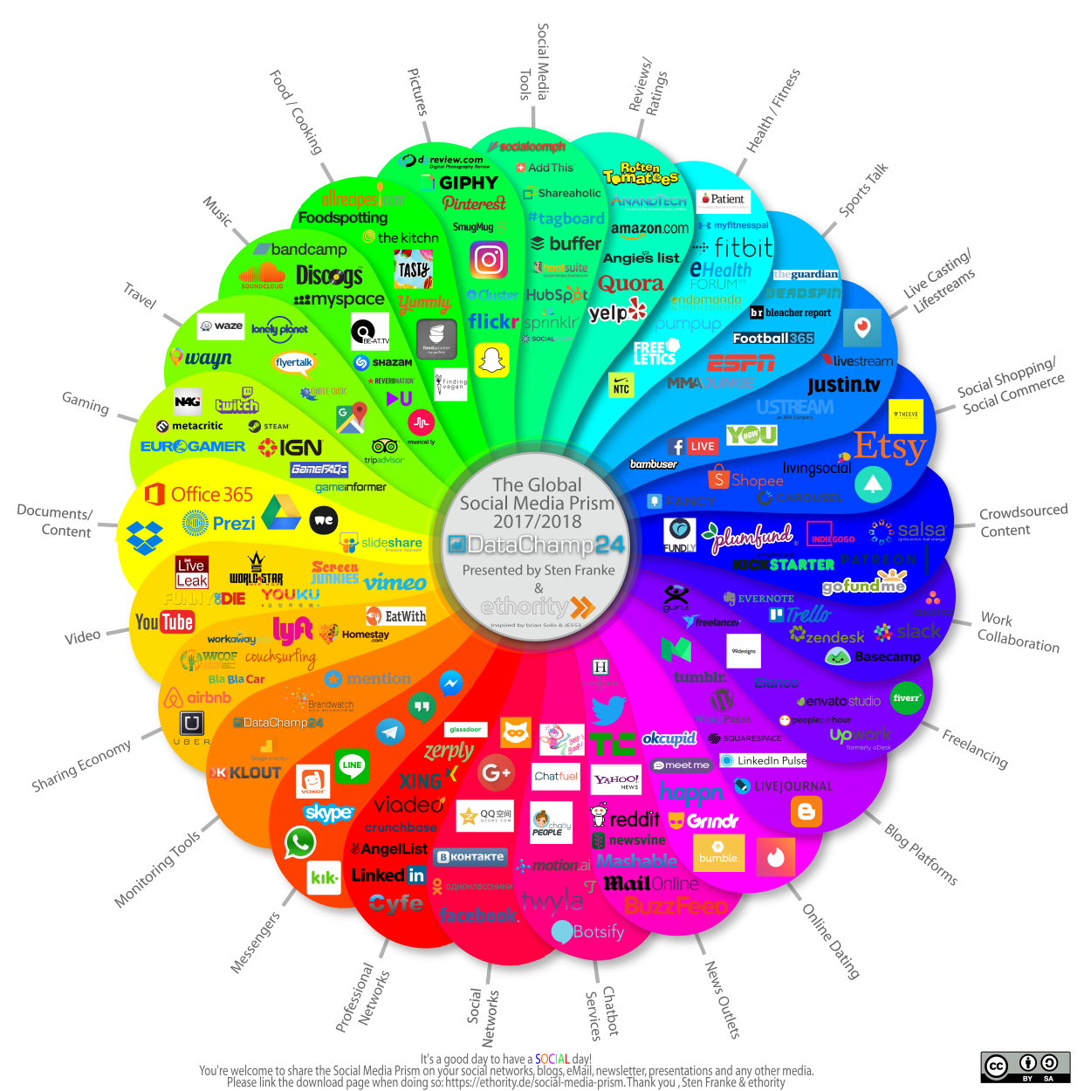
Build digital communities
Integrate into users’ digital worlds
Image: https://ethority.de/en/social-media-prism/ by Sten Frenke / CC BY-SA 2.0
Notes:
Image: https://ethority.de/en/social-media-prism/ by Sten Frenke / CC BY-SA 2.0

Slide 45
Opportunities

Slide 46
Image: https://www.flickr.com/photos/torange-biz/15171785597 by tOrange biz / CC BY 2.0
Plant many seeds
Try lots of decent ideas instead of one good one
See what works
Seize the white space
“Don’t limit your innovation”
(Mathews, 2012)
Notes:
Image: https://www.flickr.com/photos/torange-biz/15171785597 by tOrange biz / CC BY 2.0
Mathews, B. (2012). Think Like a Startup: A White Paper to Inspire Library Entrepreneurialism. http://chronicle.com/blognetwork/theubiquitouslibrarian/2012/04/04/think-like-a-startup-a-white-paper/.

Slide 47
Thank You!
Lynn Silipigni Connaway, PhD
Senior Research Scientist
connawal@oclc.org
@LynnConnaway

Slide 48
References
Association of College and Research Libraries. (2017). Academic library impact: Improving practice and essential areas to research. Prepared by L. S. Connaway, W. Harvey, V. Kitzie, & S. Mikitish. Chicago: Association of College and Research Libraries. Available: http://www.ala.org/acrl/sites/ala.org.acrl/files/content/publications/whitepapers/academiclib.pdf
Buhler, A., Cataldo, T. T., Faniel, I. M., Connaway, L. S., Valenza, J. K., Graff, R., Elrod, R., Putnam S., Cyr C., Towler, C., Hood, E., Fowler R., Howland S., Brannon B, Langer, K., Kirlew, S. (2015-2018). Researching students’ information choices: Determining identity and judging credibility in digital spaces. IMLS Grant Project LG-81-15-0155. http://guides.uflib.ufl.edu/RSIC.
Connaway, L. S. (2016, March 7). #Librariesinlife: The convenience imperative [Blog post]. Next. http://www.oclc.org/blog/main/librariesinlife-the-convenience-imperative/.
Connaway, L. S. (2016, May 24). Is anything more important than convenience? Next. http://www.oclc.org/blog/main/is-anything-more-important-than-convenience/.
Connaway, L. S. (2017, August 25). Can you believe it? How to determine credibility in the era of fake news. Inside ASIS&T President’s Column, August 2017.

Slide 49
References
Connaway, L. S. (2017, June 19). Putting the library in the life of the user: Listen, then lead, to promote a unique and compelling role for academic libraries [Blog post]. Guest of Choice, Choice360 blog. Retrieved from http://www.choice360.org/blog/putting-the-library-in-the-life-of-the-user
Connaway, L. S. (Ed.). (2015). The library in the life of the user: Engaging with people where they live and learn. Dublin, OH: OCLC Research. http://www.oclc.org/content/dam/research/publications/2015/oclcresearch-library-in-life-of-user.pdf.
Connaway, L. S., & Dickey, T. J. (2010). The digital information seeker: Report of findings from selected OCLC, RIN, and JISC user behavior projects. http://www.jisc.ac.uk/media/documents/publications/reports/2010/digitalinformationseekerreport.pdf.
Connaway, L. S., & Faniel, I. M. (2015). Reordering Ranganathan: Shifting user behaviours, shifting priorities. SRELS Journal of Information Management 52(1), 3–23. http://i-scholar.in/index.php/sjim/article/view/60392/51360.
Connaway, L. S., Dickey, T. J., and Radford, M. L. (2011). “If it is too inconvenient I’m not going after it”: Convenience as a critical factor in information-seeking behaviors. Library & Information Science Research 33(3), 179-190.

Slide 50
References
Connaway, L. S., Kitzie, V., Hood, E. M., & Harvey, W. (2017). The many faces of digital visitors & residents: Facets of online engagement. With contributions from A. Benedetti, A. Canals, L. Gregori, E. O. Espinet, D. Lozano, M. Man, J. C. Morales, S. G. Ricetto, R. Melgrati, E. M. Méndez Rodríguez, A. Sada, P. Sidorko, P. Sirito, V. Steel, T. van der Werf, & E. Woo. Dublin, OH: OCLC Research. doi:10.25333/C3V63F.
Connaway, L. S., Lanclos, D. M., & Hood, E. M. (2013). “‘I always stick with the first thing that comes up on Google…’ Where people go for information, what they use, and why.” EDUCAUSE Review Online. http://www.educause.edu/ero/article/ialways-stick-first-thing-comes-google-where-people-go-information-what-they-use-and-why.
Hildreth, S. (2013). Chapter fifteen. In J. Janes (Ed.), Library 2020: Today’s Leadings Visionaries Describe Tomorrow’s Library (pp. 99-103). Lanham: Scarecrow Press.
Lankes, R. D. (2016). The new librarianship field guide. Cambridge: MIT Press.
Mathews, B. (2012). Think like a startup: A white paper to inspire library entrepreneurialism. http://chronicle.com/blognetwork/theubiquitouslibrarian/2012/04/04/think-like-a-startup-a-white-paper/.
Merriam-Webster’s Words of the Year 2018: Justice, plus pansexual, maverick, lodestar, and 7 more of our top lookups in 2018. (n.d.). https://www.merriam-webster.com/words-at-play/word-of-the-year-2018-justice/justice

Slide 51
References
Oxford Dictionaries. (2018, November 14). The Oxford Word of the Year 2018 is… [Tweet]. Retrieved from https://twitter.com/oxfordwords/status/1062846136388476928.
Ptacek, B. (2013). Chapter eighteen. In J. Janes (Ed.), Library 2020: Today’s Leadings Visionaries Describe Tomorrow’s Library (pp. 117-120). Lanham: Scarecrow Press.
Radford, M. L., & Connaway, L. S. (2005–2008). Seeking synchronicity: Evaluating virtual reference services from user, non-user, and librarian perspectives. Funded by the Institute of Museum and Library Services (IMLS). https://www.oclc.org/research/publications/all/synchronicity.html.
Steiner, P. (1993, July 5) On the internet [Cartoon]. The New Yorker. Retrieved from https://en.wikipedia.org/wiki/File:Internet_dog.jpg
White, D. S., & Connaway, L. S. (2011-2014). Digital visitors and residents: What motivates engagement with the digital information environment. Funded by JISC, OCLC, and Oxford University. http://www.oclc.org/research/activities/vandr.html.
Word of the Year 2018 is... (n.d.). https://en.oxforddictionaries.com/word-of-the-year/word-of-the-year-2018.

