Slide 1
2019
Columbus, OH
1 May 2019
Using FAST (Faceted Application of Subject Headings) in CONTENTdm
Eric Childress
Terry Butterworth
Community Manager
Senior Librarian and Archive Specialist
Notes:
Using FAST (Faceted Application of Subject Headings) in CONTENTdm S39. WEDS 11:25 AM-12:10 PM. Room 3B. Terry Butterworth & Eric Childress, OCLC FAST (Faceted Application of Subject Headings) is a faceted terminology system based chiefly on the Library of Congress Subject Headings (LCSH), and available from OCLC. CONTENTdm is a widely-used content management system from OCLC that allows institutions to integrate controlled vocabularies into their metadata authoring workflow. Because FAST is easy to use and easily learned, it has proven to be an excellent solution for the OCLC Library and Archives for digitization projects. We will describe FAST and outline the approach the OCLC Library has taken to integrating and leveraging FAST in CONTENTdm. Keywords: Cataloging; Collection Management Systems; CONTENTdm; Digital Collections; Metadata;

Slide 2
FAST (Faceted Application of Subject Headings)
Faceted vocabularies derived chiefly from the Library of Congress Subject Headings (LCSH)
A joint effort by OCLC Research & the Library of Congress
Maintained by OCLC
8 facets
Simple to learn and apply
Faceted-navigation-friendly
Modern in its design

Slide 3
FAST by the numbers
~121 Million WorldCat records have FAST headings
Personal Names | 745 K
Corporate Names | 377 K
Events | 12.5 K
Uniform Titles | 64 K
Chronological | 676
Topical | 409 K
Geographic | 180 K
Form/Genre | 3 K
Total | 1.8 M
Notes:
as of 1 Jan 2019

Slide 4
Example: Code name: Lise : the true story of the woman who became WWII's most highly decorated spy
LCSH
FAST

Slide 5
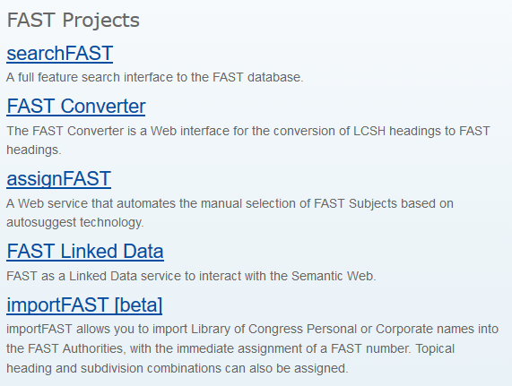
Openly available with free tools
Data and data dumps are licensed under:
Open Data Commons Attribution License (ODC-By)

Slide 6
FACETVOC-L (Faceted Controlled Vocabularies discussion list)
Introduced August 2016
Hosted by OCLC Research,
Focused on faceted controlled vocabularies used in libraries, archives and museums.
To subscribe or unsubscribe to the list, go to http://listserv.oclclists.org/scripts/wa.exe?A0=FACETVOC-L

Slide 7
Application
Approaches to creating controlled vocabularies in CONTENTdm
Notes:
Approaches to creating controlled vocabularies in CONTENTdm Identifying FAST headings and getting them into CONTENTdm takes some planning

Slide 8
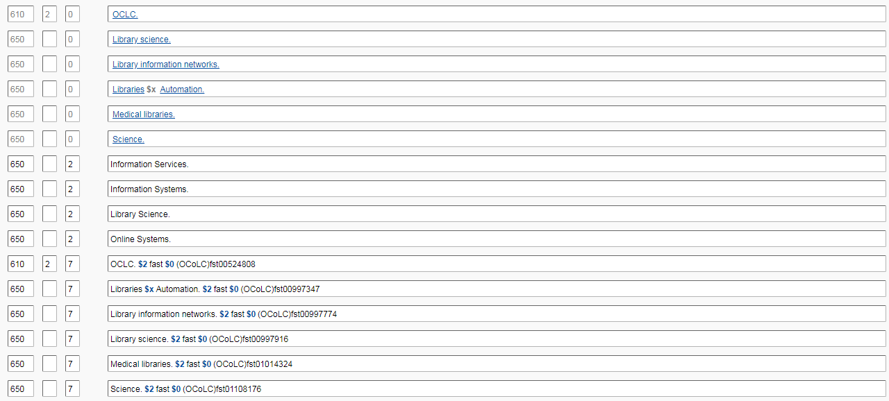
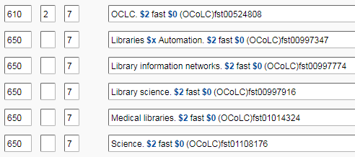
FAST (Faceted Application of Subject Headings)
Creating a FAST text file
Notes:
One way to create a controlled vocabulary using FAST records is to use the subject entries in your WorldCat records. This way you are identifying terms that are relevant to your collection. For example, we have several items dealing with architectural drawings and building details, and I initially loaded all the FAST terms under the LC subject heading Architecture. This caused problems with CONTENTdm trying to load my controlled vocabulary each time because it held thousands and thousands of terms I never used.

Slide 9
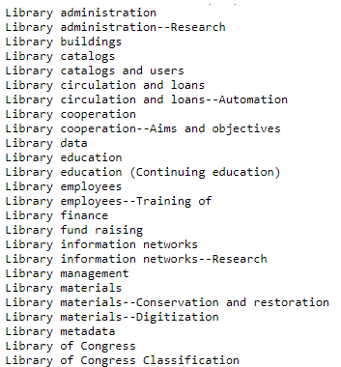
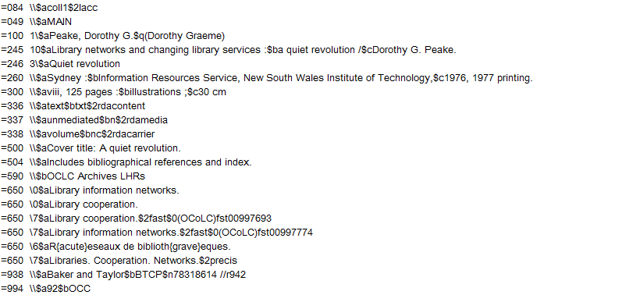
FAST (Faceted Application of Subject Headings)
Identifying terms
Notes:
By taking all my WorldCat records and extracting the FAST headings using MarcEdit, I was able to create a text file that I could load into CDM.

Slide 10
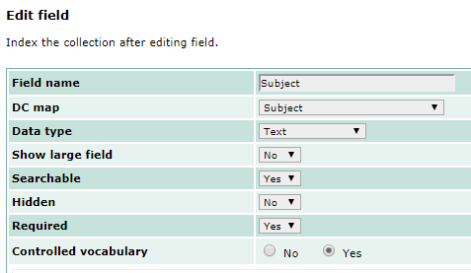
CONTENTdm administration
Setting up the vocabulary

Slide 11
CONTENTdm administration
Setting up the vocabulary
Notes:
You have a few options here. You can send your file to CONTENTdm support to have the vocabulary loaded on the server for your use or import it locally from a shared location. If you already have subject headings in your records, you can create a vocab based on that content, or you can create a temporary vocab using one that OCLC has already made available.

Slide 12
CONTENTdm administration
Setting up the vocabulary
Notes:
You can then share the vocabulary with all the collections, so you only have to set it up once.

Slide 13
CONTENTdm administration
Loading terms
Notes:
Now, within the CONTENTdm admin module, I can copy all the terms my FAST text file and add them to the controlled vocabulary if I didn’t already import it.

Slide 14
2019
Columbus, OH
FAST and CDM
Questions?
Eric Childress
Terry Butterworth
childree@oclc.org
butterwt@oclc.org

