Slide 1
CNI Fall Membership Meeting - 2018
From Prototype to Production: Turning new ideas into useful services
December 10, 2018
Andrew K. Pace, Executive Director, OCLC Research
Holly Tomren, Head of Metadata and Digitization Services, Temple University Libraries

Slide 2
Agenda
Ideation to R&D to production plan in 5 steps
Examples: IIIF and Linked Data Prototype
Participant / Library perspective
How do we make this repeatable?

Slide 3
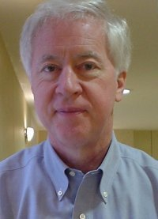
“Ideas are cheap.”
Thomas B. Hickey, Ph.D.
Chief Scientist, OCLC Research, 1977-2016

Slide 4
The problem is there’s already a way we do this.
The good news is there’s already a way we can do this.
Research Scientist
Excuse me. I’m right here! Does anyone care what I think?
Customer
Product Manager
Photo by rawpixel on Unsplash

Slide 5
5 steps of ideation & experimentation

Slide 6
Step 1: product vision statement
Project Passage: Linked Data Wikibase Prototype
Work with our members through a foundational shift in the collaborative work of libraries, communities of practice, and end-users—dramatically improving efficiency, embracing the inclusive, diverse, and earnest OCLC membership, and empowering a new and trusted knowledge work enabled by the web.

Slide 7
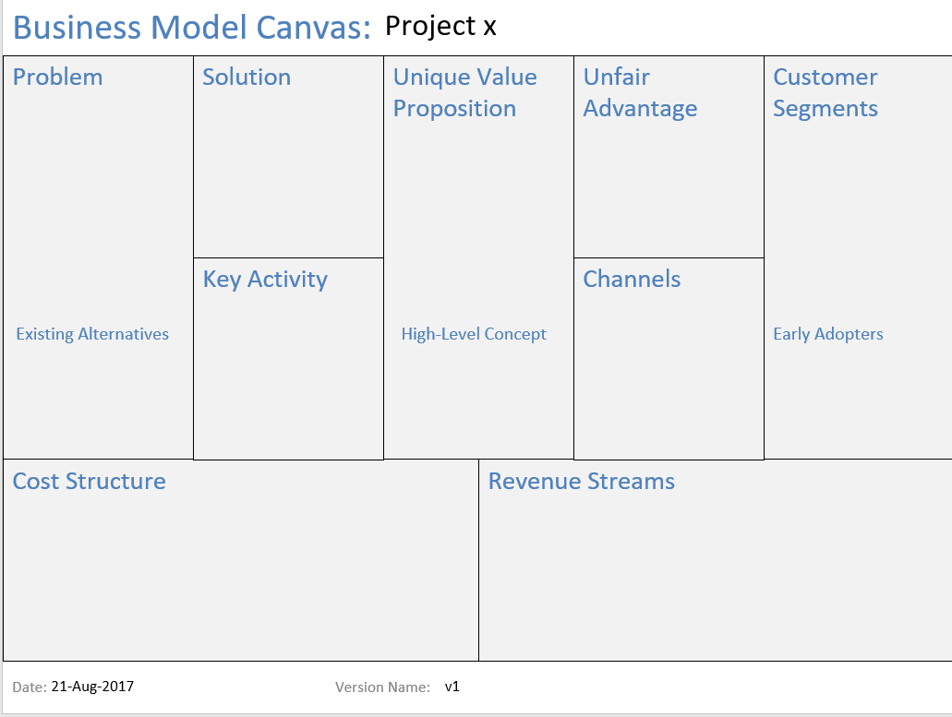
Step 2: justification
“Lean canvas”
Succinct business-focused view that helps you determine the real effort behind a good idea

Slide 8
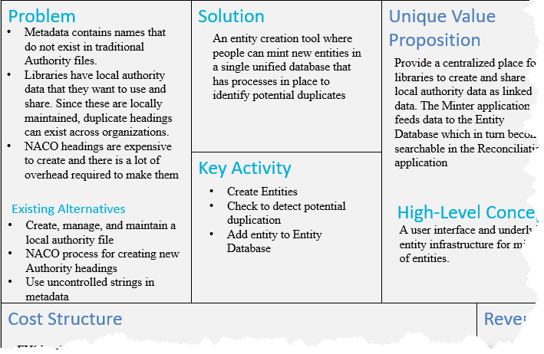
Quick-and-easy
This is a sniff-test, not a full business plan or market roll-out strategy
The more precisely right you try to be, the more precisely wrong you will be

Slide 9
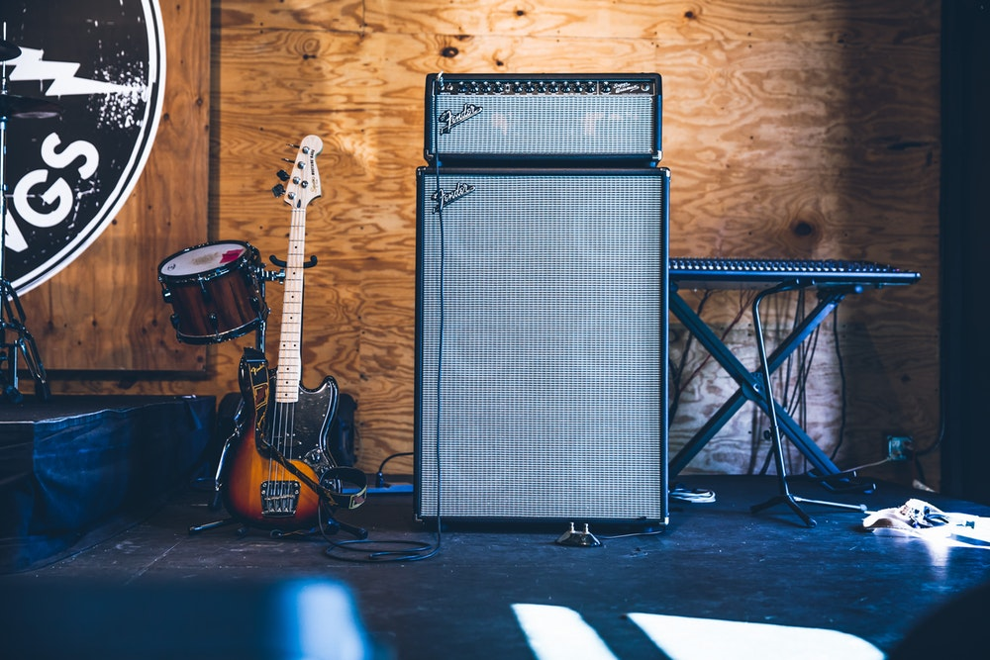
Step 3: Put the band together
“Happiness is best attained through fidelity to a worthy purpose.”
- Helen Keller
Photo by Austin Neill on Unsplash

Slide 10
“Project Passage”
Phase II Partners (May ‘18 – Sep ‘18)
American University
Brigham Young University
Cleveland Public Library
Harvard University
Michigan State University
National Library of Medicine
North Carolina State University
Northwestern University
Princeton University
Smithsonian Library
Temple University
University of Minnesota
University of New Hampshire
Yale University
Phase I Partners (Dec ’17 - Apr ‘18)
Cornell University
University of California, Davis
OCLC Research
OCLC Global Technolo-gies
OCLC Global Product Management

Slide 11
Step 4: Set Team Expectations
Demand participation
Expect resistance
Communicate frequently
Document everything
Set an end-date for experimentation
Photo by rawpixel on Unsplash

Slide 12
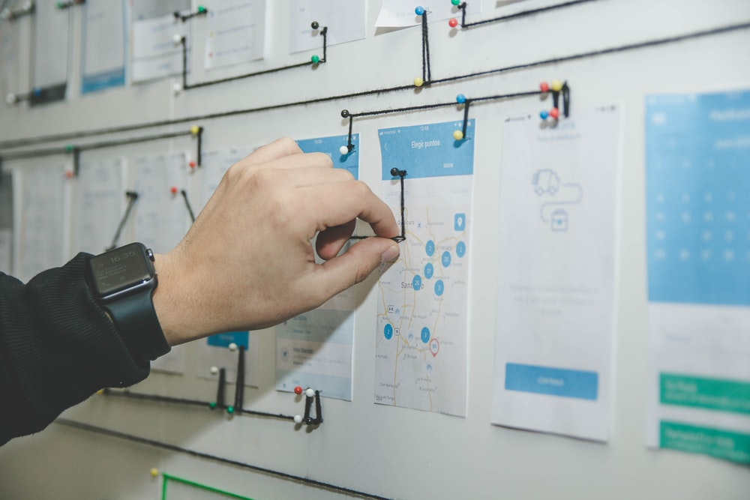
Step 5: Accept the outcome
Not every idea is a winner; fail fast and move on
You should be disappointed if you wind up with something that looks exactly like you expected to build from the start
If the plan for production looks different from your prototype, look back at your vision statement and lean canvas and see if they still hold true
Photo by NeONBRAND on Unsplash
Photo by Alvaro Reyes on Unsplash

Slide 13
EXAMPLES

Slide 14
Two recent OCLC internal and external partnerships
IIIF: International Image Interoperability Framework™
“Project Passage”: Linked Data Wikibase Prototype

Slide 15
http://iiif.io/
International Image Interoperability Framework™

Slide 16
Current status
52 IIIF Consortium members
1+ Billion Images using IIIF from Libraries, Archives, and Museums
OCLC’s CONTENTdm supports Image and Presentation APIs
45 Million Manifests
The IIIF standard has 4 primary APIs:
Image
Presentation
Search
Authentication
Plus 1 in development phase:
Discovery

Slide 17
Productionized linked data
OCLC’s first productionized, supported and used linked data service
“Linked Open Usable Data”
-Rob Sanderson
https://www.getty.edu/research/tools/vocabularies/newbury_sanderson_itwg_2017.pdf

Slide 18
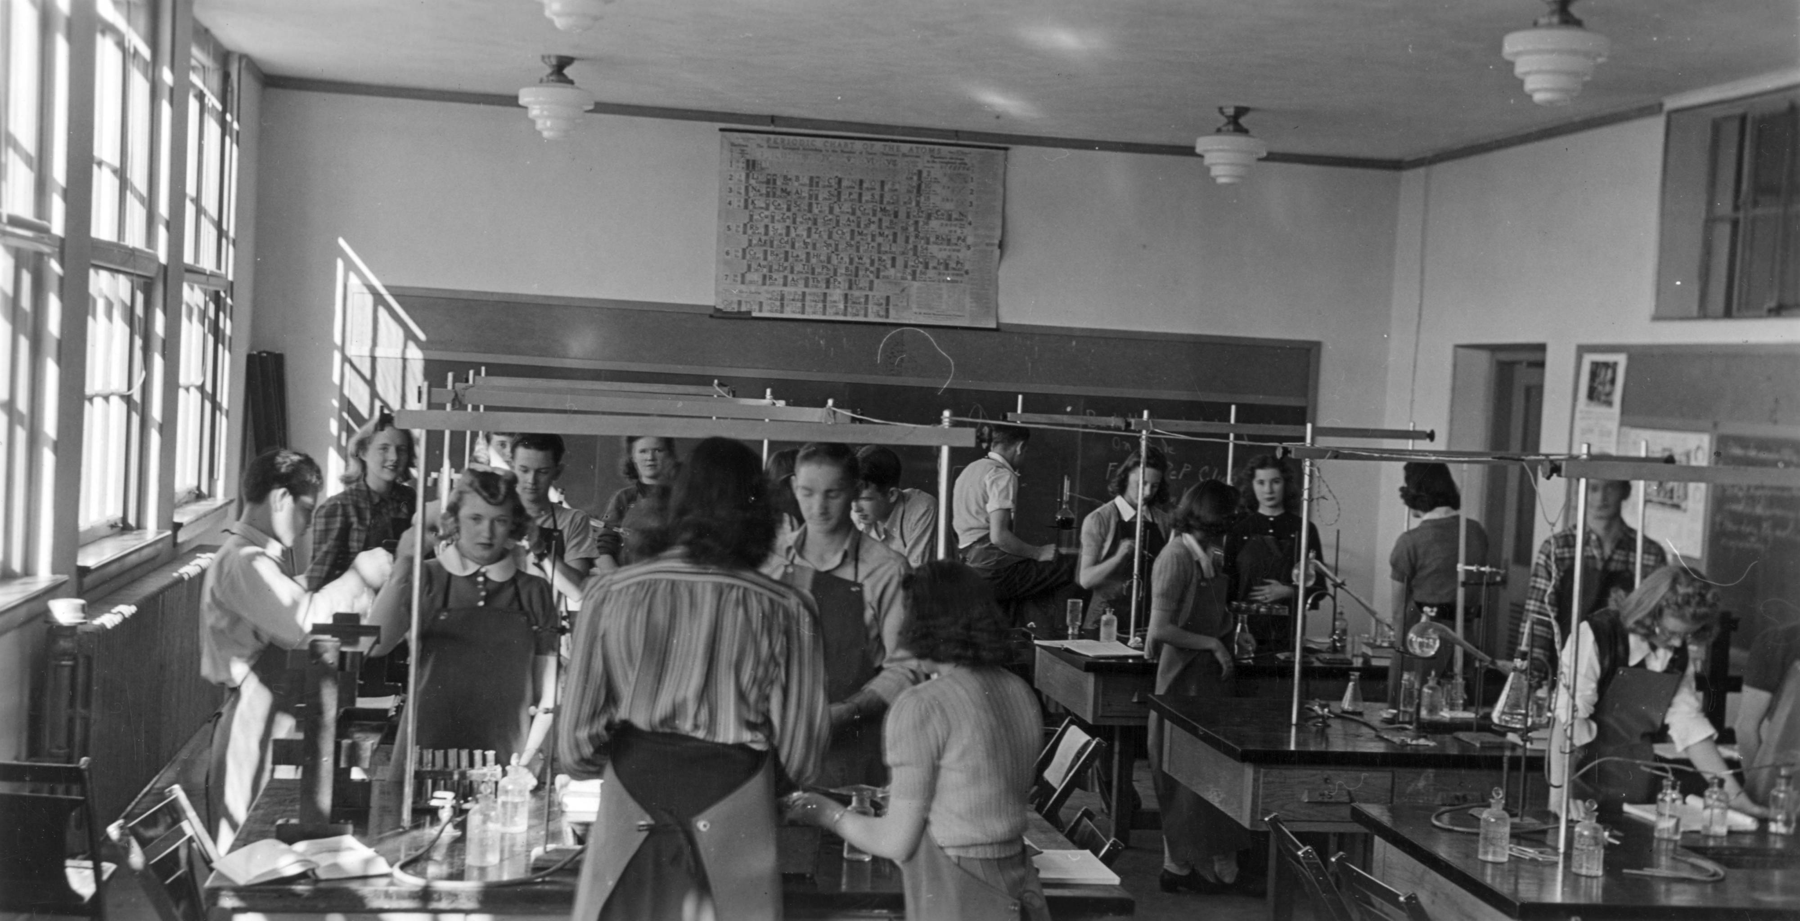
Crossing Divisions
IIIF Presentation API: A collaboration between OCLC Research, product management, and production engineering and operations staff
Functional prototype developed by OCLC Research
Production teams made sure it was “street legal”
Ongoing information sharing
From Denver Public Library: http://digital.denverlibrary.org/digital/iiif/p15330coll22/1751/full/full/0/default.jpg

Slide 19
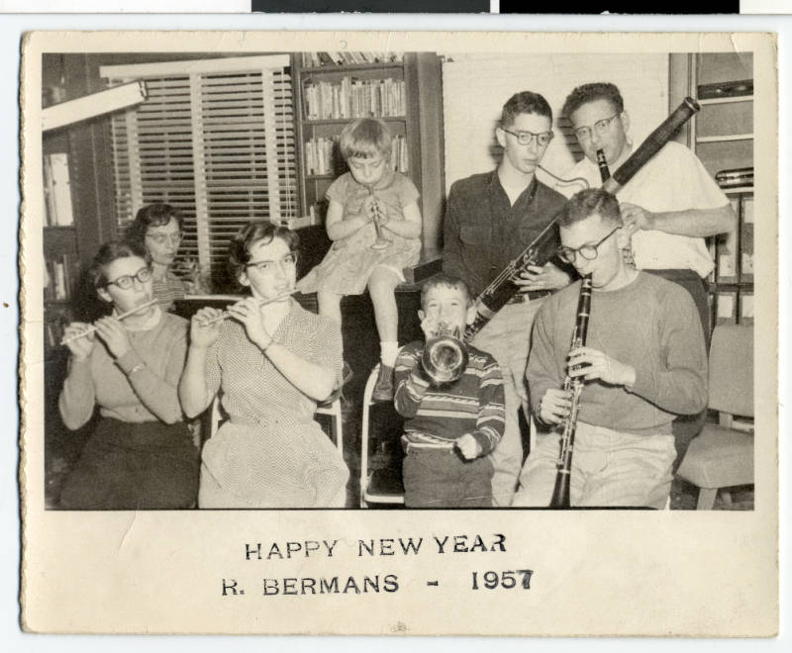
Catalysis
Integrating the Mirador viewer
Harry Ransom Center’s García Márquez collection
Huntington Library manuscripts
WorldCat Discovery inline image viewer (OpenSeadragon) for CONTENTdm results
FromThePage transcription round-trip data service
From Minnesota Reflections:
https://reflections.mndigital.org/catalog/jhs:450#/image/0

Slide 20
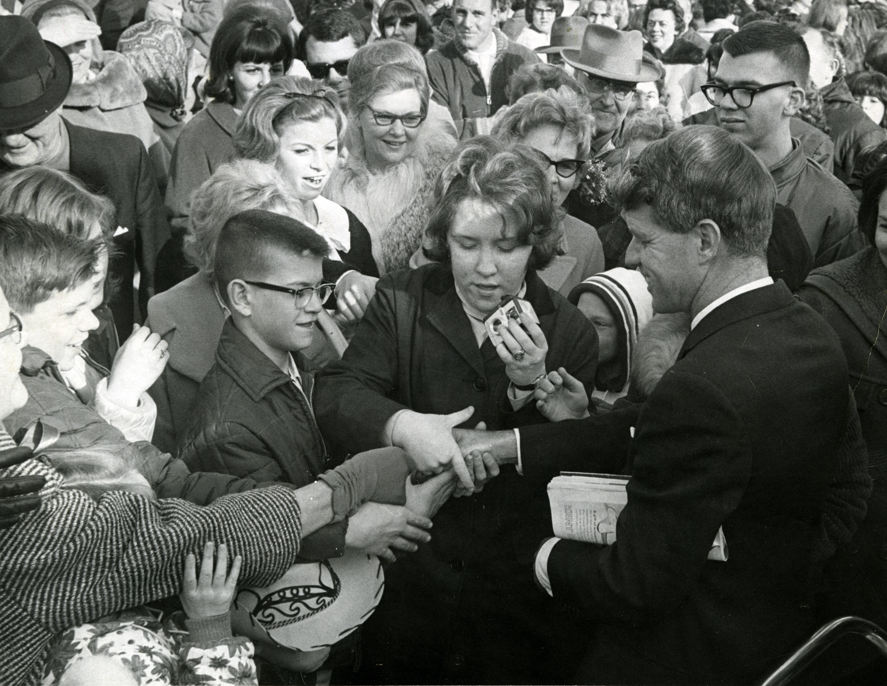
OCLC IIIF Support and Participation
OCLC is a member of the IIIF Consortium
OCLC Product and OCLC Research staff are active contributors to IIIF working groups
OCLC Research has been prototyping for the IIIF Discovery API
Continue the Research/Tech/Product and CONTENTdm Users’ Group collaboration to prototype and test advances in IIIF integration and support
From Denver Public Library: http://digital.denverlibrary.org/digital/iiif/p15330coll22/92976/full/full/0/default.jpg

Slide 21
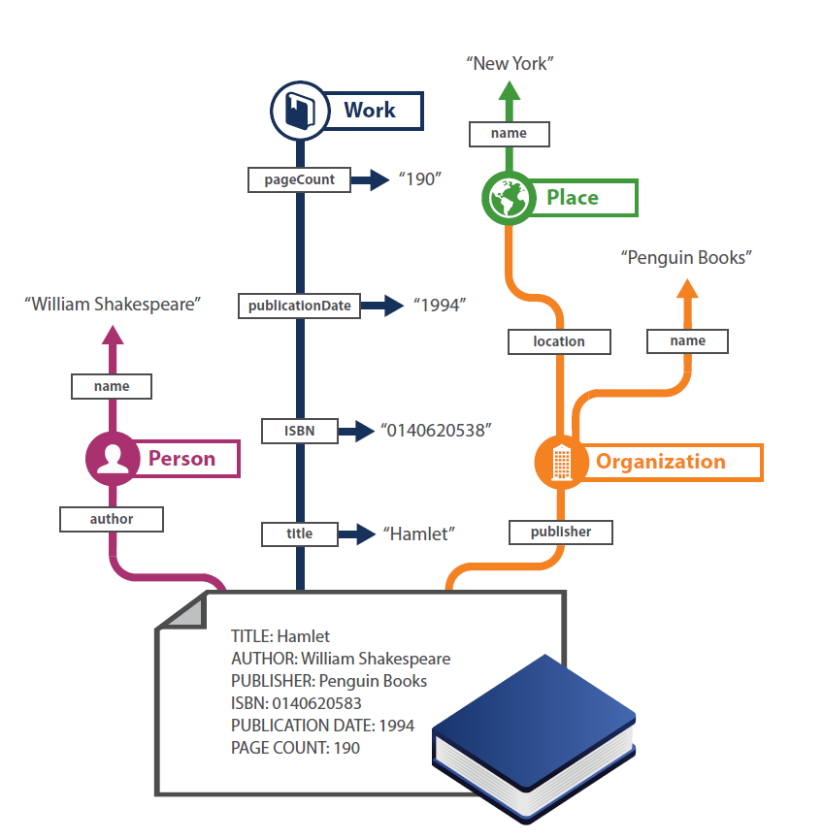
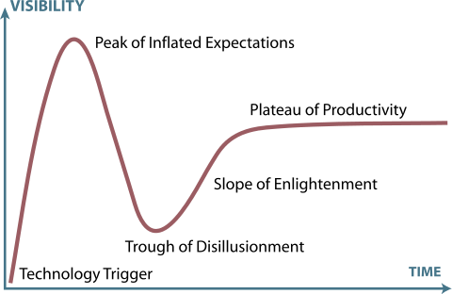
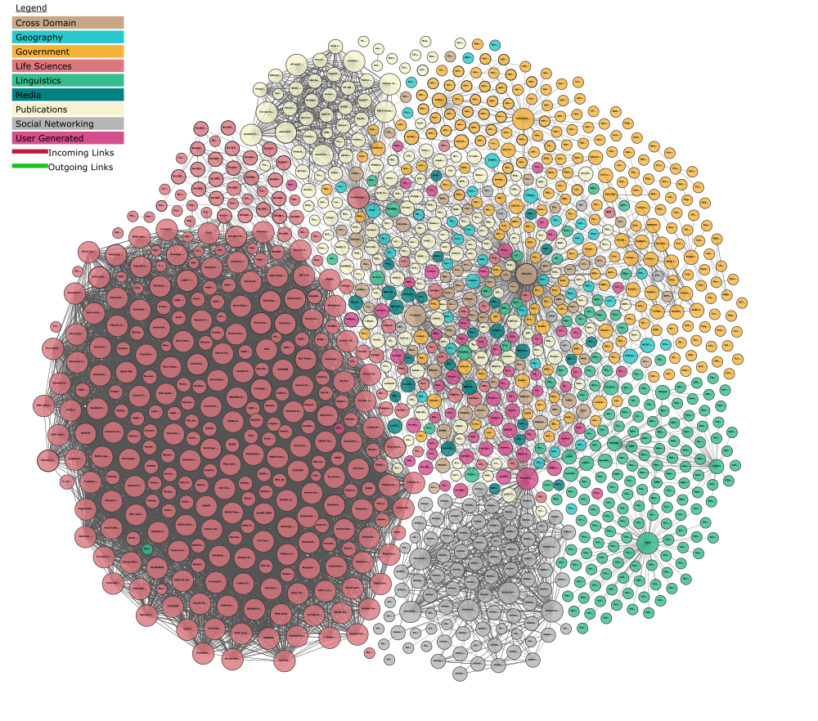
“Project Passage”: Wikibase Linked Data Prototype
http://oc.lc/ld-prototypes

Slide 22
About the Pilot Project
Ran from December 2017 through September 2018
16 OCLC Member libraries participated
The objective was to evaluate a framework for reconciling, creating, and managing bibliographic and authority data as linked data entities and relationships
The pilot Wikibase instance included 1.2M entities, mostly data representing overlaps between Wikidata, VIAF, and WorldCat

Slide 23
Build – Observe – Adjust
Retriever
Serialization API
Taxonomy navigation
Property-based constraints
Improved search experience
Explorer UI
OpenRefine API
Wikimedia commons links
PHASE 3
Entity editor
Reconciliation API
SPARQL endpoint
PHASE 2
PHASE 1

Slide 24
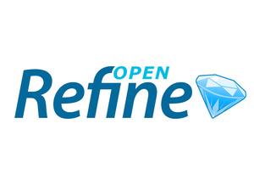
How: A few key technologies
Pywikibot
Notes:
Wikibase – The wikibase extension to MediaWiki provides the primary user interface for creating and editing items and properties.
Mediawiki API – Search and retrieval based on keyword searching or via entity identifiers.
SPARQL Query Service – A SPARQL Endpoint combined with a user-friendly Query Service interface supports complex and granular queries based on items, properties, and their relationships.
OpenRefine API – OpenRefine is an application for cleaning and reconciling data, using Reconciliation APIs and SPARQL endpoints. We're testing an OpenRefine-optimized API, to make it easier for those who use that application to connect to the system and reconcile their data.

Slide 25
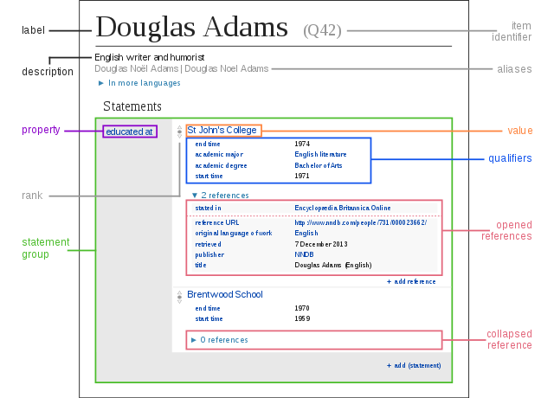
IN THEORY
IN PRACTICE

Slide 26
Some Technical Take-aways
Wikibase was ideal for the prototype: great software, well-designed and accessible to those inclined to extend it
“Wikibase allows for complexity without insisting on it.” – Jeff Young
There are many great MediaWiki community extensions available, far more than we had time to try out
The Wikidata data model, software framework, and community are enabling a paradigm shift in how the world records knowledge

Slide 27
Non-technical take-aways
Entity work is a lot different from Authority work: need to devote significant time to notability, property, and reference requirements and guidelines
Additional consideration of technical aspects including reconciliation and scalability
Much can be accomplished through partnership
Community input will always determine the path forward

Slide 28
LIBRARY PERSPECTIVE

Slide 29
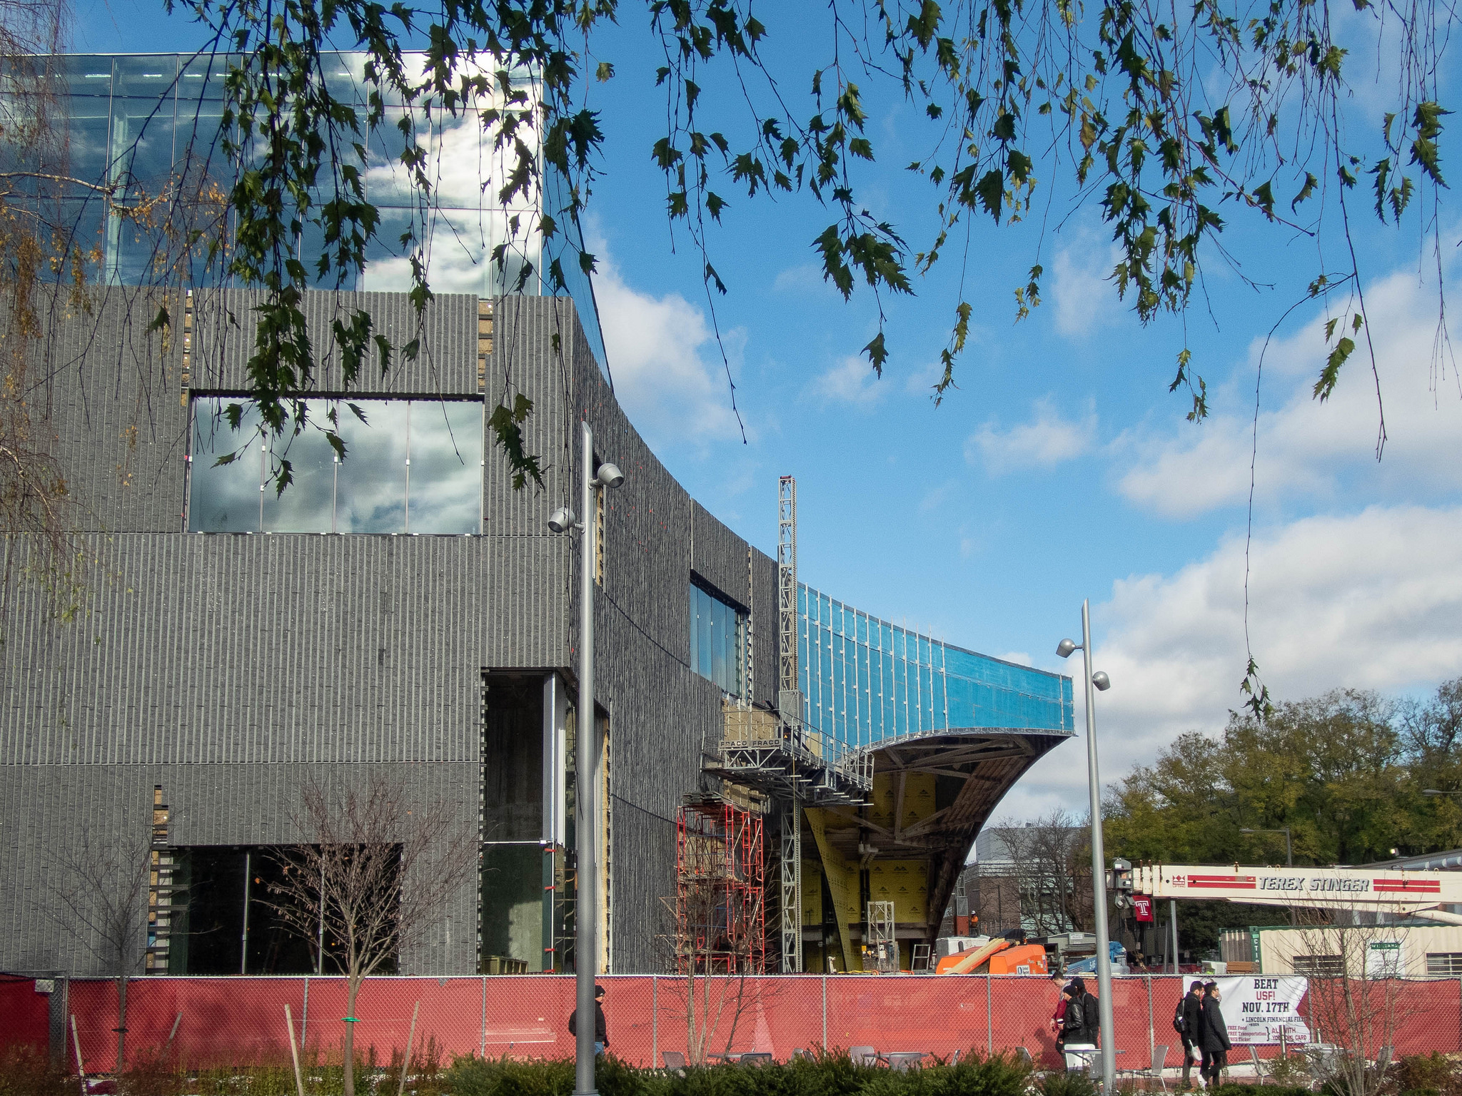
Project Passage at Temple Libraries
Phase II Pilot: May-Sept 2018
Weekly office hours
Community Center discussion
Homework assignments
Advisory Group: Oct 2018-
Charles Library Under Construction at Temple University by Tom Ipri on Flickr

Slide 30
Temple Libraries Project Team
Rachel Appel, Digital Projects Librarian
Jasmine Clark, Resident Librarian
Matt Ducmanas, Special Collections Cataloger
Leanne Finnigan, Database Maintenance Librarian
Holly Tomren, Head of Metadata Strategy & Digitization Services

Slide 31
Why We Participated
Hands-on cataloging experience in linked data environment
Practical workflows and integration with other components of existing metadata environments
Lessons learned for local linked data projects

Slide 32
Assignment: Translations
Welsh translation of James and the Giant Peach
Questions:
Level of description
Data model: which properties are inherited or “cascade”
http://www.worldcat.org/oclc/779859780

Slide 33
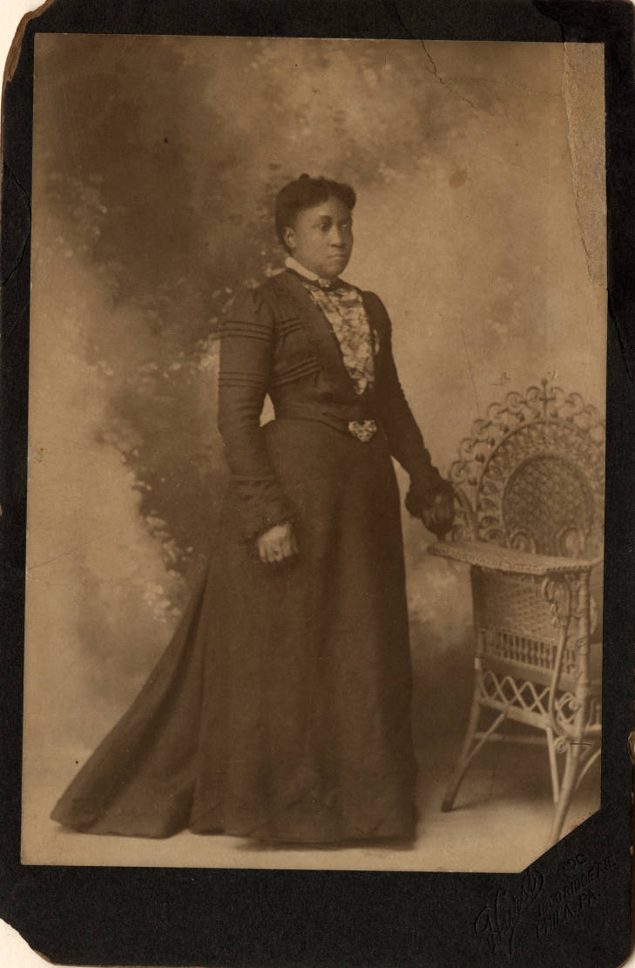
Assignment: Digital Images
Caroline Still Anderson
Passage:
Depicts: Caroline Still Anderson
Instance of: photograph, portrait
Original:
Subjects: African American women physicians, African American women educators, Portraits
Photo from Temple University Libraries, Charles L. Blockson Afro-American Collection
Notes:
New property: color (sepia, black-and-white, etc.)
Link back to original in digital library for item-level detail such as dimensions, file formats, outside scope of Passage

Slide 35
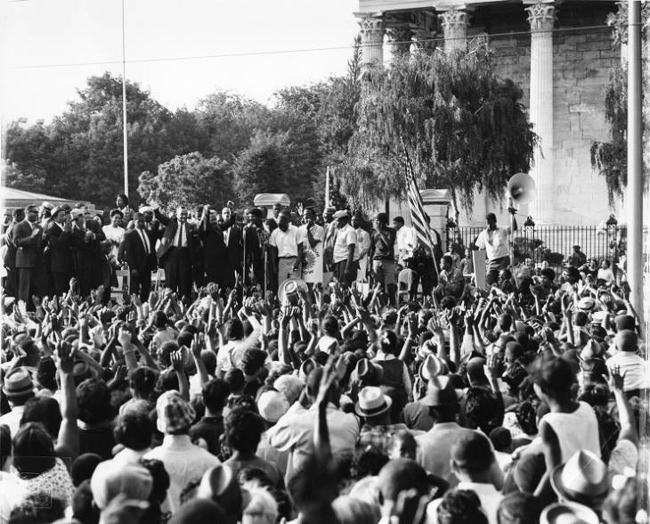
Assignment: Digital Images
Reverend Dr. Martin Luther King Jr. and Cecil B. Moore attend a protest rally at Girard College
Photographer: John W. Mosley
Depicts: Martin Luther King, Jr., Cecil B. Moore
Depicts: Event -> Girard College -> Philadelphia
Photo from Temple University Libraries, Charles L. Blockson Afro-American Collection
Notes:
Depicts event
Created entity for John W. Mosley, photographer
Event entity contains context of desegregation, civil rights movement
Concerns about context

Slide 36
Assignment: Events
Civil Rights demonstration at Girard College, August 3, 1965
Instance of: event, demonstration
Location: Girard College
Point in time: August 3, 1965
Subjects: Desegregation, School integration, African American civil rights movement, Civil and political rights
Notes:
Also note that this is one of a series of protests that took place over several years. Other work was done by OCLC staff and other partners with related events and what kinds of properties were needed to relate events to each other.

Slide 37
Assignment: Collections
Alternative and underground comics collection, 1937-2004
John W. Mosley Photographs
Question: How effectively can rich textual descriptions be “entified”?
Passage collection entity links out to finding aid and/or digital collection landing page for more details
Notes:
Were able to provide connections between items in a collection to point them back to the collection description – very important for context
Collection descriptions themselves were a bit bare – archival collection descriptions contain a lot of free text – how do you “entify” that in a linked data environment?

Slide 39
Other Assignments
SPARQL queries
Open Refine reconciliation
Retriever testing

Slide 40
What we learned
Different ways of thinking:
Data models and levels of description
Cascading descriptions and relationships
Cataloging without any text strings
Working with entities that are not as well defined by current cataloging standards, such as Events
Vocabularies & data sources beyond LC, FAST, and VIAF - especially, getting more familiar with Wikidata
Conceptualizing properties & relationship types

Slide 41
What worked
Hands-on experience
UI mostly intuitive and easy to use
All components in place: back end and front end (Explorer), as well as Open Refine integration and SPARQL endpoint
Explorer interface gave us perspective on how description & discovery would look for the end-user

Slide 42
What worked
Ability to experiment
Ability to quickly mint entities; Retriever increased convenience
Easy to editing and iteration, with clear history of edits
Confidence rankings, qualifiers, references

Slide 43
What worked
Homework assignments & office hours
Collaboration with community
Responsiveness from OCLC
Direct access to OCLC technologists

Slide 44
What didn’t work as well
Concerns about context
Initial lack of topical entities (improved later in the project with Retriever tool)
Initial lack of properties (some added by OCLC during the project, but more are needed)

Slide 45
What didn’t work as well
Explorer interface could be more robust
Workflow for creating object entities, especially prior to development of Retriever tool
Data loss with Retriever

Slide 46
Lingering questions
Transparency of and governance of data model
Redundancy with Wikidata
Scope of Passage; where does Passage transition to another environment (WorldCat, digital library or repository, finding aid, etc.)
Opportunity for more time, deeper exploration

Slide 47
STEP 6: Make it repeatable

Slide 48
What makes a good innovation incubator?
 | LC Labs | British Library Labs | JSTOR Labs | DPLA Pro | Europeana Pro | OSU Library Labs | Harvard Library Labs | NYPL Labs (defunct)
Experiments/Apps/Betas | x | x |  |  | x | x |  | x
APIs/Keys/Developer space | x |  | x | x | x
Data Science Projects |  | x | x |  |  |  | x | x
Crowdsourced transcription | x |  |  |  |  |  |  | x
Blog | x | x | x | x
Outputs--Video, Reports, Presentations, Showcase | x | x | x |  |  | x |  | x
Github |  |  |  | x
Innovation Challenges / Awards |  | x |  |  | x
Feedback solicitation |  |  |  |  |  | x
Tester recruitment |  |  |  |  |  | x
Events | x | x | x |  |  |  |  | x
Public Domain Content focus |  |  |  |  |  |  |  | x

Slide 49
What makes a good innovation incubator?
 | LC Labs | British Library Labs | JSTOR Labs | DPLA Pro | Europeana Pro | OSU Library Labs | Harvard Library Labs | NYPL Labs (defunct)
Experiments/Apps/Betas | x | x |  |  | x | x |  | x
APIs/Keys/Developer space | x |  | x | x | x
Data Science Projects |  | x | x |  |  |  | x | x
Crowdsourced transcription | x |  |  |  |  |  |  | x
Blog | x | x | x | x
Outputs--Video, Reports, Presentations, Showcase | x | x | x |  |  | x |  | x
Github |  |  |  | x
Innovation Challenges / Awards |  | x |  |  | x
Feedback solicitation |  |  |  |  |  | x
Tester recruitment |  |  |  |  |  | x
Events | x | x | x |  |  |  |  | x
Public Domain Content focus |  |  |  |  |  |  |  | x

Slide 50
OCLC ResearchWorks
Starting point
Goals
Research Datasets
Experimental Apps
APIs: Documented and Keyed
Feedback mechanism
Events
Community engagement
iSchool internship opportunities & researcher interaction
New scholarly output
New dataset creation

Slide 51
OCLC ResearchWorks Event
https://researchworks19.eventbrite.com/
APRIL 25-26, 2019
Dublin, OH

Slide 52
Discussion & Questions
Questions about the project examples?
What makes a good library lab?
What elements make the Ideation→R&D→Production flow successful?
What kind of library datasets interest you?
What kind of experimental applications interest you?

Slide 53
Thank you.
Holly Tomren
holly.tomren@temple.edu
Andrew K. Pace
pacea@oclc.org
Massive Linked Open Data Cloud (Reference Database), under-exploited by Publishers. (Linking Open Data cloud diagram 2017–08–22, CC-BY-SA by Andrejs Abele, John P. McCrae, Paul Buitelaar, Anja Jentzsch, and Richard Cyganiak. http://lod-cloud.net/)

